Slide 1
Progress of measurement of cosmic ray spectrum with the LHAASO experiment
Ma Lingling, Zhang Shoushan, Yin Liqiao, Wang Liping, You Zhiyong, Wang Yudong，Feng Cunfeng
IHEP, SDU
Oct 13-15, 2021 @ShangHai

Slide 2
Outline
LHAASO science in cosmic ray measurement
The commonly trigger data status
The energy scale of WCDA-1 and propagation to WFCTA
The full FOV observation of WFCTA and the energy reconstruction
The effects of weather to the energy scales of WFCTA
Parameters sensitive to the mass compositions
The measurement of light composition energy spectrum
Summary and next plan

Slide 3
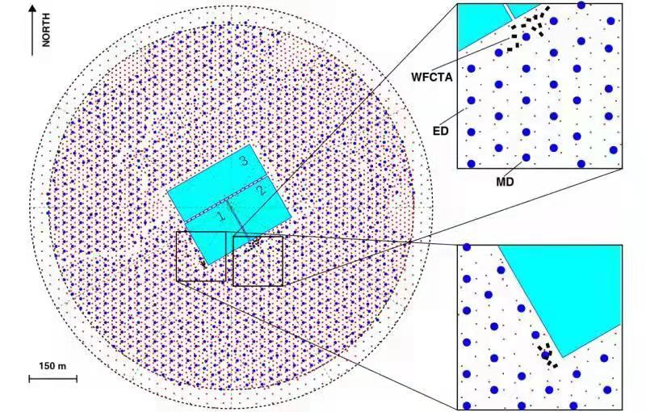
LHAASO science in cosmic ray measurement
High altitude
Reduce the energy threshold and get the energy scale
Multi variable measurements
To get the individual composition spectra
Shed light on the origin of cosmic rays

Slide 4
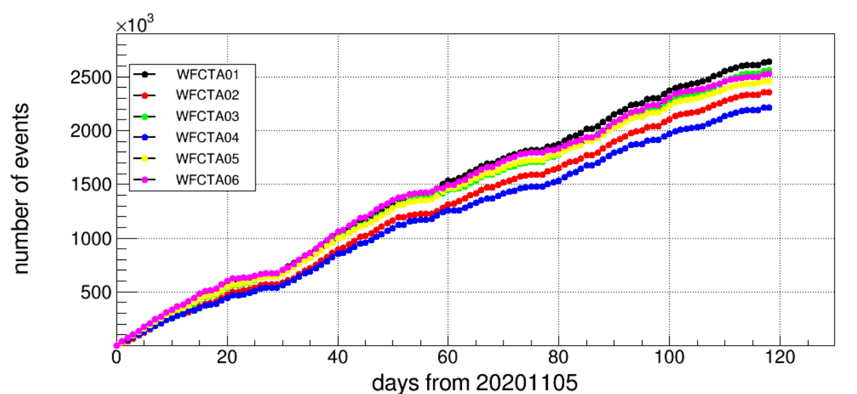
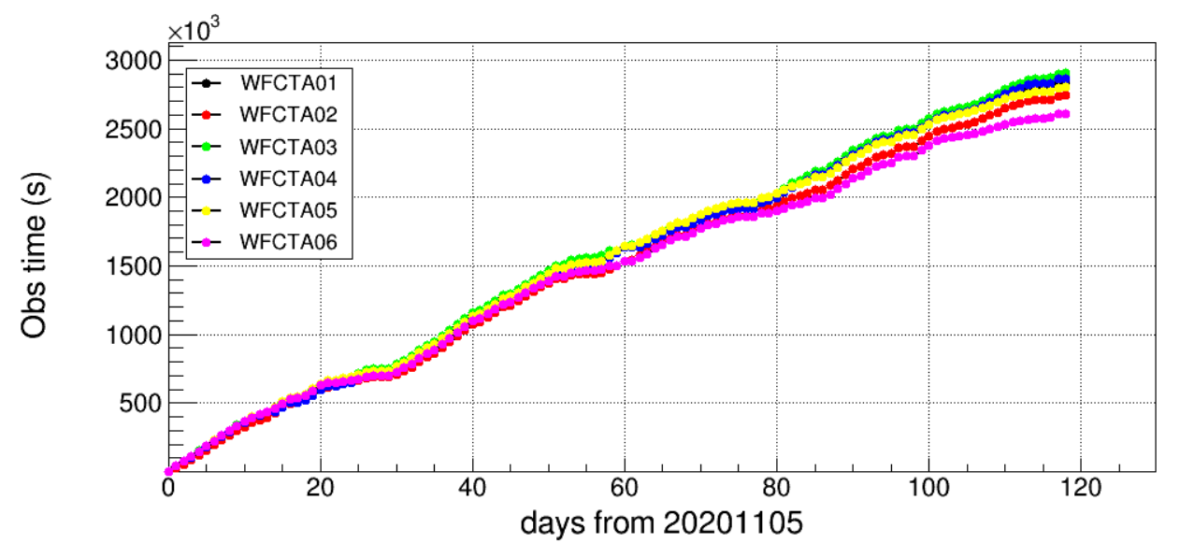
The commonly trigger data status
Good event selection criteria：
WFCTA:
HV>75V，electric current<1.5A
Infrared temperature <-65°
Opening angle between main axis and Moon>30°
Npix>10
Image center |MeanX|<6° |MeanY|<6°
KM2A:
Event rate is normal
WCDA:
Event rate is normal
1.48*10^7
20201105-20210303
720hours

Slide 5
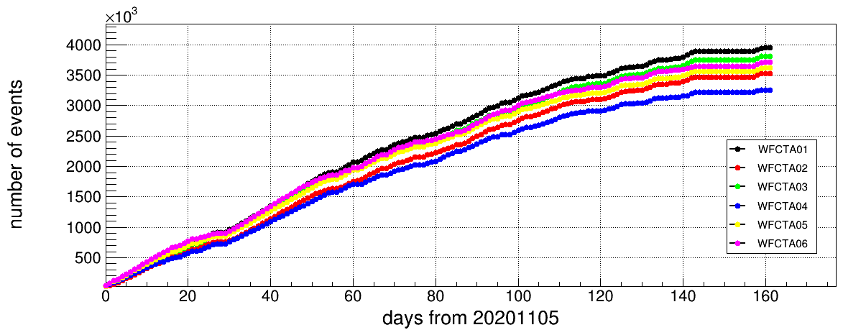
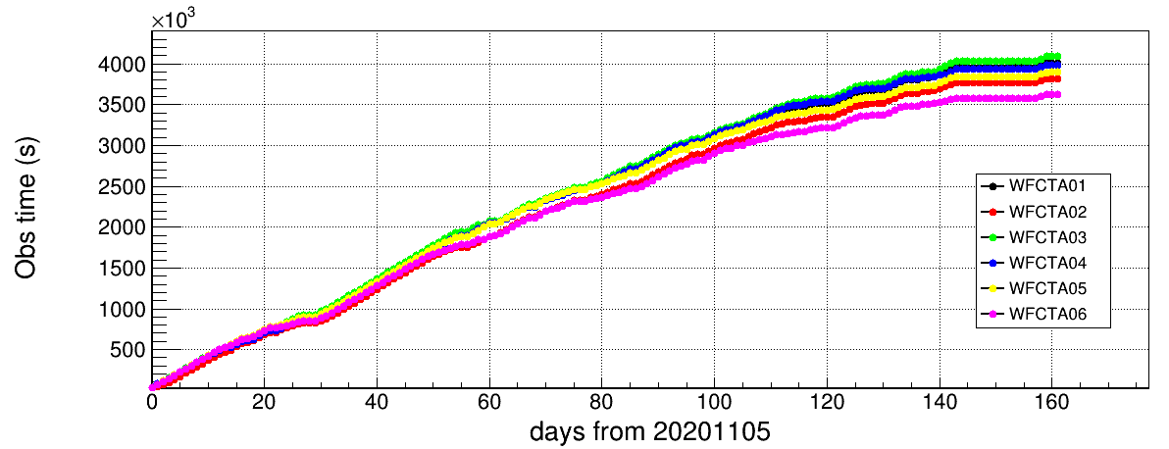
The commonly trigger data status
Good event selection criteria：
WFCTA:
HV>75V，electric current<1.5A
Infrared temperature <-65°
Opening angle between main axis and Moon>30°
Npix>10
Image center |MeanX|<6° |MeanY|<6°
KM2A:
Event rate is normal
Zenith angle >0
Number of triggered detectors: Ned>19
After noise filter: Ned>10
Number of Ne with 100m from core:>10
2.08*10^7
20201105-20210415
970hours

Slide 6
The energy scale of WCDA-1 and propagation to WFCTA

Slide 7
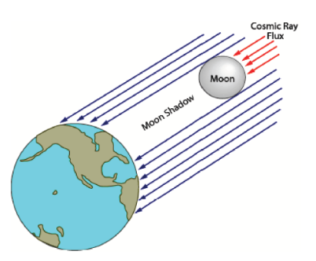
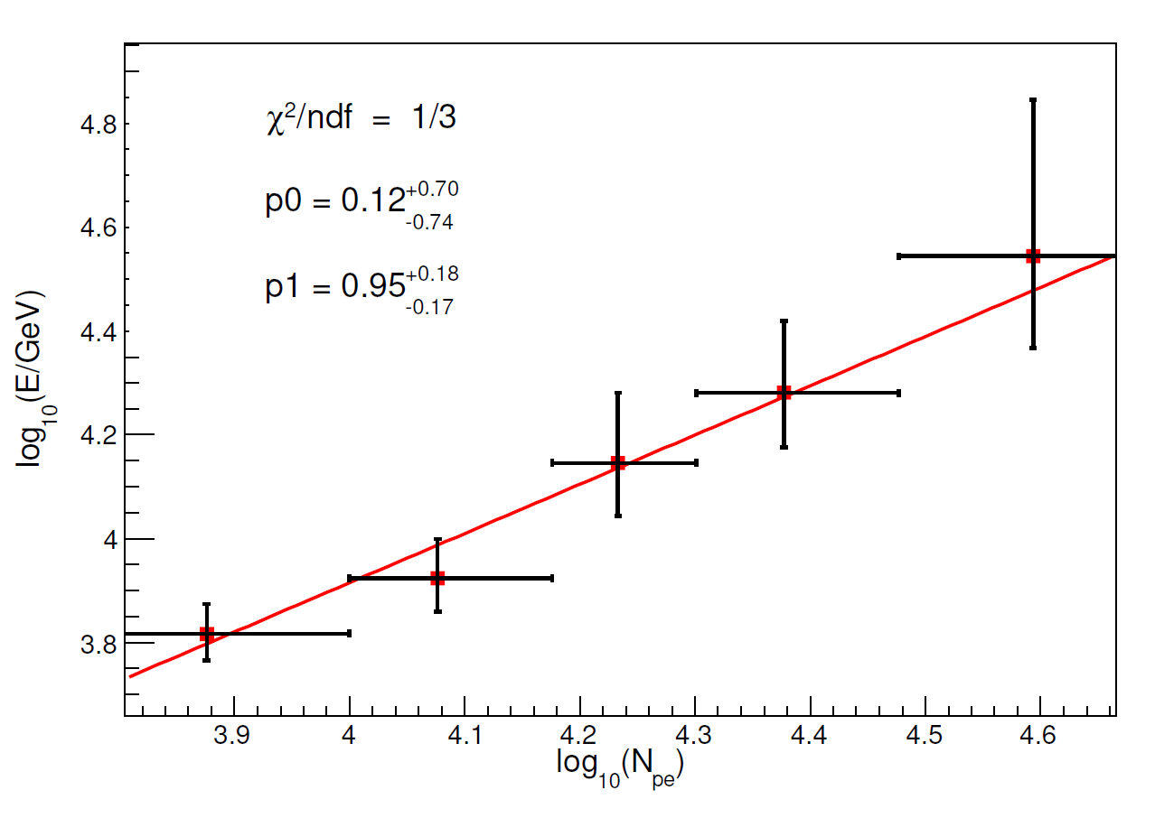
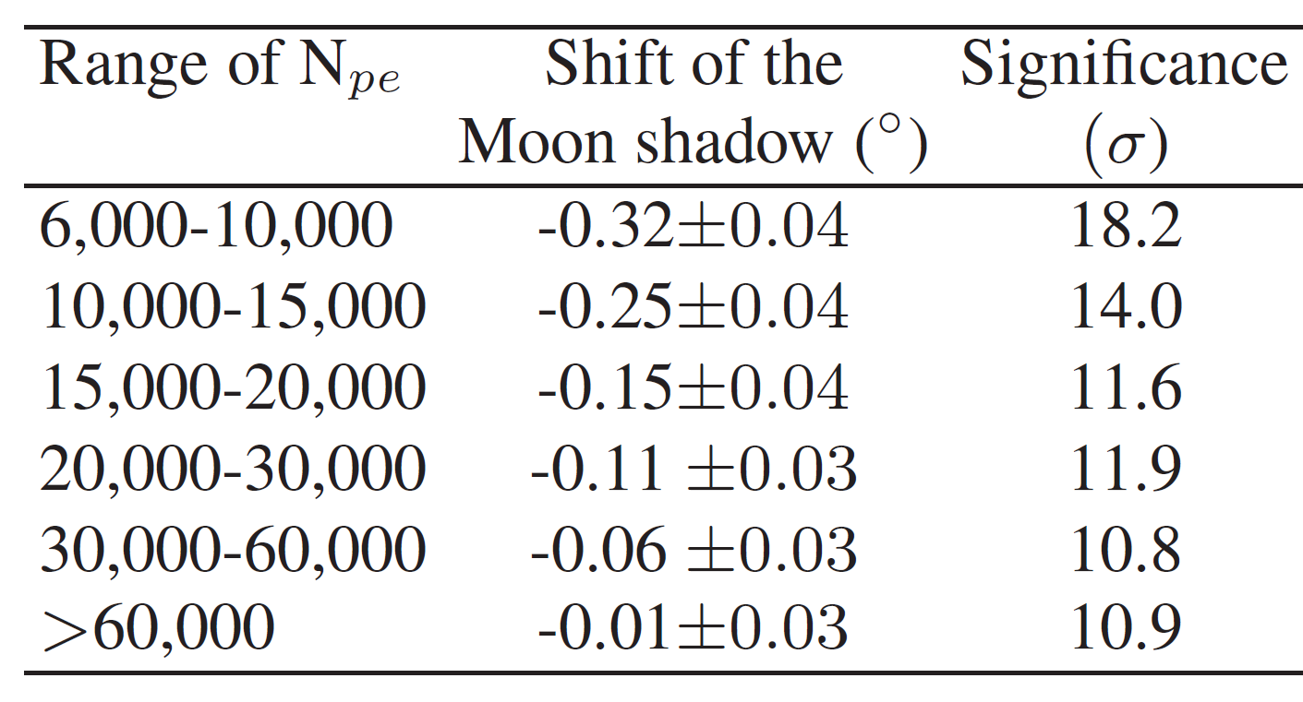
The energy scale of WCDA-1
The magnetic field between the Earth and the Moon can be seen as a magnetic spectrometer
$$∆=z∗1.59°/E(TeV)$$
Data set ：
WCDA-1, 01/05/2019-31/01/2020
Nhit>200
Zenith angles<45°
$$\text{The} \text{trigger} \text{efficiency} \text{of} \text{WCDA}\text{-1 }\text{is} \text{different} \text{for} \text{protons} \text{and} \text{helium} \text{nuclei}$$
$$\text{In} \text{a} \text{give} \text{Npe} \text{range}$$
$$\text{N}\text{P}\text{：}\text{N}\text{he}\text{ = 2}\text{：}\text{1}$$
$$\text{Ep}\text{：}\text{E}\text{he}\text{ = 1}\text{：}\text{1.9}$$
The Moon Shadow shifts westward :
$$∆=2.1/E(TeV)$$
$$E\left(GeV\right)=aN_{pe}^{b}$$
$$a={1.33}_{−1.06}^{+5.26}$$
$$b=0.95±0.17$$

Slide 8
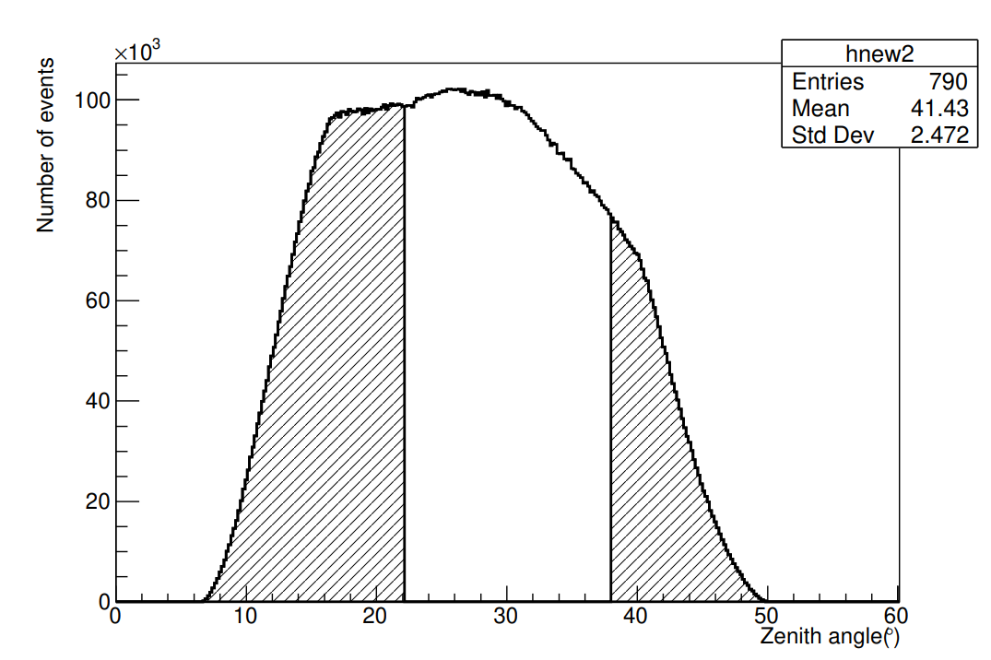
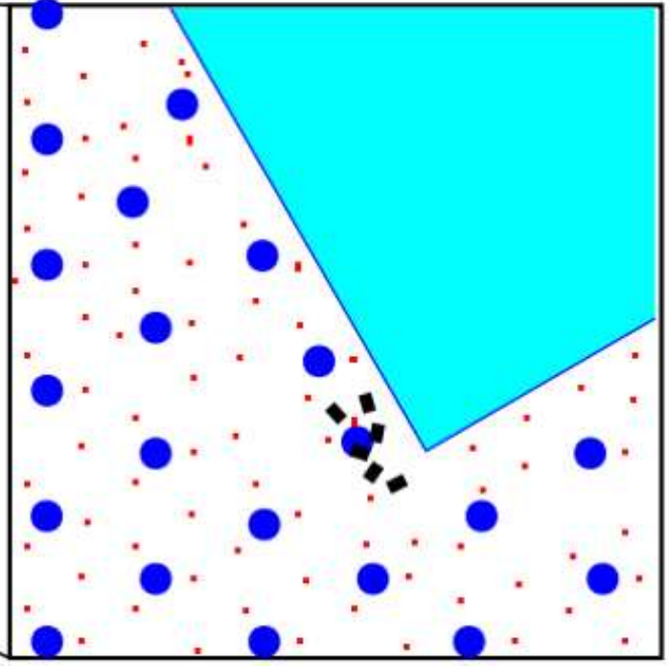
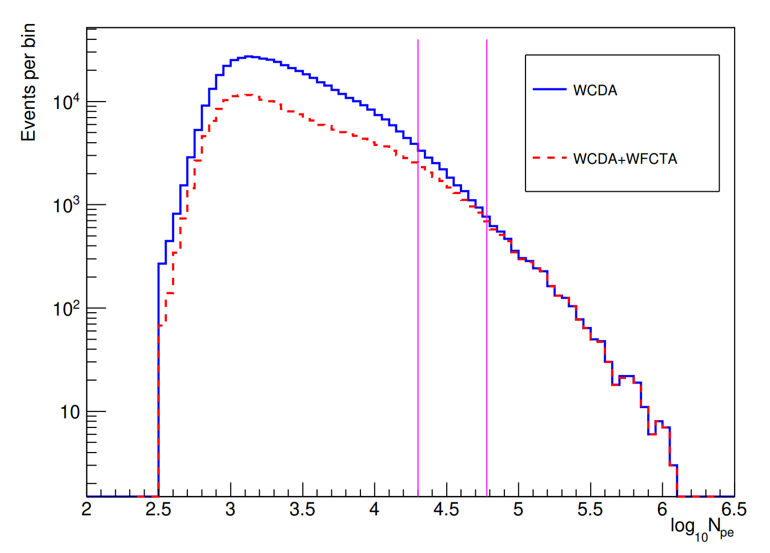
Energy Scale of WFCTA
The commonly triggered events:
22°<Zenith angles <38°
Nhit>200
20k<Npe<60k
WFCTA can only be operated on dark nights or at most with partial moonlight.
The energy scale of WFCTA can not be calibrated by the moon shadows.
The commonly trigger of WCDA-1 and WFCTA can be achieved by offline.
The energy scale of WCDA-1 can propagate to the WFCTA by the commonly triggered events.
Due to the different energy threshold, the effective energy range is expected about 20 TeV of the commonly triggered events.

Slide 9
The moon shadow with the selection criteria of commonly triggered events
22°<Zenith angles <38°
Nhit>200
20k<Npe<60k
$$∆=0.1±0.03°$$
$$E=21±6.5TeV$$

Slide 10
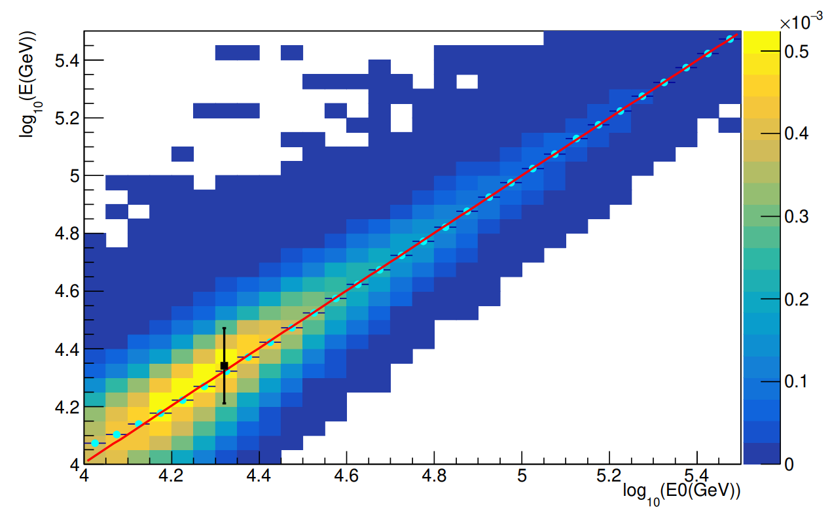
Energies of the commonly triggered events derived by WFCTA and by the formula of the absolute energy scale
Data Set of WCDA-1+WFCTA:
22°<Zenith angles <38°
|corex|<55m, |corey|<55
Nhit>200
20k<Npe<60k
21.9 TeV by WFCTA
23.4±0.1±1.3TeV by the formula of the absolute energy scale
The energy distribution of commonly triggered events derived by WFCTA (red line) and by the formula of the absolute energy scale(black line).
Energy response of WFCTA
For air showers with energies greater energy, the energy reconstruction total relies on the simulations of the air showers and detectors

Slide 11
The full FOV observation of WFCTA and the energy reconstruction

Slide 12
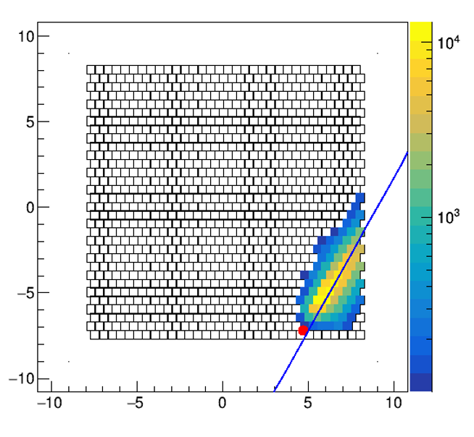
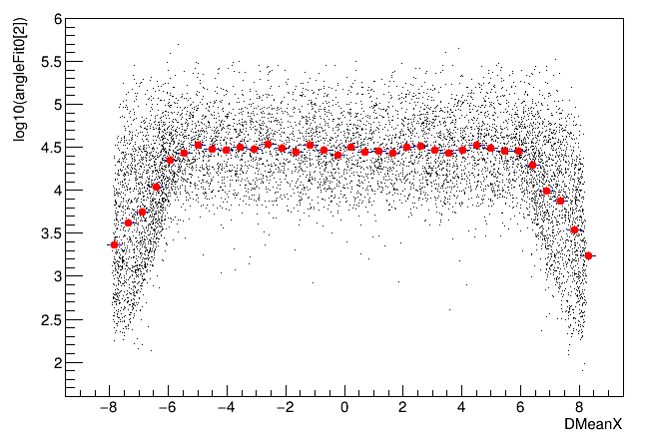
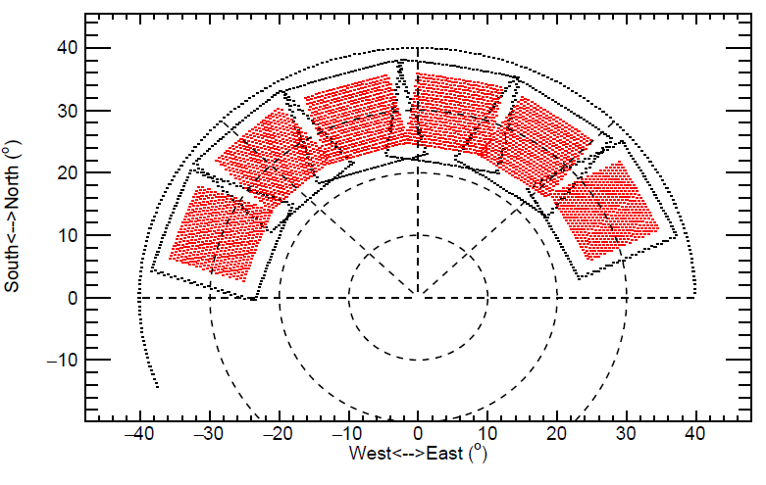
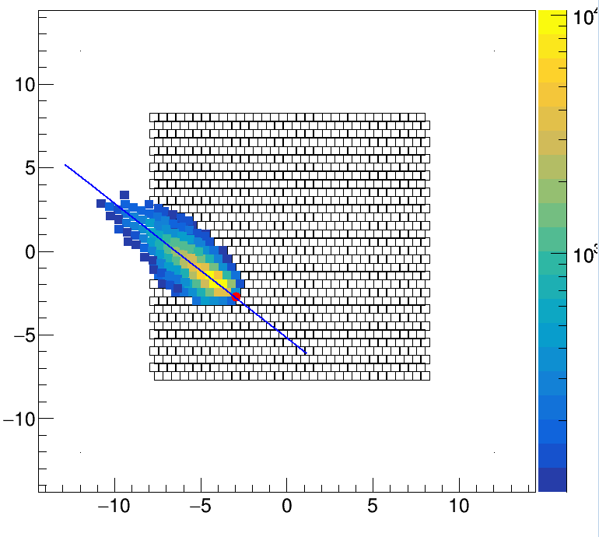
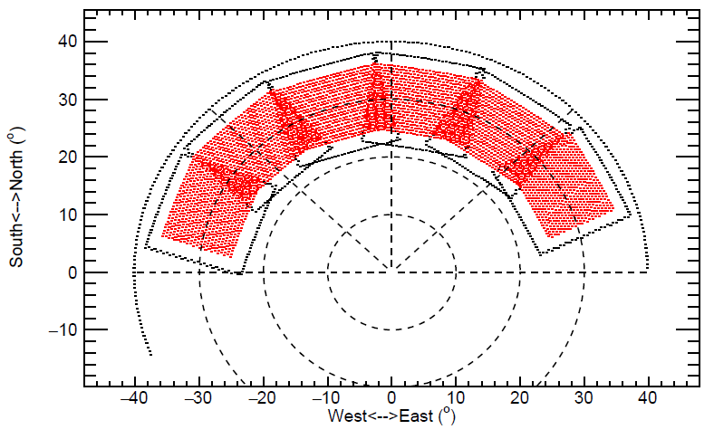
Full FoV observation of WFCTA
Showers with arriving directions near the edge of the FOV of WFCTA can’t be observed completely, which should be removed during data analysis to maintain high energy resolution.
Increase aperture with high energy resolution

Slide 13
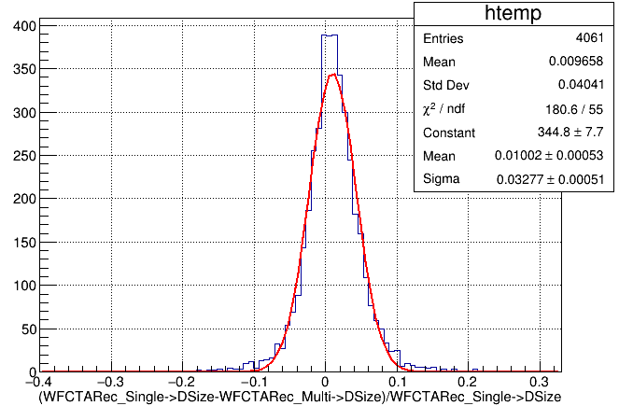
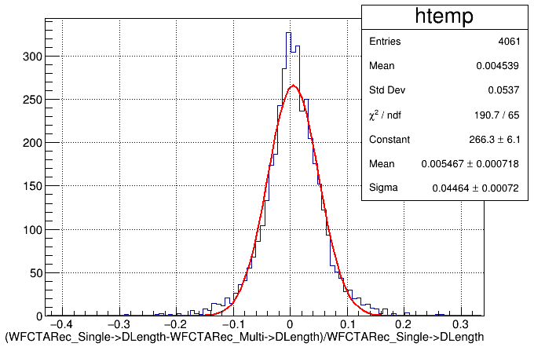
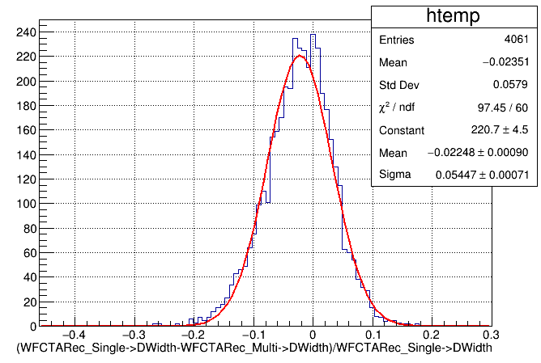
Comparison of the combined images with the real images with the ideal ones
Size
Width
Length

Slide 14
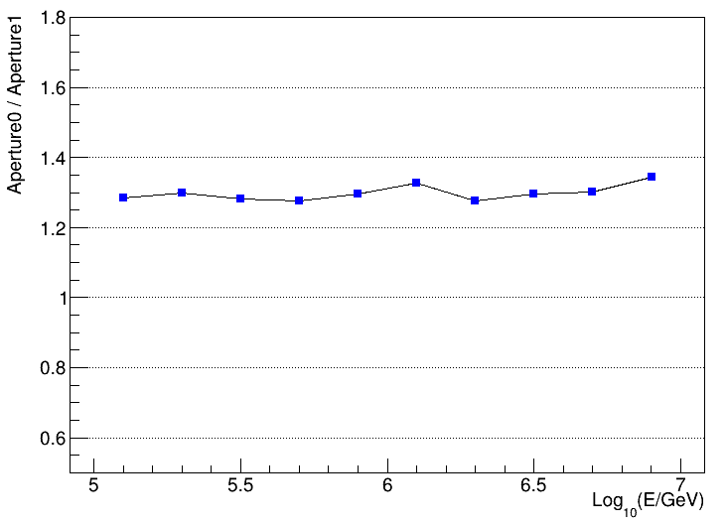
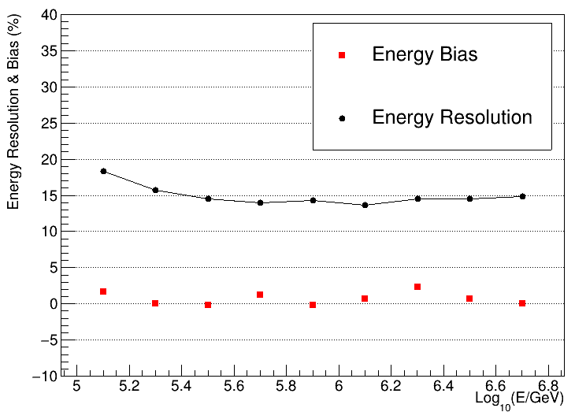
Increase aperture 30% with high energy resolution(15%)
ZhiYong You’s talk for detail on Oct. 14th

Slide 15
The effects of the weather to the energy scale of WFCTA
The event rate （or energy threshold）changes of WFCTA can changes the weather condition
The distribution of event rate of WFCTA in each half hour

Slide 16
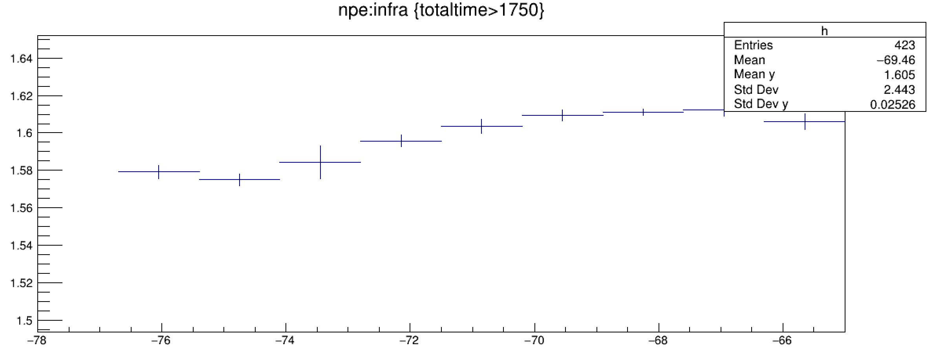
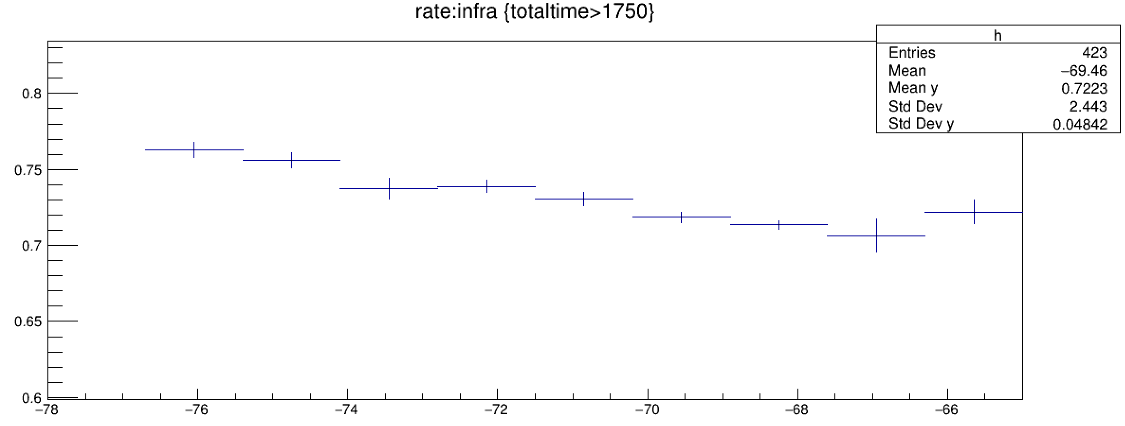
Event rate
Npe
Relative energy scale changes about 9%
Infrared temperature
Infrared temperature

Slide 17
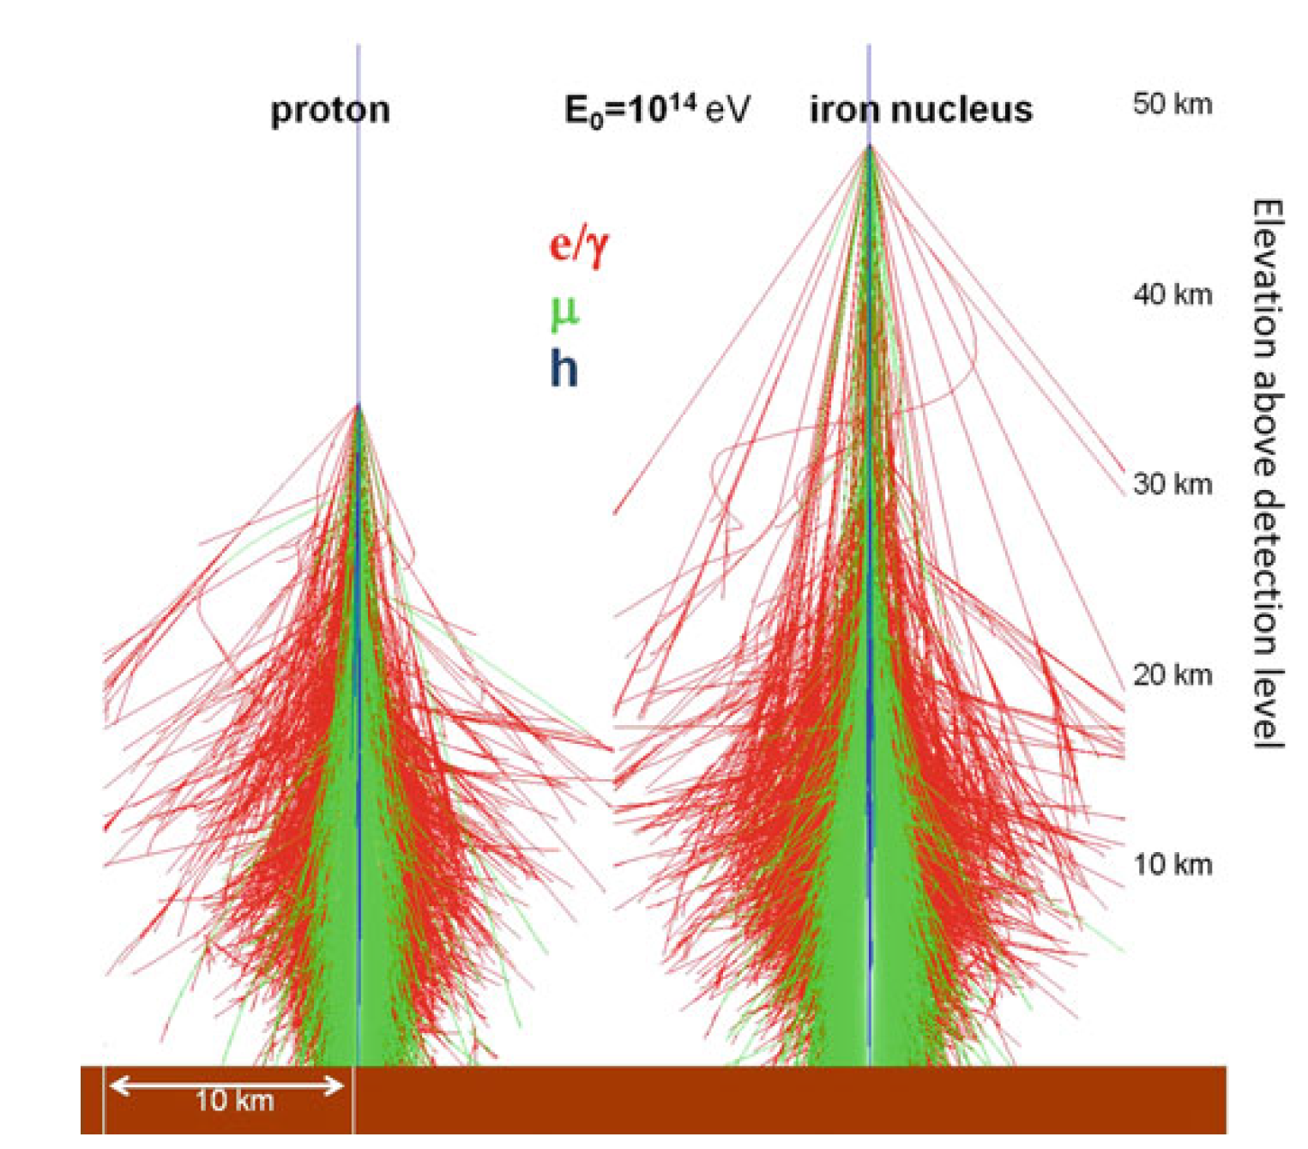
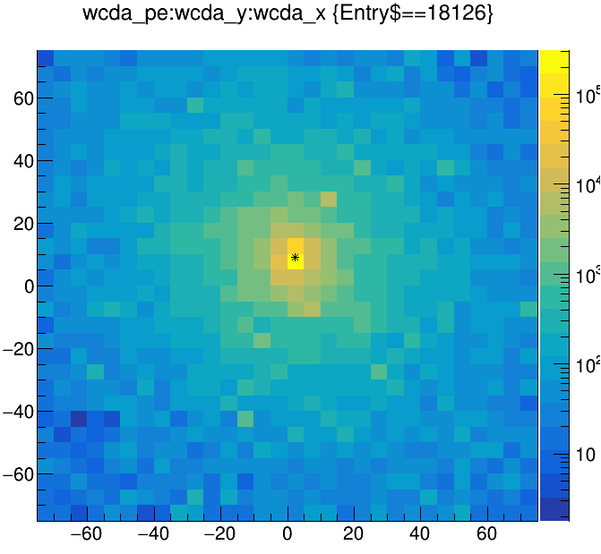
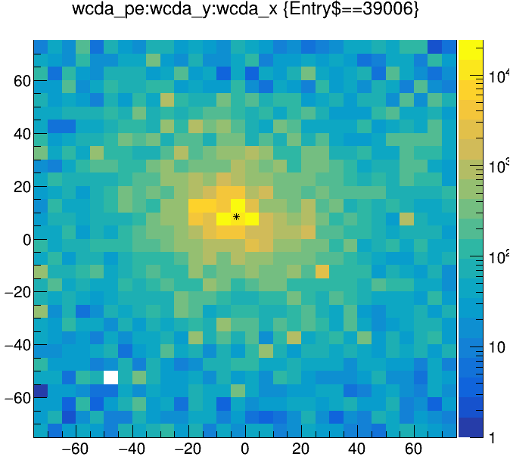
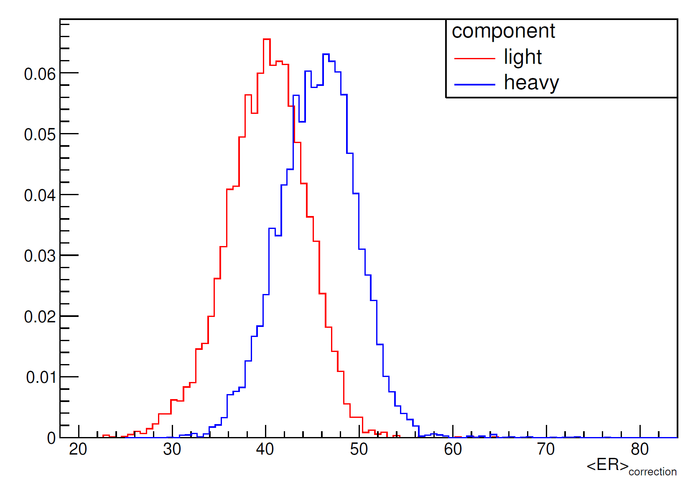
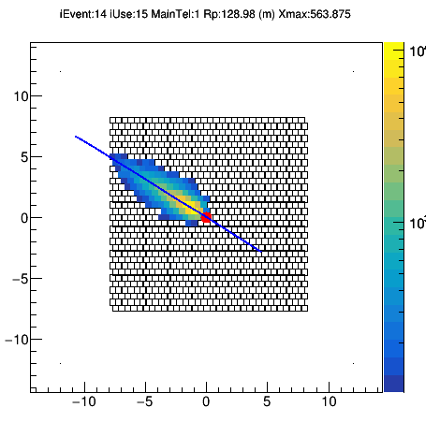
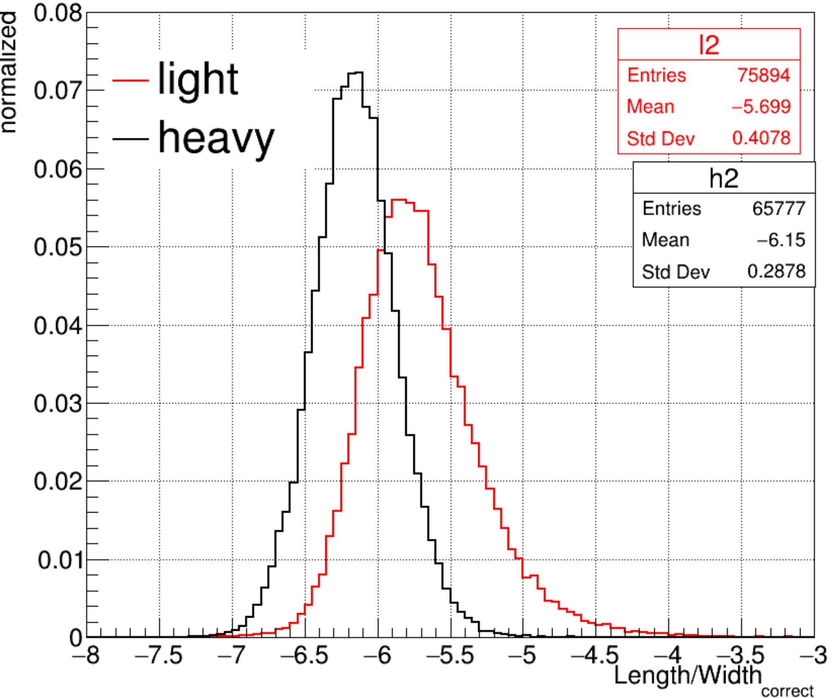
Parameters sensitive to the mass compositions
Proton
Iron
1: Width of the image:
2: shape of the Cherenkov image: related to the Xmax

Slide 18
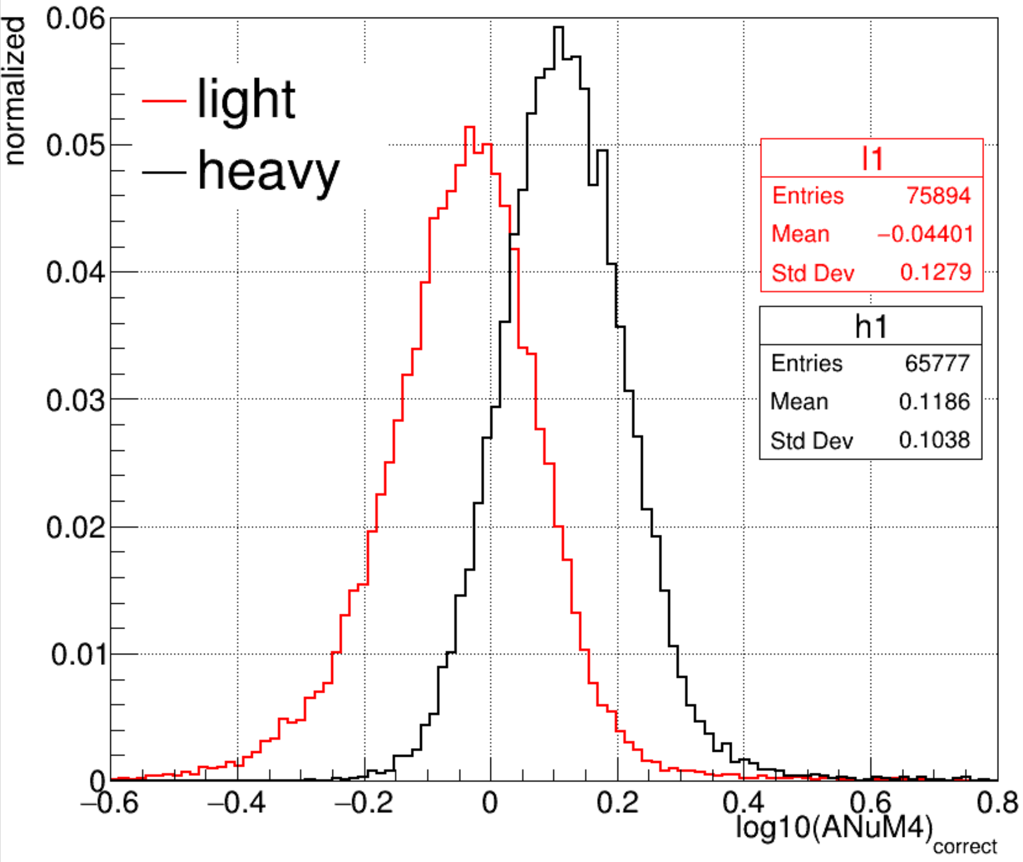
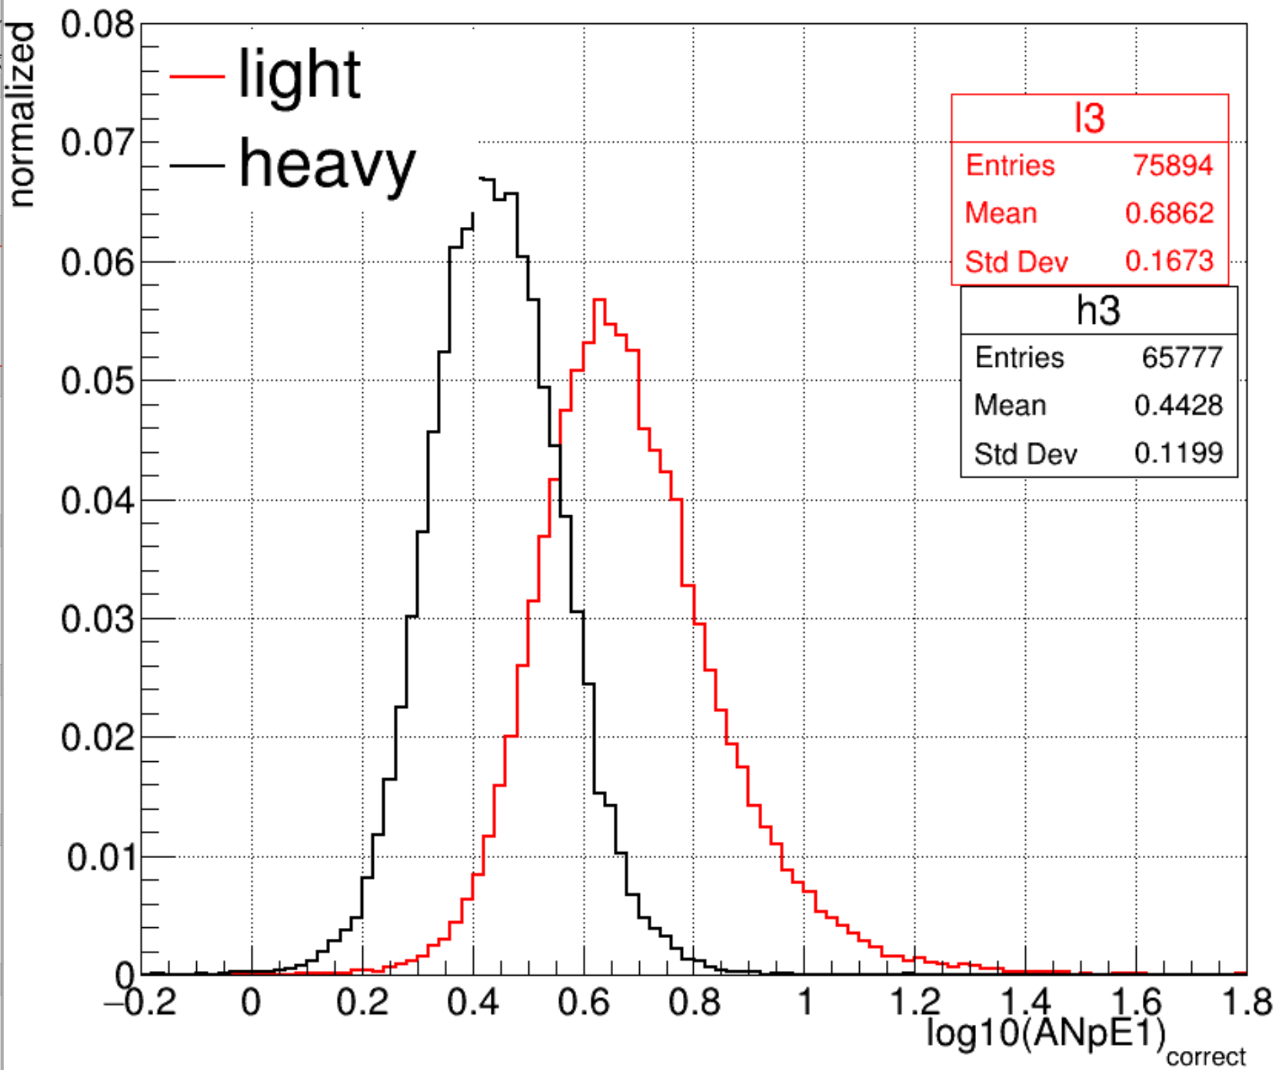
Parameters sensitive to the mass compositions
Muon（$N_{μ}=A{(\frac{E}{AC})}^{β}=A^{1−β}{(\frac{E}{C})}^{β}$）
Ne: showers with a given energy

Slide 19
The measurement of light composition energy spectrum

Slide 20
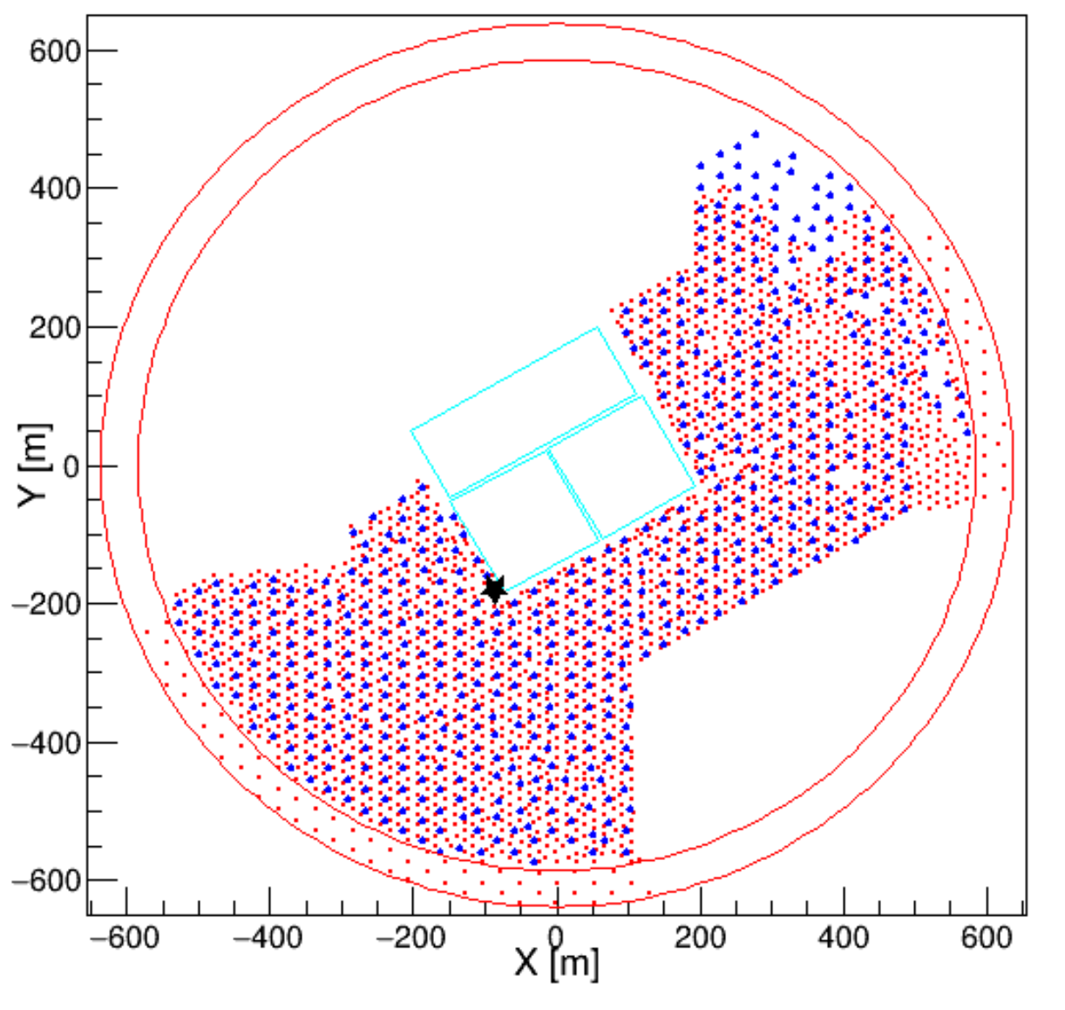
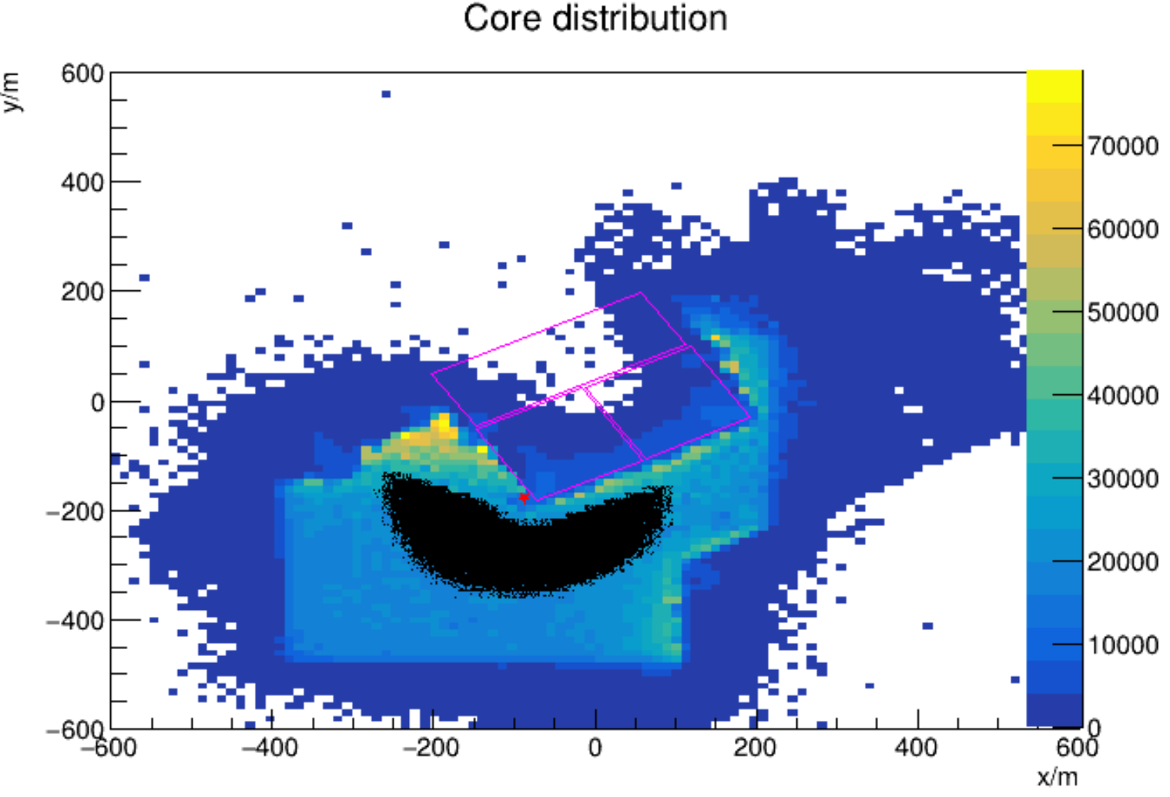
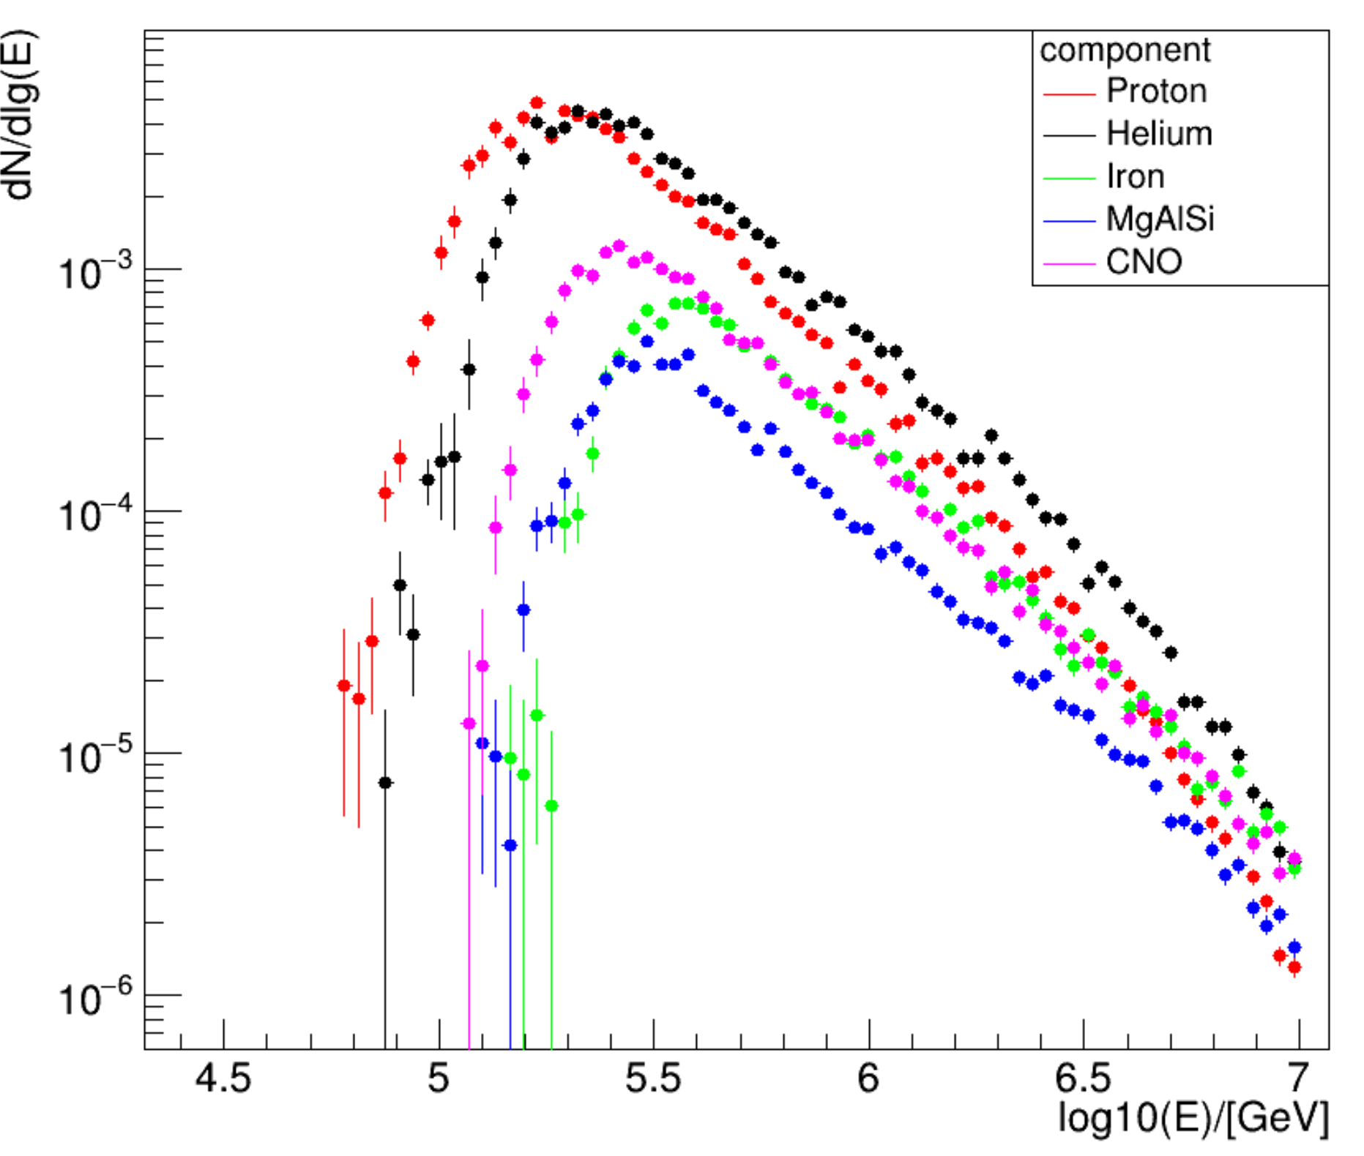
Data used
Joint data:$6 WFCTA \&\& \frac{1}{2}KM2A$
Date: 2020.11.1-2020.11.30;2021.1.1-2021.2.28
Weather: clear and moonless night
KM2A array :
Trigger detector : $NtrigE>20$
Number of Electromagnetic particle : $NpE2>20$ && $\frac{NpE1}{NpE2}>2$
WFCTA array :
Npix of Cherenkov image : $Npix>10$

Slide 21
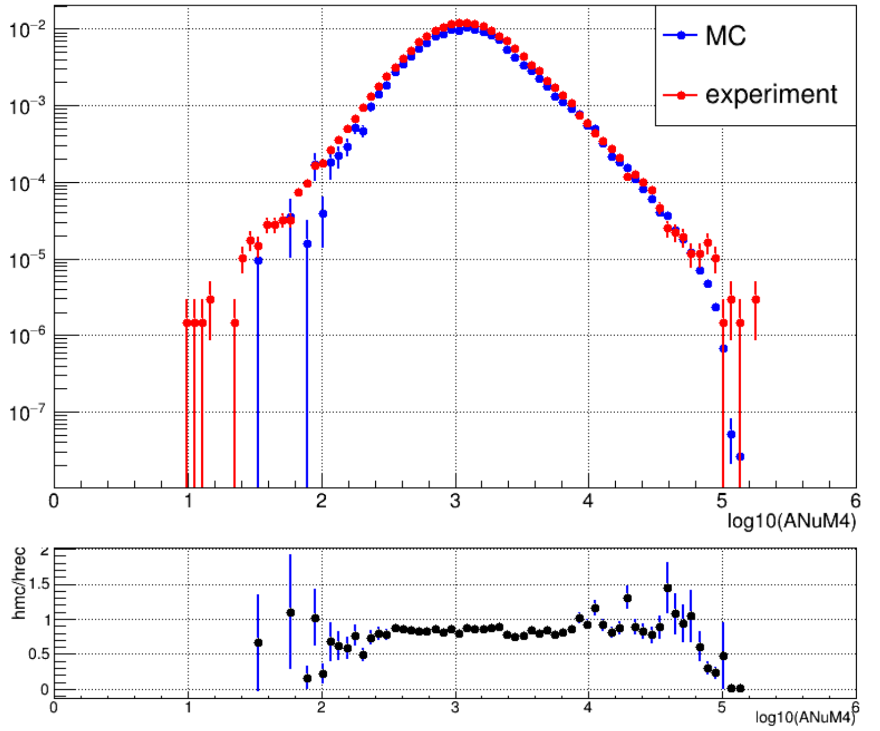
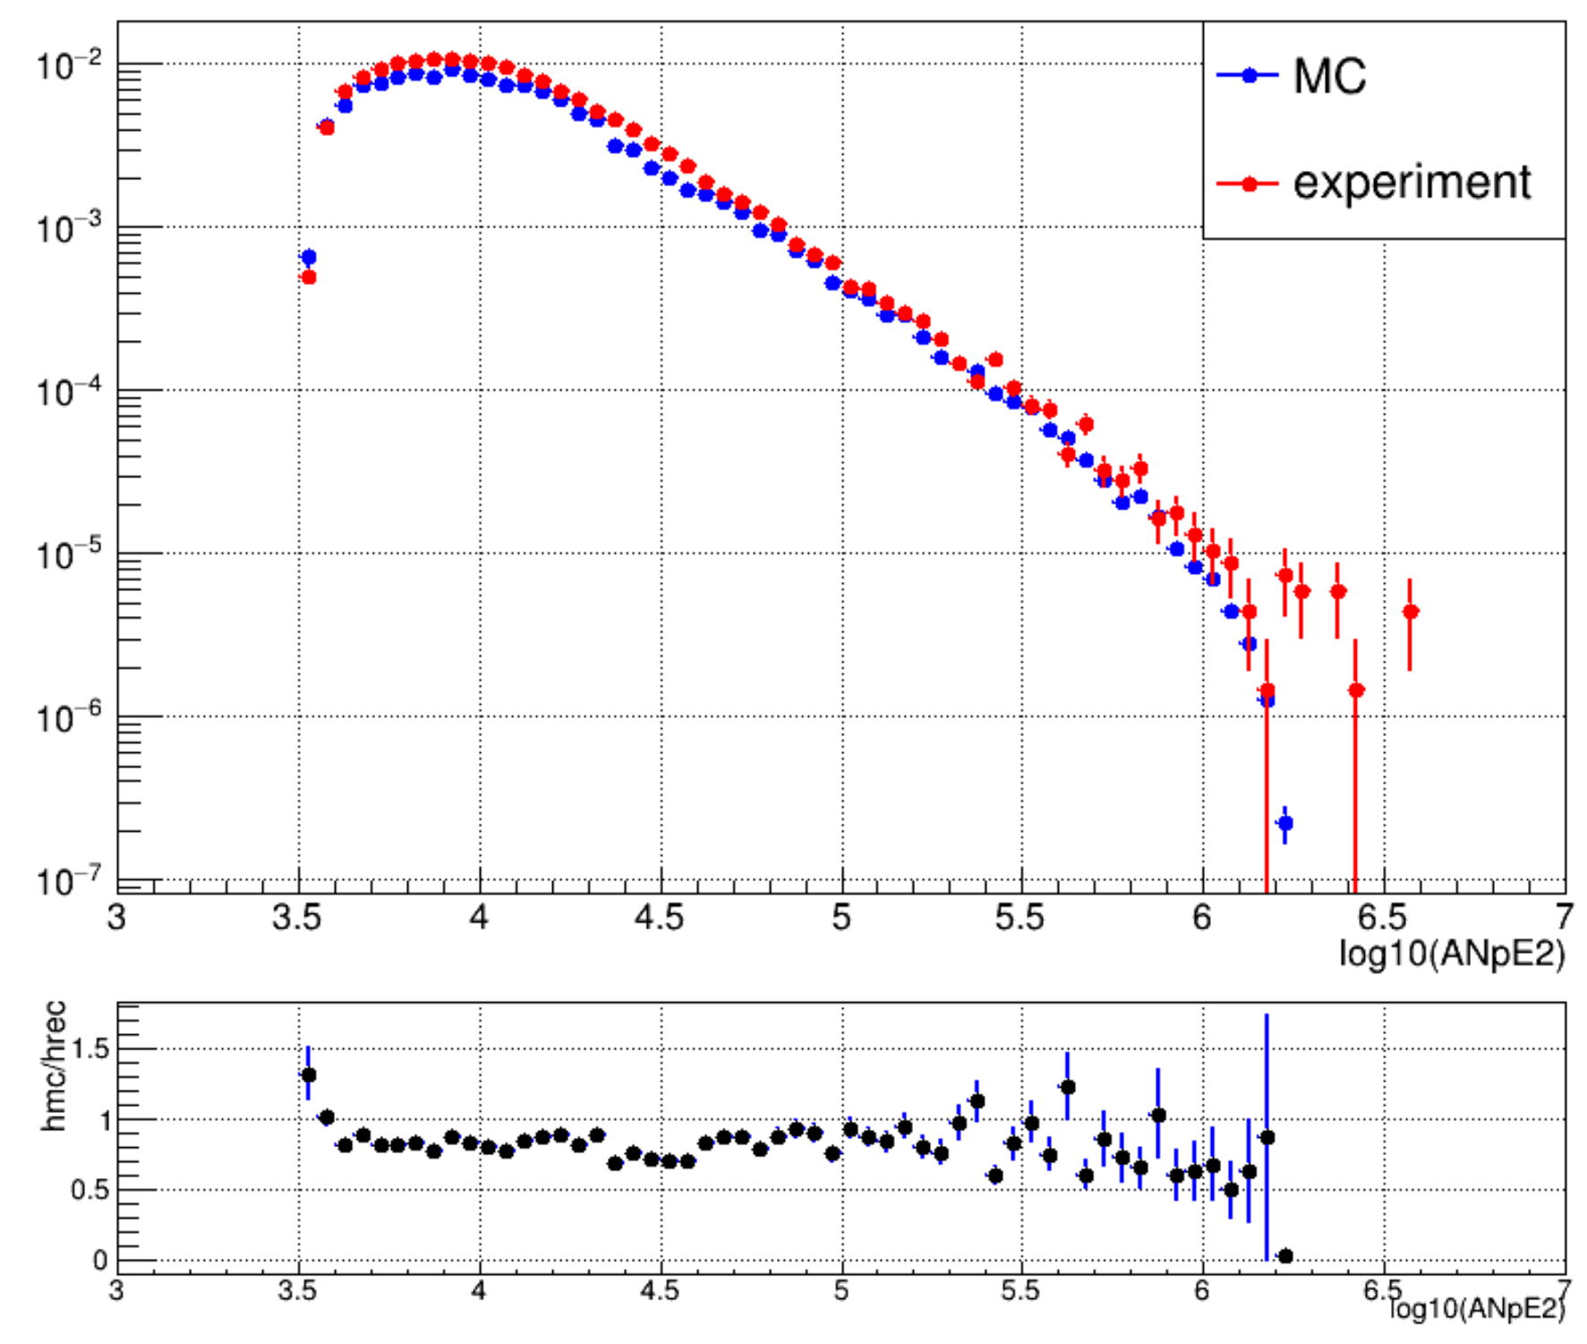
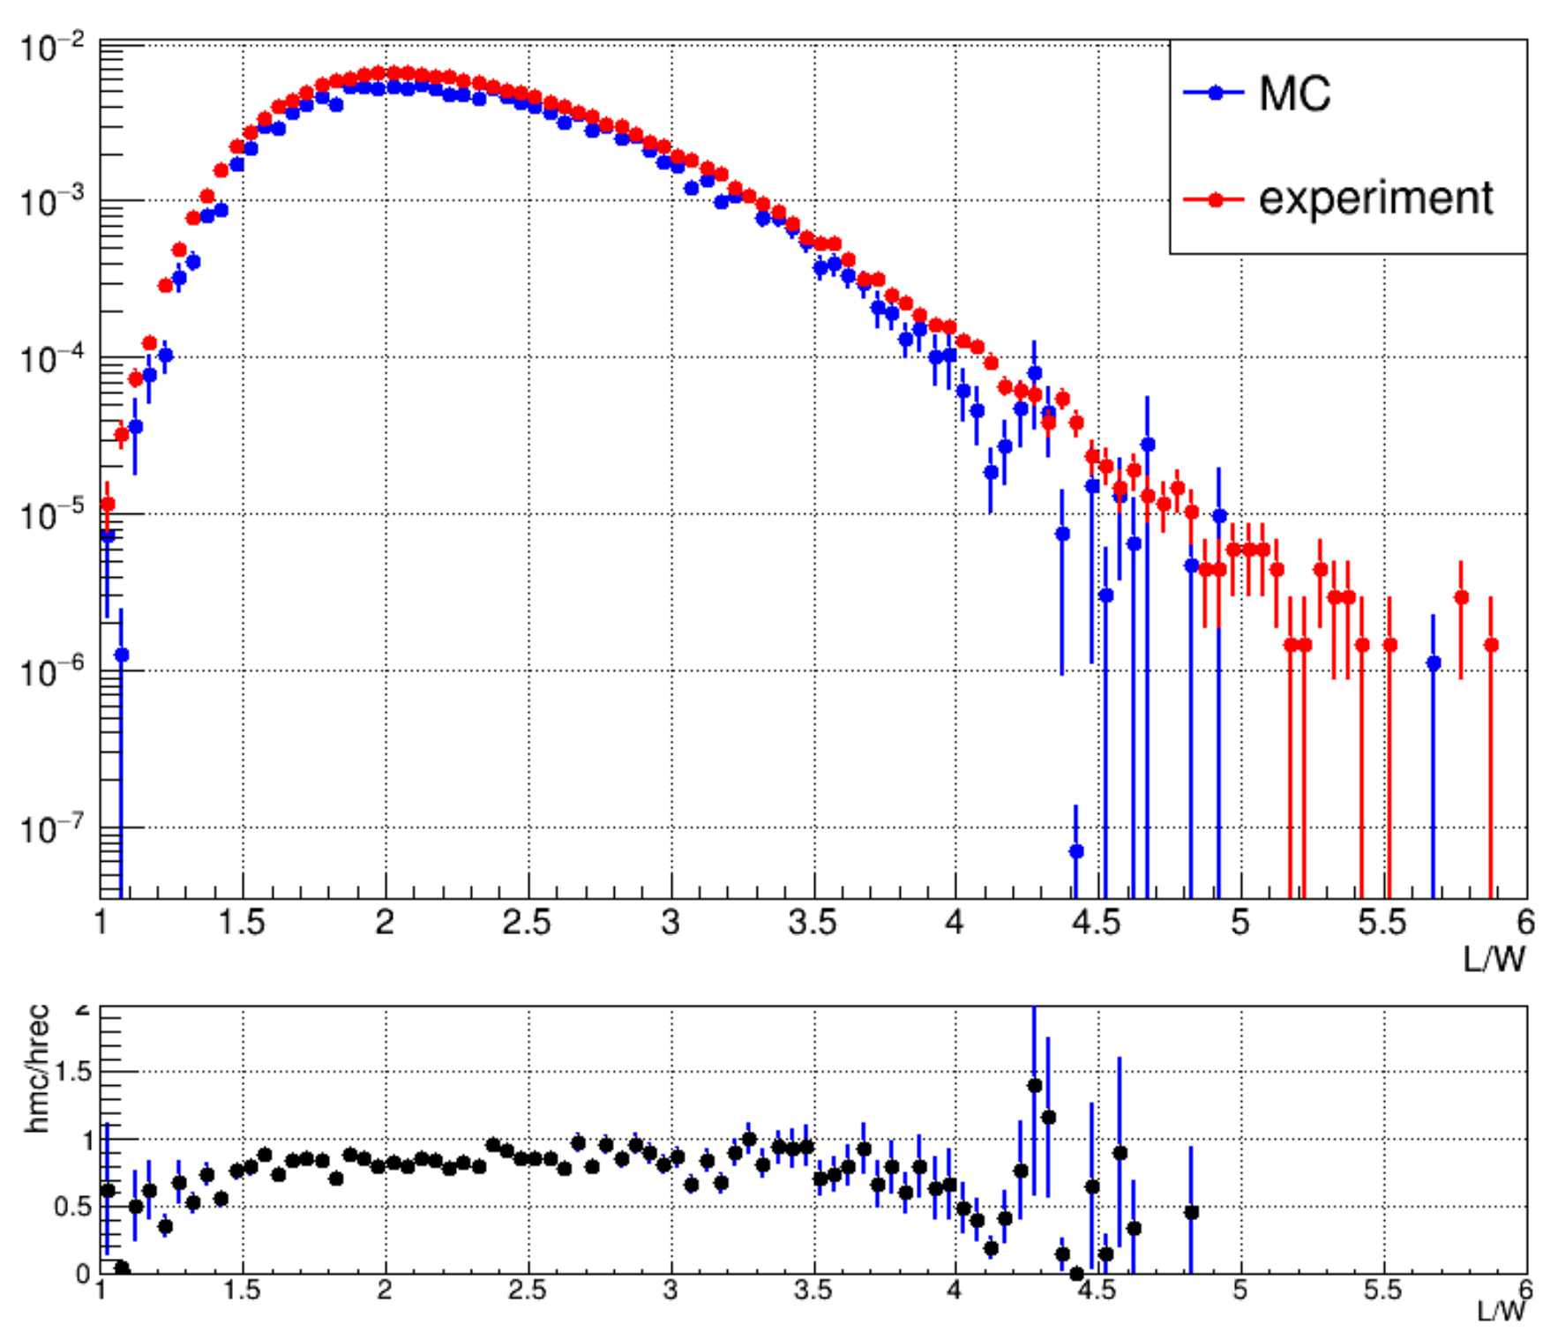
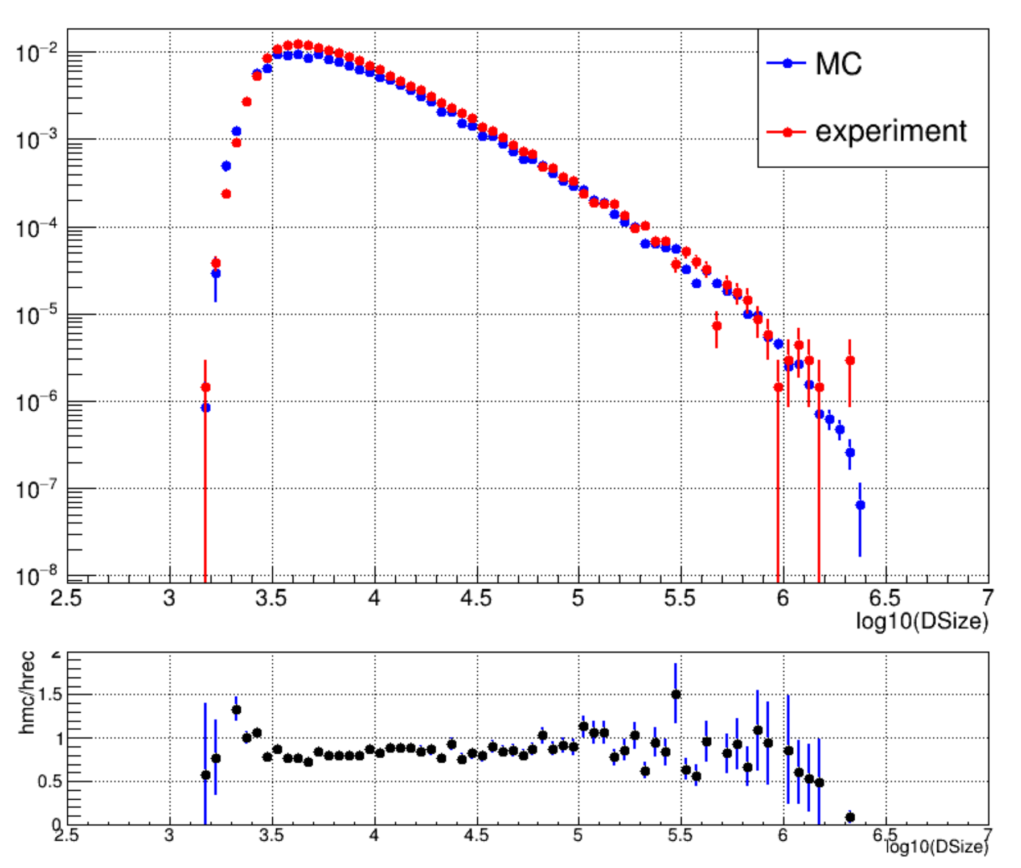
Comparison between data and simulation
ANuM4: In circle 30-380; density of muon * area
ANpE2: In circle 40-200; density of Electromagnetic particles * area
$\frac{Length}{Width}$: Length and width ratio of Cherenkov image
Size: Total size of Cherenkov photons detected by WFCTA
event rate of MC :0.136Hz ; event rate of experiment :0.164Hz

Slide 22
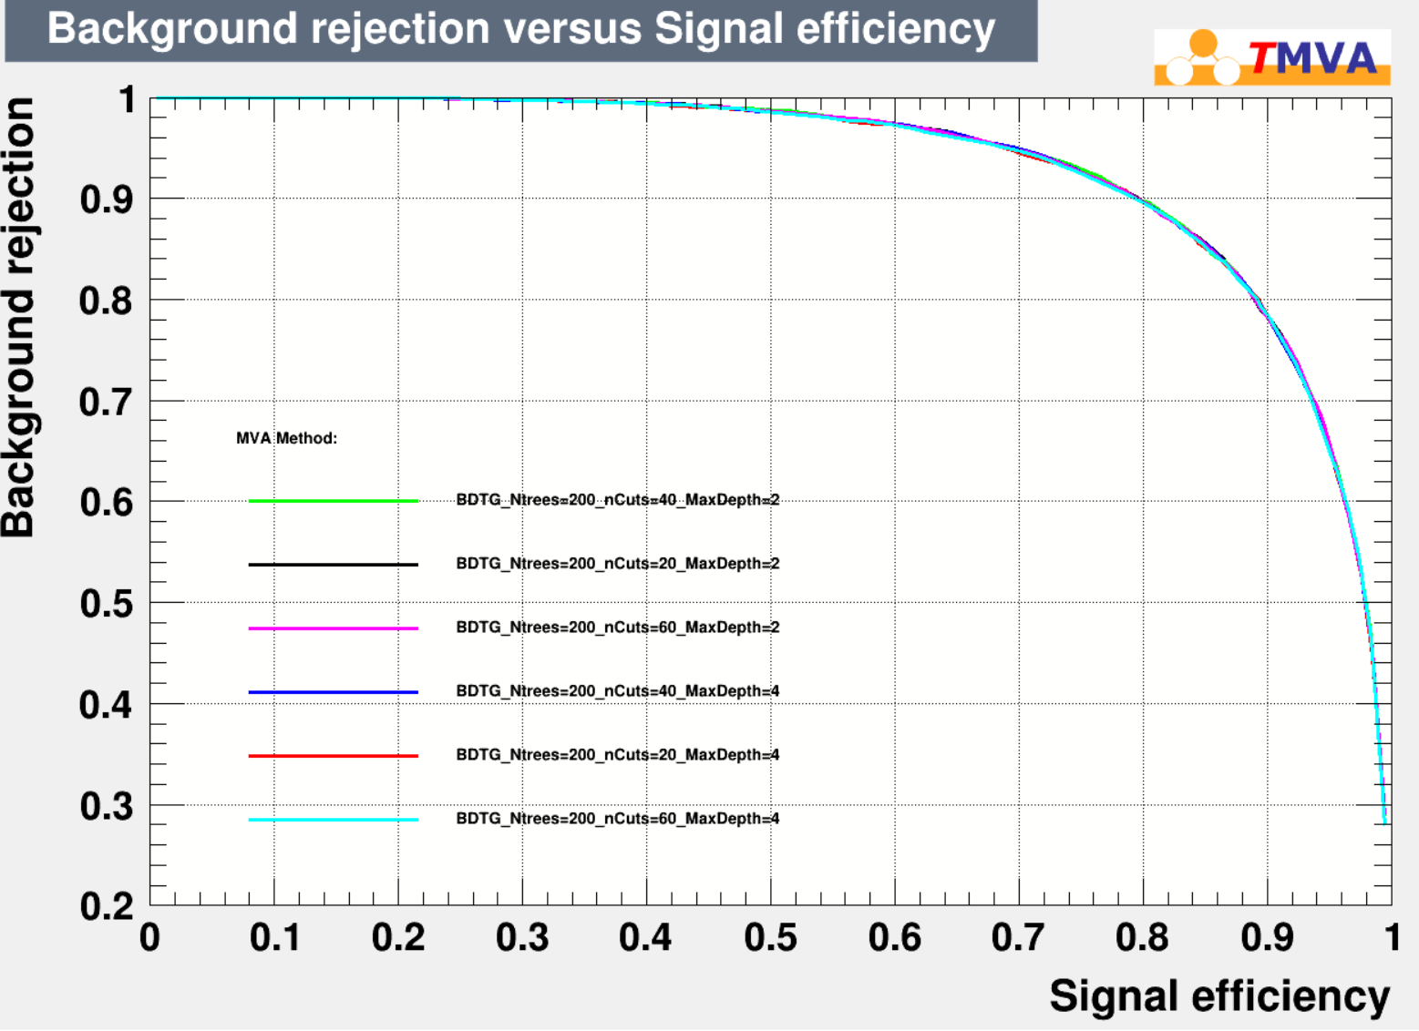
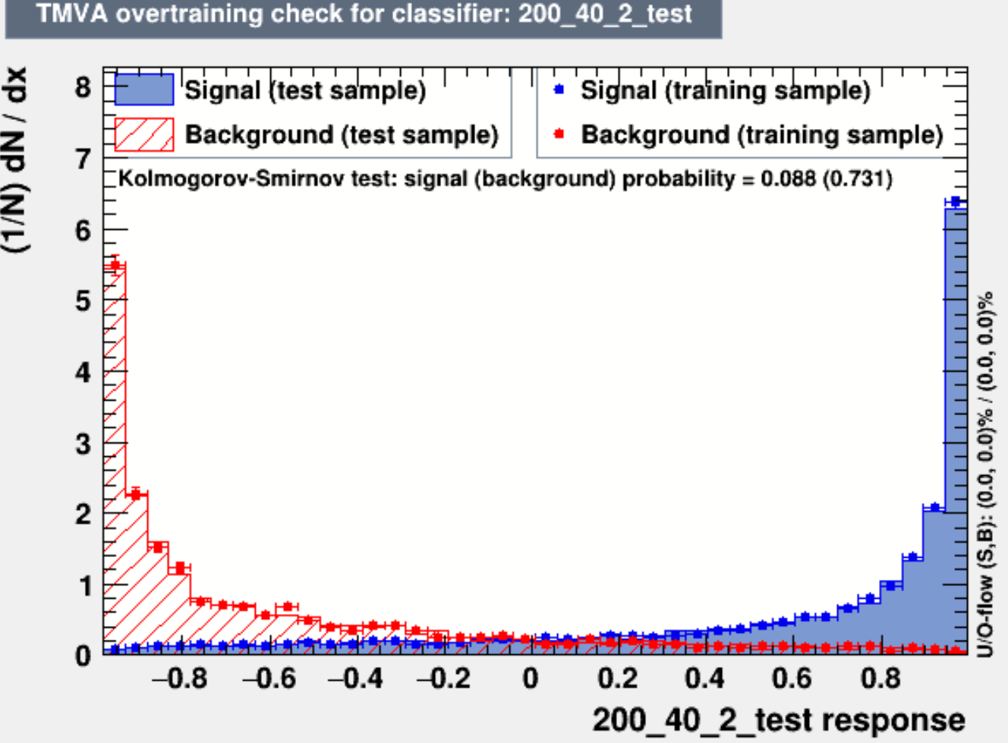
Multiple Variable Analysis(Classification)
Receiver Operating Characteristic(ROC)
TMVA comparison
The training results are in good agreement with the test results

Slide 23
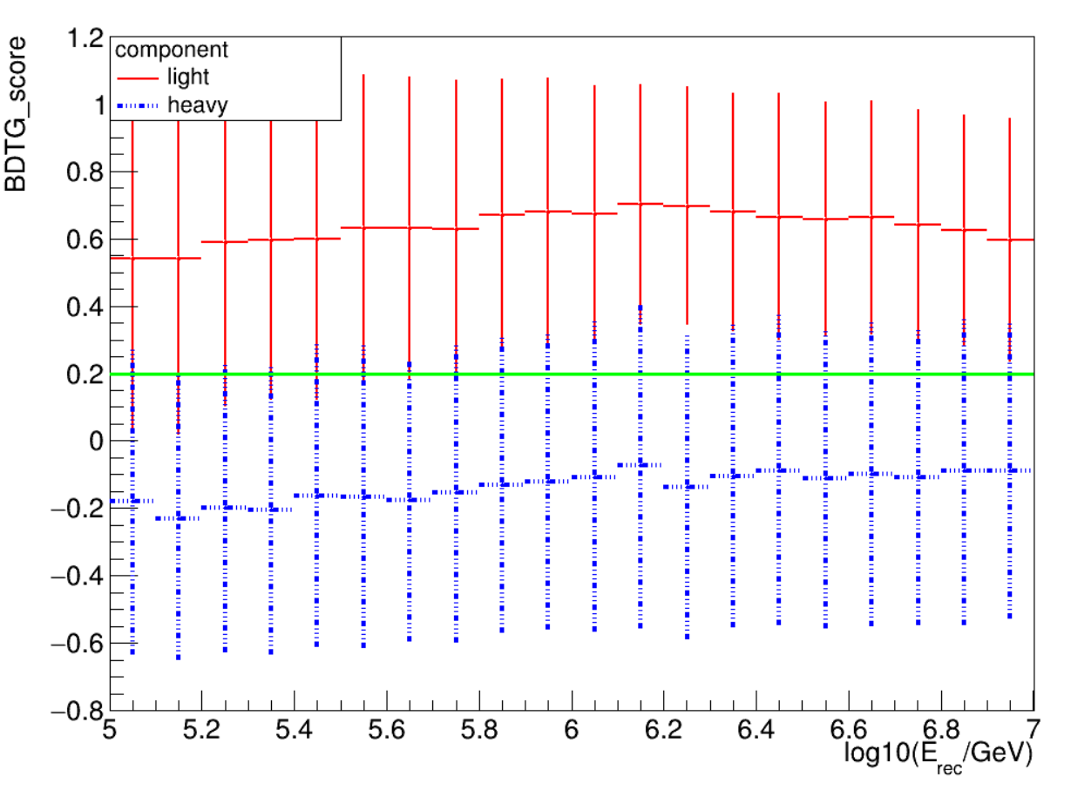
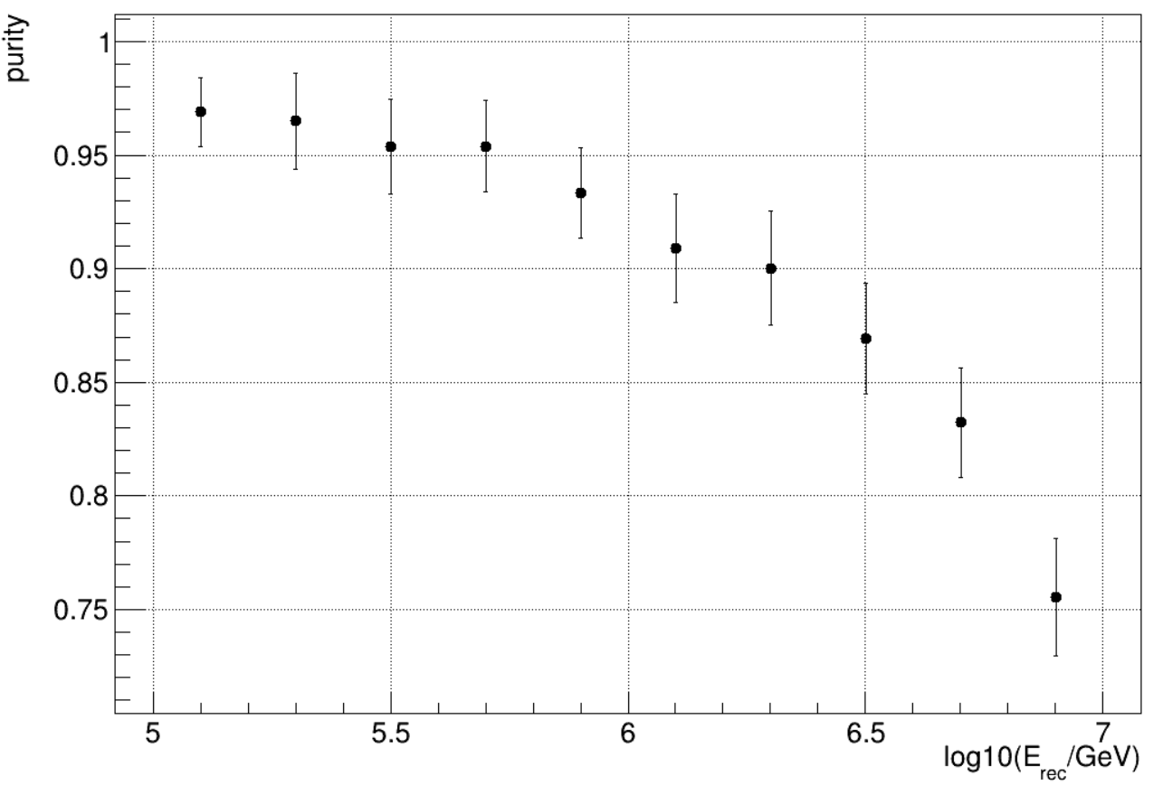
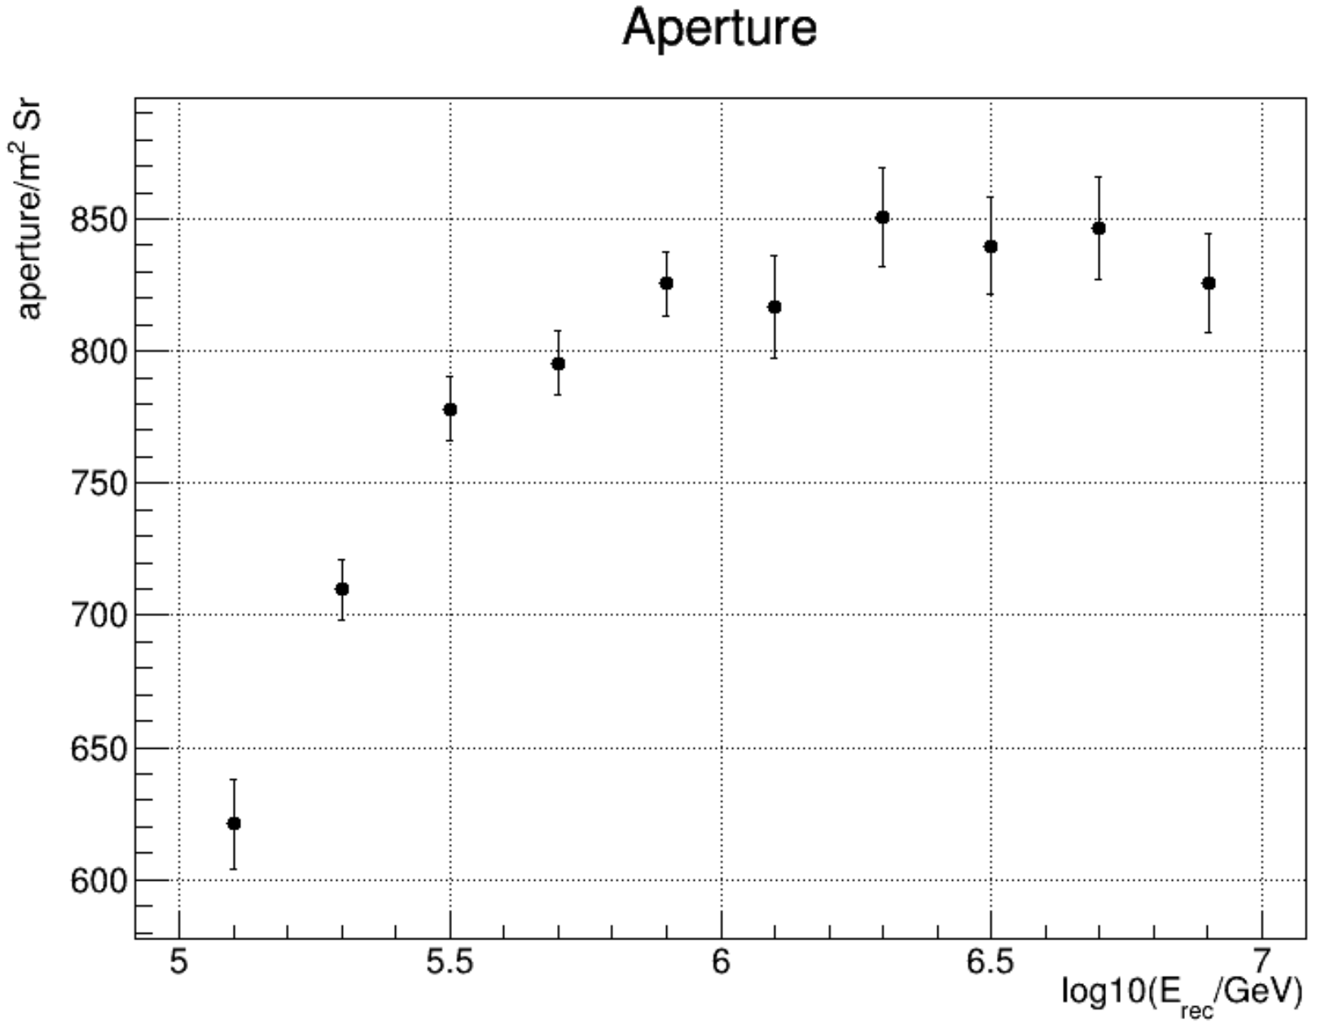
Multiple Variable Analysis(Application)
Input data:MC data
$$purity=\frac{signal}{signal+background}$$
$$Aperture=\frac{{event}_{select}}{{event}_{throw}}×S_{throw}×Ω$$
MVA cut: BDTG_score>0.2

Slide 24
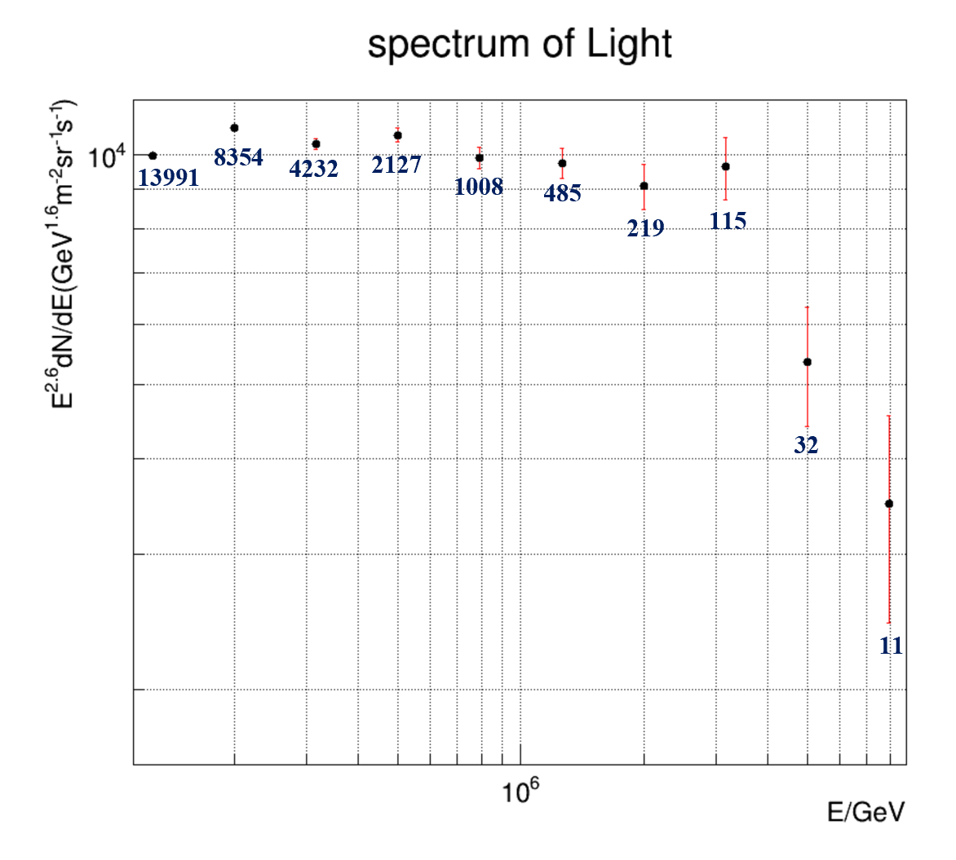
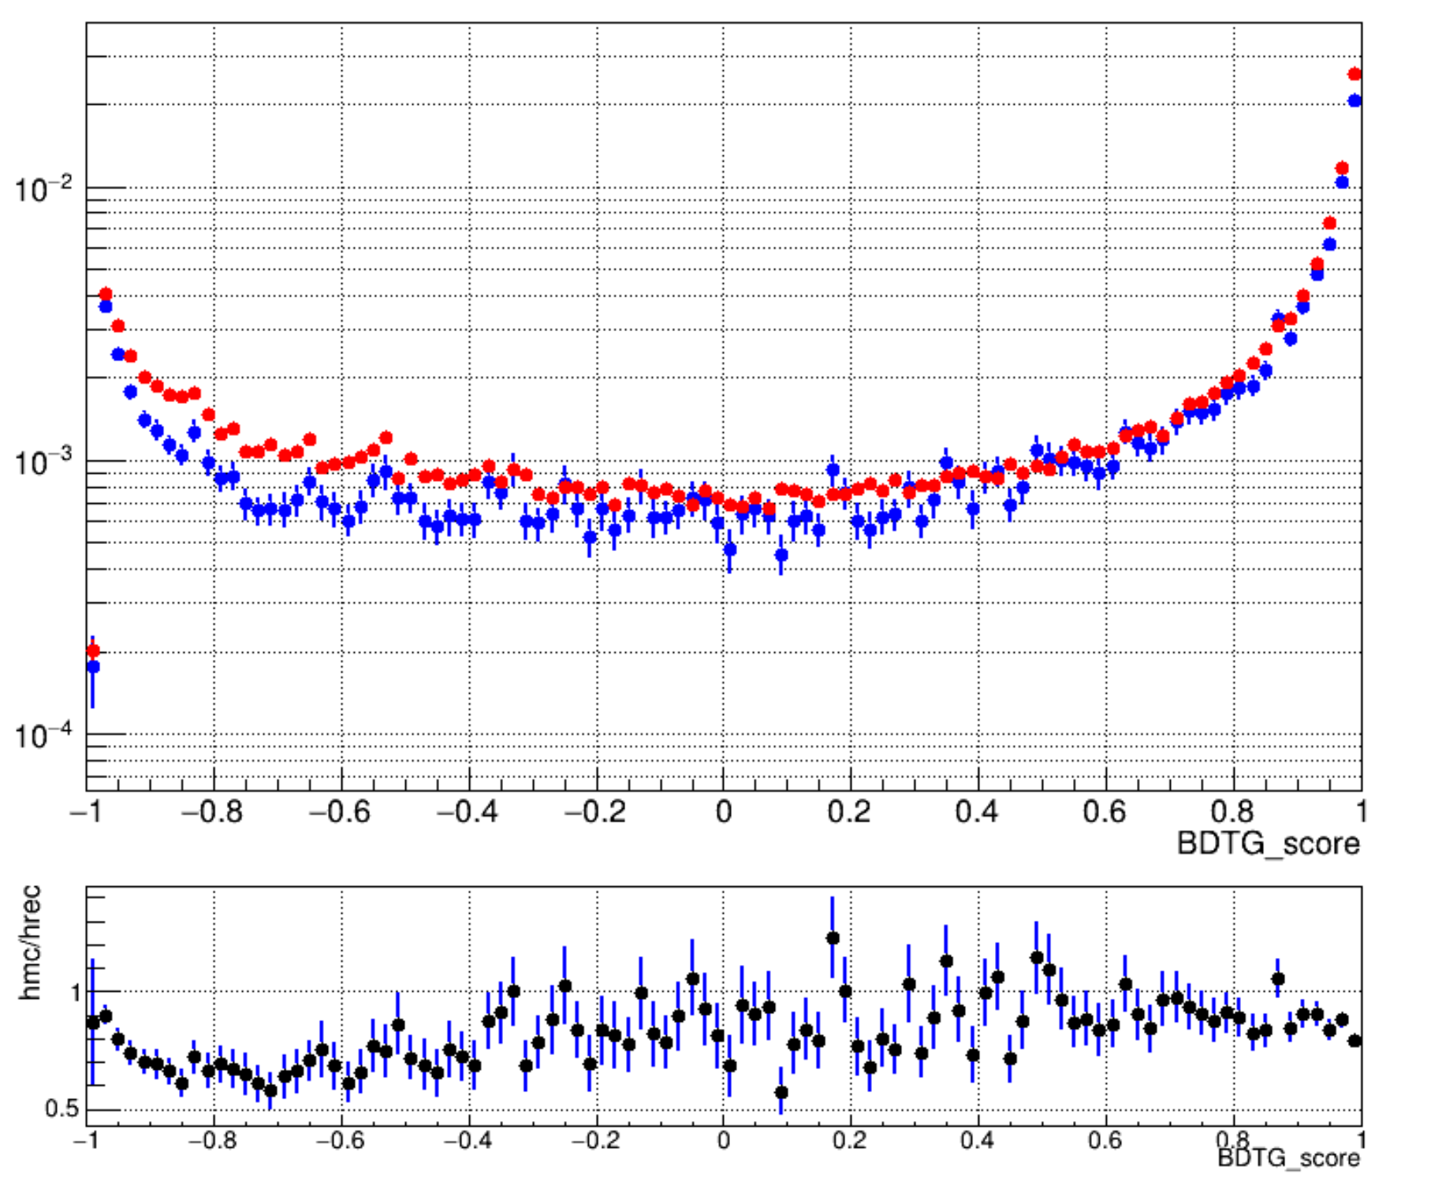
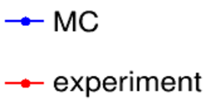
Identify experiment data by MVA
Score distribution of experiment and MC
Preliminary results of light component energy spectrum
Lingping Wang’s talk for detail on Oct. 14th

Slide 25
Summary and next plan
Commonly triggered data of the three detectors with high quality are accumulated.
Full FOV observation of WFCTA is achieved
Energy scale of WCDA-1 is obtained and propagated to WFCTA.
The relative energy scale caused by the weather condition is 9%.
Experiment data and simulation data are consistent within 25%.
Preliminary light composition spectrum is obtained.
Systematic uncertainties caused by composition models and hadronic models will be studied

Slide 26
Thank you!

