Slide 1
The second LHAASO collaboration meeting in 2021 & LHAASO Project status meeting
Thunderstorm Activity at LHAASO observatory
Xuejian Chen, Peihan Wang
Xunxiu Zhou, Daihui Huang, Axikegu, Lin Chen
Southwest Jiaotong University

Slide 2
Outline
1. The introduction of thunderstorm activity
2. The thunderstorm activity at LHAASO
3. Thunderstorm 20210610
4. Summary and next step

Slide 3
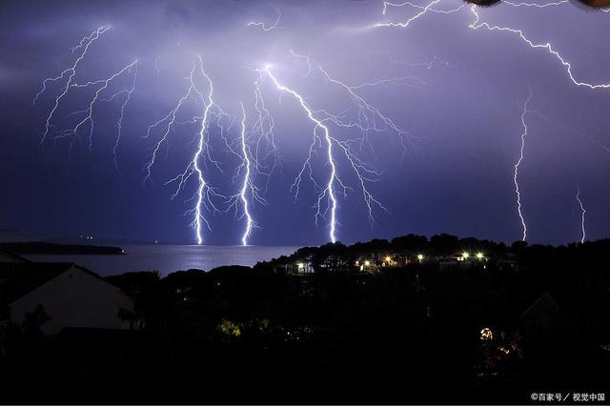
1.The introduction of thunderstorm activity
Thunderstorms are common weather phenomena at high altitudes
The strength of atmospheric electric fields could be up to 1000 V/cm or even higher
Thunderstorms can inflict immense death and property damage worldwide

Slide 4
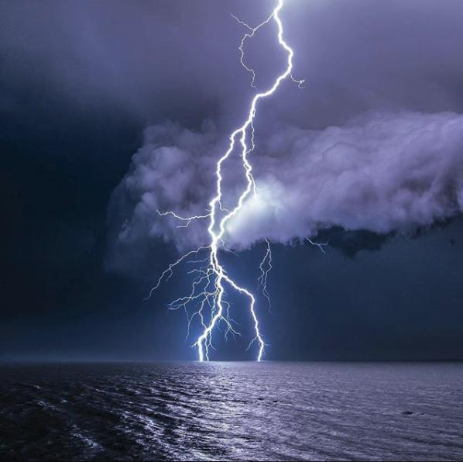
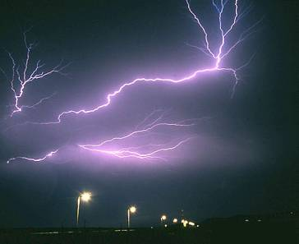
The lighting during thunderstorm
Positive ground lighting
Negative ground lighting
Lightning in the cloud
Intercloud lightning
Lightning outside the cloud

Slide 5
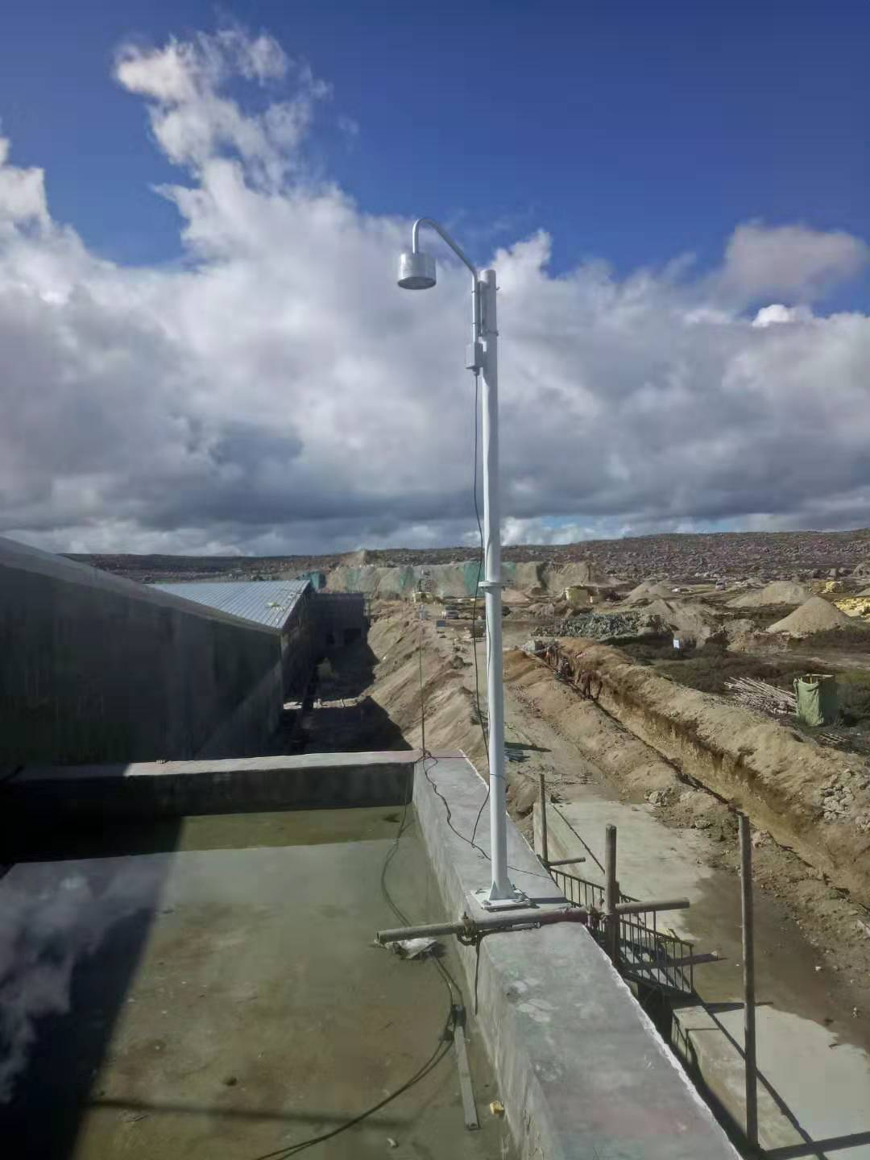
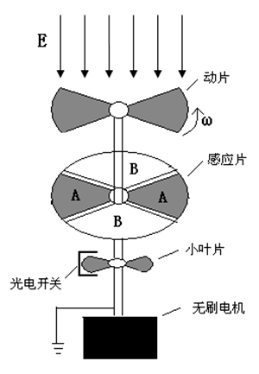
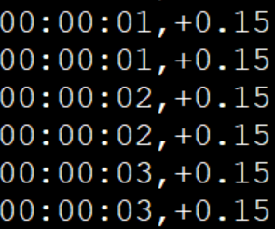
The EFM-100c at LHAASO observatory
The data of electric field:
Time (hour: minute: second)
Polarity of field (‘+’ or ‘-’)
Intensity of field
Scale: ±1000 V/cm

Slide 6
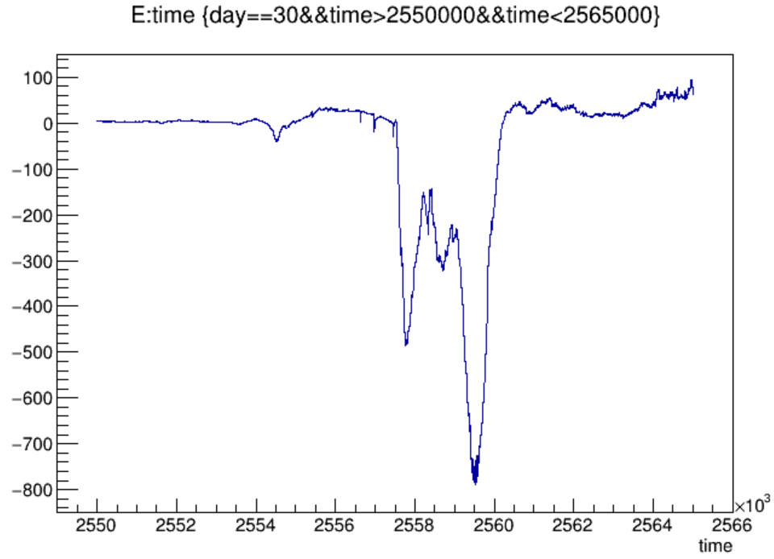
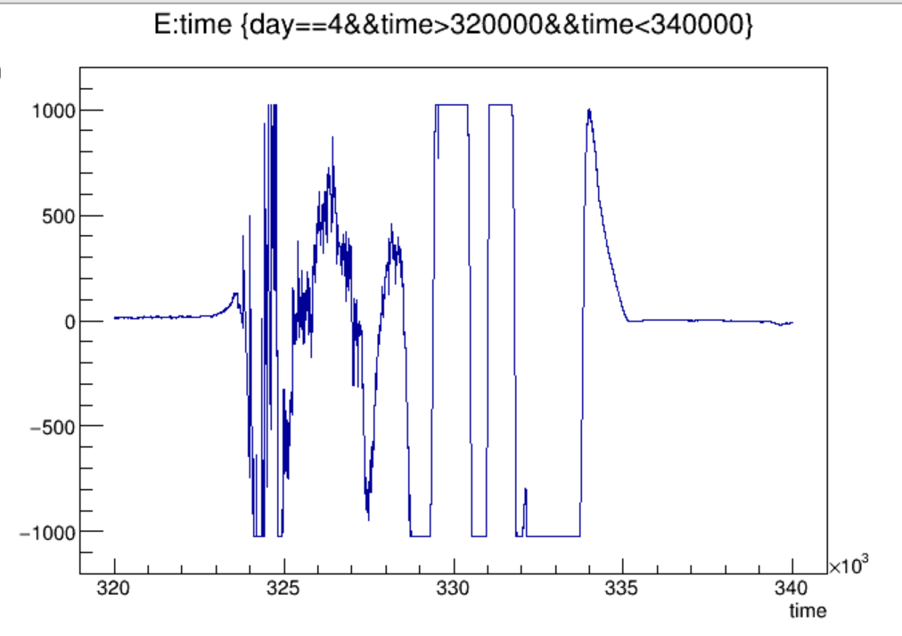
2.The thunderstorm activity at LHAASO
Data selection
The maximum strength of the near-earth atmospheric electric field is larger than 500 V/cm and lasts for at least 8 minutes,or it is higher than 900V/cm at least 4 minutes.

Slide 7
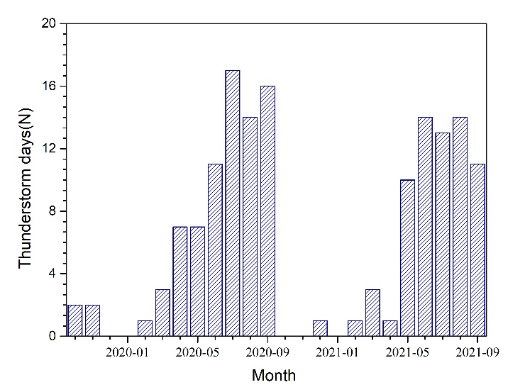
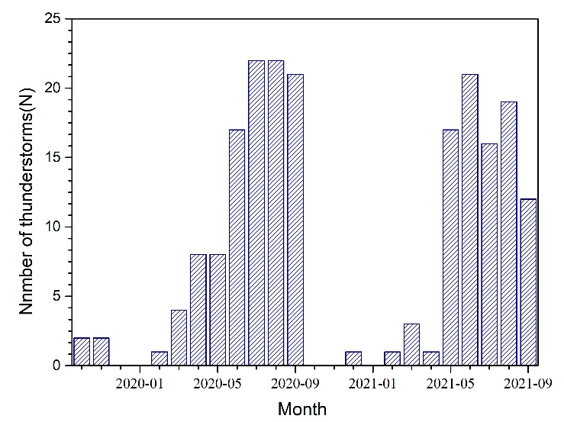
Thunderstorm day and number
199 thunderstorms, 148 thunderstorm days
Thunderstorms mainly occur from June to September, Proportion: 75%

Slide 8
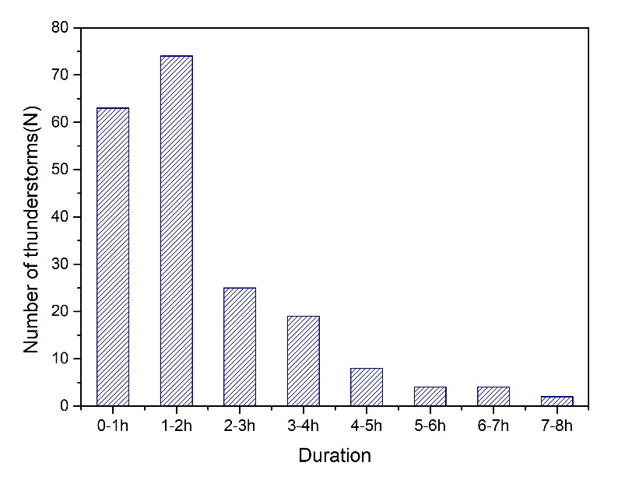
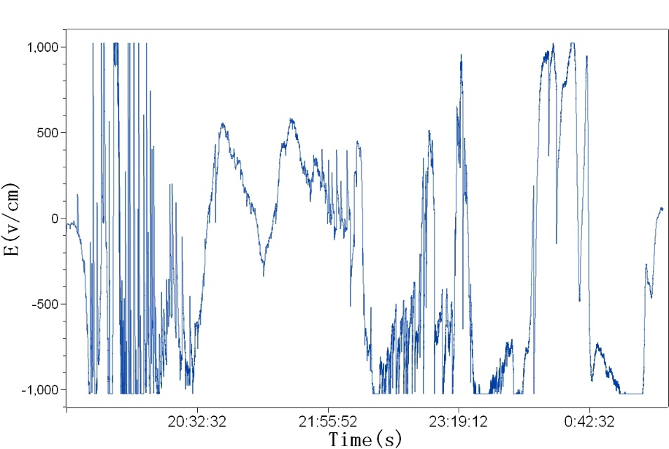
Thunderstorm duration
Most thunderstorms last less than 2h
The thunderstorm 20210624 lasted 6.3 hours

Slide 9
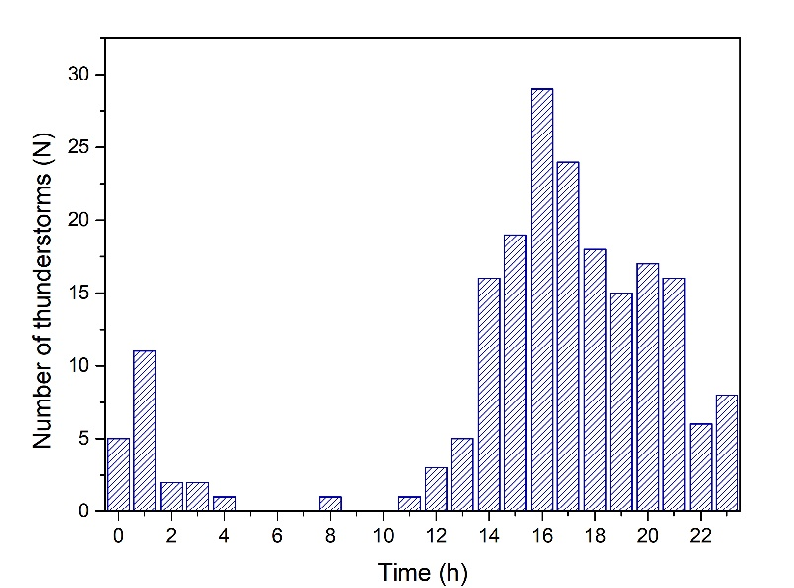
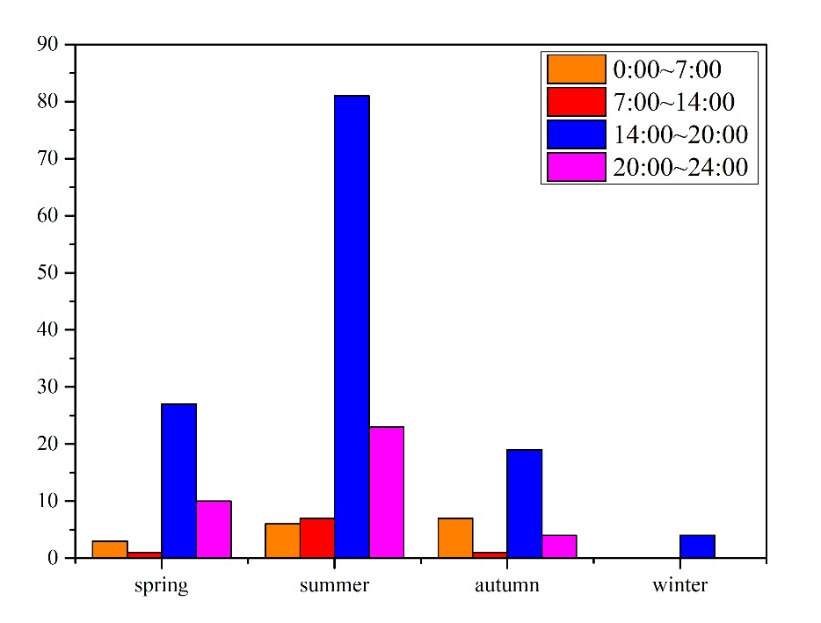
Daily distribution of thunderstorms
Thunderstorms mainly occur at 14-21 o'clock, Proportion: 78%
There are also a few thunderstorms in the middle of the night

Slide 10
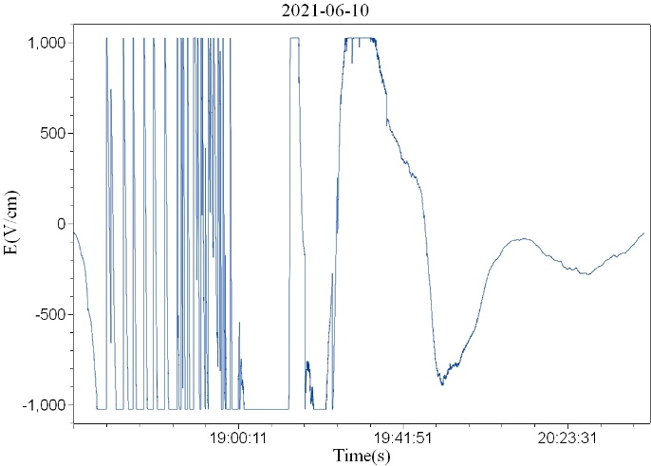
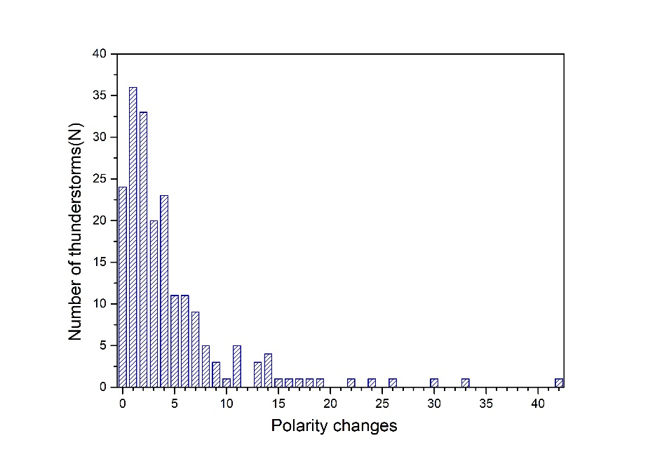
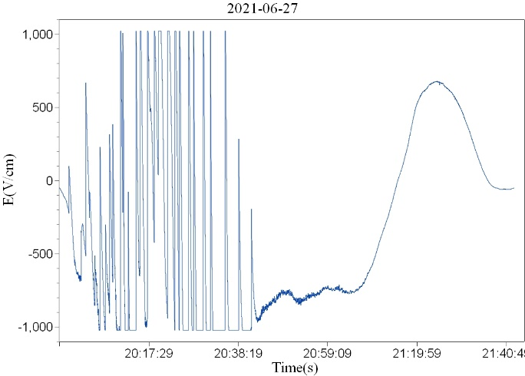
The polarity variations of thunderstorm fields
Most thunderstorms have electric field polarity reversal, Proportion: 88%

Slide 11
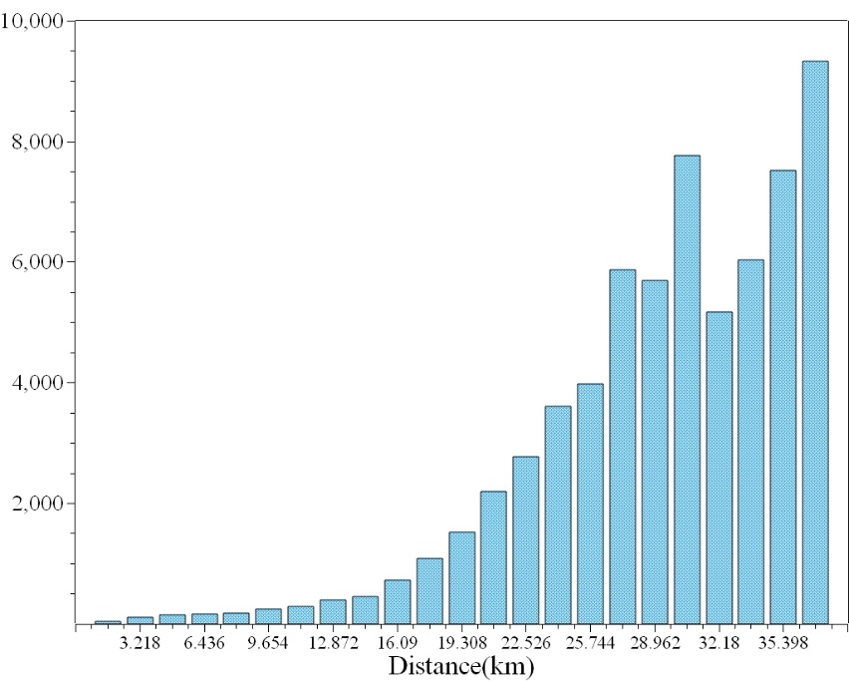
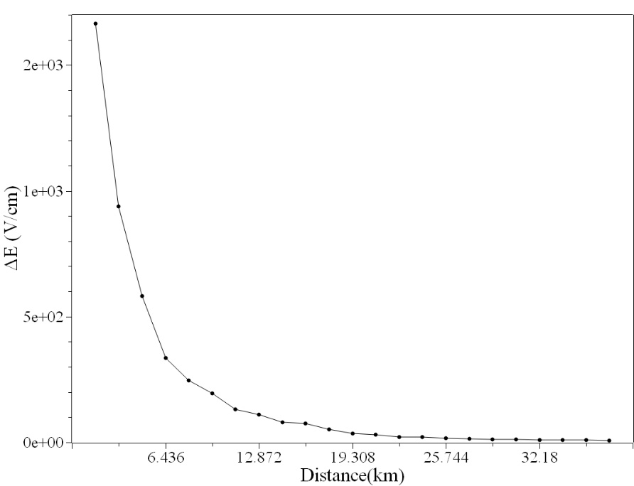
Lighting and the variation of electric field
The number of lightning increases with distance
Intensity variations of electric field decreases with distance

Slide 12
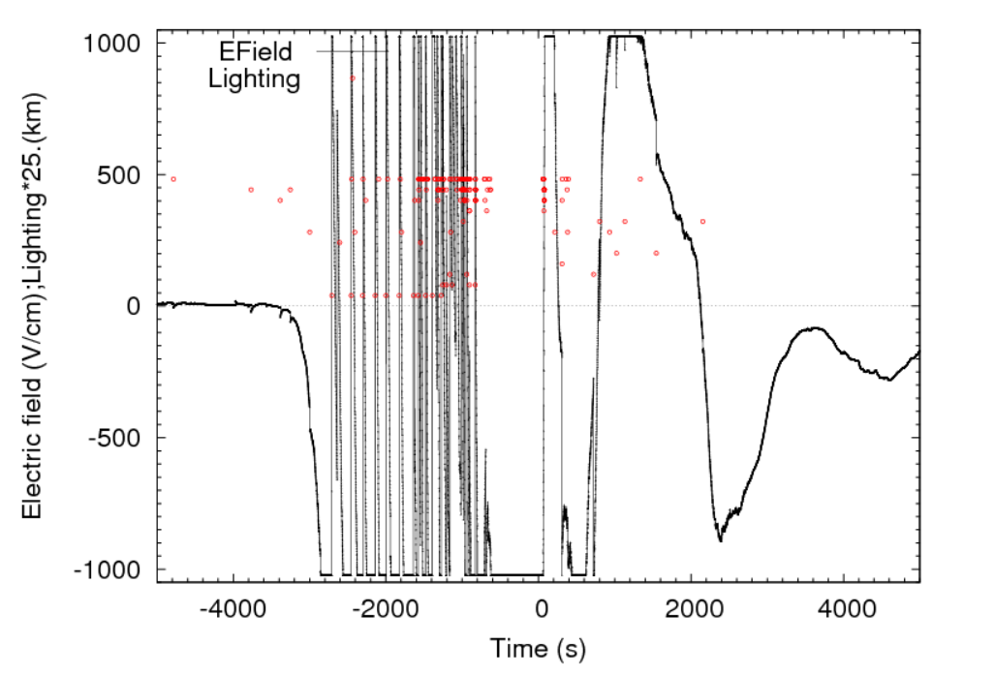
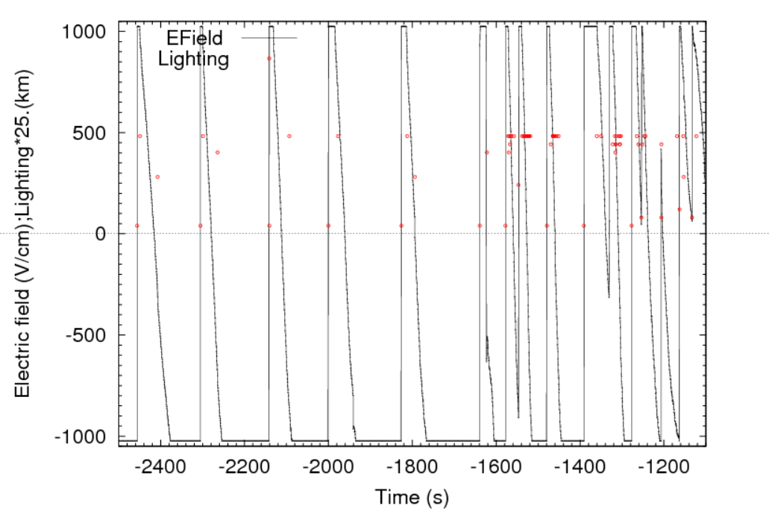
3.Thunderstorm 20210610
Number of variations in polarity：42
1.6 km lightning:11

Slide 13
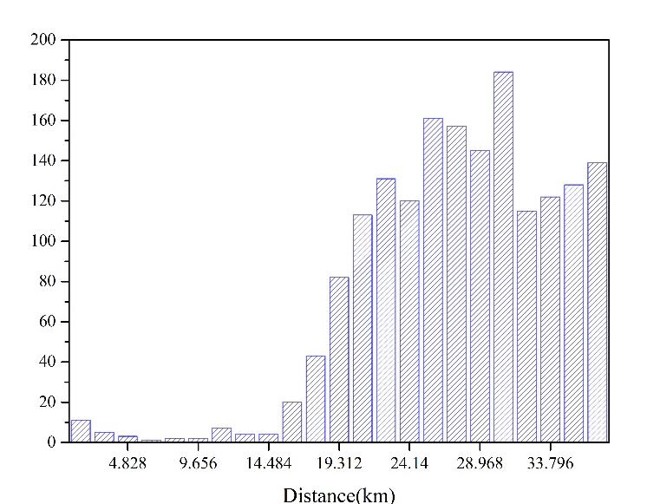
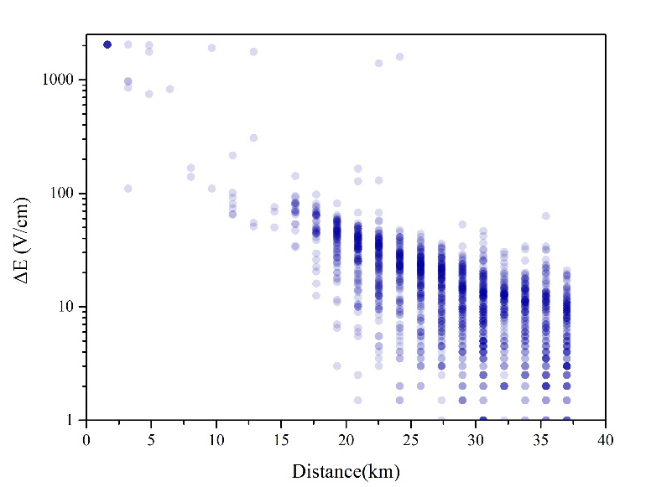
Lighting and the variation of electric field
The number of lightning decreases first and then increases with distance
Intensity variations of electric field decreases with distance

Slide 14
Near-by Lighting
Thundercloud is close to the ground
Strong variation of near-earth thunderstorm electric field
Parameter | 2019-10-2021-09 | 2021-06-10 | Proportion
(1) 1.6 km Lightning | 40 | 11 | 27.5%
(2) 3.2 km Lightning | 68 | 5 | 7.3%
(3) |ΔE| > 2000V/cm | 30 | 12 | 40.0%
(1)(3) | 23 | 10 | 43.4%
(2)(3) | 5 | 1 | 20.0%

Slide 15
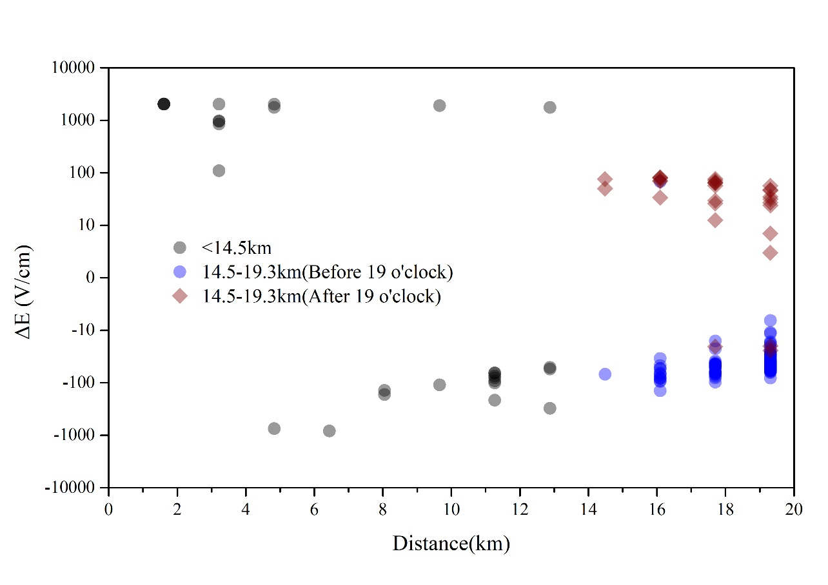
Distance - ΔE

Slide 16
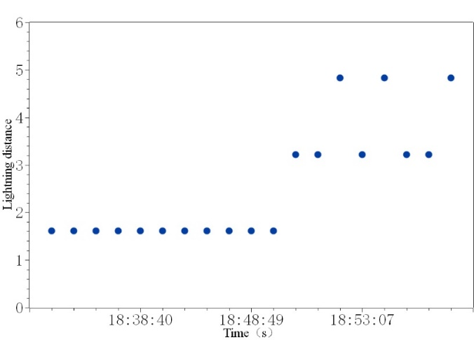
Lighting < 4.8 km
rise
Charge center rise
release

Slide 17
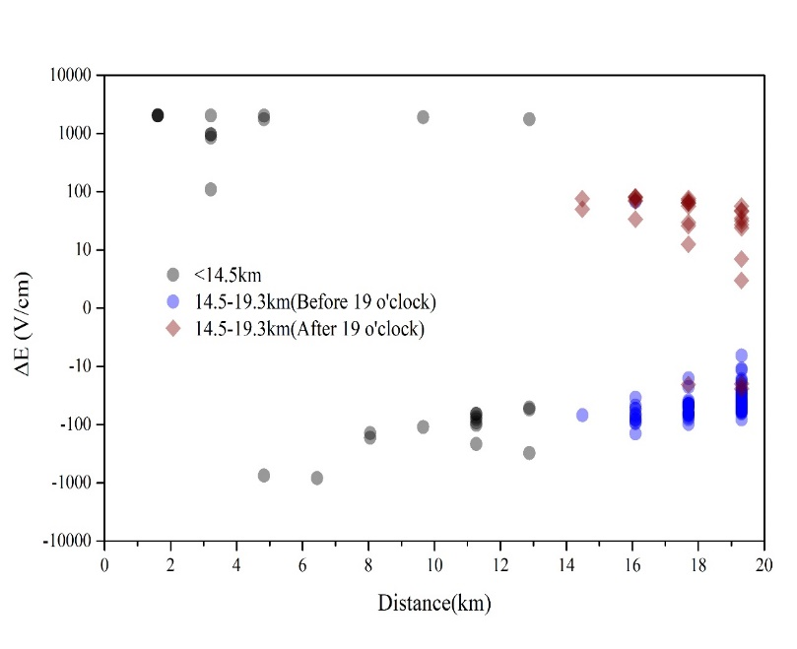
Lightning ：6.4-12.8km
6.4-12.8km is the positive power center
Different ΔE corresponds to different lightning types
Altitude
2
1
3
0

Slide 18
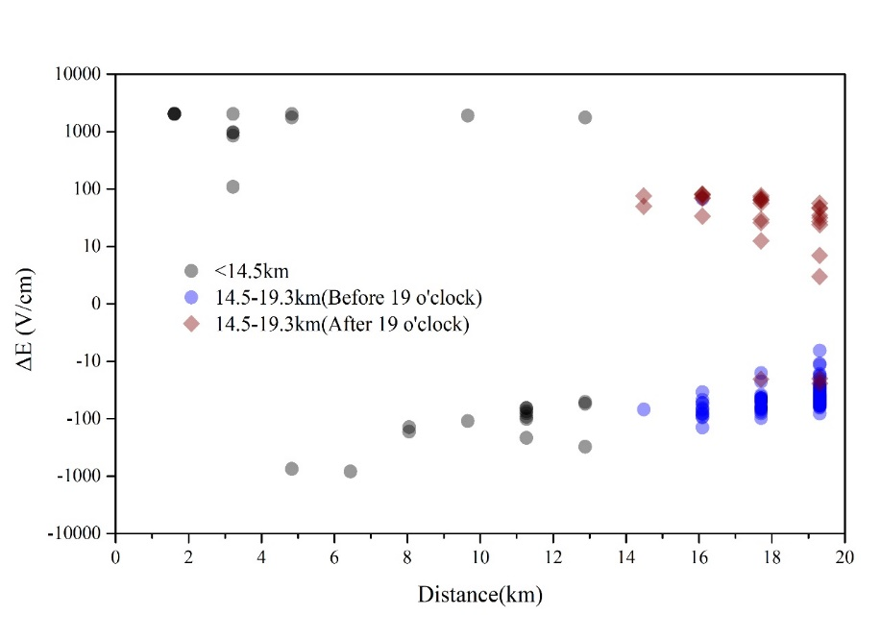
Lightning ：14.5-19.3 km
Before and after 19:00, the electric field changes are opposite.
Time | Statistics
Before 19：00 | 117 lightning
 | ΔE<0 : 116 lightning
After 19：00 | 32 lightning
 | ΔE>0 : 29 lightning

Slide 19
The structure of thundercloud
Altitude
19.3
14.5
12.8
11.3
9.6
8.0
6.4
4.8
3.2
1.6
0
Charge structure of thundercloud before 19:00
Charge structure of thundercloud after 19:00

Slide 20
The model of thundercloud
Electric field calculation model
$σ=\frac{Q}{πR^{2}}$
Real electric charge
R
2.$E=\frac{σ}{ε_{0}}\left[1−\frac{H}{\sqrt{H^{2}+R^{2}}}\right]$
H
3. $E=\frac{Q}{{πε}_{0}}\left[\frac{\sqrt{H^{2}+R^{2}}−H}{R^{2}\sqrt{H^{2}+R^{2}}}\right]$
If : R=5 Km is a constant
Induced charge
$$∆E=\frac{Q}{{πε}_{0}}\left[\frac{\sqrt{H_{−}^{2}+R^{2}}−H_{−}}{R^{2}\sqrt{H_{−}^{2}+R^{2}}}−\frac{\sqrt{H_{+}^{2}+R^{2}}−H_{+}}{R^{2}\sqrt{H_{+}^{2}+R^{2}}}\right]$$

Slide 21
Calculation verification
Distance | ΔQ | Number
1.609 | 40.84 | 11 | 449.24 | 805.8
3.219 | 29.96 | 5 | 149.8
4.828 | 68.92 | 3 | 206.76
6.437 | 54.87 | 1 | 54.87 | 379.65
8.047 | 14.21 | 2 | 28.42
9.656 | 29.6 | 2 | 59.2
11.265 | 16.2 | 7 | 113.4
12.875 | 30.94 | 4 | 123.76
14.484 | 16.72 | 4 | 66.88 | 2775.78
16.093 | 22.36 | 20 | 447.2
17.703 | 19.34 | 43 | 831.62
19.312 | 17.44 | 82 | 1430.08

Slide 22
Summary and next step
1. The thunderstorm electric fields and lightings at LHAASO observatory were studied.
2. The thunderstorm 20210610 was analyzed in detail and get a simple charge structure of thundercloud.
3. More thunderstorm events need to be analyzed.
Thanks!

