Slide 1
Magnetic Field and Radiation Mechanisms in Relativistic Jets:
GRB Outflow as One Example
Jirong MAO
Yunnan Observatories, CAS

Slide 2
Relativistic Jets
Relativistic jets have high-energy emission
Objects: GRBs, blazars, pulsars …
Jet is important target for LHAASO
Many complicated issues:
B-field, particle acceleration, radiation…
are involved

Slide 3
IACT Observations to TeV-GRBs
GRB 190114C -- MAGIC
GRB 180720B -- H.E.S.S.
(MAGIC collaboration, 2019a,b, Nature)
GRB 190829A -- H.E.S.S.
(H.E.S.S collaboration, 2021, Science)

Slide 4
Traditional Explanation: Fireball Model
TeV emission: GRB afterglow
external shock sweeping up the surrounding medium
electrons in the medium are accelerated
Radiation mechanism:
synchrotron + synchrotron self-Compton
Successful to GRB 190114C & GRB 180720B

Slide 5
Problem 1: Electron Cooling ?
GRB: a few to hundred seconds
TeV afterglow: a few hours
High-energy electrons cooling: fast or slow?
---- to emit TeV photons, electrons usually
need cooling fast
---- could not last long time
---- energy injection of electron is necessary
if TeV emission takes longer time
---- what kind of acceleration mechanism?

Slide 6
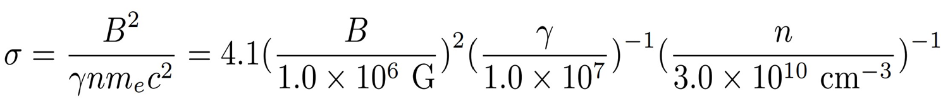
Problem 2: Magnetized ?
Traditional fireball model & radiation mechanisms:
B-field is necessary but NOT dominated
However:
How to release B-field energy quickly?

Slide 7
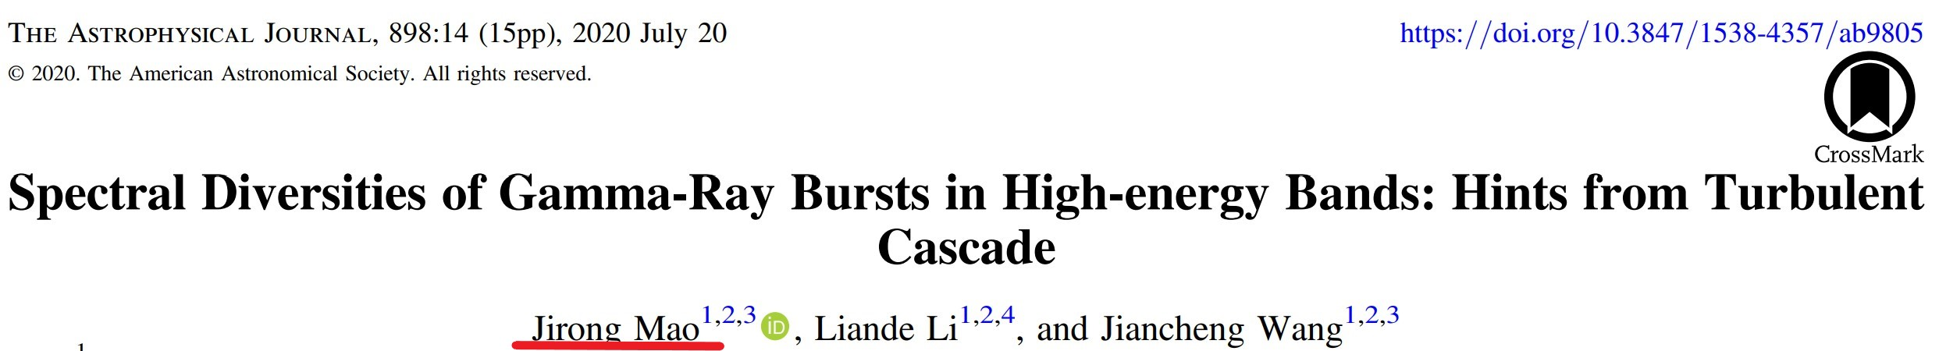
Problem 3: High-energy spectral softening
Photons scattering to high energy electrons (IC/SSC)
---- IC/SSC photons are harder
Softer photons detected by Fermi-LAT
---- Why?

Slide 8
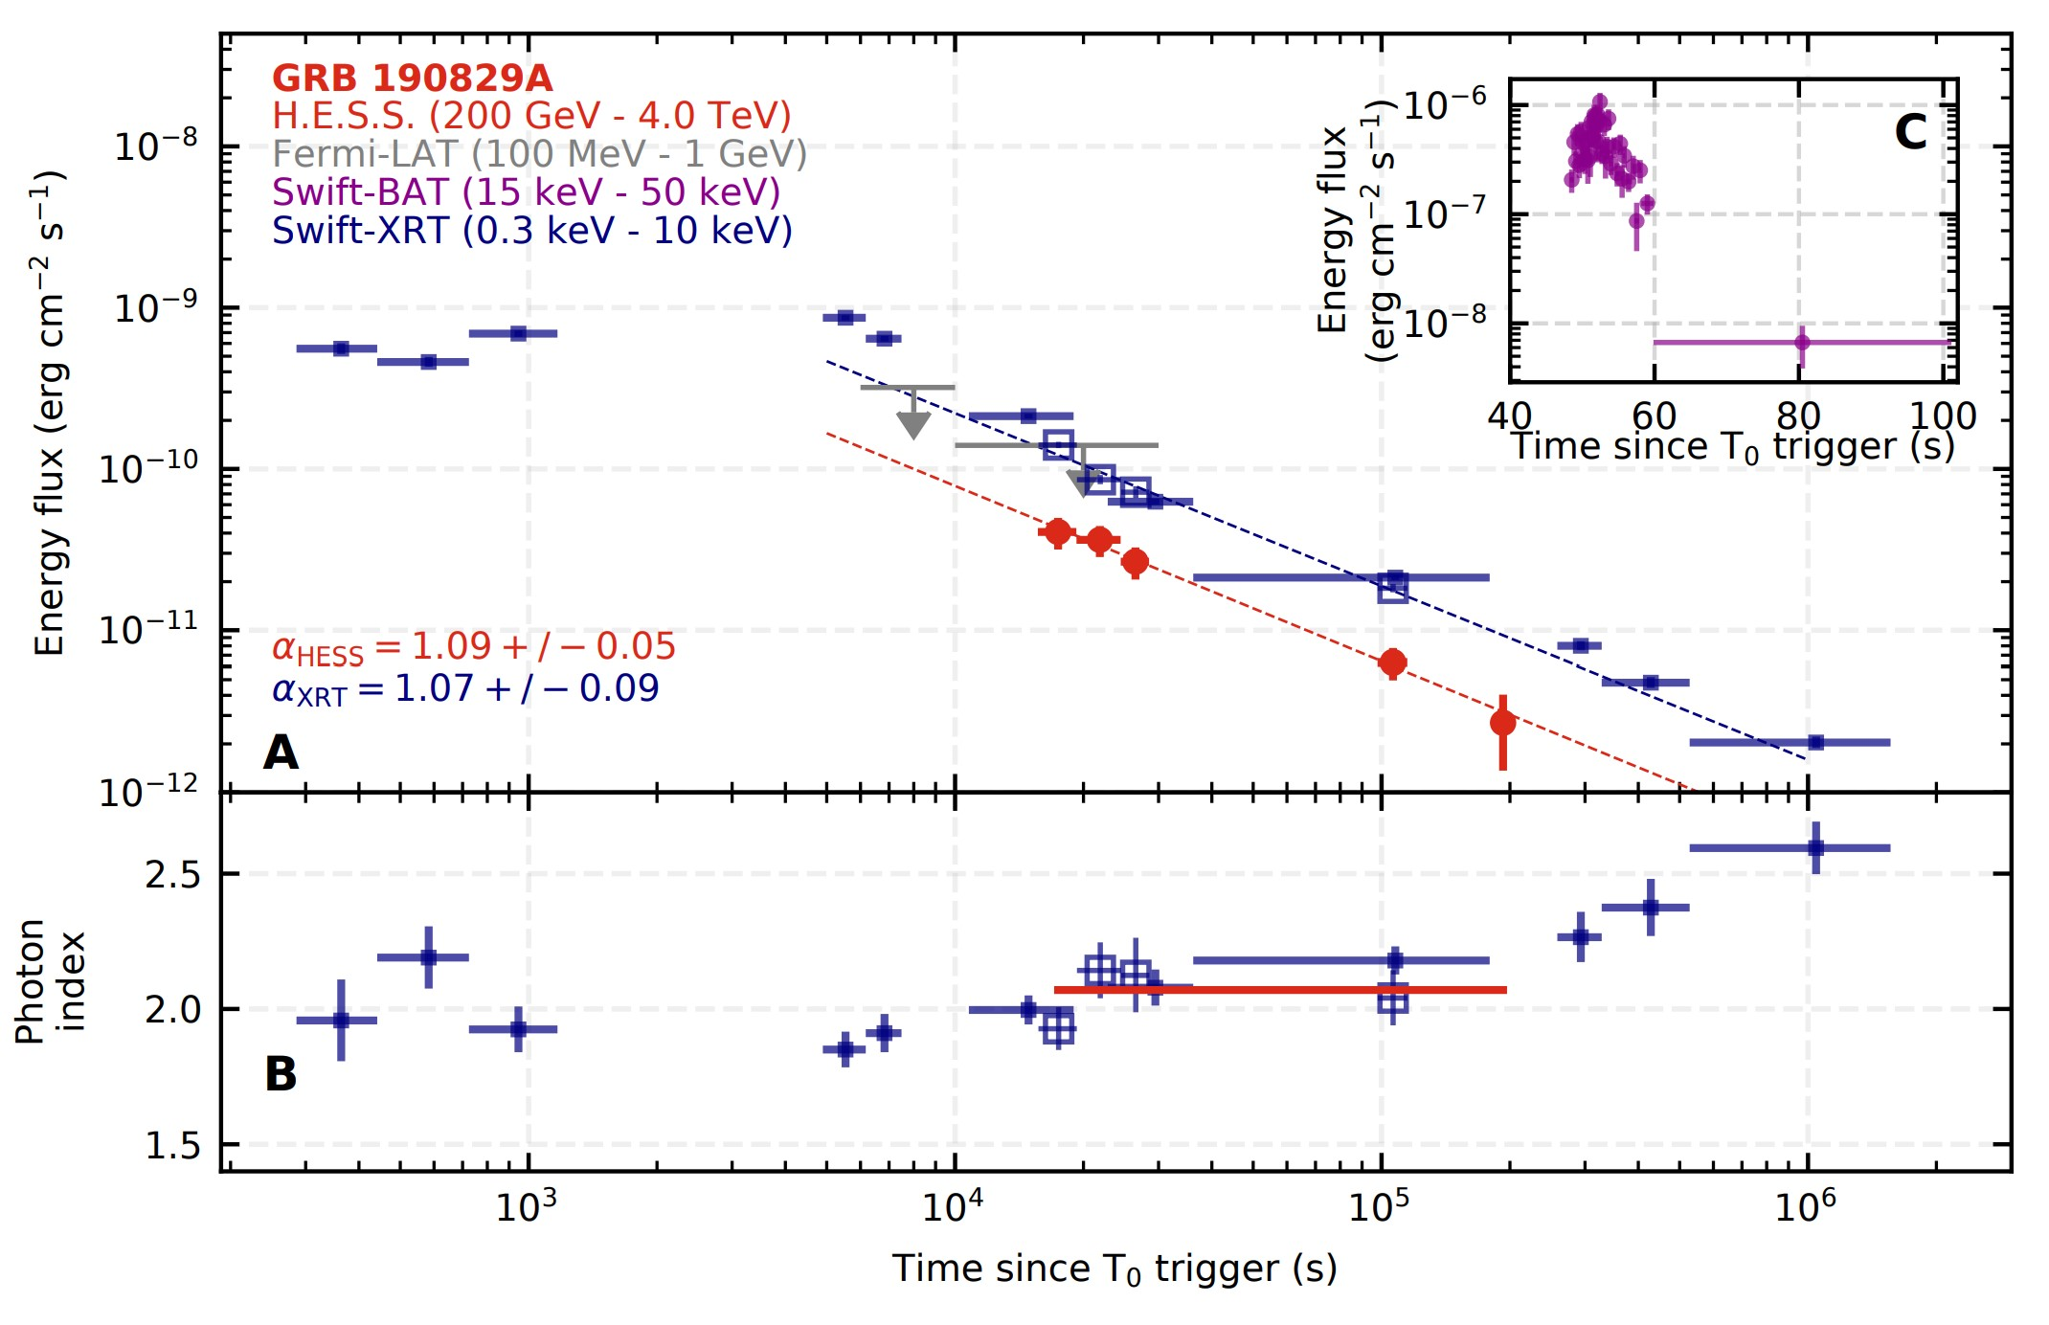
Problem 4：GRB 190829A Challenge

Slide 9
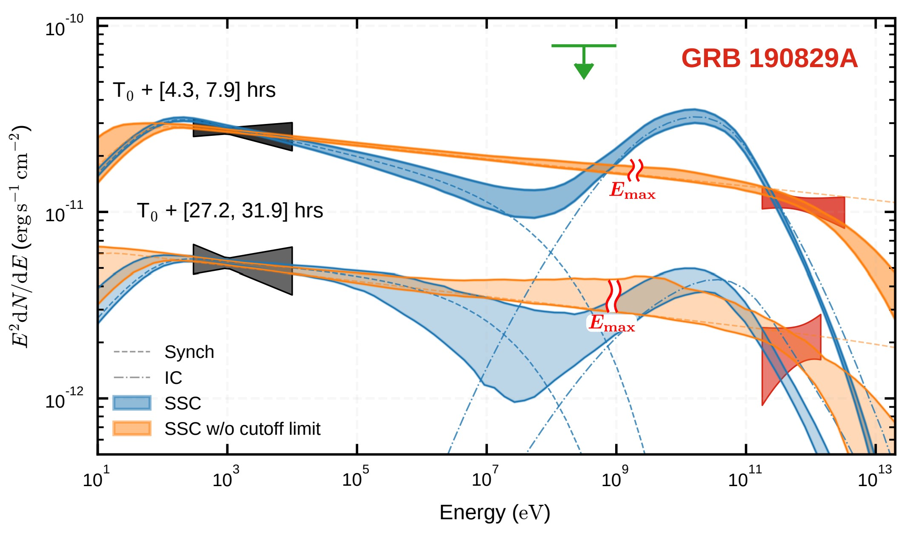
Problem 4: GRB 190829A Challenge

Slide 10
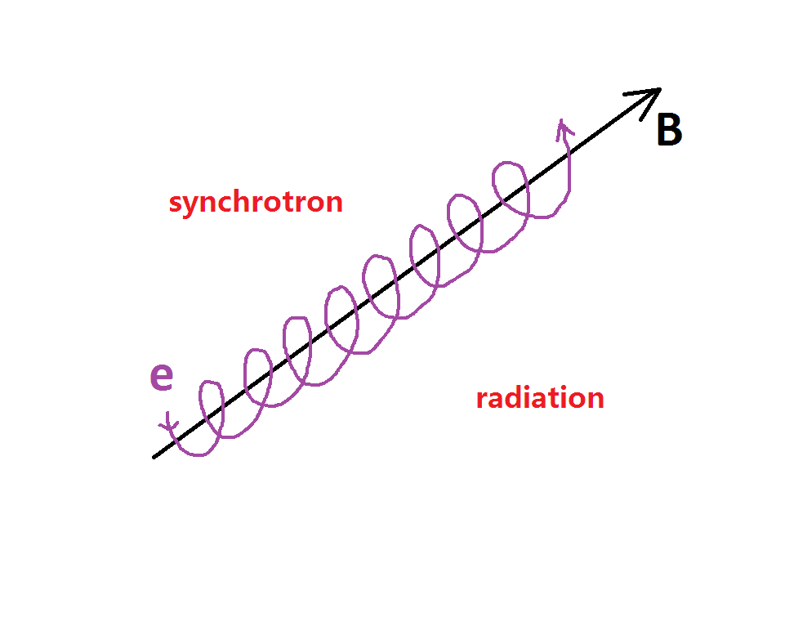

Slide 11
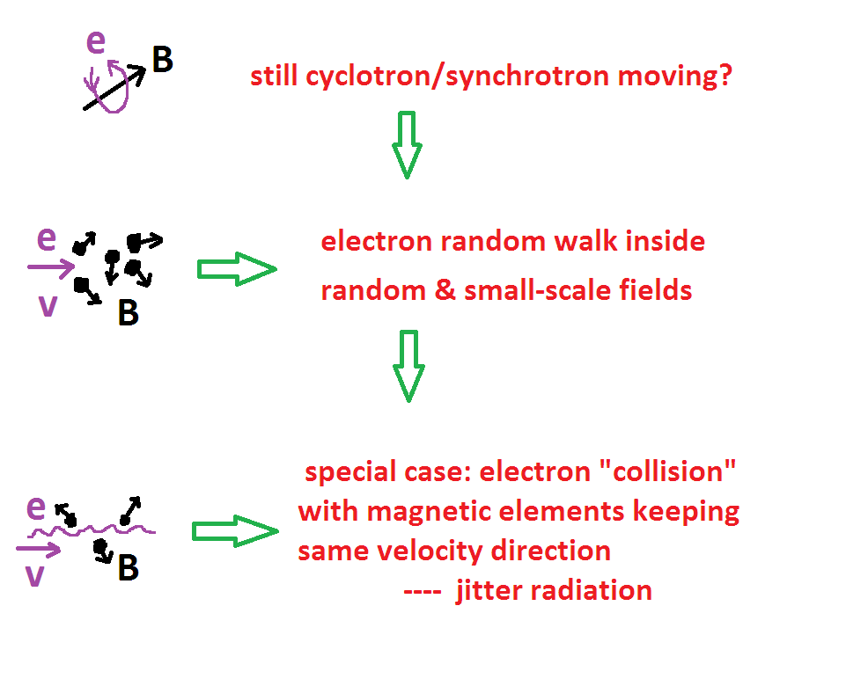

Slide 12
Synchrotron vs Jitter

Slide 13
Synchrotron vs Jitter
Relativistic electrons in ordered and large-scale magnetic field: Synchrotron
Relativistic electrons radiation in random and small-scale magnetic field: Jitter

Slide 14
Jitter Regime
Radiation by a single relativistic particle in small scale magnetic field (Landau & Lifshitz 1971):

Slide 15


Perturbation Theory
Radiation is related to perturbation
Dispersion relation (e.g., collisionless shock)
Maximum radiative frequency

Slide 16
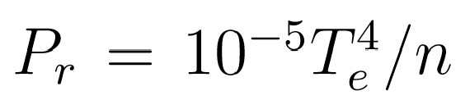
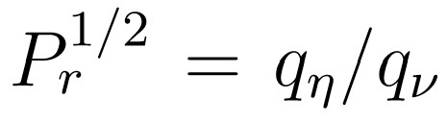
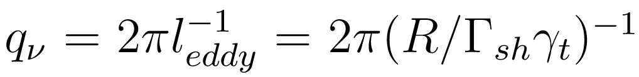
Radiative Frequency
Prandtl number
Turbulent lengthscale
Maximum radiative frequency

Slide 17
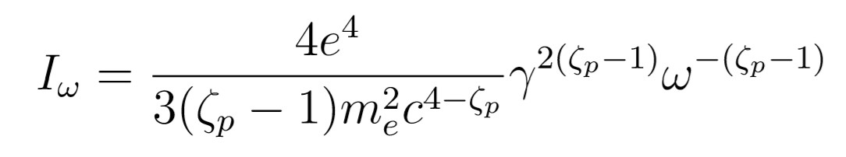

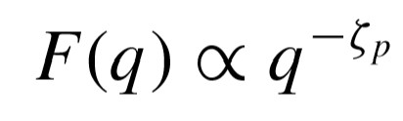
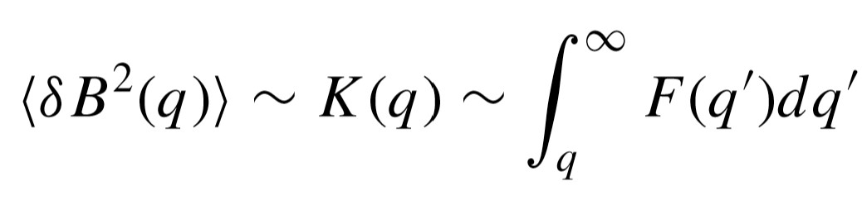
Radiative Spectrum
power-law spectrum
Spectral index is related to turbulent spectral
index
magnetic field

Slide 18
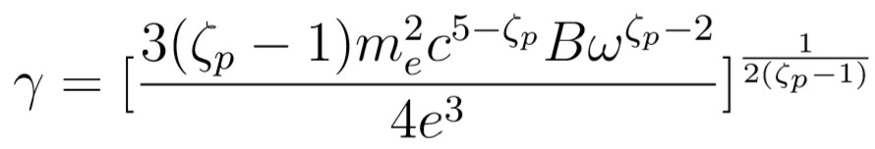

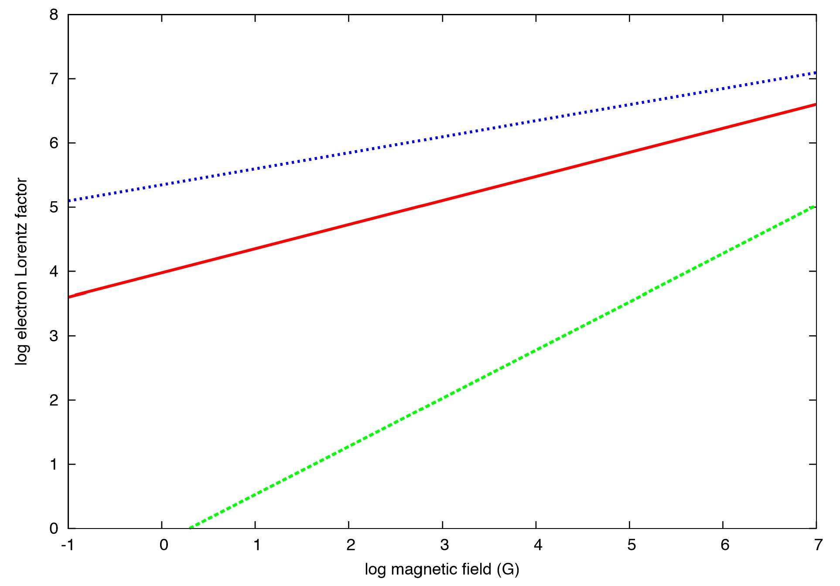
Hint 1. Acceleration Related to Cooling
acceleration in electromagnetic field
Electron Lorentz factor with cooling

Slide 19
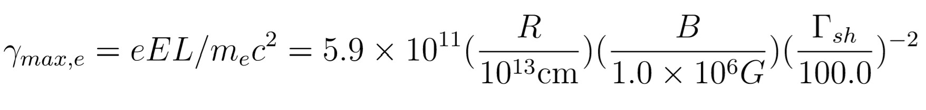
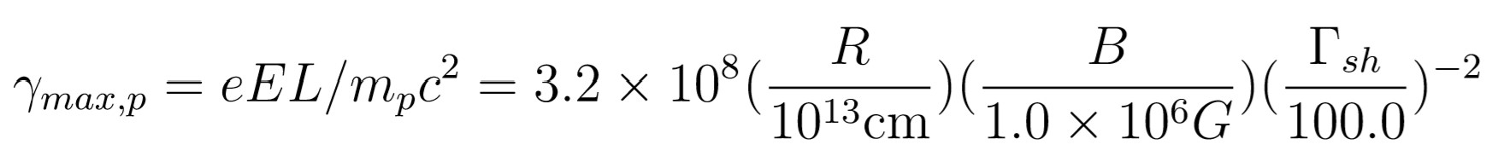
Particle Acceleration without Cooling
Electron Lorentz Factor
Proton Lorentz Factor

Slide 20
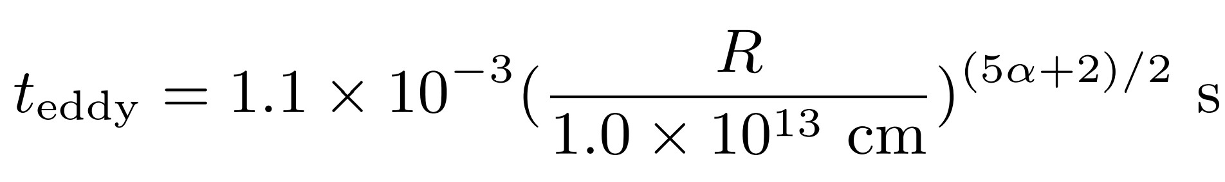
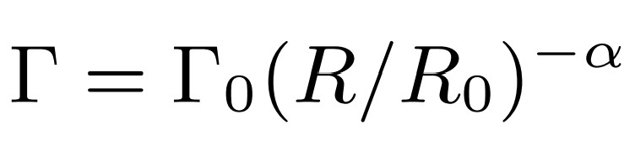
Hint 2. Timescale
Turbulence cascade timescale
Radiation timescale ~ turbulence dynamic timescale

Slide 21
Hint 3. Magnetic Field
B-field is generated by turbulence
B-field has random distribution
Jitter radiation is in the magnetized jet
B-field can be effectively dissipated by
particle acceleration

Slide 22
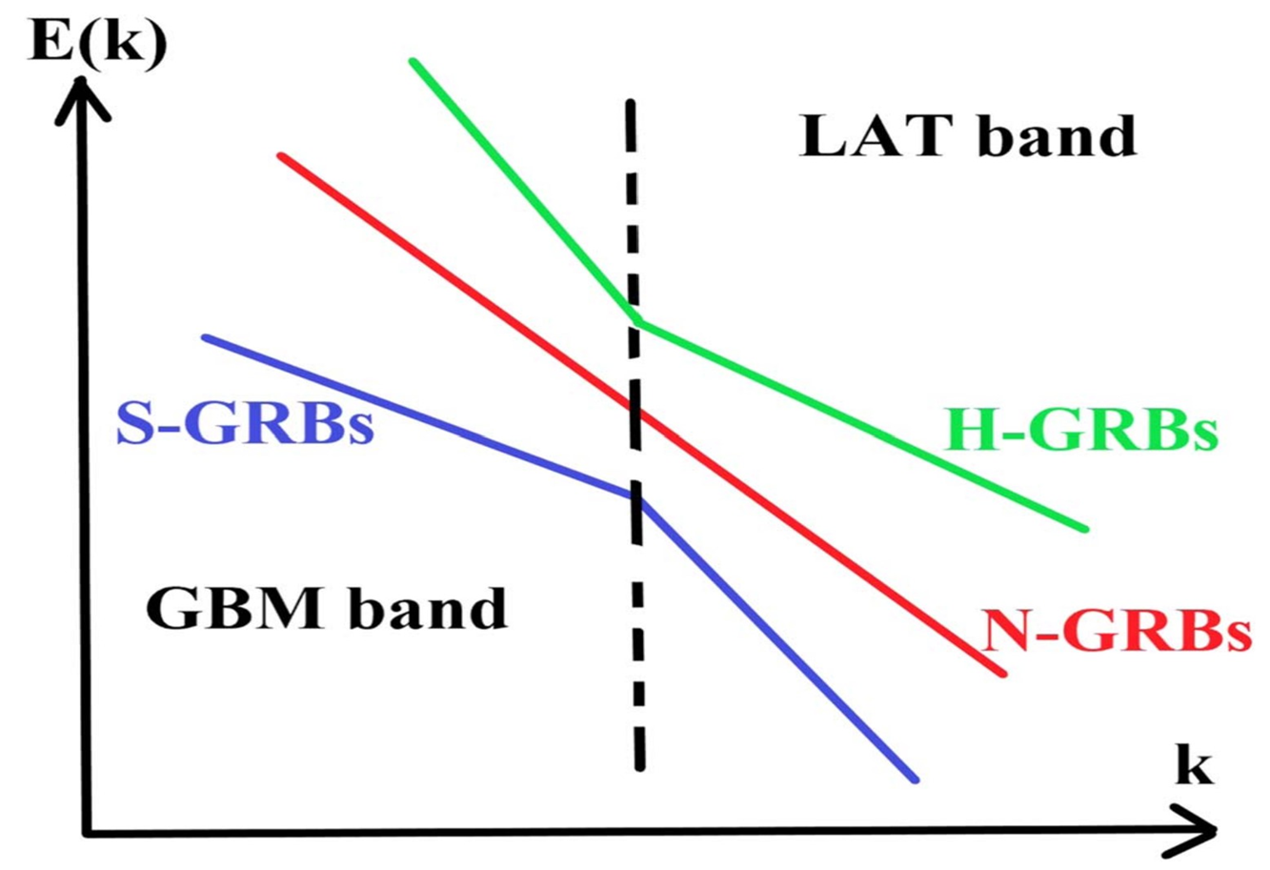
Hint 4. Spectrum Diversity
Softening: turbulence cascade
Hardening: inverse turbulence cascade

Slide 23
Addition: Synchrotron Radiation Limit
Synchrotron radiation is limited 160 MeV
relativistic boosting 100-1000 hard to reach TeV band:
Larmor orbit time*synchrotron lass rate < electron energy
Radiation frequency is limited by electron Larmor motion
Jitter radiation: NO this limit:
electron has no Larmor motion
Single component: jitter
double component: Jitter self-Compton

Slide 24
Unsolved Problems in our Framework
High-energy Photon cutoff:
IC/SSC ---- electron energy & Klein-Nishina section
Jitter? e.g., Landau damping
can be examined by TeV observation (LHAASO…)
kinetic lengthscale: plasma lengthscale
NOT hydrodynamic lengthscale
acceleration, kinetic turbulence,
magnetic reconnection, magnetic energy dissipation
Speculation: TeV energy released in even smaller region

Slide 25
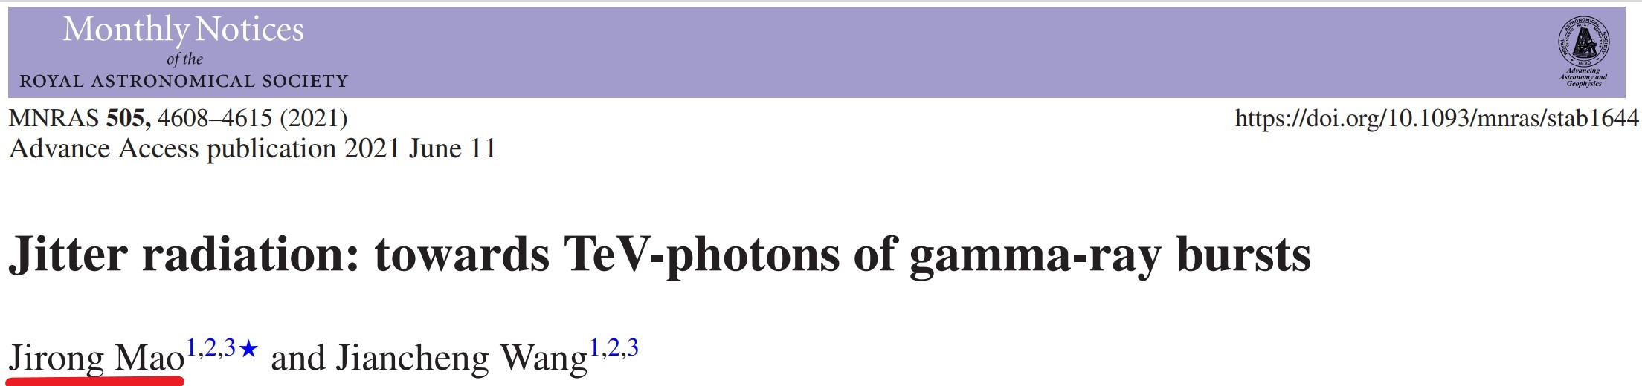
A Few Words More
I am NOT against traditional models
Novel ideas/theroy are necessary
Please understand me
allow me to try and go further

