Slide 1
Study of ENDA with Sand Cubes at YBJ
Presenter: Dixuan Xiao
Tibet University
the ENDA Group
The second LHAASO Collaboration meeting,
Shanghai, Oct 15, 2021

Slide 2
Outline
Algorithm upgrade
Sand cube test at YBJ
Summary and next steps

Slide 3
1. Algorithm upgrade
With old algorithm, number of detected neutrons was much less than expected.
New algorithm at FPGA program of FADC
  Remove trigger condition “pulse shape is higher than threshold at least continuous three bins”
  Change pulse shape sampling time window from 500μs into 2 μs to reduce complication

Slide 4
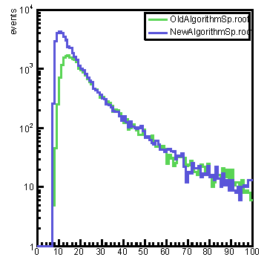
single neutron pulse height distribution
New algorithm decreases threshold of detector and then increases neutrons.
Detector #1
FADC count

Slide 5
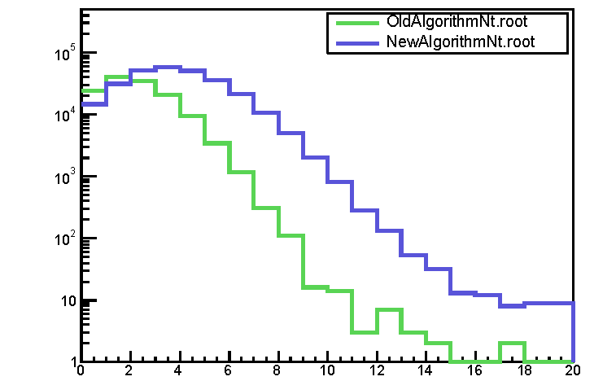
neutron distribution of triggered events
We took data of 16 full days acquired from the old algorithm( Apr. – May, 2021) and another 16 days from the new algorithm( Jul. – Aug, 2021).
events
neutrons
The new algorithm can record more neutrons in triggered events.

Slide 6
FADC problems
Solved problems by ourselves
  New algorithm
  After WR time is wrong (01/01/1970), sometimes program can not recover by itself and FADC firmware has to be restarted.
  When thunderstorm, some of channels stop work.
  Wrong measurement of pulse height due to short cable problem inside FADC
Remained problems:
  10MHz noise
  Big noise causing that threshold can not be tuned down more
  Absolute time measurement has a fluctuation of 1.7ms in coincidence with KM2A
  Shower arrival time difference between pre-8 and post-8 detectors.

Slide 7
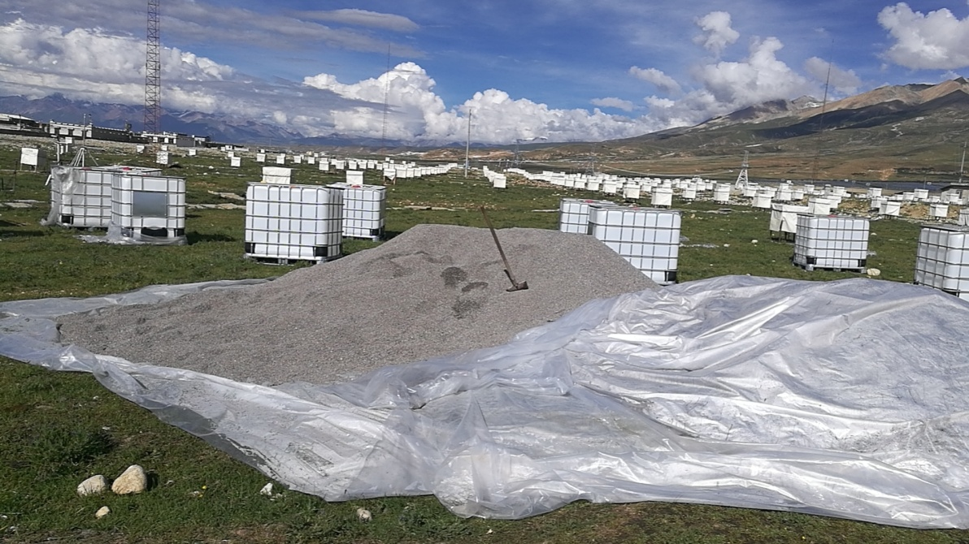
2. Sand cube test at YBJ
We are building 1m³ SandCube under detectors:
To protect media (hadron target) from rain;
To improve knowledge about media because we can know more precisely about ingredient of sand than one of soil.
Make M-C simulation with GEANT4

Slide 8
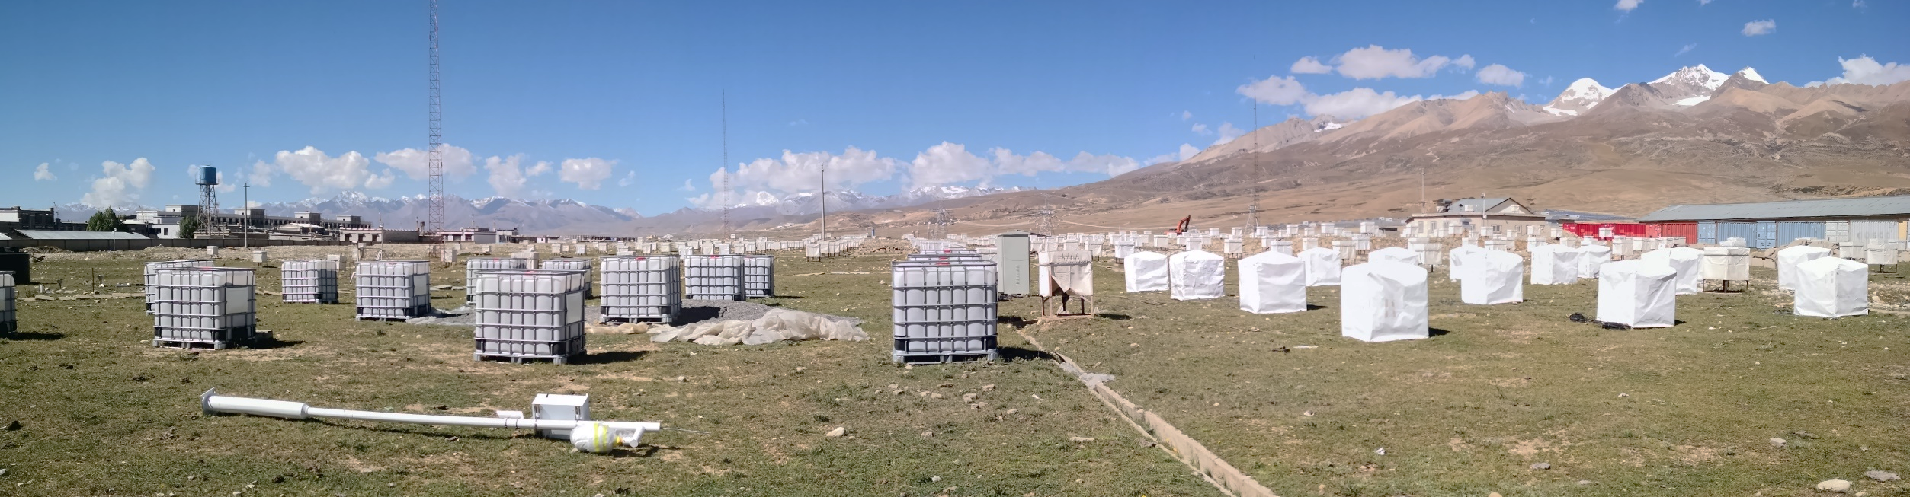
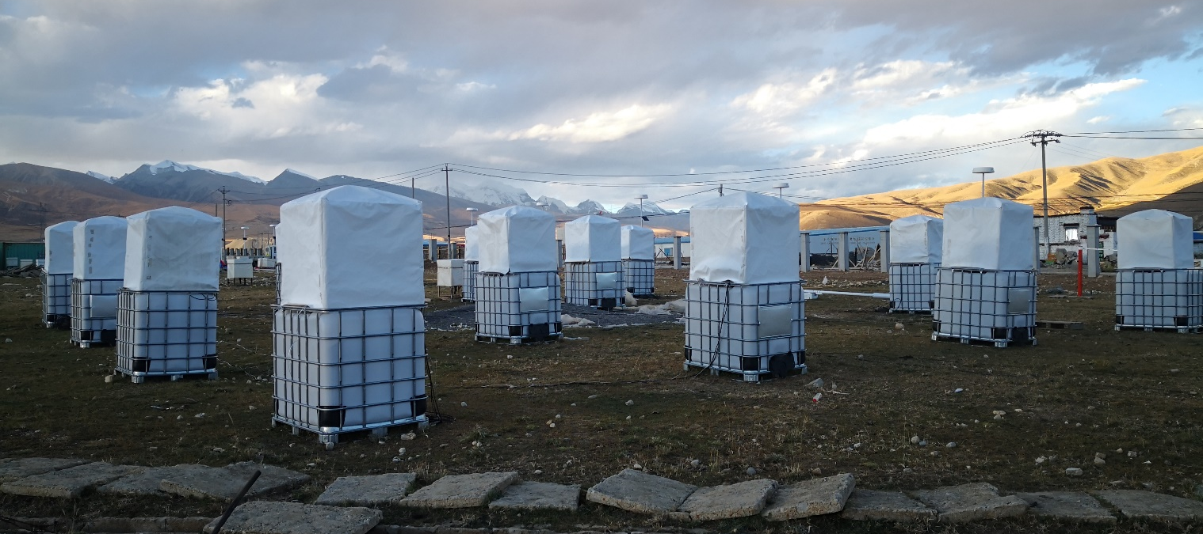
near sand cubes
on sand cubes

Slide 9
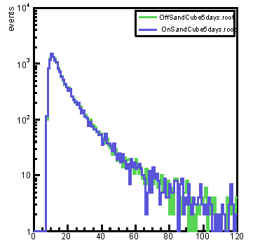
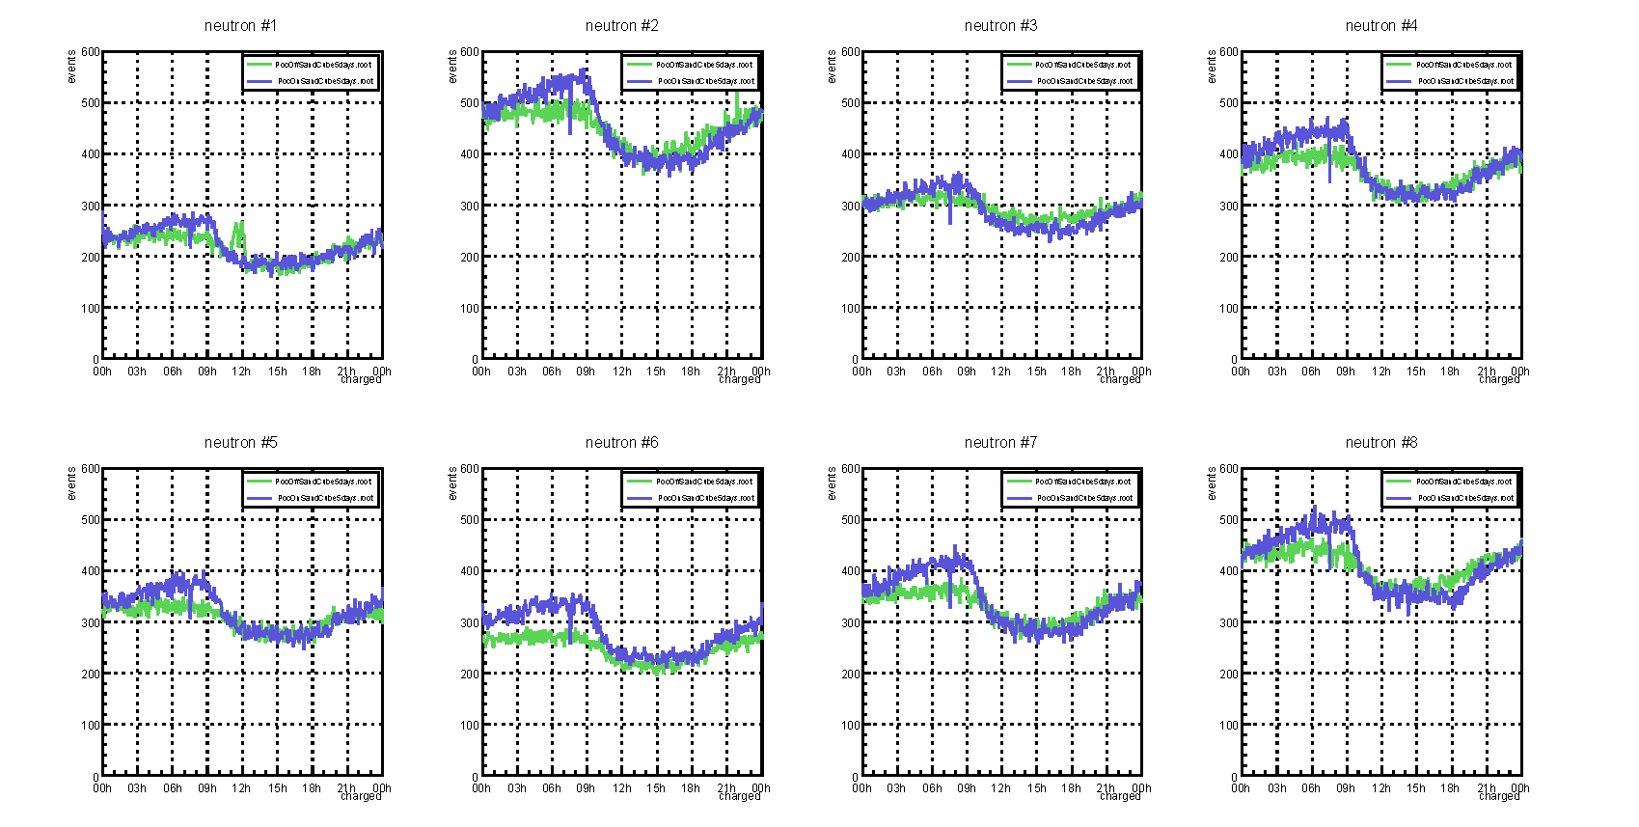
Comparison: single neutrons
Detector #1
single neutron pulse height distribution
Sum of Counting rate (per min) in 5 days
Detector #1
Time in one day (hour)
FADC count
single neutron detection is not different between with/without sand cubes

Slide 10
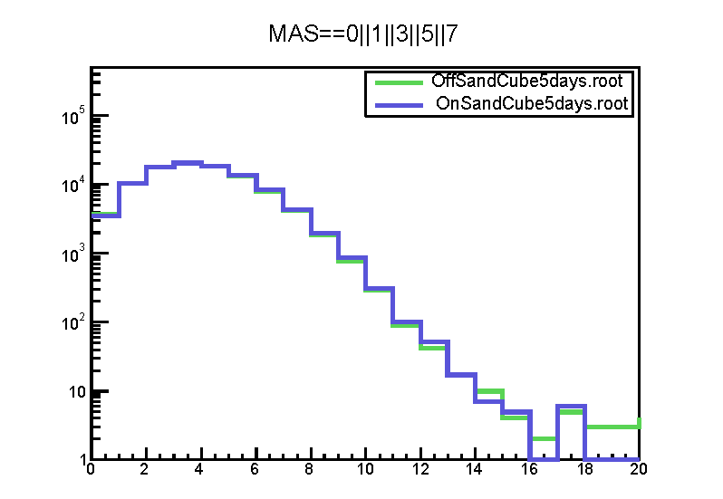
Comparison: triggered events
We took data of 5 days when detectors mounted on sand cube( 23rd- 27th, Sept) and another 5 days near sand cubes( 6th-10th, Oct).
events
neutrons

Slide 11
Comparison: ratio between with/without sand cubes
events
neutrons
Neutrons<12, background + smaller showers, ratio increases slightly to 1.05;
Neutrons>=12, bigger showers, still poor statistics

Slide 12
3. Summary and next steps
Algorithm had been upgraded, and the new algorithm solves problem of lack neutrons.
Sand cubes have been added for test. More statistics is waited for.
Difference between with-sand-cube and without-sand-cube will be compared with simulation.

Slide 13
Backup

Slide 14
