Slide 1
The Status of LHAASO Computing Platform
Yujiang Bi (毕玉江)
biyujiang@ihep.ac.cn
On Behalf of IHEP-CC
2021-10

Slide 2
Outline
Overview
Current Status
Next Plan
Summary

Slide 3
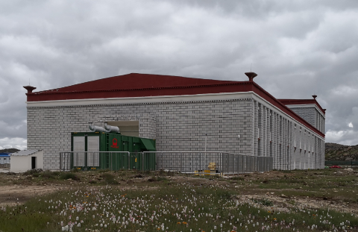
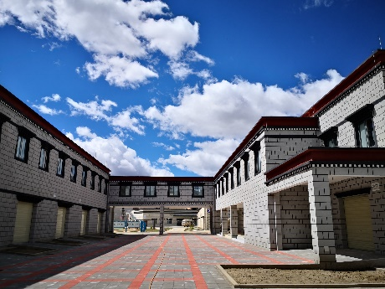
LHAASO Data Processing Platform
~600Mbps
~2.4Gbps
On-Site data center @ Haizi Mountain observatory
3764 CPU cores and 4.37 PB disk storage for calibration and rapid reconstruction
Operation Center @ Daocheng County
Distributed
Computing sites
(grid/cloud)
Large Offline Data Center at CC-IHEP
10052 CPU cores and 35 PB disk storage, 25 PB tape storage for simulation, reconstruction, analysis, data storage and archive
Dongguan

Slide 4
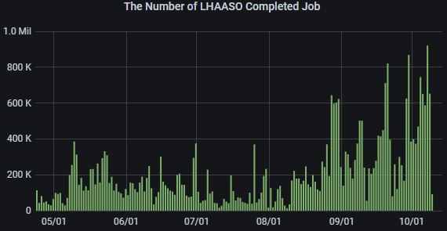
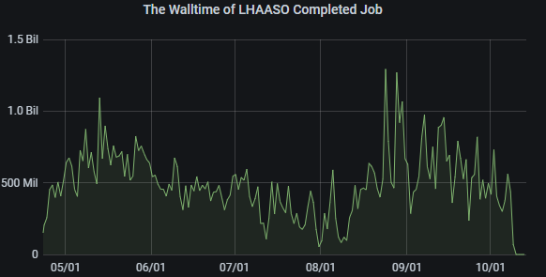
Job & Resource Status
Resource: (cpu cores)
On-site data center: 3764 cores
IHEP data center: 10052 cores
HTCondor Cluster
2021.4.23 – 2021.10.13
33,665,650 Jobs Completed
23,703,829 CPU Hours Consumed
Distribution of user’s cpu hours

Slide 5
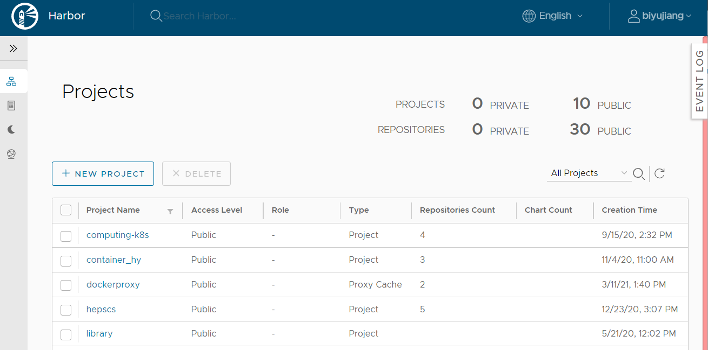
Jobs in Container
Jobs are running in containers for better support with old OS.
Jobs need SL6 or SL5 are wrapped in containers by HTCondor
Containerization at whole IHEP cluster for the better security and flexibility
hep_container toolset
Satisfying various OS requirements
Centos7.8 for the remote site
GPU supported
IHEP private registry
Maintaining private container images
Based on Harbor V2.0
Docker & Singularity supported
Trivy & Clair as vulnerability scanners
Contact zhengw@ihep.ac.cn for help
dockerhub.ihep.ac.cn

Slide 6
Storage Overview
Add /home/lhaaso as user working directory
Huawei 9950 with 80 PCIE4.0 NVME SSDs
/home/lhaaso/<user>
limit 200 GB capacity & 300 thousand files
Quota Query:
/cvmfs/common.ihep.ac.cn/software/cctools/homequota –h
Automatical email alert for quota exceeding
Location | Mount Path | Total Capacity | Used Space | Free Space
On-site Data Center | /eos/daocheng | 4.37 PB | 2.74 PB | 1.63 PB
 | /lhmtfs/user | 87 TB | 6.9 TB | 76 TB
IHEP Data Center | /eos/lhaaso | 33.44 PB | 12.69 PB | 20.75 PB
 | /eos/user | 2.39 PB | 1.62 PB | 0.77 PB
 | /lhaasofs | 610 TB | 228 TB | 352 TB
 | /home/lhaaso | 74TB | 6.6TB | 67.2TB
 | /castor/lhaaso | 25 PB | 9.90 PB | 15.1 PB

Slide 7
Disk Storage – EOS
The main filesystem for LHAASO, 3 instances:
EOS Daocheng
EOS Beijing
EOS for CTA Tape Service (testing)
EOS Daocheng:
Capacity:
from 2.54 PB to 4.37 PB (2021/09)
Data grows fast: 2.744 PB used.
EOS BEIJING:
Upgraded from 4.8.31 to 4.8.40(2020/08) .
Capacity：from 14.5 PB to 35.83 PB
Used: 14.31 PB
EOS for TAPE
Newly added for New Tape Service – CTA
Two nodes with 286 TB in total.
The read bandwidth reached 70 GB/s , and writing bandwidth 34GB/s at Sep.

Slide 8
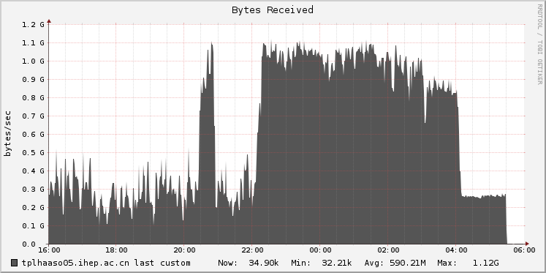
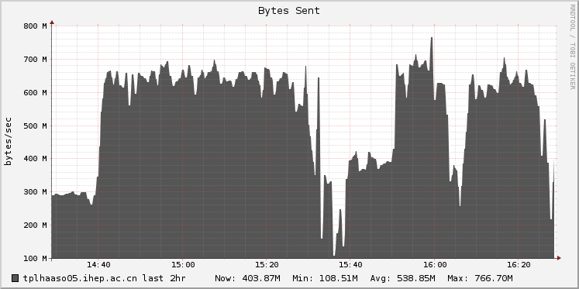
Tape Archive Service
Tape Hardware
Drives: 20 LTO7 Drives in total, 8 added this year
Frames: 1 main frame and 5 extended with 3 added this year
Tapes: 2400 LTO 7 Tapes, and 2750 Tapes added this year
Tape Storage
Replicated tapes stored at B112/B113 in MDT Building
Castor Service
1 Castor/Stager Server cnslhaaso
4 Tape Server tplhaaso0[1-4]
16 LTO7 drives for Castor
EOSCTA – New Tape Service
A production setup for LHAASO
1 tape server laso-tape05 with 4 LTO7 drives
A small eos for CTA with 2 nodes laso01/02.
A Central CTA node cta and Database node ctadb.
Benchmark finished and preparing for migration

Slide 9
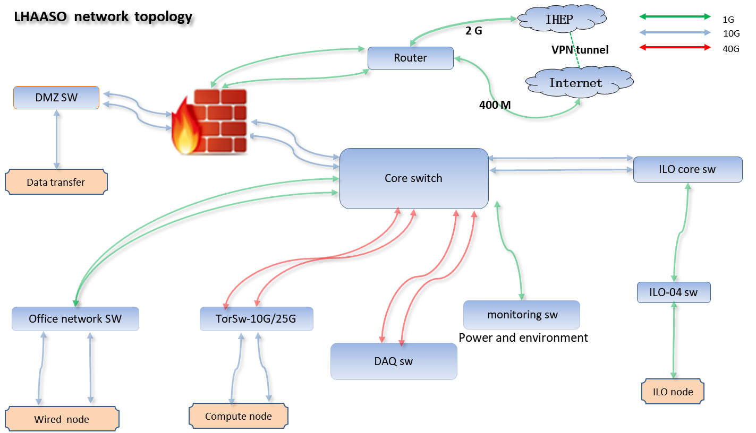
Network status
LHAASO Daocheng Base
Secure internet access gateway added
Simplify Network Management with Bandwidth Management
Web Filtering
LHAASO (haizi mountain)
Dedicated network bandwidth upgrade：LHAASO←→IHEP 1G → 2G
network performance evaluation：2.1G available
Total bandwidth (2 links) up to 2.5G
Dual link automatic switching
Network quality analysis and Device link detection protocol
when one link down, switch to another link, avoid service interruption
Office network ready
Including wired network and wireless network

Slide 10
Data Transfer System
Two Network Links
Dedicated network 2Gbps
VPN LINK 400Mbps
Data Transfer System
Written with Shell + Redis
Distributed deployment to support high transfer speed
Full use the network bandwidth
In case of the possible one-link low performance
Transfer Status
Started from 06/02/2018, works well, and transferred ~ 5PB raw data.

Slide 11
KM2A Digital Equipment Management
KM2A Digital Equipment Management Software
Manage and maintain KM2A Equipment records
Available since 2021/07
What does Equipment Management Software do?
Display basic infos of equipment through online map
ED, MD, GGD management
Device Accessory warehouse
Maintenance log & equipment Statistic
Online map
locate all devices through the map
http://km2a.ihep.ac.cn/

Slide 12
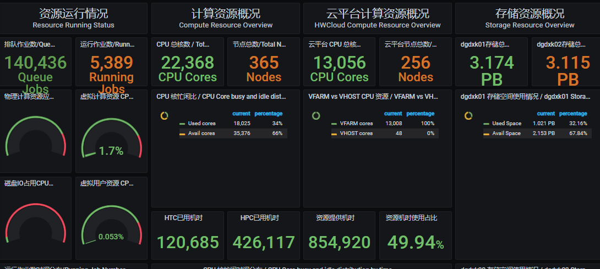
Multi-Center Platform - Dongguan
Dongguan Science Computing Center
Intel、ARM & GPU computing nodes
35000 CPU Cores, 143.8 TB RAM, 80 GPUs
Huawei 100 G RoCEv2 Network
Filesystems
6PB storage and 1PB cloud storage
LHAASO Computation @Dongguan
WCDA Simulation
KM2A RAW Data Analysis
G4WCDA ported to ARM.
Type | Intel x86 | ARM | GPU | Cloud Computing
Confs | Xeon Gold 6240R 48 Cores, 256 GB RAM | Kunpeng 920 96 Cores, 256GB RAM | 4 Telsa V100 48 Cores, 256GB RAM | Xeon Gold 5218 52 Cores, 226GB RAM
Resource | 250 | 100 | 20 | 250

Slide 13
What Next to Do?
Putting CTA into Production
Replacing Castor tape system
Castor tape data migration to CTA
Workflow to automatically backup
Data Transfer System
Rewriting Data Transfer System
Written by Python, more stable and reliable
Spade with EOS & XRootD Protocol Support

Slide 14
Summary
Computing Platform is A Significant Component of LHAASO
Provides service for LHAASO offline data processing
Computing recourses, storage and network upgraded
Next Plan
Upgrading Castor to EOSCTA
Better tape management and performance
Migration and archive workflow underway
Data Transfer System Development
Rewritten with Python & Redis
Spade with EOS & XRootD Support
Full container support -- more secure
DHTC – integrate more computing resources

Slide 15
Q&A
Thanks for your attentions!
谢谢！

