Slide 1
Migration to Key4HEP
2020.04.13
Zou Jiaheng

Slide 2
Key4HEP
Turnkey Software for Future Colliders
https://github.com/key4hep
Current components in repository
EDM4hep
K4FWCore

Slide 3
EDM4hep
CEPCSW will use PLCIO before EDM4hep is ready
There is a version now
Earlier migrate to EDM4hep, fewer works in the future
LCIO
EDM in Marlin
Code generator
PODIO
PLCIO
Current EDM in CEPCSW
Similar interfaces with LCIO
EDM4hep
EDM in the future

Slide 4
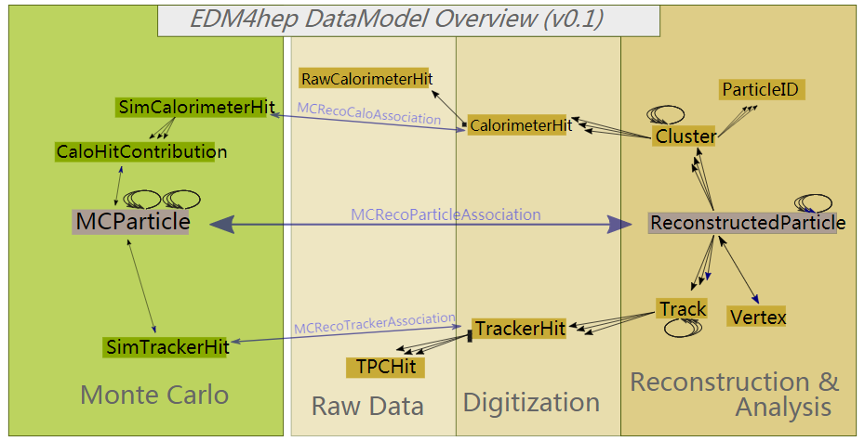
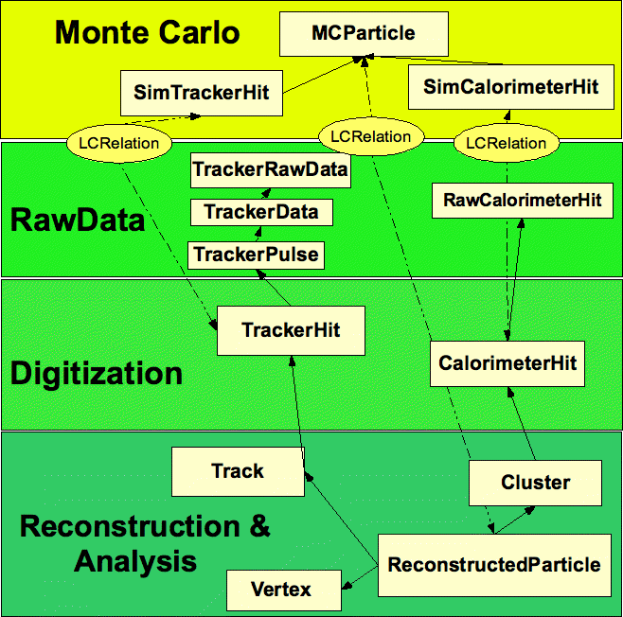
Good News
The interfaces of EDM4hep and plcio(LCIO) are very similar
Now we can get data objects from associations

Slide 5
MCParticleCollection.h
CaloHitContributionCollection.h
SimCalorimeterHitCollection.h
SimTrackerHitCollection.h
RawCalorimeterHitCollection.h
TPCHitCollection.h
CalorimeterHitCollection.h
TrackerHitCollection.h
ParticleIDCollection.h
ClusterCollection.h
TrackCollection.h
VertexCollection.h
ReconstructedParticleCollection.h
MCRecoCaloAssociationCollection.h
MCRecoTrackerAssociationCollection.h
MCRecoParticleAssociationCollection.h
EventHeaderCollection.h
MCParticleCollection.h
CaloHitContributionCollection.h
SimCalorimeterHitCollection.h
SimTrackerHitCollection.h
RawCalorimeterHitCollection.h
TPCHitCollection.h (Deprecated in LCIO)
TrackerPulseCollection.h
TrackerDataCollection.h
TrackerRawDataCollection.h
CalorimeterHitCollection.h
TrackerHitCollection.h
TrackerHitPlaneCollection.h
TrackerHitZCylinderCollection.h
ParticleIDCollection.h
ClusterCollection.h
TrackCollection.h
VertexCollection.h
ReconstructedParticleCollection.h
LCRelationCollection.h
EventHeaderCollection.h

Slide 6
Necessary Changes
Namespace: plcio -> edm4hep
CellID
Two ints (4bytes * 2), cellID1, cellID0 -> a long long (8 bytes), (cellID1<<32) | cellID0
Missing classes and interfaces
Is necessary or can be replaced? Implement by our selves if necessary
Helper classes to handle ObjectID
TrackerHit::getRawHits()
CalorimeterHit::getRawHit() which is not present in current edm4hep
…?

Slide 7
K4FWCore
Both CEPCSW/FWCore and K4FWCore are Porting from FCC/FWCore
What we added in CEPCSW/FWCore
LCIODataSvc to read LCIO data in Gaudi
What we are doing with K4FWcore
Implement an algorithm (LCIOInput) instead of the service to do the convertion
No impact to K4FWCore, easier to users
The LCIOInput algorithm
A standalone K4LCIOReader ( https://github.com/ihep-sft-group/K4LCIOReader )
An algorithm wrapper that can cooperate with K4FWCore

