Slide 1
Impedance and HOM heating in MDI for CEPC
Liu Yu dong, Wang Na, Bai Sha, Wang Dou，Wang Hai Jing

Slide 2
CEPC CDR Parameters
 | Higgs | W | Z（3T） | Z（2T）
Number of IPs | 2
Beam energy (GeV) | 120 | 80 | 45.5
Circumference (km) | 100
Synchrotron radiation loss/turn (GeV) | 1.73 | 0.34 | 0.036
Crossing angle at IP (mrad) | 16.5×2
Piwinski angle | 3.48 | 7.0 | 23.8
Number of particles/bunch N_{e} (10¹⁰) | 15.0 | 12.0 | 8.0
Bunch number (bunch spacing) | 242 (0.68μs) | 1524 (0.21μs) | 12000 (25ns+10%gap)
Beam current (mA) | 17.4 | 87.9 | 461.0
Synchrotron radiation power /beam (MW) | 30 | 30 | 16.5
Bending radius (km) | 10.7
Momentum compact (10⁻⁵) | 1.11
β function at IP β_{x}* / β_{y}* (m) | 0.36/0.0015 | 0.36/0.0015 | 0.2/0.0015 | 0.2/0.001
Emittance ε_{x}/ε_{y} (nm) | 1.21/0.0024 | 0.54/0.0016 | 0.18/0.004 | 0.18/0.0016
Beam size at IP σ_{x} /σ_{y} (μm) | 20.9/0.06 | 13.9/0.049 | 6.0/0.078 | 6.0/0.04
Beam-beam parameters ξ_{x}/ξ_{y} | 0.018/0.109 | 0.013/0.123 | 0.004/0.06 | 0.004/0.079
RF voltage V_{RF} (GV) | 2.17 | 0.47 | 0.10
RF frequency f _{RF} (MHz) (harmonic) | 650 (216816)
Natural bunch length σ_{z} (mm) | 2.72 | 2.98 | 2.42
Bunch length σ_{z} (mm) | 4.4 | 5.9 | 8.5
HOM power/cavity (2 cell) (kw) | 0.46 | 0.75 | 1.94
Energy spread (%) | 0.134 | 0.098 | 0.080
Energy acceptance requirement (%) | 1.35 | 0.90 | 0.49
Energy acceptance by RF (%) | 2.06 | 1.47 | 1.7
Photon number due to beamstrahlung | 0.082 | 0.050 | 0.023
Beamstruhlung lifetime /quantum lifetime* (min) | 80/80 | >400
Lifetime (hour) | 0.43 | 1.4 | 4.6 | 2.5
F (hour glass) | 0.89 | 0.94 | 0.99
Luminosity/IP L (10³⁴cm⁻²s⁻¹) | 2.93 | 10.1 | 16.6 | 32.1

Slide 3
CEPC high luminosity Z (2T)
 | CEPC-CDR | CEPC-30MW | CEPC-39MW
Number of IPs | 2 | 2 | 2
Energy (GeV) | 45.5 | 45.5 | 45.5
Circumference (km) | 100 | 100 | 100
SR loss/turn (GeV) | 0.036 | 0.036 | 0.036
Half crossing angle (mrad) | 16.5 | 16.5 | 16.5
Piwinski angle | 23.8 | 27.9 | 33.0
N_{e}/bunch (10¹⁰) | 8.0 | 12.0 | 15.0
Bunch number | 12000 | 14564 (20.6ns+10%gap) | 15000
Beam current (mA) | 461 | 839.9 | 1081.4
SR power /beam (MW) | 16.5 | 30 | 38.6
Bending radius (km) | 10.7 | 10.7 | 10.7
Momentum compaction (10⁻⁵) | 1.11 | 1.11 | 1.11
β_{IP} x/y (m) | 0.2/0.001 | 0.2/0.001 | 0.2/0.001
Emittance x/y (nm) | 0.18/0.0016 | 0.18/0.0016 | 0.18/0.0016
Transverse σ_{IP} (um) | 6.0/0.04 | 6.0/0.04 | 6.0/0.04
ξ_{x}/ξ_{y}/IP | 0.004/0.079 | 0.004/0.093 | 0.004/0.098
V_{RF} (GV) | 0.1 | 0.10 | 0.10
f _{RF} (MHz) (harmonic) | 650 | 650 | 650
Nature bunch length σ_{z} (mm) | 2.42 | 2.42 | 2.42
Bunch length σ_{z} (mm) | 8.5 | 10.0 | 11.8
HOM power/cavity (kw) | 1.94 (2cell) | 2.29 (1cell) | 3.15 (1cell)
Energy spread (%) | 0.08 | 0.1 | 0.115
Energy acceptance (DA) (%) | 1.5 | 0.6 | 0.7
Energy acceptance by RF (%) | 1.7 | 1.7 | 1.7
Lifetime by rad. Bhabha scattering (hour) | 2.9
Lifetime (hour) | 2.5 | 2.0 | 1.8
L_{max}/IP (10³⁴cm⁻²s⁻¹) | 32.1 | 74.5 | 101.6

Slide 4
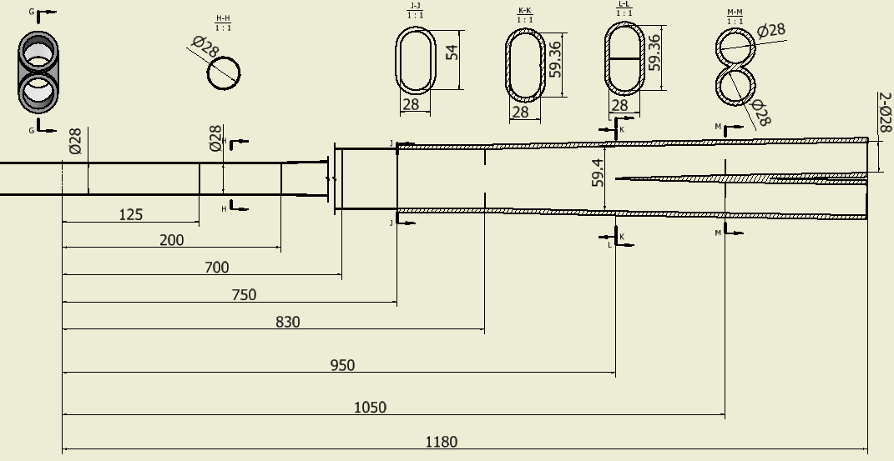
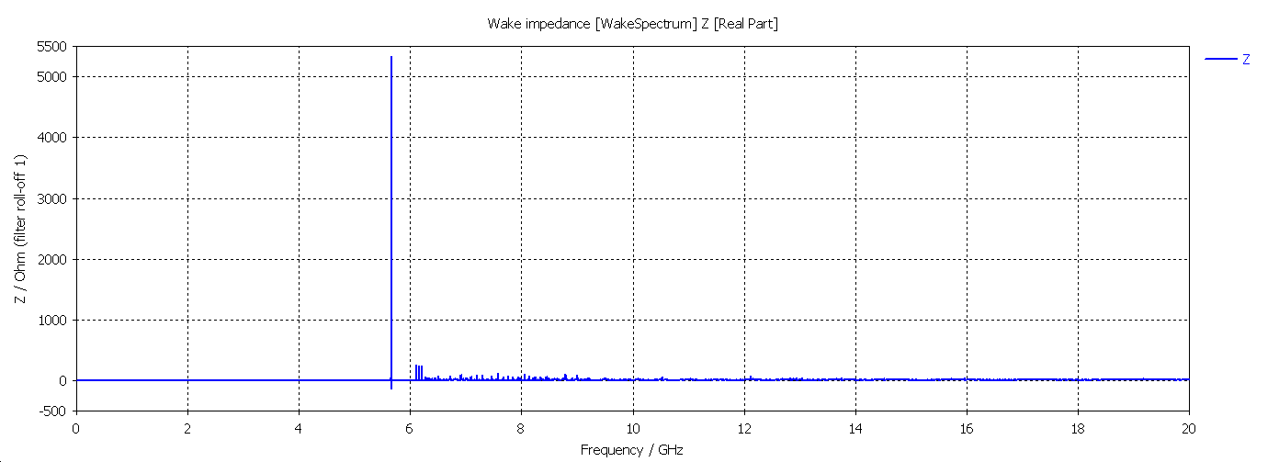
Model 0
σ_{z}=5mm@k_loss:0.051 v/pc
P_{loss}: H/W/Z:
21.28w/86.24w/301.28w
Fre_cutoff:8.24GHz
σ_{z}=5mm@k_loss: 0.0315v/pc
P_{loss}: H/W/Z:
13.14w/53.27w/186.08w

Slide 5
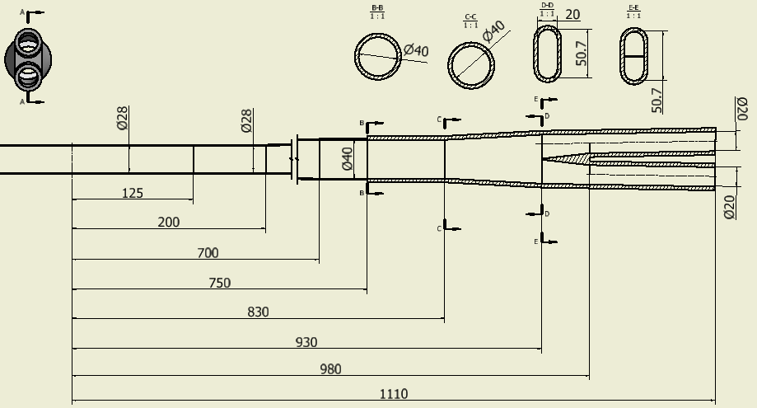
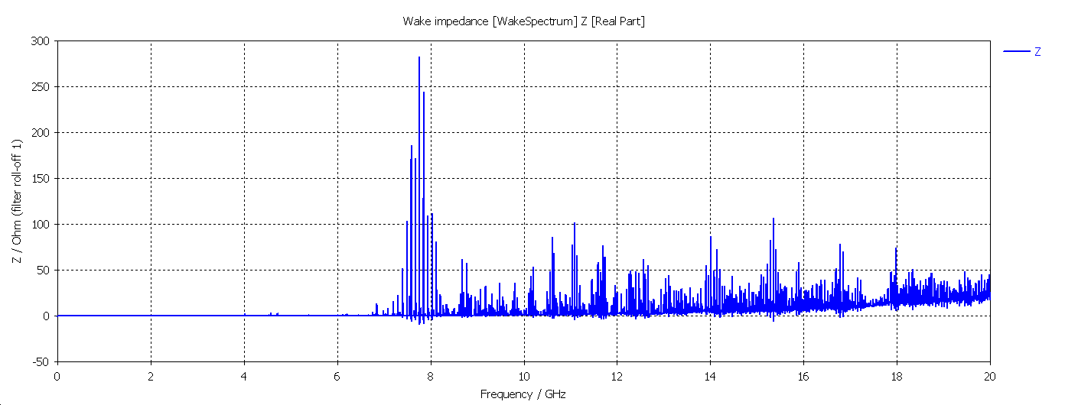
Model 1
σ_{z}=5mm@k_loss: 0.00758v/pc
P_{loss}: H/W/Z:
3.16w/12.8w/44.8w
Fre_cutoff:8.24GHz
σ_{z}=5mm@k_loss: 0.019v/pc
P_{loss}: H/W/Z:
8.13w/32.9w/115.2w

Slide 6
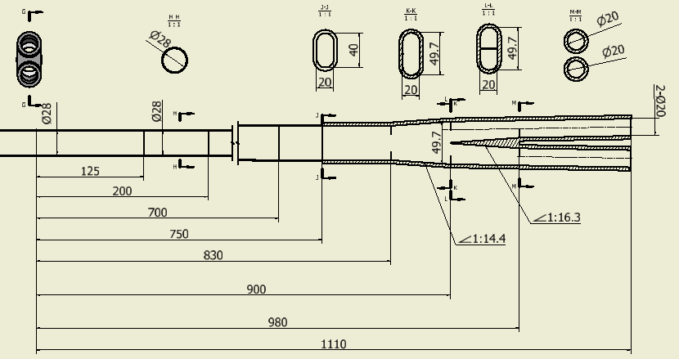
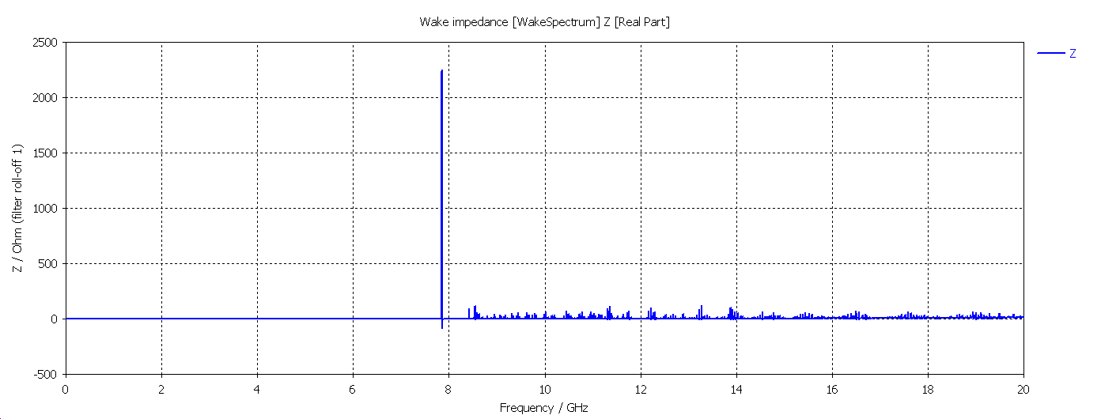
Model 2
σ_{z}=5mm@k_loss: 0.0095v/pc
P_{loss}: H/W/Z:
3.96w/16.1w/56.1w
Fre_cutoff:8.24GHz
σ_{z}=5mm@k_loss: 0.017v/pc
P_{loss}: H/W/Z:
7.09w/28.7w/100.4w

Slide 7
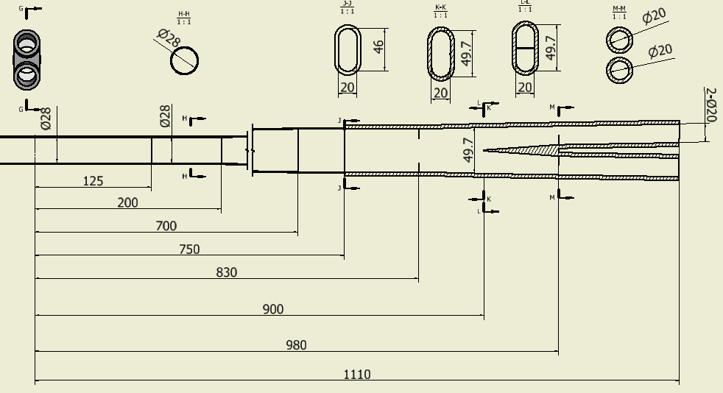
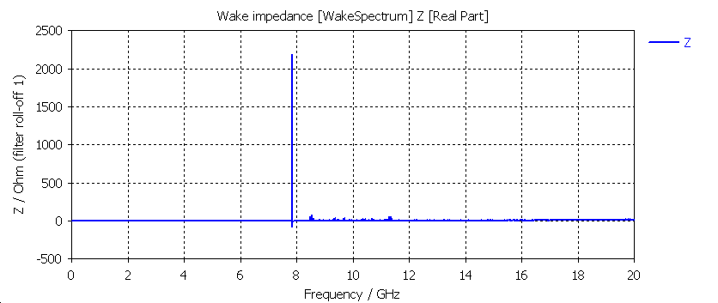
Model 3
σ_{z}=5mm@k_loss: 0.0088v/pc
P_{loss}: H/W/Z:
3.67w/14.88w/51.98w
Fre_cutoff:8.24GHz
σ_{z}=5mm@k_loss: 0.0156v/pc
P_{loss}: H/W/Z:
6.5w/26.38w/92.15w

Slide 8
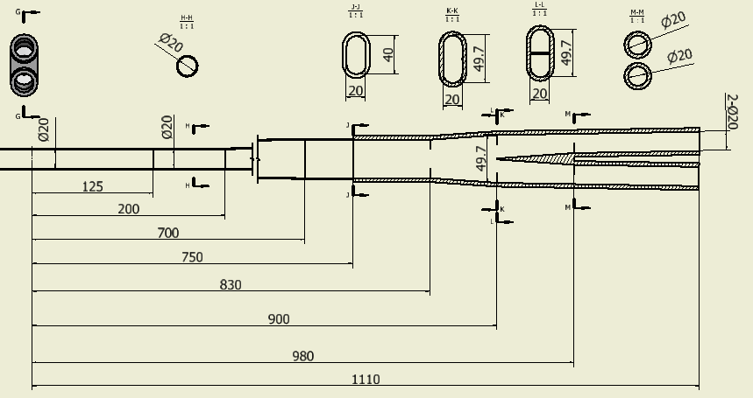
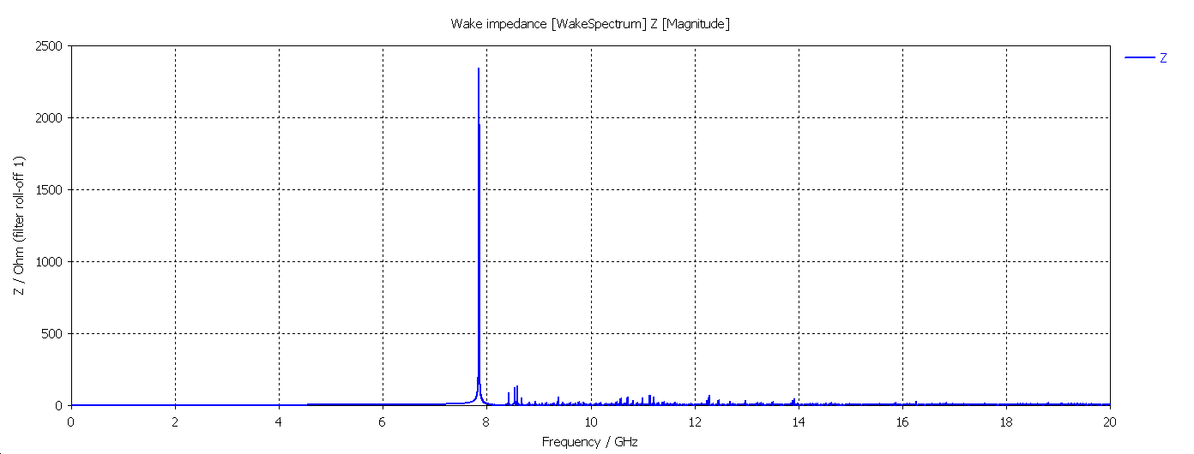
Model 4
σ_{z}=5mm@k_{loss}: 0.0175v/pc
P_{loss}: H/W/Z:
7.3w/29.5w/103.4w
Fre_cutoff:11.49GHz
σ_{z}=5mm@k_{loss}: 0.0062v/pc
P_{loss}: H/W/Z:
2.58w/10.5w/36.6w

Slide 9
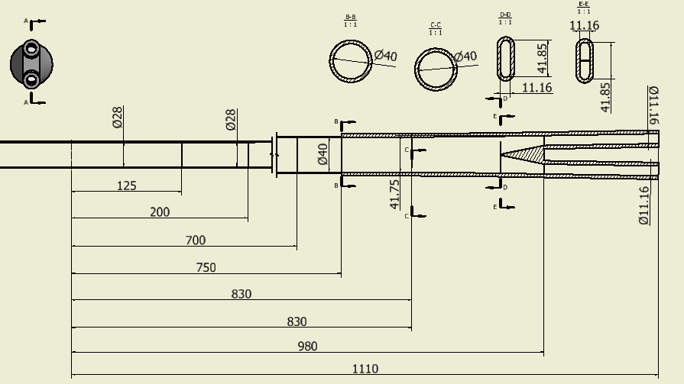
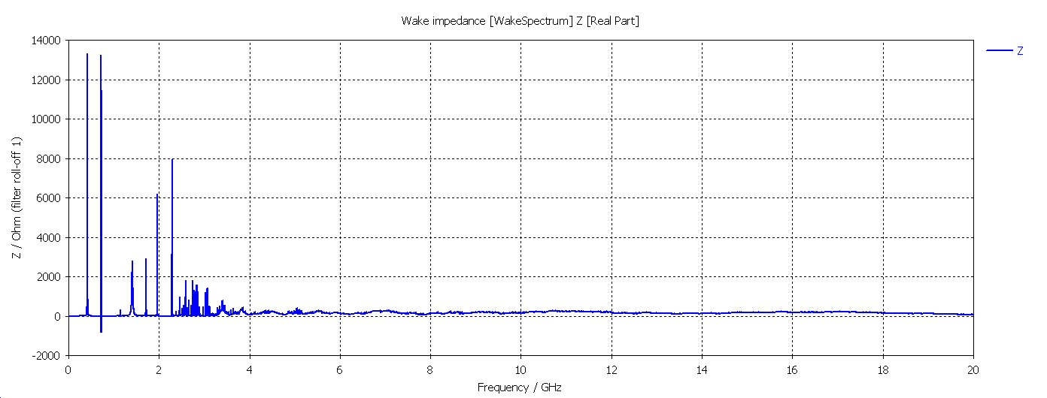
Model 5
σ_{z}=5mm@k_{loss}: 2.04v/pc
P_{loss}: H/W/Z:
0.85kw/3.44kw/12.05kw
Fre_cutoff:8.24GHz
σ_{z}=5mm@k_{loss}: 0.6658v/pc
P_{loss}: H/W/Z:
0.28kw/1.13kw/3.93kw

Slide 10
Summary on HOM heating Power for MDI （CDR beam parameters）
MDI Model | H |  | W |  | Z
Model 0 (28mm-28mm) | P_{trap}: 21.28w | P_{pro}: 13.14w | P_{trap}: 86.24w | P_{pro}: 53.27w | P_{trap}: 301.28w | P_{pro}:186.08w
 | P_{total}: 34.42w |  | P_{total}: 139.51w |  | P_{total}: 487.36w
Model 1 (28mm-20mm) | P_{trap}:3.16w | P_{pro}:8.13w | P_{trap}:12.8w | P_{pro}:32.9w | P_{trap}:44.8w | P_{pro}:115.2w
 | P_{total}: 11.29w |  | P_{total}:45.7w |  | P_{total}:160w
Model 2 (28mm-20mm) | P_{trap}:3.96w | P_{pro}:7.09w | P_{trap}:16.1w | P_{pro}:28.7w | P_{trap}:56.1w | P_{pro}:100.4w
 | P_{total}:11.05w |  | P_{total}:44.8w |  | P_{total}:156.5
Model 3 (28mm-20mm) | P_{trap}:3.67w | P_{pro}:6.5w | P_{trap}:14.88w | P_{pro}:26.38w | P_{trap}:51.98w | P_{pro}:92.15w
 | 10.17w |  | 41.26 |  | 144.13
Model 4 (20mm-20mm) | P_{trap}:7.3w | P_{pro}:2.58w | P_{trap}:29.5w | P_{pro}:10.5w | P_{trap}:103.4w | P_{pro}:36.6w
 | P_{total}:9.88w |  | P_{total}:40w |  | P_{total}:140w
Model 5 (28mm-11mm) | P_{trap}:0.85kw | P_{pro}:0.28kw | P_{trap}:3.44kw | P_{pro}:1.13kw | P_{trap}:12.05kw | P_{pro}:3.93kw
 | P_{total}:1.13kw |  | P_{total}:4.57kw |  | P_{total}:15.98kw

Slide 11
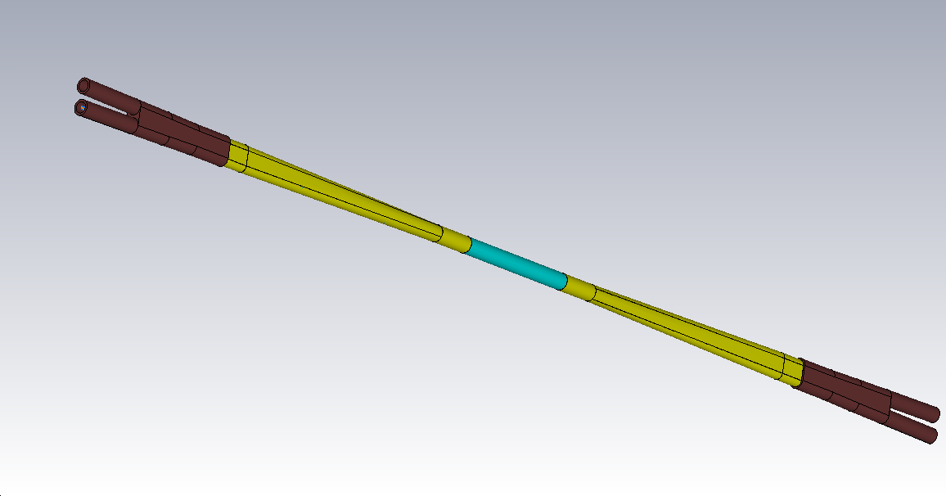
Mechanical structure and materials for Mode 3
Total length:2220mm
Cu: 360mm
Al: 625mm
Be: 250mm

Slide 12
Model 3: Power deposition in Be (Z &CDR parameters &σ_{z}@5mm&material@PEC)
σ_{z}=5mm@k_loss: 0.0088v/pc
P_{loss}: H/W/Z:
3.67w/14.88w/51.98w
Fre_cutoff:8.24GHz
σ_{z}=5mm@k_loss: 0.0156v/pc
P_{loss}: H/W/Z:
6.5w/26.38w/92.15w
Resistive wall: 2*7.08w
Trap mode power (below f_cut_off): 2*51.98w
Power propagating from MDI (above f_cut_off): 2* (92.15*250/1e9) ~ 0w
HOM from other part of the ring: 2*12.84w
Total power on Be pipe: 143.8w

Slide 13
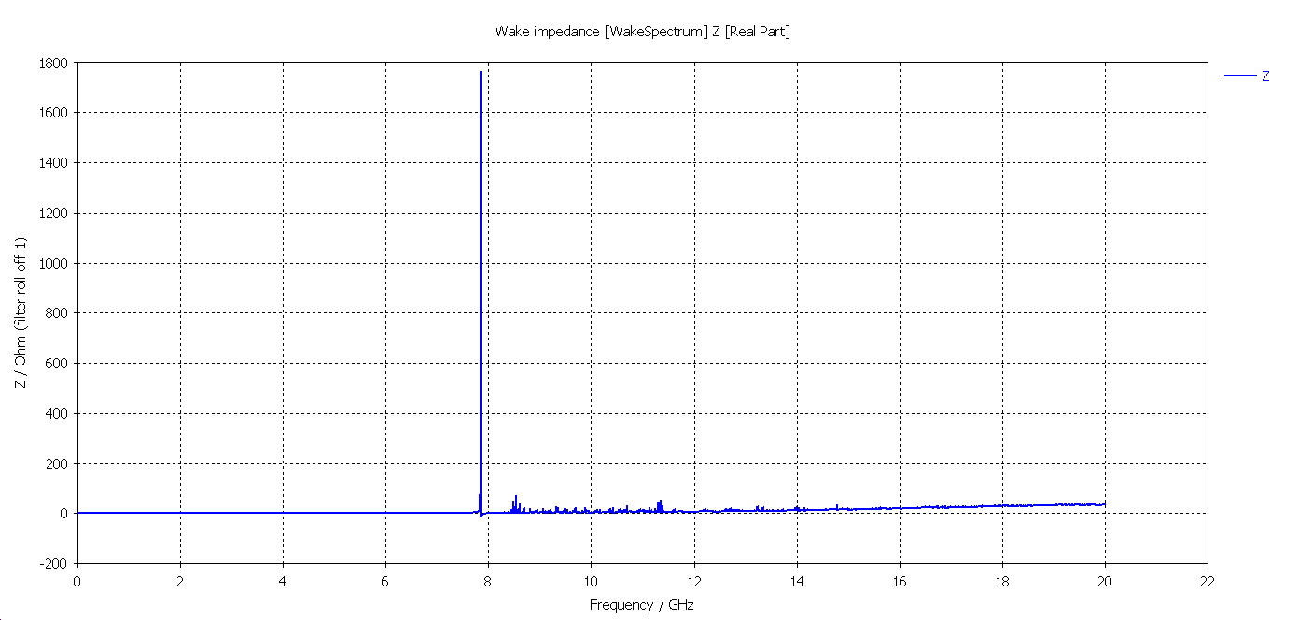
Model 3: Power deposition in Be (Z &CDR parameters &σ_{z}@5mm&material@Lossy mental)
Fre_cutoff:8.24GHz
σ_{z}=5mm@k_{loss}: 0.0177v/pc
P_{loss}: Z:104.56w
σ_{z}=5mm@k_{loss}:0.0325 v/pc
P_{loss}: Z: 191.9w
Trap mode power (below f_cut_off): 2*104.56w
Power propagating from MDI (above f_cut_off): 2* (191.9*250/1e9) ~ 0w
HOM from other part of the ring: 2*12.84w
Total power on Be pipe: 234.8w

Slide 14
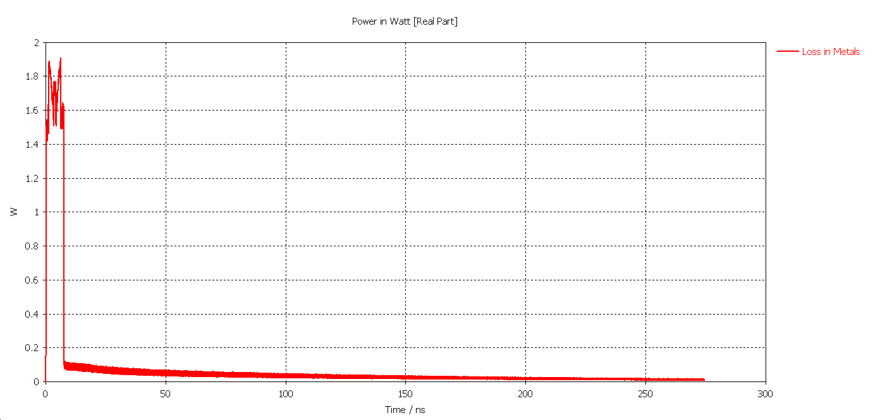
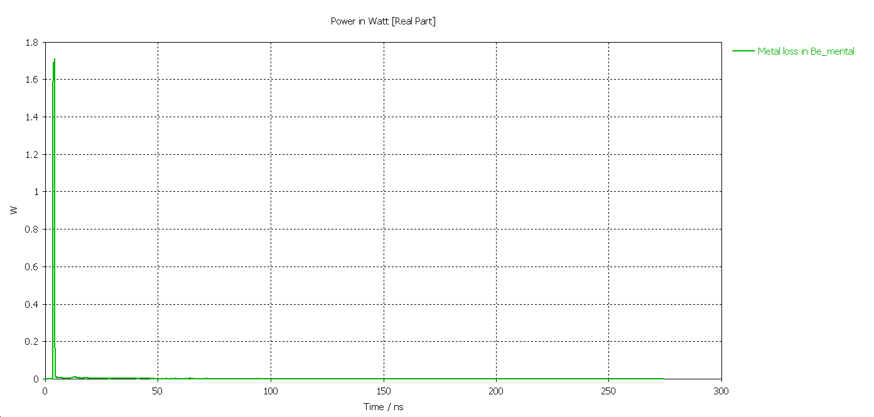
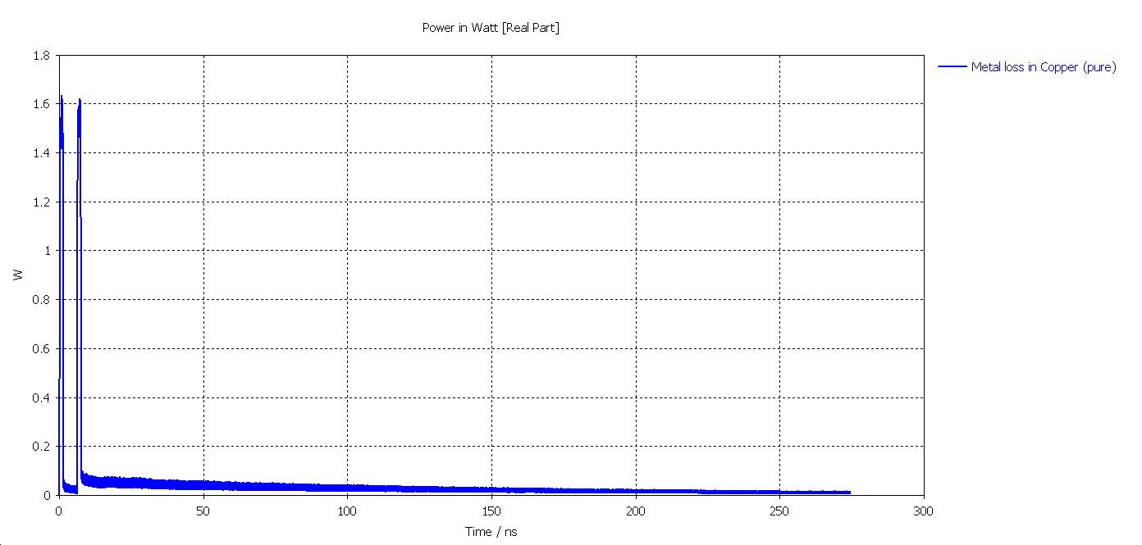
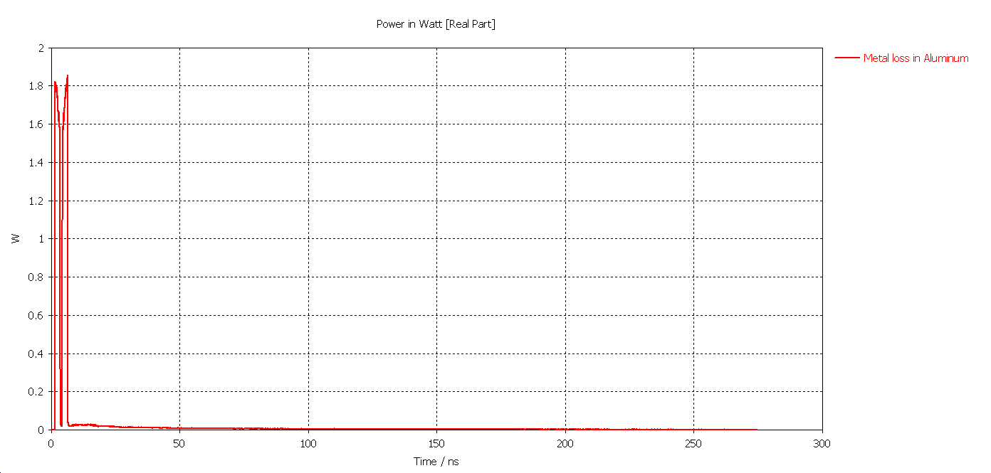
Model 3: Power deposition in Be (Z &CDR parameters &σ_{z}@5mm&material@Lossy mental)
Z: P_total_t=148.5w
Z: P_Be=12.22w
Z: P_Al=60.45w
Z: P_Cu=75.83w

Slide 15
Model 3: Power deposition in Be (Z &CDR parameters &σ_{z}@5mm&material@Lossy mental)
Directly power deposition in Be pipe: 2*12.22w
Power from Cu and Al pipe deposited in Be: 2* (60.45*250/2220+75.83*250/2220)w
HOM from other part of the ring: 2*12.84w
Total power on Be pipe (maximum): 80.77w

Slide 16
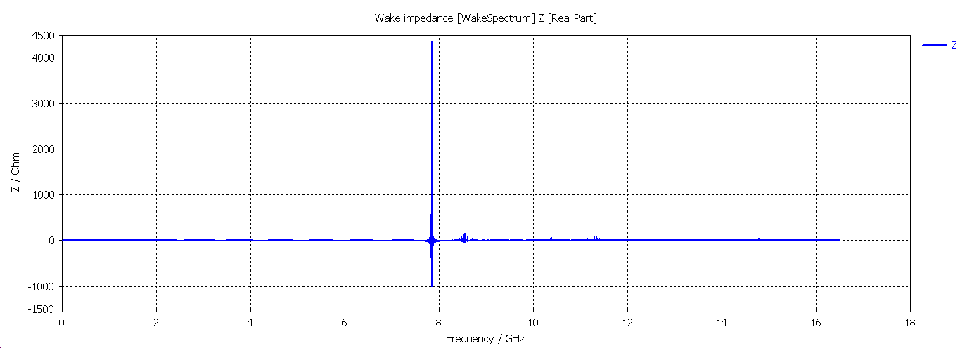
Model 3: Power deposition in Be ( Z &High Luminosity &σ_{z}@6.2mm&material@PEC)
Fre_cutoff:8.24GHz
σ_{z}=6.2mm@k_{loss}: 0.0064v/pc
P_{loss}: Z: 165.98w
σ_{z}=6.2mm@k_{loss}: 0.0075v/pc
P_{loss}: Z: 195w
Resistive wall: 2*21.83w
Trap mode power (below f_cut_off): 2*165.98w
Power propagating from MDI (above f_cut_off): 2* (195*250/1e9)~0w
HOM from other part of the ring: 2*49.41w
Total power on Be pipe: 474.4w
Total power on Be pipe: 235.95w

Slide 17
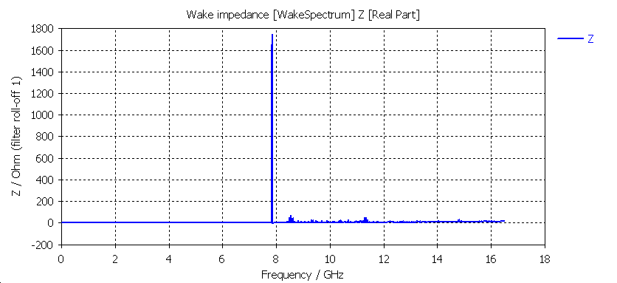
Model 3: Power deposition in Be ( Z &High Luminosity &σ_{z}@6.2mm&material@lossy mental)
σ_{z}=6.2mm@k_{loss}: 0.0132v/pc
P_{loss}: Z: 343.2w
Fre_cutoff:8.24GHz
σ_{z}=6.2mm@k_{loss}: 0.0096v/pc
P_{loss}: Z: 249.65w
Trap mode power (below f_cut_off): 2*343.2w
Power propagating from MDI (above f_cut_off): 2* (249.65*250/1e9)~0w
HOM from other part of the ring: 2*49.41w
Total power on Be pipe: 785.22w

Slide 18
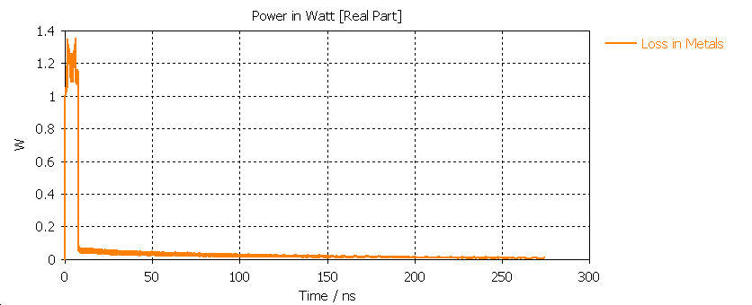
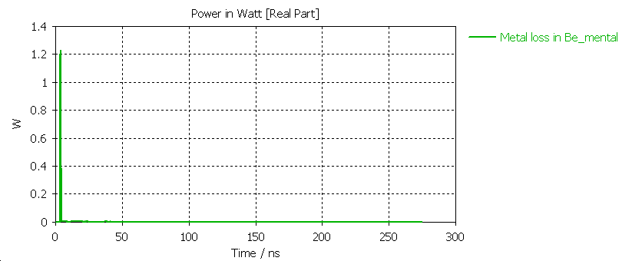
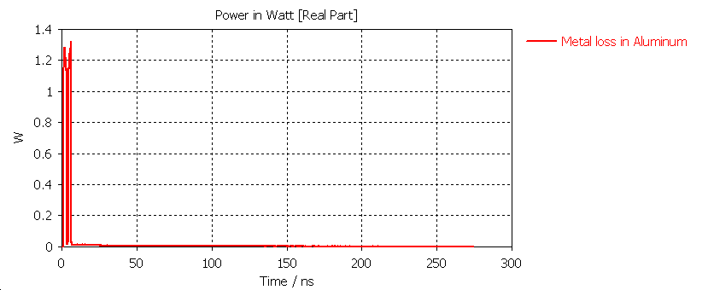
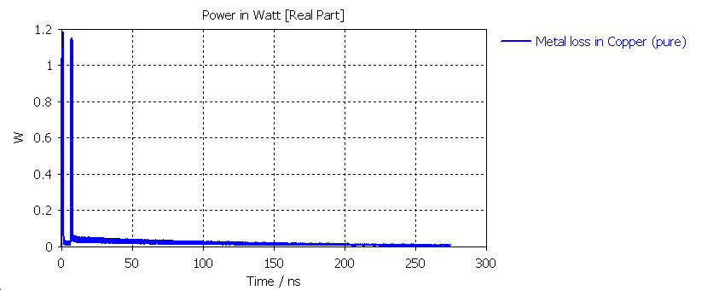
Model 3: Power deposition in Be ( Z &High Luminosity &σ_{z}@6.2mm&material@lossy mental)
Z: P_total_t=449.93w
Z: P_Be=36.41w
Z: P_Cu=233.72w
Z: P_Al=179.80w

Slide 19
Model 3: Power deposition in Be ( Z &High Luminosity &σ_{z}@6.2mm&material@lossy mental)
Directly power deposition in Be pipe: 2*36.41w
Power from Cu and Al pipe deposited in Be: 2* (179.80*250/2220+233.72*250/2220)w
HOM from other part of the ring: 2*49.41w
Total power on Be pipe (maximum): 264.8w

Slide 20
Summary
For Model 3 (with Be pipe aperture 28mm, final quadrupole aperture 20mm), the structure is feasible for beam parameters in CDR.
CDR beam Parameters Maximum Power on Be: 234.8 w
Beam Parameters on High Luminosity Z: Maximum Power on Be: 785.2 w
 | CDR beam parameters |  |  | High Luminosity beam parameters
 | PEC | Lossy mental (frequency domain) | Lossy mental (time domain) | PEC | Lossy mental (frequency domain) | Lossy mental (time domain)
Power on Be(w) | 143.8 | 234.8 | 80.77 | 474.4 | 785.22 | 264.8
Power density (w/cm²) | 0.65 | 1.07 | 0.37 | 2.16 | 3.57 | 1.2
Temperature with coolant(℃) | 341.2 | 428.3 | 253.7 | 588.1 | 694.9 | 455.7
Temperature without coolant(℃) | 28.4 | 32.3 | 25.7 | 42.4 | 58.5 | 33.6

Slide 21
Back up for temperature on Be （Contribution by Wang Hai Jing）

Slide 22
Super KEKEB | Be | others
Power (W) | 70 | 500~550
Area of inner profile (cm^2) | 144.5
Power density (W/cm^2) | 0.48
Coolants | paraffin | water
Delta T of coolant (K) | 10 | 5 (核算4.7)
 | CDR beam parameters |  |  | High Luminosity beam parameters
 | PEC | Lossy mental (frequency domain) | Lossy mental (time domain) | PEC | Lossy mental (frequency domain) | Lossy mental (time domain)
 | 143.8w | 234.8w | 80.77w | 474.4w | 785.22w | 264.8w
自然冷却最高温度（˚C） | 341.2 | 428.3 | 253.7 | 588.1 | 694.9 | 455.7
强制冷却最高温度（˚C） | 28.4 | 32.3 | 25.7 | 42.4 | 58.5 | 33.6
材料Be，导热系数216 W/(m·K)，比热1925J/kg·K
数据来自www.matweb.com
Be 热辐射系数估计为0.61（与自然冷却温度关系很大）
强制冷却取对流系数1000W/m^2·K

Slide 23
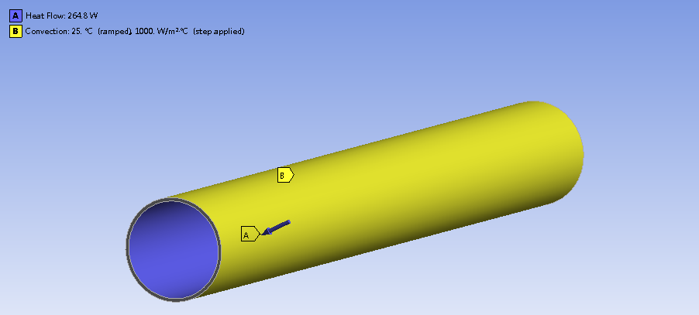
载荷及边界：
内表面加载热功率
外表面对流
管壁厚1mm
若管壁为0.5mm厚，对稳态温升无明显影响
热载荷为264.8W时
 | 管壁厚1mm | 管壁厚0.5mm
自然冷却最高温度（˚C） | 455.7 | 464.1
强制冷却最高温度（˚C） | 33.6 | 33.9

Slide 24
Back up
SuperKEKB 热功率及冷却介质
以785.22W为例介绍计算详细过程及正确性验证

Slide 25
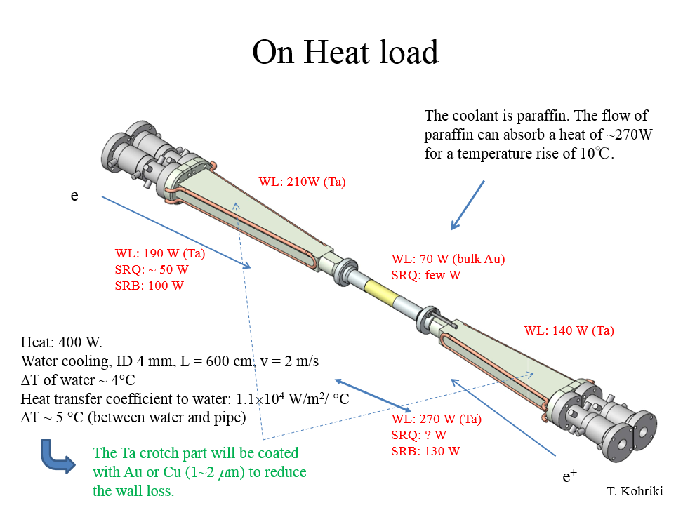

Slide 26
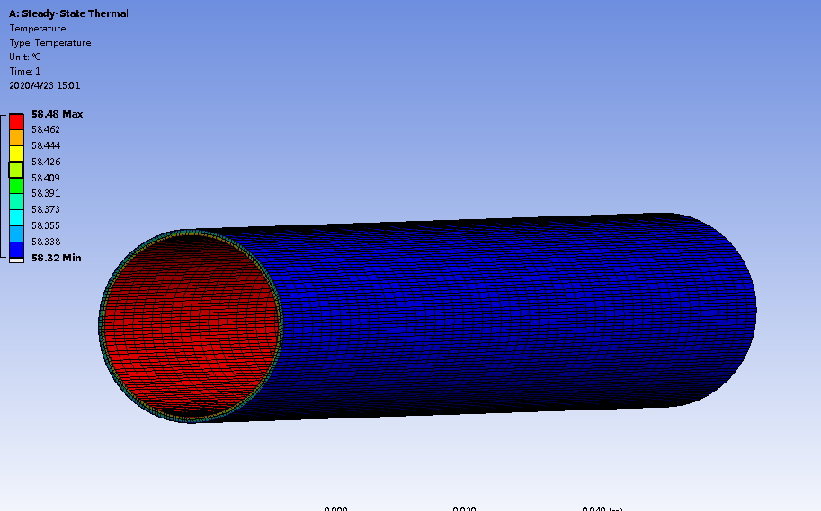
对流系数：1000W/m^2·K
最高温度：58 ˚C
温度较低，不用考虑热辐射。

Slide 27
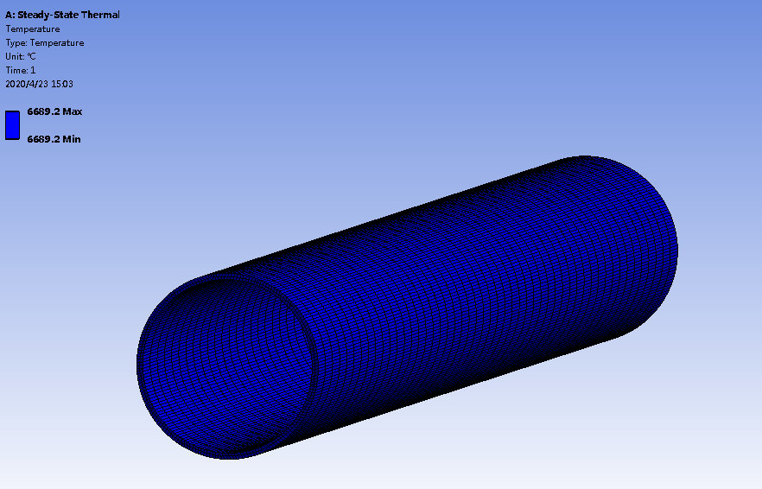
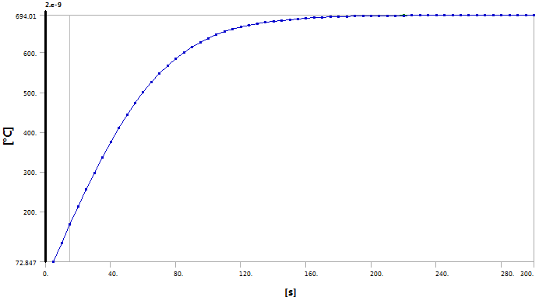
对流系数：5W/m^2·K （自然空冷）
若不考虑辐射，最高温度：6689 ˚C
最高温度太高，必须考虑辐射。
假设Be为黑体，辐射系数0.61，约200秒后达到平衡，最高温度：694 ˚C
上述计算中，辐射系数为估计值，加工精度越高，该值越低，温升越大.
辐射系统从0.8~0.05（铝抛光）变化时，最高温度 655˚C-1782˚C变化
需要强制冷却

Slide 28
温度计算验证
若只考虑材料吸热，温升
取1s时间，温升
Ansys计算1s温升为9.76 ˚C
若只考虑对流，则对流带走热量应为加载功率。
Ansys内理论加载功率758.22W，统计对流带走热量758.0W
若只考虑辐射，则辐射热量应为加载功率$E=εEb=εC_{0}∙A∙[{\left(\frac{T}{100}\right)}^{4}$-${\left(\frac{T0}{100}\right)}^{4}$]
取$ε=0.61，C0=5.67\left(W/{m^{2}∙K^{4}}\right),得T=$992.3K=719.2 ˚C
Ansys计算温度为738.5˚C
$$∆T=Q/\left(c∙m\right)$$
$∆T=\frac{785.2}{\left(1925∙pi∙\frac{D^{2}−d^{2}}{4}∗0.25∗1844\right)}=$9.71˚C
传导过程正确
对流过程正确
辐射过程正确

