Slide 1
CEPC MDI SC Magnet System
Yingshun Zhu
Institute of High Energy Physics, Chinese Academy of Sciences
April 24, 2020

Slide 2
Outline
Overview of CEPC MDI SC magnets
Design of QD0
Design of superconducting quadrupole magnet QF1
Design of superconducting anti-solenoid
QD0 design with updated requirement
Summary

Slide 3
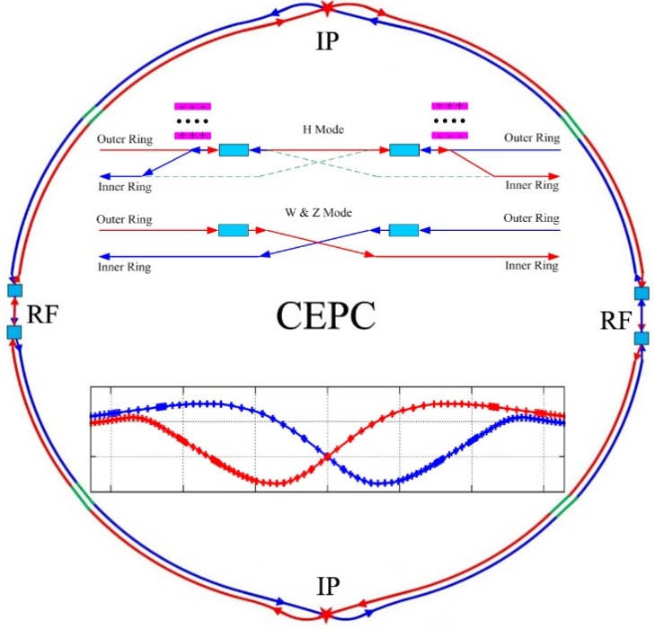
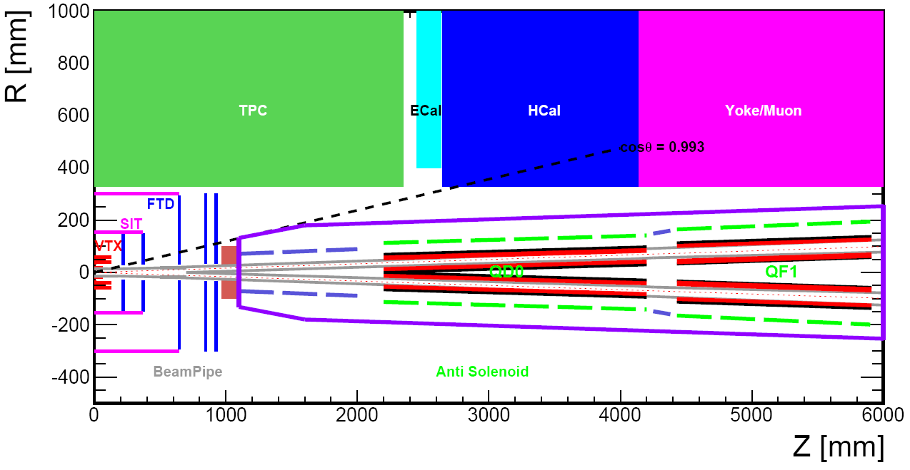
Overview of CEPC MDI SC magnets
CEPC is a Circular Electron Positron Collider with a circumference about 100 km, beam energy up to 120 GeV proposed by IHEP.
Most magnets needed for CEPC Accelerator are conventional magnets.
To greatly squeeze the beam for high luminosity, compact high gradient final focus quadrupole magnets are required on both sides of the IP points in CEPC collider ring.
CEPC MDI layout
Sketch of CEPC Collider ring

Slide 4
The CDR requirements of the Final Focus quadrupoles (QD0 and QF1) are based on L* of 2.2 m, beam crossing angle of 33 mrad.
QD0 and QF1 magnets are operated inside the field of Detector solenoid magnet with a central field of 3.0 T.
To cancel the effect of the longitudinal detector solenoid field on the accelerator beam, anti-solenoids before QD0, outside QD0 and QF1 are needed.
The total integral longitudinal field generated by the detector solenoid and accelerator anti-solenoid is zero; Local net solenoid field in the region of quadrupole is close to zero.
Table 1: Requirements of Interaction Region quadrupole magnets for Higgs
Magnet | Central field gradient (T/m) | Magnetic length (m) | Width of GFR (mm) | Minimal distance between two aperture beam lines (mm)
QD0 | 136 | 2.0 | 19.6 | 72.6
QF1 | 110 | 1.48 | 27.0 | 146.20

Slide 5
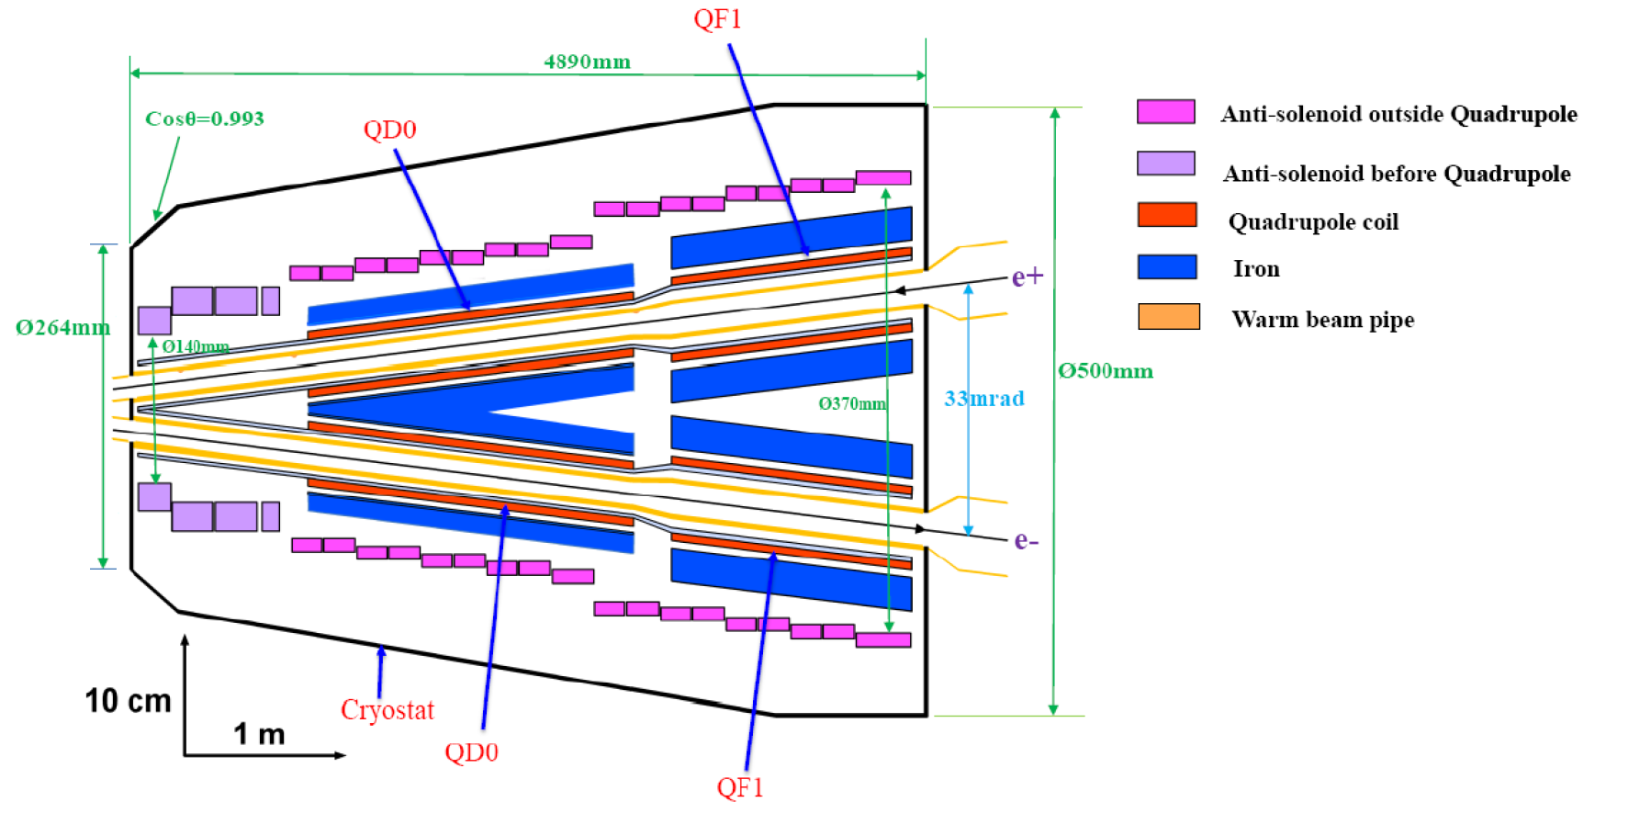
CEPC MDI SC Magnets start at z=1.12m, including: superconducting QD0,QF1, anti-solenoid on each side of the IP point.
Inner radius of beam pipe is 10 mm.
QD0, QF1, and anti-solenoid coils are in the same cryostat.
Schematic layout of QD0, QF1, and anti-solenoid

Slide 6
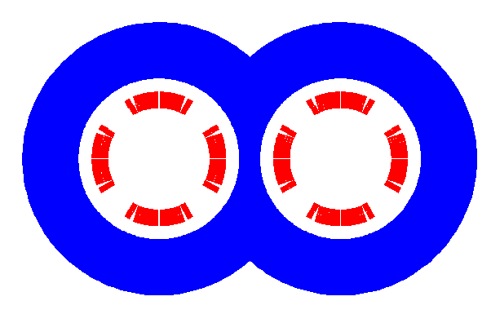
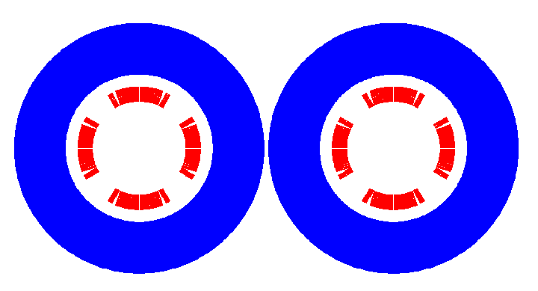
QD0 design with CDR diameter
QD0 CDR: 136T/m, inner diameter 40mm, length 2m.
Overall design
Minimal distance between two aperture beam lines: 72.6 mm.
Not enough space to place two single apertures side by side, so a compact design is adopted.
cos2θ quadrupole coil using NbTi Rutherford: highest magnetic efficiency and cooling capacity, good stability, elimination of field crosstalk.
Iron yoke can enhance the field gradient, reduce the coil excitation current.
Iron core in the middle part is shared by the two apertures.

Slide 7
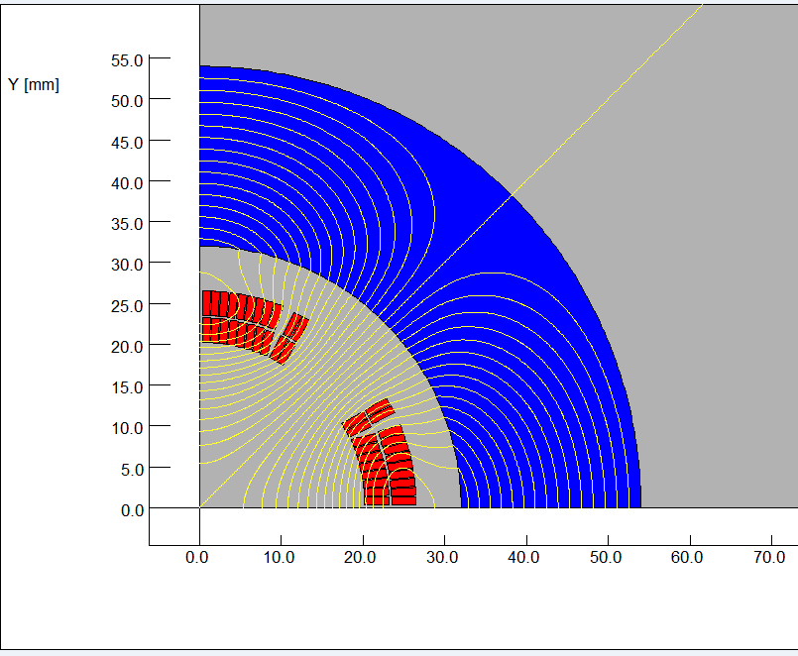
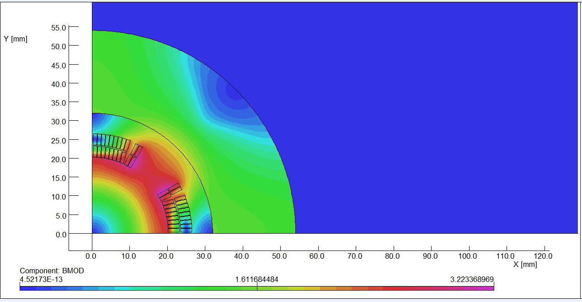
The design of QD0 is based on two layers cos2θ quadrupole coil using NbTi Rutherford cable with iron yoke.
The QD0 single aperture coil cross section is optimized with four coil blocks in two layers separated by wedges, and there are 21 turns in each pole.
2D magnetic field calculation is performed using OPERA.
Actual insulation thickness and coil fabrication process are taken into account.
2D flux lines (1/4 cross section)
Magnetic flux density distribution

Slide 8
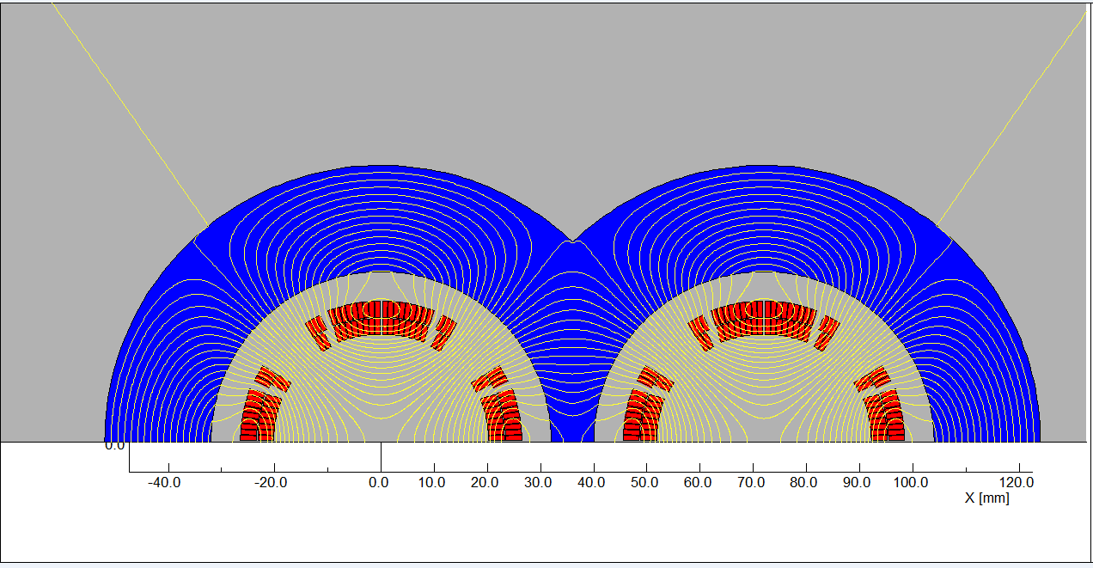
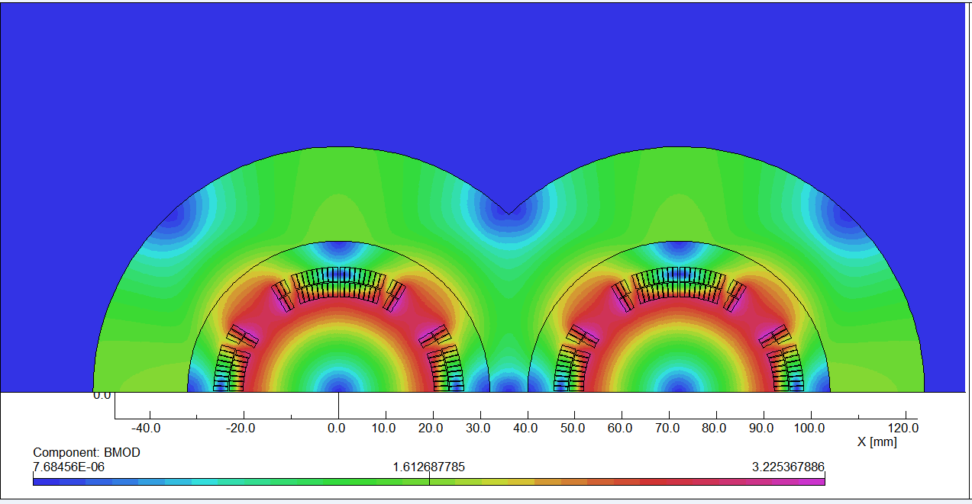
2D field cross talk of QD0 two apertures near the IP side.
The field harmonics as a result of field crosstalk is smaller than 0.5×10⁻⁴. Compared with the iron-free design, the excitation current can be reduced.
2D Flux lines
Bmod distribution

Slide 9
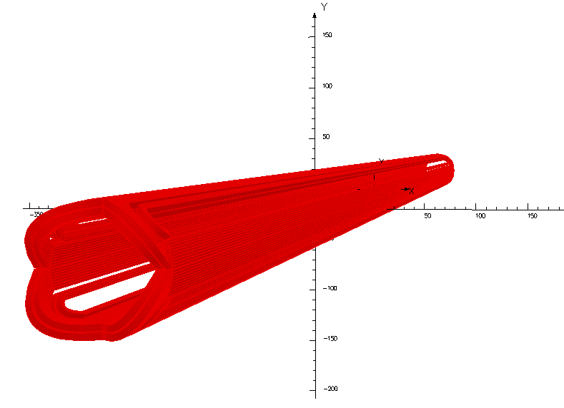
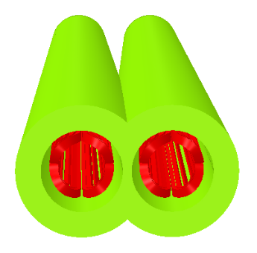
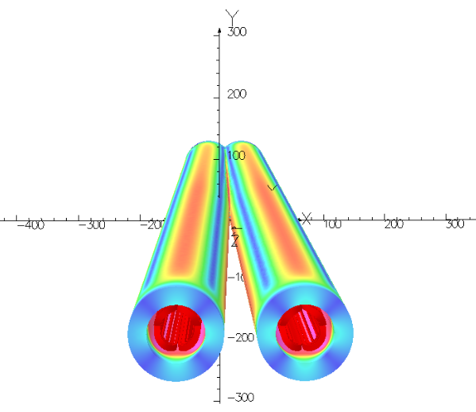
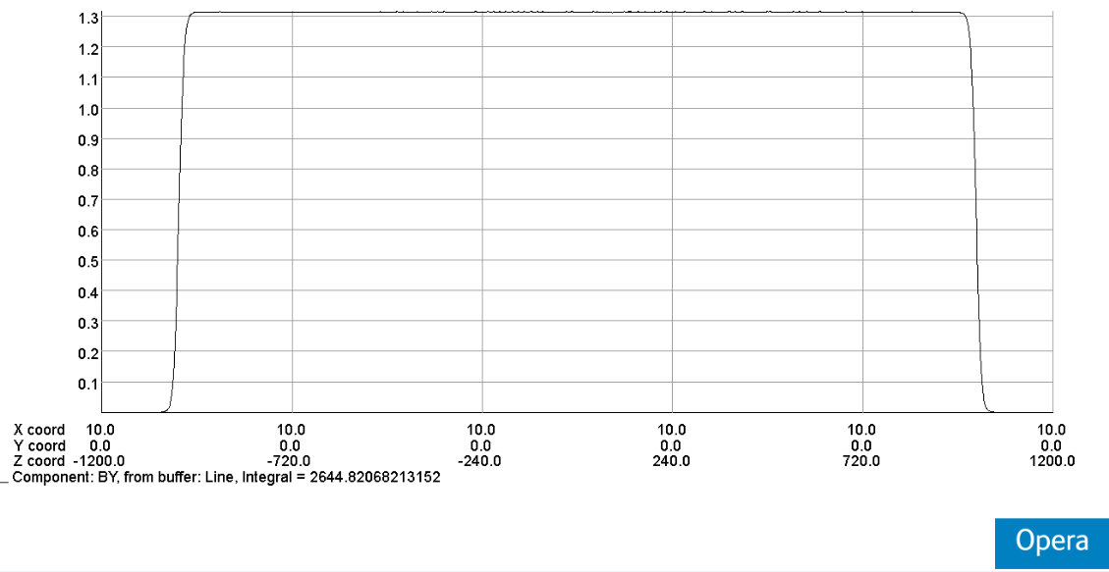
QD0: Double aperture quadrupole magnet using cos2θ coil with iron yoke, with crossing angle between two apertures.
Novel design, the first such magnet in the world.

Slide 10
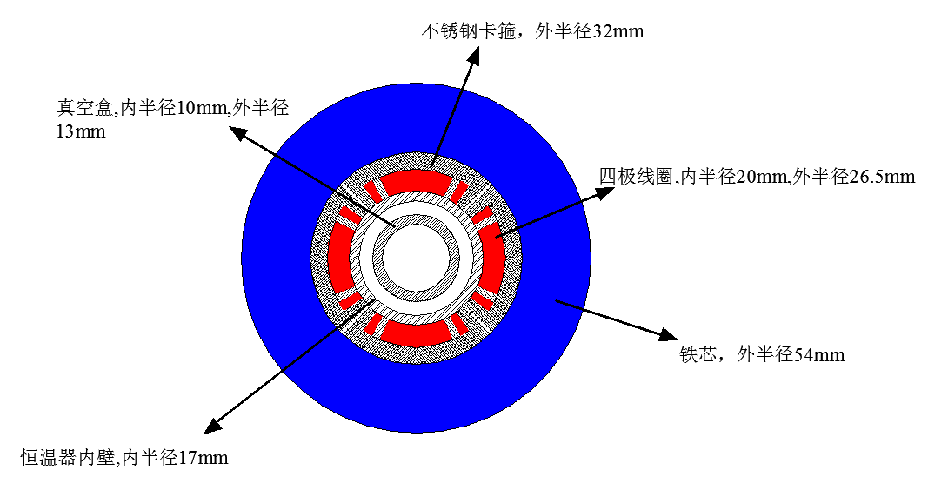
Design parameters of QD0:
Table 2: Design parameters of QD0 (with iron core)
Magnet name | QD0
Field gradient (T/m) | 136
Magnetic length (m) | 2.0
Coil turns per pole | 21
Excitation current (A） | 2080
Coil layers | 2
Conductor | Rutherford Cable, width 3 mm, mid thickness 0.93 mm, keystone angle 1.9 deg, Cu:Sc=1.3, 12 strands
Stored energy (KJ) (Double aperture) | 21.5
Inductance (H） | 0.010
Peak field in coil (T) | 3.3
Coil inner diameter (mm) | 40
Coil outer diameter (mm) | 53
X direction Lorentz force/octant (kN) | 112
Y direction Lorentz force/octant (kN) | -108
The current of QD0 at W and Z model will decrease.

Slide 11
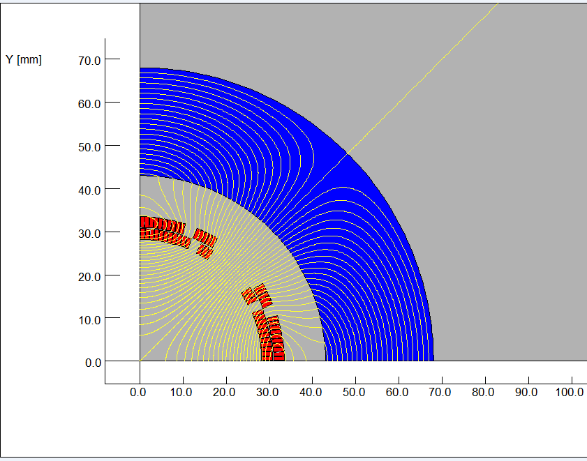
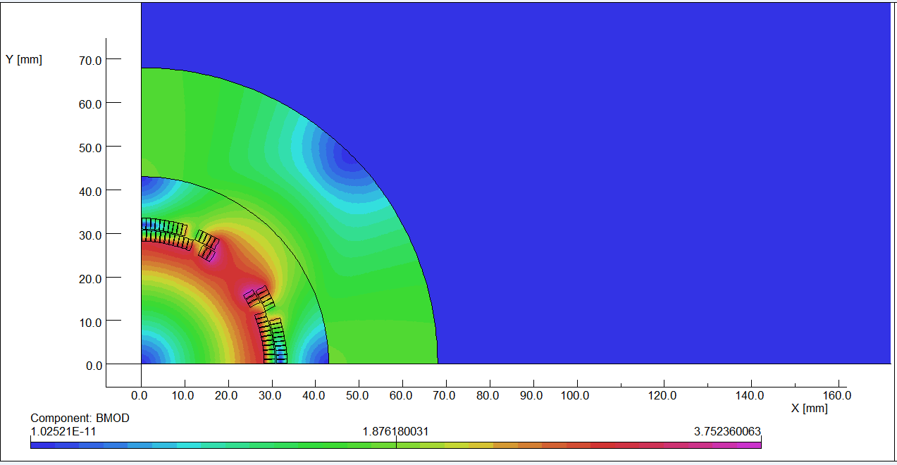
Design of superconducting quadrupole magnet QF1
The design of QF1 magnet is similar to the QD0 magnet, except that there is iron yoke around the quadrupole coil for QF1.
The used Rutherford cable is similar to that of QD0. Since the distance between the two apertures is much larger and the usage of iron yoke, the field cross talk between the two apertures of QF1 is not a problem.
After optimization, the QF1 coil consists of four coil blocks in two layers separated by wedges, and there are 29 turns in each pole.
2D flux lines (One quarter cross section)
Magnetic flux density distribution

Slide 12
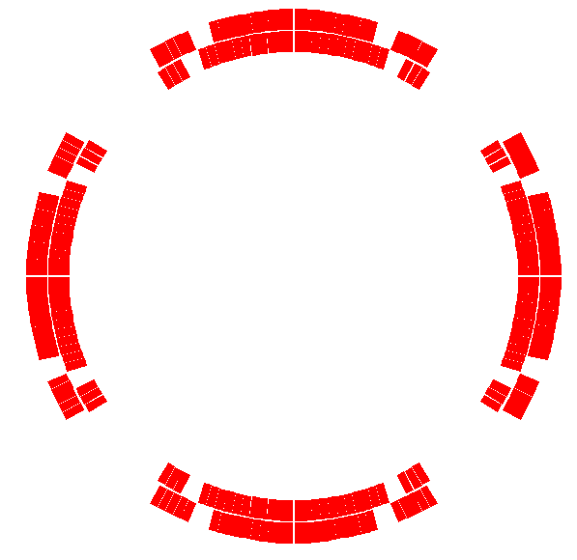
Table 3: 2D field harmonics of QF1 (unit, 1×10⁻⁴)
n | B_{n}/B₂@R=13.5mm
2 | 10000
6 | 1.08
10 | -0.34
14 | 0.002
Coil cross section of single aperture QF1

Slide 13
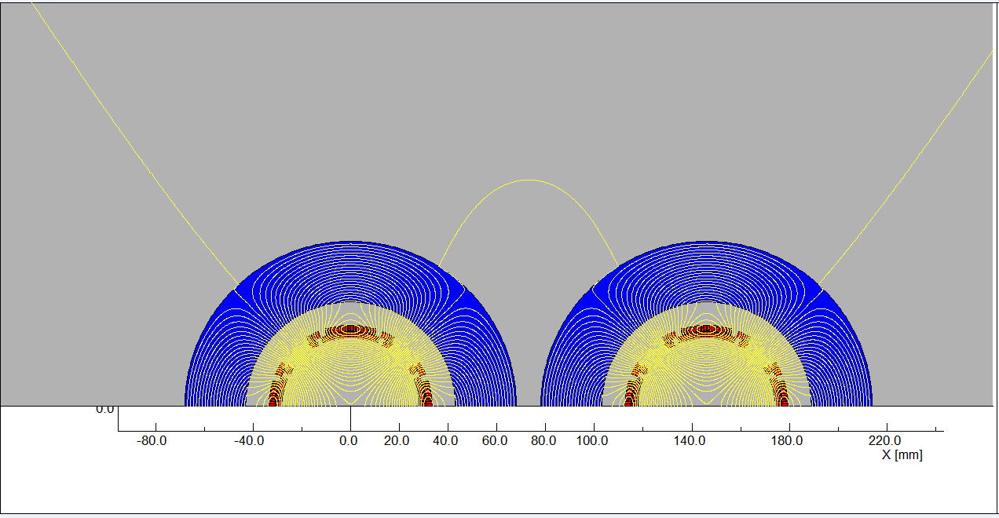
Field cross talk of QF1 two apertures is modelled and studied in OPERA-2D.
The calculation results show that, the iron yoke can well shield the leakage field of each aperture, the field harmonics as a result of field cross talk between the two apertures can be neglected.
Two aperture Flux lines

Slide 14
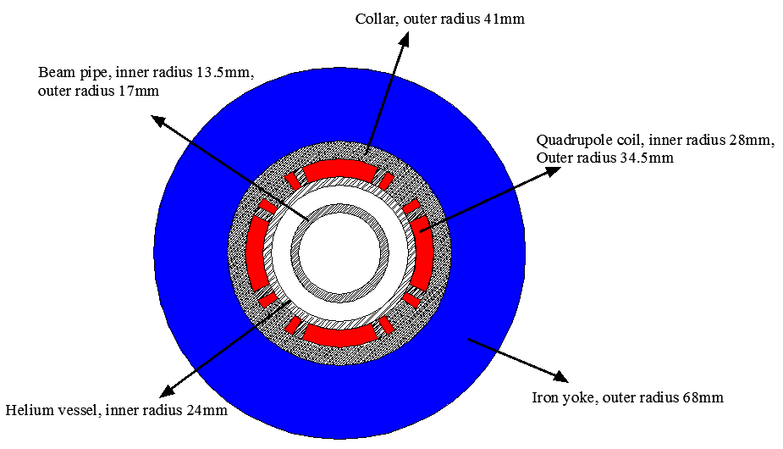
Design parameters and magnet Layout of QF1:
Table 4: Design parameters of QF1
Magnet name | QF1
Field gradient (T/m) | 110
Magnetic length (m) | 1.48
Coil turns per pole | 29
Excitation current (A） | 2250
Coil layers | 2
Conductor size (mm) | Rutherford Cable, width 3 mm, mid thickness 0.95 mm, 12 strands
Stored energy (KJ) | 30.5
Inductance (H） | 0.012
Peak field in coil (T) | 3.8
Coil inner diameter (mm) | 56
Coil outer diameter (mm) | 69
X direction Lorentz force/octant (kN) | 110
Y direction Lorentz force/octant (kN) | -120
Single aperture QF1
The current of QF1 at W and Z model will decrease.

Slide 15
Design of superconducting anti-solenoid
The design requirements of the anti-solenoids in the CEPC Interaction Region are summarized below:
1) The total integral longitudinal field generated by the detector solenoid and anti-
solenoid coils is zero.
The longitudinal field inside QD0 and QF1 should be smaller than a few
hundred Gauss at each longitudinal position.
The distribution of the solenoid field along longitudinal direction should meet
the requirement of the beam optics for emittance.
The angle of the anti-solenoid seen at the collision point satisfies the Detector
requirements.
The design of the anti-solenoid fully takes into account the above requirements. The anti-solenoid will be wound of rectangular NbTi-Cu conductor.

Slide 16
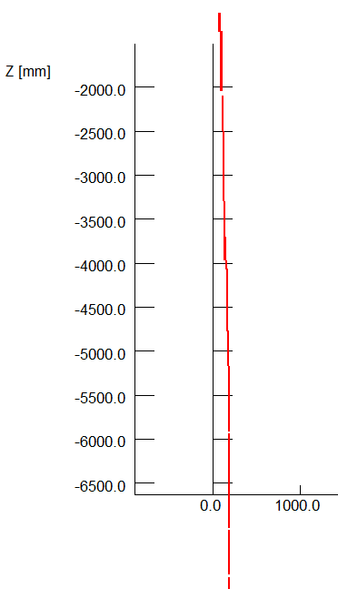
The magnetic field of the Detector solenoid is not constant, and it decreases slowly along the longitudinal direction.
In order to reduce the magnet size, energy and cost, the anti-solenoid is divided into a total of 29 sections with different inner coil diameters.
These sections are connected in series, but the current of some sections of the anti-solenoid can be adjusted using auxiliary power supplies if needed.
The anti-solenoid along longitudinal direction:
1) 4 sections, from IP point to QD0;
2) 12 sections, QD0 region;
3) 6 sections, QF1 region;
4) 7 section, after QF1 region.
To reduce the length of the cryostat, the sections of
anti-solenoid after QF1 region with low field will be
operated at room-temperature.

Slide 17
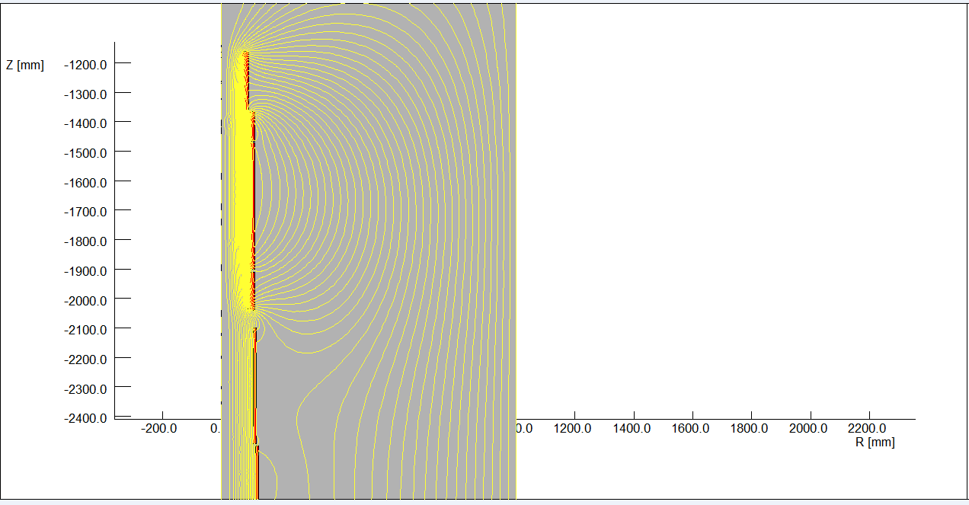
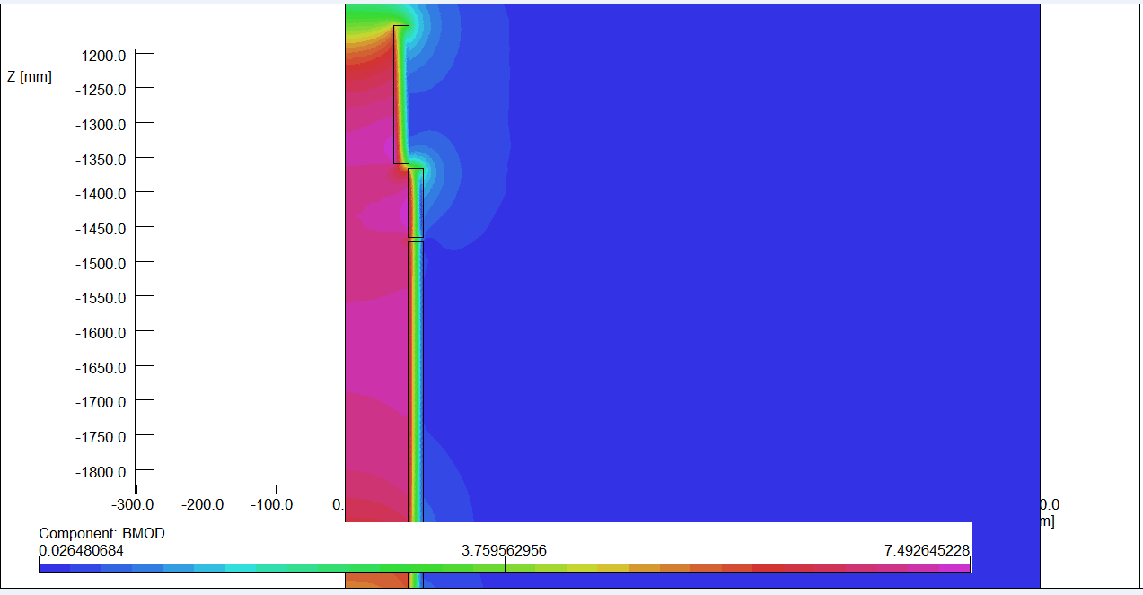
Magnetic field calculation and optimization is performed using axi-symmetric model in OPERA-2D.
The central field of the first section of the anti-solenoid is the strongest, with a peak value of 7.2T.
2D flux lines
Magnetic flux density distribution

Slide 18
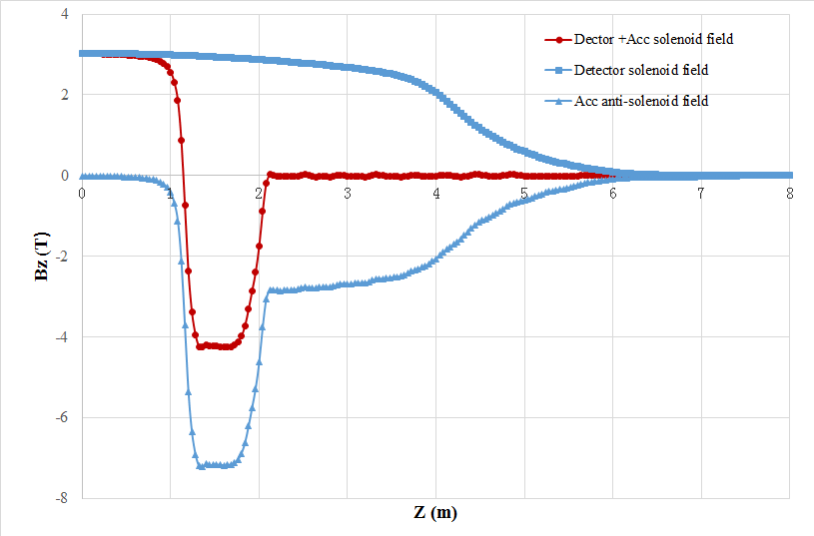
Combined field of Anti-solenoid and Detector solenoid.
The net solenoid field inside QD0 and QF1 at each longitudinal position is smaller than 300 Gs.
The combined field distribution of anti-solenoid and Detector solenoid well meets the requirement of beam dynamics for emittance.

Slide 19
Design parameters of Anti-solenoid:
Table 5: Design parameters of Anti-solenoid
Magnet name | Anti-solenoid before QD0 | Anti-solenoid QD0 | Anti-solenoid after QD0
Central field（T） | 7.2 | 2.8 | 1.8
Magnetic length（m） | 1.1 | 2.0 | 1.7
Conductor (NbTi-Cu, mm) | 2.5×1.5
Coil layers | 16 | 8 | 4/2
Excitation current（kA） | 1.0
Stored energy (KJ) | 715
Inductance（H） | 1.4
Peak field in coil (T) | 7.7 | 3.0 | 1.9
Number of sections | 4 | 11 | 7
Solenoid coil inner diameter (mm) | 120
Solenoid coil outer diameter (mm) | 390
Total Lorentz force F_{z} (kN) | -75 | -13 | 88
Cryostat diameter (mm) | 500

Slide 20
QD0 design with updated requirement
The requirement of the Final Focus quadrupoles is recently updated.
Design considerations
The field gradient of quadrupoles is reduced compared to that in CDR; the development of QDa is the most challenging.
Design of quadrupoles and anti-solenoid is similar to that in CDR.
Space for the corrector coil is enough inside the bore of quadrupole.
Iron yoke is used to eliminate the field crosstalk from the two apertures.
Table 6: Updated Requirements of final focus quadrupole magnets for Higgs
Magnet | Central field gradient (T/m) | Magnetic length (m) | Width of GFR (mm) | Minimal distance between two aperture beam lines (mm)
QDa | 77.5 | 1.5 | 19.2 | 72.61
QDb | 77.5 | 1.5 | 22.0 | 124.75
QF1 | 63.4 | 2.0 | 30.9 | 181.85

Slide 21
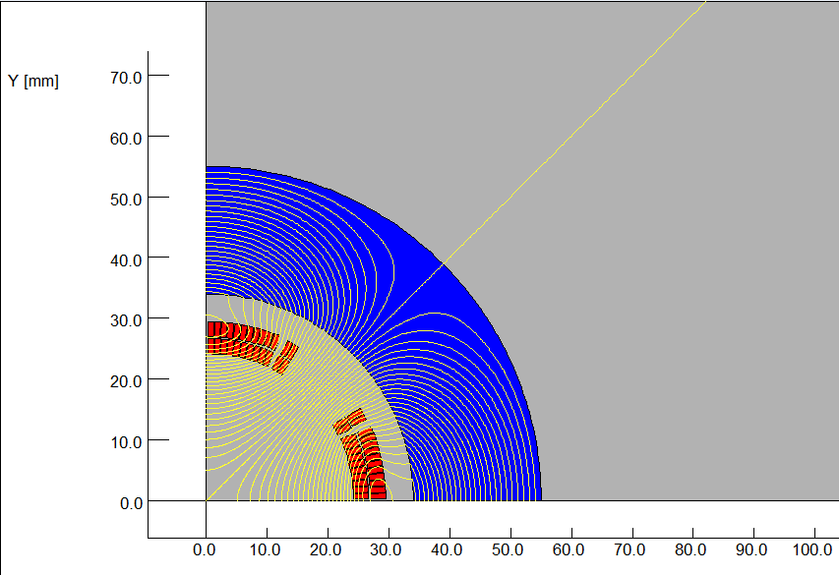
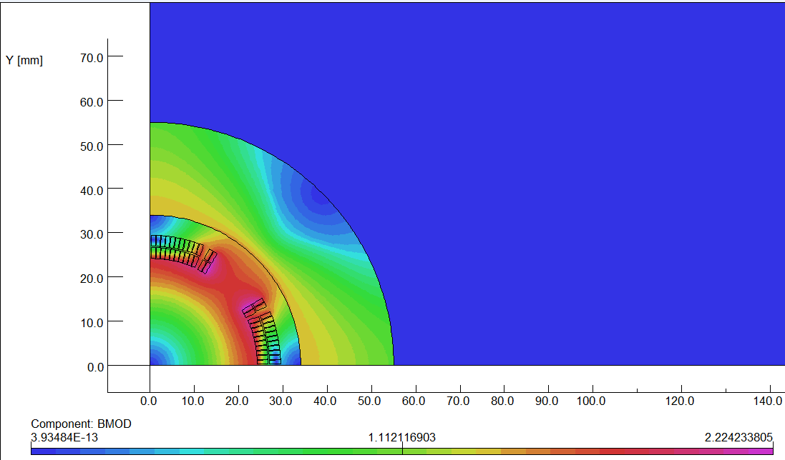
Design progress of QDa
The design of QDa is based on two layers cos2θ quadrupole coil using Rutherford cable with iron yoke.
The QDa single aperture cross section is optimized with four coil blocks in two layers separated by wedges, and there are 25 turns in each pole.
The excitation current of QDa is 1240A, and each multipole field in single aperture is smaller than 1×10⁻⁴.
2D flux lines (1/4 cross section)
Magnetic flux density distribution

Slide 22
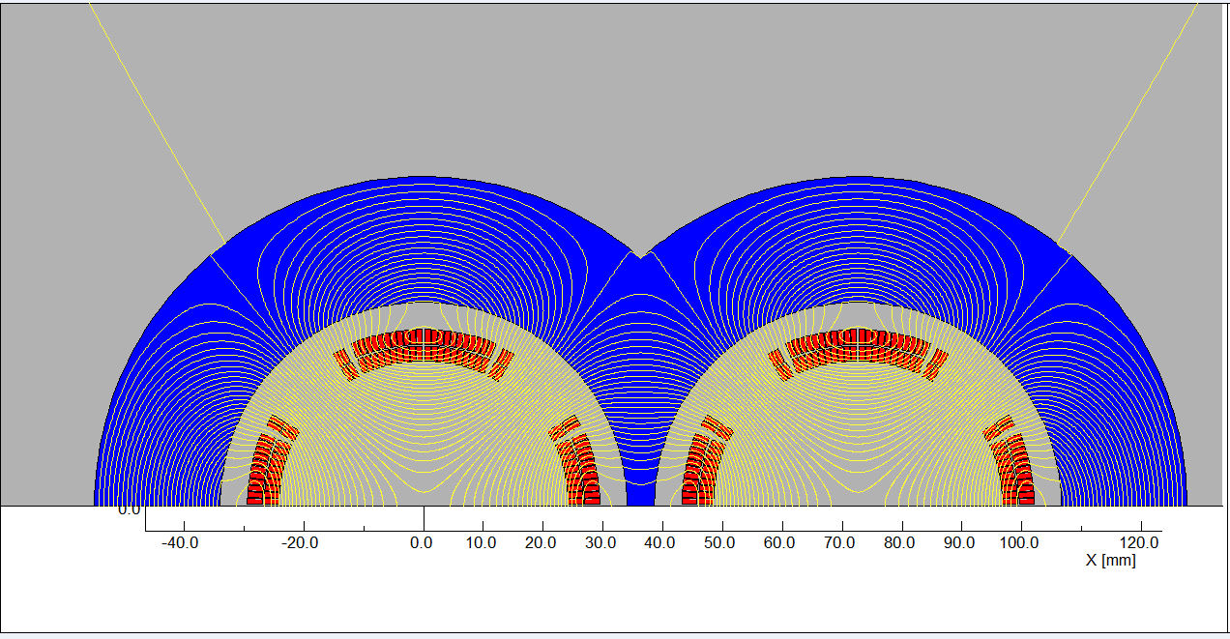
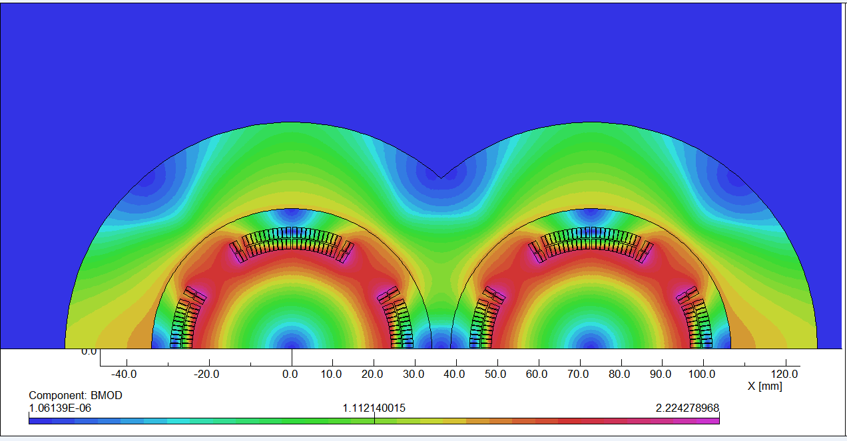
Field cross talk of the two apertures is studied.
2D field cross talk of QDa two apertures near the IP side, where the distance between two aperture centerlines is minimum.
Iron yoke can well shield the leakage field of each aperture. The field harmonics as a result of field crosstalk is smaller than 0.5×10⁻⁴.
2D Flux lines
Bmod distribution

Slide 23
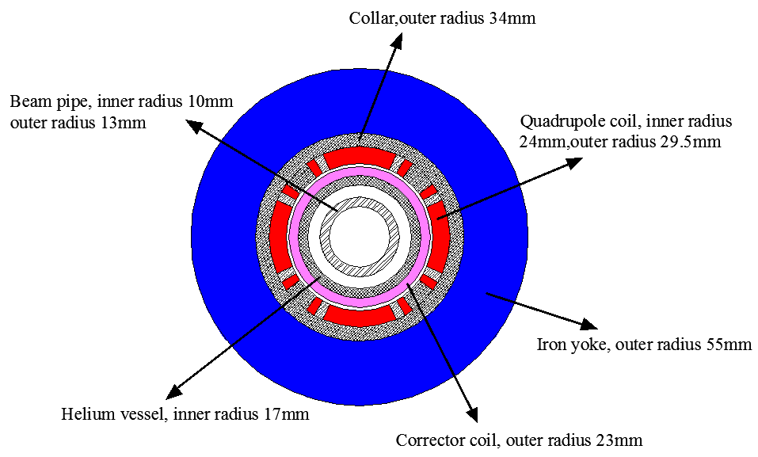
Design parameters and single aperture cross section of QDa:
Table 7: Design parameters of QDa for Higgs
Magnet name | QDa
Field gradient (T/m) | 77.5
Magnetic length (m) | 1.5
Coil turns per pole | 25
Excitation current (A） | 1240
Coil layers | 2
Conductor | Rutherford Cable, width 2.5 mm, mid thickness 0.93 mm, keystone angle 1.9 deg
Stored energy (KJ) (Double aperture) | 8.0
Inductance (H） | 0.010
Peak field in coil (T) | 2.4
Coil inner diameter (mm) | 48
Coil outer diameter (mm) | 59
X direction Lorentz force/octant (kN) | 39
Y direction Lorentz force/octant (kN) | -34

Slide 24
Summary
MDI superconducting magnets are key devices for CEPC.
The design of superconducting magnets meet the requirement.
The width of iron core in the middle part of the QD0 two apertures is very limited, but it is effective in shielding magnetic field crosstalk..
Compared with the iron-free design of QD0, the excitation current with iron yoke can be substantially reduced.
The anti-solenoid is divided into a total of 29 sections with different inner coil diameters, with a max central field of 7.2 T.

Slide 25
Thanks for your attention!

