Slide 1
CEPC MDI accelerator status
Sha Bai
For CEPC MDI group
2020-4-24

Slide 2
Outline
MDI layout and IR design
Heat load
  Synchrotron radiation
  Beam loss background
MDI accelerator components and progress

Slide 3
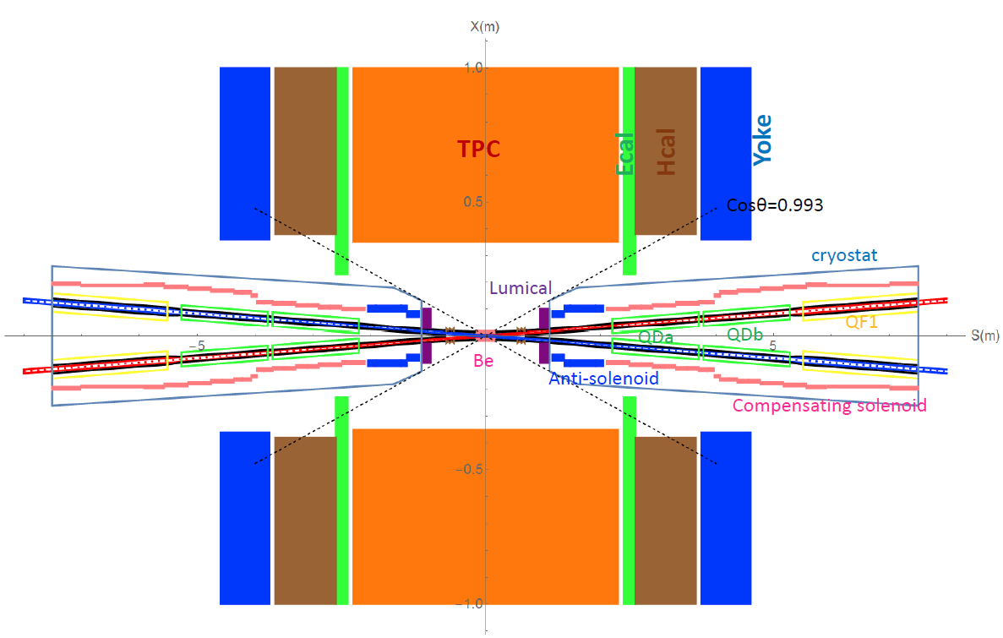
MDI layout and IR design
The Machine Detector Interface (MDI) of CEPC double ring scheme is about ±7m long from the IP.
The CEPC detector superconducting solenoid with 3T magnetic field and the length of 7.6m.
The accelerator components inside the detector without shielding are within a conical space with an opening angle of cosθ=0.993.
The e+e- beams collide at the IP with a horizontal angle of 33mrad and the final focusing length is 2.2m.

Slide 4
Critical energy of bending magnets in IR
Name | length | angle | Distance from IP | Cirtical energy
BMV01IRU | 115.01 | -0.00076 | 83.69 | 25.3keV
BMV02IRU | 68.95 | -0.00195 | 215.28 | 108.4keV
BMV03IRU | 68.95 | -0.00187 | 286.23 | 103.9keV
BMV1IRU | 68.95 | 0 | 428.23 | 0
BMV2IRU | 68.95 | -0.00352 | 430.23 | 195.7keV
BMV3IRU | 68.95 | -0.00352 | 503.28 | 195.7keV
BMV01IRD | 75.05 | 0.00072 | 57.04 | 36.6keV
BMV02IRD | 44.2 | 0.00344 | 174.08 | 298.3keV
BMV03IRD | 44.2 | 0.00256 | 220.28 | 222.0keV
BMV1IRD | 44.2 | 0 | 268.58 | 0
BMV2IRD | 44.2 | 0.00537 | 314.78 | 465.7keV
BMV3IRD | 44.2 | 0.00537 | 363.08 | 465.7keV

Slide 5
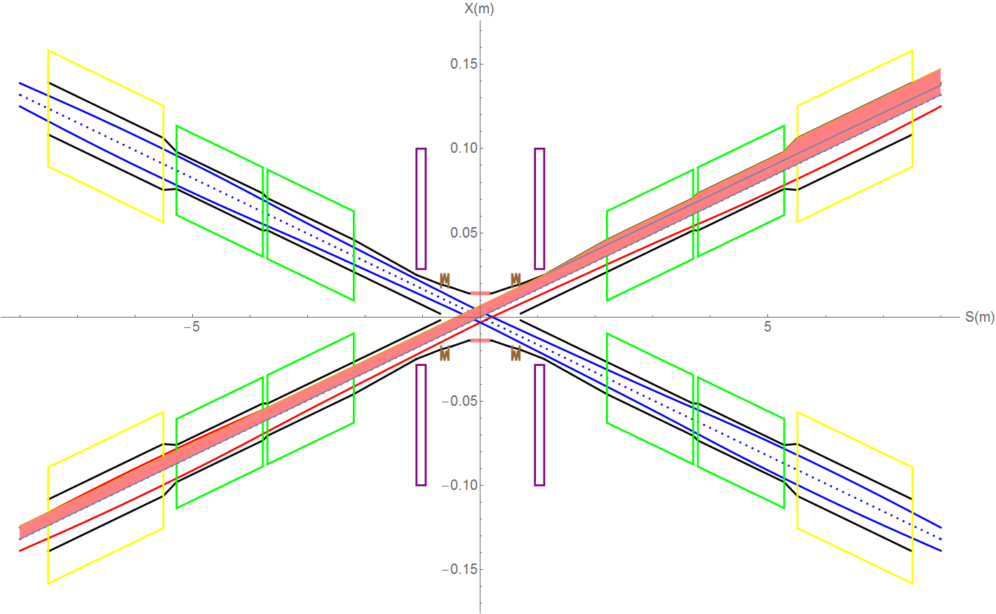
SR on IR beam pipe from last bend upstream
“Room temperature” beam pipe and conduction cooled superconducting magnet has to be adopted.
The synchrotron radiation power between exit of Lumical and entrance of QDa is 12.5W, on QDa is 0.75W along 1.5m, on QDb is 0.9W along 1.5m, the region between QDa and QDb is 6.3W(0.08m). SR on QF1 is 1.78W along 2m. The region between QDb and QF1 is 19.6W(0.23m).
QF1
QDb
QDa

Slide 6
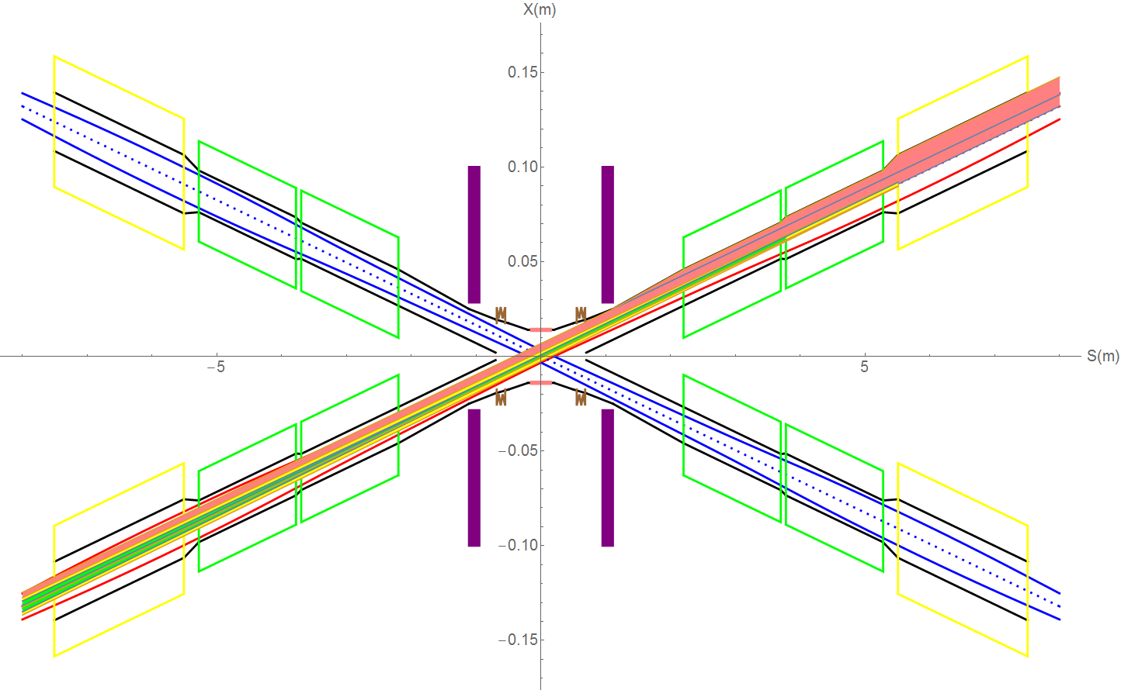
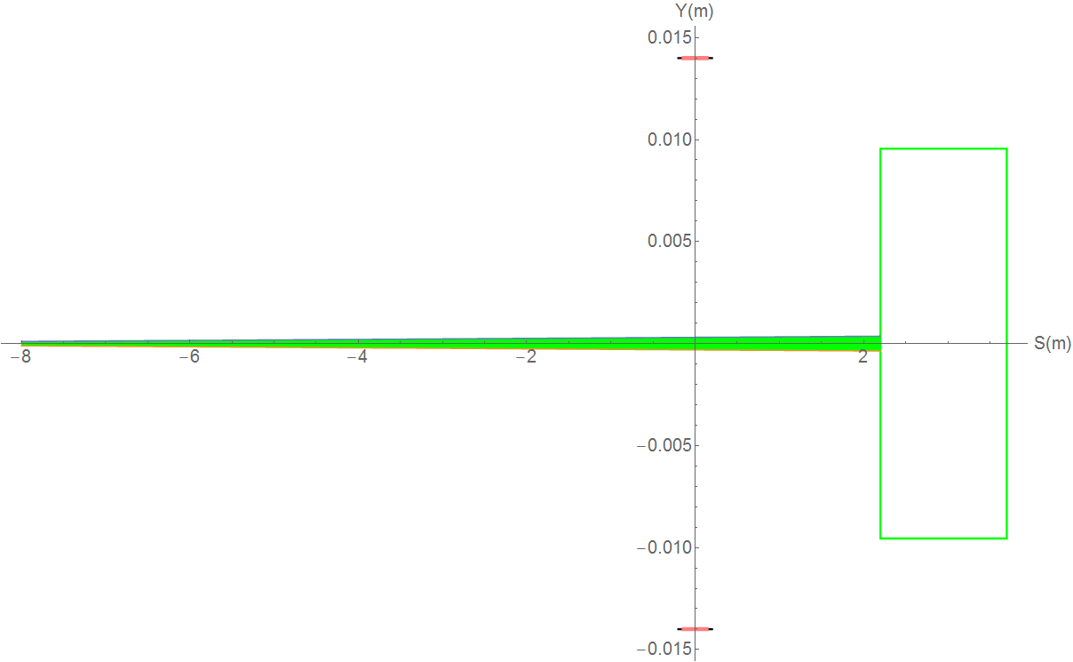
SR from last bend upstream of IP and Final Doublet
Normal condition
QF1
Last bending magnet generates a fan of SR with power 27.8W contributed by e+ will go through the IP. The critical energy of photons is about 25.3keV. No SR hits directly on the detector beryllium pipe.
The total SR power generated by the QDa magnet is 80.9W in horizontal and 40.3W in vertical. The critical energy of photons is about 458.7keV in horizontal and 271.2keV in vertical.
The total SR power generated by the QDb magnet is 242.3W in horizontal and 65.5W in vertical. The critical energy of photons is about 657.9keV and 361.5keV in vertical.
The total SR power generated by the QF1 magnet is 245.9W in horizontal. The critical energy of photons is about 428.3keV.
The total SR power generated by the QF1 magnet is 187.5W in vertical. The critical energy of photons is about 613.5keV.
QDb
QDa
QDa

Slide 7
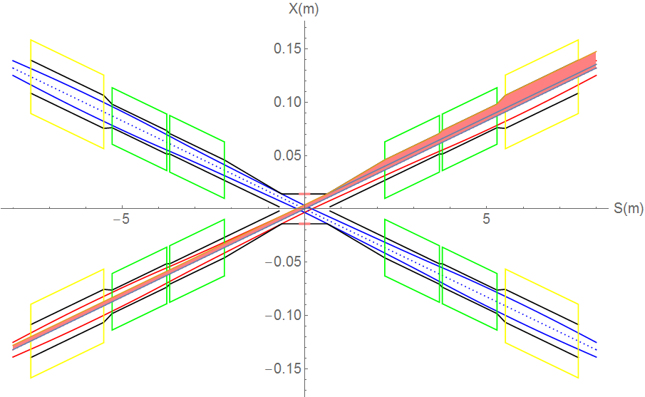
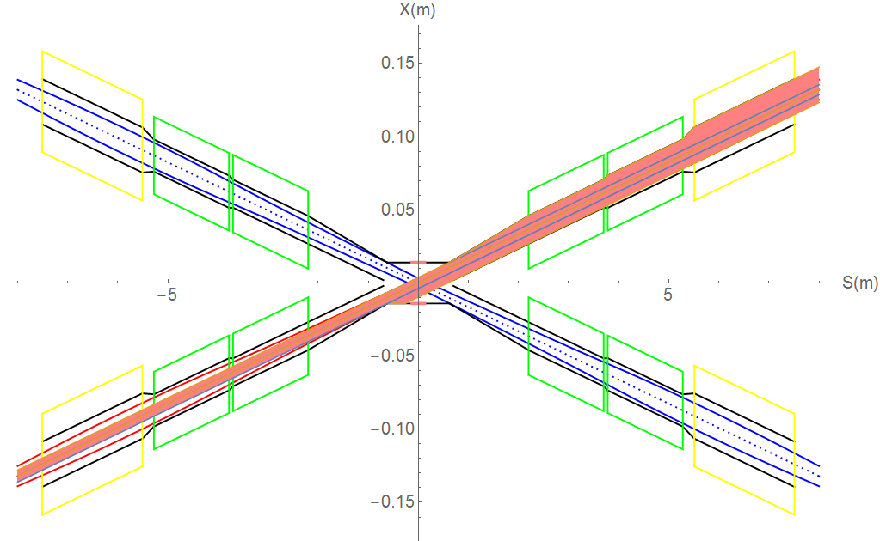
SR from last bending magnet upstream of IP and Final Doublet
Extreme condition
(a) Beam angle offset 0~-2mrad
SR Gaussian distribution~ 0.36mm in width narrow band
When the beam angle moves from 0 to -2mrad, the detector pipe (IP~0.62m) has no SR heat load. 0.62~0.7m beam pipe SR power ~0.76W，average power density~ 26388.89W/m². 0.7m~2.2m SR power~23.9W, APD~44259W/m². QDa~0.75W，APD~1351.35W/m² . QDb~0.9W，APD~1578.95W/m².
Qda~QDb power~6.3W，APD~212837.84W/m²。
QF1~1.78W，APD~2282.05W/m²。
QDb~QF1 ~19.6W，APD~224256.3W/m²。
(b) Beam angle offset 0~+0.115mrad
b) When the beam moves from 0 to 0.115mrad,
the detector pipe (IP~0.26m) has no SR heat load.
0.26~0.62m beam pipe SR power ~24.2W，
average power density~ 188086W/m².
0.62m~0.7m SR power~0.76W, APD~26388W/m².
0.7m~2.2m SR power~54.5W, APD~100925W/m²
QDa~0.66W，APD~1189.2W/m²。QDb~0.73W，APD~1280.7W/m²。
QDa~QDb~5.69W，APD~192229.7W/m²。
QF1~1.3W，APD~1666.67W/m²。
QDb~QF1~16.97W，APD~194164.8W/m²。

Slide 8
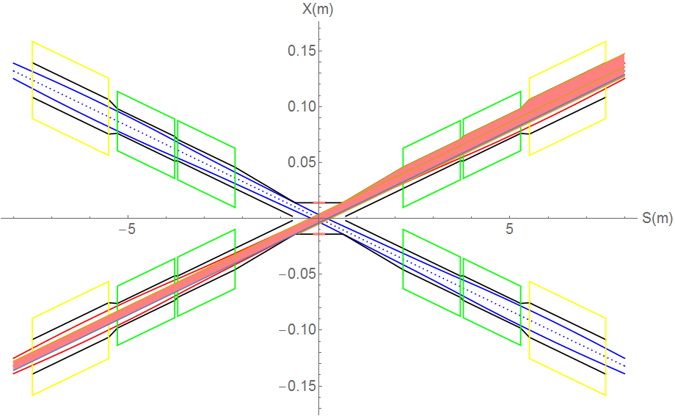
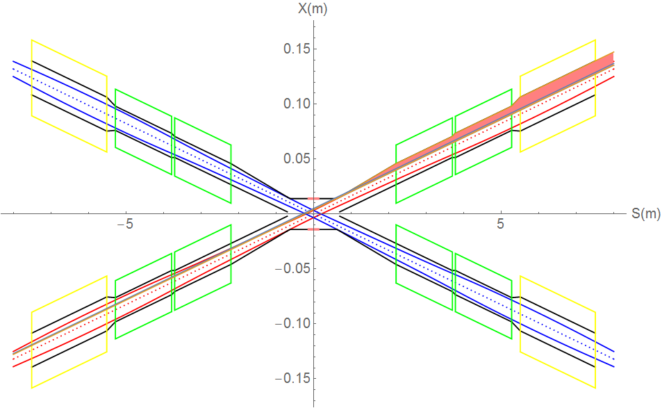
SR from last bending magnet upstream of IP and Final Doublet
Extreme condition
(c) Beam position offset 0~+5mm
SR Gaussian distribution~ 0.36mm in width narrow band
c) Since shortest distance at 0.62 to beam axis, the upstream SR will be prevented, no SR thermal load from IP to 0.62m. The thermal load of other vacuum chamber no change (same as normal conditions), parameters of dipole no change, but SR fan will move up.
(d) Beam position offset 0~-5mm
d) Since shortest distance at 0.62 to beam axis, the upstream SR will be prevented, no SR thermal load from IP to 0.62m. The thermal load of other vacuum chamber no change (same as normal conditions), parameters of dipole no change, but SR fan will move down.

Slide 9
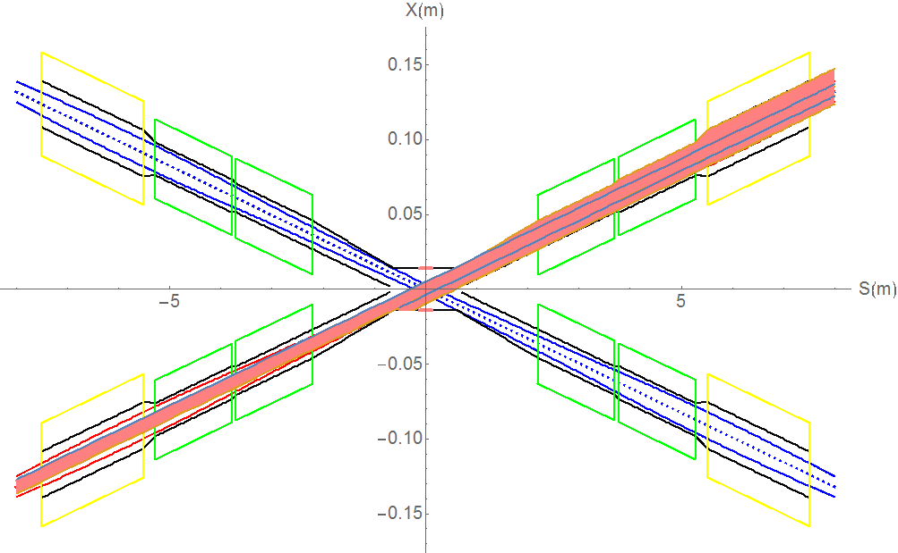
SR from last bending magnet upstream of IP and Final Doublet
Extreme condition
(e) Beam position 0~-5mm+angle offset
SR Gaussian distribution~ 0.36mm in width narrow band
e) When the beam position offset ~-5mm, SR will hit on the beam pipe with +0.055mrad beam angle. the detector pipe (IP~0.266m) has no SR heat load. 0.266~0.62m beam pipe SR power ~23.85W，average power density~ 187199W/m². 0.62m~0.7m SR power~0.79W, APD~27430W/m². 0.7m~2.2m SR power~55.2W，APD~102222.2W/m²。
QDa~0.31W，APD~558.56W/m²。QDb~0.31W，APD~543.86W/m²。QDa~QDb~5.71W，APD~192905.4W/m²。
QF1~0.88W，APD~1128.2W/m²。QDb~QF1~17.02W，APD~194736.8W/m²。
(f) Beam position 0~+5mm+angle
offset
f) When the beam position offset ~+5mm, SR will hit on the beam pipe with +0.175mrad beam angle. the detector pipe (IP~0.259m) has no SR heat load. 0.259~0.62m beam pipe SR power ~24.5W，average power density~ 188571W/m². 0.62m~0.7m SR power~0.74W, APD~25694W/m². 0.7m~2.2m~53.8W，APD~99629.6W/m²。QDa~0.998W，APD~1798.2W/m²。
QDb~1.06W，APD~1859.65W/m²。QDa~QDb~5.68W，APD~191891.89W/m²。QF1~1.73W，APD~2217.95W/m²。
QDb~QF1~16.93W，APD~193707.09W/m²。

Slide 10
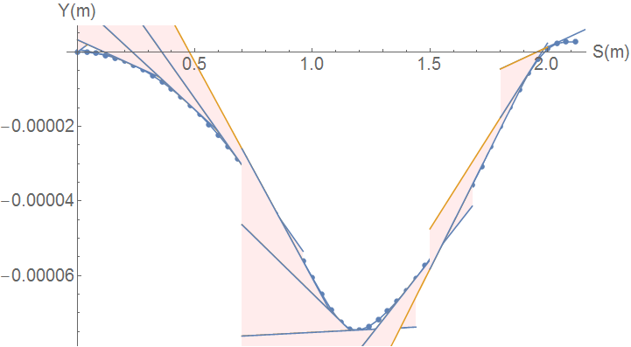
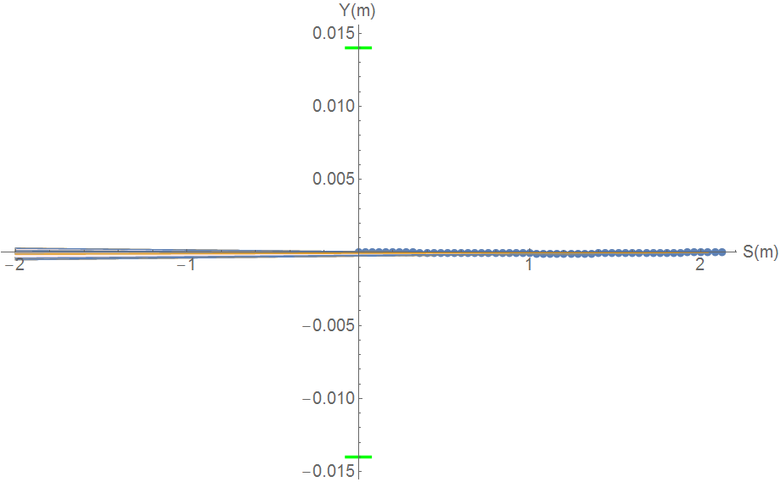
SR from solenoid combined field
Horizontal trajectory will coupled to the vertical
Due to the sol+anti-sol field strength quite high, maximum~4.24T, transverse magnetic field component is quite high.
SR from vertical trajectory in sol+anti-sol combined field should be taken into account.
SR sector is focused in a very narrow angle from
-116urad to 131urad
SR will not hit Berryllium pipe, and not background to detector.
SR will hit the beam pipe ~213.5m downstream from IP
Water cooling is needed.
Maximum: 670keV
Maximum: 31W

Slide 11
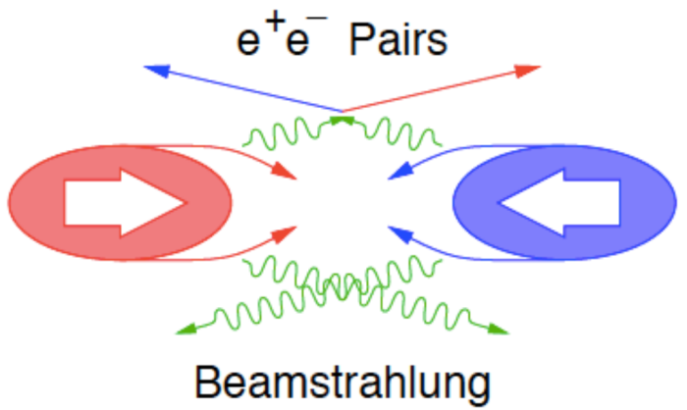
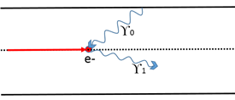
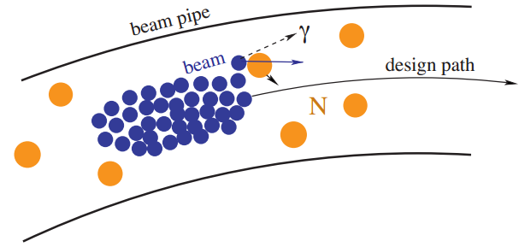
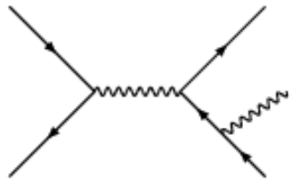
Beam loss Backgrounds at CEPC
IP1
Beam-Thermal photon
scattering
CEPC
Beam Lost Particles
Energy Loss > 1.5%
(energy acceptance)
IP3
Beam-Gas
Scattering
Radiative Bhabha
scattering

Slide 12
Beam loss due to Radiative Bhabha scattering
Without collimators
With collimator
With collimators
Heat load power on the Be pipe (IP~0.125m) ~9mW. （0.125m~0.7m) ~0.034W.
Heat load power on beam pipe(0.7m~2.2m) ~0.21W.
Heat load power on beam pipe(QD0) ~1.92W.
Heat load power on beam pipe(QD0~QF1) ~0.023W.
Heat load power on beam pipe(QF1) ~0.18W.

Slide 13
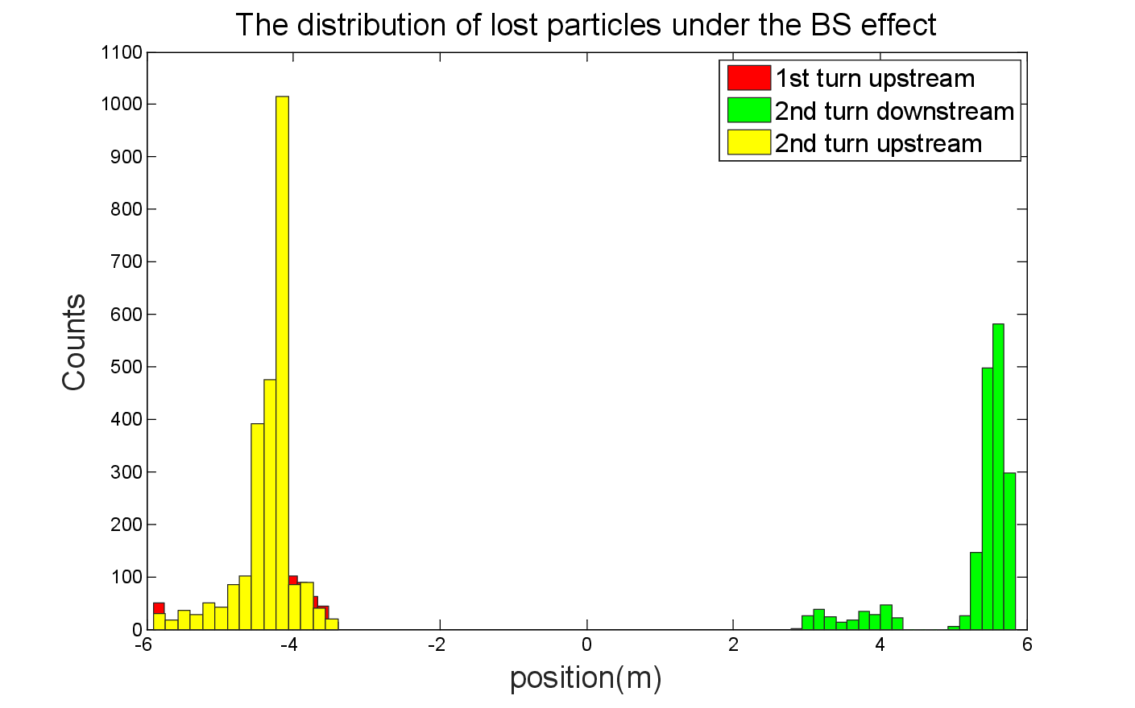
Beam loss due to Beamstrahlung
With collimator
Without collimator
There is no beam loss due to Beamstrahlung with the collimators, thus no heat load on beam pipe in MDI.

Slide 14
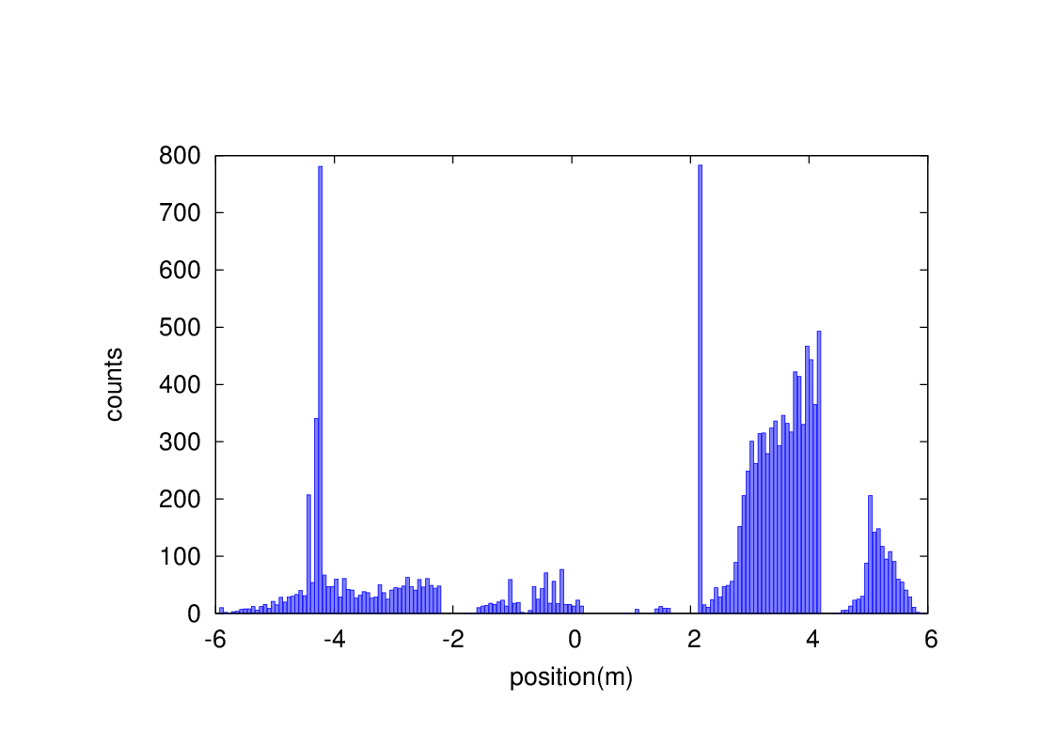
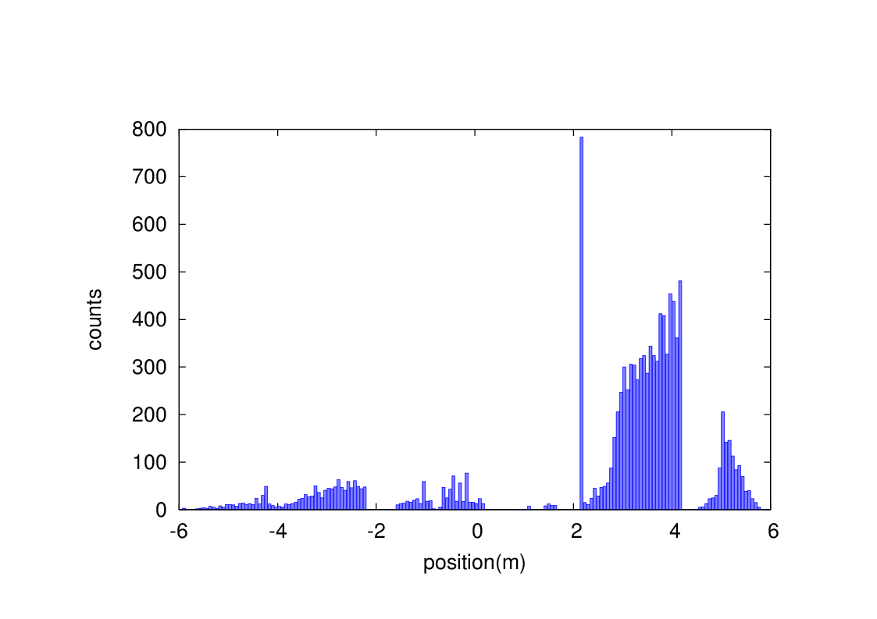
Beam-Gas bremsstrahlung
Without collimators
With collimator
With collimators
Heat load due to BG loss on the detector pipe (IP~0.7m) ~7.5uW.
Heat load power on beam pipe(0.7m~2.2m) ~3.3mW
Heat load power on beam pipe(QD0) ~0.011W
Heat load power on beam pipe(QD0~QF1) ~0W
Heat load power on beam pipe(QF1) ~1.2mW

Slide 15
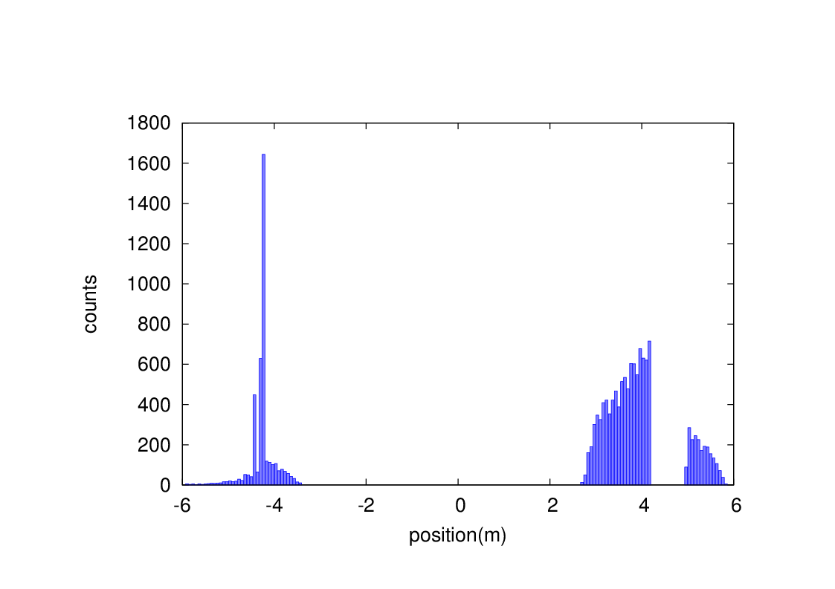
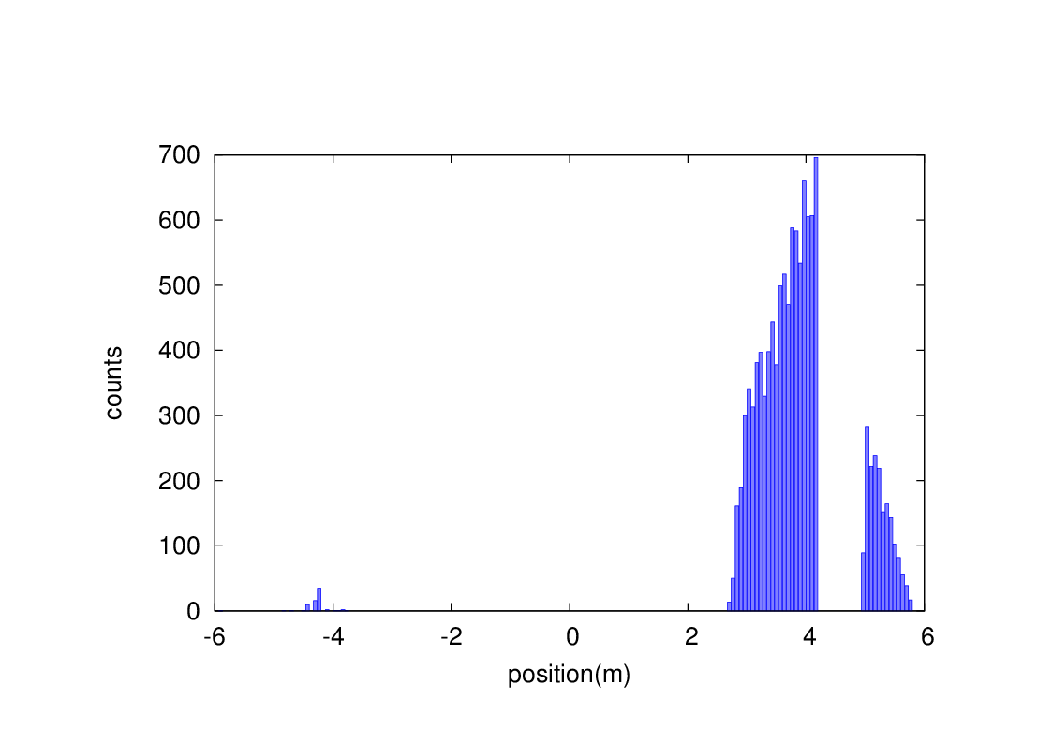
Beam-Thermal photon scattering
Without collimator
With collimator
With collimator
Heat load due to BTH loss on the detector pipe (IP~0.7m) ~0W.
Heat load power on beam pipe(0.7m~2.2m) ~0W
Heat load power on beam pipe(QD0) ~7.5mW
Heat load power on beam pipe(QD0~QF1) ~0W
Heat load power on beam pipe(QF1) ~1.1mW

Slide 16
MDI accelerator components status
Name | status
Superconducting magnet QD0 | Under design
Superconducting magnet QF1 | Under design
Cryostat | Under design
Anti-solenoid | Under design
IPBPM | Under design
IR vacuum chamber | Under design
RVC(remote vacuum connection) | Under design
Shielding | Under design
Cooling system | Under design
Vacuum pump | Under design
Supporting system | Under design
Flange | Under design
Bellows | Under design
Alignment | Under design
Trimming support in SC magnet | Under design
HOM absorber | Under design
Auxiliary coils in SC magnet | Under design
24

Slide 17
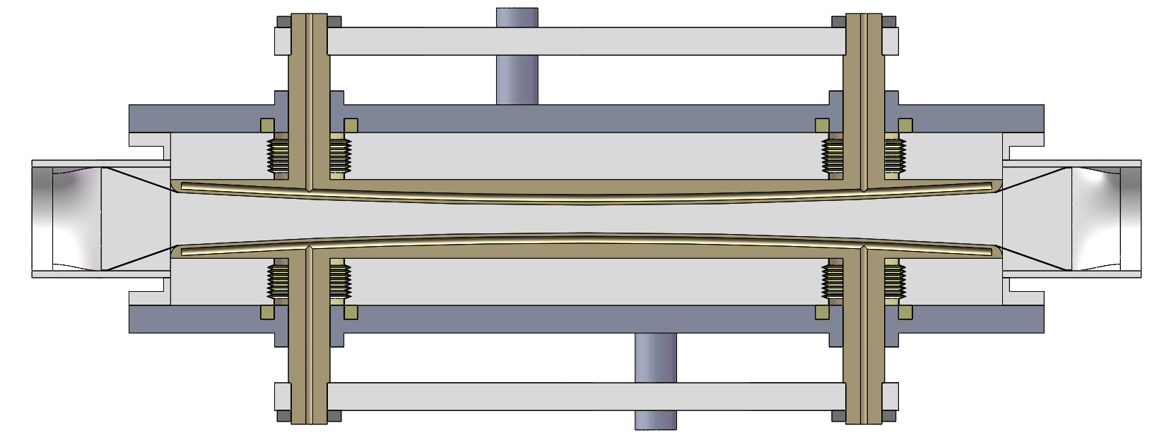
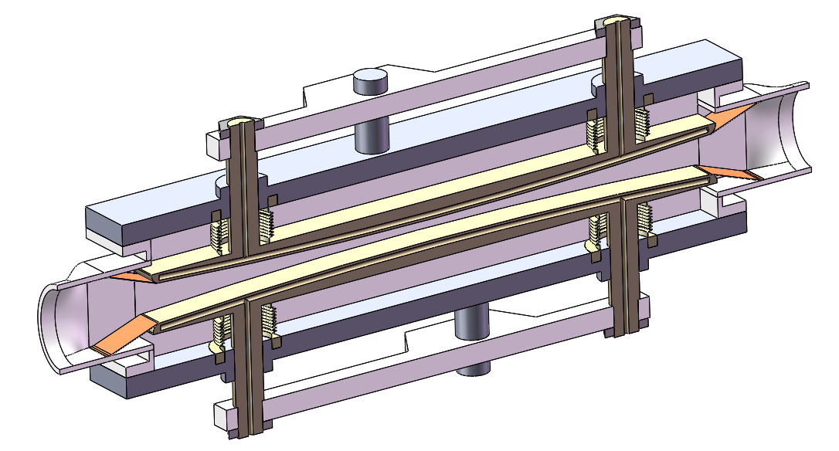
Collimator design structure
Cooling water entrance
Cooling water exit
Beam
Transition spring sheet
Movable baffle
Considering the collimation section, the movable baffle can not protrude the step between the vacuum pipe and the collimator section. The vacuum pipe in the collimator section transits from elliptical section to rectangular section.
During the moving process of the movable baffle, the spring sheet is always pressed on the baffle to realize the gradual transition of the moving process.
Structural design and refinement (including machinery, vacuum, etc.); drive scheme design (drive, control, etc.); material selection (considering physical requirements, heat dissipation, strength, etc.); finite element simulation (thermal-structural).

Slide 18
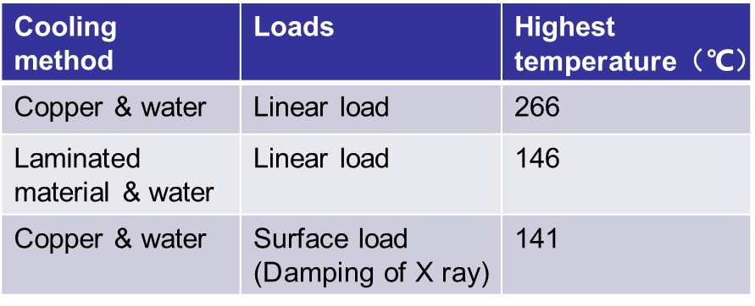
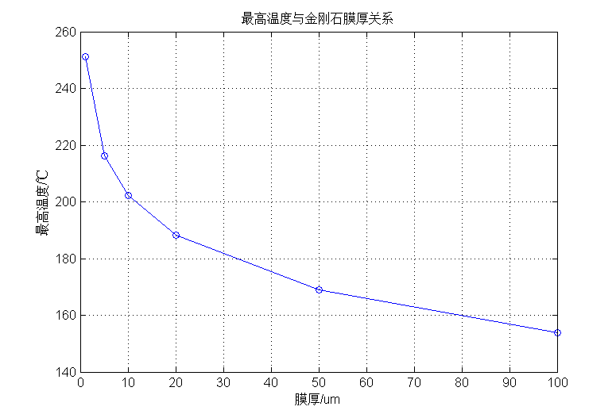
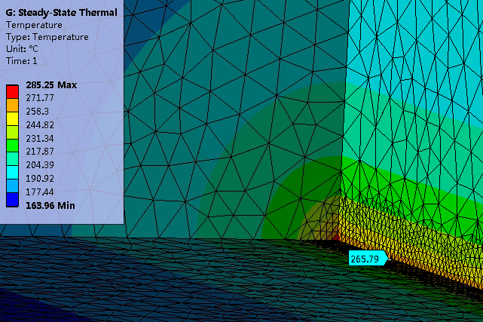
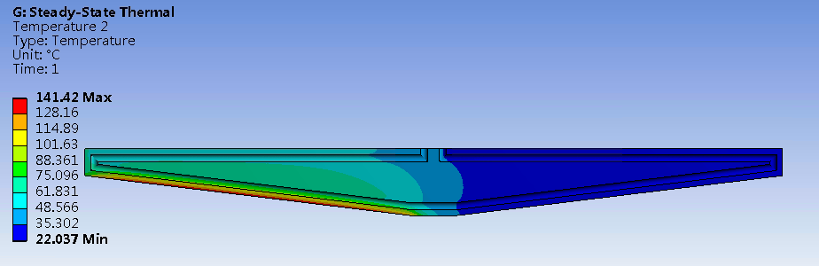
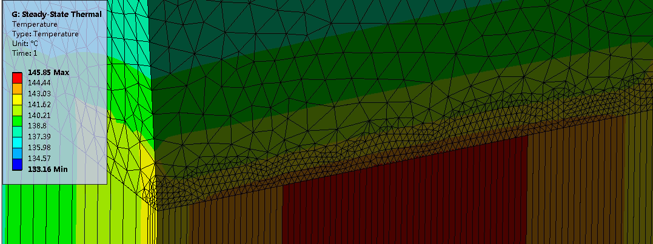
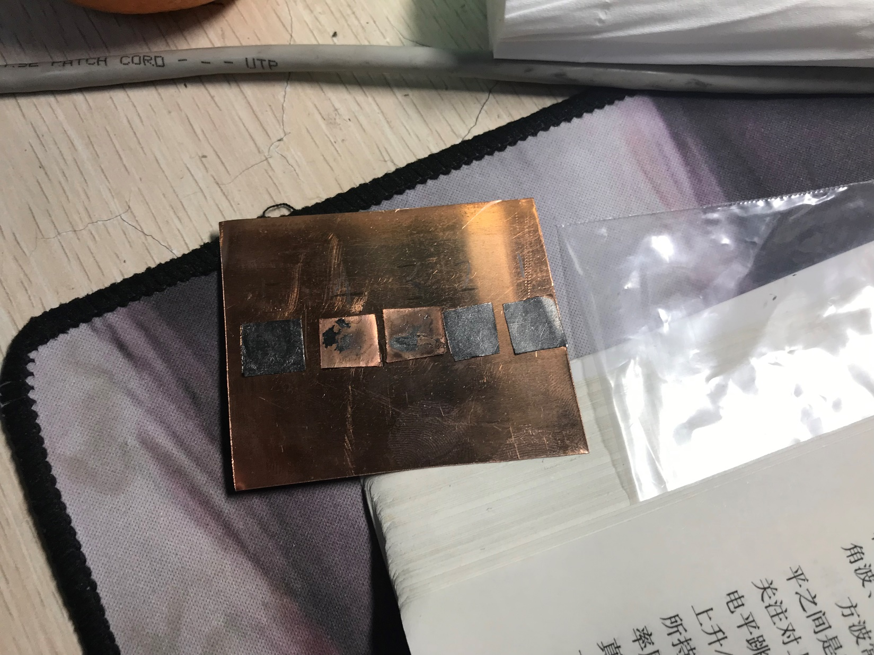
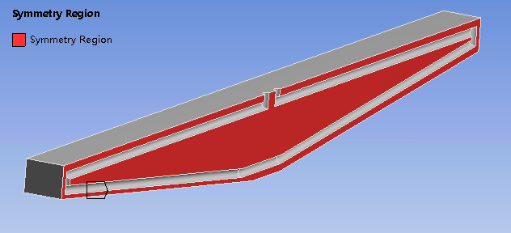
Collimator design
Difficulties
  High thermal load. The synchrotron radiation power is 7700W
  Minimize impedance. Design of RF fingers will be considered in the next step.
A design is proposed using laminated material with metal and membrane of high thermal conductivity, the photon absorber is also considered.
Y: Highest temperature;
X: Thickness of membrane of high thermal conductivity
Copper & water, linear load
Copper & water, surface load
Laminated material & water, linear load
Laminated material with copper and graphene film
(Supported by one NSFC, have no money now)

Slide 19
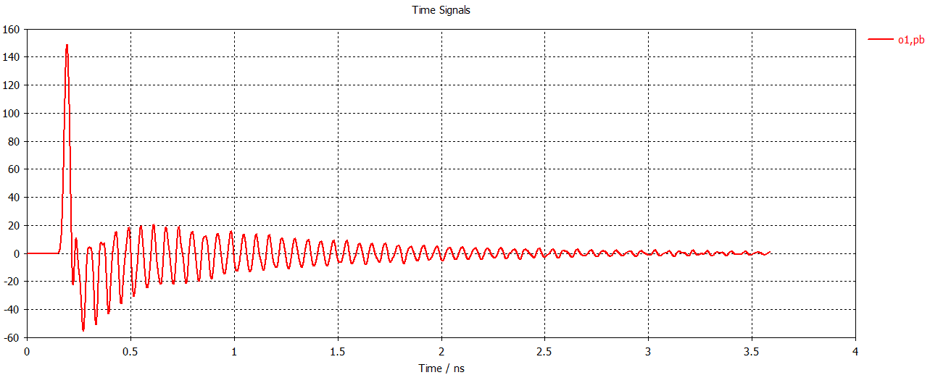
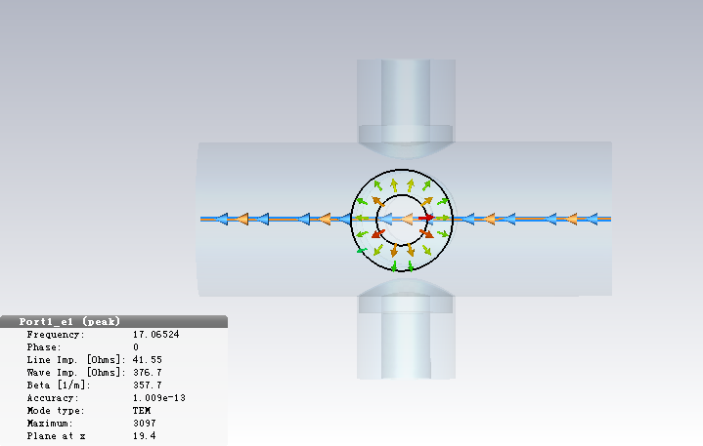
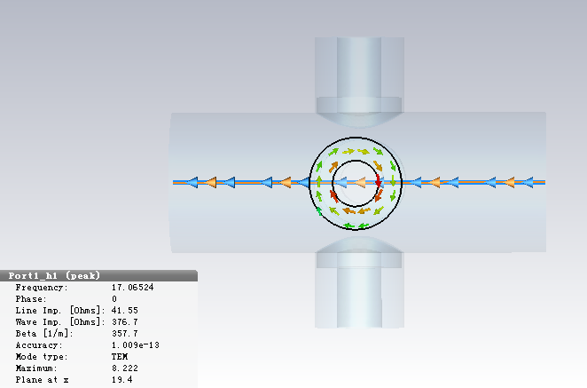
IP BPM
Considering response time and calibration difficulty, two 4 button electrodes BPM at each side of CEPC IR is adopted.
There is a bellows for the requirements of installation in the crotch region, located about 0.7 m from the IP. IP BPM will be installed at 80cm from the IP in the double pipe part.
Beam pipe size：diameter 18.74mm
Bunch length：2.68mm
Single bunch charge：24nC
Electrodes signal(bunch length 2.68mm)
Electromagnetic field at electrodes
Due to the short bunch length, signal has many resonance hump, signal amplitude proportional to the bunch charge.
Signal intensity can be satisfied by CEPC MDI requirement.

Slide 20
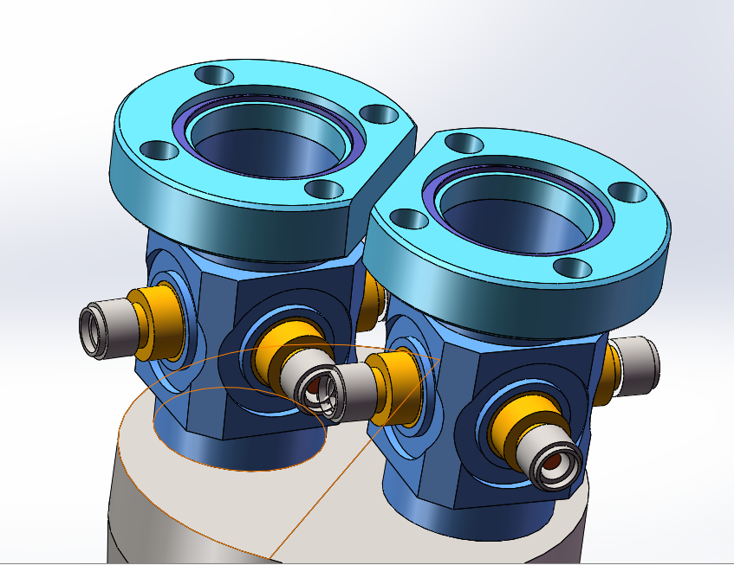
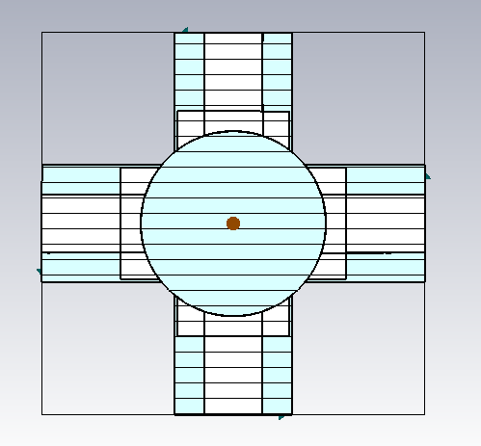
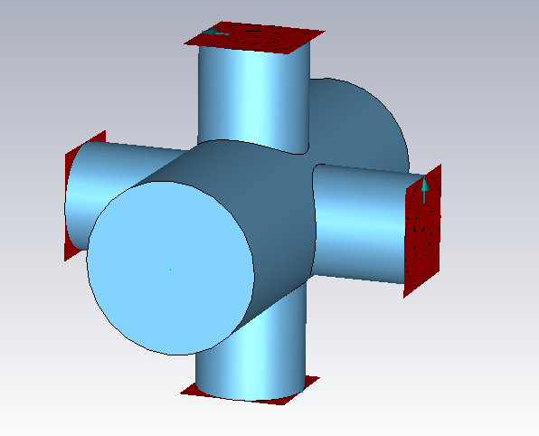
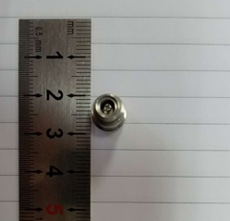
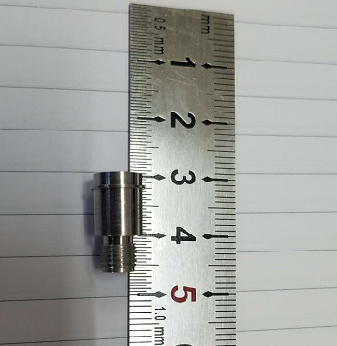
IP BPM
4 button electrodes structure
4 button electrodes size
Electrode diameter:11.4mm
Inner conductor diameter: 6mm
Electrode pole to beam line:19.4mm
Monitoring the time when two beams arrive at the collision point, it is better to be consistent strictly.
Space conflict for the inside two buttons, can be solved by the new position design for lumical and IR beam pipe.

Slide 21
Summary
Heat load from SR and beam loss in IR vacuum chamber.
No SR heat load on Be pipe.
SR Gaussian distribution in a very narrow band, cooling structure.
Heat load from beam loss is quite small.
Heat load from SR on collimator is serious, difficult for material and high thermal conductivity.
Heat load from beam loss on collimator is in progress.

