Slide 1
Progress of Beampipe engineering design
---Simulation and optimization(1)
Ji Quan
May 29,2020

Slide 2
Contents:
1. Layout of Beampipe and Design Update
2. Thermal-hydraulic estimation
3. Structure Optimization of Vertex
4. Preliminary Design of LumiCal
5. Summary and Plan

Slide 3
1. Layout of Beampipe and Design Update
A: Carbon fiber cylinder
B: Air channel
C: The central Be pipe
D: The extending Al pipe
vertex
LumiCal
Progress and update: (compared with Ver. 20200116)
No modification for the general layout
a. comprised of 4 components: A、B、C、D
b. To support 2 detectors: Vertex and LumiCal
2) According to the design requirements of LumiCal, the length of the
Beampipe is increased from 1400mm to 1500mm.
3) According to the calculation of the heat load provided by accelerator,
the cooling design of Beampipe has been checked.
4) The structure design has been optimized, and feasibility of air cooling has been calculated.
5) Preliminary engineering of LumiCal has been carried out.
Conclusion：
The dimension of Beampipe is within
of bounds of detector angle arcCOS0.99

Slide 4
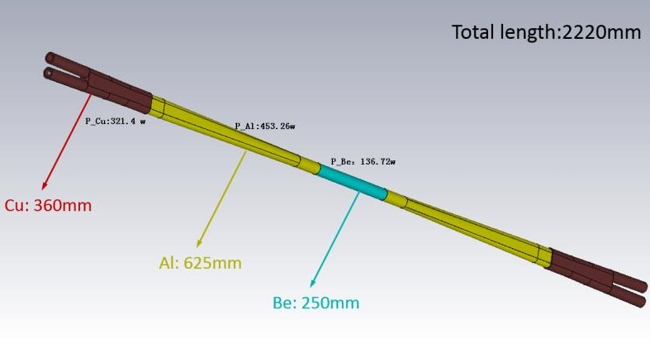
2. Thermal-hydraulic estimation
Vacuum pipe size of beampipe:
beryllium
aluminum
aluminum
aluminum
aluminum
stainless
steel
Transition section
(No Cooling)
stainless
steel
The estimated heat load is as follows:
Total thermal power : (only High order mode heat )
453.26+136.72+453.26 = 1043.24 (W)
Because of the high power of the thermal load, the double-layer
cooling structure must be designed to ensure the working
temperature of the beam pipe

Slide 5
The whole temperature field is simulated by the length 1400mm three-dimensional model, see the figure bellow.
The initial conditions for calculation are as follows:
Be
SS304L
Al
Al
SS304L
Coolant: paraffin,
four inlet, four outlet
Inlet temperature: 23℃
Inlet velocity: 0.6m/s
Coolant: water,
2 inlet,2 outlet
Inlet temperature: 23℃
Inlet velocity: 2m/s
Coolant: water,
2 inlet,2 outlet
Inlet temperature: 23℃
Inlet velocity: 2m/s
 | Total heat | Area | Heat flux
 | W | m2 | W/cm²
Be | 136.72 | 2.2e-2 | 0.63
Al | 453.26 | 1.02E-01 | 0.45

Slide 6
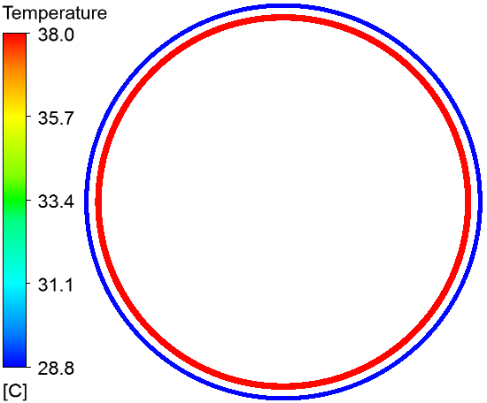
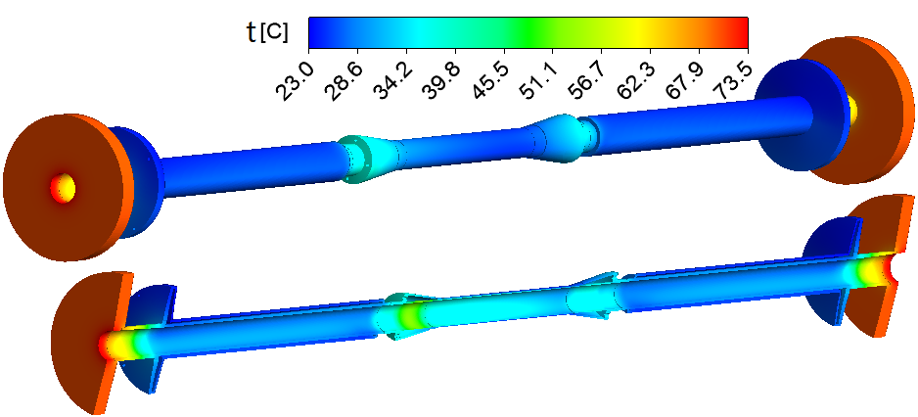
The calculation results are as follows：
Temperature distribution of beam pipe:
Maximum temperature:28.9℃
Paraffin inlet
Paraffin outlet
Temperature distribution of Be pipe
cross section(z=113mm)
Maximum temperature
of transition section: 35℃
Maximum temperature
of transition section: 40℃
Maximum temperature
of transition section: 70℃
Maximum temperature
of transition section: 70℃
Conclusion:
1. Where there is double cooling structure, the temperature is low
2. Where there is no double cooling structure, the temperature is high

Slide 7
Detail structure
备注：400+550+550=1500 mm
Central Be pipe:
inlet
outlet
inner Be: T=0.50mm L=400mm(240+80+80) D(inner)=Ø28mm
gap: T=0.50mm
outer Be: T=0.35mm L=230mm D(inner)=Ø30mm
Coolant: paraffin

Slide 8
Extending Al pipe:
outlet
inlet
inner pipe: T=2.5mm
gap: T=1.0mm
outer pipe: T=1.5mm
Coolant: water

Slide 9
3. Cooling Structure Optimization of Vertex
1) Optimization of air cooling channel --- We only optimized the design scheme of parallel and stratified flow
Air Inlet (4-ɸ6)
Air Outlet
Ver. 20200116
Air Inlet (4-ɸ12)
Ver. 20200529
Air Outlet
a. Optimization of outlet and inlet of air duct ：
Location of wind outlet and inlet: moved from inside to both ends for easy installation of air duct
Diameter of air inlet and outlet: increased from ɸ6mm to ɸ12mm, to improve the wind speed flowing on the chip surface

Slide 10
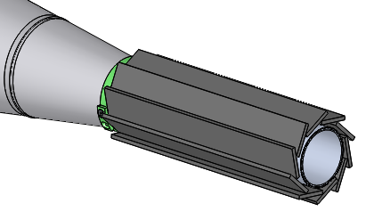
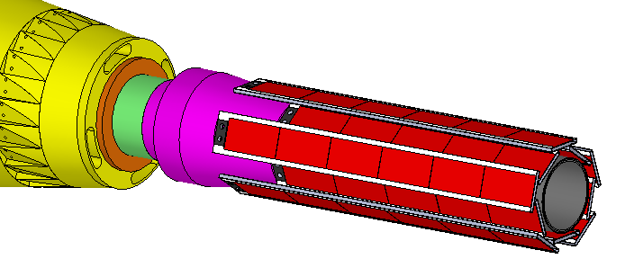
b. Optimization of the first layer layout
From single layer layout to double layer layout
Purpose: to provide air channel for inner silicon chip of the first layer

Slide 11
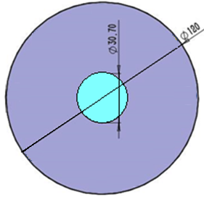
2) Feasibility calculation of air cooling
In pursuit of low material budget, the best way to cool the silicon detector is by air cooling, However, due to
the tight space, the wind speed required for cooling cannot be provided.
The poor air cooling effect is also due to the poor heat conduction effect of carbon fiber materials.
So, coating graphene on the surface of carbon fiber can effectively improve the heat dissipation effect and
reduce the surface working temperature of the chip
For the wind speed that can be provided under the beam tube structure：Very low
Φ12
(Wind speed is inversely proportional to area)
Duct inlet area |  |  |  |  | Vertex cavity cross section
ID | speed | Number | flow | Sectional area | OD | ID | Sectional area | Effective area | 面积比 | Actual speed
mm | m/s |  | m3/min | mm2 | mm | mm | mm2 | m2 |  | m/s
6 | 15 | 8 | 0.203 | 226.08 | 120 | 30.7 | 1.06E+04 | 1.03E+04 | 45 | 0.33
12 | 15 | 4 | 0.407 | 452.16 | 118 | 30.7 | 1.02E+04 | 9.91E+03 | 22 | 0.68

Slide 12
Simulation model :
Si发热层：257mm*12.8mm*0.05mm*10片
石墨烯导热层：
698mm*16.8mm*0.1mm
柔性电路板：
698mm*16.8mm*0.07mm
碳纤维支架：698mm*16.8*0.2mm
Air cooling model
Graphene heat conducting layer model
Results are as follows：
Calculation conditions： Carbon fiber length: 698mm； Air velocity:0.3m/s Graphene coating thickness:0.1mm | Heat flow density | Maximum temperature
 |  | Air cooling (No graphene) | The thermal conductivity of graphene 1700 | The thermal conductivity of graphene 5000
 | mW/cm2 | ℃ | ℃ | ℃
 | 200 | 537.9 | 186.6 | 103.7
 | 100 | 276.7 | 103.2 | 62
 | 50 | 146.6 | 61.6 | 41

Slide 13
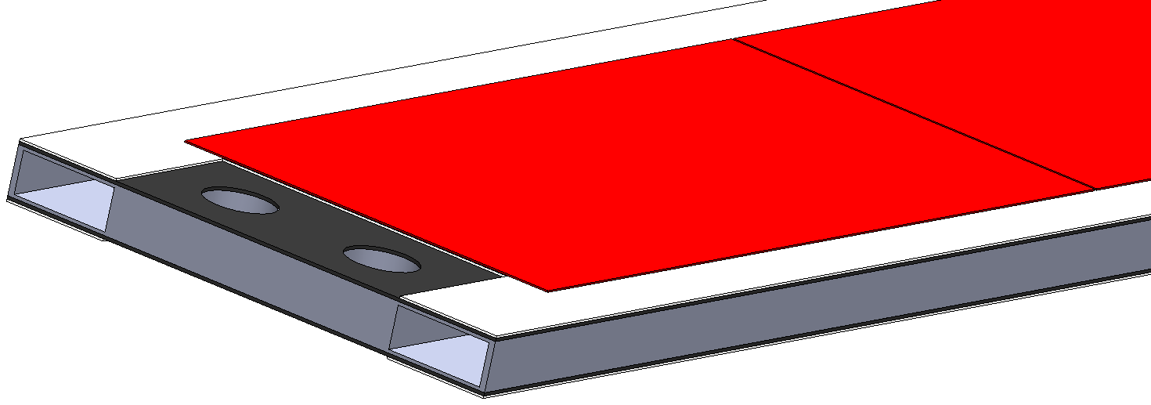
2) Detailed design of the carbon fiber supporting structure
Flexible plate
(double)
The section shape and parameters of carbon fiber
support structure are as follows:
Silicon chip
Thickness of vertical section：0.2mm
Thickness of horizontal section: 0.1mm
Width: 16.8mm
carbon fiber support structure
We have compared the thickness of various sections.
The vertical thickness of 0.2mm and the horizontal
thickness of 0.1mm are the best results.
Detection unit of the Vertex consists of two flexible plates
and a carbon fiber supporting bar

Slide 14
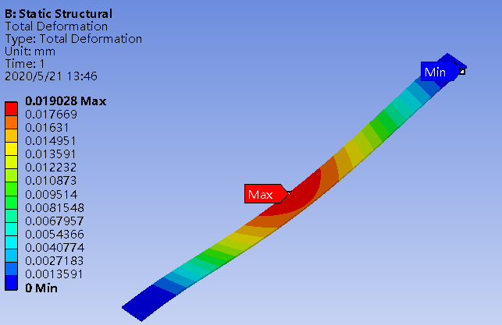
Optimization results of the first layer of carbon fiber bars:
length：314mm
Initial conditions for calculation:
height :1.5mm,
Loading: self weight,
Loading: 2.7g(Weight of flexible plate)
deformation：0.02mm

Slide 15
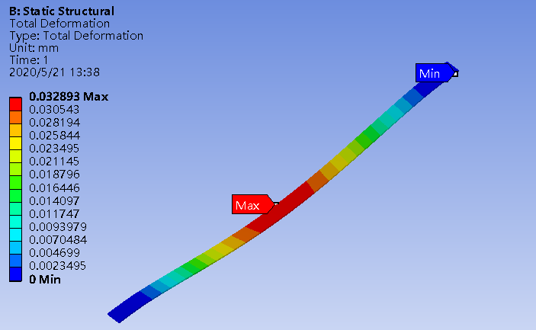
Optimization results of the second layer of carbon fiber bars:
length：488mm
Initial conditions for calculation:
height :2mm,
Loading: self weight,
Loading: 5.3g(Weight of flexible plate)
deformation：0.033mm

Slide 16
Optimization results of the third layer of carbon fiber bars:
length：698mm
Initial conditions for calculation:
height :3.5mm,
Loading: self weight,
Loading: 8g(Weight of flexible plate)
deformation：0.05mm

Slide 17
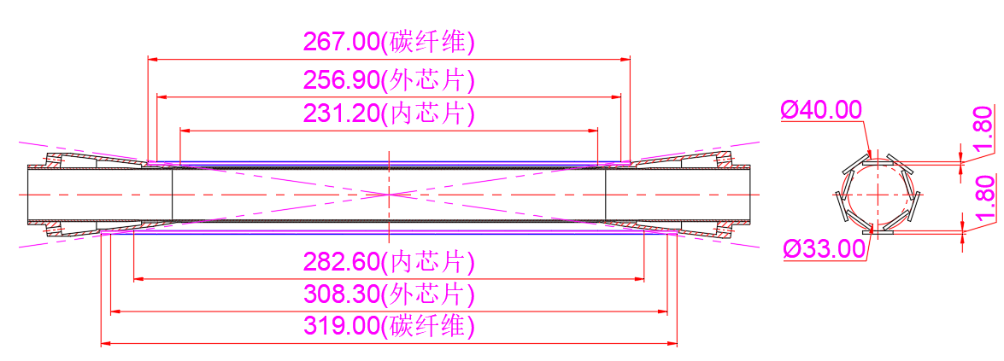
Detailed structure and dimensions --- Vertex
Detailed dimensions of
the first layer of carbon fiber bars
Detailed dimensions of
second and third layer carbon fiber bars

Slide 18
Detailed structure and dimensions --- Carbon fiber cylinder
Thickness:1.5mm
This is a key component, which can strengthen the beam pipe and form the air channel for cooling vertex

Slide 19
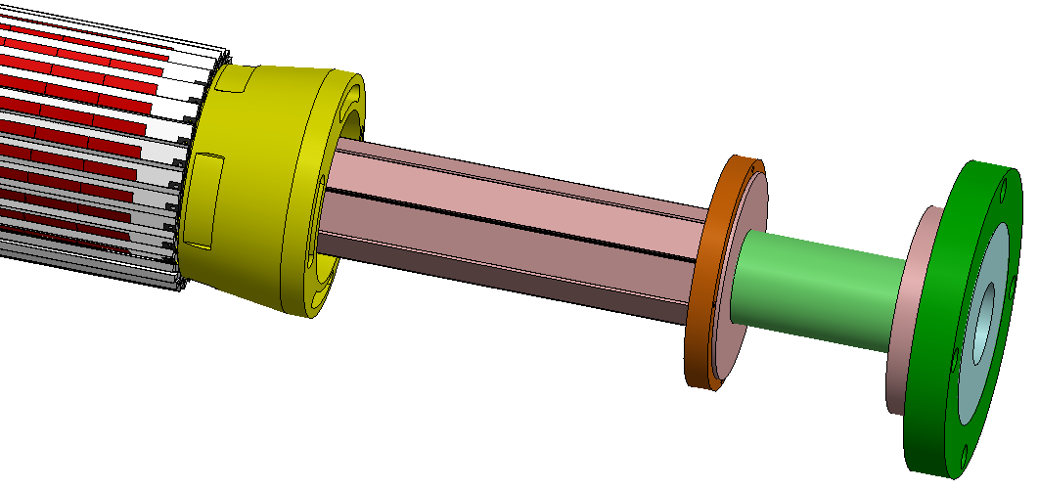
4. Preliminary Design of LumiCal
B:Vertical detector of LumiCal(Si)
A:axial detector of LumiCal
C:Vertical detector of LumiCal(Si-W)
Difficulty:
In order to increase the air cooling effect of vertex,
the detector of LumiCal is sealed inside, which
increases the design difficulty of heat dissipation
and outgoing cable

Slide 20
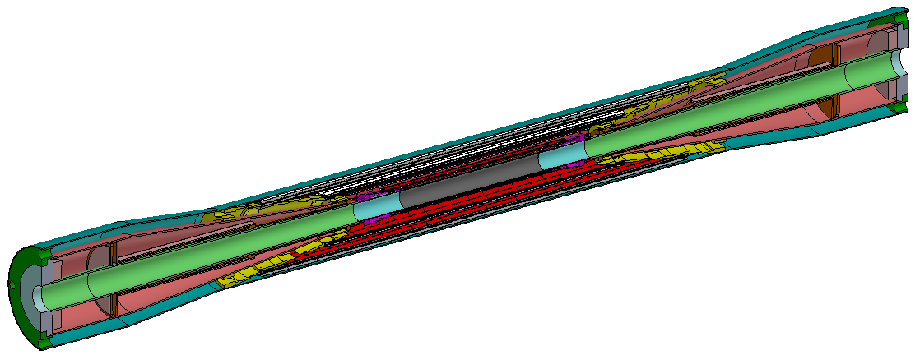
D: The extending Al pipe
C: The central Be pipe
B: Air channel
A: Carbon fiber cylinder
vertex
LumiCal
Ver. 20200529

Slide 21
5. Summary and Plan
Summary
1) The dimension of Beampipe is within of bounds of detector angle arcCOS0.99
2) According to the cooling simulation of Beampipe，the present design can handle1kW power dissipation
3) The cooling design of Vertex still needs optimization. Increasing the heat transfer coefficient might be an optional choice
for the optimization.
Suggestion: to develop graphene layer on the flexible circuit board and on the carbon fiber supporting structure.
Plan:
Move forward in the engineering design for TDR based on CDR, to provide baseline for future design.
to improve the engineering design of Beampipe, including Vertex and LumiCal.
to carry out design of the other detectors.

Slide 22
工作内容：
探测器总体的工程设计(CDR的TDR工程转化工作)
人员：
纪 全 全面负责
张锐强 机械设计(借用，东莞分部)
肖松文 机械设计(借用，东莞分部)
魏少红 材 料 (借用，东莞分部)
陆友莲 热工计算(借用，东莞分部)
近期拟计划开展的关键技术研究：
1.薄壁铍-铝管的焊接性能研究
2.石墨烯涂层的可行性研究
经费：
1.铍-铝薄壁管的焊接 30万元人民币
2.石墨烯涂层的研制 15万元人民币

Slide 23
Thanks !

