Slide 1

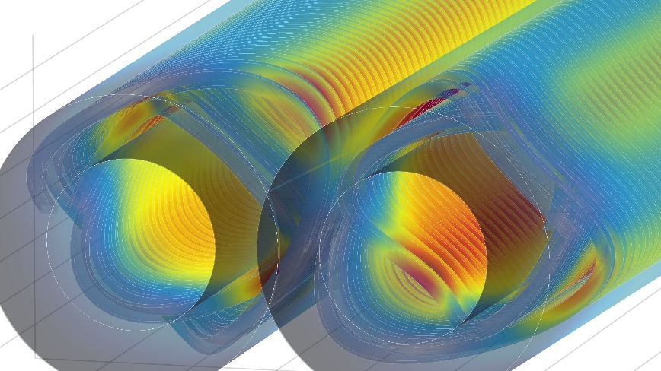
Overview of MDI at FCC-ee
M. Koratzinos
CEPC MDI Workshop
27/5/2020

Slide 2
Preface
What is presented is our baseline choice that is included in our FCC-ee CDR Volume 2 - The Lepton Collider (preprint submitted to Eur. Phys. J. ST 20 December 2018), plus any recent work
The FCC MDI team is (authors of our recent paper from eeFACT18: http://accelconf.web.cern.ch/AccelConf/eefact2018/papers/wexba02.pdf)
M. Boscolo, O.R. Blanco-Garcia, N. Bacchetta, E. Belli, M. Benedikt, H. Burkhardt, M. Gil Costa, K. Elsener, E. Leogrande, P. Janot, H. Ten Kate, D. El Khechen, A. Kolano, R. Kersevan, M. Lueckhof, K. Oide, E. Perez, N.A. Teherani, O. Viazlo, Y. Voutsinas, F. Zimmermann, M. Dam, A. Blondel, M. Koratzinos, A. Novokhatski, M. Sullivan, A. V. Bogomyagkov, E. B. Levichev, S. Sinyatkin, F. Collamati
…and growing!
Acknowledgements
Sergei Sinyatkin and the whole team at BINP for the original idea of the compensation scheme
Eugenio Paoloni et al. from the SuperB project for the CCT idea for FF quads
Glyn Kirby and Jeroen Van Nugteren of CERN/TE-MSC for fruitful discussions, guidance and the use of very useful tools (the Field program)
Katsunobu Oide and Frank Zimmermann for helpful discussions
The whole FFC collaboration for their support
Rapid prototyping courtesy Ideasquared at CERN (Markus Nordberg, Jani Kalasniemi, Hans Hagenes Boe
FF quad manufacturing: the CERN main workshop (K. Schibor)
Tool manufacturing courtesy the CMS experiment (A. Ball and M. Alidra and his team at point 5)
FF quad winding curtesy Herman Ten Kate and Tim Mulder
Quad prototype measurement campaign: Carlo Petrone

Slide 3

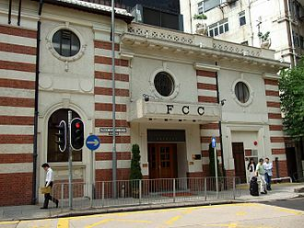

A tale of two projects
CEPC and FCC-ee are the two circular collider future flagship projects with a lot in common and very few differences!

Slide 4
Contents
The requirements
The IR magnets
  The compensation scheme
  FF quadrupoles
  Crab waist sextupoles
The luminometer
Beam pipe considerations
Mechanical design considerations
(Backgrounds and collimation – as extra slides)

Slide 5
What is MDI?
MDI (Machine-Detector Interface) is a very loose term covering many different systems, all having in common that can be considered either a part of the machine or a part of the detector
MDI covers the area close to the beam pipe and around the interaction point of each experiment. It includes
  The beam pipe around the IP
  Any final focus elements, if inside the detector
  The detector solenoid compensation scheme
Also has to deal with
  The effects of passing and colliding beam (all types of backgrounds, SR radiation, impedance heating)
…Without forgetting important engineering aspects
  tolerances, mechanical vibration, force management, cryogenics
At the same time, MDI elements should not impede detector quality
  Hermeticity, adequate coverage for the luminometer, etc.
Space is at a premium

Slide 6
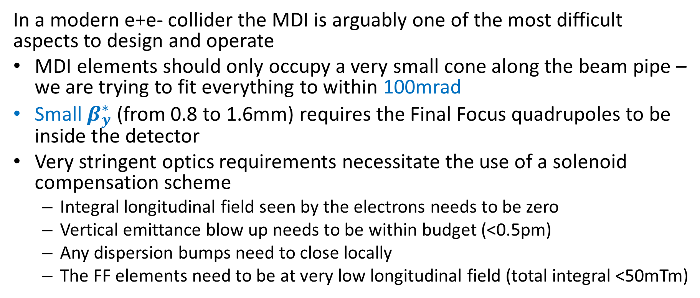
Why is MDI important?
In a modern e+e- collider the MDI is arguably one of the most difficult aspects to design and operate
MDI elements should only occupy a very small cone along the beam pipe – we are trying to fit everything to within 100mrad
Small $β_{y}^{∗}$ (from 0.8 to 1.6mm) requires the Final Focus quadrupoles to be inside the detector
Very stringent optics requirements necessitate the use of a solenoid compensation scheme
  Integral longitudinal field seen by the electrons needs to be zero
  Vertical emittance blow up needs to be within budget (<0.5pm)
  Any dispersion bumps need to close locally
  The FF elements need to be at very low longitudinal field (total integral <50mTm)

Slide 7
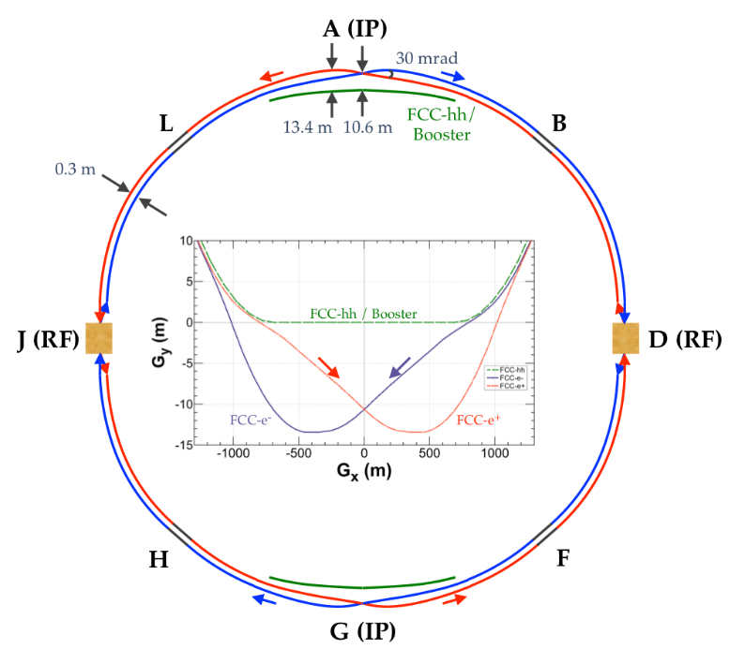
Key parameters for MDI design
Asymmetric IR optics
crab-waist scheme ➔ large horizontal crossing angle: 30 mrad
Flexible optics design: common lattice for all energies, except for a small rearrangement in the RF section
Large energy acceptance ( >2.8 % ) at high energy, due to strong beamstrahlung that limits beam lifetimes
Synchrotron radiation at FCC-ee is one of the main drivers for the MDI design
Self-imposed limit: E_{critical} < 100 keV for incoming beam to IP from 500 m
  Very soft bends 500m upstream the IP
  Last dipole is ~100m upstream from the IP and is very long (~200m) and very weak (~30Gauss @Z)
countermeasures:
  SR mask tips to intercept SR photon fans
  high-Z shielding (W) outside vacuum chamber
  sawtooth ridged chamber inside FF quad being considered
  absorbers and/or SR collimators
shielding
20
M. Boscolo
SR mask tip
m
2.2
3
Notes:
Common lattice: betatron tune, phase advance in the arc cell, final focus optics and configuration of sextupoles are set to optimum energy by changing the strength of the magnets

Slide 8
Magnetic element design

Slide 9
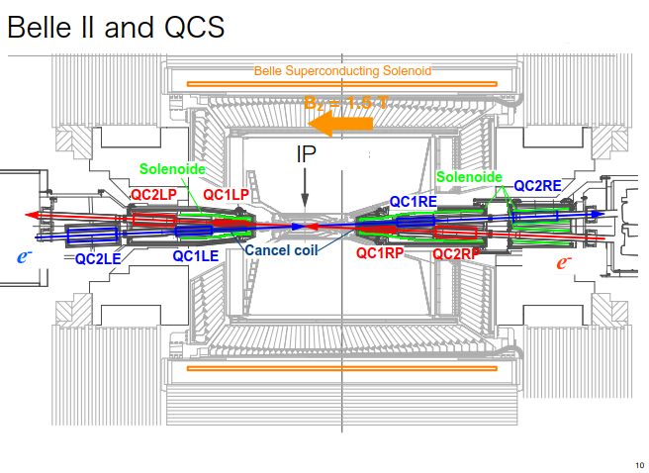
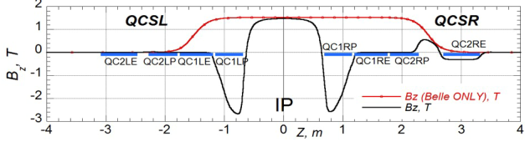
Prior art
55 individually powered magnetic elements!
4 FF quadrupoles per beam line
35 corrector coils
8 cancel coils
4 compensation solenoids
Detector solenoid 1.5T
We do not want to re-invent the wheel, but can we simplify / improve?
Note that first FF quad sits in high magnetic field

Slide 10
FCC-ee: five requirements at the IP related to magnet design
Adequate space for the detectors: magnetic elements reach angles of up to 100 mrad. The luminosity counter sits unobstructed in front of all magnetic elements.
In order to minimise emittance blow-up due to coupling between transverse planes, the integrated field seen by the electrons crossing the IP should be zero. If the compensation is off by 0.1% then the resulting vertical emittance blow up is 0.1 pm per IP – the effect is quadratic.
Vertical emittance blow-up due to fringe fields in the vicinity of the IP should be significantly smaller than the nominal emittance budget. Problem worse at the Z. We aim at a fraction of the nominal vertical emittance of 1 pm for two IPs.
The final focus quadrupoles should reside in a zero-field region to avoid transverse beam coupling; the maximum integrated solenoid field at the final focus quadrupoles should be less than 50 mTm at each side of the IP.
The field quality of the final focus quadrupoles should have errors smaller than 1 × 10⁻⁴ for all multipoles.

Slide 11
Design considerations to satisfy all requirements
Requirement 4 (Zero field @ quads) means that screening solenoids are needed.
Requirement 3 (emittance blow up) necessitates the use of a compensating solenoid.
We have managed to fit the compensating solenoids in the region upstream of the screening solenoids, whereas the area of ±1.23 m from the IP is completely free of magnetic elements, and therefore the luminometer and other technical elements can reside.
Requirement 5 (field quality) is demanding due to the close proximity of the two final focus quadrupoles for the two beams.
Finally, requirement 2 (integrated field zero) can be satisfied by tuning the overall level of compensation by adjusting the currents of the compensating and the screening solenoids

Slide 12
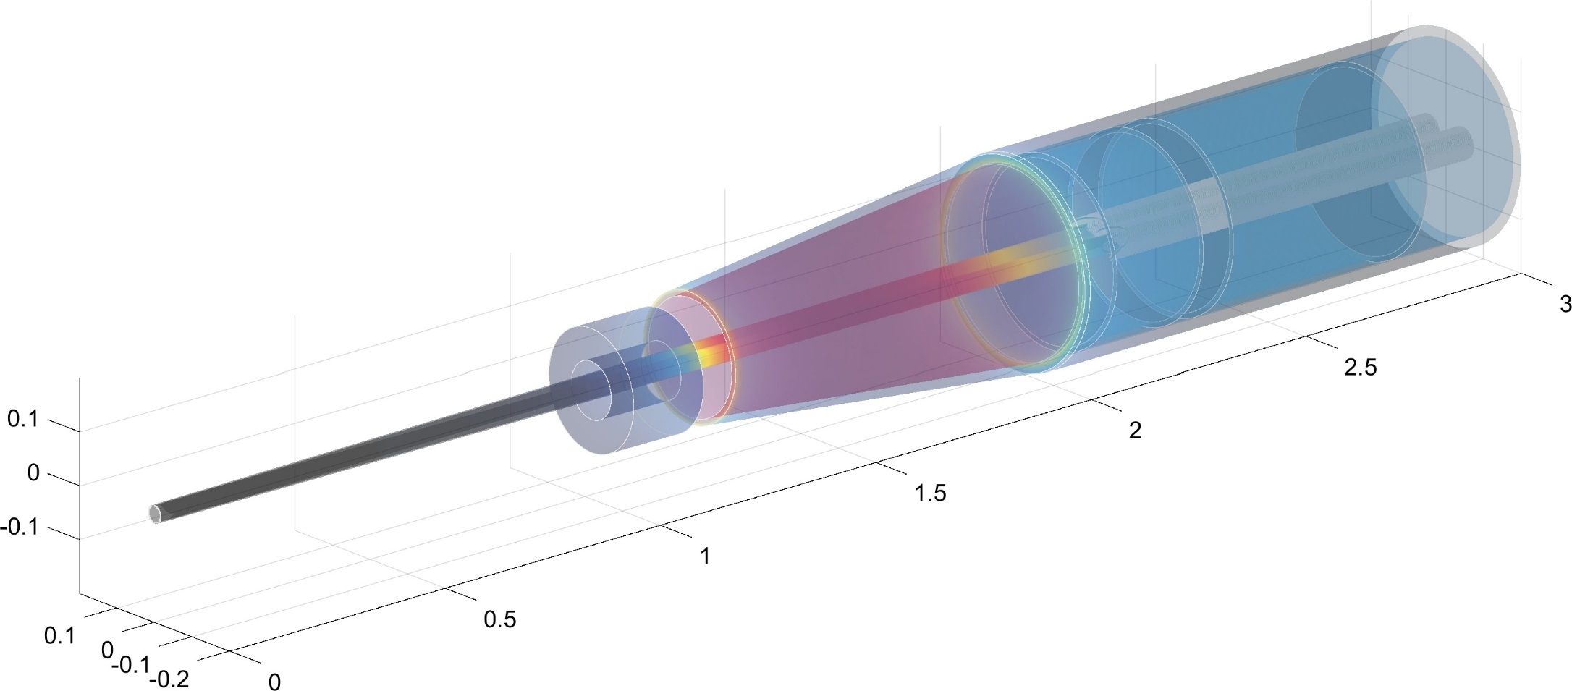
The FCC-ee baseline solution
L* = 2.2m; 30mrad opening angle between beamlines
Luminometer needs to fit in front of magnetic elements and as far back as possible to have a decent rate
FF quads sit in a zero longitudinal field region (integral of solenoid field <50mTm ) encompassed by a screening solenoid which needs to extend to L* of 2.0m
A compensating solenoid must sit between the screening solenoid and luminometer to ensure an integral field of zero
Screening solenoid
This is the design with the minimum number of magnetic elements.
Luminometer
IP
FF quads
Compensating solenoid

Slide 13
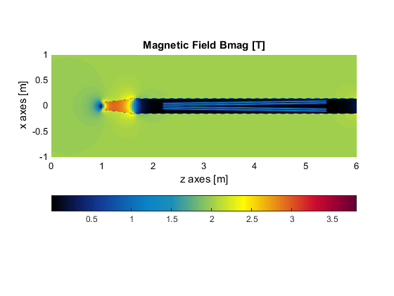
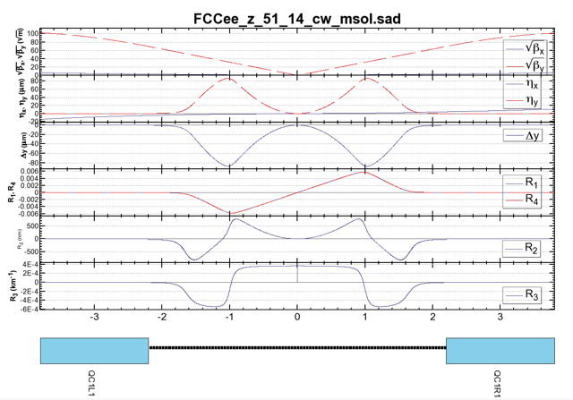
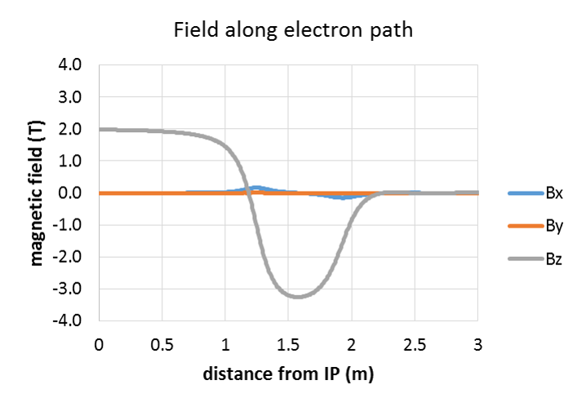


The compensation scheme
View from top
$$e^{+}$$
Magnetic field (T)
$$e^{−}$$
Vertical emittance blow-up 0.24 pm for two IPs @ the Z
Dispersion closes completely locally (requirement 3)
(T)
3
2
1
0
-1
-2
-3
Magnetic field
Optics functions SAD
-3 -2 -1 0 1 2 3 (m)
Emittance blow-up results have been obtained using the full SAD optics analysis program using as input detailed field maps obtained by the magnetic design.

Slide 14
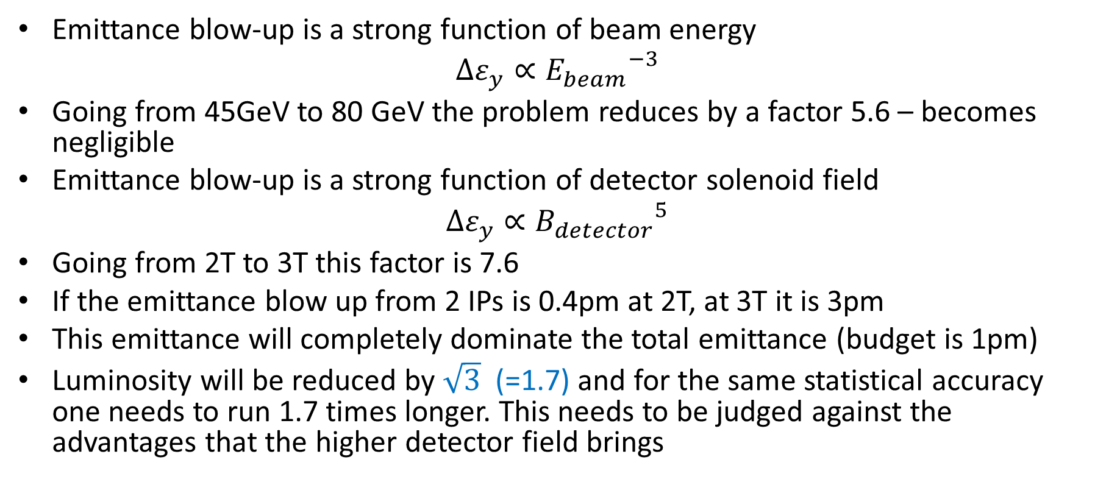
Emittance blow up – 2T or 3T detector field?
Emittance blow-up is a strong function of beam energy
$$∆ε_{y}∝{E_{beam}}^{−3}$$
Going from 45GeV to 80 GeV the problem reduces by a factor 5.6 – becomes negligible
Emittance blow-up is a strong function of detector solenoid field
$$∆ε_{y}∝{B_{detector}}^{5}$$
Going from 2T to 3T this factor is 7.6
If the emittance blow up from 2 IPs is 0.4pm at 2T, at 3T it is 3pm
This emittance will completely dominate the total emittance (budget is 1pm)
Luminosity will be reduced by $\sqrt{3}$ (=1.7) and for the same statistical accuracy one needs to run 1.7 times longer. This needs to be judged against the advantages that the higher detector field brings

Slide 15
Final focus quadrupole design
The stringent requirements of the final focus quadrupoles are satisfied by using a canted-cosine theta design. The proposed design features iron-free coils with crosstalk and edge effect compensation, with a field quality (from simulation!) of around 0.1 units for all multipoles (requirement 5).
Dipole and skew quadrupole correctors can be incorporated without increasing the length of the magnetic system
A full magnetic analysis has been performed, including a misalignment analysis.

Slide 16
What is a CCT magnet (a.k.a. “double Helix”)?
Conventional
CCT (Double Helix)
Novel idea (discovered in the 70ies, but gained momentum recently with the advent of CNC manufacturing and 3D printing)
  Excellent field quality
  Engineering simplicity: no pre-stress; fast prototyping
  Simpler and cheaper than conventional designs
  But: more conductor for same field compared to conventional design

Slide 17
The CCT advantages and disadvantages
Disadvantages:
  Each layer produces a field of the chosen multipole plus an (unwanted) solenoid field
  The solenoid fields of the two layers exactly cancel out, but the multipole fields add up
  Due to this cancellation, more conductor (~30% more) is needed to deliver the same field as a conventional design
Advantages:
  The field away from the edges has excellent homogeneity and purity, as it is produced by a perfect cosine(theta) current.
  Also, and most importantly for our application, the multipole mix is a local property of the magnet, which can vary along its length
  This is not possible with a traditional design.
  Stress management: highest stress where material is strongest; no need to pre-stress

Slide 18
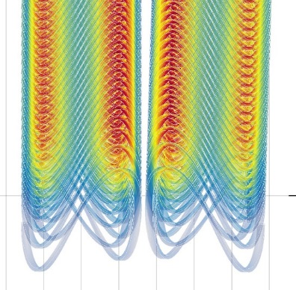
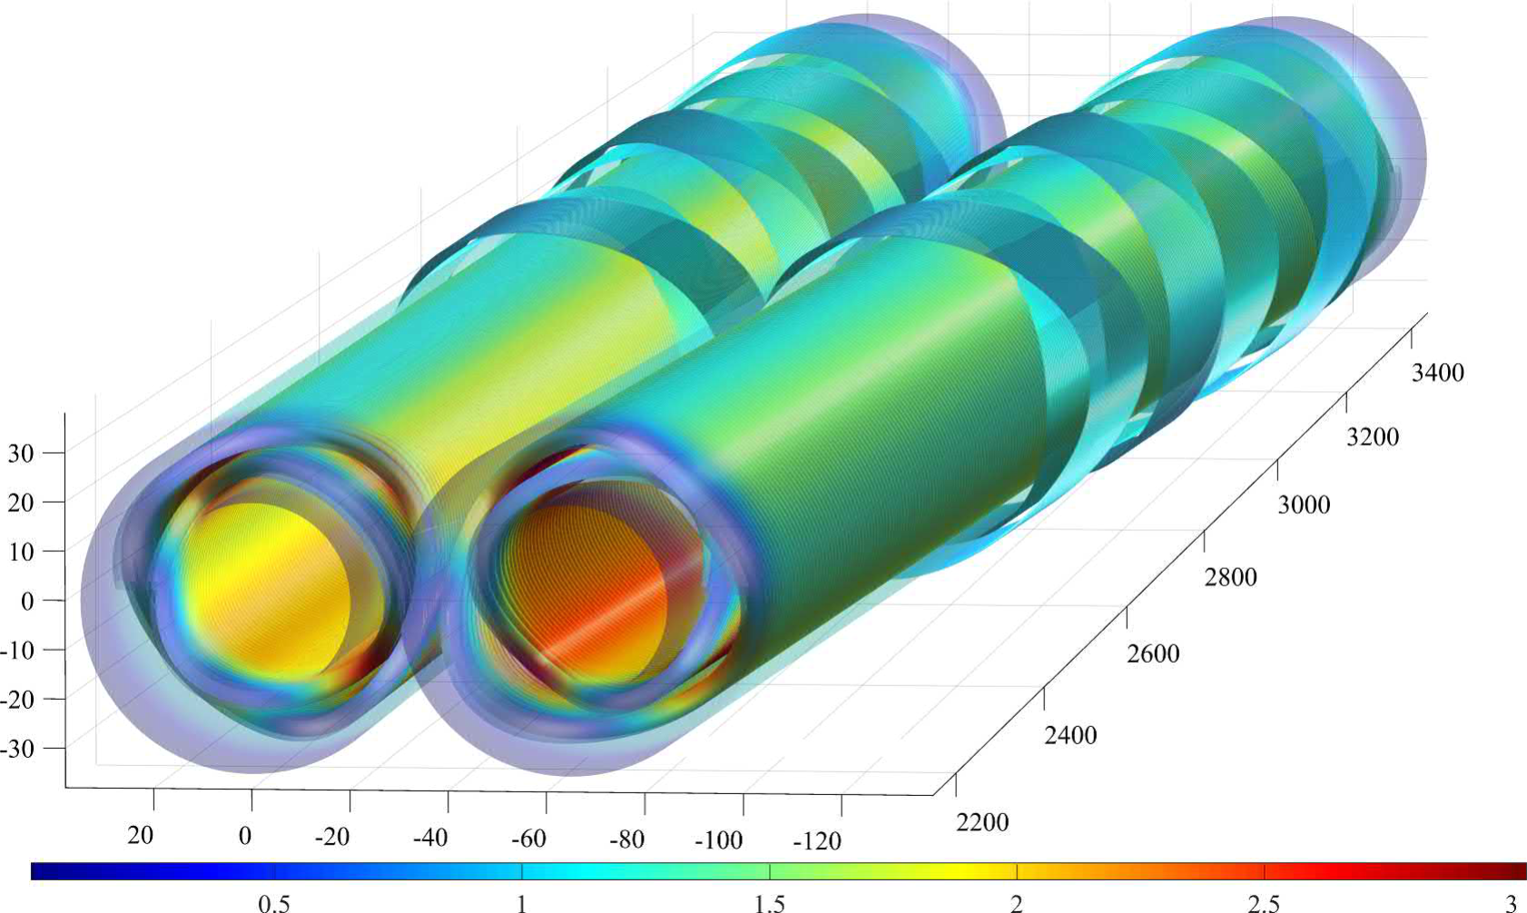
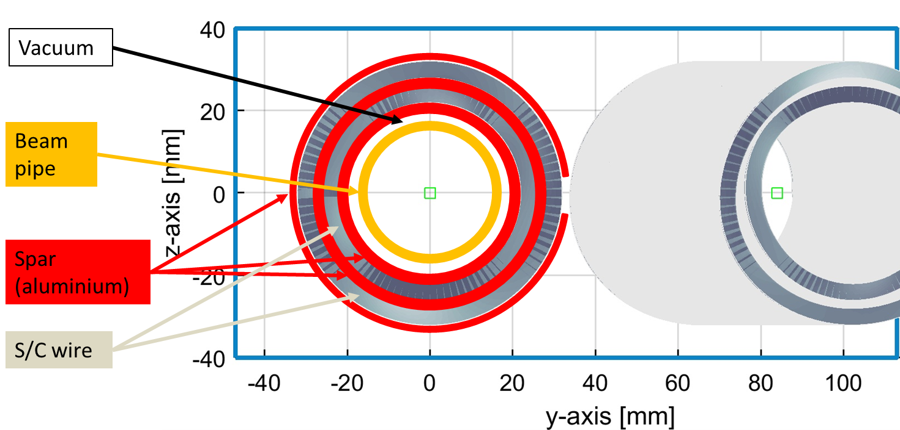
QC1L1
QC1L1 is the first and most demanding pair of quadrupoles of the final focus system of FCC-ee
Iron-free design
Inner bore: 40mm (diameter)
Fits outside the warm water-cooled beam pipe of inner diameter 30mm

Slide 19
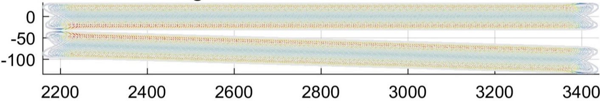
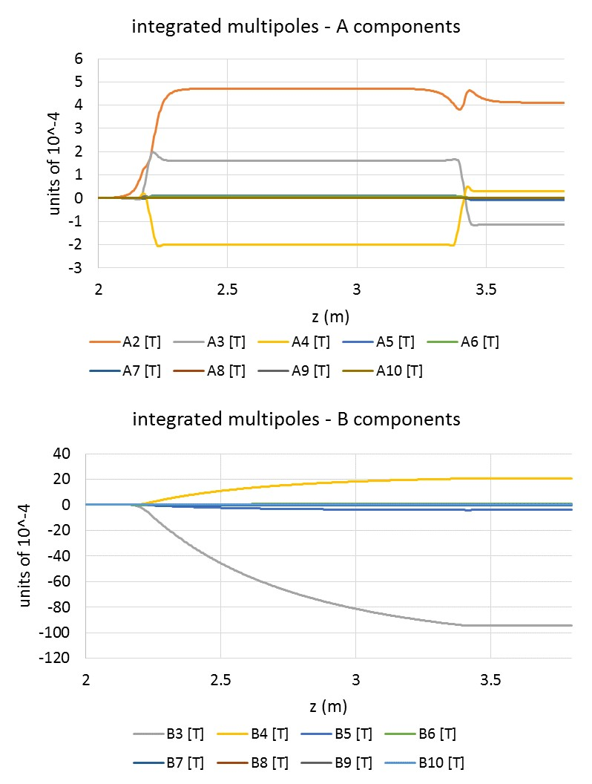
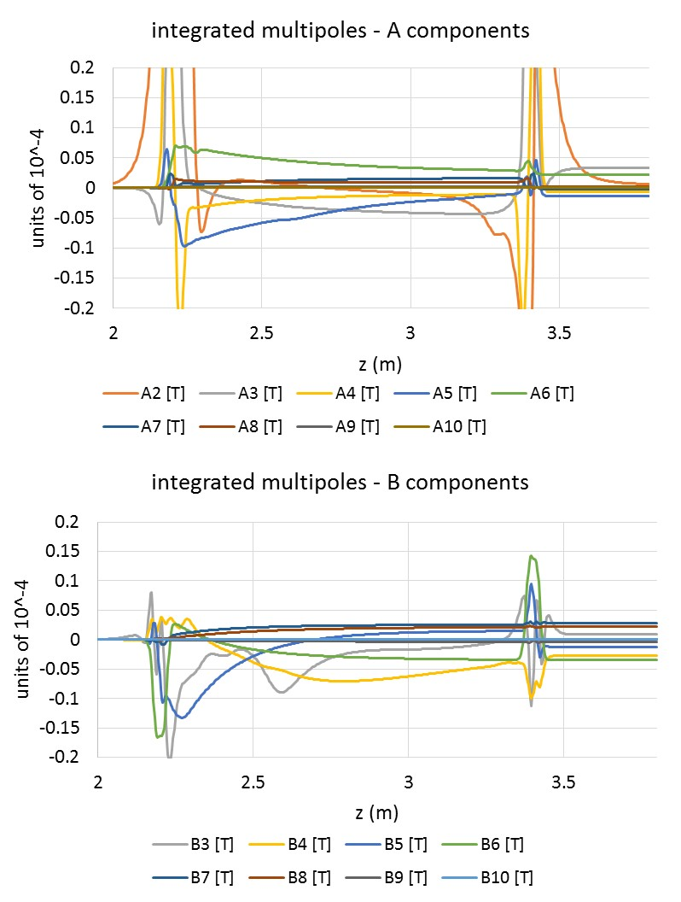
Crosstalk compensation
QC1L1 quadrupole:
length = 1200mm
Aperture: 40mm
distance at tip: 66mm
angle 30mrad
powered together
Before compensation
After compensation
After compensation: all multipoles are under 0.1 units (limited by alignment errors, not included here)

Slide 20
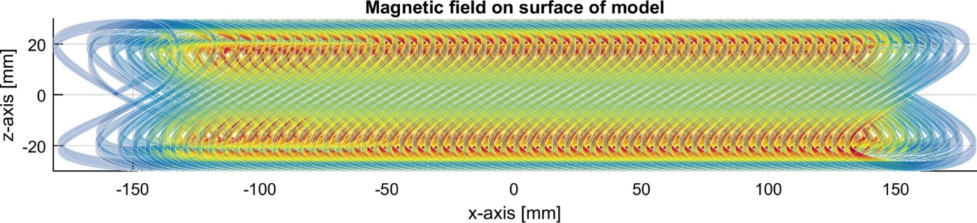
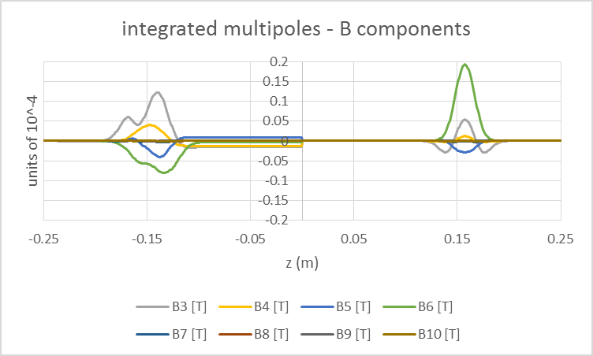
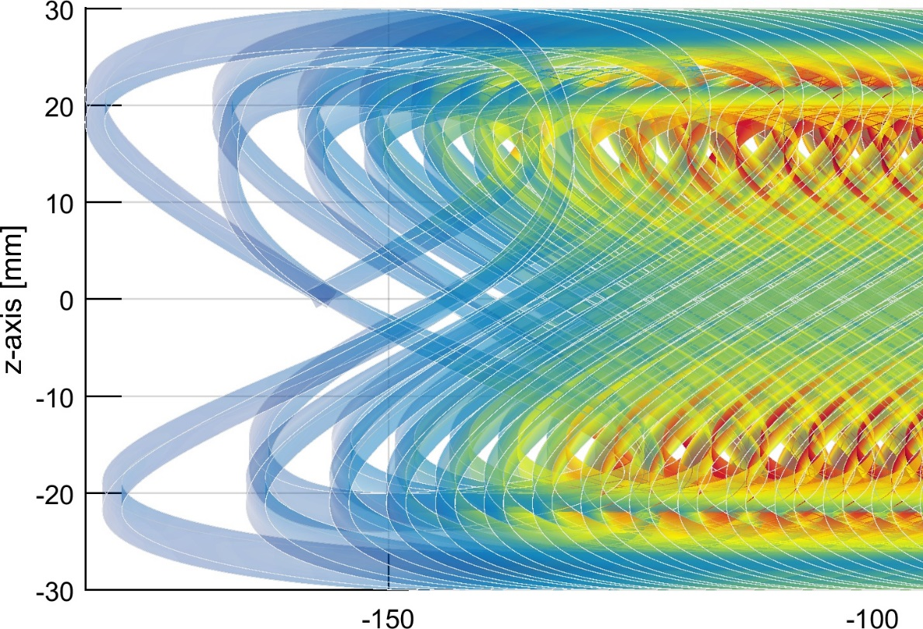
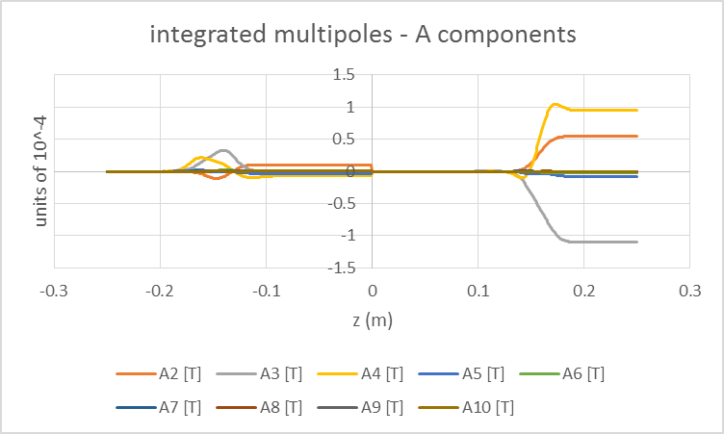
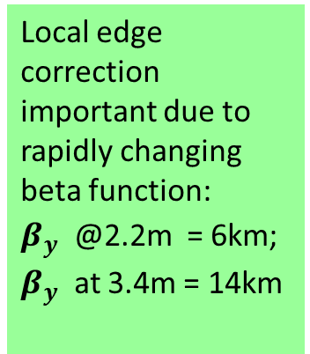
The FF quadrupole – local edge compensation
corrected
uncorrected
Local edge correction important due to rapidly changing beta function:
$β_{y}^{}$ @2.2m = 6km; $β_{y}^{}$ at 3.4m = 14km
Magnet field quality is excellent throughout
The first two turns of the quadrupole contain, apart from the B2 component, all the necessary components to nullify the edge effects.
20

Slide 21
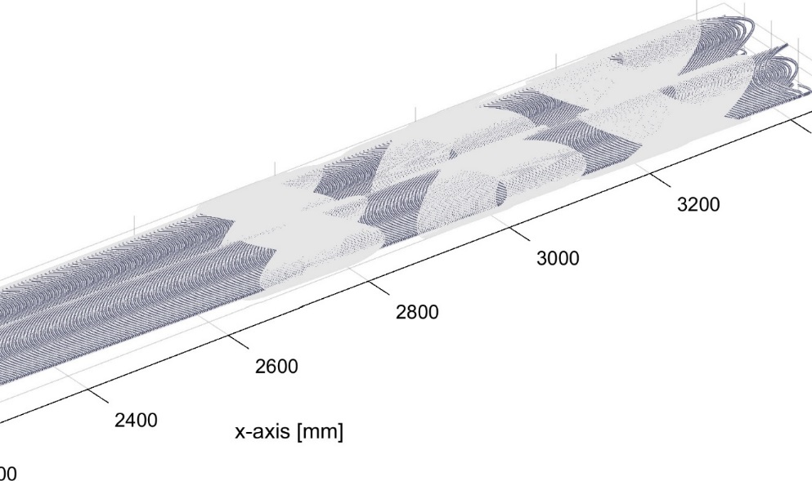
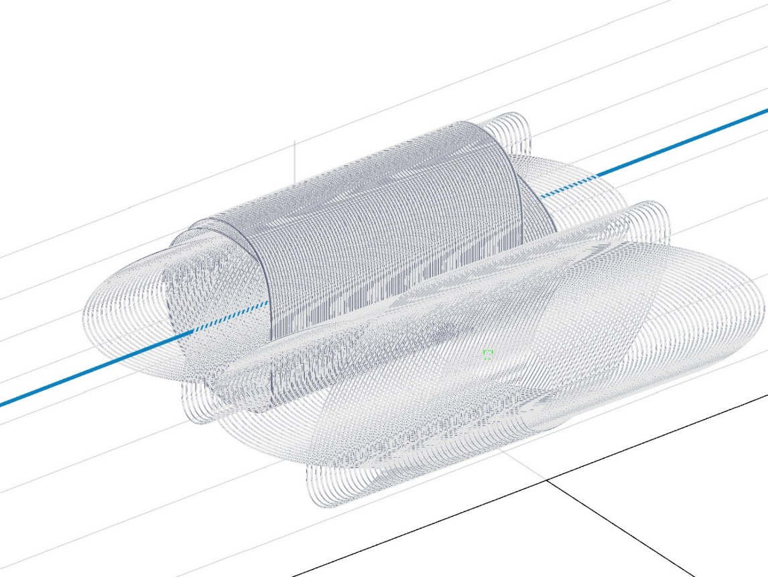
Correctors
Correctors can be packaged very efficiently
IP
Distance from IP (mm)
B1 corrector
A1 corrector
A2 corrector
0.5mm wire, critical current @3T is 300A, physical length ~20cm
Compensation loop of left corrector
Optics requirements are that a number of correctors is needed as close to the IP as possible
The absence of iron in this design makes it possible to include a number of correctors as extra rings on top of the quadrupole
These correctors do not take extra (longitudinal) space in the design.
Each corrector comes with its own compensating coil in the other aperture to compensate for the (small) crosstalk
Main right corrector, for reference
Main left corrector

Slide 22
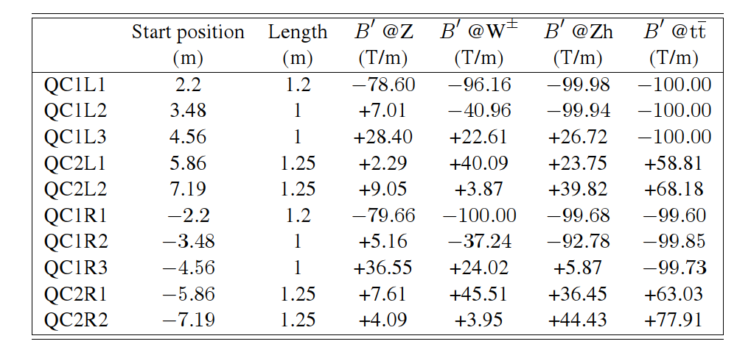
The FCC-ee Final Focus magnets

Slide 23
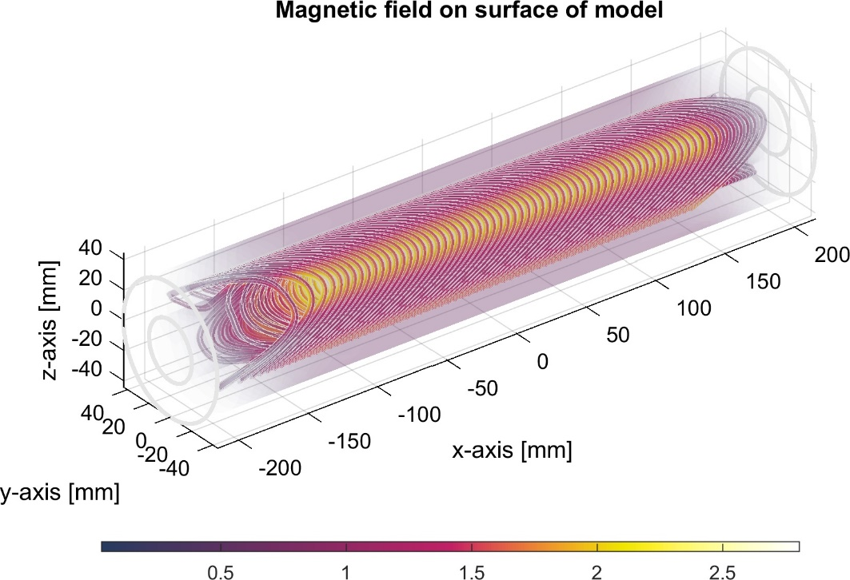
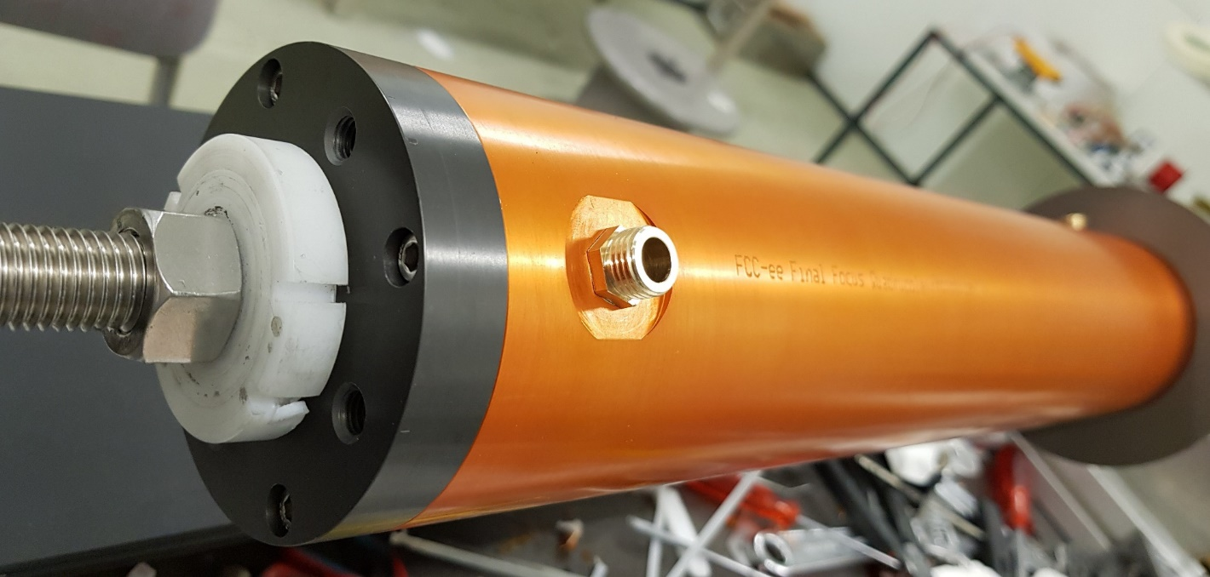
FF prototype news
CCT is a relatively new idea in magnet design, and never one has been built with compensation. It is therefore imperative that a prototype is build and tested
➔ the FCC FF quad prototype project was born
Steps completed:
  Full magnetic analysis
  Full mechanical design
  Manufacturing of all parts and tools
  winding table, with stepper motor
  Winding completed
  Outer sleeve and endplates installed.
  Mechanical assembly completed
Rotating probe (C. Petrone)
  Sensing coils (special to quadrupoles) completed
  Design of rotating shaft under way
  Warm testing: Q3 of 2020 (has been shifted)
  Cold testing: Q4 of 2020

Slide 24
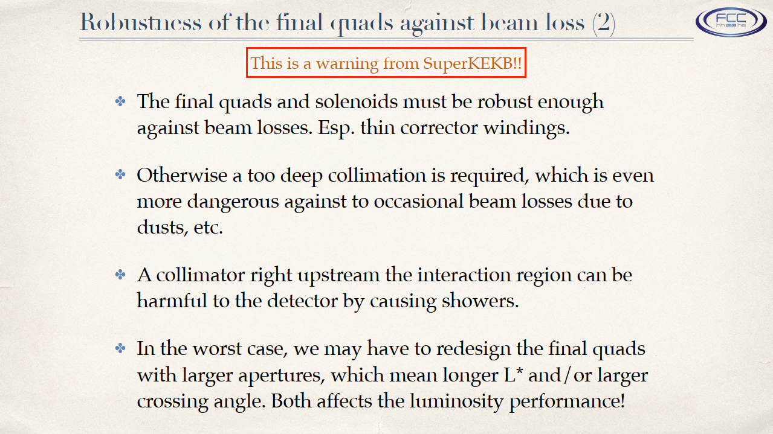
A warning from SuperKEKb
Although NbTi conductor is adequate for the FF quads and correctors, we should consider HTS conductors because of the extra margin we will get against quenches.
This is a technology that can be tested today
We can be sure that in 20 years HTS conductors will be cheaper and better
K. Oide, 26/6/2019

Slide 25
Luminosity counter

Slide 26
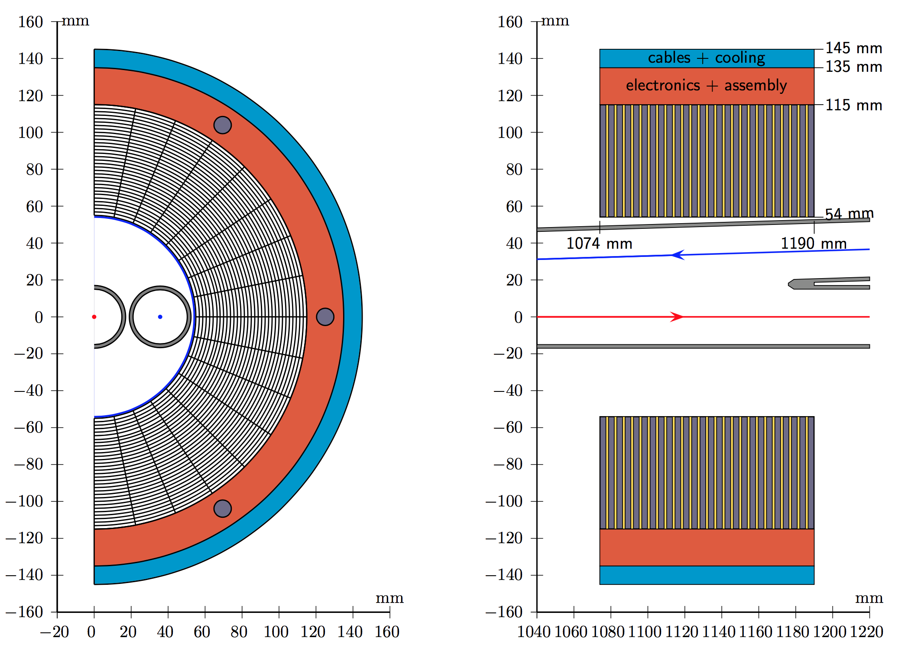
LumiCal
Goal: absolute luminosity measurement to 10⁻⁴ at the Z
The luminosity calorimeter is a key device in the MDI area: tight space, alignment and background requirements.
Vital statistics:
W+Si sandwich: 3.5 mm W + Si sensors in 1 mm gaps
25 layers total: 25 X0
Cylindrical detector dimensions:
  Radius: 54 < r < 145 mm
  Along outgoing beamline: 1074 < z < 1190 mm
Sensitive region: 55 < r < 115 mm
Detectors centred on and perpendicular to outgoing beamline
Angular coverage(>1 Moliere radius from edge):
  Wide acceptance: 62-88 mrad
  Narrow acceptance: 64-86 mrad
  Bhabha crosssection@ 91.2 GeV: 14 nb
Region 115 < r < 145 mm reserved for services:
  Red: Mechanical assembly, read-out electronics, cooling, equipment for alignment; Blue: Cabling of signals from front-end electronics to digitizers
Accuracy:
Aim for construction and metrology precision of 1 μm
M. Dam

Slide 27
Mechanical design and integration

Slide 28
Mechanical design
Going towards a TDR, we need a mechanical design study, at least at the conceptual level
  can the system be built?
  Can it be assembled?
  Can it be cooled?
  Can we stay within the 100mrad cone?
  How about vibrations? Will they kill luminosity?
An effort for a conceptual mechanical design has just started
  We are still not at the level of a real, detailed, mechanical design

Slide 29
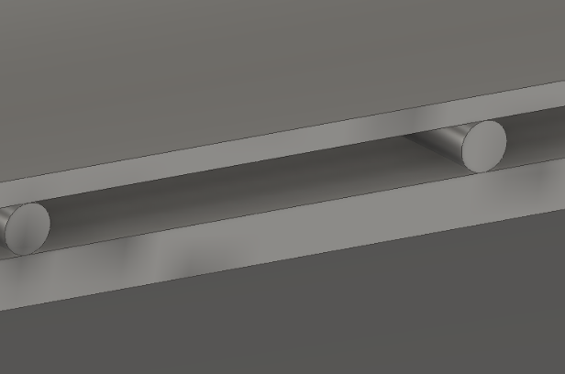
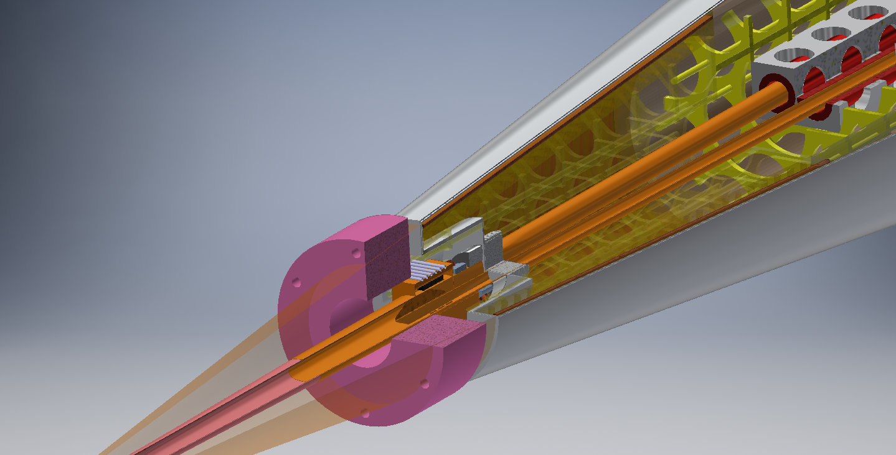
Mechanical design
We are opting for a thin cryostat design with all load bearing structures inside the magnet coils
Thin cryostat
1mm outer wall
2mm vacuum + spacers
2mm inner wall
100 mrad cone

Slide 30
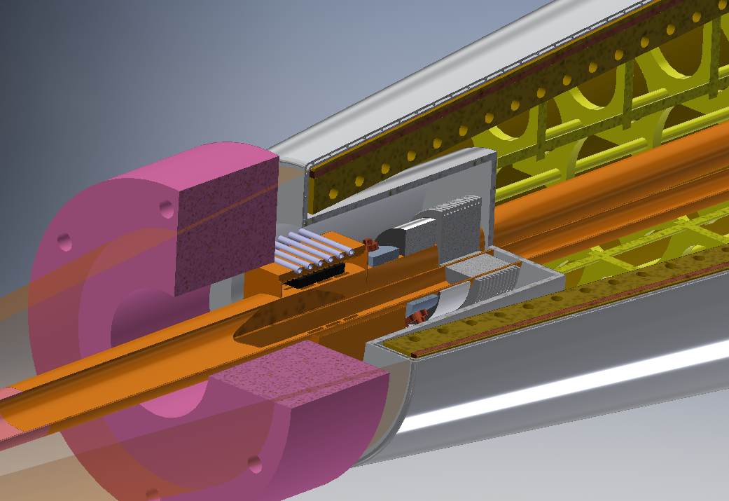
Zoom on front face of cryostat

Slide 31
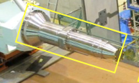
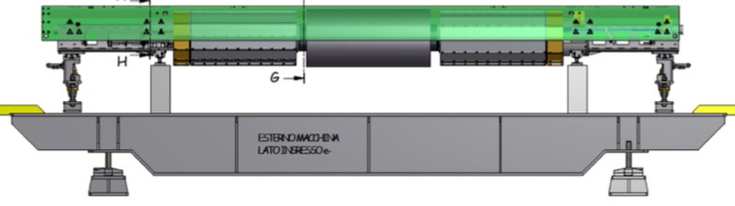
Integration and assembly
We have two options for suspending the various MDI elements inside the detector
  Cantilever design a-la SuperKEKb
  One piece insert like DAFNE
A cantilever design
needs a remotely operated flange
The two sides are decoupled
A one piece insert
Needs a lot of space on one side of the detector
The detector hole is defined by the largest cross section

Slide 32
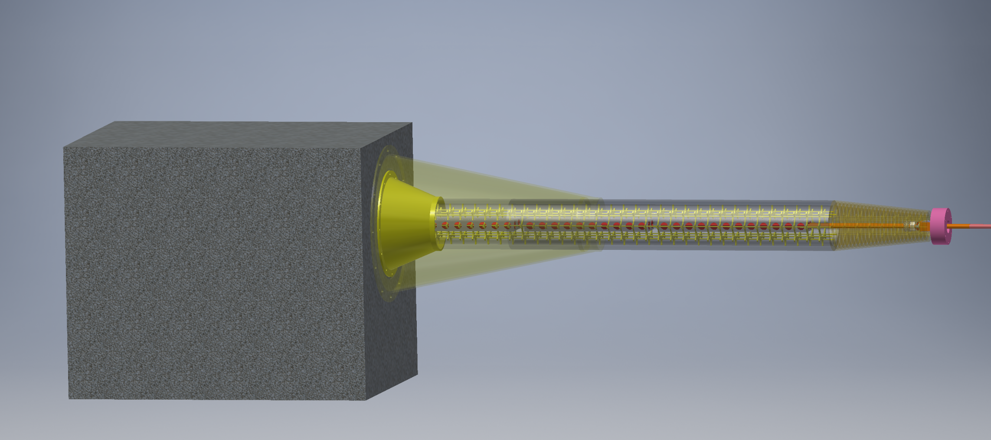
Cantilever assembly
Conceptual design
From support to tip of compensating solenoid
4370 mm

Slide 33
Forces calculation
Such a large magnet system is usually associated with substantial forces.
I have made an initial calculation of the forces on each element (screening solenoid, compensating solenoid) for the benefit of the mechanics integration team
The FF quads are sitting in zero field, so there is no force on them (but there is a force between them)
A misalignment study is also performed

Slide 34
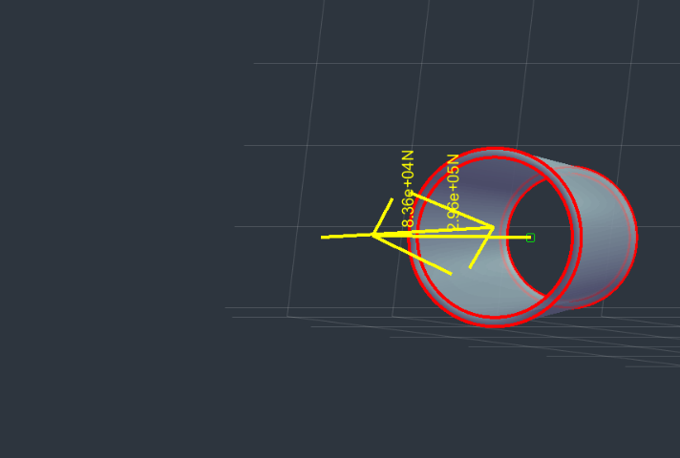
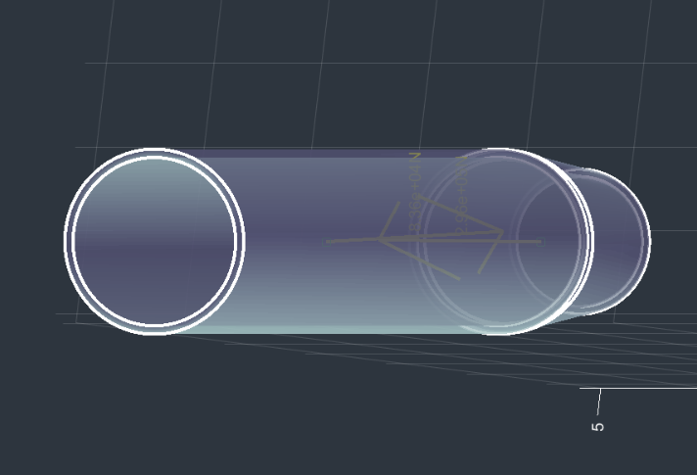
Perfect alignment: force on the solenoids, left side
Forces and torques with misalignment have also been computed
For both sides:
Screening solenoid: -80kN towards the IP
Comp. solenoid: +300kN, towards the endcap

Slide 35
beam pipe

Slide 36
Beam pipe design around the IP
What defines the beam pipe dimensions is:
SR hitting the detector area
Beam sizes
Heating due to impedance
For physics, we want this as small as possible
A series of masks and shielding protect from SR
M. Boscolo
Can it be made smaller?
We have opted for a 30mm dimeter beam pipe close to the IP.
Central region +-12.5cm is water cooled beryllium (5um of gold, 1.5mm beryllium, 1mm of water)
Beam pipe around the FF quadrupoles (QC1L1, QC1L2, QC1L3) is 30mm diameter

Slide 37
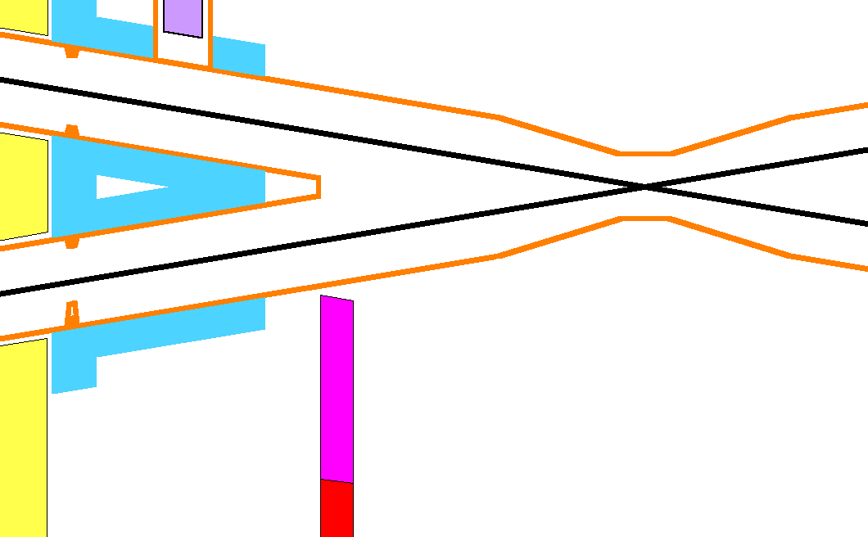

Moving from 15 to 10mm radius
Close up
2D-top view with expanded x-coordinate
FF SR strikes here with 903 photons > 10 keV.
With the 7 mm mask tip this number becomes 18 >10 keV.
QC1
Compensating solenoid
QC1
Be
shielding
Central detector
Lumical
Closest distance from beam line to central chamber is 11.25 mm
Soft bend radiation fan
Without changing the mask tip, this surface gets 8.9 W of SR power and 3.64e5 incident photons > 10 keV.
With the mask tip at 7 mm this number goes to 0.2 photons >10 keV.
L*=2.2m
HOM absorbers
Mask tip is 10 mm from the beam line
Mask tip increased to shield the tapered section
The SR fan from the last bend magnet misses the central chamber
The mask at -2.1 m shadows the central chamber
No SR direct hits in the central region
Now central beam pipe is +-9cm with diameter 20mm, then a taper of 31cm on each side
M. Sullivan

Slide 38
Central beam pipe: 30mm vs 20mm
Work in progress!
Two aspects: SR background and resistive heating
The 10mm radius beam pipe needs a deeper mask (standard design: 10mm from the central beam line, new design: 7mm or even 5mm mask)
The 10mm radius beam pipe (even though shorter) intercepts FF quadrupole radiation even with a 5 mm radius mask
For the 45GeV case a 7mm mask is fine (even 10 mm mask is OK?)
For the 120GeV case a 5 mm mask is needed
(SR from the quads is difficult to estimate since it depends on beam tails)
Beam pipe | Heat load @45GeV | Max Temp. [K]
diameter [mm] | [W/m] | without cooling
30 | 97 | 88
20 | 145 | 198
Going to a 10mm radius central beam pipe does not seem to be out of the question!
Work is continuing
The heat load critically depends on the bunch length – here assumed to be 12mm – non-colliding beams heat more
Work in progress to study trapped modes with an improved beam pipe model
A. Novokhatski

Slide 39
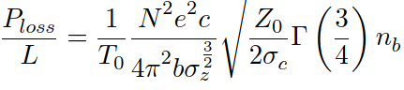
Cold vs warm beam pipe
If we can afford a cold beam pipe depends on the heat load
In the vicinity of the final focus quads (2.2 to 5.6 m from the IP)
  Resistive wall heat load @ beampipe radius
  of 15mm WITH COLLISIONS: ~100W/m
  Radiative bhabha heat load: ~40W/m
If the beam pipe is cold, the only way to remove the heat is if we have liquid helium below the lamda point (Helium II)
This comes at a cost! The LHC manages 900W per 1W of heat removed at 1.9 K
In the vicinity of QC1 (length 3.4m, two beam pipes) the heat power is ~1000W per side. This needs a cryogenic system of 1MW per side
(cf: the whole of the LHC cryogenic installation is 150kW at 4.5K and 20kW @1.9K
➔ beam pipe should be warm

Slide 40
Vibration management

Slide 41
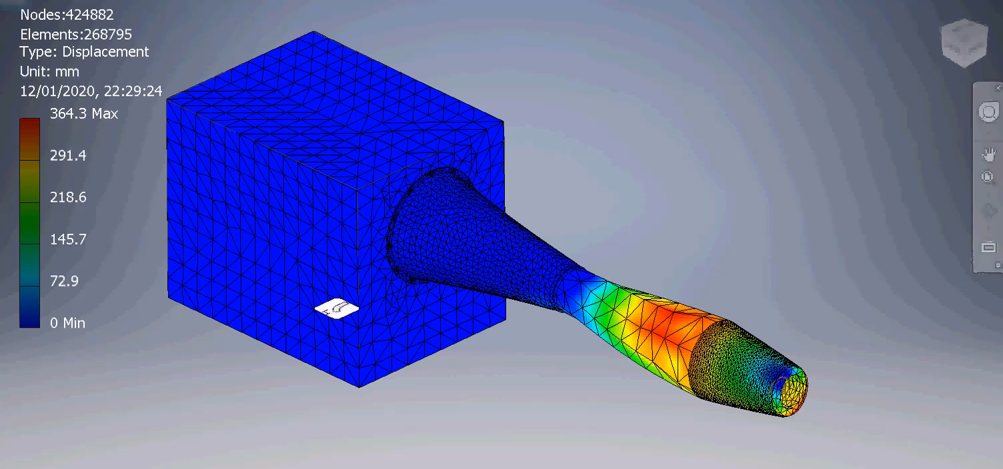
Vibration management and feedback
Work only starting
Here the situation is considerably simpler than (single pass) linear colliders
The FF quads for the e+ and e- beams sit is close proximity (O(10cm))
Any coherent motion of the e+ and e- FF quads per side creates the same orbit deviation for both beams (i.e. no effect) up to the revolution frequency of the machine (3000Hz)
The above is not true for the main arc quadrupoles as the beta functions for a twin quad are not the same for e+ and e-. To be studied
Any incoherent motion (that will have a much smaller amplitude than coherent motion) needs to be looked at.
Based on the above, an orbit feedback looking at the beam-beam deflection will probably be sufficient. The response time will be very fast if we apply something similar to the ILC's intra-train feedback, which is below microsecond. A more usual system can handle up to 1/10 of revolution freq., thus 300 Hz, where external vibration is already very small. The beam-beam deflection method has been well established with beam at B-factories and SLC for many years
Example of twist mode in our cantilevered design (F9, 306Hz)
K. Oide

Slide 42
Crab waist sextuples

Slide 43
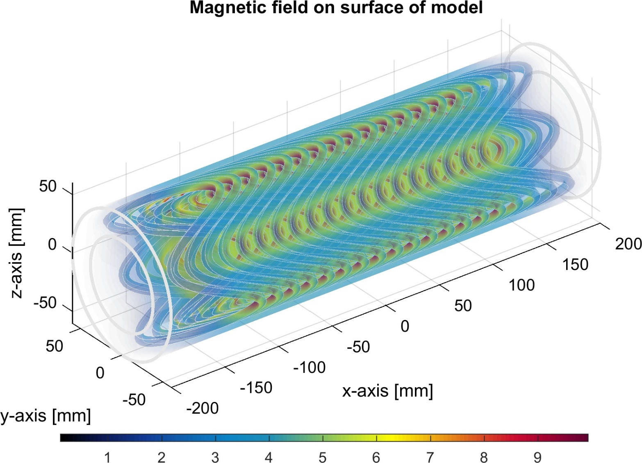
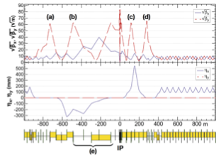
Grab waist sextupoles
NbTi conductor is not suitable for this project. We should use HTS tape for it. Readily available from industry, although currently more expensive than NbTi
Unique to FCC-ee, is a set of four strong sextupoles in the vicinity of the IP (a, b, c, d below, strength is B'' : 7350 T/m^2)
78mm aperture, single aperture
Very short (30cm)
Very high field (10-11T on the conductor)
CCT is ideally suited – correctors can go on top as extra rings saving space
Preliminary design

Slide 44
Conclusions
The IR magnets
  The compensation scheme is the simplest possible and fulfils all our requirements
  FF quadrupoles are challenging but CCT design ideally suited for our application
  FF quadrupole prototype built and awaits testing
Smaller beam pipe for the area around the vertex detector considered
  Not out of the question
Mechanical integration work has started

Slide 45
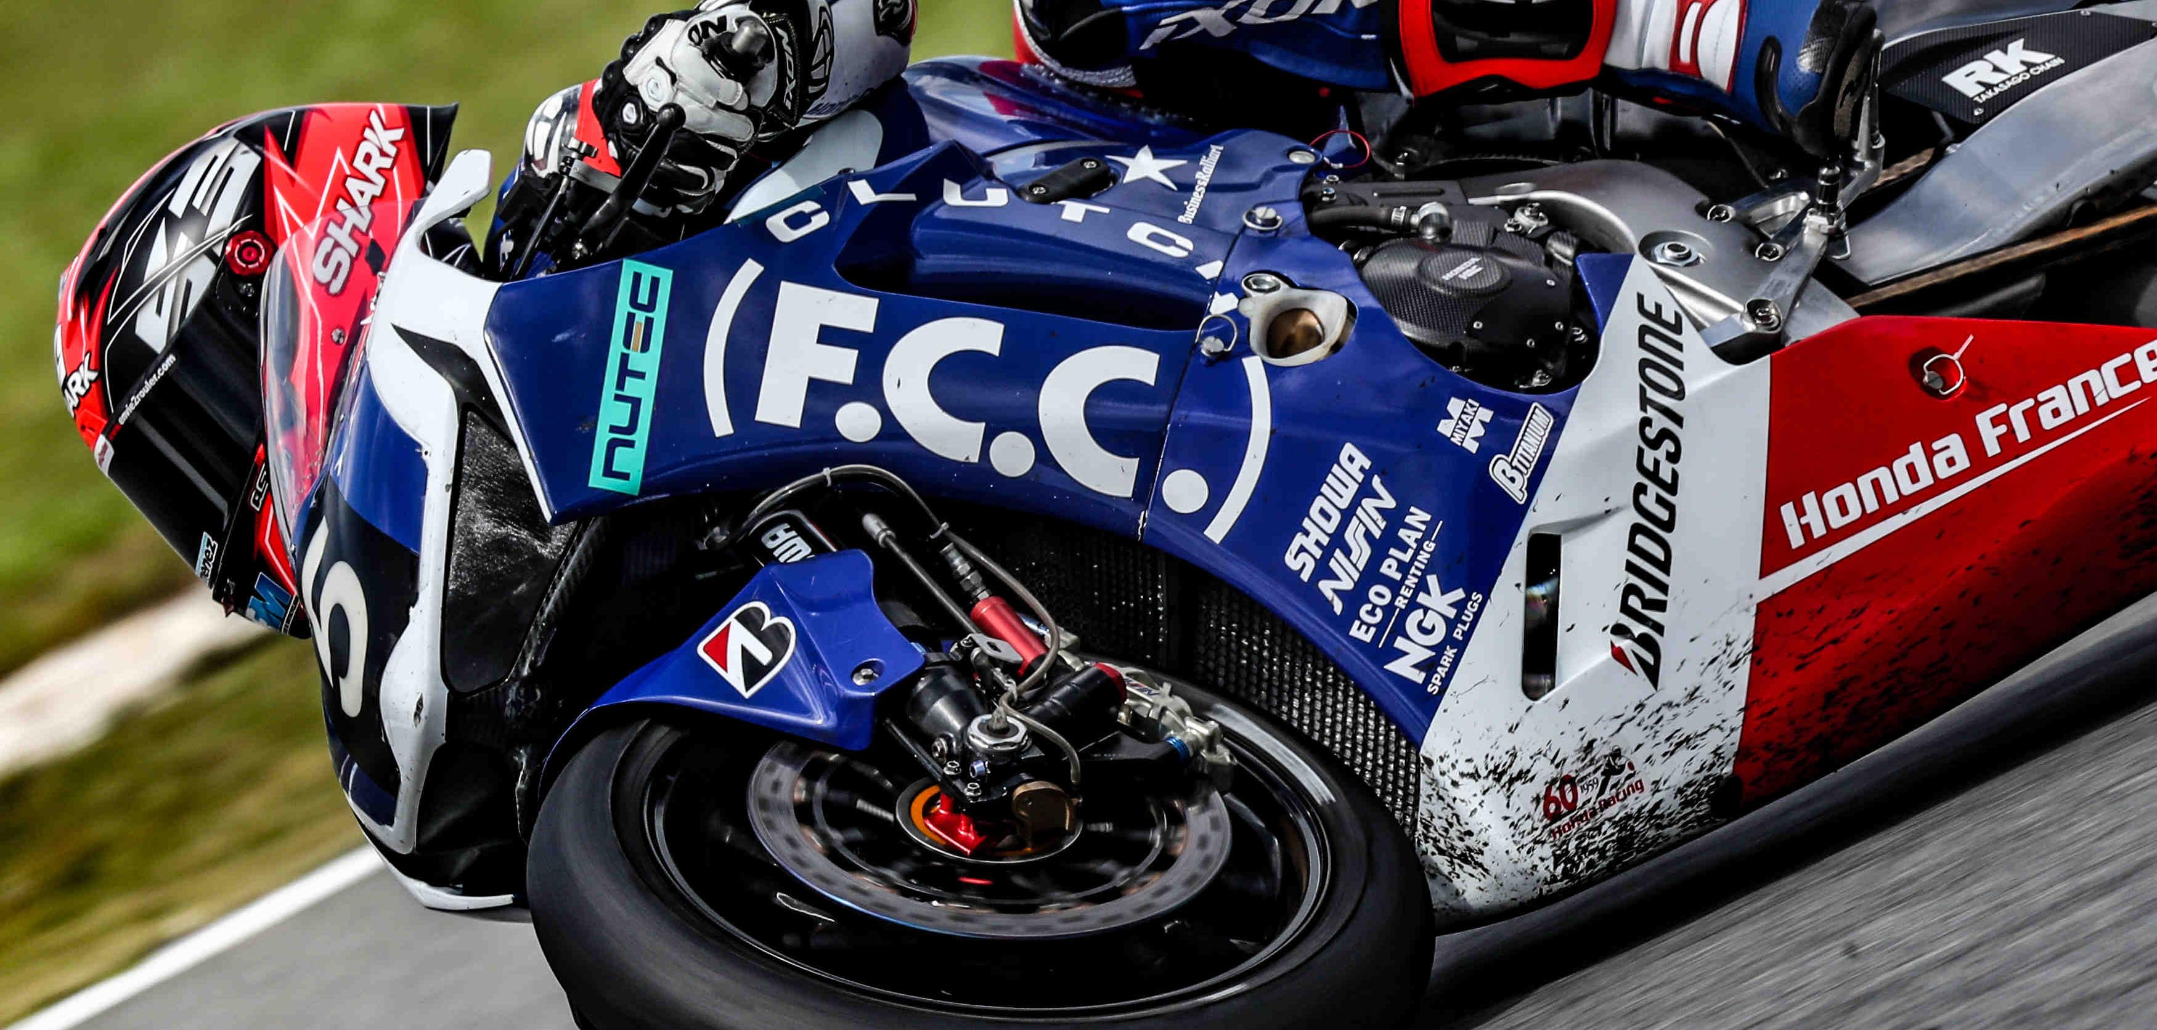
GO, FCC!

Slide 46
Extra slides

Slide 47
Background studies

Slide 48
Backgrounds
An essential part of the study and very resource demanding
We need to
  generate this background,
  track it to the detector and
  estimate its effect
A variety of generation, tracking and physics codes need to work together
Two broad categories
  IP backgrounds: due to colliding beams
  Single beam backgrounds: present even in the absence of collisions

Slide 49
Generators and tools
Background source | Generator | Tracking code for loss map
Beamstrahlung | GuineaPig , BBWS | SAD, MADX
Radiative Bhabha | GuineaPig, BBBrem | SAD, MADX
Pair production (incoherent dominant) | GuineaPig | Geant4
γγ to hadrons | combination of GuineaPig and Phythia | Geant4
IP
Studied, small effect
Synchrotron Radiation | Geant4, SYNRAD+, BKG_SYNC | MDISim / G4
Thermal photons | MC by H. Burkhardt | MADX
Beam-Gas Bremstrahlung (BGBrem) | Geant4 | MDISim (G4/ROOT/MADX)
Beam-Gas Coulomb (BGCoul) | MC by A. Ciarma & M.B. (in progress) | interface with PTC_MADX
Touschek | MC by A. Ciarma & M.B. (planned) | interface with PTC_MADX
Single beam

Slide 50
Beamstrahlung
Beamstrahlung is Synchrotron Radiation in field of opposing beam, estimated at the Z with Guinea-Pig
The IR will generate a very significant flux and power of hard X-rays, lost mostly in the first downstream bend (49-55 m from IP)
Classical SR and Guinea-Pig | <Nγ> | <Eγ> keV | Power KW
IP magnets (quad, solenoid) | 1.3 | 24 | 43 kW
Beamstrahlung | 0.15 | 2000 | 417 kW
(also without collisions)
photon energies extend into the GDR region
~460 kW hitting in a narrow ~5 m wide region 49-55 m downstream from IP
We need to dissipate order 100 kW/m
H. Burkhardt
As well as a few MW / IP with spectrum extending into tenths of MeV (strongly varying with bb-parameters and residual separation)

Slide 51
Radiative Bhabha
BBBrem has been implemented in SAD
Beam loss due to radiative Bhabha for FCC-ee at the Z:
  4 kW in the region up to 400 m downstream the IP
  150 W within the first quad QC1
The effect of beam-beam adds another 20% on the loss at QC1.
The result is neither sensitive to the misalignment of aperture at QC1, nor to the IP solenoid field.
The tolerance of the final focus quadrupole for such amount of beam loss must be examined.
Cross check with other methods is necessary and in progress.
Z peak : losses all happen well before reaching the second IP
182.5 GeV: a few losses in the vicinity of the second IR. Tracking into the detector (CLD) was done and checked that this background is negligible.
K. Oide

Slide 52
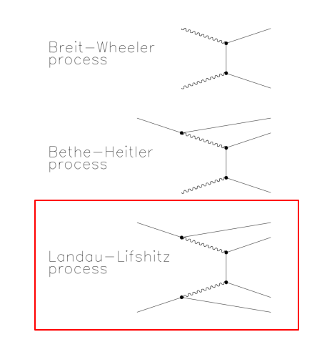
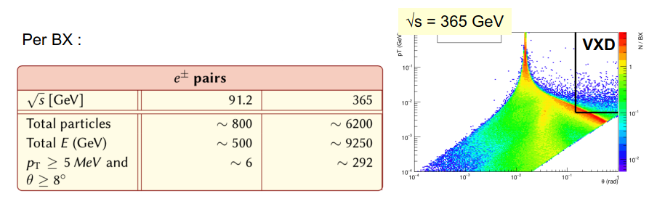
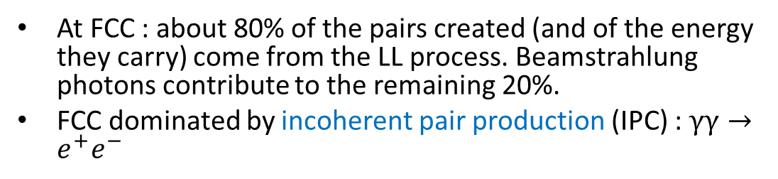
Pair production
At FCC : about 80% of the pairs created (and of the energy they carry) come from the LL process. Beamstrahlung photons contribute to the remaining 20%.
FCC dominated by incoherent pair production (IPC) : $γγ→e^{+}e^{−}$
E. Perez
Large # of particles is created, that carry (collectively) up to 9 TeV. But few particles reach the detector, even at the highest energy.

Slide 53
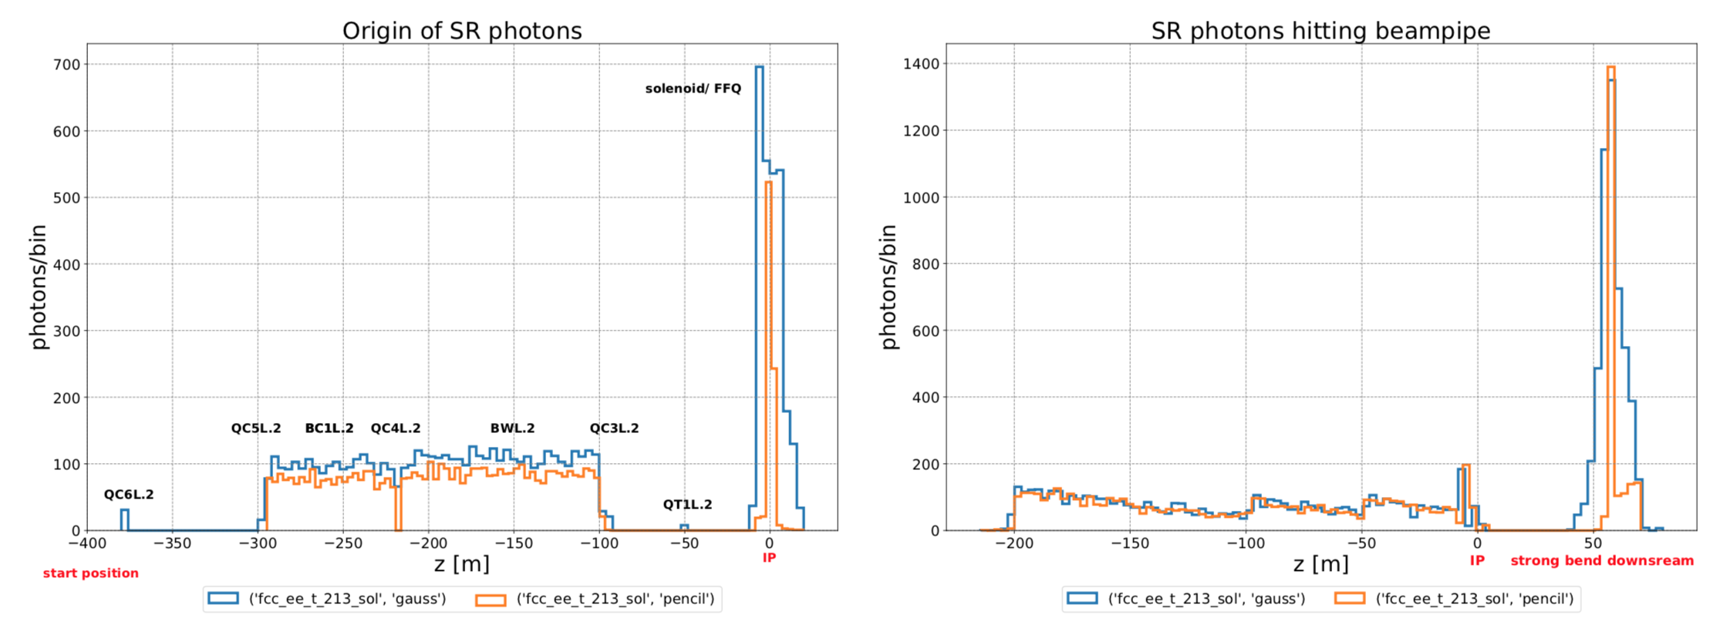
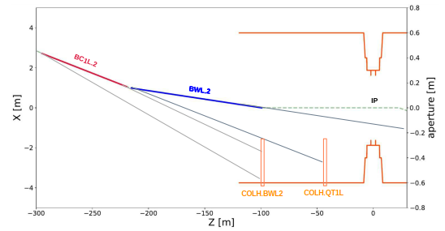
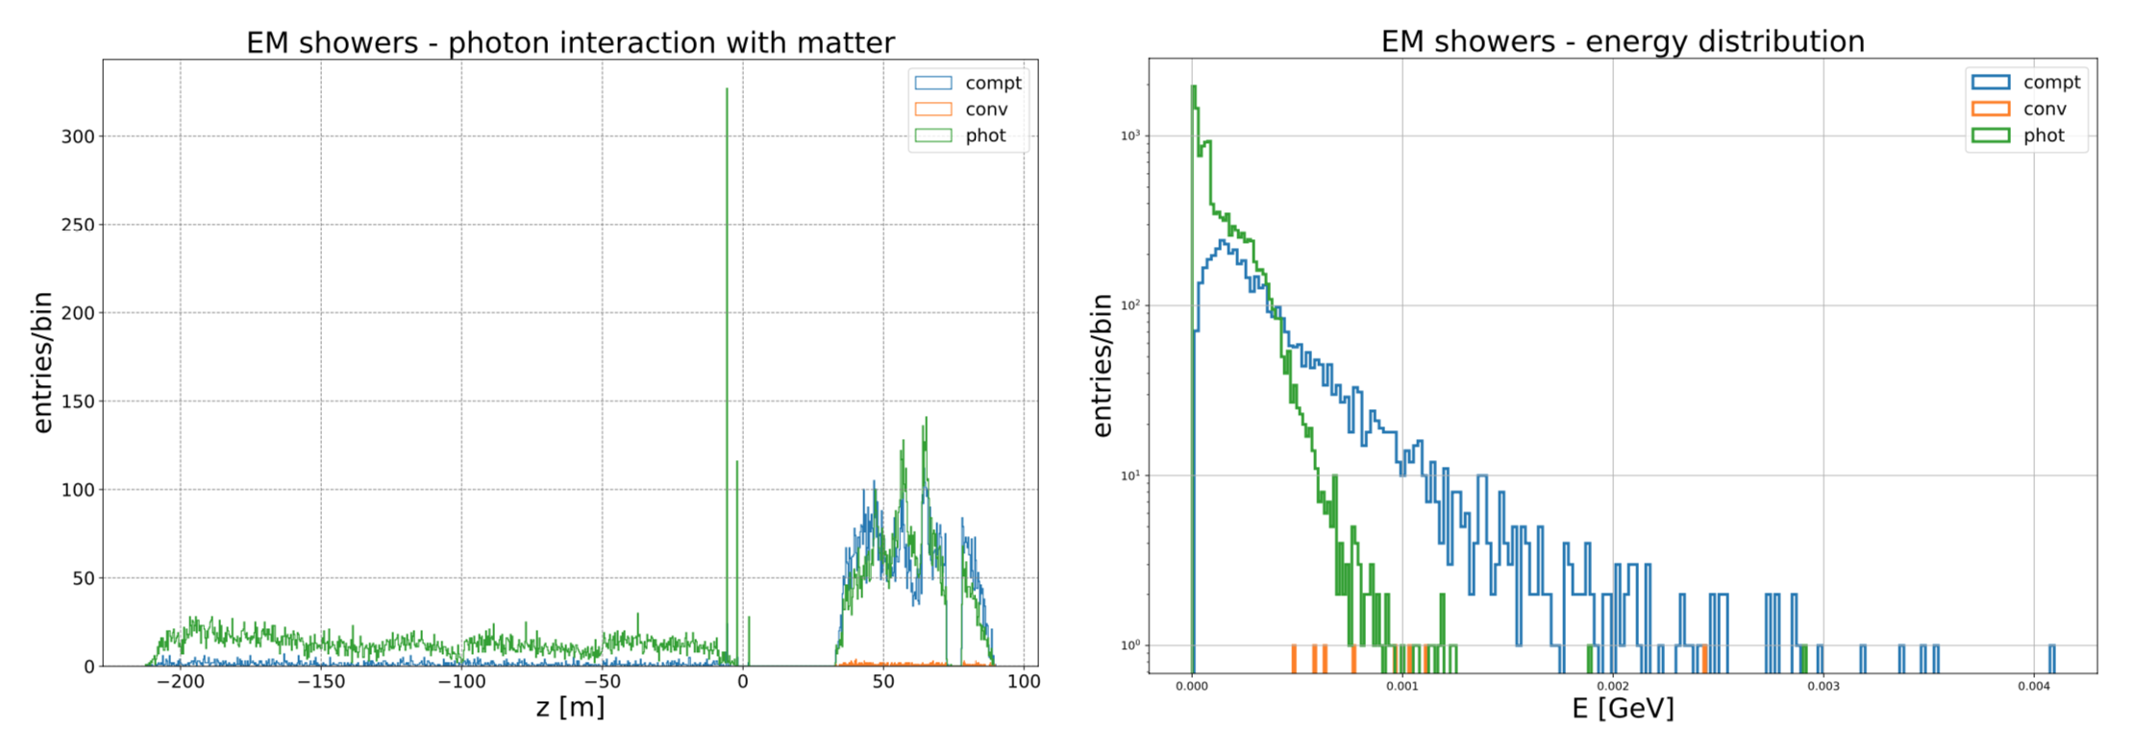
Synchrotron Radiation
IR collimators and SR cones
Origin of SR photons
SR photons hitting the beampipe
photon interaction with the beampipe
energy distribution
MDISim: Powerful simulation tool for very detailed analysis
Interfaces MADX/ROOT/GEANT4
→ Collimator strategy
M. Luckhof

Slide 54
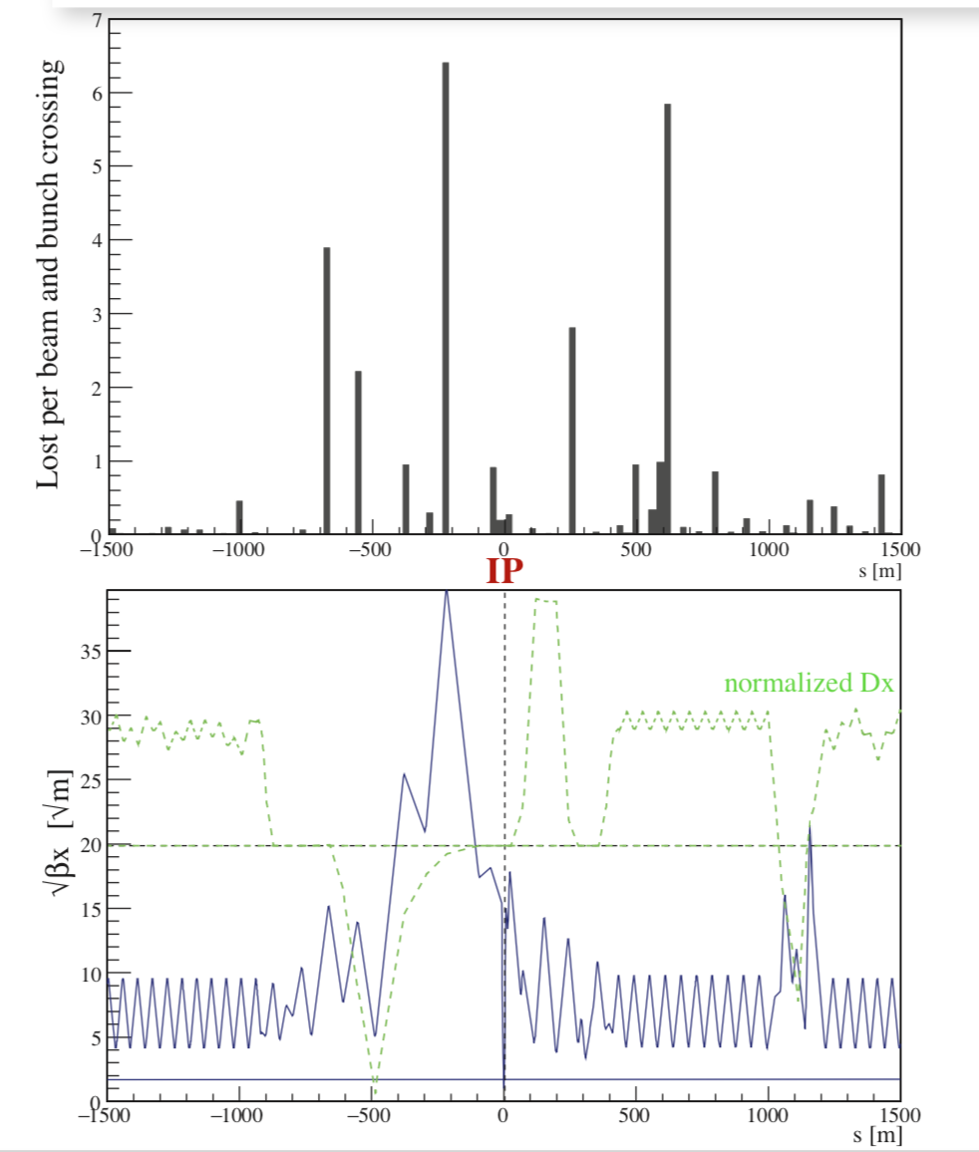


Thermal photon scattering
First described in 1987 by V. Telnov, it was the main single beam lifetime limitation in LEP. Well measured and simulated using the algorithm described in SL/Note 93-73
Today simulation is done using C++ with multithreading, 10⁹ events in few min
Normalized loss distribution +/- 1.5 km around IP
photon density
𝛒γ = 5.3×10¹⁴ m⁻³
182.5 GeV
Thermal γ 31.2 ± 0.5 |s|<1.5 km from IP
lost/beam/crossing
of which 11.1 ± 0.3 |s|< 300 m
very roughly
0.07 eV thermal photons
boosted by γ² to GeV
energy loss from beam
mitigation by off-momentum collimators
H. Burkhardt

Slide 55


Beam – gas scattering
Inelastic
IR Loss map
Z position where a primary electron is lost after a BG interaction
FCC-ee energy | Loss rate [-800;+200] m from IP [MHz] | Loss Rate [-20;+20] m from IP [MHz]
Z | 147 | 29
W | 16 | 3
H | 3 | 0.5
t | 0.5 | 0.1
tracked only into lumical showing negligible backgrounds rates
Elastic
Most of the particles are lost close to the IR final focus quadrupoles, where the physical aperture gets smaller
Most of particles are lost at the first turn

Slide 56
Misalignment analysis
Perfect alignment
Name | Fx [N] | Fy [N] | Fz [N] | Fmag [N] | Tx [N.m] | Ty [N.m] | Tz [N.m] | Tmag [N.m]
main detector solenoid | 7.2E+05 | 7.2E+05 | 2.4E+03 | 1.0E+06 | -2.3E+03 | 2.3E+03 | 5.3E-02 | 3.2E+03
Screening solenoid | 1.5E+03 | 1.5E+03 | -8.4E+04 | 8.4E+04 | 5.5E+02 | -5.4E+02 | -1.1E+04 | 1.1E+04
Comp. solenoid | 8.9E+02 | 9.1E+02 | 3.0E+05 | 3.0E+05 | 6.5E+01 | -6.5E+01 | 2.6E+03 | 2.6E+03
Screening sol. right | 1.5E+03 | 1.5E+03 | 8.4E+04 | 8.4E+04 | -5.5E+02 | 5.4E+02 | -1.1E+04 | 1.1E+04
Comp. solenoid right | 8.9E+02 | 9.1E+02 | -3.0E+05 | 3.0E+05 | -6.6E+01 | 6.6E+01 | 2.6E+03 | 2.6E+03
Misalignment in x of screening solenoid only by 10mm
Screening solenoid | -8.2E+03 | 1.3E+03 | -8.3E+04 | 8.3E+04 | 3.0E+02 | 1.3E+04 | -1.1E+04 | 1.7E+04
Comp. solenoid | 1.0E+04 | 1.1E+03 | 3.0E+05 | 3.0E+05 | 2.8E+01 | 2.5E+03 | 2.5E+03 | 3.6E+03
Screening sol. right | 1.5E+03 | 1.5E+03 | 8.4E+04 | 8.4E+04 | -5.5E+02 | 5.4E+02 | -1.1E+04 | 1.1E+04
Comp. solenoid right | 8.9E+02 | 9.1E+02 | -3.0E+05 | 3.0E+05 | -6.6E+01 | 6.7E+01 | 2.6E+03 | 2.6E+03
Misalignment in x of screening solenoid by 10mm and comp. solenoid by 10mm
Screening solenoid | 1.4E+03 | 1.5E+03 | -8.4E+04 | 8.4E+04 | 5.2E+02 | -1.2E+03 | -1.1E+04 | 1.1E+04
Comp. solenoid | 7.1E+02 | 8.7E+02 | 3.0E+05 | 3.0E+05 | 6.0E+01 | -3.4E+02 | 2.6E+03 | 2.6E+03
Screening sol. right | 1.5E+03 | 1.5E+03 | 8.4E+04 | 8.4E+04 | -5.5E+02 | 5.4E+02 | -1.1E+04 | 1.1E+04
Comp. solenoid right | 8.9E+02 | 9.1E+02 | -3.0E+05 | 3.0E+05 | -6.6E+01 | 7.0E+01 | 2.6E+03 | 2.6E+03
As above, plus 100mrad twist of comp. solenoid
Screening solenoid | 2.7E+04 | 2.1E+03 | -7.8E+04 | 8.3E+04 | 1.5E+03 | -4.0E+04 | -1.1E+04 | 4.1E+04
Comp. solenoid | -2.7E+04 | 2.7E+02 | 2.9E+05 | 2.9E+05 | 1.5E+03 | 5.1E+04 | 2.5E+03 | 5.1E+04
Screening sol. right | 1.5E+03 | 1.5E+03 | 8.4E+04 | 8.4E+04 | -5.5E+02 | 5.2E+02 | -1.1E+04 | 1.1E+04
Comp. solenoid right | 8.6E+02 | 9.1E+02 | -3.0E+05 | 3.0E+05 | -6.5E+01 | 3.3E+01 | 2.6E+03 | 2.6E+03

Slide 57




The FCC-ee FF quadrupole prototype – magnetic design, mechanical design, manufacturing

Slide 58









Assembly and winding of prototype

