Slide 1
MDI Issues During Commissioning and Beyond
M. Sullivan
for the
CEPC MDI Workshop May 28-29, 2020

Slide 2
Outline
Introduction and some general remarks
The start of the accelerator
Initial
Evolvin
Final
Beam tails
Other concerns
Beam aborts
Radiation monitoring
Temperature monitoring
Maintaining luminosity
Summary and conclusions

Slide 3
Introduction
MDI concerns
Maximize the detector acceptance
Accommodate the machine lattice
Help to fit the final focus magnets into the IR design
Help to calculate the backgrounds in the detector
Supply the sources of backgrounds to the detector simulation team
With engineering help
Design and support the final focus magnets
Maintain the beams in collision (usually with fast orbit feedback correctors)
Design the beam pipe in the detector
…

Slide 4
Some remarks
In many cases, at least part of the MDI team needs to evolve into the background team
Usually, this is mostly from the detector side but it would be very helpful if there were at least one person from the machine side and at the very least the background team needs someone who understands the machine side of things
The first order of business for the MDI team is to calculate the expected backgrounds for the final design machine and determine that these background levels are acceptable

Slide 5
Some more remarks
This is done through a combination of
Collimation
To reduce BGB, Coulomb, Touschek, etc. backgrounds
Masking
To protect the central chamber from direct SR
To protect the central chamber from forward scatter and backscatter SR
Geometric design
Specifying final bend magnet locations and strengths
Vacuum requirements
Specifying where low vacuum regions are needed
Once this is done then the team has an IR design that should work

Slide 6
So now what comes after that?
Now that the baseline design has been defined and verified through calculations of background rates that the detector has found to be acceptable what next?
Now the question becomes how do we get the accelerator and detector from a typical starting point to the final design?
Initially, the accelerator (and detector) go through a commissioning phase where various parts of the accelerator (and detector) are tested under colliding (and non-colliding) beam conditions

Slide 7
Initial Commissioning Phase
Usually the accelerator is completed before the detector is ready
This means the accelerator can start to shake down the various subsystems
Gun
Injection accelerator
Positron source
Positron transport lines
Damping rings
Injection transport lines
Injection into the ring(s)
Storing and ramping
RF system
…

Slide 8
Initial Commissioning (2)
Usually, the detector is still rolled offline and is taking CR triggers to shakedown detector subsystems
There are probably some background detectors at the IP to try to get some first measurements of the background rates
The accelerator team may try to collide the beams at this time but without the detector (and perhaps without the FF quads) this exercise is most likely not very informative
The accelerator team at this time will try to maximize the beam currents in each ring and maximize the beam pipe “scrubbing” around the rings
The backgrounds will be very high and the beam lifetimes will be low

Slide 9
Commissioning Phase – Stage 2
Stage 2 commissioning phase is when the detector rolls onto the beam line
This stage might be a year after the start of the initial commissioning phase
Now the accelerator team has the final hardware and can now start to optimize performance by maximizing luminosity
The detector magnetic field (and, of course, the FF quads if they were missing) are now present
At this point the beam currents are still low and generally the lifetime is set by how tight the collimators can be in order to lower the beam related backgrounds in the detector
The luminosity is also low. Usually, at least 10 times below design.

Slide 10
Commissioning Stage 2 (cont.)
This is a difficult time for all groups
The detector team wants to collect data as soon as possible
The accelerator team wants to improve the machine performance as quickly as they can
Both efforts tend to be hampered by high backgrounds in the detector and short beam lifetimes
Opening collimators will improve the beam lifetime but then the detector backgrounds may become too high and the detector may have to turn off
Even when the detector is off the radiation doses from the high backgrounds may still be a problem
Increasing the beam currents also tends to increase the detector backgrounds
The background sources at this point tend to be BGB, Coulomb and perhaps SR from the beam particles out at very high sigmas
The beam tails tend to be high at this point
The beams are still “scrubbing” the beam pipes all around the ring

Slide 11
Evolving from the Commissioning phase
As the accelerator continues to run, the backgrounds will slowly improve, and beam currents can be increased
Also as the machine becomes better understood by the accelerator team the luminosity should improve
Sometimes even without increasing beam currents
At this point, the backgrounds are tolerable but probably still higher than originally calculated for the final design parameters
The backgrounds will tend to be high until the beam currents begin to approach the design values
They need to be at least within a factor of two of the final beam currents

Slide 12
Evolving stage (cont.)
This stage will take probably 1-2 yrs
Things will improve and the beam tails will go down allowing for tighter collimator settings without reducing the beam lifetime too much
This will also allow for more beam current
The luminosity should be improving allowing the detector to collect more data
Only near the end of this stage will the backgrounds begin to approach the design background rates
Assuming ALL sources of backgrounds have been thought of and have been accounted for in simulation

Slide 13
Approaching the final design running point
If all goes well, and nothing has been missed, then the machine and detector are humming along nicely with the detector collecting data while the accelerator is approaching design luminosity
Perhaps, at this time, the accelerator team is collecting ideas to try to improve the performance beyond the design values
One possibility is to further reduce beta* values
Or perhaps alter the ring lattices to reduce emittances
Perhaps new beam-beam simulations suggest alternative running schemes
…

Slide 14
Beam tail generators
As mentioned earlier, the initial non-gaussian beam tails mostly are populated by BGB and Coulomb events that manage to remain inside the dynamic aperture of the accelerator
When the beam pipe scrubbing is going on these interaction rates can be very high – the vacuum is sometimes 10-100 times higher than the no beam vacuum pressure
As the pressure improves the beam tails from these sources diminishes
However, as bunch currents increase and as the collision parameters improve, other sources can start to produce beam tails
Beam-beam
Inter-bunch scattering
Luminosity terms (radiative Bhabha)

Slide 15
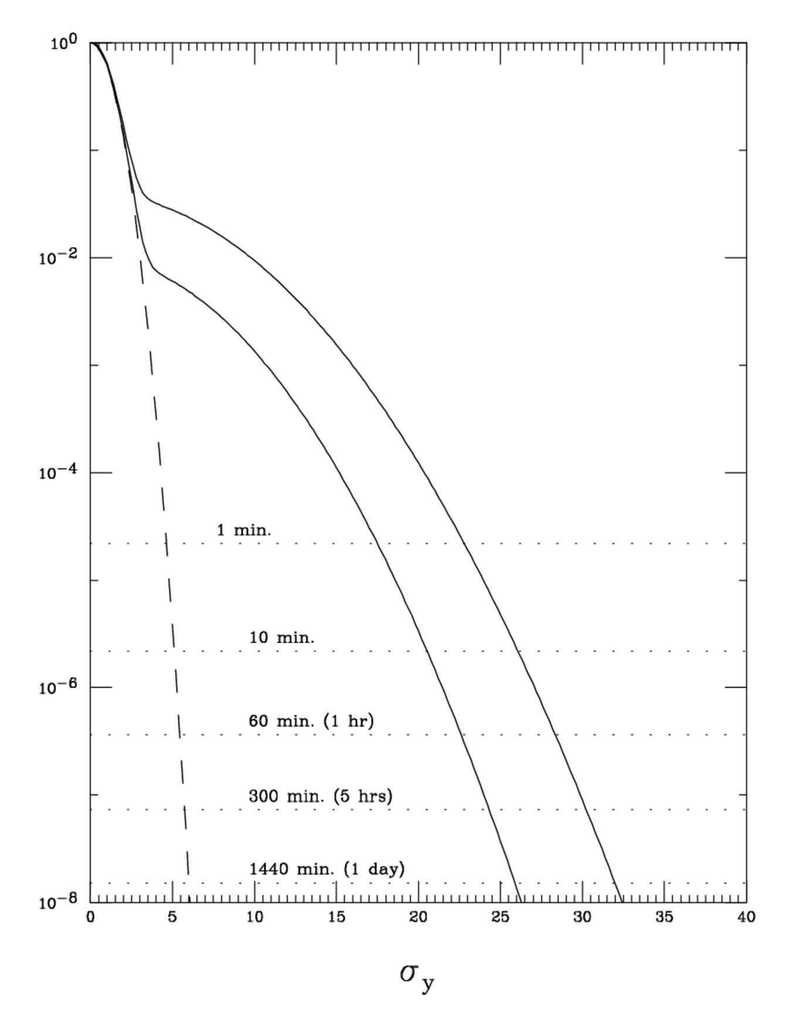
Possible beam tail distributions for SuperKEKB
Here are some possible beam tail distributions that may be present in the HER of the SuperKEKB this year. The dashed line is a core gaussian distribution.
The distributions are based in part by the measured lifetime of the of the HER and by measured background rates in the PXD (vertex detector)
The data are from earlier in this present running period (Feb. 2020)
The lower beam tail is what is hoped for as the “scrubbing” continues and the vacuum improves
X beam tail
Y beam tail
Earlier this year?
Earlier this year?
Perhaps later?
Perhaps later?
Lifetime of >1 hr @15 sigma
Lifetime of >1 hr @30 sigma

Slide 17
Other things to worry about
Instrumentation
Thermocouples
You need to have plenty of TCs especially near the IR but also around each ring
In places where HOM power may cause heating (i.e. every bellows section,…)
Radiation monitors
These also need to be around the ring as well as near the IR
These monitors need to be tied into the beam abort system
Beam abort
The beam abort system should try to be as fast as possible in order to minimize damage to the machine as well as to the detector
In the IR most (if not all) of the nearby magnet power supplies should be wired to abort the beam if a supply trips off or is about to quench
This includes the detector solenoidal field

Slide 18
Still more to worry about
The luminosity feedback
The orbit feedback that maintains optimal luminosity may need to be tied to the beam abort system
This will only be known when the machine is colliding and suddenly gets out of collision
This may be OK, as it was for the PEP-II B-Factory, but it may also cause one or both of the beams to go unstable
The feedback will try to correct for final focus vibration or other local vibrations
If some vibrations are too fast the feedback will not be able to keep up and the average luminosity will be reduced
We discovered this in the PEP-II B-Factory. Our collision orbit feedback was rather slow (one beam position and angle update (x, y, y’) about every 9 sec.)
Our operators uncovered a magnet position oscillation that was about 1 Hz and fortunately, we were able to greatly dampen this oscillation
In addition, we decided we should upgrade our luminosity orbit feedback and we developed a system that updated at 1 Hz
A copy of this system is now in use at SuperKEKB
“FLUM: Fast-Dither Luminosity Feedback” by Alan Fisher https://www.slac.stanford.edu/grp/ad/op/mcc_talks/2007_0620_alan_fisher_fast_dither.pdf
Early Commissioning of the Luminosity Dither Feedback for SuperKEKB
https://inspirehep.net/literature/1736105

Slide 19
Designing for early running
Based on likely scenarios for starting up and commissioning the accelerator and detector (mentioned above), the MDI design team should try to build into the IR design background safety factors for detector subsystems of at least 10 if at all possible and preferably higher
For some subsystems this will be easy
Detectors at large radius
Muon trackers
Particle ID
Large angle calorimeter
But for others this will be difficult
Detectors close to the beam pipe
Luminosity detector
Vertex tracker
Low angle calorimeter

Slide 20
Design in a safety margin
A safety margin can also protect the design from unexpectedly high backgrounds
SuperKEKB and Belle II are struggling with this issue
The backgrounds present in the machine are higher than they estimated
If the design has missed the magnitude of a background then usually this is because some source was missed or the known source is stronger than was estimated
Simulators almost never overestimate a background
It is very difficult to get good estimates of all possible background sources

Slide 21
Summary
The MDI team has put together a very good IR design
The next step is to worry about the fact that the initial backgrounds in the detector will be higher than the design values (maybe by as much as a factor of 10)
These initial high backgrounds should come down as the accelerator gets into a steady state and becomes better understood by the accelerator team
In addition, initial beam pipe “scrubbing” (out-gassing from SR striking the pipe around the ring(s)) should also improve with time as the accelerator continues to run

Slide 22
Summary (2)
The important fact is that generally the detector wants to take data as soon as possible and this is when backgrounds are still high
If the detector can accept (even if only temporarily, months to maybe as much as a year) this higher background then the accelerator team can concentrate on improving the backgrounds as well as improving the luminosity performance – the physics comes out sooner!
Keep in mind that as the luminosity increases usually the backgrounds decrease
So building in a background safety factor can be of enormous benefit

Slide 23
Conclusions
The CEPC accelerator is an exciting new project that has the potential of finding New Physics and in extending the SM
The detector will be anxious to start collecting data as soon as it is possible
Usually, backgrounds tend to be higher than the design values during the start up and commissioning of the new machine
If the MDI and detector teams can create a high safety factor for the expected background rates, then the detector should be able to take data at as early a stage as possible
In addition, the accelerator team will be able to more quickly improve the machine performance if the detector can tolerate higher than expected background rates

Slide 24
Thank you

