Slide 1
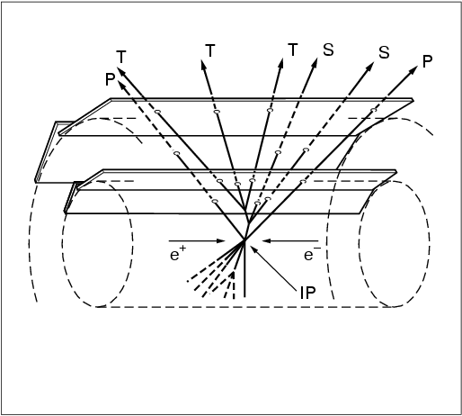
The SLD Vertex Detector
Lessons for MDI at Higgs Factories
Chris Damerell
Rutherford Appleton Lab

Slide 2
This invitation brings back happy memories – my only visit to China: Beijing in 2007, for an ILC workshop which included the first review of tracking systems. The outcome revealed several concerns, leading in 2008 to the concept of the SPT (Silicon Pixel Tracker), reported at an ILC workshop in Sendai, Japan. This has become probably the front-runner for the ILC detector tracking system (for all of ILD, SiD and CLICdp).
At SLD, we mainly studied e+e- → Z⁰ (91 GeV) → q q (q = uds, c, b) Most of the physics depended on separately tagging light quark, charm and b jets
At CEPC(ee), you will study e+e- → Z⁰ (91GeV) + H⁰ (125 GeV) → q q + q q etc
so there are many similarities, but your events will be more complex (4 jets with overlap etc)
As Bjorn Wiik said in his summary talk at Saariselka, 1991, ‘We’re going to need a very good vertex detector.’
What does this mean? Our achievement in the 1990s, that went beyond the reach of LEP and (even now)
the LHC GPDs (ATLAS and CMS), was high efficiency and purity for identifying charm and b jets separately. Due to the
different lifetimes (~10⁻¹³ s and 10⁻¹² s respectively) this is much more difficult for charm than for Bs.
So how was it done?
First and foremost, we required a small radius beampipe. It was estimated in 1981 that SLC would need only a ‘drinking straw’. So we thought we were being modest in planning for a 10 mm radius beampipe……

Slide 3
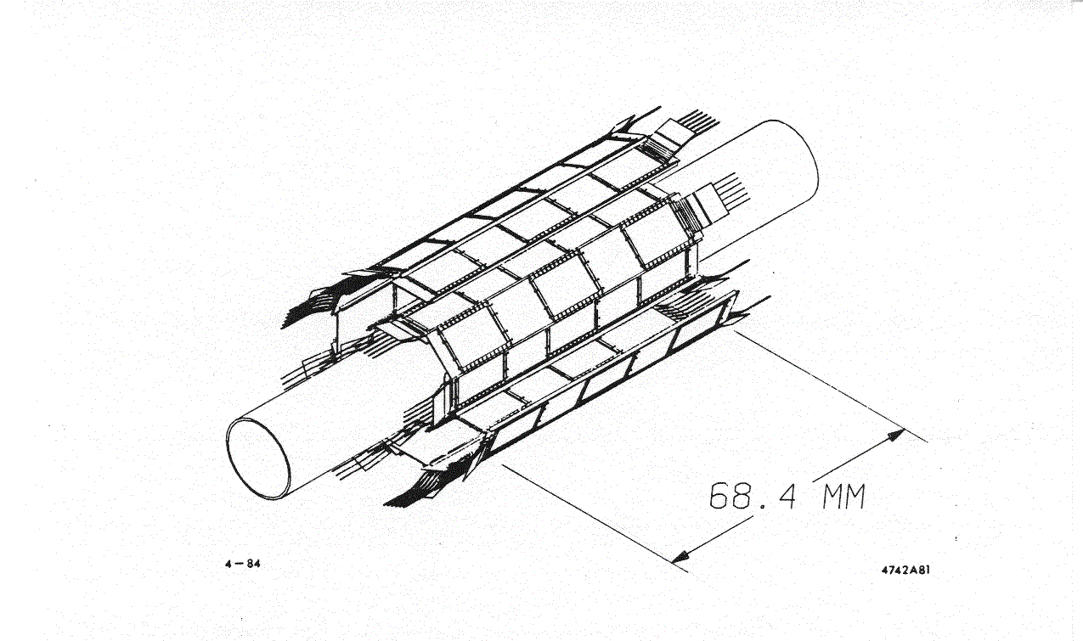
SLD Design Report 1983 and
DOE (Temple) Review
5-CCD ladders
Full azimuthal coverage with each of 2 barrels
The second requirement, to achieve clean identification of b and charm jets, was a pixel-based vertex detector with spatial resolution ~ 5 μm, hence pixel size ~ 20 μm square (This technology was established during the 1980s in CERN – in the ACCMOR Collaboration studying hadronic production of charm particles)
We proposed a detector with 120 CCDs, 26 Mpixels. A beautiful concept – we were entirely confident, but they allocated us 100% contingency – unheard of! This proved to be a wise judgement.
But it was not to be. Fortunately for us, the Mark II detector ran during SLD construction,
after it was moved from PEP to SLC ………

Slide 4
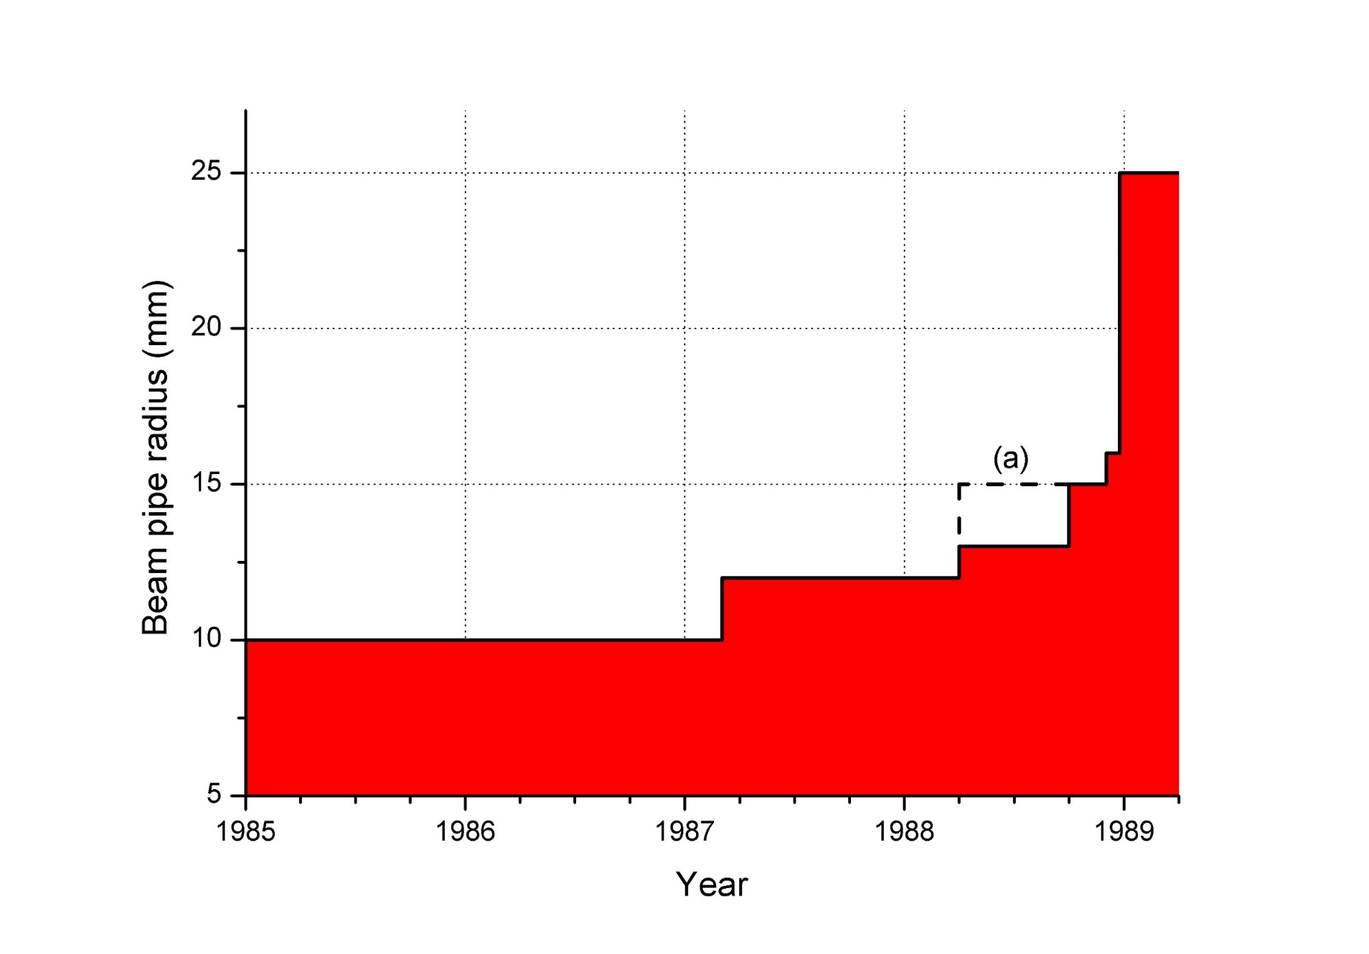
One opinion: ‘Give ‘em anything: they’ll learn to live with it’, was fundamentally flawed. Remember what happened at LEP.
SLD Advisory Group Meeting 1989: Another opinion: ‘480 CCDs is ridiculous’

Slide 5
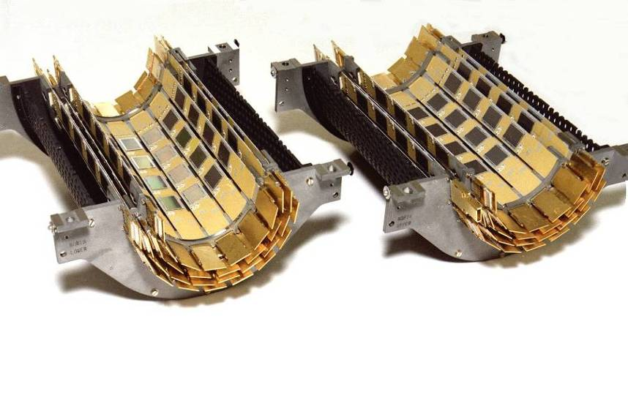
VXD1 was a 3-ladder prototype used in the engineering run in 1991
VXD2
Instead of 2 layers, each with full azimuthal coverage, we were forced into 2 pairs of layers with longer 8-CCD ladders, in order to achieve 1-hit coverage with Layer (1+2) and with Layer (3+4). Also, reduced polar angle coverage (ladders still too short)

Slide 6
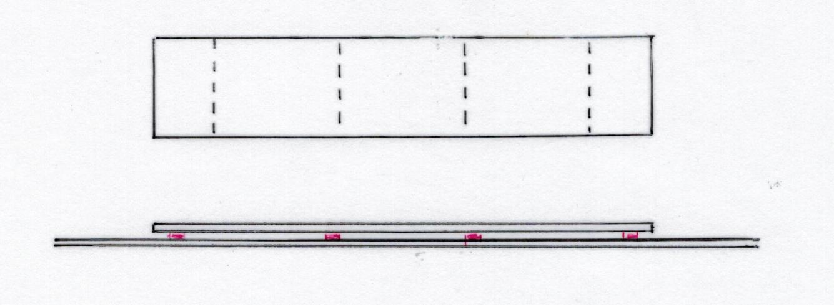
My talk to the e2V CCD team January 1993, then an SLD Collaboration Meeting May 1993
e2V was the world’s first CCD manufacturer to master the art of ‘stitching’ tiles in device processing - needs ~5 nm registration between adjacent tiles
E M M M E
8 cm
No longer 8, but just 2 CCDs per ladder, of active length 16 cm.
Some reluctance: ‘We already have the world’s best vertex detector’, etc; but:
Su Dong: That’s the vertex detector I joined SLD to build!

Slide 7
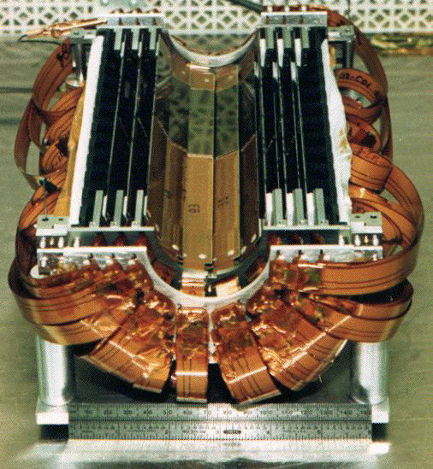
VXD3

Slide 8
VXD3 – some key features
CCDs: 4000 Rows x 800 Columns → 3.2 Mpixels (15 times VXD2)
48 ladders, 96 CCDs, 307 Mpixels (2.5 times VXD2)
Beampipe with slightly smaller radius, thinner-walls: thinner titanium liner: thinner CCDs: thinner ladder substrates (beryllium instead of alumina)
Hence, overall layer thickness reduced from 1.15% X_0 to 0.4% X_0 *
State-of-art electronics, much more compact than for VXD2, achieving local sparse readout with optical fibre connections to off-detector electronics, keeping the readout time almost unchanged wrt VXD2.
At last, we had the detector we needed to do the physics (pure and efficient tagging of b and charm jets)
* Word of caution regarding MU3E with their layers of 0.1 % X_0. Not suitable for vertex detector (Joost Vossebeld)

Slide 9
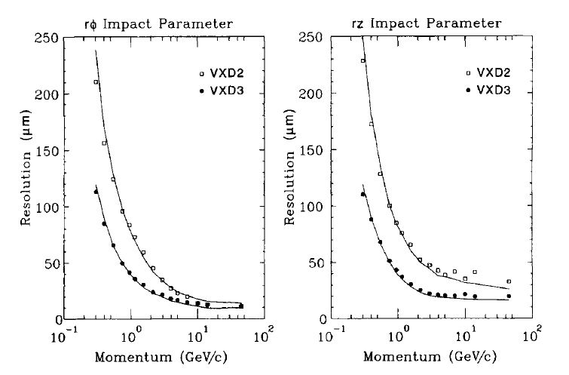
The bottom line
There’s more to it than the average impact parameter resolution, which derived mostly from the increased lever arm inner to outer of VXD3 wrt VXD2:
VXD3 delivered robust 3-hit coverage, hence standalone tracking. So we could help refine the track-finding procedures in the drift chamber
However, immediately after installation, VXD3 was almost destroyed! It was saved only by the Lazarus Effect:
operating temperature reduced from 220 K to 180 K

Slide 10
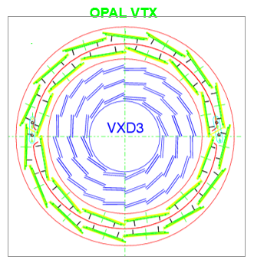
Our big headache regarding installation: how to switch from VXD1 to VXD2 to VXD3, in the most congested and inaccessible part of the detector system?
An intense meeting of SLD Advisory Group during 1991. The original plan was falling apart almost by the day. Bill Ash to the rescue.

Slide 11
SLD in 1991, VXD1 installed

Slide 12
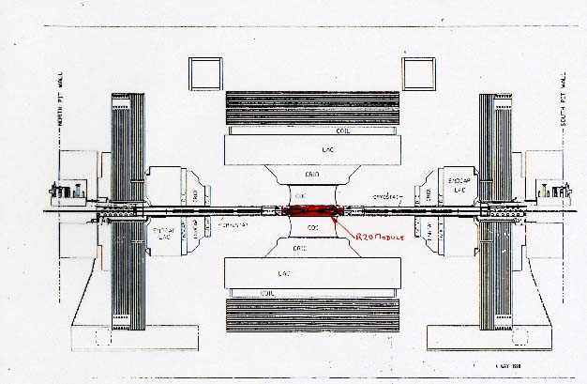
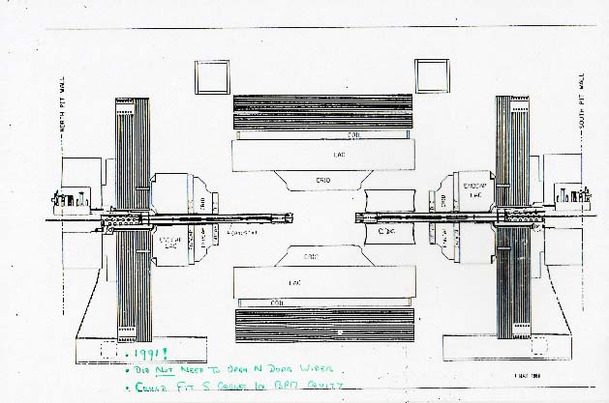
3 independent tractor motion systems, for 500 tons plus two of 125 tons

Slide 13
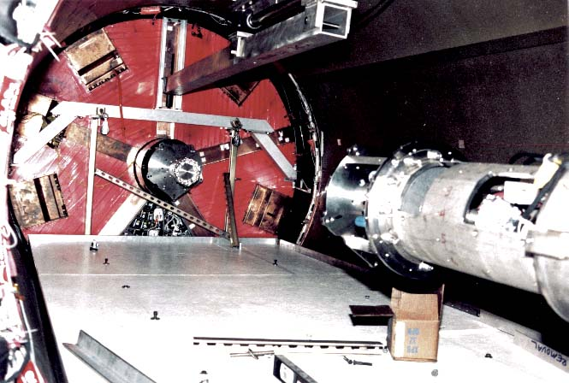
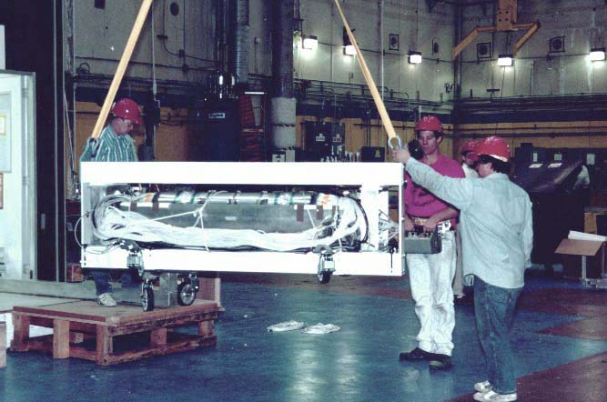
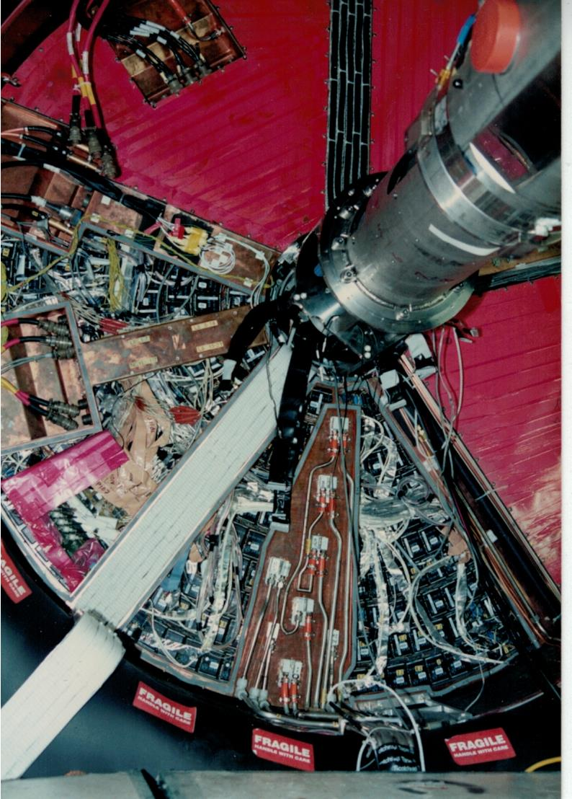
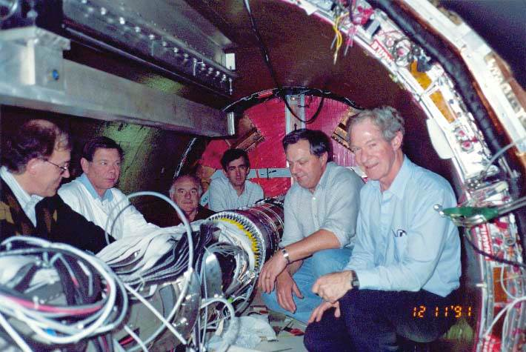

Slide 14
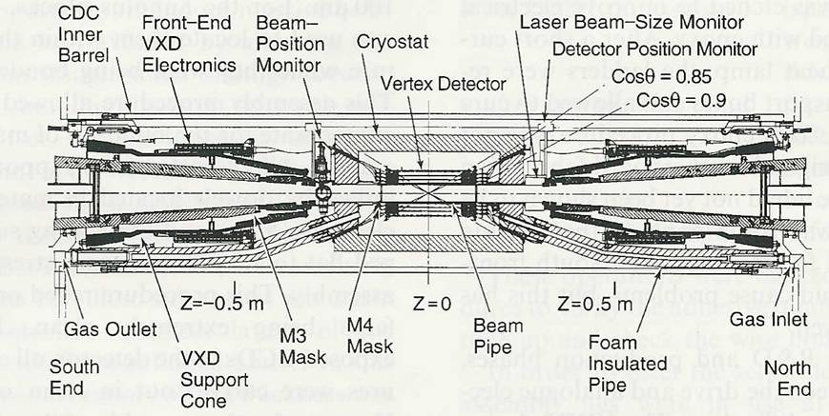
Cross-section of ‘R20 module’ – VXD3 version
Delicate 3-point support (cone, Vee and flat) from beampipe
Foam
Heavy vacuum pipe carrying FF quads is supported from the end-doors of SLD. During door opening/closing these would droop or lift, breaking the delicate braze joints. Precision servo system eliminated dangerous stresses.
Be-stainless steel
braze joints

Slide 15
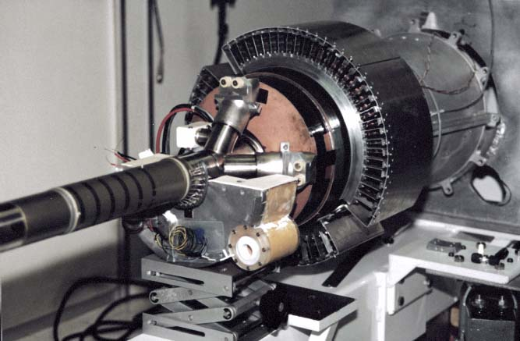
First of 6 sections
of foam cryostat
Stainless steel-beryllium braze joint, wall thickness 0.75 mm
When in SLD, transfer to outer beampipe sections (north and south) and subsequent operations (SLD door opening and closing) required careful planning and execution.

Slide 16
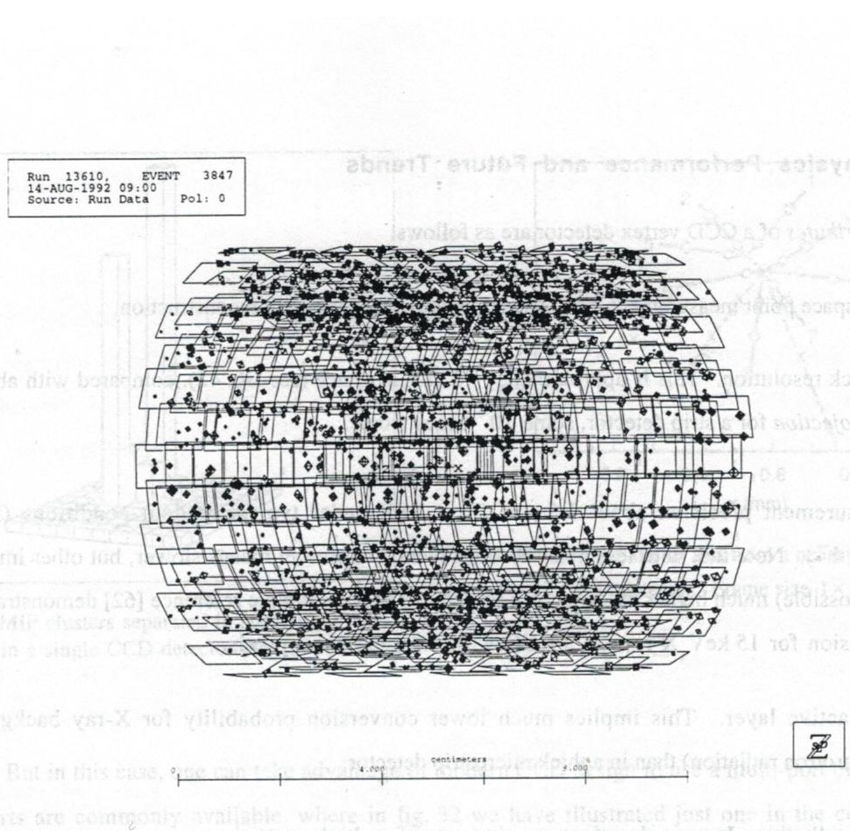
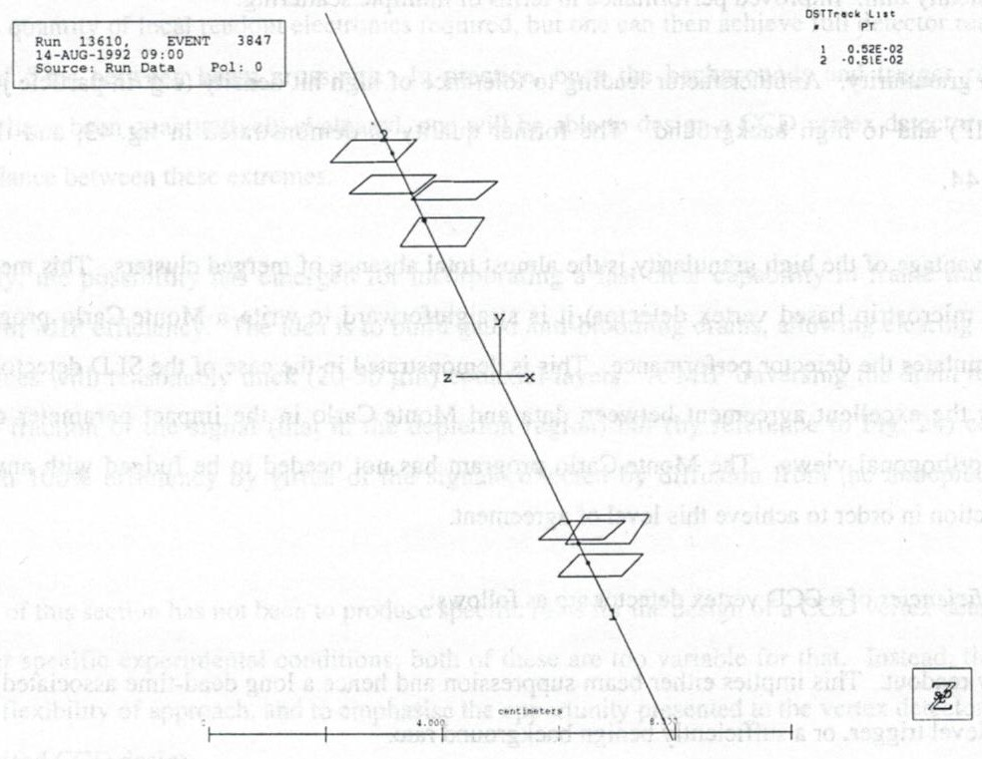
VXD2 ran for 3 years 1992-1994
VXD3 ran for 3 years 1996-1998, by which time SLC worked beautifully
Backgrounds at SLC were at first sight alarming!
Pixels have ~4000 times finer granularity than microstrips –
hence able to soak up massive number of background hits.
We had the world’s best vertex detector, but the B tagging performance was ‘no better than LEP’
David Jackson, former grad student on ALEPH, worked diligently in his new office in SLAC for a few months

Slide 17
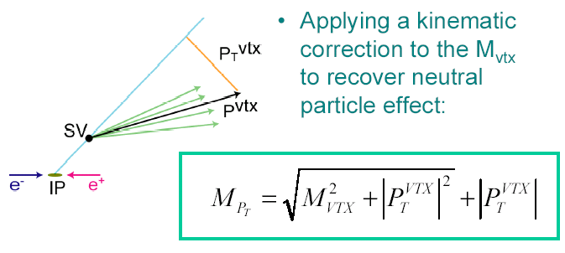
‘P_{T} Corrected Vertex Mass’
P_{T}^{miss}
Apply a kinematic correction to M_{VTX} to partially recover effect of missing neutral particles:
M_{PT} is the main parameter for tagging of, and discrimination between, b- and c-jets. A brilliant development, led by
Dave Jackson and Su Dong
ZVTOP continued to evolve as LCFIVertex (Nicolo de Groot, Sonja Hillert), then from 2007 as LCFIPlus (Tomohiko Tanabe, Masako Iwasaki, Jan Strube) – now used by all of SiD, ILD, CLICdp
M_{PT} is the main parameter for jet b-tagging

Slide 18
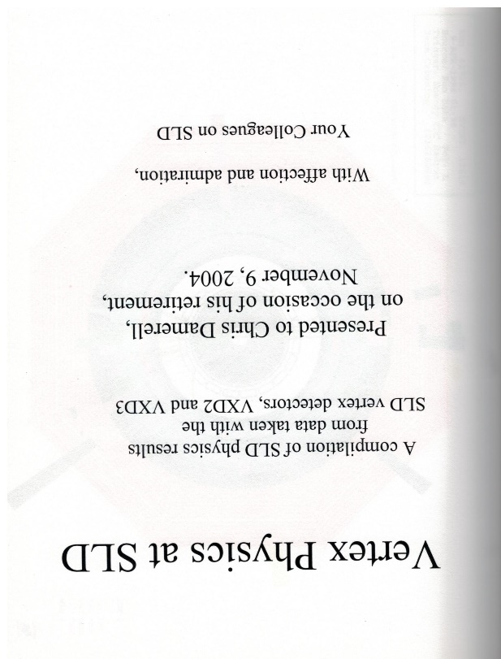
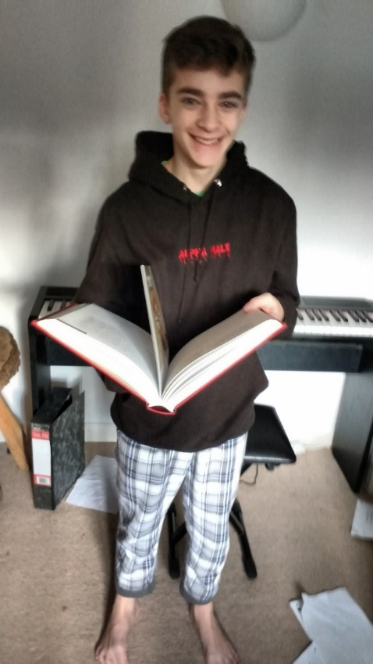
200 pages, 30 papers, in PRL, Phys Rev, Physics Letters

Slide 19
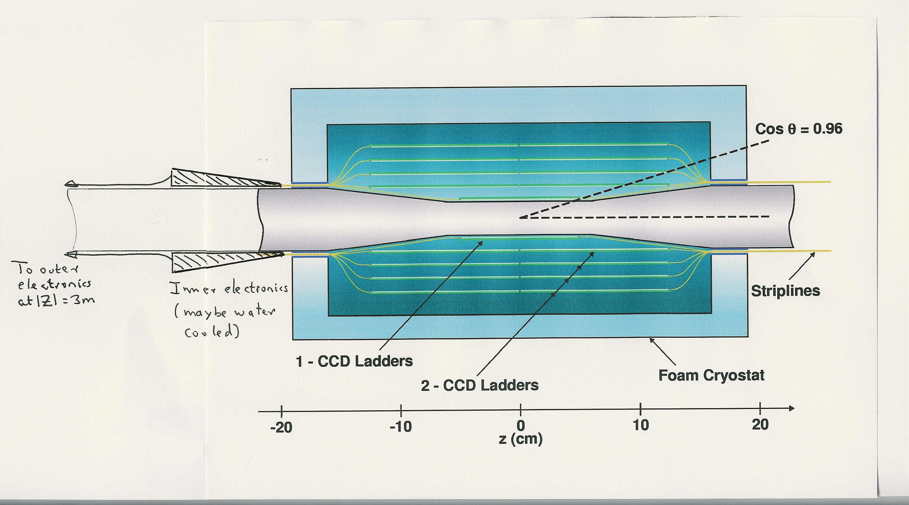
Conceptual 5-layer vertex detector for ILC
Preferred technology is now stitched CMOS pixel devices (20 μm pixels) building on the developments of W Snoeys et al for ALICE. 1 or 2 devices per 25 cm long ladder, as shown

Slide 20
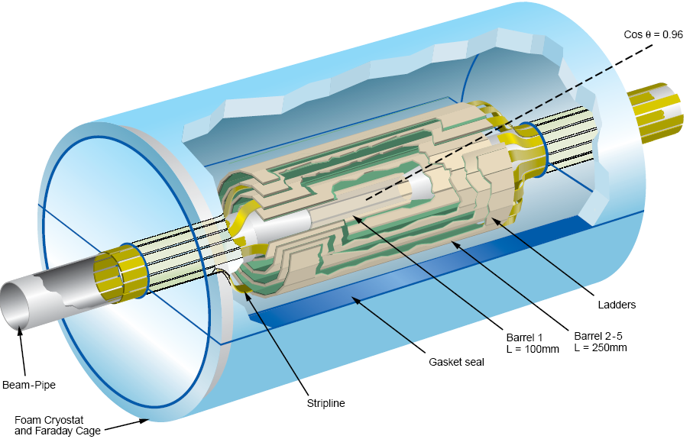
Generic long-barrel detector
Note absence of endcap detectors, as part of vertex detector system. By all means have endcap tracking detectors

Slide 21
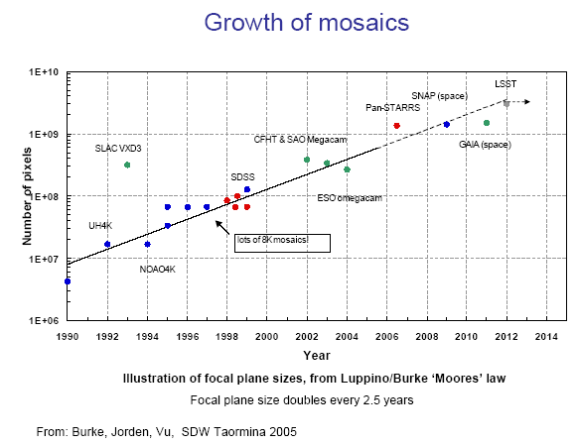
.
.
ALICE ITS-2
LSST
2020

Slide 22
After all this, what lessons did we learn, that might be relevant to CEPC(ee)?
There’s a non-negotiable need for a small radius beampipe (~15 mm), or much physics would be lost. Can this small radius be guaranteed, after what happened at LEP and SLC? Can the LEP-2 conditions be reliably simulated, and results carried forward to CEPC? Does the much larger machine circumference imply a higher risk? [remember the ‘loose bolts’ incident in the SLC LINAC]
Presuming a necked-down beampipe is needed (ie it cannot be cylindrical over an extended length) the ‘R20 module’ installation procedure might be attractive.
Should one cater for cryogenic operation? This feature gave VXD3 one of it’s ‘9 lives’. Subsequent vertex detectors have suffered damage from unexpected beam glitches at RHIC and Belle-II. Cryogenic operation demands an excellent gas seal, since a small leak would have serious consequences for other detector systems. For this to work, the R20 module approach is preferred or maybe obligatory, as opposed to assembling the detector round the installed beampipe.
Whatever else, there needs to be a clear procedure for upgrading or replacing the vertex detector at unpredictable time intervals. Putting a delicate detector so close to the beam is inevitably risky. Experience with SLD, then with the STAR vertex detector at RHIC, and with Belle-II (the DEPFET-based vertex detector) show that convenient access for repairs or replacement is a general requirement, if you push for small radius.
Best of luck with this great adventure!

Slide 23


