Slide 1
Mechanics in the IR and Integration Scheme
Haijing Wang
CEPC MDI Workshop, 2020/5/28

Slide 2
Outline
Integration Scheme
Key mechanics issues in the IR
  Vacuum chambers
  Vacuum connection mechanism
  Support system
  Alignment scheme
Movable collimators
Lists to be done

Slide 3
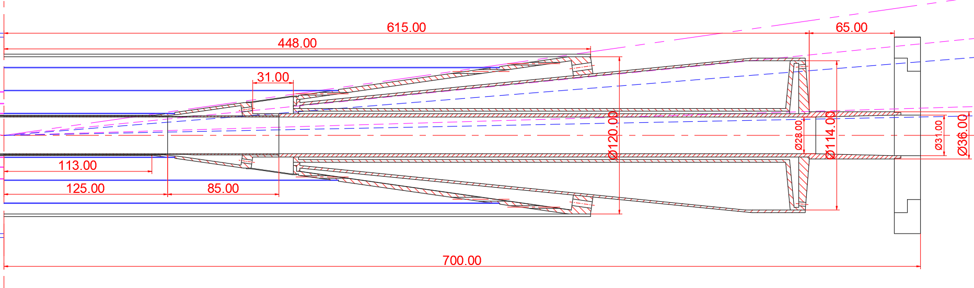
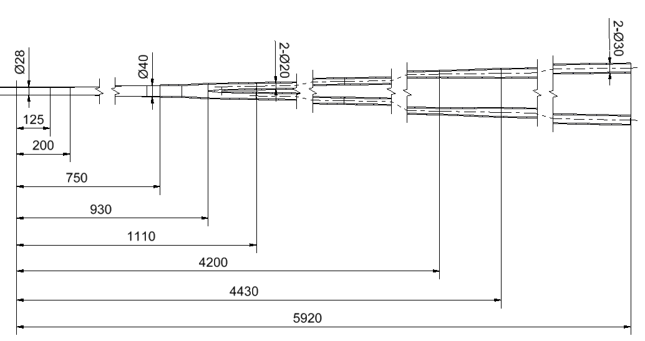
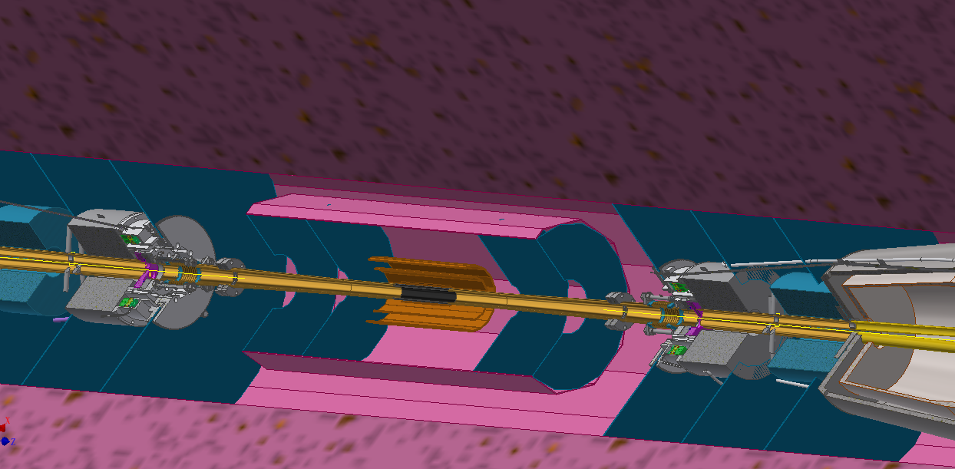
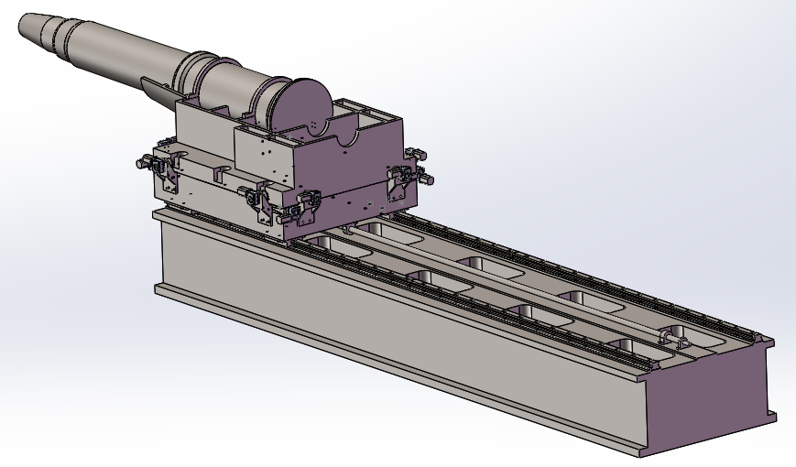
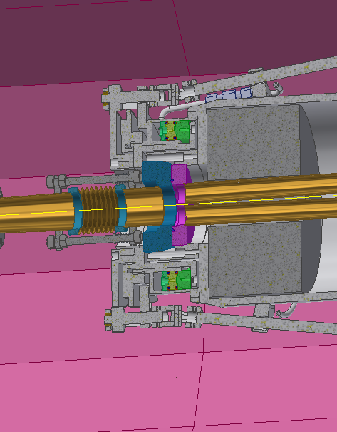
MDI mechanics
IP chamber by Q. Ji
First vacuum pump @±6.5m
Connection interface of detector and accelerator
SC magnets, cryostat and their support

Slide 4
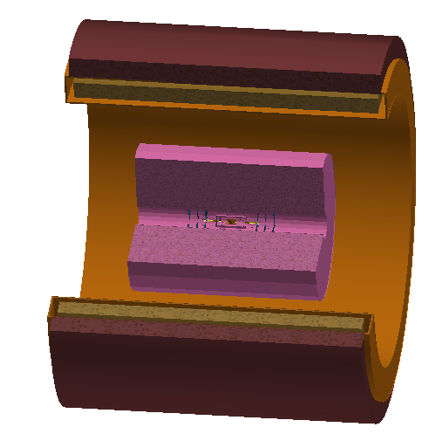
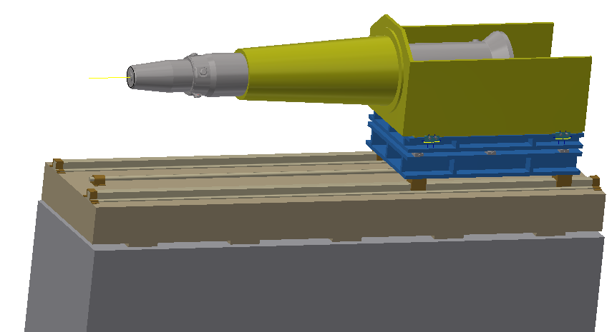
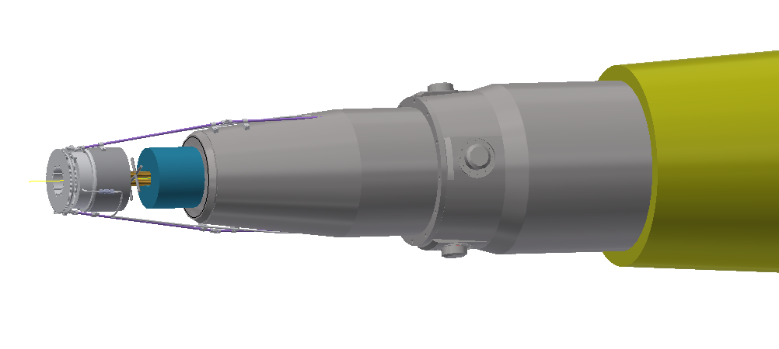
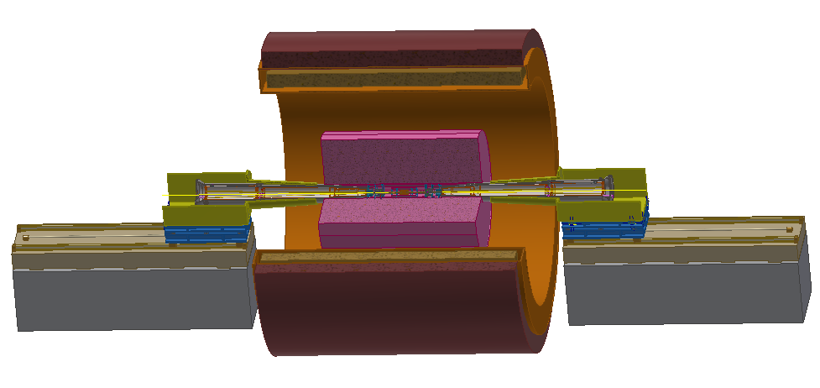
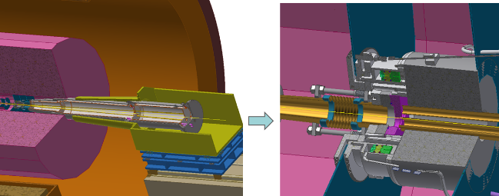
Integration scheme
Installation scenario of accelerator devices
  Assume the IP chamber and the detectors, the yoke have been installed.
  The remoted vacuum connection methods will be used.
  The support system of cryostat is under studying.
  The idea of Lumical being moved to the detector part has been discussed.
Pre-alignment of SC magnets and installation of accelerator components
The similar procedure at the other side
The connection and alignment of one side

Slide 5
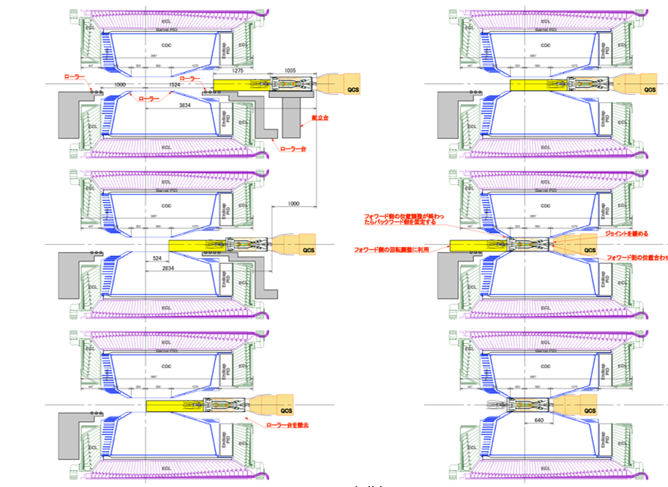
Integration scheme
An alternative scenario
  The baseline of SuperKEKB before the validation of RVC.
  This scenario is connecting one end of IP chamber with cryostat outside the detector .
  But unlike the asymmetry of SuperKEKB MDI, this scenario can't cut out the remote vacuum connection at the other end of IP chamber.
Not advisable
From K. Kanazawa of KEKB, the 18th KEKB Accelerator Review Committee, 2013

Slide 6
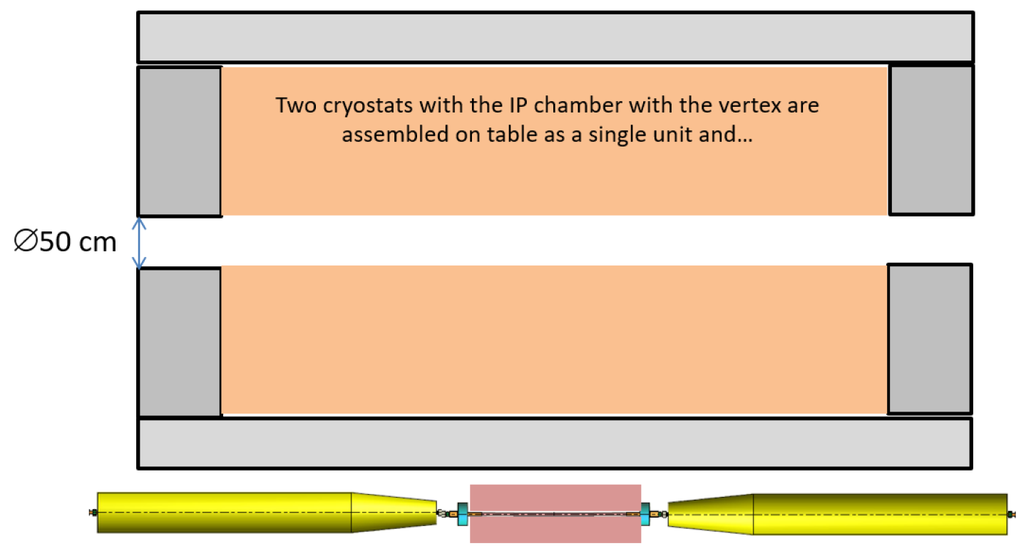
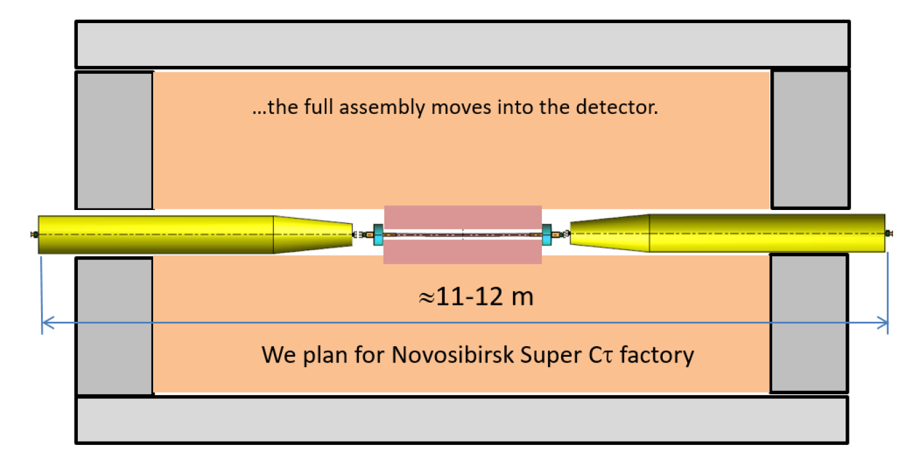
Integration scheme
Another alternative scenario
  The method like DAFNE. Being considered by FCC and BINP.
This scenario is connecting both ends of IP chamber outside the detector like
DAFNE.
The two cryostats can be well pre-aligned but it is impossible to move the whole assembly into the detector without changing the size of detector hole.
Not advisable
A. Bogomyagkov, et al., Mechanical design of the FCC-ee interaction region, FCC week (24 –28 June 2019) Brussel
A.Bogomyagkov, MDI issues of BINP Super TauCharmfactory, Report on IAS 2020.(Hongkong, 2020).

Slide 7
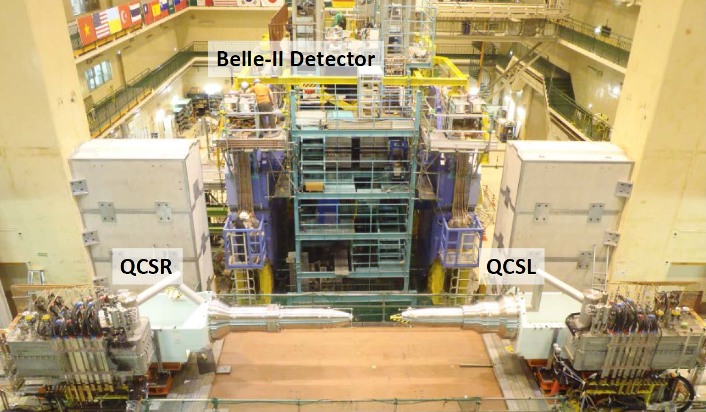
Integration scheme
Accelerator foundation is fixed. It is good at:
  Beam stability.
  Integration of detector before push-in.
Detector foundation is fixed. It is good at:
  Detector stability
Maybe we can find balanced approach (very long distance with only beam pipes near MDI)
Before and after BESIII push-in
Before Beast(II) push-in
Detector push-pull arrangement

Slide 8
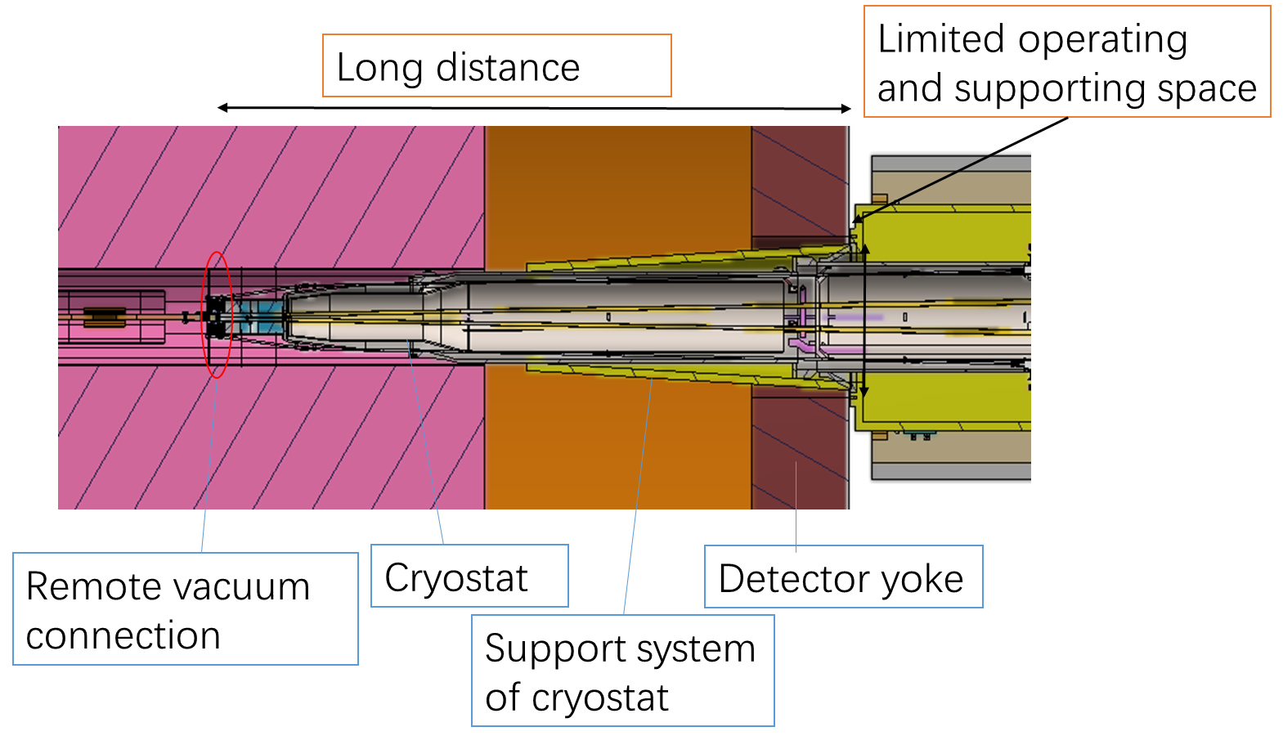
Key mechanics issues in the IR
Highly correlated with cantilever length
Key issues:
  Design of vacuum chambers.
  Vacuum connection. Leak rate requirement: ≤2.7e-11Pa.m3/s
  Support system. Stability, accuracy, easy-operating.
  Alignment scheme. Requirement: ≤50 μm.

Slide 9
Key mechanics issues in the IR
 | Distance from yoke boundary to connection location (m) | Alignment requirements of SC/ deformation of cryostat (μm)
BEPCII | ~2.3 (has manual operation space) | Tested deformation: 960
SuperKEKB | ~3.5 (the longer side) [1] | Analyzed deformation: 900 [2]
FCC-ee | ~4.37 [3] | Alignment error: ≤50 [4]
CEPC | ~3.8-6.1 * | Alignment error: ≤50
[1] Hiromi linuma, SuperKEKB status. Report, Nov, 2013。
[2] Hiroshi Yamaoka, et al, The mechanical and vibration studies of the final focus magnet-cryostat for SuperKEKB. Proceedings of IPAC 2014, Dresden, Germany.
[3] M. Koratzinos, Overview of MDI at FCC-ee, Report on IAS 2020.(Hongkong, 2020).
[4] Future Circular Collider Study. Volume 2: The Lepton Collider (FCC-ee). Conceptual Design Report. V0.20, 8 Nov, 2018
*: The distance needs to be discussed further. The current design is based on the shortest version.

Slide 10
Key mechanics issues in the IR
vacuum chambers.
IP chamber
Y-shape
chamber
Cryostat chamber
Paraffin cooled
Water cooled
Be
Al
Cu
IP
Remote vacuum connection
IP BPM
Lumical
HOM absorber

Slide 11
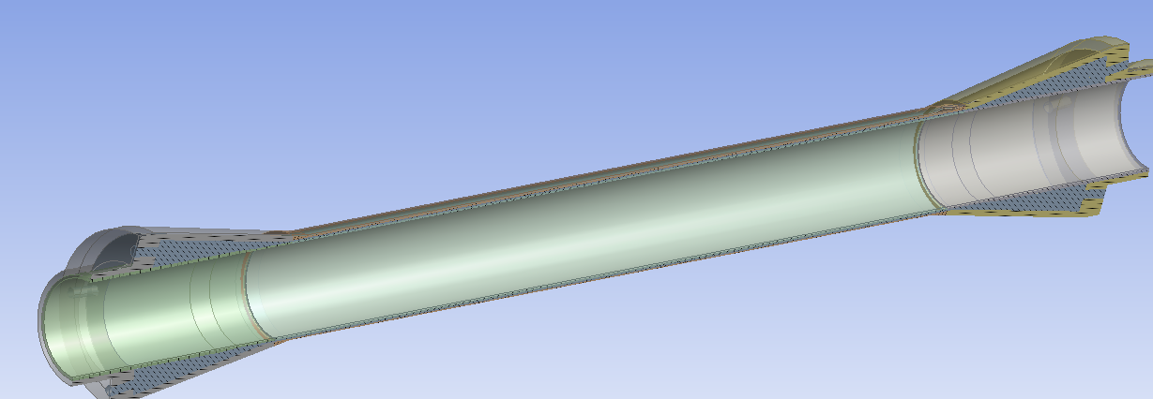
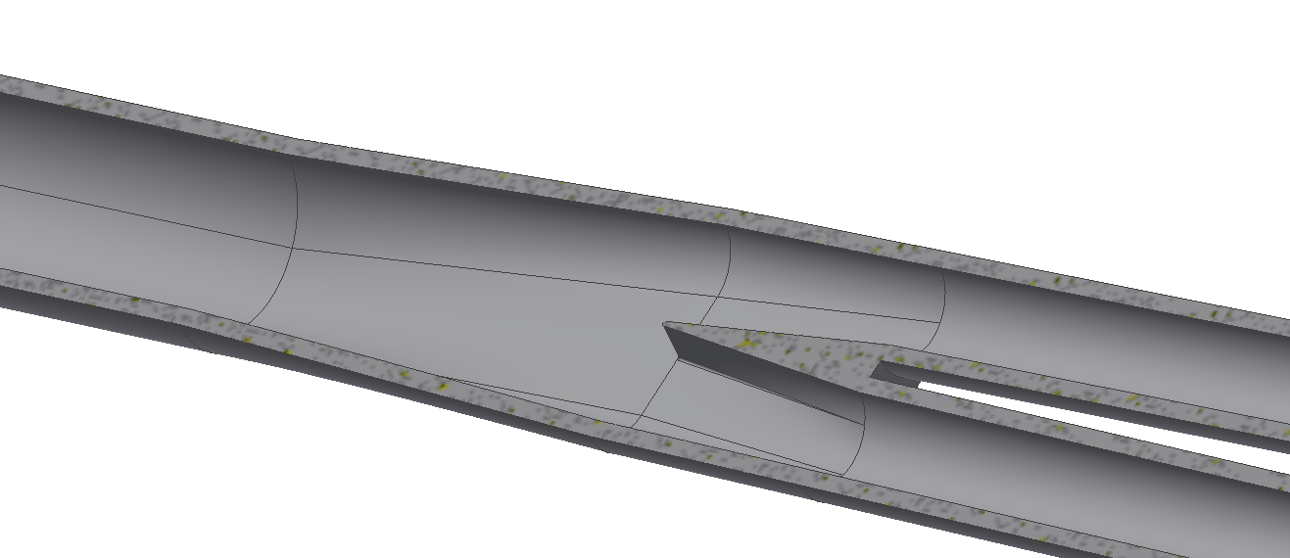
Key mechanics issues in the IR
  No SR load.
  HOM load is about 800 W @high luminosity
  Double layer Beryllium chamber.
IP chamber
Inlet velocity (m/s) | 0.5 | 1 | 2 | 3
Outer layer temperature (℃) | 20.1-45.0 | 20.0-30.9 | 19.8-24.0 | 20.0-22.1
Inner layer temperature (℃) | 30.3-77.9 | 29.0-63.3 | 28.1-52.3 | 27.7-47.5
Paraffin temperature (℃) | 20-77.9 | 20-63.2 | 20-52.3 | 20-47.4
Pressure drop (Pa) | 1.1e4 | 2.2e4 | 4.6e4 | 7.4e4
  Smooth transition to reduce HOM.
  About 360 mm long with remote vacuum connection mechanism, IP BPM, Lumical main body and other nesessary mechanisms.
  Space limited.
Y-shape chamber

Slide 12
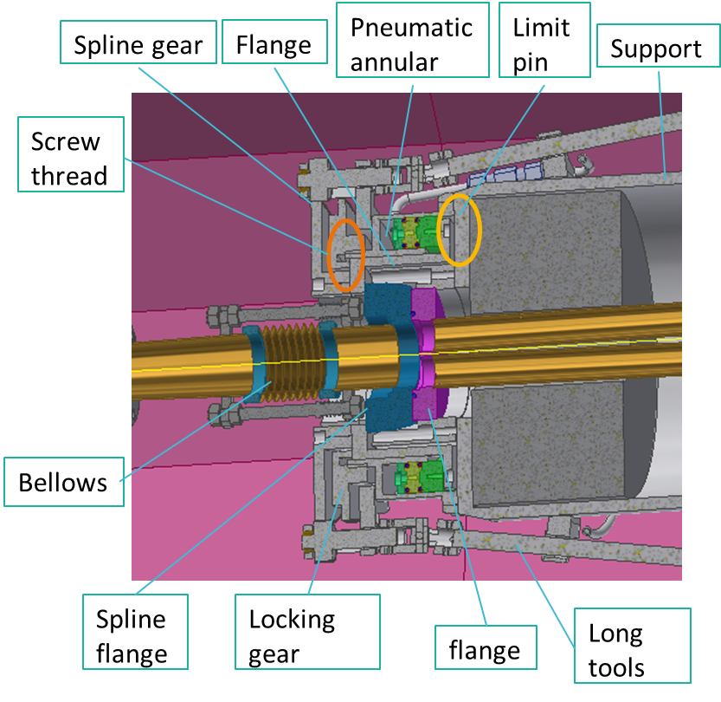
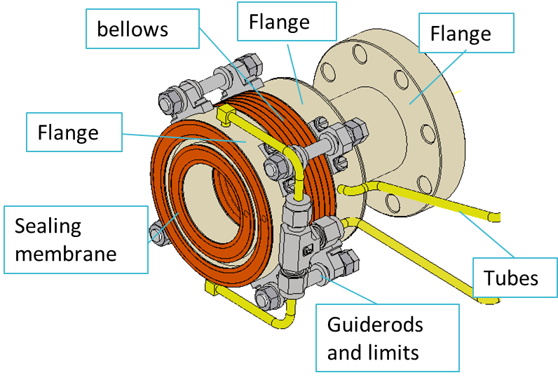
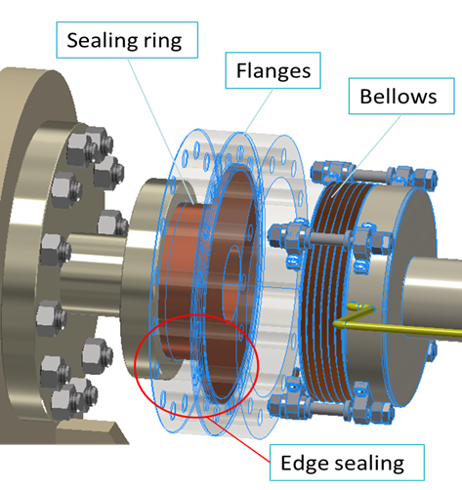
Key mechanics issues in the IR
vacuum chambers.
Inflatable seal Design
RVC Design
Three MDI installation scenarios→ Remote vacuum connection is inevitable.
Remote vacuum connection design is relatively independent on other devices.

Slide 13
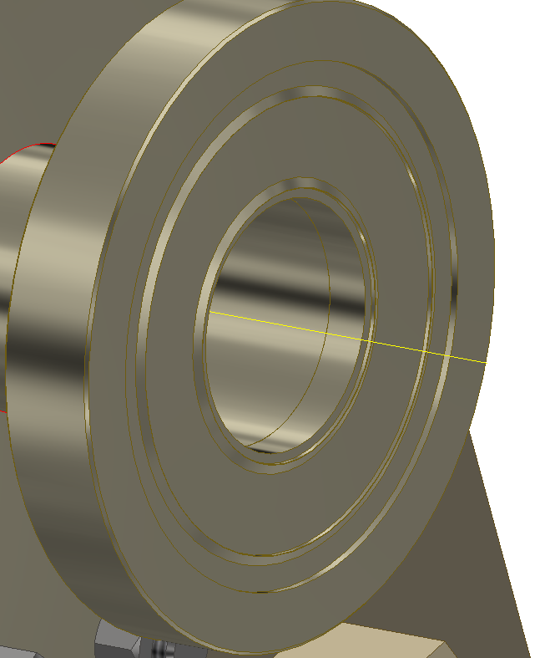
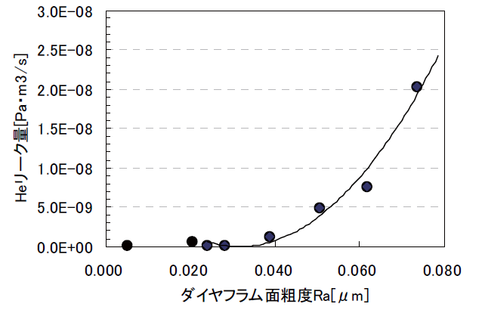
Key mechanics issues in the IR
Leak rate estimation
  RVC has successful experience from SuperKEKB.
  Inflatable seal design.
    Improve surface roughness.
    Single-layer → double layer, leak rate can be improved from 1e-6 Pa.m3/s to 8.5e-10 Pa.m3/s from CSNS experience.
    Replace membrane sealing by edge sealing
From J-PARC

Slide 14
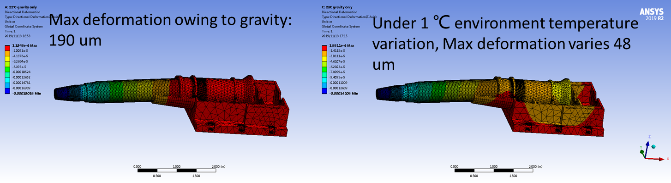
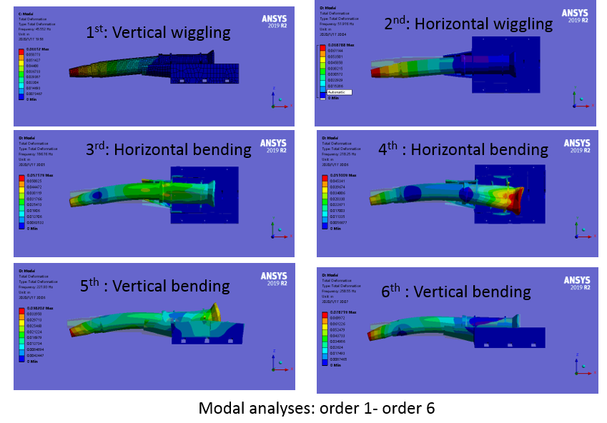
Key mechanics issues in the IR
Support system of SC magnets
Key points
  Stability (static and modal)
  Accuracy
  Easy-operating
  Dimensions

Slide 15
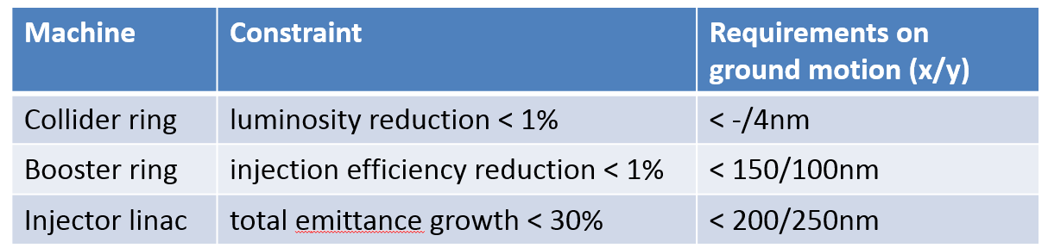
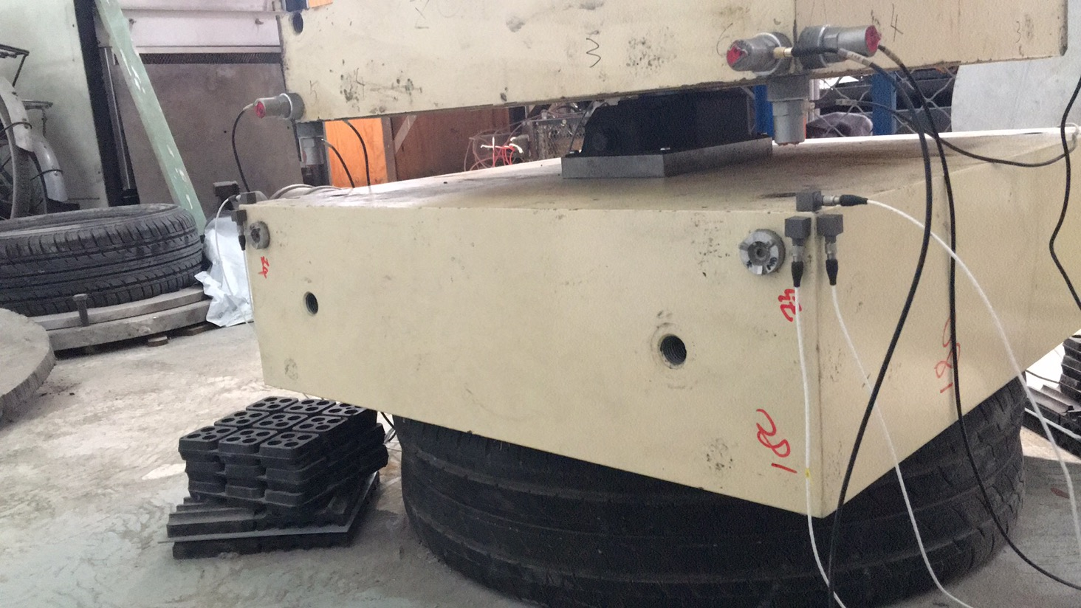
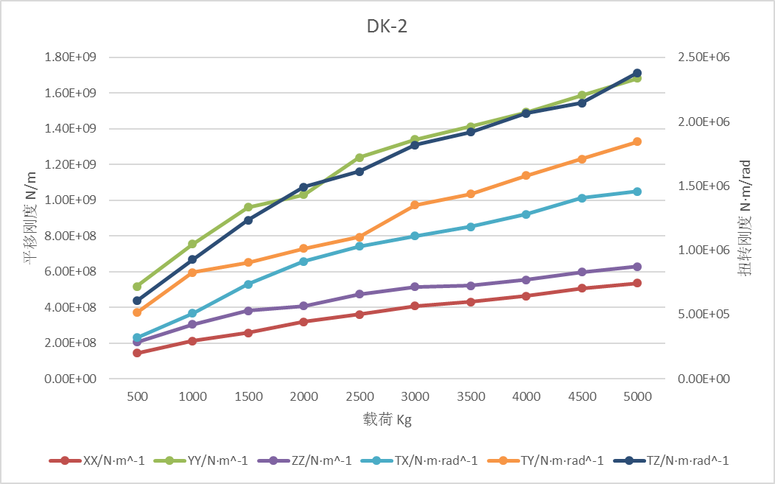
Key mechanics issues in the IR
From Y. Wang
High stability
Confliction
High stiffness for stability Flexibility for high accuracy.
Studies on support stiffness is on-going.
Motor driven wedges jacks for high stiffness and accuracy.
Auxiliary support, high damping material/structure are also in consideration

Slide 16
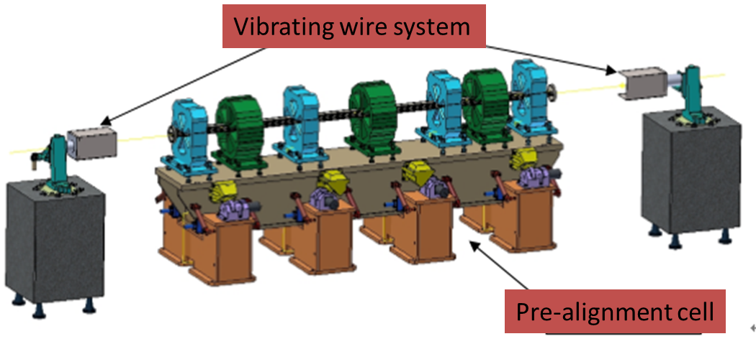
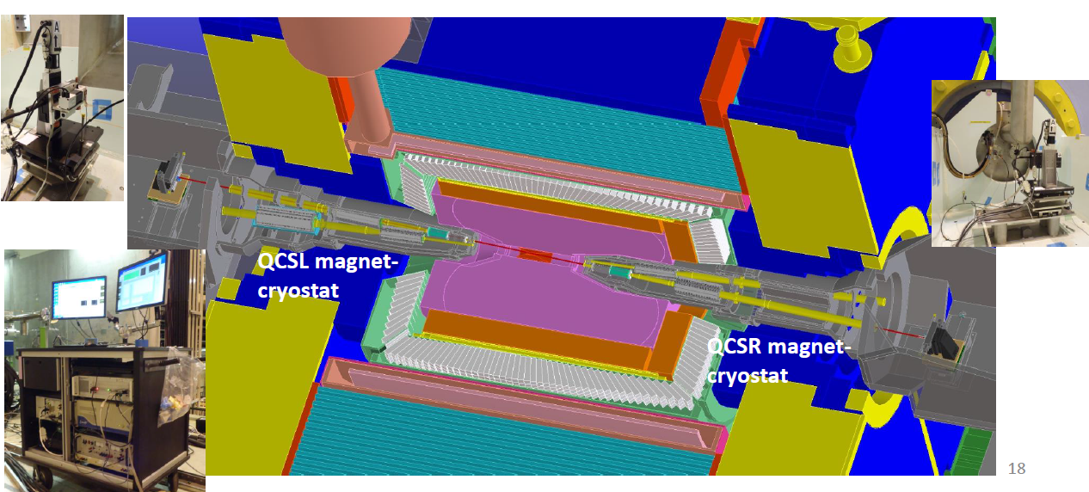
Key mechanics issues in the IR
Alignment scheme
Alignment scenario:
  Pre-align the SC magnets using vibrating wire system to “certain location” to compensate the effect of loads.
  Align the SC magnets on two cryostats using optical system.
  Measure misalignment using SSW and adjust cryostats or corrector magnets meet the alignment requirements.
  Details are under study.
From X. Wang
VWS is a candidate pre-alignment method, accuracy of magnet centers: ≤10 μm
SSW measurement of SuperKEKB
Max. center misalignment is 0.69 mm
“Every alignment errors are able to corrected by the corrector magnets.
N. Ohuchi, IPAC2018

Slide 17
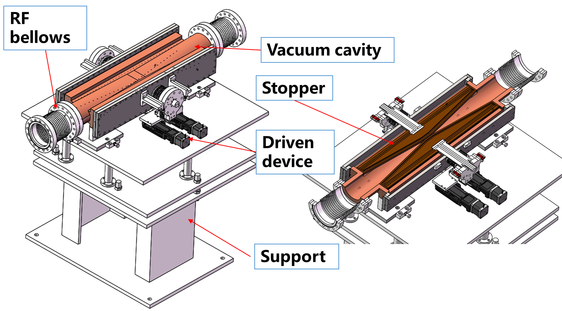
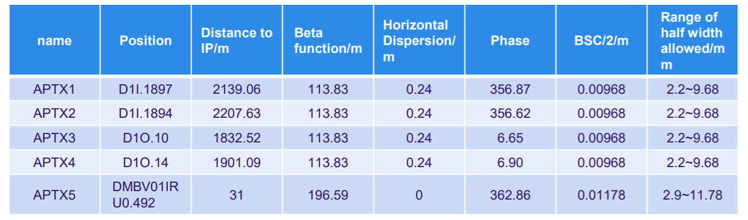
Movable collimators
Located in the straight line between dipoles.
5 movable collimators in TDR stage.
Thermal loads at normal operation:
  SR power: 7700W
  HOM and Beam deposition: much lower
  Thermal loads at accident cases are under study.

Slide 18
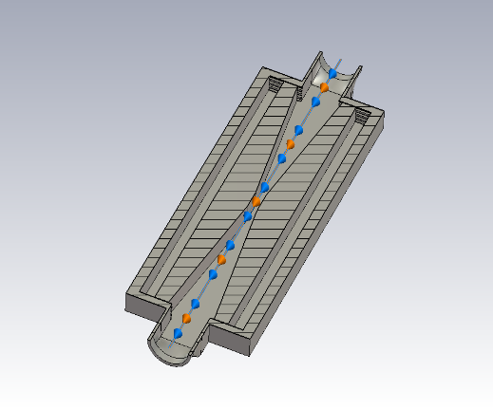
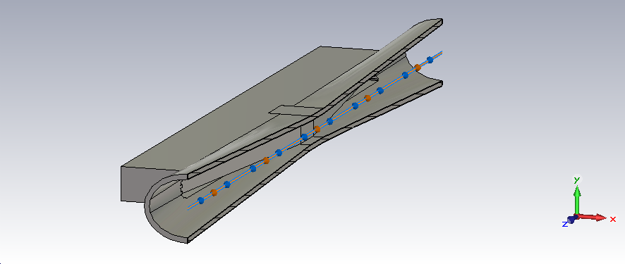
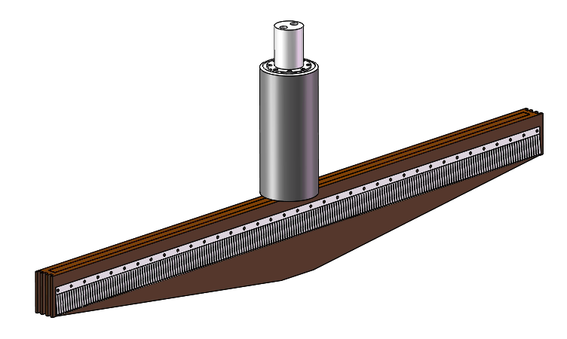
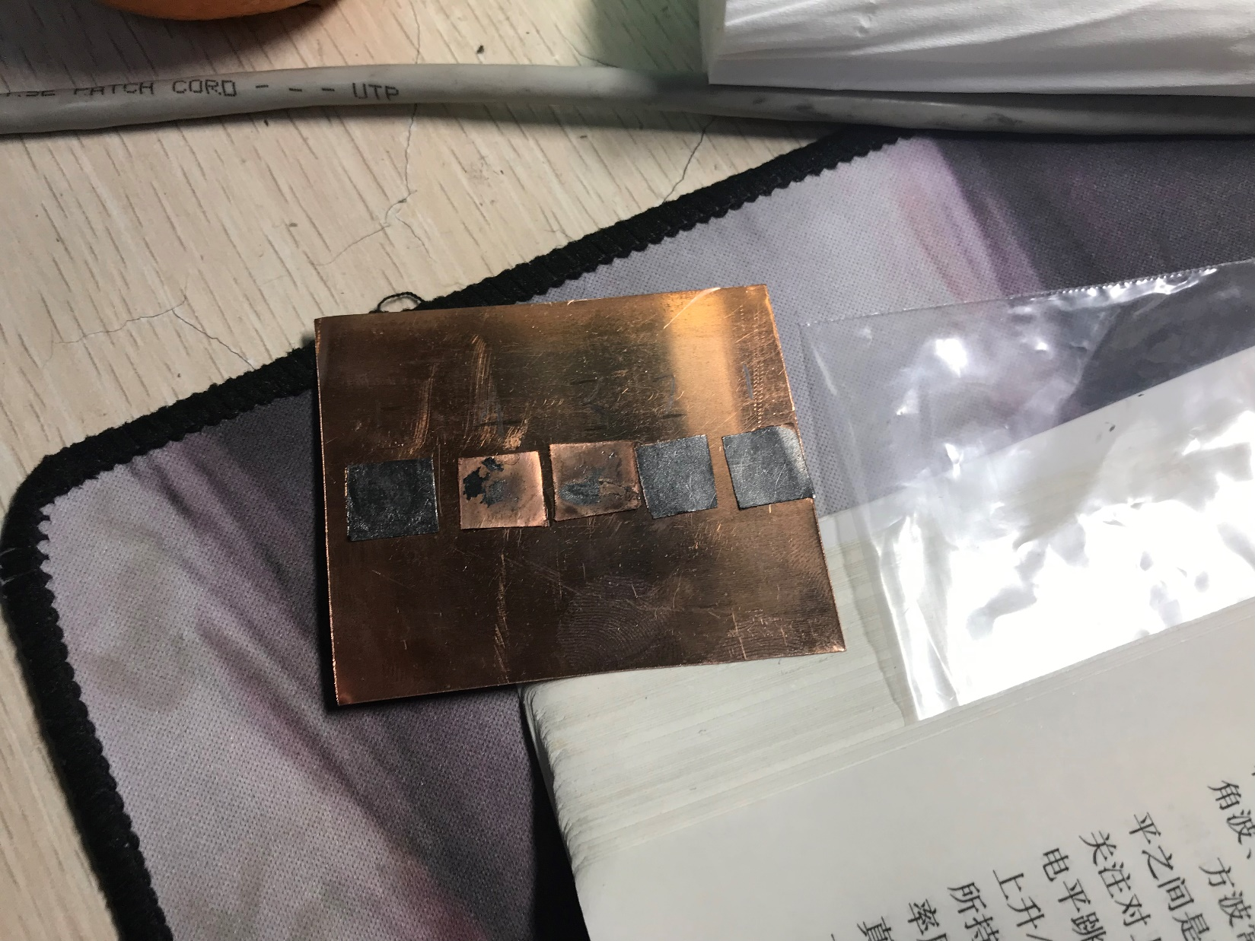
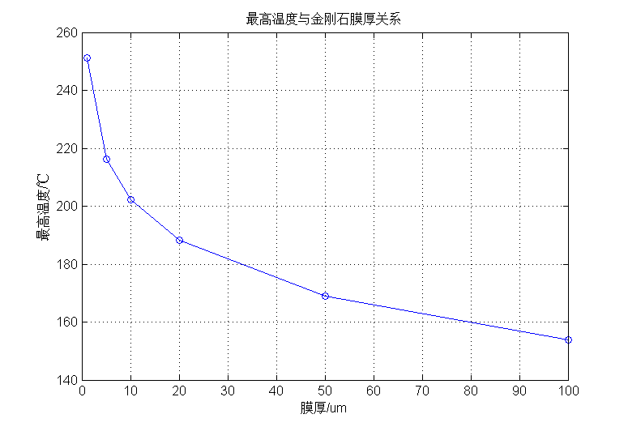
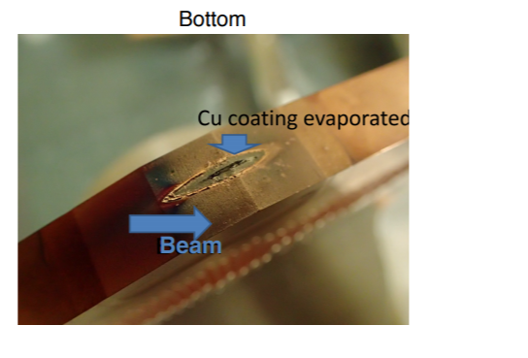
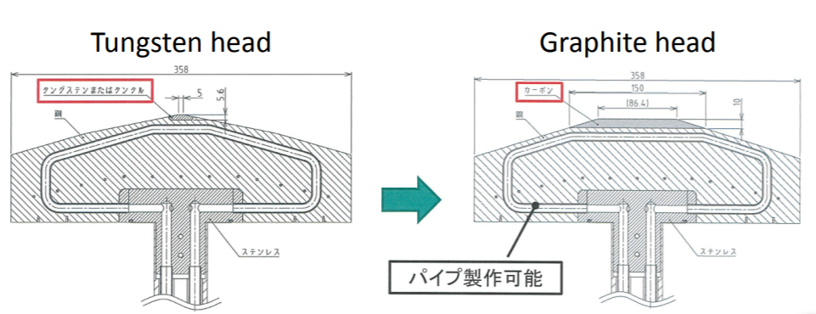
Movable collimators
Gradual rectangle profile
Gradual ellipse has lower energy loss.
Gradual ellipse profile
Y: Highest temperature;
X: Thickness of graphene membrane
Graphene film is a candidate material for thermal dissipation.
Laminated material with copper and graphene film

Slide 19
Lists to be done
We have made a rough integration scheme of the CEPC MDI, as well as some detailed designs. We will do:
  The more detailed integration scheme.
  Continue to optimize the vacuum layout.
  Detailed analyses of the cryostat & support assembly, including the deformation and vibration, considering gravity, temperature, magnetic field force.
  Detailed alignment method and accuracy estimation.
  Detailed analyses and design of the movable collimators.

Slide 20
Thanks

Slide 21
Back up

Slide 22
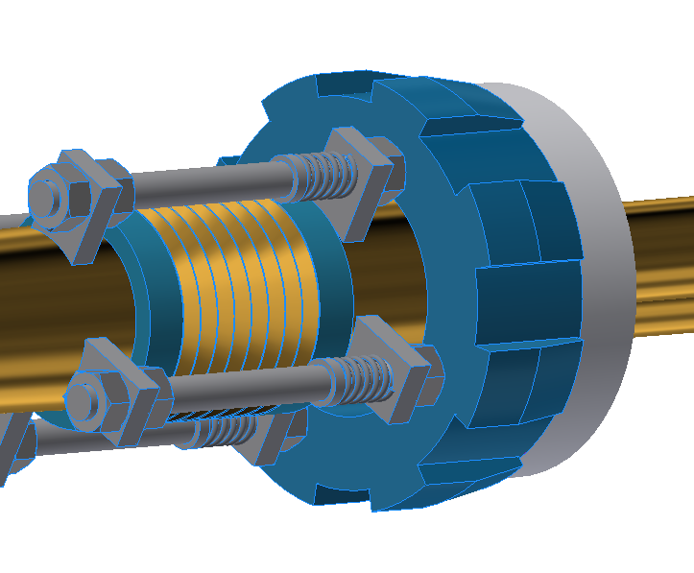
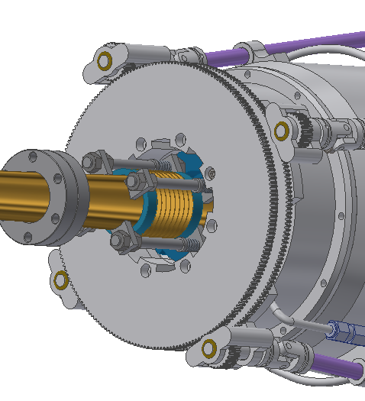
Back up
RVC Design
Spline flange
Flange
Pneumatic annular
Limit pin
Spline gear
Support
Screw thread
Spline gear
Bellows
Dimensions:
Transversal: Max. ϕ264mm
Longitudinal: ~223mm
Spline flange
Locking gear
Long tools
flange
  * Cooperate with Shenyang Huiyu vacuum technics co., Ltd.

Slide 23
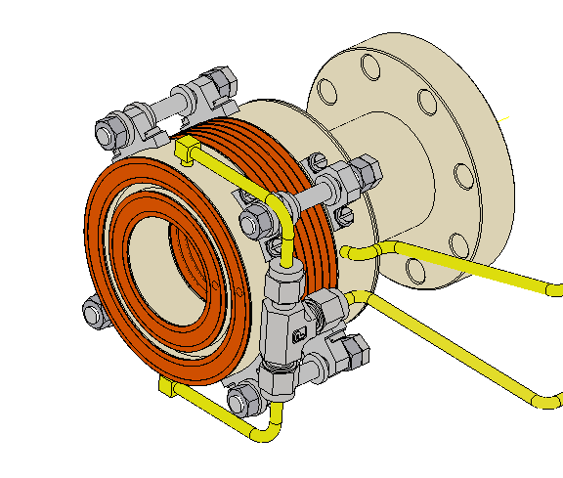
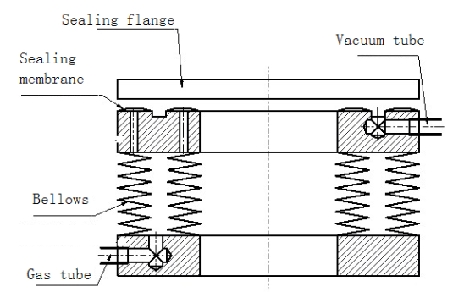
Back up
Inflatable seal design
  Experience from CSNS: leak rate ~10-7 Pa.m3/s level, four levels higher then CEPC requirement.
Flange
bellows
Flange
Flange
Sealing membrane
Tubes
Guiderods and limits
Dimensions:
Transversal: Max. ϕ112mm
Longitudinal: ~120mm

Slide 24
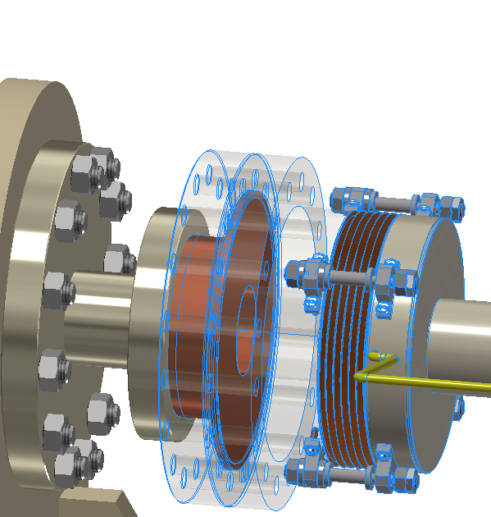
Back up
Inflatable seal design
Sealing ring
Flanges
Improved methods
  Precision machining of sealing membrane and flange.
  Different materials of sealing membrane and flange.
  Using edge sealing instead of membrane sealing.
  …
Bellows
Edge sealing

Slide 25
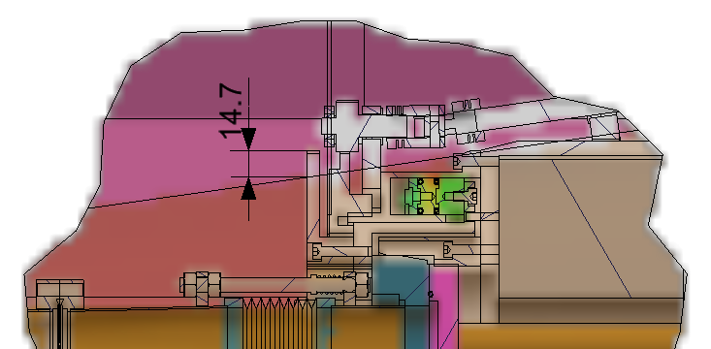
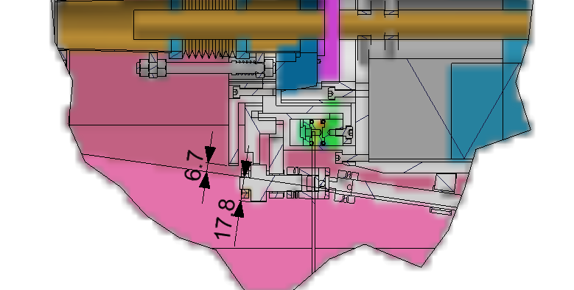
Back up
 | RVC | Inflatable seal | Long tools
Sealing methods | Pneumatic clamping with auxiliary locking | Pneumatic clamping | Screws clamping using long tools
Advantages | Successful experience from SuperKEKB | Successful experience from CSNS; Small and simple; Bellows at accelerator side | Simple and small
Disadvantages | Big and complex; Bellows at IP chamber side | Difficult for leak rate requirement | Difficult in operation
Before moved
The bellows of all methods have RF fingers.
Physics requirements: all accelerator devices are within acos0.99.
RVC design exceeds the boundary.
New consideration is that main body of Lumical move to IP assembly, thus the space is better.
After moved

Slide 26
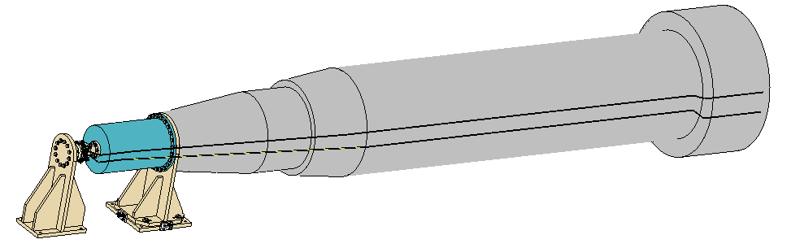
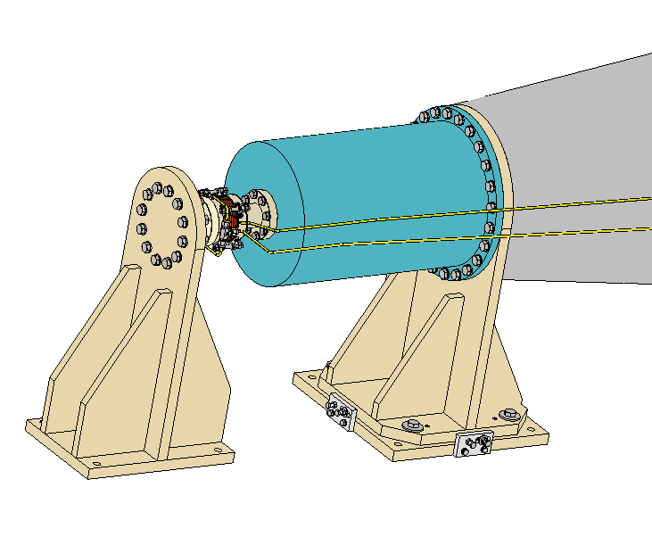
Back up
Test schemes
Support
“Fake” cryostat
IP assembly interface（fixed）
Support at accelerator part (can be adjusted to simulate the deformation and misalignment of cryostat)
Remote vacuum connection（eg. Inflatable seal）

Slide 27
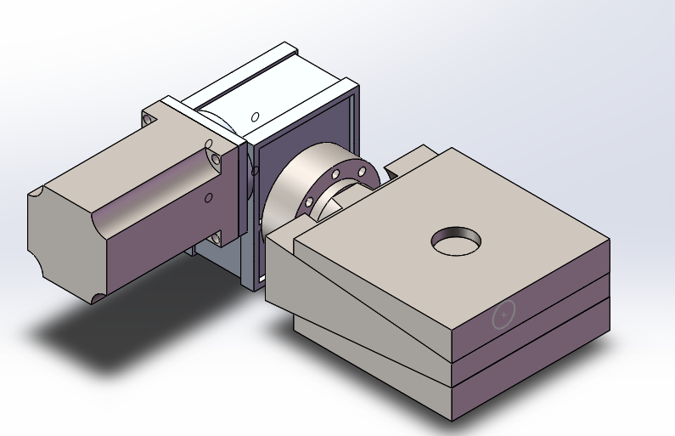
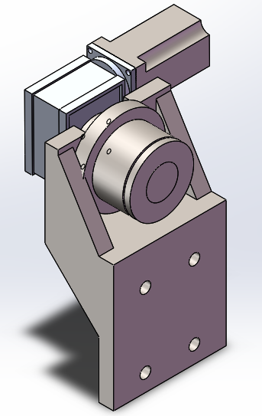
Back up
Support system of SC magnets
  The alignment accuracy of SC magnets: ≤30 μm, at least ≤50 μm.
  Movement mechanism: high precision track & rack.
  Adjusting mechanism: motor driven wedges jacks for vertical direction, motor driven screw jacks
Cryostat
Adjusting mechanism
Support bed
Movement mechanism
  * Cooperate with Beijing Institute of Space Mechatronics

Slide 28
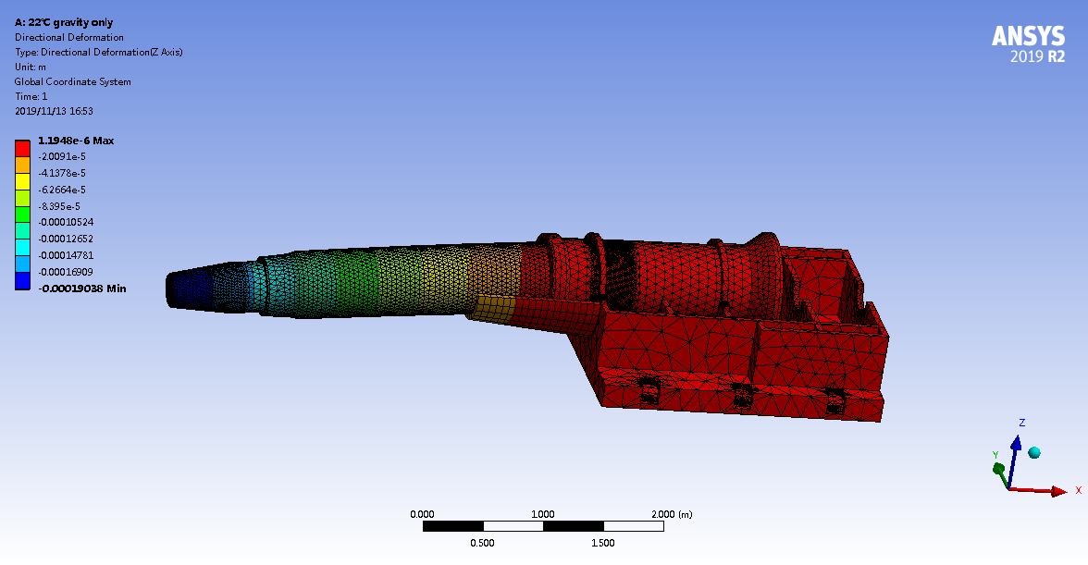

Back up
Max deformation owing to gravity: 190 um
Under 1 ℃ environment temperature variation, Max deformation varies 48 um
~3.6m
The current design of cryostat is 5 meters long with18 mm thick stainless walls. The weight of the cryostat is about 2 tons.
Only the cryostat itself is considered in the calculation above.
If the yoke length gets larger, the deformation will be even larger, which is proportional to the 4th power of length.
If the weight of components inside the cryostat and the magnetic field forces are considered, the deformation will be much larger.

Slide 29



Back up
Synchrotron radiation: 7700W @120GeV, 30MW.
Preliminary thermal-static analyses by synchrotron radiation have been done. Material: Glidcop-Al15.
Photon energy damping in
Copper @ 300 KeV
Highest Von Mises Stress by synchrotron radiation: 81 MPa
Highest temperature by synchrotron radiation: 148 ℃
Cooling method | Loads | Highest temperature（℃）
Copper & water | Surface load | 286
Copper & water | Volume load (Damping of X ray) | 148
Laminated material & water | Surface load | 146

Slide 30
Back up
Laminated materials with metal and high-thermal-conductivity membrane is considered for severe heat load.
Y: Highest temperature;
X: Thickness of membrane of high thermal conductivity
Laminated material with copper and graphene film
* From Carsten Niebuhr, IAS MDI Workshop, Hongkong, 16.-17.01.20

Slide 31

Back up
Two inner profiles are designed, gradual rectangle and gradual ellipse with movable stoppers in them.
RF fingers are at the edges of the stoppers to decrease impedance.
Gradual rectangle profile
Gradual ellipse profile
 |  | Energy loss (no RF fingers) (W)
 |  | Higgs | W | Z
Gradual rectangle profile | Stopper open | 66 | 267 | 933
 | Stopper closed | 39 | 160 | 560
Gradual ellipse profile | Stopper open | 8 | 32 | 112
 | Stopper closed | 19 | 76 | 266
  * From Y Liu et al., Impedance and Collective Instabilities for Collider, Booster and damping ring in CEPC, this workshop

