Slide 1

CEPC MDI Accelerator Status
Sha Bai
for CEPC MDI group
CEPC MDI workshop
2020-05-28

Slide 2
Outline
MDI layout and IR design
Synchrotron radiation in IR and heat load
Beam loss in IR and heat load
Collimator design
Beam pipe design in IR
HOM absorber
IP BPM
Summary

Slide 3
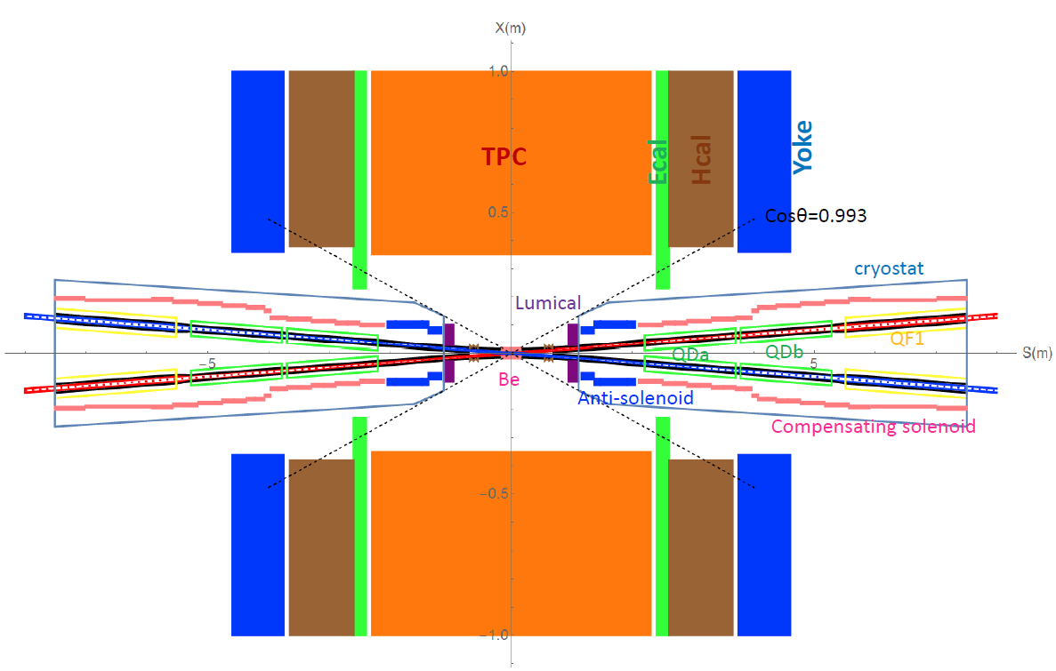
MDI layout and IR design
The Machine Detector Interface (MDI) of CEPC double ring scheme is about ±7m long from the IP.
The CEPC detector superconducting solenoid with 3T magnetic field and the length of 7.6m.
The accelerator components inside the detector without shielding are within a conical space with an opening angle of cosθ=0.993.
The e+e- beams collide at the IP with a horizontal angle of 33mrad and the final focusing length is 2.2m.

Slide 4
MDI parameters
 | range | Peak filed in coil | Central filed gradient | Bending angle | length | Beam stay clear region | Minimal distance between two aperture | Inner diameter | Outer diameter | Critical energy (Horizontal) | Critical energy (Vertical) | SR power (Horizontal) | SR power (Vertical)
L* | 0~2.2m |  |  |  | 2.2m
Crossing angle | 33mrad
MDI length | ±7m
Detector requirement of accelerator components in opening angle | 13.6˚
QDa/QDb |  | 2.4T | 77.5T/m |  | 1.5m | 19.2/22.0mm | 72.61/124.75mm | 48mm | 59mm | 458.7/657.9keV | 271.6/361.5keV | 80.9/242.3W | 40.3/65.5W
QF1 |  |  | 63.4T/m |  | 2m | 30.9mm | 181.85mm | 56mm | 69mm | 428.3keV | 613.5keV | 245.9W | 187.5W
Lumical | 0.95~1.11m |  |  |  | 0.16m |  |  | 57mm | 200mm
Anti-solenoid before QD0 |  | 7.26T |  |  | 1.1m |  |  | 120mm | 390mm
Anti-solenoid QD0 |  | 2.8T |  |  | 2m |  |  | 120mm | 390mm
Anti-solenoid QF1 |  | 1.8T |  |  | 1.48m |  |  | 120mm | 390mm
Beryllium pipe |  |  |  |  | ±118mm |  |  | 28mm
Last B upstream | 83.69~198.7m |  |  | 0.76mrad | 115.01m |  |  |  |  | 25.3keV
First B downstream | 57.04~132.09m |  |  | 0.72mrad | 75.05m |  |  |  |  | 36.6keV
Beampipe within QDa/QDb |  |  |  |  | 1.5m |  |  |  |  |  |  | 0.75/0.9W
Beampipe within QF1 |  |  |  |  | 2m |  |  |  |  |  |  | 1.78W
Beampipe between QD0/QF1 |  |  |  |  | 0.23m |  |  |  |  |  |  | 19.6W

Slide 5
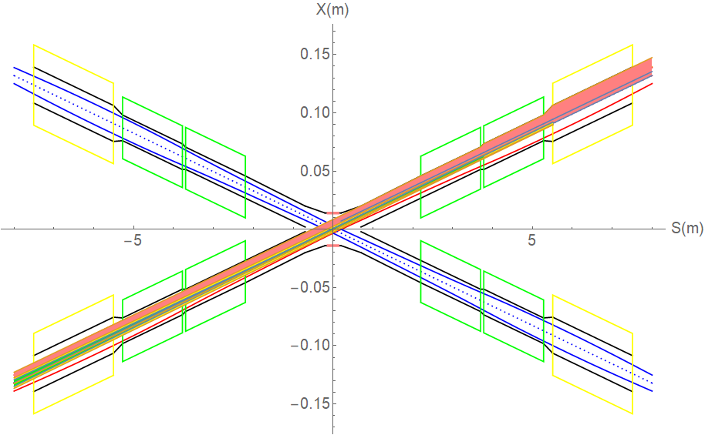
SR from last bend upstream of IP and Final Doublet
Normal condition
QF1
QDb
SR power ~mW (IP~0.7m) with 3 mask tips. SR power ~10W, APD~330W/cm² , water cooling.
SR on 0.7m~ entrance of QDa beam pipe is 5.3W, APD ~0.98W/cm²
SR on QDa is 0.75W along 1.5m, APD ~0.14 W/cm²
SR on QDb is 0.9W along 1.5m, APD ~0.16 W/cm²
The region between QDa and QDb is 6.3W(0.08m). APD~21.3 W/cm²
SR on QF1 is 1.78W along 2m. APD~0.23 W/cm²
The region between QDb and QF1 is 19.6W(0.23m). APD~22.4 W/cm²
QDa
Name | Higgs | tt | Z
BMV01IRU | 25.3keV | 146.3keV | 2.5keV
BMV02IRU | 108.4keV | 268.6keV | 4.7keV
BMV03IRU | 103.9keV | 365.4keV | 6.4keV
BMV1IRU | 0 | 0 | 0
BMV2IRU | 195.7keV | 606.37keV | 10.7keV
BMV3IRU | 195.7keV | 606.37keV | 10.7keV
BMV01IRD | 36.6keV | 293.4keV | 5.3keV
BMV02IRD | 298.3keV | 183.3keV | 12.3keV
BMV03IRD | 222.0keV | 820.1keV | 14.7keV
BMV1IRD | 0 | 0 | 0
BMV2IRD | 465.7keV | 1444.59keV | 25.4keV
BMV3IRD | 465.7keV | 1444.59keV | 25.4keV
 | tt | Higgs(βy=1mm) | Z
QD0_SR_power_X (W) | 157.6 | 80.9 | 3.6
QD0_SR_power_Y (W) | 83.4 | 40.3 | 4.7
QD0_critical_energy_X(KeV) | 1711.4 | 458.7 | 33.5
QD0_critical_energy_Y(KeV) | 942.3 | 271.2 | 22.4
QF1_SR_power_X (W) | 23.9 | 245.9 | 9.0
QF1_SR_power_Y (W) | 2.5 | 187.5 | 1.2
QF1_critical_energy_X(KeV) | 604.9 | 428.3 | 42.5
QF1_critical_energy_Y(KeV) | 163.4 | 613.5 | 12.7

Slide 6
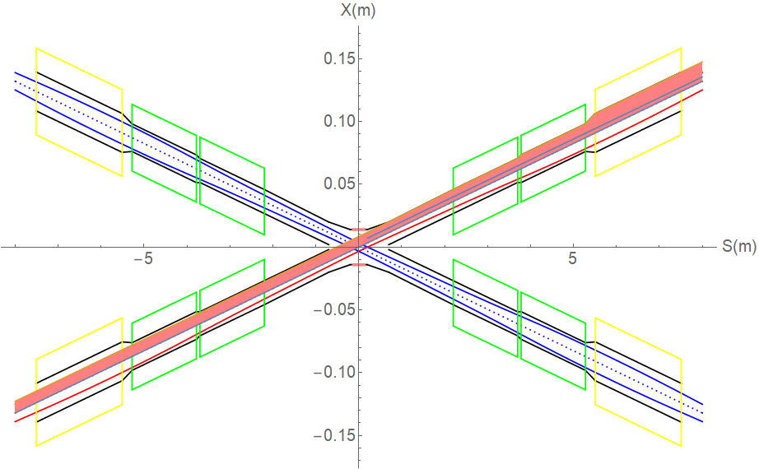
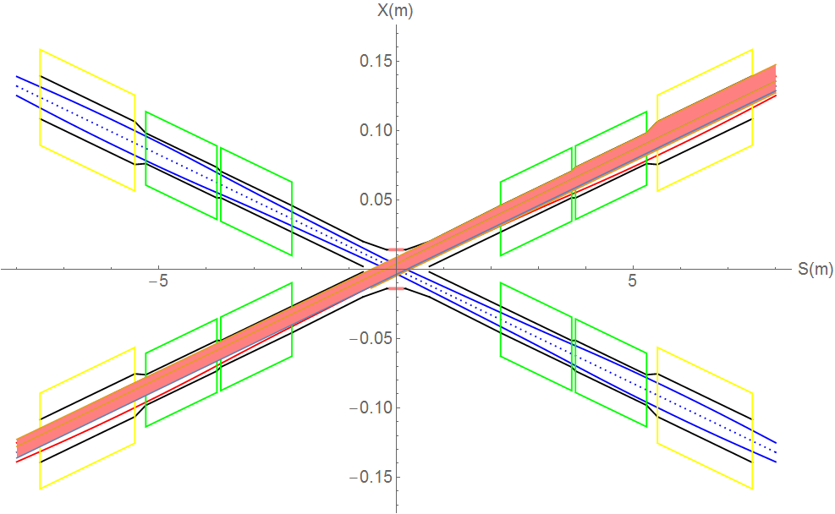
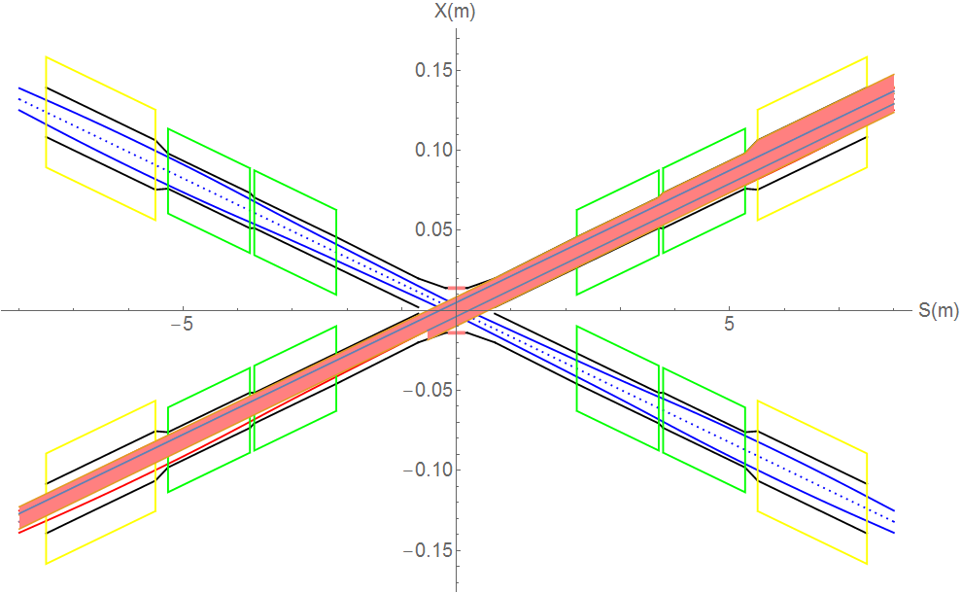
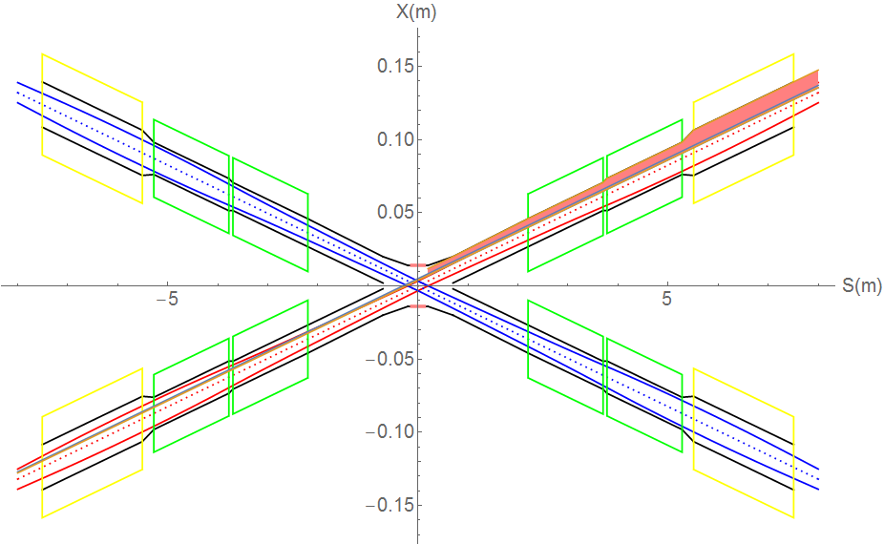

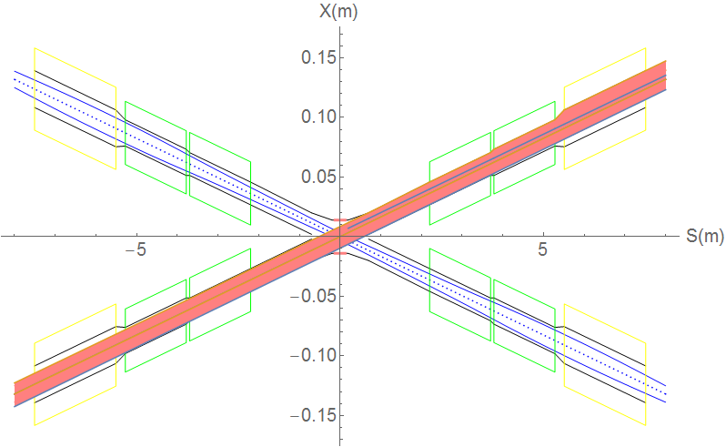
SR from last bending magnet upstream of IP
Extreme condition
(e) Beam position 0~+5mm+angle offset
The detector pipe (IP~0.7m) has no SR heat load.
For (c) and (d), thermal load of no change, but SR fan will move up and down.
When the beam position offset ~-5mm, SR will hit on the beam pipe with +0.041mrad beam angle, When the beam position offset ~+5mm, SR will hit on the beam pipe with +0.159mrad beam angle.
0.7m~2.2m，SRpower~73.8W
APD~13.7W/cm² 。QDa~0.998W， APD~0.18W/cm²。
QDb~1.06W，
APD~0.19W/cm²。 QDa~QDb~5.71W， APD~19.3W/cm²。
QF1~1.73W，
APD~0.22W/cm²。
QDb~QF1~17.02W， APD~19.5W/cm²。
(a) Beam angle offset 0~-2mrad
(c) Beam position offset 0~+5mm
(b) Beam angle offset 0~+0.115mrad
(d) Beam position offset 0~-5mm
(f) Beam position 0~-5mm+angle offset
SR Gaussian distribution with narrow band~ 0.36mm in width

Slide 7
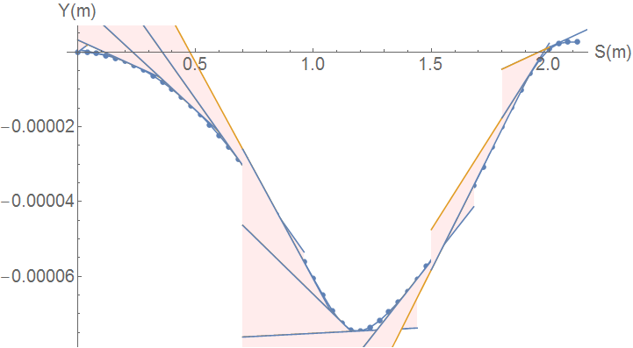
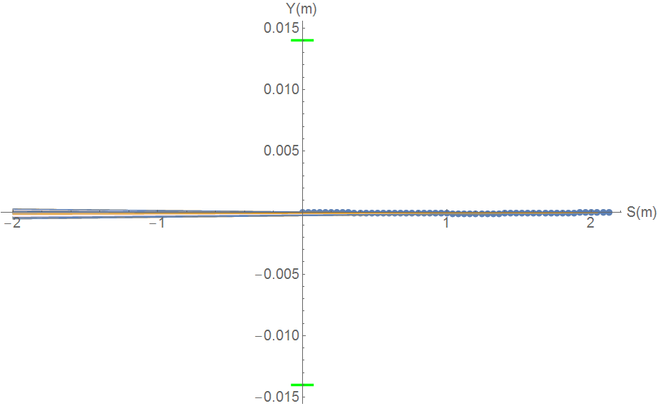
SR from solenoid combined field
Horizontal trajectory will coupled to the vertical
Due to the sol+anti-sol field strength quite high, maximum~4.24T, transverse magnetic field component is quite high.
SR from vertical trajectory in sol+anti-sol combined field should be taken into account.
SR fan is focused in a very narrow angle from
-116urad to 131urad
SR will not hit Berryllium pipe, and no background to detector.
SR will hit the beam pipe ~213.5m downstream from IP
Water cooling is needed.
Maximum: 670keV
Maximum: 31W

Slide 8
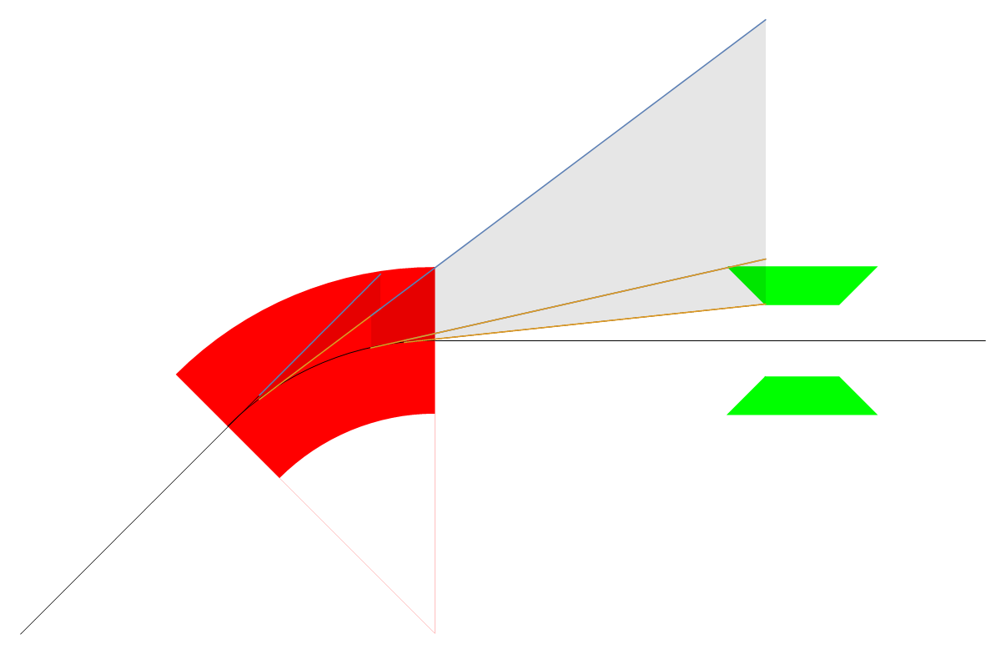
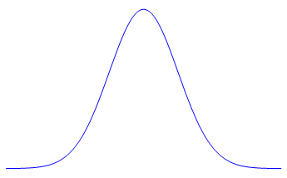

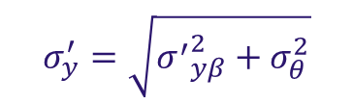
Synchrotron radiation at collimator
Horizontal plane
Synchrotron radiation from the upstream bending magnet in the ARC can contribute to the heat load of the collimators.
SR hit collimators: critical energy~357keV, power~7.7kW.
SR uniform distribution in horizontal plane and Gaussian distribution in vertical plane.
Total vertical angular divergence of SR photon beam~ 8.52urad.
Bend
Collimator
Vertical plane
beam
$$\sim ±\frac{1}{γ}$$
$$σ_{y}^{′}=\sqrt{{σ^{′}}_{yβ}^{2}+σ_{θ}^{2}}$$

Slide 9
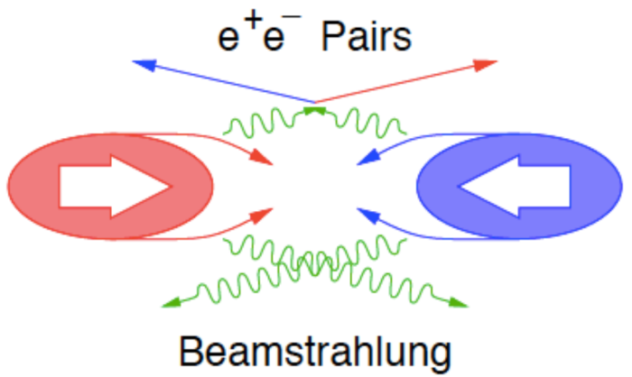
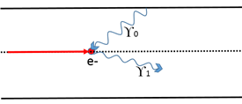
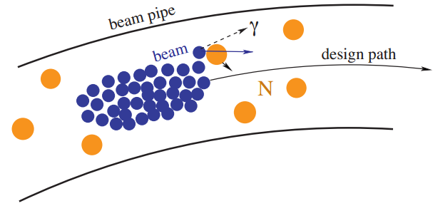
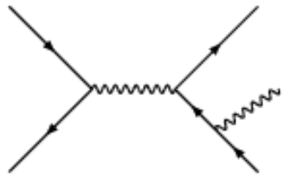
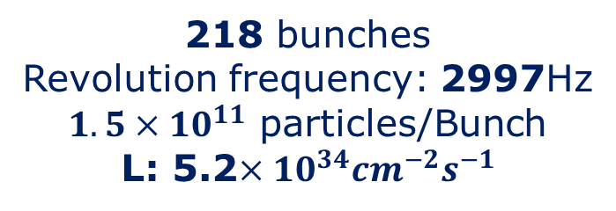
Beam loss Backgrounds at CEPC
IP1
Beam-Thermal photon
scattering
Beamstrahlung
218 bunches
Revolution frequency: 2997Hz
$1.5×{10}^{11}$ particles/Bunch
L: 5.2$×{10}^{34}{cm}^{−2}s^{−1}$
Beam Lost Particles
Energy Loss > 1.5%
(energy acceptance)
IP3
Beam-Gas
Scattering
Radiative Bhabha
scattering

Slide 10
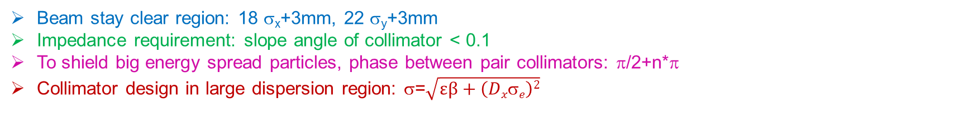
Collimator design
Beam stay clear region: 18 σ_{x}+3mm, 22 σ_{y}+3mm
Impedance requirement: slope angle of collimator < 0.1
To shield big energy spread particles, phase between pair collimators: π/2+n*π
Collimator design in large dispersion region: σ=$\sqrt{εβ+\left(Dxσe\right)2}$
name | Position | Distance to IP/m | Beta function/m | Horizontal Dispersion/m | Phase | BSC/2/m | Range of half width allowed/mm
APTX1 | D1I.785 | 2388.31 | 100.99 | 0.2 | 384.11 | 0.00181 | 1.81~8.42
APTX2 | D1I.787 | 2325.75 | 100.99 | 0.2 | 384.36 | 0.00181 | 1.81~8.42
APTY1 | D1I.791 | 2075.48 | 19.52 | 0.1995 | 387.46 | 0.003348 | 0.079~3.3
APTY2 | D1I.793 | 2012.92 | 19.52 | 0.1995 | 387.71 | 0.003348 | 0.079~3.3
APTX3 | D1O.5 | 1856.35 | 101.95 | 0.20 | 6.877 | 0.00182 | 1.82~8.45
APTX4 | D1O.7 | 1918.92 | 101.95 | 0.20 | 7.127 | 0.00182 | 1.82~8.45
APTY3 | D1O.10 | 2075.33 | 101.95 | 0.1 | 7.75 | 0.00182 | 0.182~3.67
APTY4 | D1O.16 | 2388.17 | 101.95 | 0.1 | 9.00 | 0.00182 | 0.182~3.67
APTX5 | DMBV01IRU0.1 | 17.4 | 510.83 | 0 | 390.87 | 0.015 | 4~15
horizontal collimator half width 4mm(13σ_{x}), Vertical collimator half width 3mm (22σ_{y})
The collimators will not have effect on the beam quantum lifetime.

Slide 11
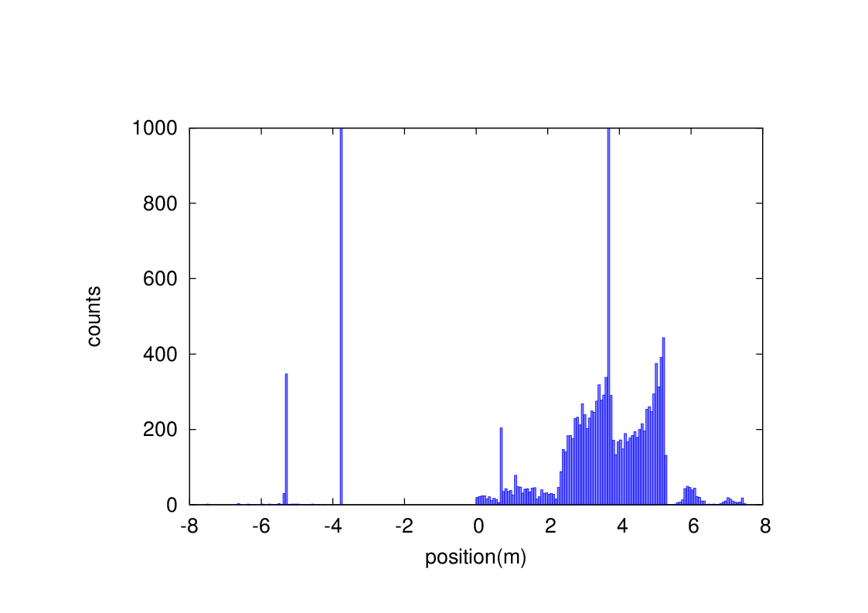
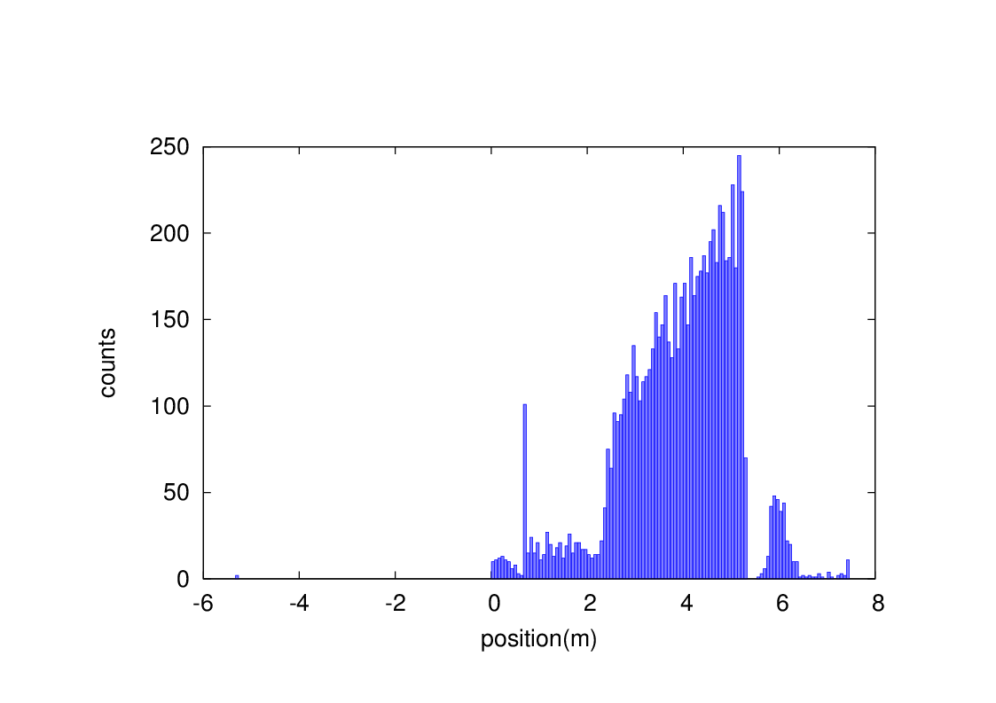
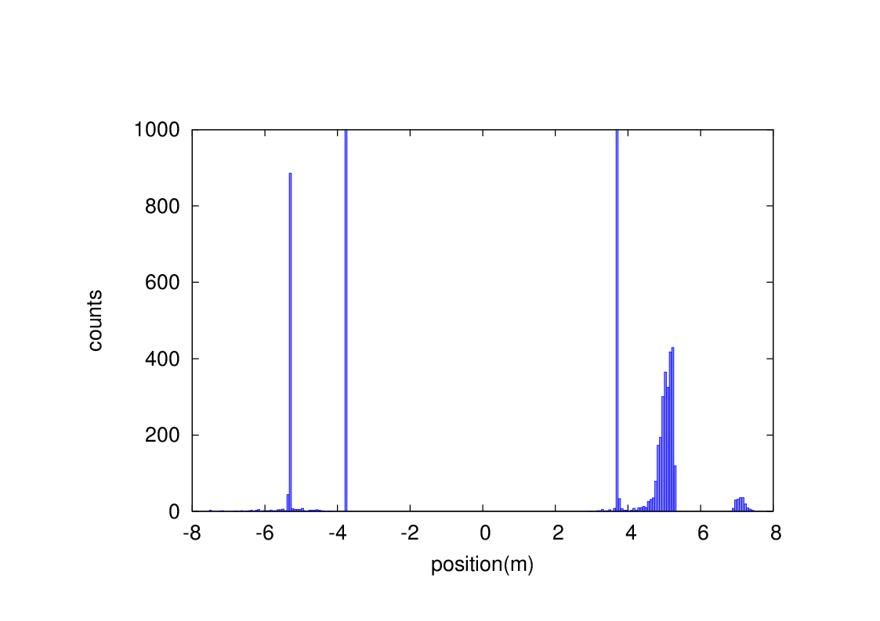
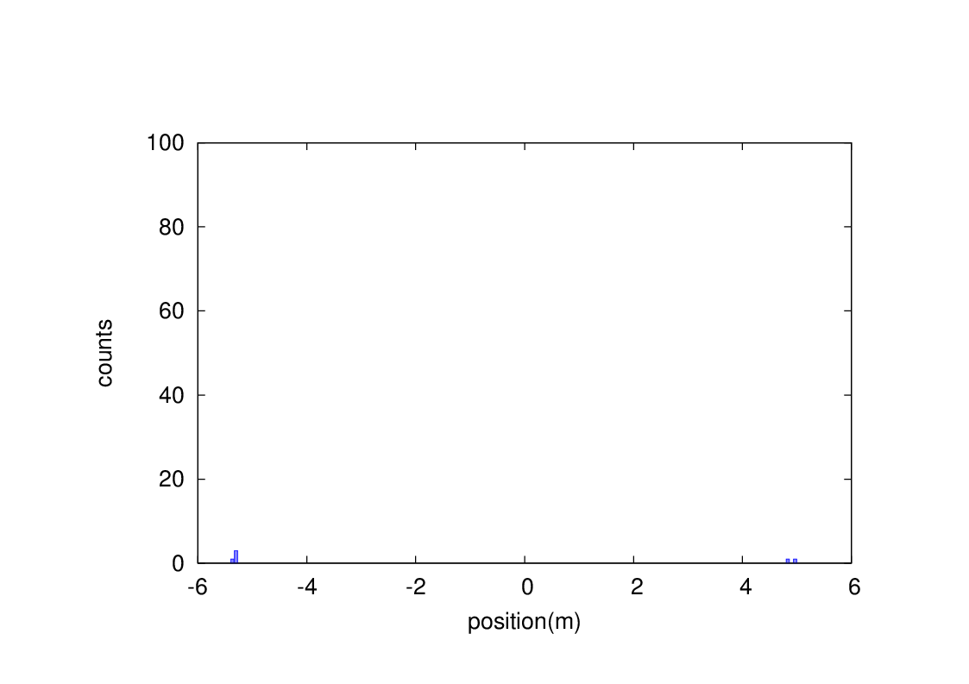
Beam loss from RBB and BS
Without collimator
With collimator
Radiative Bhabha scattering
Without collimator
With collimator
Beamstrahlung

Slide 12
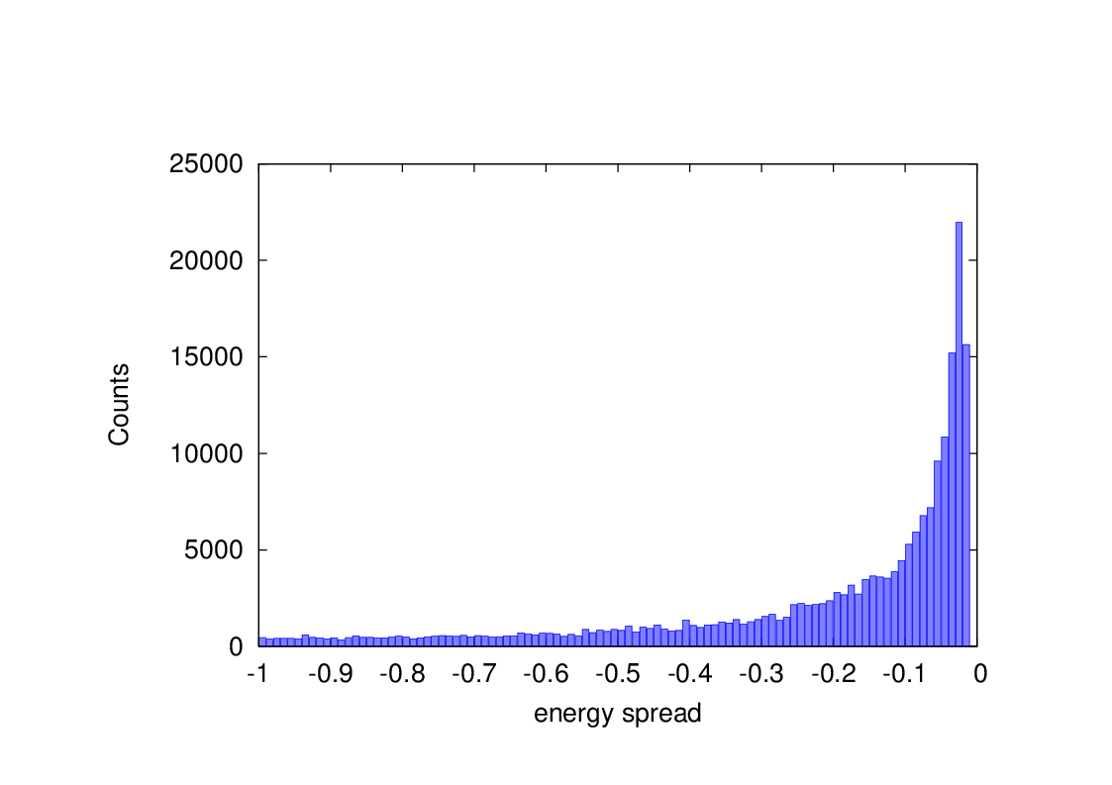
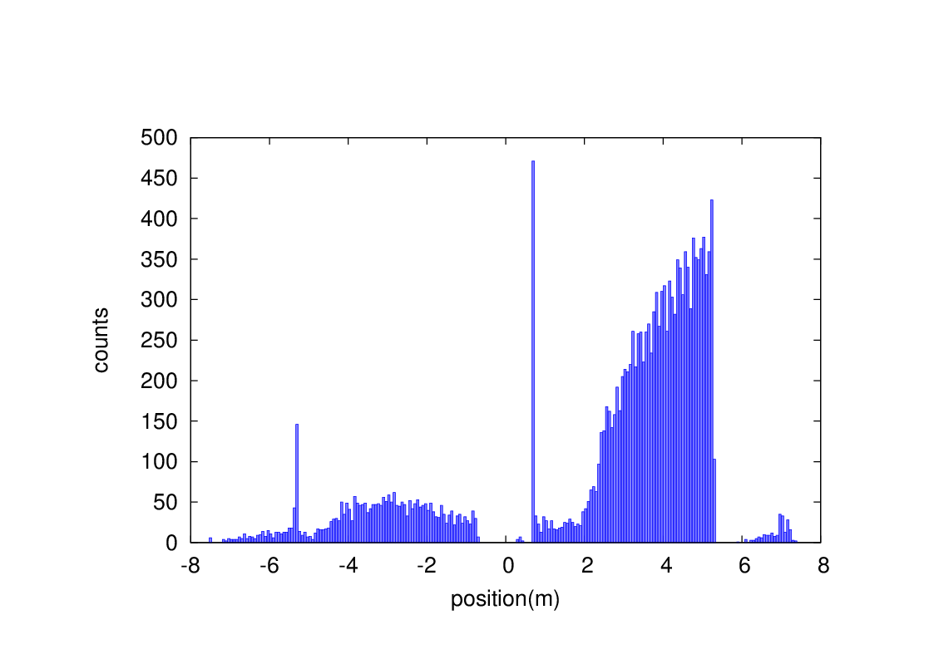
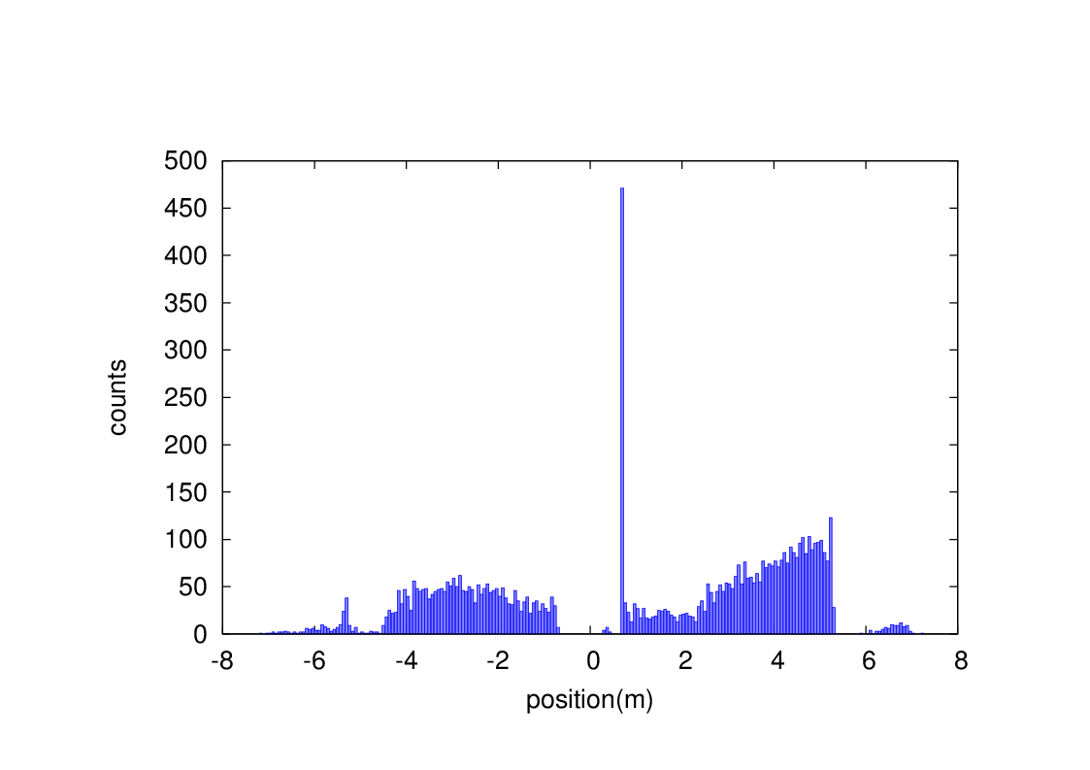
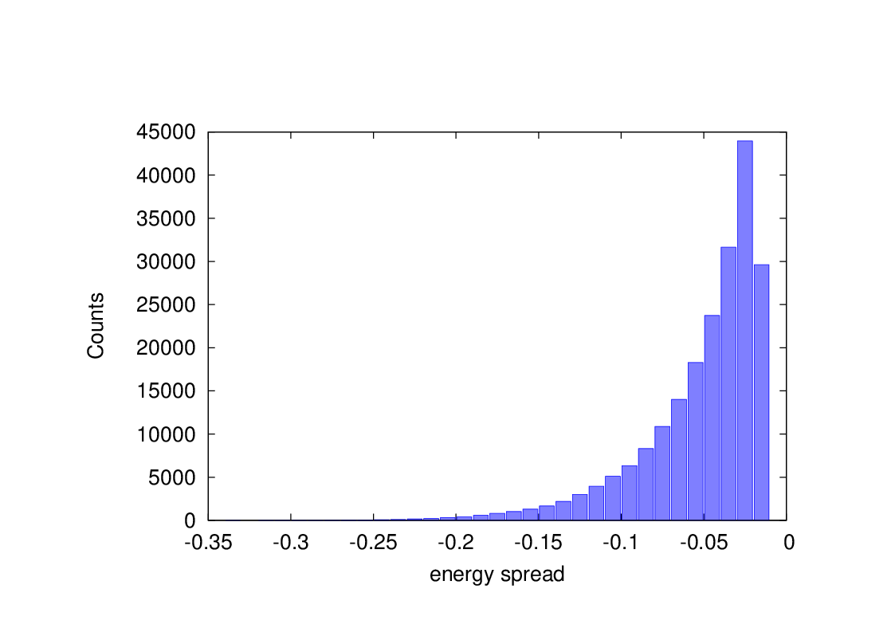
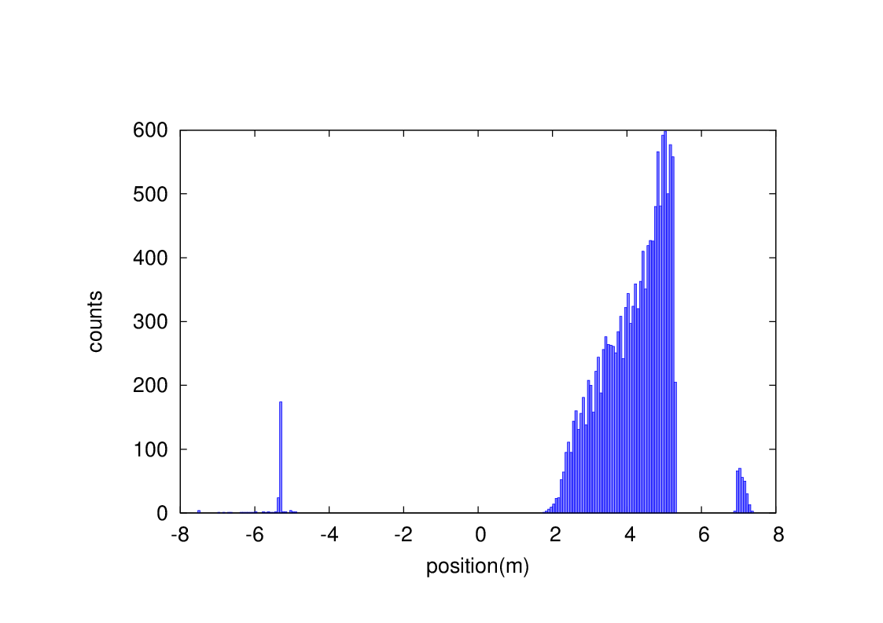
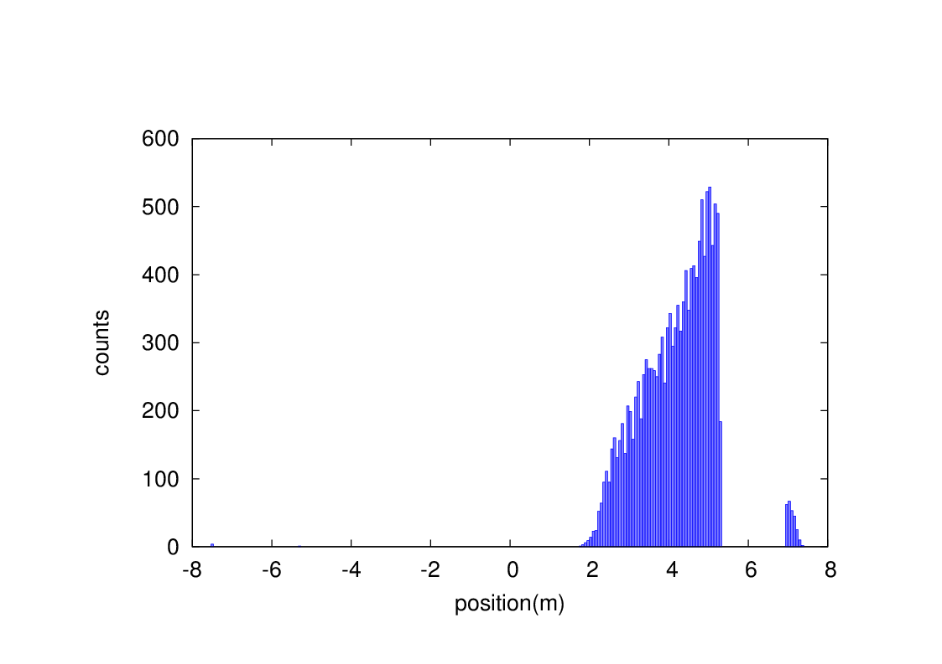
Beam loss from Beam-gas bremsstrahlung and Beam thermal photon scattering
events
Without collimator
With collimator
BG
events
Without collimator
With collimator
BTH

Slide 13
Heat load from RBB loss in IR
With collimators
Heat load power on Be pipe (IP~0.125m) ~6.7mW.
Heat load power on the detector pipe (0.125m~0.7m) ~0.024W.
Heat load power on beam pipe(0.7m~2.2m) ~0.17W.
Heat load power on beam pipe(QDa~QDb) ~2.13W.
Heat load power on beam pipe(QDb~QF1) ~0.01W.
Heat load power on beam pipe(QF1) ~0.26mW.

Slide 14
Heat load from Beamstrahlung loss in IR
With collimator
Heat load power on Be pipe (IP~0.125m) ~0W.
Heat load power on the detector pipe (0.125m~0.7m) ~0W.
Heat load power on beam pipe(0.7m~2.2m) ~0W.
Heat load power on beam pipe(QDa~QDb) ~3.8uW.
Heat load power on beam pipe(QDb~QF1) ~3.8uW.
Heat load power on beam pipe(QF1) ~0W.

Slide 15
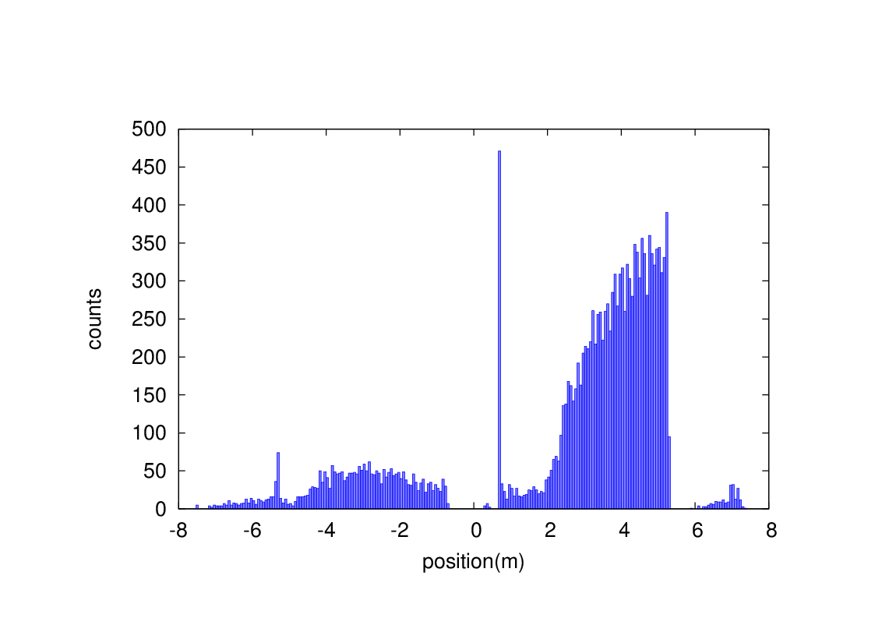
Heat load from Beam-Gas bremsstrahlung
With collimators
Heat load due to BG loss on Be pipe (IP~0.125m) ~0W.
Heat load due to BG loss on the detector pipe (0.125m~0.7m) ~4.8uW.
Heat load power on beam pipe(0.7m~2.2m) ~4.2uW
Heat load power on beam pipe(QDa~QDb) ~5.9uW
Heat load power on beam pipe(QDb~QF1) ~0.5uW
Heat load power on beam pipe(QF1) ~3.7uW

Slide 16
Heat load from Beam-Thermal photon scattering
With collimator
Heat load due to BTH loss on Be pipe (IP~0.125m) ~0W.
Heat load due to BTH loss on the detector pipe (0.125m~0.7m) ~0W.
Heat load power on beam pipe(0.7m~2.2m) ~1.2uW
Heat load power on beam pipe(QDa~QDb) ~1.8uW
Heat load power on beam pipe(QDb~QF1) ~0.6uW
Heat load power on beam pipe(QF1) ~0.66uW

Slide 17
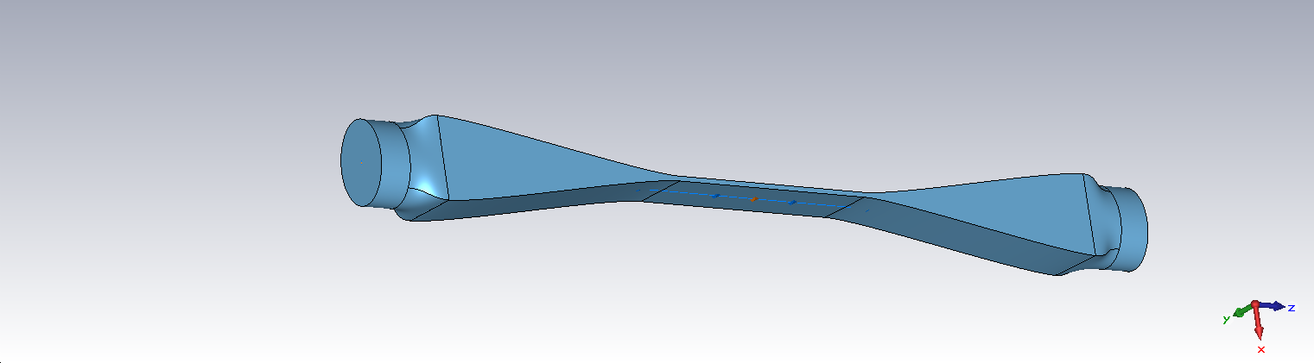
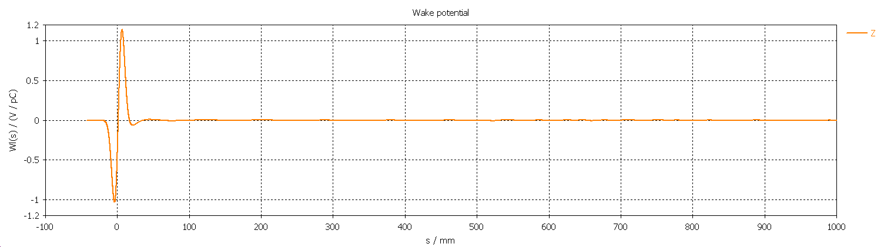
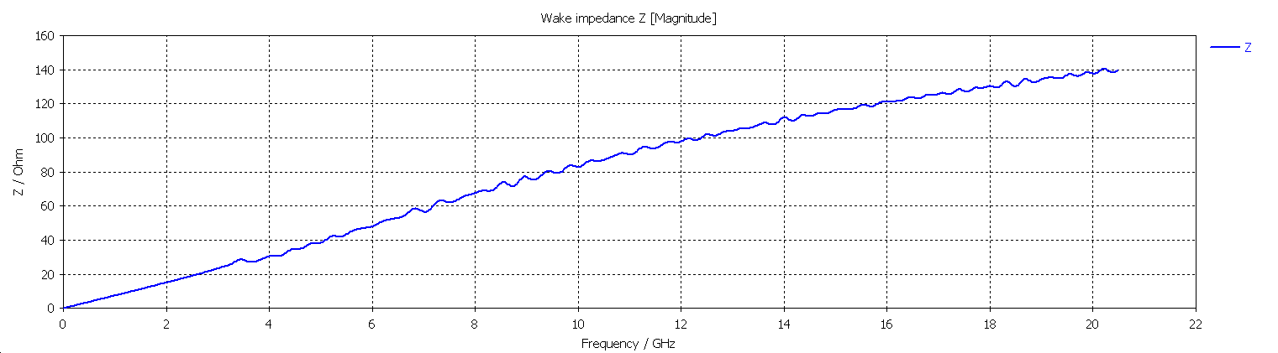
Collimator impedance
Wake Integration type : Indirect Interfaces
Simulated wake length : 1000 mm
Wake shift x : 0 mm
Wake shift y : 0 mm
Wake-Loss-Factor : 1.403765e-001 V/pC
Entry interface at z-coordinate: -3.851471e+002 mm (grid-index: 102)
Exit interface at z-coordinate : 3.851471e+002 mm (grid-index: 4681)

Slide 18
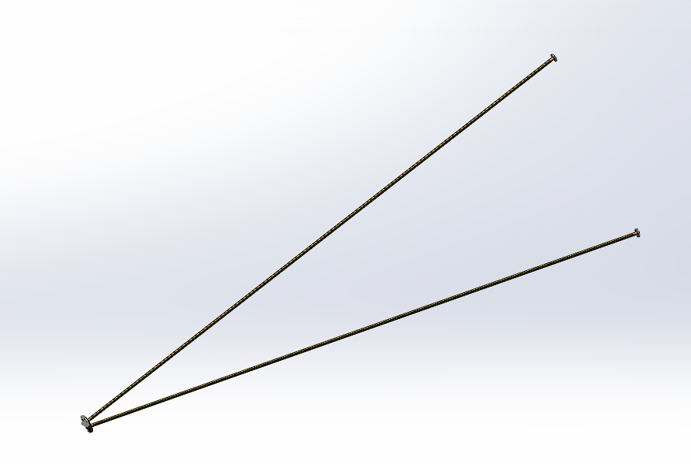
IR vacuum chamber
IR vacuum pressure ~3e-10Torr, copper chamber inner surface coated with NEG.
Double layer beam pipe for detector part, single layer beam pipe for accelerator vacuum chamber, with water cooling structure.
Coolants: Paraffin for Be, Water for others
3 Mask tips, SR power ~10W, APD~330W/cm² , water cooling.

Slide 19
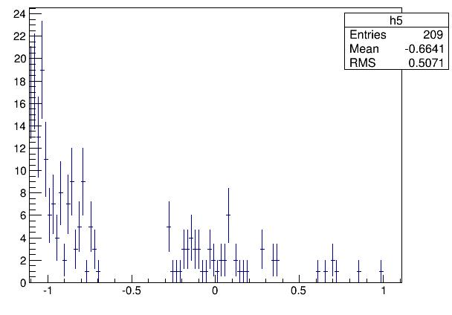
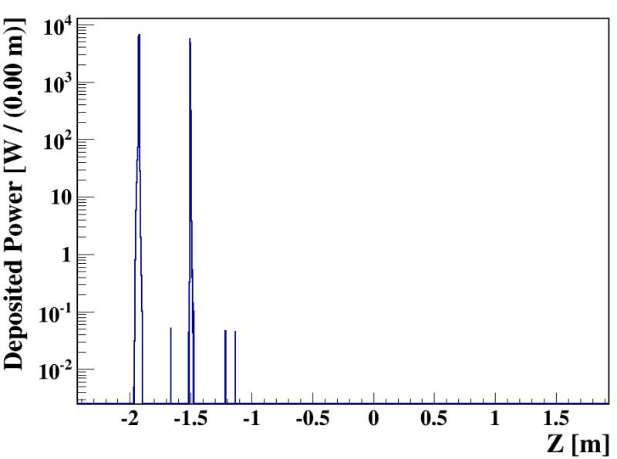
HOM absorber
HOM mainly generated from crotch point（z~±700mm）
HOM power on Be pipe ~234W for CDR and ~785W for High luminosity Z mode.
Temperature with coolant ~58.5℃
HOM absorber required to reduce HOM power in High luminosity Z mode
Beam pipe
HOM absorber design: inner surface of the beam pipe is grooved and coated with absorbing material, and the outer surface of the beam pipe is water cooled.
Distance from IP is around 70cm just before the crotch point.
Impedance
Synchrotron radiation from Final doublet magnets and reflection part from mask，~mW power.
SR resistance acceptable for HOM absorber

Slide 20
IP BPM
Considering response time and calibration difficulty, two 4 button electrodes BPM at each side of CEPC IR is adopted.
Most of CEPC IR beam pipe are cylinder or conic, only the part from 70cm to 95cm is special shape.
There is a bellows for the requirements of installation in the crotch region, located about 0.7 m from the IP. IP BPM will be installed at 80cm from the IP in the double pipe part.
Beam pipe size：diameter 18.74mm
Bunch length：2.68mm
Single bunch charge：24nC

Slide 21
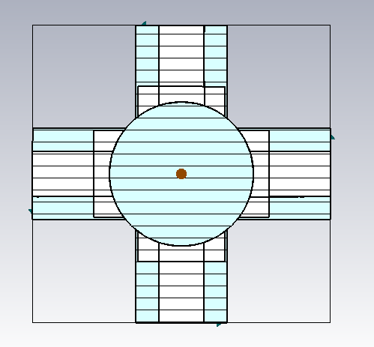
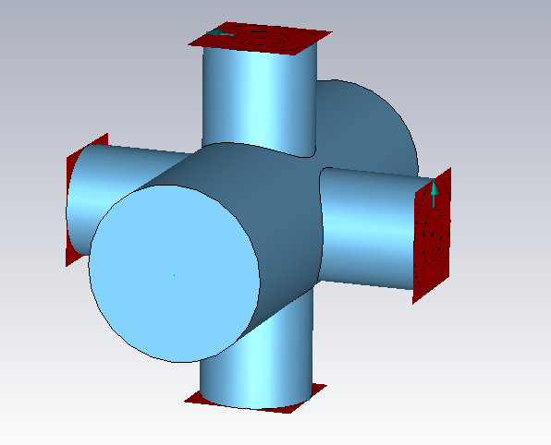
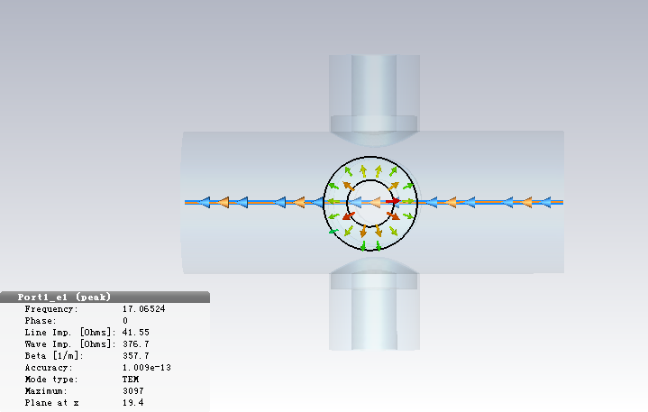
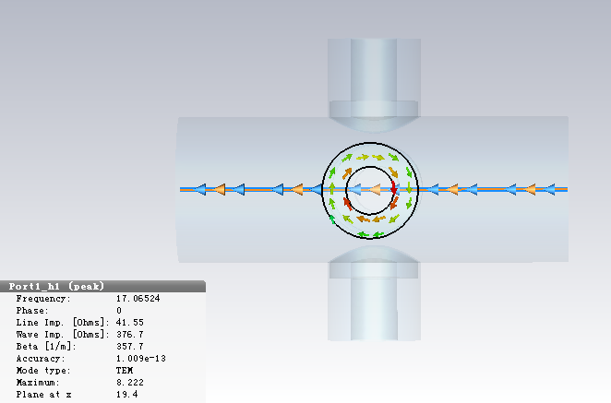
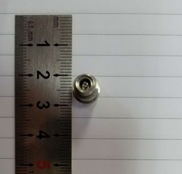
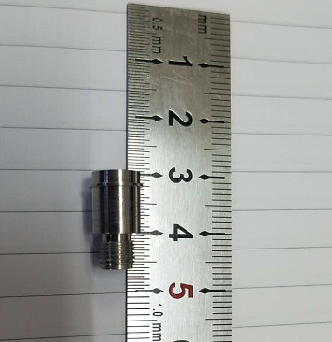
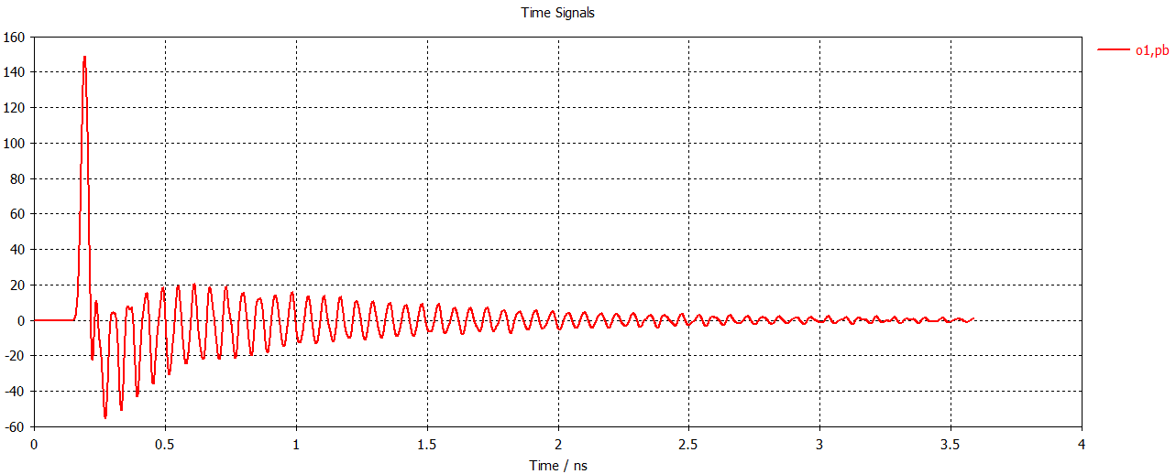
IP BPM design
4 button electrodes structure
Electromagnetic field at electrodes
4 button electrodes size
Electrodes signal(bunch length 2.68mm)
Electrode diameter:11.4mm
Inner conductor diameter: 6mm
Electrode pole to beam line:19.4mm
Size and signal intensity can be
satisfied by CEPC MDI requirement.
Due to the short bunch length, signal has many resonance hump, signal amplitude proportional to the bunch charge.

Slide 22
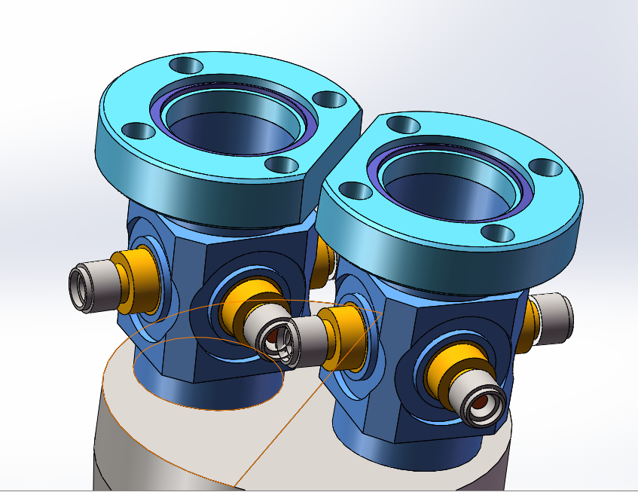
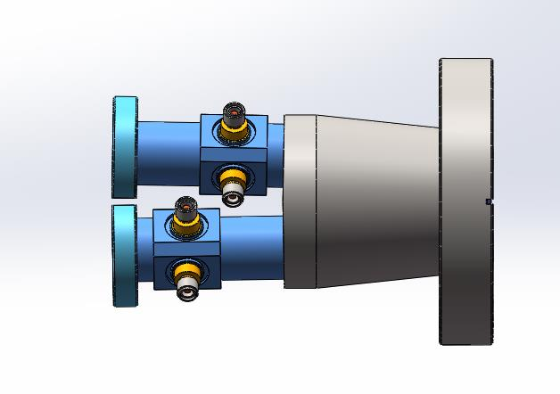
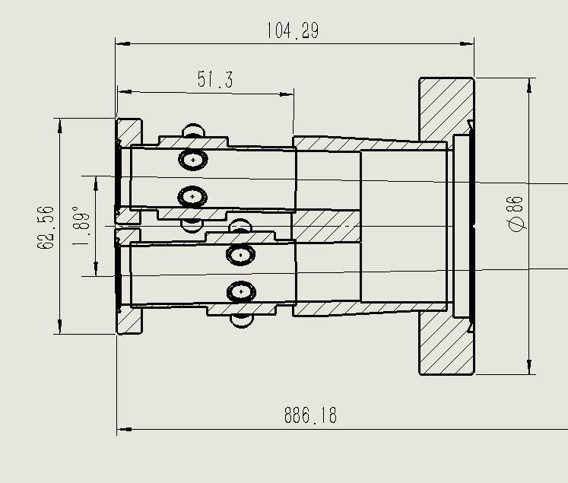
IP BPM design
Space conflict for the inside two buttons has been solved by staggering the position ~1cm.
Monitoring the time when two beams arrive at the collision point, e+ and e- signals can be distinguished.

Slide 23
Critical problem in MDI
No shielding design in IR
High vacuum requirement from Beam-Gas scattering, vacuum pump design in IR
Detector magnet yoke (± 6m) too long, accelerator supporting system doesn’t work.

Slide 24
Summary
SR Gaussian distribution in a very narrow band, cooling structure.
Heat load from beam loss is quite small.
Heat load from HOM in IR with High luminosity Z should take into account of HOM absorber.
Collimators are designed in the ARC and interaction region.
Synchrotron radiation and impedance are taken into account for collimators.
HOM of IR beam pipe has been simulated, water cooling and synchrotron radiation were considered and HOM absorber is under design.
IP BPM under design.

Slide 25
Thanks

