Slide 1
Impedance and HOM Heating in IR region of MDI for CEPC
Liu Yu dong, Wang Na, Wang Hai Jing, Bai Sha, Wang Dou

Slide 2
outline
Beam parameters in CDR and high luminosity Z (2T) for CEPC
Structure and Layout of the vacuum chamber in IR
Impedance results and power deposition for different IR pipe model
Summary

Slide 3
CEPC CDR Parameters
 | Higgs | W | Z（3T） | Z（2T）
Number of IPs | 2
Beam energy (GeV) | 120 | 80 | 45.5
Circumference (km) | 100
Synchrotron radiation loss/turn (GeV) | 1.73 | 0.34 | 0.036
Crossing angle at IP (mrad) | 16.5×2
Piwinski angle | 3.48 | 7.0 | 23.8
Number of particles/bunch N_{e} (10¹⁰) | 15.0 | 12.0 | 8.0
Bunch number (bunch spacing) | 242 (0.68μs) | 1524 (0.21μs) | 12000 (25ns+10%gap)
Beam current (mA) | 17.4 | 87.9 | 461.0
Synchrotron radiation power /beam (MW) | 30 | 30 | 16.5
Bending radius (km) | 10.7
Momentum compact (10⁻⁵) | 1.11
β function at IP β_{x}* / β_{y}* (m) | 0.36/0.0015 | 0.36/0.0015 | 0.2/0.0015 | 0.2/0.001
Emittance ε_{x}/ε_{y} (nm) | 1.21/0.0024 | 0.54/0.0016 | 0.18/0.004 | 0.18/0.0016
Beam size at IP σ_{x} /σ_{y} (μm) | 20.9/0.06 | 13.9/0.049 | 6.0/0.078 | 6.0/0.04
Beam-beam parameters ξ_{x}/ξ_{y} | 0.018/0.109 | 0.013/0.123 | 0.004/0.06 | 0.004/0.079
RF voltage V_{RF} (GV) | 2.17 | 0.47 | 0.10
RF frequency f _{RF} (MHz) (harmonic) | 650 (216816)
Natural bunch length σ_{z} (mm) | 2.72 | 2.98 | 2.42
Bunch length σ_{z} (mm) | 4.4 | 5.9 | 8.5
HOM power/cavity (2 cell) (kw) | 0.46 | 0.75 | 1.94
Energy spread (%) | 0.134 | 0.098 | 0.080
Energy acceptance requirement (%) | 1.35 | 0.90 | 0.49
Energy acceptance by RF (%) | 2.06 | 1.47 | 1.7
Photon number due to beamstrahlung | 0.082 | 0.050 | 0.023
Beamstruhlung lifetime /quantum lifetime* (min) | 80/80 | >400
Lifetime (hour) | 0.43 | 1.4 | 4.6 | 2.5
F (hour glass) | 0.89 | 0.94 | 0.99
Luminosity/IP L (10³⁴cm⁻²s⁻¹) | 2.93 | 10.1 | 16.6 | 32.1

Slide 4
CEPC high luminosity Z (2T)
 | CEPC-CDR | CEPC-30MW | CEPC-39MW
Number of IPs | 2 | 2 | 2
Energy (GeV) | 45.5 | 45.5 | 45.5
Circumference (km) | 100 | 100 | 100
SR loss/turn (GeV) | 0.036 | 0.036 | 0.036
Half crossing angle (mrad) | 16.5 | 16.5 | 16.5
Piwinski angle | 23.8 | 27.9 | 33.0
N_{e}/bunch (10¹⁰) | 8.0 | 12.0 | 15.0
Bunch number | 12000 | 14564 (20.6ns+10%gap) | 15000
Beam current (mA) | 461 | 839.9 | 1081.4
SR power /beam (MW) | 16.5 | 30 | 38.6
Bending radius (km) | 10.7 | 10.7 | 10.7
Momentum compaction (10⁻⁵) | 1.11 | 1.11 | 1.11
β_{IP} x/y (m) | 0.2/0.001 | 0.2/0.001 | 0.2/0.001
Emittance x/y (nm) | 0.18/0.0016 | 0.18/0.0016 | 0.18/0.0016
Transverse σ_{IP} (um) | 6.0/0.04 | 6.0/0.04 | 6.0/0.04
ξ_{x}/ξ_{y}/IP | 0.004/0.079 | 0.004/0.093 | 0.004/0.098
V_{RF} (GV) | 0.1 | 0.10 | 0.10
f _{RF} (MHz) (harmonic) | 650 | 650 | 650
Nature bunch length σ_{z} (mm) | 2.42 | 2.42 | 2.42
Bunch length σ_{z} (mm) | 8.5 | 10.0 | 11.8
HOM power/cavity (kw) | 1.94 (2cell) | 2.29 (1cell) | 3.15 (1cell)
Energy spread (%) | 0.08 | 0.1 | 0.115
Energy acceptance (DA) (%) | 1.5 | 0.6 | 0.7
Energy acceptance by RF (%) | 1.7 | 1.7 | 1.7
Lifetime (hour) | 2.5 | 2.0 | 1.8
L_{max}/IP (10³⁴cm⁻²s⁻¹) | 32.1 | 74.5 | 101.6

Slide 5
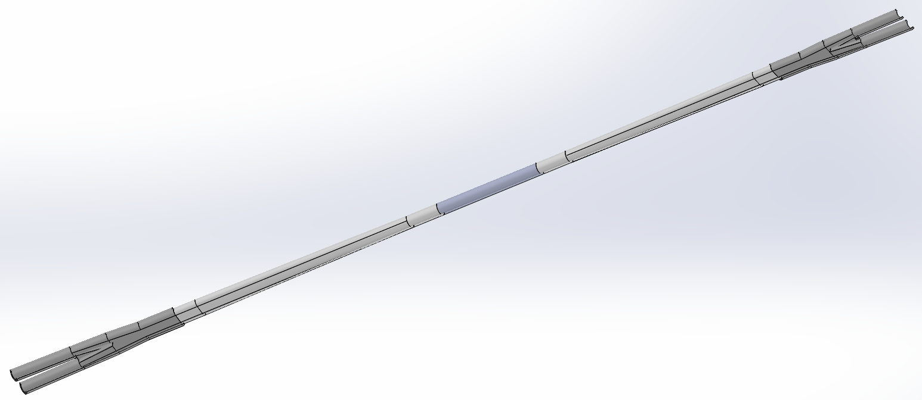
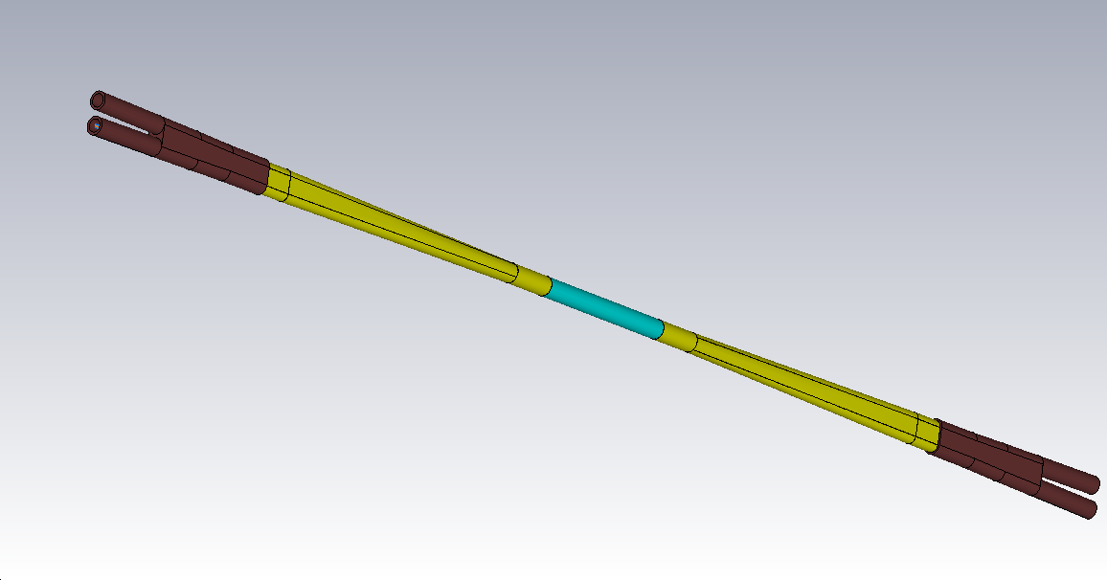
Structure and Layout of IR pipe
Be pipe
Al: Transition pipe
Total length:2220mm
Cu: Y-shape crotch
SQ Pipe
Cu: 360mm
Al: 625mm
Be: 250mm

Slide 6
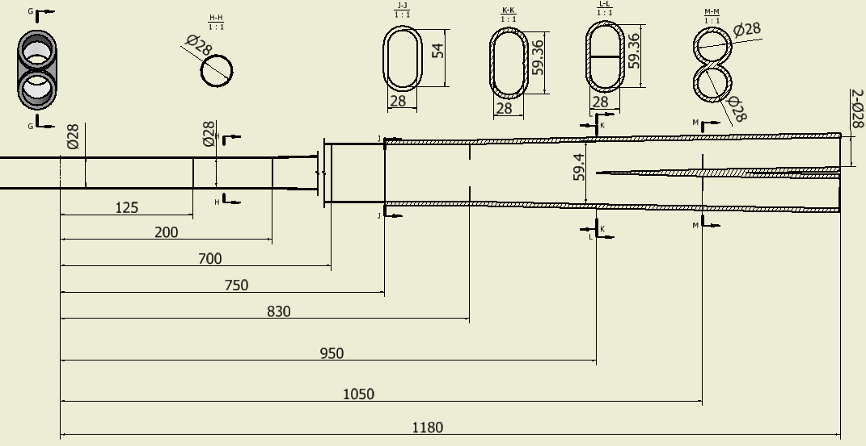
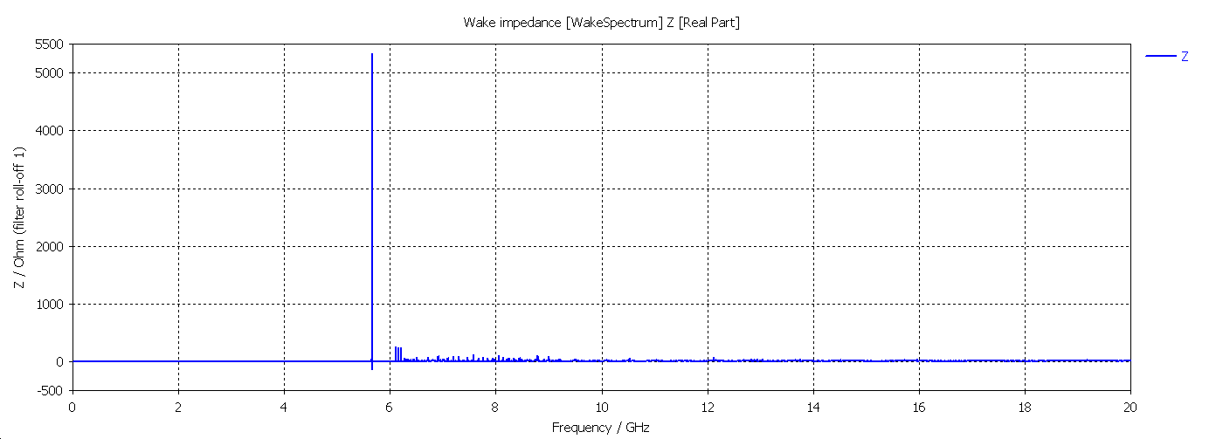
Model 0
Cut off Frequency of SCQ Pipe(φ28mm): 8.195 GHz
Cut off Frequency of Be pipe (φ28mm): 8.195 GHz
5.6632 GHz
σ_{z}=5mm: Two beam in the IR
Loss factor Trap in IR@k_trap:0.0504 v/pc
P_{trap}: H/W/Z: 42.0w/170.4w/595.2w
P_{prop}: H/W/Z: 26.8w/108.6w/379.4w

Slide 7
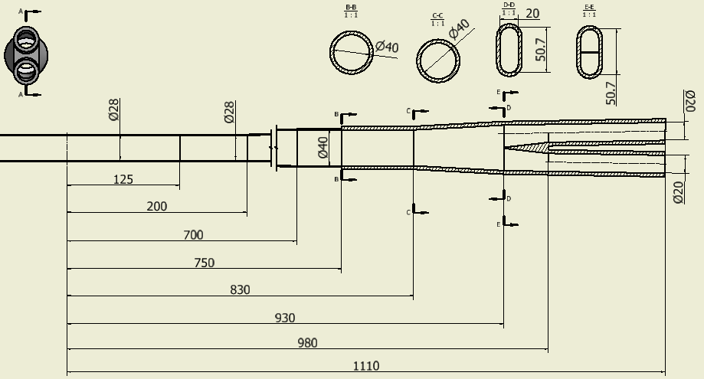
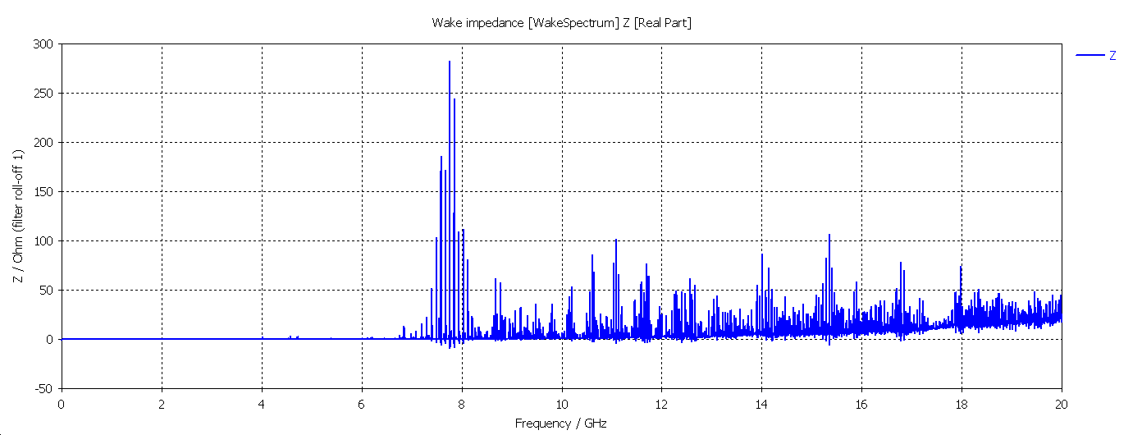
Model 1
7.763GHz
Cut off Frequency of SCQ Pipe(φ20mm): 11.474 GHz
Cut off Frequency of Be pipe (φ28mm): 8.195 GHz
σ_{z}=5mm: Two beam in the IR
Loss factor Trap in IR @k_trap: 0.0148v/pc
P_{trap}: H/W/Z: 12.3w/49.8w/174.2w
P_{prop}: H/W/Z: 10.2w/41.6w/145.5w

Slide 8
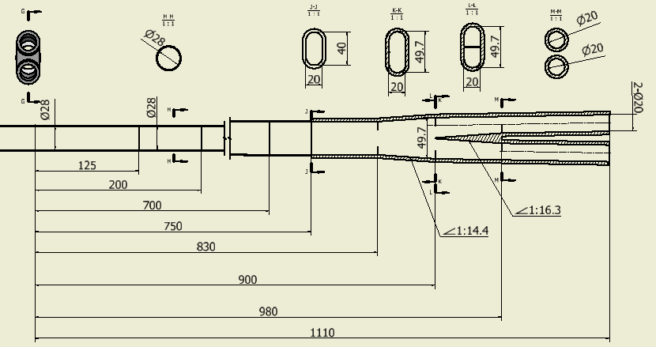
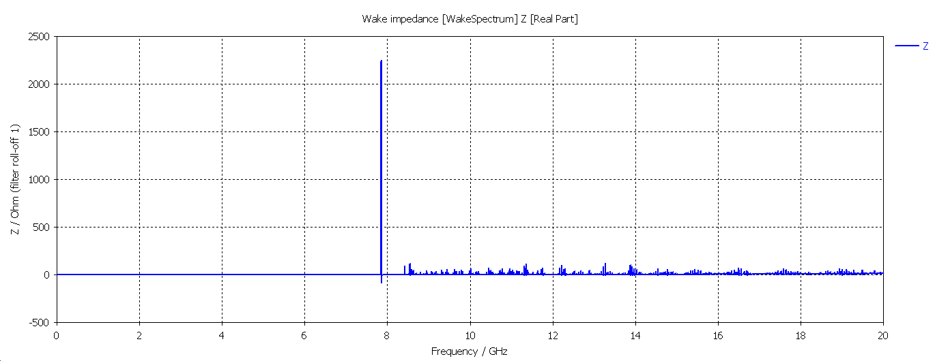
Model 2
Cut off Frequency of SCQ Pipe(φ20mm): 11.474 GHz
Cut off Frequency of Be pipe (φ28mm): 8.195 GHz
7.853GHz
σ_{z}=5mm: Two beam in the IR
Loss factor Trap in IR @k_trap: 0.018v/pc
P_{trap}: H/W/Z: 15.0w/60.7w/212.3w
P_{prop}: H/W/Z: 7.1w/28.9w/101.2w

Slide 9
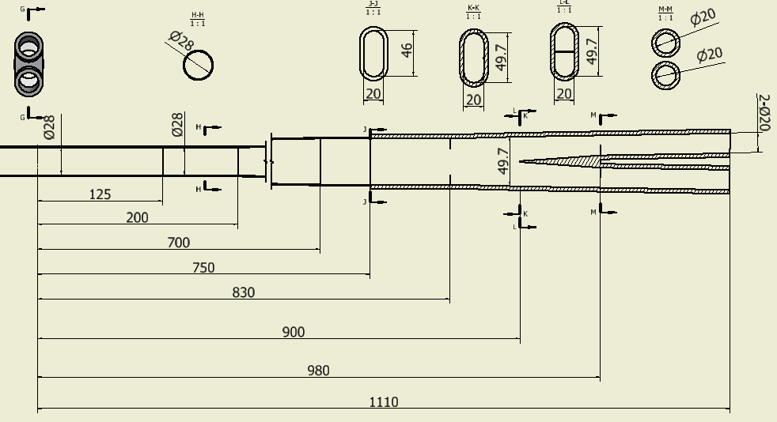
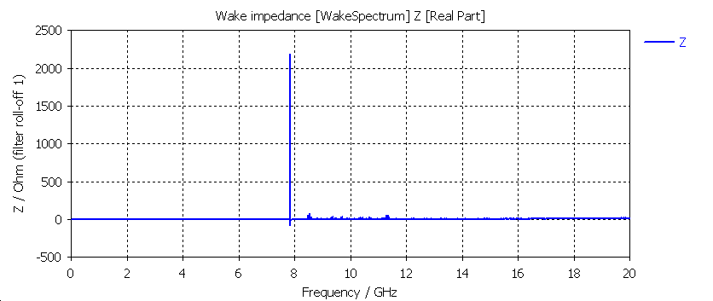
Model 3
Cut off Frequency of SCQ Pipe(φ20mm): 11.474 GHz
Cut off Frequency of Be pipe (φ28mm): 8.195 GHz
7.847GHz
σ_{z}=5mm: Two beam in the IR
Loss factor Trap in IR @k_trap: 0.017v/pc
P_{trap}: H/W/Z: 14.2w/57.5w/201.1w
P_{prop}: H/W/Z: 6.2w/25w/87.3w

Slide 10
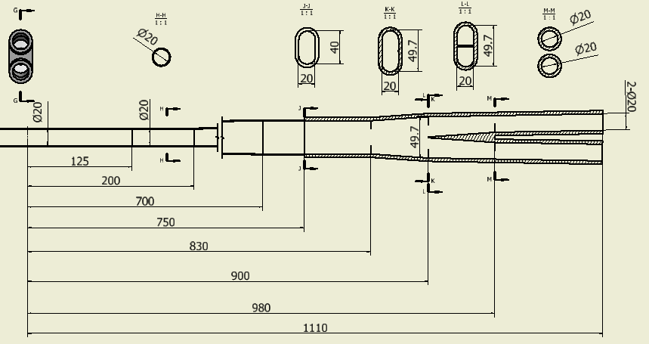
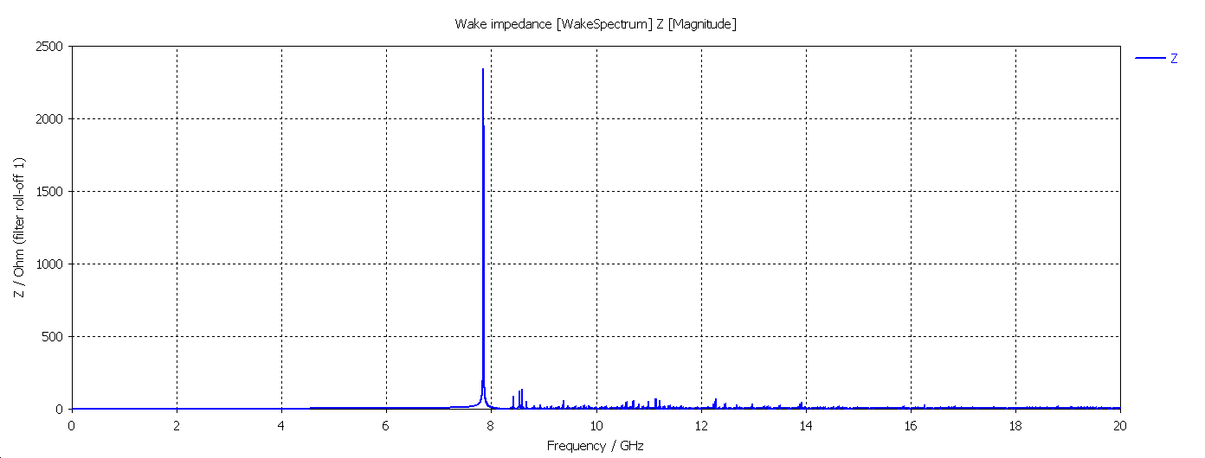
Model 4
Cut off Frequency of SCQ Pipe(φ20mm): 11.474 GHz
Cut off Frequency of Be pipe (φ20mm): 11.474 GHz
7.851GHz
σ_{z}=5mm: Two beam in the IR
Loss factor Trap in IR @k_trap: 0.0174v/pc
P_{trap}: H/W/Z: 14.5w/58.9w/205.9w
P_{prop}: H/W/Z: 5.19w/21.0w/73.4w

Slide 11
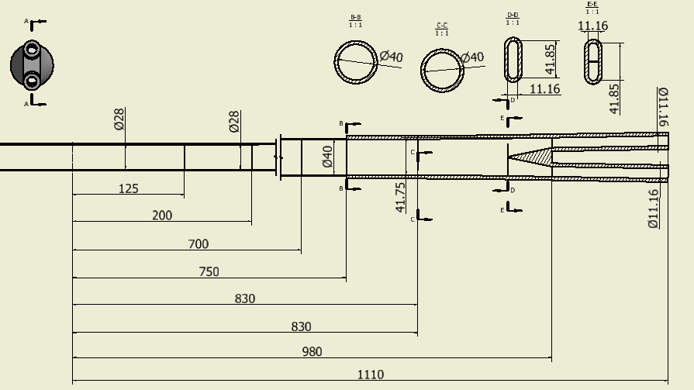
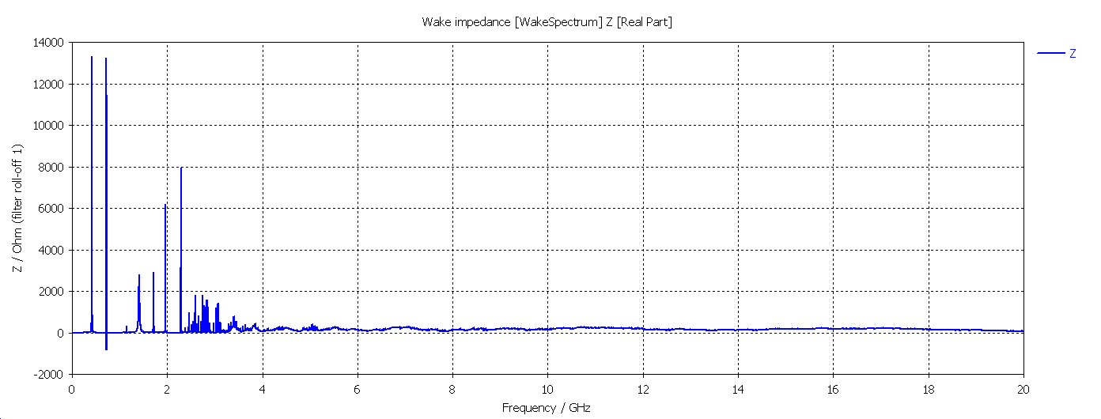
Model 5
Cut off Frequency of SCQ Pipe(φ11.160m): 20.5GHz
All mode traped in the IR pipe
Impedance from this big cavity
σ_{z}=5mm: Two beam in the IR
Loss factor Trap in IR @k_trap: 2.703v/pc
P_{trap}: H/W/Z: 2.2kw/9.1kw/31.9kw

Slide 12
Summary on HOM heating Power for IR （CDR beam parameters）
IR Model | H |  | W |  | Z
Model 0 (28mm-28mm) | P_{trap}: 42w | P_{pro}: 26.8w | P_{trap}: 170.4w | P_{pro}: 108.6w | P_{trap}: 595.2w | P_{pro}:379.4w
 | P_{total}: 68.8w |  | P_{total}: 279w |  | P_{total}: 974.6w
Model 1 (28mm-20mm) | P_{trap}:12.3w | P_{pro}:10.2w | P_{trap}:49.8w | P_{pro}:41.6w | P_{trap}:174.2w | P_{pro}:145.5w
 | P_{total}: 22.5w |  | P_{total}: 91.4w |  | P_{total}: 319.7w
Model 2 (28mm-20mm) | P_{trap}:15w | P_{pro}:7.1w | P_{trap}:60.7w | P_{pro}:28.9w | P_{trap}:212.3w | P_{pro}:101.2w
 | P_{total}: 22.1w |  | P_{total}: 89.6w |  | P_{total}: 313.5w
Model 3 (28mm-20mm) | P_{trap}:14.2w | P_{pro}:6.2w | P_{trap}:57.5w | P_{pro}:25w | P_{trap}:201.1w | P_{pro}:87.3w
 | P_{total}: 20.4w |  | P_{total}: 82.5 w |  | P_{total}: 288.4w
Model 4 (20mm-20mm) | P_{trap}:14.5w | P_{pro}:5.2w | P_{trap}:58.9w | P_{pro}:21.0w | P_{trap}:205.9w | P_{pro}:73.4w
 | P_{total}: 19.7w |  | P_{total}: 79.9w |  | P_{total}: 279.3w
Model 5 (28mm-11mm) | P_{trap}:2.2kw | P_{pro}:- | P_{trap}:9.1kw | P_{pro}:- | P_{trap}:31.9kw | P_{pro}:-
 | P_{total}:2.2kw |  | P_{total}:9.1kw |  | P_{total}:31.9kw

Slide 13
Model 3: Power deposition in different region of IR
(Z &CDR parameters &σ_{z}@5mm&material@PEC)
Source of the heating:
Total length:2220mm
Ohmic loss
Power trapped in IR pipe (f< 11.474GHz)
HOM from other part of the ring
Cu: 360mm
Al: 625mm
Be: 250mm
Be pipe: 2*7.08+2*5.45+2*12.84=50.74W
Al: Transition pipe: 2*31.3+2*58.76+2*64.2=308.52w
Cu: Y-shape crotch: 2*10.69+2*36.33+2*36.97=167.98w
Total power on IR pipe: 527.24w

Slide 14
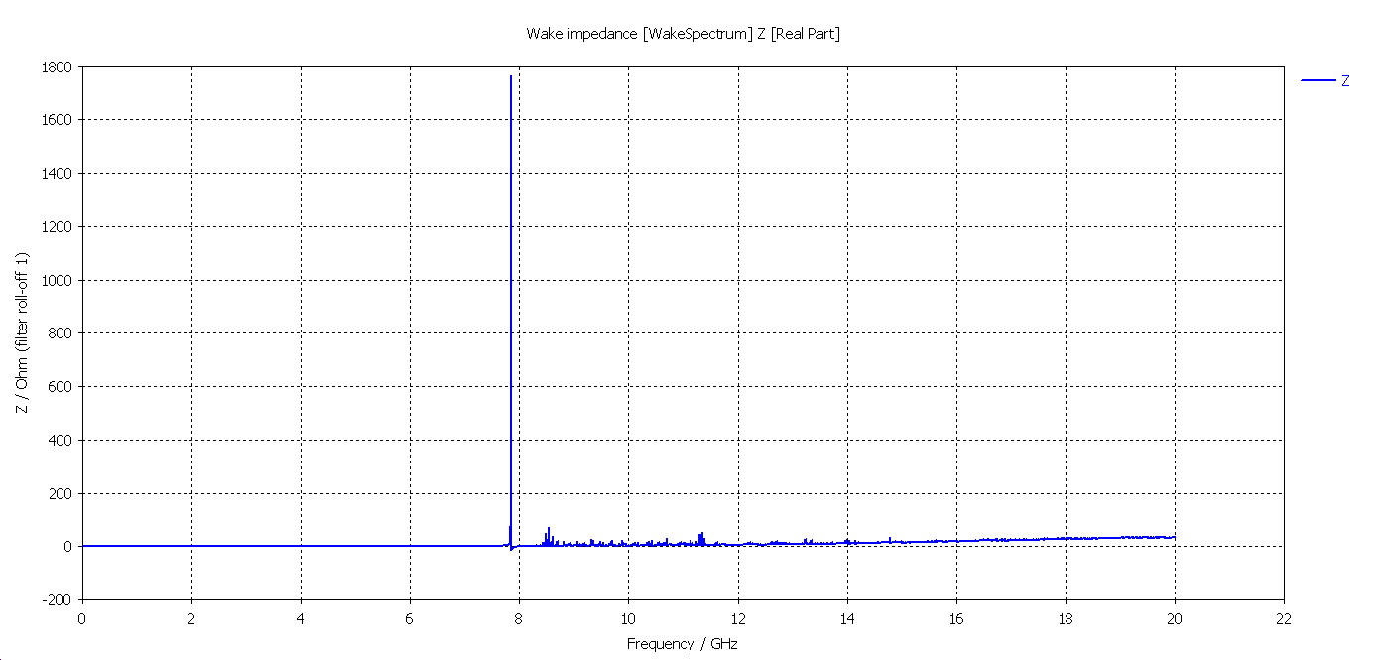
Model 3: Power deposition in different region of IR
(Z &CDR parameters &σ_{z}@5mm&material@Lossy mental)
σ_{z}=5mm: Two beam in the IR
Loss factor Trap in IR @k_trap: 0.0309v/pc
P_{trap}: H/W/Z: 25.7w/104.4w/364.7w
Source of the heating:
Power trapped in IR pipe (f< 11.474GHz)
HOM from other part of the ring
Be pipe: 2*8.78+2*12.84=43.24W
Al: Transition pipe: 2*106.9+2*64.2=342.2w
Cu: Y-shape crotch: 2*66.58+2*36.97=207.1w
Total power on IR pipe: 592.94w

Slide 15
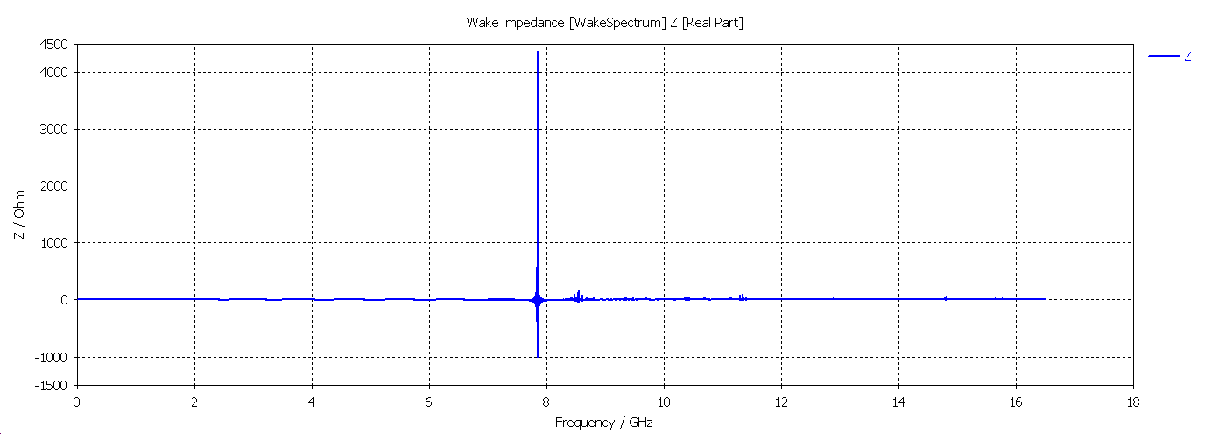
Model 3: Power deposition in different region of IR
( Z &High Luminosity &σ_{z}@6.2mm&material@PEC)
σ_{z}=6.2mm: Two beam in the IR
Loss factor Trap in IR @k_trap: 0/0114v/pc
P_{trap}: H/W/Z: 9.5w/38.5w/592.6w
Ohmic loss；(2)Power trapped in IR pipe (f< 11.474GHz)
(3)HOM from other part of the ring
Source of the heating:
Be pipe: 2*21.83+2*14.7+2*49.41=171.88W
Al: Transition pipe: 2*96.48+2*173.7+2*247.0=1034.36w
Cu: Y-shape crotch: 2*32.96+2*107.9+2*142.3=566.32w
Total power on IR pipe: 1772.56w
Total power on Be pipe: 235.95w

Slide 16
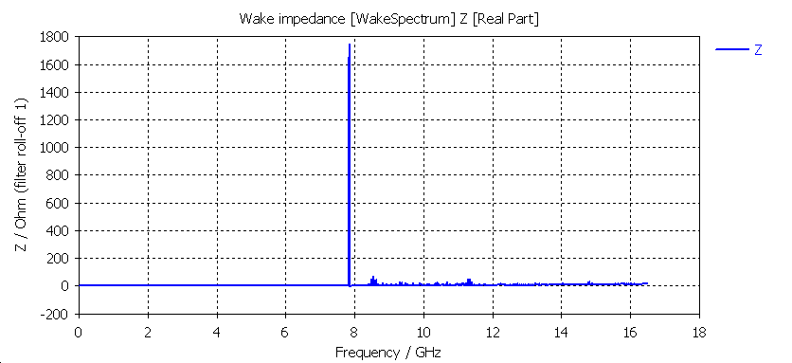
Model 3: Power deposition in different region of IR
( Z &High Luminosity &σ_{z}@6.2mm&material@lossy mental)
σ_{z}=6.2mm: Two beam in the IR
Loss factor Trap in IR @k_trap: 0.0196/v/pc
P_{trap}: H/W/Z: 16.38w/66.4w/1021.2w
Source of the heating:
Power trapped in IR pipe (f< 11.474GHz)
HOM from other part of the ring
Be pipe: 2*19.04+2*49.41=136.9W
Al: Transition pipe: 2*301.61+2*247.0=1097.22w
Cu: Y-shape crotch: 2*189.94+2*142.3=664.48w
Total power on IR pipe: 1898.6w

Slide 17
Summary
For Model 3 (with Be pipe aperture 28mm, quadrupole aperture 20mm), the structure is feasible for beam parameters in CDR.
Maximum Power deposition in IR different region:
Maximum Power | CDR beam parameters | High Luminosity beam parameters
Be pipe (w) | 50w | 136.9
Al: Transition pipe (w) | 342 | 1097
Cu: Y-shape crotch (w) | 207 | 664
Total power in IR pipe (w) | 592 | 1898
Total length:2220mm
Be: 136.9w
Cu: 332w
Thanks for your attention!
Al: 548w

