Slide 1
Superconducting Magnets in CEPC Interaction Region
Yingshun Zhu
Institute of High Energy Physics, Chinese Academy of Sciences
May 29, 2020
CEPC MDI Workshop

Slide 2
Outline
Overview of CEPC MDI SC magnets
Design of QD0 and short model magnet
Design of quadrupole QF1 and anti-solenoid
QD0 design with updated requirement
Summary

Slide 3
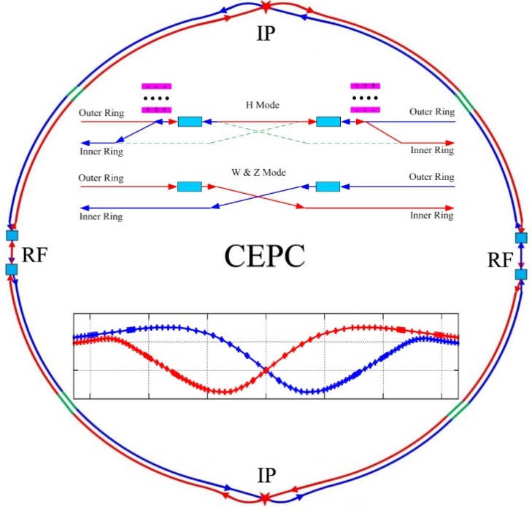
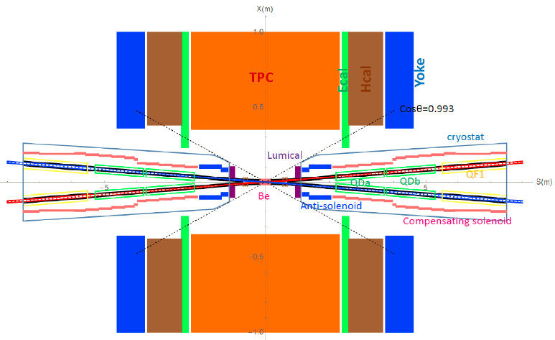
Overview of CEPC MDI SC magnets
CEPC is a Circular Electron Positron Collider with a circumference about 100 km, beam energy up to 120 GeV proposed by IHEP.
Most magnets needed for CEPC Accelerator are conventional magnets.
To greatly squeeze the beam for high luminosity, compact high gradient final focus quadrupole magnets are required on both sides of the IP points in CEPC collider ring.
Sketch of CEPC Collider ring
CEPC MDI layout

Slide 4
The CDR requirements of the Final Focus quadrupoles (QD0 and QF1) are based on L* of 2.2 m, beam crossing angle of 33 mrad.
QD0 and QF1 magnets are operated inside the field of Detector solenoid magnet with a central field of 3.0 T.
To cancel the effect of the longitudinal detector solenoid field on the accelerator beam, anti-solenoids before QD0, outside QD0 and QF1 are needed.
The total integral longitudinal field generated by the detector solenoid and accelerator anti-solenoid is zero; Local net solenoid field in the region of quadrupole is close to zero.
Table 1: Requirements of Interaction Region quadrupole magnets for Higgs
Magnet | Central field gradient (T/m) | Magnetic length (m) | Width of GFR (mm) | Minimal distance between two aperture beam lines (mm)
QD0 | 136 | 2.0 | 19.6 | 72.6
QF1 | 110 | 1.48 | 27.0 | 146.20

Slide 5
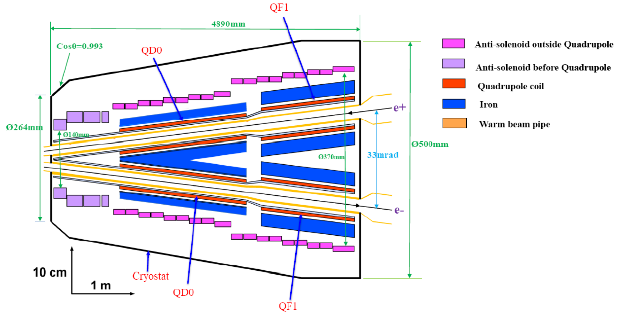
CEPC MDI SC Magnets start at z=1.12m, including: superconducting QD0,QF1, anti-solenoid on each side of the IP point.
Inner radius of beam pipe is 10 mm.
QD0, QF1, and anti-solenoid coils are in the same cryostat.
Schematic layout of QD0, QF1, and anti-solenoid

Slide 6
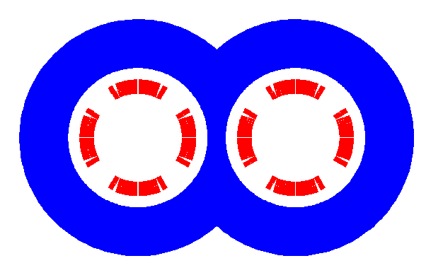
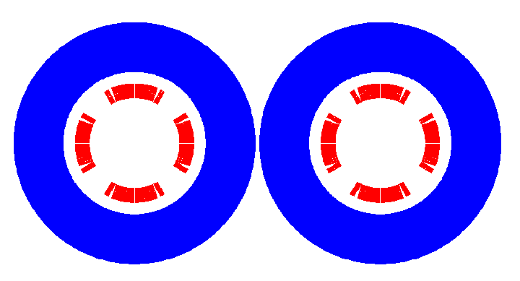
QD0 design with CDR Parameter
QD0 CDR: 136T/m, inner diameter 40mm, length 2m.
Iron-free design of QD0 is presented in the CDR report.
QD0 design of iron option
Minimal distance between two aperture beam lines: 72.6 mm.
Not enough space to place two single apertures side by side, so a compact design is adopted.
cos2θ quadrupole coil using NbTi Rutherford: highest magnetic efficiency and cooling capacity, good stability, elimination of field crosstalk.
Iron yoke can enhance the field gradient, reduce the coil excitation current.
Iron core in the middle part is shared by the two apertures.

Slide 7
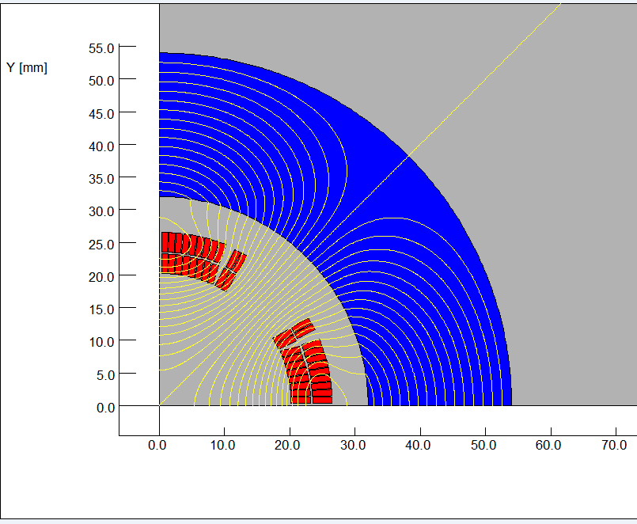
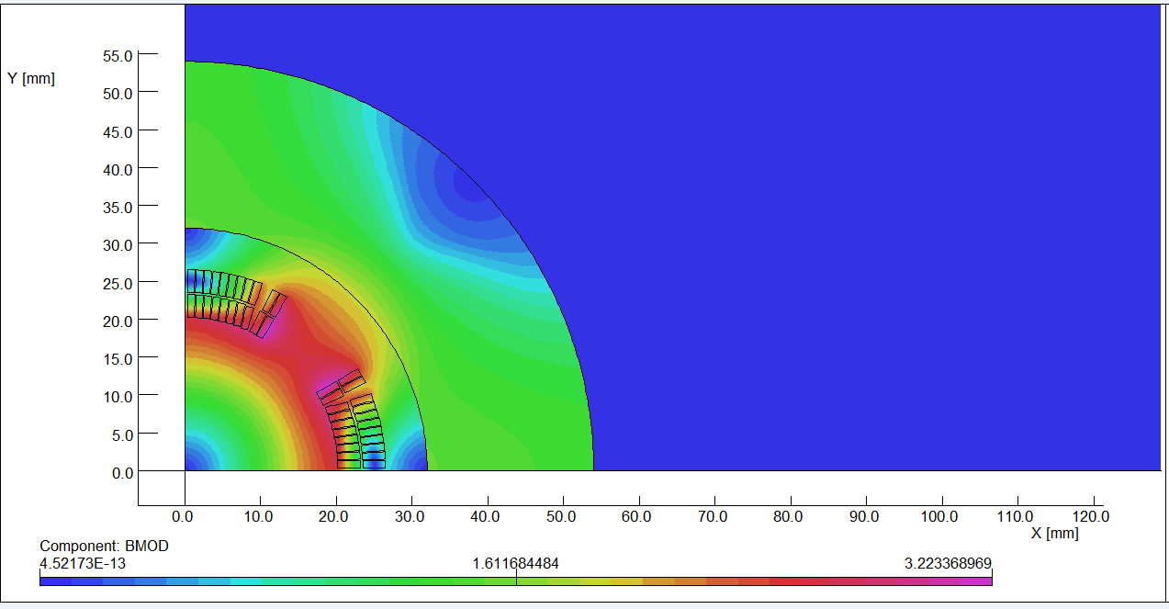
The design of QD0 is based on two layers cos2θ quadrupole coil using NbTi Rutherford cable with iron yoke.
The QD0 single aperture coil cross section is optimized with four coil blocks in two layers separated by wedges, and there are 21 turns in each pole.
2D magnetic field calculation is performed using OPERA.
Actual insulation thickness and coil fabrication process are taken into account.
2D flux lines (1/4 cross section)
Magnetic flux density distribution

Slide 8
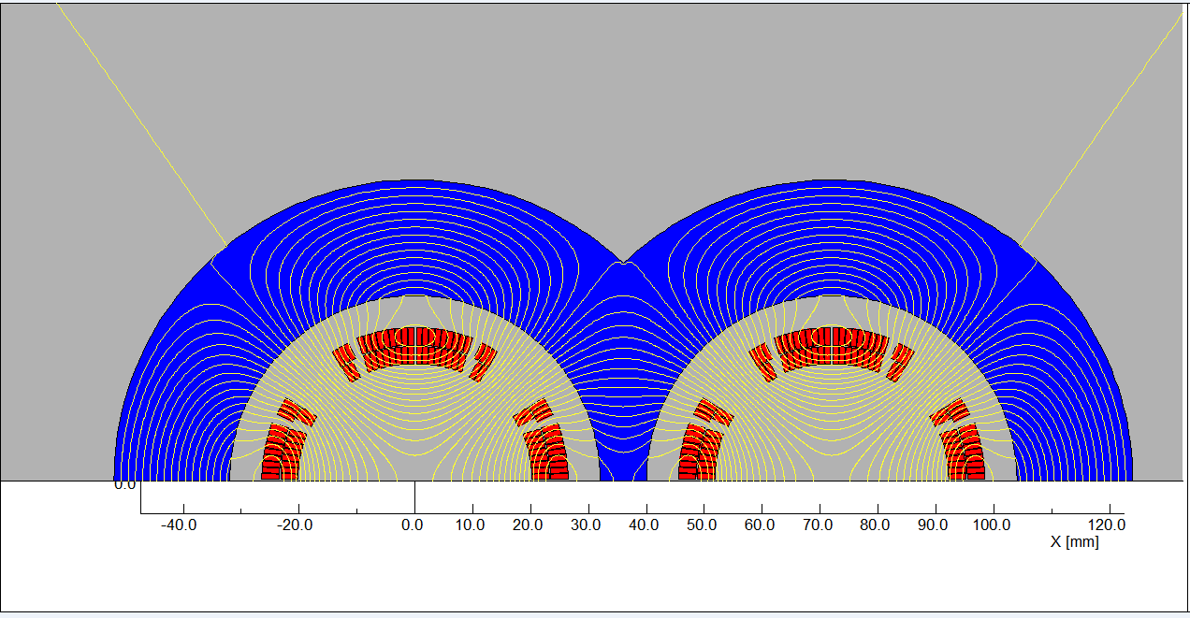
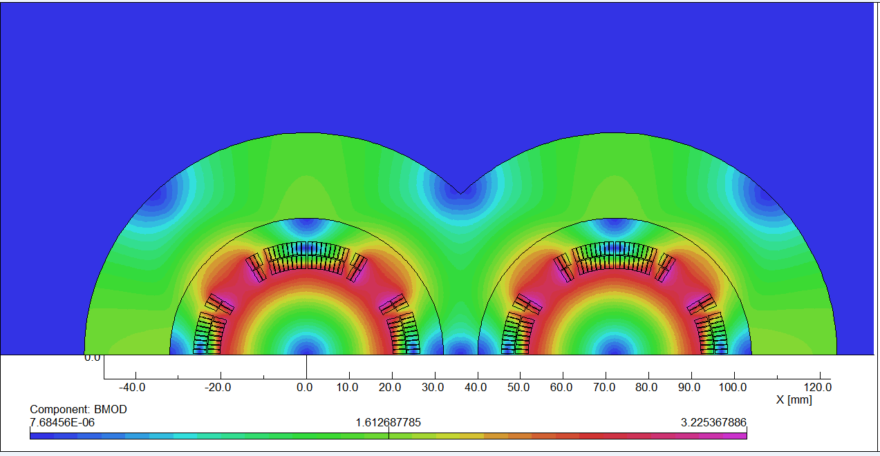
2D field cross talk of QD0 two apertures near the IP side.
The field harmonics as a result of field crosstalk is smaller than 0.5×10⁻⁴. Compared with the iron-free design, the excitation current can be reduced.
2D Flux lines
Bmod distribution

Slide 9
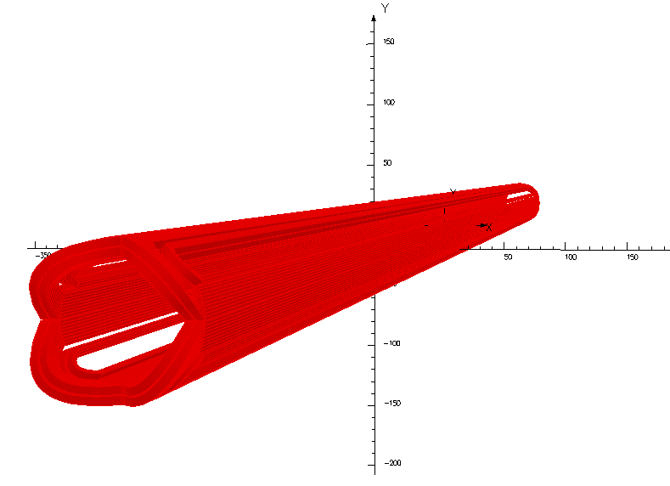
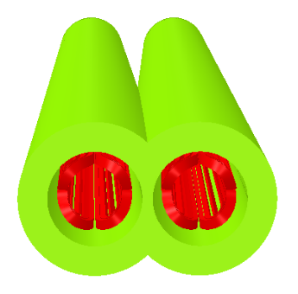
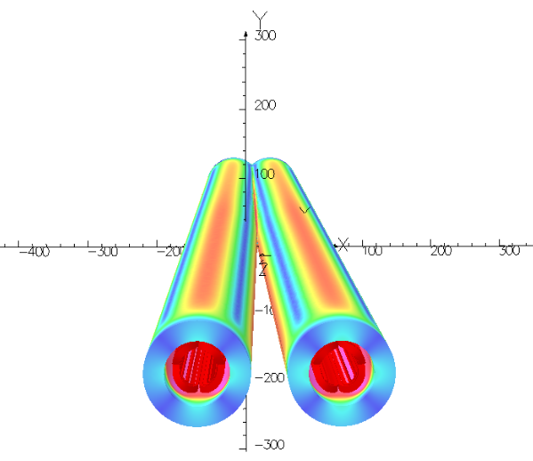
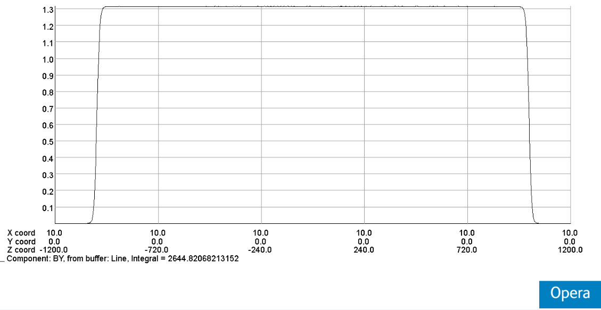
QD0: Double aperture quadrupole magnet using cos2θ coil with iron yoke, with crossing angle between two apertures.
Novel design, the first such magnet in the world.

Slide 10
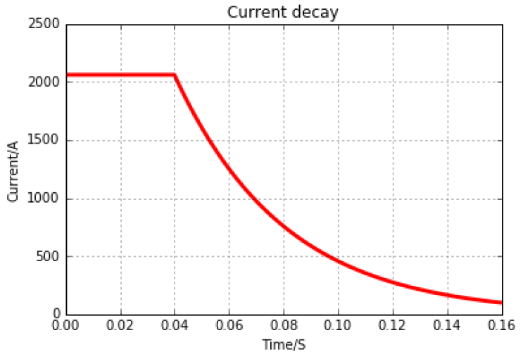
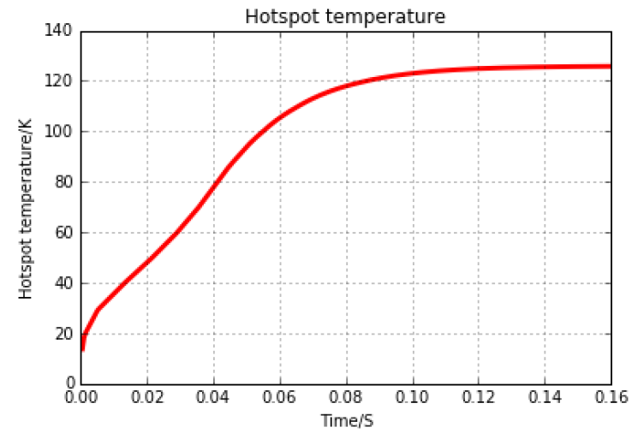
Quench simulation of QD0, safe
Dump resistance=0.24Ω，Delay time= 40 ms.
Hot spot temperature: 126K
Magnet resistance: 0.009Ω
Peak voltage : 500V

Slide 11
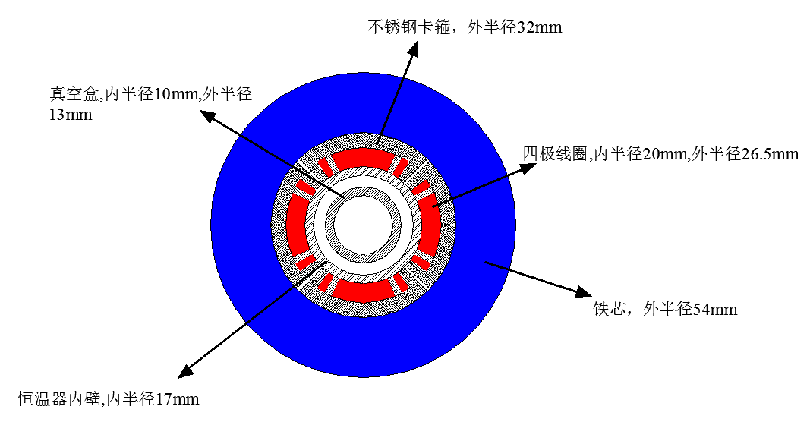
Design parameters of QD0:
Table 2: Design parameters of QD0 (with iron core)
Magnet name | QD0
Field gradient (T/m) | 136
Magnetic length (m) | 2.0
Coil turns per pole | 21
Excitation current (A） | 2080
Coil layers | 2
Conductor | Rutherford Cable, width 3 mm, mid thickness 0.93 mm, keystone angle 1.9 deg, Cu:Sc=1.3, 12 strands
Stored energy (KJ) (Double aperture) | 21.5
Inductance (H） | 0.010
Peak field in coil (T) | 3.3
Coil inner diameter (mm) | 40
Coil outer diameter (mm) | 53
X direction Lorentz force/octant (kN) | 112
Y direction Lorentz force/octant (kN) | -108
The current of QD0 at W and Z model will decrease.

Slide 12
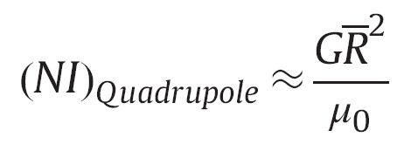
The coil turns, the coil dimension and the excitation current of QD0 are checked using the expressions of Ampere-Turns for superconducting quadrupole magnets based on sector coils.
(no iron)
(with iron)
Yingshun Zhu, et al., Study on Ampere-Turns of Superconducting Dipole and Quadrupole Magnets Based on Sector Coils, Nuclear Instruments and Methods in Physics Research A, 2014, 741: 186-191.

Slide 13
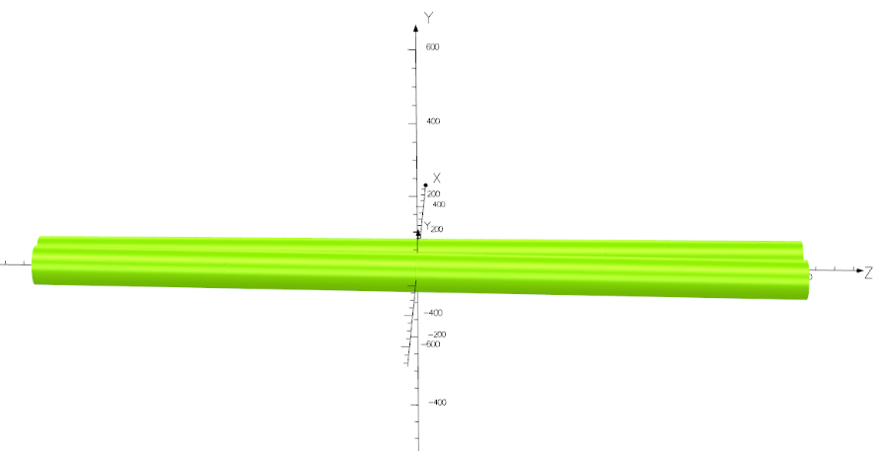
Design of QD0 short model magnet
Novel design of QD0:
Collared cos2θ quadrupole magnet with shared iron yoke and crossing angle between two aperture centerlines.
So far, there is no cos2θ superconducting quadrupole magnet developed in China.
In the R&D of CEPC interaction region superconducting magnets, the first step is to develop a short QD0 model magnet with 0.5m length (near IP side).

Slide 14
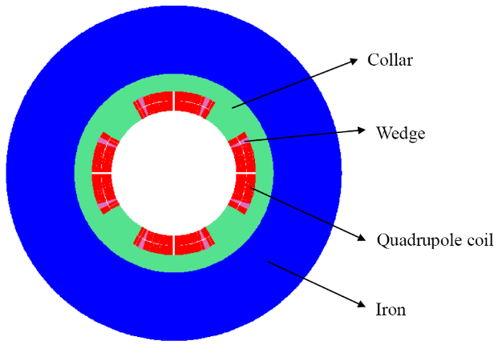
The aim of QD0 short model magnet:
Verify magnet design;
Exploring magnet manufacturing technology;
Master cryogenic testing Technology;
Master the magnetic and quench performance of magnet;
Lay the foundation for the development of long QD0 prototype.

Slide 15
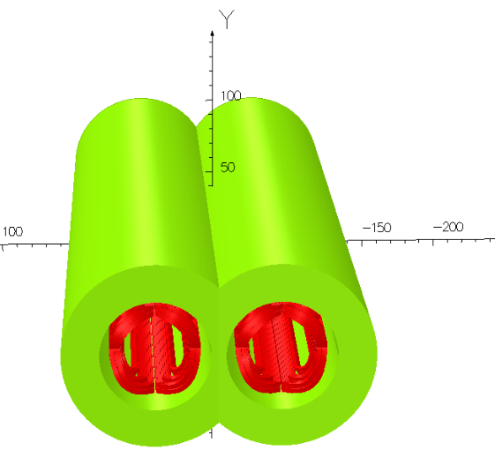
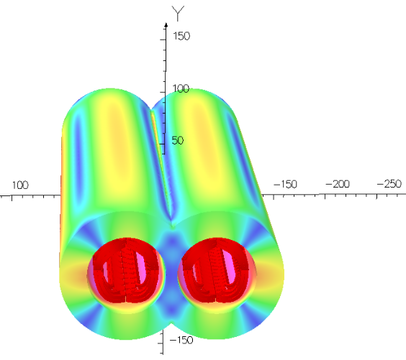
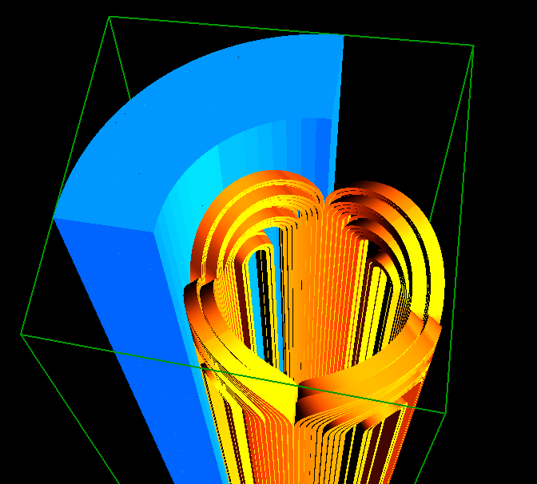
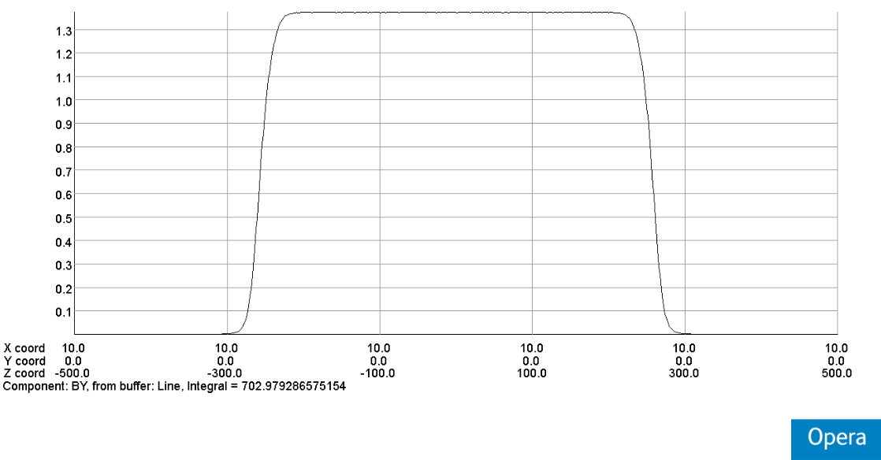
3D field simulation of two apertures 0.5m QD0.

Slide 16
3D field simulation result shows that, local field harmonic as a result of field cross talk is smaller than 0.5 unit (1×10⁻⁴).
Each integrated multipole field as a result of field crosstalk between the two apertures is smaller than 0.3 unit.
The dipole field is smaller than 10 Gs at each longitudinal position.
Table 3: 3D integrated field harmonics（unit, 1×10⁻⁴）
n | B_{n}/B₂@R=9.8 mm
2 | 10000.0
3 | -0.28
4 | 0.017
5 | -0.01
6 | 0.06
7 | -0.02
8 | 0.022
9 | 0.012
10 | -1.78
11 | -0.02
12 | 0.015

Slide 17
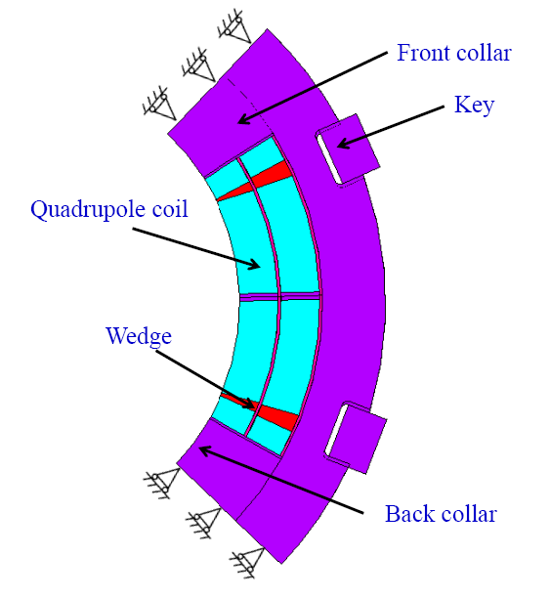
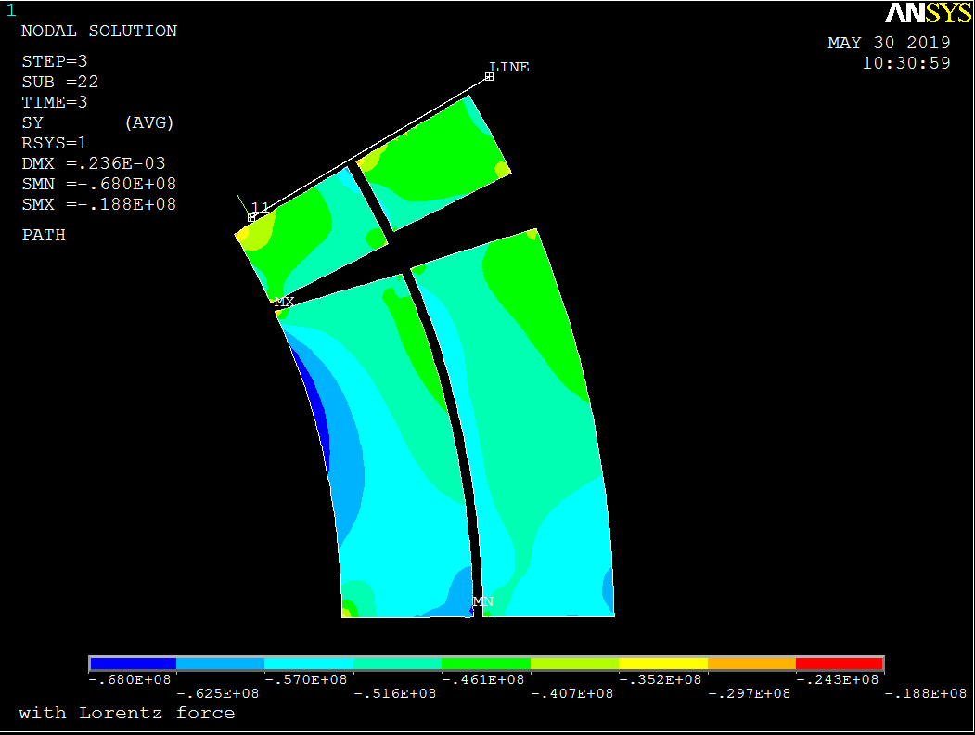
Stress analysis of QD0 short model magnet:
A total of 8 keys are used in the whole cross section.
The FEM analysis result shows that, the stress in each component during each operation step is safe.
Collar material with high strength is required.
Model
Stress in coil after excitation

Slide 18
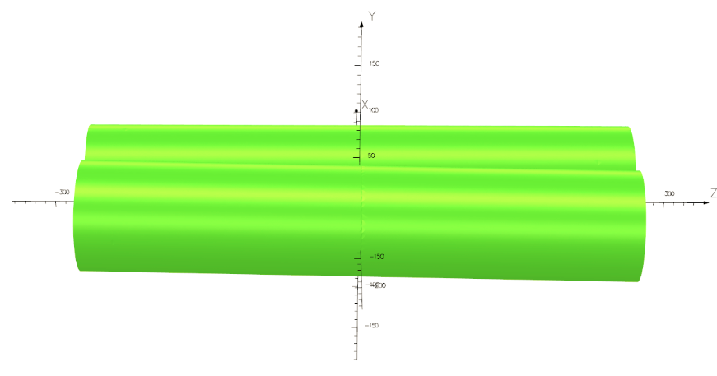
Influence of solenoid field on the quadrupole
Quadrupoles are located inside the bore of Accelerator anti-solenoid, which can cancel the field of Detector solenoid.
The cancellation of solenoid is not perfect, and residual solenoid field exists. During optimization, the solenoid field is smaller than 300 Gs in the quadrupole region.
3D field simulation of 0.5m QD0 with 300 Gs background solenoid field:
300 Gs solenoid

Slide 19
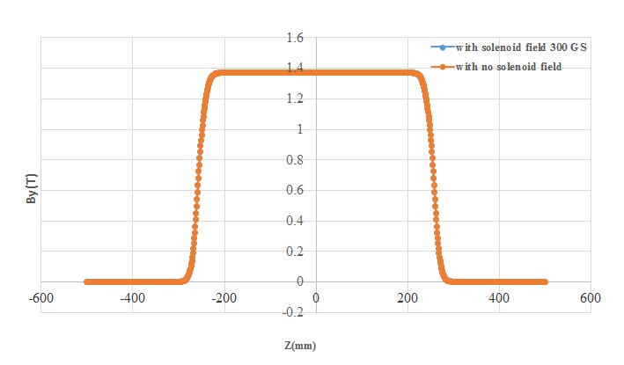
3D field simulation result shows that, the quadrupole magnet can work normally under 300Gs solenoid field.
The magnetic field in the iron core increases, but magnetic field saturation is not serious.
The change in the integrated field gradient is smaller than 3×10⁻⁴ ; the change in the integrated multipole field is smaller than 0.2×10⁻⁴.
Magnetic fled distribution along longitudinal direction

Slide 20
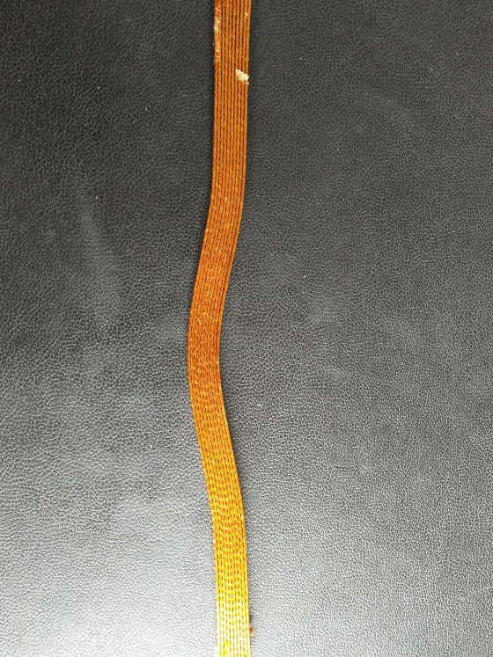
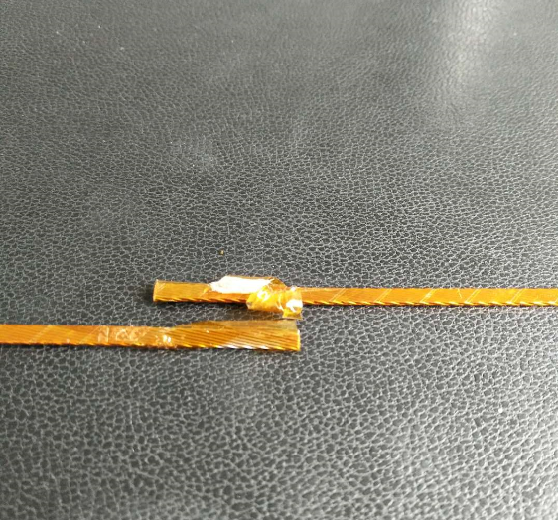
Specifications on NbTi/Cu Strand and keystoned Rutherford Cable:
Strand:
NbTi/Cu, 0.5mm in diameter,
Cu/Sc=1.3, Filament diameter < 8μm,
@4.2K, Ic≥340A@3T，Ic≥280A@4T，Ic≥230A@5T.
Rutherford Cable:
Width: 3mm, mid thickness: 0.93 mm, keystone angle: 1.9 deg, No of stands: 12.
Cu Rutherford cable sample

Slide 21
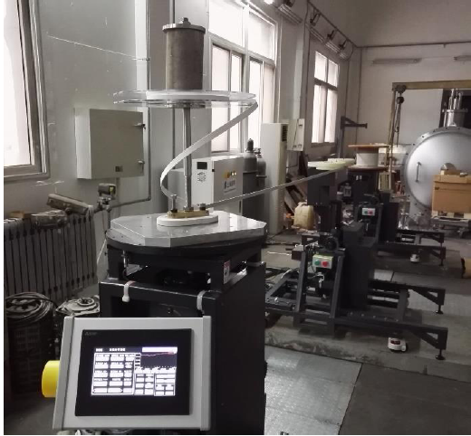
Cost inquiry for QD0 short model magnet fabrication has been completed.
The basic hardware necessary for prototype magnet was investigated.
Winding machine for 0.5m QD0 quadrupole coil is available in IHEP Magnet Group (need some tooling).
The physical design of QD0 short model magnet passed the experts review in July 2019.
IHEP winding machine
Review meeting

Slide 22
R&D plan toward TDR
In the R&D of CEPC superconducting magnets, firstly QD0 short model magnet (the most critical part of CEPC SC magnets) is planed to be developed:
Field gradient: 136T/m, inner diameter 40mm, length 0.5m.
Crossing angle between two aperture centerlines: 33 mrad.
In practice, can it really meet the requirement?
Need funding support: 50W RMB, including: superconductor, magnet fabrication and assembly, field measurement system, quench protection system, cryogenic test, etc.
Need manpower: 5.

Slide 23
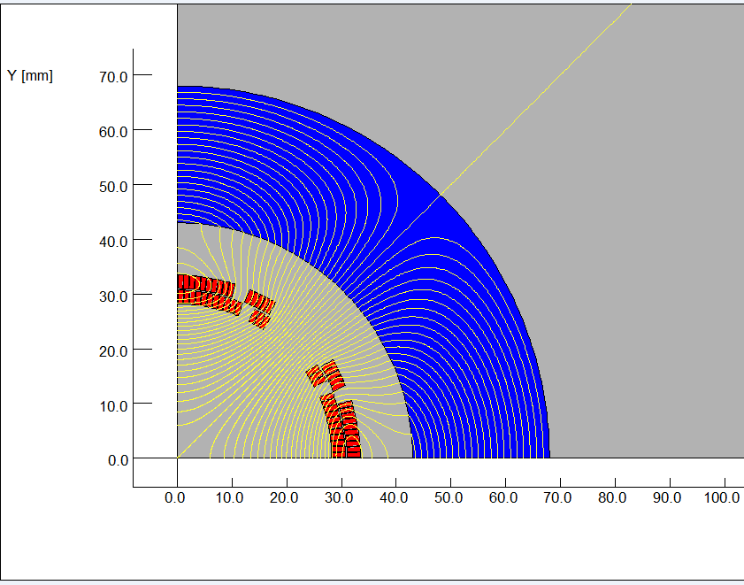
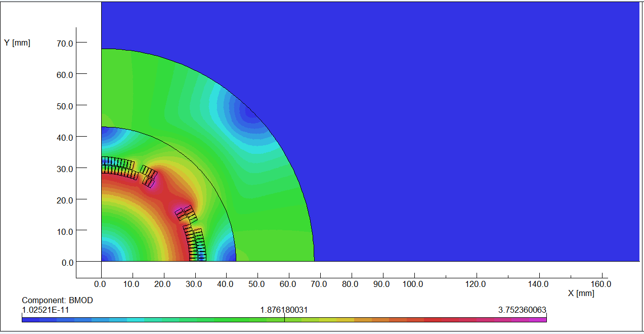
Design of superconducting quadrupole magnet QF1
The design of QF1 magnet is similar to the QD0 magnet, except that there is iron yoke around the quadrupole coil for QF1.
The used Rutherford cable is similar to that of QD0. Since the distance between the two apertures is much larger and the usage of iron yoke, the field cross talk between the two apertures of QF1 is not a problem.
After optimization, the QF1 coil consists of four coil blocks in two layers separated by wedges, and there are 29 turns in each pole.
2D flux lines (One quarter cross section)
Magnetic flux density distribution

Slide 24
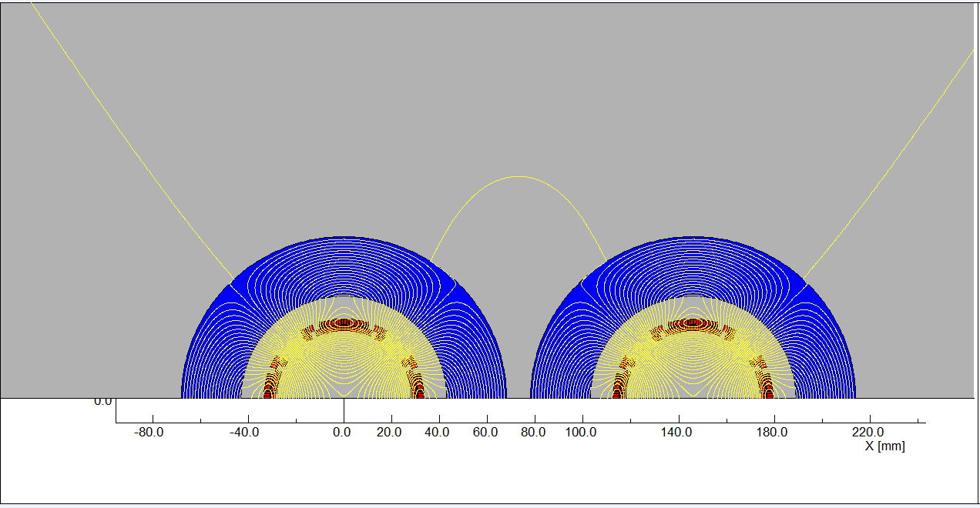
Field cross talk of QF1 two apertures is modelled and studied in OPERA-2D.
The calculation results show that, the iron yoke can well shield the leakage field of each aperture.
Each systematic field harmonics is smaller than 1 unit (1×10-4).
The non-systematic field harmonics as a result of field cross talk can be neglected.
Two aperture Flux lines

Slide 25
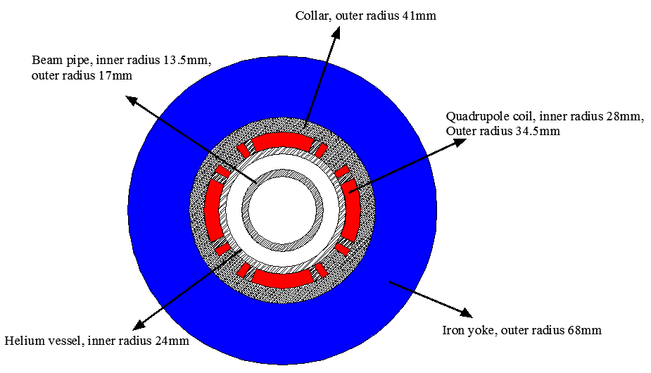
Design parameters and magnet Layout of QF1:
Table 4: Design parameters of QF1
Magnet name | QF1
Field gradient (T/m) | 110
Magnetic length (m) | 1.48
Coil turns per pole | 29
Excitation current (A） | 2250
Coil layers | 2
Conductor size (mm) | Rutherford Cable, width 3 mm, mid thickness 0.95 mm, 12 strands
Stored energy (KJ) | 30.5
Inductance (H） | 0.012
Peak field in coil (T) | 3.8
Coil inner diameter (mm) | 56
Coil outer diameter (mm) | 69
X direction Lorentz force/octant (kN) | 110
Y direction Lorentz force/octant (kN) | -120
Single aperture QF1
The current of QF1 at W and Z model will decrease.

Slide 26
Design of superconducting anti-solenoid
The design requirements of the anti-solenoids in the CEPC Interaction Region are summarized below:
1) The total integral longitudinal field generated by the detector solenoid and anti-
solenoid coils is zero.
The longitudinal field inside QD0 and QF1 should be smaller than a few
hundred Gauss at each longitudinal position.
The distribution of the solenoid field along longitudinal direction should meet
the requirement of the beam optics for emittance.
The angle of the anti-solenoid seen at the collision point satisfies the Detector
requirements.
The design of the anti-solenoid fully takes into account the above requirements. The anti-solenoid will be wound of rectangular NbTi-Cu conductor.

Slide 27
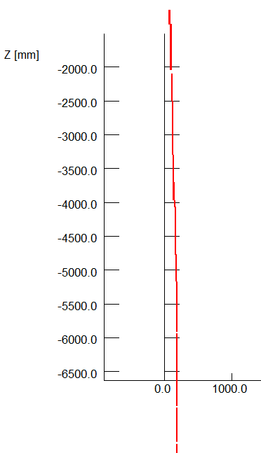
The magnetic field of the Detector solenoid is not constant, and it decreases slowly along the longitudinal direction.
In order to reduce the magnet size, energy and cost, the anti-solenoid is divided into a total of 29 sections with different inner coil diameters.
These sections are connected in series, but the current of some sections of the anti-solenoid can be adjusted using auxiliary power supplies if needed.
The anti-solenoid along longitudinal direction:
1) 4 sections, from IP point to QD0;
2) 12 sections, QD0 region;
3) 6 sections, QF1 region;
4) 7 section, after QF1 region.
To reduce the length of the cryostat, the sections of
anti-solenoid after QF1 region with low field will be
operated at room-temperature.

Slide 28
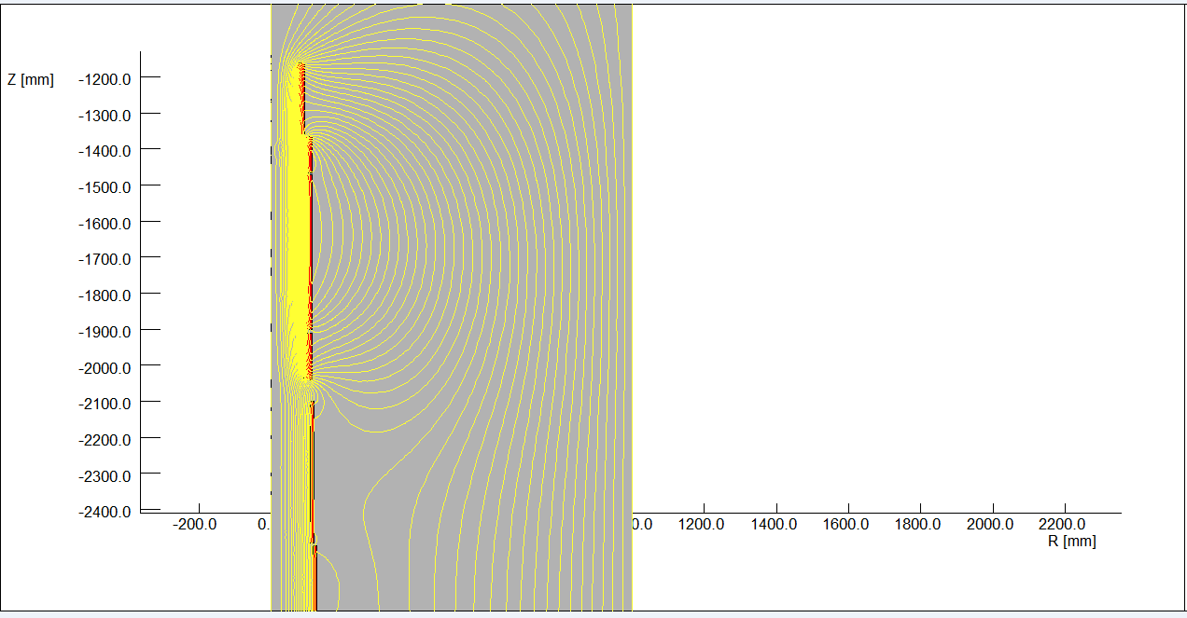
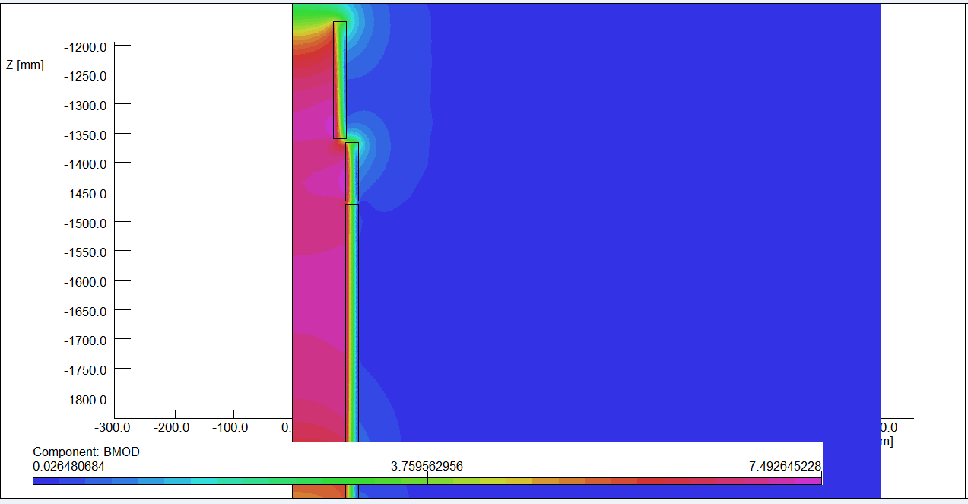
Magnetic field calculation and optimization is performed using axi-symmetric model in OPERA-2D.
The central field of the first section of the anti-solenoid is the strongest, with a peak value of 7.2T.
2D flux lines
Magnetic flux density distribution

Slide 29
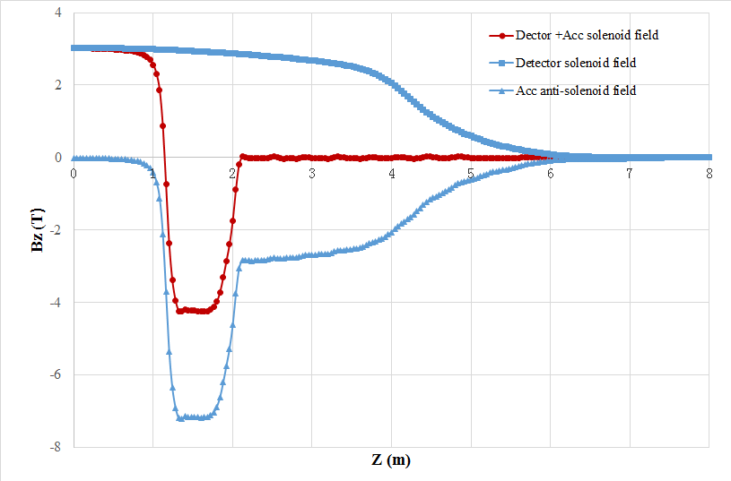
Combined field of Anti-solenoid and Detector solenoid.
The net solenoid field inside QD0 and QF1 at each longitudinal position is smaller than 300 Gs.
The combined field distribution of anti-solenoid and Detector solenoid well meets the requirement of beam dynamics for emittance.

Slide 30
Design parameters of Anti-solenoid:
Table 5: Design parameters of Anti-solenoid
Magnet name | Anti-solenoid before QD0 | Anti-solenoid QD0 | Anti-solenoid after QD0
Central field（T） | 7.2 | 2.8 | 1.8
Magnetic length（m） | 1.1 | 2.0 | 1.7
Conductor (NbTi-Cu, mm) | 2.5×1.5
Coil layers | 16 | 8 | 4/2
Excitation current（kA） | 1.0
Stored energy (KJ) | 715
Inductance（H） | 1.4
Peak field in coil (T) | 7.7 | 3.0 | 1.9
Number of sections | 4 | 11 | 7
Solenoid coil inner diameter (mm) | 120
Solenoid coil outer diameter (mm) | 390
Total Lorentz force F_{z} (kN) | -75 | -13 | 88
Cryostat diameter (mm) | 500

Slide 31
QD0 design with updated requirement
The requirement of the Final Focus quadrupoles is updated in 2019.
Design considerations
The field gradient of quadrupoles is reduced compared to that in CDR; the development of QDa is the most challenging.
Design of quadrupoles and anti-solenoid is similar to that in CDR.
Space for the corrector coil is enough inside the bore of quadrupole.
Iron yoke is used to eliminate the field crosstalk from the two apertures.
Table 6: Updated Requirements of final focus quadrupole magnets for Higgs
Magnet | Central field gradient (T/m) | Magnetic length (m) | Width of GFR (mm) | Minimal distance between two aperture beam lines (mm)
QDa | 77.5 | 1.5 | 19.2 | 72.61
QDb | 77.5 | 1.5 | 22.0 | 124.75
QF1 | 63.4 | 2.0 | 30.9 | 181.85

Slide 32
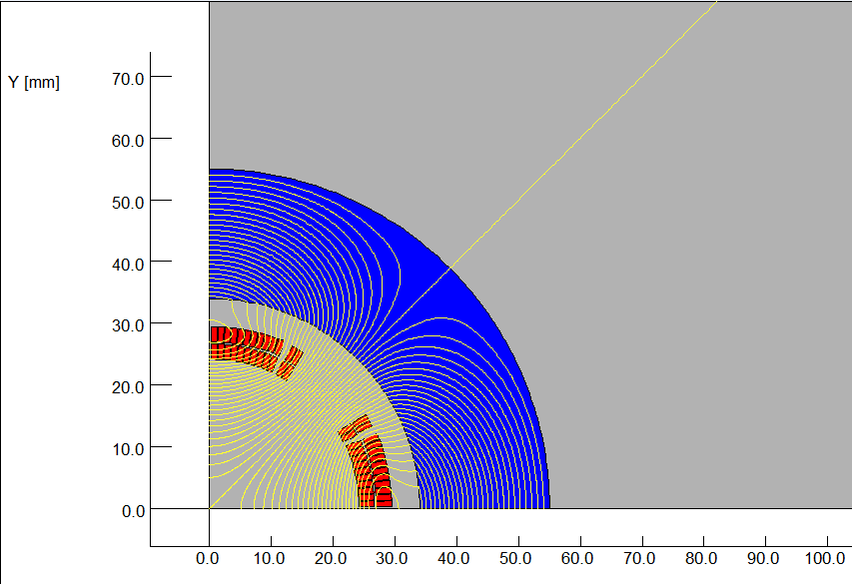
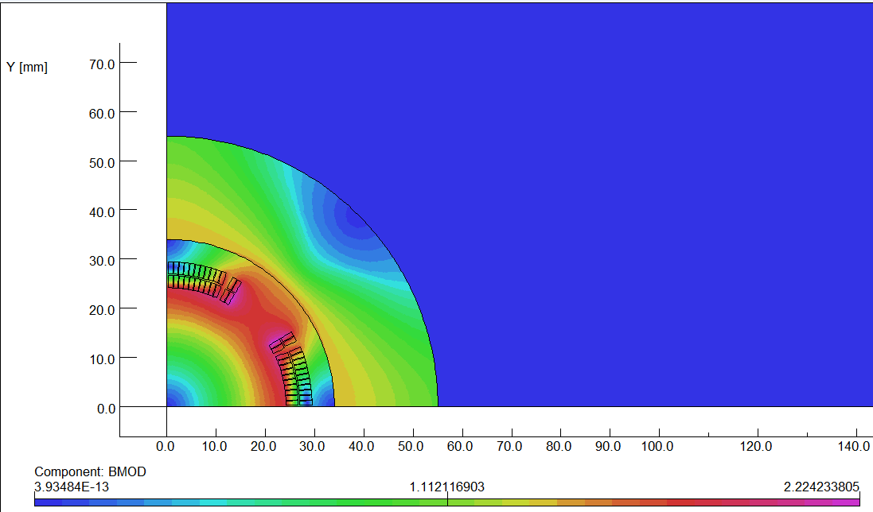
Design progress of Qda (inner diameter 48mm)
The design of QDa is based on two layers cos2θ quadrupole coil using Rutherford cable with iron yoke.
The QDa single aperture cross section is optimized with four coil blocks in two layers separated by wedges, and there are 25 turns in each pole.
The excitation current of QDa is 1240A, and each multipole field in single aperture is smaller than 1×10⁻⁴.
2D flux lines (1/4 cross section)
Magnetic flux density distribution

Slide 33
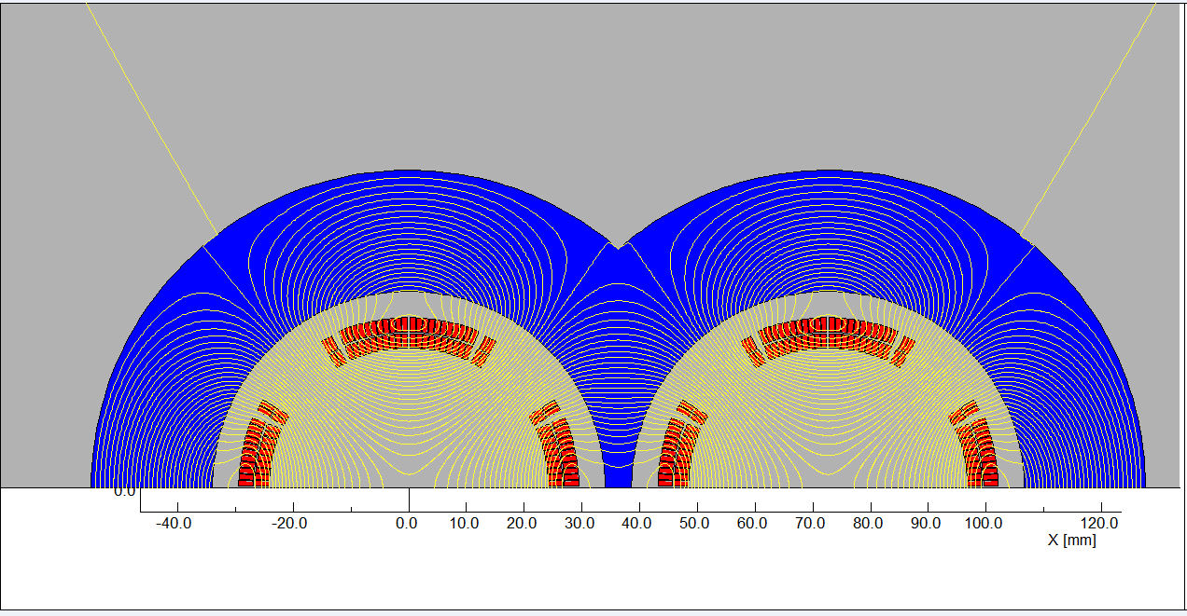
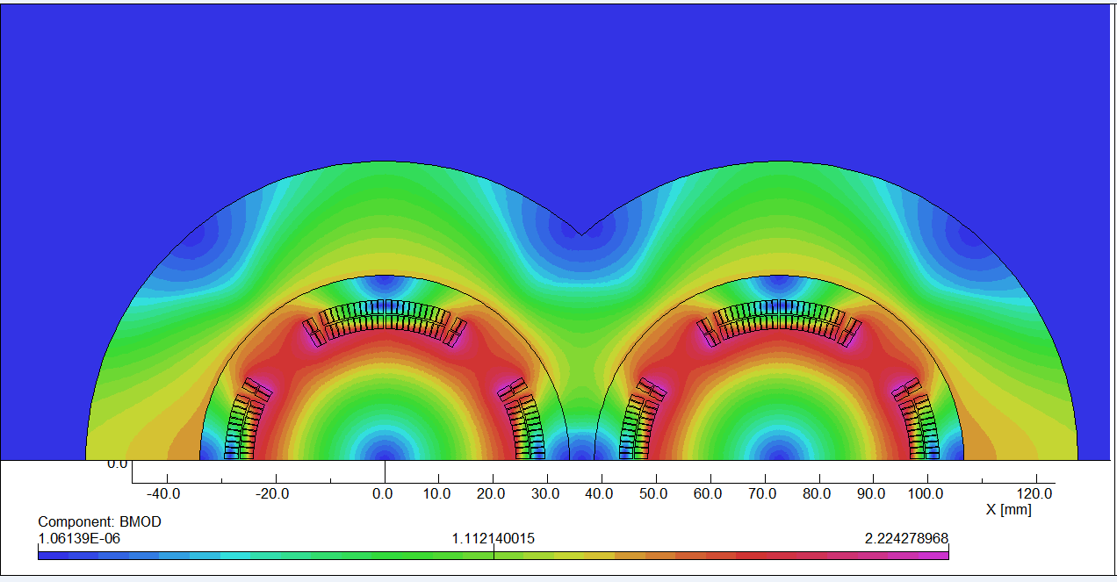
Field cross talk of the two apertures:
2D field cross talk of QDa two apertures near the IP side, where the distance between two aperture centerlines is minimum.
Iron yoke can well shield the leakage field of each aperture. The field harmonics as a result of field crosstalk is smaller than 0.5×10⁻⁴.
The dipole field in each single aperture as a result of field crosstalk is smaller than 5 Gs.
2D Flux lines
Bmod distribution

Slide 34
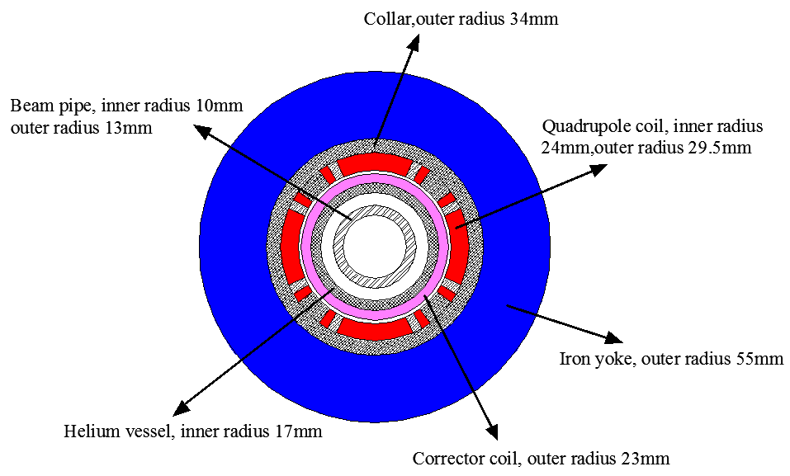
Design parameters and single aperture cross section of QDa:
Table 7: Design parameters of QDa for Higgs
Magnet name | QDa
Field gradient (T/m) | 77.5
Magnetic length (m) | 1.5
Coil turns per pole | 25
Excitation current (A） | 1240
Coil layers | 2
Conductor | Rutherford Cable, width 2.5 mm, mid thickness 0.93 mm, keystone angle 1.9 deg
Stored energy (KJ) (Double aperture) | 8.0
Inductance (H） | 0.010
Peak field in coil (T) | 2.4
Coil inner diameter (mm) | 48
Coil outer diameter (mm) | 59
X direction Lorentz force/octant (kN) | 39
Y direction Lorentz force/octant (kN) | -34
To minimize the quench caused by beam loss, a thin layer of liquid helium will be introduced inside superconducting corrector coils.

Slide 35
Feasibility of HTS superconducting magnet technology is being considered for CEPC IR superconducting magnets.
Advantage: Large critical current, heat load resistant,
High operating temperature.
Disadvantage: Expensive, conductor and coil manufacture not mature,
Large diameter of superconductor filament.
HTS Bi-2212 option for CEPC SC quadrupole
Bi-2212: High current carrying capacity, isotropic properties, relatively mature production technology
Similar cross section as NbTi option;
Wind and react; or React and wind;

Slide 36
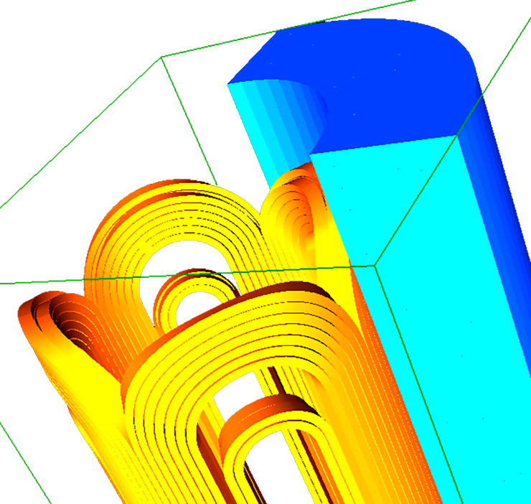
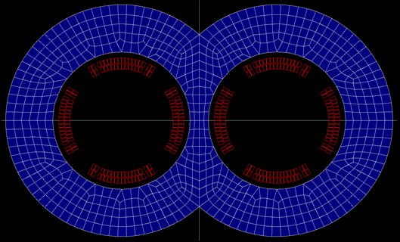
Bi-2212 option of QDa
Two layers cos2θ quadrupole coil using Rutherford cable with iron yoke.
Inner diameter 48mm, Bi-2212 strand diameter 0.8 mm.
Rutherford Cable: Width 2.4mm, No of stands: 6, 17turns each pole.
The excitation current of QDa is 1800A, and each multipole field in each aperture is smaller than 2×10⁻⁴.
As a first step, some test on Bi-2212 conductor is planned.
Field calculation model

Slide 37
Summary
MDI superconducting magnets are key devices for CEPC. The design of superconducting magnets meet the requirement.
Novel design of QD0 is adopted. Despite limited space, magnetic field cross talk effect between two apertures is negligible using iron yoke.
Compared with the iron-free design of QD0, the excitation current with iron yoke can be substantially reduced.
The anti-solenoid is divided into a total of 29 sections with different inner coil diameters, with a max central field of 7.2 T.
The first step of the R&D is to develop a QD0 short model magnet with a magnetic length of 0.5 m. Its physical design has been finished and reviewed. Its fabrication is planned to be started (depending on fund).
With the reduced field gradient in the updated design, both the NbTi option and HTS option for superconducting quadrupole magnet will be considered.

Slide 38
Thanks for your attention!
CEPC MDI Workshop

