Slide 1
Impacts of Detector Stray Field on Booster
Dou Wang, Yuan Zhang, Daheng Ji, Feipeng Ning
CEPC MDI Workshop, 28-29 May, 2020, C305, IHEP.

Slide 2
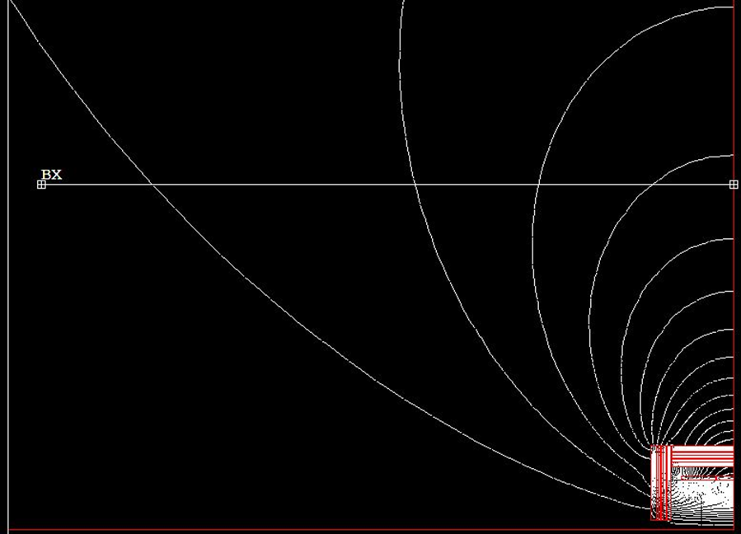
Detector Stray Field on Booster
Detector outer size: 6.01m (z) × 6.06m (r)
Booster bypasses the collider ring from the outer side. (Seperation: 25 m)
Beam dynamics effects of detector stray field is strongest at 10 GeV.
F. P. Ning
25 m

Slide 3
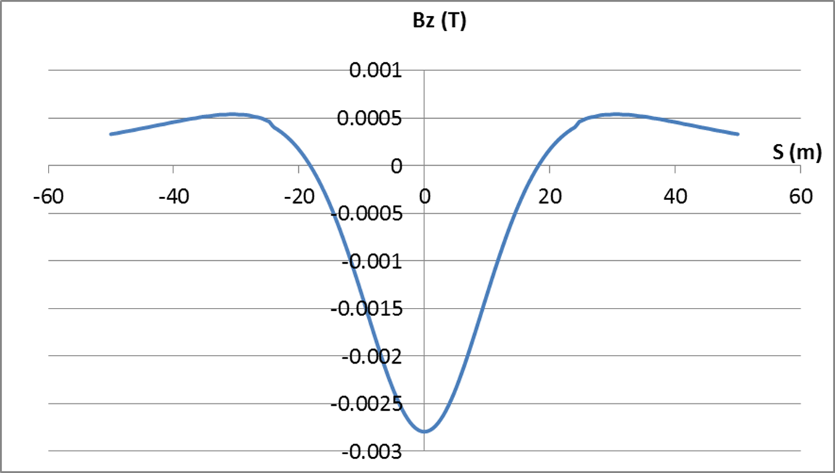
Effects of detector longitudinal field
Longitudinal component of detector stray field can be modeled as solenoid.
Magnetic data is from detector people.
Only Bz was considered as the first step.
100 slices (-50m ~ 50m): simulate the real distribution of longitudinal field.
F. P. Ning

Slide 4
Bz=28 Gs
Factor (Bz)=1.0
Coupling=0.001
Close orbit: ~ 0 m
Longitudinal field only make contribution to the coupling factor.

Slide 5
Bz=84 Gs
Factor (Bz)=3.0
Coupling=0.009
Close orbit: ~ 0 m

Slide 6
Bz=140 Gs
Factor (Bz)=5.0
Coupling=0.024
Close orbit: ~ 0 m

Slide 7
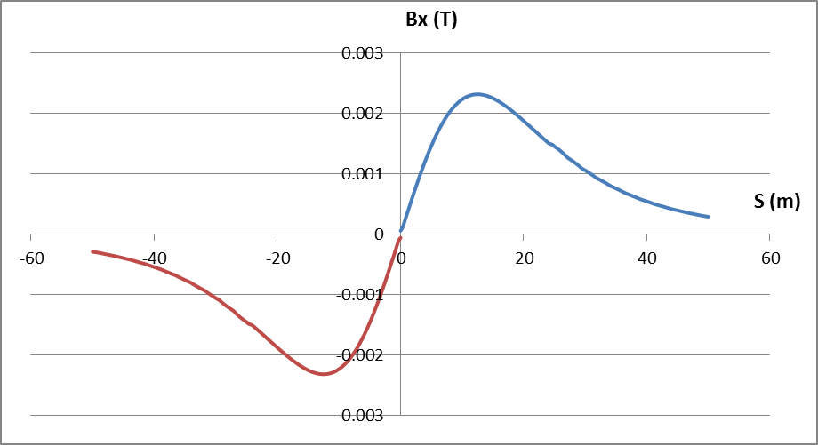
Effects of detector horizontal field
Horizontal component of detector stray field can be modeled as dipoles with vertical bending effect.
Magnetic data is from detector people.
Combined effects of Bz+Bx were considered.
100 slices (-50m ~ 50m): simulate the real distribution of horizontal field.
F. P. Ning

Slide 8
Bz=2.8Gs Bx=2.3 Gs
Factor(Bz)= Factor(Bx)= 0.1
Coupling=0.0005
Close orbit: Δy(max) ~ 5 mm
5mm vertical local orbit may reduce the dynamic acceptance at 10GeV.

Slide 9
Bz=28Gs Bx=23 Gs
Factor(Bz)= Factor(Bx)= 1.0
Coupling=0.068
Close orbit: Δx(max) ~ 15 um, Δy(max) ~ 50 mm
Horizontal close orbit is induced by the coupling effect.
Without correction, the vertical orbit distortion and coupling is intolerable.

Slide 10
Bz=28Gs Bx=23Gs w. correction
Factor(Bz)= Factor(Bx)= 1.0
Coupling=0.019
Close orbit: Δx(max) ~ 15 um, Δy(max) ~ 8 mm
With 2 correctors, the vertical orbit and coupling is controlled.
Some orbit leak to the whole ring for vertical plane

Slide 11
Bz=28Gs Bx=23Gs w. correction
Factor(Bz)= Factor(Bx)= 1.0
Coupling=0.0012
Close orbit: Δx(max) ~ 200 nm, Δy(max) ~ 0.8 mm
With 8 correctors, the vertical orbit and coupling is controlled well.
No orbit leak to the whole ring

Slide 12
Bz=56Gs Bx=46Gs w. correction
Factor(Bz)= Factor(Bx)= 2.0
Coupling=0.0083
Close orbit: Δx(max) ~ 900 nm, Δy(max) ~ 1.7 mm
With 8 correctors, the vertical orbit and coupling is controlled well.
No orbit leak to the whole ring

Slide 13
Bz=84Gs Bx=69Gs w. correction
Factor(Bz)= Factor(Bx)= 3.0
Coupling=0.04
Close orbit: Δx(max) ~ 2 um, Δy(max) ~ 2.2 mm
With 8 correctors, the vertical orbit and coupling can be controlled.
No orbit leak to the whole ring

Slide 14
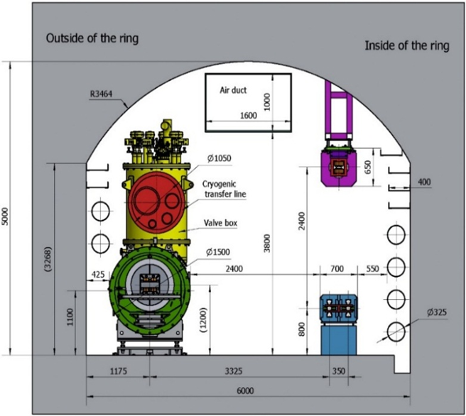
Effects of detector vertical field
Vertical component of detector stray field is not zero due to 2.4m height difference between collider ring and booster.
Magnetic data is estimated by analytical calculation.
Max By: 2.3 Gs
Combined effects of Bz+Bx+By were considered.
100 slices (-50m ~ 50m): simulate the real distribution of detector field.
2.4m

Slide 15
Bz=28Gs Bx=23Gs By=2.3 Gs
Factor(Bz)= Factor(Bx)= Factor(By)= 1.0
Coupling=0.0012
Close orbit: Δx(max) ~ 5 mm, Δy(max) ~ 0.8 mm
Only vertical orbit correction (8 correctors)
Horizontal orbit can not be controlled
5 mm Horizontal local orbit may reduce the dynamic acceptance at 10GeV.

Slide 16
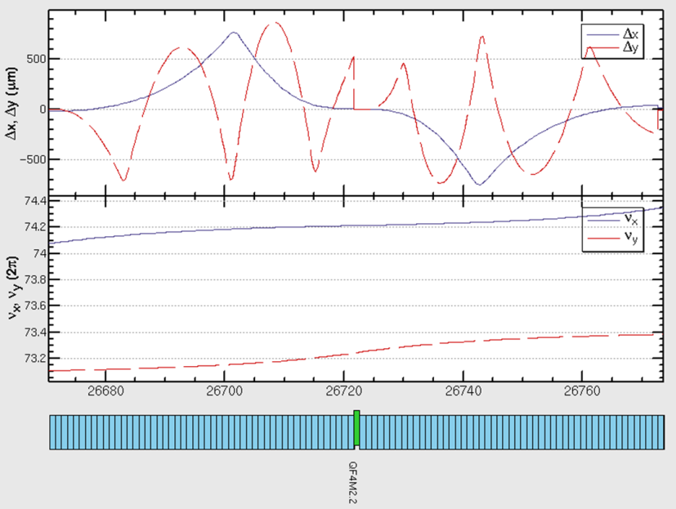
Bz=28Gs Bx=23Gs By=2.3 Gs
Factor(Bz)= Factor(Bx)= Factor(By)= 1.0
Coupling=0.0012
Close orbit: Δx(max) ~ 0.8 mm, Δy(max) ~ 0.8 mm
Orbit correction for two planes (8 v correctors+ 2 h correctors)
Both horizontal and vertical orbit is controlled well.

Slide 17
Bz=84Gs Bx=69Gs By=6.9 Gs
Factor(Bz)= Factor(Bx)= Factor(By)= 3.0
Coupling=0.04
Close orbit: Δx(max) ~ 2.2 mm, Δy(max) ~ 2.2 mm
Orbit correction for two planes (8 v correctors+ 2 h correctors)
Both horizontal and vertical orbit can be controlled.

Slide 18
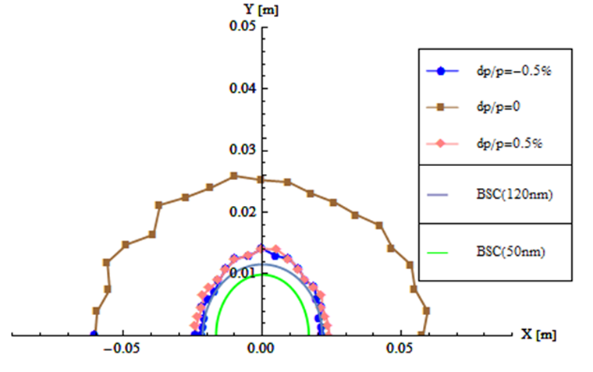
Booster DA with detector stray field
Factor(Bz)= Factor(Bx)= Factor(By)= 3.0
8 v correctors+ 2 h correctors to correct the orbit
No influence to booster DA @10GeV
W detector field
W/O detector field

Slide 19
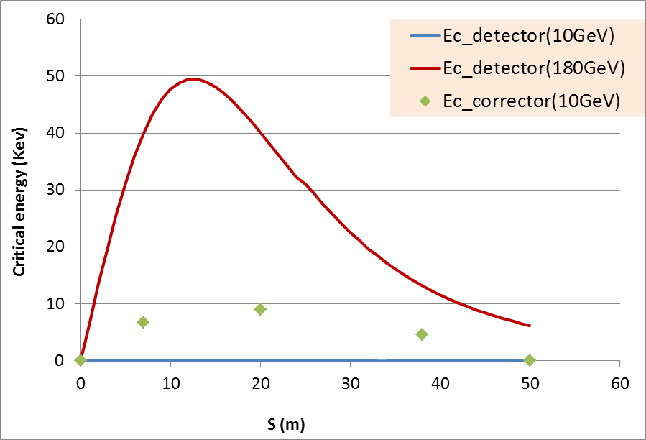
SR due to detector stray field
Critical energy (Bx=23Gs)
Critical energy (detector)@ 180GeV
50 kev
Critical energy(arc) @180GeV
1077 kev
SR energy loss & SR power
 | Arc | Det (23 Gs) | Det (46 Gs) | Det (69 Gs)
U0_180GeV (MV) (U0_det/U0_arc) | 7836.2 | 72.6 (0.009) | 290.4(0.037) | 650.6 (0.083)
Extra RF voltage (%) | ⁄ | 0.8 | 3 | 7
P0_180GeV (kw) | 861.982 | 7.986 | 31.944 | 71.566
U0_10GeV (kV) (U0_det/U0_arc) | 74.6 | 0.4 (0.005) | 2.4 (0.032) | 6.4 (0.086)
P0_10GeV (w) | 559.5 | 3 | 18 | 48

Slide 20
Summary
Impacts of detector stray field on booster were calculated with real field distribution.
Beam dynamics effects of detector field is strongest at 10 GeV.
Vertical orbit distortion due to Bx is dominant effect.
Local orbit correction is essential.
Correction to the detector stray field seems possible at low field level by orbit correction.

