Slide 1
Lattice design of the CEPC collider ring
Yiwei Wang, Bin Wang, Jin Wu, Yuanyuan Wei, D. Wang,
Yuan Zhang, Chenghui Yu, Jie Gao
The Institute of High Energy Physics, Chinese Academy of Sciences
CEPC MDI Workshop
IHEP, CAS, 28-29 May 2020

Slide 2
Outline
Correction of magnet errors based on CDR lattice
Lattice design for a higher luminosity
Dynamic aperture optimization
Summary
Notes:
difficulties

Slide 3
Correction of magnet errors
based on CDR lattice (by*=1.5mm)
Bin Wang, Yuanyuan Wei, Yiwei Wang

Slide 4
Correction scheme
Closed-orbit-distortion (COD) correction with sextupoles off
BPMs placed at quadrupoles (~1500, 4 per betatron wave)
Horizontal correctors placed beside focusing quadrupoles（~1500）
Vertical correctors placed beside defocusing quadrupoles（~1500）
Orbit correction is applied using orbit response matrix and SVD method.
Turn on the sextupoles and perform COD correction again
Dispersion correction with dispersion free steering
orbit manipulation by knob correctors
Beta beating correction with LOCO of Accelerator Toolbox
Coupling and vertical dispersion correction (Local coupling parameter correction)
Using the trim coils of the sextupoles (~1000), which providing skew-quadrupole field
4

Slide 5
The alignment requirement
Case 1
Component | $∆x$ (μm) | $∆y$ (μm) | $∆θ_{𝔃}$ (μrad)
Arc quadrupole | 100 | 100 | 100
IR Quadrupole | 50 (30 for FF) | 50 (30 for FF) | 50 (30 for FF)
Sextupole | 100 | 100 | 100
Out of 1000 seeds, 831 converged
ex = 1.217$±$0.005 nm
ey = 0.043 $±$0.002 pm
ey/ex = (0.0035 $±$0.0002)%
Component | Field error
Dipole | 0.01%
Quadrupole | 0.02%
Case 2
Component | $∆x$ (μm) | $∆y$ (μm) | $∆θ_{𝔃}$ (μrad)
Arc quadrupole | 100 | 100 | 100
IR Quadrupole | 50 | 50 | 50
Sextupole | 100 | 100 | 100
Out of 500 seeds, 300 converged
ex = 1.218$±$0.009 nm
ey = 0.059 $±$0.002 pm
ey/ex = (0.0048 $±$0.0002)%
Component | Field error
Dipole | 0.01%
Quadrupole | 0.02%
Case 3
Component | $∆x$ (μm) | $∆y$ (μm) | $∆θ_{𝔃}$ (μrad)
Arc quadrupole | 100 | 100 | 100
IR Quadrupole | 100 | 100 | 100
Sextupole | 100 | 100 | 100
Low converged rate of the beta-beating correction (~20%).
Further correction is undergoing.
Component | Field error
Dipole | 0.01%
Quadrupole | 0.02%
Low converged rate of the beta-beating correction (~20%).
Further correction is undergoing.

Slide 6
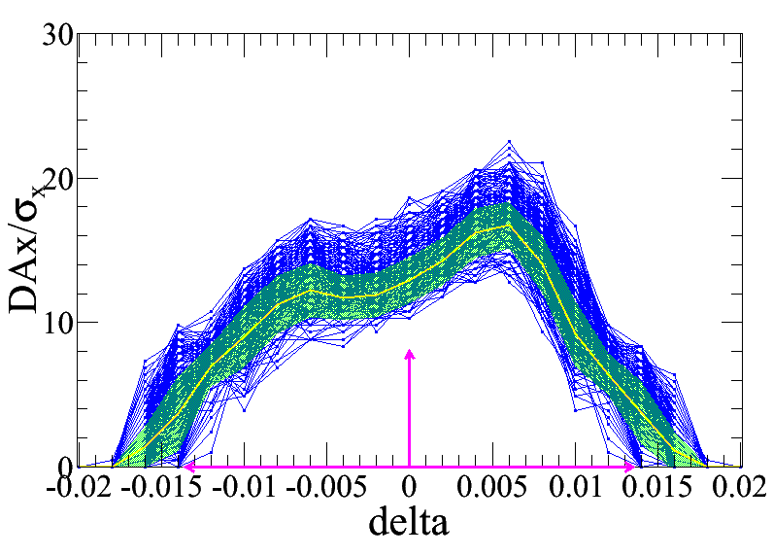
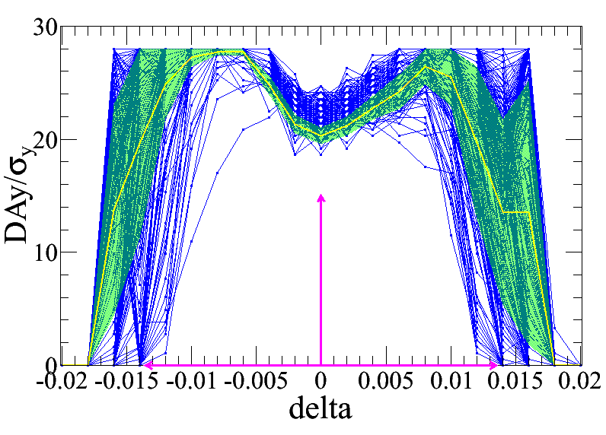
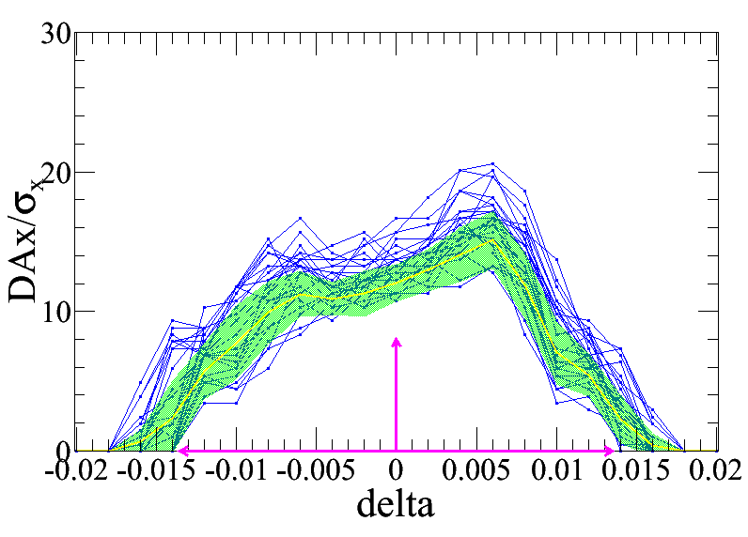
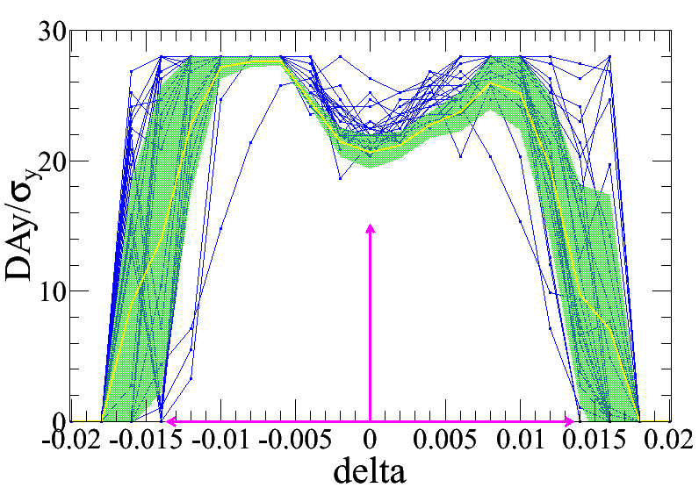
Dynamic aperture with error and corrections
Case 2: IR=50mm, 226 seeds satisfy
Case 3: IR=100mm, 25 seeds satisfy

Slide 7
Lattice design for a higher luminosity

Slide 8
 | Higgs (CDR) | Way to a high luminosity Higgs lattice
Number of IPs | 2
Beam energy (GeV) | 120
Circumference (km) | 100
Synchrotron radiation loss/turn (GeV) | 1.73 | The filling factor of bends should be increased to get a even lower SR with smaller emiitance.
Crossing angle at IP (mrad) | 16.5×2
Piwinski angle | 3.48
Number of particles/bunch N_{e} (10¹⁰) | 15.0 | single bunch charge increased thus larger momentum acceptance required
Bunch number (bunch spacing) | 242 (0.68μs)
Beam current (mA) | 17.4
Synchrotron radiation power /beam (MW) | 30
Bending radius (km) | 10.7
Momentum compact (10⁻⁵) | 1.11
β function at IP β_{x}* / β_{y}* (m) | 0.36/0.0015 | much larger natural chromaticity
Emittance ε_{x}/ε_{y} (nm) | 1.21/0.0024
Beam size at IP σ_{x} /σ_{y} (μm) | 20.9/0.06
Beam-beam parameters ξ_{x}/ξ_{y} | 0.018/0.109
RF voltage V_{RF} (GV) | 2.17
RF frequency f _{RF} (MHz) (harmonic) | 650 (216816)
Natural bunch length σ_{z} (mm) | 2.72
Bunch length σ_{z} (mm) | 4.4
HOM power/cavity (2 cell) (kw) | 0.46
Energy spread (%) | 0.134
Energy acceptance requirement (%) | 1.35 | larger momentum acceptance required
Energy acceptance by RF (%) | 2.06
Photon number due to beamstrahlung | 0.082
Beamstruhlung lifetime /quantum lifetime* (min) | 80/80
Lifetime (hour) | 0.43
F (hour glass) | 0.89
Luminosity/IP L (10³⁴cm⁻²s⁻¹) | 2.93
D. Wang
et al

Slide 9
Lattice design with higher luminosity
Optimization of the quadrupole radiation effect
Interaction region: longer QD0/QF1 (2m/1.48m => 3m/2m)
ARC region: longer quadrupoles (2m => 3m )
Reduction of dynamic aperture requirement from injection
Straight section region: larger βx at injection point (600m => 1800m)
Maximization of bend filling factor to minimize the synchrotron radiation loss per turn
ARC region: sextupoles in two rings changed from staggered to parallel; The left drifts are used for longer bend.
RF region: shorter phase tuning sections
Stronger optimization and stricter hardware requirement should be made to get enough dynamic aperture

Slide 10
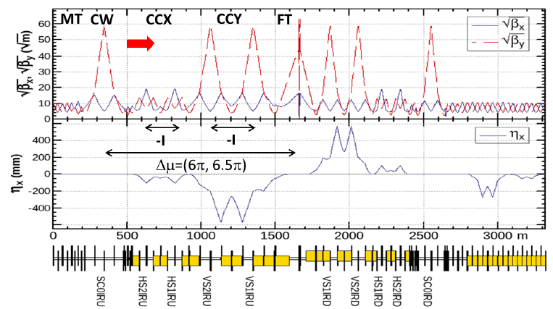
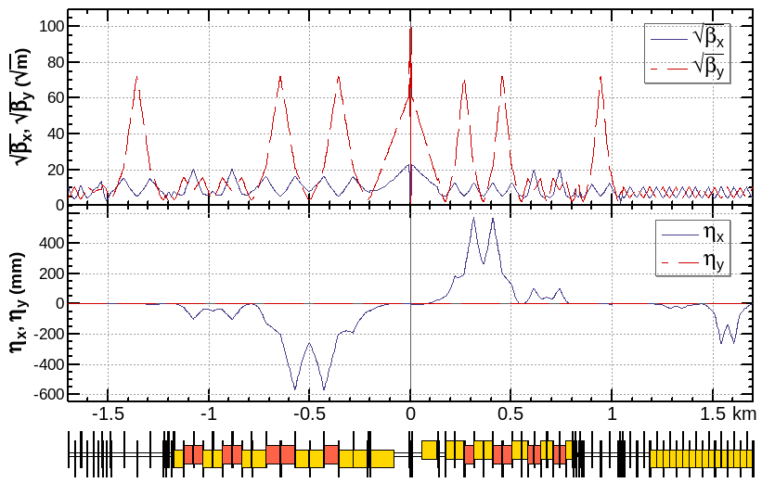
Optics design of Interaction region
local chromaticity correction of both plane, asymmetric layout 1), crab-waist collision 2)
L*=2.2m, θ_{C} =33mrad, G_{QD0} =77 T/m, G_{QF1} =63 T/m, L_{QD0} =3.0m, L_{QF1} =2.0m
IP upstream of IR: Ec < 120 keV within 400m, last bend Ec = 25.5keV (45 keV CDR)
IP downstream of IR: Ec < 300 keV within 250m, last bend Ec = 36.6keV (97 keV CDR)
1) K. Oide et al., ICHEP16.
2) M. Zobov et al., Phys. Rev. Lett. 104, 174801(2010).

Slide 11
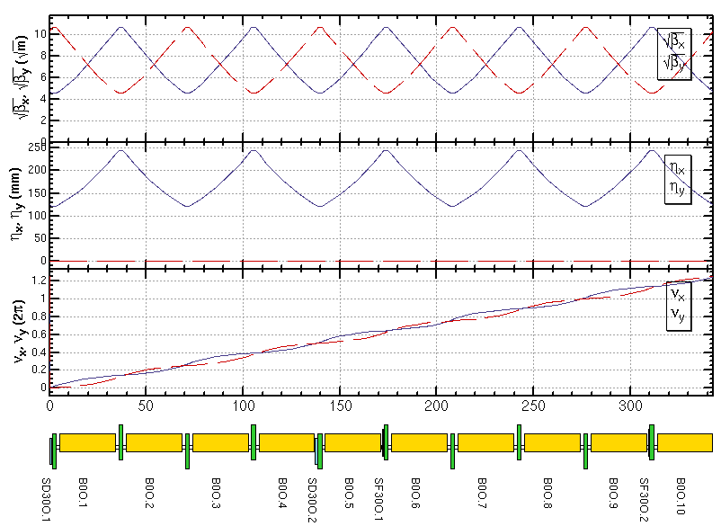
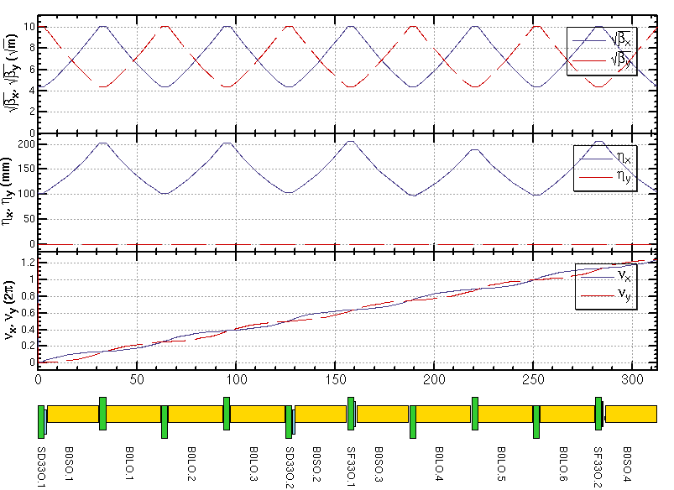
Maximization of the bend filling factor in the ARC
 | CDR lattice | High lum. lattice
Emittance [nm] | 1.21 | 0.89
Period length [m] | 342.9 | 312.8
Drift length In one period [m] | 31.8 | 10.2
Dipole length In one period [m] | 286.9 | 268.4
Quadrupole length In one period [m] | 20 | 30
Sextupole length In one period [m] | 4.2 | 4.2
Dipole filling factor [%] | 83.7 | 85.8
Quadrupole filling factor [%] | 5.8 | 9.6

Slide 12
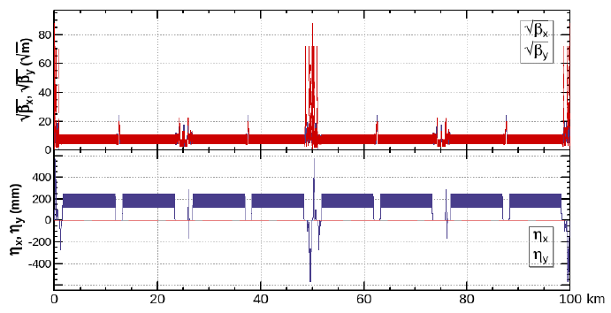
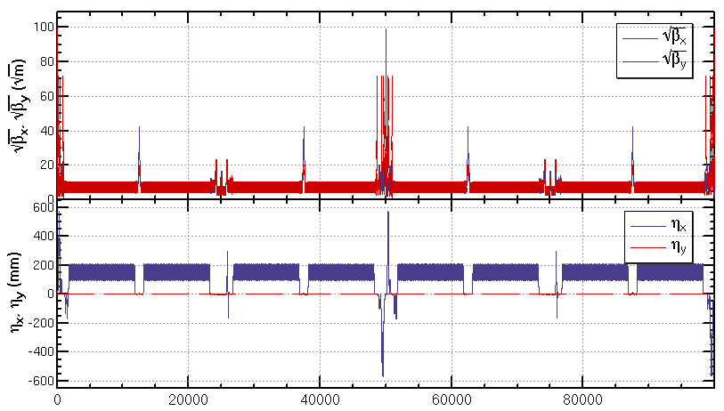
Optics of the whole collider ring

Slide 13
Dynamic aperture optimization

Slide 14
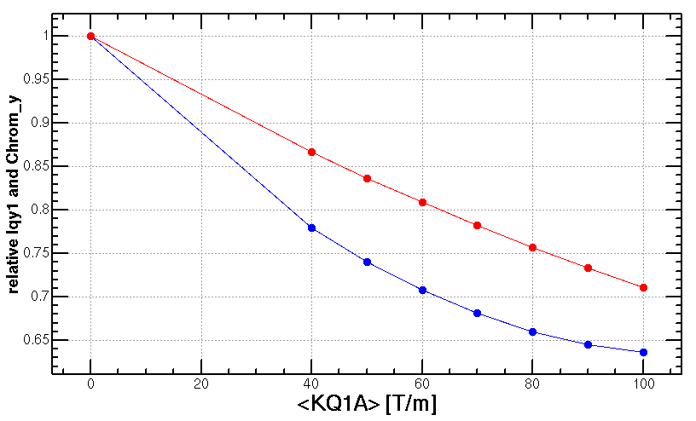
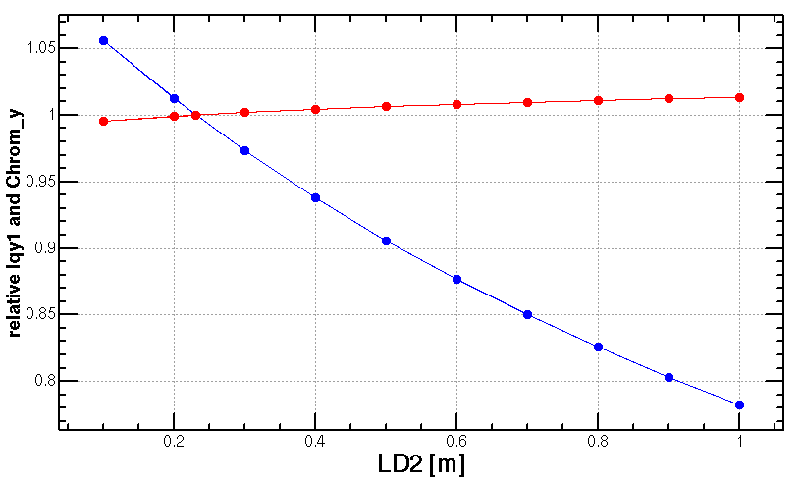
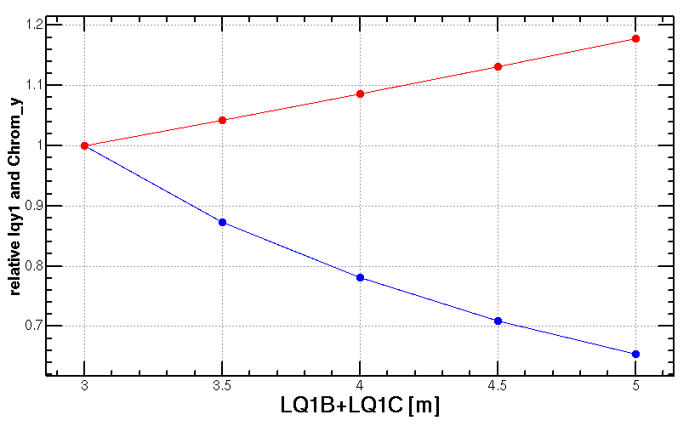
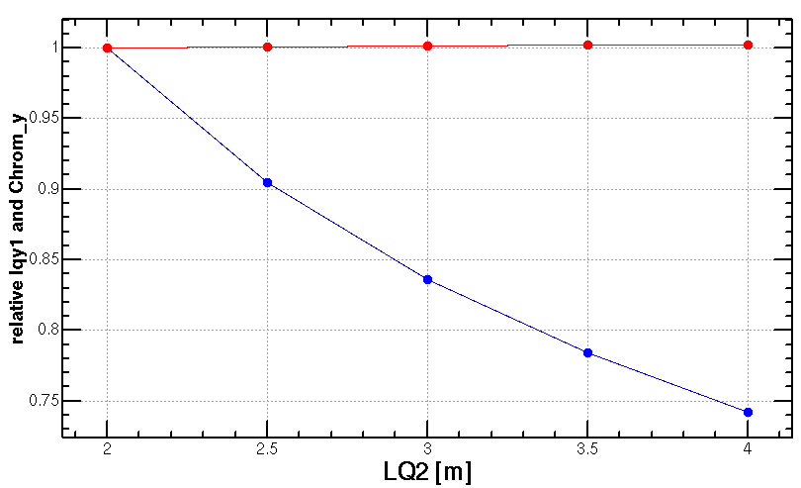
Optimization of final doublet design
Add weak quadrupole coils
Distance of Q1 and Q2
Radiation power y
Chromaticity y
length of Q1
length of Q2
This knob need to be check with DA result.

Slide 15
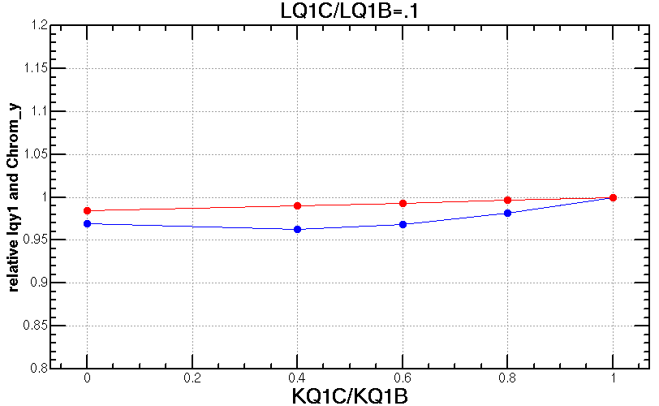
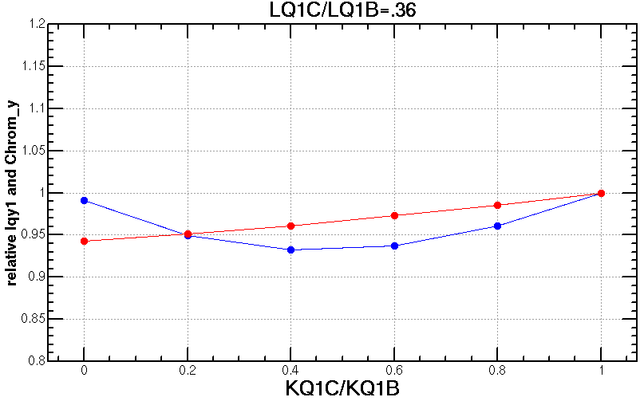
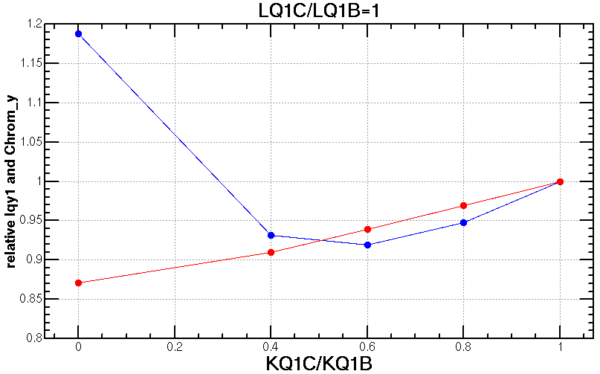
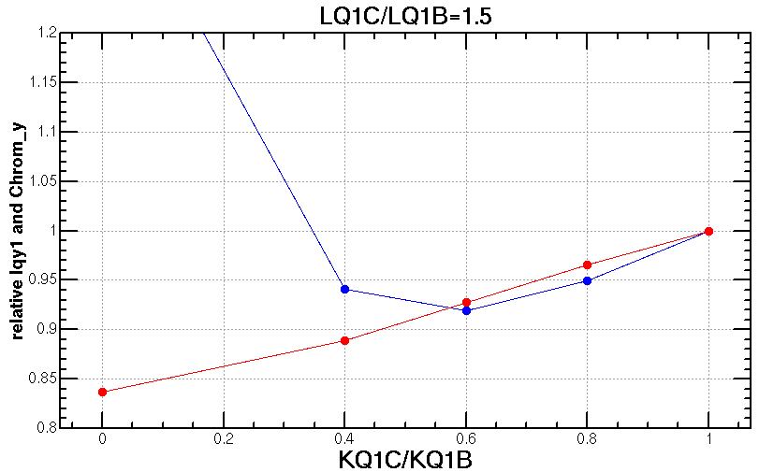
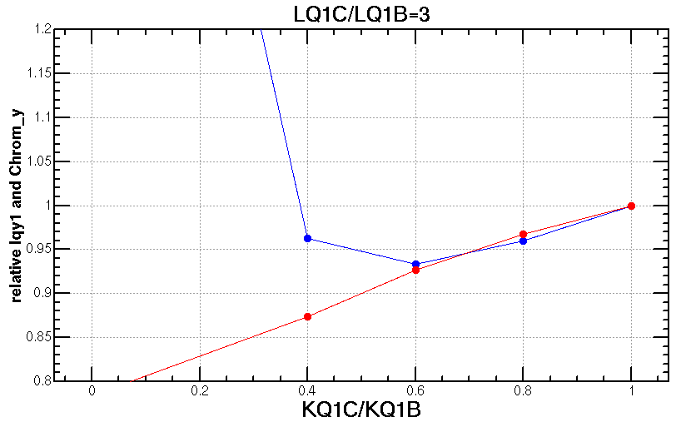
Optimization of final doublet design
Different strength ratio of Q1B and Q1C with different length ratio of Q1B and Q1C when keep total length of Q1B+Q1C
Minimum of radiation power occurs at KQ1C/KQ1B≈0.6
Different length of Q1B and Q1C doesn’t affect much on the minimum of the power and chromaticity.
Provide more freedom of the FD technical design
Shorter and stronger Q1B help a bit on the DA.
Iqy1≈Kb^2*βb*Lb+Kc^2*βc*Lc ≥ 2KbKc(βbβcLbLc)^1/2
when Kc/Kb=((βb/βc)/(Lc/Lb))^1/2

Slide 16
Optimization of final doublet design
The vertical radiation power and chromaticity decreased significantly.
These optimization will help to further decrease the by*
Parameters | Before optimization | After optimization | Contribution to Py | Contribution to Chromy
Px [a.u.] | 30 | 26 | - | -
Py [a.u.] | 1209 | 674 | 0.56 | -
Chromx [a.u.] | -90 | -118 | - | -
Chromy [a.u.] | -3429 | -2909 | - | 0.85
<KQ1A> [T/m] | 0 | 40 | 0.78 | 0.87
KQ1C/KQ1B | 1 | 0.6 | 0.92 | 0.94
LD2 [m] | 0.23 | 0.6 | 0.88 | 1.00
LQ1B+LQ1C [m] | 3 | 3.5 | 0.87 | 1.04
LQ1C/LQ1B | 1 | 1 | - | -
LQ2 [m] | 2 | 2 | - | -
with εx=0.68nm, cp=1%, σe=0.134%, bx*=0.33m, by*=1mm

Slide 17
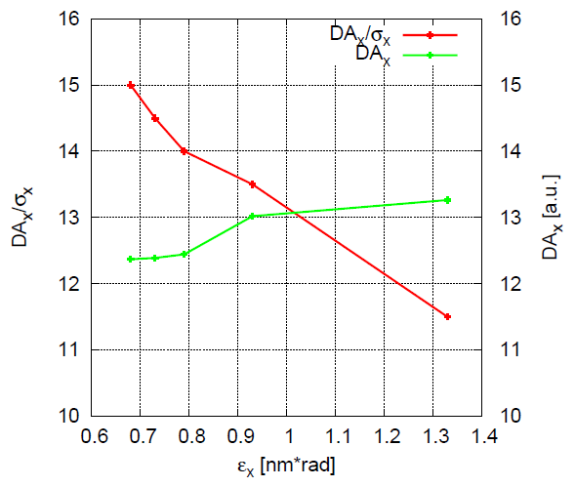
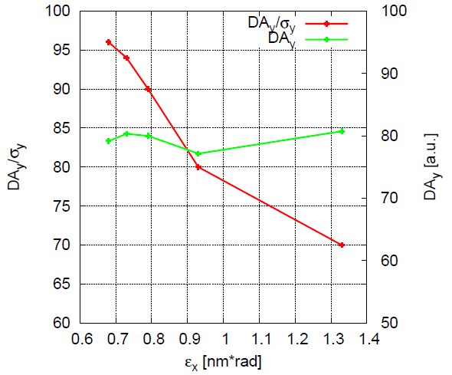
Dynamic aperture vs. emittance
Larger normalized dynamic aperture with smaller emittance ( for ex~1nm )
The nonlinearity in interaction region is much larger than the arc region
Better DA with smaller emittance benefits from smaller nonlinearity in the IR and smaller beam size though stronger nonlinearity in ARC thus stronger error correction will need
Efficient direction of dynamic aperture optimization
Just show the tendency; each dynamic aperture result can be further optimized with directly optimization
DA without fluctuation
Notes:
More slides with the explanation

Slide 18
Optimization of dynamic aperture
Start point of the optimization
Nonlinearity optimized term by term with 10 families of sextupoles in the IR and 4 families of sextupoles in the ARC.
Dynamic aperture further optimized with MODE
Higgs dynamic aperture with 90% survival of 100 samples
Including radiation damping, fluctuation, energy sawtooth and tapering, beam-beam effects, w/o error
145 turns (2 damping times), 4 initial phases

Slide 19
Different versions of lattice
To make sure the effect of changement, different versions were studied
V1, bx*=0.36m, by*=0.001m, ex=1.1nm rad: 15$σ_{x}$*$18σ_{y}$*1.5%
V2, bx*=0.33m, by*=0.001m, ex=0.89nm rad: 17$σ_{x}$*$22σ_{y}$*1.5% (benefit from smaller nonlinearity in IR and smaller beam size)
V3, bx*=0.33m, by*=0.001m, ex=0.89nm rad, shorten the RF region (to increase the bend filling faction): 18$σ_{x}$*$21σ_{y}$*1.5%
V4, bx*=0.33m, by*=0.001m, ex=0.89nm rad, shorten the RF region, add octupole and decapole for vertical chromaticity correction: 18$σ_{x}$*$21σ_{y}$*1.5%
V5, bx*=0.33m, by*=0.001m, ex=0.89nm rad, shorten the RF region, add octupole and decapole for vertical chromaticity correction, add multipoles for horizontal chromaticity correction : 11$σ_{x}$*$21σ_{y}$*1.3%
V6, bx*=0.33m, by*=0.001m, ex=0.68nm rad, with final doublet optimization
Notes:
difficulties

Slide 20
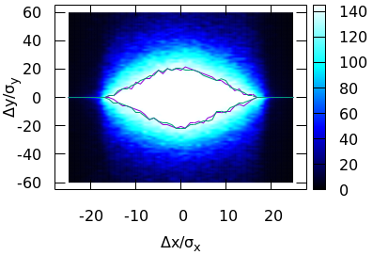
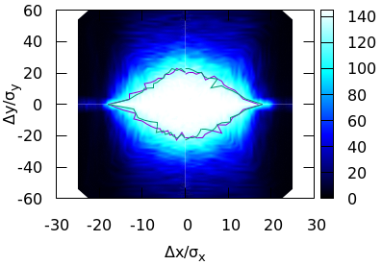
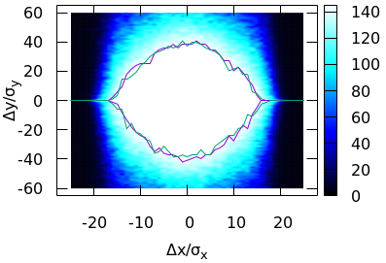
Status of DA optimization
Jin Wu,
Yuan Zhang,
Yiwei Wang
145 turns tracked, 100 samples for radiation fluctuation, IR sextupoles + 32 arc sextupoles
With beam-beam and SR radiation damping and fluctuation, without errors
The on-momentum DA should be large enough even with errors.
The momentum acceptance need to be further optimized to fulfill the requirement ~1.7 %
CDR: 18$σ_{x}×20σ_{y}$
bx*=0.36m, by*=1.5mm, ex=1.2nm rad
High lum V4: 18$σ_{x}×20σ_{y}$
bx*=0.33m, by*=1mm, ex=0.89nm rad
High lum V6: 16$σ_{x}×40σ_{y}$
bx*=0.33m, by*=1mm, ex=0.68nm rad
Notes:
difficulties

Slide 21
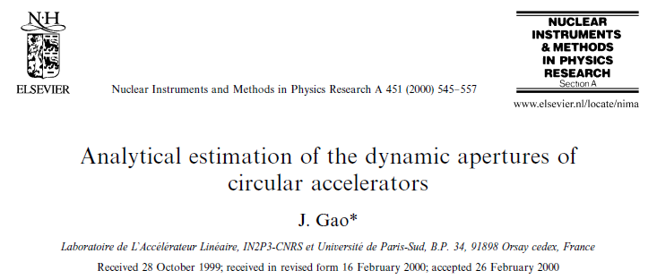
Analytic formula for dynamic aperture
Jie Gao and Ming Xiao’s analytic formula for DA
On momentum
Off momentum

Slide 22
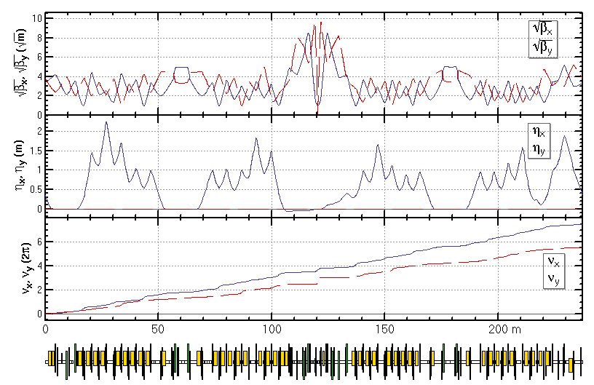
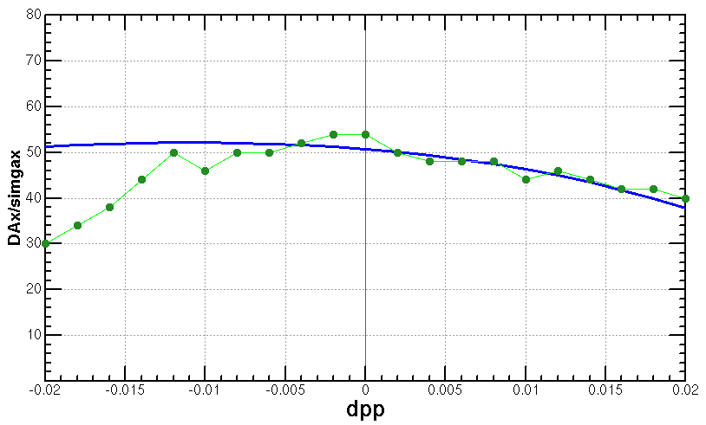
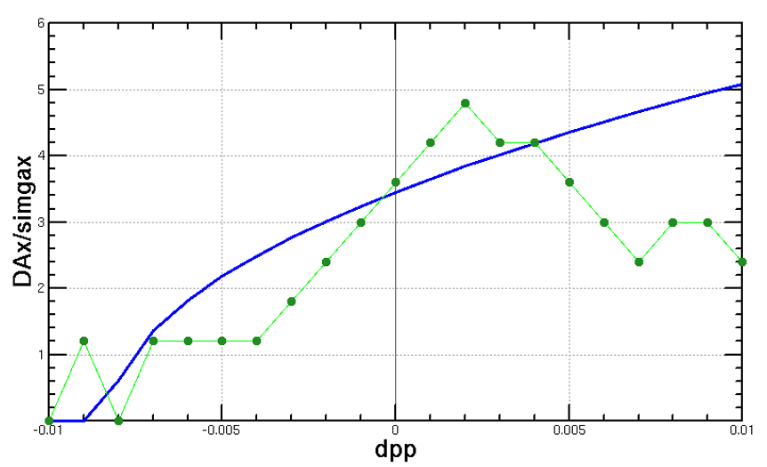
Comparison of analytic and simulation result
The analytic and simulation results of dynamic aperture agree well for small energy deviation particles.
Jie Gao and Ming Xiao’s analytic formula for DA are used.
BEPC II lattice: agree well with tracking
CEPC lattice: agree well with tracking if mainly 3rd resonance exsit
Including more aberration in the DA formula is under going
analytic
simulation
analytic
simulation
BEPCII, w/o synchrotron motion
CEPC, w/ mainly 3rd resonance, w/o synchrotron motion

Slide 23
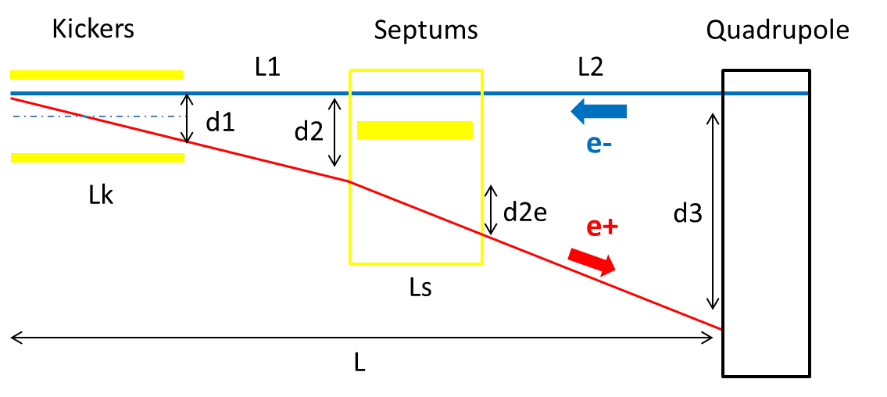
New separation scheme with kicker and septum
Use kicker to instead of electro-static separator in order to reduce the impedance.
(Proposed by Jinhui Chen)
 | Kicker | Septum
Integrated strength BL [T*m] | 0.1624 | 1.4
Strength B [Guass] | 203 | 1000 | Field for up to 182.5GeV. Septum is weak to suppress emittance growth.
Effective length Leff [m] | 8 | 14
Half width of good field region Hgf/Vgf [mm] | 10.1/3.8 @ 5E-4 | 18.9/3.8 @ 5E-4 | Kicker: 18σx+3mm+d1/2, 18σy+3mm Septum: 18σx+3mm+d2e/2, 18σy+3mm
Half width of beam stay clear Hbsc/Vbsc [mm] | 9.6/3.6 | 9.2/3.6 | 18σx+3mm, 18σy+3mm
Septum width width [mm] | - | 5

Slide 24
Summary
Lattices for a higher luminosity has been designed whose by*=1mm, ex=0.68 to 0.89nm rad
Stronger optimization had be made in order to get enough dynamic aperture.
Dynamic aperture optimization
The on-momentum DA should be large enough even with errors.
The further optimization of momentum acceptance is under going to achieve 1.7%.
Some new attempts made for further optimization of dynamic aperture including final doublet optimization, decreasing emittance and application of analytic DA formula.
With by*=1.5mm lattice, error correction made with 1000 random seeds and the pre-alignment requirements has been loosed, especially for the IR quadrupoles.

