Slide 1

CEPC MDI
Beam
Backgrounds Study
Haoyu Shi
IHEP
On Behalf of the CEPC MDI BG Study Group
CECP MDI Workshop, Online, 2020

Slide 2
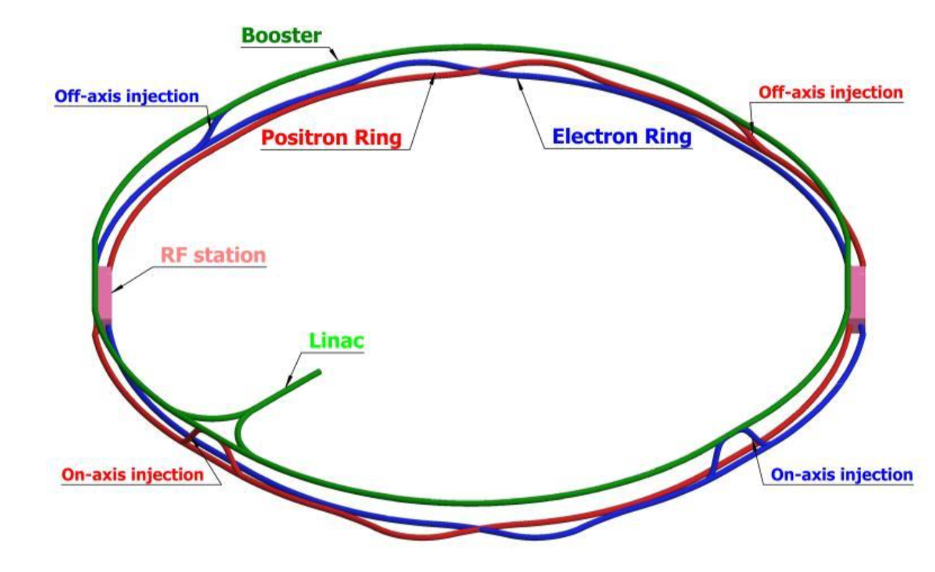
Outline
Motivation & Workflow
Background Study Status in detail
Summary & Outlook

Slide 3
Motivation
& Workflow
Backgrounds may impact IR components, especially detectors in several ways, so that they are important inputs to the detector(also accelerator) design, such as radiation tolerance, detector occupancy…
Simulation
Design
Benchmark

Slide 4
Workflow
Simulation
Benchmark
Design

Slide 5
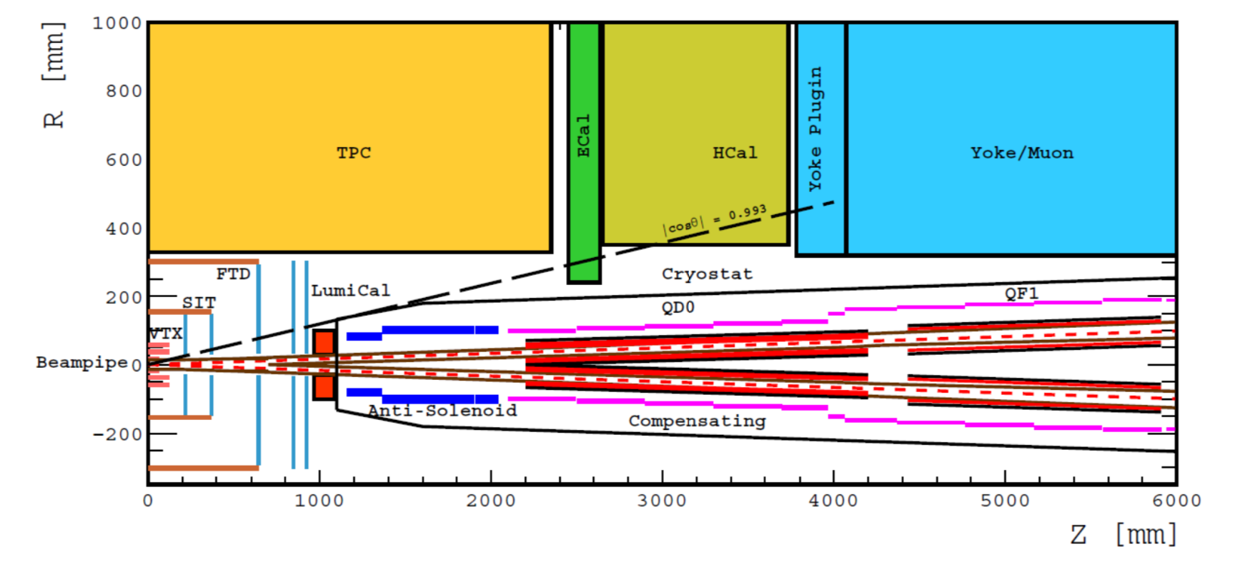
Interaction Region Layout
Based on CDR Design and Parameters for both Detector & Accelerator
Higgs Mode, One IP, One Beam
Impact on Vertex Detector
Notes:
Geometry Consistence.

Slide 6
Workflow
Simulation
Benchmark
Design

Slide 7
Source Analysis
Effects
  Single Beam
    Touschek Scattering
    Beam Gas Scattering
    Beam Thermal Photon Scattering
    Synchrotron Radiation
  Luminosity Related
    Beamstrahlung
    Radiative Bhabha Scattering
  Injection
Photons
Off Energy Beam Particles
Notes:
Photons except SR and Pair Pro?

Slide 8
Workflow
Simulation workflow used for one fixed Design&Parameters:
Generation
Tracking
Detector Simulation
Quantify Impacts using hit density, TID, and NIEL
Let the particles move alongside the pipe
Record the lost particles within the IR
Adopted the method ATLAS used(ATL-GEN-2005-001) for background estimation
Using the existing generators
Building our own generators
Cross Check

Slide 9
Basic Simulation
For Photon BGs and Beam BGs
Using its own Generator.
Using SAD or BDSim as tracking tool.
Using Geant4 to perform full detector simulation

Slide 10
Source Analysis
Effects
  Single Beam
    Touschek Scattering
    Beam Gas Scattering
    Beam Thermal Photon Scattering
    Synchrotron Radiation
  Luminosity Related
    Beamstrahlung(Pair Production)
    Radiative Bhabha Scattering
Photons
Off Energy Beam Particles
Notes:
Photons except SR and Pair Pro?

Slide 11
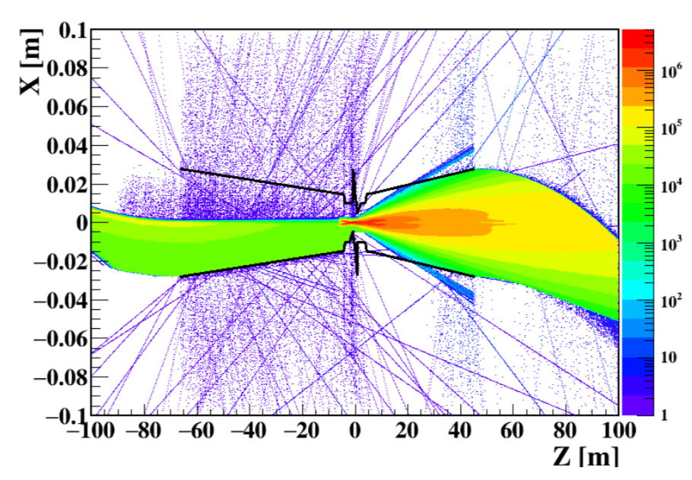
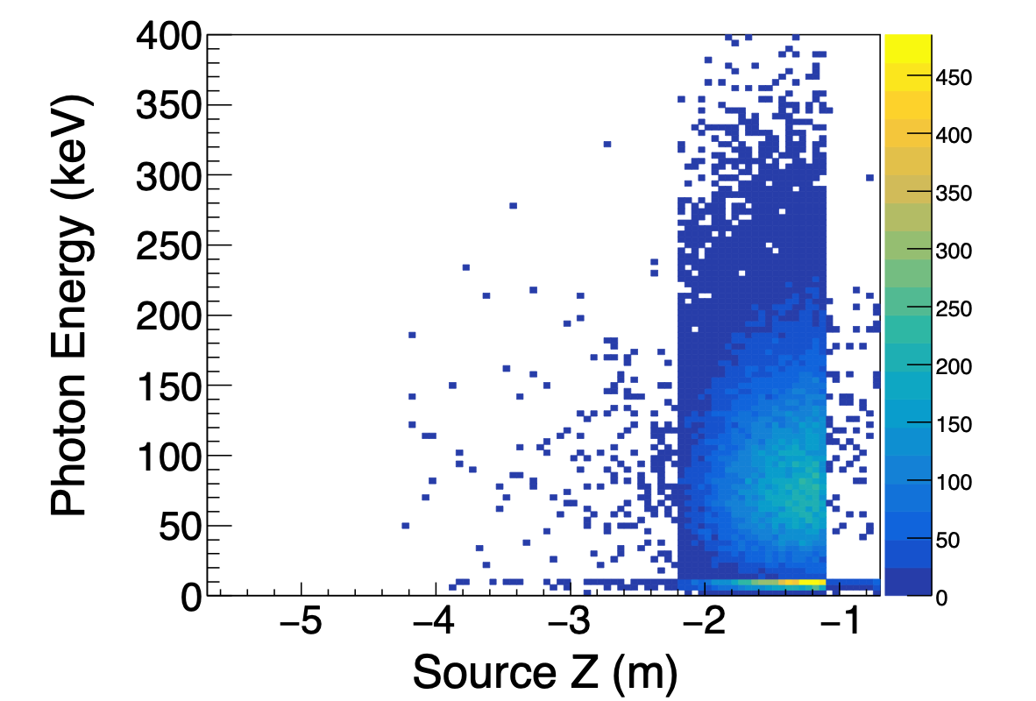
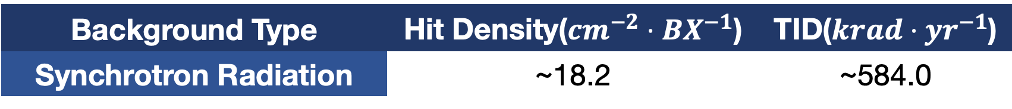
Synchrotron Radiation
Beam bent by magnets would emit synchrotron radiation, sometimes would be critical at circular machines
Using BDsim&Geant4 as the tool to transport beam particles from the last dipole to the interaction region and record the particles hitting the central beryllium pipe
K. Li
Background Type | Hit Density($cm^{−2}⋅BX^{−1}$) | TID($krad⋅yr^{−1}$)
Synchrotron Radiation | ~18.2 | ~584.0

Slide 12
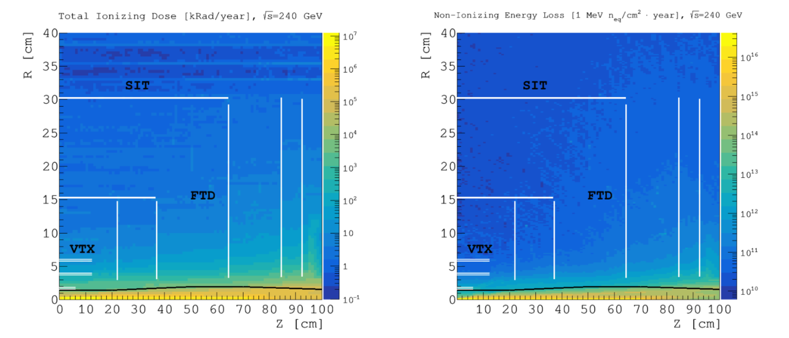
Pair Production
Charged Particles attract by the opposite beam emit photons(beamstrahlung), followed by an electron-positron pair production.
Using Guinea-pig++ as the generator and implementing the external magnetic field by code updating.
W. Xu

Slide 13
Source Analysis
Effects
  Single Beam
    Touschek Scattering
    Beam Gas Scattering
    Beam Thermal Photon Scattering
    Synchrotron Radiation
  Luminosity Related
    Beamstrahlung
    Radiative Bhabha Scattering
Photons
Off Energy Beam Particles
Notes:
Photons except SR and Pair Pro?

Slide 14
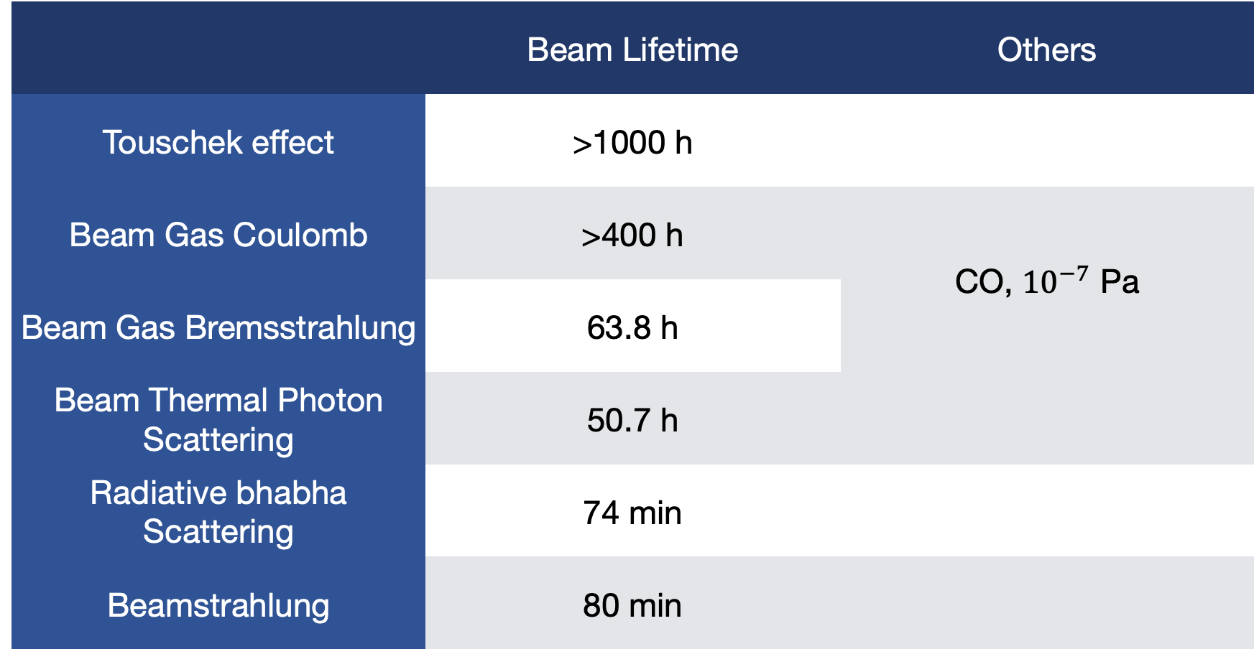
CEPC Beam Lifetime
 | Beam Lifetime | Others
Touschek effect | >1000 h
Beam Gas Coulomb | >400 h | CO, ${10}^{−7}$ Pa
Beam Gas Bremsstrahlung | 63.8 h
Beam Thermal Photon Scattering | 50.7 h
Radiative bhabha Scattering | 74 min
Beamstrahlung | 80 min

Slide 15
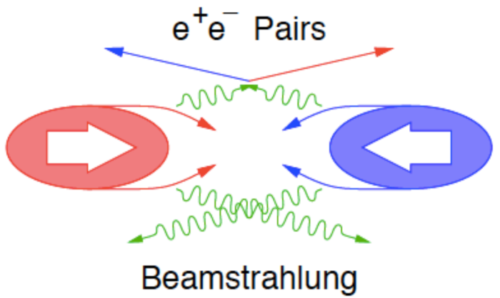
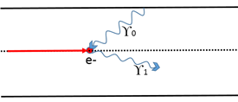
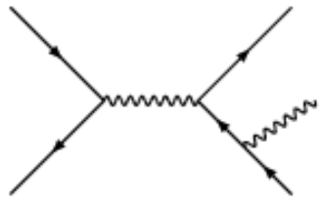
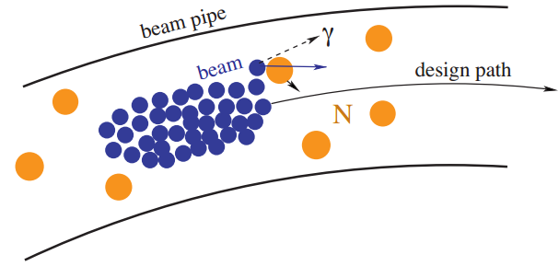
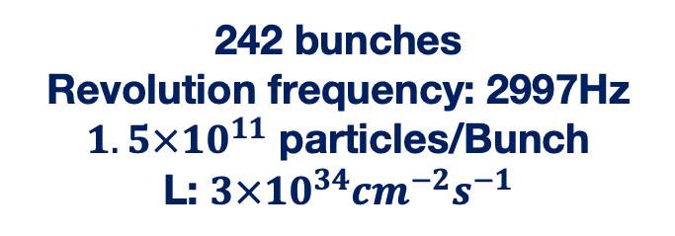
Off Energy Beam
Beam-Thermal photon
Scattering
IP1
Beamstrahlung
242 bunches
Revolution frequency: 2997Hz
$1.5×{10}^{11}$ particles/Bunch
L: $3×{10}^{34}{cm}^{−2}s^{−1}$
Beam Lost Particles
Energy Loss > 1.5%
(energy acceptance)
IP3
Radiative Bhabha
Scattering
Beam-Gas Brem
Scattering

Slide 16
Energy Spectra

Slide 17
Beamstrahlung
Beamstrahlung is the radiation background from one beam of charged particles in storage rings or linear colliders caused by its interaction with the electromagnetic field of the other beam
Generated by formula(PyBS)
  Code Written by Dr. Yue
Checked with Guinea-Pig++

Slide 18
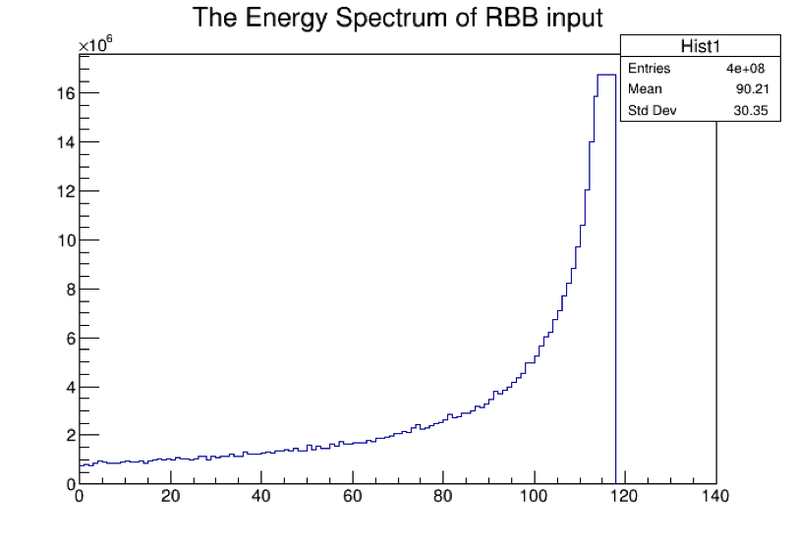
Radiative Bhabha
Radiative bhabha scattering represents the progress that one electron/position interact with the other and emit photons. The electron/position could loss energy, and might become background.
Generated by bbbrem
Could also generated by formula(Py_RBB)
  Code Written by Dr. Yue

Slide 19
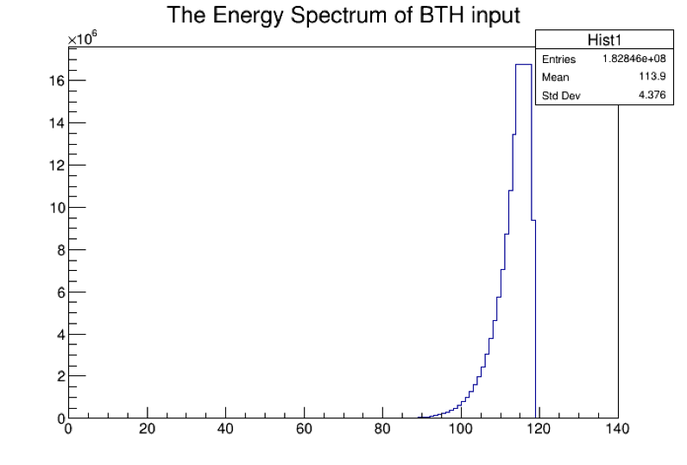
Beam Thermal Photon
Beam Particle interact with the photon emitted by beam pipe
  Important on high energy machine
The same as Beam-Gas:
Generated by PyBTH:
  Written by Dr. Yue
  The scattering was generated with 200 meters to the IP
  Tracking whole ring for many turns

Slide 20
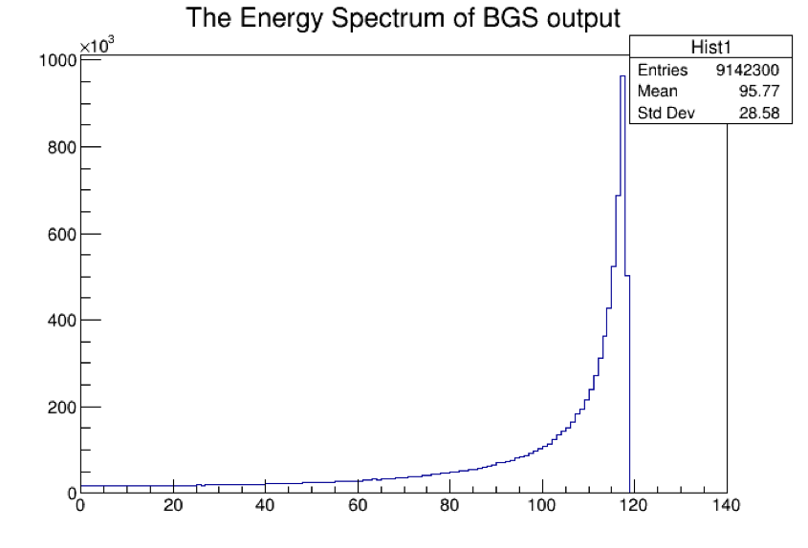
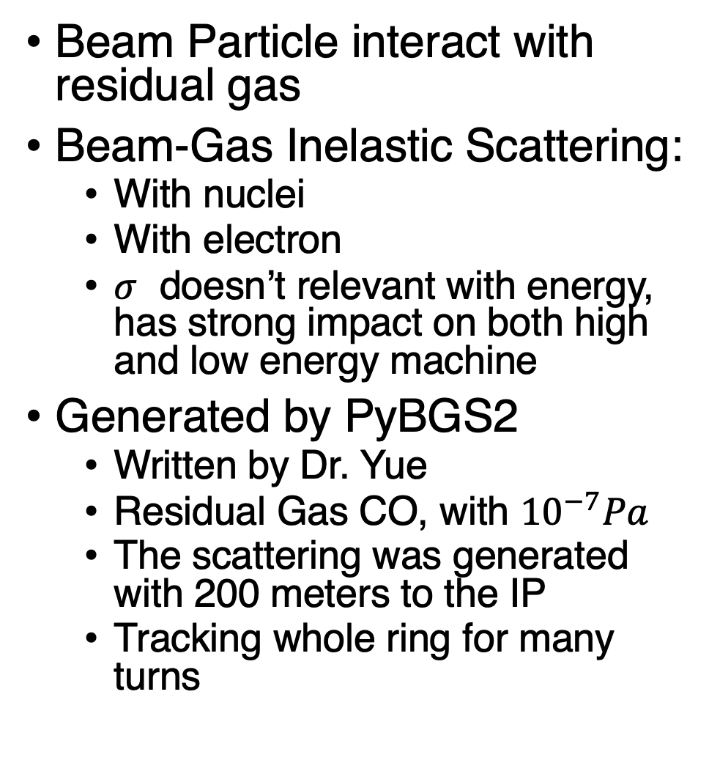
Beam Gas
Beam Particle interact with residual gas
Beam-Gas Inelastic Scattering:
  With nuclei
  With electron
  $σ$ doesn’t relevant with energy, has strong impact on both high and low energy machine
Generated by PyBGS2
  Written by Dr. Yue
  Residual Gas CO, with ${10}^{−7}Pa$
  The scattering was generated with 200 meters to the IP
  Tracking whole ring for many turns

Slide 21
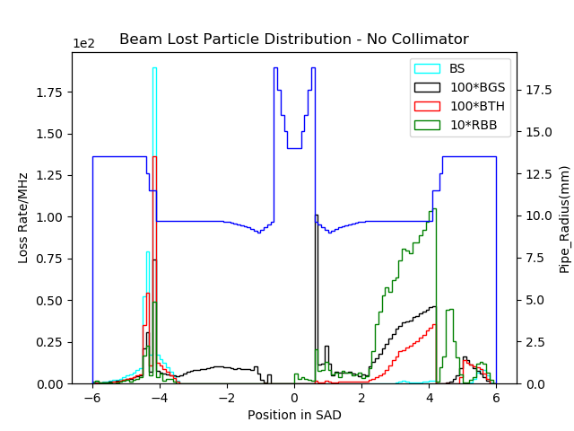
Lost Distribution without Collimators
Finished at Mid-summer, 2019
4 types of Backgrounds
Normalized to loss rate in MHz(one beam)
BS contributes the most
Notes:
Convert the Y-aixs to Loss Power

Slide 22
Ways to Mitigate
Using Shielding/Mask/Collimator
Others?

Slide 23
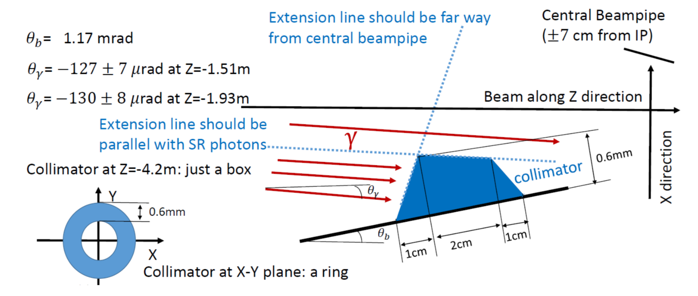

SR Mask
We also need Au coating for central beam pipe
K. Li
$±$20 cm from IP

Slide 24
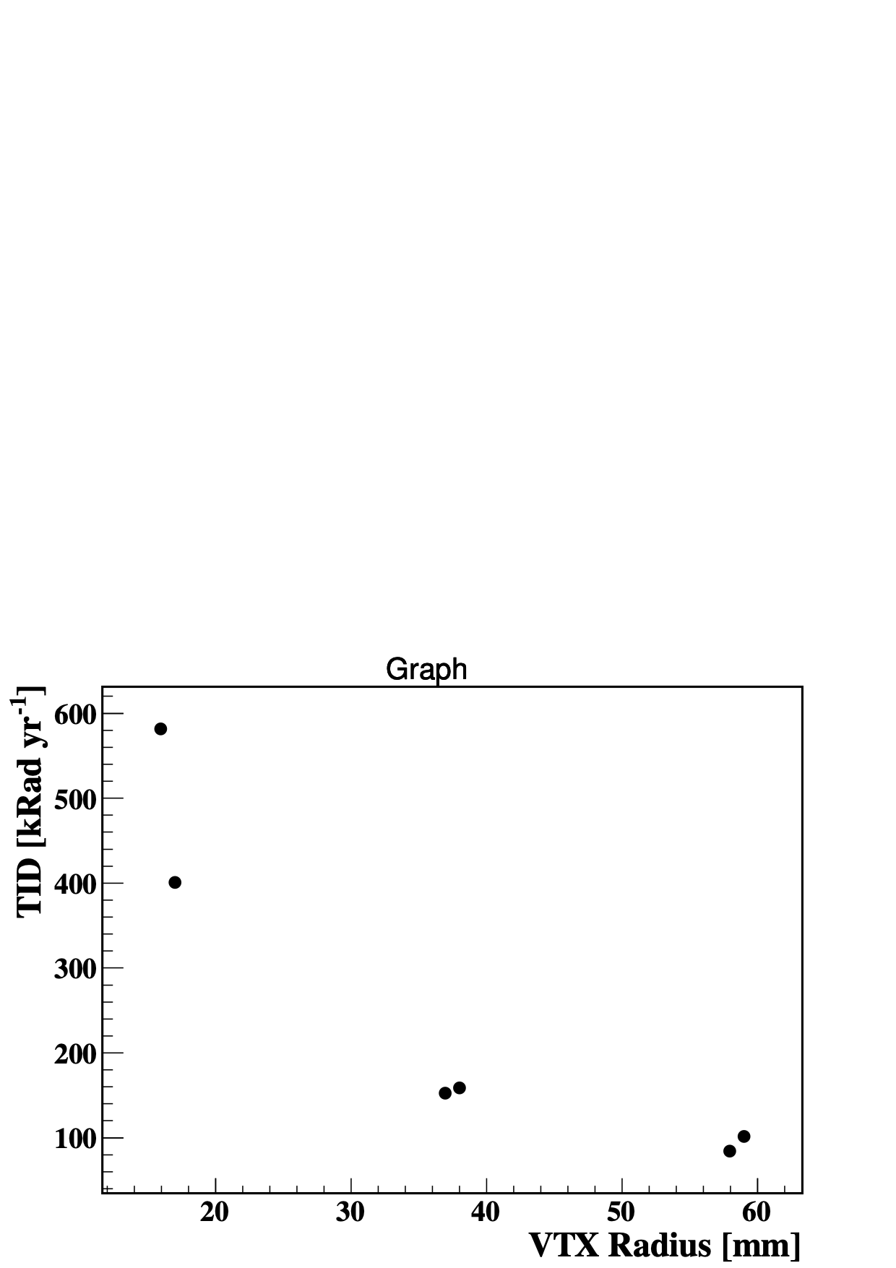
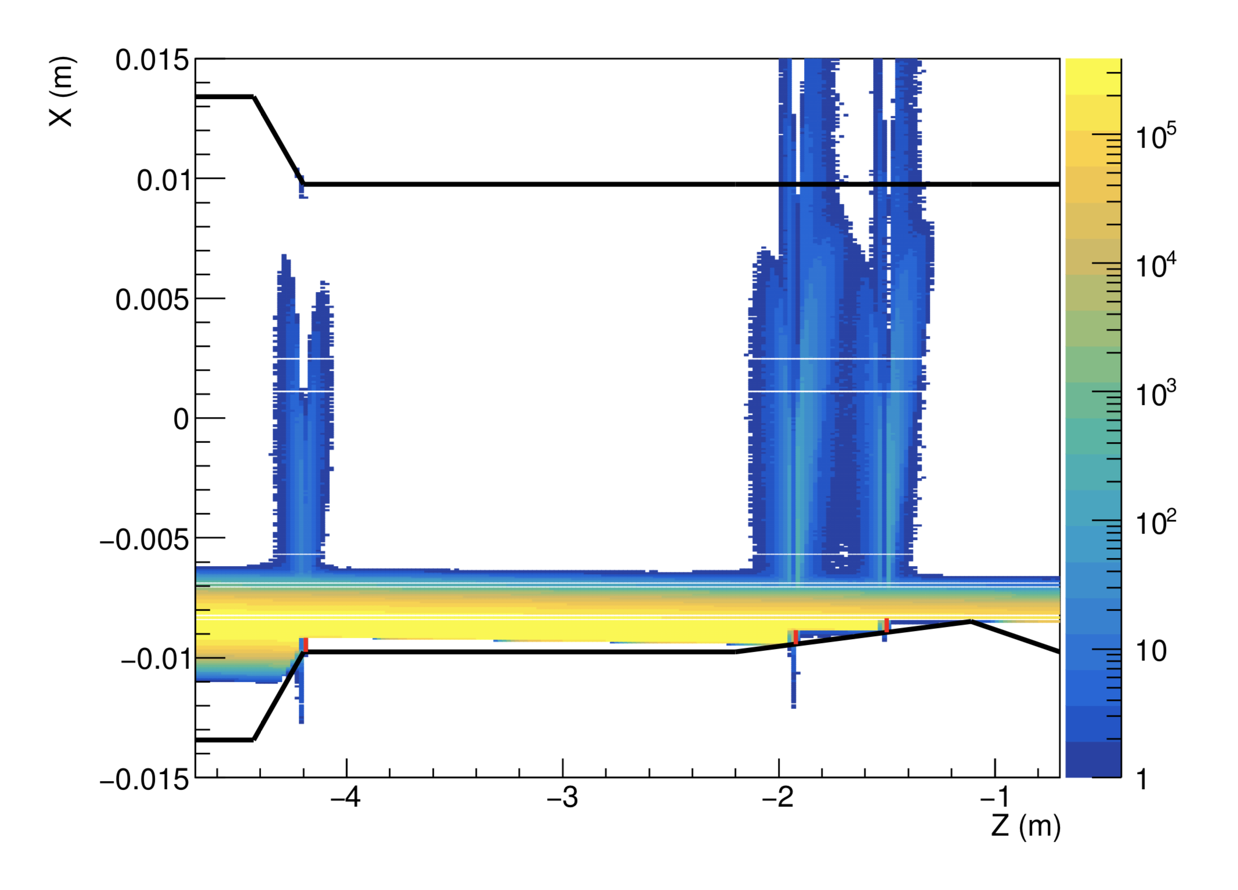
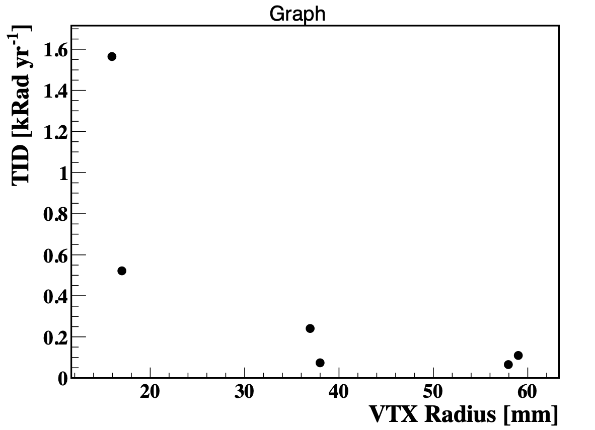
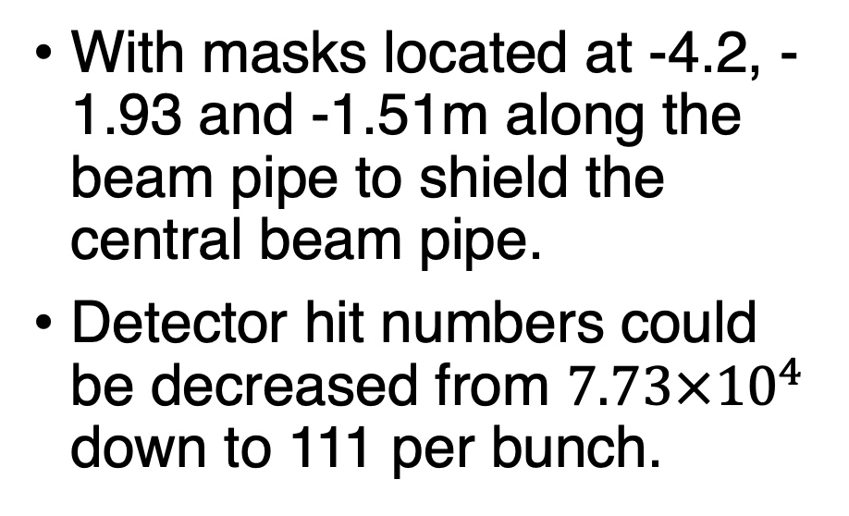
Effectiveness
K. Li
With masks located at -4.2, -1.93 and -1.51m along the beam pipe to shield the central beam pipe.
Detector hit numbers could be decreased from $7.73×{10}^{4}$ down to 111 per bunch.

Slide 25
Collimator
Collimators are need.
Now we put 2 sets of horizontal collimators, but sure to need more in future.
S. Bai
Name | Location | Distance to IP
APTX1 | D1I.1897 | 2139.06
APTX2 | D1I.1894 | 2207.63
APTX3 | D1O.10 | 1832.52
APTX4 | D1O.14 | 1901.09

Slide 26
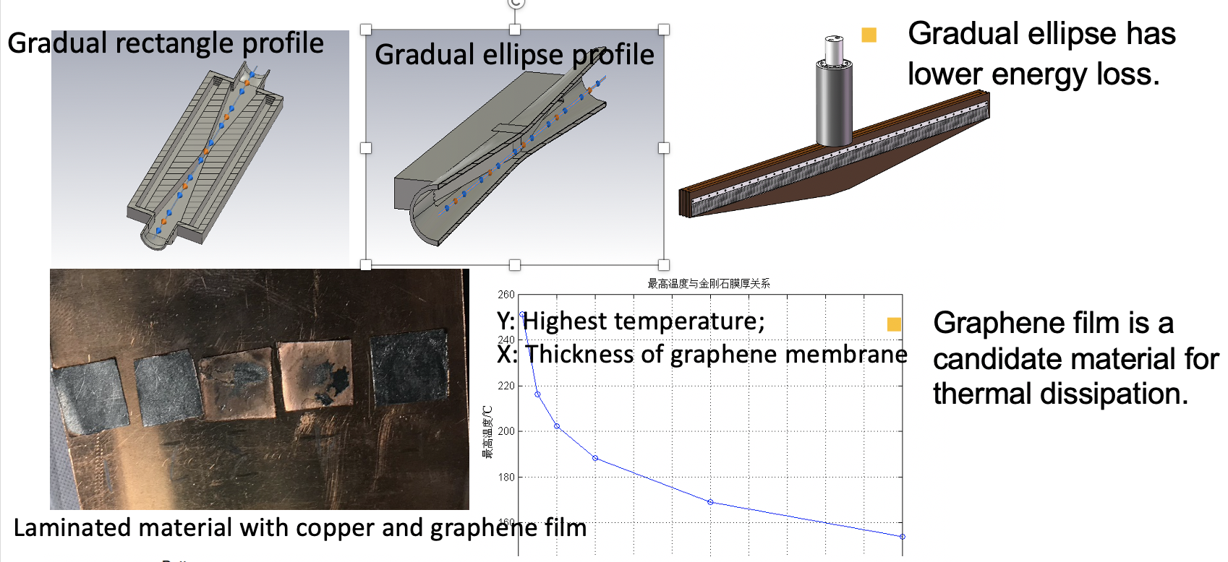
Collimator
In simulation, we thought the collimators were "perfect”
H. Wang

Slide 27
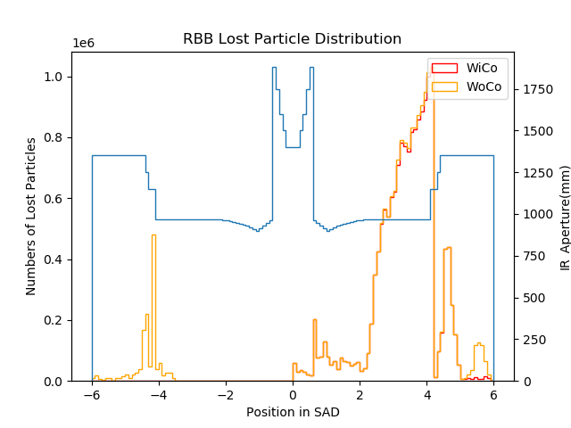
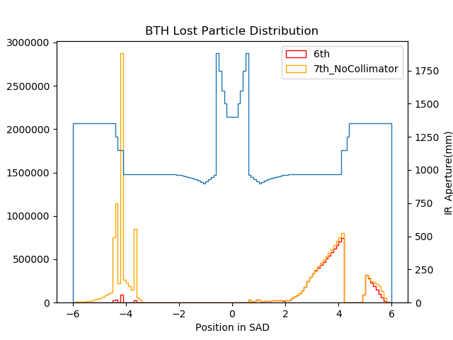
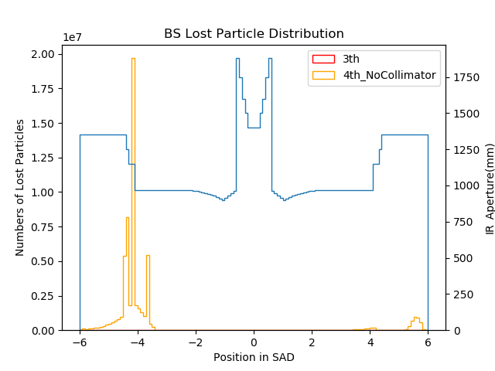
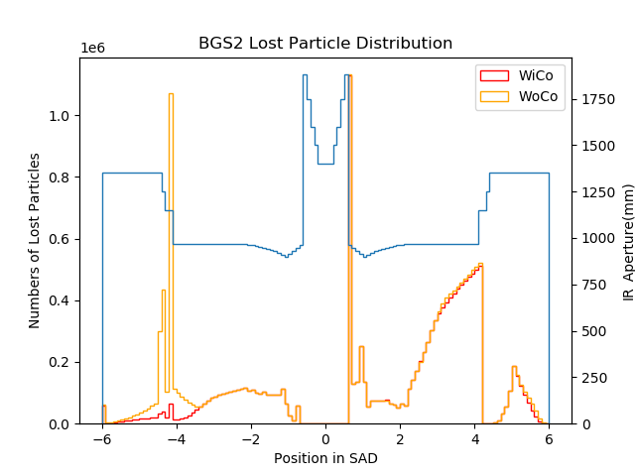
Collimator Effects

Slide 28
Collimator Effects - BS

Slide 29
Collimator Effects - RBB

Slide 30
Collimator Effects - BTH

Slide 31
Collimator Effects – BGS2

Slide 32
Lost Distribution with Collimators
Including Radiative Bhabha, Beam-Gas, Beam Thermal Photon. Almost No Beamstrahlung.
Increase tracking turns to 200
Normalized to loss power in mW(one beam)
Notes:
The lost distribution about 4m looks strange. It might because we did not carefully slice the aperture here. The improvement of the slices might be helpful.

Slide 33
Lost Distribution with Collimators
Including Radiative Bhabha, Beam-Gas, Beam Thermal Photon. Almost No Beamstrahlung.
Increase tracking turns to 200
Normalized to loss power in mW(one beam)

Slide 34
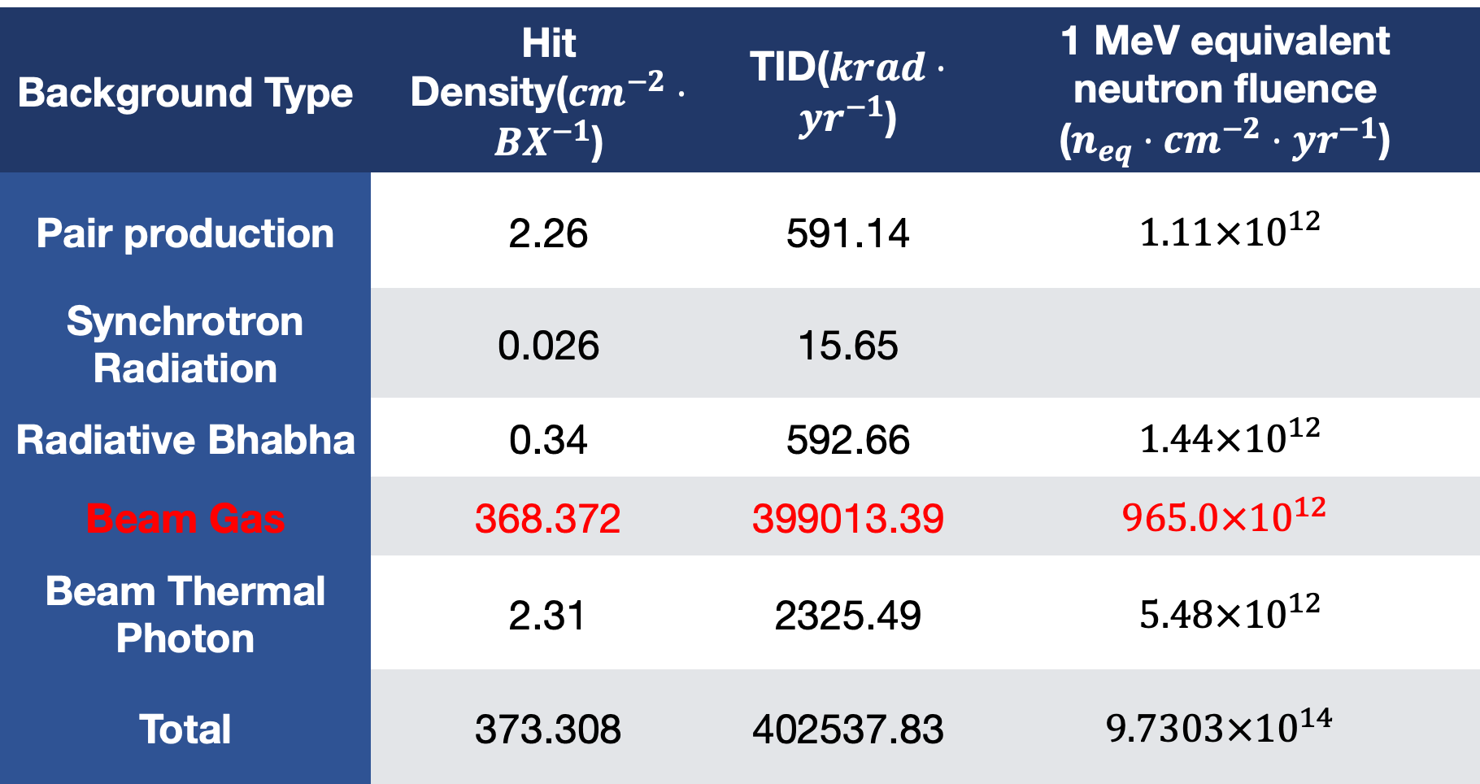
Combine Results
Higgs Backgrounds on 1st layer of Vertex.
With a safety factor of 10.
Finished in November, 2019
Background Type | Hit Density($cm^{−2}⋅BX^{−1}$) | TID($krad⋅yr^{−1}$) | 1 MeV equivalent neutron fluence ($n_{eq}⋅cm^{−2}⋅yr^{−1}$)
Pair production | 2.26 | 591.14 | $1.11×{10}^{12}$
Synchrotron Radiation | 0.026 | 15.65
Radiative Bhabha | 0.34 | 592.66 | $1.44×{10}^{12}$
Beam Gas | 368.372 | 399013.39 | $$965.0×{10}^{12}$$
Beam Thermal Photon | 2.31 | 2325.49 | $5.48×{10}^{12}$
Total | 373.308 | 402537.83 | $$9.7303×{10}^{14}$$

Slide 35
Thoughts to Mitigate BGS Bremsstrahlung
Does the simulation right?
What are the key parameters?
Check the normalization factor
Improve Vacuum
Add More Collimator(s)
Get more sliced and correct aperture settings

Slide 36
Update of Normalization Factor - 1
In previous simulation, we only simulated the particles generated in first 200m upstream.
How about other region?
  We assume they contribute the same as the first 200m in prior estimation
  If they won’t lost in the IR, then the results should be divided by 500
The normalization factor should be some value between 1~500.
 | 200m | Whole Ring
N. Generated | 94305 | 5434566
N. Lost in IR | 13387 | 18887
R. Lost in IR | 0.142 | 0.00348
Normalization Factor | 1 | 0.0245
Beam Thermal Photon has the same problem, and the results would also be updated

Slide 37
Add One More Collimator - Position
Red Line and Black Line are different runs with 4 Collimator Sets.
Orange Line shows one more collimator located at -30m.
Aqua Line shows one more collimator located at -6m.
Far is safe. Chose -31m.

Slide 38
Conclusion of this initial study
Add one more set of collimator after the last bending magnet can help cut down the lost within the IR
For now, -30.92m could be one choice.
However, this collimator here must be thicker than others.
For now, 10cm Copper + 4cm Tungsten seems to be Ok.
Initial Results, more study need to be done in future.
No Neutrons survive at -6m.
Other issues, including heat deposition, photons hitting the magnets, instability of the beam, other particles might come out from the collimator, etc., would be done in future.
Collimators | Hit Density | TID | NIEL
4 Co | 36.8372 | 39901.139 | 9.65e+13
5 Co | 7.797 | 8354.393 | 2.02e+13
Ratio | 4.72 | 4.77 | 4.77

Slide 39
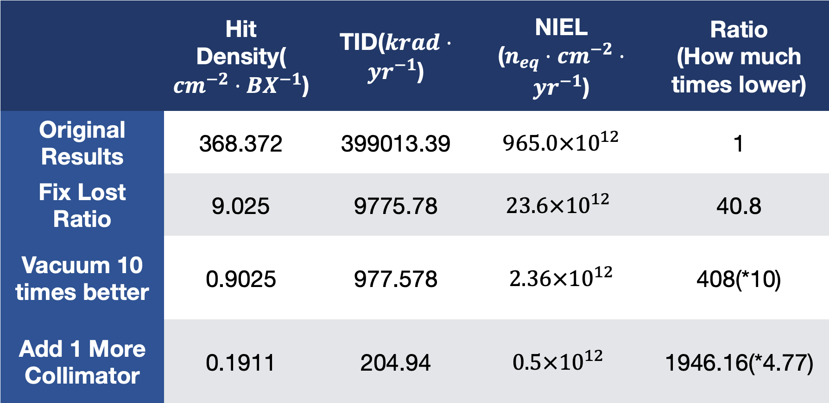
Improve Vacuum & Others
 | Hit Density($cm^{−2}⋅BX^{−1}$) | TID($krad⋅yr^{−1}$) | NIEL ($n_{eq}⋅cm^{−2}⋅yr^{−1}$) | Ratio (How much times lower)
Original Results | 368.372 | 399013.39 | $$965.0×{10}^{12}$$ | 1
Fix Lost Ratio | 9.025 | 9775.78 | $$23.6×{10}^{12}$$ | 40.8
Vacuum 10 times better | 0.9025 | 977.578 | $$2.36×{10}^{12}$$ | 408(*10)
Add 1 More Collimator | 0.1911 | 204.94 | $$0.5×{10}^{12}$$ | 1946.16(*4.77)

Slide 40
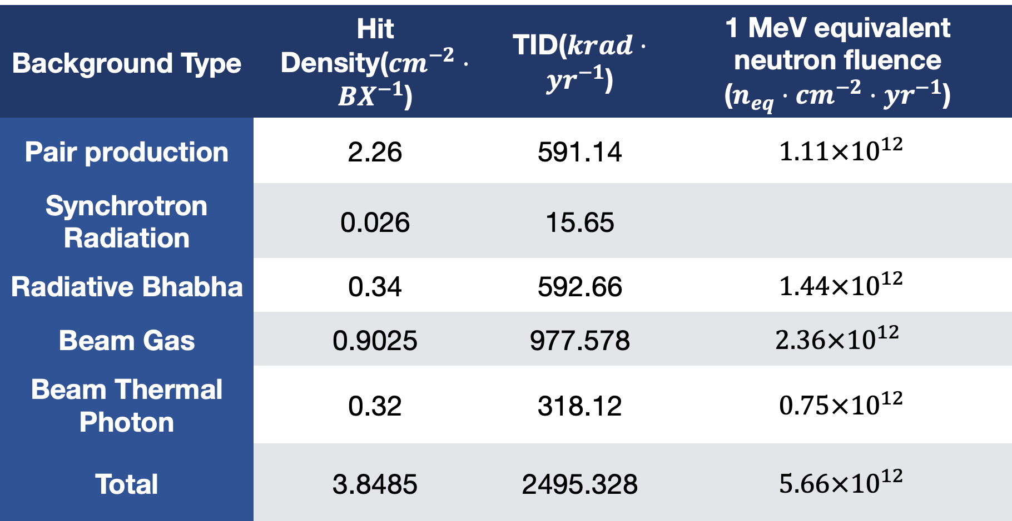
Combine Results - Updated
Higgs Backgrounds on 1st layer of Vertex. With a safety factor of 10.
Background Type | Hit Density($cm^{−2}⋅BX^{−1}$) | TID($krad⋅yr^{−1}$) | 1 MeV equivalent neutron fluence ($n_{eq}⋅cm^{−2}⋅yr^{−1}$)
Pair production | 2.26 | 591.14 | $1.11×{10}^{12}$
Synchrotron Radiation | 0.026 | 15.65
Radiative Bhabha | 0.34 | 592.66 | $1.44×{10}^{12}$
Beam Gas | 0.9025 | 977.578 | $$2.36×{10}^{12}$$
Beam Thermal Photon | 0.32 | 318.12 | $0.75×{10}^{12}$
Total | 3.8485 | 2495.328 | $5.66×{10}^{12}$
The updated results of BGs and BTH were simply rescaled from prior results. More
simulation tasks including accelerator tracking and full detector simulation are on going,
and hopefully get the new results within 1 or 2 months.

Slide 41
The aperture settings within the IR need to be improved
More accurate slice at some points and some region

Slide 42
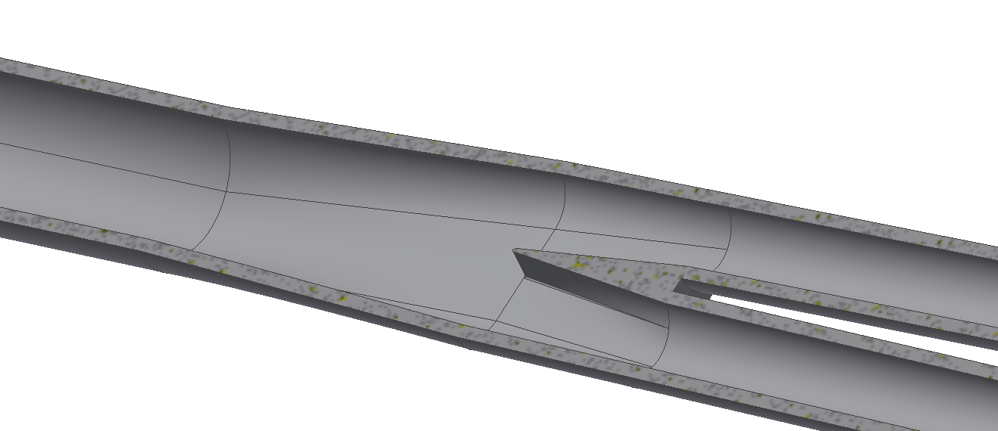
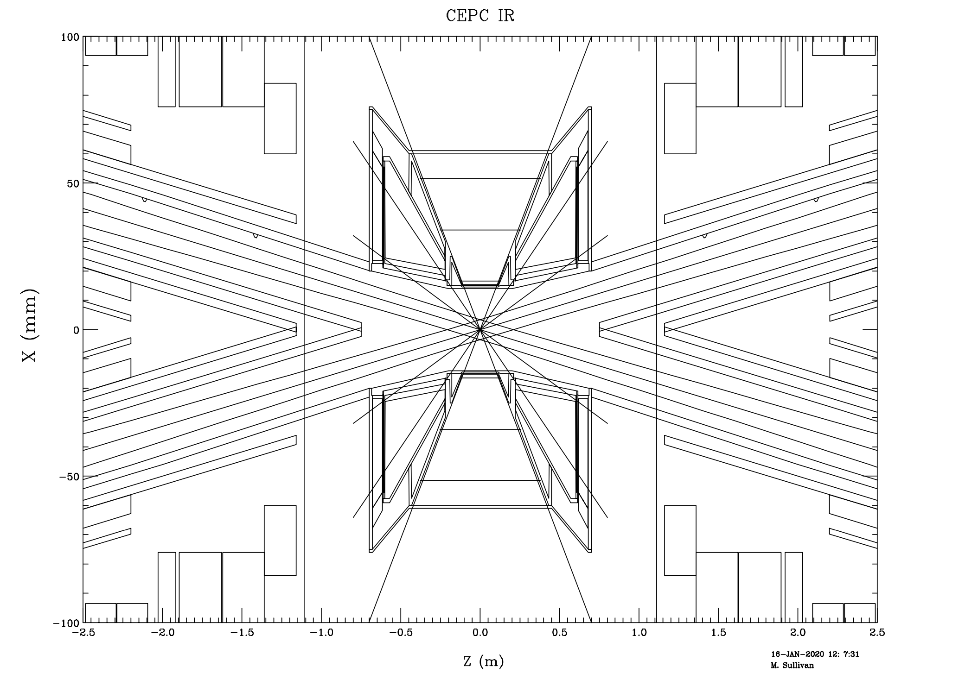
The aperture settings within the IR need to be improved
More accurate slice at some points and some region
The aperture settings of the single beam pipe were not accurate
H. Wang
M. Sullivan

Slide 43
What we have done and what we haven’t
Vertex Only. Other sub-detectors also need to be done
Effects | Beam BG | Photon BG
Touschek | To Do | -
Beam Gas Coulomb | To Do | -
Beam Gas Brem | Doing | To Do
Beam Thermal Photon | Doing | To Do
SR | - | Done with CDR
RBB | Done with CDR | To Do
BS | Done with CDR | Done with CDR

Slide 44
Workflow
Simulation
Benchmark
Design

Slide 45
Benchmark - Motivation
Important to validate the modellings and Monte Carlo Simulation codes for the CEPC beam background simulation with real data where they are applicable
  BEPC II/BES III, SuperKEKB/Belle II, LEP I/II…
Vacuum pressure is critical to Beam-Gas Scattering.
  We may need to know the worst case, and take it into account for simulation.

Slide 46
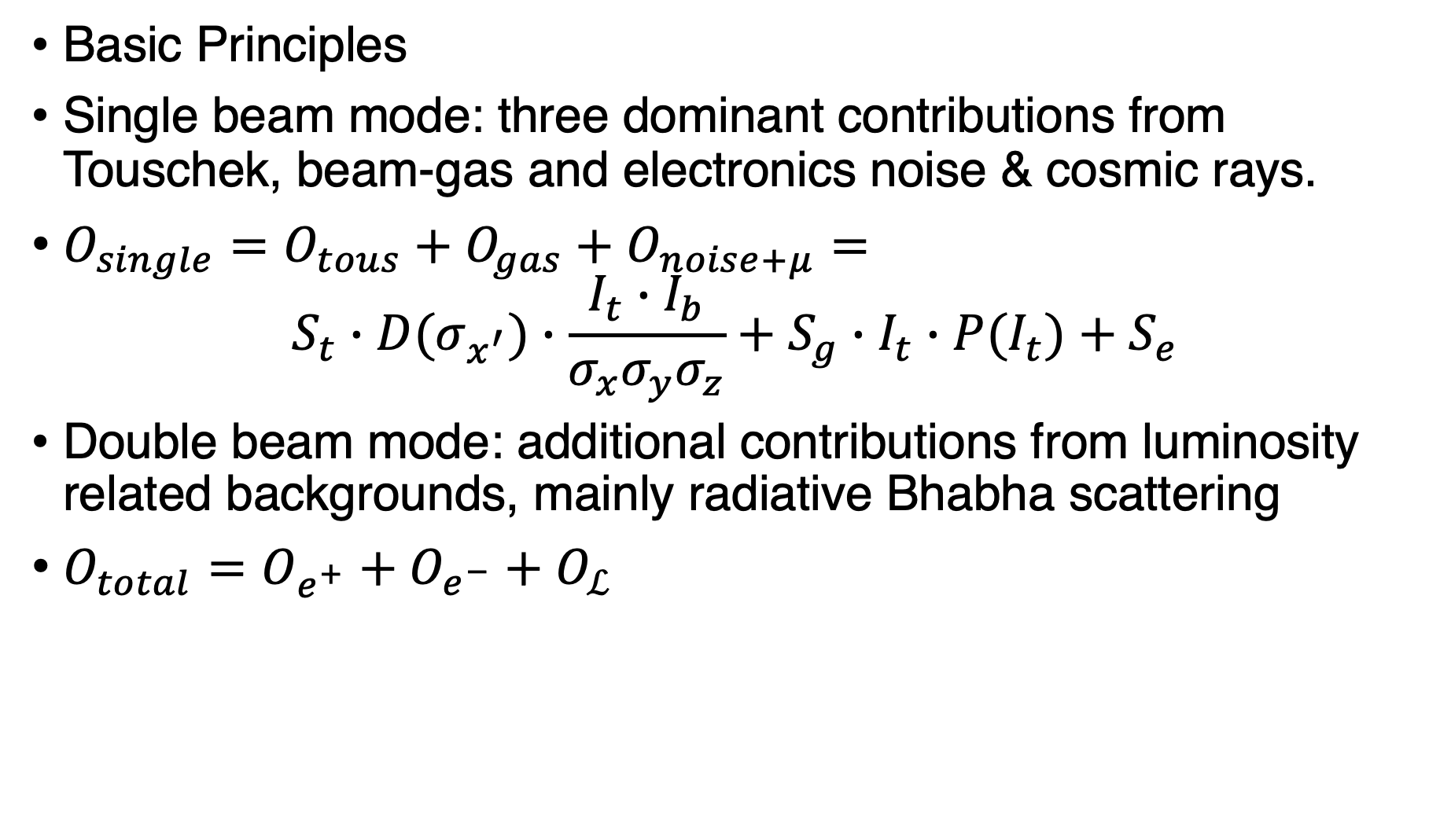
What can be learnt from BEPCII/BESIII
Basic Principles
Single beam mode: three dominant contributions from Touschek, beam-gas and electronics noise & cosmic rays.
$O_{single}=O_{tous}+O_{gas}+O_{noise+μ}=$
$$S_{t}∙D(σ_{x^{′}})∙\frac{{I_{t}∙I}_{b}}{{σ_{x}σ_{y}σ}_{z}}+S_{g}∙I_{t}∙P(I_{t})+S_{e}$$
Double beam mode: additional contributions from luminosity related backgrounds, mainly radiative Bhabha scattering
$O_{total}=O_{e^{+}}+O_{e^{−}}+O_{ℒ}$

Slide 47
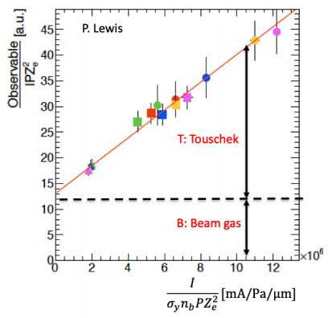
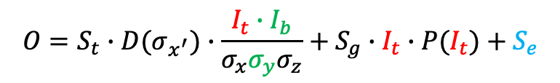
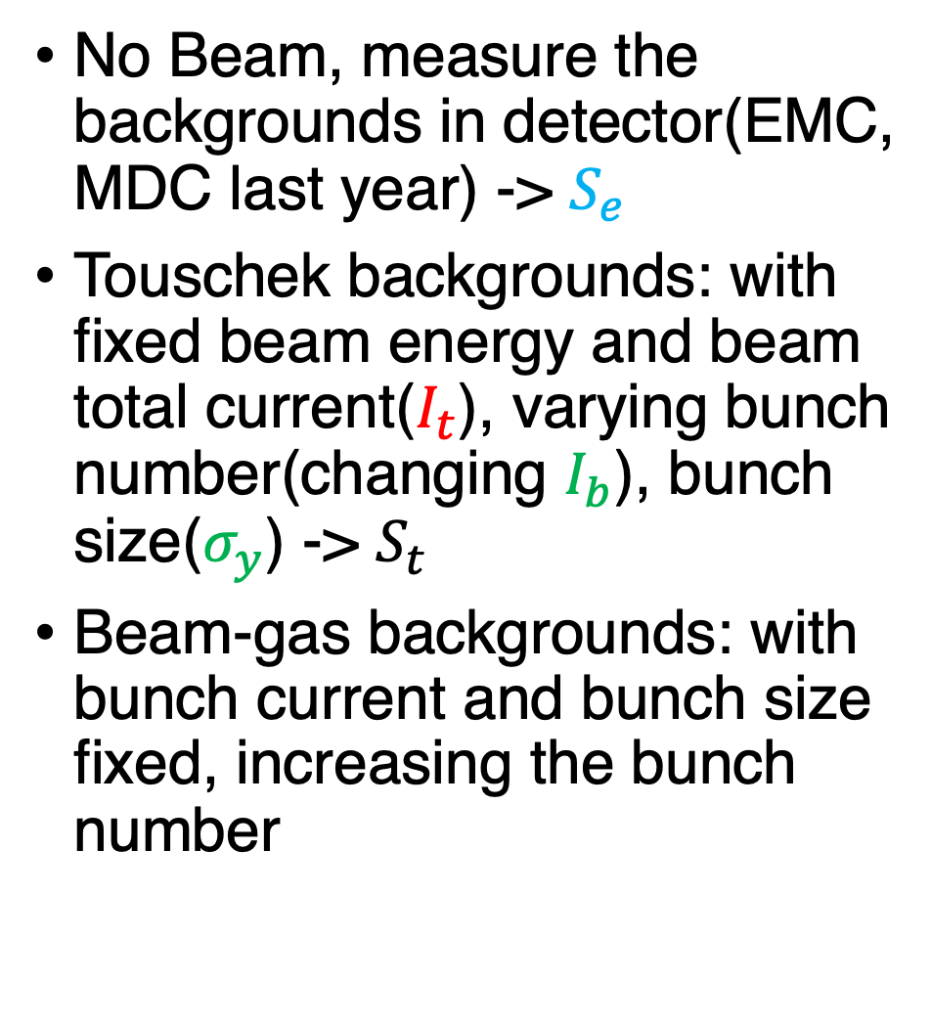
Single Beam Mode
$$O=S_{t}∙D(σ_{x^{′}})∙\frac{{I_{t}∙I}_{b}}{{σ_{x}σ_{y}σ}_{z}}+S_{g}∙I_{t}∙P(I_{t})+S_{e}$$
No Beam, measure the backgrounds in detector(EMC, MDC last year) -> $S_{e}$
Touschek backgrounds: with fixed beam energy and beam total current($I_{t}$), varying bunch number(changing $I_{b}$), bunch size($σ_{y}$) -> $S_{t}$
Beam-gas backgrounds: with bunch current and bunch size fixed, increasing the bunch number
SuperKEKB Plots

Slide 48

Double Beam Mode
Fixed beam energy & current, bunch parameters, operating
  Single e+/e- beam
  Separate e+ and e- beams
  Colliding e+ and e- beams
$$O_{total}=O_{e^{+}}+O_{e^{−}}+O_{ℒ}$$

Slide 49
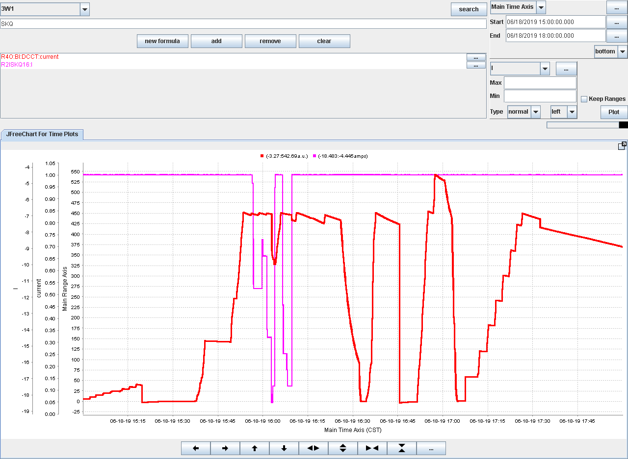
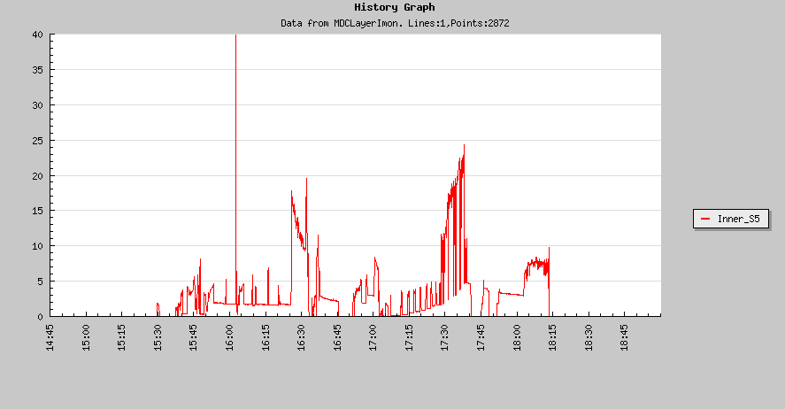
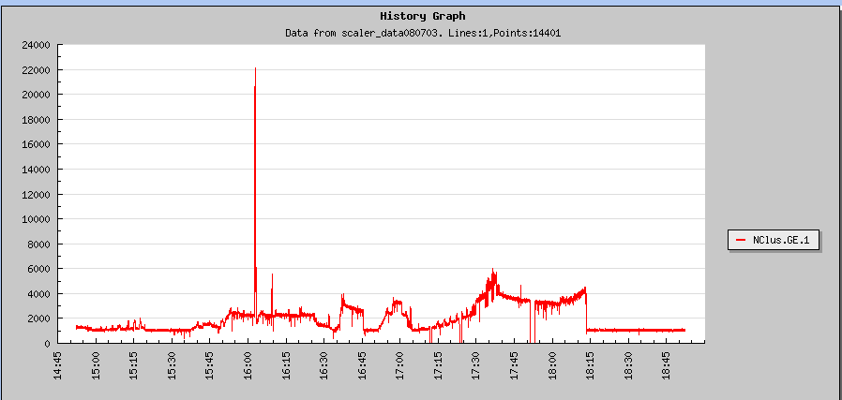
Machine Studies Last Summer
Two hours of machine time allocated to background studies last summer.
Recorded parameters: bunch size, beam current, beam lifetime, vacuum pressure, MDC/EMC cluster counts.

Slide 50
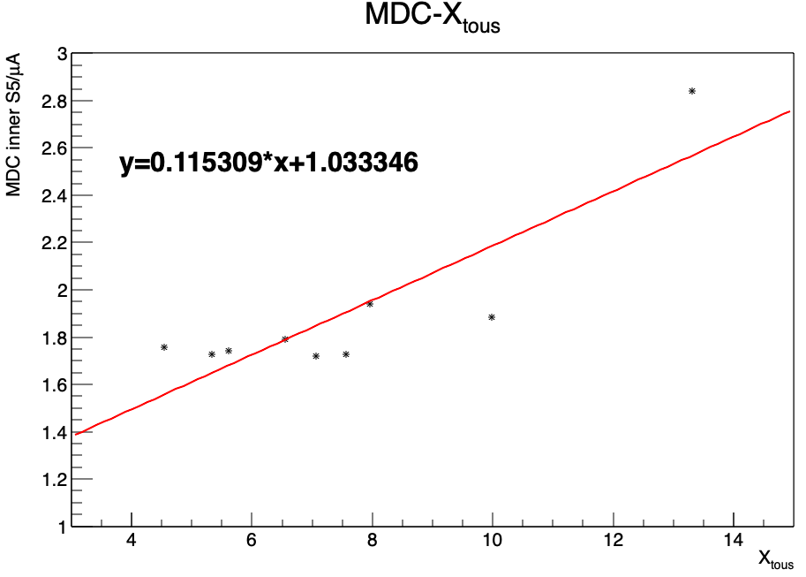
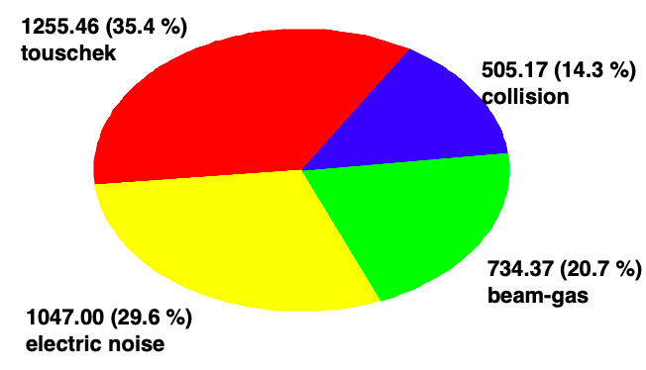
We may need one more round
Simulations results DO NOT match the measurements
Let the accelerator and detector configured properly before study
Most importantly, longer time, more data.

Slide 51
What need to be understood before experiment?
The critical parameters for backgrounds
The “real” effects of the parameters we changed, and the paraments we want to change.
  Like ”k”
The results in detector that comparable for both simulation and experiments
  We may only use EMC. How to convert the results from simulation and the data taken from the experiments to same quantity.

Slide 52
Summary
Background Study Checklist
Category | Tasks | Status
Design | IR Design Optimization | To Do
 | Collimator Design | Doing
Simulation | BG Simulation | Doing
 | Collimator Simulation | To Do
 | Detector Simulation | Doing
 | IR Components Simulation | To Do
Benchmark | BEPCII/BESIII Machine Study | To Do
 | Literature Benchmark | Doing

Slide 53
Summary & Outlook
Improve & Optimize our study
  Understand as more aspects as we can
  Build a workflow & toolkit we can use for further study(may only need to change design and parameters)
(New) Baseline. The same design and parameters in all procedures and tools.
More Ways to mitigate the backgrounds:
  More Collimators.
  Shielding at hotspot
Other Mode. Z?W?
The impact on other sub detectors / accelerator components in the IR

Slide 54
Critical Topics
Thank You
Physics/machine/detector modeling – with sufficient accuracy
  Experience from other experiments (LEP, BII/BES III, SuperKEKB/Belle II)
  Dedicated beam background studies with BEPC II/BES III
  Identifying known and unknown missing background sources
Background mitigation and machine and detector protection
  Collimators, masks, shielding – improved design with better understanding of backgrounds
  Machine and detector geometry implementation in simulation – nontrivial
Manpower and funding support
  H. Zhu (detector), B. Sha (machine), B. Wang (machine), H. Shi (machine & detector), W. Xu (detector), H, Shi (USTC, BII/BESIII backgrounds)
  Available (400 k) supported by X. Lou + bidding for NSFC funding

Slide 55
Backup

Slide 56
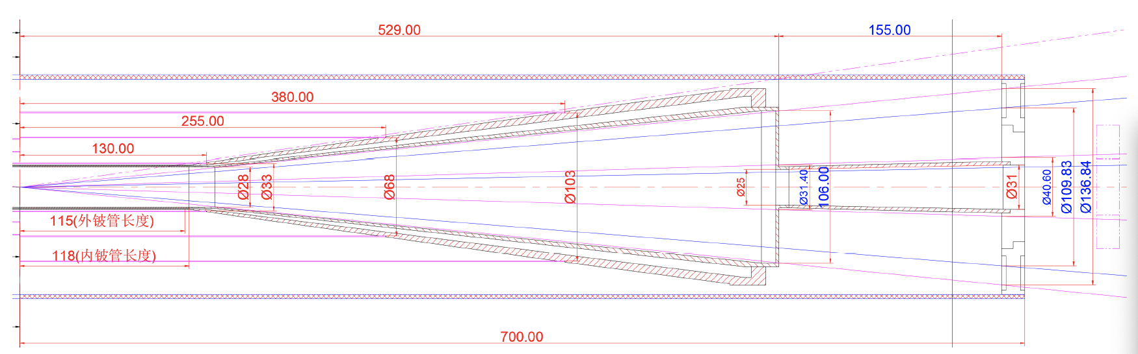
Old: LumiCal mounted on the Quadrupole and inserted together into the detector, caveat: too much material in front of LumiCal
New: LumiCal with reduced weight mounted on the beampipe instead, together with a supporting structure to mitigate the deformation of the central beryllium beampipe
Interface to machine
LumiCal
coverage: 30-100 mrad
LumiCal precision requirements/performance being re-evaluated
Mechanical design including beampipe cooling structure ongoing …
Radiation backgrounds to be re-estimated (increased backscattering into the tracking volume)

Slide 57
Normalization Factor
Length: | Generated | Lost in IR
0~1000 | 530211 | 25721
1000~2000 | 536228 | 26953
2000~3000 | 558359 | 6807
3000~4000 | 540082 | 4460
4000~5000 | 539904 | 3827
5000~6000 | 539905 | 1180
6000~7000 | 539905 | 3370
7000~8000 | 539905 | 3189
8000~9000 | 558359 | 1172
9000~10000 | 540067 | 2834
Whole Ring | 5434566 | 18887

Slide 58
Update of Normalization Factor
 | Beam Gas | Beam Thermal Photon
N. Generated in 200m | 94305 | 94305
N. Lost in IR with 200m | 13387 | 4647
R. Lost in IR with 200m | 0.142 | 0.0492
N. Lost before 2m with 200m | 5117 | 249
R. Lost before 2m with 200m | 0.0543 | 0.00264
N. Generated in WR | 5434566 | 5434566
N. Lost in IR with WR | 18887 | 36599
R. Lost in IR with WR | 0.00348 | 0.00673
N. Lost before 2m with WR | 591 | 517
R Lost before 2m with WR | 0.00011 | 9.513e-5
NF w/o dist changing | 0.0245 | 0.137
NF w/ dist changing | 0.002 | 0.036

Slide 59
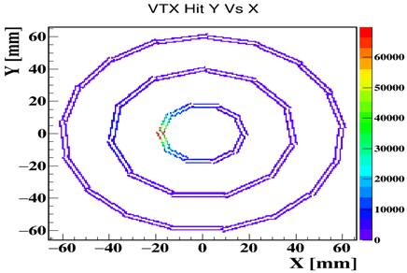
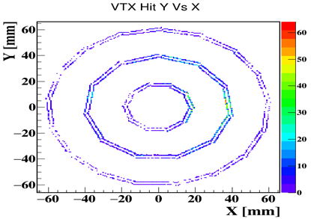
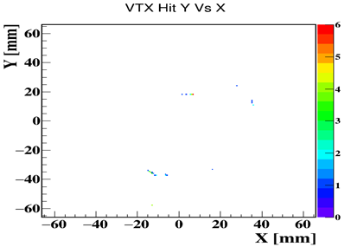
Reshape the lost distribution
Z:-6~0m
Z:0~2m
Z:2~6m

Slide 60
Reshape the lost distribution

Slide 61
Update of Normalization Factor - 2
 | 200m | Whole Ring
N. Generated | 94305 | 5434566
N. Lost in IR | 13387 | 18887
R. Lost in IR | 0.142 | 0.00348
NF w/o dist changing | 1 | 0.0245
N. Lost before 2m | 5117 | 591
R Lost before 2m | 0.0543 | 0.00011
NF w/ dist changing | 1 | 0.002

Slide 62
问题
1 几何落实不统一（加速器设计，探测器设计，更新）
2 如何验证模拟的准确性，Benchmark？
3 最关键的问题，Beam Gas，如何进一步优化？
4 其余的光子本底，是没有影响，还是没计算影响？如果是后者，如何研究？
5 其余的能散束流本底，问题同上
6 其余能量状态的问题？
7 外层探测器，甚至是对撞区加速器部件的影响

Slide 63
Tracking Position

