Slide 1

TaichuPix-1 pixel analog test results
Ying ZHANG

Slide 2
Overview of the testing status
Four chips (test boards #2-#5) have been tested
chip (#4&#5) functional to the external charge injection (APULSE), some common features:
  Internal Bandgap output is ~0.46V, 0.3V lower than design value, leading to output range of CDACs/VDACs much lower than design
    IBIAS & ITHR can NOT reach the nominal value for pixel (440 nA & 4.5 nA)
      IBIAS_max.= 240-255 nA; ITHR_max. = 0.62-0.68 nA
    Each chip provides different biasing values with same DAC input codes
  Different output with same input code for DACs, especially CDACs
    Note: current biasing can not be monitored directly
  Measured analog output (OUT_A) seems to be saturated for all input charges from threshold (> ~150 e-) to 2140 e-
    Amplitude ranges from 360 mV to 480 mV, depending on the biasing condition, but changes slightly (< 10 mV) due to different inputs
    Reason of saturation under study
  Delay of leading edge of OUT_A decreases with increasing of input charge → coincide with simulation

Slide 3
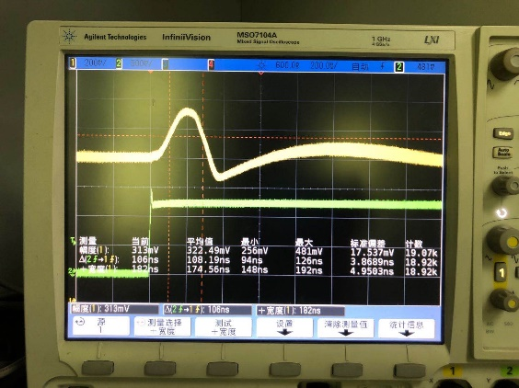
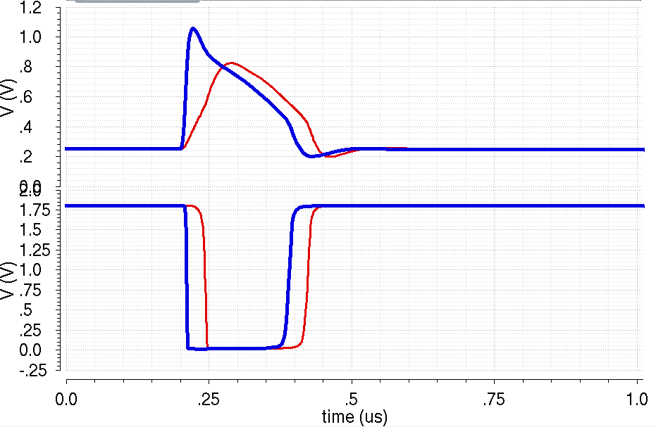
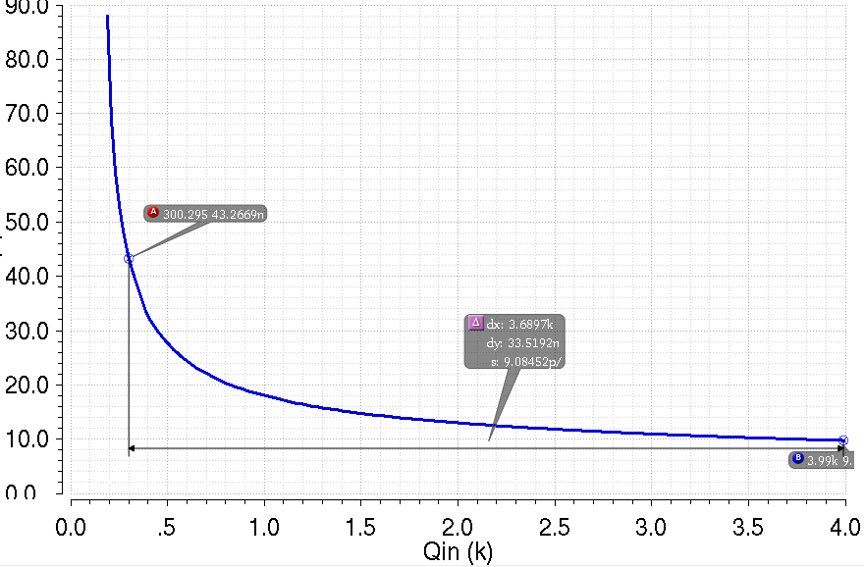
Timing performance
Measured delay of leading edge → Time difference from 50% of leading edge of OUT_A to 50% of APULSE
Simulated delay of leading edge → Time difference from 50% of leading edge of OUTD (connected to in-pixel digital) to 50% of PIX_IN
Simulated delay of leading edge
Measured delay of leading edge
Qin = 300 e⁻
Qin = 3000 e⁻
Out_A
Analog buffer output
Out_D
Apulse
Delay of leading edge vs. input charge
Delay of leading edge (ns)
    Time walk ~33 ns @ 300e – 4 ke-

Slide 4
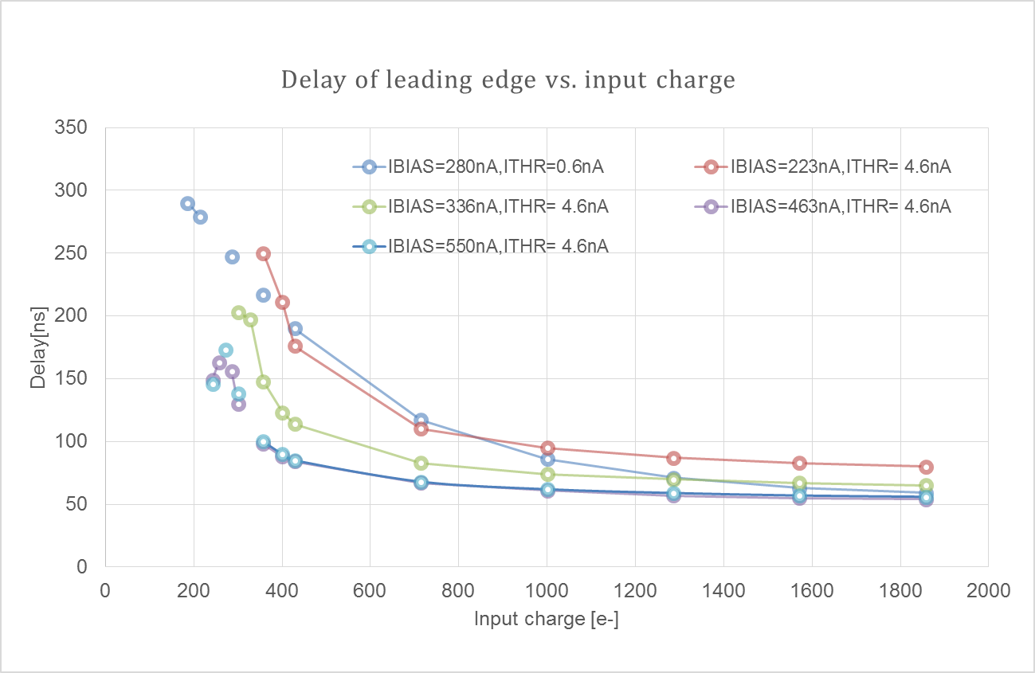
Timing performance
VPWELL= 0 V, pulsing with VHIGH = 1.8 V, varying VLOW
Best case: Time walk@300e-1.9 ke- = 76 ns
*IBIAS= 280 nA case measured with chip#4, the others measured with chip #5

Slide 5
Effect of discriminator stage
Whether the bias current (IDB) of discriminator provided, the measured analog output different
Different effect of IDB for chip4 and chip5
  For chip5, if IDB is not provided, the analog output has no response to APULSE
  For chip4, the analog output is lower when IDB is not provided

Slide 6
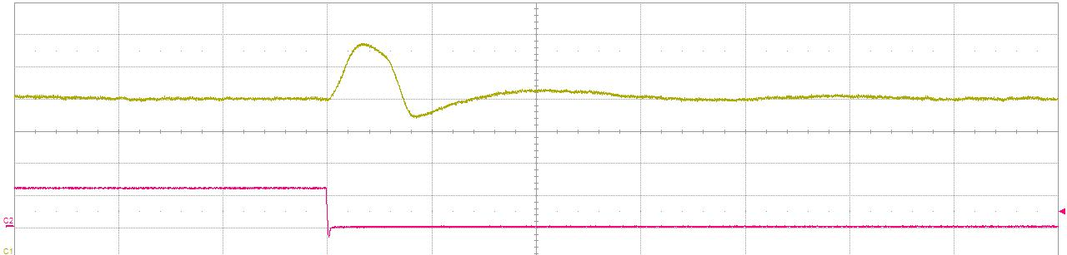
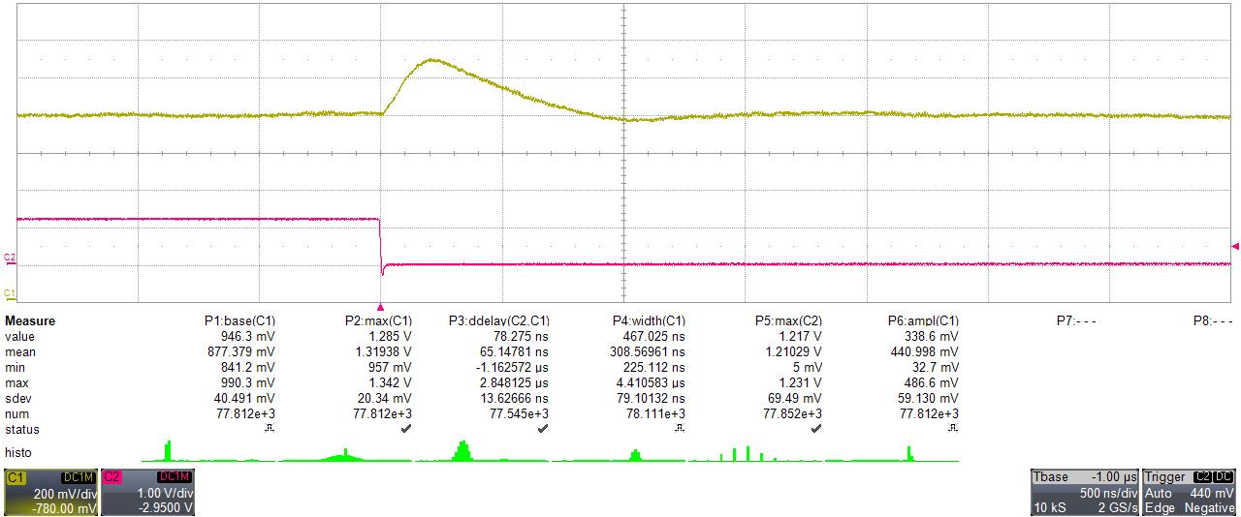
Chip #4 performance
Effect of IDB, unexpected performance
OUTA@1.1Vin with IDB
OUTA@1.1Vin without IDB

Slide 7

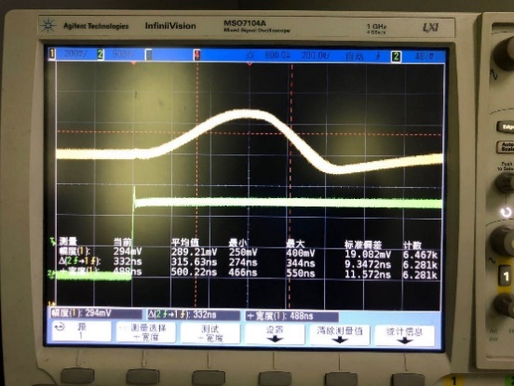
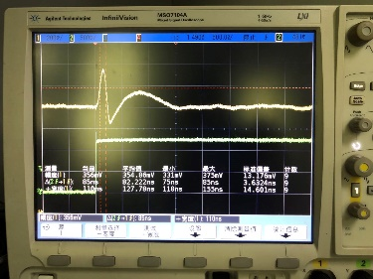
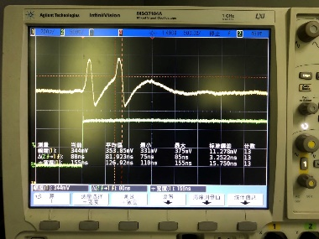
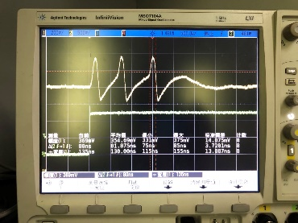
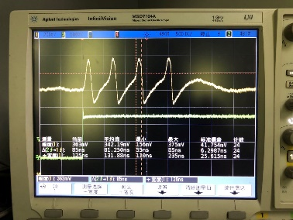
Multiple response peaks (1)
In some conditions, there are more than one response peaks observed, when the internal BandGap and BIAS_GEN used
VRESET=1.6 V
VRESET=1.7 V
VRESET=1.7 V
VRESET=1.5 V

Slide 8
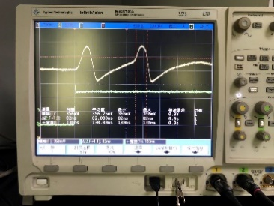
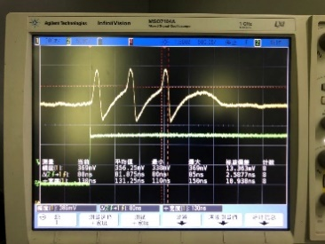
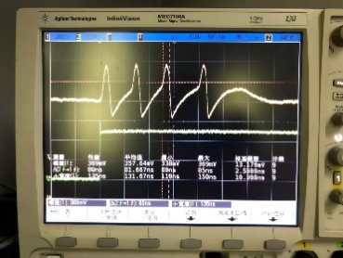
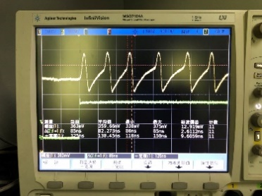
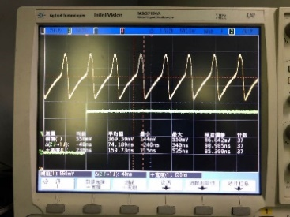
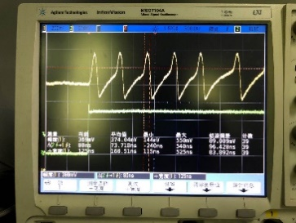
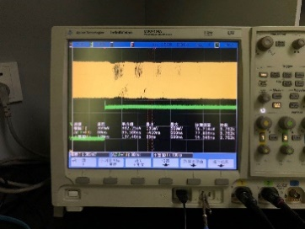
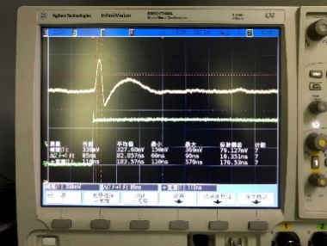
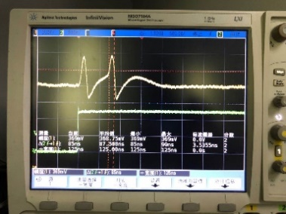
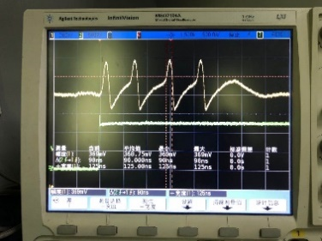
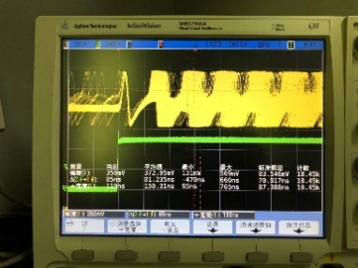
Multiple response peaks (2)
In some conditions, there are more than one response peaks observed, when the internal BandGap and BIAS_GEN used
VRESET=1.4 V
VRESET=1.2 V
VRESET=1.1 V

Slide 9
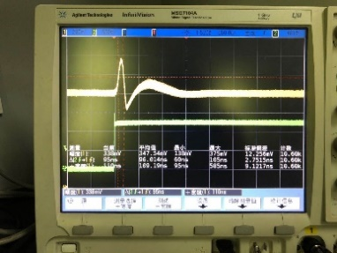
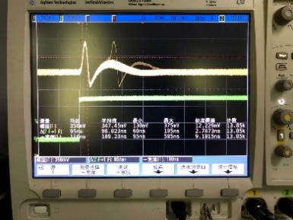
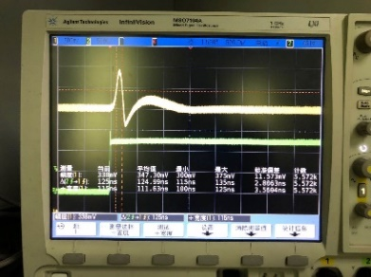
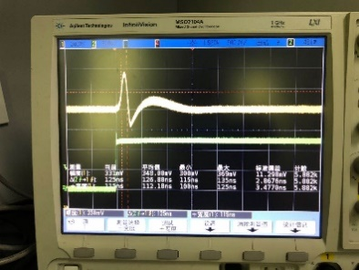
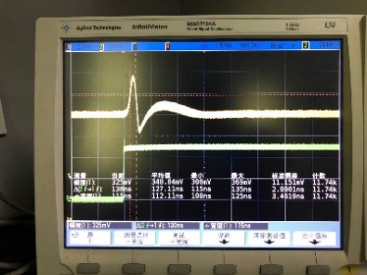
Multiple response peaks (3)
In some conditions, there are more than one response peaks observed, when the internal BandGap and BIAS_GEN used
No multiple response peaks observed when external IBIAS_20U used.
VRESET=1.0 V
VRESET=0.9 V
VRESET=0.5 V
VRESET=0.0 V

Slide 10
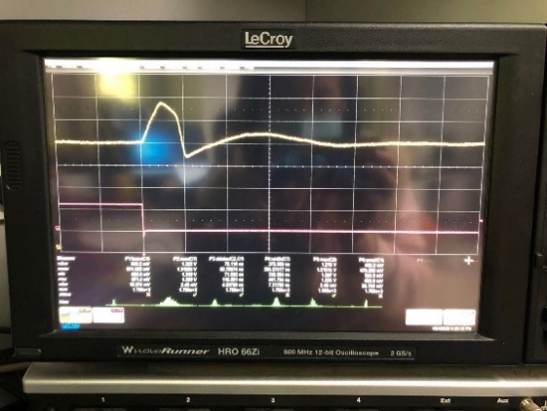
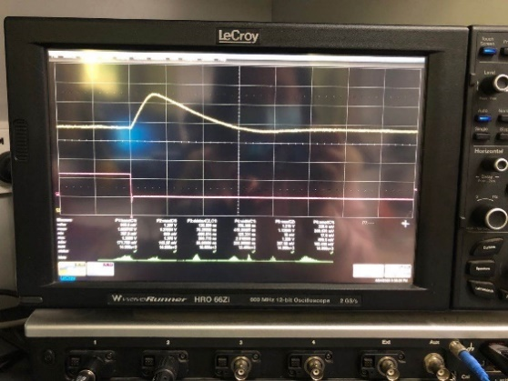
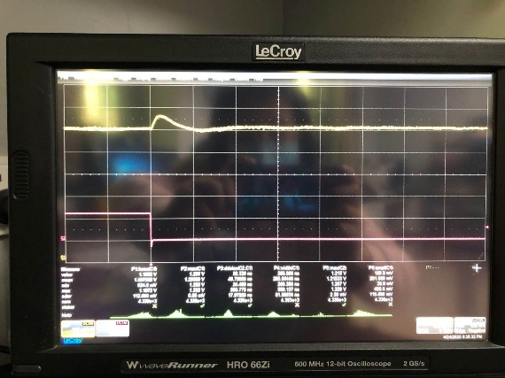

Effect of VPWELL
Response to injected input at different VPWELL with same biasing (Chip4)
Front-end can work with negative VPWELL, but DACs need to be re-configured to provide right biasing, chip 4 died during testing
  May due to IO pad
VPWELL=0.026 V
VPWELL=0.484 V
VPWELL=1.506 V
VPWELL=1.998 V

