Slide 1
CEPC detector solenoid magnet R&D
Ning Feipeng
For the CEPC Detector Magnet Team
2020-06-15

Slide 2
Outline
1, New yoke design of CEPC detector magnet.
2, Leak magnetic field distribution
3, CEPC HTS plan
4, Conclusion

Slide 3
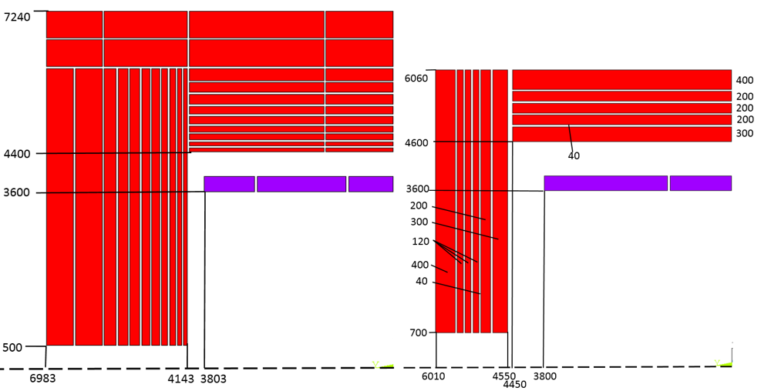
1, New Yoke design
 | CMS | CEPC CDR version | CEPC New version
Central field (T) | 4 | 3 | 3
Operating current (A) | 19600 | 15779 | 16796
Inner diameter of coil (mm) | 6360 | 7200 | 7200
Length of coil (mm) | 12480 | 7606 | 7600
Barrel yoke inner diameter (mm) | 9180 | 8800 | 9200
Barrel yoke outer diameter (mm) | 14000 | 14480 | 12120
Total length of yoke (mm) | 20040 | 13966 | 12020
Weight of barrel yoke (t) | 6000 | 5940 | 3137
Weight of each end cap (t) | 2000 | 3316.6 | 1144
Total weight of yoke (t) | 10,000 | 12,573 | 5,425
CDR version
New version

Slide 4
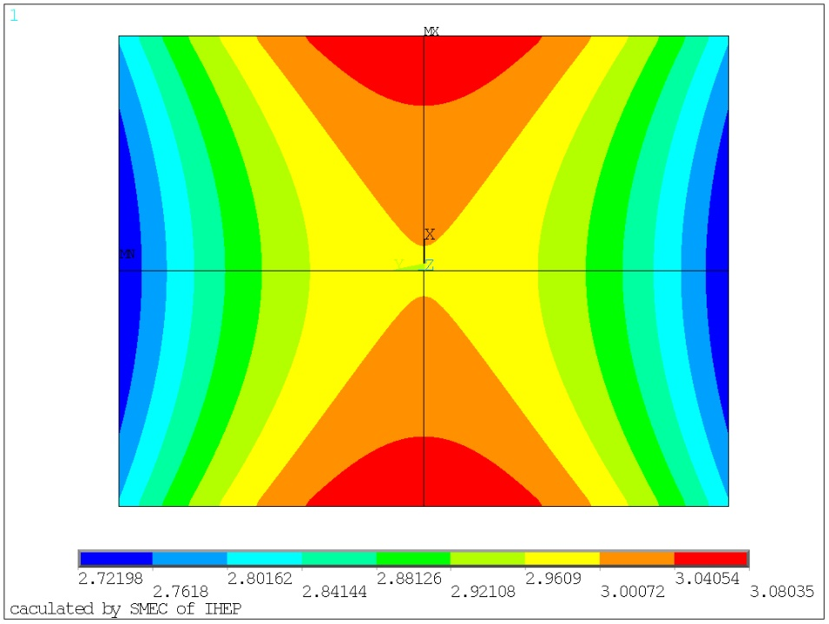
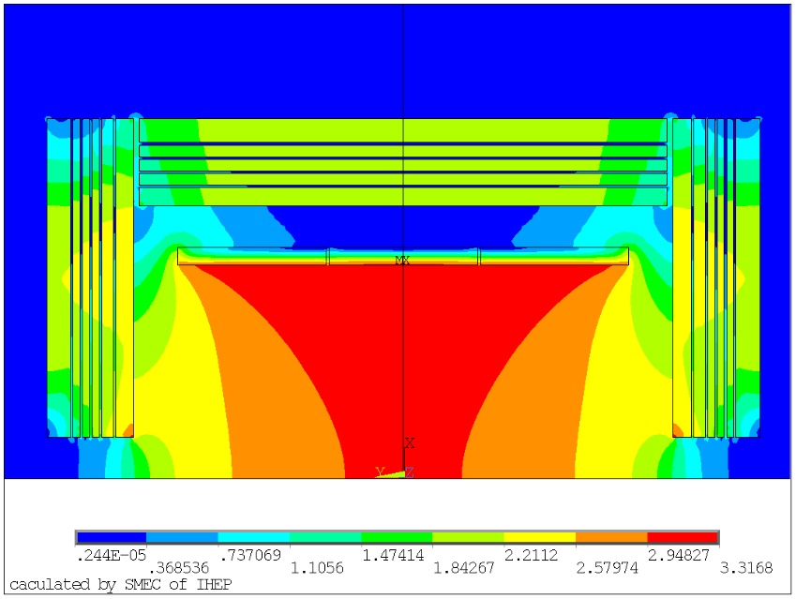
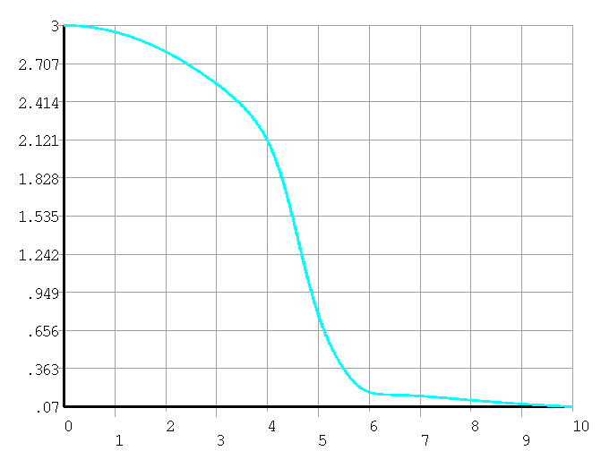
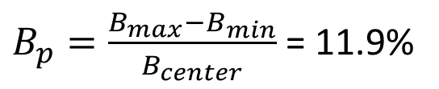
Magnetic field distribution
The non-uniformity of Tracking Volume (diameter 3.62m,length 4.7m) is 11.9%
$B_{p}=\frac{B_{max}−B_{min}}{B_{center}}$ = 11.9%
 | Bmax (T) | Bmin (T) | non uniformity
CDR version | 3.06 | 2.79 | 9.2%
New version | 3.08 | 2.72 | 11.9%

Slide 5
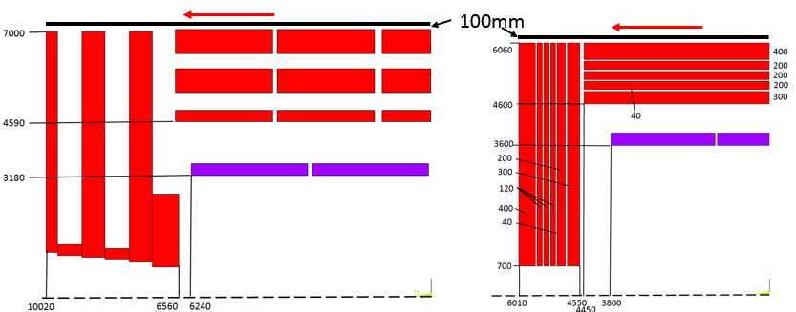
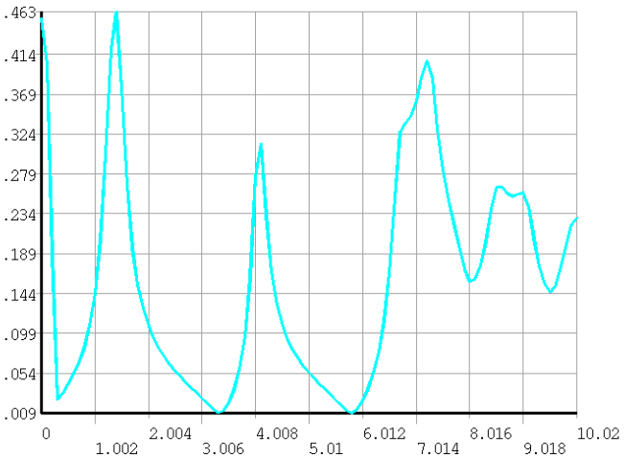
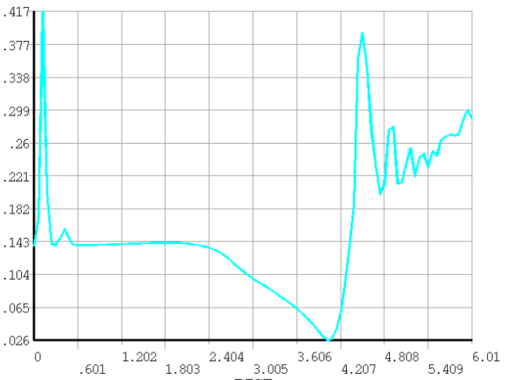
2, Leak magnetic field distribution
There are some equipment on the top of the barrel yoke, such as vacuum pump. So the magnetic field on the top of the barrel yoke must be controlled.
CMS
CEPC new Version

Slide 6
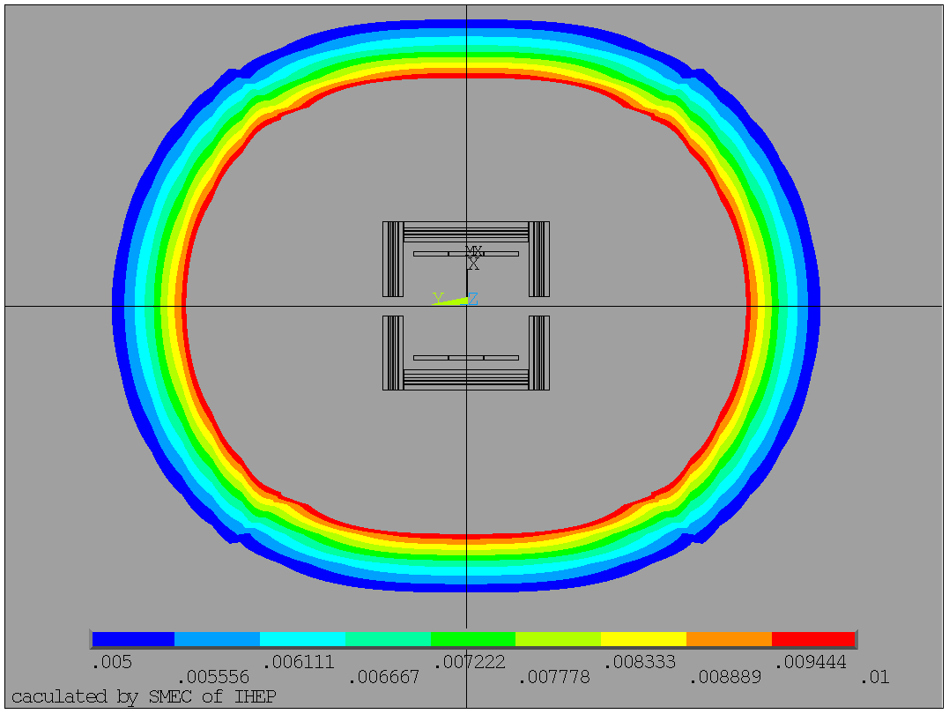
2, Leak magnetic field distribution
100 Gauss
Leak field |  | CMS | CEPC CDR | New Version
50 Gs | R direction | 25.2 m | 13.6 m | 20.6 m
 | Z direction | 32 m | 15.8 m | 25.5 m
100 Gs | R direction | 19.2 m | 10 m | 16.4 m
 | Z direction | 25.2 m | 11.6 m | 20.1 m
50 Gauss

Slide 7
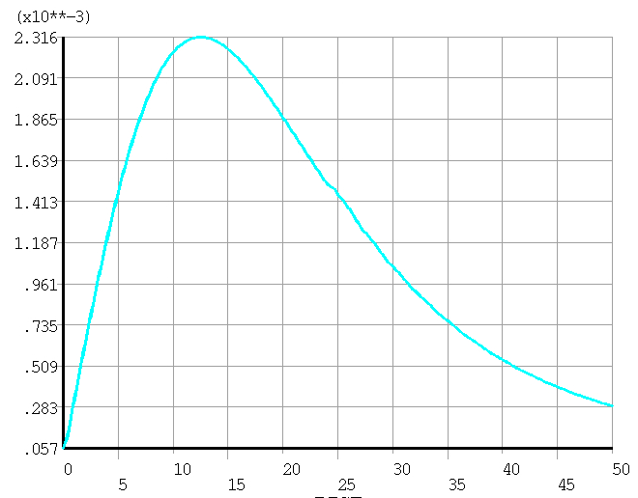
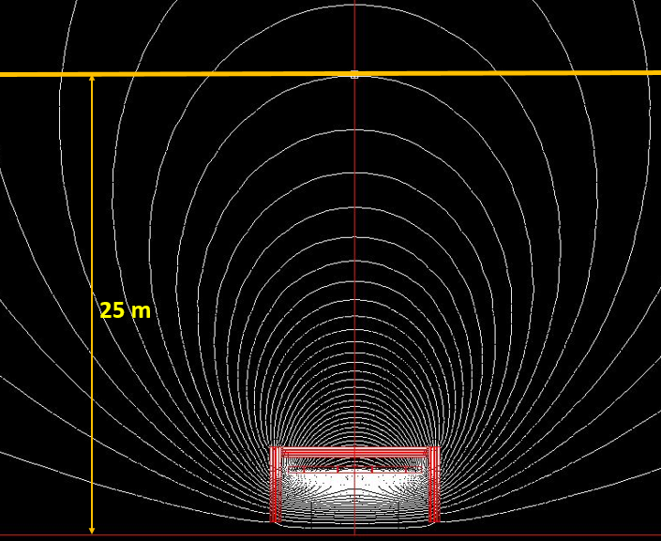
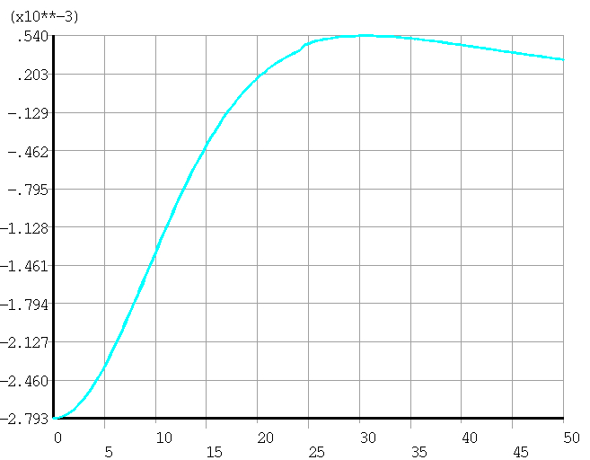
2, Leak magnetic field distribution
23 Gs
Magnetic field at Booster (radial R=25m)
CDR version | 8.4 Gs
New version | 28 Gs
Meet the requirement of less than 50 Gs.
BX
X
BY
Y
-28 Gs

Slide 8
3, CEPC HTS plan
HTS SOLENOID FOR IDEA Detector
  Based on the LTS plan of IDEA detector.
Property | Value
Magnetic field in center (T) | 2
Free bore diameter (m) | 4
Cold mass inner radius (m) | 2.2
Cold mass length (m) | 6

Slide 9
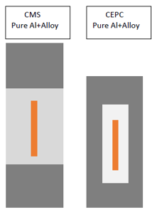
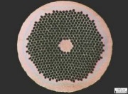
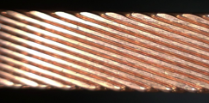
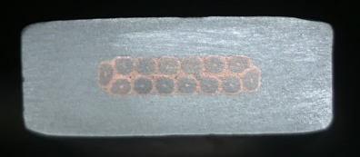
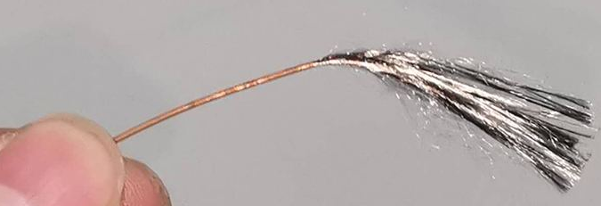
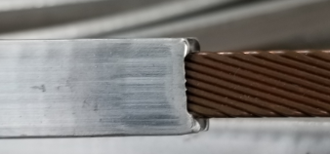



Cable development
LTS Cable development
Under development
NbTi wire
Rutherford Cable
Al Stabilized Rutherford Cable
$$√$$
$$√$$
NbTi Rutherford cable

Slide 10
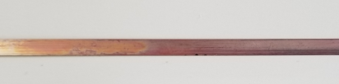
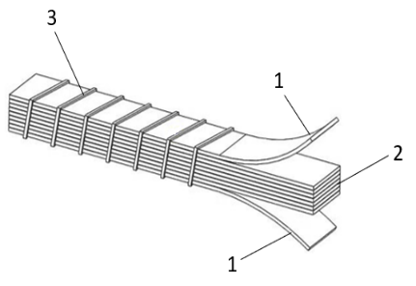
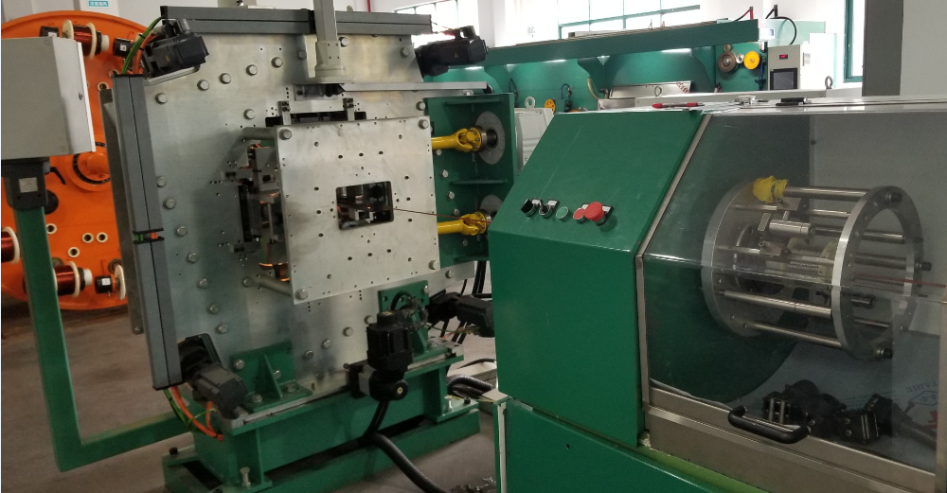
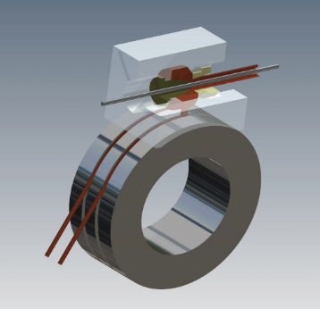
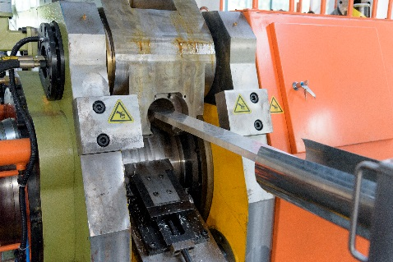
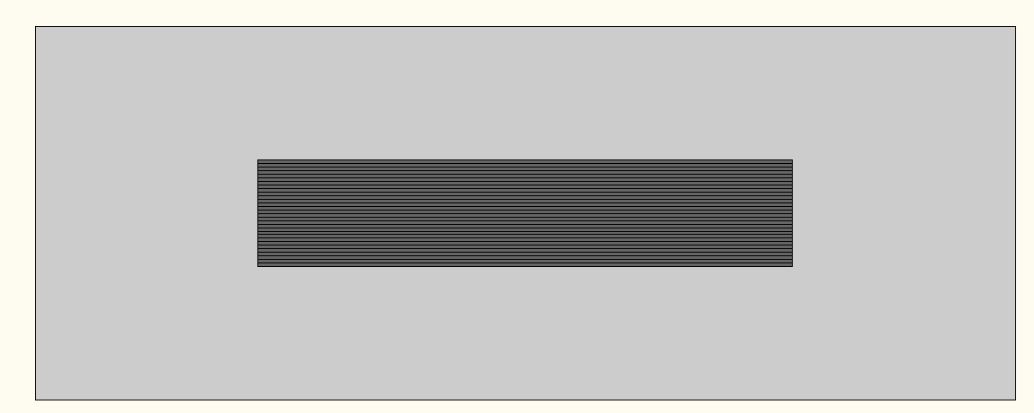
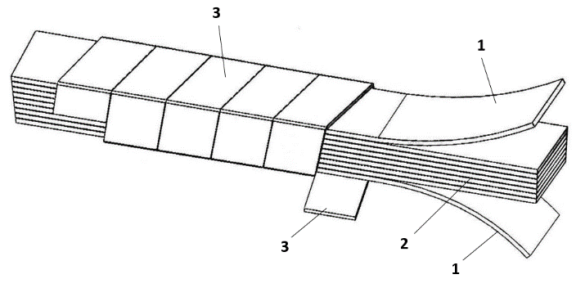
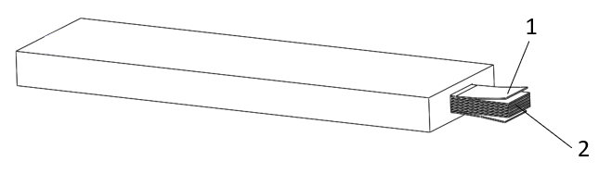
Cable development
HTS Cable development
ReBCO tape
1, HTS stack cable
2, Add Al stabilization to HTS stack cable
20 layers Al Stabilized ReBCO Stacked Tape Cable
Under development
Under development

Slide 11
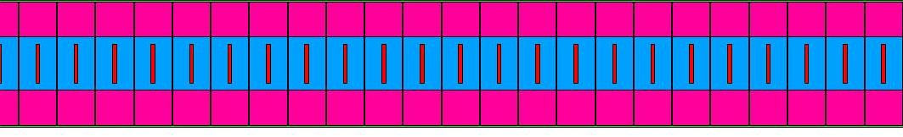
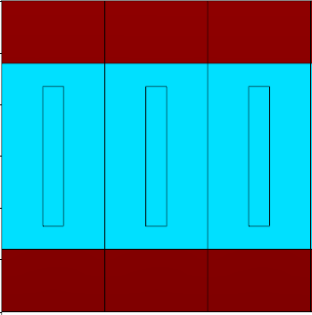
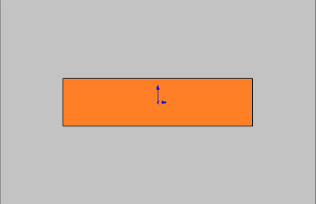
3, CEPC HTS plan
Coil winding
LTS
vertical configuration
HTS
horizontal configuration

Slide 12
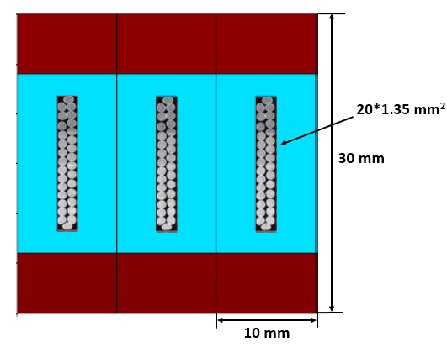
Radiation thickness calculation
IDEA LTS version
Material | Thickness | Radiation thickness |  | Nuclear Interaction length
 | X, mm | X₀, mm | X/X₀ | λ0, mm | λ=X/λ0
NbTi | 0.675 | 15.028 | 0.0449 | 204.5 | 0.0033
Cu | 0.675 | 14.36 | 0.0470 | 153.2 | 0.0044
Stabilizer,Al | 30 | 88.9 | 0.3375 | 397 | 0.0756
Glass/epoxy | 5 | 286 | 0.0175
Total, X_{tot} |  |  | 0.4469 |  | 0.083
Trajectory
2:
Material | Thickness | Radiation thickness |  | Nuclear Interaction length
 | X, mm | X₀, mm | X/X₀ | λ0, mm | λ=X/λ0
NbTi | 10 | 15.028 | 0.6654 | 204.5 | 0.0489
Cu | 10 | 14.36 | 0.6964 | 153.2 | 0.0653
Stabilizer,Al | 10 | 88.9 | 0.1125 | 397 | 0.0252
Glass/epoxy | 5 | 286 | 0.0175
Total, X_{tot} |  |  | 1.4918 |  | 0.1394
1
2
Cryostat (25 mm Al): X0= 0.28, λ= 0.07
Trajectory
1:
Total | X0 | λ
Weight averaged value | 0.59 | 0.09
Total (including cryostat) | 0.87 | 0.16

Slide 13
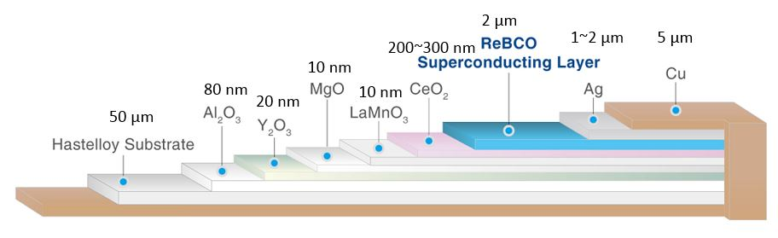
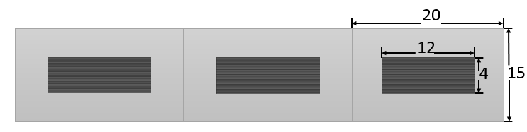
Radiation thickness calculation
IDEA HTS version
  35 layers HTS tape
Material | Thickness | Radiation thickness |  | Nuclear Interaction length
 | X, mm | X₀, mm | X/X₀ | λ0, mm | λ=X/λ0
Cu | 0.35 | 14.36 | 0.0244 | 153.2 | 0.0023
Fe | 1.75 | 17.57 | 0.0996 | 167.7 | 0.0104
Ag | 0.07 | 8.543 | 0.0082 | 154 | 0.0005
YBa2Cu3O7 | 0.07 | 12.49 | 0.0056 | 296.5 | 0.0002
MgO | 0.00000035 | 78.28 | 0.0000 | 274 | 0.0000
Al2O3 | 0.0000028 | 70.38 | 0.0000 | 247.9 | 0.0000
CeO2 | 0.0000105 | 16.54 | 0.0000 | 230 | 0.0000
Al stablizer | 15 | 88.97 | 0.1686 | 397 | 0.0378
MLI, Fiber glass | 0 | 286 | 0.0000 | 415 | 0.0000
Glassepoxy | 2 | 286 | 0.0070 | 428.9 | 0.0047
Total, X_{tot} |  |  | 0.3134 |  | 0.0559
1
Cryostat (25 mm Al): X0= 0.28, λ= 0.07
Total | X0 | λ
Track 1 | 0.313 | 0.056
Total (including cryostat) | 0.593 | 0.126

Slide 14
Radiation thickness calculation
IDEA LTS and HTS Comparison
Consider using the same Cryostat (25 mm Al): X0= 0.28, λ= 0.07
Total | X0 | λ
LTS | 0.87 | 0.16
HTS | 0.59 | 0.13
1
2
The cryostat:
1

Slide 15
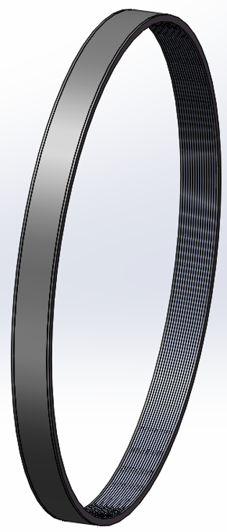
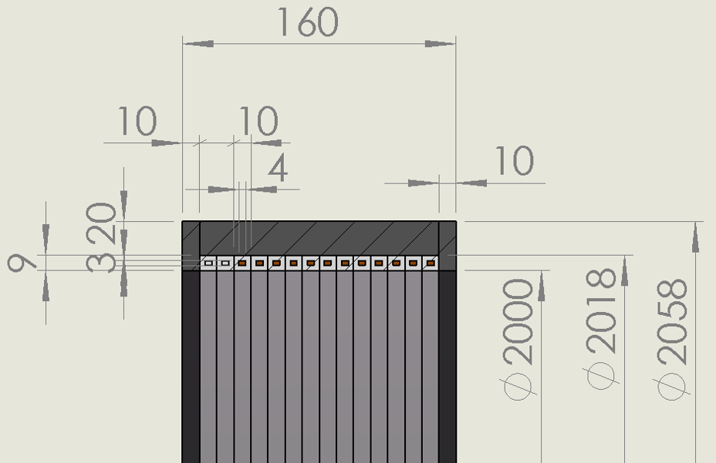
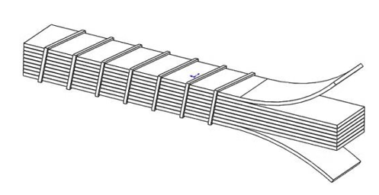
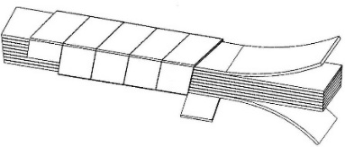
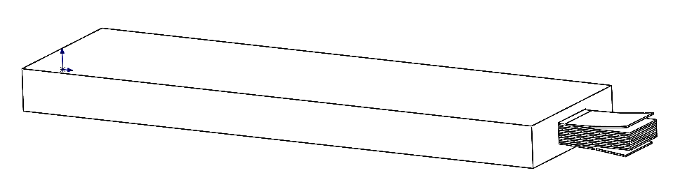
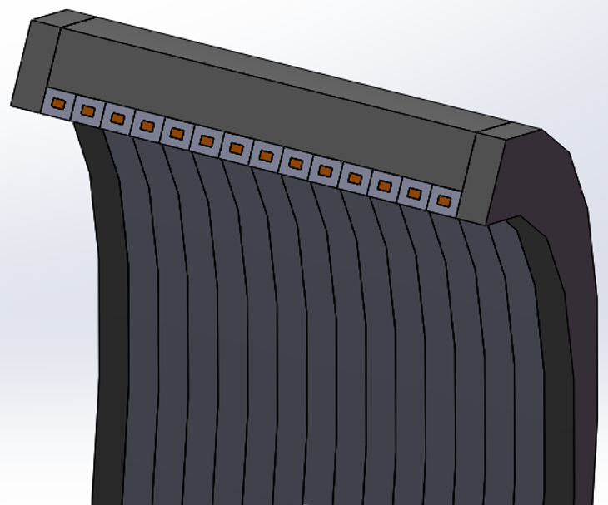
HTS plan R&D
Need to develop the Al stabilized HTS stack cable or other HTS cable.
Got fund (3 million yuan)from CAS to develop the cable and prototype coil.
3 years, from 2019.9 to 2022.9
2 years, from 2022.9 to 2024.9

Slide 16
Conclusion
New Yoke version has been designed
Low temperature cable is developing on time. Cooperation on large coil winding process is also done.
The prototype of cryogenic system is developing.
Gets funds for the prototype development of HTS plan, and is developing HTS cable.

