Slide 1
CEPC all connecting transport line design
Cui Xiaohao
Accelerator Physics Group
Institute of High Energy Physics
15 June, 2020

Slide 2
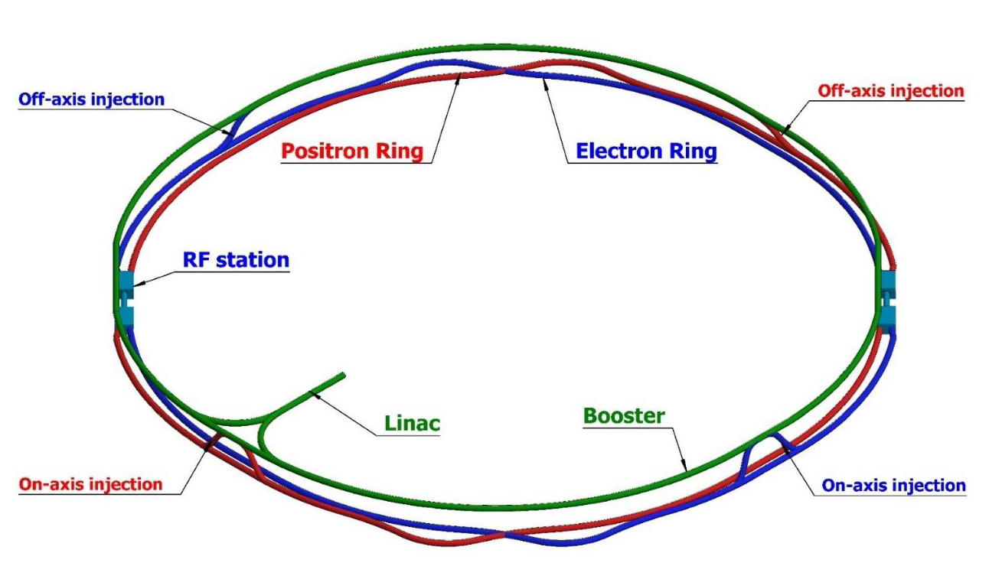
Introduction:
The CEPC is a circular e+e- collider with a 100-km circumference.
The collider will operate as a Higgs factor (240 GeV center-of-mass energy), and a W factory(160 GeV center-of-mass energy), and Z factory(91 GeV), and maybe tt.
It consists of a double-ring collider, a booster, and a linac.
There is a damping ring to reduce the emittance of the positron beam.
Transport lines are needed to connect these different part of CEPC.
120GeV
120GeV
100km
Damping ring
e+
e-
10-120GeV

Slide 3
Introduction:
1. Transport line from Linac to damping ring;
2. Transport line from Linac to booster ring;
3. Transport line from booster to collider ring: off-axis injection;
4. Transport line from booster to collider ring: on-axis injection;
5. Transport line from collider to dump.

Slide 4
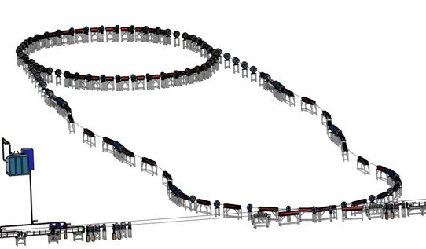
1. Linac to Damping Ring
Linac repetition: 100Hz
two-bunch in the damping ring
Energy: 1.1 GeV
Before damping ring, Energy spread of the beam should be reduced in order to match the RF acceptance of the damping ring.
After damping ring, Bunch of the beam should be reduced to control the energy spread after acceleration.

Slide 5
Energy/Bunch compression
 | EC
E₀ (Gev) | 1.1
δ₀ (%) | 0.6
σ_{z0} (mm) | 1.5
f_{RF} (MHz) | 2860
V_{RF} (MV) | 22.0
Length of acc. Structure (m) | 0.82
φ_{RF} (degree) | 89.7
R₅₆ (m) | -0.833
E_{f} (Gev) | 1.1
δ_{f} (%) | 0.18
σ_{zf} (mm) | 5
 | BC
E₀ (Gev) | 1.1
δ₀ (%) | 0.05
σ_{z0} (mm) | 7.5
f_{RF} (MHz) | 2860/1300
V_{RF} (MV) | 13.1/29
Length of acc. Structure (m) | 0.48/2.5
φ_{RF} (degree) | 89.6
R₅₆ (m) | -1.4
E_{f} (Gev) | 1.1
δ_{f} (%) | 0.54
σ_{zf} (mm) | 0.7

Slide 6
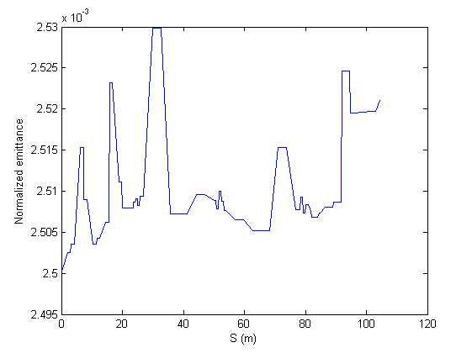
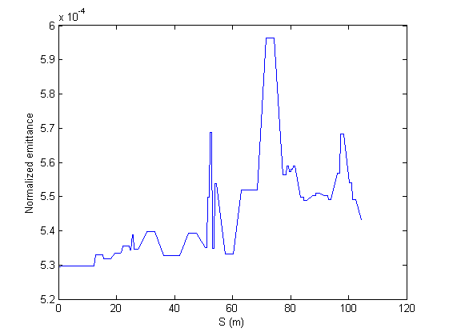
Emittance evolution
Linac → DR
DR → Linac
6

Slide 7
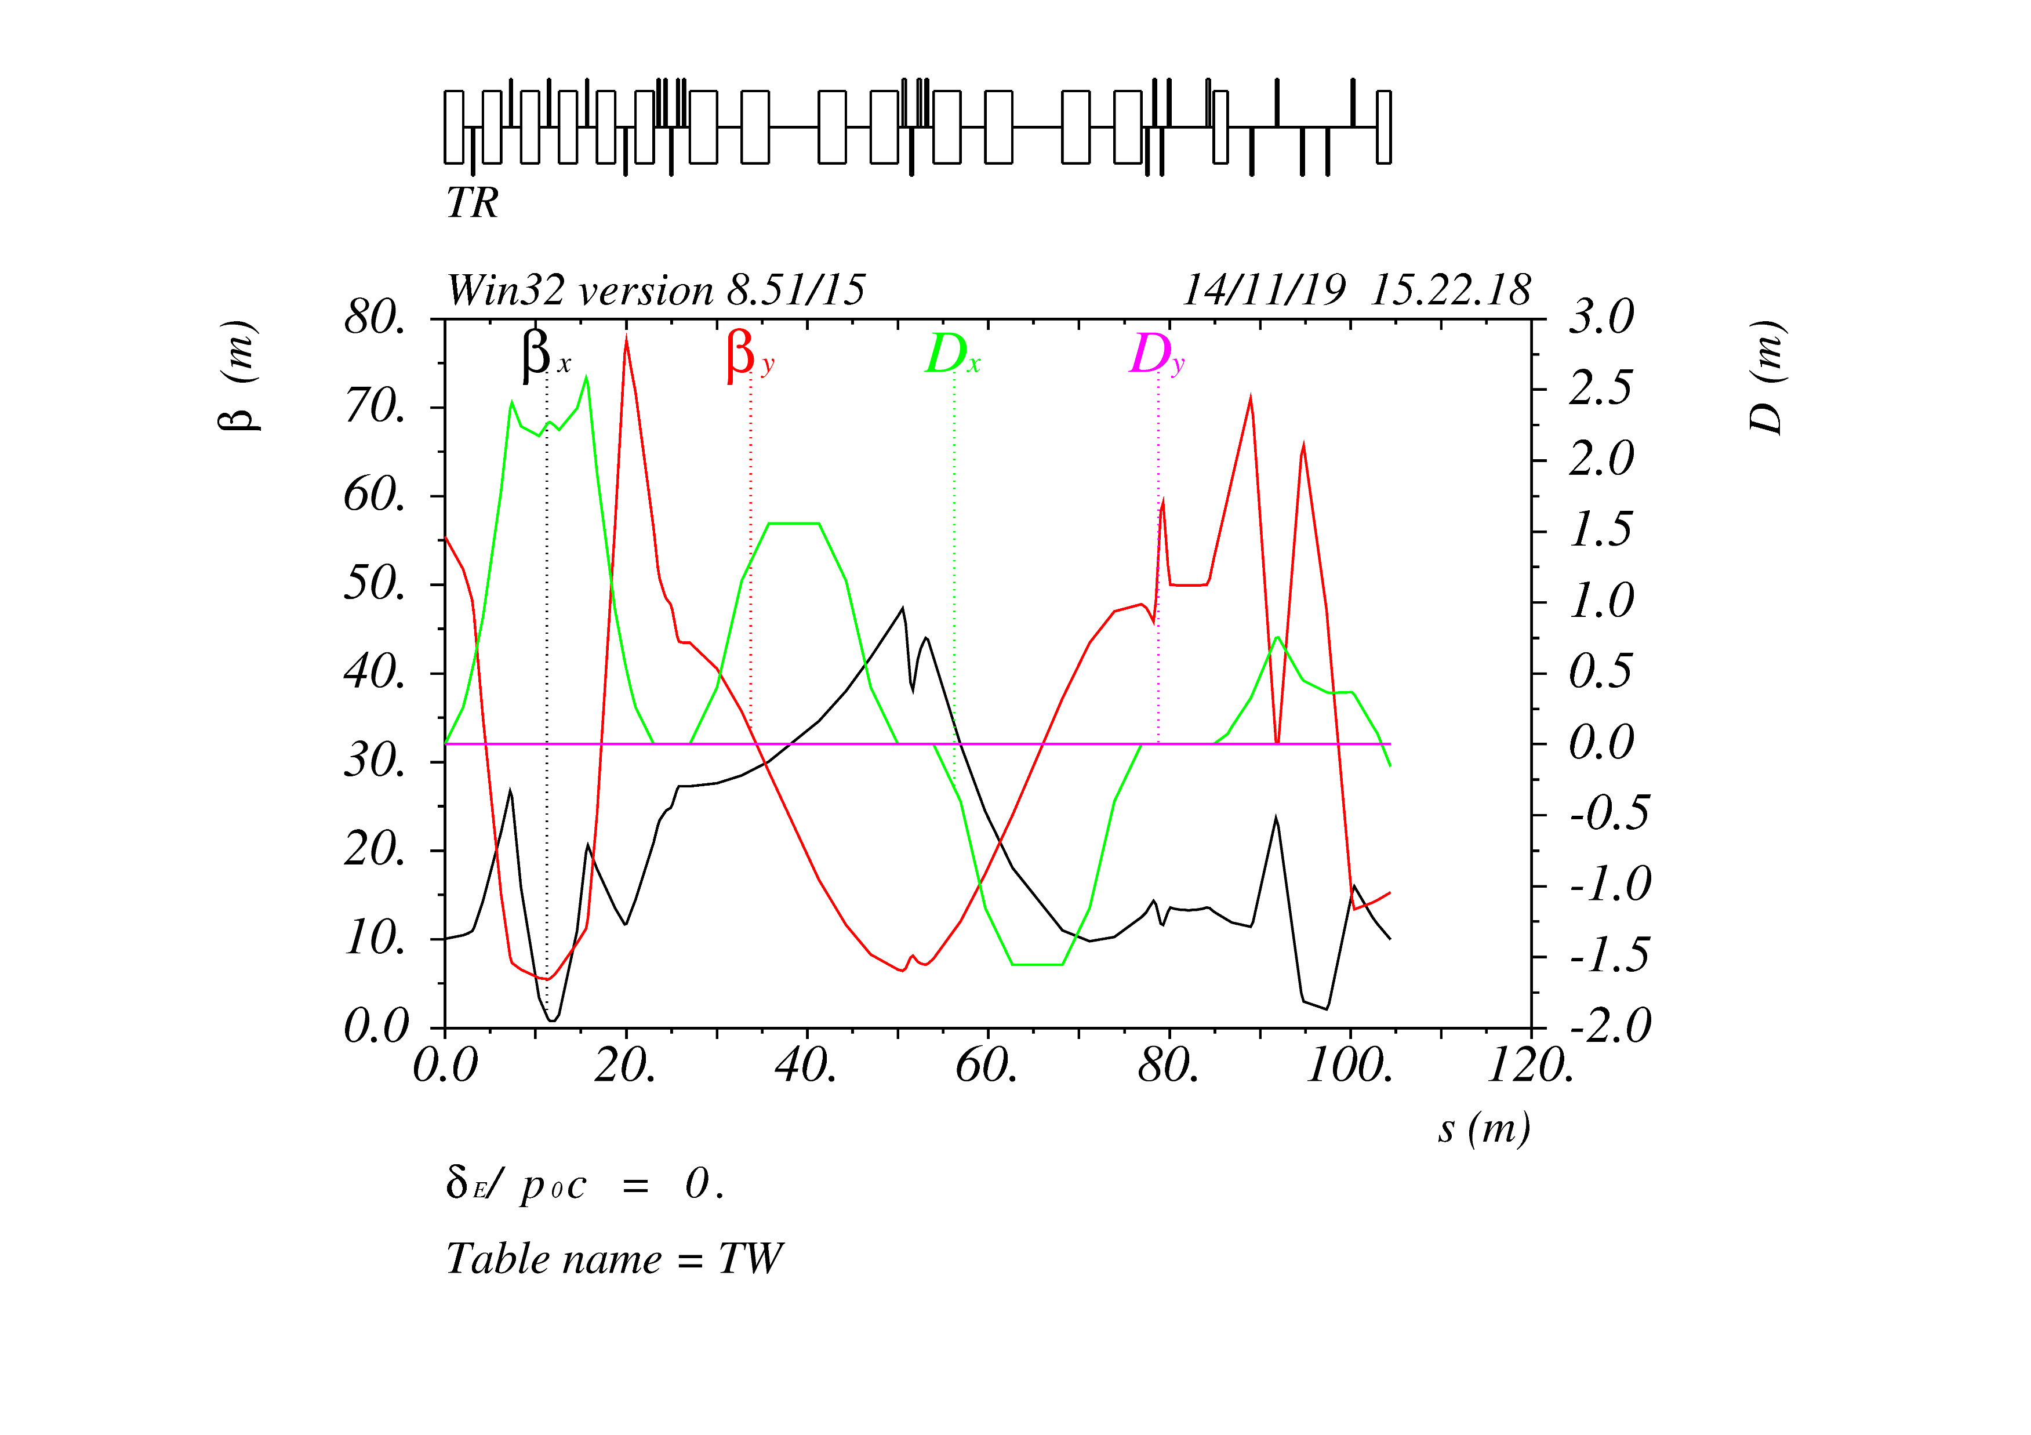
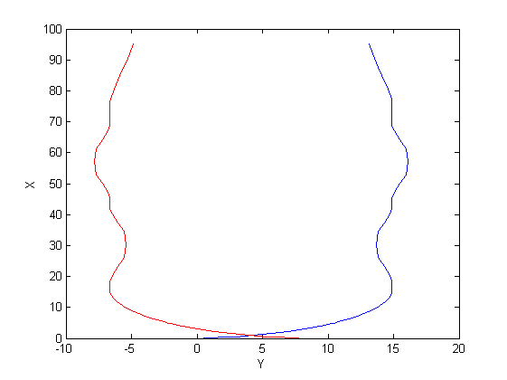
1. Linac to Damping Ring

Slide 8
2. Linac to Booster
Transport line
Linac
Linac
100 m
Separation
booster
Guiding the beam from Linac to the booster
Beam Energy: 10 GeV
horizontal bending section and one vertical bending section
Vertical bending section matches the 100m height
Vertical slope
Horizontal bending

Slide 9
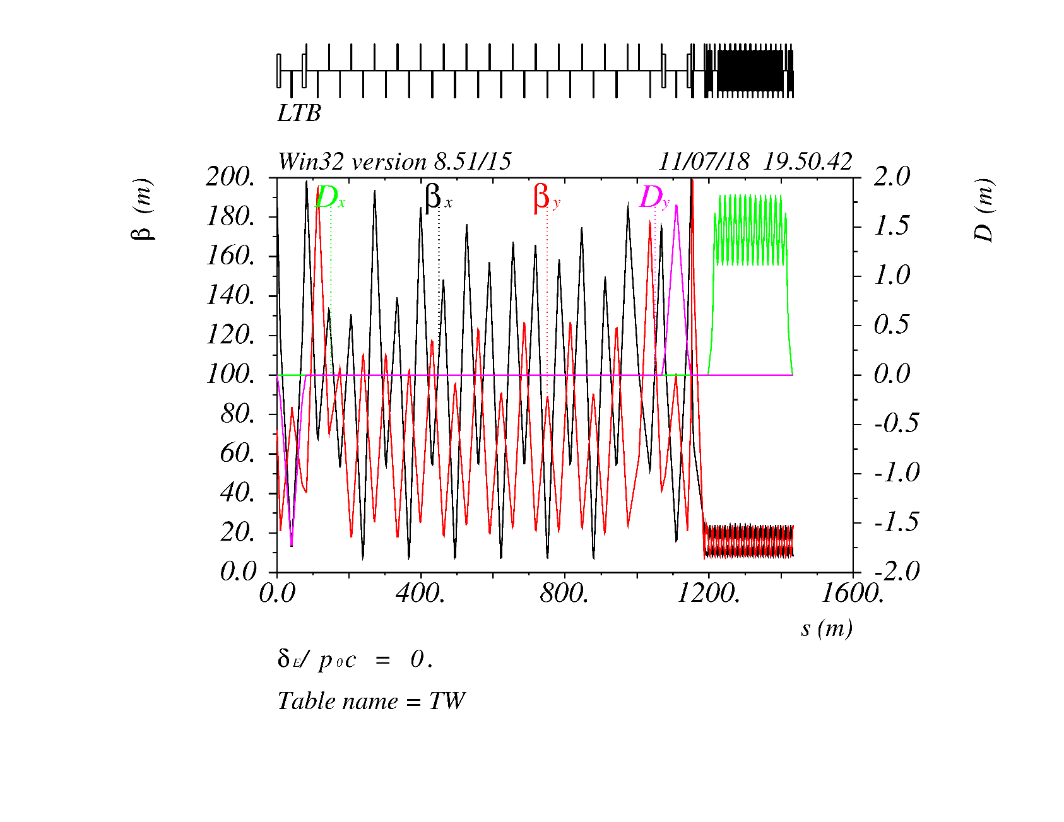
2. Linac to Booster

Slide 10
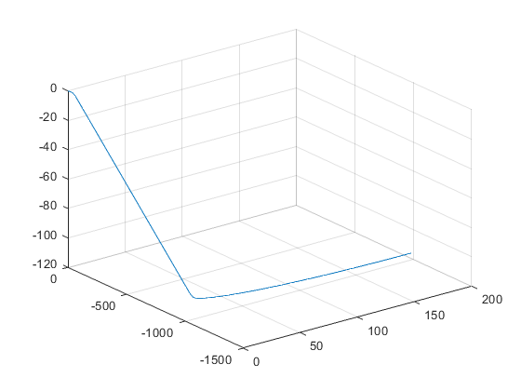
Transfer Line Survey

Slide 11
3. Booster to collider:off-axis
The booster and collider are in the same tunnel.
The booster is 2.4 m higher than the collider.
Consider the case of 45.5GeV, 80GeV, and 120 GeV.
Booster
Transport line
2.4 m
Collider

Slide 12
3. Booster to collider:off-axis
The booster and collider are in the same tunnel.
The booster is 2.4 m higher than the collider.
Consider the case of 45.5GeV, 80GeV, and 120 GeV.
Booster
Transport line
2.4 m
Collider

Slide 13
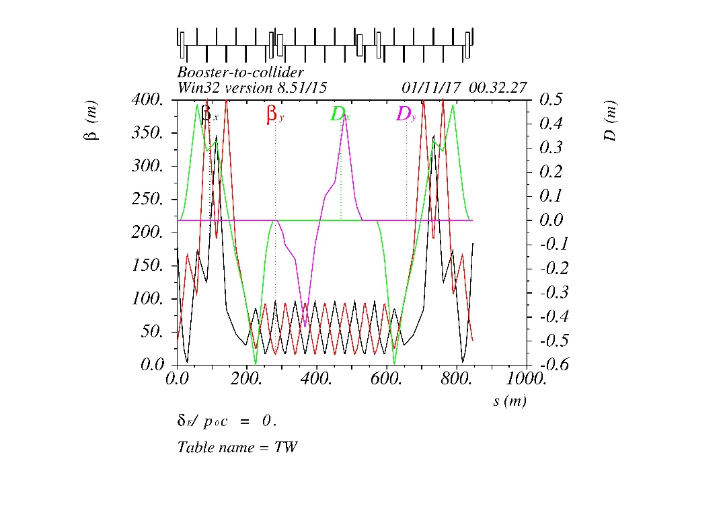
3. Booster to collider:off-axis

Slide 14
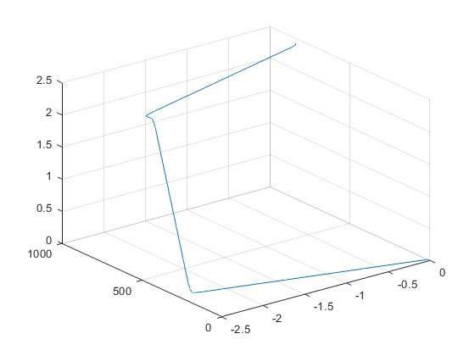
Transfer Line Survey

Slide 15
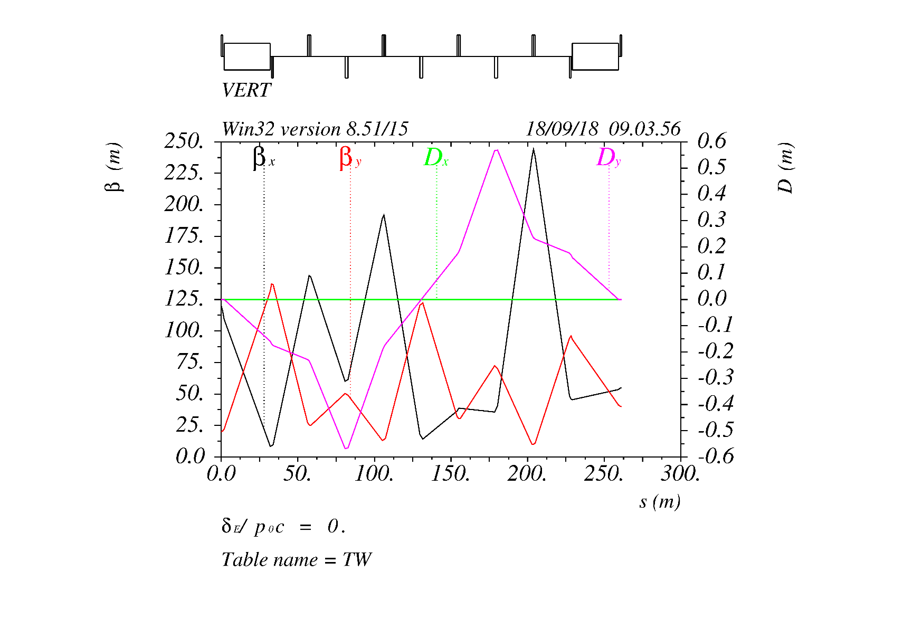
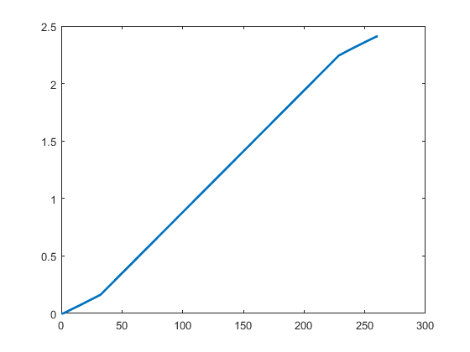
4. Booster to collider:on-axis

Slide 16
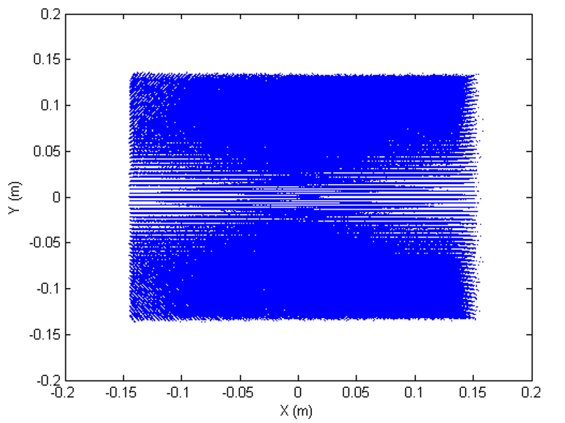
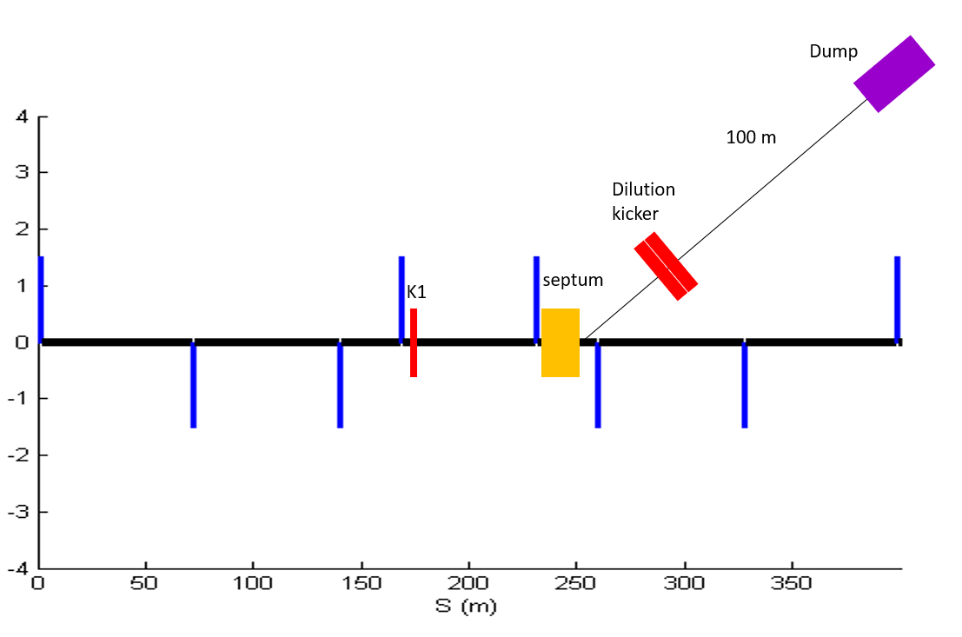
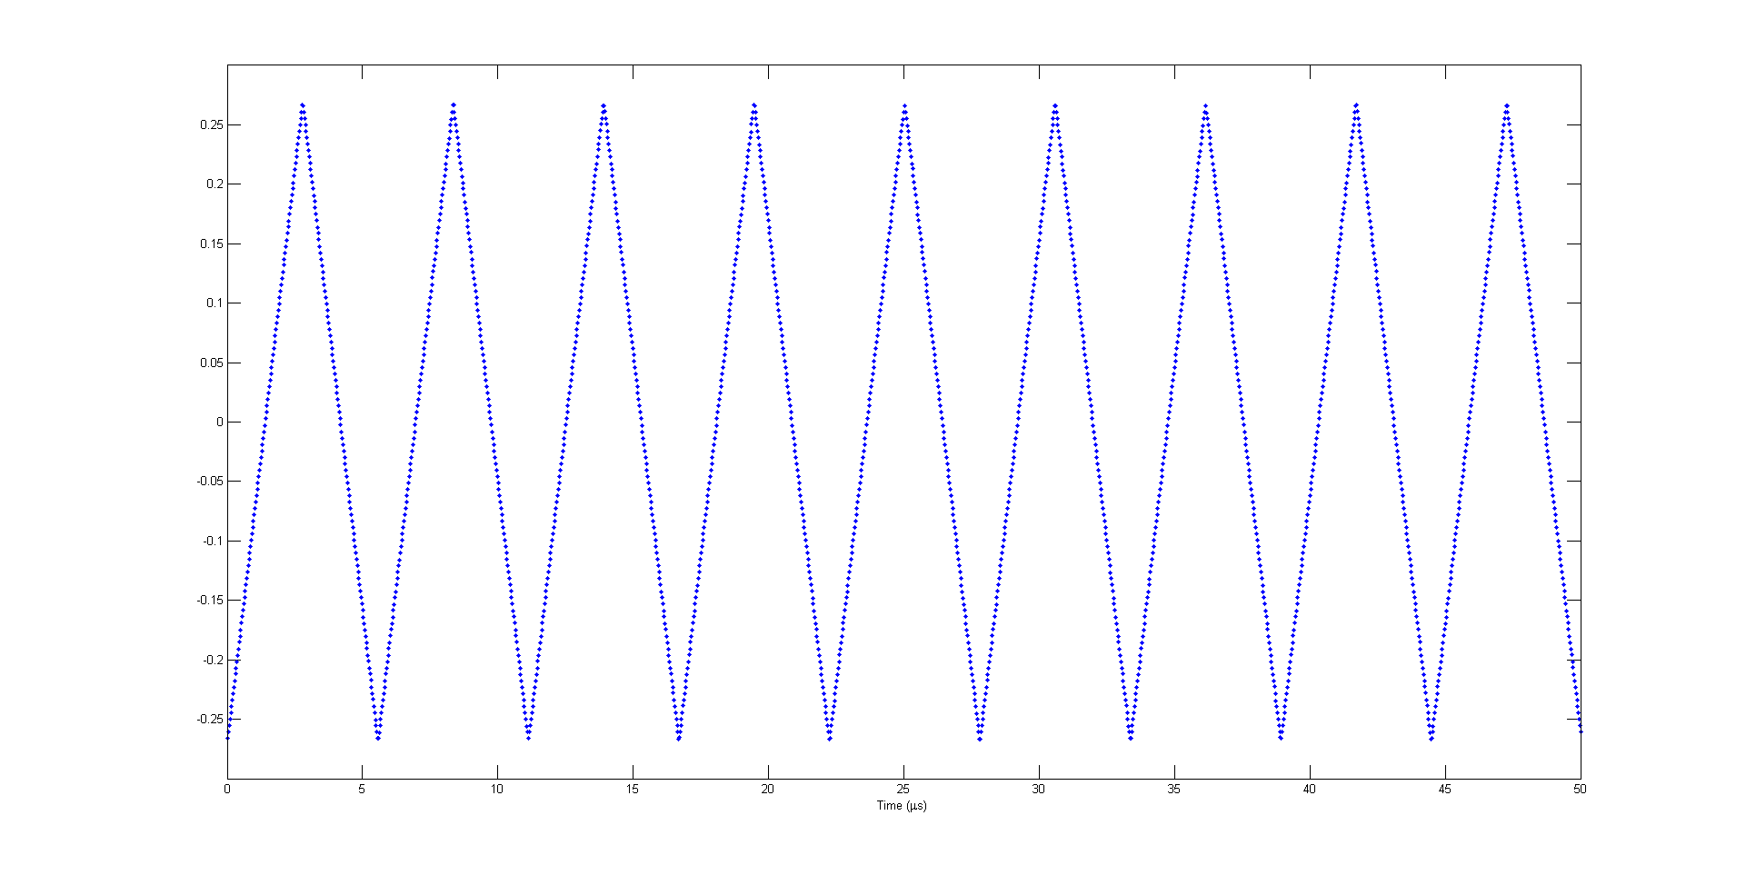
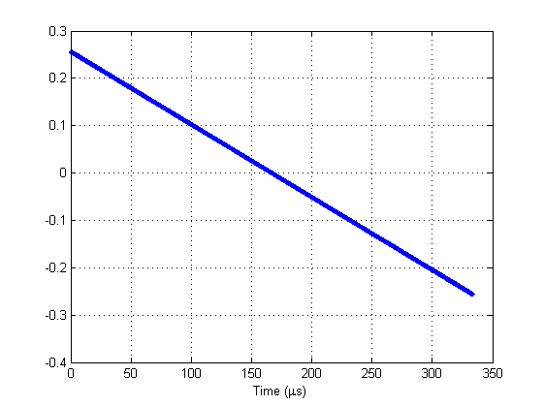
5. Collider to the dump
A set of kicker magnets has been used to dilute the beam horizontally and vertically
The Bunch distribution on the dump surface is first assumed to be 25cm x 25cm; Each bunch 2D-Gaussian: 𝜎_𝑥~3𝑚𝑚, 𝜎_𝑦~0.3𝑚𝑚
There will be some iterative simulation between AP, Magnet group, RP to finally fix the lattice design, dilution system, transfer tunnel length;

Slide 17
Thank You!

