Slide 1
CEPC ttbar parameter and booster parameters for high lum Z and ttbar option
Dou Wang
On behalf of CEPC AP group
CEPC day, IHEP, June 15th, 2020

Slide 2
outline
CEPC ttbar parameters and booster operation for ttbar
CEPC parameters and booster operation for high lum Z option

Slide 3
ttbar design principle
CEPC parameters and lattice design were optimized at Higgs.
Reduce energy to W and Z, the lattice is straightforward.
Higgs lattice is not compatible with ttbar.
FD SC quadrupoles will exceed maximum strength
BSC > beam pipe @Higgs
DA energy acceptance < requirement (beamstrahlung effect is stronger)
Critical energy of last dipole > 100kev (detector background & radiation protection)
need to redesign the lattice in IR
The location of all the magnets@Higgs must be fixed.
find out min βx*/βy* which fulfill the constraint for the FD quadrupole strength, BSC and DA acceptance
strength of all the dipoles@Higgs can not be modified

Slide 4
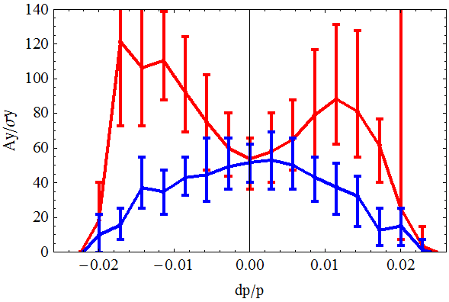
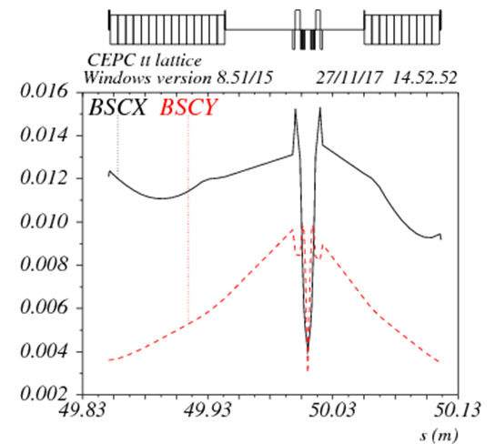
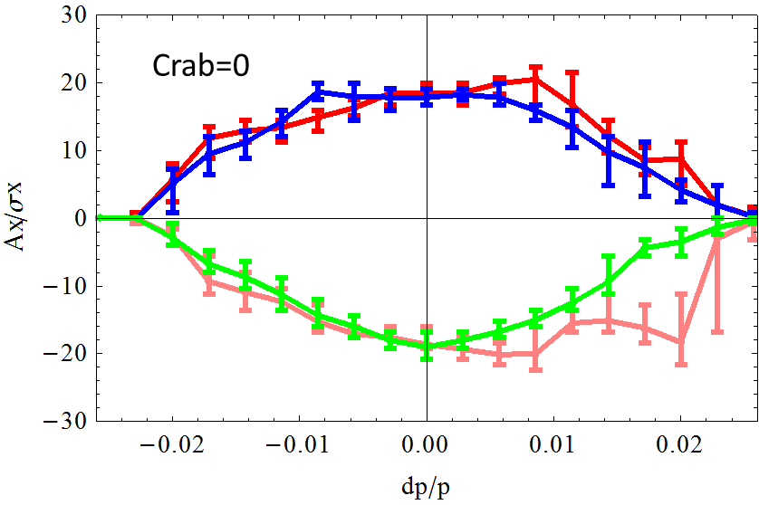
IR optics@ ttbar consistant w. CDR
D. Wang, Y. W. Wang, C. H. Yu
Add four normal quadrupoles and one attached quadrupoe for each side
BSC_x = ±(20σ_{x}+3mm)
BSC_y = ±(30σ_{y}+3mm) (coupling=1%)
DA optimization with 234 sextupole knobs
IP min beta function= 1.2m/3.7mm

Slide 5
CEPC tt parameter (180GeV)
 | tt (CDR)
Number of IPs | 2
Energy (GeV) | 180
Circumference (km) | 100
SR loss/turn (GeV) | 8.53
Half crossing angle (mrad) | 16.5
Piwinski angle | 0.9
N_{e}/bunch (10¹⁰) | 26.1
Bunch number | 28
Beam current (mA) | 3.52
SR power /beam (MW) | 30
Bending radius (km) | 10.9
Momentum compaction (10⁻⁵) | 11.4
β_{IP} x/y (m) | 1.2/0.0037
Emittance x/y (nm) | 2.4/0.0072
Transverse σ_{IP} (um) | 53.7/0.17
ξ_{x}/ξ_{y}/IP | 0.077/0.105
V_{RF} (GV) | 9.9
f _{RF} (MHz) (harmonic) | 650 (217500)
Nature bunch length σ_{z} (mm) | 2.59
Bunch length σ_{z} (mm) | 2.91
HOM power/cavity (kw) (5cell) | 0.55
Energy spread (%) | 0.16
Energy acceptance requirement (%) | 1.7
Energy acceptance by RF (%) | 2.6
Photon number due to beamstrahlung | 0.15
Lifetime due to beamstrahlung (min) | 59
Lifetime (min) | 40
F (hour glass) | 0.88
L_{max}/IP (10³⁴cm⁻²s⁻¹) | 0.34
Residual issue for ttbar operation
Ec of IP upstream
47keV →147keV

Slide 6
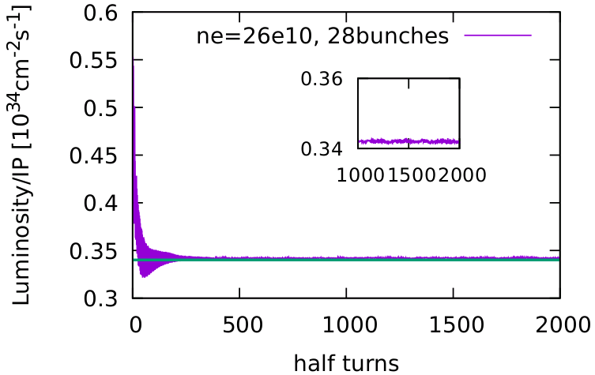
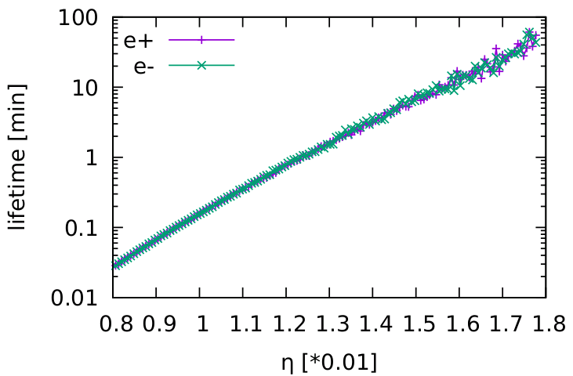
Beam-beam simulations
Y. Zhang
Beam-beam simulations agree well with the analytical estimation.
DA bandwidth requirement by simulation: > 1.7%

Slide 7
Booster parameter @injection
 |  | tt | H | W | Z
Beam energy | GeV | 10
Bunch number |  | 28 | 242 | 1524 | 6000
Threshold of single bunch current | μA | 25.7
Threshold of beam current (limited by coupled bunch instability) | mA | 100
Bunch charge | nC | 1.39 | 0.78 | 0.63 | 0.45
Single bunch current | μA | 4.2 | 2.3 | 1.8 | 1.3
Beam current | mA | 0.12 | 0.57 | 2.86 | 7.51
Energy spread | % | 0.0078
Synchrotron radiation loss/turn | keV | 73.5
Momentum compaction factor | 10⁻⁵ | 2.44
Emittance | nm | 0.025
Natural chromaticity | H/V | -336/-333
RF voltage | MV | 193 | 101 | 62.7
Betatron tune ν_{x}/ν_{y}/ν_{s} |  | 263.18/261.28/0.18 | 263.18/261.28/0.13 | 263.18/261.28/0.1
RF energy acceptance | % | 3.4 | 2.5 | 1.9
Damping time | s | 90.7
Bunch length of linac beam | mm | 1.0
Energy spread of linac beam | % | 0.16
Emittance of linac beam | nm | 40

Slide 8
Booster parameter @extraction
 |  | tt |  | H |  | W | Z
 |  | Off axis injection | On axis injection | Off axis injection | On axis injection | Off axis injection | Off axis injection
Beam energy | GeV | 180 |  | 120 |  | 80 | 45.5
Bunch number |  | 28 | 27+1 | 242 | 235+7 | 1524 | 6000
Maximum bunch charge | nC | 1.25 | 43 | 0.72 | 24.0 | 0.58 | 0.41
Maximum single bunch current | μA | 3.8 | 131 | 2.1 | 70 | 1.7 | 1.2
Threshold of single bunch current | μA | 730 |  | 300
Threshold of beam current (limited by RF power) | mA | 0.5 |  | 1.0 |  | 4.0 | 10.0
Beam current | mA | 0.11 | 0.23 | 0.52 | 1.0 | 2.63 | 6.91
Injection duration for top-up (Both beams) | s | 31.5 | 35 | 25.8 | 35.4 | 45.8 | 275.2
Injection interval for top-up | s | 73 |  | 47.0 |  | 153.0 | 504.0 | 274.1
Current decay during injection interval |  | 3%
Energy spread | % | 0.14 |  | 0.094 |  | 0.062 | 0.036
Synchrotron radiation loss/turn | GeV | 7.7 |  | 1.52 |  | 0.3 | 0.032
Momentum compaction factor | 10⁻⁵ | 2.44
Emittance | nm | 8.0 |  | 3.57 |  | 1.59 | 0.51
Natural chromaticity | H/V | -336/-333
Betatron tune ν_{x}/ν_{y} |  | 263.18/261.28
RF voltage | GV | 8.5 |  | 1.97 |  | 0.585 | 0.287
Longitudinal tune |  | 0.18 |  | 0.13 |  | 0.10 | 0.10
RF energy acceptance | % | 0.85 |  | 1.0 |  | 1.2 | 1.8
Damping time | ms | 15.5 |  | 52 |  | 177 | 963
Natural bunch length | mm | 3.0 |  | 2.8 |  | 2.4 | 1.3
Injection duration from empty ring | h | 0.15 |  | 0.17 |  | 0.25 | 2.2

Slide 9
Beam transfer efficiency
Beam loss budget
Booster: 3% beam loss due to quantum lifetime
Booster: 5% beam loss during ramping process
Transport line (Linac→booster): 1% beam loss
Transport line (booster→collider): 1% beam loss
Transfer efficiency
Booster transfer efficiency: > 92%
Total transfer efficiency: > 90% (99%*92%*99%)

Slide 10
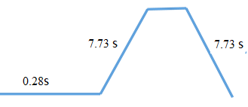
CEPC booster inj/ext time structure
ttbar
1 cycle
electron
positron
Injection from Linac to booster: 0.28s
Ramp up @booster: 7.73s
Ramp down @booster: 7.73s
Injection time (two beam)@ttbar: 1cycle=15.7s×2=31.5s

Slide 11
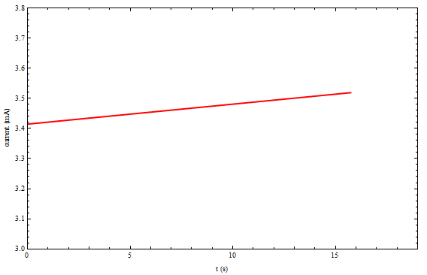
Current evolution for ttbar
Top up → one injection (31.5s) every 73s
Beamstrahlung lifetime + Bhabha lifetime → 40 min

Slide 12
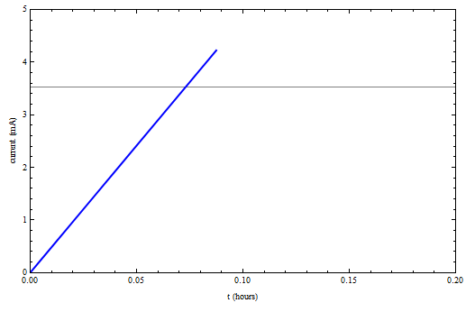
Current evolution for ttbar
Threshold of beam current (limited by RF power): 0.5mA
Full injection → 9 min
Touchek lifetime→ 7000 hours

Slide 13
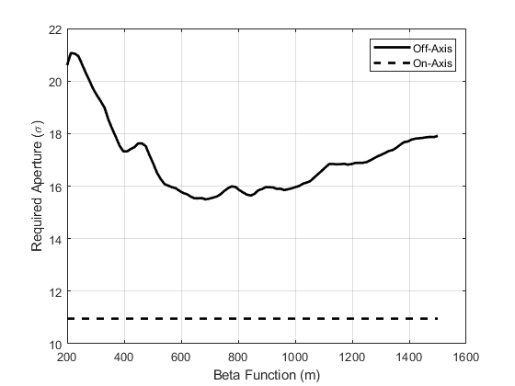
DA requirement of Collider @tt
DA of collider: 17σx×50 σy ×2.3% (w/o errors)
Minimum DA requirement of collider for off-axis injection: 15.2σx
It’s better to keep two kinds of injection: off-axis & on-axis
X. H. Cui

Slide 14
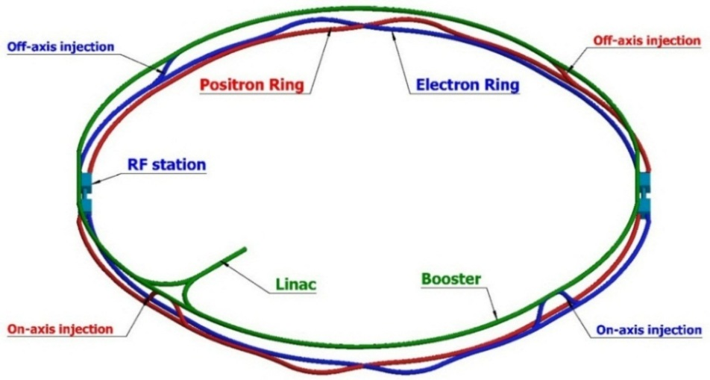
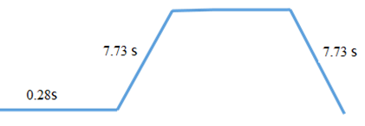
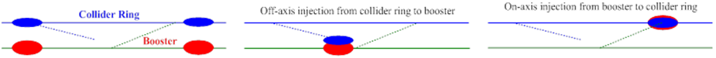
Injection scheme@ tt
Off-axis injection with horizontal bump for collider
On-axis injection in vertical plane with vertical local bump for booster
- top up injection: 31.5s
- top up injection: 35s
tt on-axis injection
tt off-axis injection
15.5ms*4*28=1.7s
4 damping time

Slide 15
Inj./ext. requirement for ttbar
D. Wang, X. H. Cui, J. H. Chen
Bunches in booster for tt is less than Higgs
Kicker technical difficulty depends on the bunch structure of Z mode. (Kicker speed for rise up=25ns)
Higher energy (180GeV) can be realized by stronger kickers/septa or longer kickers/septa (enough space)
Inj./ext. hardware is not a issue for ttbar.
 | inj | ext(off-axis) | inj/ext (on-axis)
Energy（GeV） | 10 | 180 | 180
Bunch number | 28 (half ring) | 28 (half ring) | 1 (half ring)
Bunch seperation（us） | 5.9 | 5.9 | 5.9
Inj/ext scheme | Bunch by bunch | Bunch by bunch | Bunch by bunch
Kicker repetition (Hz) | 100 | 1000 | 1000
Kicker pulse duration (us) | <11.8 | <11.8 | <11.8
Kicker speed for rise up (us) | <5.9 | <5.9 | <5.9
Timing delay (us) | <5.9 | <5.9 | <5.9
Inj/ext duration (s) | 0.28 | 0.028 | 0.001
Kicker angle (mrad) | 0.11 | 0.2 | 0.1
Kicker integrated strength (T.m) | 0.004 | 0.12 | 0.06

Slide 16
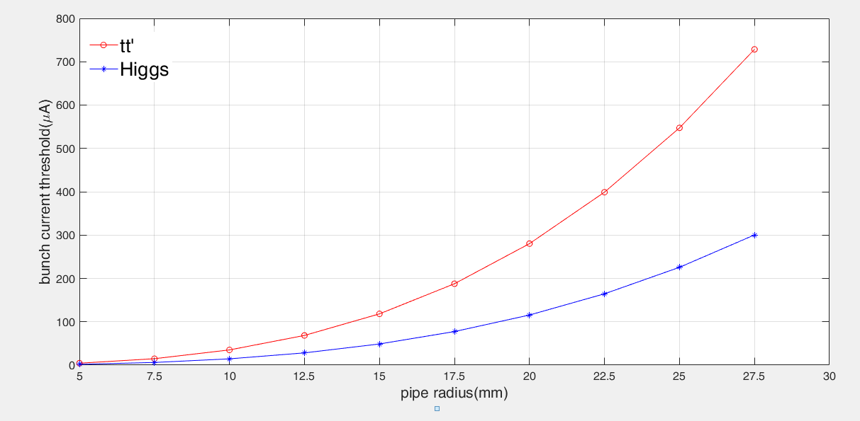
Threshold of single bunch current (TMCI) for booster
25.7uA (10GeV), 300 uA (120GeV), 730uA (180GeV)
Maximum single bunch current: 131uA → on axis injection for collider ring
Y. D. Liu

Slide 17
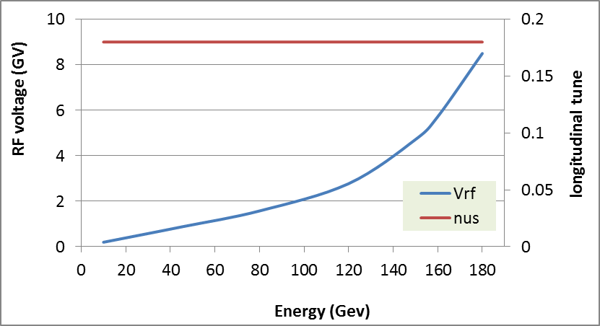
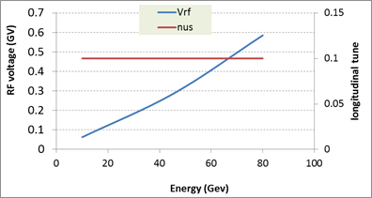
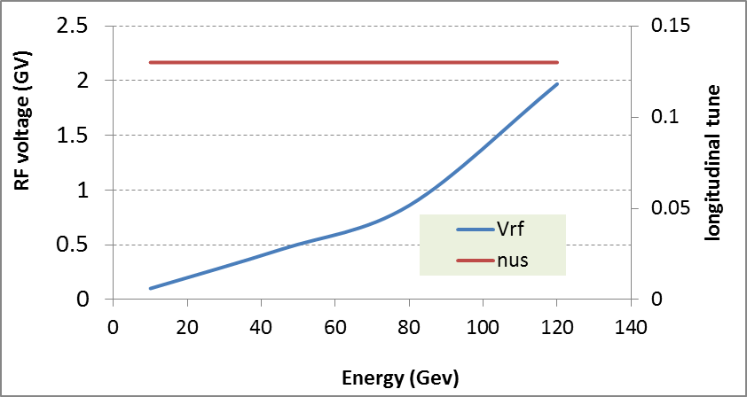
RF ramping curve
Different RF ramping curve for each energy mode
νs for tt: 0.18
νs for Higgs: 0.13
νs for W & Z: 0.1
tt
Max RF voltage @tt determined by longitudinal quantum lifetime.
η_{RF}: ~ 6 ×δ
VRF (180GeV)=8.5GV
Higgs
W &Z

Slide 18
Analytical estimation for beam evolution
Positron emittance was reduced thanks to damping ring.
emit_x
emit_y
Emittance @injection = 40nm
Bunch length @injection = 1mm
Energy spread @injection = 0.16%
Ramping time @ tt:7.7s

Slide 19
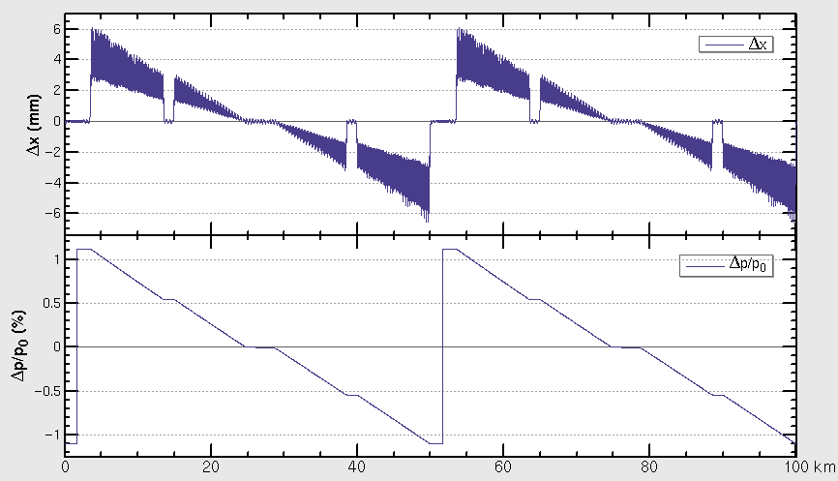
Sawtooth effect @180GeV
2 RF stations
Maximum sawtooth orbit: 6 mm
Energy deviation: 1.1%
Emittance growth: ~3.6%
Study of orbit correction with errors is going on.
D. Wang, D. H. Ji

Slide 20
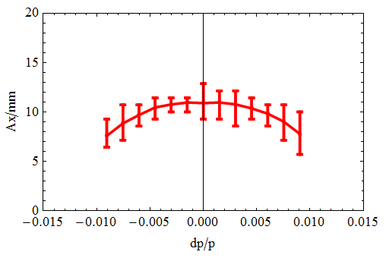
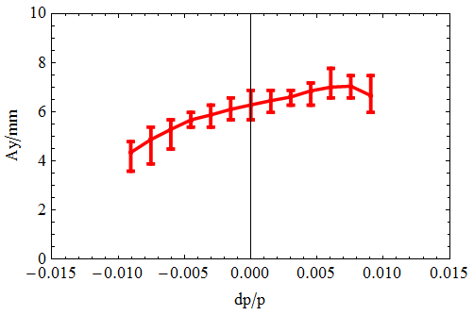
Booster DA w sawtooth effect @tt
sawtooth orbit was considered
DA tracking w/o errors (50 seeds, 100 turns)
DA > requirement (BSC)
Need careful error study
- BSCX=4σx+3mm=7.7mm
- BSCY=4σx+3mm=3.3mm

Slide 21
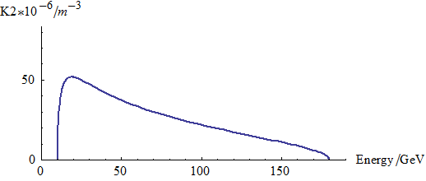
Eddy current effect
D. Wang, Y. Chen, Wen Kang
Dedicated ramping curve to control the maximum K2.
Analytical study was done – deeper understanding about eddy current
New formula created → agree with simu.
Dipole w core → multipole field
Dipole w/o core → No multipole field
*
K2 reaches max at 20GeV.
Max K2=0.000052 (m⁻³)
* Yuan Chen, et al., https://arxiv.org/abs/1910.09781

Slide 22
Correction to eddy current effect
Chromaticity distortion is corrected by 2 sext. families during ramping.
Small DA reduction @ 20GeV with dynamic chromaticity correction

Slide 23
design parameters of booster dipole magnets
W. Kang
 | Iron Yoke | CT
Max. field [Gs]@180GeV | 510 | 510
Max. field [Gs]@120GeV | 338 | 338
Min. field [Gs]@10GeV | 28 | 28
Good field region (mm) | 55 | 55
Field uniformity | 0.1% | 0.1%
Coil turns of magnet | 4 | 6
Max.current (A)@180GeV | 646 | 1765
Max.current (A)@120GeV | 428 | 1160
Min.current (A)@10GeV | 37 | 96
Max.current density(A/mm²) | 0.65 | 0.9
Max. power loss (W)@180GeV | 546 | 2935
Max. power loss (W)@120GeV | 245 | 1272
Avg. power loss (W)@10-180GeV | 224 | 1205
Inductance (mH) | 0.32 | 0.36
Magnet size（mm） | 330 | 350
Magnet length (mm) | 4650 | 5100
Magnet weight (ton) | 1.4 | 1.5

Slide 24
Booster PS parameters @tt(180GeV)
B. Chen
H 120GeV
 | Cable loss 120GeV(MW) | Magnet power 120GeV(MW) | PS loss 120GeV(MW)
Dipole | 3.2547 | 6.4657 | 1.0800
Quadrupole | 2.5977 | 12.2638 | 1.6513
Sextupole | 1.1712 | 0.2710 | 0.1602
Corrector | 0.1133 | 0.0088 | 0.0136
Max. power | 7.1369 | 19.0093 | 2.9051 | 29.05
Avg. power | 2.8547 | 7.6037 | 1.1621 | 11.62
tt 180GeV
 | Cable loss 180GeV(MW) | Magnet power 180GeV(MW) | PS loss 180GeV(MW)
Dipole | 7.3230 | 14.8712 | 2.4660
Quadrupole | 5.8447 | 28.2066 | 3.7835
Sextupole | 2.6352 | 0.6234 | 0.3621
Corrector | 0.1133 | 0.0088 | 0.0136
Max. power | 15.9163 | 43.7100 | 6.6251 | 66.25
Avg. power | 6.3665 | 17.4840 | 2.6501 | 26.50
    In 180GeV operation, the average loss power of booster magnet power supply is 26.50MW, which is increased by about 128% compared with 120GeV and 7.2% compared with 175GeV
    The structural design of the power supply will consider the demand of power expansion in future
    Power supply adopts modular design
    Series-parallel connection technology of modular will be used to realize the demand of power expansion

Slide 25
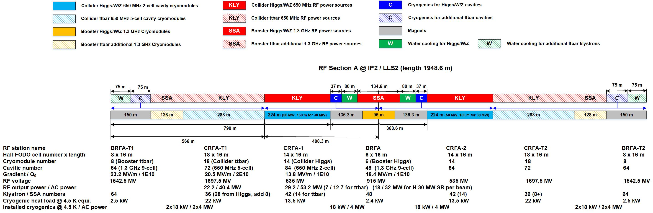
CEPC RF Section Layout
J. Y. Zhai
Space for additional cavities of ttbar has been reserved both for collider and booster.
collider
collider
booster
booster

Slide 26
CEPC high luminosity Z (2T)
 | CEPC-CDR | CEPC-30MW | CEPC-39MW
Number of IPs | 2 | 2 | 2
Energy (GeV) | 45.5 | 45.5 | 45.5
Circumference (km) | 100 | 100 | 100
SR loss/turn (GeV) | 0.036 | 0.036 | 0.036
Half crossing angle (mrad) | 16.5 | 16.5 | 16.5
Piwinski angle | 23.8 | 27.9 | 33.0
N_{e}/bunch (10¹⁰) | 8.0 | 12.0 | 15.0
Bunch number | 12000 | 14564 (20.6ns+10%gap) | 15000
Beam current (mA) | 461 | 839.9 | 1081.4
SR power /beam (MW) | 16.5 | 30 | 38.6
Bending radius (km) | 10.7 | 10.7 | 10.7
Momentum compaction (10⁻⁵) | 1.11 | 1.11 | 1.11
β_{IP} x/y (m) | 0.2/0.001 | 0.2/0.001 | 0.2/0.001
Emittance x/y (nm) | 0.18/0.0016 | 0.18/0.0016 | 0.18/0.0016
Transverse σ_{IP} (um) | 6.0/0.04 | 6.0/0.04 | 6.0/0.04
ξ_{x}/ξ_{y}/IP | 0.004/0.079 | 0.004/0.093 | 0.004/0.098
V_{RF} (GV) | 0.1 | 0.10 | 0.10
f _{RF} (MHz) (harmonic) | 650 | 650 | 650
Nature bunch length σ_{z} (mm) | 2.42 | 2.42 | 2.42
Bunch length σ_{z} (mm) | 8.5 | 10.0 | 11.8
HOM power/cavity (kw) | 1.94 (2cell) | 2.29 (1cell) | 3.15 (1cell)
Energy spread (%) | 0.08 | 0.1 | 0.115
Energy acceptance (DA) (%) | 1.5 | 1.5 | 1.5
Energy acceptance by RF (%) | 1.7 | 1.7 | 1.7
Lifetime (hour) | 2.5 | 2.0 | 1.8
L_{max}/IP (10³⁴cm⁻²s⁻¹) | 32.1 | 74.5 | 101.6

Slide 27
Lifetime for Z mode
Bhabha lifetime
- cross section @Z: 1.4×10⁻²⁵ cm²
η=1.1% | CEPC-CDR | CEPC-39MW
τ_{BB} (h) | 2.75 | 2.18
Touchek lifetime
 | CEPC-CDR | CEPC-39MW
τ_{TC} (h) | 33 | 24
Beamstrahlung lifetime
η=1.1% | CEPC-CDR | CEPC-39MW
τ_{BS} (h) | 9.3E5 | 79

Slide 28
Booster parameter @injection
 |  | Z(3T/2T_CDR) | Z(2T_39MW)
Beam energy | GeV | 10
Bunch number |  | 6000 | 7500
Threshold of single bunch current | μA | 25.7
Threshold of beam current (limited by coupled bunch instability) | mA | 100
Bunch charge | nC | 0.45 | 0.84
Single bunch current | μA | 1.3 | 2.44
Beam current | mA | 7.51 | 17.6
Energy spread | % | 0.0078
Synchrotron radiation loss/turn | keV | 73.5
Momentum compaction factor | 10⁻⁵ | 2.44
Emittance | nm | 0.025
Natural chromaticity | H/V | -336/-333
RF voltage | MV | 62.7
Betatron tune ν_{x}/ν_{y}/ν_{s} |  | 263.18/261.28/0.1
RF energy acceptance | % | 1.9
Damping time | s | 90.7
Bunch length of linac beam | mm | 1.0
Energy spread of linac beam | % | 0.16
Emittance of linac beam | nm | 40

Slide 29
Booster parameter @extraction
 |  | Z(3T_CDR) | Z(2T_CDR) | Z(2T_39MW)
Beam energy | GeV | 45.5
Bunch number |  | 6000 |  | 7500
Maximum bunch charge | nC | 0.41 |  | 0.76
Maximum single bunch current | μA | 1.2 |  | 2.85
Threshold of single bunch current | μA | ⁄
Threshold of beam current (limited by RF power) | mA | 10.0 |  | ?
Beam current | mA | 6.91 |  | 16.2
Injection duration for top-up (Both beams) | s | 275.2 |  | ?
Injection interval for top-up | s | 504.0 | 274.1 | 197.3
Current decay during injection interval |  | 3%
Energy spread | % | 0.036
Synchrotron radiation loss/turn | GeV | 0.032
Momentum compaction factor | 10⁻⁵ | 2.44
Emittance | nm | 0.51
Natural chromaticity | H/V | -336/-333
Betatron tune ν_{x}/ν_{y} |  | 263.18/261.28
RF voltage | GV | 0.287
Longitudinal tune |  | 0.10
RF energy acceptance | % | 1.8
Damping time | ms | 963
Natural bunch length | mm | 1.3
Injection duration from empty ring | h | 2.2 |  | ?

Slide 30
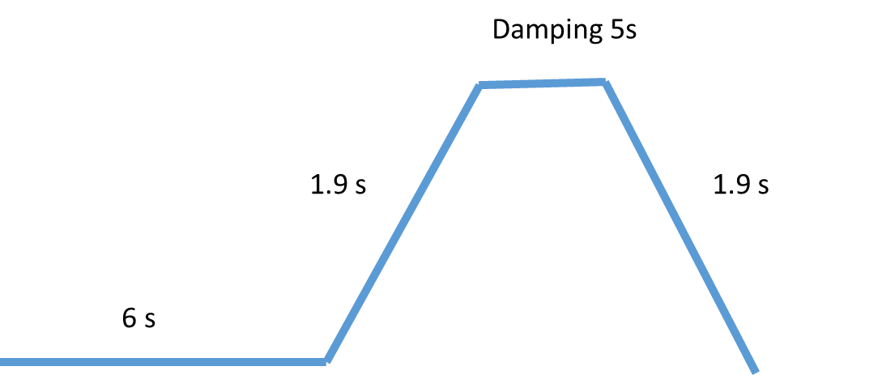
Top up injection for Z(2T_39MW)
Z
75 s
75 s
2 cycles
Interval requirement for top up injection: 197.3s
Top up injection time for two beam: (75s+1.9s+5s+1.9s)×4=335.2s
Injection time is dominated by the injection from Linac to booster.
Injection speed of Linac needs to be improved.
e.g., Linac speed×2, (37.5s+1.9s+5s+1.9s)×4=185.2s
Kicker rise speed in damping ring (4 bunches in damping ring)

Slide 31
Full injection for Z(2T_39MW)
With CDR Linac design, The saturated current: ~ 650mA
If Linac speed ×2, the injection from empty ring take ~ 5 h.
Two bunches/pulse
Repetition: 200Hz
CDR Linac
faster Linac (×2)

Slide 32
Booster max current limited by RF
J. Y. Zhai
For CDR, the max beam current is limited by input RF power.
- H: 1mA, W: 4mA, Z: 10mA
For high lum. Z, the max beam current is limited by RF HOM power.
Bunch charge: 0.45nC → 0.84nC
Total current: 7.5mA → 17.6mA
Duty ratio: ×2
RF HOM power: 5W → 45W
16 cavities for Z operation need to be upgraded.

Slide 33
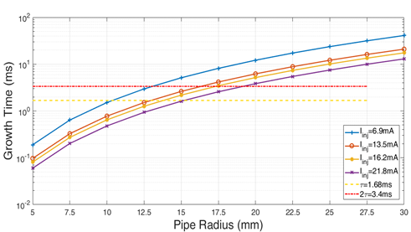
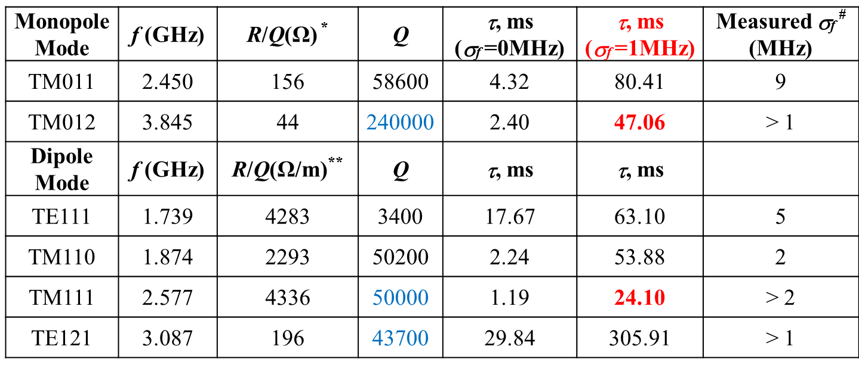
Multi-bunch instability for Z(2T_39MW)
Growth time due to resistive wall (16mA): ~15ms
10GeV
Y. D. Liu
Growth time due to RF HOMs
Transverse: 24.1 ms (include frequency spread)
Longitudinal: 47 ms (include frequency spread)
J. Zhai, H. Zheng
Requirement to feedback system
transverse: 3.3ms (10 turns)
Longitudinal: 47ms (141 turns)
Update to feedback system
- One more longitudinal feedback
J. H. Yue

Slide 34
Inj./ext. requirement for Z(2T_39MW)
D. Wang, X. H. Cui, J. H. Chen
No modification for extraction kickers of booster
Requirements to injection kickers (10GeV) need to be updated
Time of rising up: 25ns → 20ns
Kicker repetition: 100Hz → 200Hz
trivial changement for the hardware
 | inj(2T_CDR) | inj(2T_39MW) | ext(2T_CDR) | ext(2T_39MW)
Energy（GeV） | 10 | 10 | 45.5 | 45.5
Bunch number | 6000 | 7500 | 6000 | 7500
Bunch separation（ns） | 25 | 20 | 25 | 20
Inj/ext scheme | Bunch by bunch | Bunch by bunch | Train by train | Train by train
Bunch number/train | 80 | 100 | 80 | 100
Train number | 75 | 75 | 75 | 75
Train separation（us） | 2.46 | 2.46 | 2.46 | 2.46
Kicker repetition (Hz) | 100 | 200 | 1000 | 1000
Kicker pulse duration (us) | <0.05 | <0.04 | <6.9 | <6.9
Kicker flat top（us） |  |  | 1.98 | 1.98
Kicker speed for rise up (ns) | 25 | 20 | <2460 | <2460
Timing delay (us) | <2.46 | <2.46 | <4.4 | <4.4
Injection time (s) | 60 | 37.5 | 0.075 | 0.075
Kicker angle (mrad) | 0.11 | 0.11 | 0.2 | 0.2
Kicker integrated strength (T.m) | 0.004 | 0.004 | 0.03 | 0.03

Slide 35
Summary
Both ttbar parameter and high lum. Z parameter is proposed with the support of real lattice design.
- Luminosity @tt: 3.4×10³³cm⁻²s⁻¹
- Luminosity @Z: 1.0×10³⁶cm⁻²s⁻¹
Booster physics design and according hardware systems for ttbar operation is checked to make sure it can support tt energy mode.
Strong SR effect (180GeV) to beam dynamics
Efficient and low-cost correction scheme
Booster physics design and according hardware systems for high lum. Z option is checked to make sure the injection system can support high luminosity goal.
Injection speed of Linac needs to be improved (double bunches/ double repetition).
RF cavities for Z on booster need to be upgraded.

Slide 36
Back up

Slide 37
CEPC CDR Parameters
 | Higgs | W | Z（3T） | Z（2T）
Number of IPs | 2
Beam energy (GeV) | 120 | 80 | 45.5
Circumference (km) | 100
Synchrotron radiation loss/turn (GeV) | 1.73 | 0.34 | 0.036
Crossing angle at IP (mrad) | 16.5×2
Piwinski angle | 3.48 | 7.0 | 23.8
Number of particles/bunch N_{e} (10¹⁰) | 15.0 | 12.0 | 8.0
Bunch number (bunch spacing) | 242 (0.68μs) | 1524 (0.21μs) | 12000 (25ns+10%gap)
Beam current (mA) | 17.4 | 87.9 | 461.0
Synchrotron radiation power /beam (MW) | 30 | 30 | 16.5
Bending radius (km) | 10.7
Momentum compact (10⁻⁵) | 1.11
β function at IP β_{x}* / β_{y}* (m) | 0.36/0.0015 | 0.36/0.0015 | 0.2/0.0015 | 0.2/0.001
Emittance ε_{x}/ε_{y} (nm) | 1.21/0.0024 | 0.54/0.0016 | 0.18/0.004 | 0.18/0.0016
Beam size at IP σ_{x} /σ_{y} (μm) | 20.9/0.06 | 13.9/0.049 | 6.0/0.078 | 6.0/0.04
Beam-beam parameters ξ_{x}/ξ_{y} | 0.018/0.109 | 0.013/0.123 | 0.004/0.06 | 0.004/0.079
RF voltage V_{RF} (GV) | 2.17 | 0.47 | 0.10
RF frequency f _{RF} (MHz) (harmonic) | 650 (216816)
Natural bunch length σ_{z} (mm) | 2.72 | 2.98 | 2.42
Bunch length σ_{z} (mm) | 4.4 | 5.9 | 8.5
HOM power/cavity (2 cell) (kw) | 0.46 | 0.75 | 1.94
Energy spread (%) | 0.134 | 0.098 | 0.080
Energy acceptance requirement (%) | 1.35 | 0.90 | 0.49
Energy acceptance by RF (%) | 2.06 | 1.47 | 1.7
Photon number due to beamstrahlung | 0.082 | 0.050 | 0.023
Beamstruhlung lifetime /quantum lifetime* (min) | 80/80 | >400
Lifetime (hour) | 0.43 | 1.4 | 4.6 | 2.5
F (hour glass) | 0.89 | 0.94 | 0.99
Luminosity/IP L (10³⁴cm⁻²s⁻¹) | 2.93 | 10.1 | 16.6 | 32.1

Slide 38
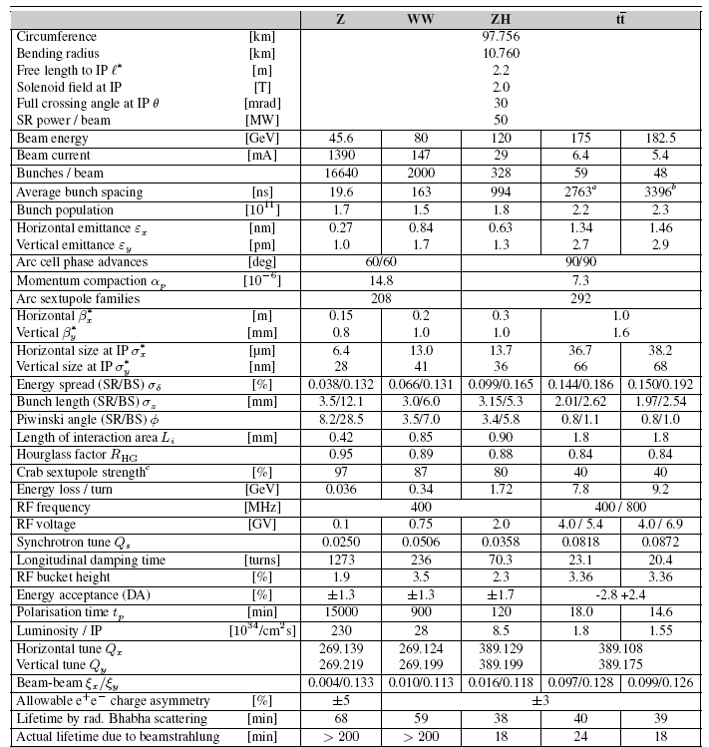
FCC-ee parameters

Slide 39
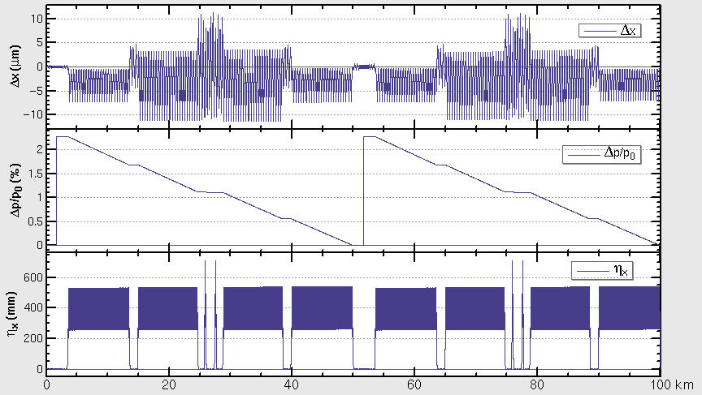
Booster DA with tapering@180GeV
sawtooth orbit was corrected by tapering
DA tracking w/o errors (50 seeds, 100 turns)
DA is good enough

Slide 40
CEPC高亮度Z增强器高频系统
J. Y. Zhai
高亮度Z增强器18 mA（0.8 nC，22.5 MHz，按直线注入时束长1 mm）对应9-cell腔每腔峰值HOM功率 85 W、平均约 45 W（取决于注入时序和直线重频，以及injection和ramp过程的束长变化），8个9-cell腔共 360 W。
CEPC增强器使用ILC/XFEL/LCLS-II型超导腔模组，按每腔平均HOM功率 1 W 量级设计（CEPC CDR 5 W，已在上限）。每腔两个HOM耦合器，HOM耦合器本身功率容量~ 10 W，只对截止频率以下及附近有效。
高亮度Z增强器超导腔高阶模功率和潜在的2 K 热负荷显著增大，同时可能对腔本身造成影响。解决方案（增强器超导腔和模组设计的重大改动）：取消HOM耦合器，扩大束管，引出所有高阶模，在腔间加 80 K 温区HOM吸收器（类似ERL）及两端常温HOM吸收器。需研究计算多腔高阶模传输特性和非超导段功率沉积、重新设计研制 1.3 GHz 9-cell（或7-cell）腔、研制低温HOM吸收器、束管内表面镀铜等。
应为HL-Z设计使用专用的增强器腔（两个8x9cell强流模组），而不是与Higgs和W共用，同时将显著降低高阶模阻抗（腔少，HOM吸收器Qe低）。

