Slide 1
CEPC instrumentation system design progress
Yanfeng Sui
On behalf Beam Instrumentation Group
Jun. 15, 2020. IHEP.

Slide 2
Outline
Investigation on beam instrumentation requirements
The beam instrumentation of interaction point(IP)
Beam position electronics test in BEPCII
Summary

Slide 3
CEPC beam instrumentation
Beam position monitor
Beam current monitor
Beam profile monitor
Bunch length measurement
Beam instrumentation at IP
Feed back system
Beam loss monitor

Slide 4
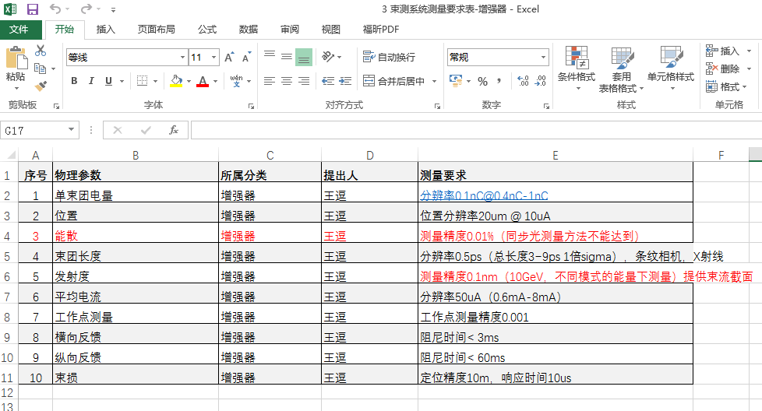
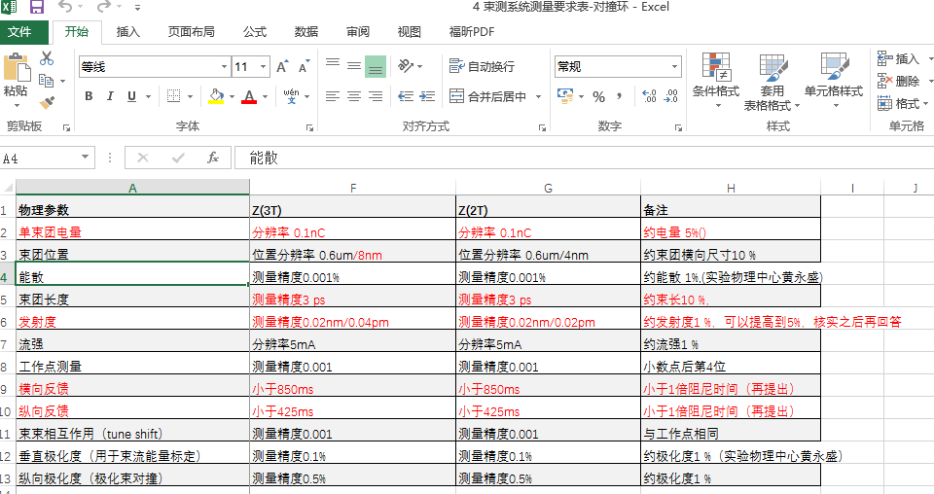
Measurement requirements
Linac （including damping ring）, booster, transport lines(LTB, BTS), Storage ring

Slide 5
Beam instrumentation
People from AP group and BI group discussed the requirements in May 20 and May 27,2020.
Most of the requirements were confirmed and listed in the table below
 | Item | Method | Parameter | Amounts
Linac | Beam position | Stripline BPM | Resolution ：30um | 140
 | Beam current | ICT | 2.5%@1nC-10nC | 42
 | Beam profile | YAG/OTR | Resolution: 30um | 80
 | Beam emittance | Q+PR | 10% | 3
 | Beam energy & spread | AM+PR | 0.1% | 3
Damping ring | Average current | DCCT | Resolution :50uA@0.1mA-30mA | 1
 | Beam position | Button BPM | Resolution : 20um @ 5mA TBT | 40
 | Tune measurement | Frequency sweeping | Resolution:0.001 | 1

Slide 6
The beam instrumentation in CEPC booster
 | Item |  | Method | Parameter | Amounts
Booster | Beam position monitor | Turn by turn | Button electrode BPM | Measurement area (x × y)：±20mm×±10mm Resolution：<0.02mm Measurement time of COD：< 4 s | 1808
 |  | Bunch by bunch | Button electrode BPM | Measurement area (x × y)：±40mm×±20mm Resolution：0.1mm | 1808
 | Bunch current |  | BCM | Measurement range：10mA / per bunch Relatively precision：1/4095 | 2
 | Average current |  | DCCT | Dynamic measurement range：0.0~1.5A Resolution:50uA@0.6-8mA Linearity：0.1 % Zero drift: <0.05mA | 2
 | Beam size |  | Double slit interferometer x ray pin hole | Resolution:0.2 µm | 2
 | Bunch length |  | Streak camera Two photon intensity interferometer | Resolution:0.5 ps | 2
 | Tune measurement |  | Frequency sweeping method | Resolution:0.001 | 2
 |  |  | DDD | Resolution:0.001
 | Beam loss monitor |  | optical fiber | Space resolution:0.6m | 400
 | Feedback system |  | TFB | Damping time<=3ms | 2
 | Feedback system |  | LFB | Damping time<=60ms | 2

Slide 7
The beam instrumentation in CEPC ring
 | Item |  | Method | Parameter | Amounts
Storage ring | Beam position monitor | Closed orbit | Button electrode BPM | Measurement area (x × y)：±20mm×±10mm Resolution：<0.6um Measurement time of COD：< 4 s | 2900
 |  | Bunch by bunch | Button electrode BPM | Measurement area (x × y)：±40mm×±20mm Resolution：0.1mm | 2900
 | Bunch current |  | BCM | Measurement range：10mA / per bunch Relatively precision：1/4095 | 2
 | Average current |  | DCCT | Dynamic measurement range：0.0~1.5A Linearity：0.1 % Zero drift: <0.05mA | 2
 | Beam size |  | Double slit interferometer x ray pin hole | Resolution:0.2 µm | 4
 | Bunch length |  | Streak camera Two photon intensity interferometer | Resolution:1ps@10ps | 2
 | Tune measurement |  | Frequency sweeping method | Resolution:0.001 | 2
 |  |  | DDD | Resolution:0.001
 | Beam loss monitor |  | PIN-diode | Dynamic range:120 dB Maximum counting rates≥10 MHz | 5800
 | Feedback system |  | TFB | Damping time<=47ms | 2
 |  |  | LFB | Damping time<=24ms | 2

Slide 8
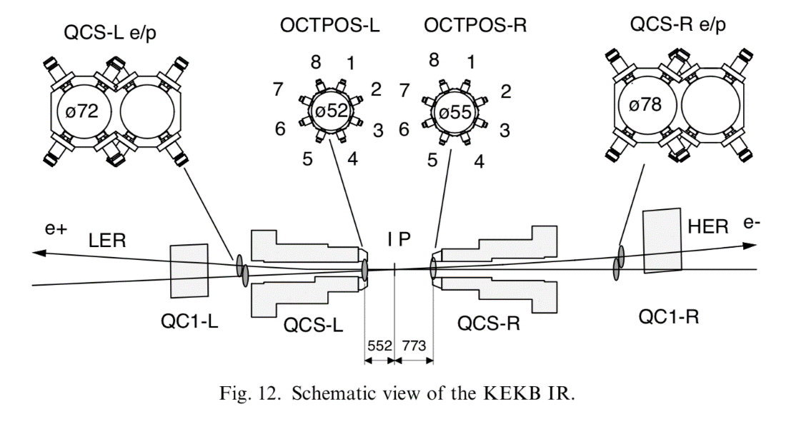
The beam instrumentation of IP
KEKB:
Four 4-electrode BPMs in the interaction region:
The e+ and e- beams are completely separated. Keep the collision condition stable, control the position offset of the interaction point and the crossing angle of the e+ and e- beams.
Special BPMs with eight button electrodes:
Installed at the front end of the superconducting quadruple magnets for the final focusing. The e+ and e- beams pass through together in BPMs.

Slide 9
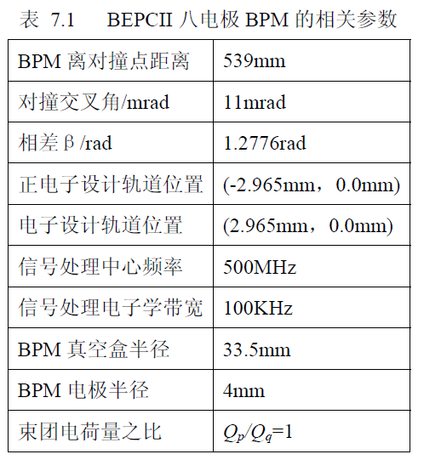
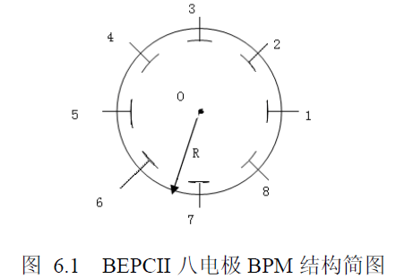
The beam instrumentation of IP
The eight electrode BPM in BEPCII:
Two BPMs in the both sides of IP.
The distance from the BPM to IP is 539 mm.
The time difference between the signals of e+ and e- beams in the same BPM.
6 variable (bunch charge and horizontal position) for two beams: p、x、y、q、u、v.
8*6 nonlinear system of equations (Newton iteration method):
R=33.5mm
Difficulties:
Sensitivity, operation time and processing difficulty

Slide 10
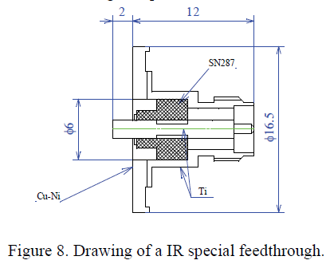
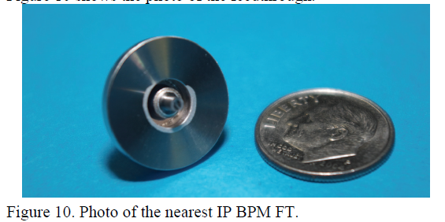
The beam instrumentation of IP
SuperKEKB:
The changes of the orbits are detected by using four BPMs at around the IP.
The distance from the IP to the BPMs is about 51cm.
IR special button electrode for IP BPM is designed.
The vacuum chamber diameter at the BPMs is 20mm.
Each BPM has 4 electrodes and their position is 10.5mm from the center of the chamber. The size of the BPM heads is 1.8mm φ. No 8 electrodes BPM.
The designed special FT for nearest IP:

Slide 11
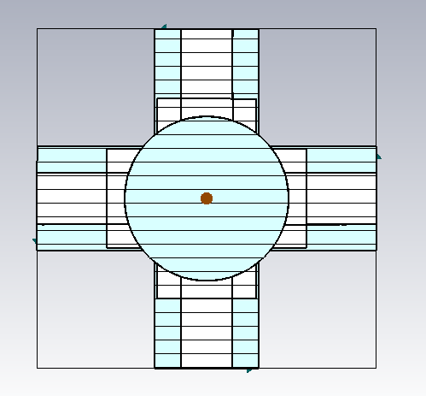
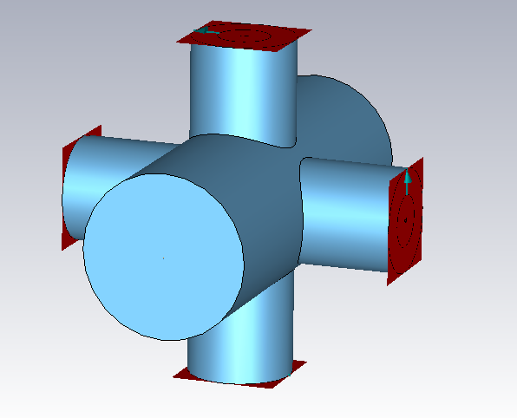
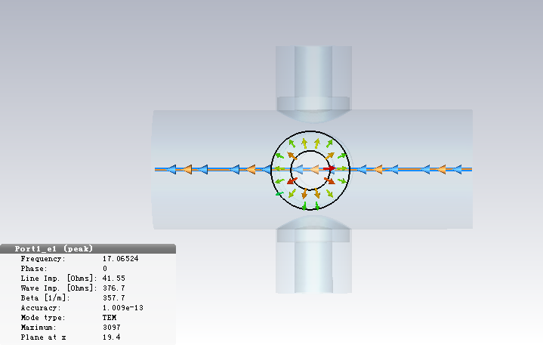
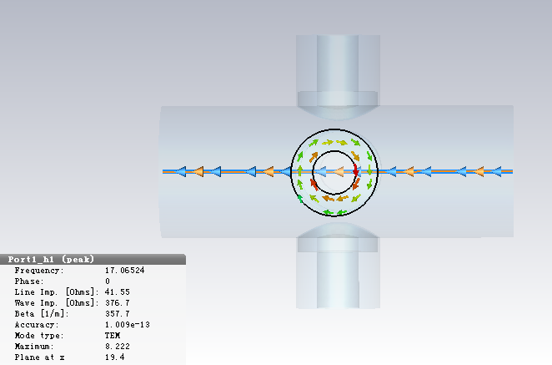
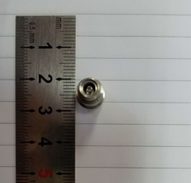
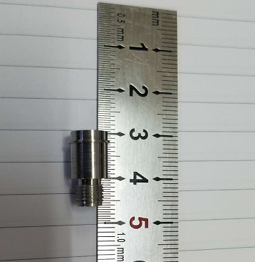
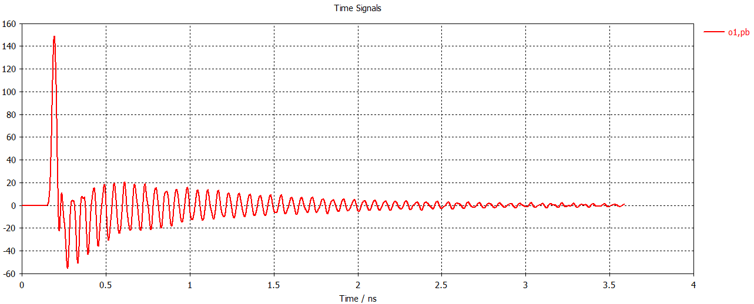
The beam instrumentation of IP
4 button electrodes structure
Electromagnetic field at electrodes
4 button electrodes size
Electrodes signal(bunch length 2.68mm)
Electrode diameter:11.4mm
Inner conductor diameter: 6mm
Electrode pole to beam line:19.4mm
Size and signal intensity can be
satisfied by CEPC MDI requirement.
Due to the short bunch length, signal has many resonance hump, signal amplitude proportional to the bunch charge.

Slide 12
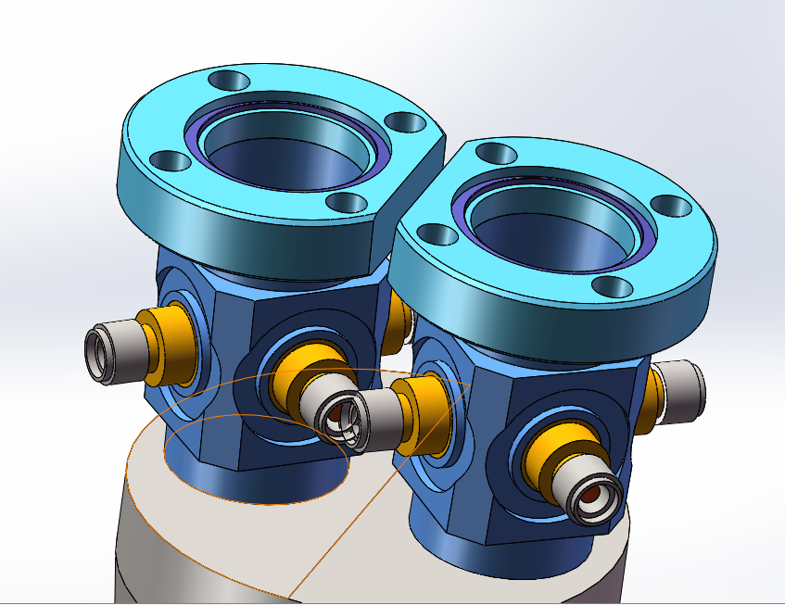
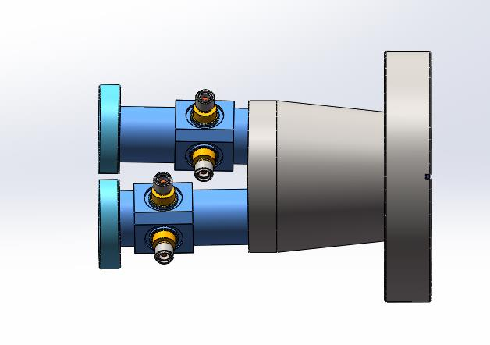
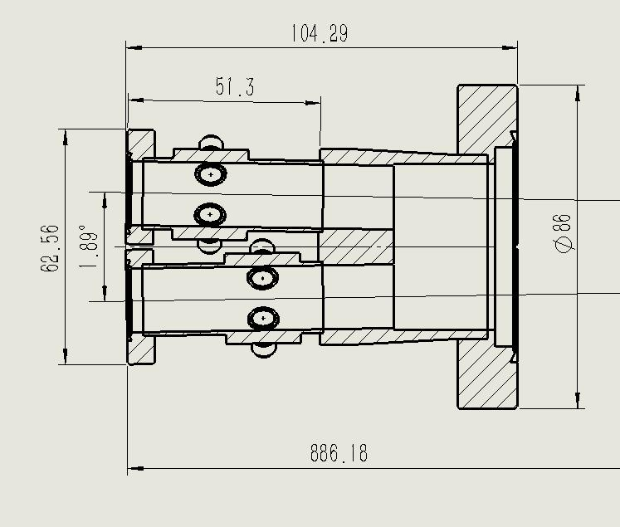
The beam instrumentation of IP
Space conflict for the inside two buttons has been solved by staggering the position ~1cm.
Monitoring the time when two beams arrive at the collision point, e+ and e- signals can be distinguished.

Slide 13
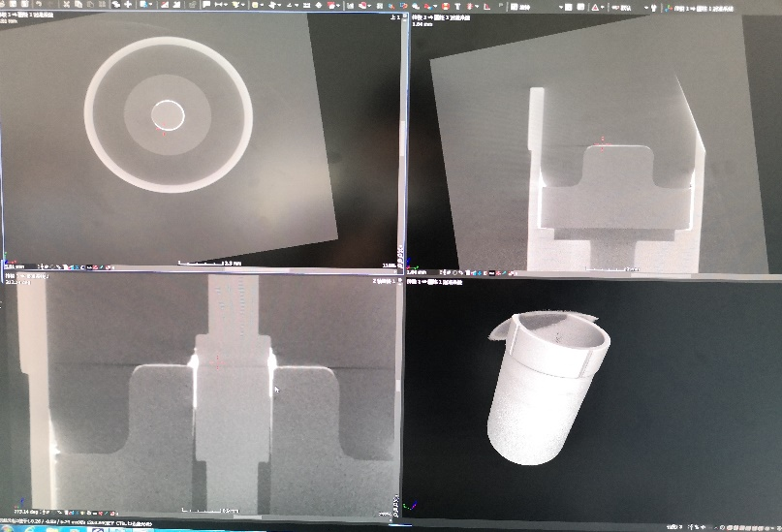
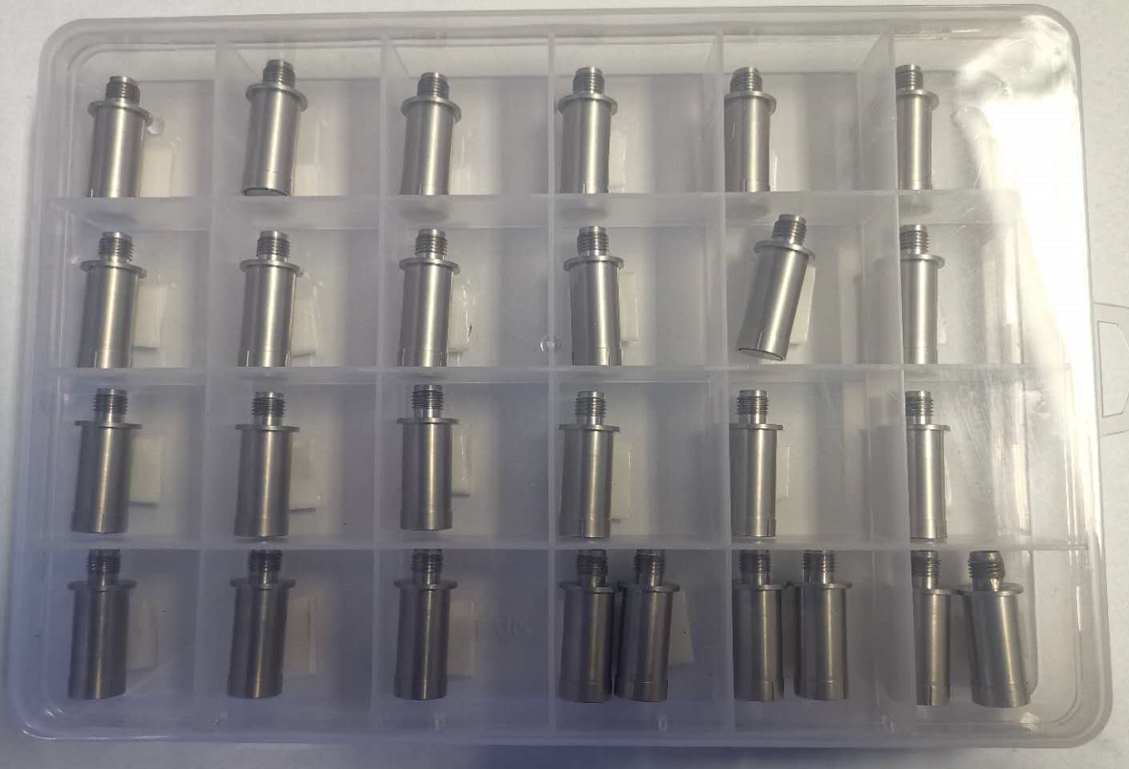
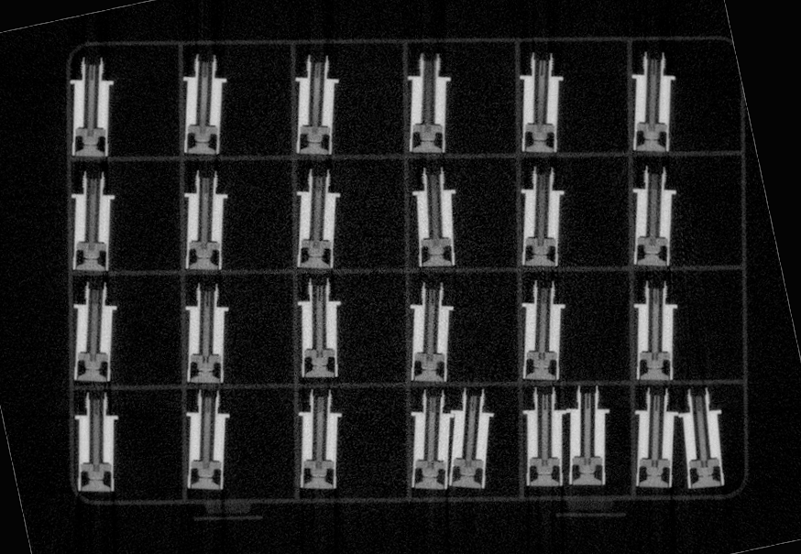
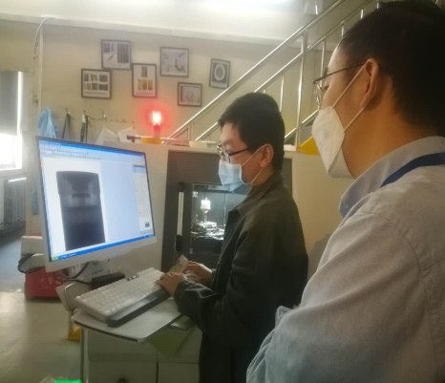
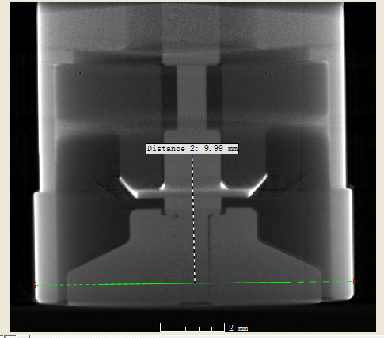
IP BPM feedthrough
Feed through check by X-ray Tomography Gap：300 ±20 μm
Tongfang Weishi@ 9MeV, 50 μm/pixel
Division of Nuclear Technology and Applications, IHEP@70keV 10μm/pixel

Slide 14
The BPM electronics
The R&D of BPM electronics founded by seed money of IHEP and other funding（HEPS-TF etc.）
Kicked off in the start of 2015
The first version of the electronics was finished in 2018. Some results of the electronics are from testing in lab and real beam.

Slide 15
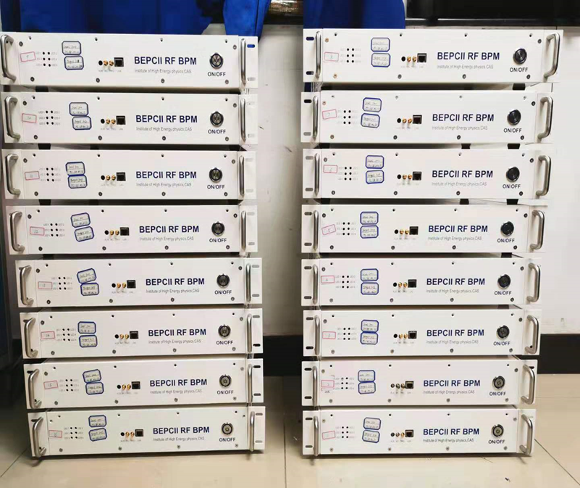
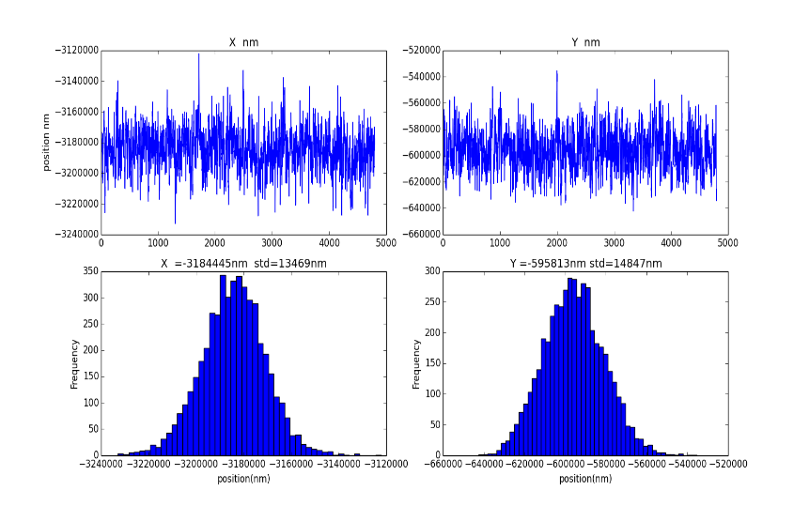
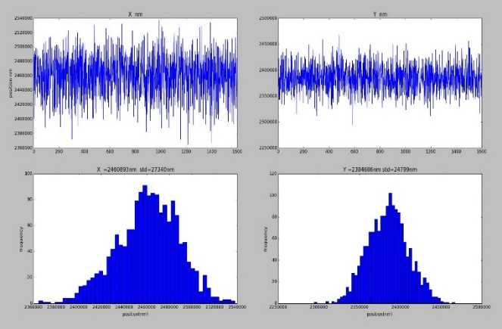
Application of BPM electronics in BEPCII
The single-pass mode BPM electronics is developed for the linac.
After finishing prototype test, small batch production and application has been done in BEPCII during the summer maintenance
The results shows that the resolution of electronics is about 14um in the lab test and 27um for the real beam test.
The lab test result shows that the resolution is about 14μm
The beam test result shows that the resolution is about 27μm

Slide 16
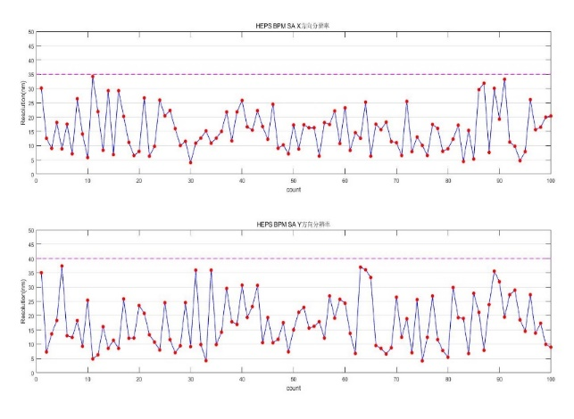
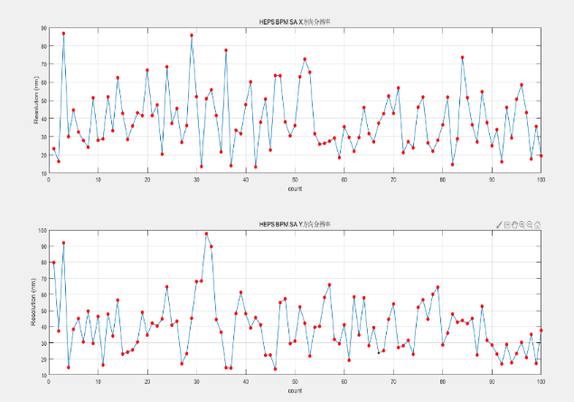
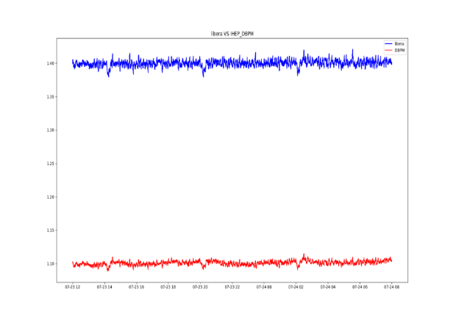
BPM electronics test in BEPCII
The BPM electronics prototype for storage ring is developed in 2018.
The prototype was put into operation in SR after testing. After one year of trouble-free operation, we plan to upgrade all Bergoz electronics to home-made type.
There are totally 100 sets of electronics for electron ring and positron ring. The work supported by BEPCII operation and maintenance Fund.
实验室测试分辨率40nm（100s）
束流测试分辨率90nm（100s）
样机纳入轨道反馈长时间运行

Slide 17
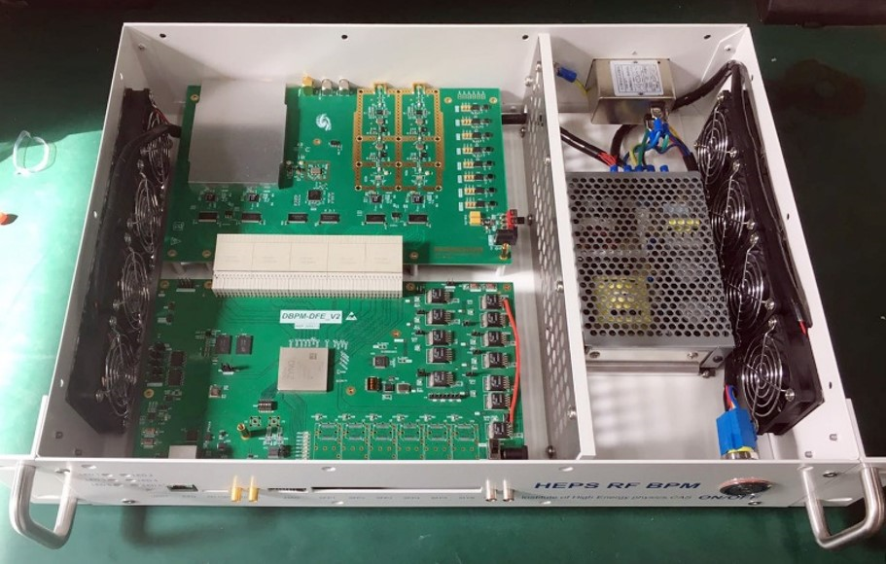
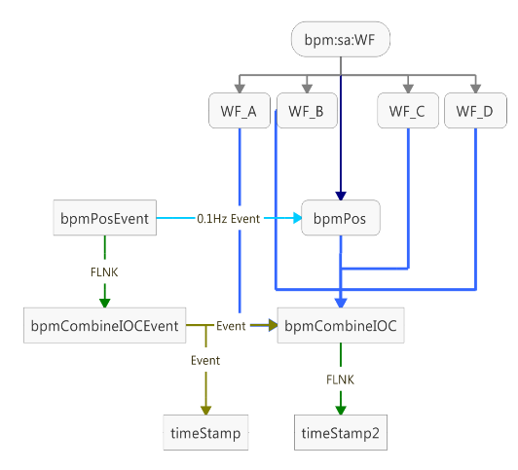
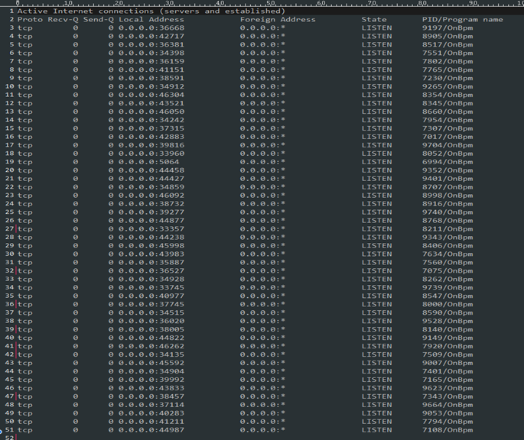
BPM electronics test in BEPCII
The first 5 sets will be installed in positron ring and put into operation in the next month before routine shutdown of this Summer.
The left BPM electronics(45) of positron ring will be installed during the period of Summer maintenance.
Next year, the BPM electronics of electron ring will upgrade to home-made type. And also, the synchrotron radiation ring will be equipped with all self-developed electronics.
The home-made BPM electronics
High-level software development and test

Slide 18
Summary
The Investigation on beam instrumentation requirements was finished. Most of measurement requirements were discussed and confirmed by AP and BI group
Complete the IP BPM design on the basis of reference to BEPCII and KEKB designs.
The BPM electronics have been used in BEPCII linac. In the next two years , the home-made electronics will be used in BEPCII SR.

Slide 19
Thank you for your attention

