Slide 1
Progress of CEPC Control System
Presented by Gang Li
Jun. 15th, 2020

Slide 2
Outline
Characteristics of CEPC Control System
Scope of the control system
Requirement information of controlled devices
Mini workshop of CEPC control system
Summary

Slide 3
Characteristics of CEPC Control System
Super scale--CEPC VS BEPCII, CSNS or HEPS
Linac: 1.2/1.4Km
Ring: 100Km
A large number of Controlled Equipments
Discrete distributed in the Linac and Ring
Quantity of controlled devices’ PV
Hundreds of thousands

Slide 4
Scope of the Control System
Control Platform
Central Control System: servers, High Level software, etc
Network System
Timing System
Post Mortem Analysis System
Machine Protection System
Power Supply Control System
Vacuum Control System
Temperature Monitoring System
Linac Control System
Integration of other system: LLRF, Cryogenic system, Injection/Extraction system etc.
Others
Everything is under Control

Slide 5
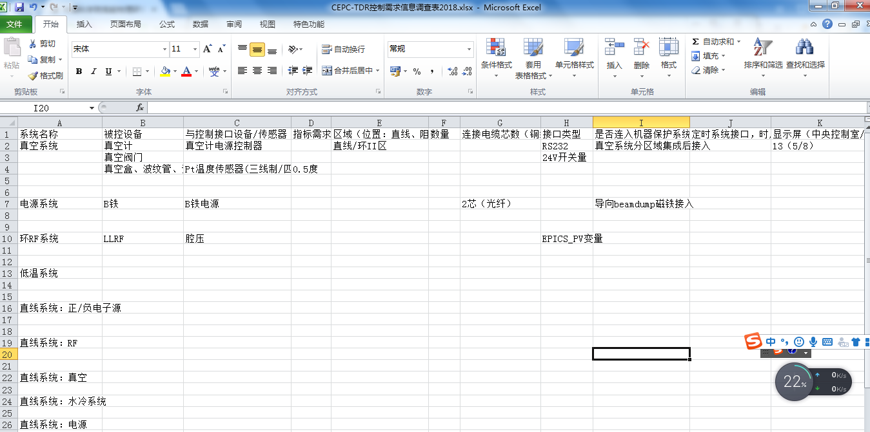
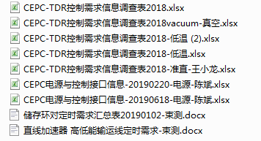
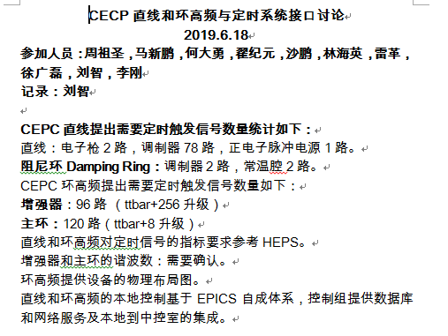
Requirement information of controlled devices

Slide 6
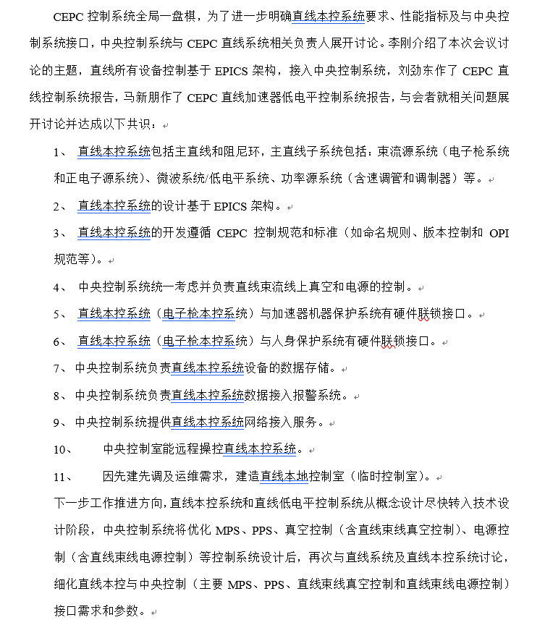
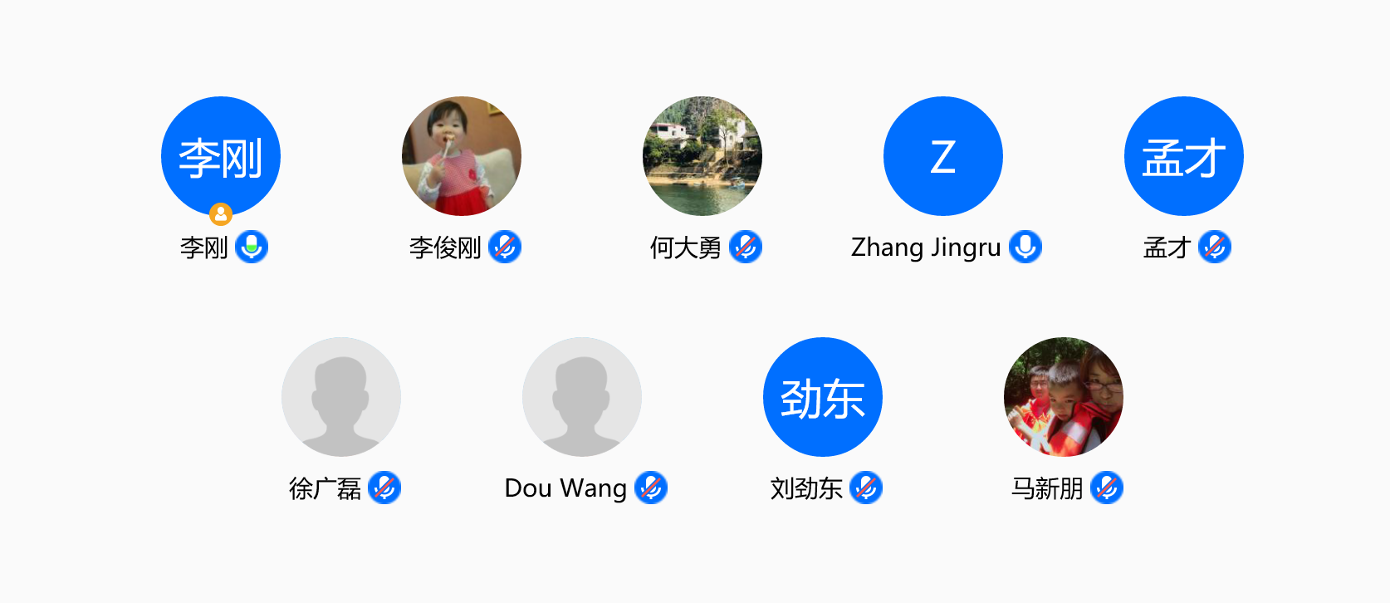
Requirement information of controlled devices
More detailed and more specific
Local Linac control system with CEPC CCS

Slide 7
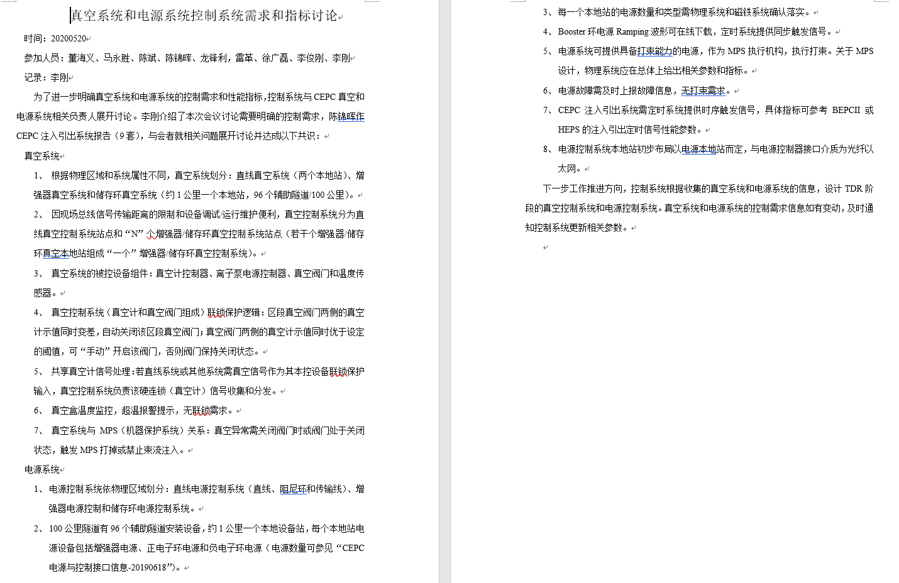
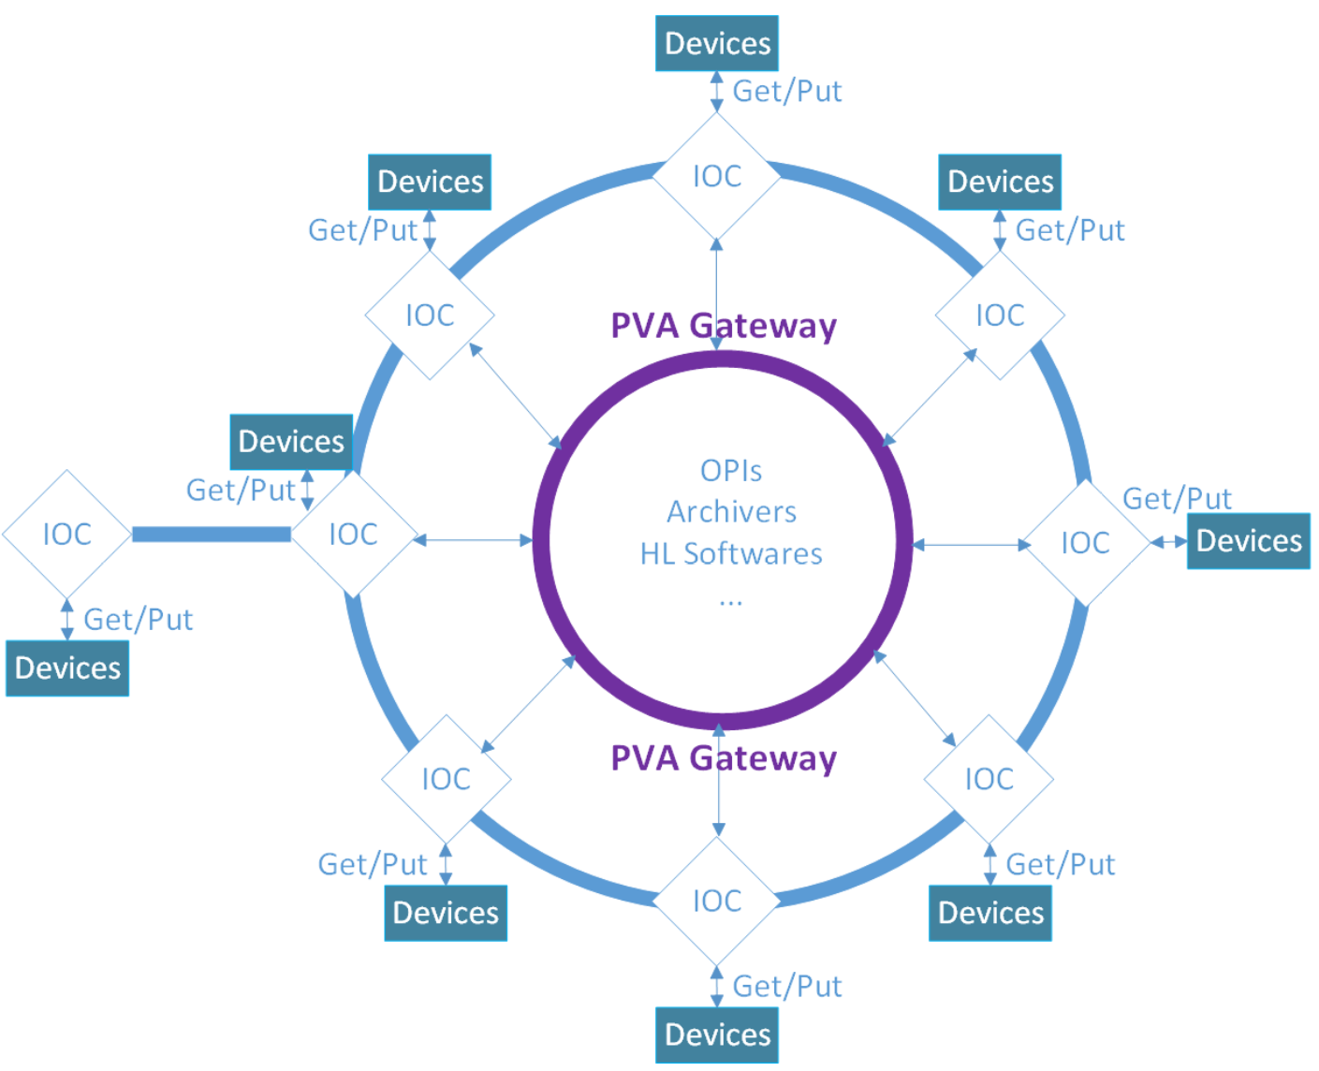
Requirement information of controlled devices
More detailed and more specific
CEPC control system of PS and Vacuum

Slide 8
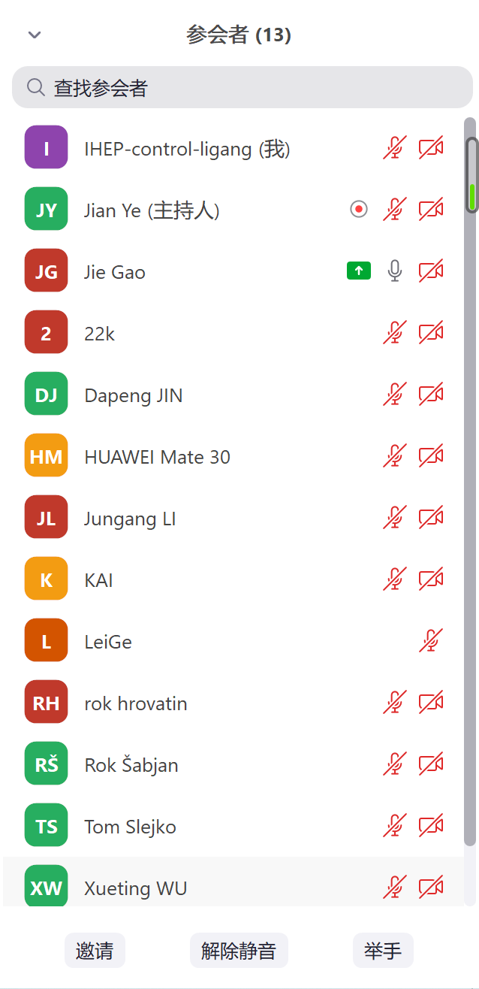
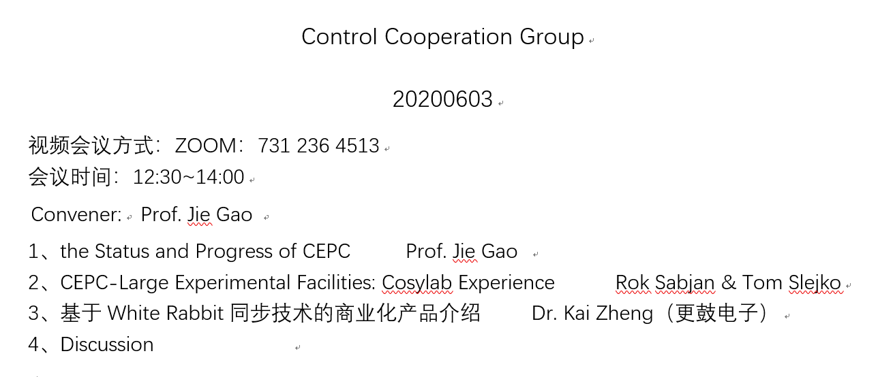
Mini workshop of CEPC control system

Slide 9
Mini workshop of CEPC control system
Cosylab
the world’s leading provider of control systems for the planet’s most complex machines; nuclear accelerators, optical and radio telescopes, fusion reactors, cancer therapy systems and much more（from web：https://www.cosylab.com/）
更鼓电子：
合肥更鼓电子科技有限公司（简称“更鼓电子”），以先进的亚纳秒时钟同步技术为核心，打造精准时间同步网络（from web：http://geekootech.com/）

Slide 10
Mini workshop of CEPC control system
Notes:
周长100Km，直径31.85Km，光速3*10e8，在光纤中速度约2*10e8

Slide 11
Summary
More detailed requirements should be further clarified, with the progress of CEPC TDR
EPICS：Cooperate closely with EPICS community or TANGO or FESA
New technique: IoT/AI/machine learning in control system
Thanks a lot!

