Slide 1
Summary of CEPC MDI workshop accelerator part
Sha Bai
For CEPC MDI group
2020-06-15
CEPC Day

Slide 2
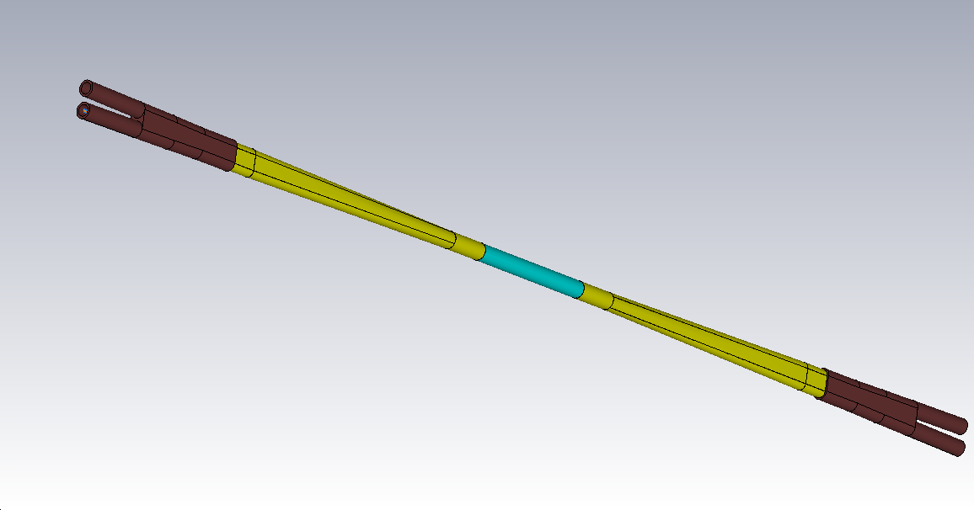
IR Heat load summary
Total length:2220mm
Cu: 360mm
Al: 625mm
Be: 250mm
Region | CDR |  |  |  | High Luminosity Z
 | SR | Beam loss | HOM | Total | SR | HOM | Total
Be pipe | ~mW | 6.7mW | 50W | 50W | ~mW | 136.9W | 136.9W
Al pipe | ~mW | 0.024W | 342W | 342W | ~mW | 1097W | 1097W
Cu pipe | 73.8W | 0.17W | 207W | 280.8W | 25.9W | 664W | 690W
QD0 | 2.8W | 2.13W | 83W | 87.9W | 3.59W | 265W | 268.6W
QD0~QF1 | 36.1W | 0.01W | 16.5W | 52.6W | 46.4W | 52W | 98.4W
QF1 | 3.1W | 0.26mW | 37W | 40.1W | 3.92W | 117W | 120.9W

Slide 3
Concerning of IR beam pipe
Temperature on IR beam pipe due to heat load
Cooling structure
Temperature on IR beam pipe due to heat load with cooling structure
Heat load transmitted to the inner wall of cryostat through heat resistance layer, temperature of Helium vessel, can be absorbed and accepted or not ? CDR can be accepted, what about high luminosity Z ?
To protect SC magnet~ radiation dose, mainly from beam loss background, Solutions: tungsten IR beam pipe; shielding of SC magnet coils.
It is unlikely to use pure tungsten, which is too brittle.
WNiFe and WNiCu are two kinds of alloys that can be made. WNiCu is non-magnetic, but it is difficult to make this alloy too long. It must be welded in sections, with each section no more than 1m.
For the 6m long IR beam pipe, there will be many welds.
Tungsten alloy is made by powder pressing. It has certain machining performance and welding performance (brazing). The vacuum performance is unknown.

Slide 4
Key issue of mechanics in IR
Detector magnet yoke (± 6m) too long, accelerator supporting system doesn’t work.
Supporting system, highly correlated with cantilever length. Alignment error~requirement : 50um~100um.
The very tight space in the crotch section: IP BPM, Lumical, HOM absorber, RVC, high vacuum requirement from Beam-Gas scattering~vacuum pump design in IR
Remote vacuum connection design is inevitable, leak rate needs to be verified.

Slide 5
Superconducting magnet & Cryogenics system
Novel design of QD0 is adopted. Despite limited space, magnetic field cross talk effect between two apertures is negligible using iron yoke.
Alignment requirement :50um~100um, very difficult to achieve. Conservative estimate > 100um.
HTS option for superconducting quadrupole magnet will be considered.
2K superfluid helium cooling method / development of efficient multi-channel pipeline / application of cryogenics pump (R & D and Research) / efficiency of 2K cryogenics system

Slide 6
Impacts of Detector Stray field on Booster
Impacts of detector stray field on booster were calculated with real field distribution.
Vertical orbit distortion due to Bx is dominant effect.
Local orbit correction is essential.
Correction to the detector field is possible if B < 50Gs

Slide 7
Other topics in MDI accelerator
Vacuum chamber in Cryostat under design: material, vacuum pressure, leak rate of each part, thermal analysis…
IP BPM: space conflict for the inside two buttons has been solved by staggering the position ~1cm. Monitoring the time when two beams arrive at the collision point, e+ and e- signals can be distinguished.

Slide 8
Thanks for all in CEPC MDI group

