Slide 1
For meeting today
ROOT is a data analysis frame work
LodeStar is data analysis frame work too, designed for LHAASO, by SDU
ROOT solves most technical problem realted to analysis.
LodeStar solves problems related to LHAASO computing and COOPERATION
The meeting today is a startup for new people on software developing with LodeStar.

Slide 2
基于LordStar的 LHAASO软件和数据
祝成光
山东大学

Slide 3
Motivation
Personal developed software are Different from each other. BUT, many code with same functionality are used collaboration-widely
Data validation and systematic estimation are heavy task and common to all.
Code/data sharing are important:
Improve coding efficiency and robustness, so that your physics result.
Efficient for cross check of physics result
LHAASO software (LhSoft) aim to:
Collect common-used code from all researchers and manage officially in version control mode
Help user to compose his/her analysis software by using as many as possible official common-code
Data are centrally managed and tagged by used processing software/version.

Slide 4
LhSoft based on LodeStar frame work
Lodestar is dedicated software frame-work for LHAASO. It's an “operation system” from the analyzer's point of view.
LodeStar defines most standards for easy code sharing.
The standard to make share-able code: package. Analysis software is made from package-level other than c++ level.
Data format for I/O
Lodestar provide functionality:
Data IO and memory management, users are free from these technical tasks.
event loop, which make user only concentrate on processing of ”ONE” event.
Provide technical solution for computing problems, such as calibration data looking up.

Slide 5
Simply to say
LHAASO software consists of plenty of common-function packages.
User make use of the packages FIRSTLY in official release to make his/her analysis software
User develop his/her own analysis-specific packages when the official package are not enough.
The user-packages, share-able, are collected into official release and used by all others.

Slide 6
Packages:Code modulation:
Package: a same-structure directory contains piece of code for a specific functionality，managed by CMT.
Package categorized by functionality:
algorithm: provide data processing in event loop.
Tools/Service: plug-in package, providing a piece of code/information for algorithm.
Data Model: standardized data structure for algorithms I/O

Slide 7
python
helloAlg
alg 3 ZhangShan
For to be referred by python macros
python
__init__.py
requirements
Define compiling parameters and relations to other packages
cmt
version.cmt
version specified
helloAlg
helloAlg
helloAlg.h
xxxx.h
header file
src
alg 2
SunLiu
helloAlg.cc
xxxx.cc
source file
http://svn.lhaaso.ihep.ac.cn/People/zhucg/tags/Examples/helloAlg/v1.0/

Slide 8
Requirements file
#compile all source file into libhelloAlg.so
library helloAlg *.cc
#install python modules into InsallArea
apply_pattern install_python_modules
#allow other package to use this package
apply_pattern linker_library library=helloAlg
#add head files into InstallArea.
apply_pattern install_more_includes more="helloAlg"
package helloAlg
# adding parameters relative to the used packages to the compiling and link command.
use SniperKernel v*
use helloSvc v* Examples
use helloTool v* Examples

Slide 9
alg 3 ZhangShan
Packages are organized in directories.
Sniper: the core of the frame work
offline: official LHAASO specific packages
myProject: user packages
Sniper
alg 1
LiShi
Reconstruction
tool 1
WangEr
Offiline
service 1
ZhaoWu
calibration
Personal packages in local myProject directory
alg 2
SunLiu
myProject

Slide 10
packages in official release
Sniper/, offline/
wanger packages
mazi
packages
zhangsan packages
Lishi
packages
Official packages are collected from all researchers, when personal package are fine to share: publish it into official
Personal packages are developed by researchers him/herself and private
Personal packages could be from official, but modified as needed. Personal packages are put in front of the official one, so that your modified one overlap the official one, even though the name are same.

Slide 11
The packages in our official release and to be published in next release
http://twiki.ihep.ac.cn/twiki/view/LHAASO/LhSoftPerson

Slide 12
Transforming your code to packages is SIMPLE
The code in event-loop is transformed to algorithm：
inherit from AlgBase
initialize() is run at the beginning of task
execute() is run event by event, operate on event and save into memory
finalize() is run at the end of the task.
Just be careful to read/write data according to data model definition.
The code which can be extracted from algorithm and used in MORE THAN ONE place is transformed to Tool/Service.
inherit from SvcBase/ToolBase
initialize() is run at the beginning of task
finalize() is run at the end of the task.
other subroutines in Tool/Service are inserted into algorithms when/where needed.

Slide 13
http://svn.lhaaso.ihep.ac.cn/People/zhucg/tags/Examples/
The example code tells what an Algorithm/Tool/Service package looks like
Use as many as possible official-exist packages, modulize your special code into packages, and then connect all packages into analysis software.

Slide 14
Self analysis code building
Just connect algorithms head-to-end, and plug in needed Tools/Services
Advantages:
easy to compose an analysis software
efficiently switch packages, such as different versions or competing packages from different researchers.
algorithm connection by data-model in memory other than data file.

Slide 15
Structure of an analysis code
disk
disk
Task
Svc 2
Svc 3
input service
Algorithm 2
Algorithm 1
Algorithm 3
output serive
data model A
data model A
data model A
data model B
data model B
data model C
data model A
Tool 1
Tool 2
Tool 1
Memory
data model A
data model B
data model C

Slide 16
Python macros to do the job
Algtask = Sniper.Task("Algtask") #main entrance
CaliAlg = Algtask.createAlg("DataCleaning/mycalialg") #algrithm 1
CaliAlg.createTool("PlaneFit/myfit1"); # tools plug-in
RecAlg = Algtask.createAlg("EventRecIhep/myrecalg") #algrithm 2
iSvc = Algtask.createSvc("RawInputSvc/InputSvc") #input service
oSvc = Algtask.createSvc("RootOutputSvc/OutputSvc") #output service
detSvc = Algtask.createSvc("DetcPosSvc/DetcPosSvc"); #other service
Omit parameter setting
alg/tool/service exchangable
version exchangable

Slide 17
property
In the macro
iSvc = Algtask.createSvc("RawInputSvc/InputSvc")
iSvc.property("InputStream").set({"/Event/RawEvent" : "/eos/lhaaso/raw/km2a/2019/0920/ES.23835.KM2A_EVENT.PHYSICS.20190920230841.001.dat"})
property set will be transferred to the code
you don't have to re-compile the code
run parameters are saved in a txt file for reference.

Slide 18
Eample of event reconstruction using KM2A data
http://twiki.ihep.ac.cn/twiki/view/LHAASO/LhKm2aReco
Following the procedure in the page above, you are able to checkout all the needed packages and run the job
You have to check out these packages because these packages are still in personal space, not published to official release,

Slide 20
Ntuple/Tree/Model
~100Gb
Raw Data
~pb
detector
database
Calibration
database
Service and Tools
input/decoding service
calibration
Reconstruction
output service
RawEvent
Memory
LHCaliEvent
LHRecEvent

Slide 21
LHAASO Data and cali data
Data for physics analysis:
Calibration/correction
data quality check/tag
data validation (a series of standard analyses)
systematic estimation
data streaming
Data should be centrally managed and clearly referred to version of software used in processing.
Data could be separated according to the physics group and maintained by physics group.

Slide 22
Ntuple/Tree/Model
~100Gb
Raw Data
~pb
detector
database
Calibration
database
Service and Tools
Trunk analysis
input/decoding service
output service
RawEvent
LHCaliEvent
LHRecEvent
calibration
Reconstruction
Calibration B
Event View
Calibration A
Branch analysis
Calibration
database

Slide 23
Physics analysis
Data streaming separation for different physics group
Loop the reconstructed event, do your statistics,producing Tree/Histograms
Produce final histograms from Tree or calculation of histograms
Draw Histograms in LHAASO style, common to all analyzer
Raw Data processing and reconstruction
tree/ntuple/RecEvent
statistics
hist producer
HistDrawing
tree/hist
hist
pdf/eps
tree/ntuple/RecEvent
statistics
hist producer
HistDrawing
tree/hist
hist
pdf/eps

Slide 24
Example: LHAASO Style and Drawing package
LhaasoStyleAlg used to set the uniform drawing style, aiming to draw beautiful plots for all LHAASO
Put this algrithm before any other drawing algorithms, you did the setting.
import LhaasoStyleAlg
myStyle = Algtask.createAlg("LhaasoStyleAlg/myStyle")
HistDrawing is the algorithm to draw plots, which try to automatically tune the drawing parameters.
draw 1D histogram
draw two 1D histogram for comparison
draw 2D histogram

Slide 25
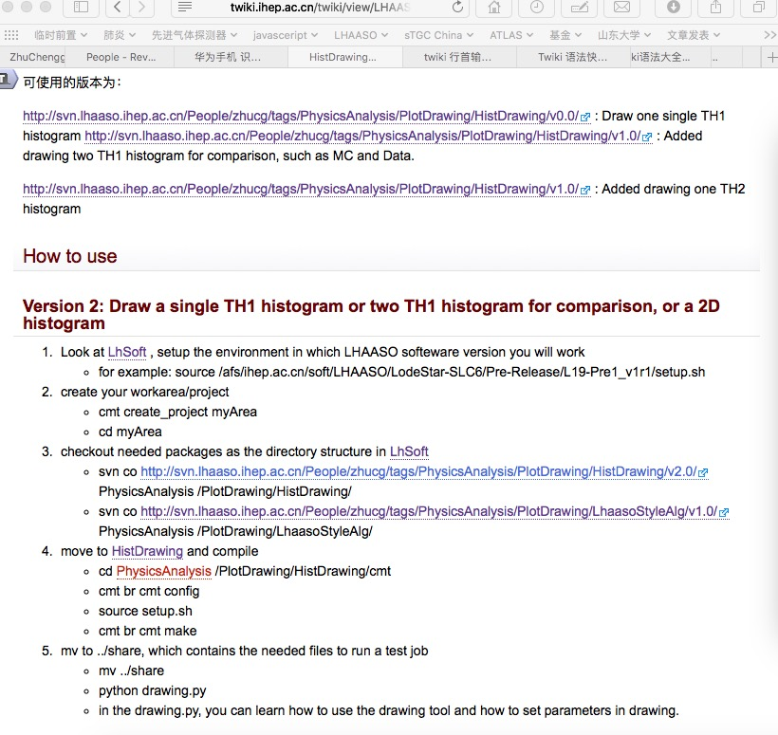
web page to tell how to use the draw tool:
http://twiki.ihep.ac.cn/twiki/view/LHAASO/HistDrawing
you can use it RIGHT NOW, even though you are not working with LodeStar yet
only if you have already a root file contains histograms

Slide 26
plotalg2 = Algtask.createAlg("HistDrawing/myplot1D-2") plotalg2.property("inputRootFile").set("MoonShadow-2020Jan.root") plotalg2.property("outputFile").set("moonSig1D-2.pdf") plotalg2.property("xTitle").set("X") plotalg2.property("yTitle").set("Y") plotalg2.property("histName1D").set(["Sig1D1"])

Slide 27
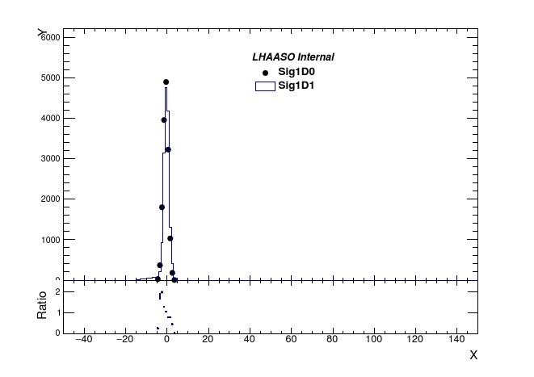
plotalg2 = Algtask.createAlg("HistDrawing/myplot1D-1") plotalg2.property("inputRootFile").set("MoonShadow-2020Jan.root") plotalg2.property("outputFile").set("moonSig1D-1.pdf") plotalg2.property("xTitle").set("X") plotalg2.property("yTitle").set("Y") plotalg2.property("histName1D").set(["Sig1D0","Sig1D1"])

Slide 28
plotalg2 = Algtask.createAlg("HistDrawing/myplot4") plotalg2.property("inputRootFile").set("MoonShadow-2020Jan.root") plotalg2.property("outputFile").set("moonSig-4.pdf") plotalg2.property("xTitle").set("X") plotalg2.property("yTitle").set("Y") plotalg2.property("histName2D").set(["SigSmooth4"])

Slide 29
An example of complete analysis
Moon Shadow:
http://twiki.ihep.ac.cn/twiki/view/LHAASO/LhMoonShadow
Following the steps in the page, you can run the analysis to draw the moon shadow.
See Gaowei's presentation

Slide 30
LHAASO software twiki for information sharing
LHAASO Twiki
http://twiki.ihep.ac.cn/twiki/view/LHAASO/WebHome
LHAASO software twiki:
http://twiki.ihep.ac.cn/twiki/view/LHAASO/LhaasoSoftware
official release
software structure and contributors
examples
SVN
LHAASO data twiki

Slide 31
The structure of the twiki now

Slide 32
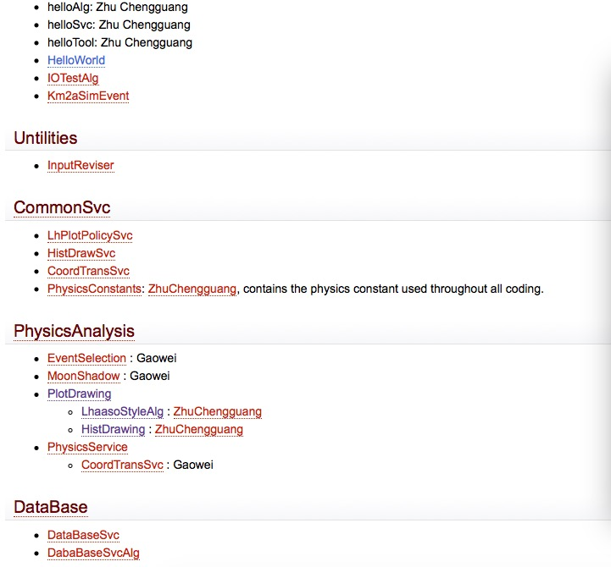
In page http://twiki.ihep.ac.cn/twiki/view/LHAASO/LhSoftPerson
it shows not only the structure of the LhSoft, but also links to a page for each pacakge, telling what the details of the pacakge is.

Slide 33
SVN for LHAASO software version control
Twiki for LHAASO SVN
http://twiki.ihep.ac.cn/twiki/view/LHAASO/LhSoftSVN
instructions on how to use SVN
how we organize the usage of the SVN space
LhSoft/LodeStar SVN:
http://svn.lhaaso.ihep.ac.cn/LodeStar/
LHAASO personal SVN:
http://svn.lhaaso.ihep.ac.cn/People/

Slide 34
Relations in SVN space

Slide 35
Summary
YOU will profit from using LodeStar.
Data input and output, event loop, memory management are job of LodeStar.
YOU will profit from code sharing from all collaboration
don't need to compose the common code by yourself any more
YOU will profit from sharing software to others
make your code deeply debugged and contribute to collaboration
The code specific to your analysis is private.
Software is tools rather than purpose. Software/Data management intends to help the outcome of physics result.

Slide 36
Thanks

