Slide 1


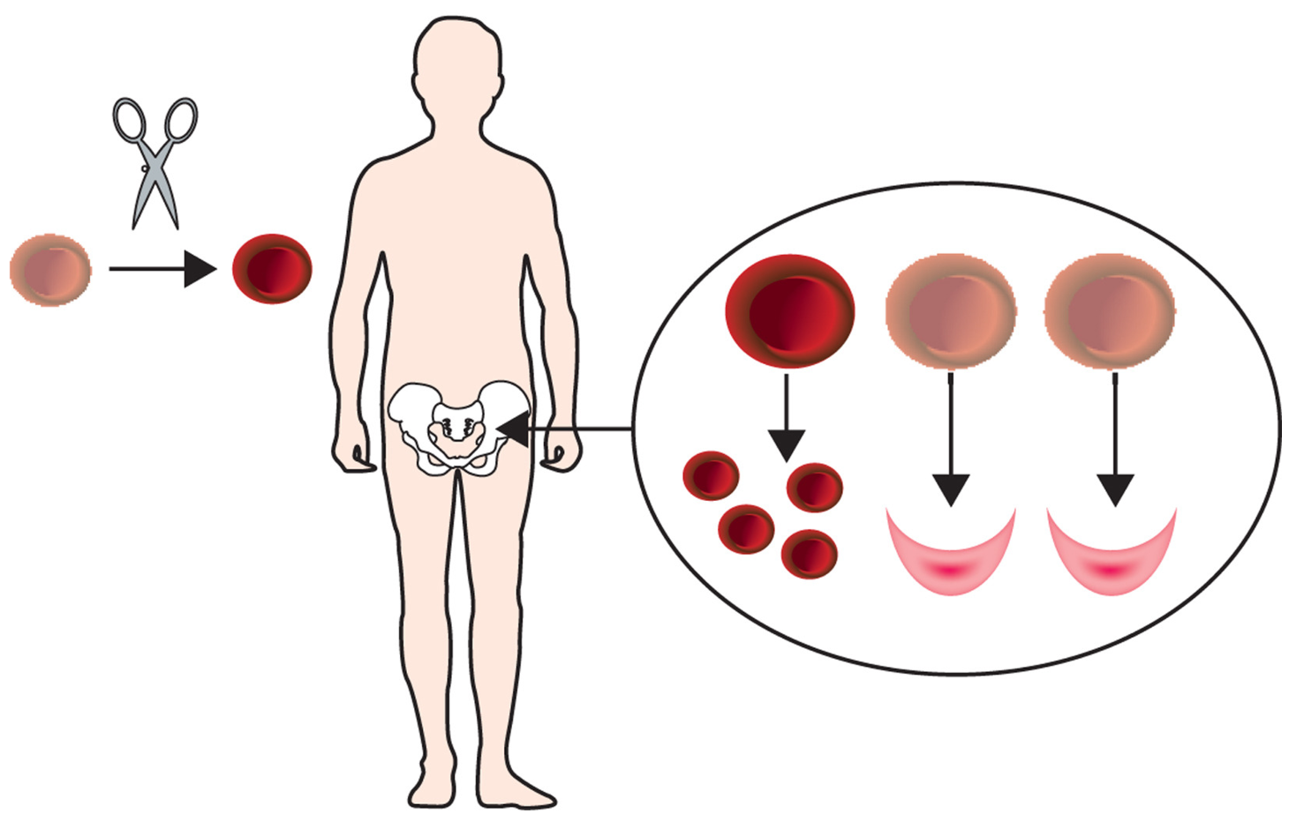

Therapeutic genome editing
Yuxuan Wu
East China Normal University

Slide 2
Therapeutic genome editing
Principle and applications of CRISPR genome editing
Therapeutic genome for β-hemoglobin disorders
Future?

Slide 3
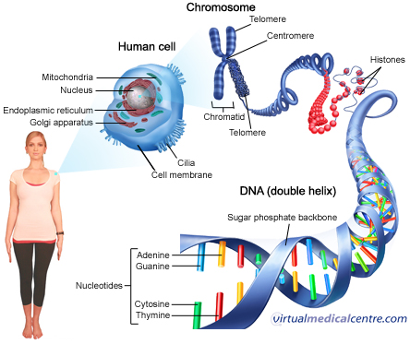

The CRISPR revolution
1. Eukaryotic genomes contain billions of DNA bases
2. Abnormalities in an individual's genetic makeup cause genetic disease.
https://edgy.app/
Notes:
Eukaryotic genomes contain billions of DNA bases and are difficult to manipulate. The development of recombinant DNA technology in the 1970s marked the beginning of a new era for biology. Molecular biologists gained the ability to manipulate DNA molecules, making it possible to study genes and harness them to develop novel medicine and biotechnology. Abnormalities in an individual's genetic makeup cause genetic disease. The area was revolutionized by the discovery and characterization of CRISPR mediated genome editing. Correction of disease-causing mutations by genome editing could eventually eradicate many genetic diseases.

Slide 4
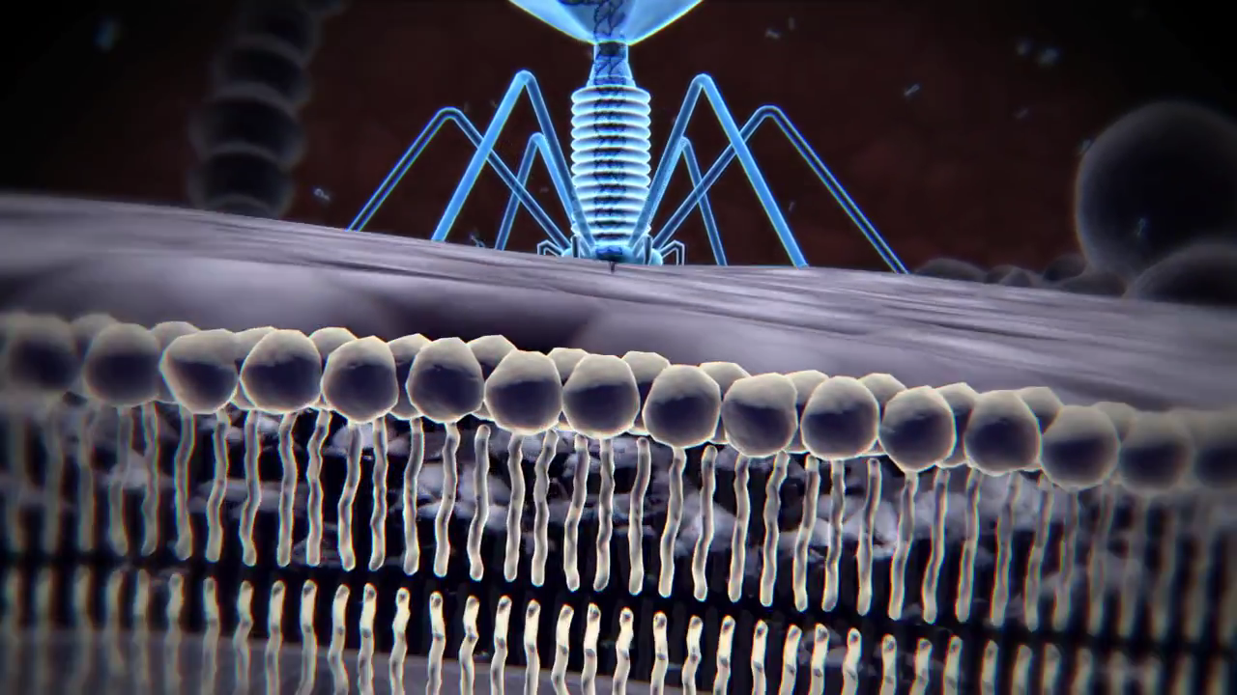
CRISPR/Cas—Clustered regularly-interspaced short palindromic repeats
The weapon of bacteria fight against virus
Notes:
Here is a movie shown the CRISPR system the bacteria used to attack the virus.

Slide 5
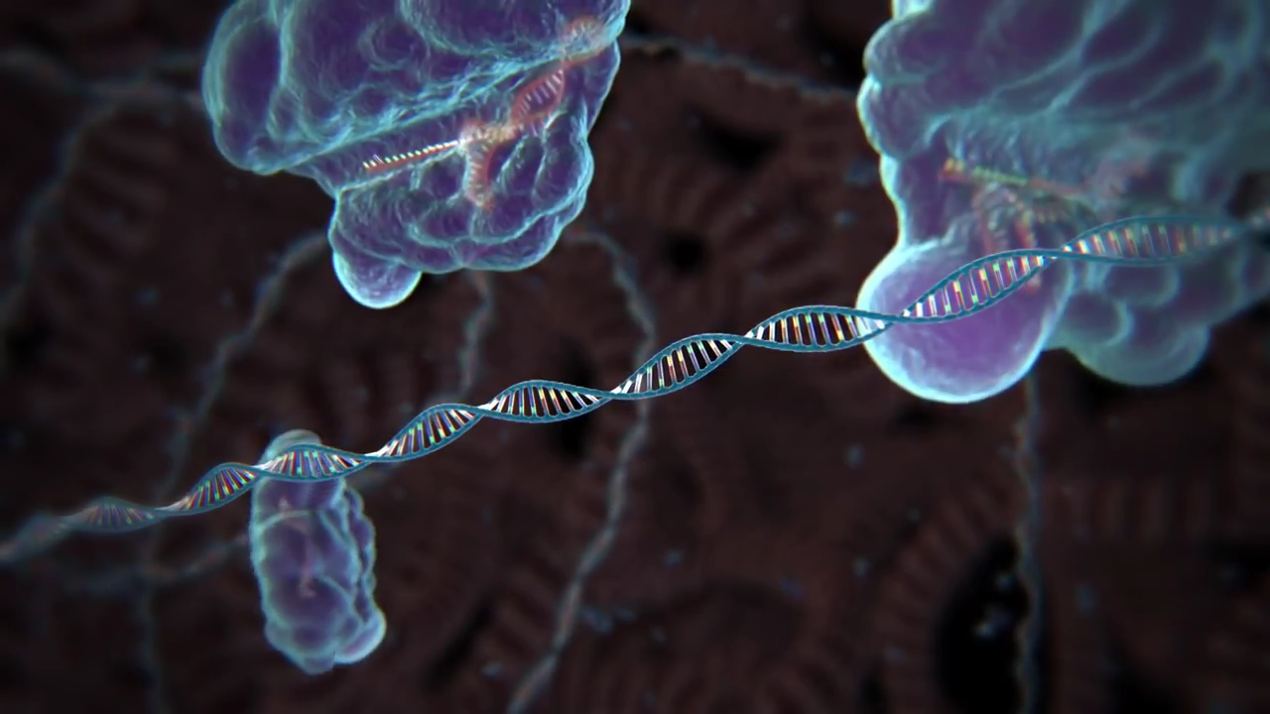
CRISPR/Cas9 - the new genome editing tool
MIT Broad Institute
Engineering CRISPR/Cas system to cut genome wherever we want
MIT Broad Institute
Notes:
Then the scientist used and improved the CRISPR system for genome editing in mammalian cells. Here is another video about the principle of CRISPR based genome editing.

Slide 6
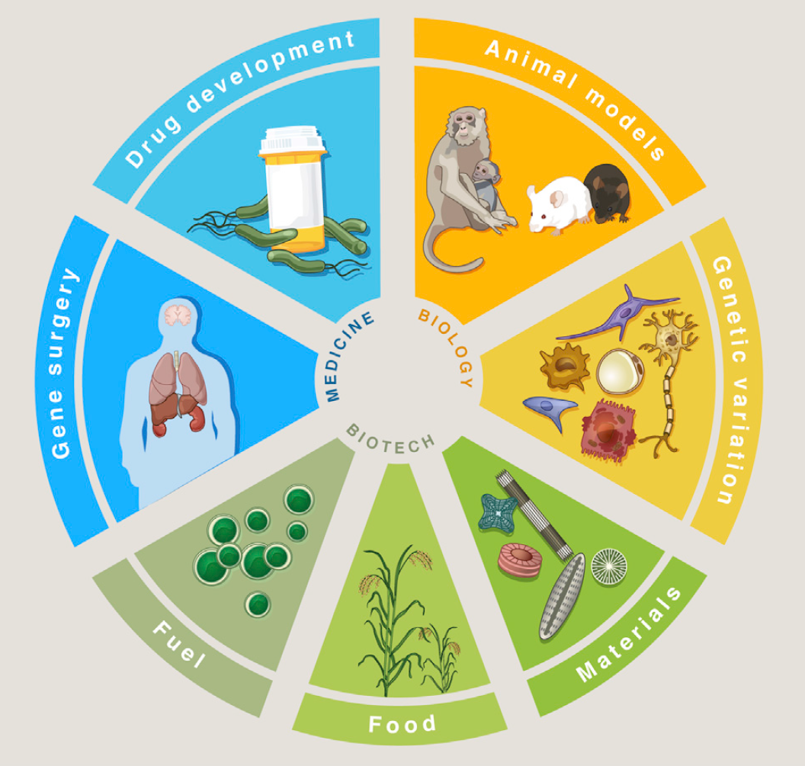
Applications of CRISPR genome editing
Notes:
Genetic and epigenetic control of cells with genome engineering technologies is enabling a broad range of applications from basic biology to biotechnology and medicine. Causal genetic mutations or epigenetic variants associated with altered biological function or disease phenotypes can now be rapidly and efficiently recapitulated in animal or cellular models (Animal models, Genetic variation). Manipulating biological circuits could also facilitate the generation of useful synthetic materials for oral drug delivery (Materials). Additionally, precise genetic engineering of important agricultural crops could confer resistance to environmental deprivation or pathogenic infection, improving food security while avoiding the introduction of foreign DNA (Food). Sustainable and cost-effective
biofuels are attractive sources for renewable energy, which could be achieved by creating efficient metabolic pathways for ethanol production in algae or corn (Fuel). Direct in vivo correction of genetic or epigenetic defects in somatic tissue would be permanent genetic solutions that address the root cause of genetically encoded disorders (Gene surgery). Finally, engineering cells to optimize high yield generation of drug precursors in bacterial factories could significantly reduce the cost and accessibility of useful therapeutics (Drug development).

Slide 7
Therapeutic genome editing
Principle and applications of CRISPR genome editing
Therapeutic genome editing for β-hemoglobin disorders
Future?

Slide 8
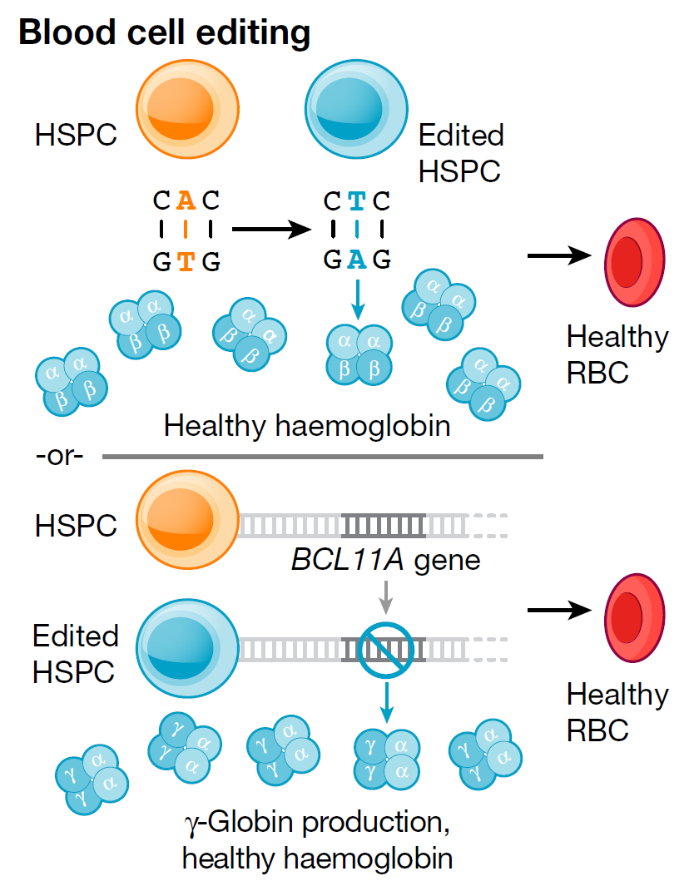
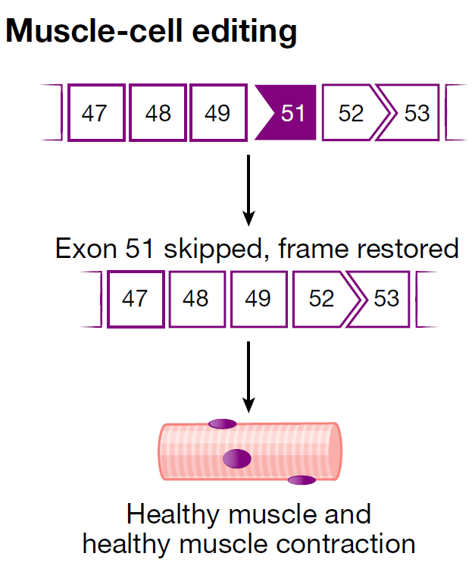
Ex vivo or in vivo gene editing
Ex vivo
In vivo
Notes:
Somatic genome-editing treatments may be accomplished in one of two ways: by removing and editing target cells in the laboratory before returning them to the patient (ex vivo, a) or by directly delivering CRISPR–Cas editing tools to the affected tissue (in vivo, b). a, Blood disorders such as sickle cell disease may be treated by editing haematopoietic stem or progenitor cells (HSPCs) ex vivo, creating normal red blood cells (RBCs). b, Disorders that affect non-removable tissues, such as DMD Muscular dystrophy , require editing of affected cell types (in this case myogenic cells) in vivo.

Slide 9
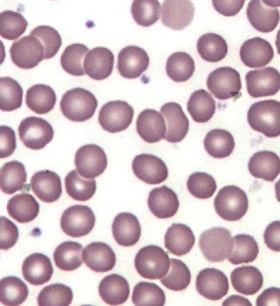
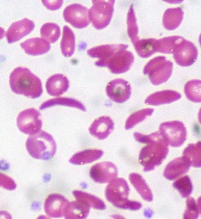
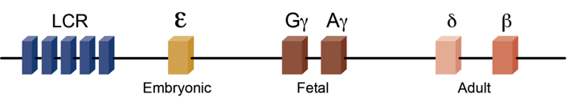
β-hemoglobin disorders, the most common monogenic diseases, remain a global public health challenge
Normal
β-thalassemia
Sickle cell disease
Notes:
The mutations in beta globin usually produce abnormal hemoglobins and anemia

Slide 10
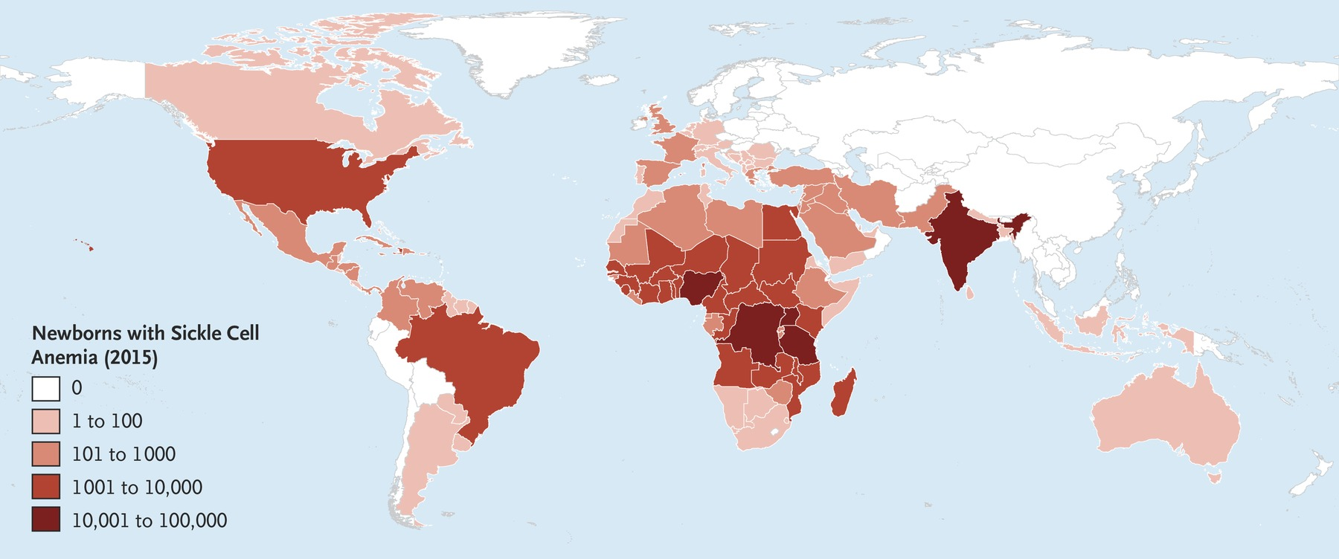
β-hemoglobin disorders, the most common monogenic diseases, remain a global public health challenge
Piel FB et al. NEJM (2017) 376:1561.
Notes:
Just in the US, sickle cell disease affects more than 100,000 Americans.

Slide 11
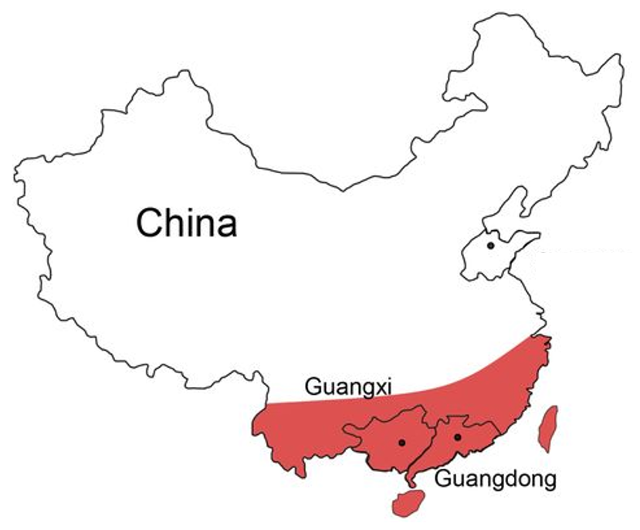
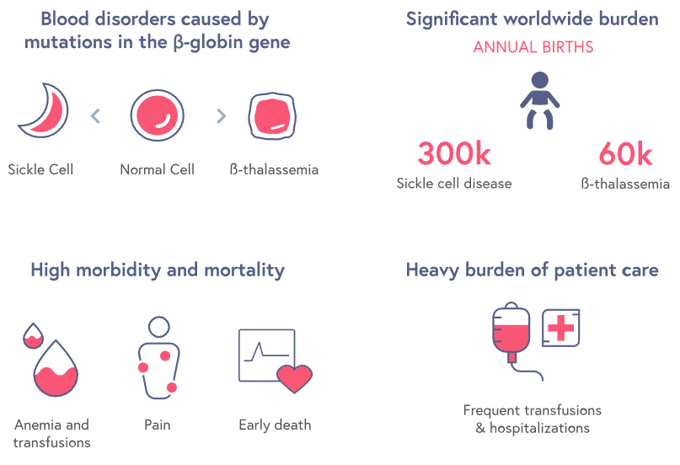
β-thalassemia in China
Notes:
In china, there are large population of thalassemia patients in southern area. The patients lack efficient treatment because of lack of blood resource and expensive clinical treatment.

Slide 12
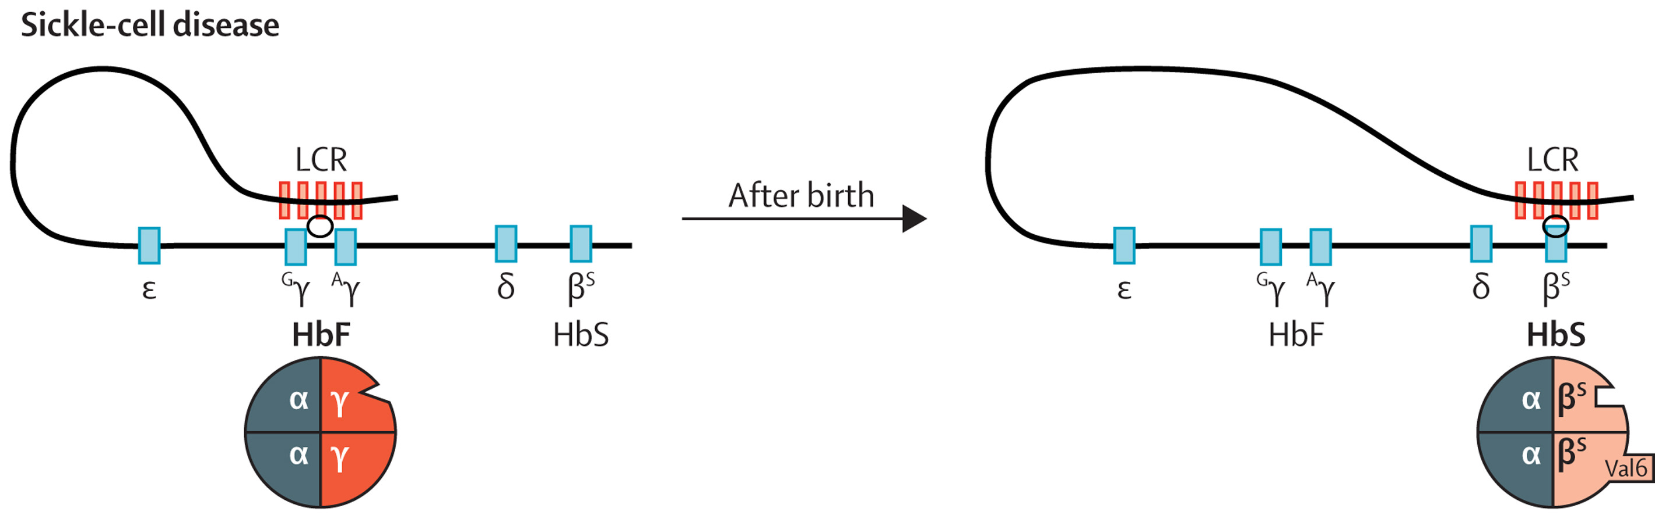
Fetal hemoglobin (HbF) induction
Lettre and Bauer. Lancet (2016) 387:2554.
Notes:
The fetal-to-adult hemoglobin switch and silencing of fetal hemoglobin (HbF) have been areas of long-standing interest among hematologists,

Slide 13
Fetal hemoglobin (HbF) induction
Therapeutic goal
Clinical induction of HbF production holds tremendous promise to ameliorate the clinical symptoms of sickle cell disease (SCD) and β-thalassemia.
Lettre and Bauer. Lancet (2016) 387:2554.
Notes:
given the fact that clinical induction of HbF holds tremendous promise to ameliorate the clinical symptoms of sickle cell disease (SCD) and β-thalassemia.

Slide 14
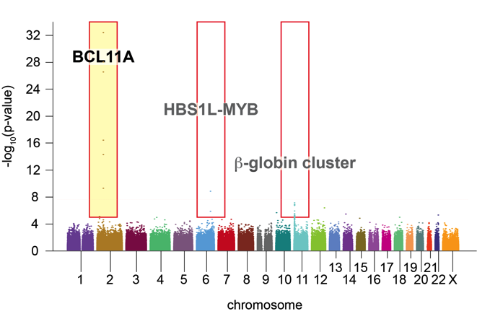
GWAS demonstrate genetic variation at BCL11A modifies
HbF level and β-hemoglobin disorder clinical severity
Manhattan plot from CSSCD. Representative of: Menzel et al. Nat Genet (2007) 39:1197; Uda et al. PNAS (2008) 105:1620; Lettre et al. PNAS (2008) 105:11869; Nuinoon et al. Hum Genet (2010) 127:303; Solovieff et al. Blood (2010) 115:1815; Bhatnagar et al. J Hum Genet (2011) 56:316.
Notes:
There are already several identified regulatory elements on the genome. BCL11A locus is the one we are interested in. But unfortunately, BCL11A genes is also essential for HSC engraftment and B cell development. So we need to find a way to get erythroid specific knock down of BCL11A genes. It is lucky that there is a erythroid specific enhancer for BCL11A gene. The enhancer depends on minimal critical sequences susceptible to NHEJ indels produced by CRISPR based genome editing.

Slide 15
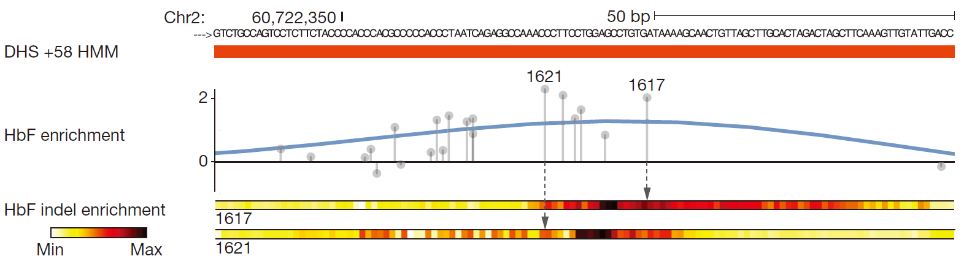
Identifying critical sequences within BCL11A erythroid enhancer
Canver et al. Nature (2015) 527:192. Half E-box/GATA composite motif from Han et al. MCB (2016) 36:157.
Notes:
Previously we had employed lentiviral pooled sgRNA screening to identify a set of sgRNAs targeting the core of the +58 erythroid enhancer of BCL11A.

Slide 16
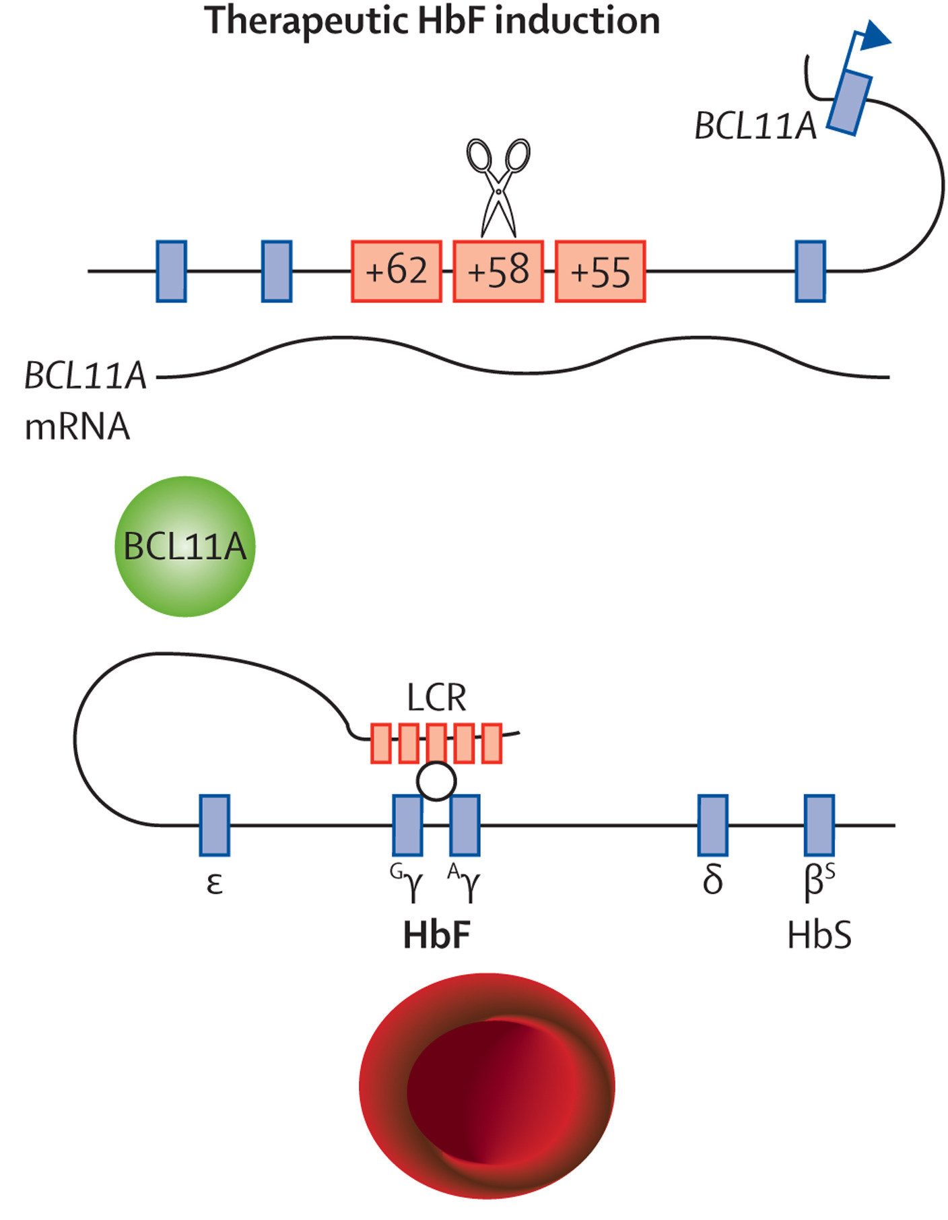
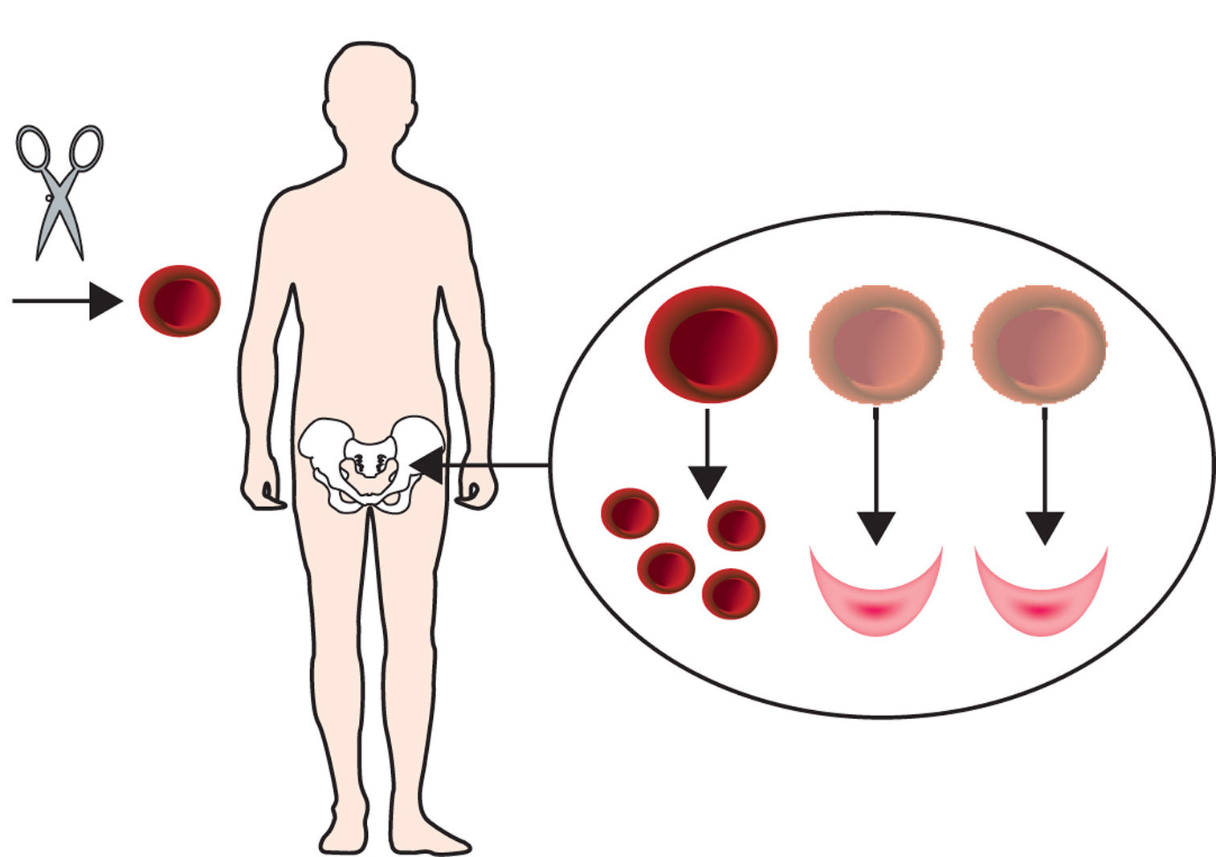
Therapeutic vision
Lettre and Bauer. Lancet (2016) 387:2554.
Notes:
These findings provided us a genome editing based new strategy for sickle cell disease and beta-thalassemia.

Slide 17
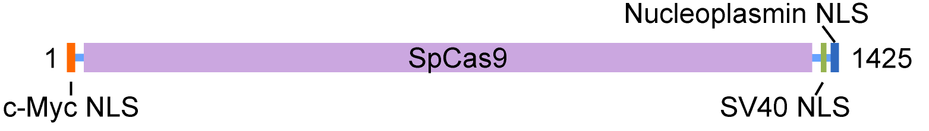
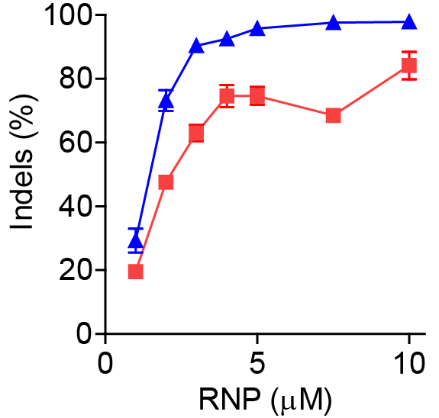
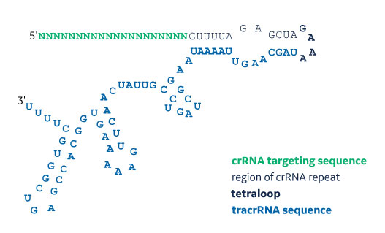
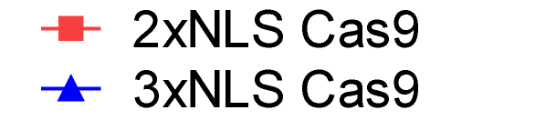
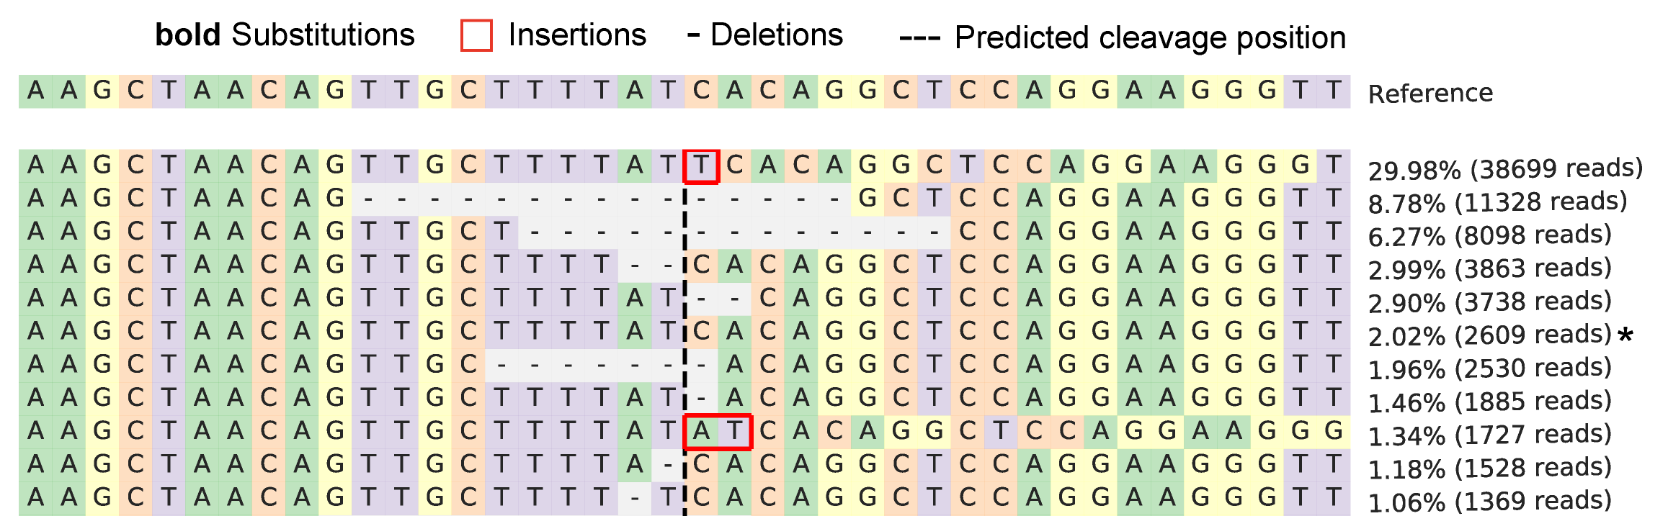
Highly efficient BCL11A enhancer editing in human HSPCs
• Optimized editing protocol with electroporation of 3xNLS Cas9 protein
• Deep sequencing confirms that the edited alleles are 98%
Unedited allele
Wu et al. Nature Medicine (2019)
Notes:
We optimized the Cas9 protein we used in the experiments described above included two SV40 nuclear localization sequences on the C-terminus. we electroporated human CD34⁺ HSPCs with BCL11A enhancer targeting RNPs. We electroporated cells with 3xNLS-Cas9 and found very efficient editing of HSC. RNP editing of BCL11A enhancer gives extremely high editing in CD34 cells. Deep sequencing confirms that the unedited BCL11A enhancer allele is just 2%, edited alleles are 98%.

Slide 18
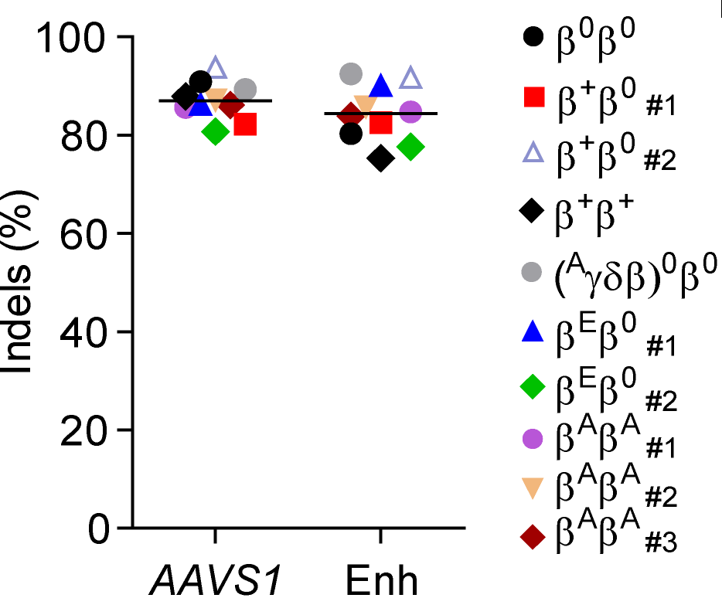
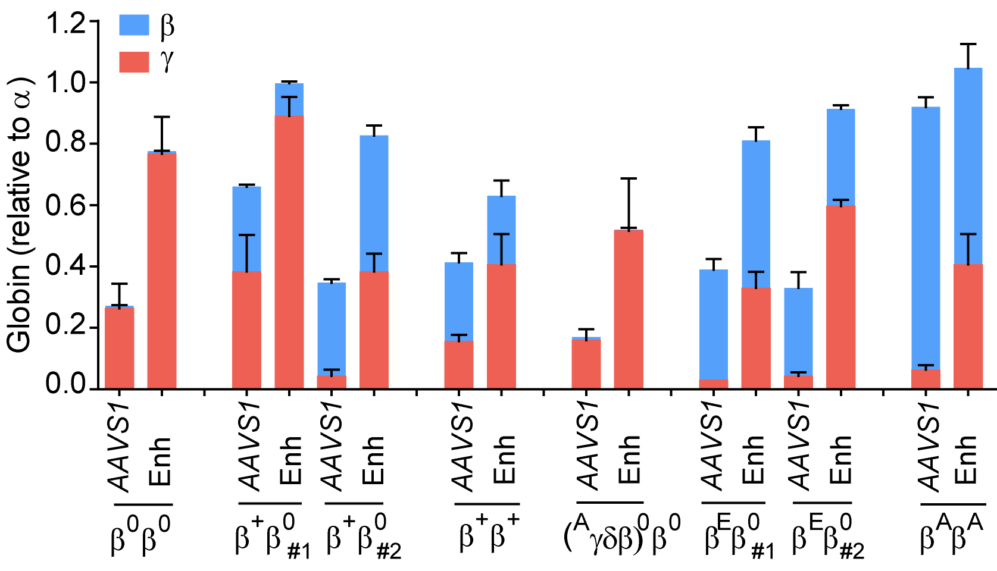
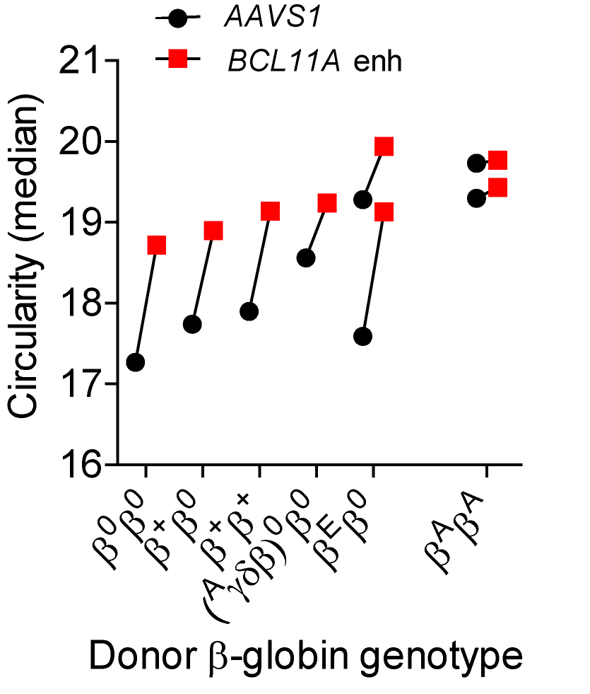
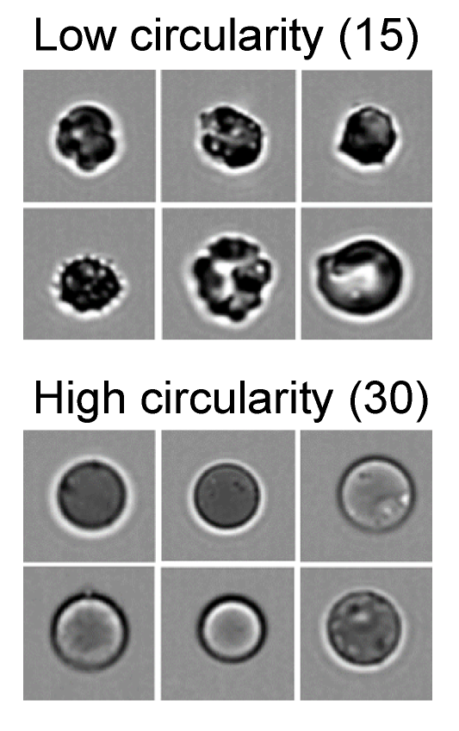
Therapeutic BCL11A enhancer editing of patient cells
β-thalassemia donor CD34+ hematopoietic stem and progenitor cells, RNP electroporation
Notes:
We wished to test if this BCL11A enhancer editing approach would result in clinically meaningful gama-globin induction. We isolated CD34⁺ HSPCs from patients with beta-thalassemia and subjected them to BCL11A enhancer editing. We included seven patient donors with varying genotypes, In each beta-thalassemia donor’s BCL11A enhancer edited cells, we demonstrated potent induction of gama-globin, with a mean of 55.6% relative to alpha-globin. We found improved enucleation of erythroid cells in each of the beta-thalassemia samples. Following BCL11A enhancer editing, we observed increases in cell size and cell circularity by imagestream analysis. Suggest Cas9 editing of BCL11A enhancer in patient-derived CD34⁺ cells is sufficient to ameliorate globin chain imbalance and erythroid maturation.

Slide 19
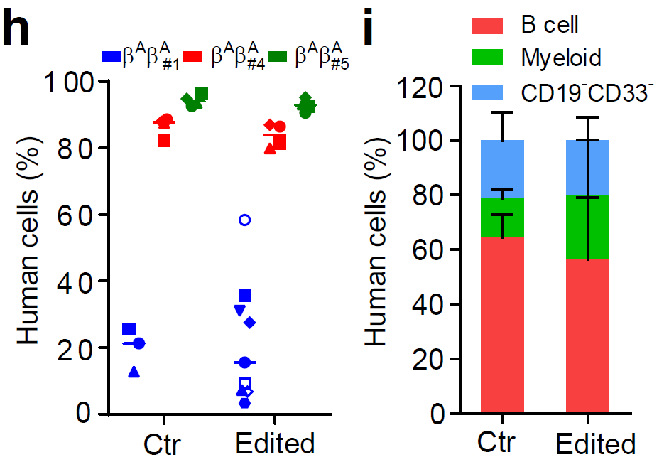
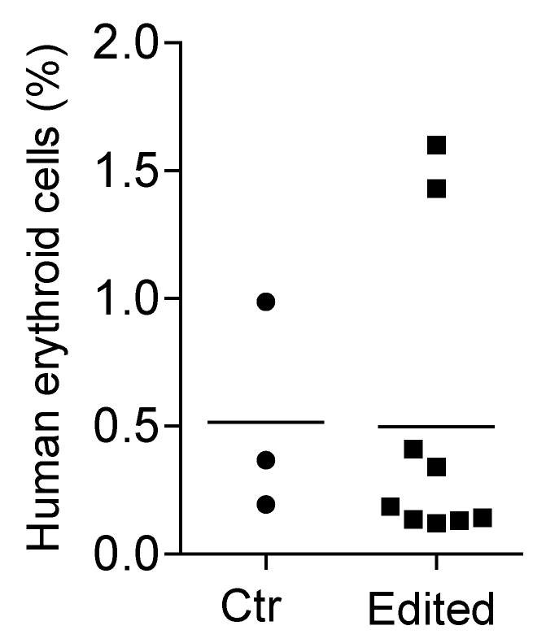
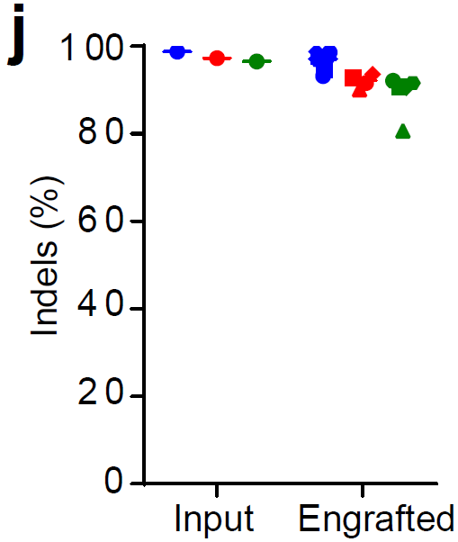
Long-term multi-lineage engraftment of Cas9 edited HSPCs in immunodeficient mice
Notes:
We also tried mouse bone marrow transplant to make sure the gene editing doesn’t affect the engraftment ability of HSC. We performed RNP electroporation with 3xNLS-Cas9 and BCL11A enhancer MS-sgRNA-1617 and observed similar human marrow engraftment after 16 weeks with edited and unedited CD34⁺ HSPC. Long-term engrafting human cells maintained 96.5% indels, similar to the 98.1% indels observed in the input cells. In the bone marrow,.

Slide 20
Lack of detectable genotoxicity of BCL11A enhancer editing
• Top 24 possible off-target (OT) sites evaluated as defined by genome-wide in vitro cleavage (CIRCLE-seq) or computational prediction (in silico)
• No off-target mutations detected in CD34+ HSPCs despite highly efficient on-target BCL11A enhancer editing (limit of detection for indels by deep sequencing is ~0.1%)
with Shengdar Tsai
Notes:
One of the major concerns with therapeutic genome editing is the potential for off-target genotoxicity. Therefore, to test the specificity of the RNP sgRNA-1617, we performed CIRCLE-seq, a method to define genome-wide target sequences susceptible to RNP cleavage in vitro. We performed amplicon deep sequencing of each of these 20 off-target sites and four additional in silico predicted off-target sites from CD34⁺ HSPCs edited with both 2xNLS-Cas9 and 3xNLS-Cas9. We did not identify any off-target sites.

Slide 21
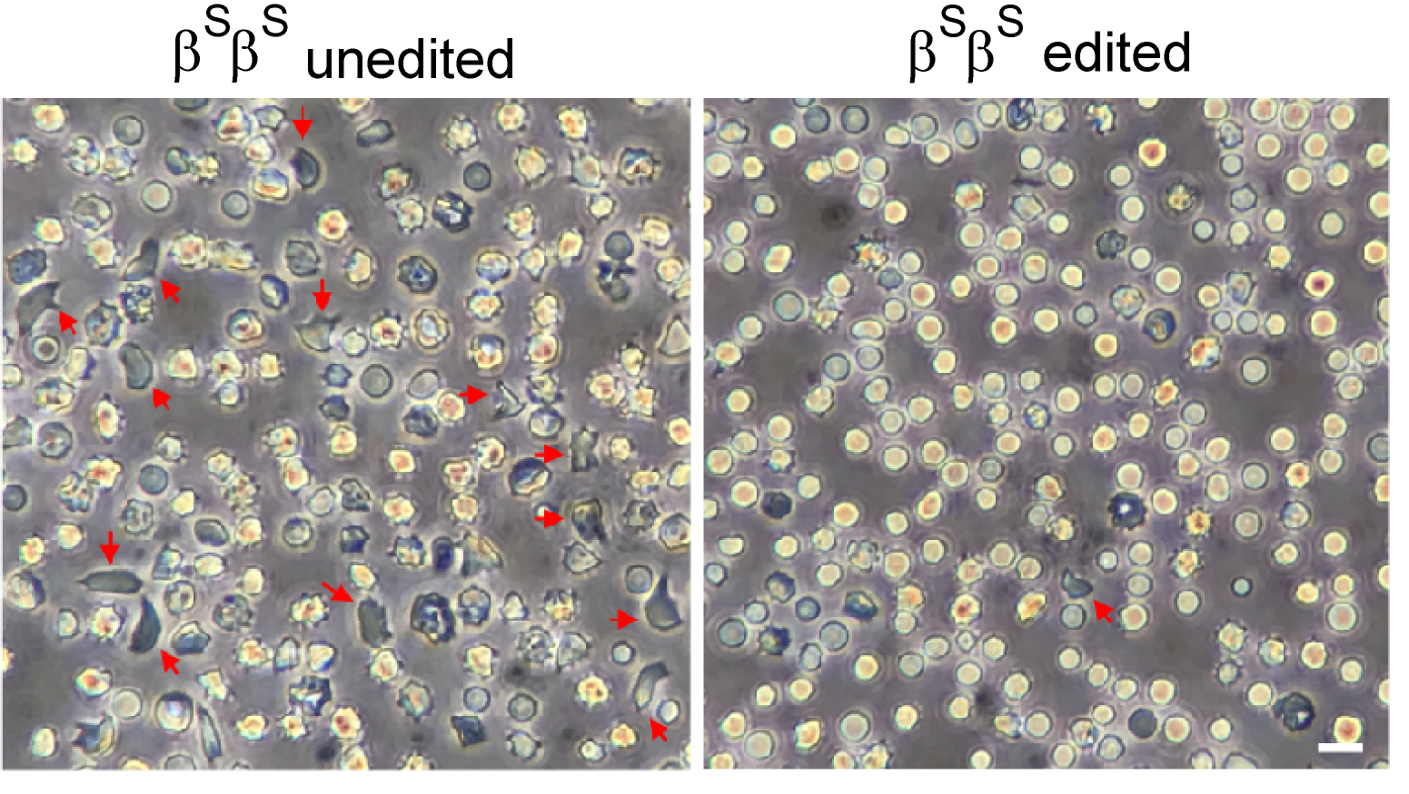
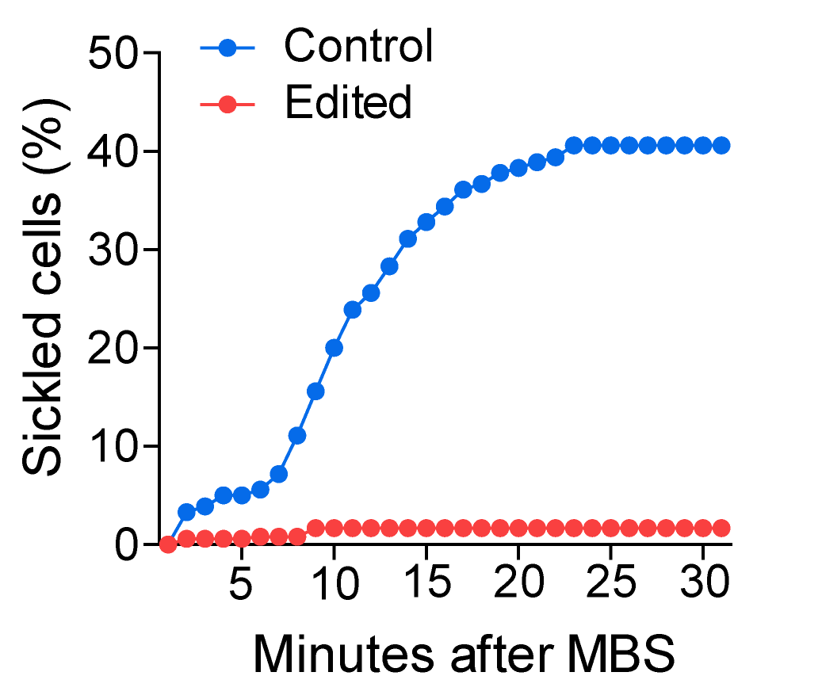
Therapeutic BCL11A enhancer editing of SCD patient cells
• Reversal of sickling propensity in edited SCD primary cells
Unedited SCD enucleated erythroid cells derived from engrafting HSCs demonstrated robust in vitro sickling following sodium metabisulfite (MBS) treatment, edited SCD cells were resistant to sickling.
Notes:
CD34⁺ HSPCs were collected from the bone marrow of engrafted mice subject to in vitro erythroid differentiation. While unedited SCD enucleated erythroid cells derived from engrafting HSCs demonstrated robust in vitro sickling following MBS treatment, edited SCD cells were resistant to sickling.

Slide 22
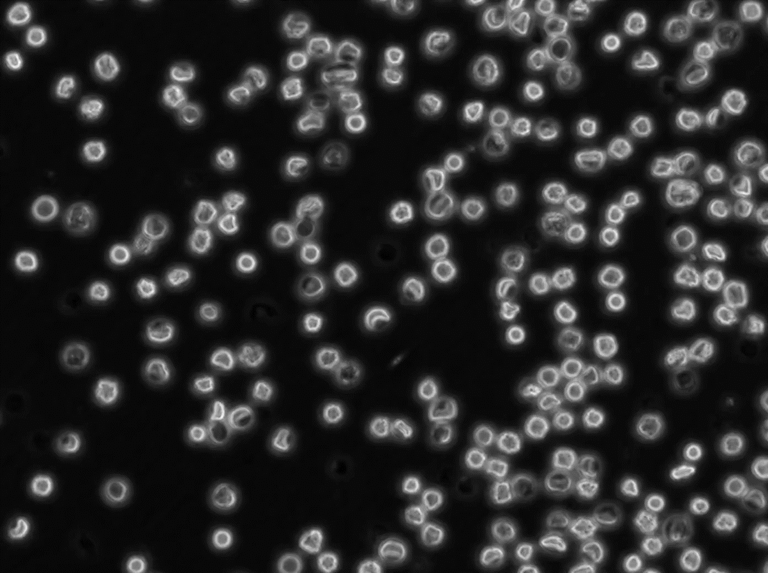
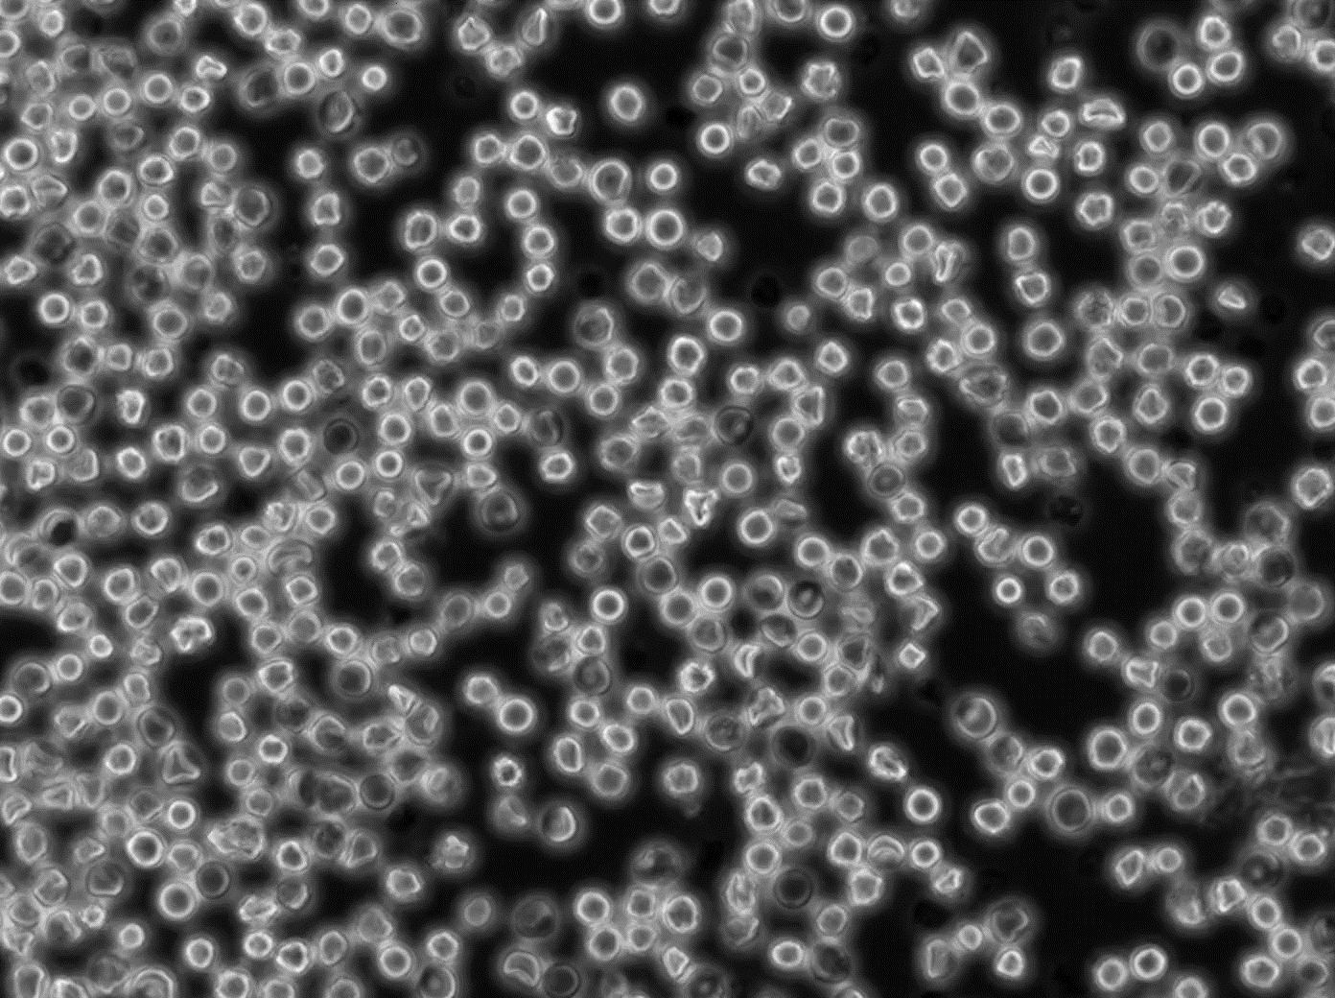
Editing BCL11A enhancer in SCD patient HSCs prevents sickling
β^{S}β^{S} unedited
β^{S}β^{S} edited
Notes:
edited SCD cells were resistant to sickling

Slide 23
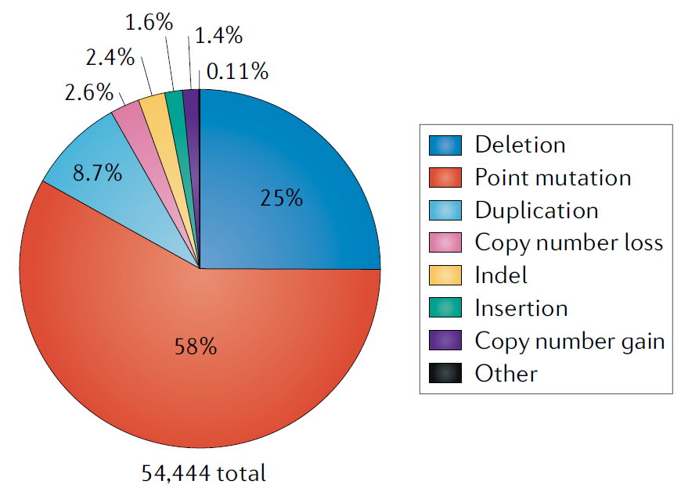
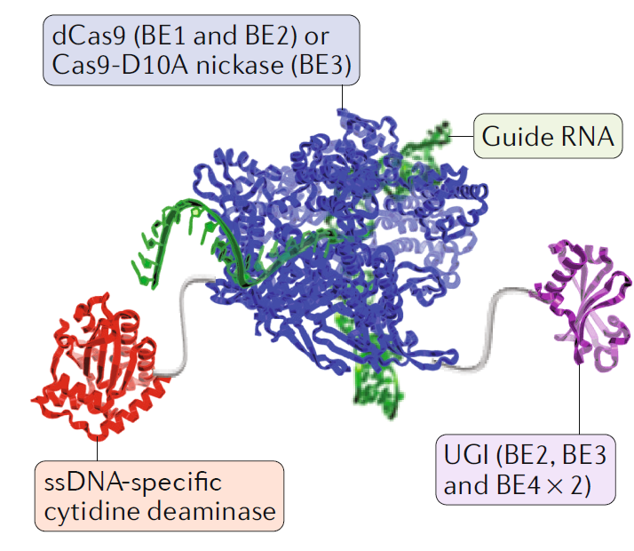
Therapeutic base editing of hematopoietic
stem cells
58%: point mutations
Base editor
Rees et al. Nature Reviews Genetics (2018)
The feasibility of base editing in HSCs to enable durable therapeutic modification of blood
Notes:
Here I will show you another genome editing tool for HSC. Because most of the genetic diseases are caused by point mutation. Base editing by nucleotide deaminases linked to programmable DNA-binding proteins represents a promising approach to permanently corrected the point mutation and remedy blood disorders.

Slide 24
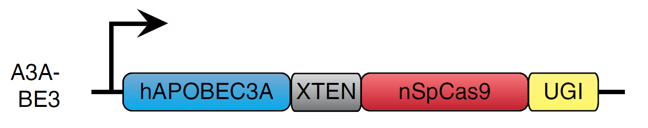
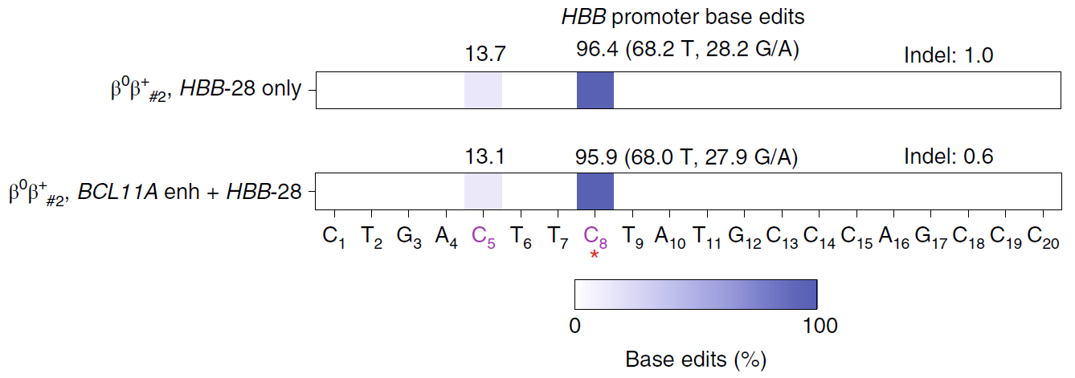
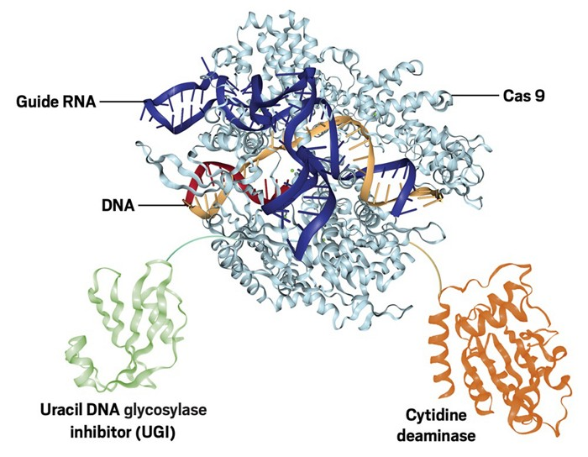
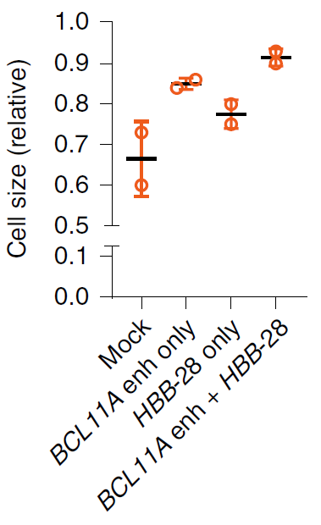
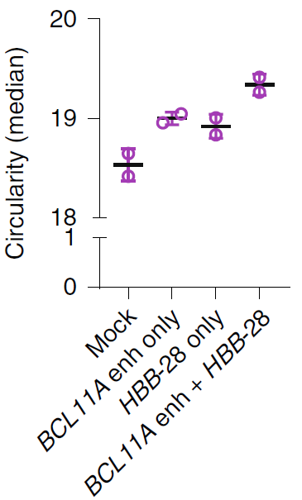
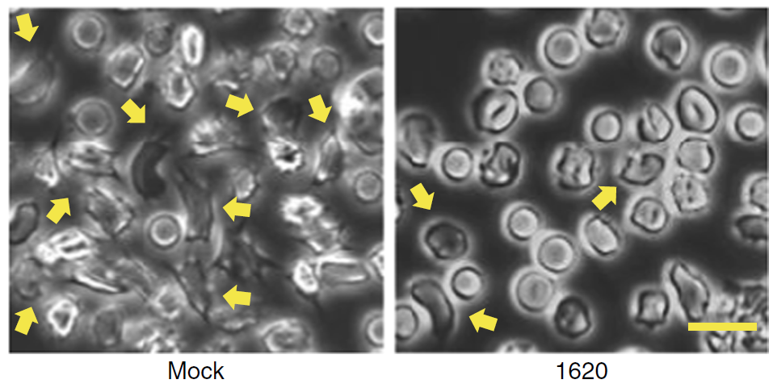
Therapeutic and multiplex base editing
Application of A3A(N57Q)-BE3 base editor in HSC
Promoter
HBB
Cure β-thalassemia or sickle cell disease
Zeng and Wu et al. Nature Medicine (2020)
Notes:
Our results demonstrate the potential of RNP base editing of human HSPCs as a feasible alternative to nuclease editing for HSC-targeted therapeutic genome modification. We can correct two mutations located at two different loci to cure beta thalassemia or sickle cell disease. More importantly, this approach could be adapted to more blood diseased caused by point mutation.

Slide 25
Therapeutic genome editing
Principle and applications of CRISPR genome editing
Therapeutic genome for β-hemoglobin disorders
Future?

Slide 26
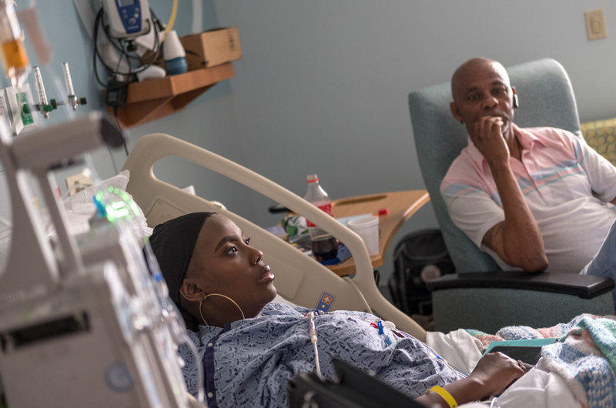
Clinical Trial
In 2018, Vertex and CRISPR Therapeutics initiated a Phase 1/2 study evaluating CTX001 in subjects with transfusion-dependent beta thalassemia.
https://www.npr.org/
The first attempt to use the gene-editing technique CRISPR to treat a genetic disorder in the U.S.
Notes:
The patent in Boston children’s hospital is licensed to CRISPR therapeutics.

Slide 27
Acknowledgments
Boston Children’s Hospital
Stuart Orkin
Matthew Canver
John P. Manis
David A. Williams
Christian Brendel
Massachusetts General Hospital
Luca Pinello
Kendell Clement
ECNU
Mingyao Liu
Dali Li
Daniel Bauer
Jing Zeng
Qiuming Yao
Mitchel Cole
Divya Vinjamur
Mir Hossain
Shuquan Rao
Chunyan Ren
Steven Coyne
Shuqian Xu
Falak Sher
Megan Hoban
University of Massachusetts
Scot Wolfe
Benjamin Roscoe
Pengpeng Liu
Kevin Luk
Brigham and Women’s Hospital
David Dorfman
St. Jude Children's Research Hospital
Shengdar Tsai
Cicera Lazzarrotto

