Slide 1

Base editor: a new generation of gene editing tool
Jia Chen
School of Life Science and Technology, ShanghaiTech University

Slide 2
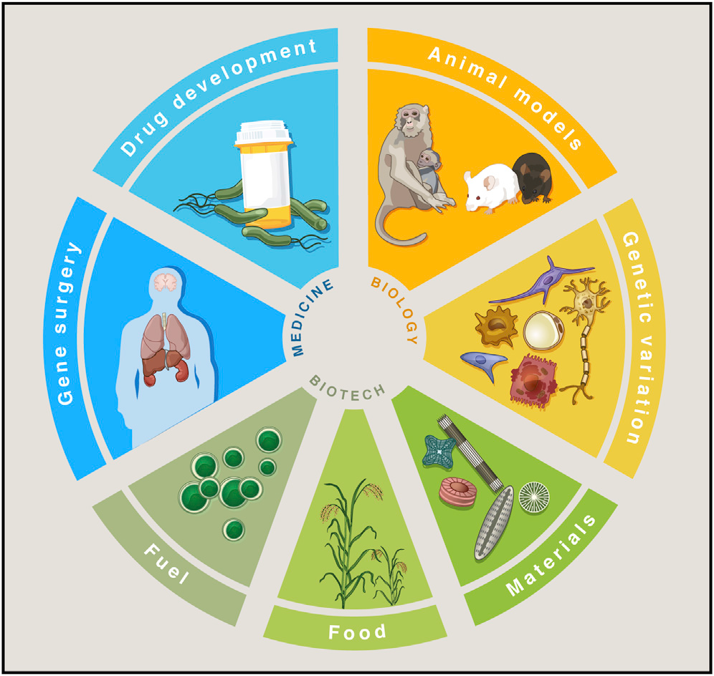
CRISPR/Cas9 gene editing system
Patrick D. Hsu, et al., Cell 2014 Jun 5;157(6):1262-78

Slide 3
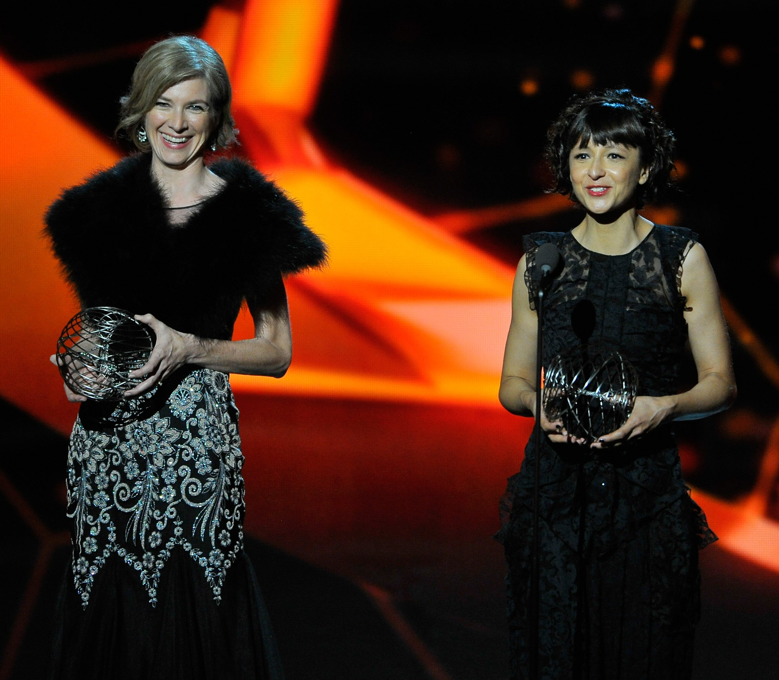
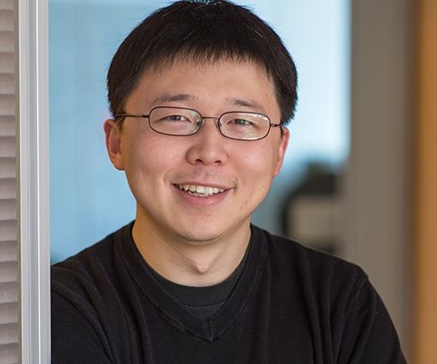
CRISPR/Cas9 Pioneers
Jennifer A. Doudna
National Academy of Sciences
American Academy of Arts and Sciences
National Academy of Medicine
Foreign Member of the Royal Society
Emmanuelle Charpentier
Foreign Member of National Academy of Sciences
Royal Swedish Academy of Sciences
German National Academy of Sciences
Feng Zhang
National Academy of Sciences
American Academy of Arts and Sciences

Slide 4
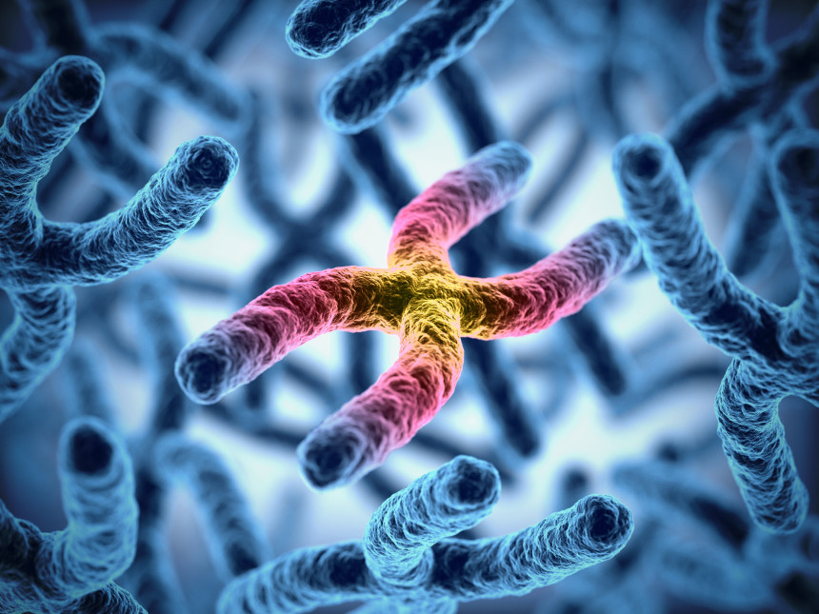
Genetic disorder/Rare disease

Slide 5
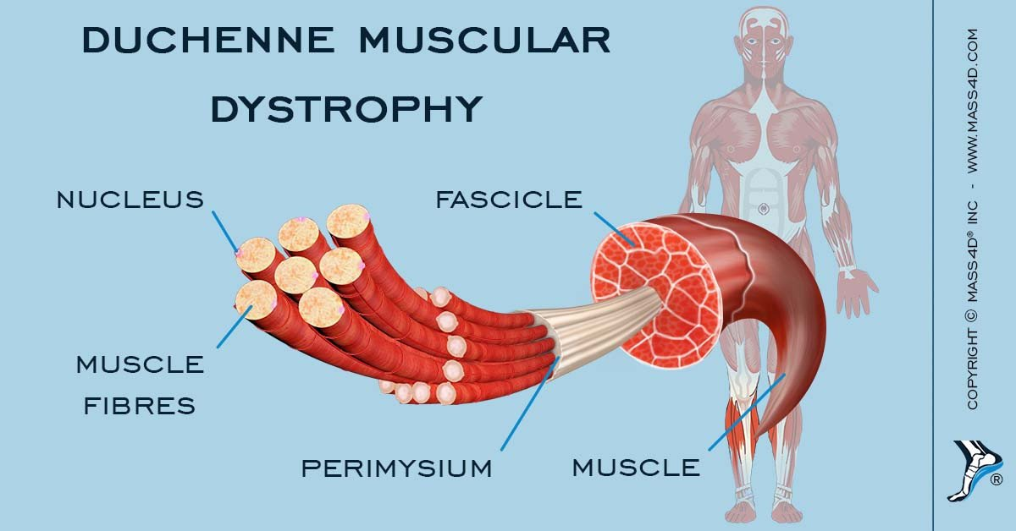
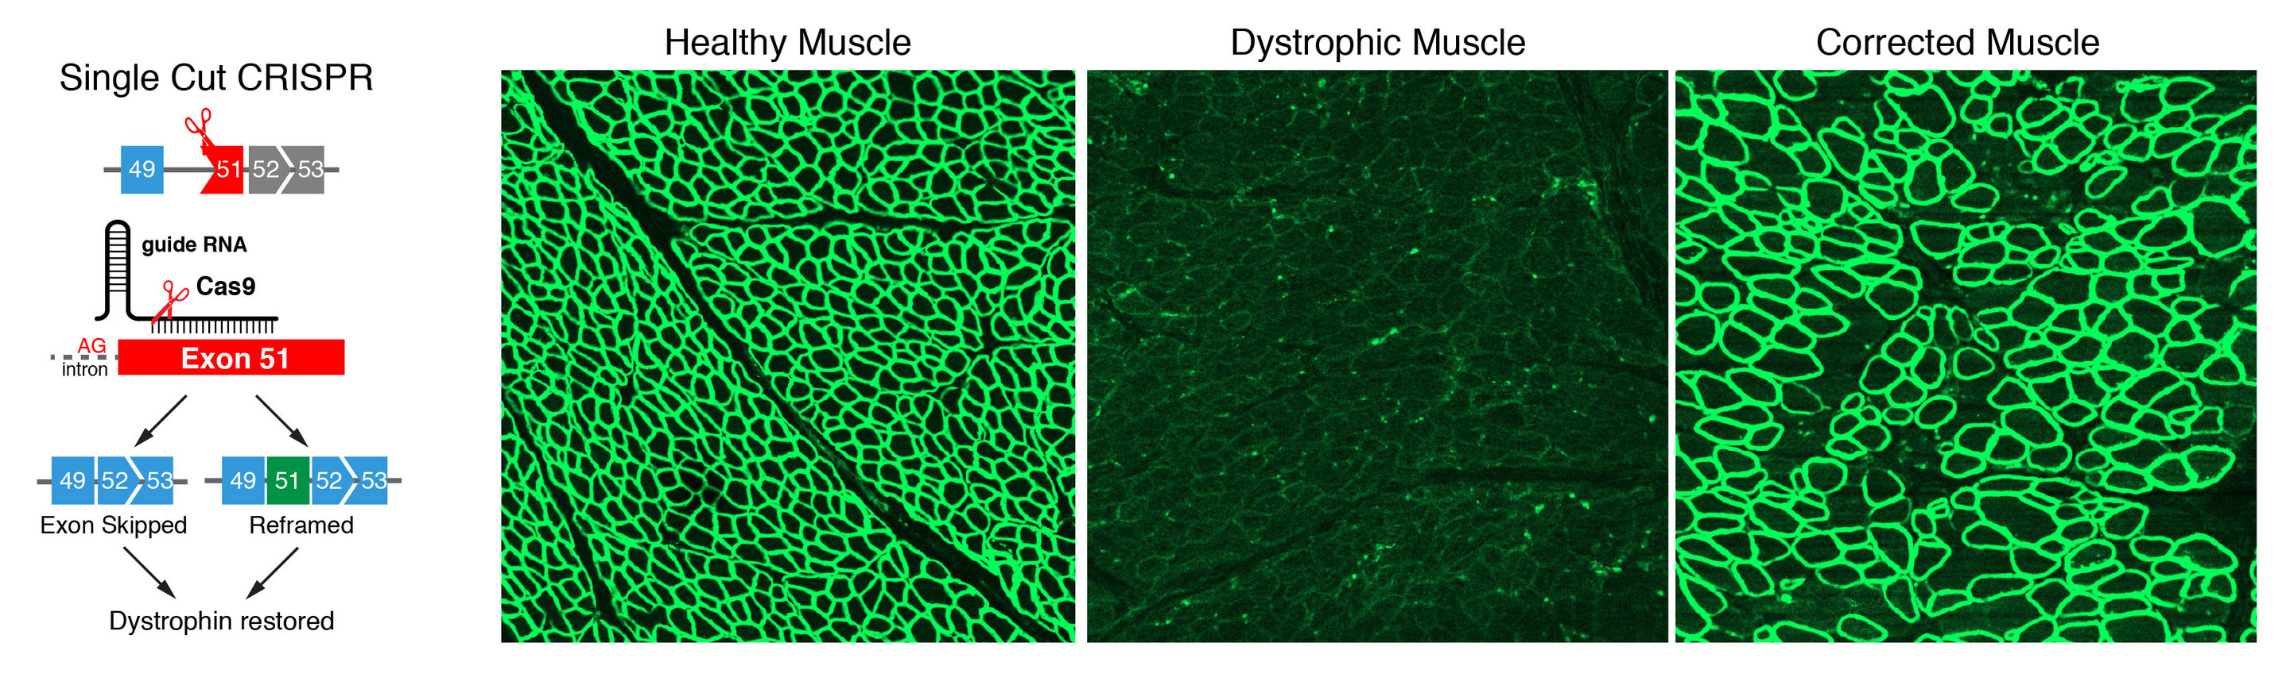
Duchenne muscular dystrophy

Slide 6
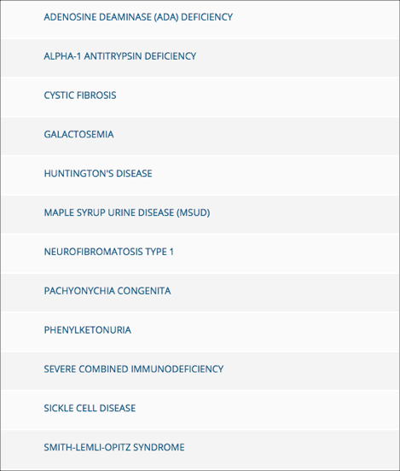
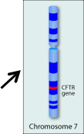
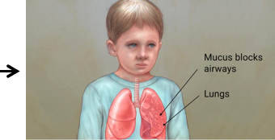
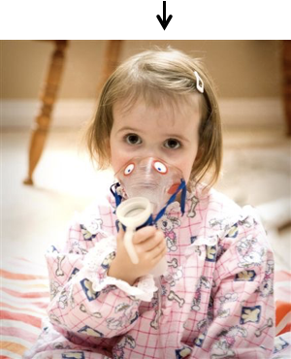
Genetic disorder derived by single base mutation

Slide 7
CRISPR/Cas9 is inefficient in precise gene correction
Komor et al., Cell, 2017, 168: 20–36

Slide 8
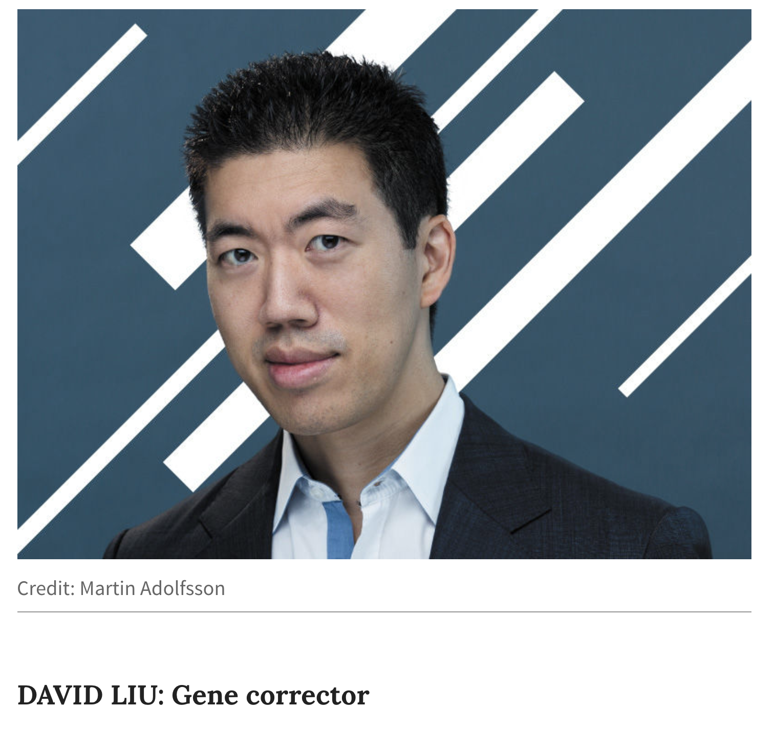
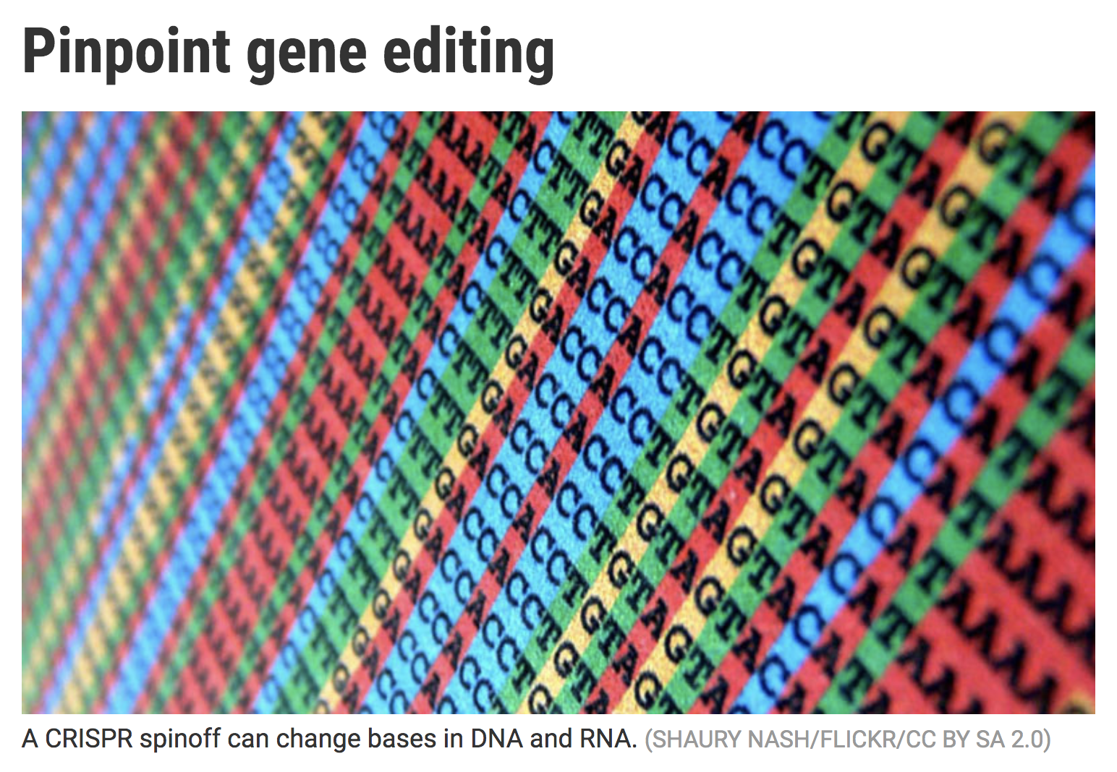
Base editing: the next generation of gene editing
#1 in Nature’s 10 people of 2017
Top 10 in Science’s breakthrough of 2017
刘如谦
Director of the Merkin Institute of Transformative Technologies in Healthcare
Broad Institute Core Institute Member and Vice-Chair of the Faculty
Howard Hughes Medical Institute Investigator
Harvard University Professor of Chemistry and Chemical Biology

Slide 9
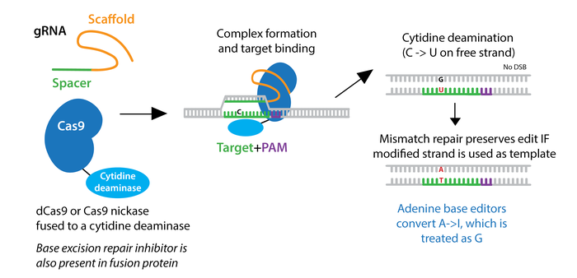
Base editing: the next generation of gene editing

Slide 10
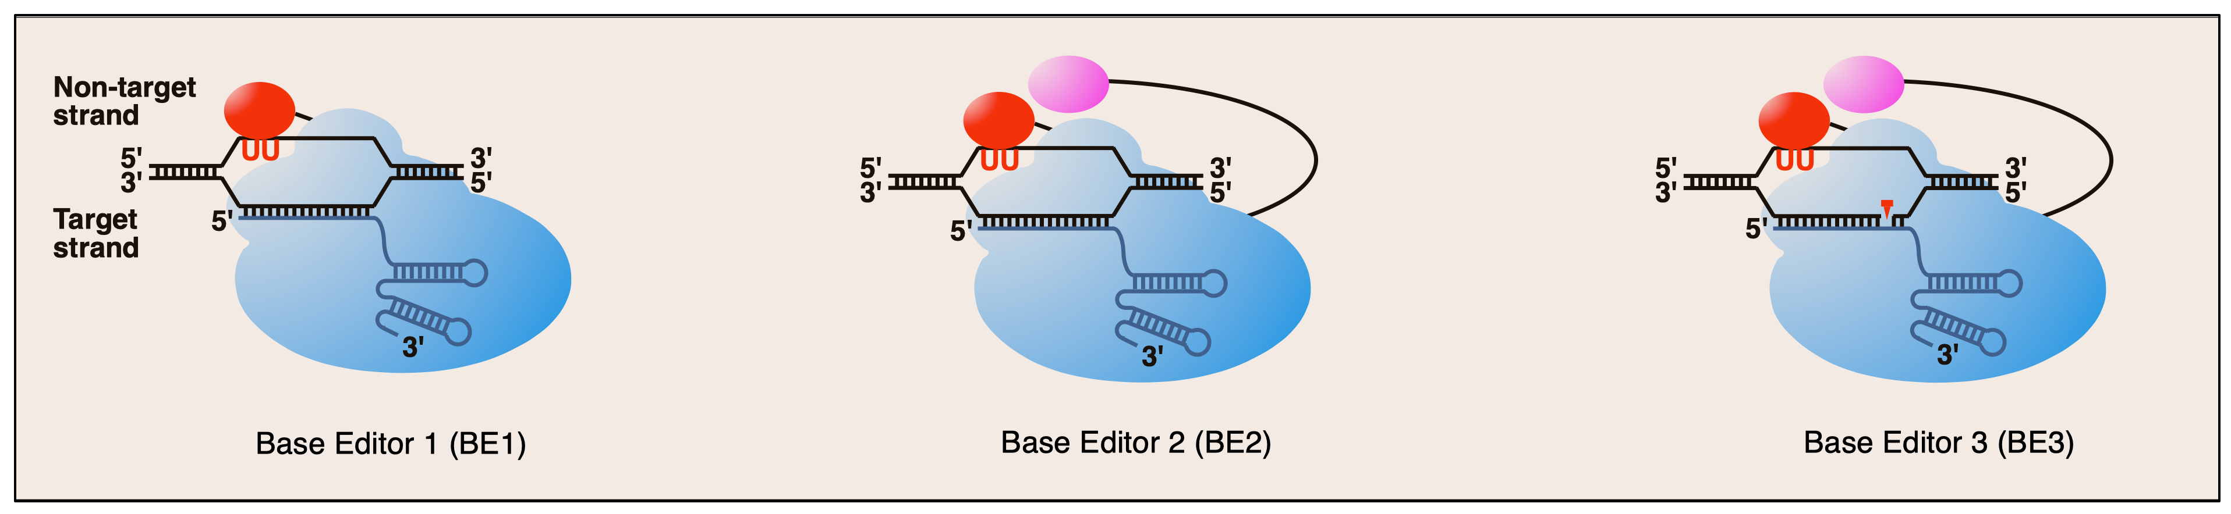
Side-products of base editor
Komor et al., Nature, 2016, 19: 420-4
Yang et al., J Genet Genomics, 2017, 44: 423-437

Slide 11
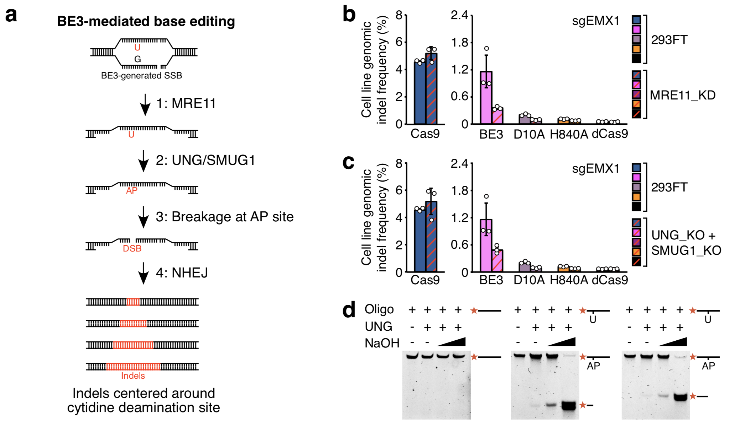
Mechanism of nCas9-BE3-induced indel formation
Lei et al., Nat Stru Mol Biol, 2018, 25:45-52

Slide 12
Mechanism of nCas9-BE-induced indel formation
DNA replication
Gap filling
nCas9 dissociation & TS resection
Uracil DNA glycosylases
Spontaneous breakage
TLS DNA polymerase
NHEJ
DNA replication
Wang et al., Cell Res, 2017, 27:1289-1292

Slide 13
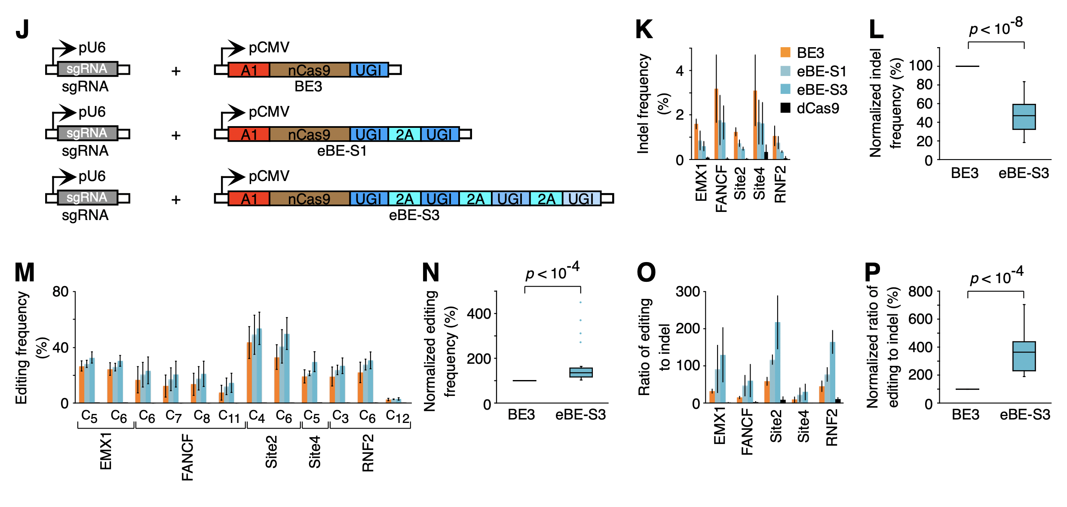
Enhanced base editing mediated by enhanced base editor (eBE)
Wang et al., Cell Res, 2017, 27:1289-1292

Slide 14
Base editing with a Cpf1-cytidine deaminase fusion
Zaidi et al., Trans Plant Sci, 2017, 22: 550-553

Slide 15
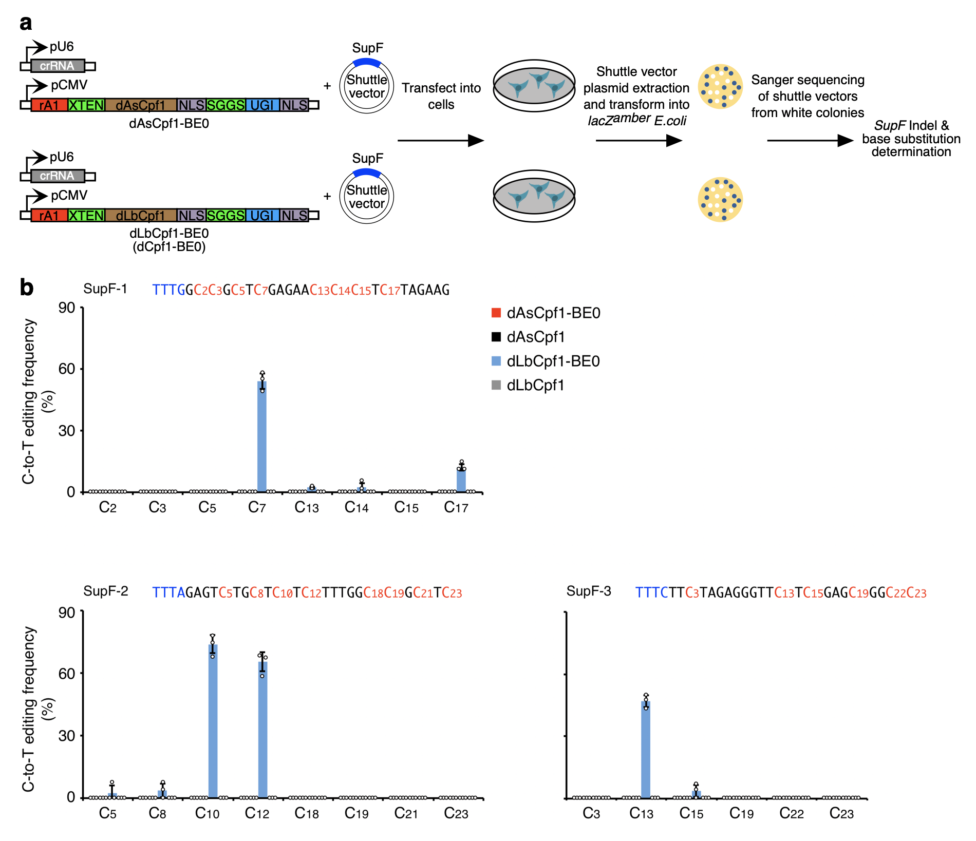
Base editing can be mediated by dLbCpf1 but not dAsCpf1
Li et al., Nat Biotechnol, 2018, 36: 324-327

Slide 16
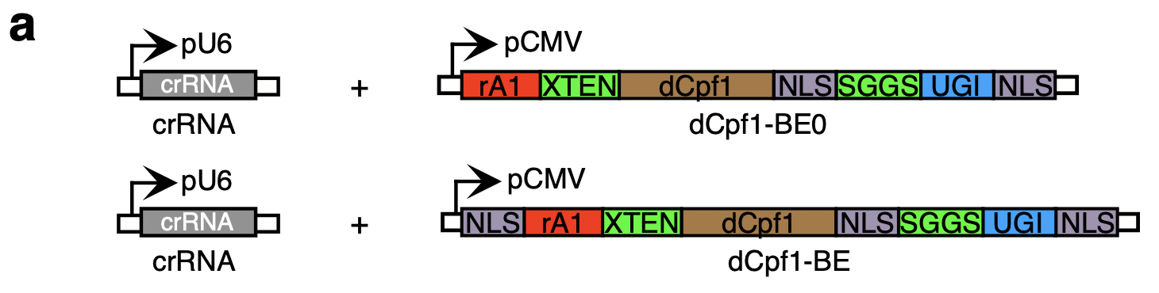
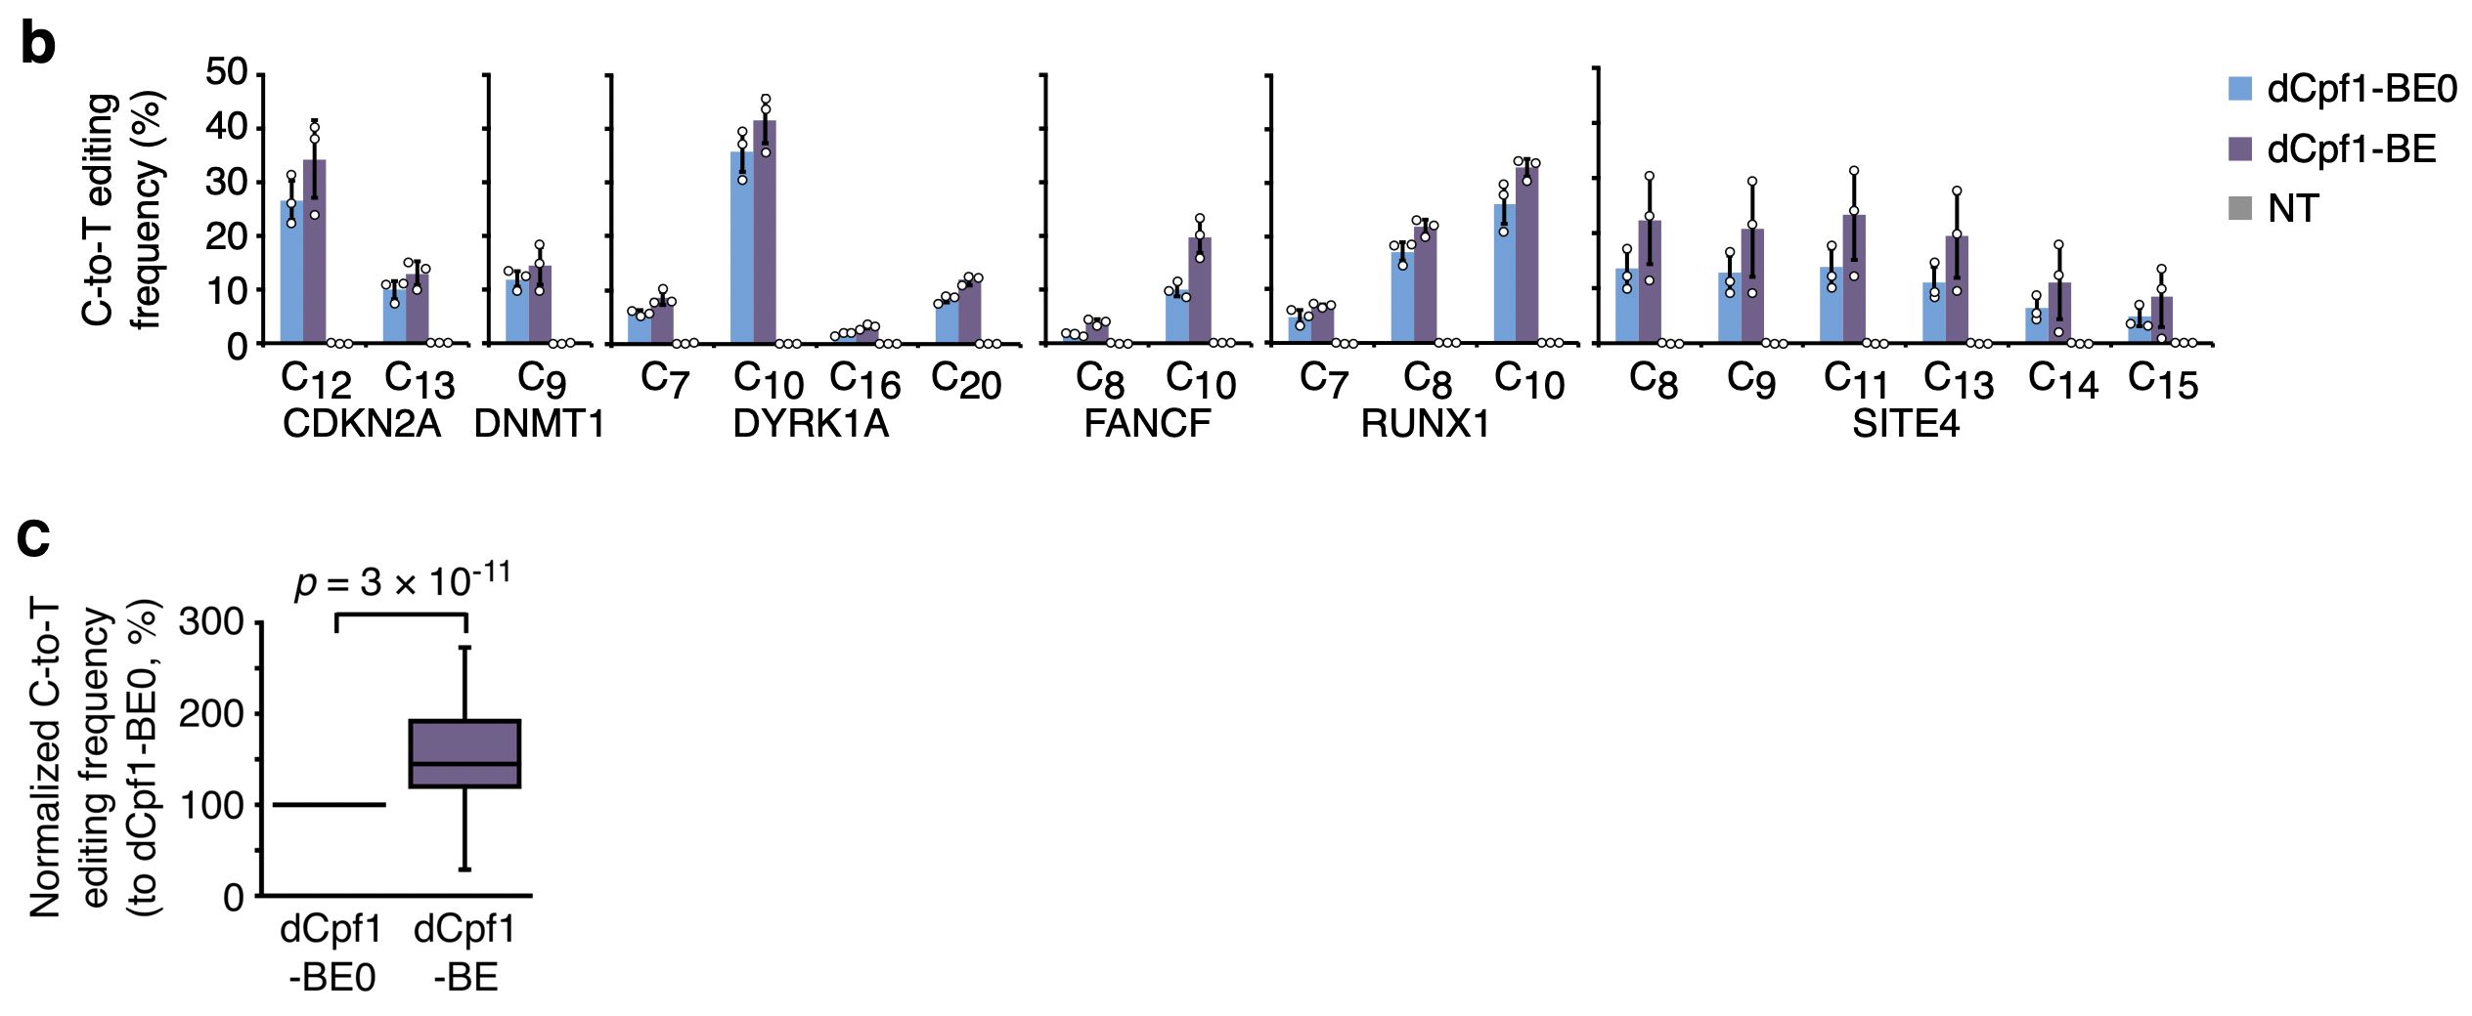
An extra N-terminal NLS can increase the base editing efficiency
Li et al., Nat Biotechnol, 2018, 36: 324-327

Slide 17
Base editing with a Cpf1-cytidine deaminase fusion

Slide 18
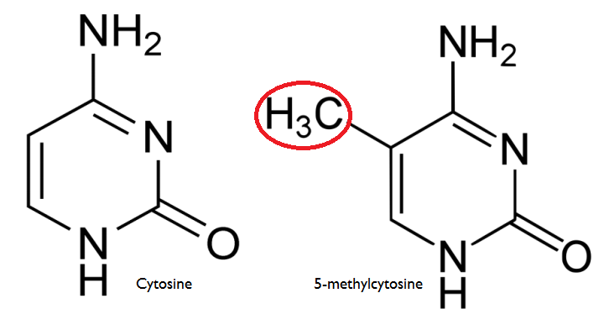
CpG methylation may impair rA1 (BE3)-mediated base editing
BE3
BE4
eBE
dCpf1-BE
SaBE3
xCas9-BE
rat APOBEC1 (rA1)

Slide 19
Effect of DNA methylation on BE3-mediated base editing
Wang et al., Nat Biotechnol, 2018, 36: 946-949

Slide 20
Effect of DNA methylation on BE3-mediated base editing
Wang et al., Nat Biotechnol, 2018, 36: 946-949

Slide 21
DNA methylation suppresses BE3-mediated base editing
Wang et al., Nat Biotechnol, 2018, 36: 946-949

Slide 22
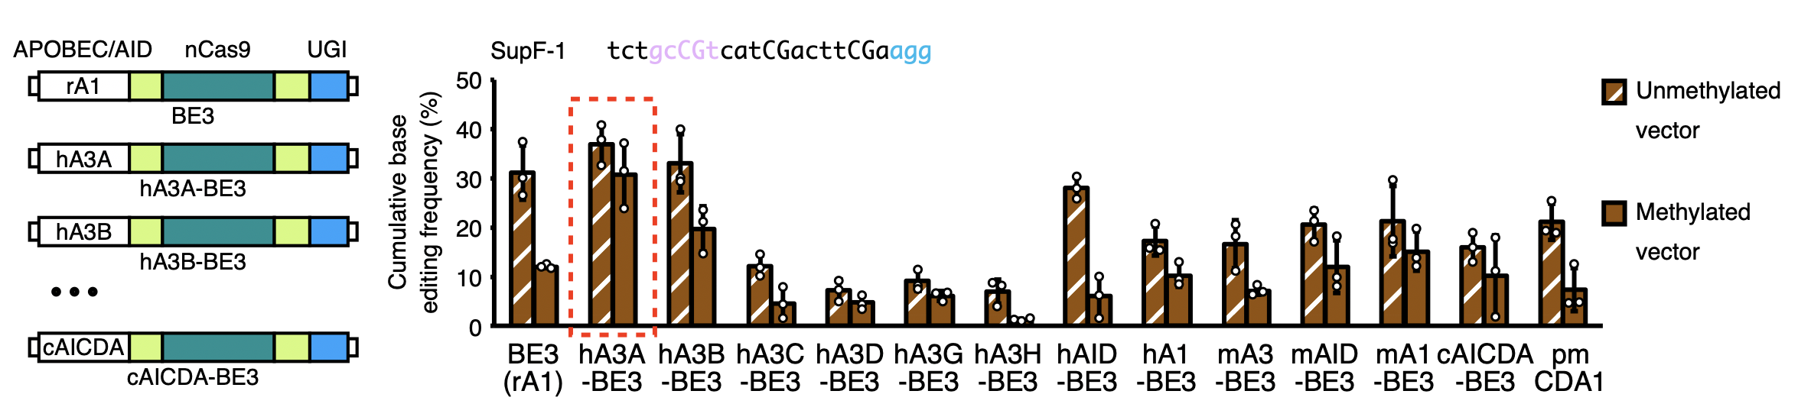
Human APOBEC3A (hA3A)-BEs mediate efficient base editing in methylated regions
Wang et al., Nat Biotechnol, 2018, 36: 946-949

Slide 23
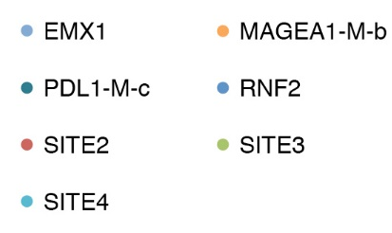
Protein engineering of hA3A to narrow the editing window
Wang et al., Nat Biotechnol, 2018, 36: 946-949

Slide 24
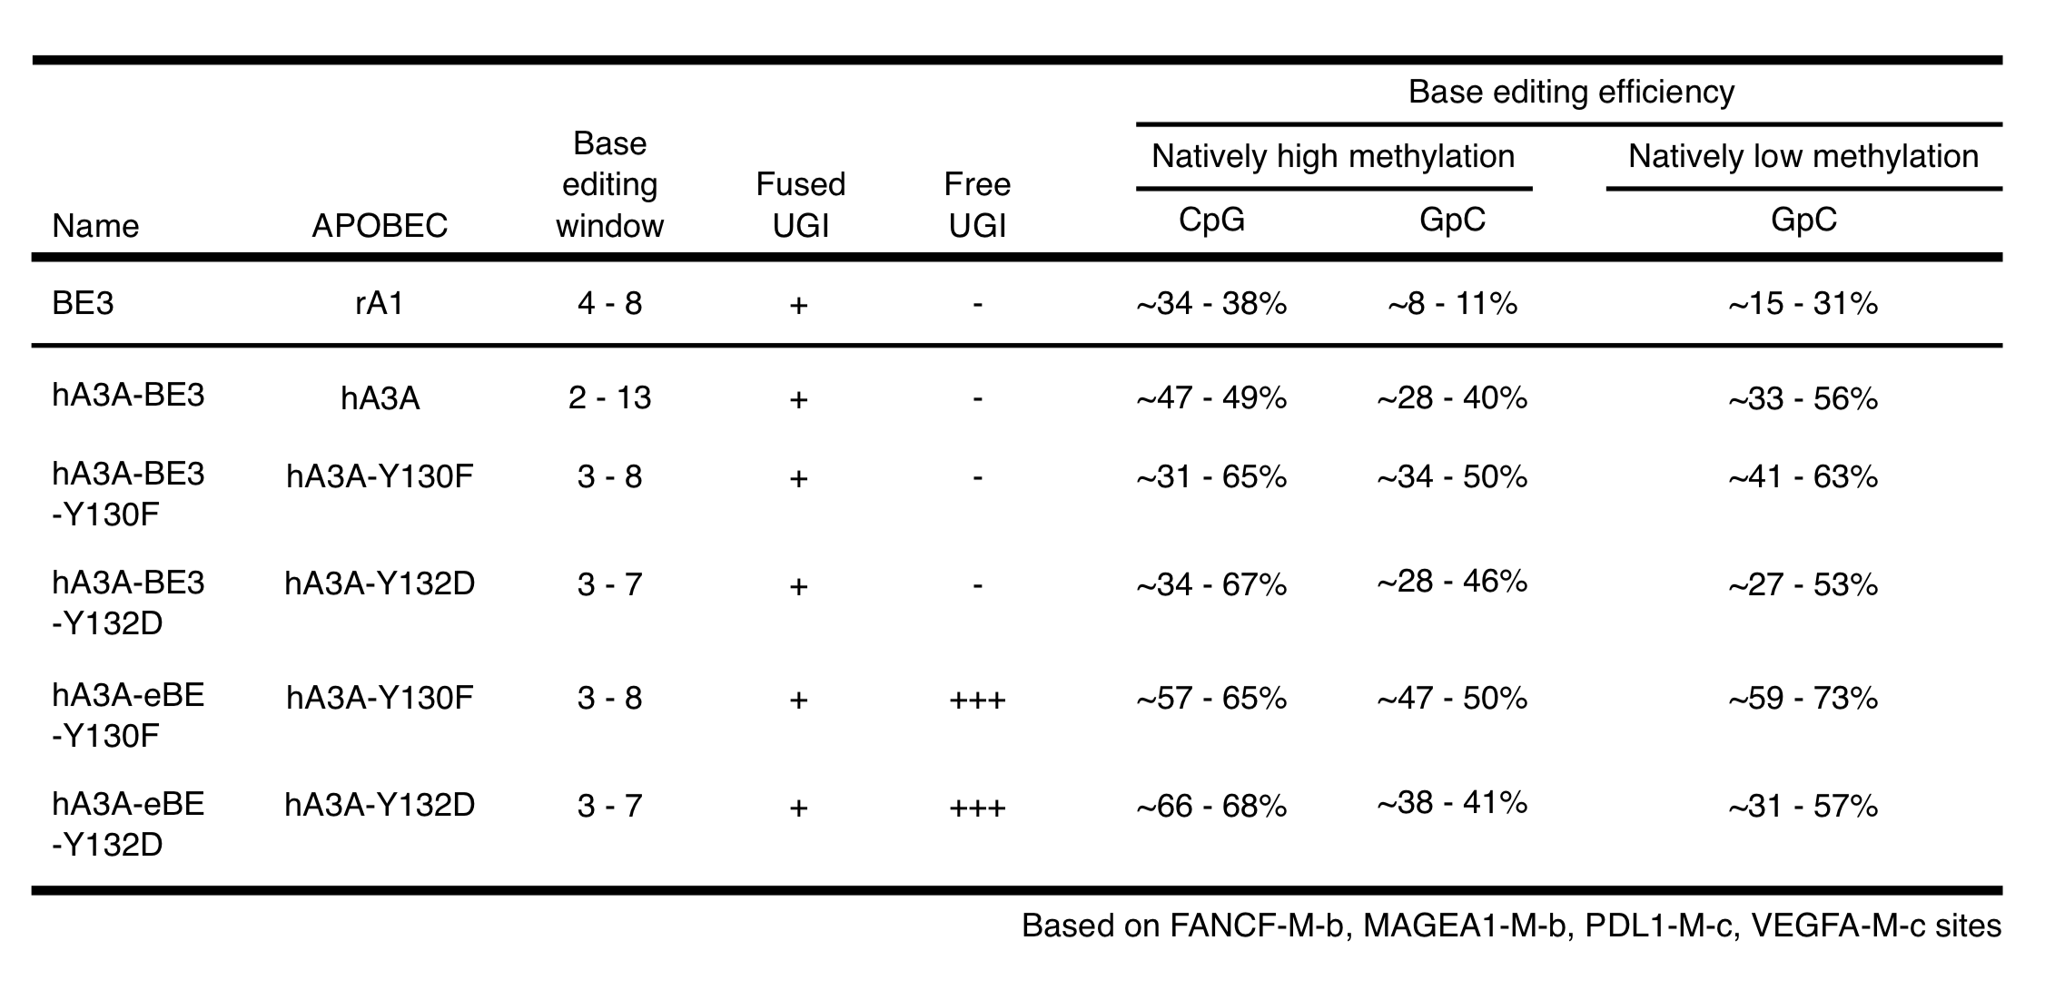
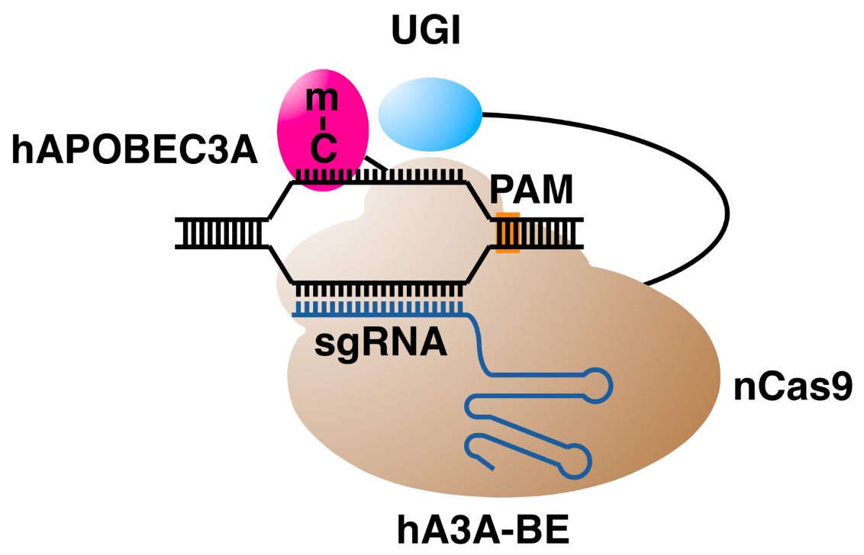
hA3A-BEs mediate efficient base editing in methylated regions

Slide 25
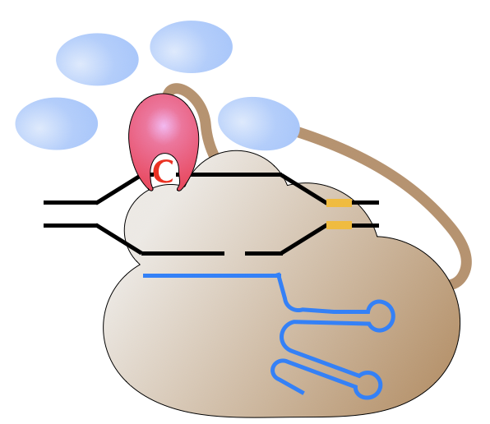
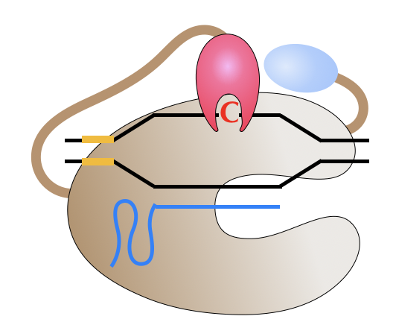
Base editors with different scopes or purposes
Enhanced base editors (eBEs) have been developed by suppressing uracil DNA glycosylase (UNG) with additional free UGI.
A series of dCpf1-BEs have been developed to extend the base editing scope to A/T-rich regions.
A series of hA3A-BEs have been developed to induce efficient base editing in methylated or G/C-rich regions.

Slide 26

Thank You!
ShanghaiTech University

