Slide 1
Phase Separation in Transcription Repression
19th Chinese-American Frontiers of Sciences Symposium
Pilong Li
Tsinghua University, Beijing, China

Slide 2
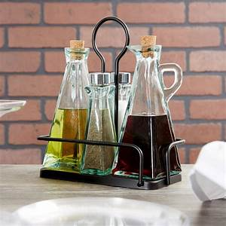
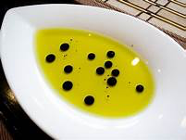
Phase Separation Phenomena in Daily Life
Phase separation: liquid-liquid phase separation, LLPS

Slide 3
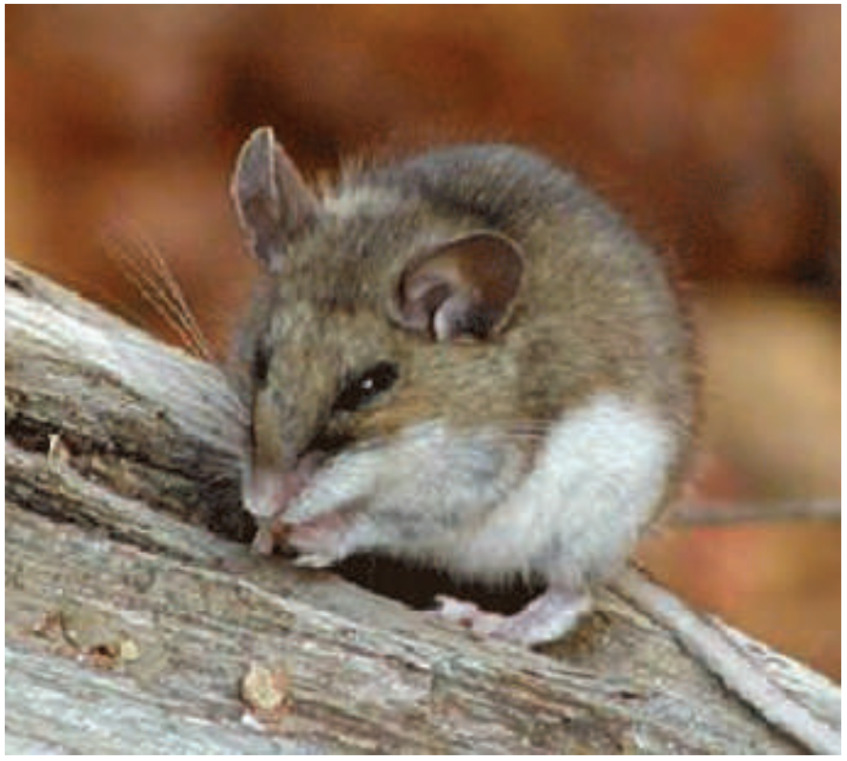
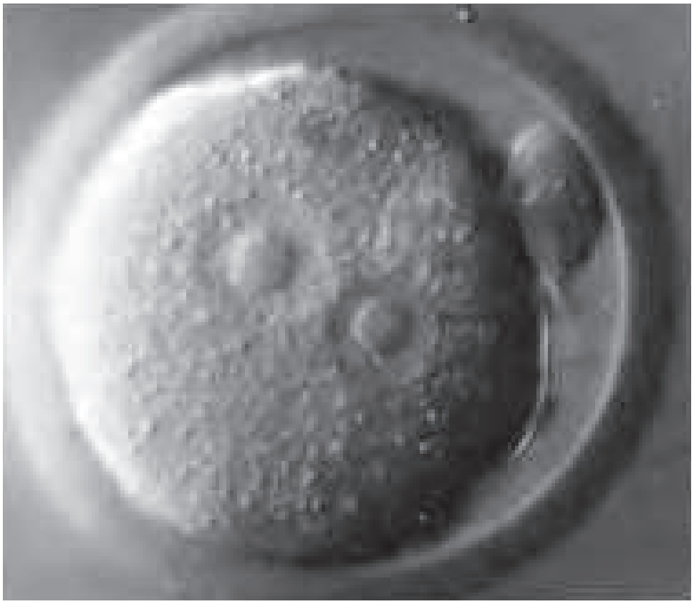
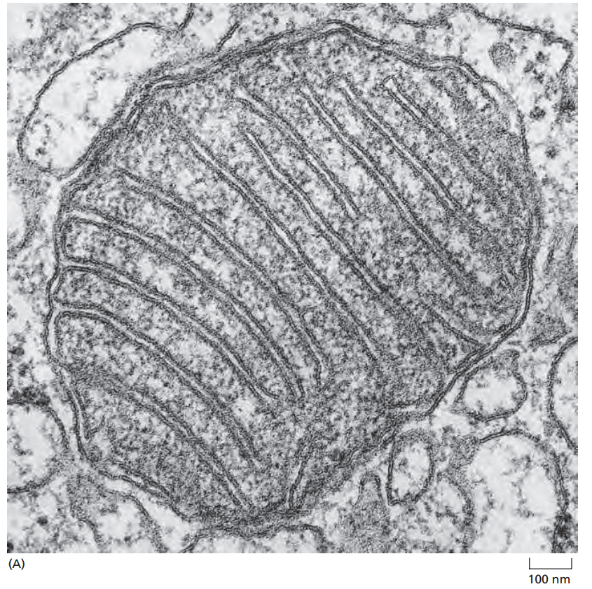
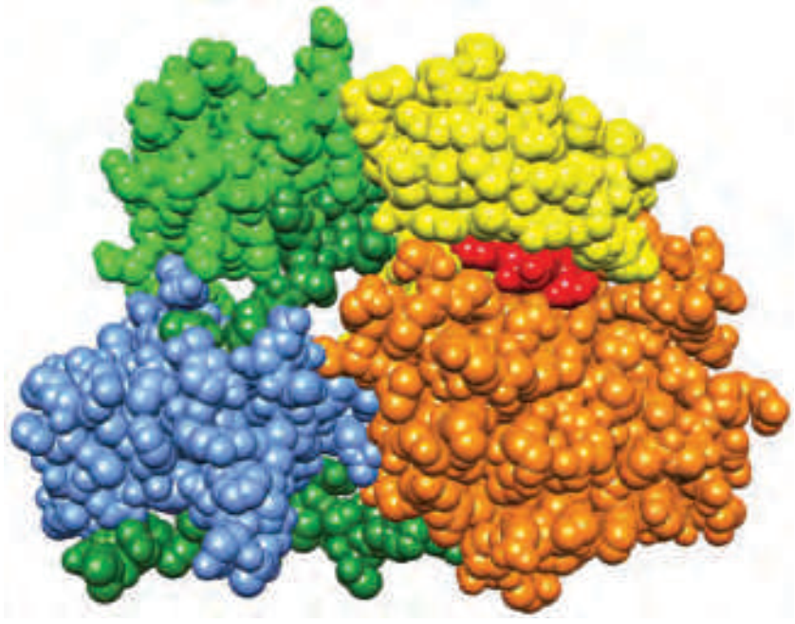
Scales of Biological Organization
Size Scales
Organisms: e.g. 10 cm
Cells: 10-100 μm
Organelles: 0.1-5 μm
Biomacromolecule: 1-10 nm
Mouse
Mouse egg
Mitochondrion
Protein
Molecular Biology of the Cell, 6th Edition
Liquid-liquid phase separation (LLPS) in cells?

Slide 4
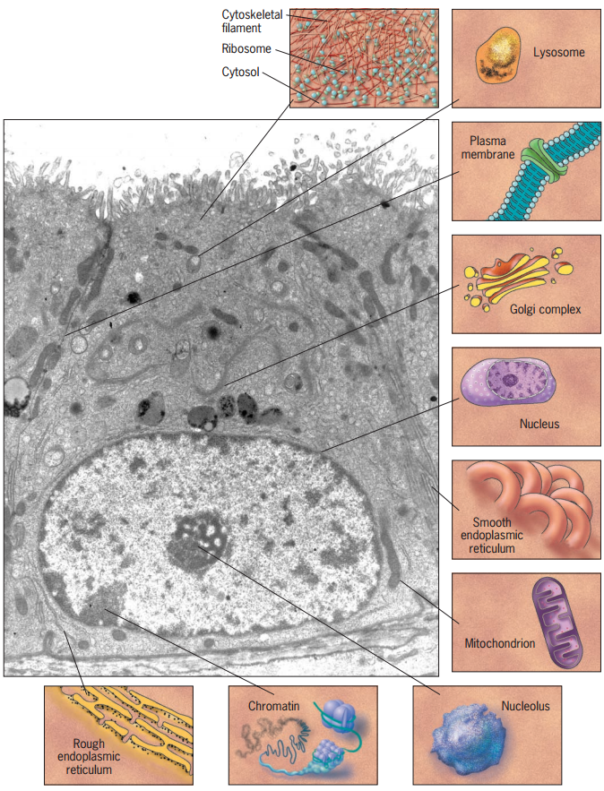
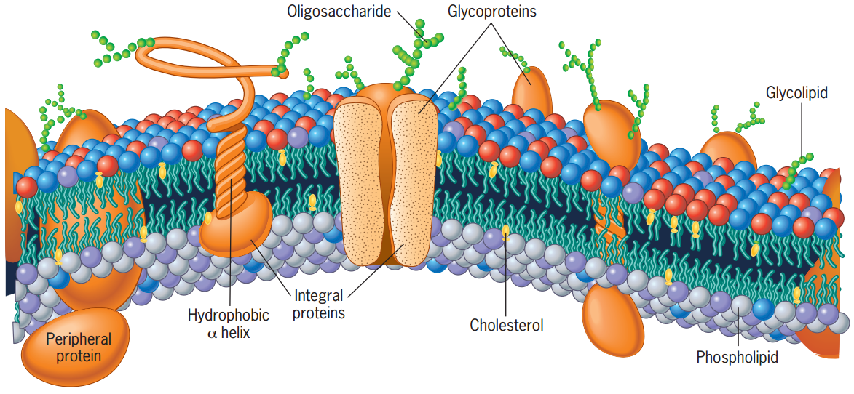
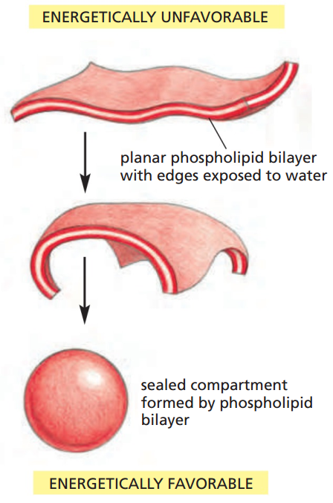
Subcellular Compartments/Organelles (I)
Conventional organelles
Membrane-bound
plasma
membrane
Lipid
bilayer
Molecular Biology of the Cell, 6th Edition
Cell and Molecular Biology, 6th Edition

Slide 5
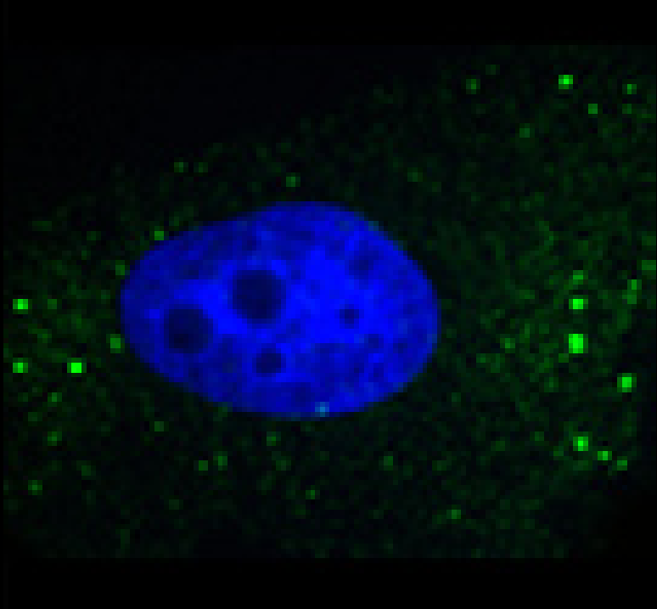
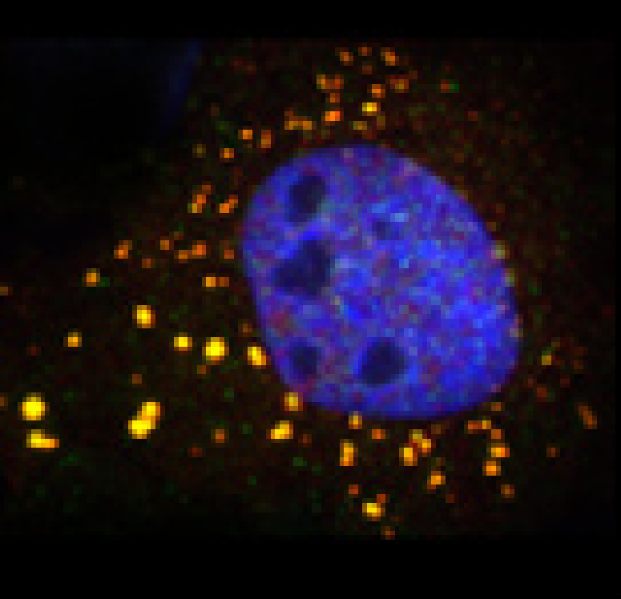
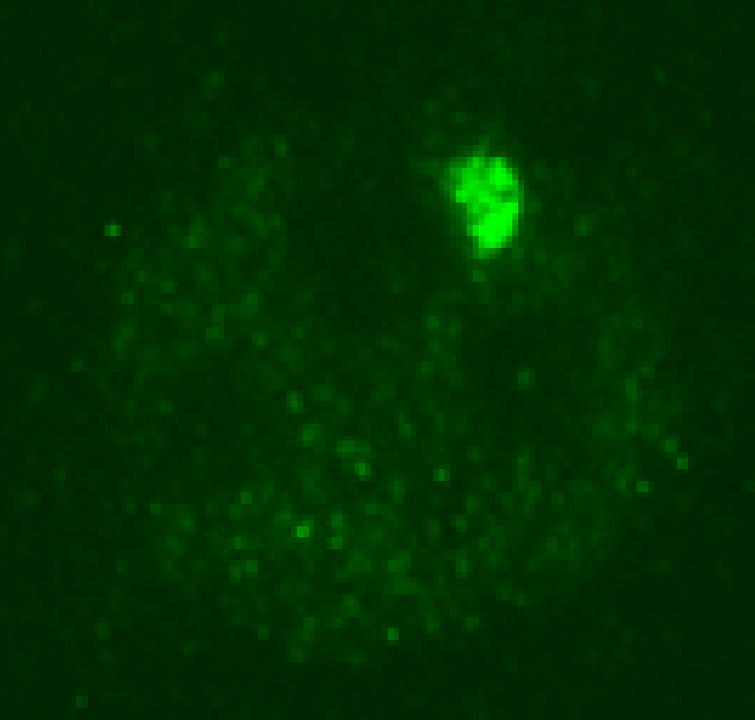
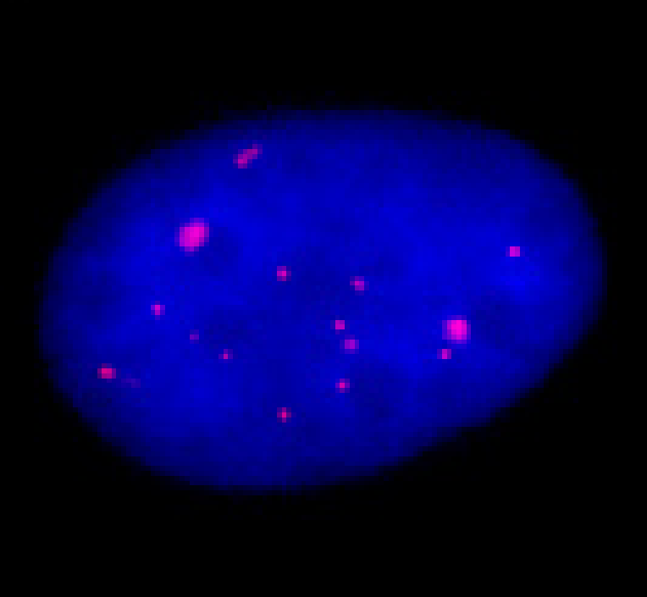
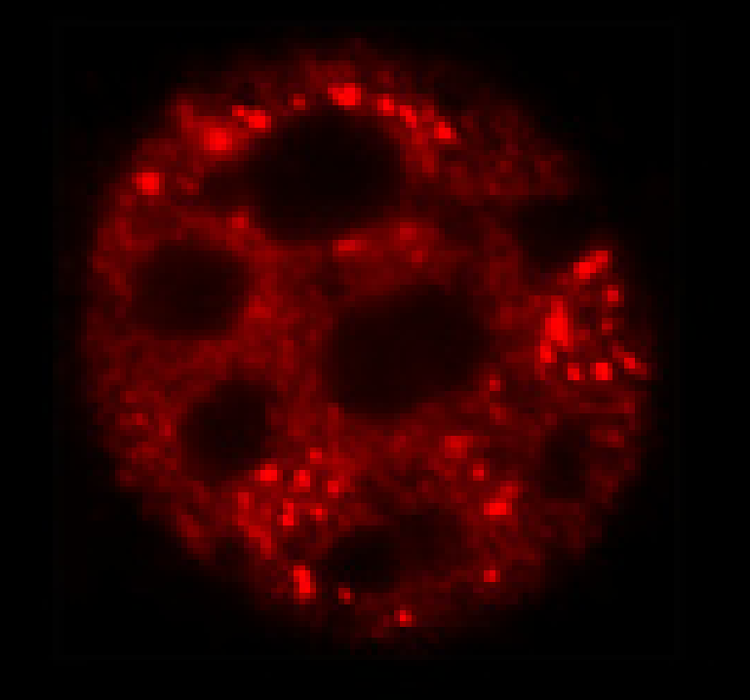
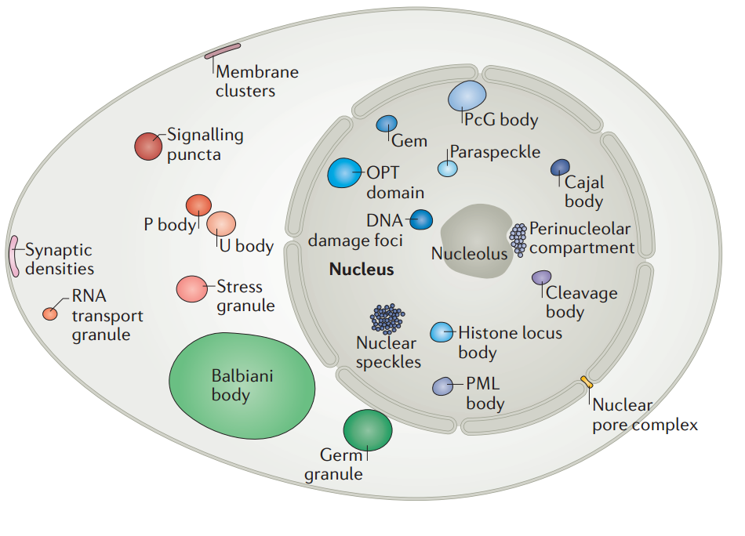
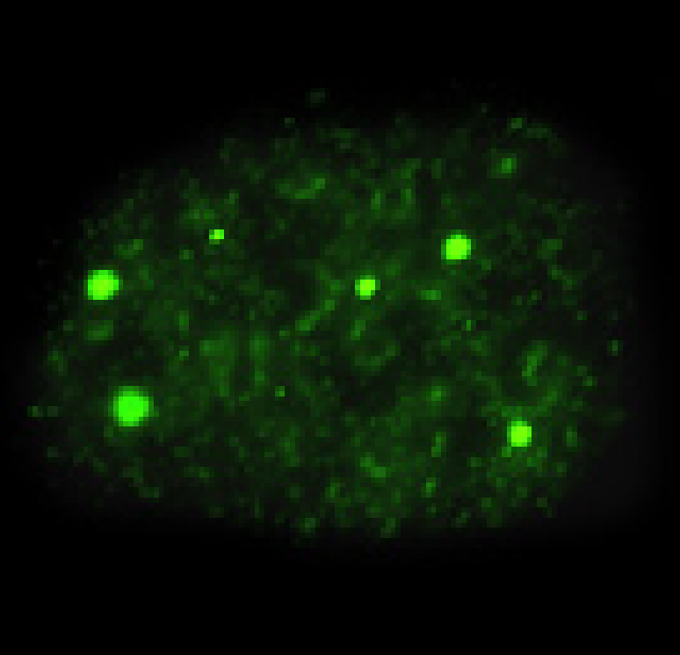
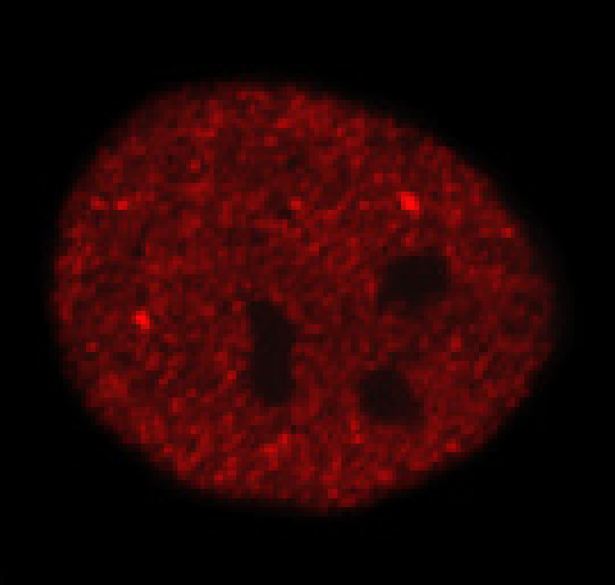
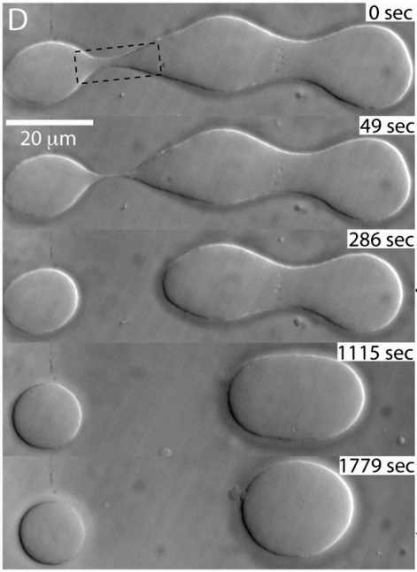
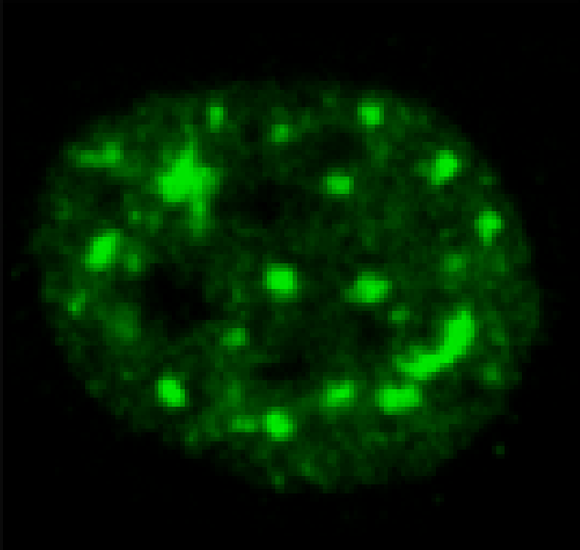
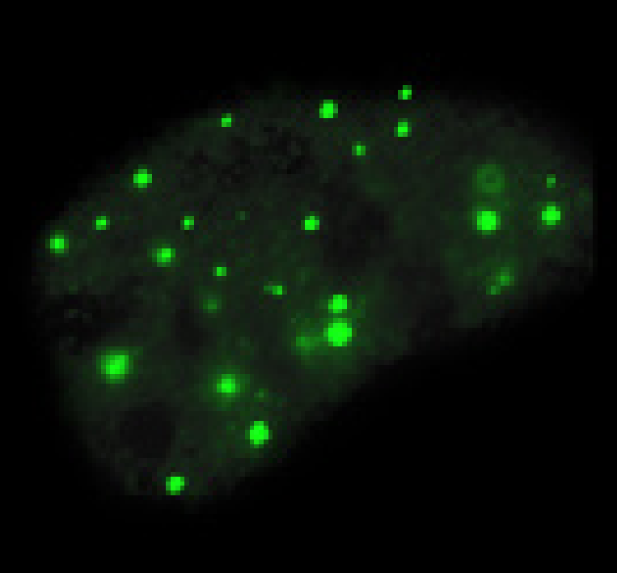
Subcellular Compartments/Organelles (II)
Membrane-less Organelles
P-granule Localization in Embryo
P body
Stress granule
OPT domain
PcG body
Paraspeckle
Cajal body
C. elegans
P Granules
Xenopus
Nucleolus
Liquid-like entities
demixed/separated
from surrounding
liquid environment
Cleavage body
Nuclear speckles
PML body
Hyman, Rosen et al., Nature Reviews (2017)
Spector, Cell (2006)
Brabgwynne, Hyman et al., Science (2009)
Brabgwynne, Hyman et al., PNAS (2011)

Slide 6
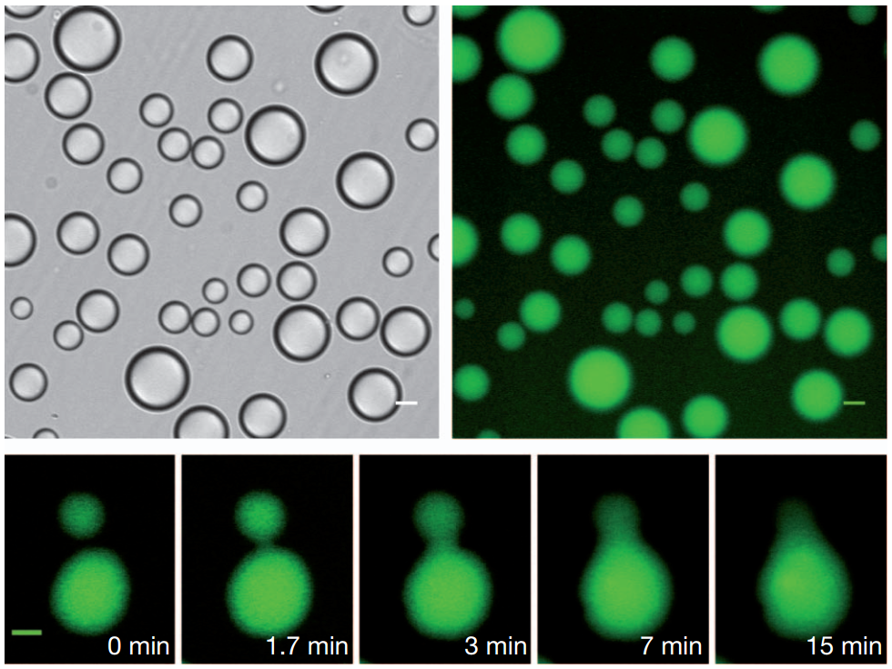
Multivalent Biomacromolecular Interactions Drive Phase Separation
Liquid-liquid phase separation
Dilute
phase
Cajal body
Condensed
phase
Li P, Rosen M et al., Nature (2012)
Notes:
Multivalent Interactions Drive Phase Separation

Slide 7
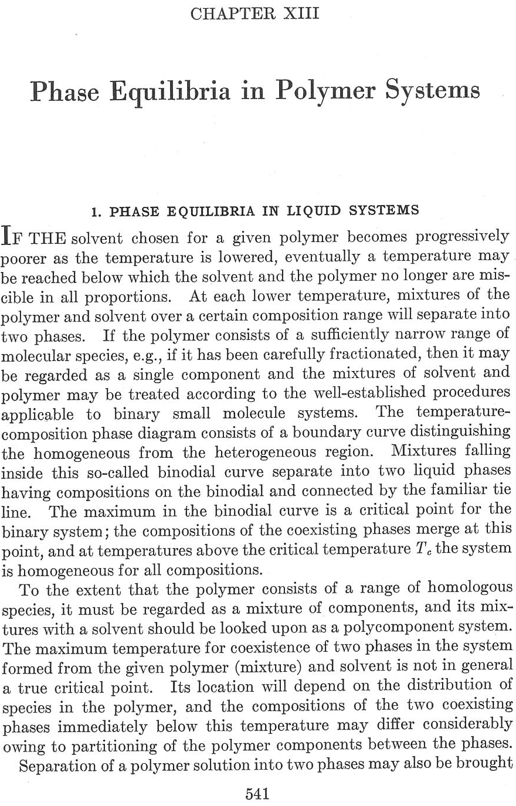
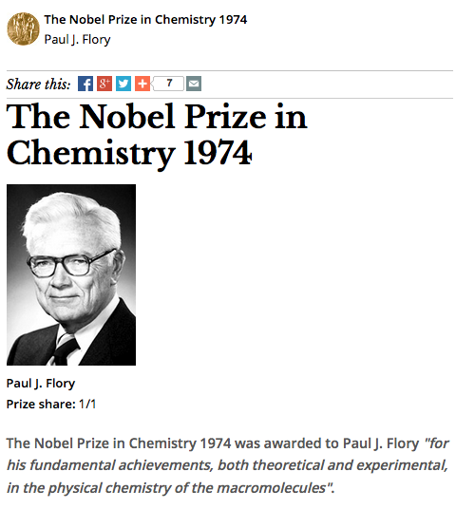
LLPS is a Well-known Phenomena in Polymer Chemistry
Notes:
Lewin's GENES XII 12th Edition
Molecular Biology of the Cell, 6th Edition
Zhang, H., et al. Sci China Life Sci (2020)

Slide 8
Representative Ways to Achieve Multivalency in Biology
Wu and Li, Chinese Science Bulletin (2019)

Slide 9
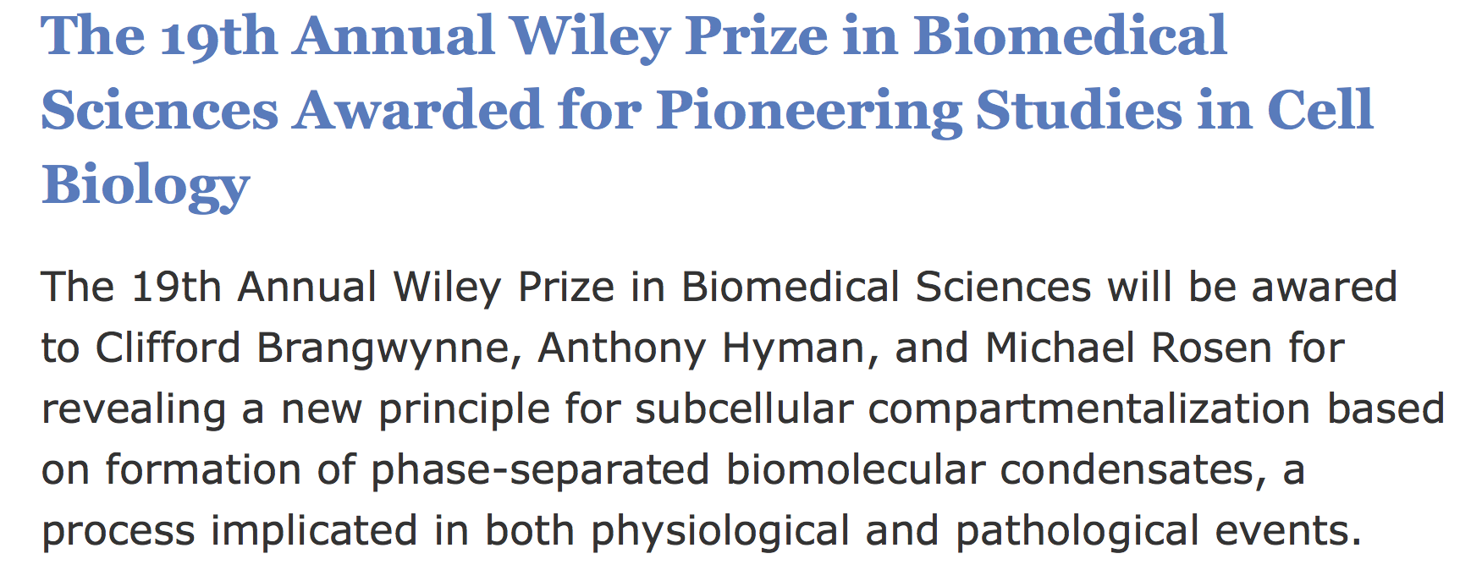
2020 Wiley Prize
Biomacromolecular LLPS becomes
a research field in biology.

Slide 10
Take-home Message from the Emerging Field
Multivalent biomacromolecular interaction-driven LLPS underlies the formation of membrane-less organelles in cells and perturbations to LLPS might cause various diseases

Slide 11
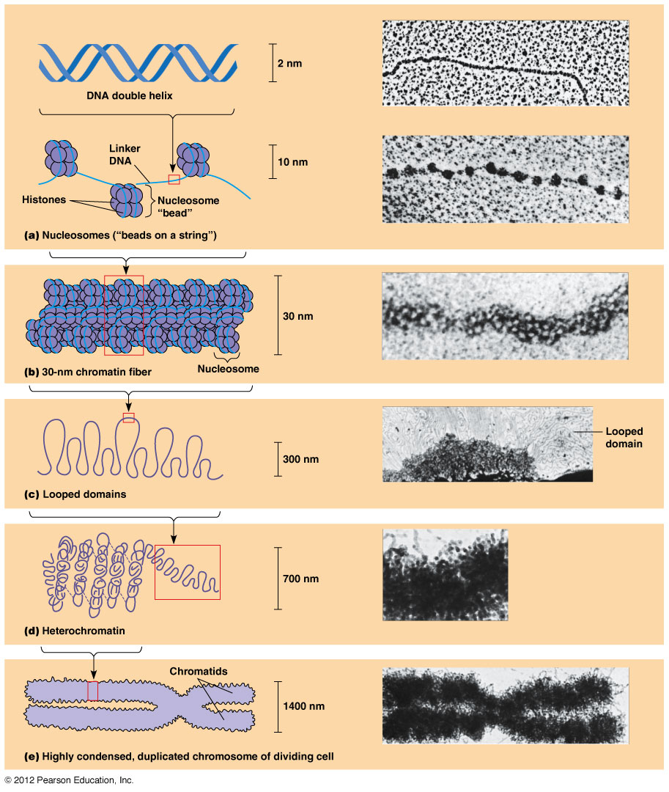
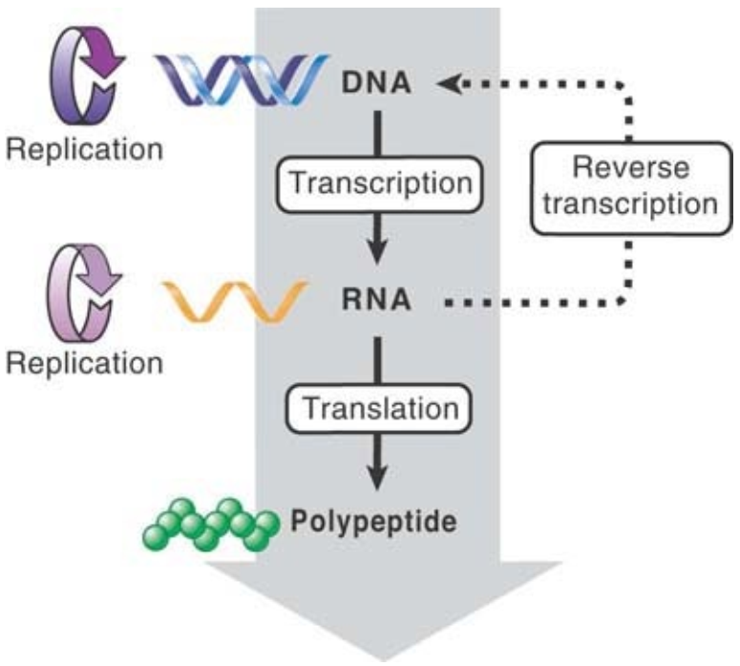
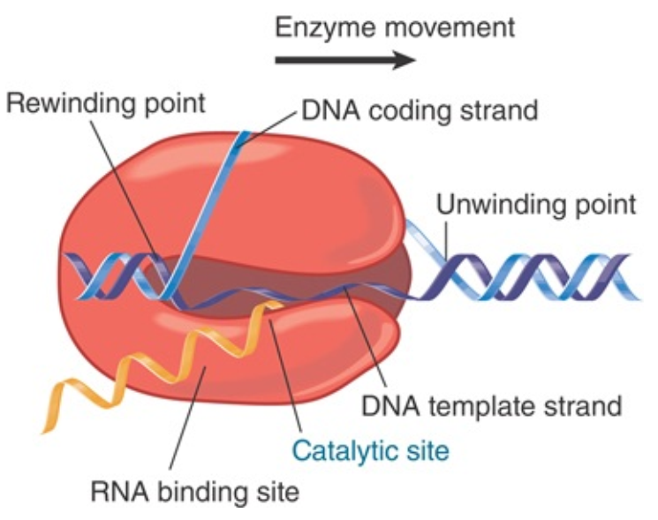
Chromosomes Compact into Nucleus
and Form Domains/Compartments
Central Dogma
Transcription
Transcription repression!
euchromatin
heterochromatin

Slide 12
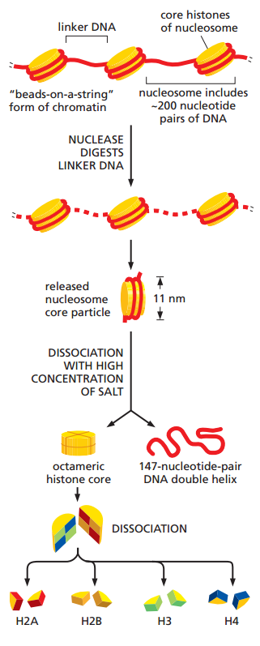
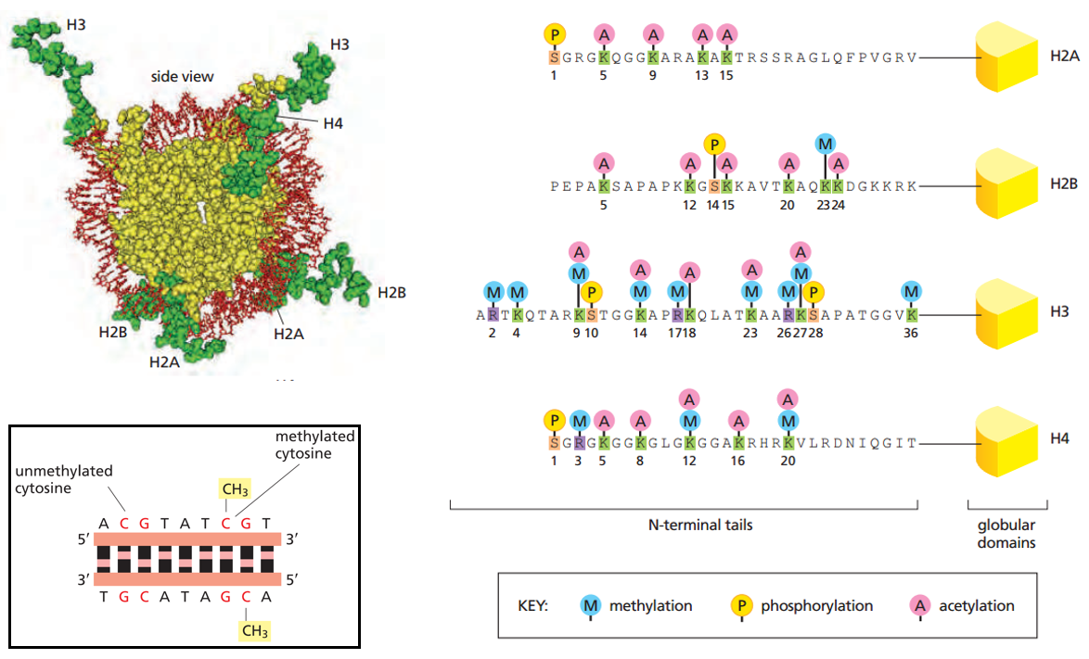
‘Epigenetic Codes/Marks’
'Histone codes'
Notes:
“mark”

Slide 13
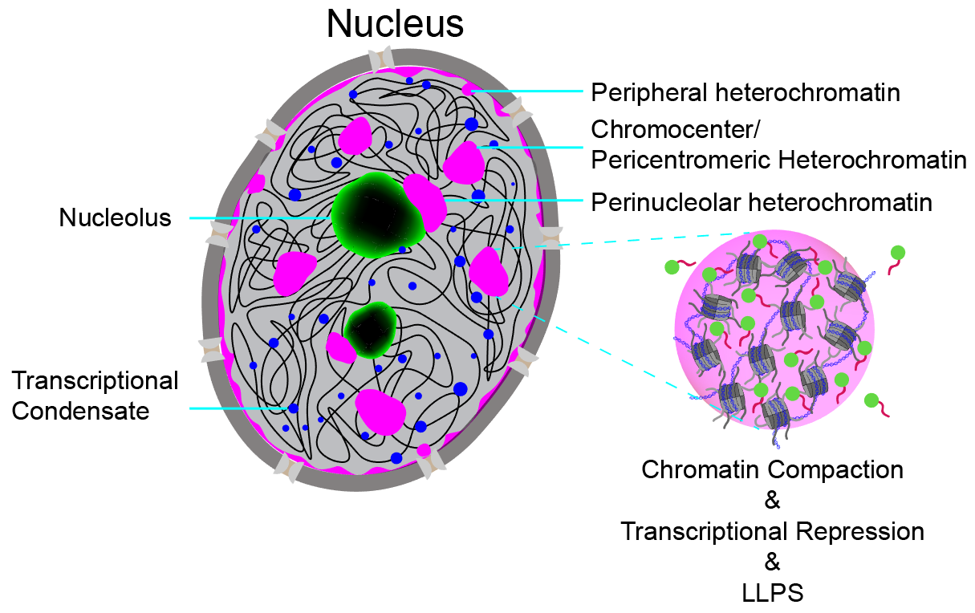
Heterochromatic Repressive Compartment
Notes:
“mark”

Slide 14
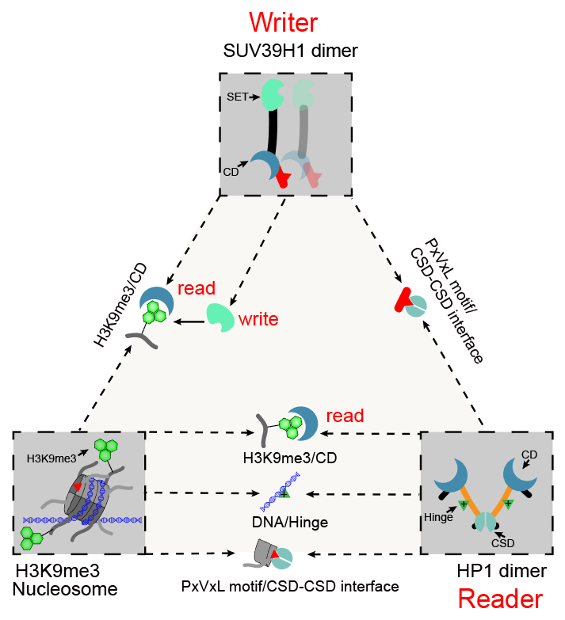
Constitutive Heterochromatin:
Mark, Writer, Reader
Extensive multivalent interactions
Heterochromatin Protein 1
Epigenetic mark

Slide 15
Multiple LLPS Mechanisms
Involving H3K9me3 Reader, HP1
Strom et al., Nature (2017)
Larson et al., Nature (2017)
Wang et al., Molecular Cell (2019)
Sanulli et al., Nature (2019)

Slide 16
LLPS-driven Heterochromatin Formation
in Animals and Plants
Celebrating 5 years of innovation at ICSB
(Science/AAAS, Washington, DC, 2019)

Slide 17
Linker Histone 1 and MeCP2 Undergo
Immiscible LLPS with Chromatin in Test Tubes
Wang et al., Cell Research, 2020

Slide 18
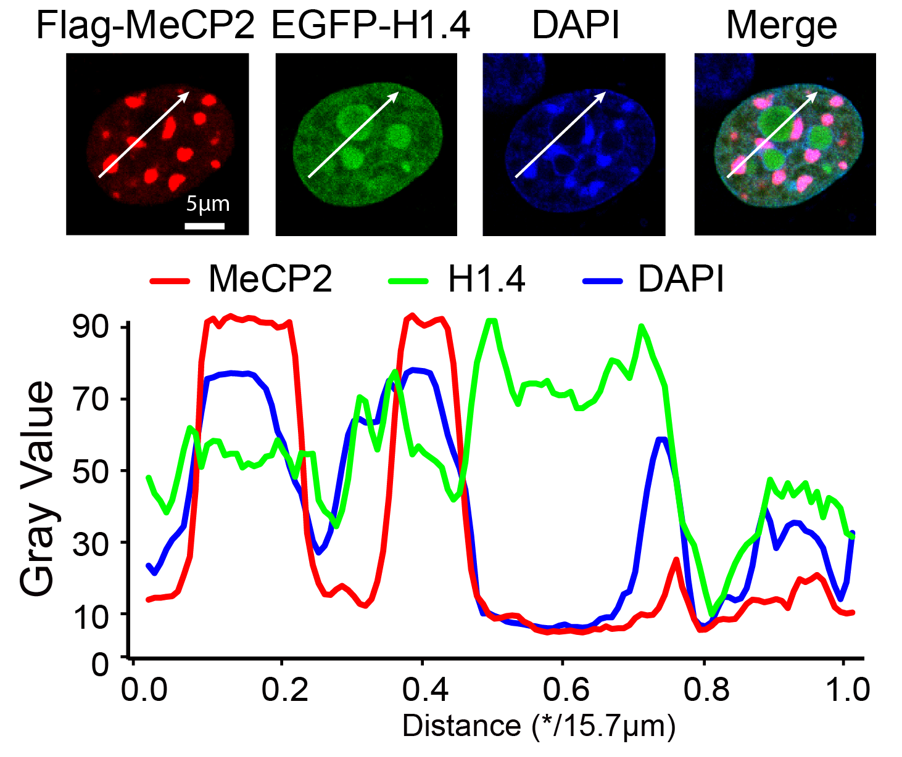
H1 and MeCP2 Form Distinct Condensates in Cells
Wang et al., Cell Research, 2020

Slide 19
Mutations in MeCP2 Cause Rett Syndrome
Acquired microcephaly
Mental retardation
Autistic features
Stereotypic hand movements
Delayed language development
http://mecp2.chw.edu.au/index.shtml
Mansour et al, 2015

Slide 20
Rett Mutations Compromise MeCP2-mediated LLPS of Chromatin and its Chromocenter Localization
Wang et al., Cell Research, 2020

Slide 21
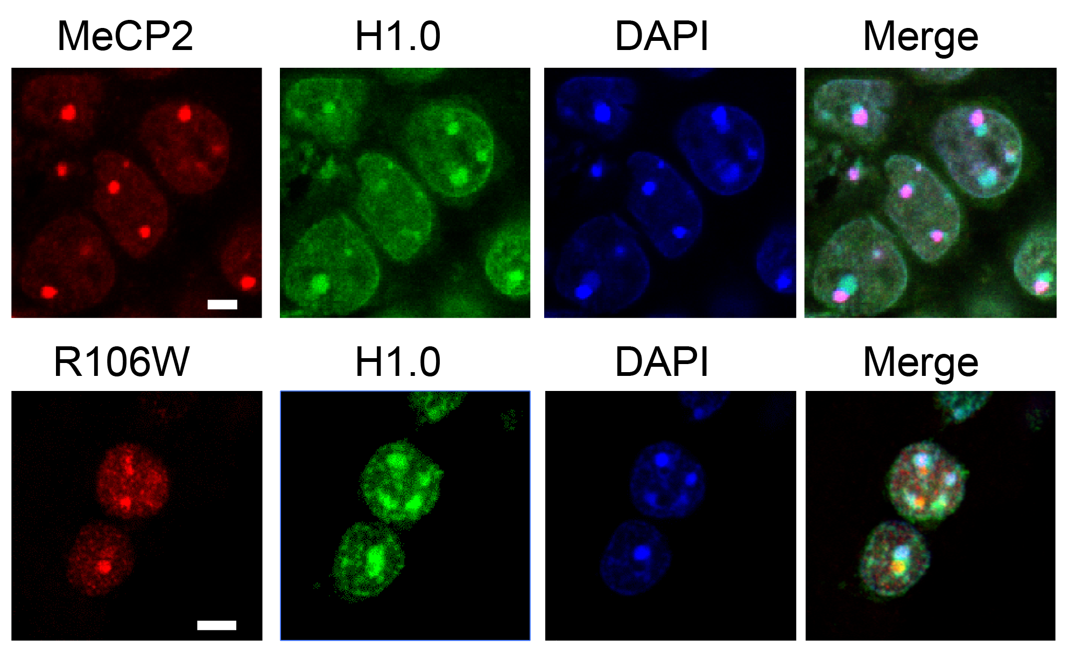
Rett Mutations Compromise MeCP2’s Ability to Counterbalance H1 for Chromocenter Localization in Neuron
Wang et al., Cell Research, 2020

Slide 22
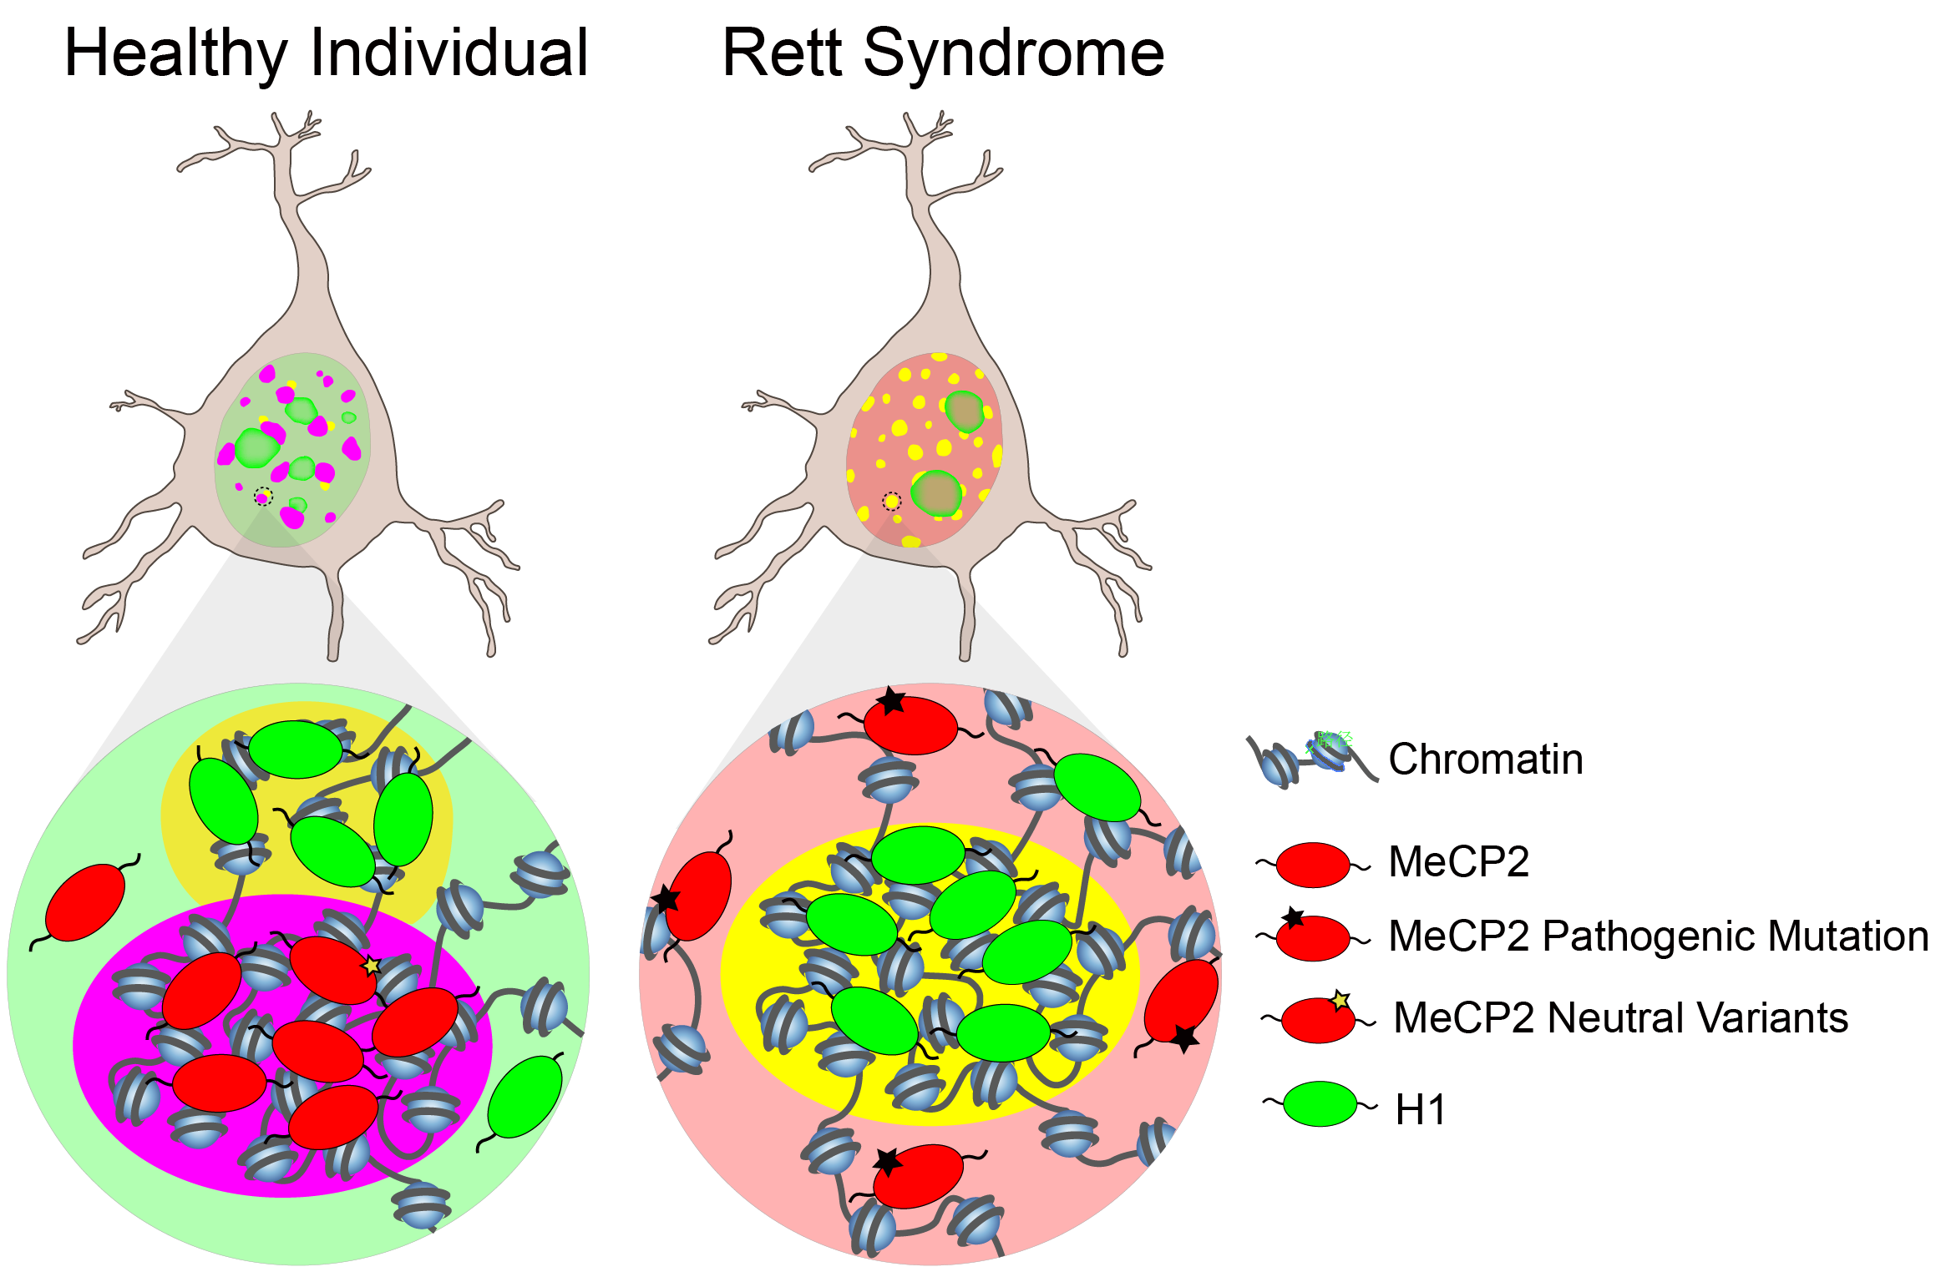
Compromised LLPS of Mutant MeCP2
Might Be a Cause for Rett Syndrome

Slide 23
Summary
Multiple phase separation mechanisms play roles in heterochromatin organization
HP1/HP1
Non-specific DNA/positive charged proteins (HP1, Histone octamer, H1, MeCP2)
H3K9me3/reader
MeCP2/mCpG
Compromise in phase separation of MeCP2 correlates with Rett syndrome

Slide 24
Acknowledgments
Li Lab
Collaborators
Liang Wang
Yifei Gao
Weiping Li
Min Zhou
Ru Li
Leiming Xie
Yuan Wang
Gaofeng Pei
Jing Wang
He Chen
Dongxue Li
Siyue Yuan
Yuting Zhu
Yuxuan Jiang
Weifan Xu
Lingyao Wang
Tao Zhang
Lei Sun
Ying Zhou
Wenjing Sun
Hongrui Liu
Mingrui Ding
Alumni:
Jian Li
Shuangshuang Dong
Wei Su
Shuai Fu
Yixuan Wei
Yuhan Li
Jianyang Hu
Chenxi Zhang
Peixuan Xia
Tsinghua University:
Prof. Haitao Li
Prof. Yi Xue
Prof. Xiao Hua Shen
Prof. Yijun Qi
Prof. Qianwen Sun
John Innes Centre:
Prof. Caroline Dean
Prof. Xiaoqi Feng
Dr. Xiaofeng Fang
Dr. Shengbo He
IBP, CAS:
Prof. Guohong Li
Mingli Hu
NIBS:
Prof. Meng-Qiu Dong
Mei-Qing Zuo
Peking University:
Prof. Zhi Qi
Linyu Zuo
National Key R&D Program of China

