Slide 1
Prospect of Detecting X-Ray Halos Around Middle-Aged Pulsars with eROSITA
Speaker: Ben Li
Co-authors: Yi Zhang, Ruo-Yu Liu and Xiang-Yu Wang
arXiv:2110.08856

Slide 2
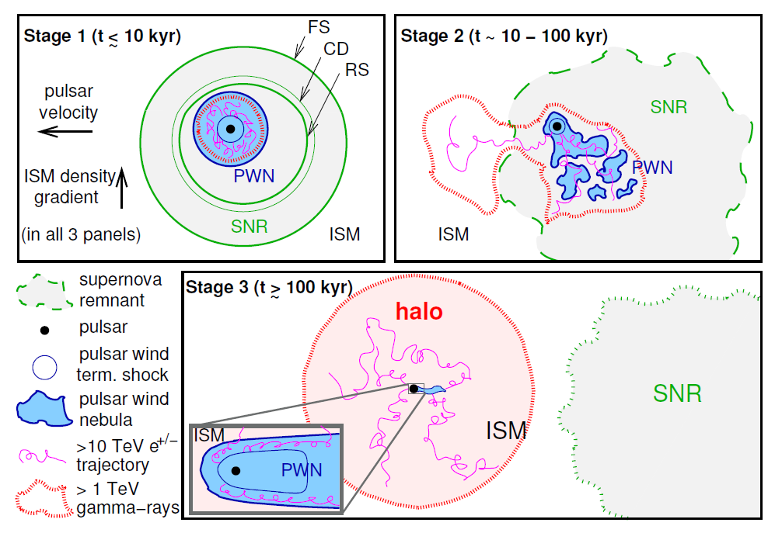
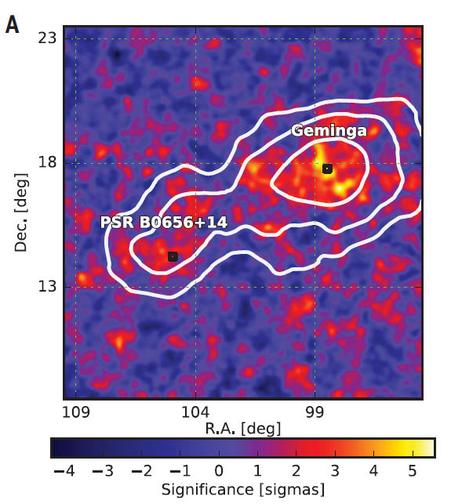
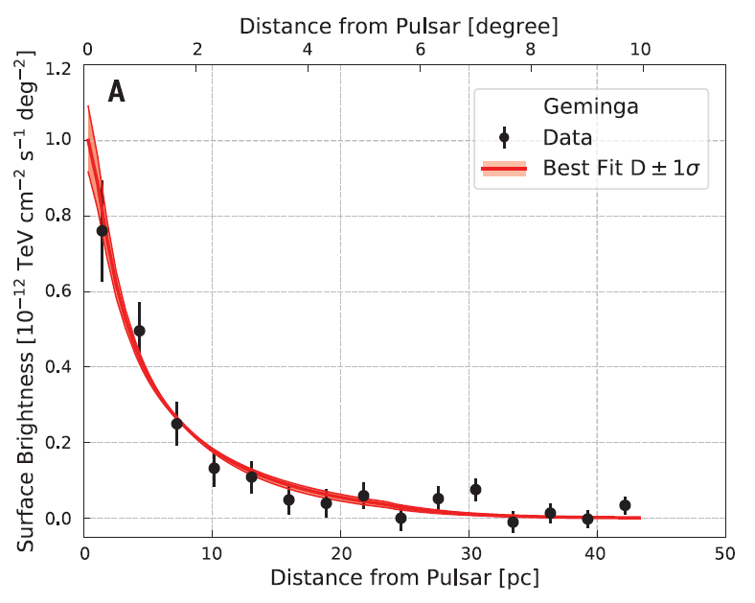
Background - pulsar halo
HAWC observation
~ 2 deg.
PWN evolution
Giacinti et al. (2020)
Abeysekara et al. (2017)
X-ray halo?

Slide 3
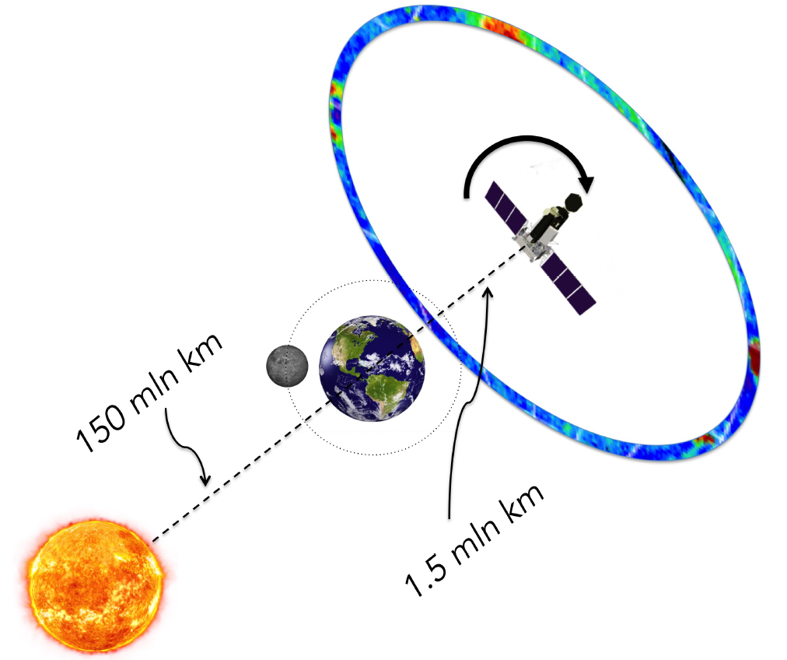
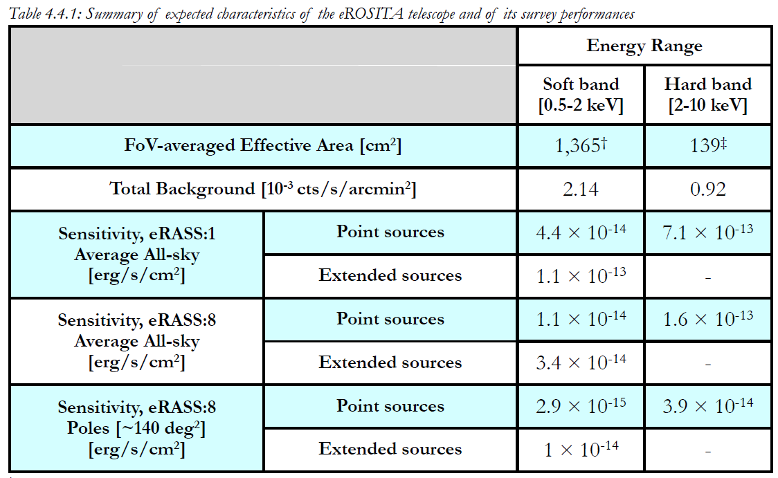
The eROSITA telescope
Why eROSITA?
eROSITA (extended ROentgen Survey with an Imaging Telescope Array) is one of the two X-ray telescopes onboard the Spectrum-Roentgen-Gamma (SRG) mission, which was launched in 2019.
Main parameters:
eROSITA has three observing modes: survey (four years), field scan and pointing.
Survey mode
eROSITA sensitivity
Merloni et al. (2012)

Slide 4
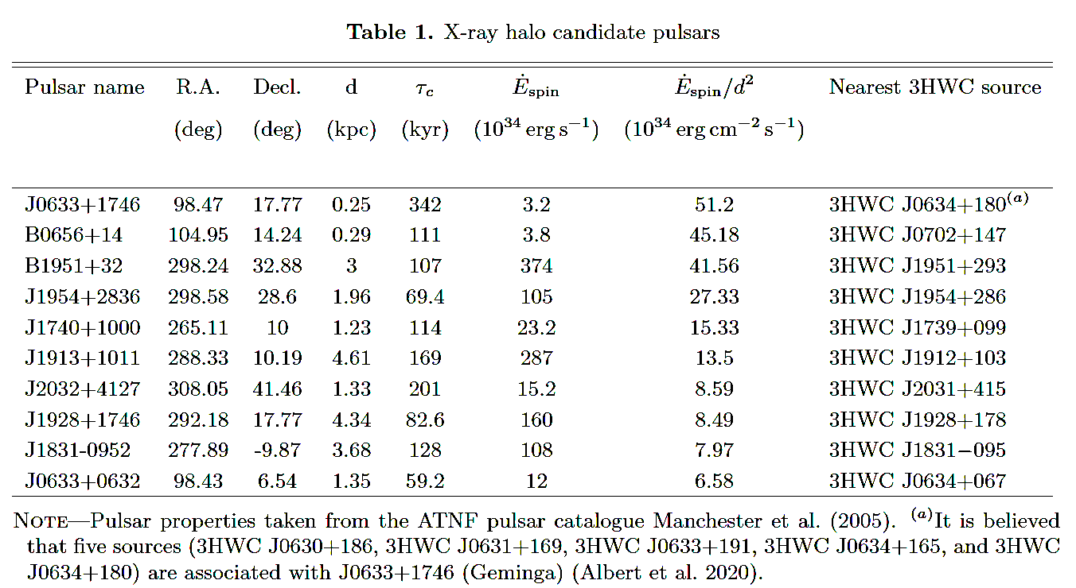
X-ray halo candidate pulsar
Selection criteria: 1. middle-aged pulsar (50 < $τ_{c}$ < 500 kyr),
2. distance (d < 5 kpc),
3. with TeV observation.
Ranked according to ${\dot{E}}_{spin}/d^{2}$. The top 10 are:

Slide 5
Model
We assume continuous injection from pulsar, and an electron injection spectrum:
where p=1.6 is the spectral index, and Ee,max is the cutoff energy.
For isotropic diffusion, the transport equation:
where with δ=1/3 is the Kolmogorov type diffusion coefficient,
and we employ $D_{0}=4.5×{10}^{27} {cm}^{−2} s^{−1}$
Analytical solution:
IC and synchrotron emission:
Atoyan et al. (1995)
Liu et al. (2019)

Slide 6
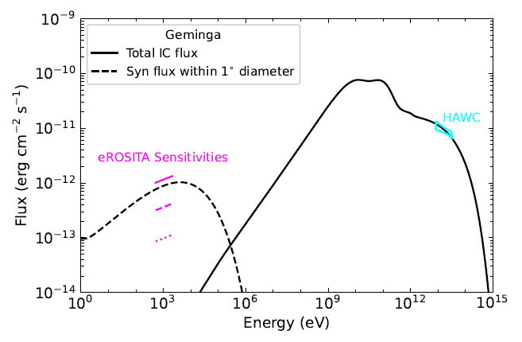
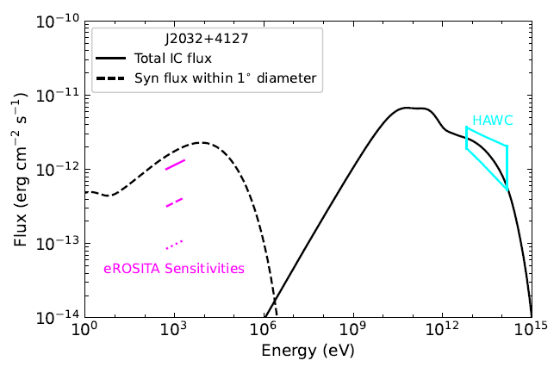
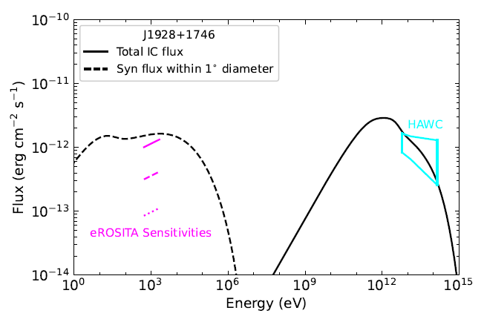
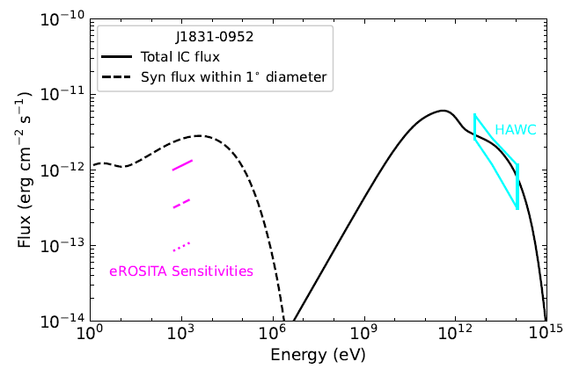
eROSITA’s detection ability
Geminga
J2032+4127
J1928+1746
J1831-0952
Almost all of the listed pulsar halo candidates could be detected by the eROSITA telescope for eRASS:8.
Three of them (PSR J2032+4127, PSR J1928+1746 and PSR J1831-0952) could even be detected for eRASS:1!

Slide 7
Spatial extension
As a whole, eROSITA could detect X-ray halos from both Geminga and PSR J1928+1746, with a radius out to 30 pc.

Slide 8
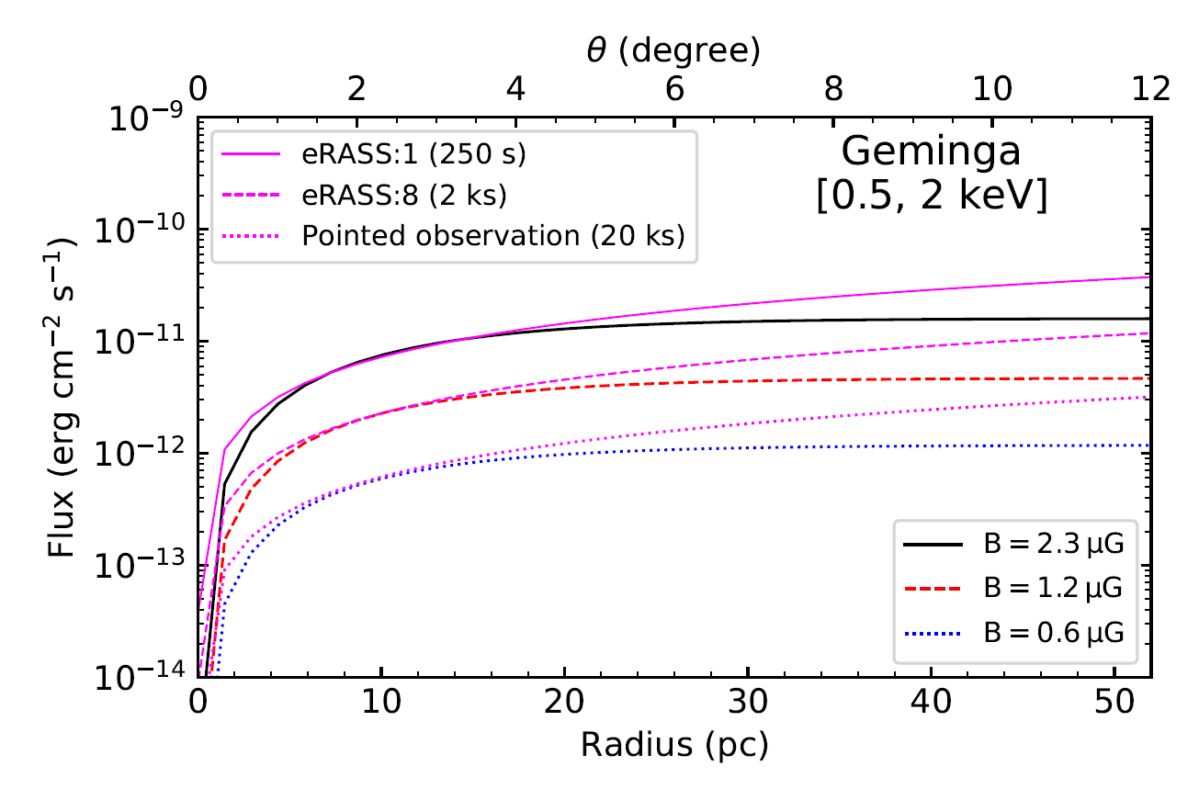
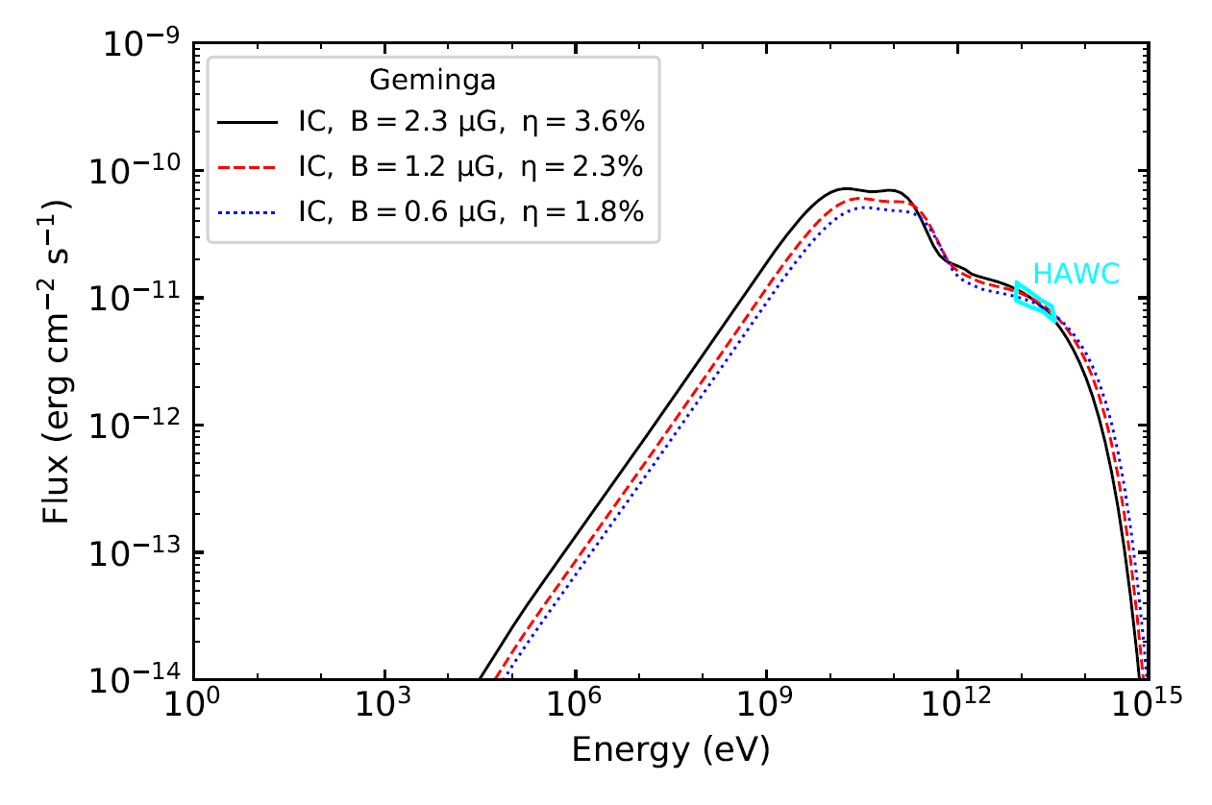
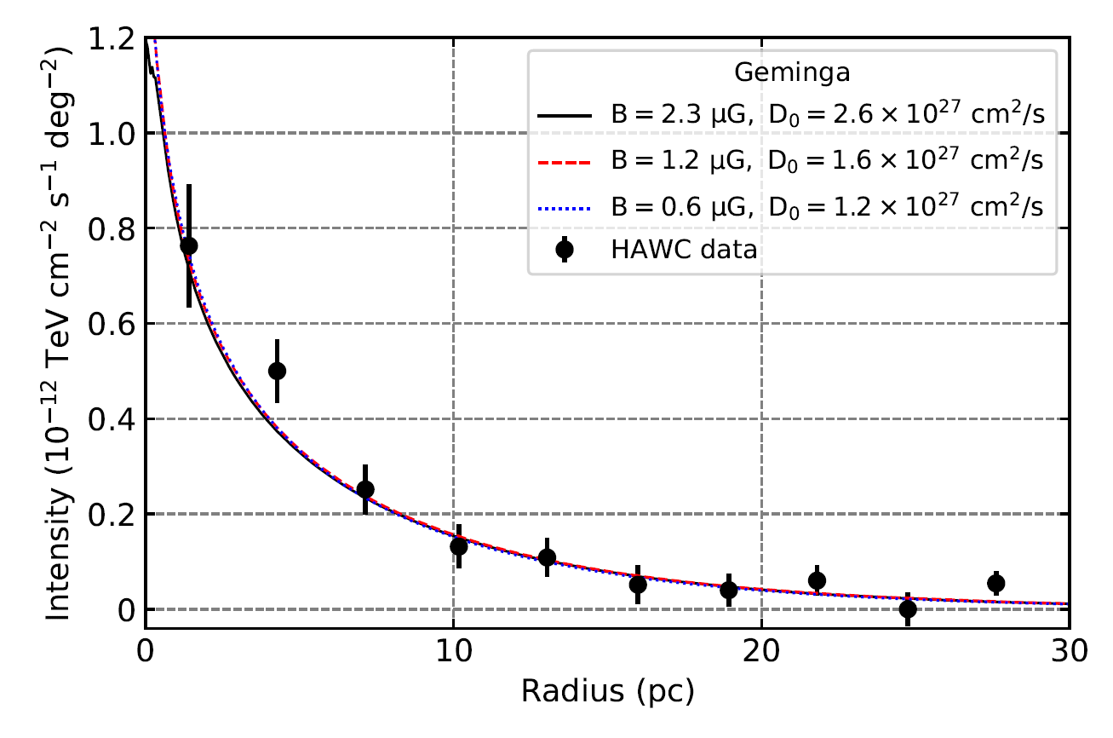
Constraining the magnetic field
Liu et al. (2019) found a low magnetic field ($B≲1 μG$) in the TeV halo of Geminga.
eROSITA is able to constrain the magnetic filed down to $0.6 μG$ for an exposure time of 20 ks.

Slide 9
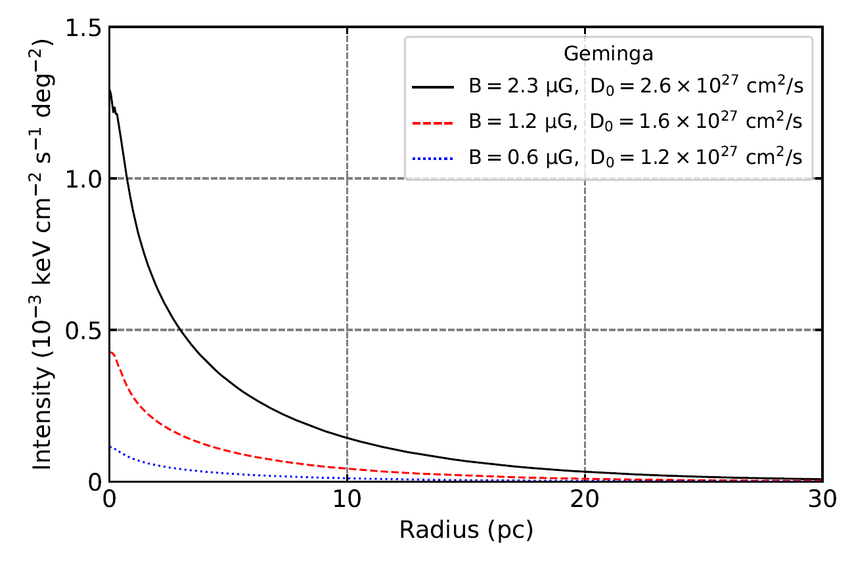
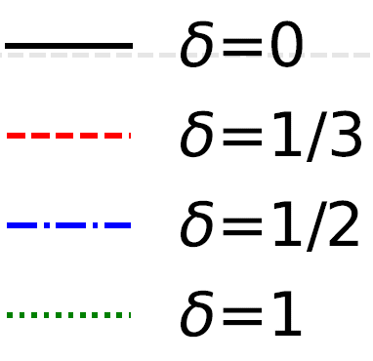
Discussion on diffusion coefficient
0.5-2keV
2-5keV
5-10keV

Slide 10
Summary
By comparing the predicted X-ray flux with the estimated sensitivities of the eROSITA telescope, we found that a number of pulsar halos could be detected by eROSITA with its four year all-sky survey.
The radial extension of the X-ray halo emission from Geminga and PSR J1928+1746 could be detected up to a radius of several tens of pc by eROSITA.
eROSITA is able to constrain the magnetic filed around Geminga down to $0.6 μG$ for an exposure time of 20 ks.
Thank you!

