Slide 1
Future gamma ray experiments
J. Cortina (CIEMAT, Madrid, Spain)

Slide 2
TeV+PeV Astronomy: wide science case

Slide 3
TeV+PeV Astronomy: wide science case

Slide 4
TeV+PeV Astronomy: wide science case

Slide 5
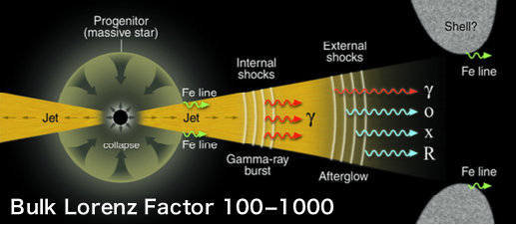
TeV+PeV Astronomy: wide science case
GRBs

Slide 6
TeV+PeV Astronomy: wide science case
EBL, LIV
GRBs

Slide 7
TeV+PeV Astronomy: wide science case
EBL, LIV
GRBs

Slide 8
TeV+PeV Astronomy: wide science case
EBL, LIV
GRBs
Science with CTA: https://arxiv.org/abs/1709.07997

Slide 9
TeV+PeV Astronomy: instrumental requirements
Angular resolution: >0.2º may be enough to resolve large structures like TeV halos but need <0.1º to resolve features inside SNR / SNR+clouds or increase sensitivity for point sources.
Spectral resolution: <10%, spectral features, lines in DM searches.
Wide energy coverage: <50 GeV for EBL studies or high statistics in fast transients, and up to PeV to identify sources of cosmic rays.
High sensitivity: current generation of IACTs has operated for ~15 years. Need significant improvement -> much larger collection area.
Large FOV ≳8º: extended objects, surveys, alerts.
For instruments with small FOV: fast repositioning for GRBs and other fast transients.

Slide 10
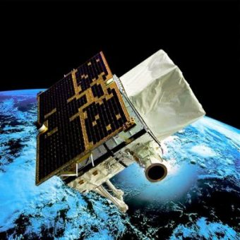
From space
Agile
2007--, >30 MeV, 3 srad, ~0.5 m² area
Fermi-LAT
2008--, >20 MeV, 2 srad, ~1 m² area

Slide 11
From space
Agile
2007--, >30 MeV, 3 srad, ~0.5 m² area
LAT detects ~1 γ-ray/3 hours from the Crab Nebula at >30 GeV
Fermi-LAT
2008--, >20 MeV, 2 srad, ~1 m² area

Slide 12
VHE = From the ground
A. Mitchell, rapporteur talk at ICRC 2021, arXiv:2109.13753v1

Slide 13
A world of experiments
A. Mitchell, rapporteur talk at ICRC 2021, arXiv:2109.13753v1

Slide 14
Shower front sampling

Slide 15
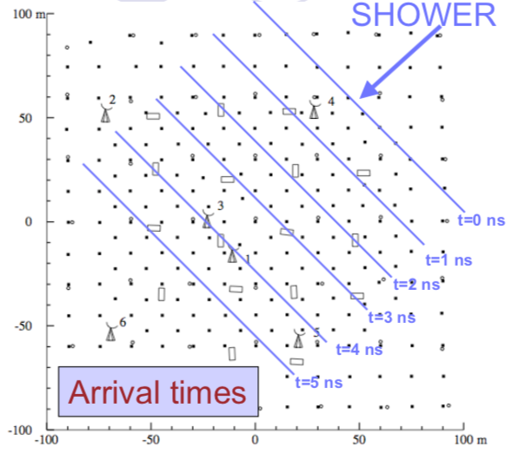
Arrays of particle detectors
An array of particle detectors sample the tail of atmospheric shower that reaches the ground.
Available information: particle density and arrival time at each detector position.
Angular and energy resolutions are limited: we are only sampling the tail.
γ-hadron separation possible through density inhomogeneities in cosmic ray showers, specially “muon tagging.”
Duty cycle 100%: operate day and night.
Large FOV: several srad.

Slide 16
If particle detectors = scintillators
PhD thesis Juan Cortina, 1997
HEGRA… (+many others)
TOTAL AREA ~40,000 m²
~250 scintillator counters
~20 muon counters
2,200 m above sea level

Slide 17
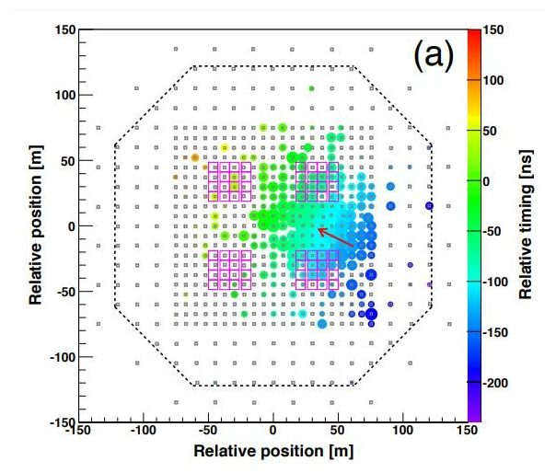
Tibet ASγ
HEGRA
TOTAL AREA ~40,000 m²
~250 scintillator counters
~20 muon counters

Slide 18
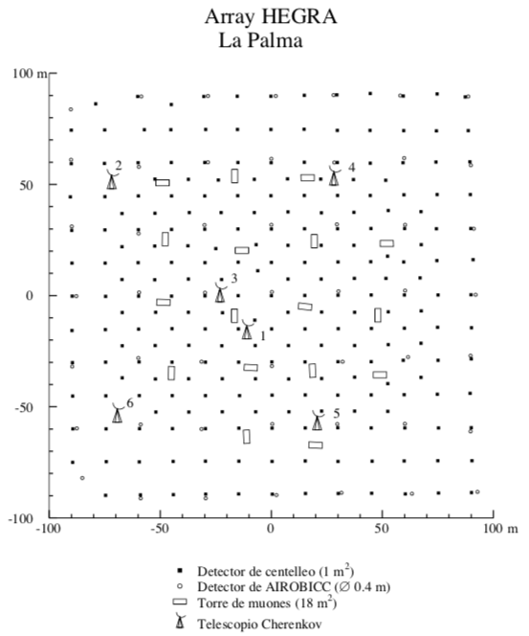
LHAASO
HEGRA
TOTAL AREA 1,300,000 m²
~5000 scintillator counters
~1200 muon counters
+ 80,000 m² water Cherenkov
+ Cher/fluorescence telescopes
4,410 m above sea level

Slide 19
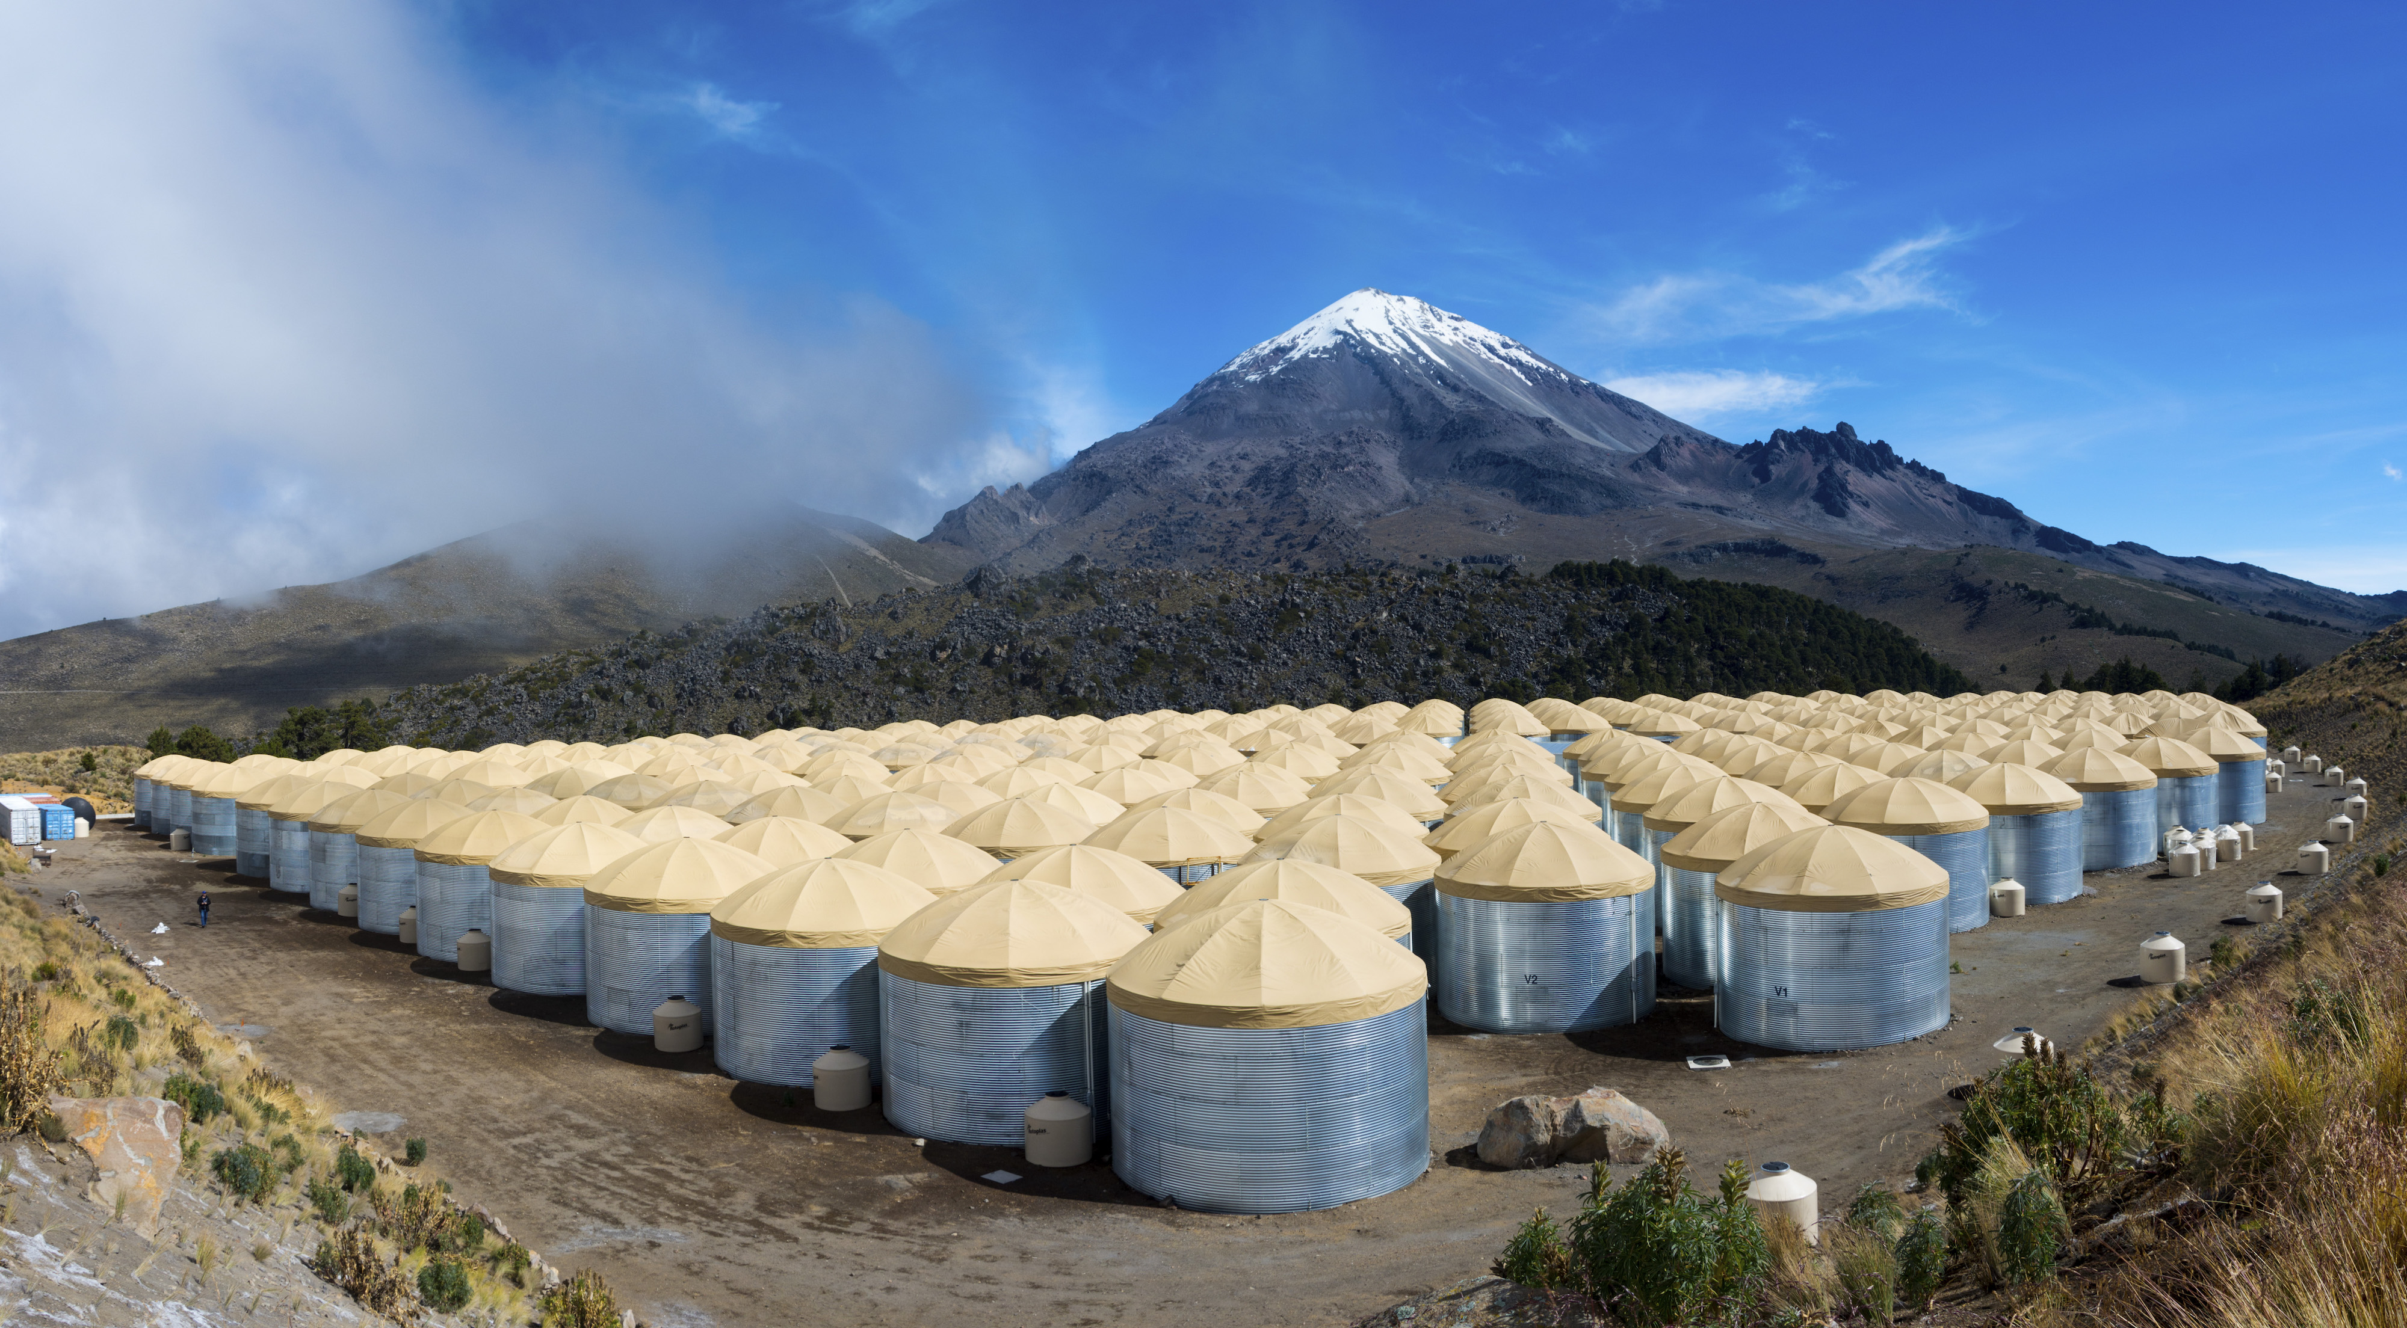
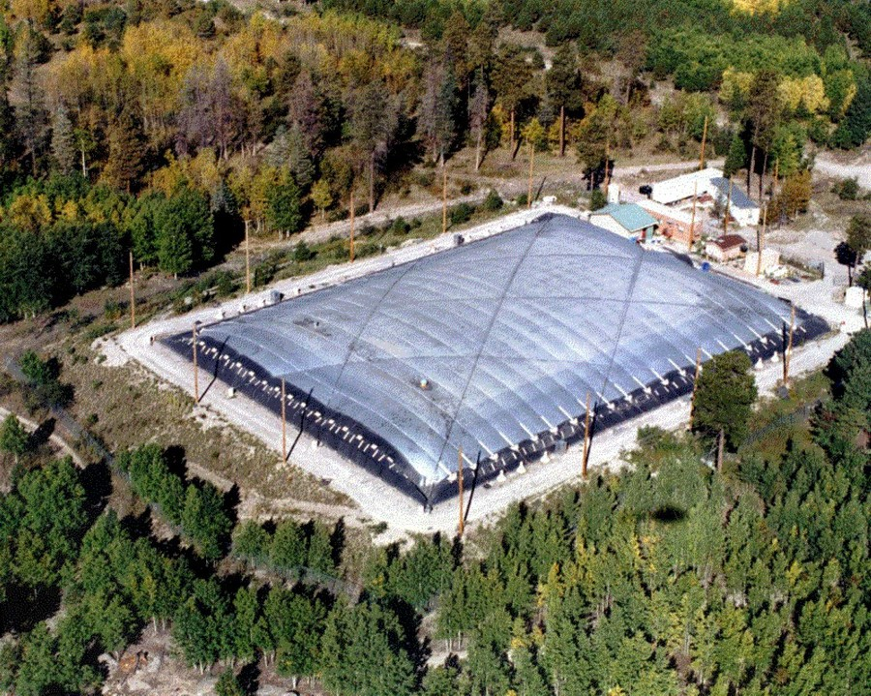
If particle detectors = water tanks
1990’s
2000’s
2010’s
Milagrito (US)
1sr, few m² area
Milagro (US)
1sr, 5,000 m² area
HAWC (US, Mexico)
1sr, ~40,000 m² area, >100 GeV

Slide 20
Water tanks, future : SWGO
Credit: J. Hinton

Slide 21
Water tanks, future : SWGO
Dense inner section (>80% coverage): 2x HAWC collection area

Slide 22
Water tanks, future : SWGO
Sparse outer section (8% coverage): 6x HAWC collection área (~250,000 m²)

Slide 23
SWGO’s sky
HAWC and LHAASO’s sky
Credit: J. Hinton

Slide 24
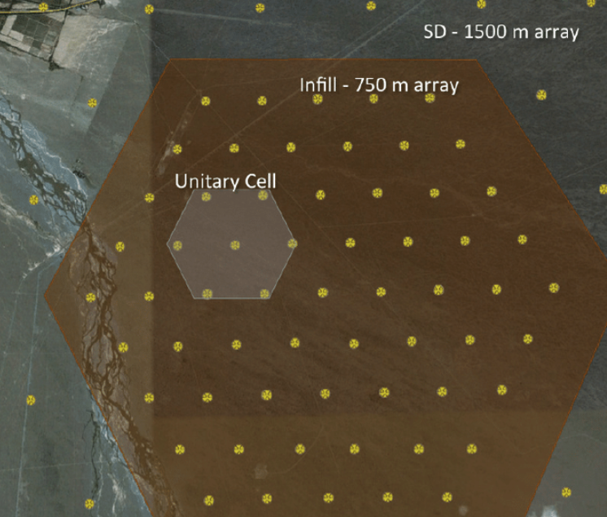
Beyond: superpevatron search?
F. Aharonian was talking yesterday about SuperPevatrons: >1 PeV. Collection areas ~10 km² would be needed.
SWGO and even LHAASO fall short. However particle array technique can be extended:
Pierre Auger uses Cherenkov tanks as well and is deploying AMIGA: tanks with 750 m spacing, each with an associated muon counter.
But threshold is too high (3×10¹⁷ eV for CRs). One would need smaller spacing.
Also remember that Cherenkov telescopes have much larger collection areas >1 km² when pointing at large zenith angles (see MAGIC observations of Crab up to 100 TeV in A&A 635, 2000, A158): technique can be used in CTA-south – with the advantage of high angular resolution.
Auger AMIGA infill

Slide 25
Cherenkov light imaging

Slide 26
Gamma ray shower generates Cherenkov light.
Light is not only collected but imaged: angular information is preserved.
Stereo: several telescopes image the same shower.
γ-ray
One single telescope is sensitive to a large γ-ray collection area >100,000 m².
Image of the whole shower, not only the tail: strong γ/h discrimination and high sensitivity, excellent angular and spectral resolutions.
Can only operate on dark nights: low duty cycle (<15%).
Optics limits FOV: ≲50 arcdeg² (~10⁻³ of the sky)

Slide 27
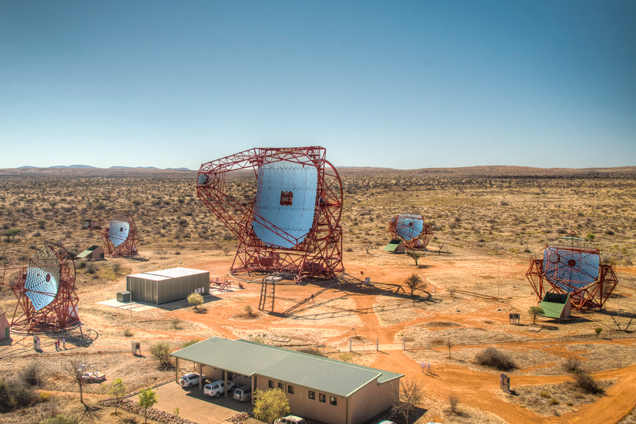
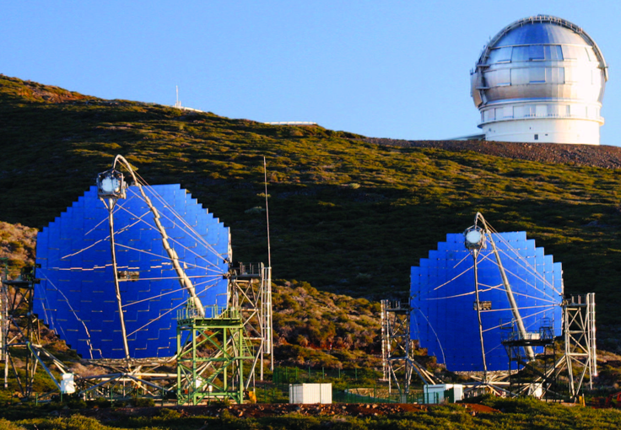
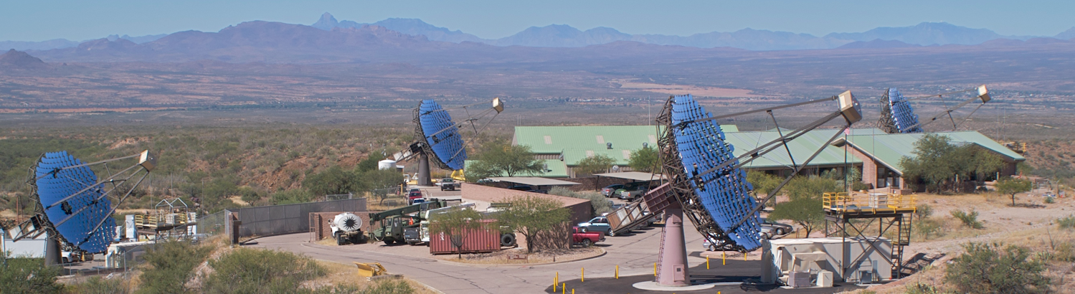
H.E.S.S. (Namibia)
4 x 108 m² (since 2003)
1 x 614 m² (since 2012)
MAGIC (La Palma)
2 x 236 m² (since 2003 / 2009)
VERITAS (Arizona)
4 x 110 m² (since 2007)

Slide 28
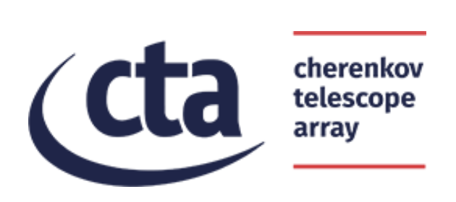
The Future

Slide 29
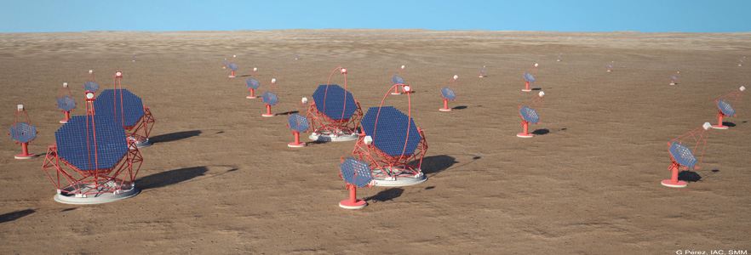
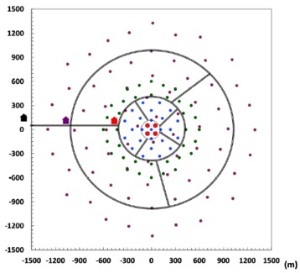
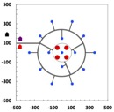
How does CTA work? ...
LST (23m)
SST (4m)
Contributions to TeVPA by V. Vodeb & O. Sergijenko
MST (12m)
South: Paranal
0.8 km
Characteristics
2 sites (north & south) → full sky coverage
3 telescope size classes → wider energy range
Tens of telescopes
→ Larger area i.e. higher sensitivity
2x2 km²
North:
La Palma

Slide 30
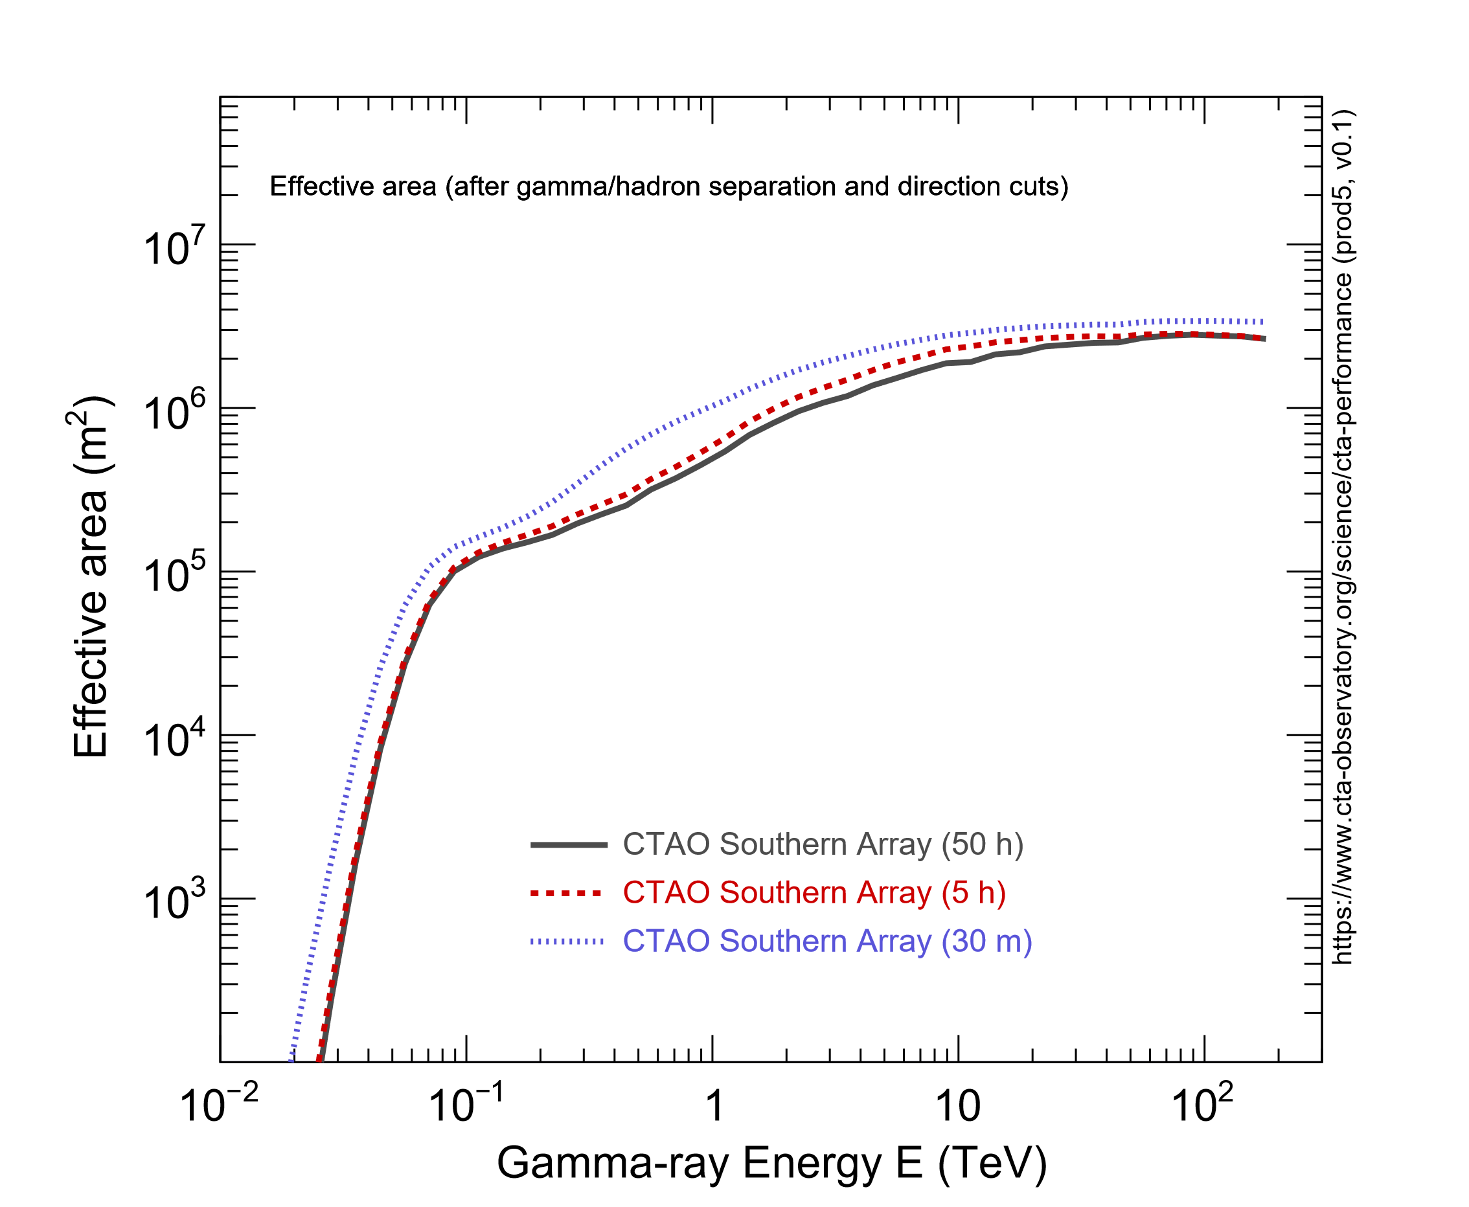
Collection areas
CTA-North
CTA-South

Slide 31
Sensitivity

Slide 32
Short term sensitivity

Slide 33
Angular resolution
LHAASO-KM2A
LHAASO-WCDA
1 PeV
LHAASO-KM2A
LHAASO from: arXiv:2101.03508
and Chinese Phys. C 45, 025002 (2021)

Slide 34
Latest from CTA: June 2021
Country representatives of Germany, Italy, Spain, France, Japan, Poland etc have agreed to finance the “alpha configuration”
4 LSTs + 9 MSTs in the north
14 MSTs + 37 SSTs in the south
A new organization called CTAO will be setup. It’s legally a European entity called ERIC.
ERIC to be established in 2022.
The two arrays should be complete in around 5 years.

Slide 35
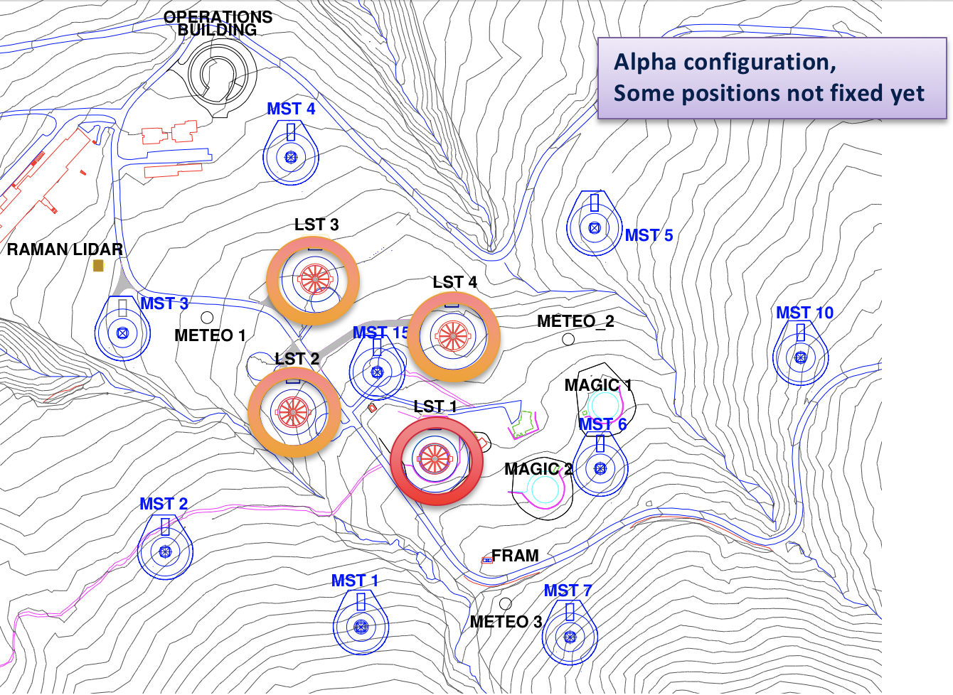
On-going construction: CTA-North
Located at Roque de los Muchachos, La Palma, Spain (also host of HEGRA, MAGIC and FACT).
Alpha configuration of CTA-North:
LST1, a fully functional prototype, is already built.
3 remaining LSTs and 1 MST to be installed in 2023.
8 remaining MSTs shortly afterwards.
photomontage

Slide 36
First CTA telescope on site: LST-1
MAGIC-2
CTA LST-1
FACT

Slide 37
The largest CTA telescopes, the lowest energies
LST (23m): mirror of 400 m²!
Targeting an energy threshold ～20 GeV. Stereo observations at the lowest energies ever observed from the ground.
Well in overlap with satellites but with collection areas >10⁴ times larger
Able to reposition to any place in the sky within 20 seconds: GRBs.
Contributions to TeVPA by D. della Volpe and A. Aguasca-Cabot

Slide 38
LST1: inauguration

Slide 39
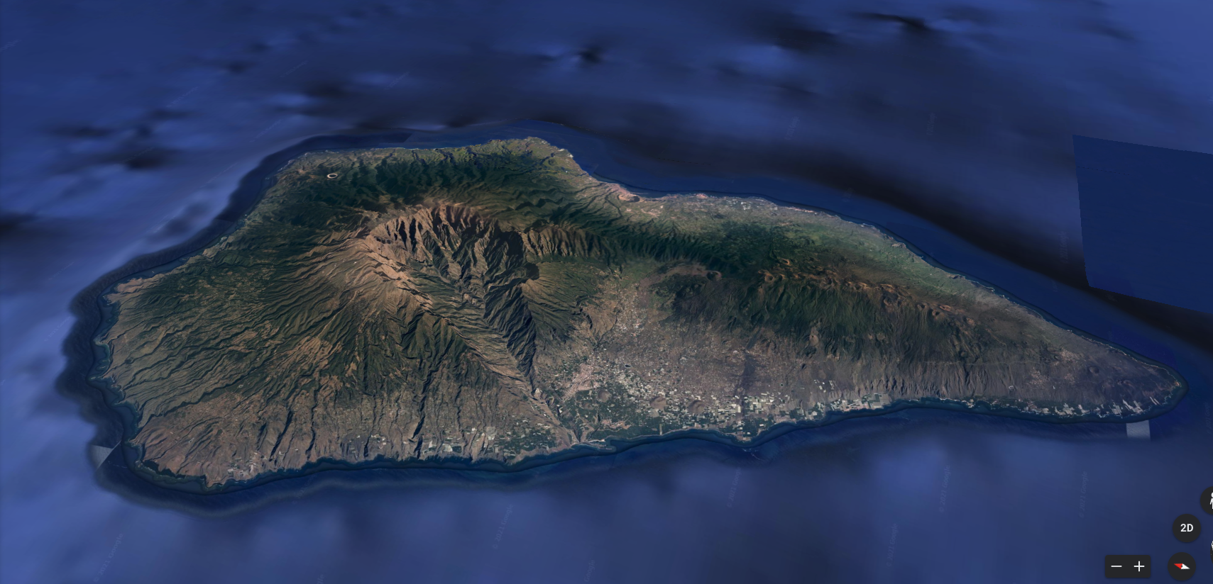
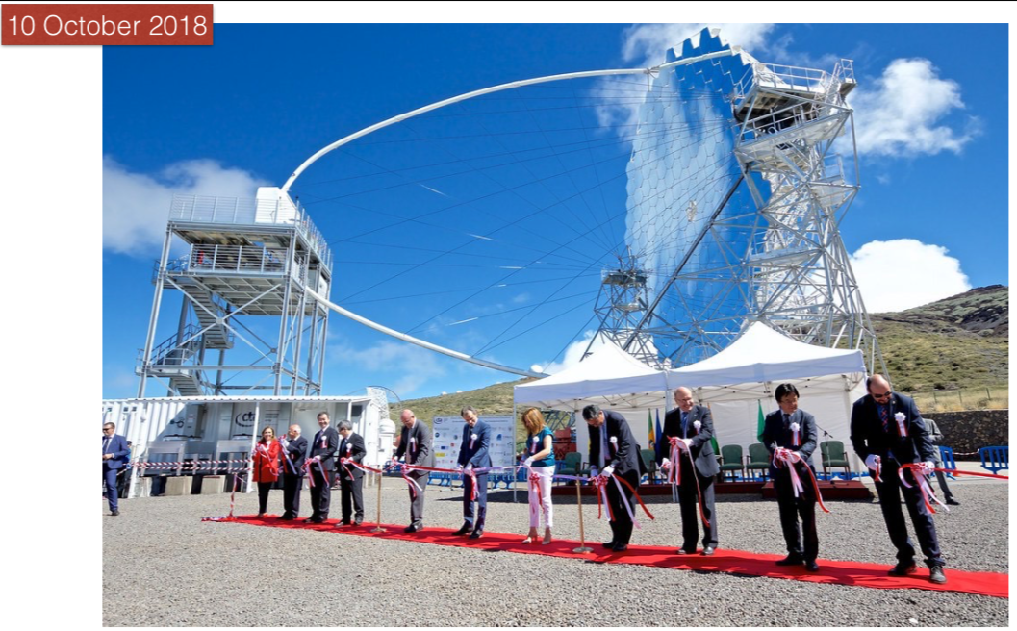
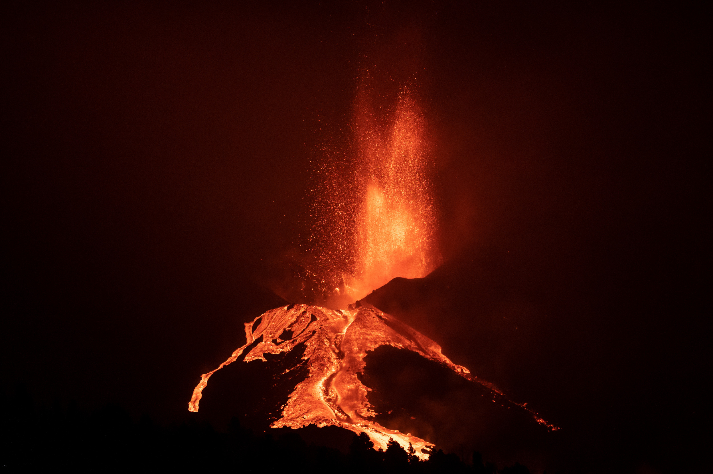
LST1: “eventful” commissioning
Volcano eruption,
Sept 19, 2021 - today
15 km

Slide 40
LST1: commissioning status
Mechanics, optics, camera: no major issues after 2 years but still debugging.
Control: still working on high level control of all sub-systems and full automation: Telescope largely operative from remote: good during Covid-19 times!
General operation pretty successful: already achieved ～ 80% duty cycle. Aiming at nominal duty cycle >95% - when volcano is over!

Slide 41
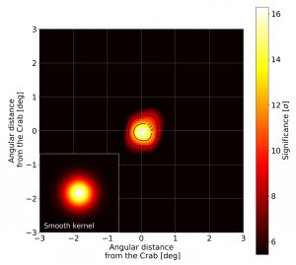
LST1: Crab Nebula observations
Detection achieved “off-the-shelf”: ～18σ in 36 min for energy threshold ～50 GeV. Stay tuned for Crab flares.
Reconstructed spectrum < 1 TeV is already consistent with previous measurements.
Preliminary
Preliminary

Slide 42
LST1: Crab PULSAR
Only 4 pulsars are detected at VHE. First detection by MAGIC took years. Now detection of Crab pulsar is achieved matter-of-factly.
Preliminary ratio of P1 and P2 points to an energy threshold ～50 GeV.
Preliminary

Slide 43
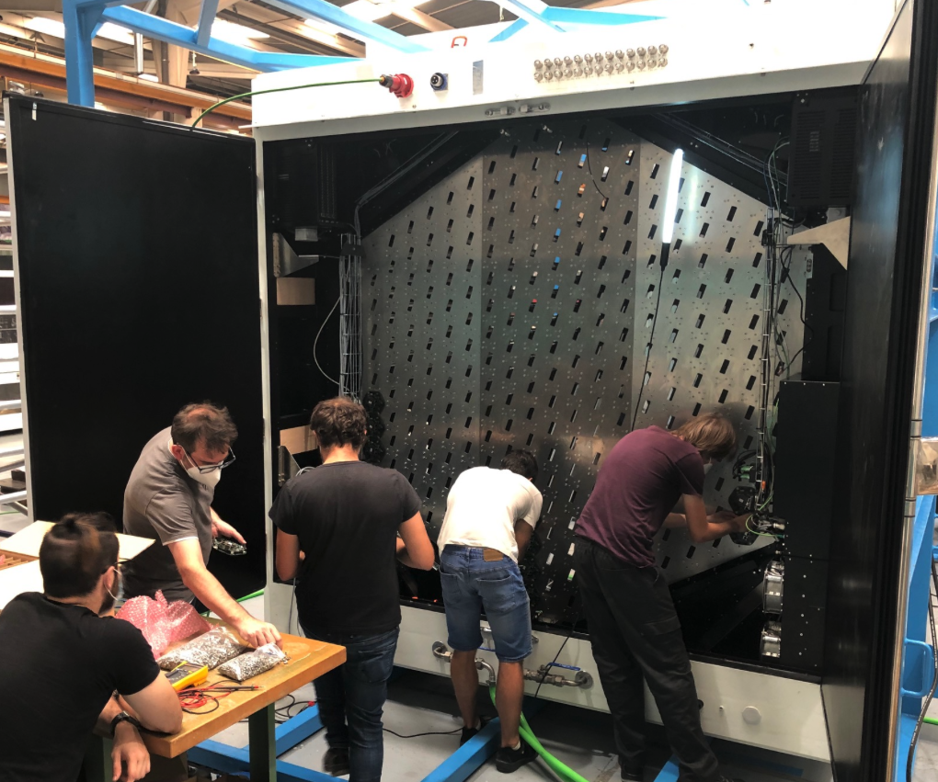
Next three LSTs in CTA-North
98% of the component production on its way or finished

Slide 44
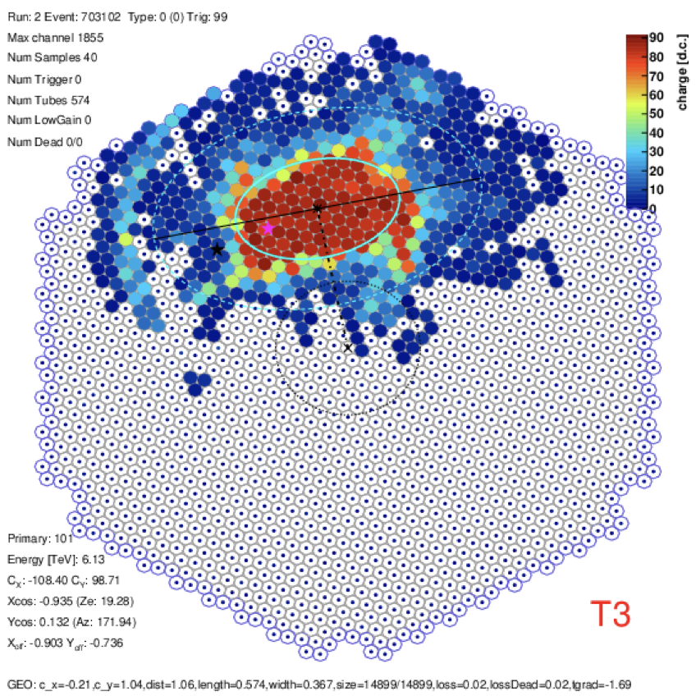
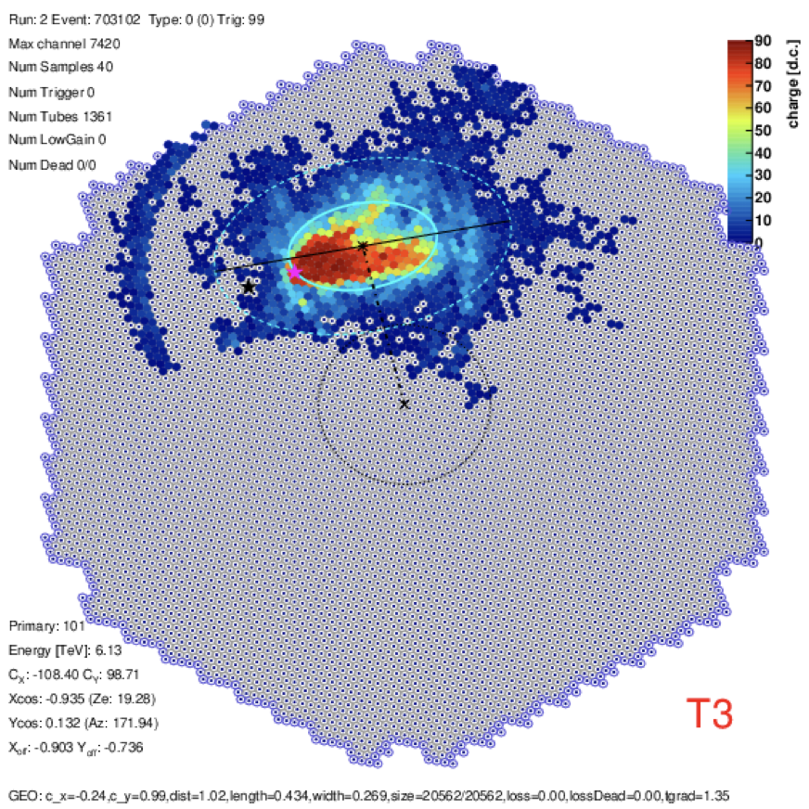
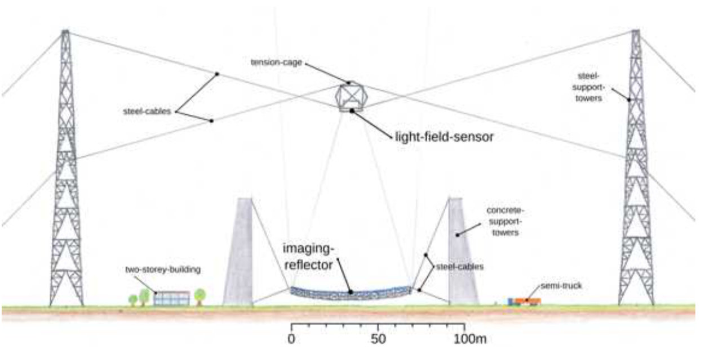
Beyond: 1-10 GeV?
LSTs should reach a threshold of ~20 GeV. What’s the limit of the IACT technique??
LST is already exploring an advanced camera equipped with higher QE SiPM and denser angular sampling.
“Plenoscope” (arXiv:1904.13368v1): breakthrough optics and SiPM in a 71 m ∅ telescope.
PMT camera (1855 x 0.1° pixel)
LST Advanced SiPM camera (7420 x 0.05° pixel)
1 GeV Plenoscope

Slide 45
Conclusions
TeV + PeV astronomy is a lively field:
constant flow of discoveries
observationally driven.
Several experiments techniques have proven successful along the last 20 years. Large potential for instrumental improvements.
IACTs, HAWC, Tibet: productive experiments.
LHAASO: just starting!
CTA: starting construction, transformational in TeV astronomy.
Promising: SWGO. Need larger area for >1 PeV.

Slide 46
Thank you!

Slide 47
backup

Slide 49
LHAASO – KM2A
LHAASO Collaboration, Observation of the Crab Nebula with LHAASO-KM2A − a performance study. Chinese Phys. C 45, 025002 (2021). doi:10.1088/1674-1137/abd01b

