Slide 1
Contribution of SNRs to Cosmic Rays
Siming Liu,
Houdun Zeng, Yuliang Xin
Southwest Jiaotong University
liusm@swjtu.edu.cn
TeV Particle Astrophysics 2021, Oct 26

Slide 2
Outline
Supernova Remnant (SNR) Origin of Galactic Cosmic Rays
Particle Acceleration in Gamma-ray SNRs
PeVatrons
Conclusions

Slide 3
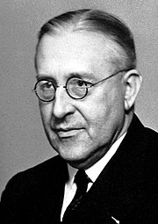
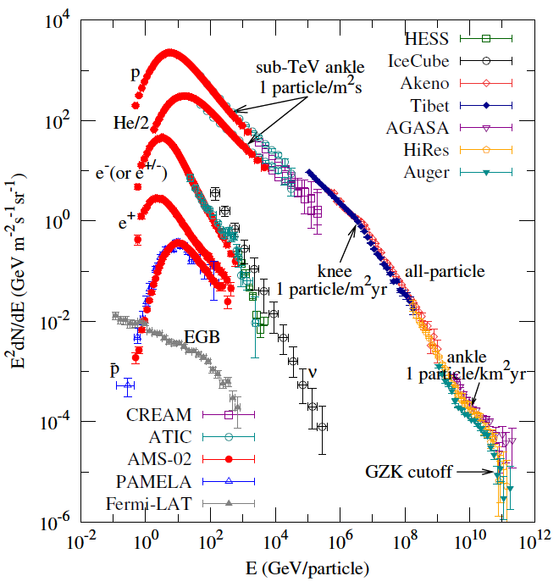
1: Cosmic Ray (CR) Spectra
Cosmic rays were discovered in 1912 by Hess via a series of balloon experiments, for which he was awarded Nobel Physics Prize in 1936.
Victor Franz Hess
It is dominated by nuclei. Electron flux is about 1% of the protons at 1GeV.
Cosmic Rays below the spectral knee at ~1e15eV are attributed to Galactic sources and above the spectral ankle at ~1e18eV Extra-Galactic
Galactic Cosmic Rays
Extra-Galactic

Slide 4
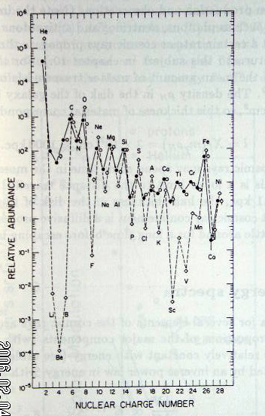
1: Cosmic Ray Composition
From B/C flux ratio one has a grammage of ~10 g/cm².
For an ISM density of 1 per cc, the distance travelled by CR is about
10000kpc, corresponding to an age of ~10 million years.
Cosmic Ray Abundance
Solar Abundance

Slide 5
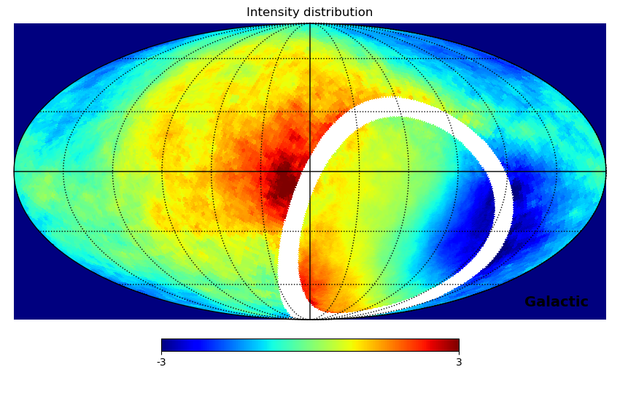
1: CR Isotropy
Cosmic rays were discovered in 1912 by Hess via a series of balloon experiments, for which he was awarded Nobel Physics Prize in 1936.
Tibet III 1PeV
Victor Franz Hess
It is dominated by nuclei. Electron flux is about 1% of the protons at 1GeV.
Cosmic Rays below the spectral knee at ~1e15eV are attributed to Galactic sources and above the spectral ankle at ~1e18eV Extra-Galactic
IceTop 1.6PeV
Relative Intensity [x10⁻³]
Galactic Cosmic Rays
Extra-Galactic

Slide 6
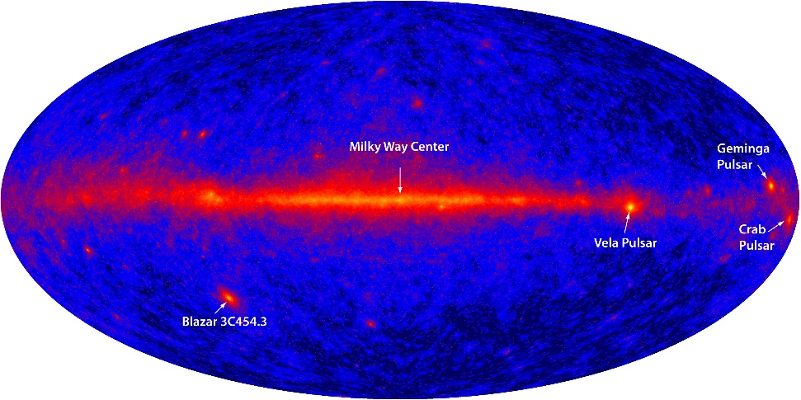
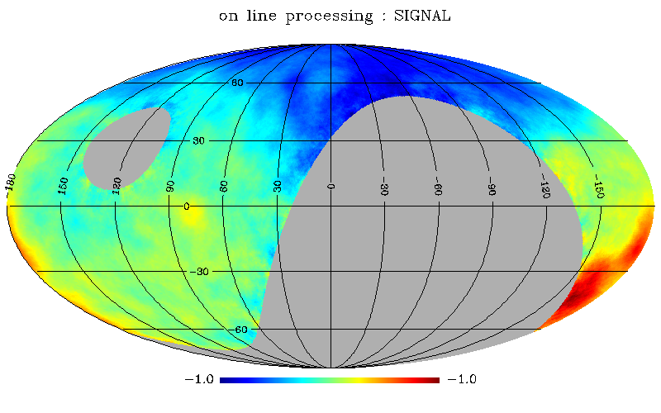
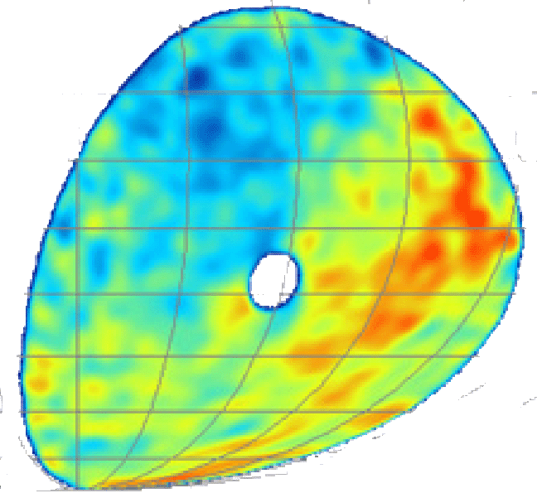
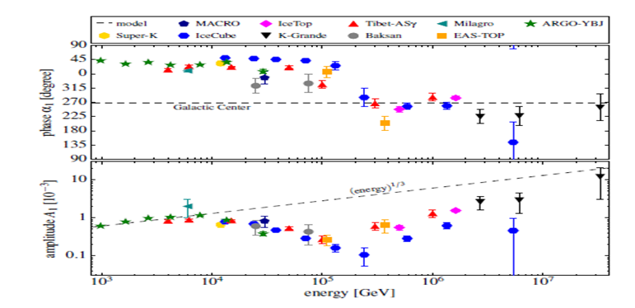
1: CR Isotropy
Cosmic rays were discovered in 1912 by Hess via a series of balloon experiments, for which he was awarded Nobel Physics Prize in 1936.
10TeV
Victor Franz Hess
Tibet III 1PeV
IceTop 1.6PeV
Relative Intensity [x10⁻³]
X.B.Qu et al., 2012
Geminga 340kyr 300pc
Galactic Cosmic Rays

Slide 7
1: Nearby Cosmic Ray Source
Γ=2.6
Γ=2.5
Geminga 340kyr 300pc

Slide 8
1: Nearby Cosmic Ray Source
Γ=2.6
Γ=2.5

Slide 9
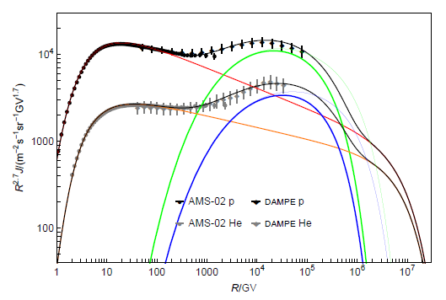
1: Nearby Cosmic Ray Source
Proton
Helium
Γ=2.6
Γ=2.5
Geminga 340kyr 300pc

Slide 10
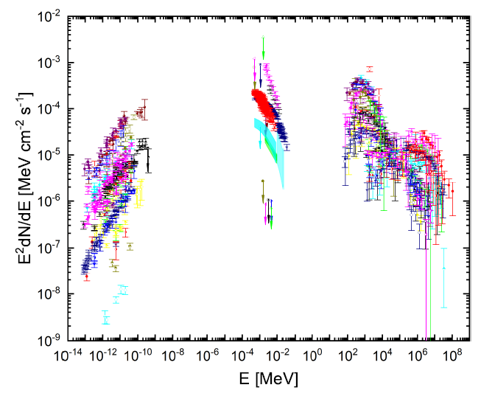
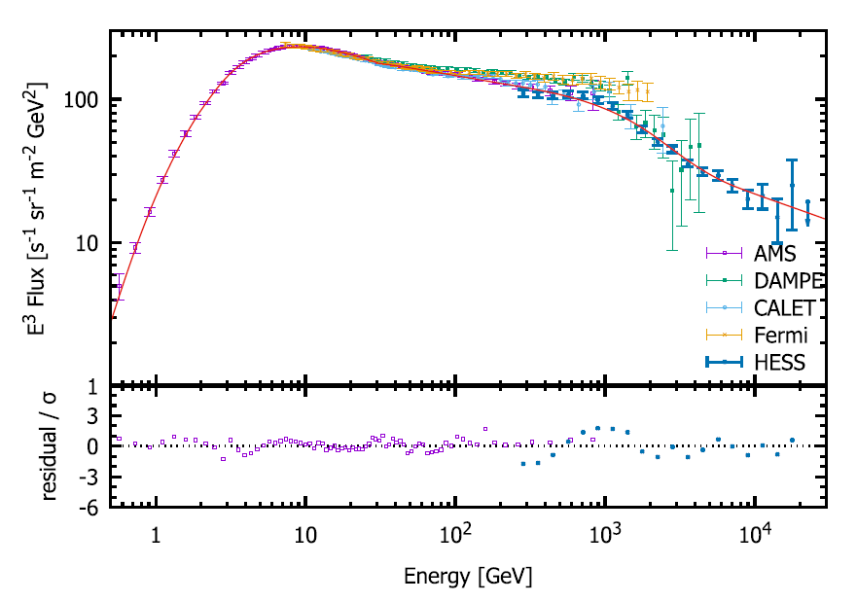
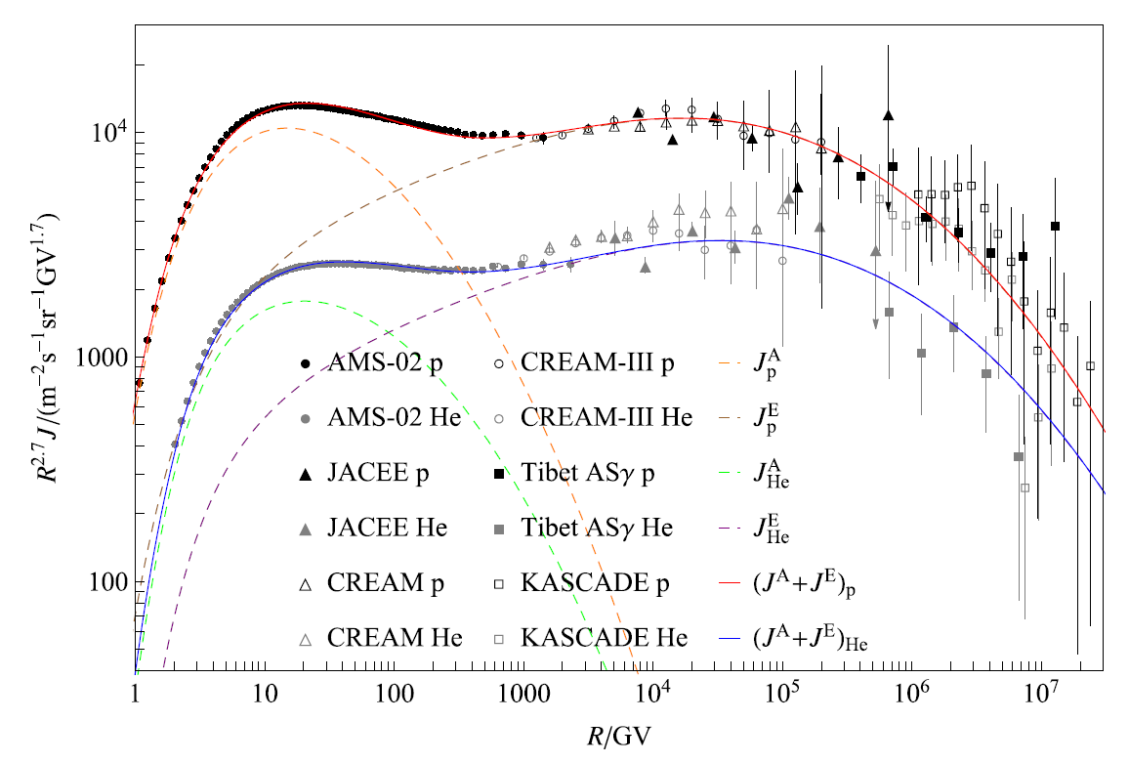
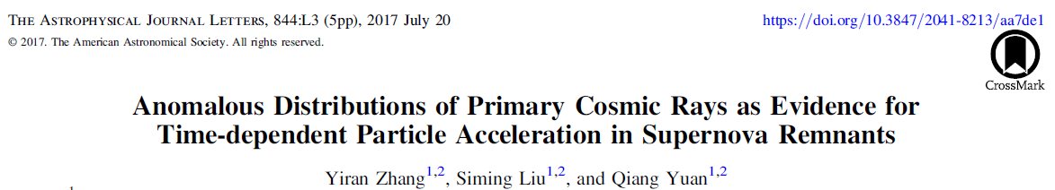
2: Gamma-ray SNRs
Young
Old
High density
Young
Low density
Electron
宇宙线正负电子谱
宇宙线质子和氦核谱
Proton
Helium
34 gamma-ray SNRs
The gamma-ray spectrum shows an evolution from hard to soft

Slide 11
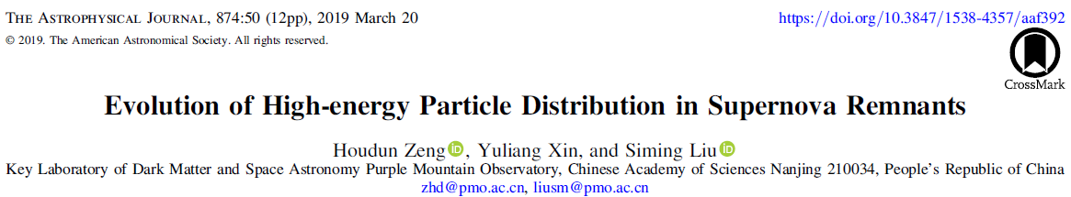
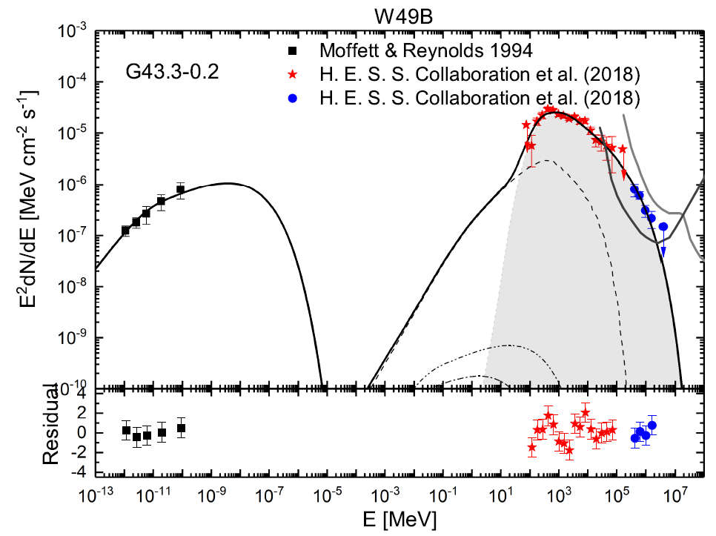
2: Gamma-ray SNRs
Escape
Radiation
acceleration

Slide 12
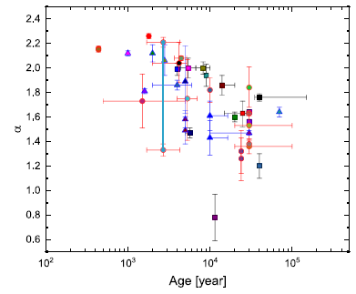
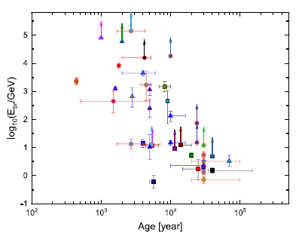
2: Gamma-ray SNRs

Slide 13
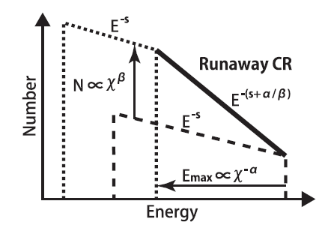
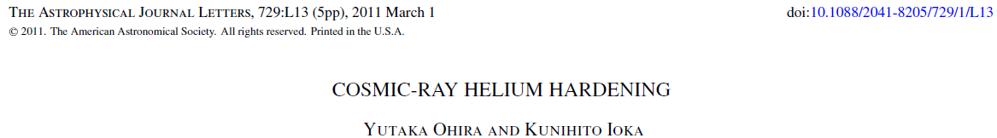
2: Particle Acceleration in SNRs
Old
Young
GeV
TeV

Slide 14
2: TeV cosmic ray acceleration in SNRs
13
5
5
6
2

Slide 15
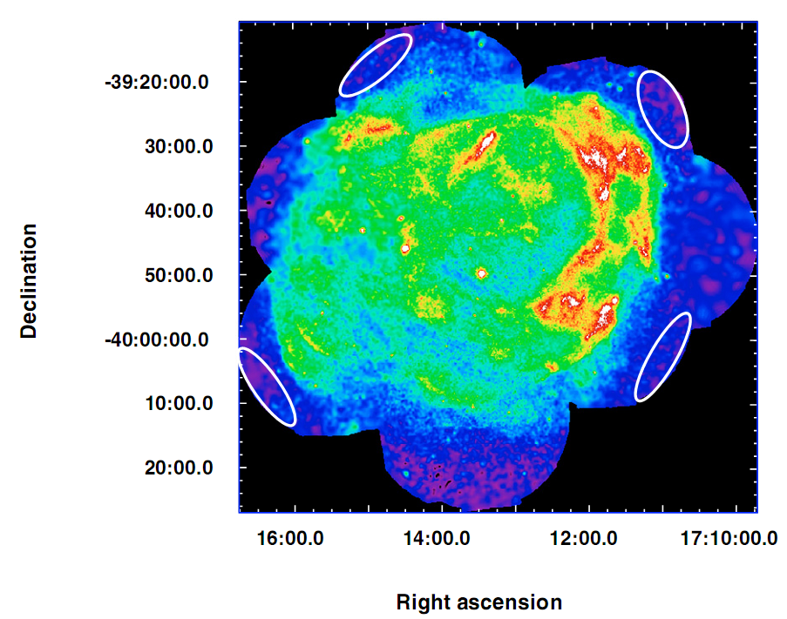
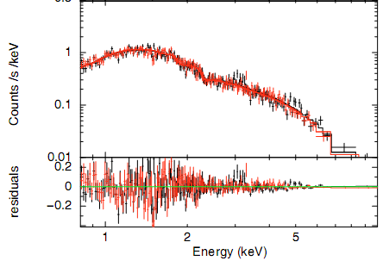
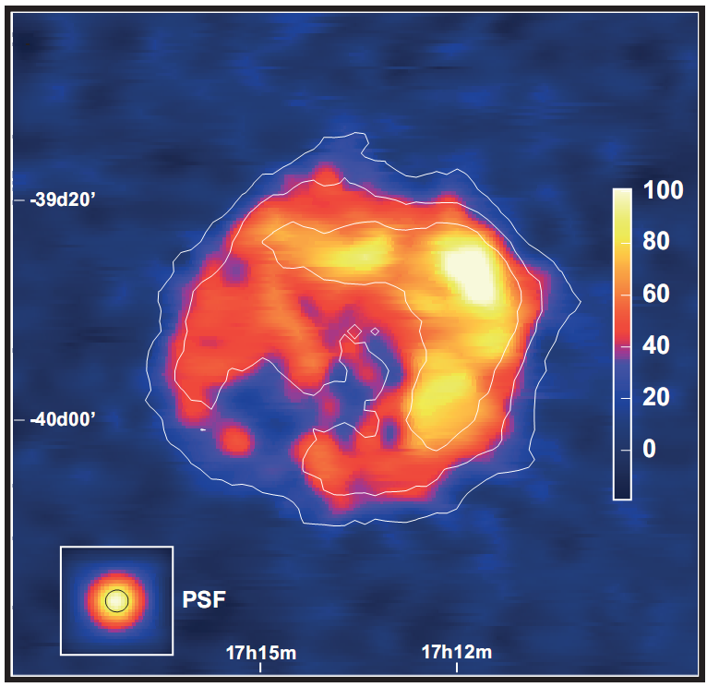
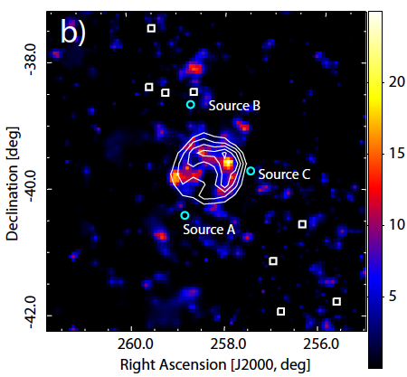
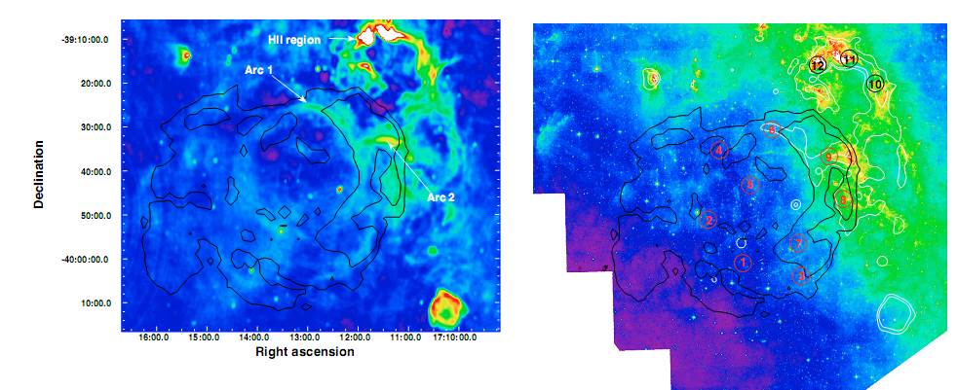
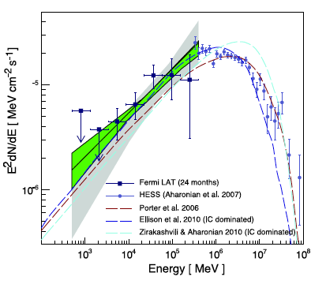

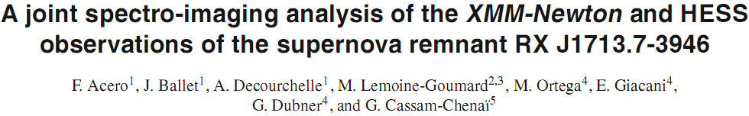
2: Shell Type TeV SNRs
TeV
X-ray
GeV
8μm
1.4GHz

Slide 16
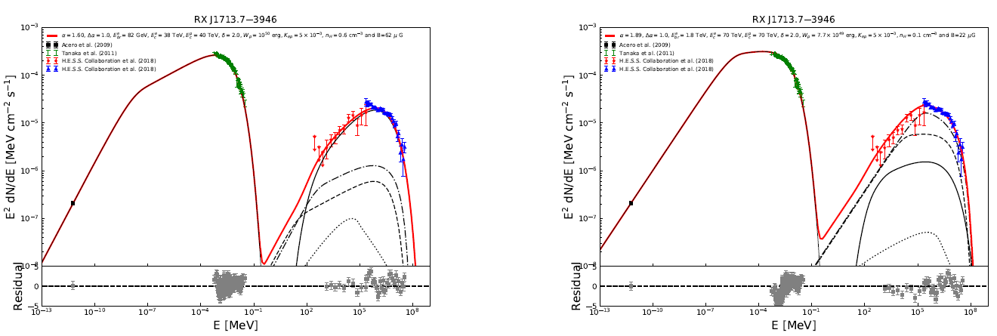
2: Hadronic vs Leptonic Models
IC
pp
synchrotron
synchrotron
Hadronic
1: More model parameters
2: Needs cold gases as background
3: Ion spectral cutoff below 100 TeV No constraint on PeV ion acceleration
Leptonic
1: Fewer model parameters
2: Supported by weak thermal X-rays
3: No constraint on ion acceleration

Slide 17
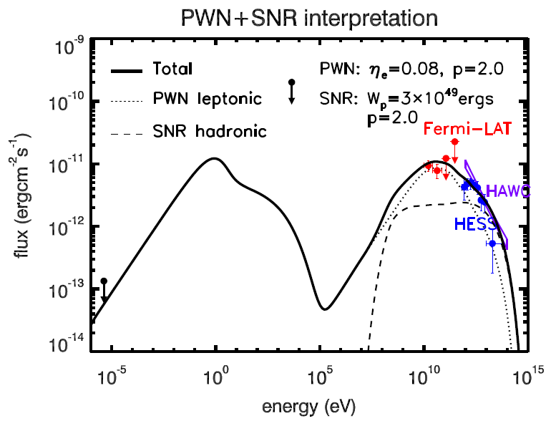
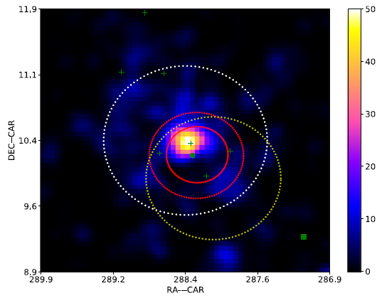
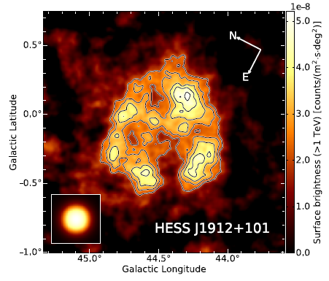
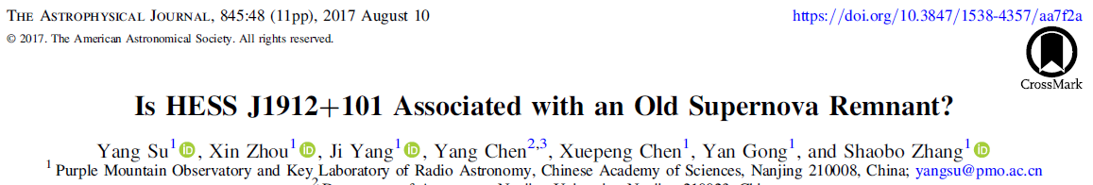
2: An old SNR with hard Υ-ray spectrum
170kyr
70-200kyr！

Slide 18
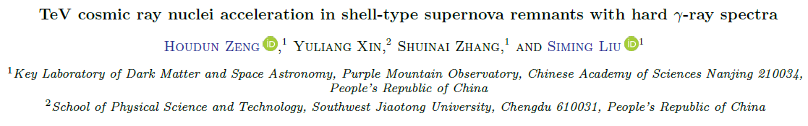
2: An old SNR with hard Υ-ray spectrum
✓

Slide 19
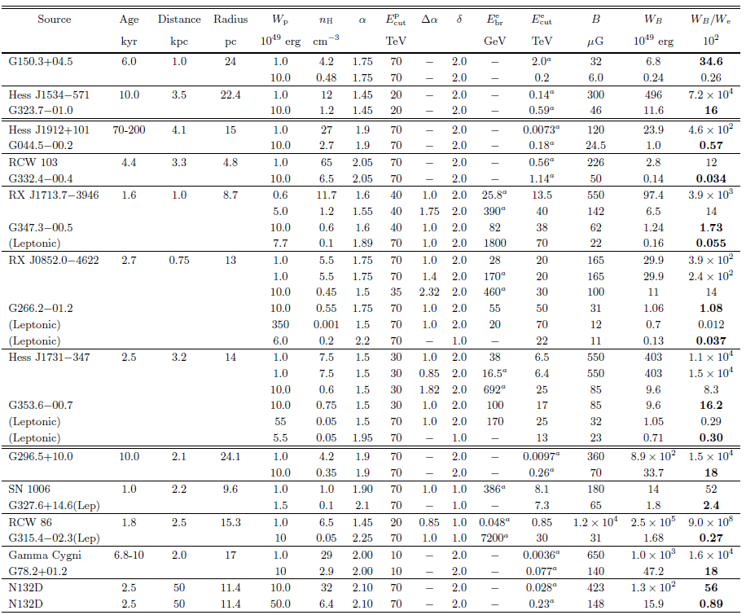

Slide 20
2: Gamma-ray SNRs
Young
Low density
Old SNRs
Electron
PWN
Young SNRs
Proton
Helium
Gamma-ray SNRs
The gamma-ray spectrum cuts off below 100 TeV. The spectrum of a PWN extends beyond 100 TeV!

Slide 21
GeV CR Acceleration

Slide 22
2: GeV Particle Acceleration in Gamma-ray SNRs

Slide 23
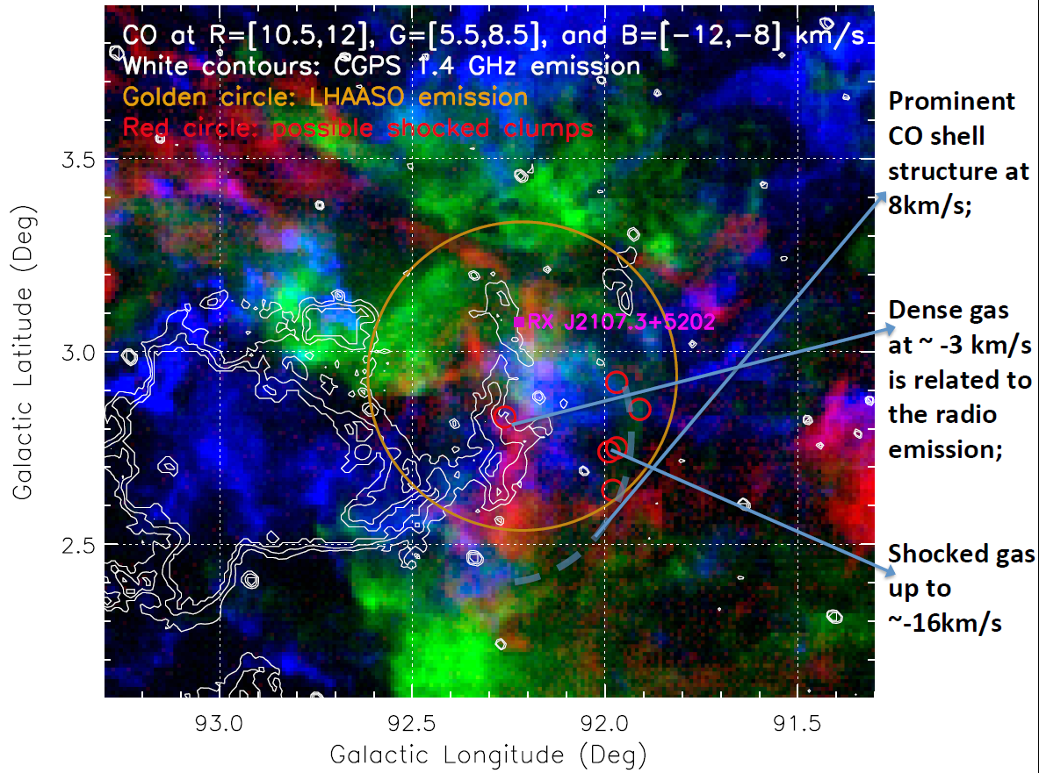
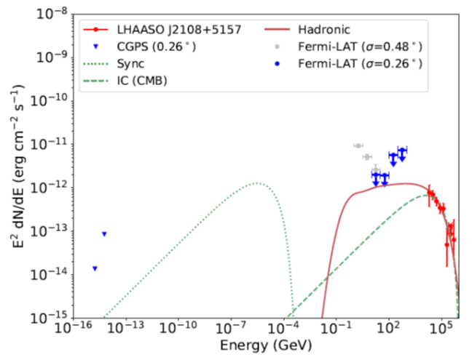
2:100TeV Photons from SNRs

Slide 24
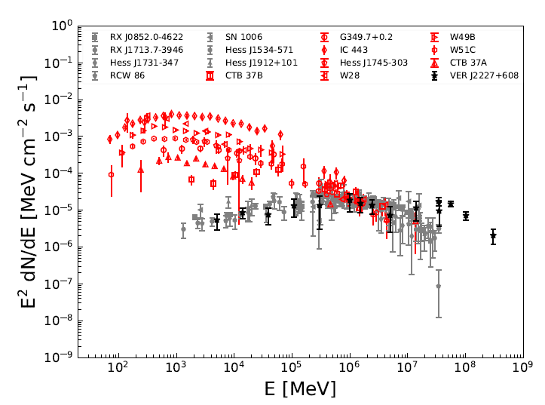
3: PeVtrons
Old SNR
PWN
Young SNR

Slide 25
3: Preliminary

Slide 26
Conclusions
Multiwavelength observations of SNRs show that they can dominate the flux of CR up to hundreds of TeV, with GeV CRs accelerated by shocks in a high density medium while TeV CRs accelerated in a low density medium.
PWNe are important PeVatrons. The origin of PeV to EeV CRs is still an open issue.

Slide 27
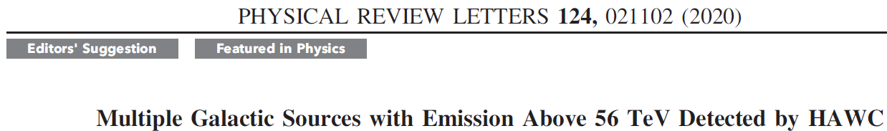
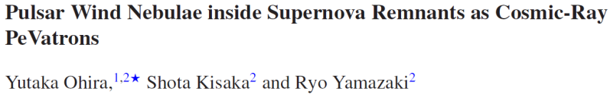
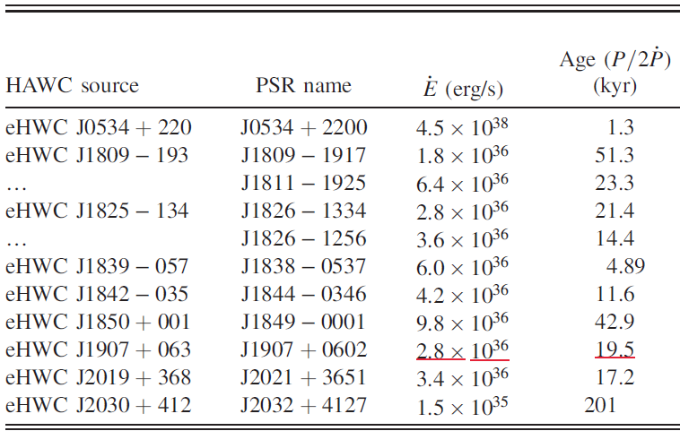
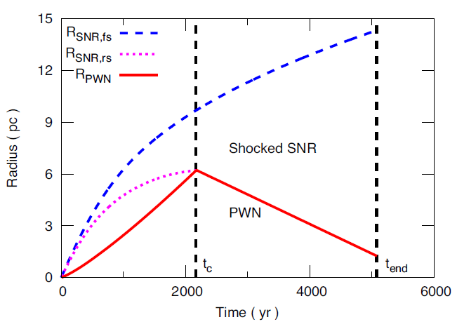
3: Interaction of Shocks and PWNe

Slide 28
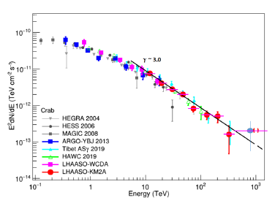
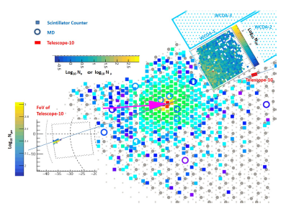
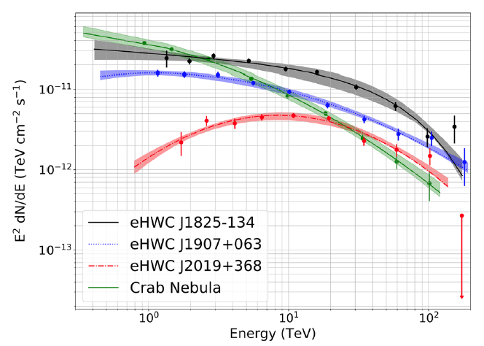
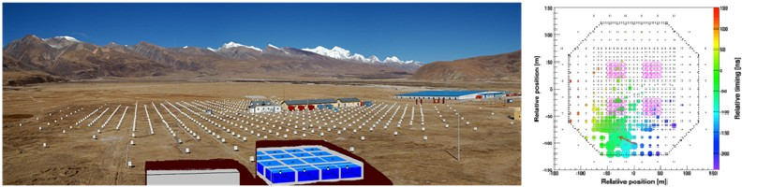
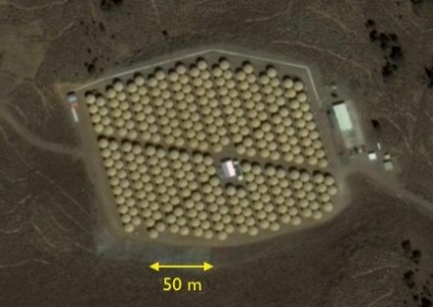
3: The Crab Nebula
Advanced Composition Explorer
PWNs？
As-gamma
HAWC

Slide 29
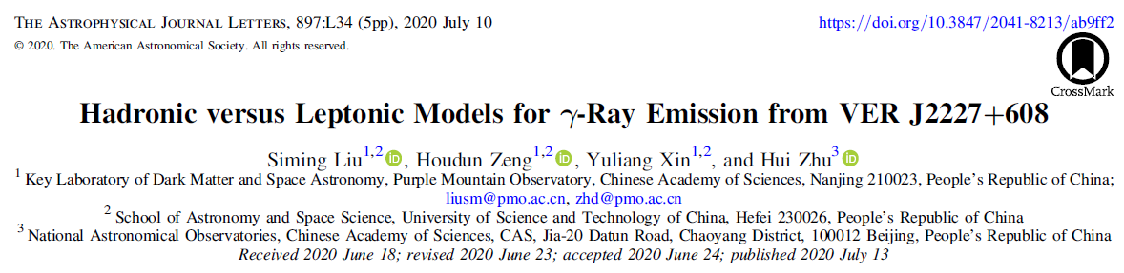
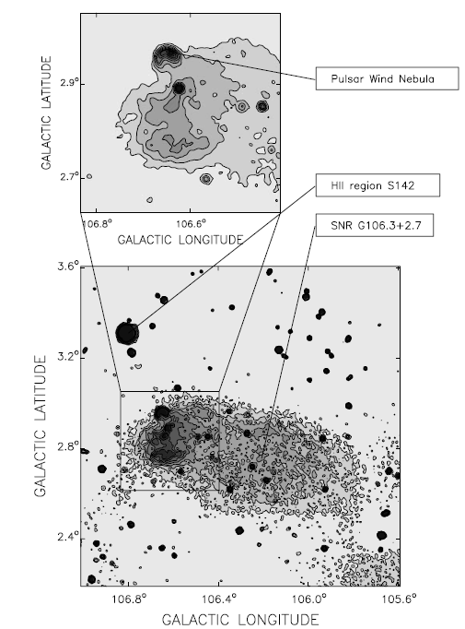
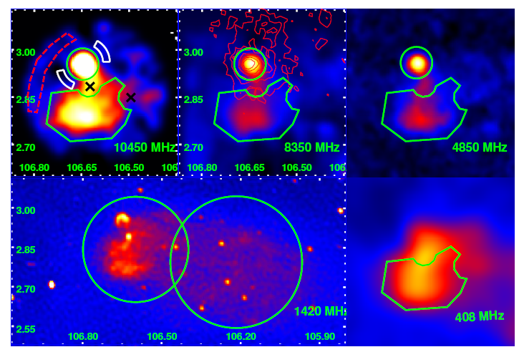
3: PeVatrons

Slide 30
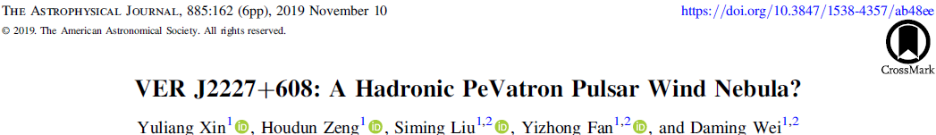
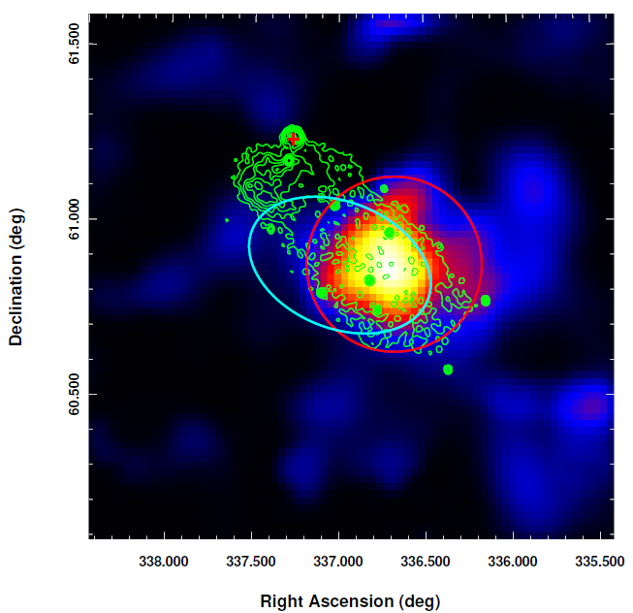



VER J2227+608: A Hadronic TeV Source？
Ec>400TeV

Slide 31





Slide 32


3: Nonthermal X-ray emission from SNR G106.3+2.7-Boomerang complex
Ge, Liu et al. 2020
The surface brightness profile implies a different origin of the X-ray emission in the tail region from the head and Boomerang region

Slide 33

3: SED

Slide 34

3: 2 radio bright sources with X-rays favor leptonic models

Slide 35
3: 3 radio bright source without non-thrmal X-rays

Slide 36




3: 3 radio medium sources with non-thrmal X-rays

Slide 37


3: 2 radio medium sources without non-thrmal X-rays

Slide 38


3：2 radio weak sources without non-thrmal X-rays

Slide 39

3：B is about10-100μG
Electron energy 1e47 erg

Slide 40

3: Mean density is about 1 cm⁻³

Slide 41

3：Magentic energy is more than 100 times higer than electrons

Slide 42


6:轻子模型要求有持续的粒子加速！

Slide 43

6：射电亮源的最佳拟合

Slide 44




１０
X-ray & TeV
100TeV
脉冲星风云？

Slide 45



CO观测

Slide 46



Slide 47




10: X-ray and gamma-ray

Slide 48


Slide 49



伽马射线观测研究宇宙线起源
The standard candle Crab: a typical electron source
100TeV
ν
Synchorotron Radiation
γ
PeV
IC
scattering
Cosmic rays

Slide 50


四川稻城
高海拔宇宙线观测站
Notes:
大家都知道，在宇宙线的研究中，人们发现了许多的基本粒子，直到上世纪50年代中期加速器实验的开始。

