Slide 1
The implications of TeV detected GRB afterglows for acceleration at relativistic shocks (TeVPA 2021)
Zhiqiu Huang
John Kirk
Gwenael Giacinti
Brian Reville

Slide 2
Outline
Basic introduction of GRBs
Relativistic shocks
Single zone SSC model
Conclusions

Slide 3
Outline
Basic introduction of GRBs
Relativistic shocks
Single zone SSC model
Conclusions

Slide 4
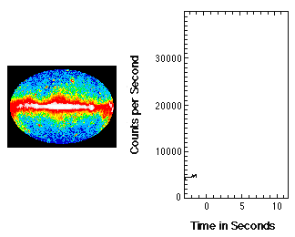
Prompt Emission

Slide 5
Afterglow
A relativistic shock
would propagate
into the ambient
medium and accelerate
particles.

Slide 6
Outline
Basic introduction of GRBs
Relativistic shocks
Single zone SSC model
Conclusions

Slide 7
Relativistic shocks
downstream
upstream
downstream
upstream
Bd
1/γs
particle
Shock normal
particle
Bu
shock
shock
γs: >> 1

Slide 8
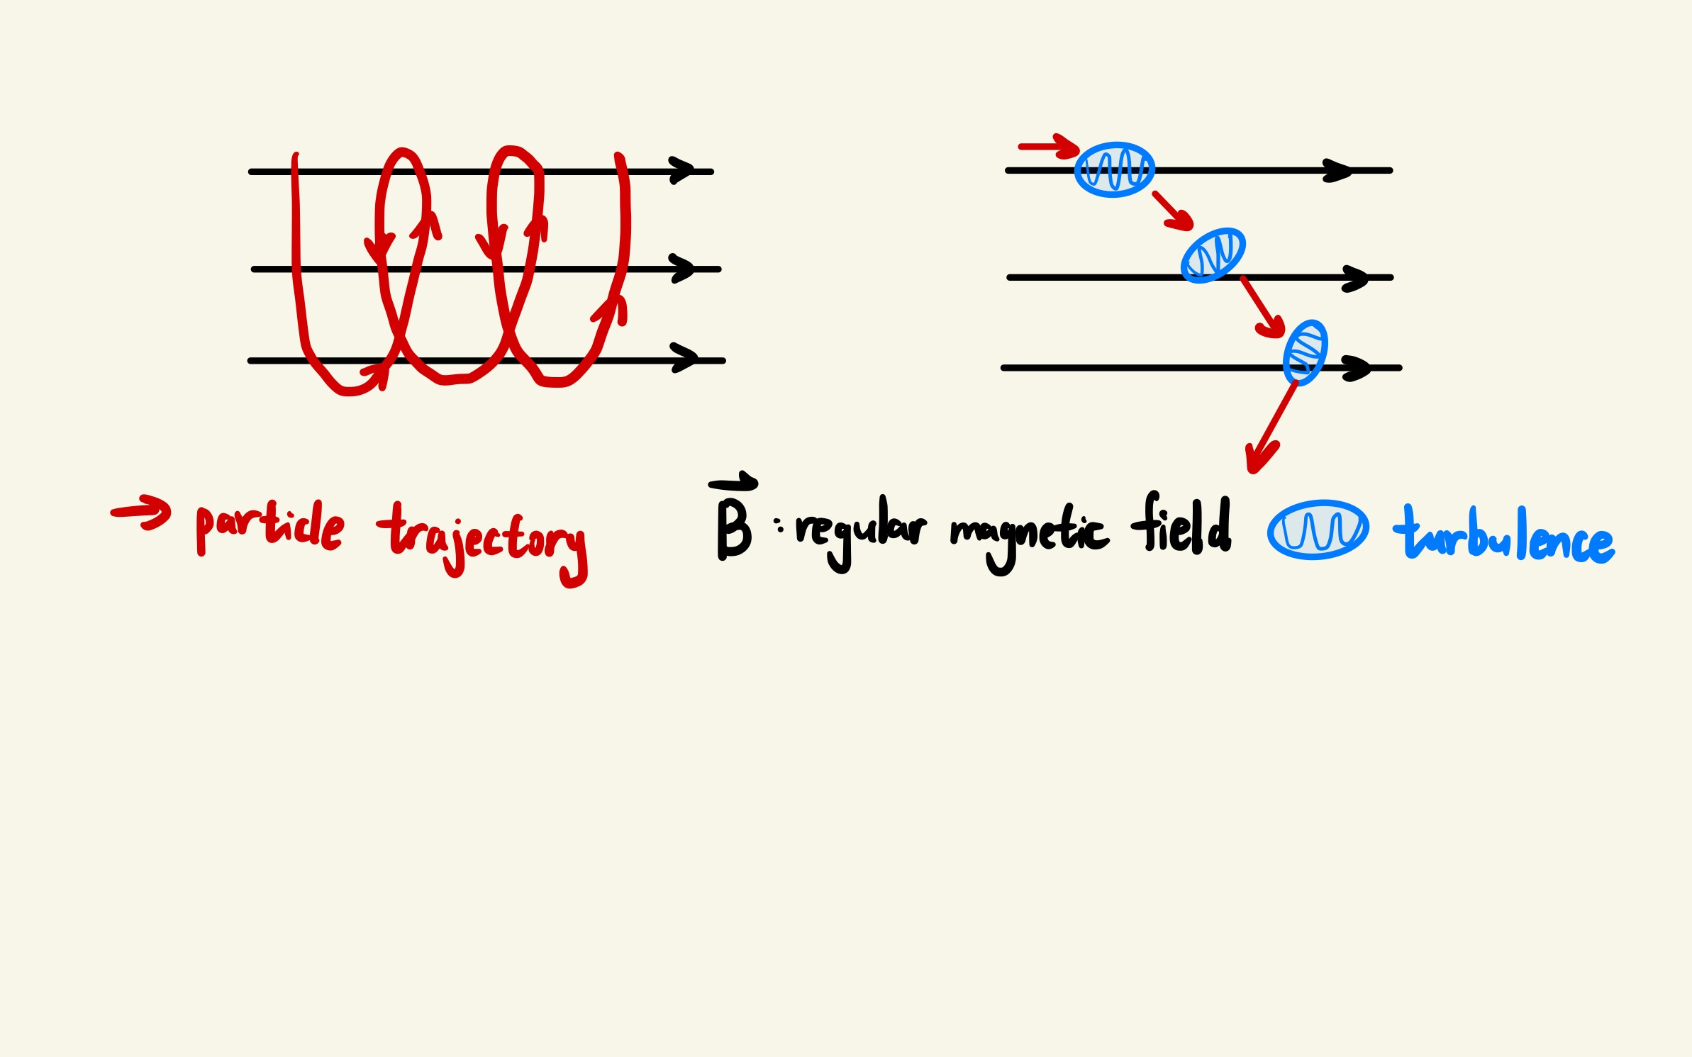
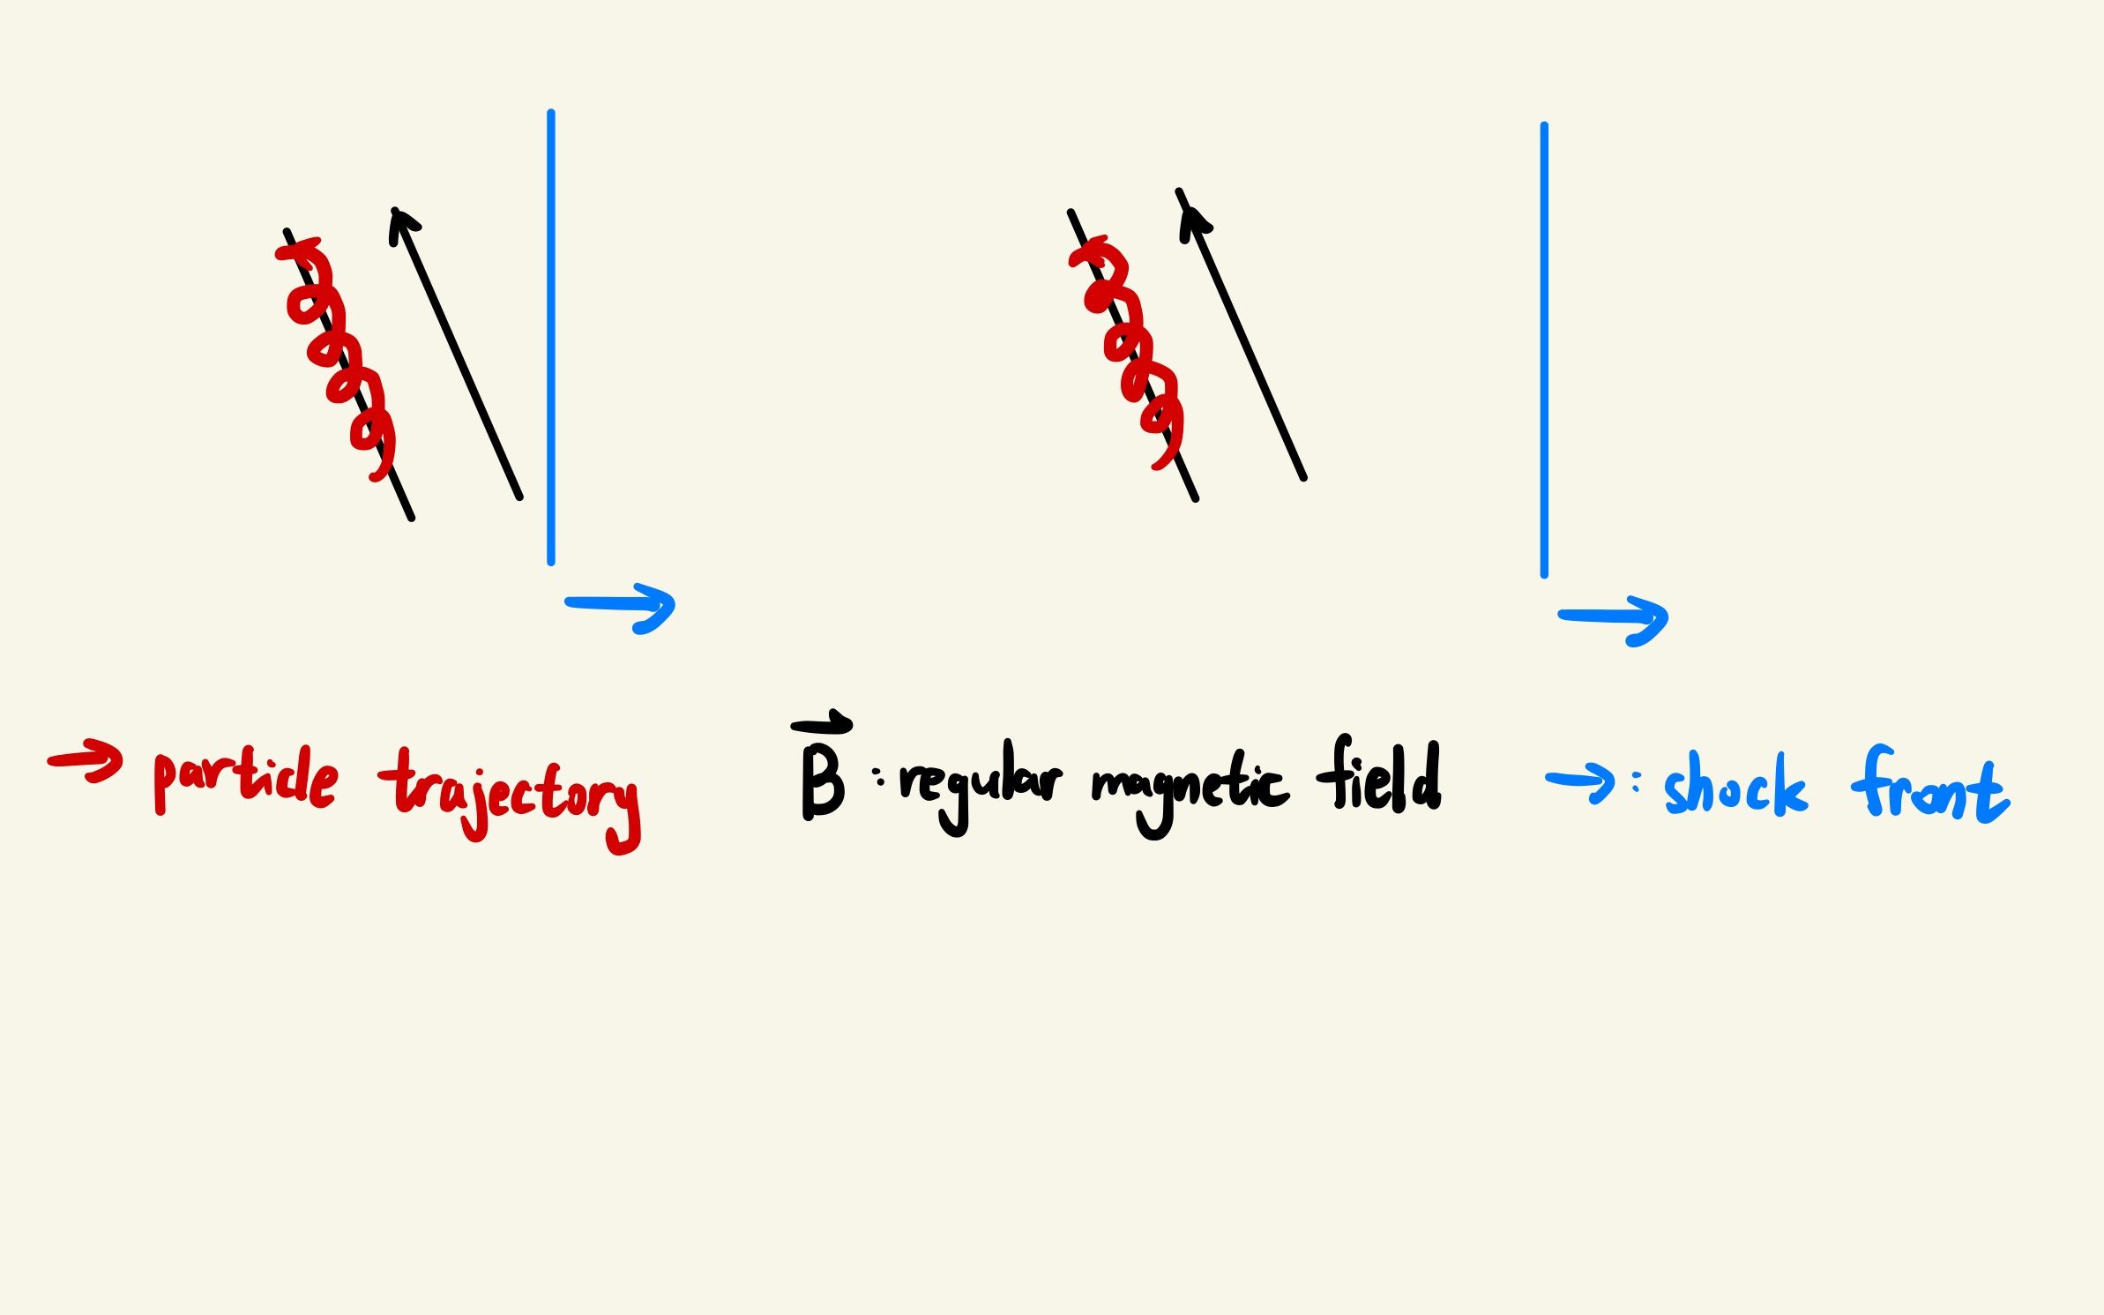
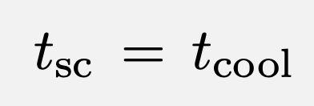
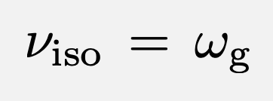
loss limit
magnetized limit

Slide 9
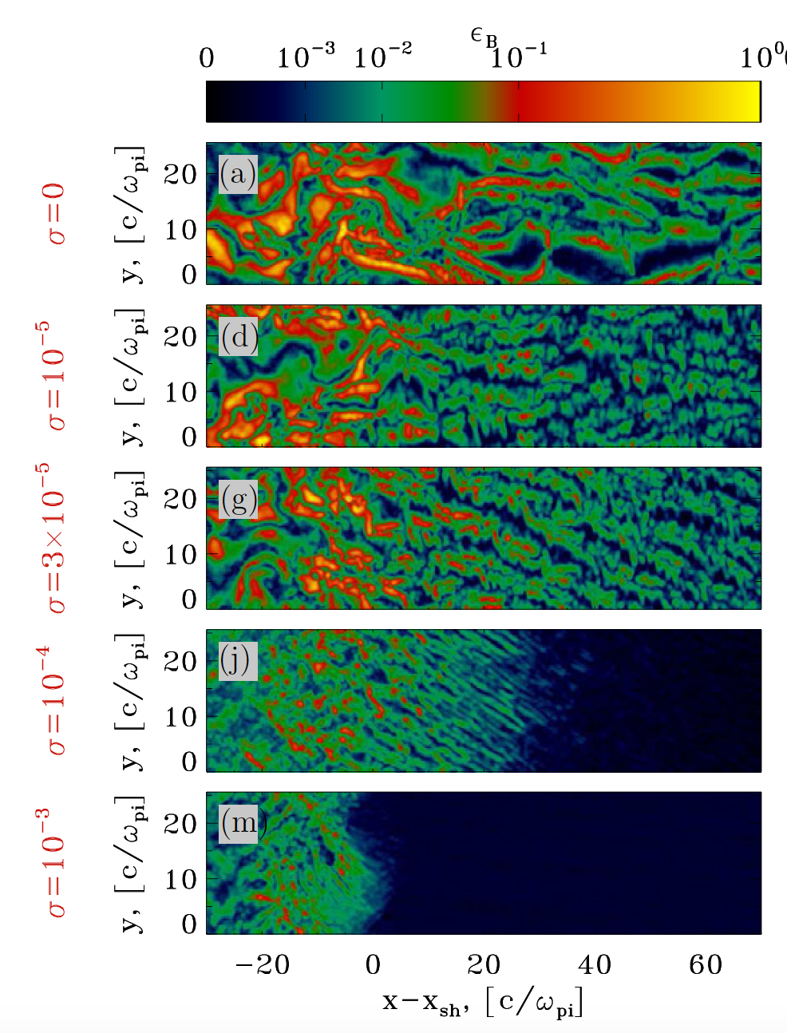
For Weibel-mediated
(unmagnetized) electron-ion shocks,
2D plot of the magnetic
energy fraction
σ: magnetization parameter in the upstream
(~ 10^-8 for typical GRB external shocks)
Sironi et al. 2013

Slide 10
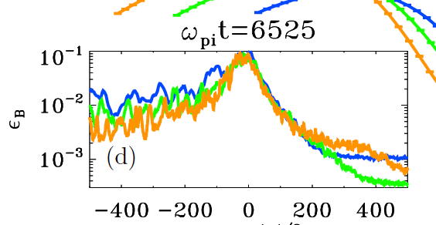
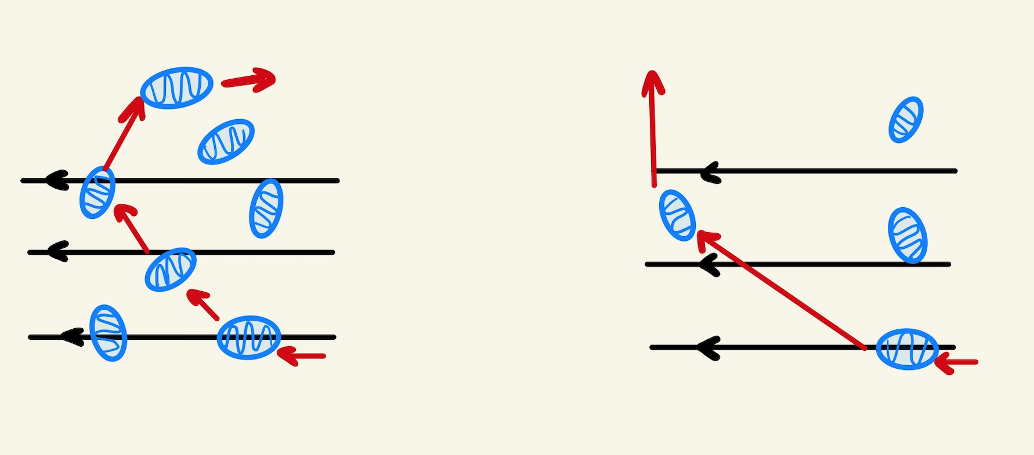
Sironi et al. 2013
damping limit
Turbulences damp away rapidly in the downstream
Turbulences damp slowly
Turbulences damp rapidly

Slide 11
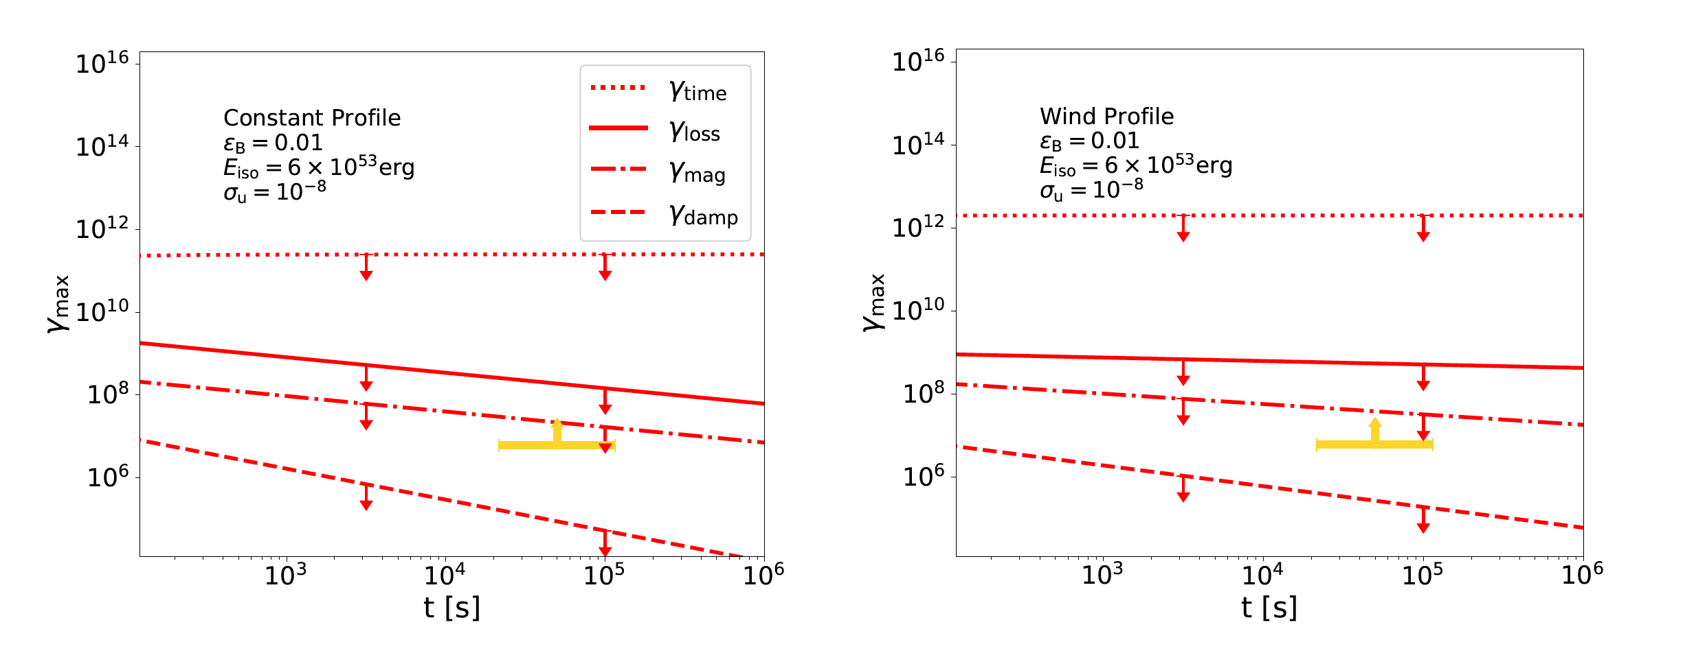
Maximum electron energy
loss limit
magnetized limit

Slide 12
Outline
Basic introduction of GRBs
Relativistic shocks
Single zone SSC model
Conclusions

Slide 13
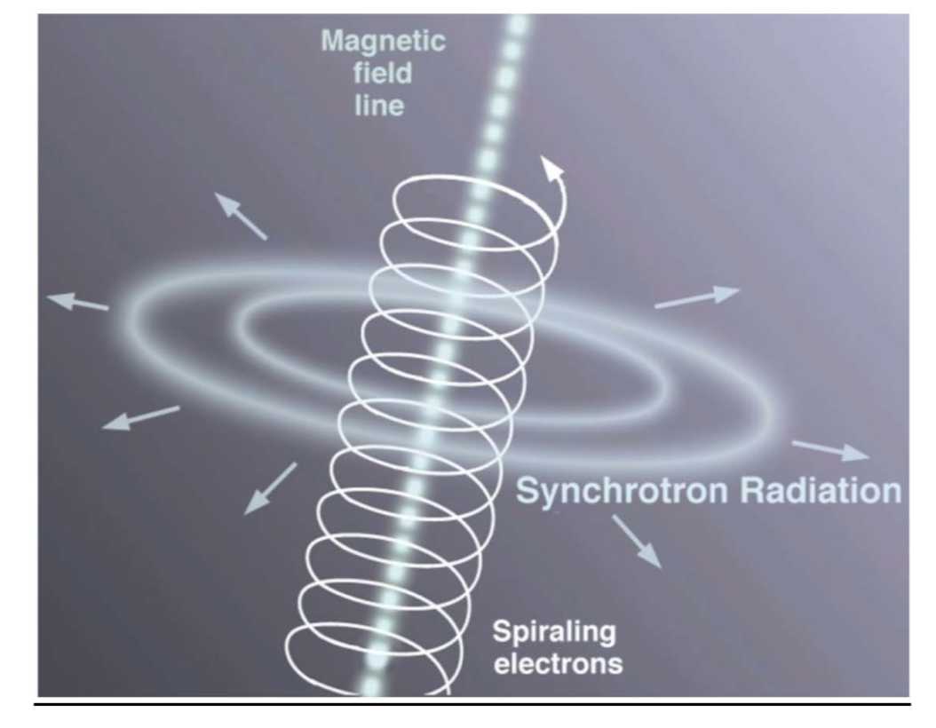
Radiative Processes
SSC (inverse Compton)
Synchrotron

Slide 14
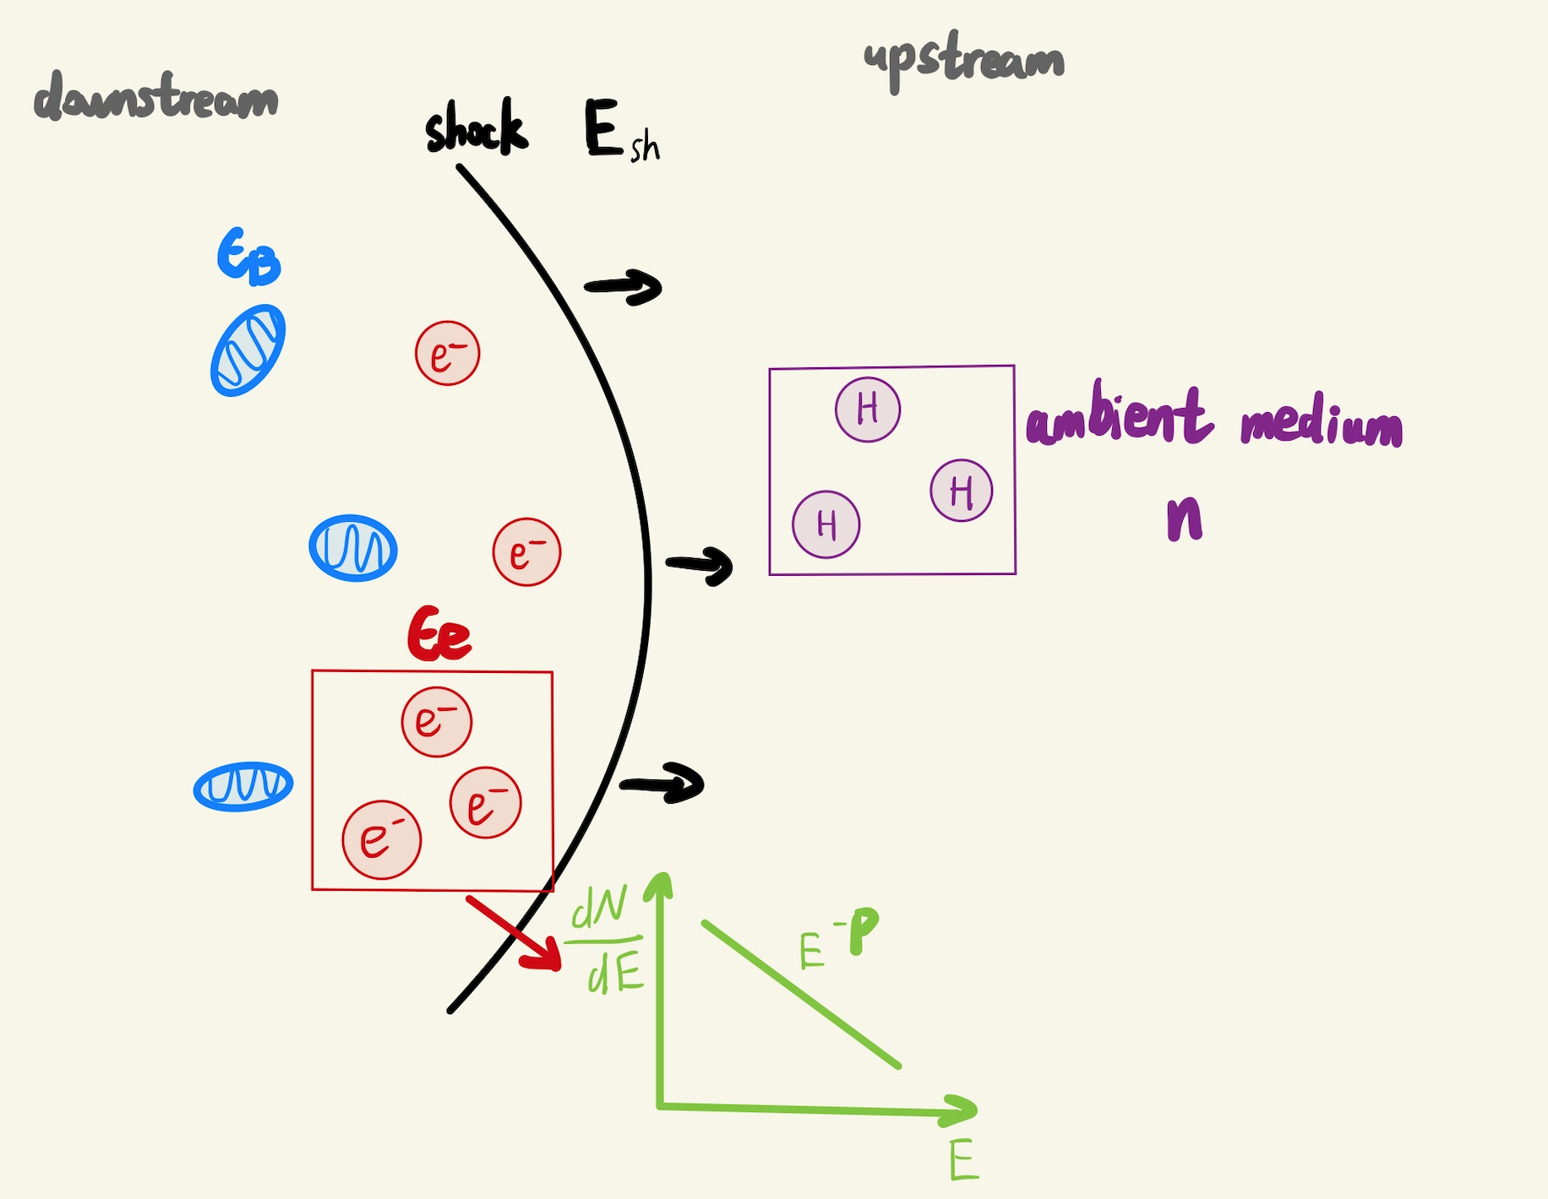

Slide 15
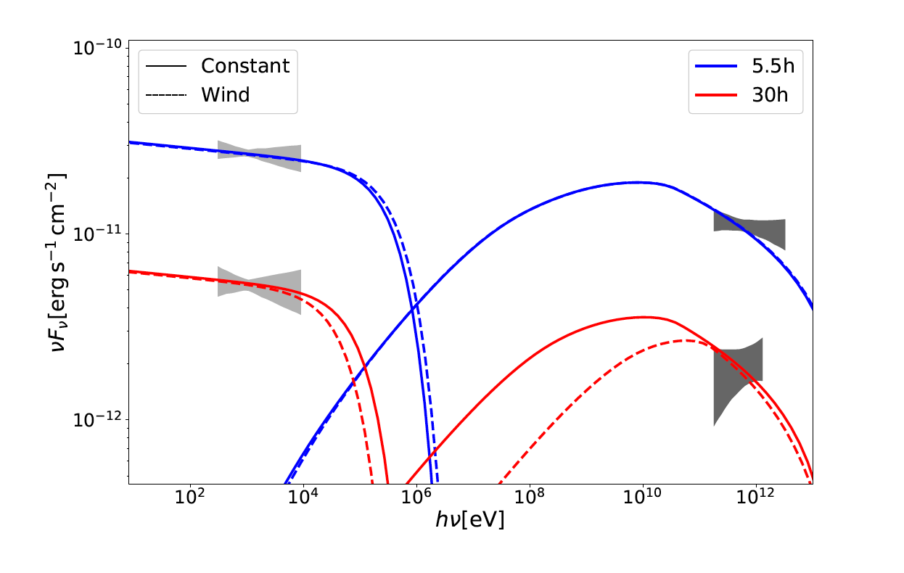
Fitting to GRB 190829A

Slide 16
Outline
Basic introduction of GRBs
Relativistic shocks
Single zone SSC model
Conclusions

Slide 17
Conclusions
Scenarios in which the magnetic field damps rapidly in the downstream of
the shock: ruled out
Iw > 10? Future simulations with larger scale structures of turbulences are
required.
Abdalla et al. 2021 show VHE gamma-ray spectrum is hard. KN suppression
softens the spectrum in TeV band, and presents a significant obstacle to
matching the data.

Slide 18
Thank you!

