Slide 1
CEPC HTS plan and Radiation thickness calculation
Ning Feipeng
2020-06-03

Slide 2
CEPC HTS plan
HTS SOLENOID FOR IDEA Detector
  Based on the LTS plan of IDEA detector.
Property | Value
Magnetic field in center (T) | 2
Free bore diameter (m) | 4
Cold mass inner radius (m) | 2.2
Cold mass length (m) | 6

Slide 3
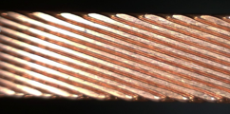
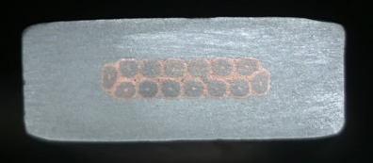
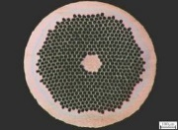
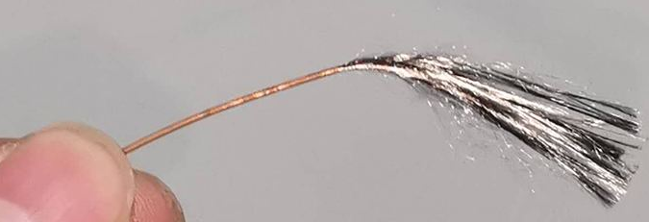
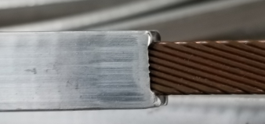
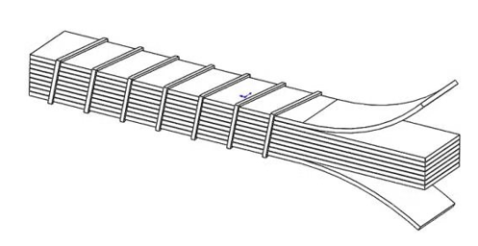
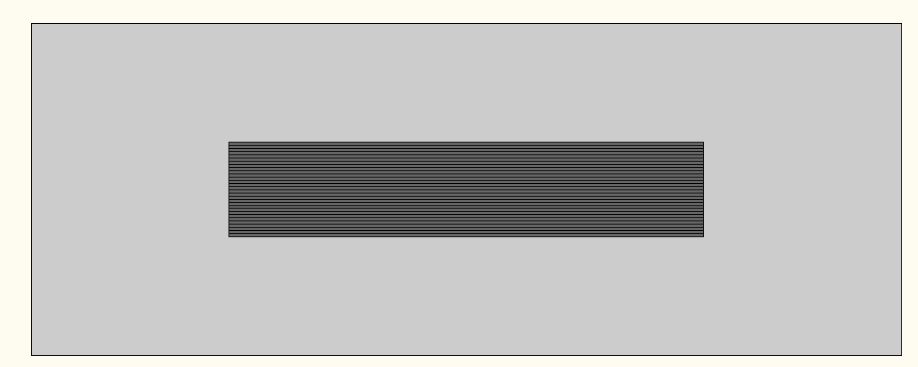
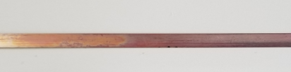
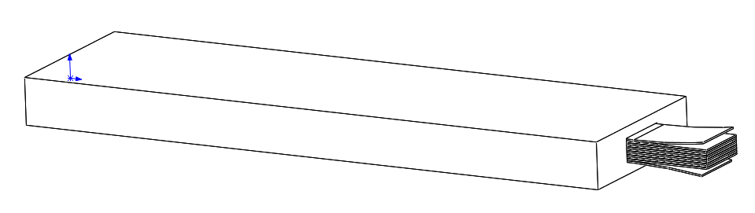
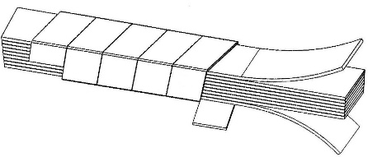
CEPC HTS plan
Cable development
NbTi wire
Rutherford Cable
Al Stabilized Rutherford Cable
LTS
ReBCO tape
ReBCO Stack Cable
Al Stabilized ReBCO Stacked Tape Cable
HTS
It is developing

Slide 4
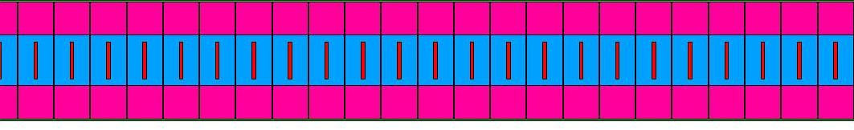
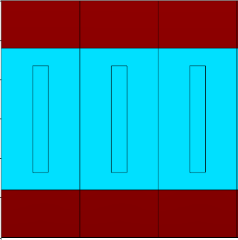
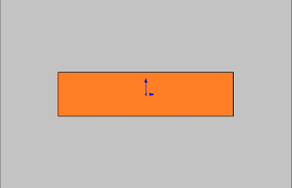
CEPC HTS plan
Coil winding
LTS
vertical configuration
HTS
horizontal configuration

Slide 5
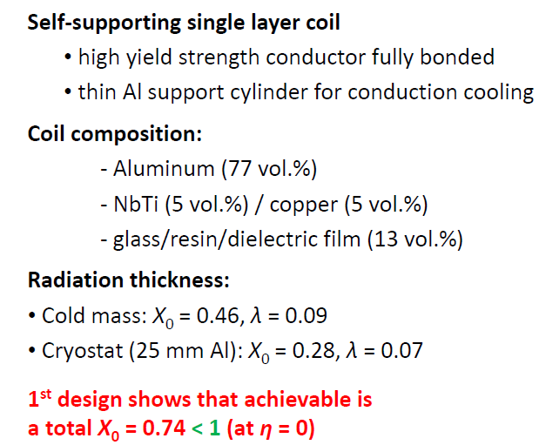
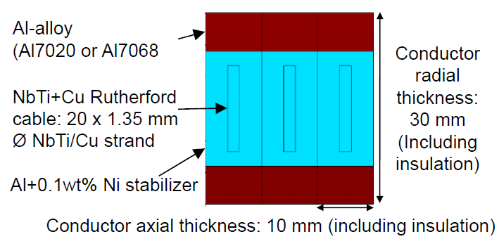
Radiation thickness calculation
IDEA LTS part
Ultra-light 2T/4m bore Detector Solenoid for FCCee-the Solenoid in the IDEA detector -Herman ten Kate, FCC Annual meeting Amsterdam, April 9-14, 2018
IDEA: a detector concept for CepC, F. Bedeschi, INFN-Pisa,CEPC CDR International Review, Beijing, September, 2018

Slide 6
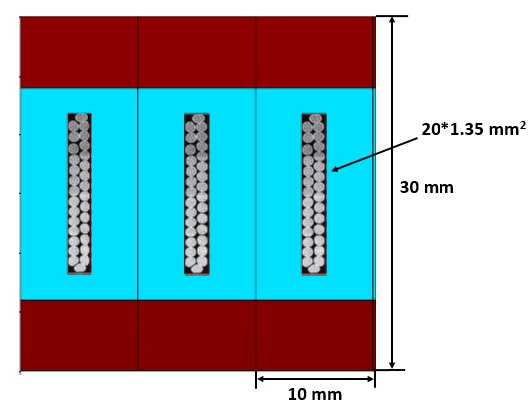
Radiation thickness calculation
IDEA LTS version
  How to calculate the radiation thickness?
Material | Thickness | Radiation thickness |  | Nuclear Interaction length
 | X, mm | X₀, mm | X/X₀ | λ0, mm | λ=X/λ0
NbTi | 0.675 | 15.028 | 0.0449 | 204.5 | 0.0033
Cu | 0.675 | 14.36 | 0.0470 | 153.2 | 0.0044
Stabilizer,Al | 30 | 88.9 | 0.3375 | 397 | 0.0756
Glass/epoxy | 5 | 286 | 0.0175
Total, X_{tot} |  |  | 0.4469 |  | 0.083
Trajectory
2:
Material | Thickness | Radiation thickness |  | Nuclear Interaction length
 | X, mm | X₀, mm | X/X₀ | λ0, mm | λ=X/λ0
NbTi | 10 | 15.028 | 0.6654 | 204.5 | 0.0489
Cu | 10 | 14.36 | 0.6964 | 153.2 | 0.0653
Stabilizer,Al | 10 | 88.9 | 0.1125 | 397 | 0.0252
Glass/epoxy | 5 | 286 | 0.0175
Total, X_{tot} |  |  | 1.4918 |  | 0.1394
1
2
Trajectory
1:
Cryostat (25 mm Al): X0= 0.28, λ= 0.07
Total | X0 | λ
Track 2 | 0.73 | 0.153
Track 1 | 1.77 | 0.21

Slide 7
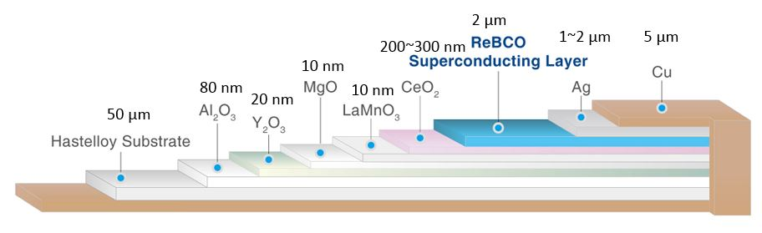
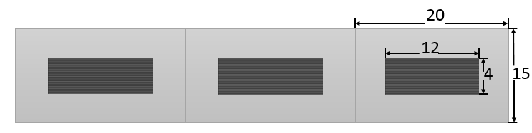
Radiation thickness calculation
IDEA HTS version
  35 layers HTS tape
Material | Thickness | Radiation thickness |  | Nuclear Interaction length
 | X, mm | X₀, mm | X/X₀ | λ0, mm | λ=X/λ0
Cu | 0.35 | 14.36 | 0.0244 | 153.2 | 0.0023
Fe | 1.75 | 17.57 | 0.0996 | 167.7 | 0.0104
Ag | 0.07 | 8.543 | 0.0082 | 154 | 0.0005
YBa2Cu3O7 | 0.07 | 12.49 | 0.0056 | 296.5 | 0.0002
MgO | 0.00000035 | 78.28 | 0.0000 | 274 | 0.0000
Al2O3 | 0.0000028 | 70.38 | 0.0000 | 247.9 | 0.0000
CeO2 | 0.0000105 | 16.54 | 0.0000 | 230 | 0.0000
Al stablizer | 15 | 88.97 | 0.1686 | 397 | 0.0378
MLI, Fiber glass | 0 | 286 | 0.0000 | 415 | 0.0000
Glassepoxy | 2 | 286 | 0.0070 | 428.9 | 0.0047
Total, X_{tot} |  |  | 0.3134 |  | 0.0559
1
Cryostat (25 mm Al): X0= 0.28, λ= 0.07
Total | X0 | λ
Track 1 | 0.5934 | 0.1259

Slide 8
Radiation thickness calculation
IDEA LTS and HTS Comparison
Consider using the same Cryostat (25 mm Al): X0= 0.28, λ= 0.07
Total | X0 | λ
LTS Track 2 | 0.73 | 0.153
LTS Track 1 | 1.77 | 0.21
HTS Track 1 | 0.59 | 0.126
1
2
1

Slide 9
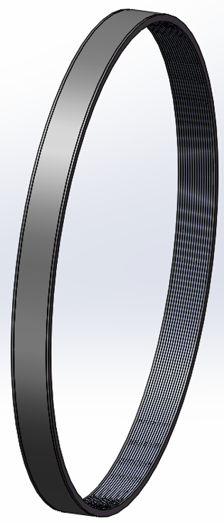
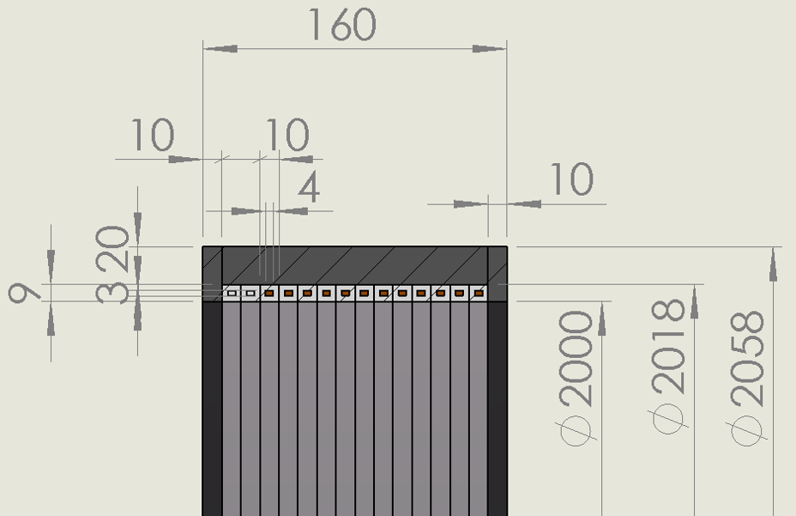

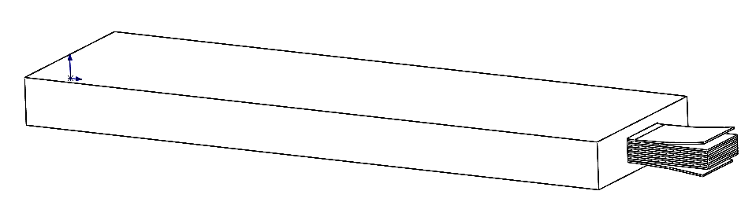
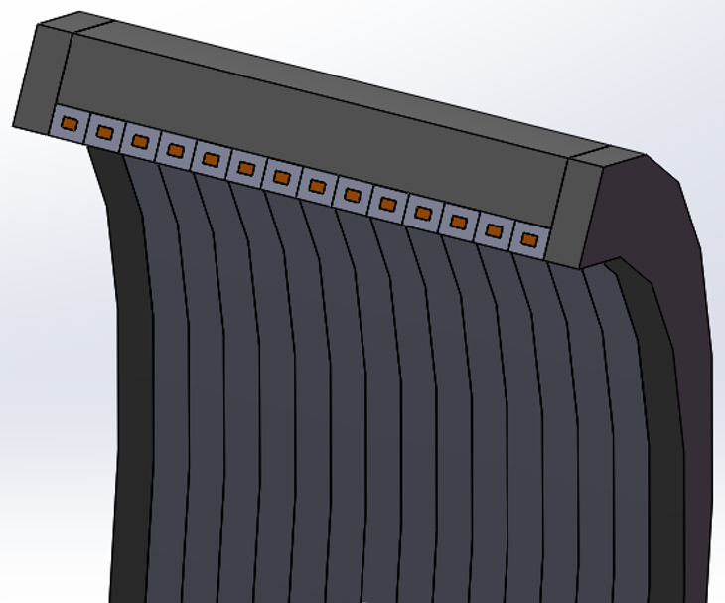
HTS plan R&D
Need to develop the Al stabilized HTS stack cable or other HTS cable.
Got fund (3 million yuan)from CAS to develop the cable and prototype coil.

Slide 10
Future
CEPC 3T inside calorimeter version, the coil parameter? Radius, length?
Radiation length requirement?
The most important thing is to develop the HTS cable.

