Slide 1
CEPC detector solenoid magnet
Ning Feipeng
For the CEPC Detector Magnet Team
2020-07-23

Slide 2
Outline
1, CEPC detector magnet parameters at present.
2, Magnet inside Calorimeter
3, Radiation length of different superconducting materials.

Slide 3
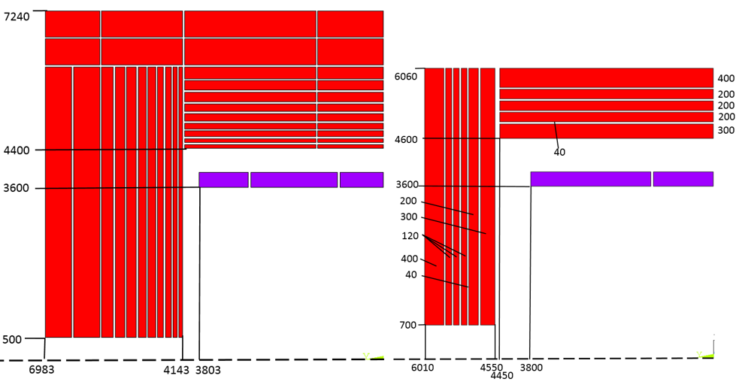
1, New version
 | CMS | CEPC CDR version | CEPC New version
Central field (T) | 4 | 3 | 3
Operating current (A) | 19600 | 15779 | 16796
Inner diameter of coil (mm) | 6360 | 7200 | 7200
Length of coil (mm) | 12480 | 7606 | 7600
Barrel yoke inner diameter (mm) | 9180 | 8800 | 9200
Barrel yoke outer diameter (mm) | 14000 | 14480 | 12120
Total length of yoke (mm) | 20040 | 13966 | 12020
Weight of barrel yoke (t) | 6000 | 5940 | 3137
Weight of each end cap (t) | 2000 | 3316.6 | 1144
Total weight of yoke (t) | 10,000 | 12,573 | 5,425
CDR version
New version

Slide 4
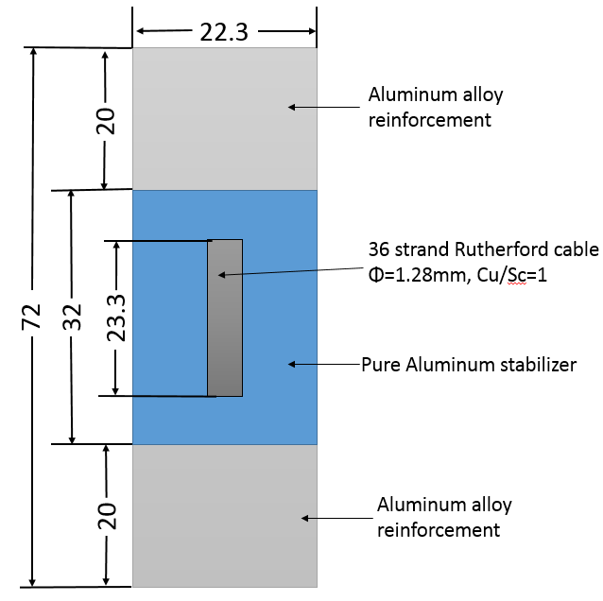
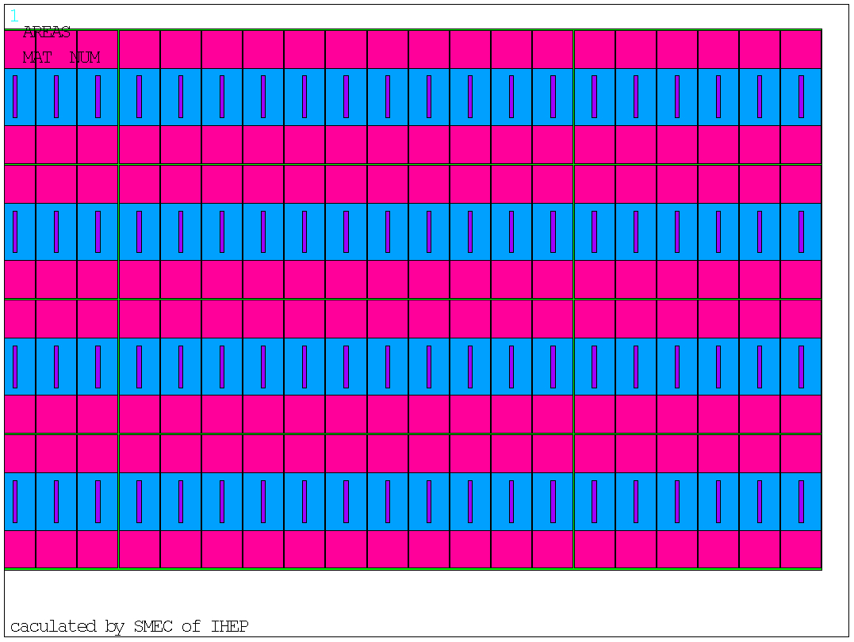
CEPC detector magnet baseline
Cable：
  Al stabilized NbTi Rutherford cable
Coil
  Divide into 3 coils in axial direction，4 layers in radial direction
Layer 4
Layer 3
Layer 2
Layer 1
Cable configuration, unit, mm

Slide 5
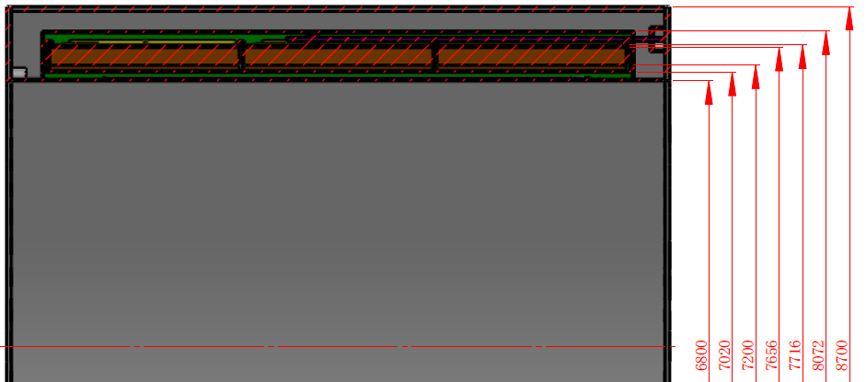
CEPC detector magnet baseline
The thickness of the magnet: 950 mm
Length: 8500 mm

Slide 6
Magnet Inside Calorimeter
Inner diameter of the magnet: 2 m
Length: 6 m
The central magnetic field strength:
  2 T ? It is similar to the plan of INFN.
  3 T ?

Slide 7
SOLENOID FOR IDEA Detector
Herman ten Kate
Ultra-light 2T/4m bore Detector Solenoid
Property | Value
Magnetic field in center (T) | 2
Free bore diameter (m) | 4
Cold mass inner radius (m) | 2.2
Cold mass length (m) | 6
The thickness of the magnet: 500 mm
Length: 6000 mm
A challenging work

Slide 8
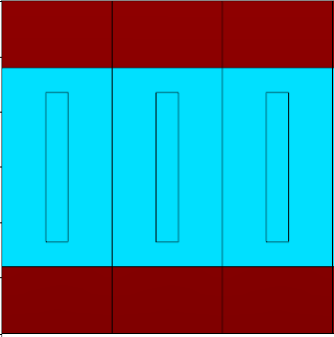
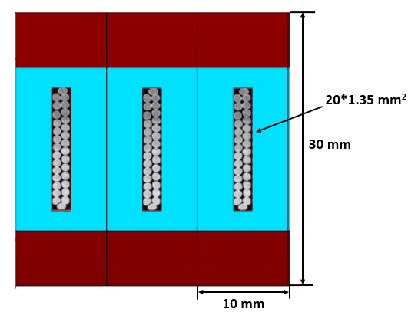
SOLENOID FOR Detector
IDEA: LTS cable
Current: 20 kA
CMS/CEPC: LTS cable
Current: 20 kA
3T IDEA: 2layers, 15 kA
30
10
The thickness of the magnet: 700-800 mm
This is more reliable.

Slide 9
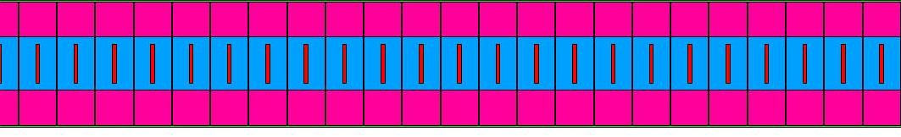
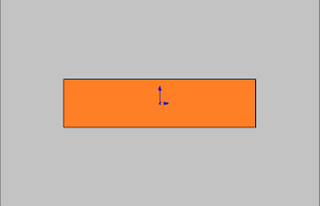
3, CEPC HTS plan
Coil winding
LTS
vertical configuration
HTS
horizontal configuration

Slide 10
Radiation thickness calculation of 2 T
IDEA LTS version
Material | Thickness | Radiation thickness |  | Nuclear Interaction length
 | X, mm | X₀, mm | X/X₀ | λ0, mm | λ=X/λ0
NbTi | 0.675 | 15.028 | 0.0449 | 204.5 | 0.0033
Cu | 0.675 | 14.36 | 0.0470 | 153.2 | 0.0044
Stabilizer,Al | 30 | 88.9 | 0.3375 | 397 | 0.0756
Glass/epoxy | 5 | 286 | 0.0175
Total, X_{tot} |  |  | 0.4469 |  | 0.083
Trajectory
2:
Material | Thickness | Radiation thickness |  | Nuclear Interaction length
 | X, mm | X₀, mm | X/X₀ | λ0, mm | λ=X/λ0
NbTi | 10 | 15.028 | 0.6654 | 204.5 | 0.0489
Cu | 10 | 14.36 | 0.6964 | 153.2 | 0.0653
Stabilizer,Al | 10 | 88.9 | 0.1125 | 397 | 0.0252
Glass/epoxy | 5 | 286 | 0.0175
Total, X_{tot} |  |  | 1.4918 |  | 0.1394
1
2
Big challenge
Cryostat (25 mm Al): X0= 0.28, λ= 0.07
Trajectory
1:
Total | X0 | λ
Weight averaged value | 0.59 | 0.09
Total (including cryostat) | 0.87 | 0.16

Slide 11
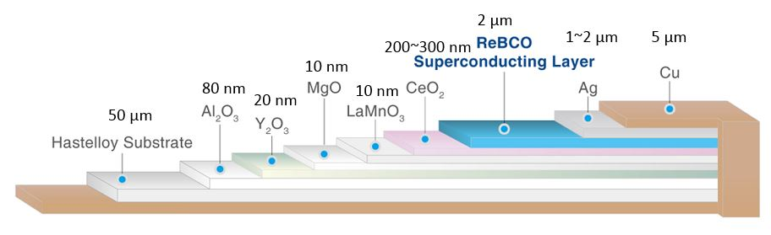
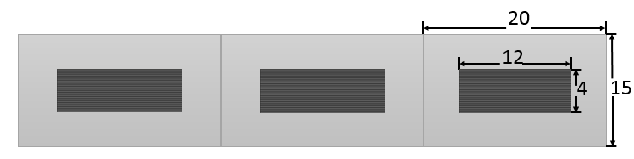
Radiation thickness calculation of 2 T
IDEA HTS version
  35 layers HTS tape
Material | Thickness | Radiation thickness |  | Nuclear Interaction length
 | X, mm | X₀, mm | X/X₀ | λ0, mm | λ=X/λ0
Cu | 0.35 | 14.36 | 0.0244 | 153.2 | 0.0023
Fe | 1.75 | 17.57 | 0.0996 | 167.7 | 0.0104
Ag | 0.07 | 8.543 | 0.0082 | 154 | 0.0005
YBa2Cu3O7 | 0.07 | 12.49 | 0.0056 | 296.5 | 0.0002
MgO | 0.00000035 | 78.28 | 0.0000 | 274 | 0.0000
Al2O3 | 0.0000028 | 70.38 | 0.0000 | 247.9 | 0.0000
CeO2 | 0.0000105 | 16.54 | 0.0000 | 230 | 0.0000
Al stablizer | 15 | 88.97 | 0.1686 | 397 | 0.0378
MLI, Fiber glass | 0 | 286 | 0.0000 | 415 | 0.0000
Glassepoxy | 2 | 286 | 0.0070 | 428.9 | 0.0047
Total, X_{tot} |  |  | 0.3134 |  | 0.0559
1
Cryostat (25 mm Al): X0= 0.28, λ= 0.07
Total | X0 | λ
Track 1 | 0.313 | 0.056
Total (including cryostat) | 0.593 | 0.126

Slide 12
Radiation thickness calculation of 2 T
IDEA LTS and HTS Comparison
Consider using the same Cryostat (25 mm Al): X0= 0.28, λ= 0.07
Total | X0 | λ
LTS | 0.87 | 0.16
HTS | 0.59 | 0.13
1
2
The cryostat:
1

Slide 13

Radiation thickness calculation of 3 T
LTS and HTS cable Comparison
Consider using the same Cryostat (50 mm Al): X0= 0.56, λ= 0.14
Total | X0 | λ
LTS | 1.18 | 0.18
HTS | 0.626 | 0.112
Total | X0 | λ
LTS | 1.74 | 0.32
HTS | 1.186 | 0.252

Slide 14
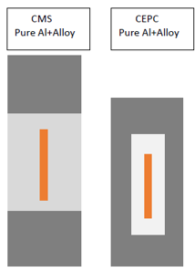
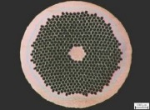
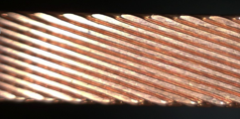
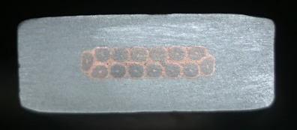
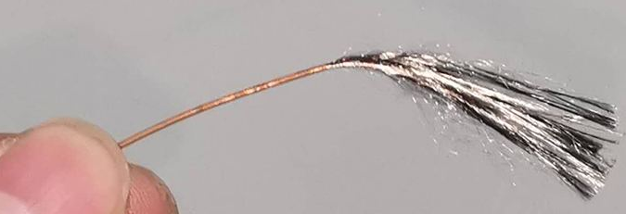
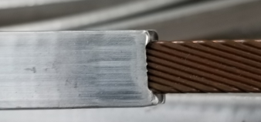



Cable development
LTS Cable development
Under development
NbTi wire
Rutherford Cable
Al Stabilized Rutherford Cable
$$√$$
$$√$$
NbTi Rutherford cable

Slide 15
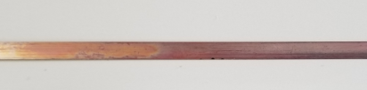
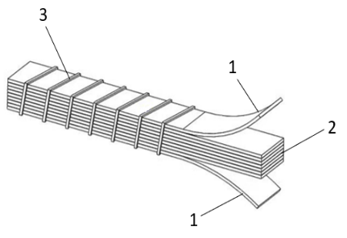
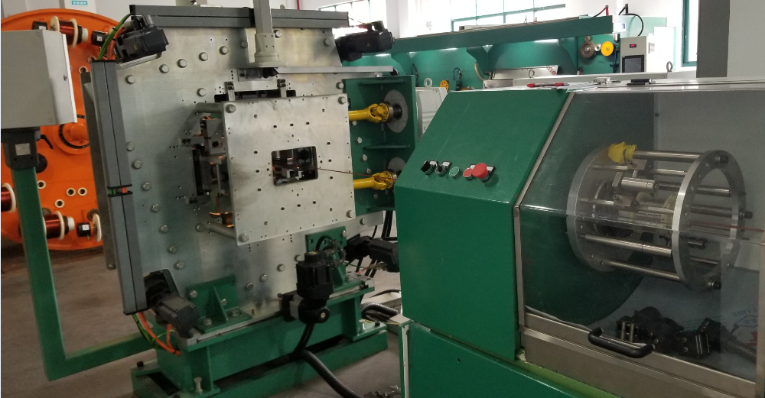
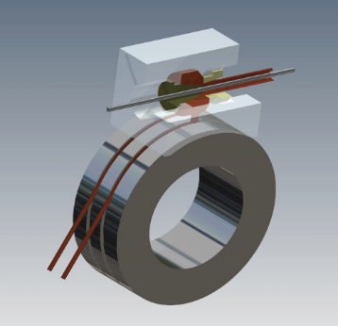
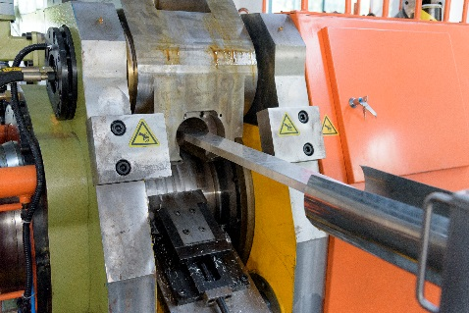
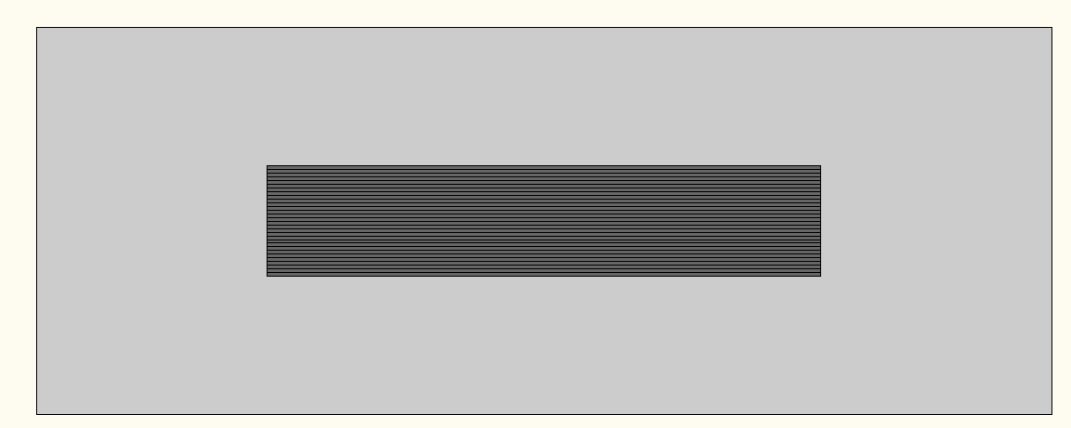
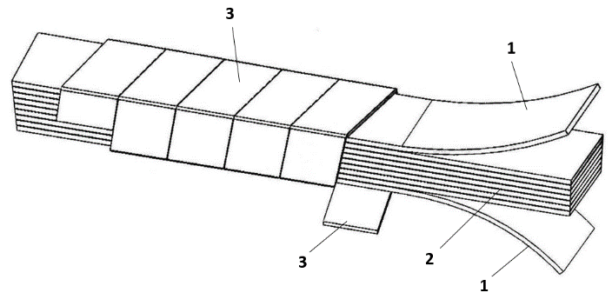
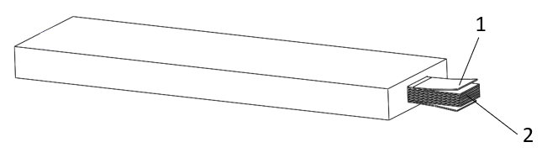
Cable development
HTS Cable development
ReBCO tape
1, HTS stack cable
2, Add Al stabilization to HTS stack cable
20 layers Al Stabilized ReBCO Stacked Tape Cable
Under development
Under development

Slide 16
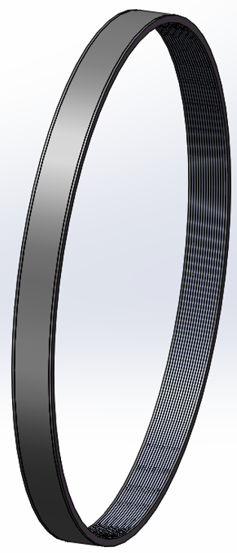
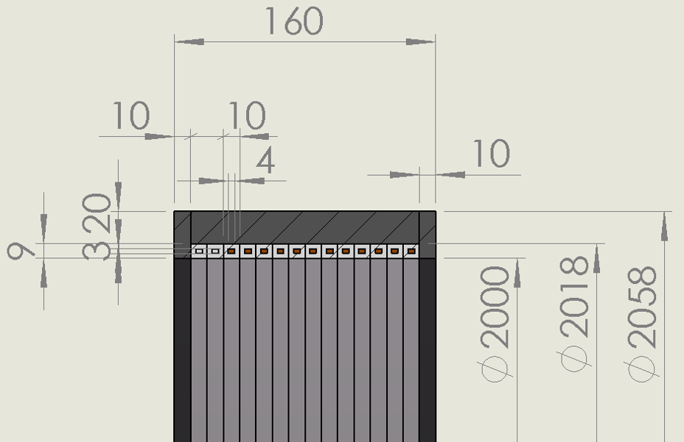
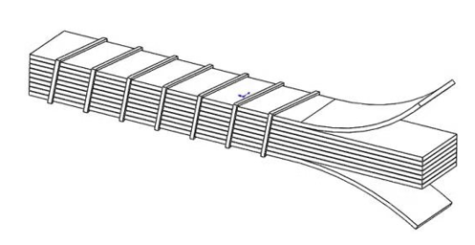
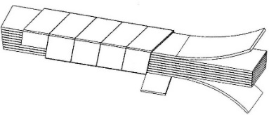
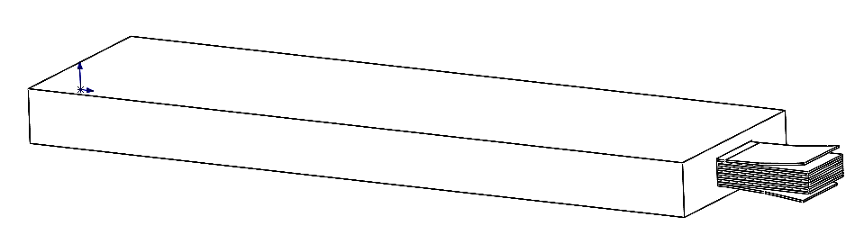
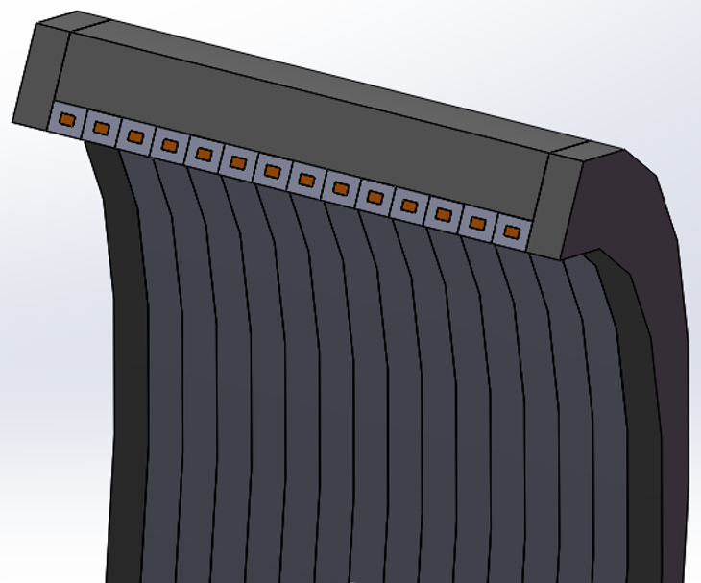
HTS plan R&D
Need to develop the Al stabilized HTS stack cable or other HTS cable.
Got fund (3 million yuan)from CAS to develop the cable and prototype coil.
3 years, from 2019.9 to 2022.9
2 years, from 2022.9 to 2024.9

