Slide 1
Geometry Convertor for CEPCSW
Chengdong FU, Tao LIN
2020/6/8

Slide 2
Contents
Introduction
Geometry for simulation
Geometry Transmitting Service
Geometry Convertor
Status
To do

Slide 3
Introduction
Simulatiuon
DD4hep
Reconstruction
MarlinTrk
etc.
Event Display
Developing

Slide 4
Geometry in DD4hep
DD4hep builds ROOT geometry according to the parameters unpacked from xml files, and then converts it to Geant4 geometry
compact
xml
ROOT Geo
Geant4 Geo

Slide 5
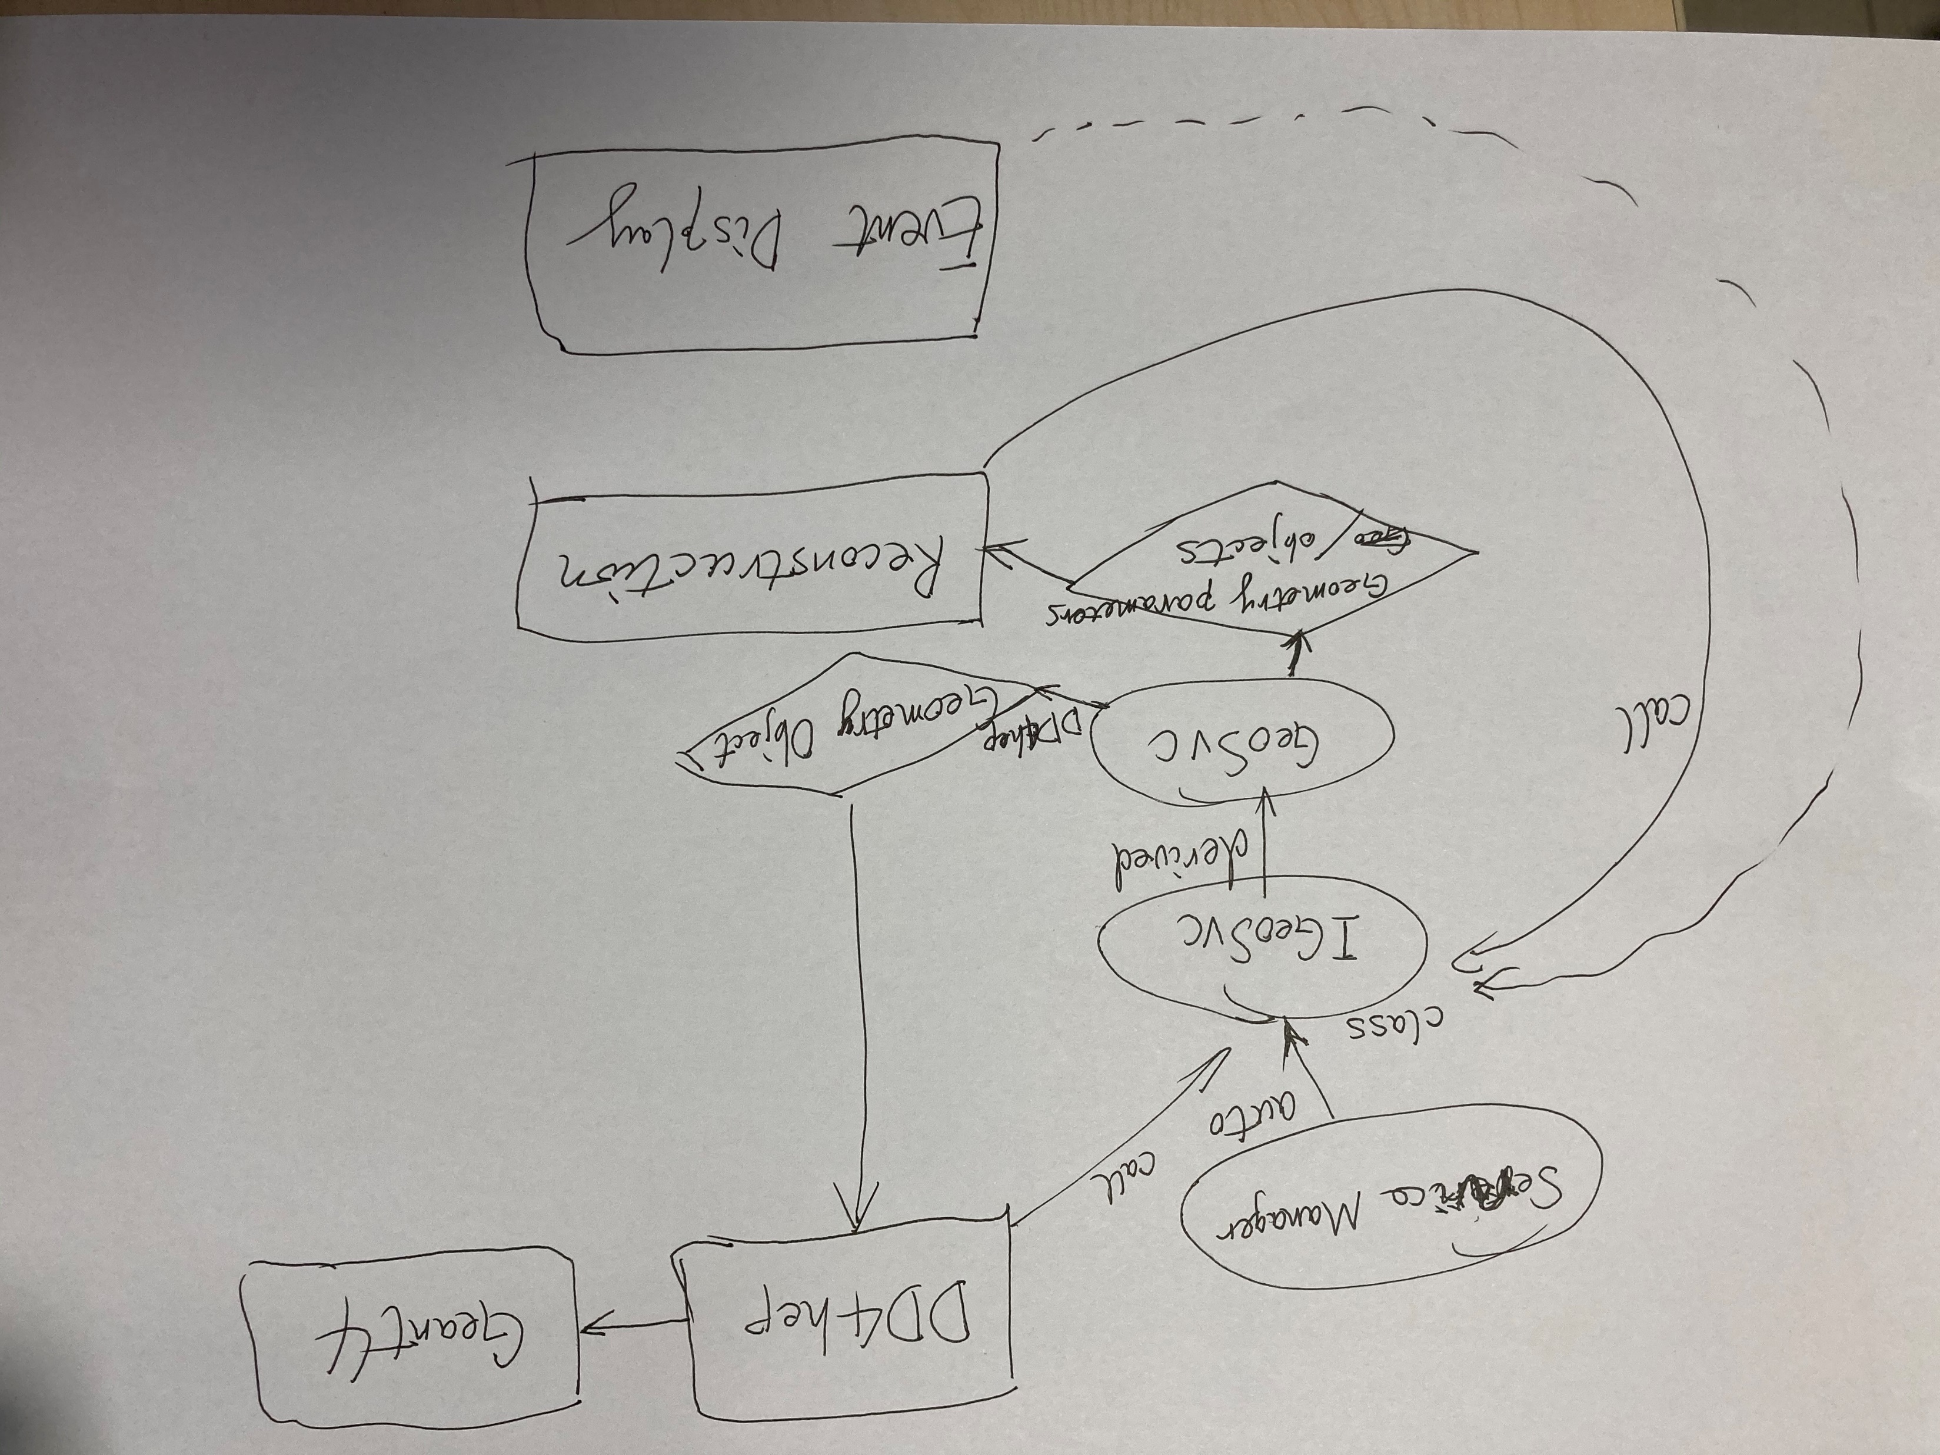
Geometry Transmitting Service
ensure to keep same!

Slide 6
Geometry Service in CEPCSW
GeoSvc
  dd4hep::DetElement getDD4HepGeo() override;
  dd4hep::Detector* lcdd() override;
  const gear::ZPlanarParametersImpl* getVXDParameters() override {return m_vxdParameters;};
  const gear::GearParametersImpl* getDetParameters(std::string name) override;
Internal convertors to realize the conversion

Slide 7
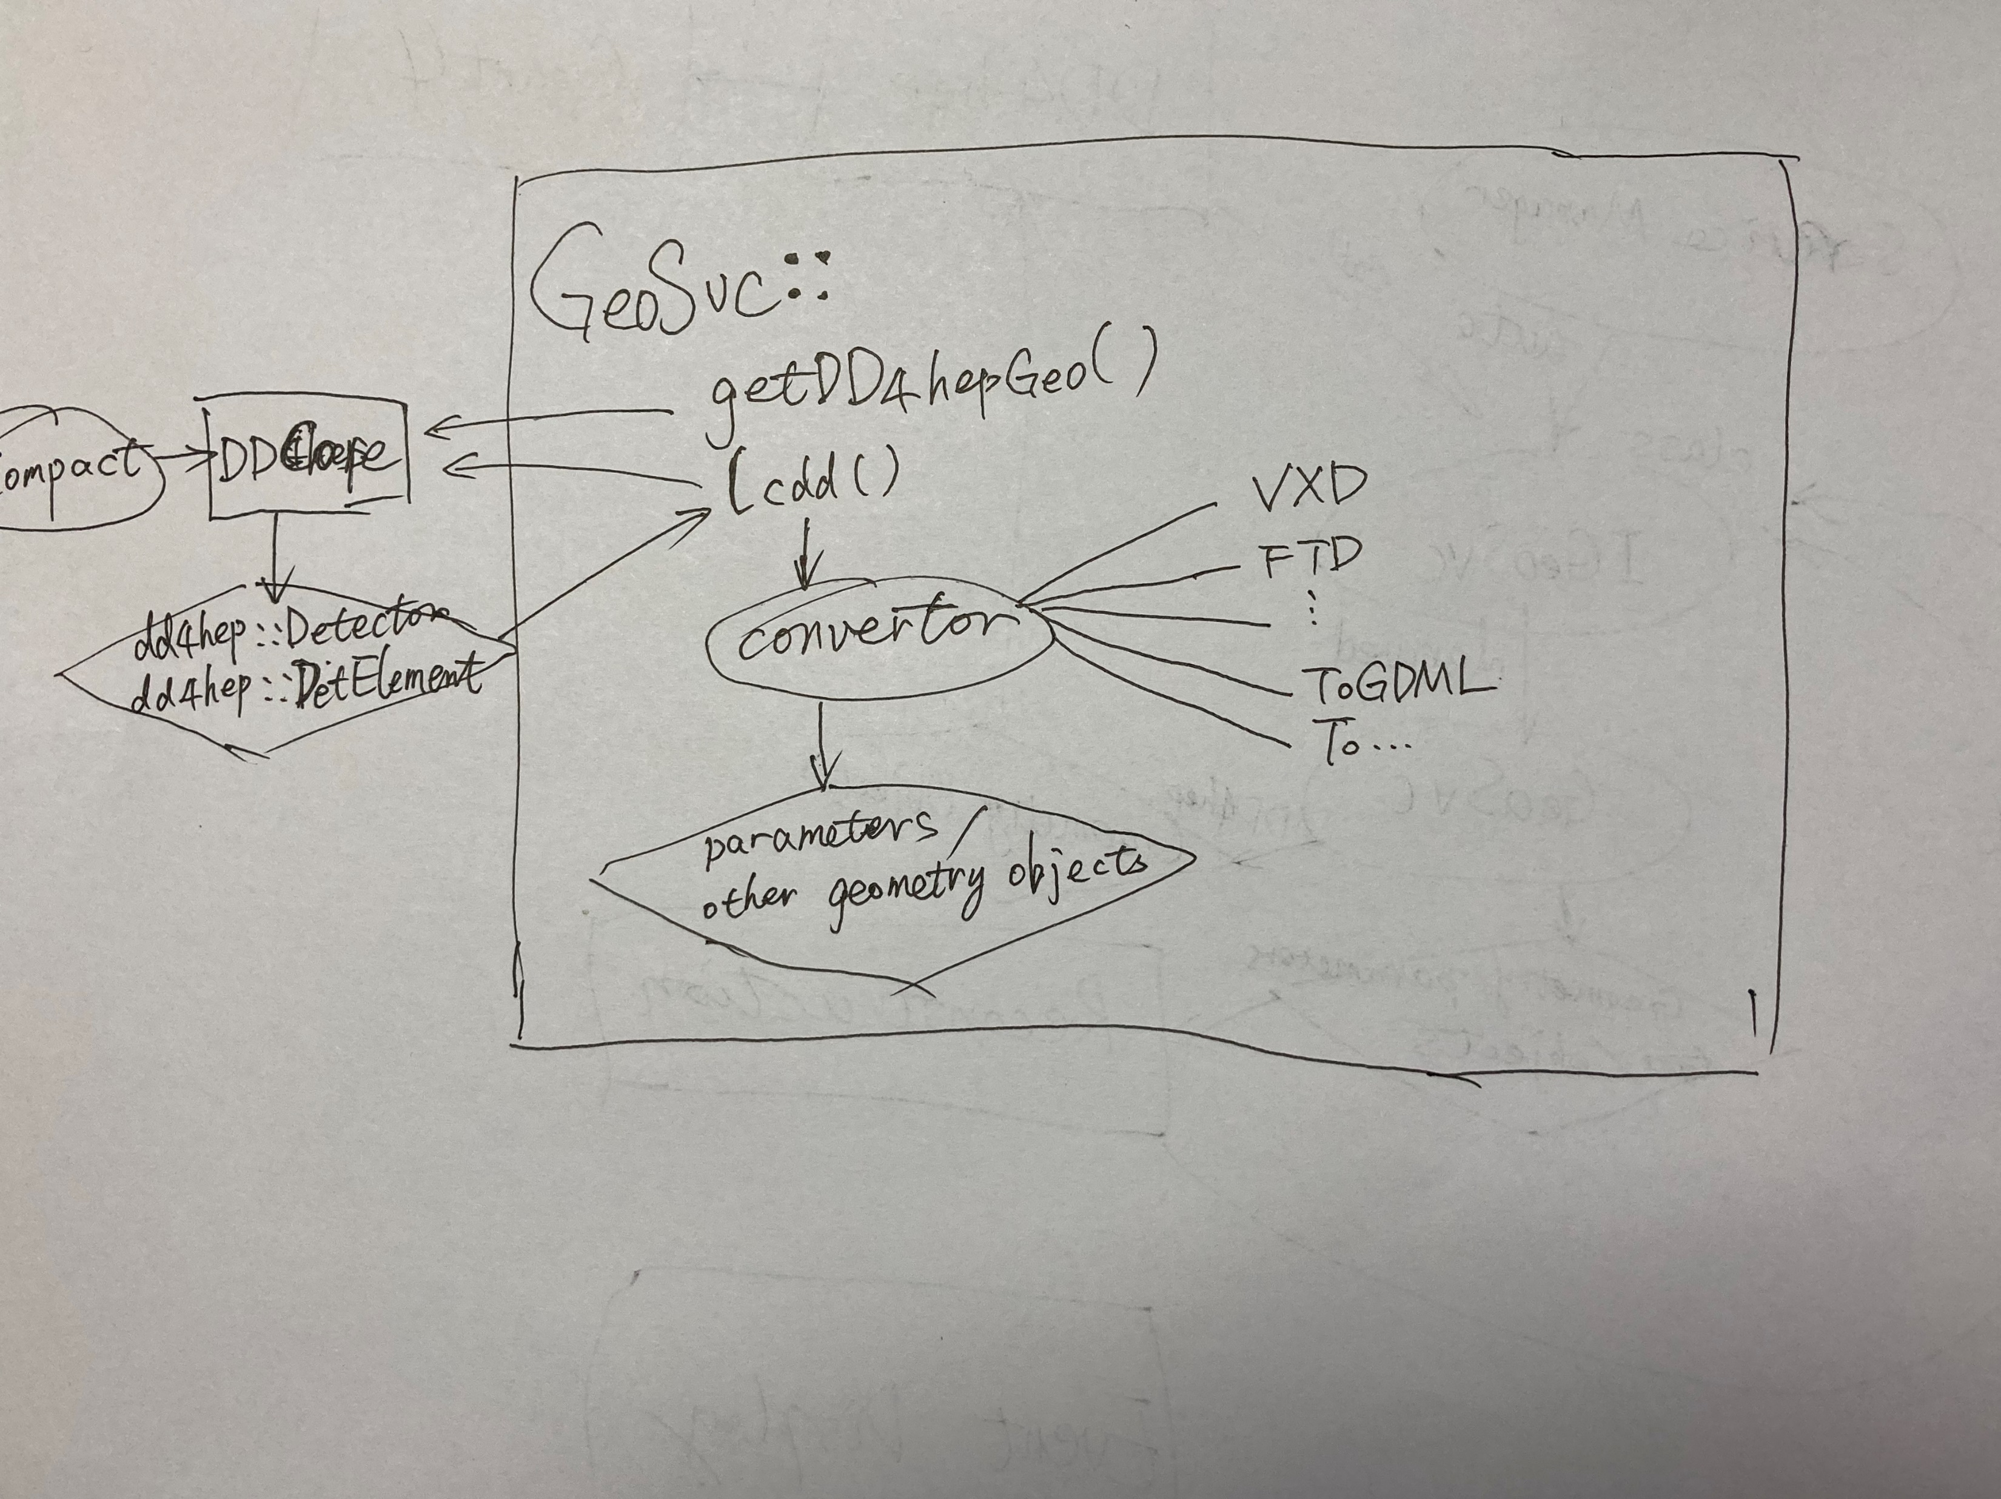
Geometry Conertor

Slide 8
Status
created VXD convertor
  two methods as alternative from VXD’s DetElement object
    → Volume→parameters
    → dd4hep::rec::ZPlanarData
  Change gear::SimpleMaterial to TMaterial
  checked
linked into tracking algorithm
  as test, keeps GearMgr as shipper for others sub-detector
  runnable
others sub-detector waiting convertor

Slide 9
VXD Parameters
# | nLadder | phi0 | radius | offset | thickness | length | width | radL
1 | 10 | -1.5708 | 16 | -2.11224 | 1 | 62.5 | 11.5 | 1014.26
 |  |  | 15.95 | -1.86224 | 0.05 | 62.5 | 11 | 93.6612
2 | 10 | -1.5708 | 17 | -2.11224 | 1 | 62.5 | 11.5 | 1014.26
 |  |  | 18 | -1.86224 | 0.05 | 62.5 | 11 | 93.6612
3 | 11 | -1.5708 | 37 | -2.03996 | 1 | 125 | 22.5 | 1014.26
 |  |  | 36.95 | -1.78996 | 0.05 | 125 | 22 | 93.6612
4 | 11 | -1.5708 | 38 | -2.03996 | 1 | 125 | 22.5 | 1014.26
 |  |  | 39 | -1.78996 | 0.05 | 125 | 22 | 93.6612
5 | 17 | -1.5708 | 58 | -2.70173 | 1 | 125 | 22.5 | 1014.26
 |  |  | 57.95 | -2.45173 | 0.05 | 125 | 22 | 93.6612
6 | 17 | -1.5708 | 59 | -2.70173 | 1 | 125 | 22.5 | 1014.26
 |  |  | 60 | -2.45173 | 0.05 | 125 | 22 | 93.6612
dd4hep::rec::ZPlanarData use half of the sensitive offsets, and has not radiation lengths.

Slide 10
Further Validation
Change compact parameters (virtual)
  side_band_electronics_option: 1→0
  ladder_radius_r3: 37mm→36mm
  ladder_length_r5: 125mm→150mm
  ladder_width_r1: 5.5mm→5.2mm
  nladder_3: 11→12
  ladder_width_r3: 11mm→10mm
  end_electronics_half_z: 5mm→6mm
  end_electronics_width_r3: 11mm→10mm
  end_electronics_width_r5: 11mm→10mm
  foam_spacer_thickness: 0.94mm→1.94mm
  layer_gap: 2mm→4.5mm
  metal_traces_material: G4_Al→G4_Cu

Slide 11
Output for Modified Compact
# | nLadder | phi0 | radius | offset | thickness | length | width | radL
1 | 10 | -1.5708 | 16 | -0.18586 | 2 | 62.5 | 10.4 | 864.585
 |  |  | 15.95 | -0.18586 | 0.05 | 62.5 | 10.4 | 93.6612
2 | 10 | -1.5708 | 18.5 | -0.18586 | 2 | 62.5 | 10.4 | 864.585
 |  |  | 20.5 | -0.18586 | 0.05 | 62.5 | 10.4 | 93.6612
3 | 12 | -1.5708 | 36 | -0.374702 | 2 | 125 | 20 | 864.585
 |  |  | 35.95 | -0.374702 | 0.05 | 125 | 20 | 93.6612
4 | 12 | -1.5708 | 38.5 | -0.374702 | 2 | 125 | 20 | 864.585
 |  |  | 40.5 | -0.374702 | 0.05 | 125 | 20 | 93.6612
5 | 17 | -1.5708 | 58 | 0.129566 | 2 | 150 | 22 | 864.585
 |  |  | 57.95 | 0.129566 | 0.05 | 150 | 22 | 93.6612
6 | 17 | -1.5708 | 60.5 | 0.129566 | 2 | 150 | 22 | 864.585
 |  |  | 62.5 | 0.129566 | 0.05 | 150 | 22 | 93.6612
Ladder width not relative with the value of end electronics width

Slide 12
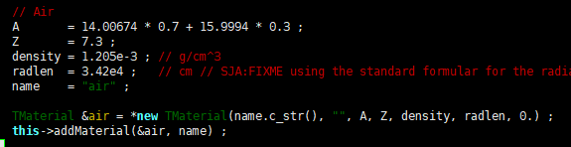
BUT… TO DO
No general convertor for every reconstruction and further reconstruction unknown still
  time to decide whether fix geometry format
    YES: one convertor & change reconstruction’s format while migrating
    NO: many convertors & create customized one for reconstruction
Many fixed materials in KalDet such as
  when to change
  To decide which way to transmit (material objects or parameters)
Not all sub-detector ready

Slide 13
backup

Slide 14
Geometry Conertor
GeoSvc
  dd4hep::DetElement getDD4HepGeo() override;
  dd4hep::Detector* lcdd() override;
  const gear::ZPlanarParametersImpl* getVXDParameters() override {return m_vxdParameters;};
  const gear::GearParametersImpl* getDetParameters(std::string name) override;

