Slide 1

CMI model and heavy multiquarks
“低质量多轻子末态研讨会”
Yan-Rui Liu (刘言锐)
Shandong University
Nanjing Normal University
2020. 6. 20

Slide 2

Content
1. CMI model
2. Hidden-charm pentaquarks
3. $cs\overline{c}\overline{s}$ and partner tetraquarks
4. Tetraquarks with four different flavors
5. $QQ\overline{Q}\overline{Q}$ & $QQ\overline{Q}\overline{q}$
Summary

Slide 3
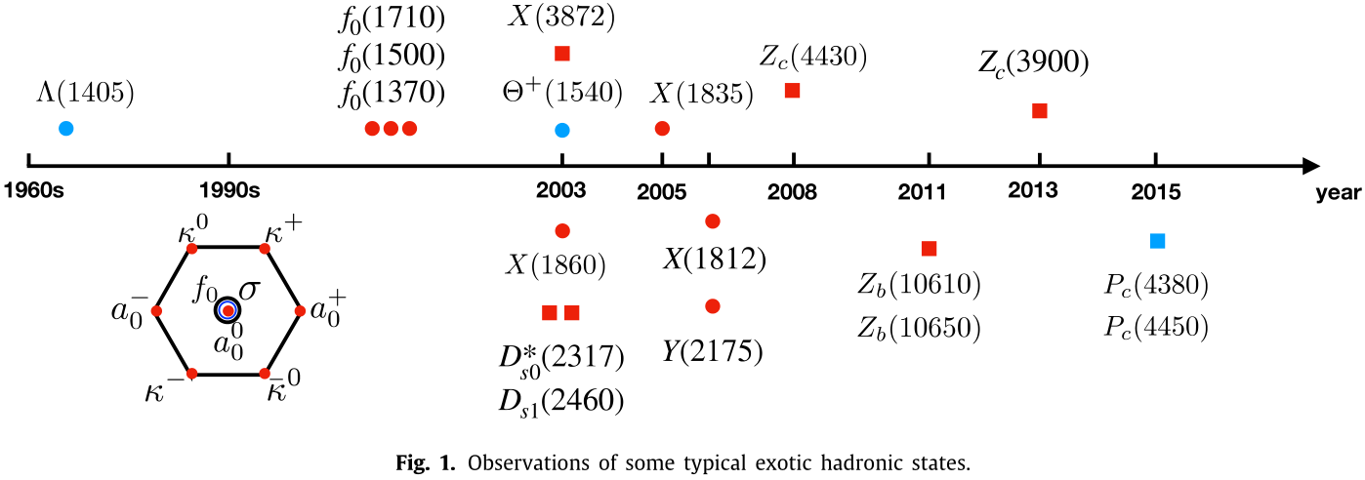
Yan-Rui Liu, Hua-Xing Chen, Wei Chen, Xiang Liu, Shi-Lin Zhu
Progress in Particle and Nuclear Physics 107 (2019) 237–320

Slide 4
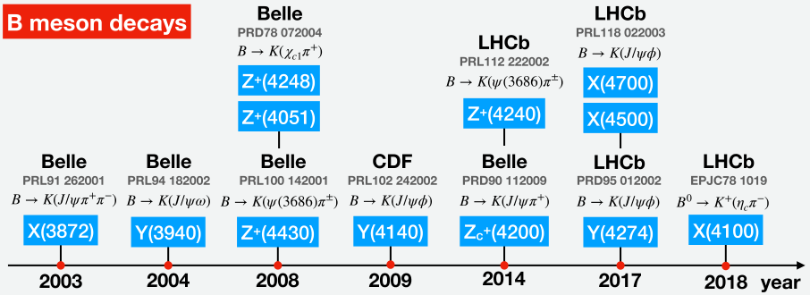
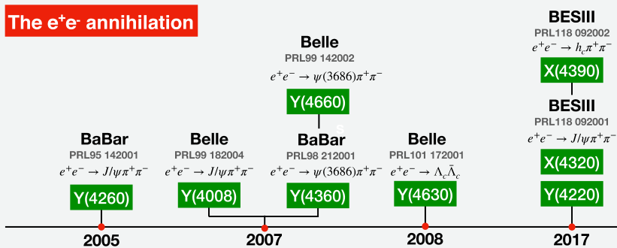
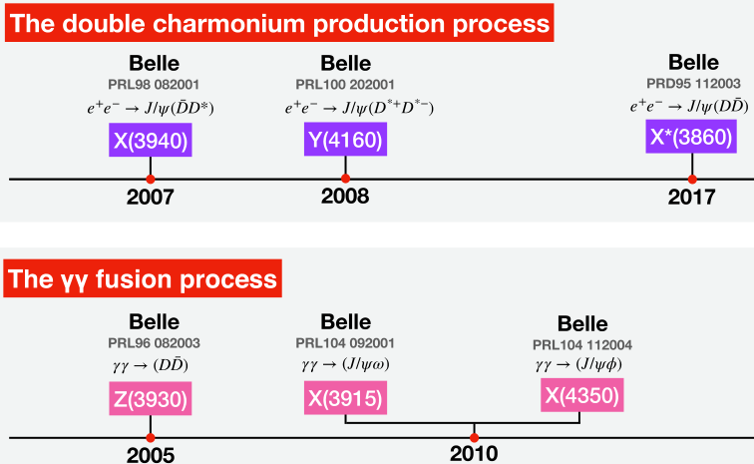
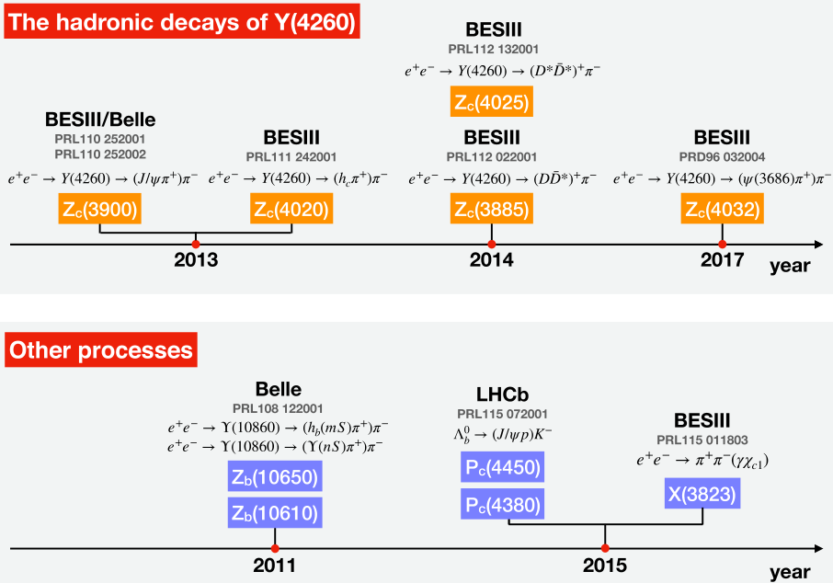

Slide 5
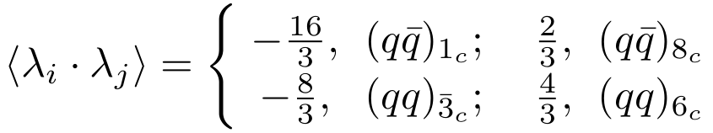

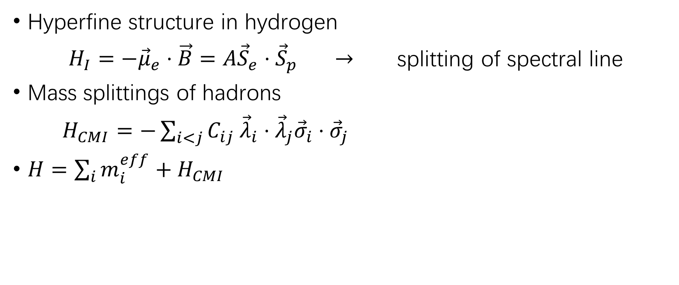
1. The color-magnetic-interaction (CMI) model
(Chromomagnetic Interaction model)
Hyperfine structure in hydrogen
$H_{I}=−{\vec{μ}}_{e}⋅\vec{B}=A{\vec{S}}_{e}⋅{\vec{S}}_{p}$ $→$ splitting of spectral line
Mass splittings of hadrons
$H_{CMI}=−\sum_{i<j}{C_{ij} {\vec{λ}}_{i}⋅{\vec{λ}}_{j}{\vec{σ}}_{i}⋅{\vec{σ}}_{j}}$
$H=\sum_{i}{m_{i}^{eff}}+H_{CMI}$

Slide 6
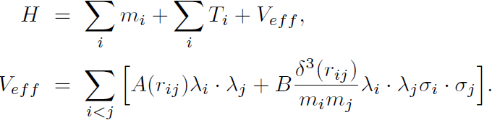
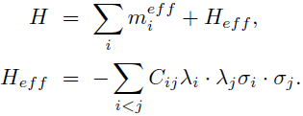
CMI model
Yan-Rui Liu, Hua-Xing Chen, Wei Chen, Xiang Liu, Shi-Lin Zhu
Progress in Particle and Nuclear Physics 107 (2019) 237–320
Mass splittings of S-wave states:
⇒
(or ⇒ )
(or ⇒ )

Slide 7
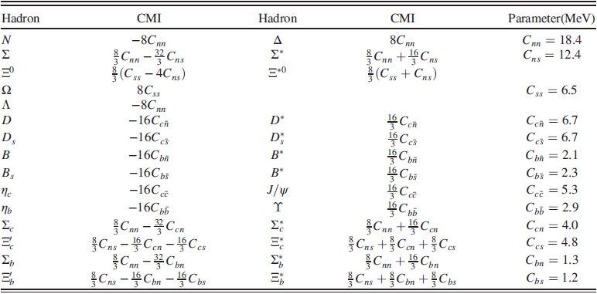
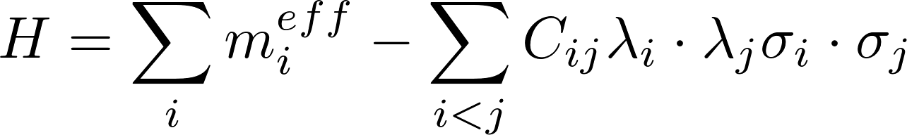

Slide 8
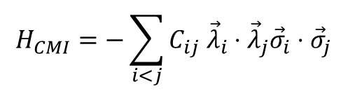
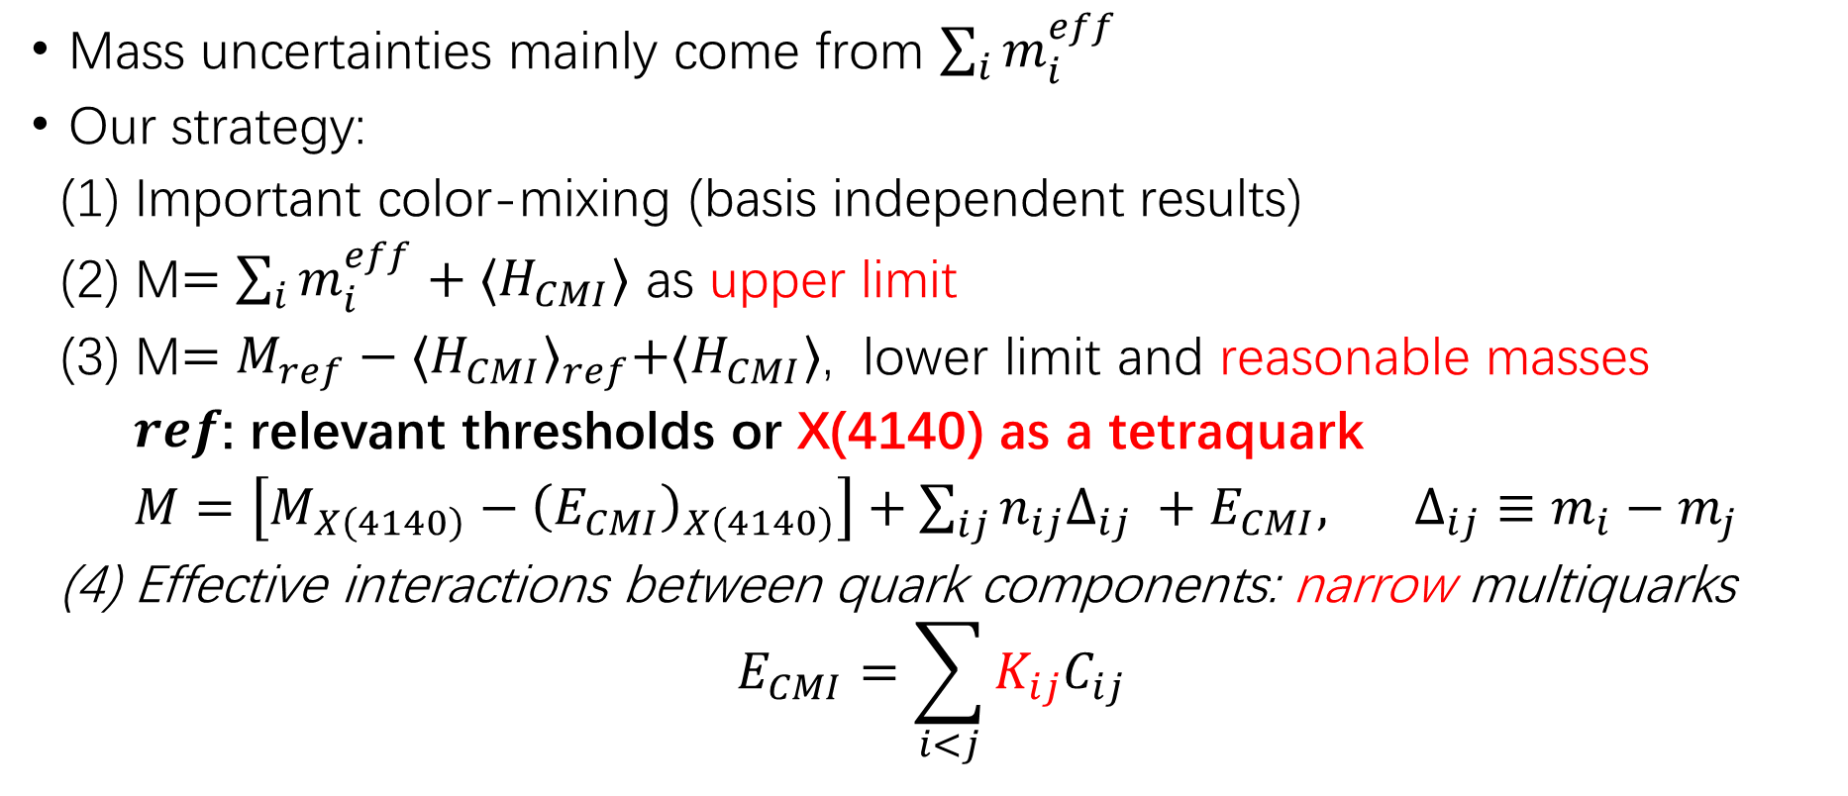
Spectra in CMI model
$$H_{CMI}=−\sum_{i<j}{C_{ij} {\vec{λ}}_{i}⋅{\vec{λ}}_{j}{\vec{σ}}_{i}⋅{\vec{σ}}_{j}}$$
Mass uncertainties mainly come from $\sum_{i}{m_{i}^{eff}}$
Our strategy:
(1) Important color-mixing (basis independent results)
(2) M$=\sum_{i}{m_{i}^{eff}+{⟨H}_{CMI}⟩}$ as upper limit
(3) M$={M_{ref}−{⟨H_{CMI}⟩}_{ref}+⟨H}_{CMI}⟩$, lower limit and reasonable masses
$ref$: relevant thresholds or X(4140) as a tetraquark
$M=\left[M_{X\left(4140\right)}−{\left(E_{CMI}\right)}_{X\left(4140\right)}\right]+\sum_{ij}{n_{ij}Δ_{ij}} +E_{CMI}, Δ_{ij}≡m_{i}−m_{j}$
(4) Effective interactions between quark components: narrow multiquarks
$$E_{CMI}=\sum_{i<j}{K_{ij}C_{ij}}$$
[Li, Liu, Liu, Si, Wu, 1809.08072;
Liu, Chen, Chen, Liu, Zhu, PPNP 107, 237 (2019)]

Slide 9
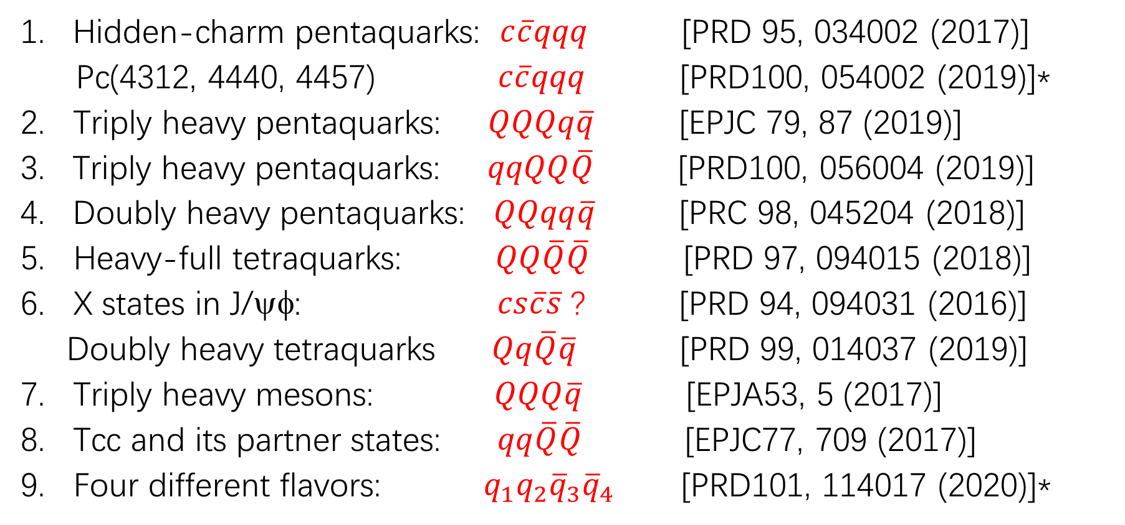
Results in several systems:
Hidden-charm pentaquarks: $c\overline{c}qqq$ [PRD 95, 034002 (2017)]
Pc(4312, 4440, 4457) $c\overline{c}qqq$ [PRD100, 054002 (2019)]*
2. Triply heavy pentaquarks: $QQQq\overline{q}$ [EPJC 79, 87 (2019)]
Triply heavy pentaquarks: $qqQQ\overline{Q}$ [PRD100, 056004 (2019)]
Doubly heavy pentaquarks: $QQqq\overline{q}$ [PRC 98, 045204 (2018)]
5. Heavy-full tetraquarks: $QQ\overline{Q}\overline{Q}$ [PRD 97, 094015 (2018)]
6. X states in J/ψφ: $cs\overline{c}\overline{s}$ ? [PRD 94, 094031 (2016)]
Doubly heavy tetraquarks $Qq\overline{Q}\overline{q}$ [PRD 99, 014037 (2019)]
7. Triply heavy mesons: $QQQ\overline{q}$ [EPJA53, 5 (2017)]
8. Tcc and its partner states: $qq\overline{Q}\overline{Q}$ [EPJC77, 709 (2017)]
9. Four different flavors: $q_{1}q_{2}{\overline{q}}_{3}{\overline{q}}_{4}$ [PRD101, 114017 (2020)]*

Slide 10

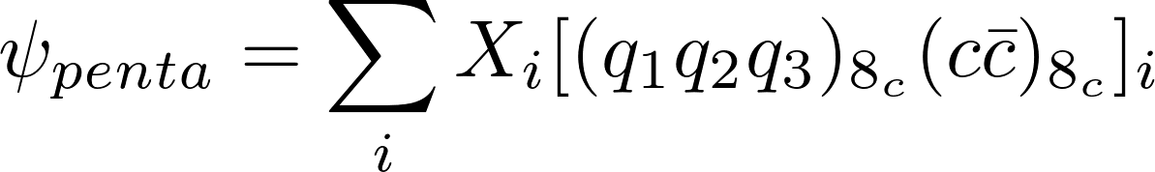
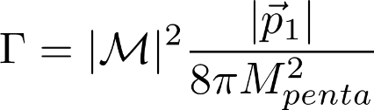
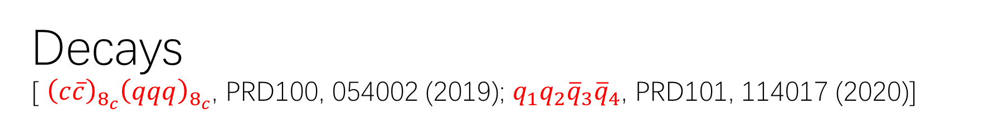
Decays
[ ${\left(c\overline{c}\right)}_{8_{c}}{\left(qqq\right)}_{8_{c}}$, PRD100, 054002 (2019); $q_{1}q_{2}{\overline{q}}_{3}{\overline{q}}_{4}$, PRD101, 114017 (2020)]

Slide 11
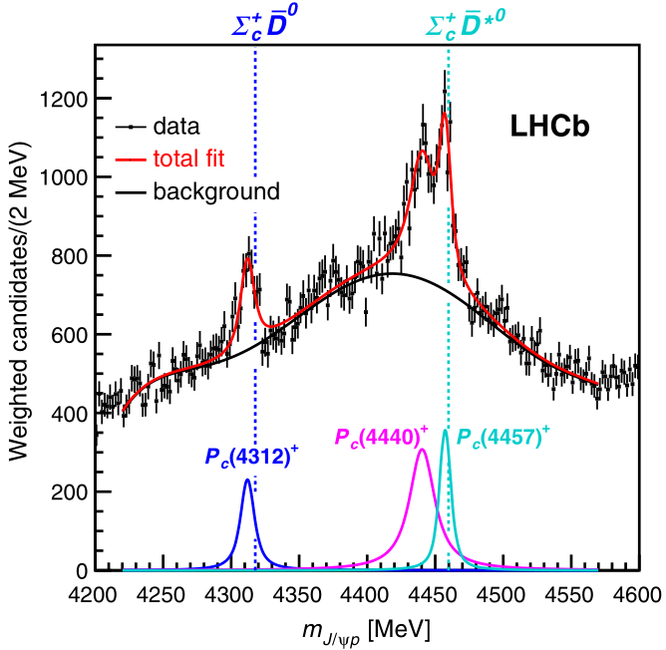

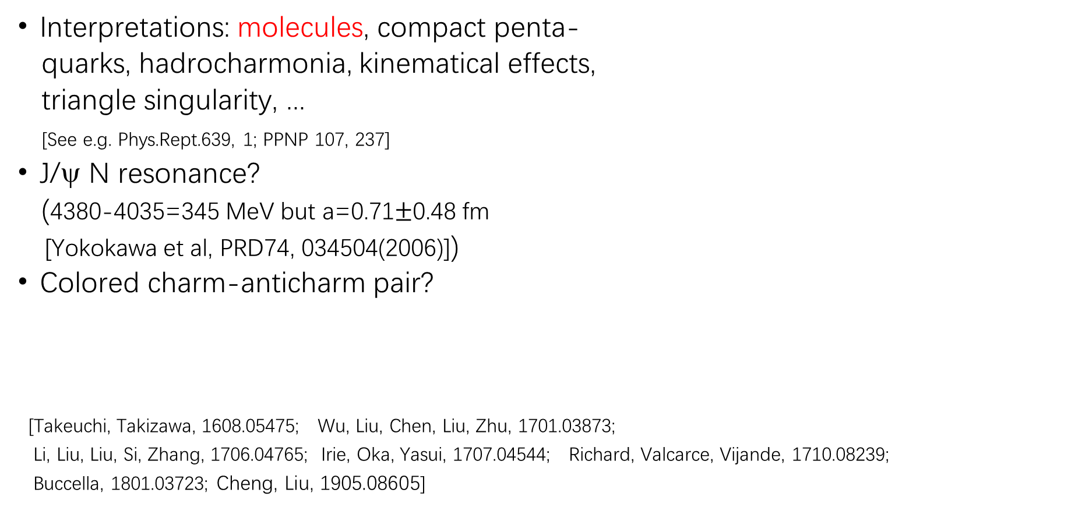
2. Hidden-charm pentaquark states
Interpretations: molecules, compact penta-
quarks, hadrocharmonia, kinematical effects,
triangle singularity, ...
[See e.g. Phys.Rept.639, 1; PPNP 107, 237]
J/ψ N resonance?
(4380-4035=345 MeV but a=0.71$±$0.48 fm
[Yokokawa et al, PRD74, 034504(2006)])
Colored charm-anticharm pair?
[Takeuchi, Takizawa, 1608.05475; Wu, Liu, Chen, Liu, Zhu, 1701.03873;
Li, Liu, Liu, Si, Zhang, 1706.04765; Irie, Oka, Yasui, 1707.04544; Richard, Valcarce, Vijande, 1710.08239;
Buccella, 1801.03723; Cheng, Liu, 1905.08605]
PRL 122, 222001 (2019)

Slide 12
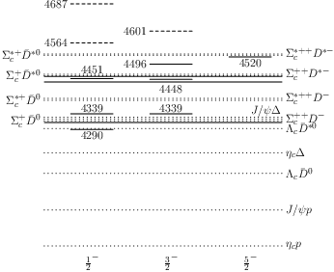

D-wave decay
Most studies favor $(nnc)(n\overline{c})$
molecule interpretations
CMI results for colored
charm-anticharm pair
${\left(uud\right)}_{8_{c}}{\left(c\overline{c}\right)}_{8_{c}}$by using
$M=\left[M_{ref}−\left\langle H_{CMI}\right\rangle \right]+H_{CMI}$
with $ref=Σ_{c}^{++}D^{−}$.

Slide 13
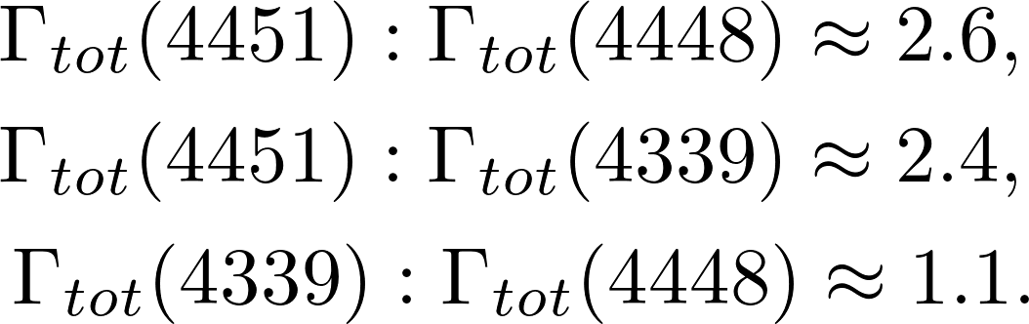


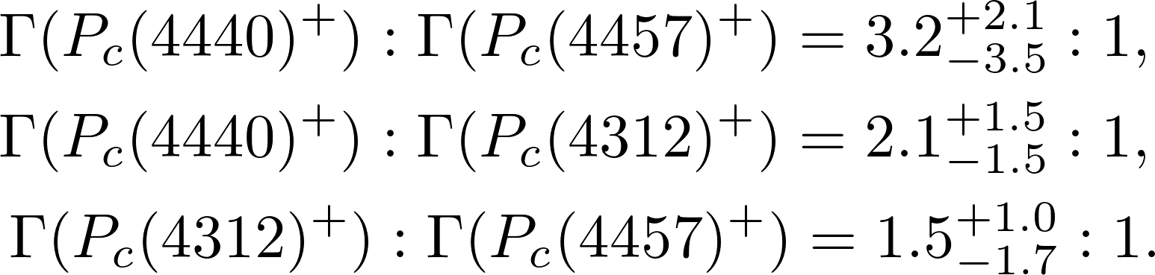
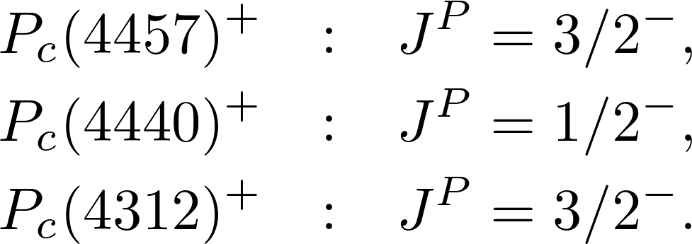

$$Jψpπ$$
[Cheng, Liu, 1905.08605]
For Pc states,
if assume .
[ from Cao, Dai, 1904.06015]
Consistent with exp. ratios:
Then assignments:
[Uncertainties of parameters do not affect much.]

Slide 14

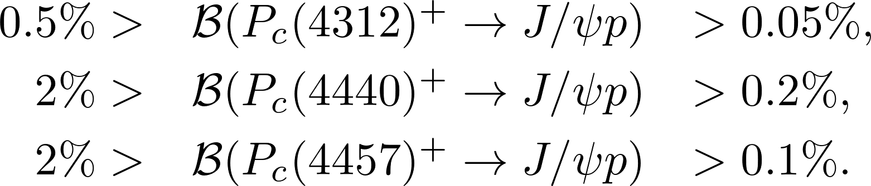
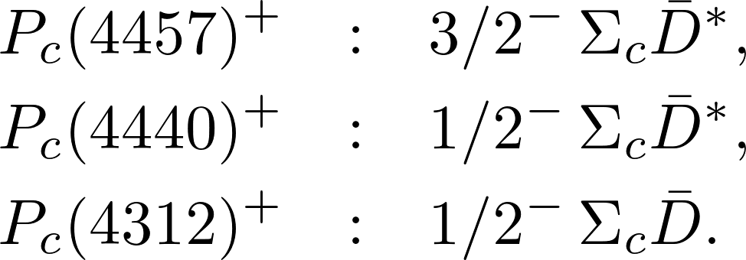
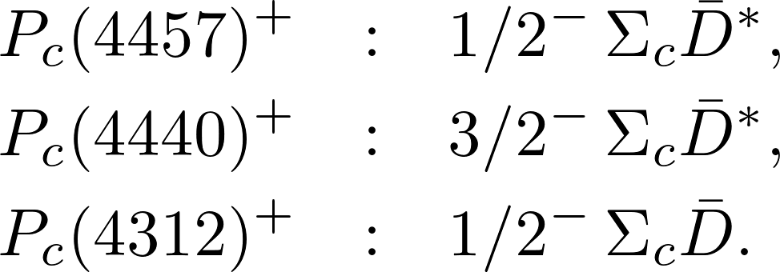
How about S-wave molecules?
Assume and
[Cao, Dai, 1904.06015]
or
Both pictures can understand the decay ratios!

Slide 15
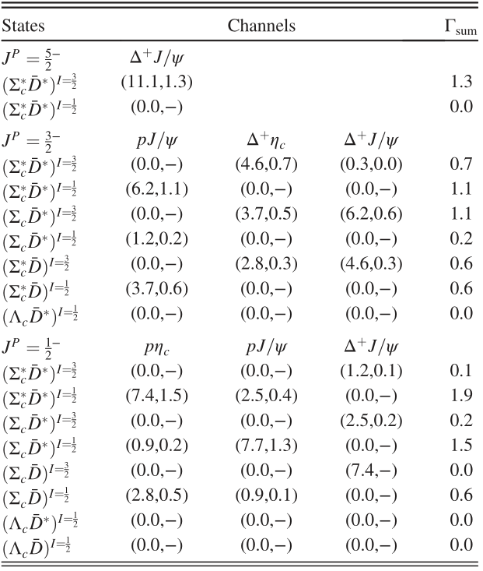
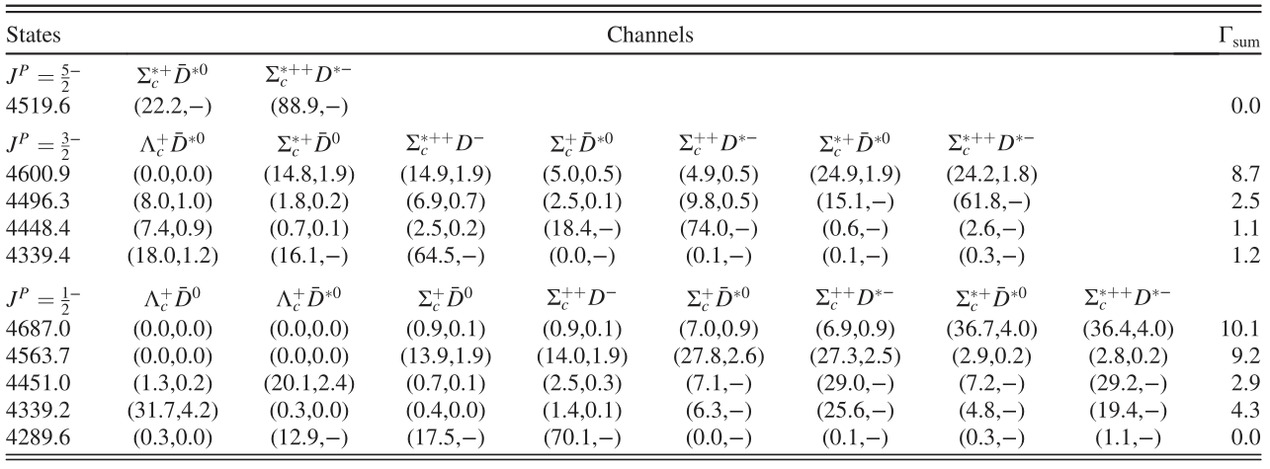
Molecules

Slide 16
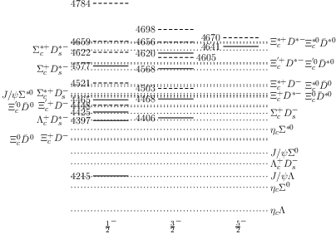
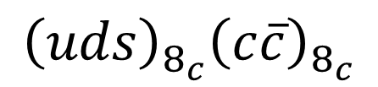

Rearrangement decays of ${\left(uus\right)}_{8_{c}}{\left(c\overline{c}\right)}_{8_{c}}$
$${\left(uds\right)}_{8_{c}}{\left(c\overline{c}\right)}_{8_{c}}$$
Rearrangement decays of molecules
Unlike uud case, also have nonvanishing open-
charm decays.

Slide 17
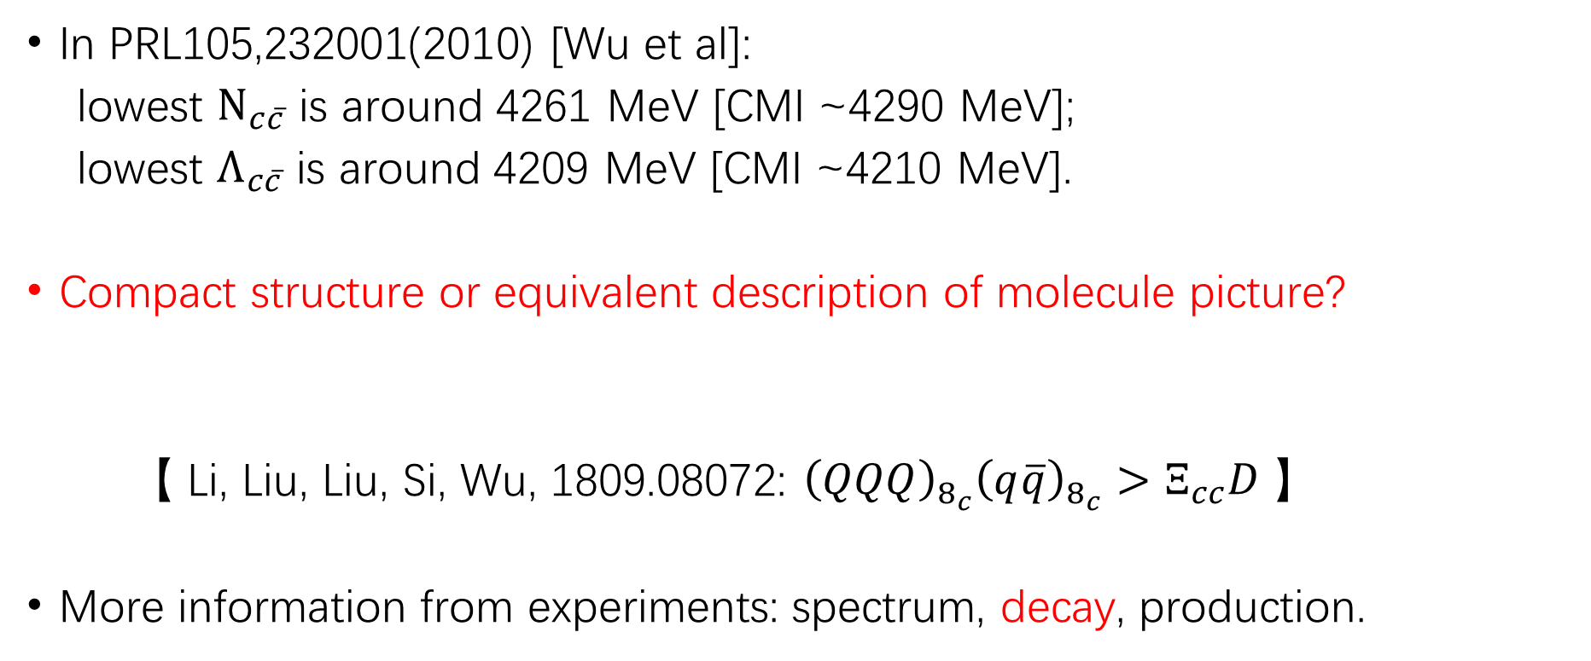
A comparison and a question
In PRL105,232001(2010) [Wu et al]:
lowest $N_{c\overline{c}}$ is around 4261 MeV [CMI ~4290 MeV];
lowest $Λ_{c\overline{c}}$ is around 4209 MeV [CMI ~4210 MeV].
Compact structure or equivalent description of molecule picture?
【 Li, Liu, Liu, Si, Wu, 1809.08072: ${\left(QQQ\right)}_{8_{c}}{\left(q\overline{q}\right)}_{8_{c}}>Ξ_{cc}D$ 】
More information from experiments: spectrum, decay, production.

Slide 18
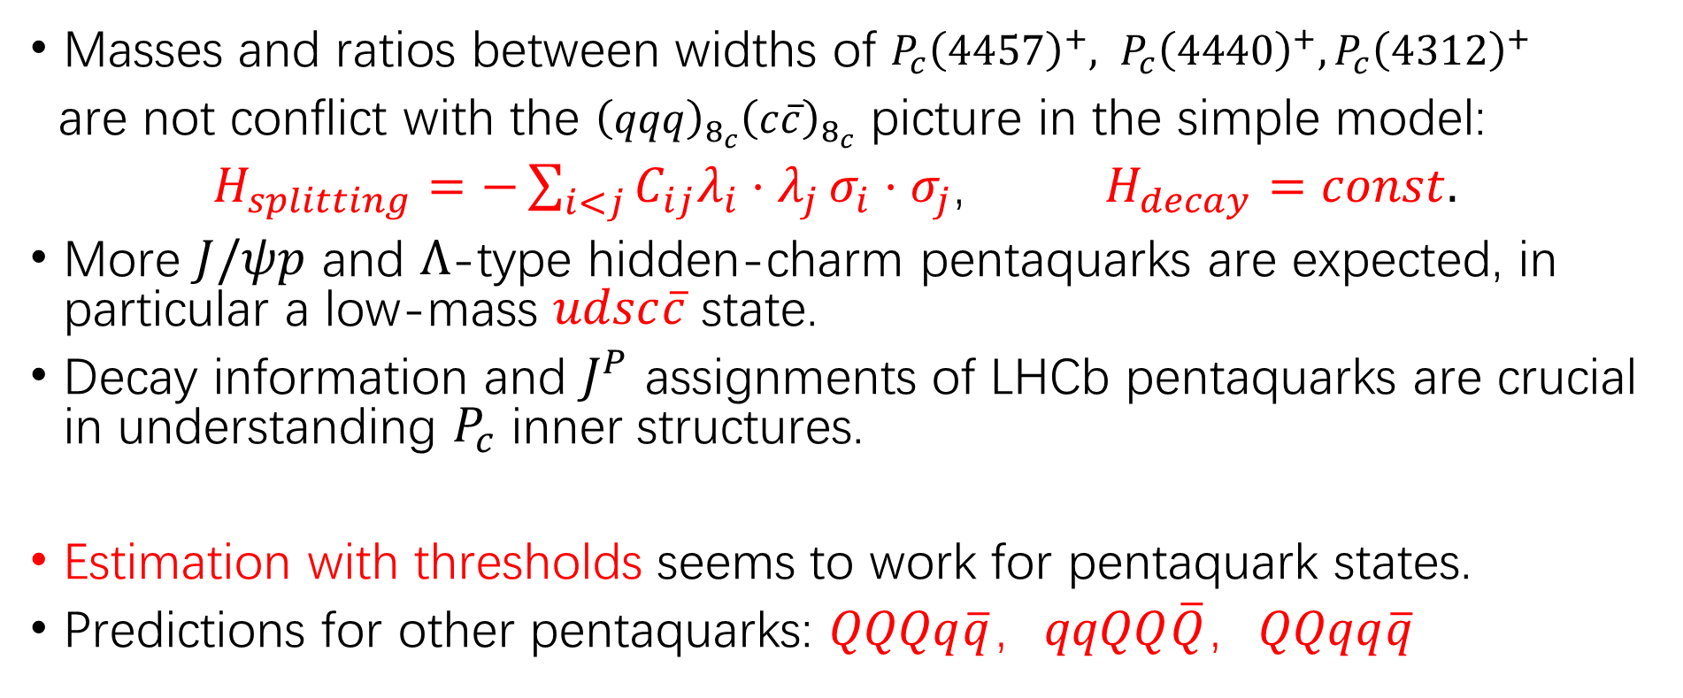
Summary for pentaquarks
Masses and ratios between widths of $P_{c}{\left(4457\right)}^{+}, P_{c}{\left(4440\right)}^{+}, P_{c}{\left(4312\right)}^{+}$
are not conflict with the ${\left(qqq\right)}_{8_{c}}{\left(c\overline{c}\right)}_{8_{c}}$ picture in the simple model:
$H_{splitting}=−\sum_{i<j}{C_{ij}λ_{i}⋅λ_{j}}σ_{i}⋅σ_{j}$, $H_{decay}=const.$
More $J/ψp$ and $Λ$-type hidden-charm pentaquarks are expected, in particular a low-mass $udsc\overline{c}$ state.
Decay information and $J^{P}$ assignments of LHCb pentaquarks are crucial in understanding $P_{c}$ inner structures.
Estimation with thresholds seems to work for pentaquark states.
Predictions for other pentaquarks: $QQQq\overline{q}，qqQQ\overline{Q}，QQqq\overline{q}$

Slide 19
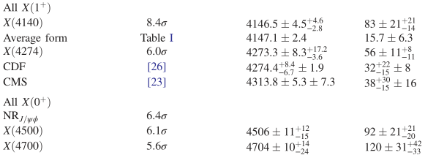
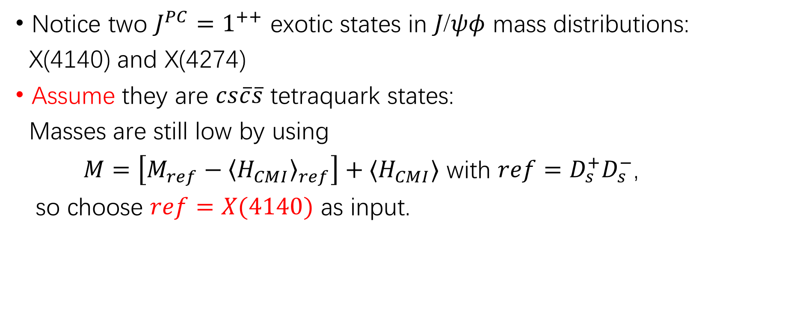
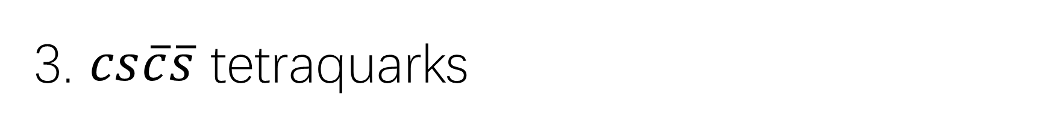
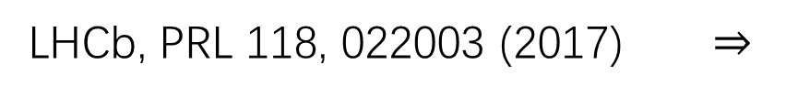
3. $cs\overline{c}\overline{s}$ tetraquarks
Notice two $J^{PC}=1^{++}$ exotic states in $Jψφ$ mass distributions:
X(4140) and X(4274)
Assume they are $cs\overline{c}\overline{s}$ tetraquark states:
Masses are still low by using
$M=\left[M_{ref}−{〈H_{CMI}〉}_{ref}\right]+{〈H}_{CMI}〉$ with $ref=D_{s}^{+}D_{s}^{−}$,
so choose $ref=X(4140)$ as input.
LHCb, PRL 118, 022003 (2017) $⇒$

Slide 20
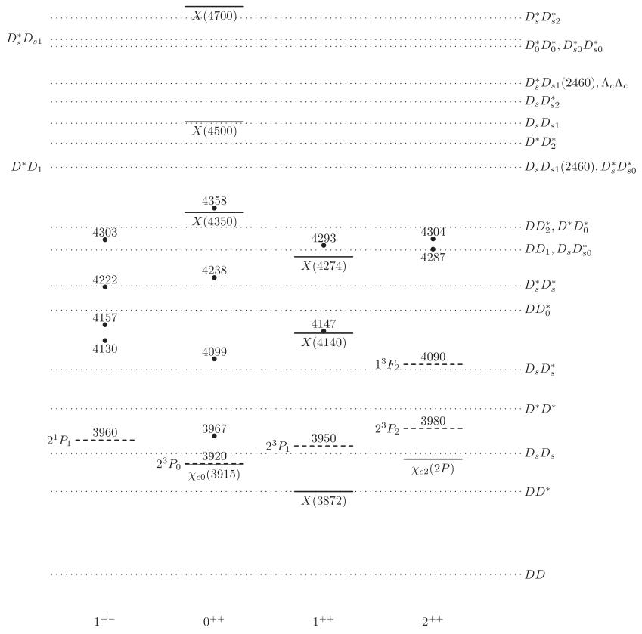

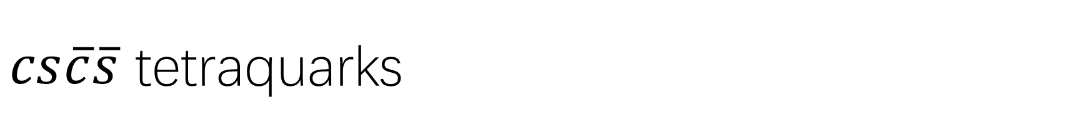
$cs\overline{c}\overline{s}$ tetraquarks
X(4350): a $0^{++}$ tetraquark
[Wu et al, PRD 94, 094031 (2016)]
Not a $D_{s}^{∗}D_{s0}^{∗}$ molecule: QSR
[Albuquerque et al, PLB 690, 141 (2010)]
No molecules. X(4274)/X(4350):
$1^{++}0^{++}$ tetraquark: quark model
[Yang, Ping, 1903.08505]
More possible $cs\overline{c}\overline{s}$ tetraquarks

Slide 21
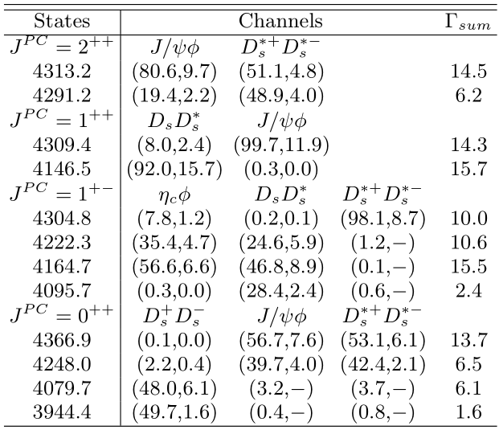

$cs\overline{c}\overline{s}$ tetraquarks
The decay model fails if
$Γ_{X(4274)}>Γ_{X(4140)}$ is true
[LHCb: $Γ_{X(4274)}<Γ_{X(4140)}$]
$α≈7.$3 GeV with LHCb data
[Cheng et al, PRD101, 114017 (2020)]

Slide 22


CMI model and $cn\overline{c}\overline{n}$ spectrum
No appropriate reference tetraquarks
Try to relate them to X(4140) with quark mass differences:
$$M_{X(4140)}− {〈H_{CMI}〉}_{X(4140)}$$
[Wu, Liu, Liu, Zhu, PRD 99, 014037 (2019) or 1810.06886]

Slide 23
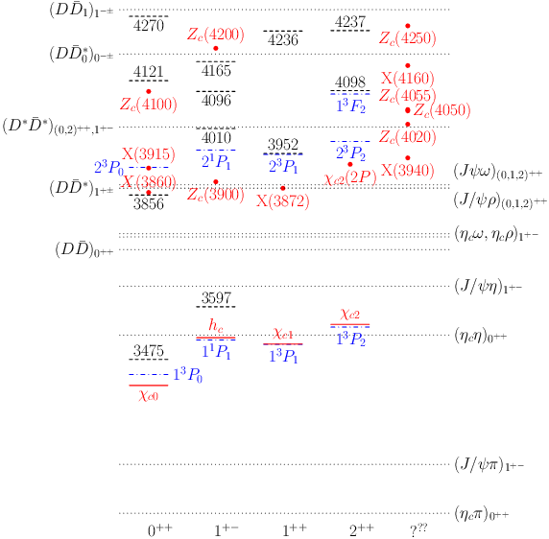
CMI model and $cn\overline{c}\overline{n}$ spectrum
[Wu, Liu, Liu, Zhu, 1810.06886]

Slide 24


CMI model and $cn\overline{c}\overline{n}$ spectrum
A $0^{++}$ tetraquark? [Wu, Liu, Liu, Zhu, 1810.06886]
$0^{+}$hadrocharmonium [Voloshin, 1810.08146]
$0^{++}$ FSI or $1^{− +}$ excited Zc(4020) ($D^{∗}{\overline{D}}^{∗}$)
[Zhao, 1811.05357]
$Z_{c}\left(4100\right)=Z_{c}\left(4050\right):0^{+}/1^{−}; Z_{c}\left(4250\right):1^{−}/1^{+}$
[Cao, Dai, 1811.06434]
$0^{+}$ Diquark-antidiquark: QSR [Sundu et al, 1812.10094]
Not $0^{+}$ or $1^{−}$ tetraquark: QSR [Wang, 1903.03468]
$0^{+}$Diquark-antidiquark: dynamical diquark
[Giron, Lebed, Peterson, 1903.04551]
$$K_{cn}<0$$

Slide 25

CMI model and $cn\overline{c}\overline{n}$ spectrum
A $0^{++}$ tetraquark?
[Wu, Liu, Liu, Zhu, 1810.06886]
$0^{++}$ tetraquark or $χ_{c0}(2P)$: QSR
[Chen et al, 1706.09731]
$0^{++}$ tetraquark: QSR
[Wang, 1704.04111]
$χ_{c0}(2P)$ should be narrow:
[Zhou, Xiao, 1704.04438]
$Z_{c}\left(4250\right)?$
X(3915), X(3940): no appropriate tetraquark assignment
?

Slide 26

CMI model and $cn\overline{c}\overline{n}$ spectrum
Lower than $1^{++}$ tetraquark.
[Wu, Liu, Liu, Zhu, 1810.06886]
Consistent with [Zhang et al, 0705.2470; Vijande et al, 0708.3285]
Coupling with $χ_{c1}(2P)$ ?
Isovector $Z\left(3950\right)?$
Note: I=0 and I=1 tetraquark states are degenerate!

Slide 27
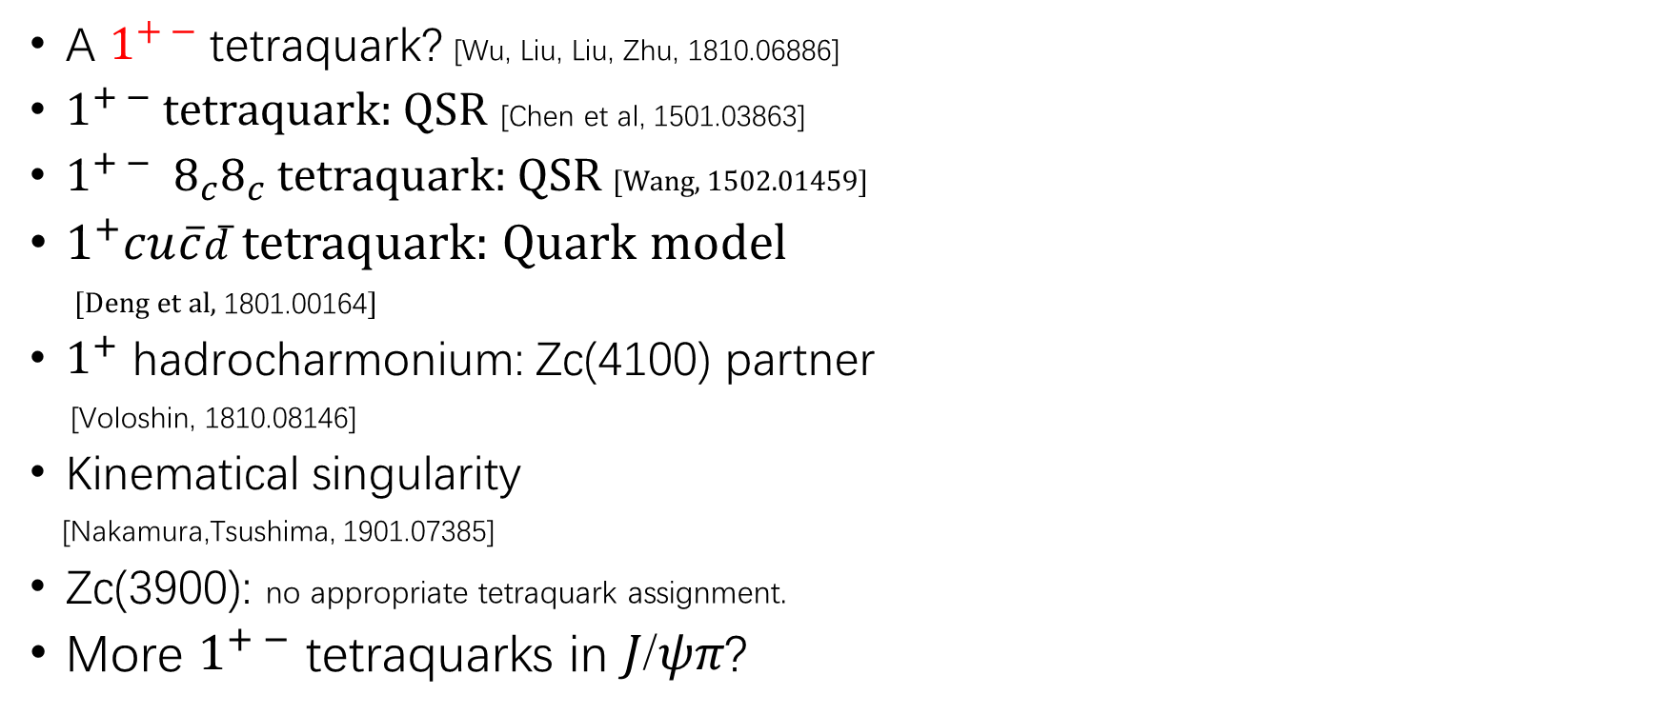
CMI model and $cn\overline{c}\overline{n}$ spectrum
A $1^{+ −}$ tetraquark? [Wu, Liu, Liu, Zhu, 1810.06886]
$1^{+ −}$ tetraquark: QSR [Chen et al, 1501.03863]
$1^{+ −}{ 8}_{c}8_{c}$ tetraquark: QSR [Wang, 1502.01459]
$1^{+}cu\overline{c}\overline{d}$ tetraquark: Quark model
[Deng et al, 1801.00164]
$1^{+}$ hadrocharmonium: Zc(4100) partner
[Voloshin, 1810.08146]
Kinematical singularity
[Nakamura,Tsushima, 1901.07385]
Zc(3900): no appropriate tetraquark assignment.
More $1^{+ −}$ tetraquarks in $Jψπ$?
?

Slide 28
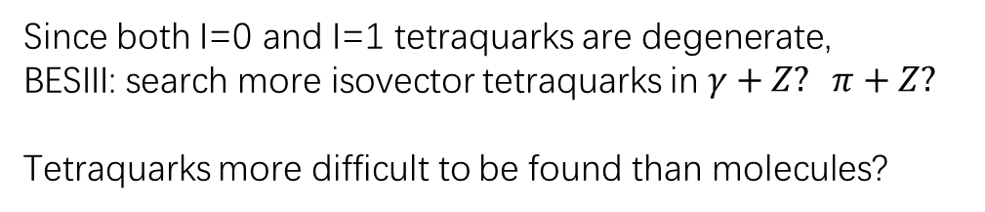

CMI model and $cn\overline{c}\overline{n}$ spectrum
No consistent tetraquark assignments
if $Z_{c}(4100)$ is a tetraquark.
Decay information is helpful.
Since both I=0 and I=1 tetraquarks are degenerate,
BESIII: search more isovector tetraquarks in $γ+Z? π+Z?$
Tetraquarks more difficult to be found than molecules?

Slide 29


Summary of $Qq\overline{Q}\overline{q}$ tetraquarks
Estimation with X(4140) gives higher masses than estimation with thresholds
More possible $cq\overline{c}\overline{q}$ (Isospin=1, 0) states are predicted. Candidates of tetraquarks: $X(4350)$, $Z_{c}(4100)$, $X(3860)$, $Z_{c}(4200)$
Problems such as decay, mixing with ${\left(c\overline{c}\right)}_{1_{c}}$, … need to be considered.

Slide 30



3. Tetraquarks with four different flavors
$F_{1−9}=bc\overline{s}\overline{n}, bs\overline{c}\overline{n}, bn\overline{c}\overline{s}, bu\overline{c}\overline{d}, bc\overline{u}\overline{d}, bu\overline{s}\overline{d}, bs\overline{u}\overline{d}, cu\overline{s}\overline{d}, cs\overline{u}\overline{d}$
$M=\left[M_{X\left(4140\right)}−{\left(E_{CMI}\right)}_{X\left(4140\right)}\right]+\sum_{ij}{n_{ij}Δ_{ij}} +E_{CMI}$
$Δ_{bc}=3330.3$ MeV, $Δ_{cn}=1362.3$ MeV, $Δ_{sn}=180.6$ MeV
LHCb, ATLAS, CDF, CMS: no evidence

Slide 31



With m=5640 MeV, $Γ∼$15 MeV
With m=5568 MeV, $Γ∼ 9$ MeV
D0:

Slide 32




$m_{T_{bs}^{−}}$ (Model-I) = 5637 MeV,
$m_{T_{bs}^{−}}$(Model-II)=6119.7 MeV.
Yu, arXiv: 1709.02571
$Γ∼$ tens of MeV
diquark-antidiquark > BK > molecule
Chen, Ping, PRD98, 054022 (2018)

Slide 33







$Γ∼10−130$ MeV
$Γ∼10$ MeV
$⇒$ $T_{cc}$ not stable but $T_{bb}$ stable
Yu, arXiv: 1709.02571

Slide 34




5. $QQ\overline{Q}\overline{Q}$ & $QQ\overline{Q}\overline{q}$
$0^{++}$: 6215 MeV, 6432 MeV

Slide 35



Slide 36

Final Summary
Estimation with thresholds seems to work for pentaquark states.
1. $P_{c}{\left(4312\right)}^{+}$ in the ${\left(uud\right)}_{8_{c}}{\left(c\overline{c}\right)}_{8_{c}}$ configuration: $J^{P}={\frac{3}{2}}^{−}$
2. Stable $Λ$-type hidden-charm pentaquark: $∼$4.2 GeV with $J^{P}={\frac{1}{2}}^{−}$
Estimation using X(4140) [$Γ_{X(4140)}>Γ_{X(4274)}$] seems to work for tetraquark states.
1. Tetraquark candidates: $X(4350)$, $Z_{c}(4100)$, $X(3860)$, $Z_{c}(4200)$
2. Lowest $T_{cc}$ unbound, $T_{bb}$ bound, $T_{bc}$ marginal
3. Search for $bu\overline{s}\overline{d}$, $bs\overline{u}\overline{d}$, $cs\overline{u}\overline{d}$ and other tetraquarks ($QQ\overline{Q}\overline{Q}, QQ\overline{Q}\overline{q}$)

Slide 37
Thank you very much!

