Slide 1
R&D progress on Linac and damping ring
Jingru Zhang
On behalf of CEPC linac team
Institute of High Energy Physics, CAS

Slide 2
Outline
1
Linac baseline design
2
R&D activities
3
Summary

Slide 3
Linac baseline design
The requirements of the booster to the linac
Parameter | Symbol | Unit | Value
e⁻ /e⁺ beam energy | E_{e-}/E_{e+} | GeV | 10
Repetition rate | f_{rep} | Hz | 100
Bunch numbers per pulse |  |  | 1
e⁻ /e⁺ bunch charge |  | nC | >1.5
Energy spread (e⁻ /e⁺ ) | σ_{E} |  | <2×10⁻³
Emittance (e⁻ /e⁺ ) | ε_{r} | nm | <40

Slide 4
Linac baseline design
Key technologies of 10 GeV S-band linac baseline
Electron gun
SHBs
Buncher
S-band accelerating structure
Pulse compressor
Positron source
Big hole accelerating structure
DR 650MHz RF cavity
LLRF
Phase reference line
……

Slide 5
Accelerating structure
S-band accelerating structure design
Motivation: It is almost 290 3m long S-band (2860MHz) accelerating structures
Goal: About 30 MV/m @1μS (without beam) accelerating gradient is expected

Slide 6
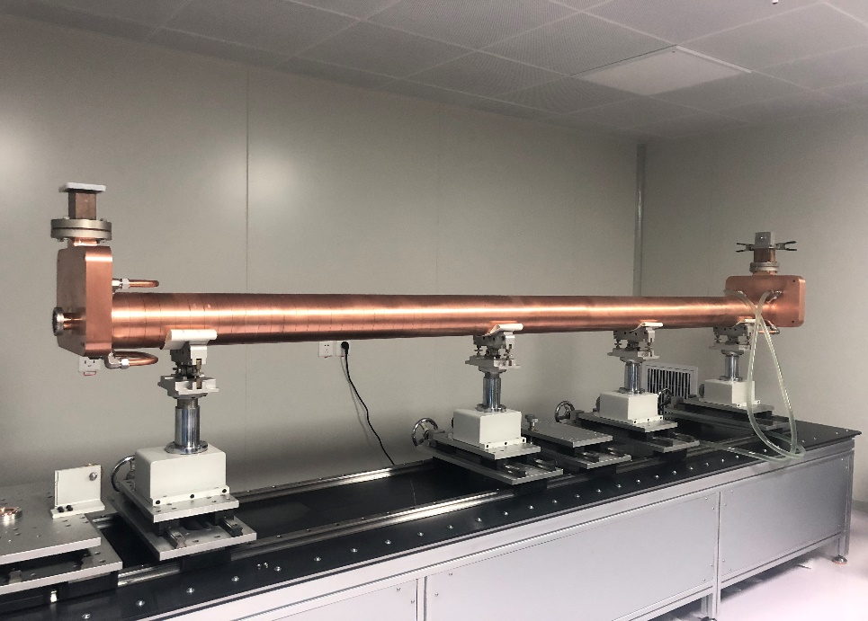
Accelerating structure
Cold test result
The phase shift and the cumulative phase shift are less than 1 deg
The VSWR is 1.02 at working frequency
The bandwith ±≥2MHz （VSWR≤1.2）

Slide 7
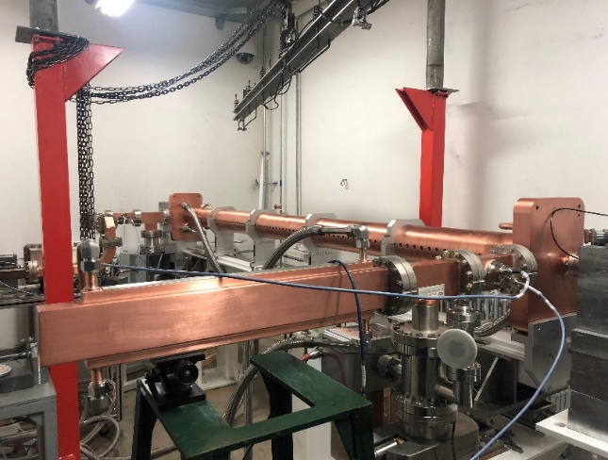
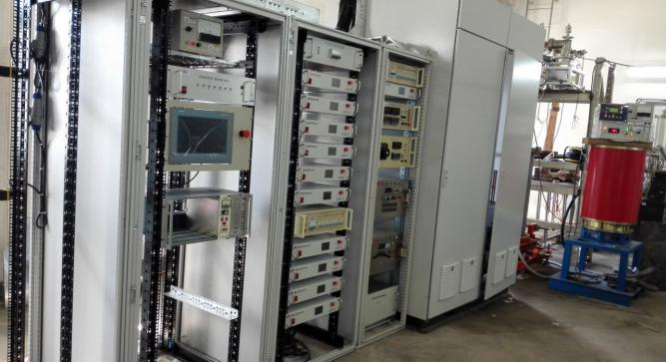
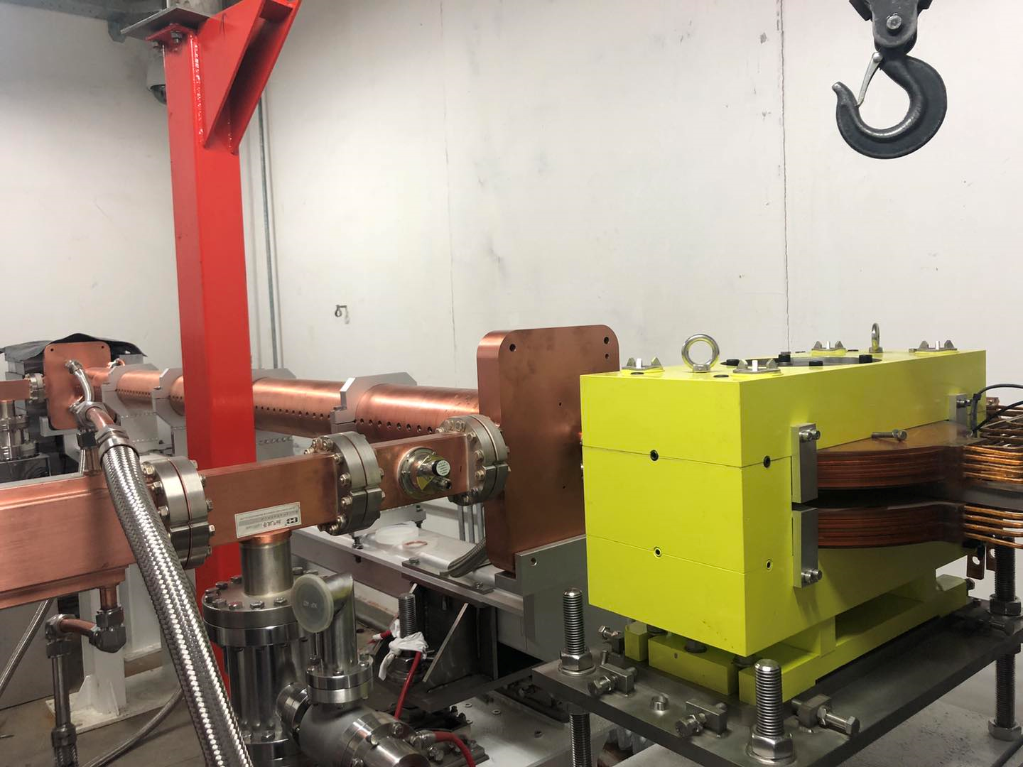
Accelerating structure
High power test
accelerating structure
Modulator &klystron
Analyzing Magnet

Slide 8
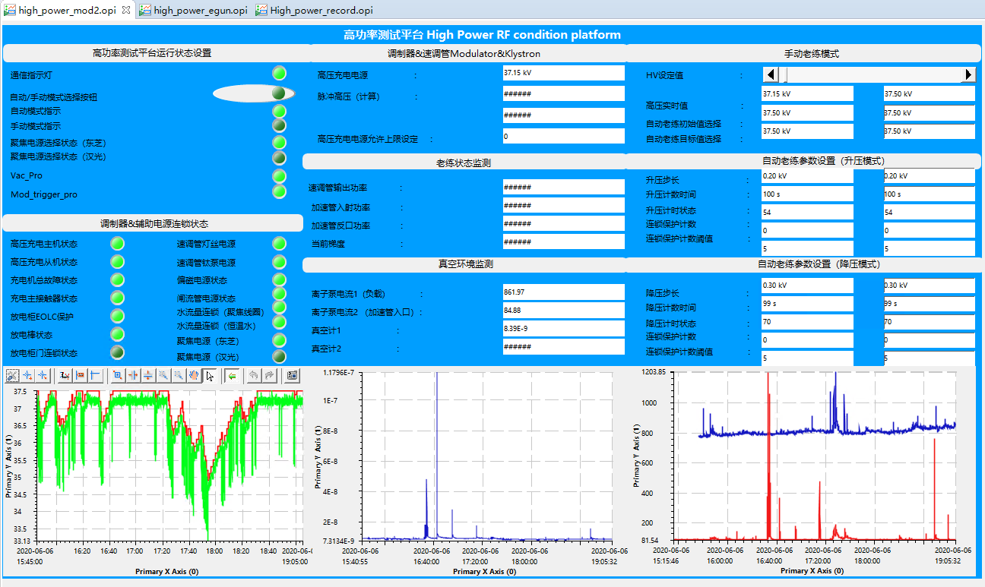
Accelerating structure
J.D. Liu
High power test
Developed automatic practice technology
Online monitoring and interlock protection of dark current are added, which provides an effective monitoring and protection
测试台联锁状态
自动老练参数配置
调制器状态
离子泵1状态
离子泵1状态
真空计状态
Control platform user interface

Slide 9
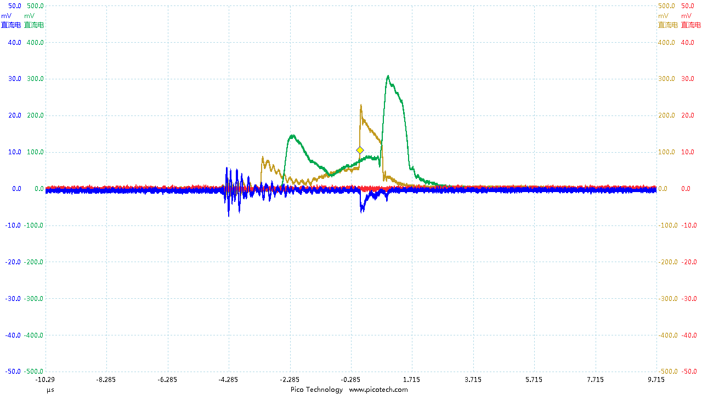
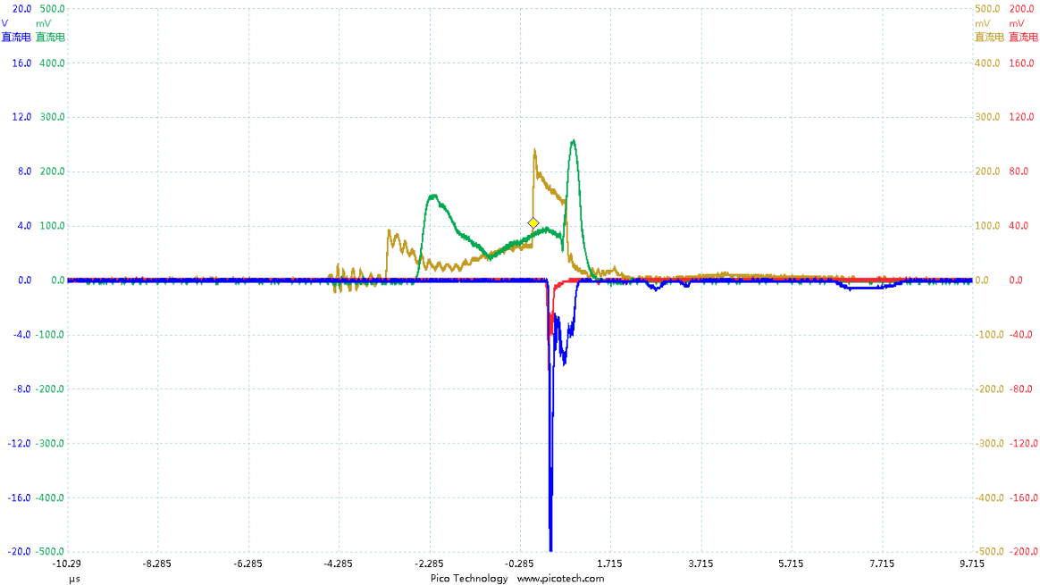
Accelerating structure
High power test
Database records the waveform when breakdown happen
Optimization of practice algorithm to improve practice efficiency

Slide 10
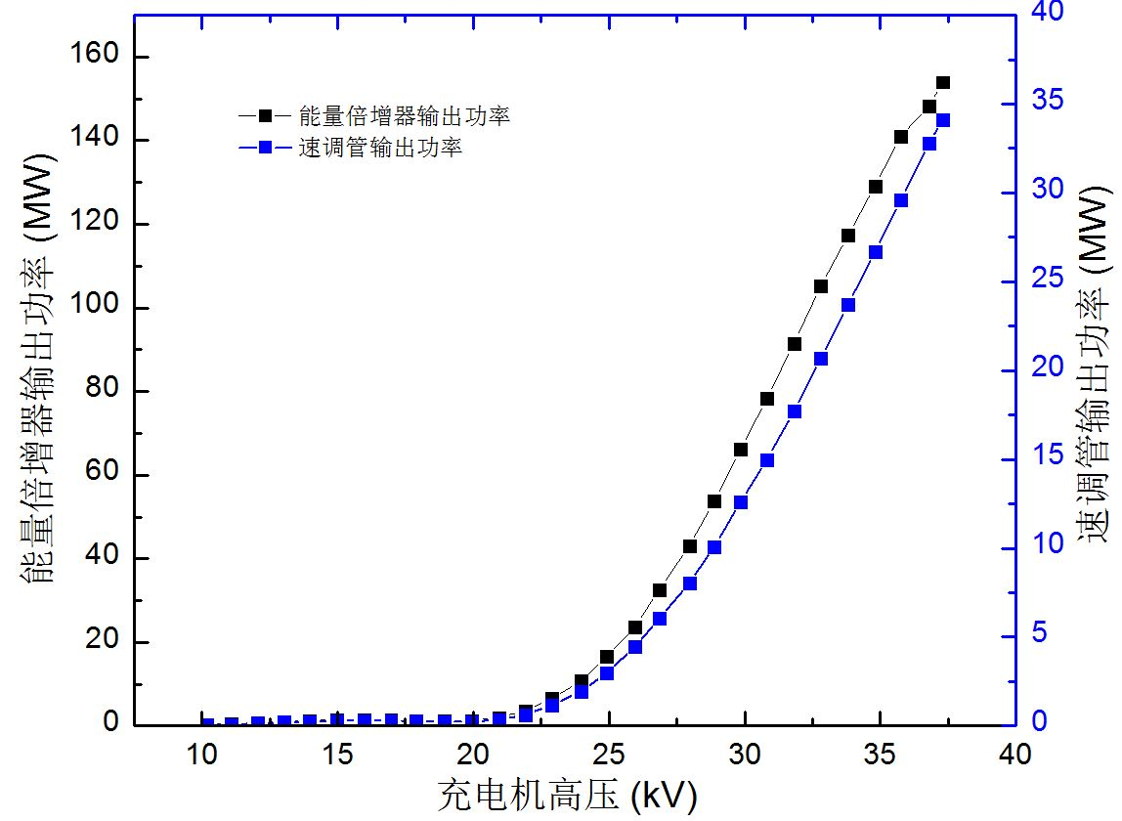
Accelerating structure
The relationship of the modulator high voltage vs. output power of the klystron
When the modulator voltage is 37kV, The klystron output is 34.1MW
With SLED, the maximum power benfore the accelerating structure is 154MW

Slide 11
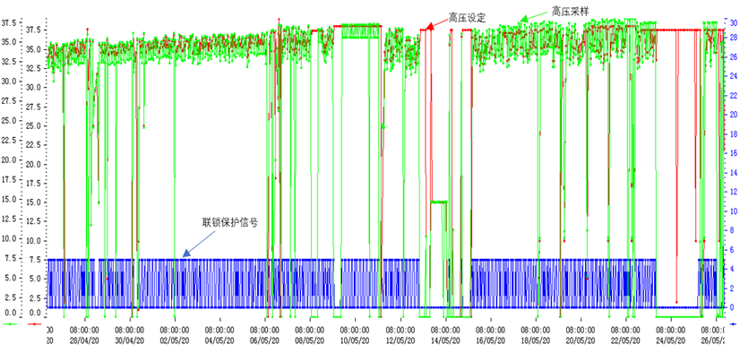
Accelerating structure
Practice steps
Pulse width 1uS, voltage to 40kV，2uS, to 40kV，With SLED, set the voltage goal 37kV
April 28 to May 26
Practice goal is 37kV
Automatice practice mode

Slide 12
Accelerating structure
With SLED, the relationship of the gradient and the input power
P_{in} the input power to the SLED
V the averge accelertiang gradient
L the total length od the structure, 3m
R the average shunt impedance, 64MΩ/m，
α attenuation of unit length, 0.48
M Energy multiplication factor, 1.8

Slide 13
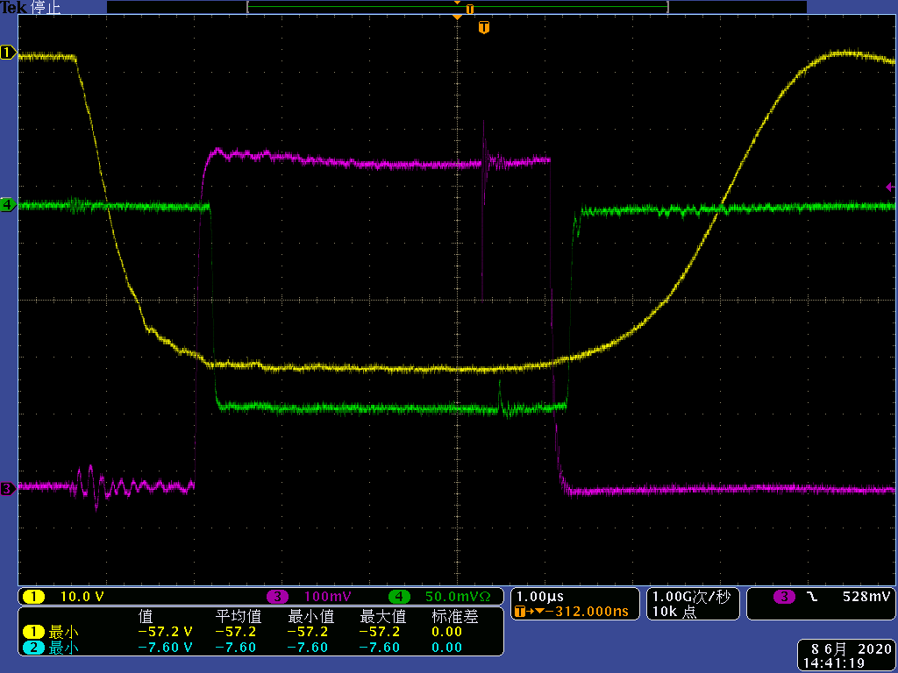
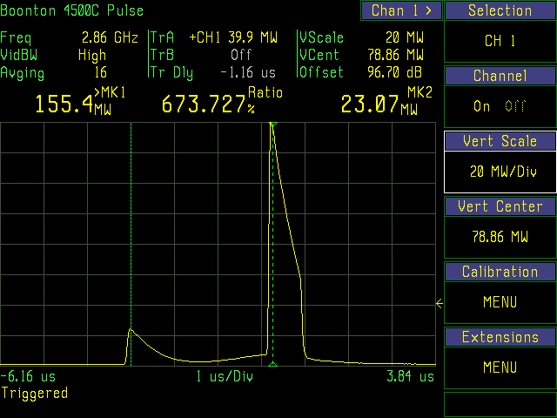
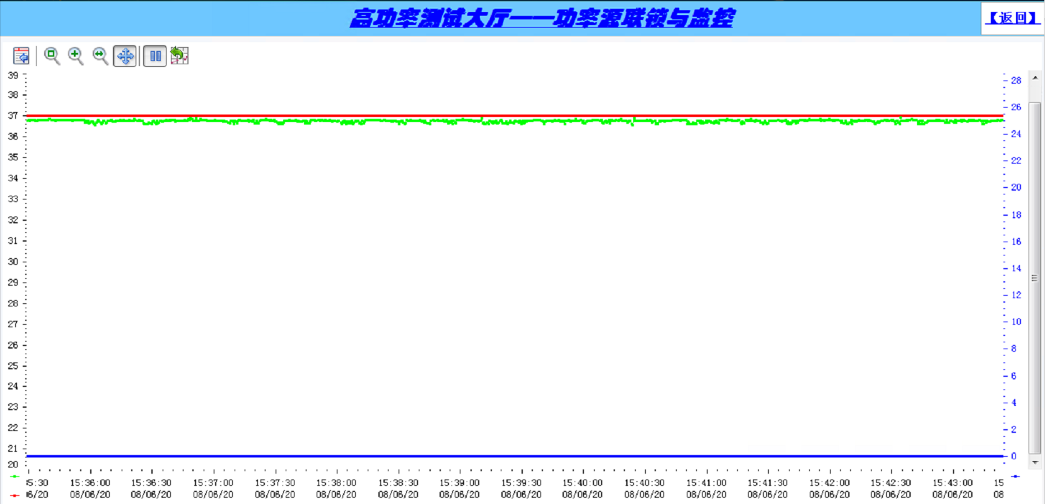
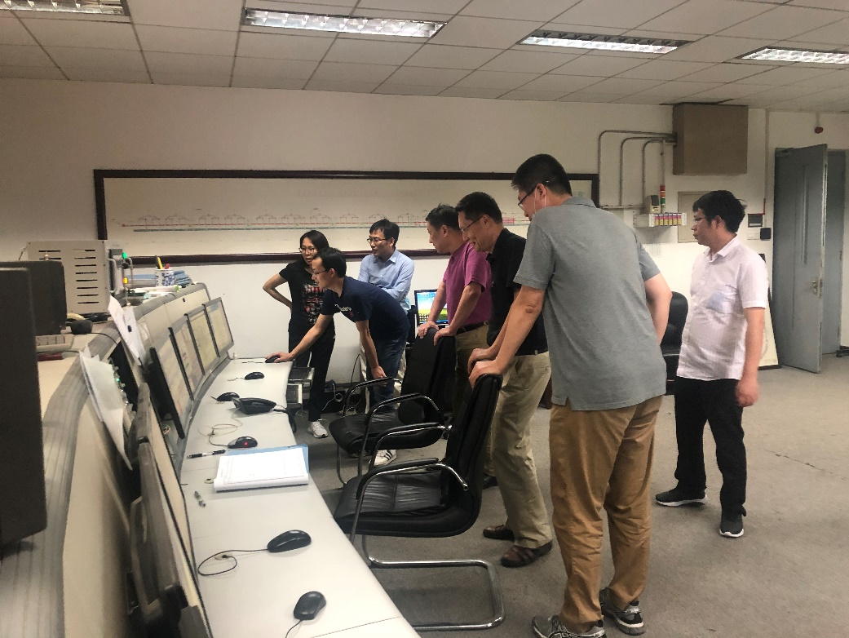
Accelerating structure
June 8, 2020，Process test and acceptance were carried out
The maximum output power is 153MW
The maximum gradient is 33MV/m
测试期间在调制器高压37kV运行情况，其中蓝线为连锁保护总信号（5V保护，0V正常），红线为脉冲调制器高压设定值，绿线为调制器高压采样值

Slide 14
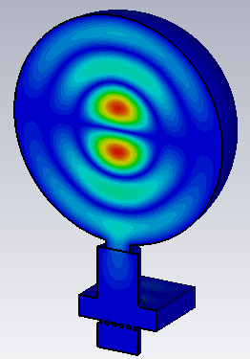
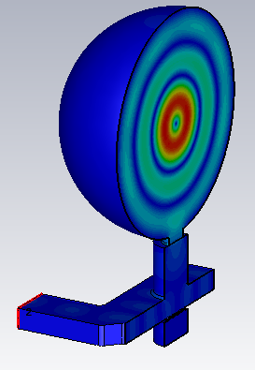
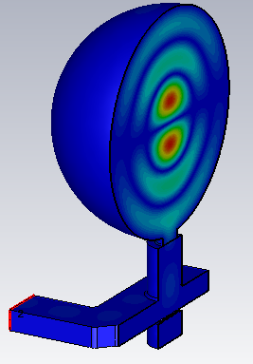
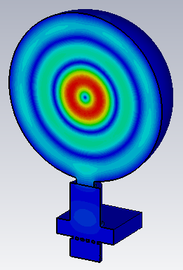
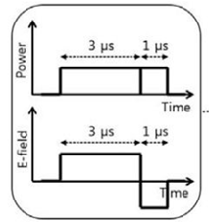
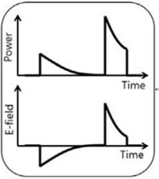
Pulse compressor
Pulse compressor
It is used to improve the peak power from the klystron and saving cost
The input power is 80 MW
The pulse width will be compressed from 4uS→0.8uS
TE₁₁₃ mode is selected
The frequency tuned by temperature control
It is including mode converter and spherical cavity
Mode 1
Mode 2
E-field distribution of the two degenerated polarized modes

Slide 15
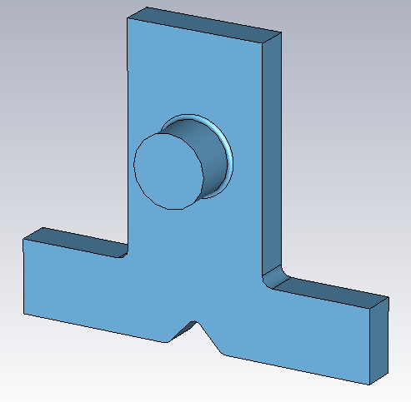
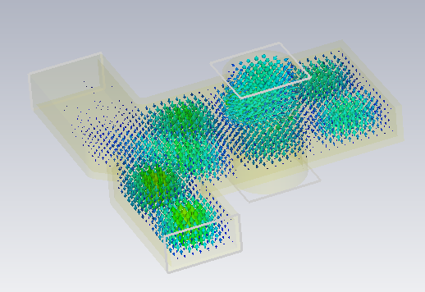
Pulse compressor
X. He
Mode converter
The TE₁₀ mode input from Port 1 will be converted into two degenerated TE₁₁ modes at Port 3
There are two degenerated TE₁₁₃ modes in the spherical cavity, The phase difference of the two modes is about 90°
The input port S₁₁ is -62.7 dB
The S₄₁ is -71dB for port 4 is for vacuum
S₁₁ / VSWR | -62.7 dB/1.0016
S₂₁ | -42.9 dB
S₃₁(1) | -3.02 dB
S₃₁(2) | -3.02 dB
Phase difference of two modes | 89.89°
S₄₁(1) | -70.9 dB
S₄₁(2) | -71.0 dB
Port 3
Port 4
Port 2
Port 1
Electromagnetic field
Vacuum model

Slide 16
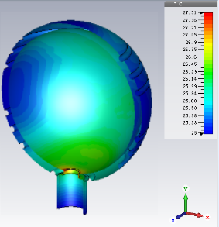
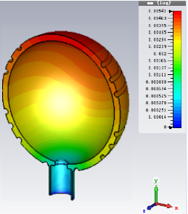
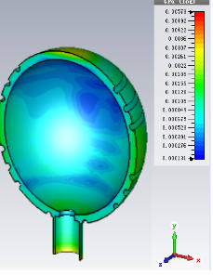
Pulse compressor
Thermal stress analysis
Wall thickness: 20mm
The maximal temperature rise is on the coupling hole of 2.5 ℃ (the water cooling flow set as 50 L/min)
The frequency tunable range of ±1 MHz is enough for all the frequency shift resulted from the input power, vacuum pumping, air pressure, etc.
CEPC parameter
Parameter | Value
SLED water temperature | 30 ℃
Room temperature | 25 ℃
Filling time | 730 ns
Klystron output power | 80 MW
Pulse width | 4 μs
Pulse repetition rate | 100 Hz
Accordingly, if we use the water temperature to tune the frequency, the temperature need to be ±3.6 ℃ change
Temperature
Deformation
Stress

Slide 17
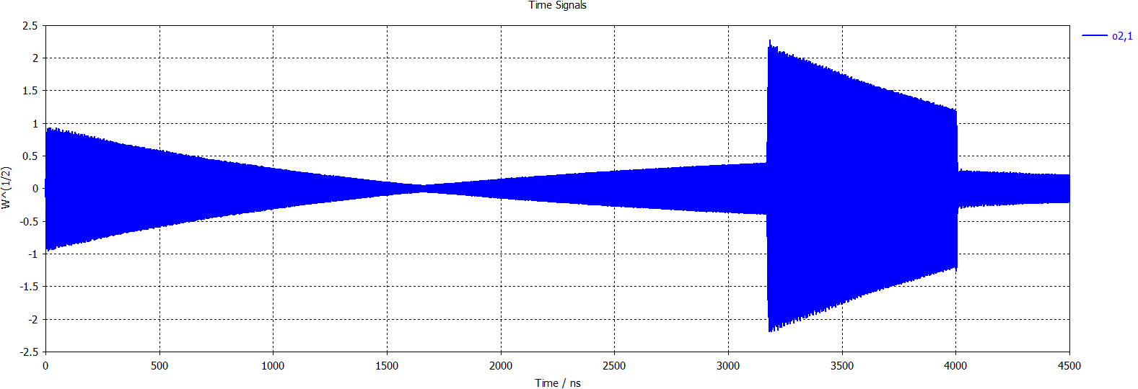
Pulse compressor
The parameters
The simulated Q factor is 94% of the theoretical one
The energy gain factor is ~1.6
Parameter | value
Frequency | 2856 MHz
Mode | TE₁₁₃
Q₀ | ~146000
VSWR | ≤1.1
Coupling factor | ~6.9
Tuning rang | ≥±1 MHz
Input power | 80MW
Repetition fre. | 100Hz
Pulse width | ~4µs
Pulse width after compress | ~0.83µs
Peak power gain | ≥7dB
Energy gain factor | ~1.6
Working temperature | 30±0.1ºC
For input signal:
Simulated compressed pulse

Slide 18
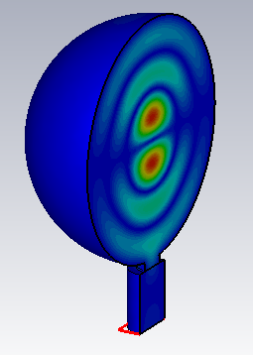
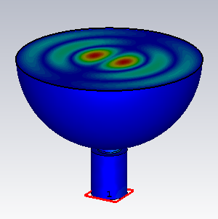
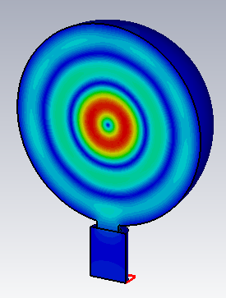
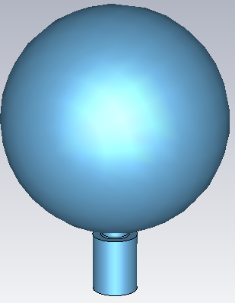
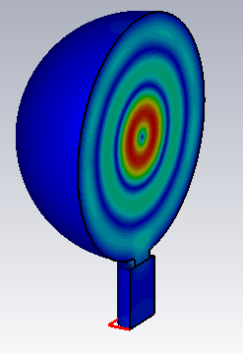
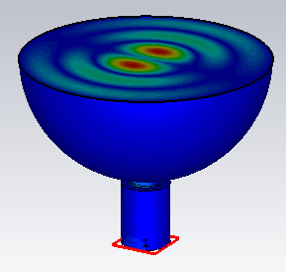
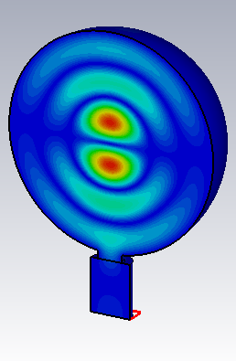
Pulse compressor
Simulated resonant spherical cavity with coupling hole（Eigenmode solver）
f₀=2855.9986 MHz, 2855.9994 MHz,
Q₀=139583, 139551
Cavity diameter
364.58mm
Electric field distribution of the twoTE₁₁₃ polarized degenerate mode
Simulation model

Slide 19
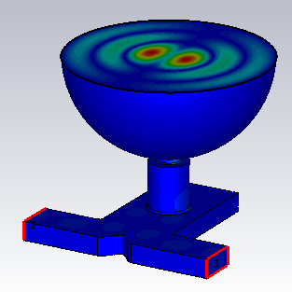
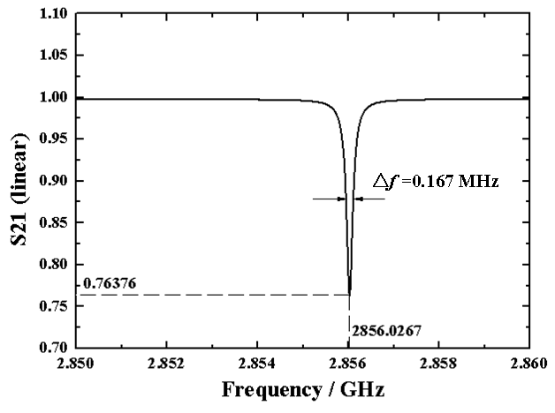
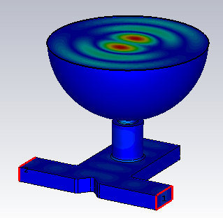
Pulse compressor
The whole pulse compressor
The Frequency solver results： Coupling Coefficient 7.47， f₀=2856.0267 MHz， Q₀=144785（the same as the Eigenmode solver results
S21 curve
Electric field distribution of the twoTE₁₁₃ polarized degenerate mode

Slide 20
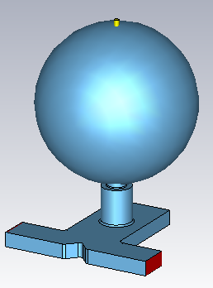
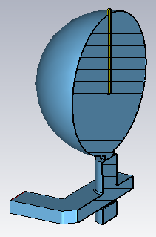
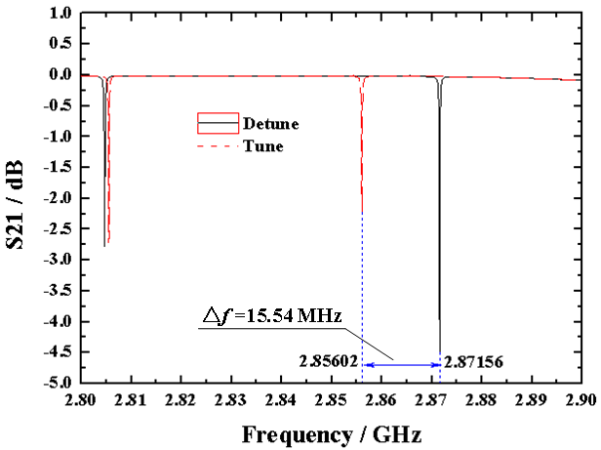
Pulse compressor
Detune calculation
Copper rod
Diameter of 12 mm
insertion depth of 210 mm
Frequency solver result: frequency changes from 2856.02 → 2871.56 MHz（△15.54 MHz），The Eigenmode solver result, from 2856.03 → 2871.41 MHz（△15.38 MHz）, the two solvers have got the same result
S11= -46.85 dB（VSWR=1.0091），S21= -0.0188 dB
Cross section view

Slide 21
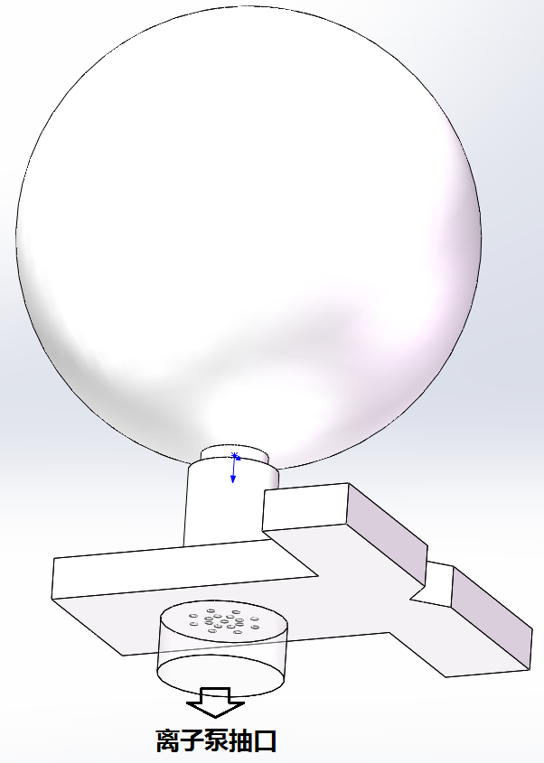
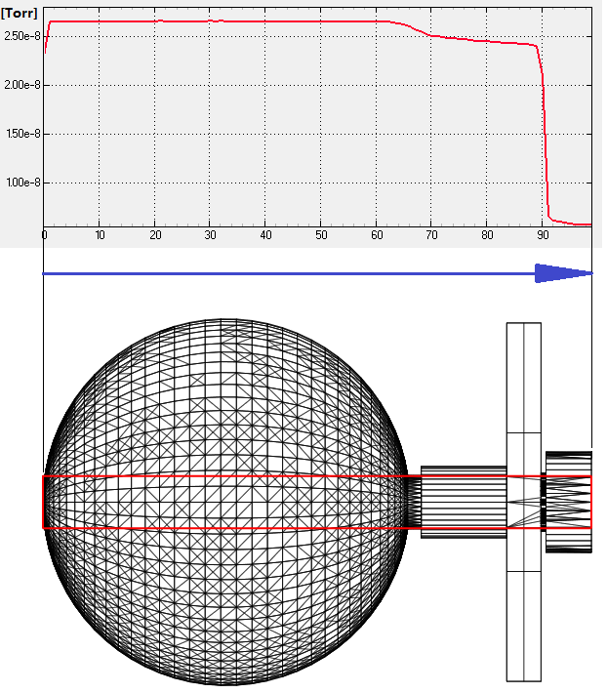
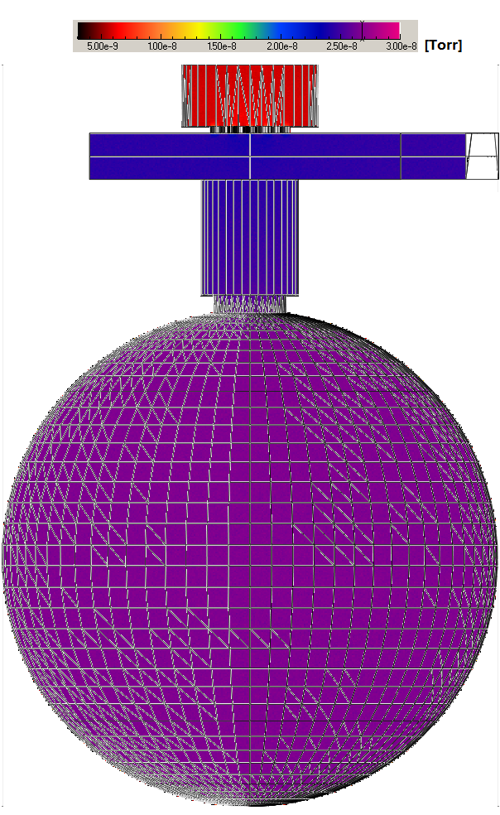
Pulse compressor
Baiqi Liu
Vacuum pumping speed and vacuum level
The pumping speed of the ion pump is 100 L/s
Considering the material as fine fabricated OFHC, the deflation rate will be：1×10⁻¹⁰ Torr.L/s/cm²
The simulation shows that the vacuum level inside the cavity is all below 3×10⁻⁸ Torr, which meet the requirements （＜ 5×10⁻⁸ Torr ）
Vacuum distribution
Simulation model
Simulation result

Slide 22
Pulse compressor
Mechanical technological design
Copper block material, milling process
High cost
Waste material
Copper plate, spinning Process √
Need mould design
Mass production will reduce costs

Slide 23
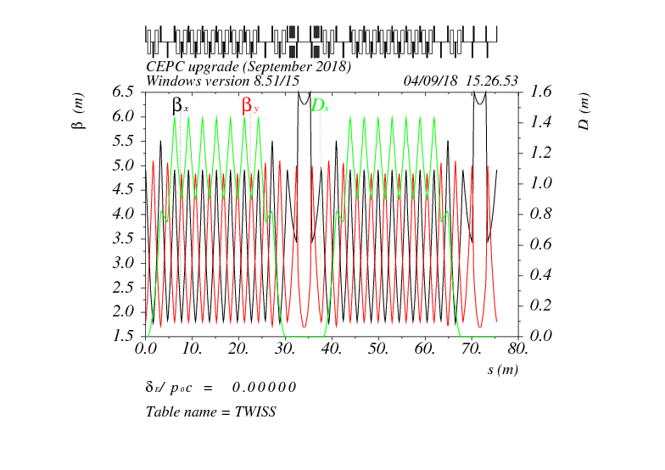
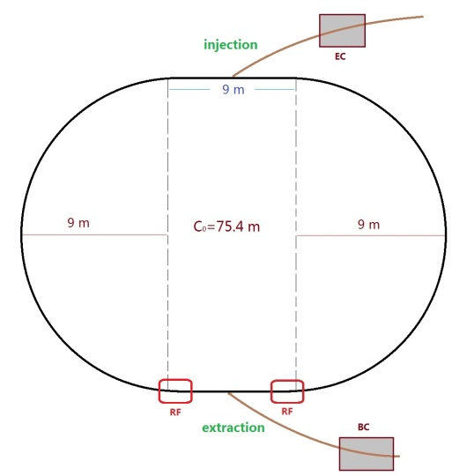
Damping Ring RF cavity
D, Wang
Damping ring
DR V2.0 | Unit | Value
Energy | GeV | 1.1
Circumference | m | 75.4
Storage time | ms | 20
Bending radius | M | 3.565
Dipole strength B₀ | T | 1.03
U₀ | keV | 36.3
Damping time x/y/z | ms | 15.2/15.2/7.6
δ₀ | % | 0.05
ε₀ | mm.mrad | 376.7
σ_{z，inj} | mm | 5.0
Nature σ_{z} | mm | 7.5
ε_{inj} | mm.mrad | 2500
ε_{ext x/y} | mm.mrad | 530/180
δ_{inj} /δ_{ext} | % | 0.2/0.05
Energy acceptance by RF | % | 1.0
f_{RF} | MHz | 650
V_{RF} | MV | 2.0

Slide 24
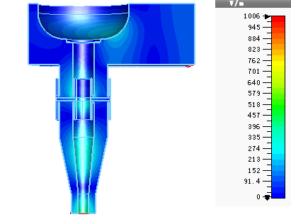
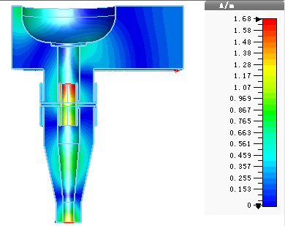
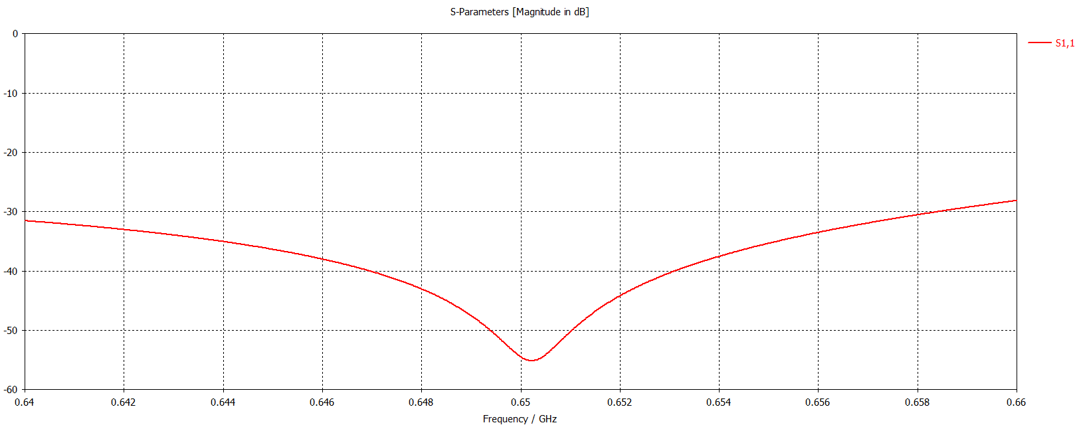
Damping Ring RF cavity
O.Z. Xiao
Input coupler and doorknob for DR 5 cell cavity
Electromagnetic field distribution
S11

Slide 25
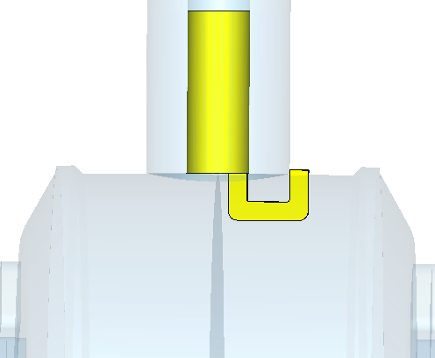
Damping Ring RF cavity
H. Shi
Coupling factor simulation
coupling loop angle（degree） | coupling degree
0 | 6.4
20 | 5.8
40 | 3.8
The coupling ring is perpendicular to the direction of the magnetic field, and the coupling degree is 6.4
Coupling degree ~ 5 at rotation angle ~ 28 degrees

Slide 26
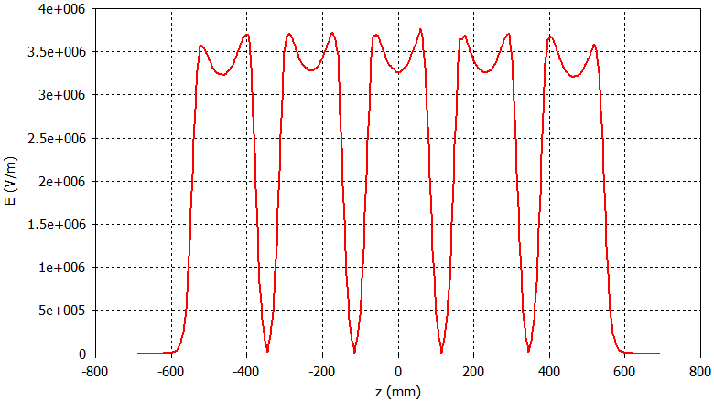
Damping Ring RF cavity
cavity parameters
 | Unit | Value
Beam tube aperture | mm | 44
Total length | mm | 1383.66
Cell length | mm | 5*230.61
Outside diameter | mm | 345
π-mode frequency | MHz | 649.993
Q0 |  | 31665
R/Q | Ω | 1316
Shunt impedance | MΩ | 20.8
Accelerating voltage | MV | 1.2 (2.0)
Accelerating gradient | MV/m | 1.04 (1.73)
Dissipated cavity power (20% margin) | kW | 45 (120)
Diameter of the tuner
φ94
Tuning rang (1.2MHz)
649.635kHz (-30mm)
650.829kHz (+30mm)

Slide 27
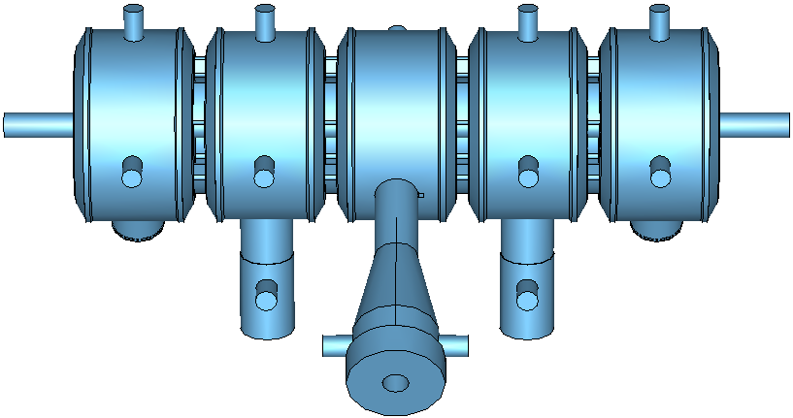
Damping Ring RF cavity
vacuum
The diameters of neck tubes of tuner and vacuum ports are 94mm
2 pump ports near the ceramic of coupler and 1 pump port for each tuner with flanges CF35 are considered. The inner diameters of these pump ports are 38mm
The aperture plates are installed near the vacuum ports

Slide 28
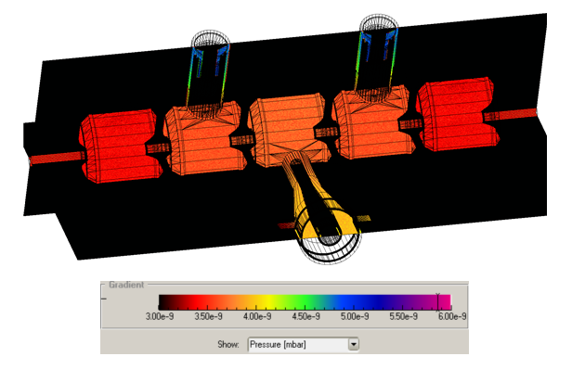
Damping Ring RF cavity
B.Q. Liu
vacuum
Two 100L/s ion pump in the No.1 & N0.5 cavities, one 15L/s is in the coupler
The vacuum pressure distribution in the cavity is uniform, 3.0e-7 ~ 3.5e-7 Pa
The vacuum at the coupler position is about 3.4e-7 Pa
The vacuum at the tuner position is about 5.2e-7 Pa
Ion pump distribution
Vacuum degree distribution

Slide 29
Damping Ring RF cavity
X.D. Weng
Machenical design
Cavity
Tunner
Coupler

Slide 30
Damping Ring RF cavity
5-CELL腔体
5-CELL腔体由5个腔体，两端端盘和中间耦合盘组成。
整个腔体关于中心轴对称，所以共有3中规格腔体，CELL-1腔体×2、 CELL-2腔体×2、 CELL-3腔体×1。
CELL-1腔体接离子泵，CELL-2腔体接调谐器，CELL-3腔体接耦合器。
每个CELL腔布置CF100窗口接真空泵、调谐器和耦合器，另外体均每个CELL腔布置两个CF35用作PICK-UP窗口。
端盘、腔体、耦合盘均设计水冷结构。

Slide 31
Damping Ring RF cavity
端盘、耦合盘水冷结构
端盘水冷结构
耦合盘水冷结构
端盘和耦合盘的冷却均采用内部交叉水道的结构。
水道尺寸为φ12mm，进水水嘴尺寸为φ12×1，接卡套接头。

Slide 32
Damping Ring RF cavity
腔体水冷结构
水冷盘管
开槽埋管
腔体为薄壁筒体，无法做内部水冷结构，因此选择外围盘管进行冷却。
为保证水冷管与腔体的良好接触和热传导，在筒体外表面开槽将水冷管埋进腔体并钎焊。

Slide 33
Damping Ring RF cavity
调谐器结构介绍
主螺母
副螺母
调节螺纹副
调谐杆外径为φ84
调谐行程±30mm
调谐范围：
649.635kHz (-30mm)
650.829kHz (+30mm)
外导体水冷使用双层管结构，调谐杆水冷使用螺旋水道结构
调节螺纹副使用双螺母结构，主螺母传动，副螺母消隙
轴承
波纹管
外水冷
内水冷
调谐杆

Slide 34
Damping Ring RF cavity
耦合器结构介绍
门钮转换器
陶瓷窗
外导体
门钮与内导体连接形式
轭流结构
内导体
耦合环

Slide 35
Summary
The accelerating structure has completed. Through the expert test and acceptance, the design goal is achieved.
The sphereral pulse compressor RF design has completed. The machanical design has started.
The DR ring 5 cell cavity is designing.

Slide 36
Thank you !

