Slide 1
Progress of CEPC Booster Magnet R&D
Wen Kang, Jianxin Zhou, Mei Yang
IHEP, July. 24, 2020

Slide 2
Contents
Specifications of the CEPCB dipole magnets
Progress of the subscale prototype iron dipole magnets
Progress of the full scale prototype CT dipole magnets
Progress of the field measurement system

Slide 3
Specifications of CEPCB dipole
 | BST-63B
Quantity | 16320
Minimum field (Gs) | 28
Maximum field (Gs) | 338
Gap (mm) | 63
Magnetic Length (mm) | 4700
Good field region (mm) | 55
Field uniformity | 0.1%
Field reproducibility | 0.05%

Slide 4
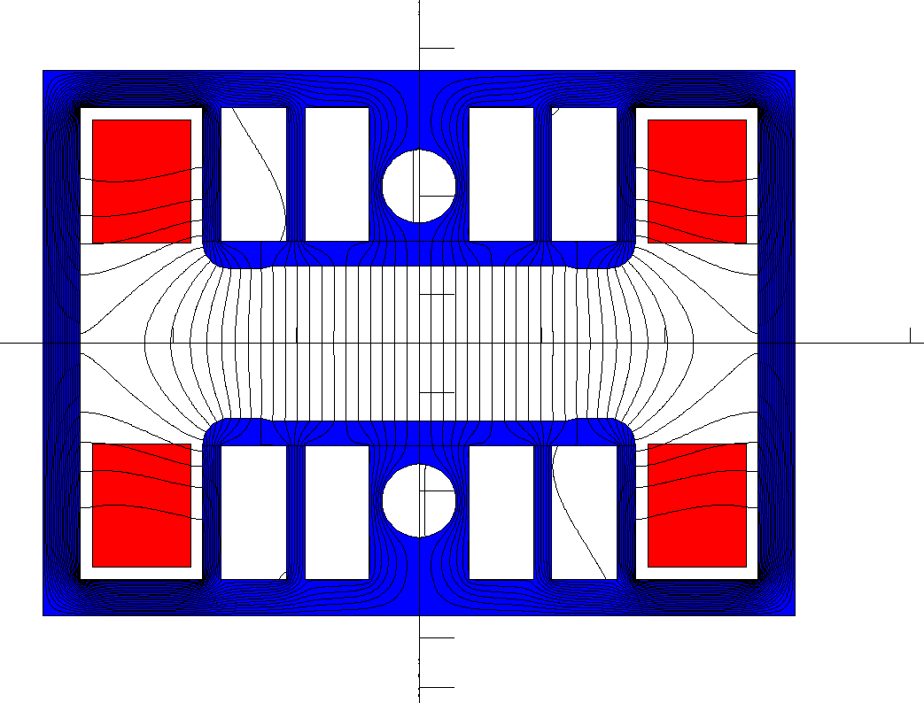
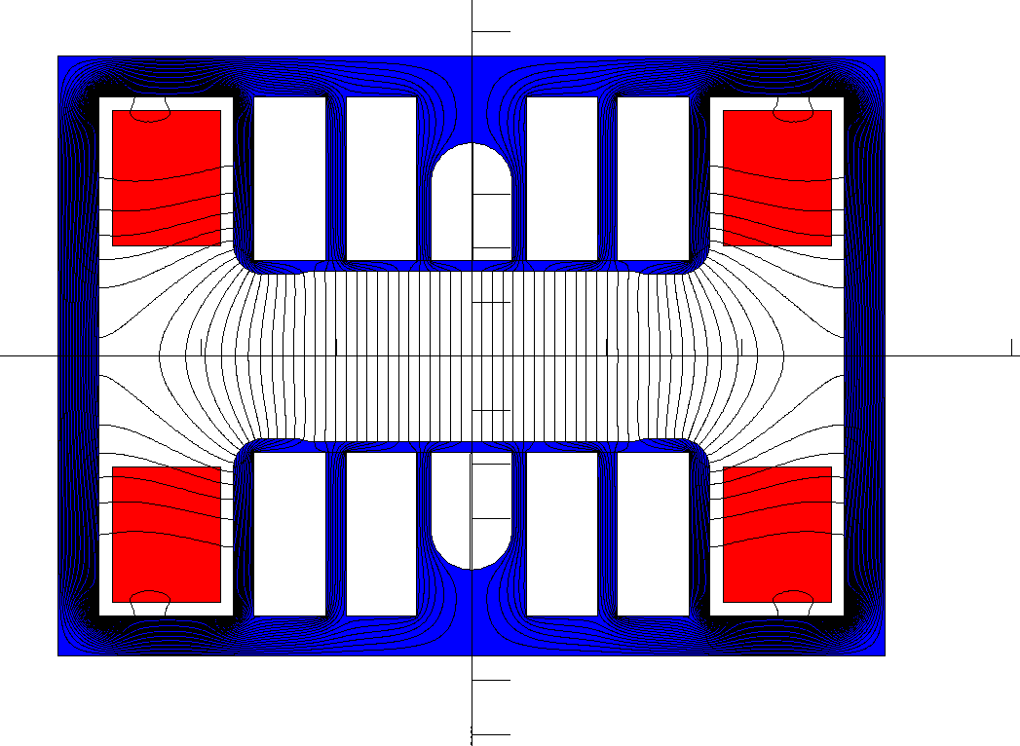
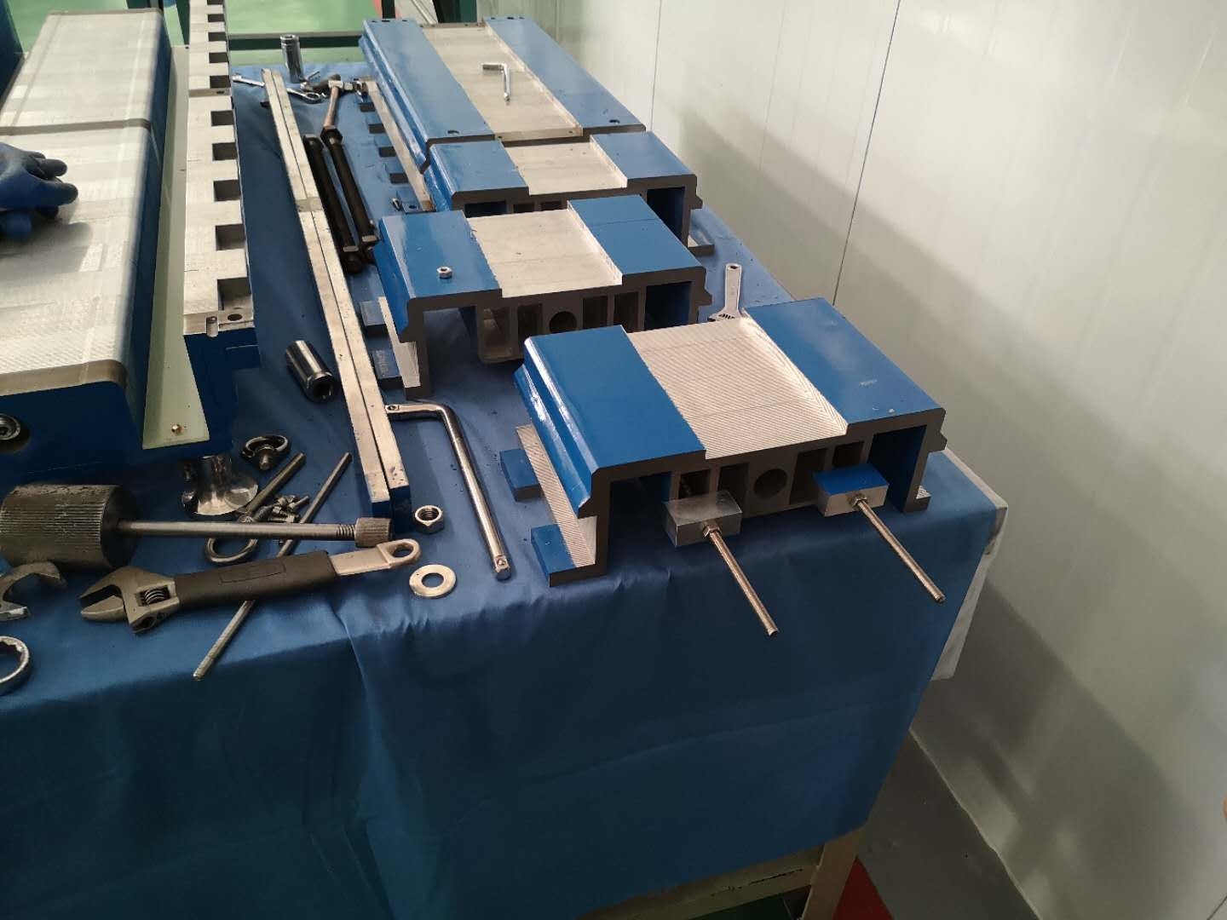
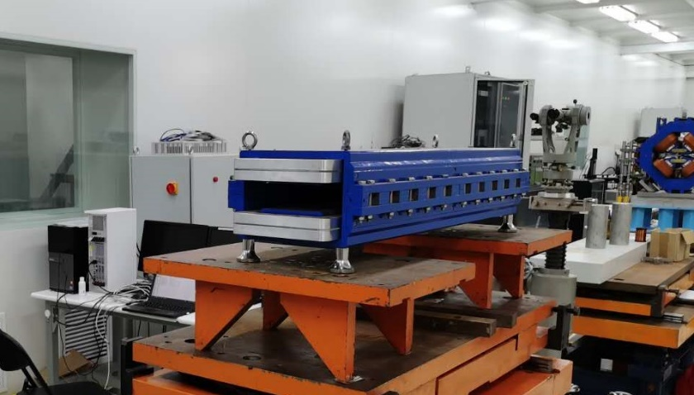
Progress of the subscale prototype dipole magnet with iron cores
In order to reduce the influence of the remnant field on the field quality, the subscale prototype dipole magnet was de-assembled and the holes of its laminations were reproduced. It was expected that the remnant field in the pole areas could be made uniform.

Slide 5
Progress of the subscale prototype dipole magnet with iron cores
The field measurement results show that the obvious modification of the magnet does not cause an obvious improvement on the low field quality.
The uniformity of low field of 28 Gs becomes a little better, from 0.35% to 0.25%. However, the uniformity of high field level becomes a little worse, from 0.1% to 0.15%

Slide 6
Progress of the subscale prototype dipole magnet with iron cores
For comparison, the half prototype magnet is made by the lamination without pole square holes. When the magnet was modified, this half magnet did not change. The field measurements show that the field distribution of the half magnet does not change yet. It mean that the fabrication of the magnet has a good repoducibilty.

Slide 7
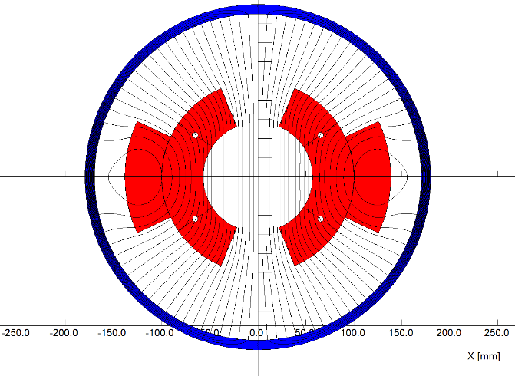
Progress of the full-scale prototype dipole magnet without iron cores
On the base of good results from the subscale CT dipole magnet, the mechanical design of a full scale prototype CT dipole magnet was finished on the cooperation with Hefei Keye company. The production of the magnet will be begun in the coming month.
The total length of the magnet including the shielding tube is 5.1m.
The cooling tubes are inserted between the coil conductors to decrease temperature rise.
The field design and mechanical design are completed up to now.

Slide 8
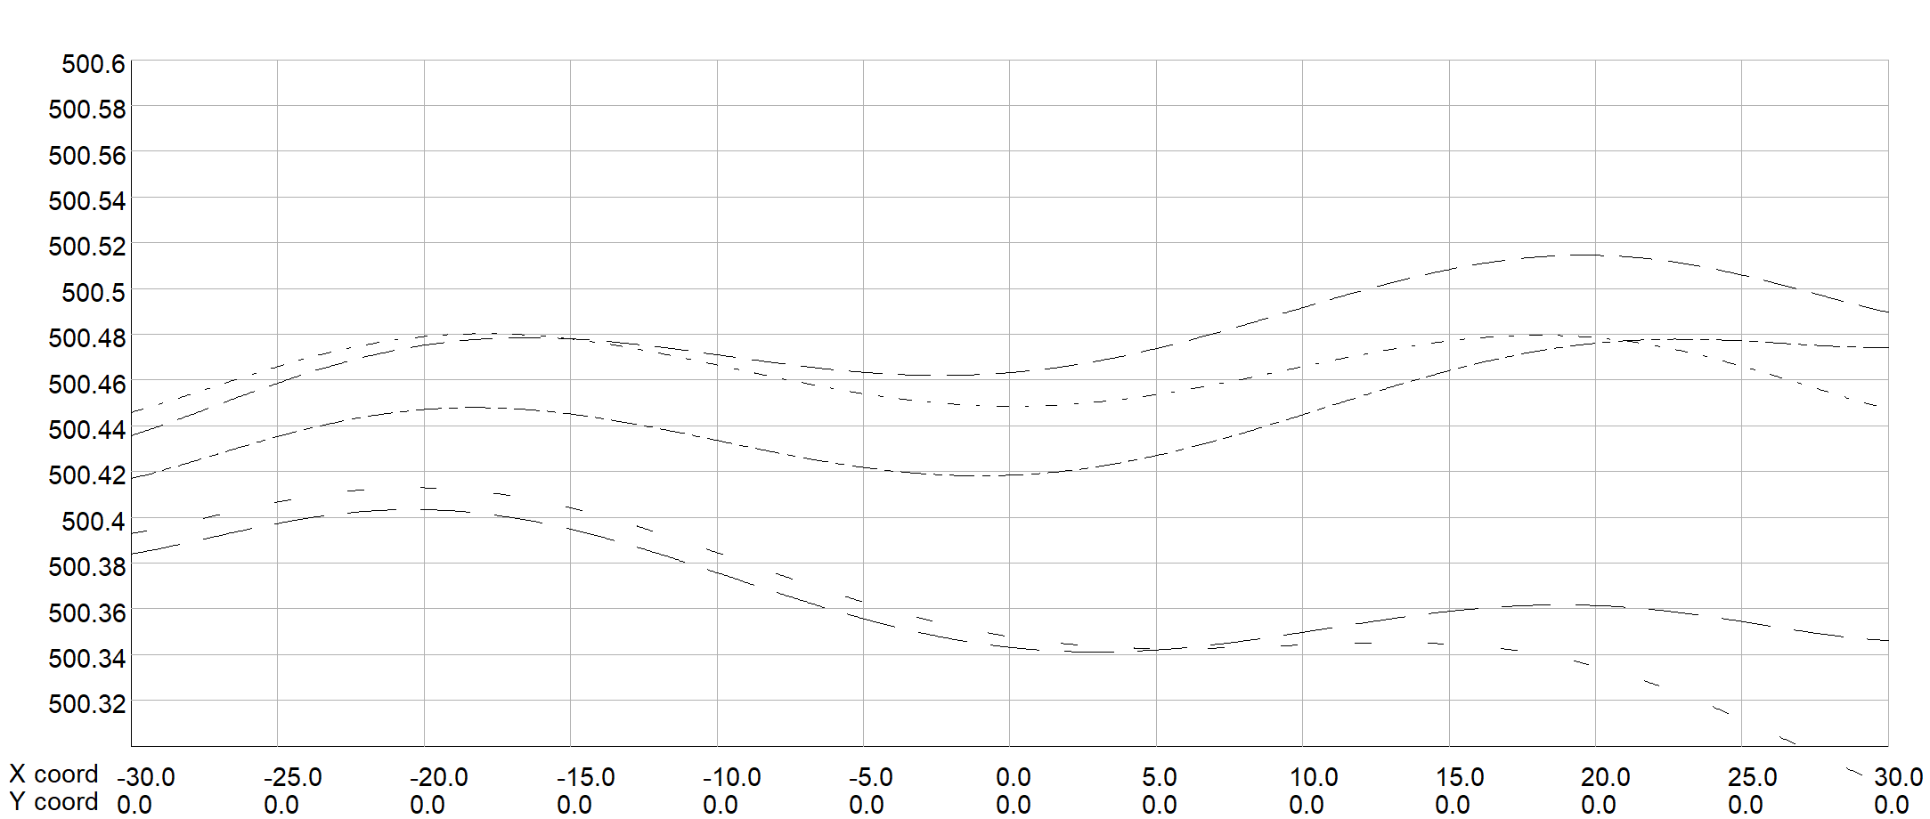
Progress of the full-scale prototype dipole magnet without iron cores
The magnet is composed of the upper and lower coils, each coil is formed by three conductors. The size and position tolerance of the conductors are the key factors for the precision of the field.
The field simulation shows,
The tolerance of size dimension for all conductors should be less than 0.05mm.
The position tolerance of the conductors should be less than 0.1mm in 5.1m longitudinal direction.

Slide 9
Progress of the full-scale prototype dipole magnet without iron cores
Each conductor is 4.7m long, it is designed to be directly fabricated from a long aluminum bar, which will need large machining and surface anodizing facility. In order to reduce the production cost, it is considered to be divided into 3 parts for convenient fabrication and then assembled together.

Slide 10
Progress of the full-scale prototype dipole magnet without iron cores
To control the size and position precision of the conductors, the supporters every 415mm in longitudinal direction are fabricated and assembled in the shielding tube.

Slide 11
Progress of the full-scale prototype dipole magnet without iron cores
After the coil conductors are produced, the whole assembly of the magnet will be done in the shielding tube, which can be opened into upper and lower parts. The position of the shielding tube that support the supporters of the CT coils will be carefully and precisely machined.

Slide 12
Parameters of the full scale CT dipole magnet
序号 | BST-63B设计参数 |  | 序号 | BST-63B设计参数 |  | 序号 | BST-63B设计参数
1 | 磁铁数量 | 1 | 18 | 电流[A]@10GeV | 96 | 35 | 最大直流电压[V]@120GeV | 1.1
2 | 磁铁气隙[mm] | 63 | 19 | 平均电流[A] | 733 | 36 | 感抗压降[mV] | 79.7
3 | 磁场 [Gs]@180GeV | 500 | 20 | 导线尺寸 [mm*mm] | I-A675R57-O-A248R13846 | 37 | 线圈R1[mm] | 57
4 | 磁场 [Gs]@120GeV | 338 | 21 | 导电截面[mm^2] | 1973.2 | 38 | 线圈R2[mm] | 100
5 | 磁场 [Gs]@10GeV | 29 | 22 | 最大电流密度[A/mm^2]@120 | 0.59 | 39 | 线圈R3[mm] | 138.46
6 | 磁有效长度 [mm] | 4700 | 23 | 最大电流密度[A/mm^2]@180 | 0.9 | 40 | 线圈角度A1[°] | 33.75
7 | 好场区宽度 [mm] | 55 | 24 | 平均电流密度[A/mm^2] | 0.37 | 41 | 线圈角度A2[°] | 67.5
8 | 积分磁场均匀性 | 0.001 | 25 | 平均匝长[m] | 11.00 | 42 | 线圈角度A3[°] | 24.8
9 | 磁场上升时间[s] | 4 | 26 | 单极导线长度[m] | 33 | 43 | 线圈端部过桥长度[mm] | 300
10 | 磁场平顶时间[s] | 1 | 27 | 线圈导线总长[m] | 66 | 44 | 线圈长度[mm] | 4700
11 | 磁场下降时间[s] | 4 | 28 | 直流电阻[mOhm] | 0.94658 | 45 | 屏蔽筒内径[mm] | 340
12 | 单极安匝数[At]@180GeV | 5160 | 29 | 最大功耗[W]@180GeV | 2800 | 46 | 屏蔽筒外径[mm] | 360
13 | 单极安匝数[At]@120GeV | 3477 | 30 | 最大功耗[W]@120GeV | 1272 | 47 | 屏蔽筒重量[kg] | 976
14 | 单极安匝数[At]@10GeV | 288 | 31 | 平均功耗[W]@10-180GeV | 1120 | 48 | 线圈重量[kg] | 385
15 | 单极线圈匝数 | 3 | 32 | 平均功耗[W]@10-120GeV | 510 | 49 | 磁铁总重[kg] | 1400
16 | 电流[A]@180GeV | 1720 | 33 | 电感[mH] | 0.300 | 50 | 所有磁铁最大功耗[MW] ]@120GeV | 20.7
17 | 电流[A]@120GeV | 1159 | 34 | 最大直流电压[V]@180GeV | 1.8 | 51 | 所有磁铁最大功耗[MW] | 8.3

Slide 13
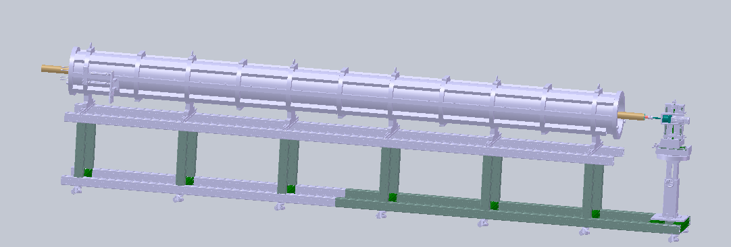
Progress of the field measurement system
The 5.5m long rotating coil field measurement system will be used to measure the field errors of the CT magnet, it is composed of
1、Long coil and coil support
2、Motor and Driver
3、Encoder
4、Motor contorl
5、Signal acquisition device
。。。。。。

Slide 14
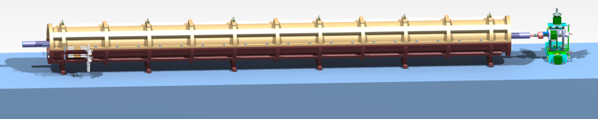
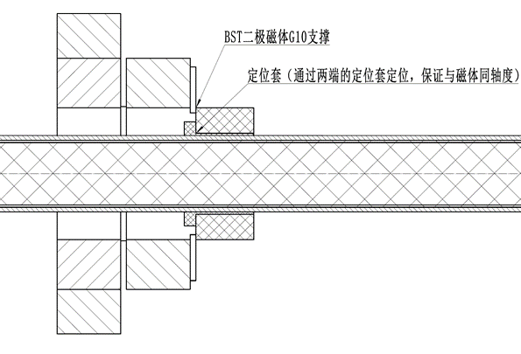
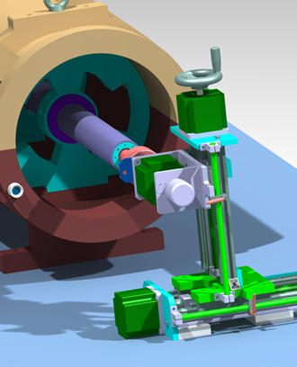
Progress of the field measurement system
Overall view
Positioning sleeve（Two sides）
Motor、Encoder
The long rotating coil is installed in a supporting tube with a total length of 5520 mm；
The positioning component is used to ensure that the measuring coil is coaxial with the magnet；
When the magnet is measured, the upper part of the magnet will be moved, the measuring coil will be installed , and then the magnet will be closed

Slide 15
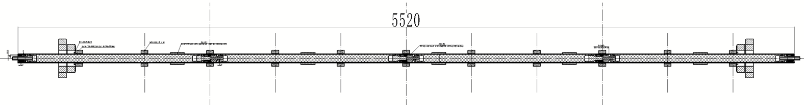
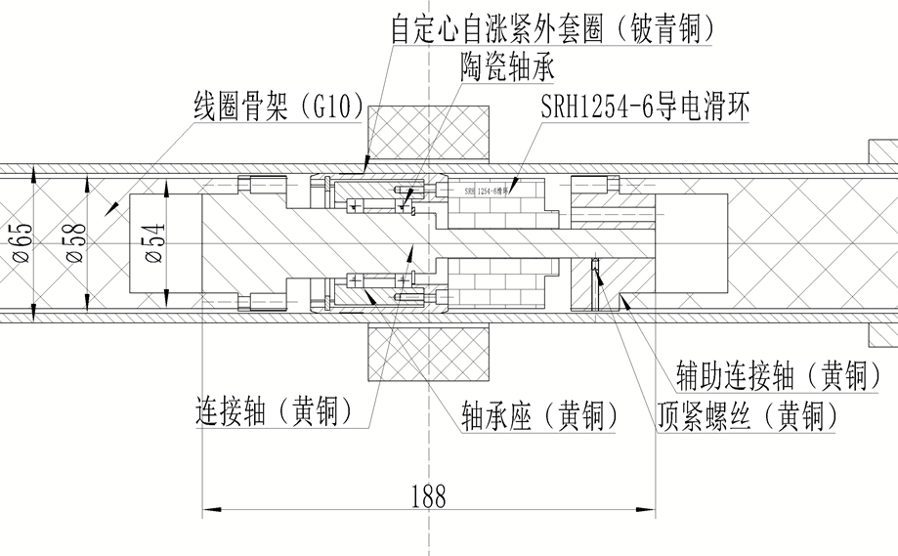
Progress of the field measurement system
The coil frame has four sections, and the length of single section is 1218mm;
The self centering and self tightening structure is adopted between the framework and the outer tube;
The two skeletons are connected through the connecting shaft and the auxiliary connecting shaft hole shaft to ensure the coaxiality;

Slide 16
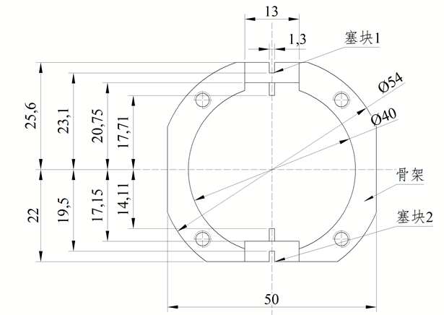
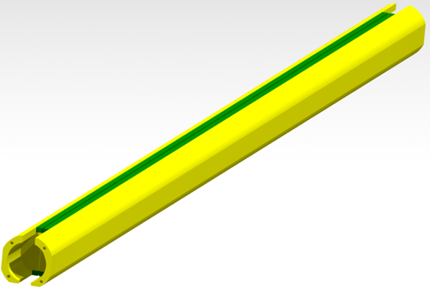
Progress of the field measurement system
The 20 strand enameled wire with a thickness of 0.09mm and a width of 1.3mm was selected to wind the coils;
The coil frame is made of G10 material with a diameter of 54mm. It is machined on the CNC machine tool to ensure the accuracy;
Accuracy: straightness ≤ 0.1mm; radius accuracy of inner and outer coils ≤± 0.02mm;

Slide 17
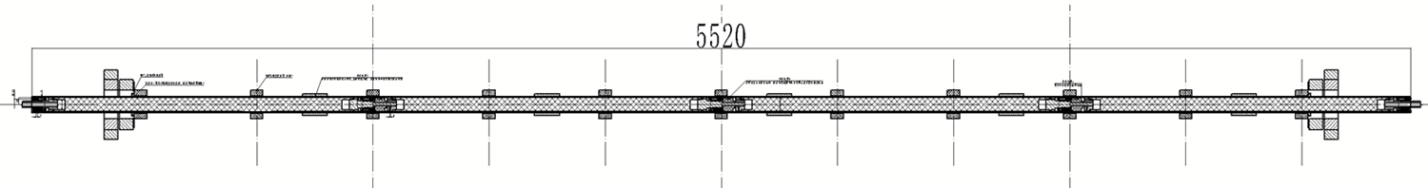
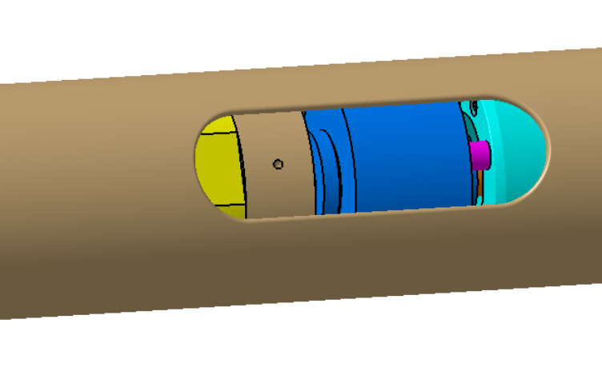
Progress of the field measurement system
1
2
3
4
Slip ring
The signal of each coil is led out to the outer supporting tube by a ceramic slip ring, and then the wire is led out of the magnet along the outer surface of the tube;
The field of the magnet in different longitudinal positions can be measured by the coil of 1, 2, 3 and 4 respectively, and the field of the whole magnet can be measured by connecting the signals in series;

Slide 18
Thank you for your attention.

