Slide 1
JUNO Distributed Computing Status
Xiaomei Zhang
On behalf of JUNO DCI group
JUNO Collaboration Meeting, July 3

Slide 2
Content
Service, site and resource status
JUNO production system and its use in real JUNO production case
Report from review panel and actions
Summary

Slide 3
System status

Slide 4
Service status
JUNO Distributed Computing system was built on DIRAC
  DIRAC provides a framework which can organize heterogeneous and distributed resources from JUNO member state
  Also provides solutions for workload management (WM) and data management (DM)
Besides DIRAC, other WLCG services have been used
  Storage Element (SE)
  CVMFS
  VOMS
  FTS3
DIRAC and all these services are working well this year

Slide 5
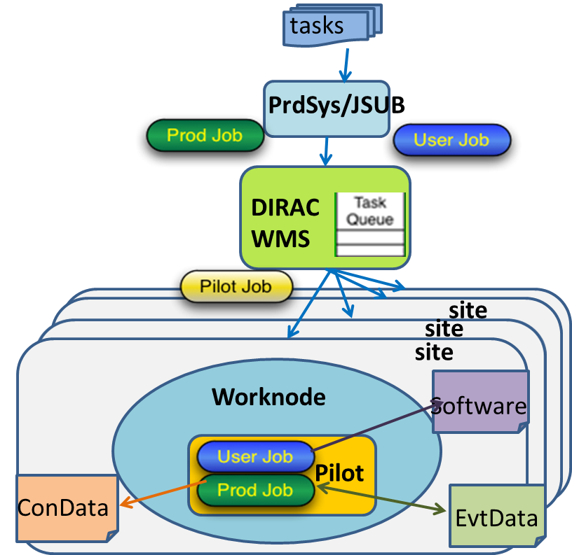
WMS (1)
JUNO DCI WMS based on DIRAC Workload Management System
  Use pilot schema and pull mode ( WLCG)
  WMS acts as middleware between resource and user
Three layers of JUNO WMS in DCI
  ProdSys/JSUB – interface for mass submission of JUNO production and user jobs
  DIRAC WMS – scheduling between jobs and resources
  Site LRMS – local scheduling
  /CreamCE/HTCondor/
  HTCondorCE/Openstack/
  OpenNebula

Slide 6
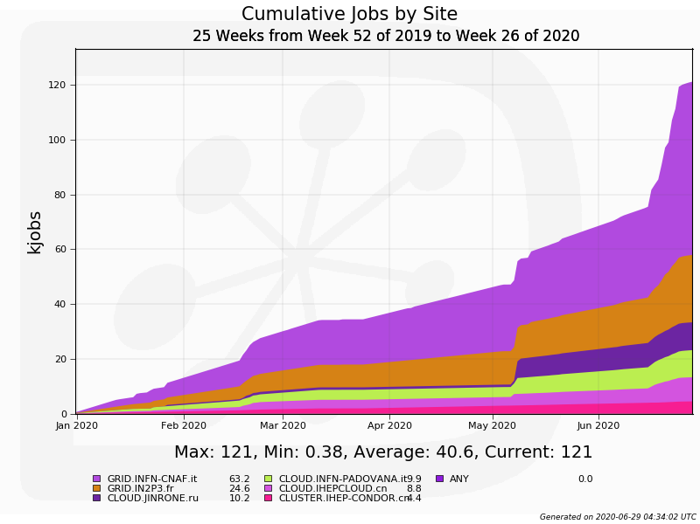
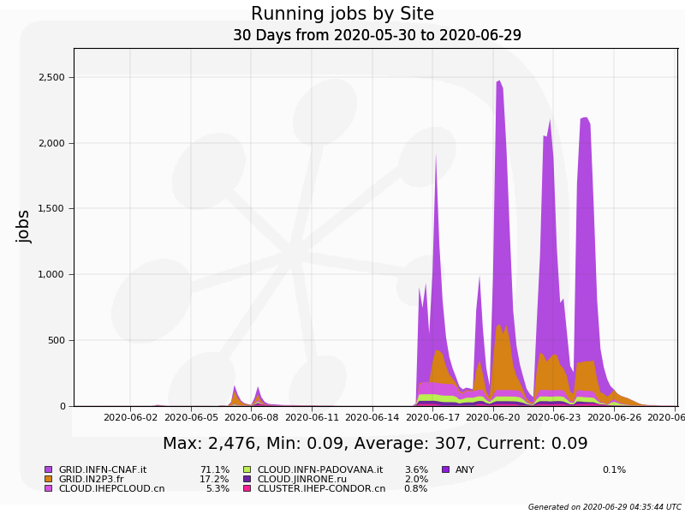
WMS (2)
Migration from CreamCE to HTCondorCE is completed
  CreamCE is going to retire before end of 2020 according to WLCG
  Two grid sites IN2P3 and CNAF are migrated successfully
WMS Status this year
  Total running job: 121K, 6 sites are joined
  Peak-time jobs: 2476, happened last week for Muon production
Notes:
Representing current resource capability can reach

Slide 7
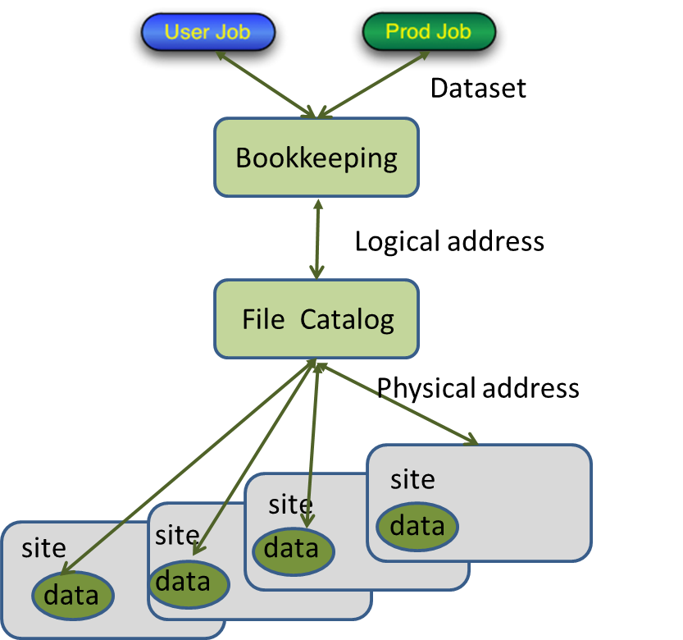
DMS (1)
Manage dataset and data files in distributed environment
Four components of JUNO DMS
  Bookkeeping provides definition of dataset to a group of files, each with logical address
  File Catalog provides a logical view and does the mapping between logical address and physical address
  File Replication System (FRS) provides a way and interface to take care of mass replications among sites
  Storage Element provides storage system with common grid interface

Slide 8
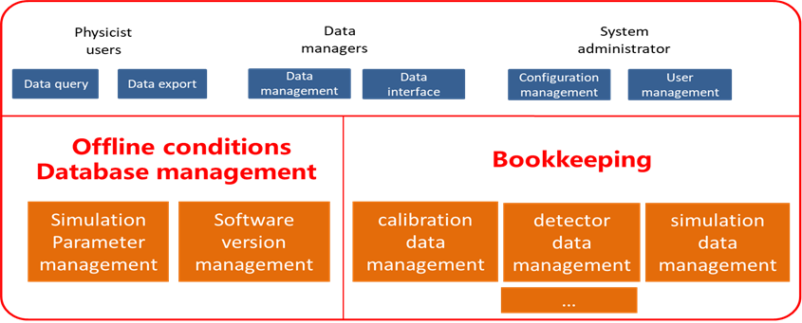
DMS (2)
Use DFC for Bookkeeping and File catalogue in current production and tests
  FC:/juno/production for production jobs
    75TB, ~13K files
  FC:/juno/user for user jobs
    17TB, ~200K files
Need to discuss and test on combination of JUNO bookkeeping and DFC

Slide 9
IHEP SE
Main SE in IHEP is StoRM with Lustre as a backend
  Currently the protocols supported: SRM, gridftp
  Plan to add support of xrootd and TPC
Next year plan to have a study on the SE based on EOS
  The EOS testbed is planned to set up next year
  The protocols to be considered: xrootd, gridftp
Current usage
  Space used: 70TB existing files: ~124K
  Plan to extend to 120TB

Slide 10
FRS and FTS
JUNO FRS has been developped based on DIRAC DMS
  File-to-File layer is using FTS3 server which has been set up in IHEP
  FRS acts as a part of JUNO PrdSys for management of dataflow
  FRS also plan to use for transfer of raw data between sites
As a transfer system, the tests have been done successfully last year which has proved its functions
  /junofs/PmtCharacterization/container_data/Measurements_DAQ/ has been transferred to JINR and CNAF
  ~11TB, >800,000 files
This year the larger scale replication with ~360TB will be carried out soon which can further understand its performance

Slide 11
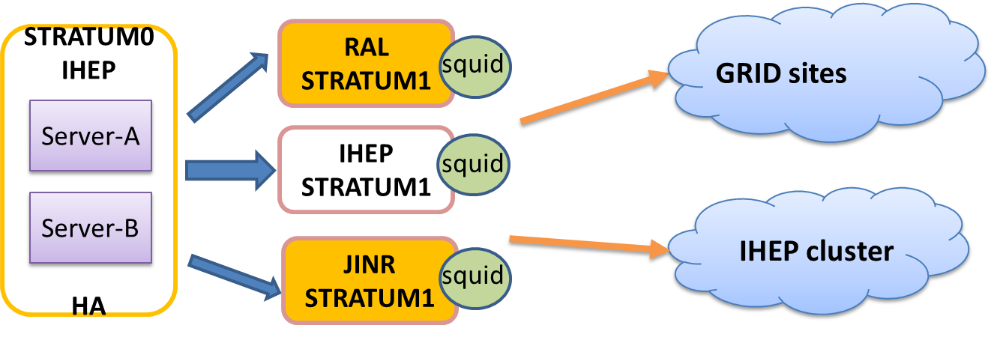
CVMFS
Server status (reliable set-up)
  CVMFS stratum0 in IHEP
  CVMFS stratum1 in RAL and JINR
  CNAF stratum1 is in plan (firewall problem)
Recent Juno software version are installed and deployed
  J19v1r0-Pre3 and J20v1r0-Pre2 are used successfully in recent production

Slide 12
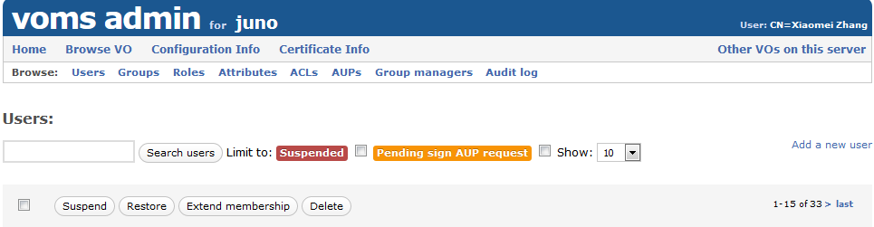
VOMS
Virtual Organization Membership Service
  Provide authentication for JUNO members to use resources in distributed environment
Main server in IHEP, mirror server in JINR
    https://voms.ihep.ac.cn:8443/voms/juno/
  https://lcgvoms02.jinr.ru:8443/voms/juno/
  Show good redundancy during May’s shutdown in IHEP
Now there are 33 members registered in VOMS

Slide 13
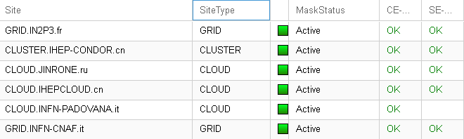
Site status
The resources integrated include Cluster, Grid and Cloud
Sites joined include IN2P3, IHEP, JINR, Padovana, CNAF
  MSU is still not available
These sites status are mostly good this year

Slide 14
CPU resource status
Resource type: HTCondor/HTCondorCE, OpenNebula, OpenStack
Sites (cores) | Normal | Resource type | Memory/core
CNAF | 300 | HTCondorCE | 3.5GB
IN2P3 | 200 | HTCondorCE | 4GB
JINR* | 2000 | OpenNebula/HTCondorCE | 4GB->16GB
Padovana | 100 | OpenStack | 4GB
IHEP* | 200 | OpenStack/HTCondor/HTCondorCE | 2.5~3.5GB
Total | 2800
*JINR newly added 2000 in OpenNebula, not tested yet. Plan to move to HTCondorCE when it is ready
*IHEP is in plan to add more resources with HTCondor or HTCondorCE

Slide 15
SE status
Main SE(Storage Element) types: dCache, StoRM,EOS
Sites (TB) | Total space | Space left | Resource type | Protocol supported
CNAF | 270 | 60 | StoRM | SRM,gridftp
IN2P3 | 44 | 30 | dCache | SRM,gridftp Xrootd
JINR | 25+600 | 13+115 | dCache+EOS | dCache: SRM, gridftp EOS: xrootd, http, gridftp
IHEP* | 120 | 60 | StoRM | SRM,gridftp
Total | 1059 | 278
*IHEP plans to add 1PB storage next year

Slide 16
JUNO production system
Notes:
Integrate all the subsystem as a whole to manage JUNO production workflow and dataflow which is required by JUNO production

Slide 17
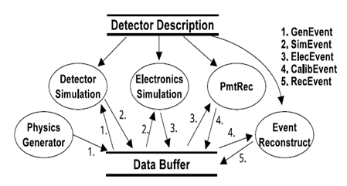
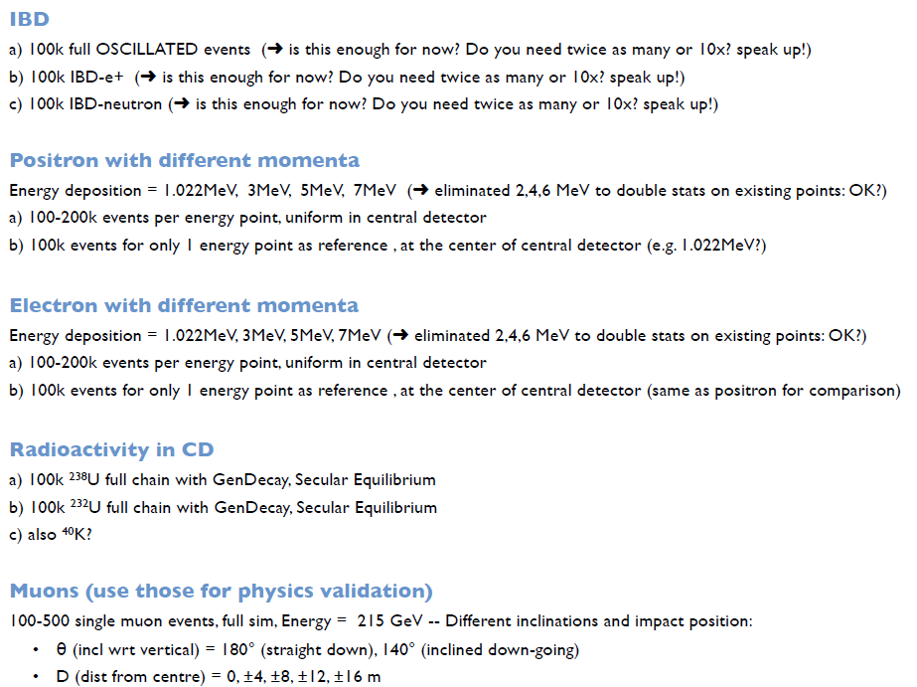
JUNO production
Data processing includes five steps
  Physics Generator (PhyGen)
  Detector Simulation (DetSim)
  Electronics Simulation (EleSim)
  PMT Reconstruction (PmtRec/Cal)
  Event Reconstruction(EvtRec)
Mass production includes large samples of physical processes (IBD*, bkgs, single particles….) with different momenta
  Each sample includes four data processing interconnected with data
  Hard to manage all these by hand in distributed environment
*IBD: Inverse Beta Decay

Slide 18

PrdSys (1)
Goals
  Manage mass workflow and dataflow automatically
  Provide ways and interface for prod groups to manage production tasks
JUNO Production System is built on DIRAC system which
  Provides a framework to chain production workflow and dataflow in an automatic data-driven way
  Closely integrates with DIRAC WMS and DMS, and submit jobs and data transfer tasks seamlessly to the related services
Prod group
Define/Submit/Control production tasks
PrdSys
Split/Create/Assign workflow and dataflow
Transformation
jobs
data
WMS
DMS
DIRAC
JUNO Resources
Notes:
DIRAC transformation system makes jobs easier

Slide 19
PrdSys (2)
JUNO production task is composed of a chain of workflow and dataflow
  Workflow: detsim, elecsim, cal, rec
  Dataflow: upload/download, replicate
  Each workflow is defined as an action module
  Input and output data registered in DFC (Dirac File Catalogue)
  Execution of modules are triggered by availability of input data in DFC
  Except Detsim module which is started with number of jobs defined in the steering file
detsim
detsim
data
elecsim
elecsim
data
cal
cal
data
rec
rec
data
DFC

Slide 20
PrdSys (3)
  Dataflow is connected to workflow seamlessly with input data query
    If moved to Rucio, much more complicated here if DIRAC and Rucio is not closely integrated
  The procedure of dataflow
    Output data of each modules is uploaded to the closest SE
    Then replicate from local SE to destination SE automatically
detsim
detsim
data
elecsim
elecsim
data
cal
cal
data
rec
rec
data
Closest SE
replicate
replicate
replicate
replicate
Final SE
IHEP
Others

Slide 21
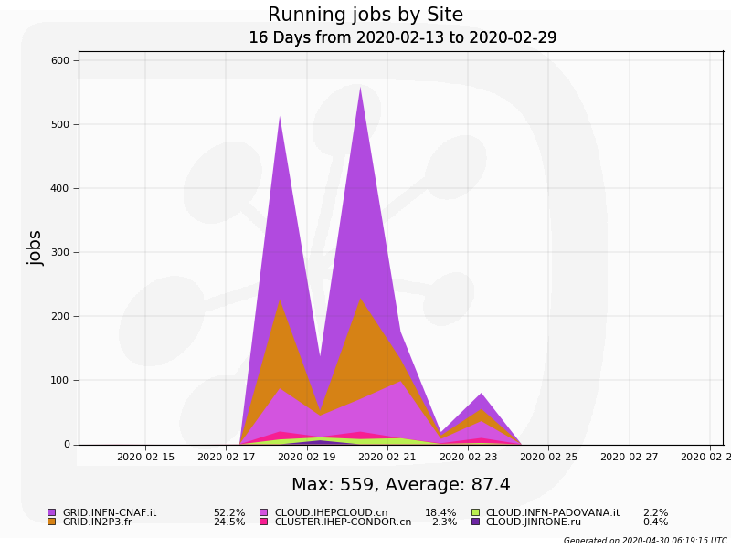
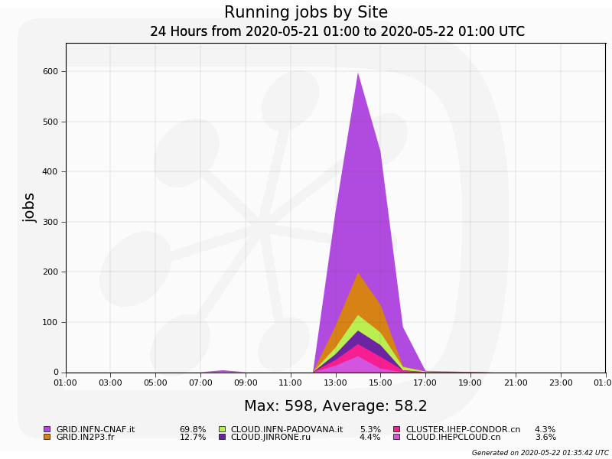
Use PrdSys in JUNO production (1)
Three productions have been done by PrdSys in 2020
  1st ML request: e- and e+ samples
    >10M events, 16TB produced on Feb.17~ 25
  2nd ML request: e-, e+, alpha, gamma fixed-energy & fixed-position samples
    ~120K events, ~338GB produced on May 21~22
  Both productions are quite successful with >99% success rate

Slide 22
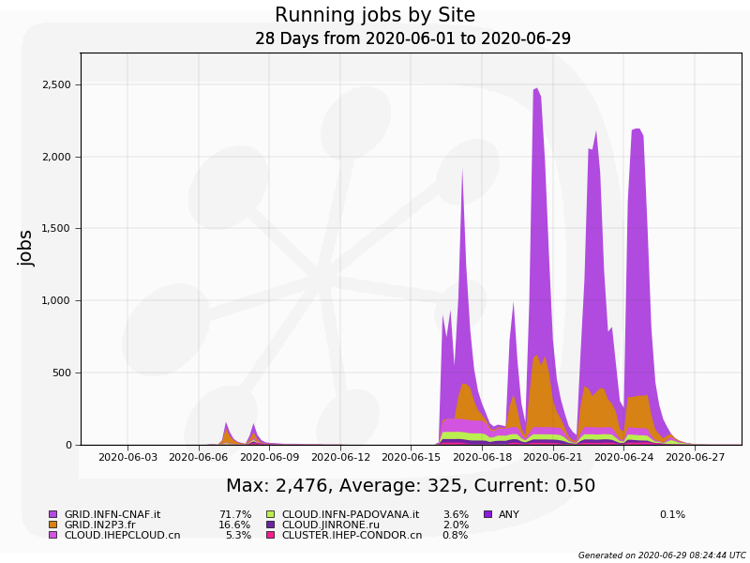
Use PrdSys in JUNO production (2)
Large scale production of muon
  Started mid June 2020, more difficult because of uneven producing time and memory
  So far 6 groups are submitted and produced
    Two groups with 300 events, four groups with 10K events
    Problems met: In2p3 site maintenance, cloud memory problem, high-memory requirements
    After the first two problems are fixed, failure rate reduced to 0.05%
300 events 2 group
10K events 4 group

Slide 23
Use PrdSys in JUNO production (3)
    Solution: All the failed jobs are collected to rerun in high-memory clusters
More details of the production and test plans is in the talk “JUNO DCI challenges”
Plans
  Make Muon production more convenient
    eg. set up high memory queues in DCI
  Work closely with JUNO production group
    DCI group to understand more requirements from MC simulation and validation
    JUNO production group to use the submission tool and interface

Slide 24
Review reports and actions
Notes:
Integrate all the subsystem as a whole to meet the requirements of JUNO production

Slide 25
Review reports (1)
The Committee recommends IHEP data center, in collaboration with the JUNO online group, during the year 2020, to test at medium scale, the reliability of the system and its ability to fulfill the requirement of the JUNO Computing Model. It is recommended also to perform challenge tests during development and deployment period
  Distributed computing group plans to have three chanllenge tests on poduction and transfer in 2020 and more before data taking periods
  Besides tests, DCI has already had and will have taken centain scale production and transfer tasks which can prove the reliability of system to a centain extent
    See the slides 9, 20,21 and also in “DCI challenges” reports

Slide 26
2020 Data challenges
Goals:
  Prove reliability of the system and understand bottleneck of the whole system
  Know if functions are ready to meet physics requirements and fulfill computing model although
Three tests are planned this year
  For jobs and replications, will fully discuss with offline and physics group and choose proper production tasks
  For resources, had first survey
  of available resource with sites,
  will inform sites weeks ahead
Sites | CPU (cores) | Total space(TB) | Space Left(TB)
CNAF | 500 | 270 | 60
IN2P3 | 1600 | 44 | 30
JINR | 2000 | 625 | 128
IHEP | 500 | 120 | 60
Total | 3600 | 1059 | 278

Slide 27
Review reports (2)
The Committee recommends to detail the roles of the different data centers, including the list of the services to be provided. Also the SLA of these services should be defined. ( Tier0 and the Tier1 are supposed to act as custodial sites for the raw data )
  Start from WLCG SLA
  Cannot have SLA without MoU
  Draft of MoU is just started

Slide 28
Computing model status
IHEP and Europe
  Hold a complete set of data in China and Europe
  In Europe, CNAF and JINR can hold a complete set of data
Raw data flow
  IHEP->CNAF
  CNAF->JINR, IN2P3
MC official production will be first considered in DCI
  MC jobs -> CNAF, JINR, IHEP, MSU, IN2P3, other sites
  MC data -> CNAF, JINR, IHEP
Now all the main central services are in IHEP
  JINR hold stratum1 server and VOMS mirror server
Other services deployment in sites need to be discussed
This will be more clear after MoU and SLA come out
IN2P3
IHEP
JINR
MSU
CNAF
CNAF

Slide 29
Review reports(3)
The Committee recommends to make efforts to ensure the coherent development of the sub-systems and their proper integration
  PrdSys (see slide 16, 17, 18) is a system integrating workflow and dataflow components to fulfill the need of JUNO production
  Recent productions (seen the slides 9, 20,21) using prdsys which well shows the coherence of the subsystems, almost going through all the subsystems
The Committee recommends to take formal steps to join LHCONE network
  In progress, see Giuseppe’s report on LHCONE

Slide 30
Review report(4)
The Committee recommends to follow the evolution of RUCIO as an alternative to DIRAC Data Management ( RUCIO is becoming the most adopted solution )
  Currently lack of man power for RUCIO
  DIRAC Data Management System has proved working well in current production
  DIRAC-RUCIO integration is still in progress, not so near, it is the right time to use it in current system
  But we can start looking into it, can have a testbed to start as soon as manpower is available

Slide 31
Review report(5)
The Committee recommends to prepare and implement a plan to have the maximum redundancy of DIRAC
  Two servers are being purchased in IHEP to start studying on that
  Xiaofei in IHEP computing center started to study on that
  Need people from sites working on deployment and maintaintenance
The Committee recommends to follow the development in WLCG in order to profit of them
  Done: migration to HTCondorCE
  To do: (looking for manpower)
    SRM, Gridftp-> Xrootd, http, tpc
    Study on IAM for future authentication
    More....
  Suggest to create a subgroup advising on news from WLCG

Slide 32
Summary
The JUNO distributed computing system is working
  Services and sites status are good
  PrdSys was successfully applied in recent production cases
Data challenge tests are in plan to prove functions and robustness
Progress has been made to the recommendation in review reports
Looking for manpower on RUCIO, DIRAC redundancy, IAM, EOS/StoRM SE

