Slide 1
A precise study of the radiative decays of $Υ$ into charmonium
Reporter : Dandan Shen
Supervisor: Ruilin Zhu
Nanjing Normal University
PQCD group meeting 2020
2020-8-15
Notes:
更多模板请关注：https://haosc.taobao.com

Slide 2
1
Introduction
2
Experimental and theoretical study
CONTENTS
3
Research method
4
Results
5
Summary
2020-8-15

Slide 3
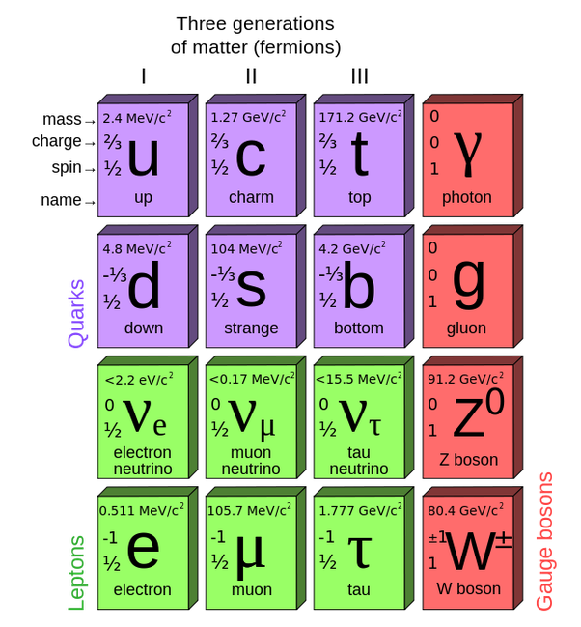
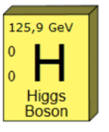
Part 1: Introduction
Standard Model
Hadron typical scale
$Λ_{QCD}≈200MeV$
Light quark flavor
up, down, strange
Heavy quark flavor
charm, bottom, top

Slide 4
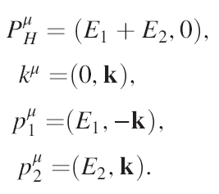
Part 1:Introduction
Heavy quarkonium and Bc mesons properties :
1)Composed of two heavy quarks.
Both bottomonium($b\overline{b}$) and charmonium($c\overline{c}$) are made of heavy quark and heavy antiquark, and are nonrelativistic bound states.
Bc meson is treated in two ways: a nonrelativistic bound state or a heavy-light meson.
2)The quark relative velocity is small.

Slide 5
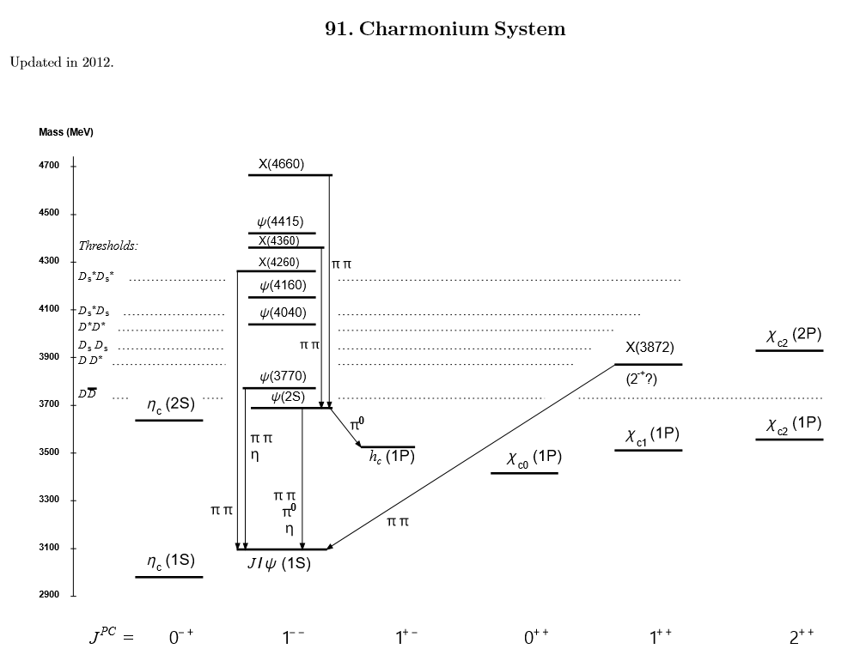
Part 1:Introduction
PDG2018

Slide 6
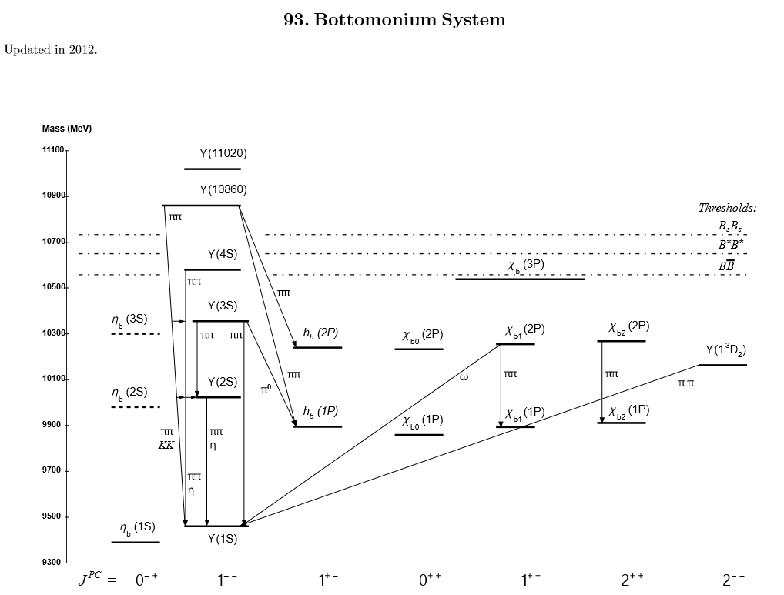
Part 1:Introduction
PDG2018

Slide 7
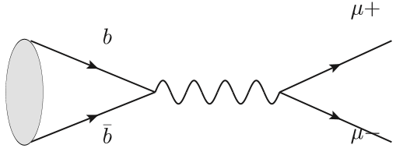
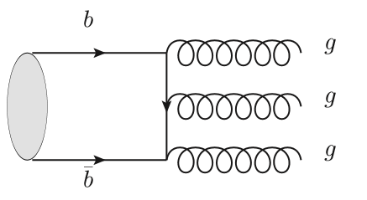
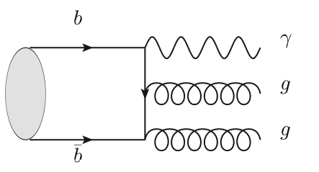
Part 1:Introduction
$Υ$ main decay modes:
PDG2018
双轻子道占7.46±0.26%
辐射衰变分支比2.2±0.6%
强衰变分支比81.7±0.7%
双轻子道占7.46±0.26% 强衰变分支比81.7±0.7% 辐射衰变分支比2.2±0.6%

Slide 8
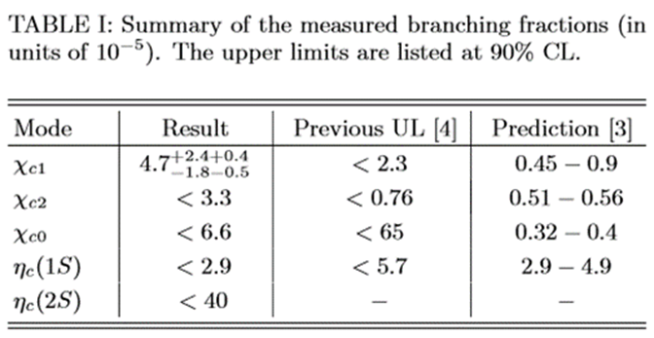
Part 1:Introduction
$Υ$ radiative decays:
PDG2018
Belle Collaboration
(Phys.Rev.Lett. 124 (2020) 12,122001)

Slide 9
Part 1:Introduction
NRQCD effective theory is a powerful framework to calculate the production cross section and the decay rate of heavy quarkonium.
Within the framework of NRQCD, the decay width for a quarkonium state H can be expressed as a sum of terms, each of which factors into a short-distance coefficient and a long-distance matrix element:
——Phys.Rev.D 55(1997) 5853 (Geoffrey T.Bodwin et al)

Slide 10
Part 2:Experimental and theoretical study
In 2019 year, the Belle Collaboration measures the Upsilon decays (Phys.Rev.Lett. 124 (2020) 12,122001): (greatly larger than theoretical predictions)
In 2007 year, Kuang-Ta Chao et al gave theoretical predictions (arxiv:hep-ph/0701009v2)：

Slide 11
Part 3:Research method
Create the topologies
Insert fields
Apply the Feynaman rules
Paint the diagrams
Diagram
generation
Feynarts
Contract indices
Calculate traces
Reduce tensor integrals
Introduce abbreviations
Algebraic
simplification
FeynCalc
Numerical evaluation
Implementation of the loop integrals
Fiesta

Slide 12
Part 3:Research method
$Υ→η_{c}+γ$ and $Υ→χ_{cJ}+γ$, J=0,1,2 Feynman diagram
$$(η_{c})$$
$$(η_{c})$$
$$Υ$$
$$χ_{cJ} (η_{c})$$
$$Υ$$
$$χ_{cJ} (η_{c})$$

Slide 13
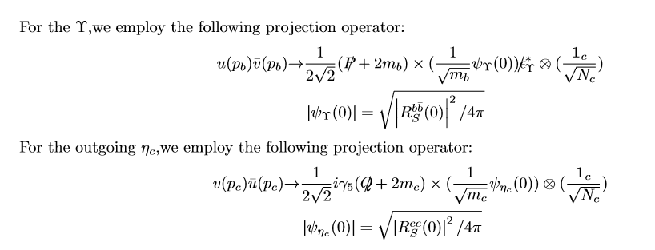
Part 3:Research method
S wave
$$1.Υ→η_{c}+γ$$
Regardless of the relative velocity:

Slide 14
Part 3:Research method
Considering relative velocity,the corresponding projection operators are:
Nuclear Physics B 931 (2018) 359-382 (Ruilin Zhu)

Slide 15
Part 3:Research method
relativistic correction:
The relativistic corrections to the form factors shall be separated into two parts, since there are two bound states, i.e. a charmonium and a bottomonium which are composed of heavy quark and heavy antiquark.
To get the relativistic corrections to the form factors of $Υ$ into S-wave charmonium, one may perform the Taylor expansion of the amplitudes in powers of $k^{μ}$:
Physical Review D.95.094012(2017) (Ruilin Zhu et al)

Slide 16
Part 3:Research method
P wave
$2.Υ→χ_{cJ}+γ$, J=0,1,2
The corresponding projection operators are:
Nuclear Physics B 931 (2018) 359-382 (Ruilin Zhu)

Slide 17
Part 3:Research method

Slide 18
Part 3:Research method
Physical Review D.69(2004) 054009 (Zhong-Zhi Song et al)

Slide 19
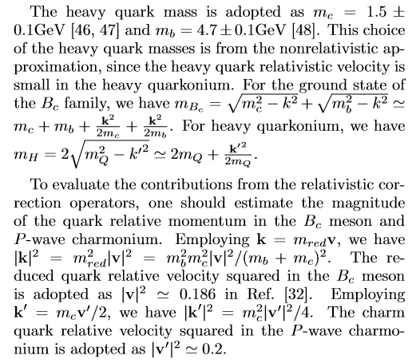
Part 3: Research method
Selection of input parameters: heavy quark mass and heavy quark relativistic velocity
$v^{2}≈0.1$ for the bottomonium
$v^{2}≈0.3$ for the charmonium

Slide 20
Part 4:Results

Slide 21
Part 4: Results
Form factor of $Υ$ decays into S-wave charmonium $η_{c}$
Tree diagram
a=
）
r=mc/mb
（
the relativistic corrections :
aQED2c=
（
）
aQED2b=
（
）

Slide 22
Part 4: Results
Form factor of $Υ$ decays into S-wave charmonium $η_{c}$
Loop diagram
a=
（
）
the relativistic corrections :
aQCD2c=

Slide 23
Part 4: Results
aQCD2b=

Slide 24
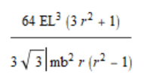
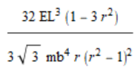
Part 4: Results
Form factor of $Υ$ decays into P-wave charmonium $χ_{c0}$
Tree diagram
b=
）
（
c=
（
）
Loop diagram
b=

Slide 25
Part 4: Results
c=
$Υ→χ_{c1}+γ$, …
$Υ→χ_{c2}+γ$, …

Slide 26
Part 4: Results
Numberical result:
$Υ→η_{c}+γ$
mb=4.67,mc=1.44
The Belle Collaboration (Phys.Rev.Lett. 124 (2020) 12,122001)

Slide 27
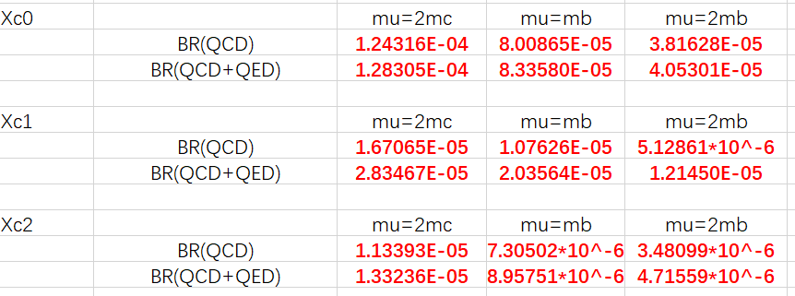
Part 4:Results
$Υ→χ_{cJ}+γ$, J=0,1,2
mb=4.67,mc=1.56
The Belle Collaboration (Phys.Rev.Lett. 124 (2020) 12,122001)

Slide 28
Part 5: Summary
Under the theoretical framework of NRQCD, the decay branching ratio of $Υ→η_{c}+γ$ and $Υ→χ_{cJ}+γ$, J=0,1,2 are calculated by factorized
When the energy scale is mb,the results consistent with the experiment
More precise calculation and model-independent determination are needed to understand the anomalies

Slide 29
Thanks

