Slide 1

Based on Phys.Rev. D101, 111901(R) (2020)
Contributions of $K^{+}K^{−}$ from resonances ρ and ω for
the ${B^{±}⟶π^{±}K}^{+}K^{−}$ decays
Wang Wen-Fei
PQCD Group Meeting
2020-08-14

Slide 2


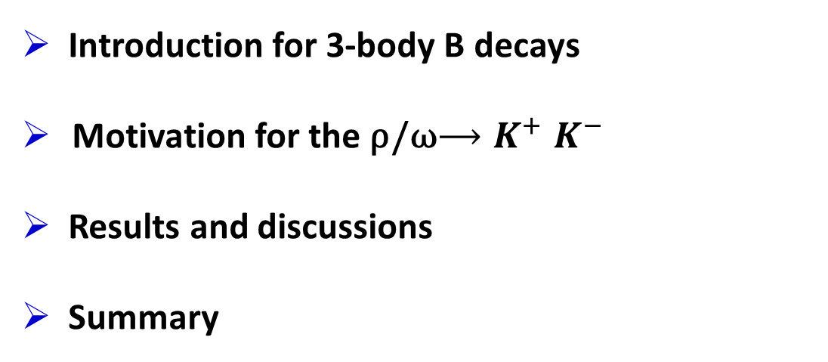
Outline
Introduction for 3-body B decays
Motivation for the ρ/ω${⟶K}^{+}K^{−}$
Results and discussions
Summary

Slide 3
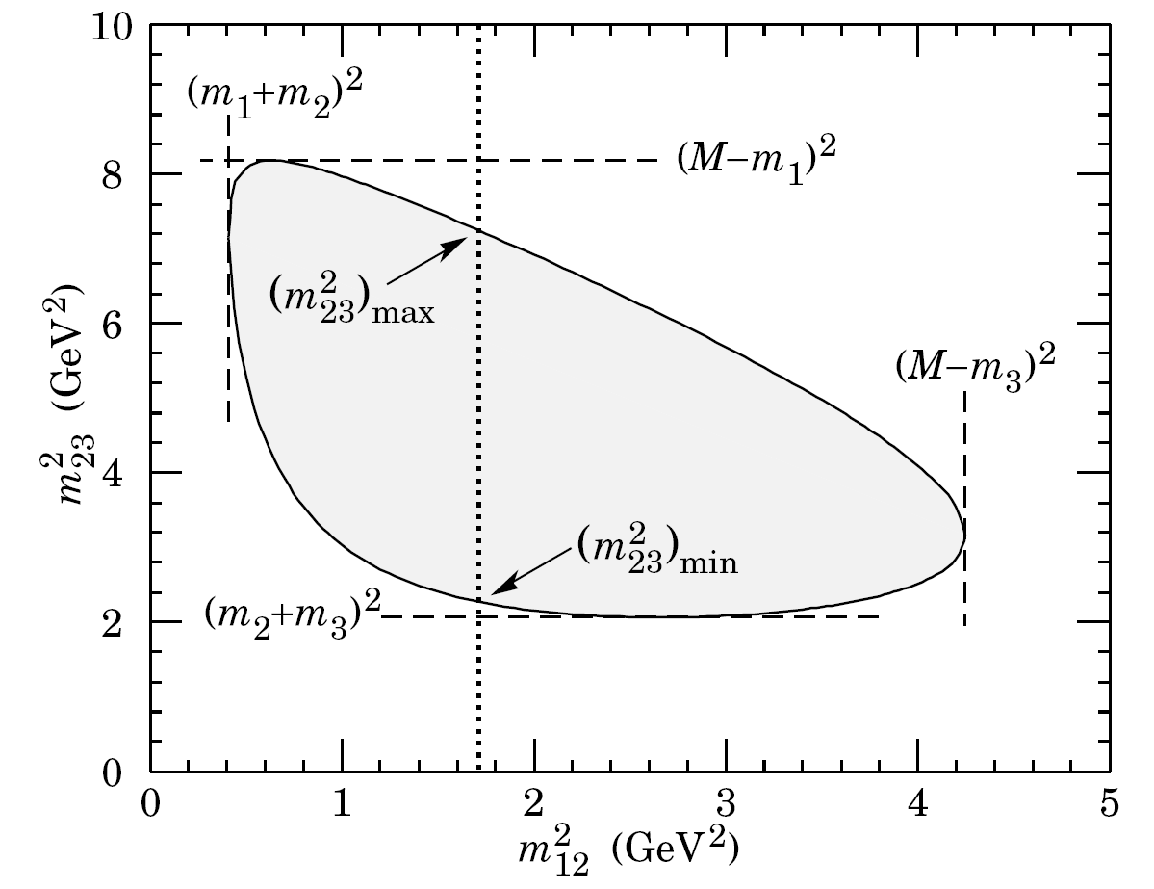
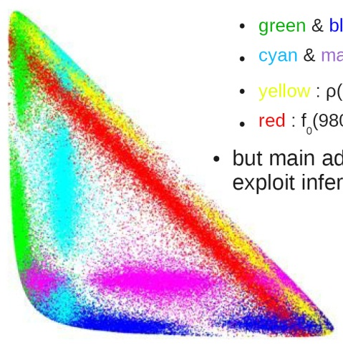
Introduction for 3-body B decays
1
Dalitz Plot

Slide 4
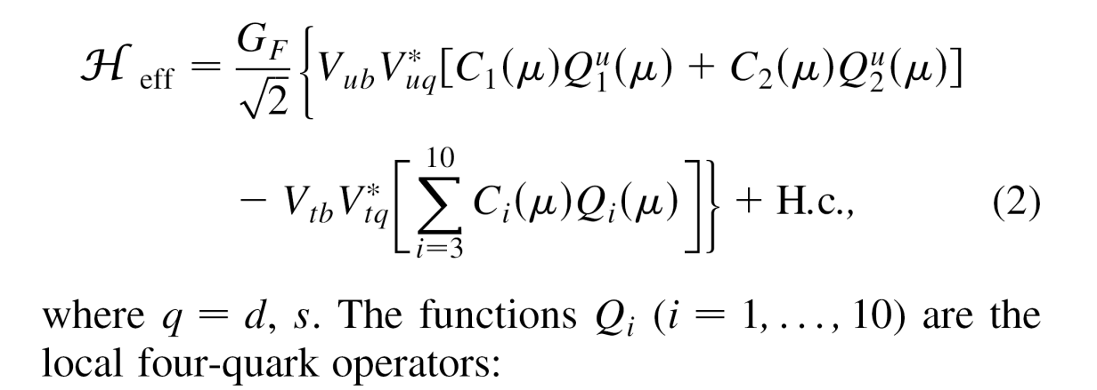
Introduction for 3-body B decays
2
The weak effective Hamiltonian:
1.
Then what about the other strong interactions?
......
2.

Slide 5
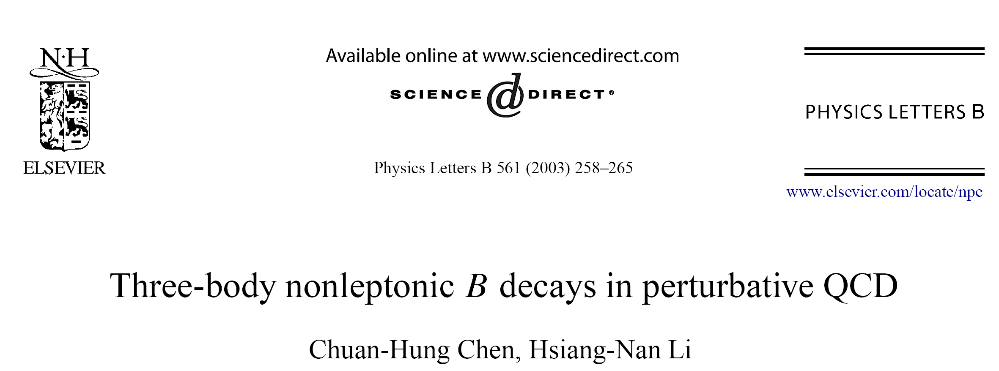
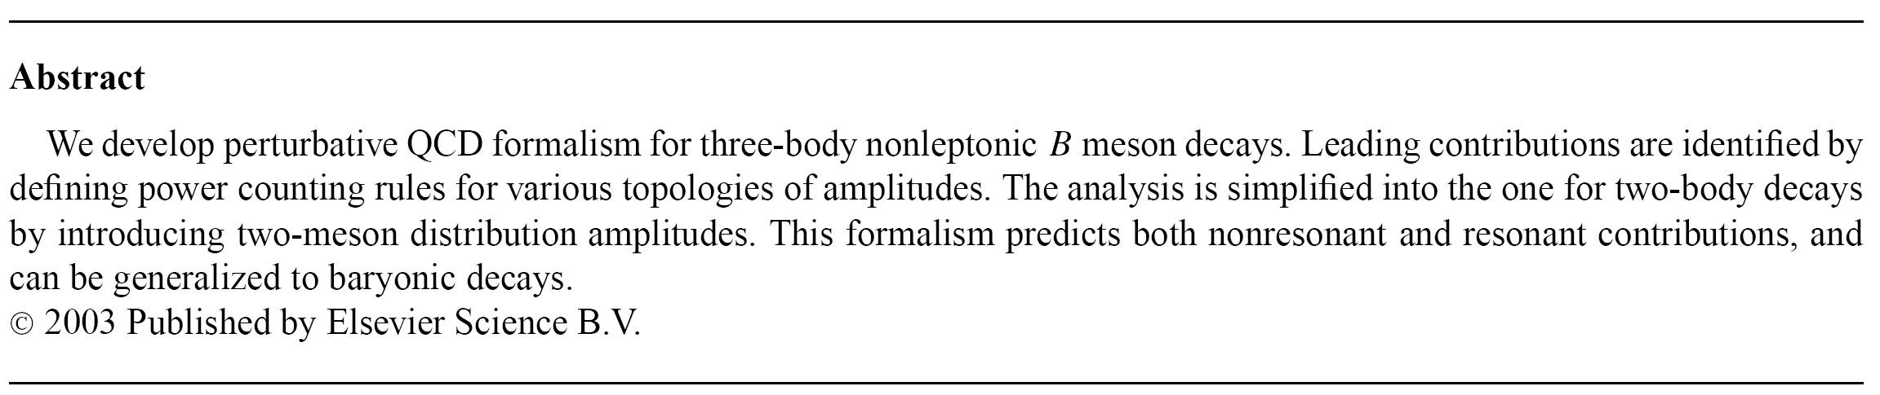
Introduction for 3-body B decays
3

Slide 6
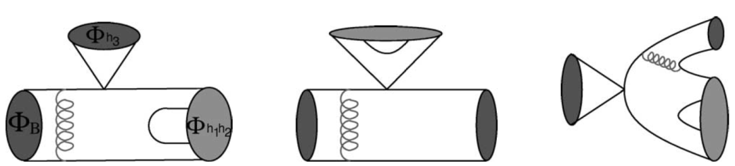
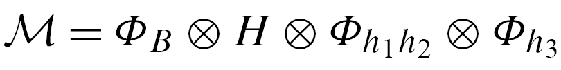
Introduction for 3-body B decays
4

Slide 7
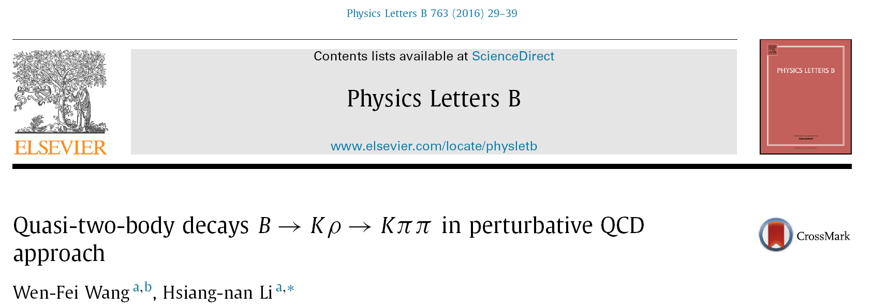
Introduction for 3-body B decays
5

Slide 8
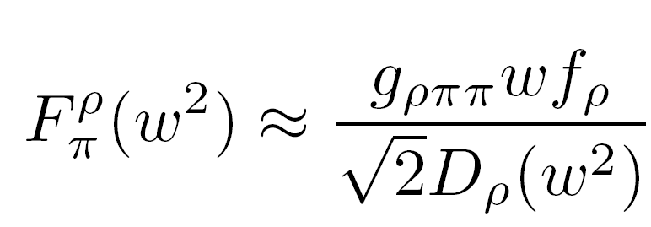
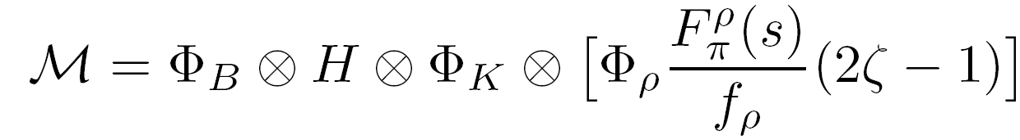
Introduction for 3-body B decays
6

Slide 9
Introduction for 3-body B decays
7

Slide 10
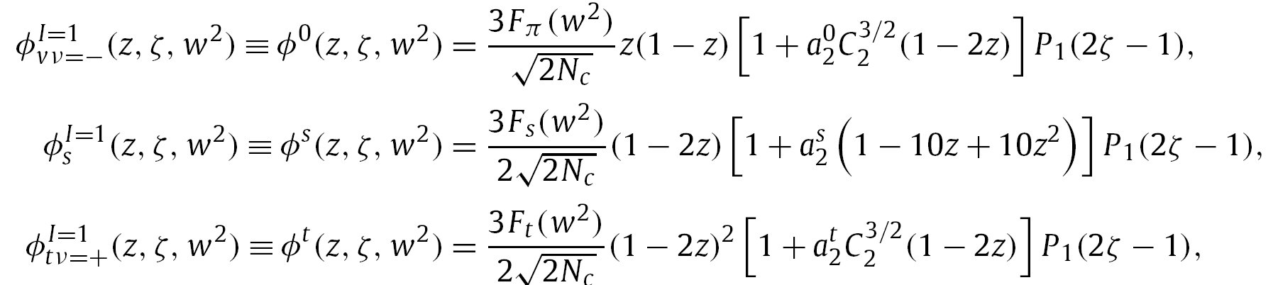
Introduction for 3-body B decays
8

Slide 11
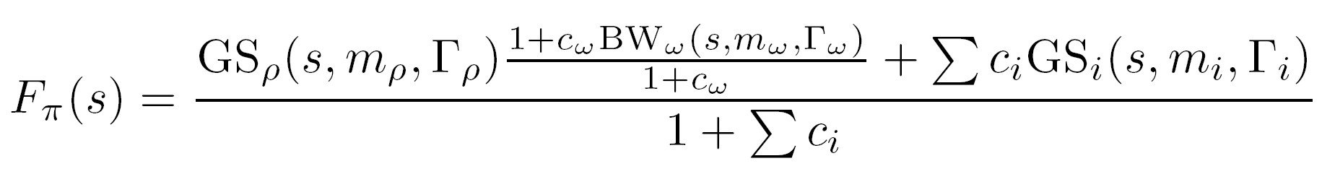
Introduction for 3-body B decays
9
G. Gounaris, J.J. Sakurai
PRL21-244(1968)

Slide 12



Introduction for 3-body B decays
10

Slide 13
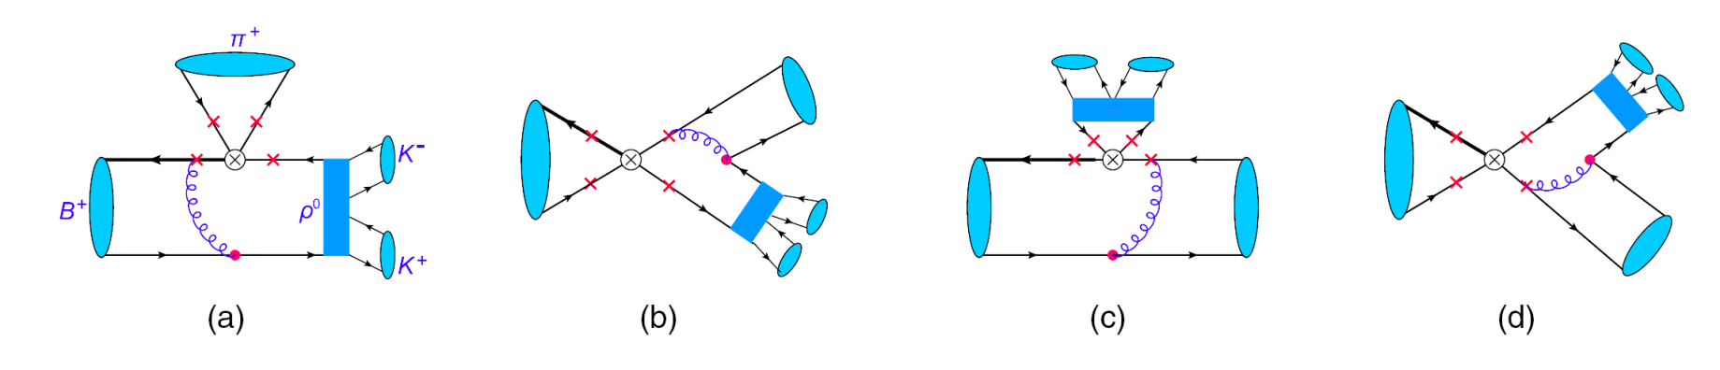
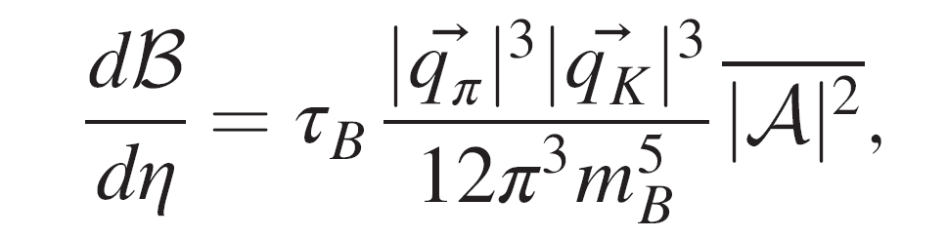
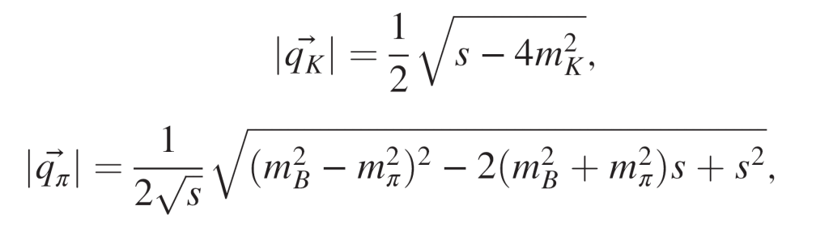
Introduction for 3-body B decays
11
2.
1.
In the rest frame
of KK pair !

Slide 14
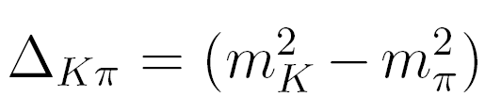
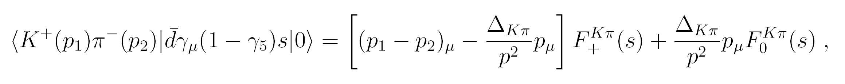

Introduction for 3-body B decays
12
2.

Slide 15
Introduction for 3-body B decays
13
2.
S-wave: PLB730(2014)336
JHEP03(2020)162

Slide 16
Introduction for 3-body B decays
14
2.

Slide 17
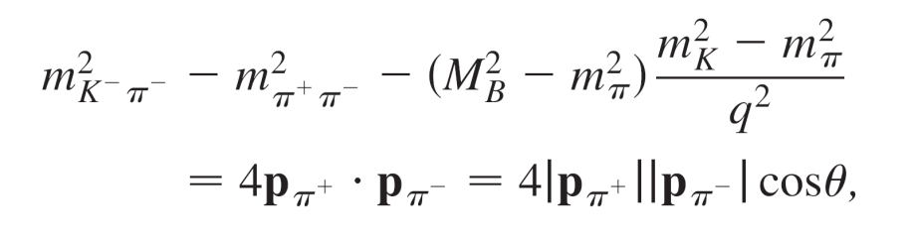

Introduction for 3-body B decays
15
2.

Slide 18
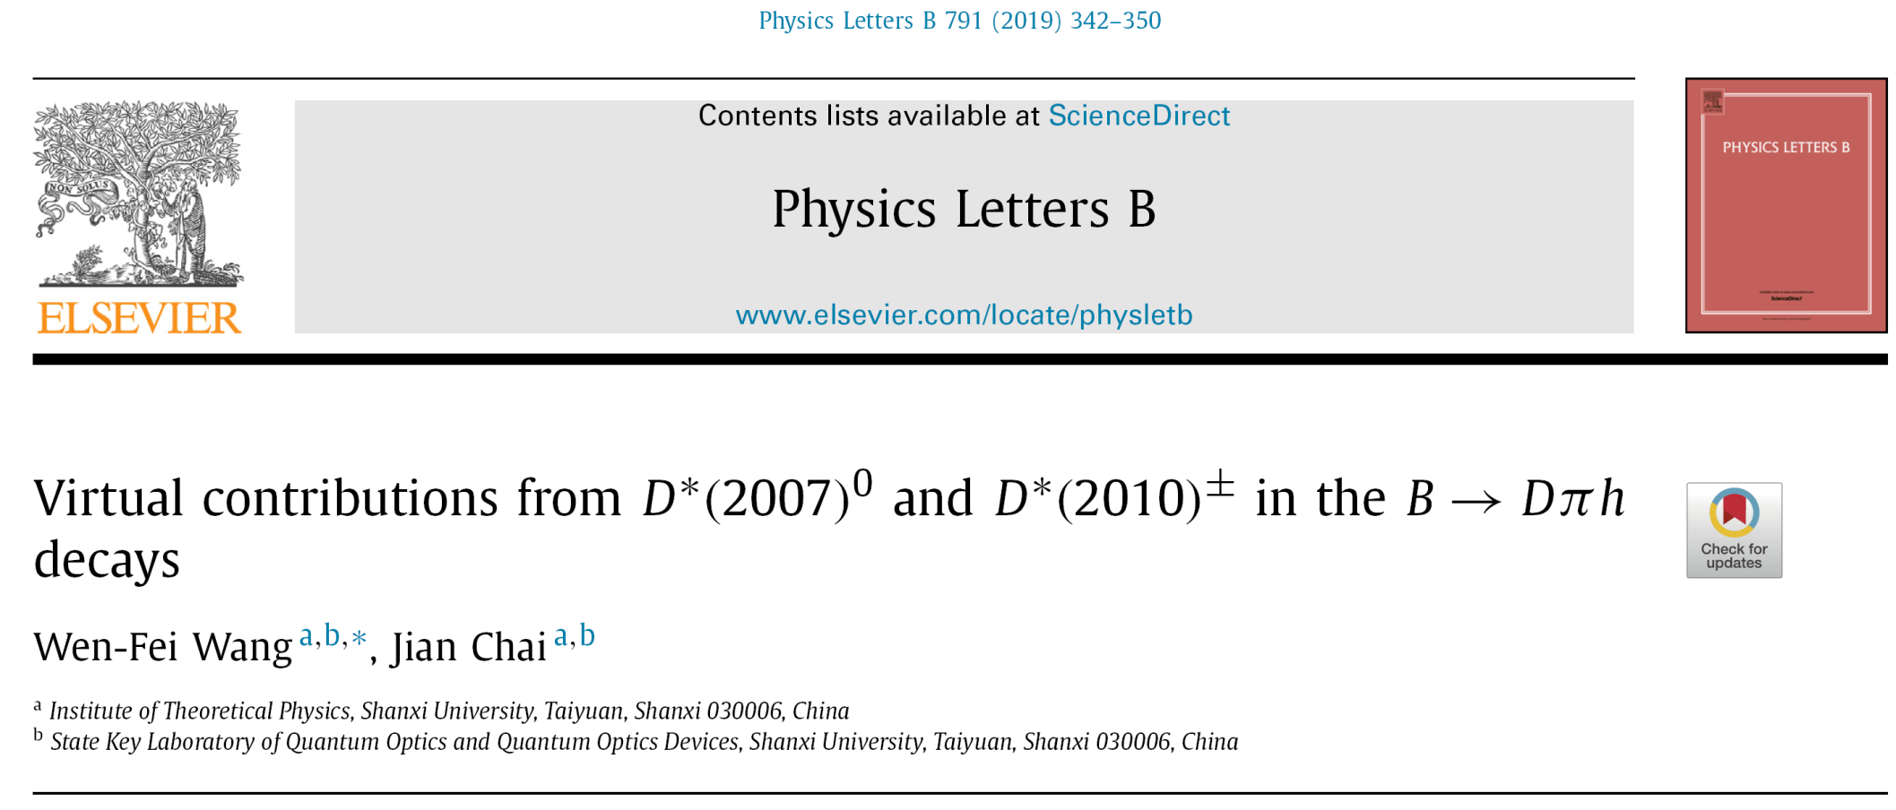
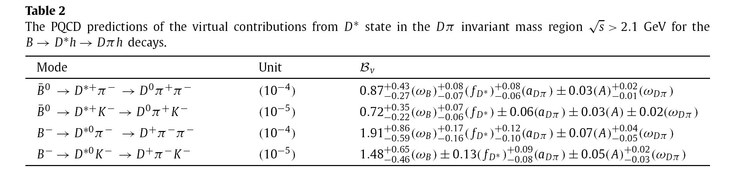

Motivation for the ρ/ω${⟶K}^{+}K^{−}$
16

Slide 19
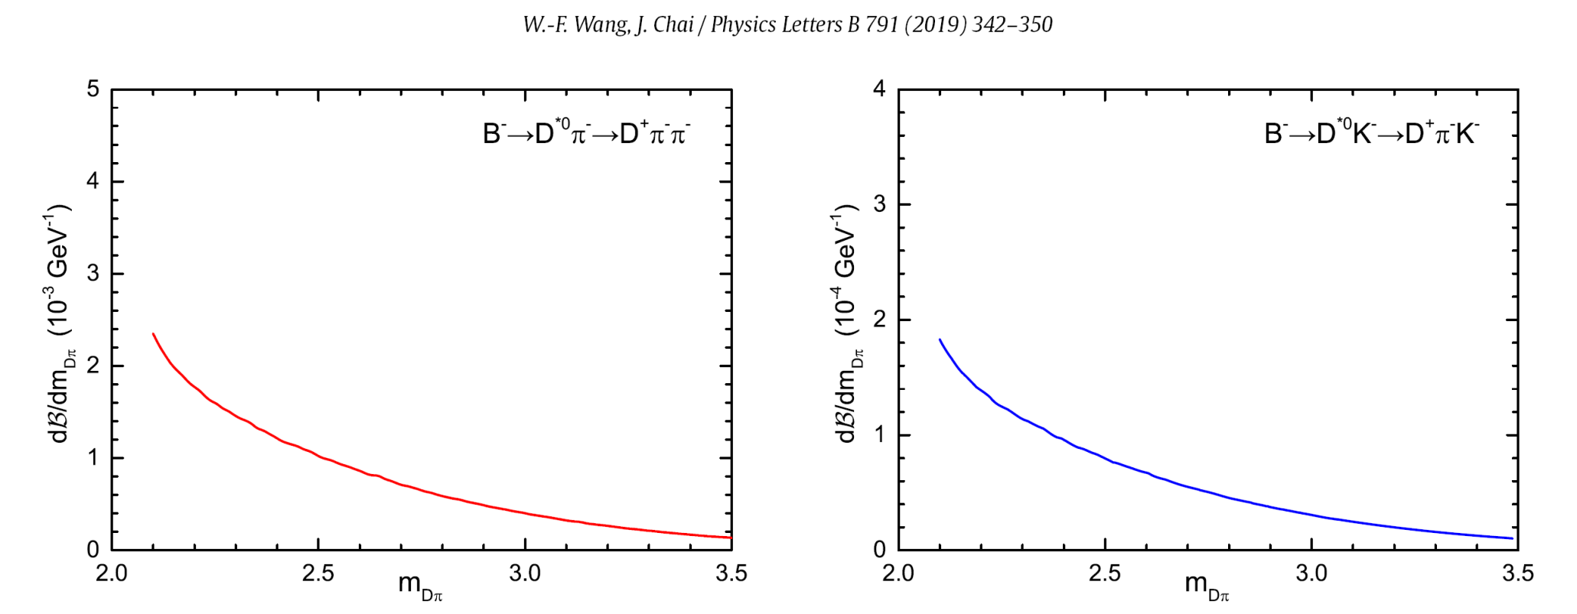
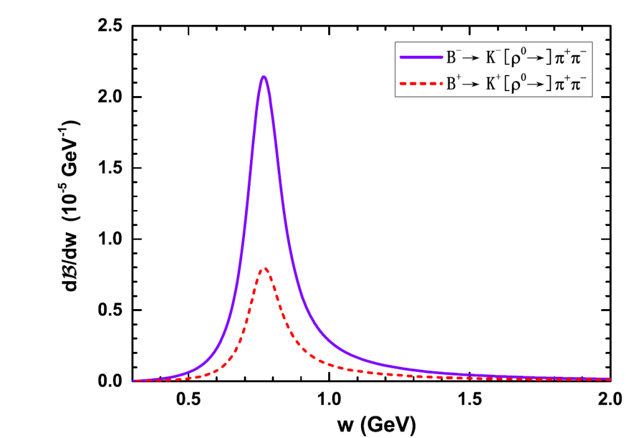
Motivation for the ρ/ω${⟶K}^{+}K^{−}$
17
KK pair threshold

Slide 20
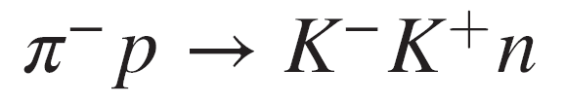
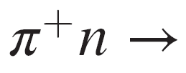
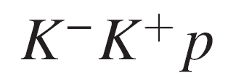
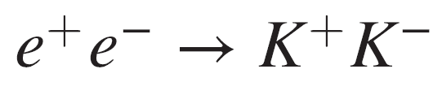


Motivation for the ρ/ω${⟶K}^{+}K^{−}$
18
ρ(770,1450) ${⟶π}^{+}π^{−}$
ρ/ω${⟶K}^{+}K^{−}$
? !

Slide 21
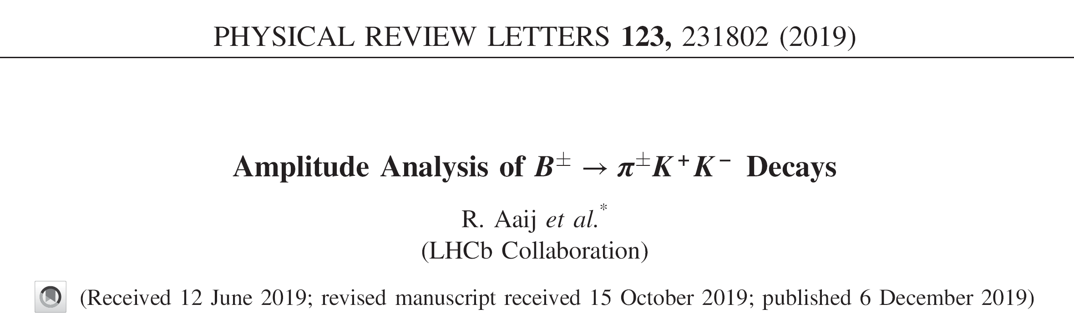
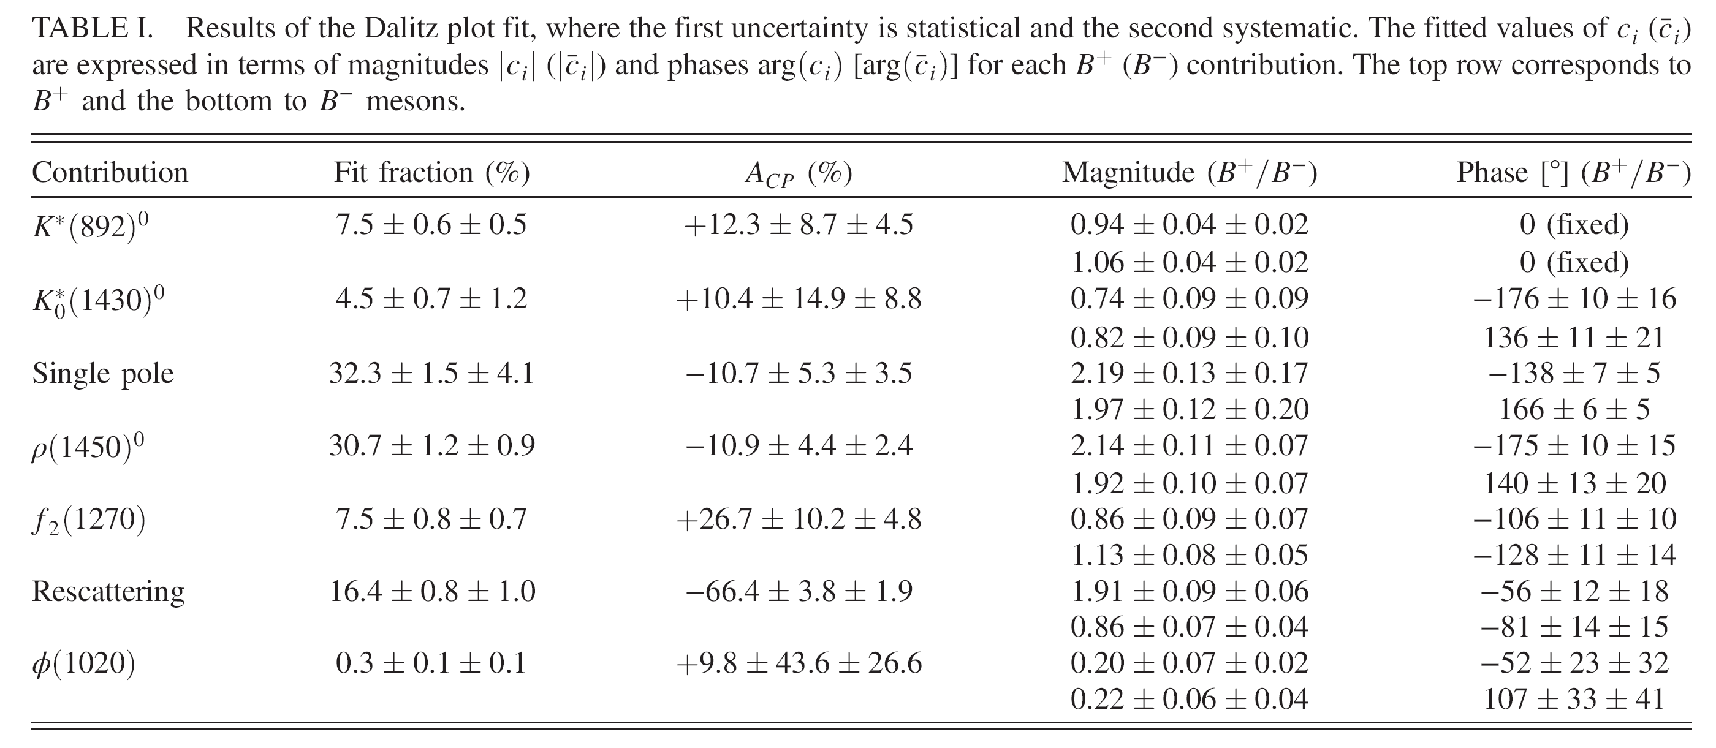
Motivation for the ρ/ω${⟶K}^{+}K^{−}$
19

Slide 22
Motivation for the ρ/ω${⟶K}^{+}K^{−}$
20
PDG2020

Slide 23
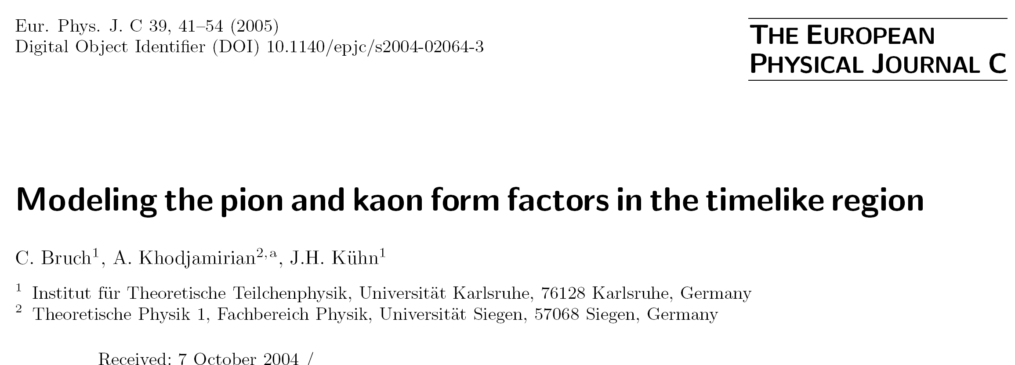
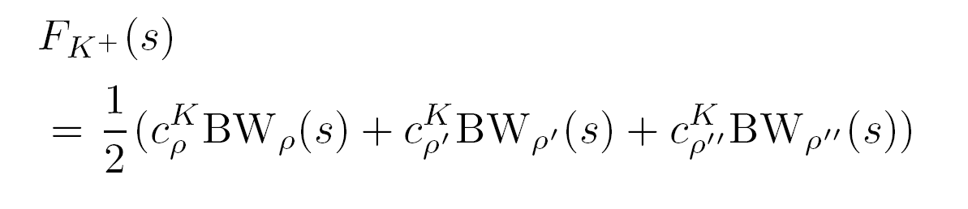
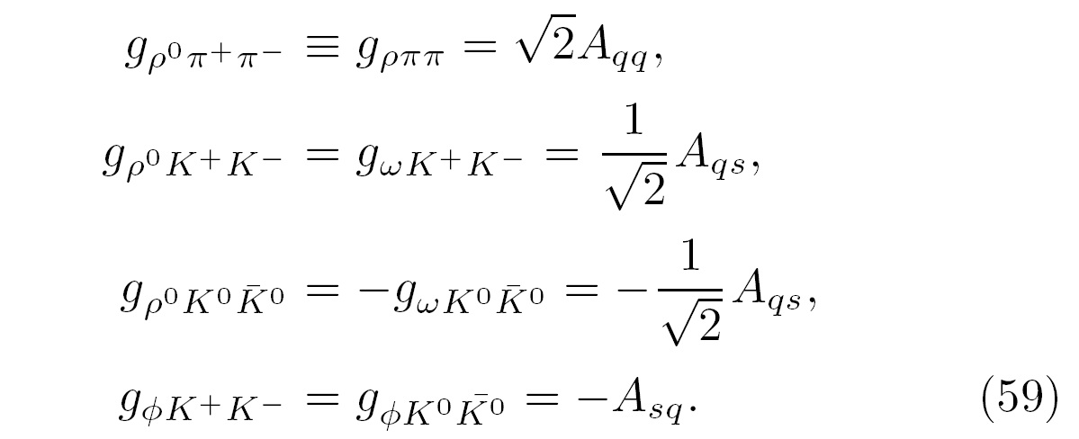
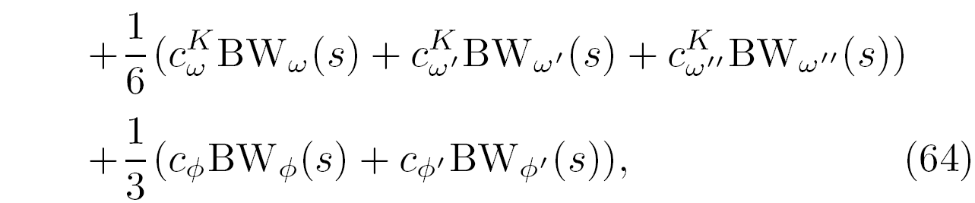
Motivation for the ρ/ω${⟶K}^{+}K^{−}$
21

Slide 24
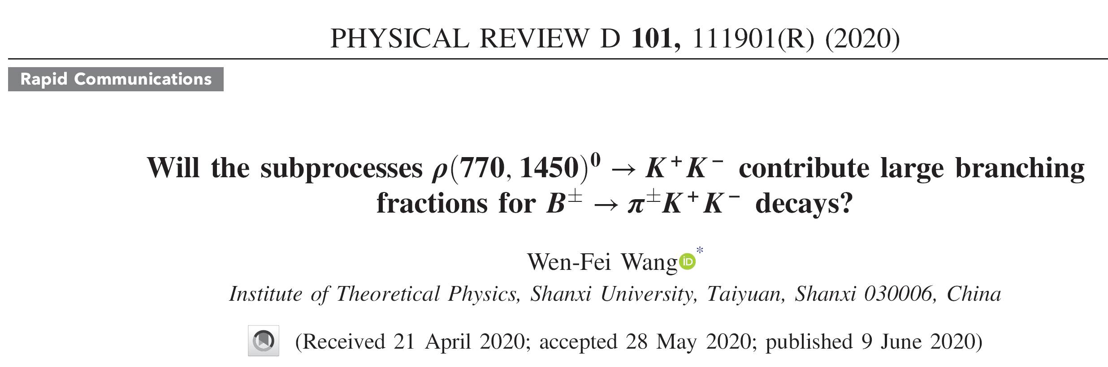
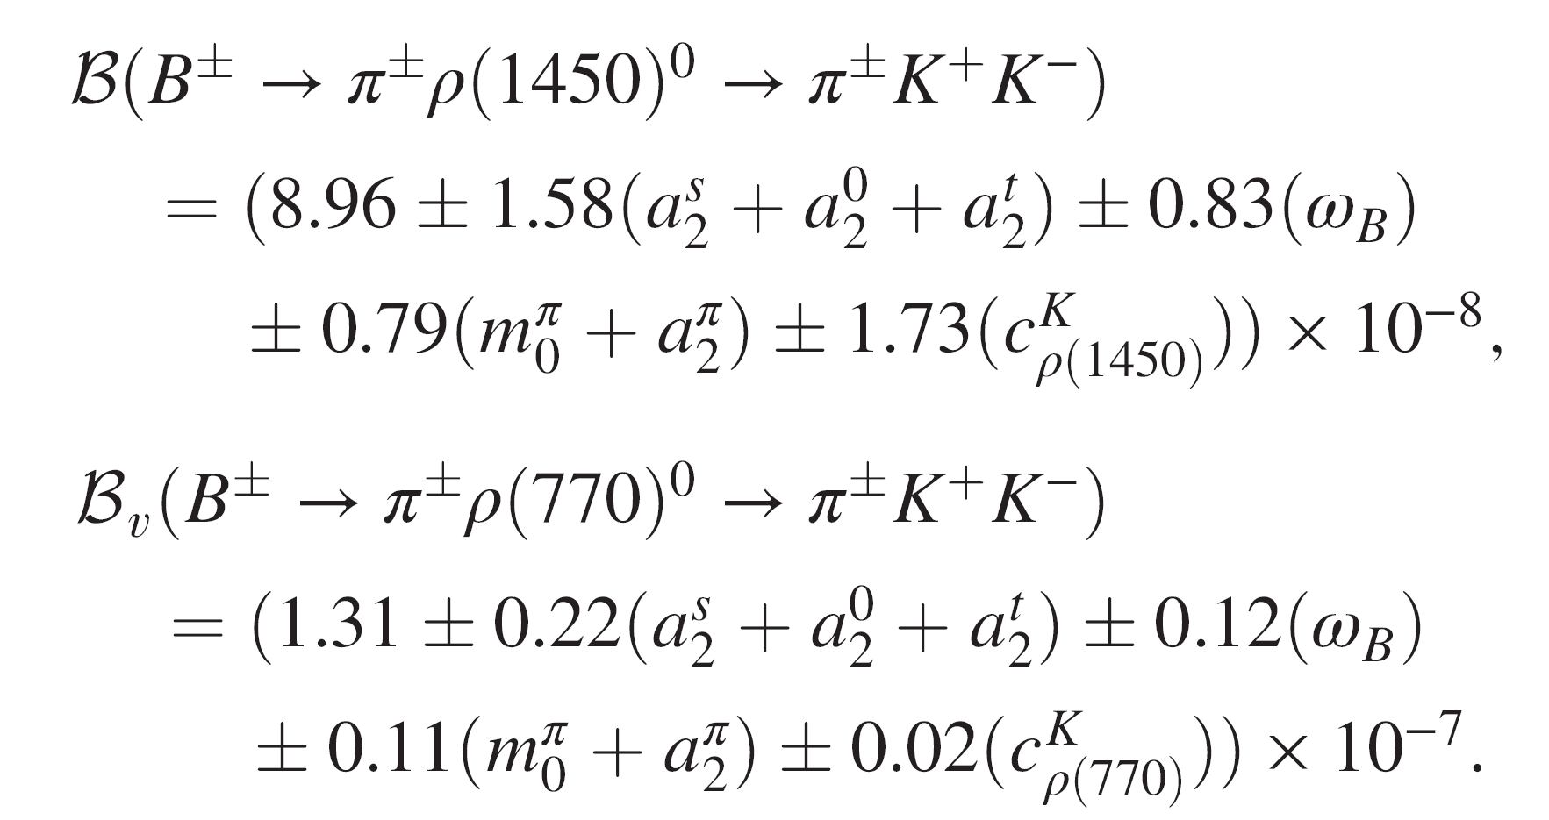
Results and discussions
22

Slide 25
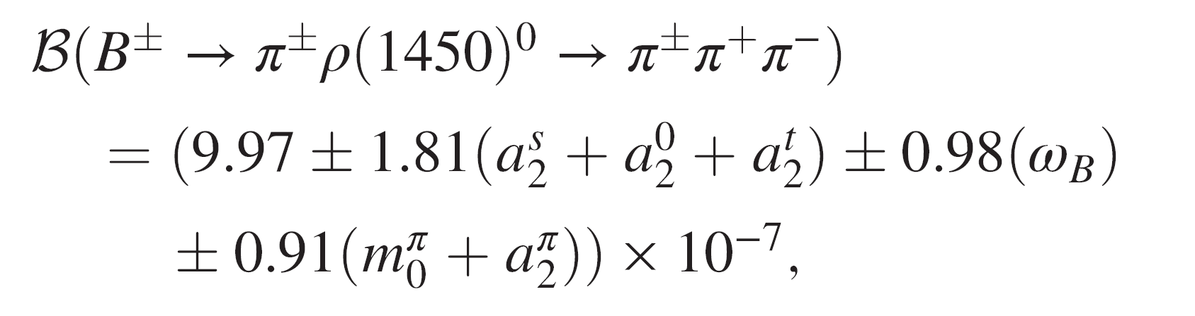
Results and discussions
23
PDG2020

Slide 26
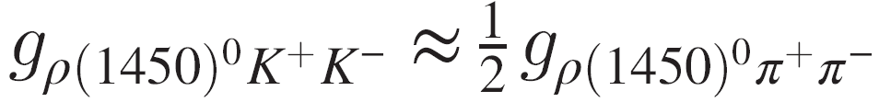
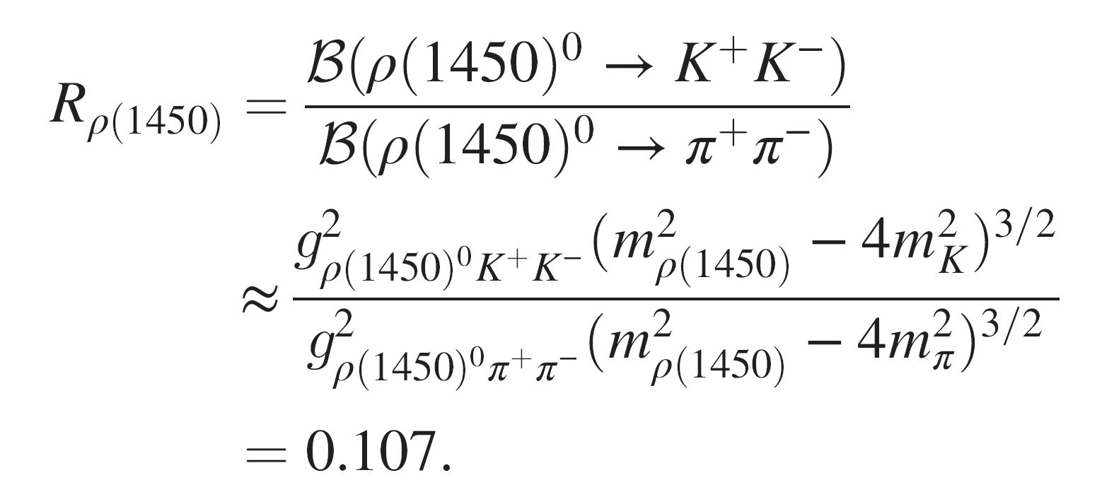
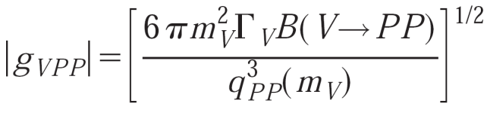

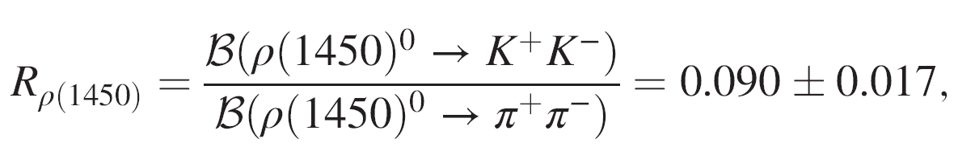
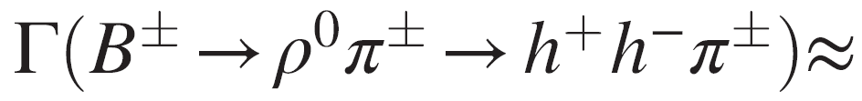
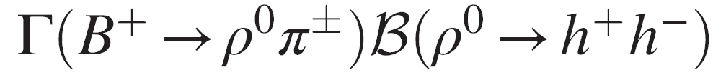
Results and discussions
24

Slide 27
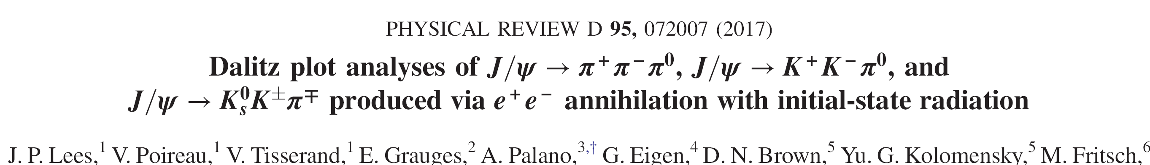

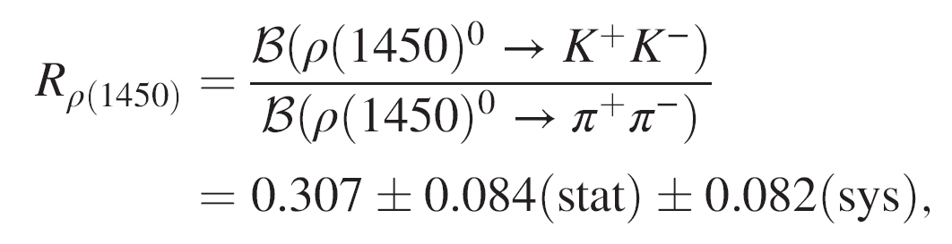
Results and discussions
25

Slide 28
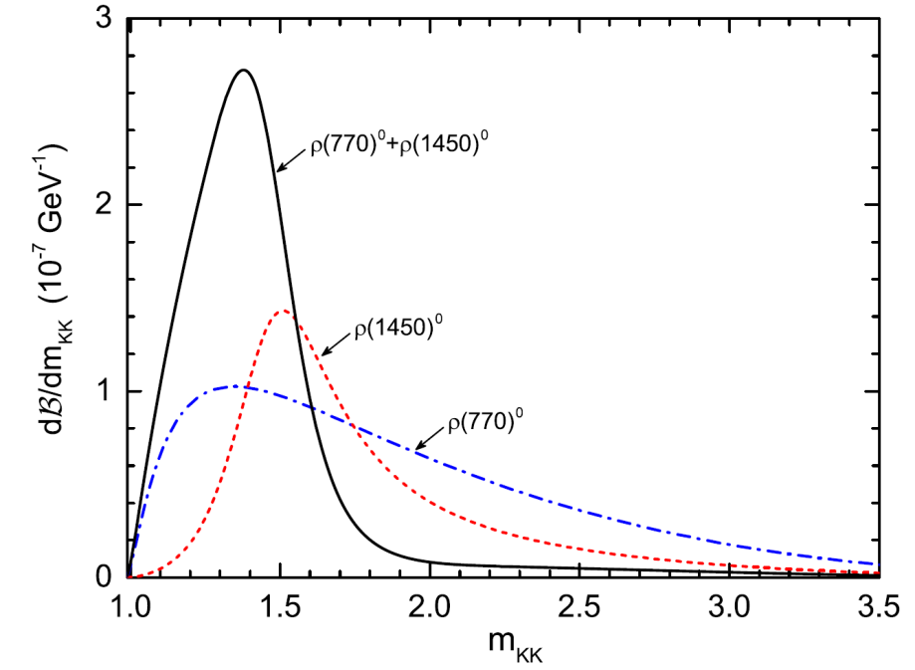

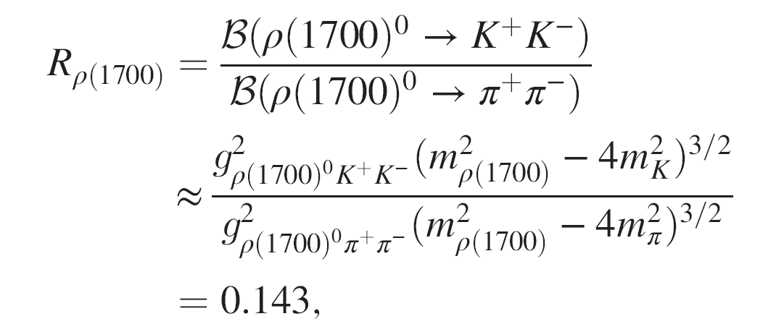
Results and discussions
26

Slide 29
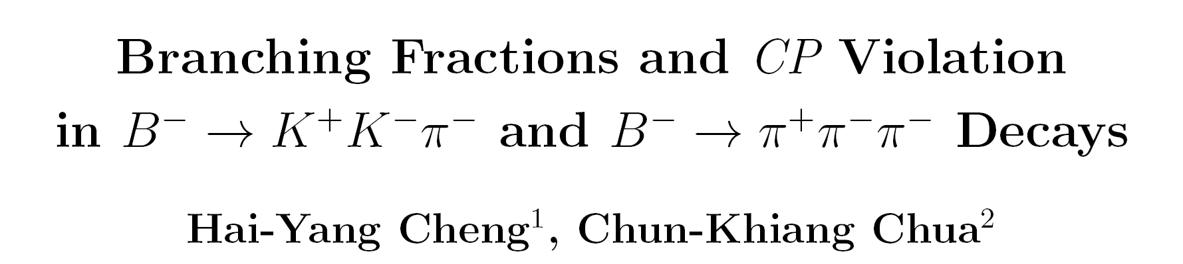
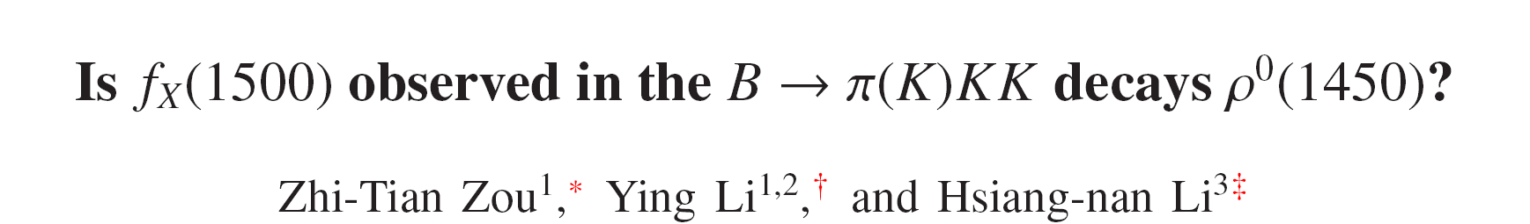
Results and discussions
27
arXiv:2007.02558
arXiv:2007.13141

Slide 30
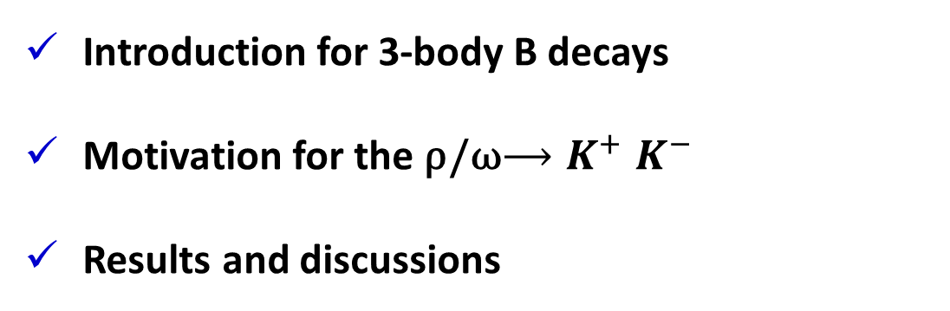
Summary
Introduction for 3-body B decays
Motivation for the ρ/ω${⟶K}^{+}K^{−}$
Results and discussions
Thank You

