Slide 1
Status of Tracking migration (Clupatra Part)
Mingrui Zhao
2020.07.27

Slide 2
Code migration almost finished. (plcio->edm4hep)
Testing on small sample is done.
They generate the exactly same output.
Codes:
/afs/ihep.ac.cn/users/z/zhaomr/workdir/GaudiTracking/CEPCSW
Reconstruction/Clupatra
Examples/options/test.py
Service/TrackSystemSvc
/afs/ihep.ac.cn/users/z/zhaomr/workdir/GaudiTracking/KalTest
/afs/ihep.ac.cn/users/z/zhaomr/workdir/GaudiTracking/KalDet
Use ConstTrackerHit/ConstTrack !!!!!!!!!!!

Slide 3
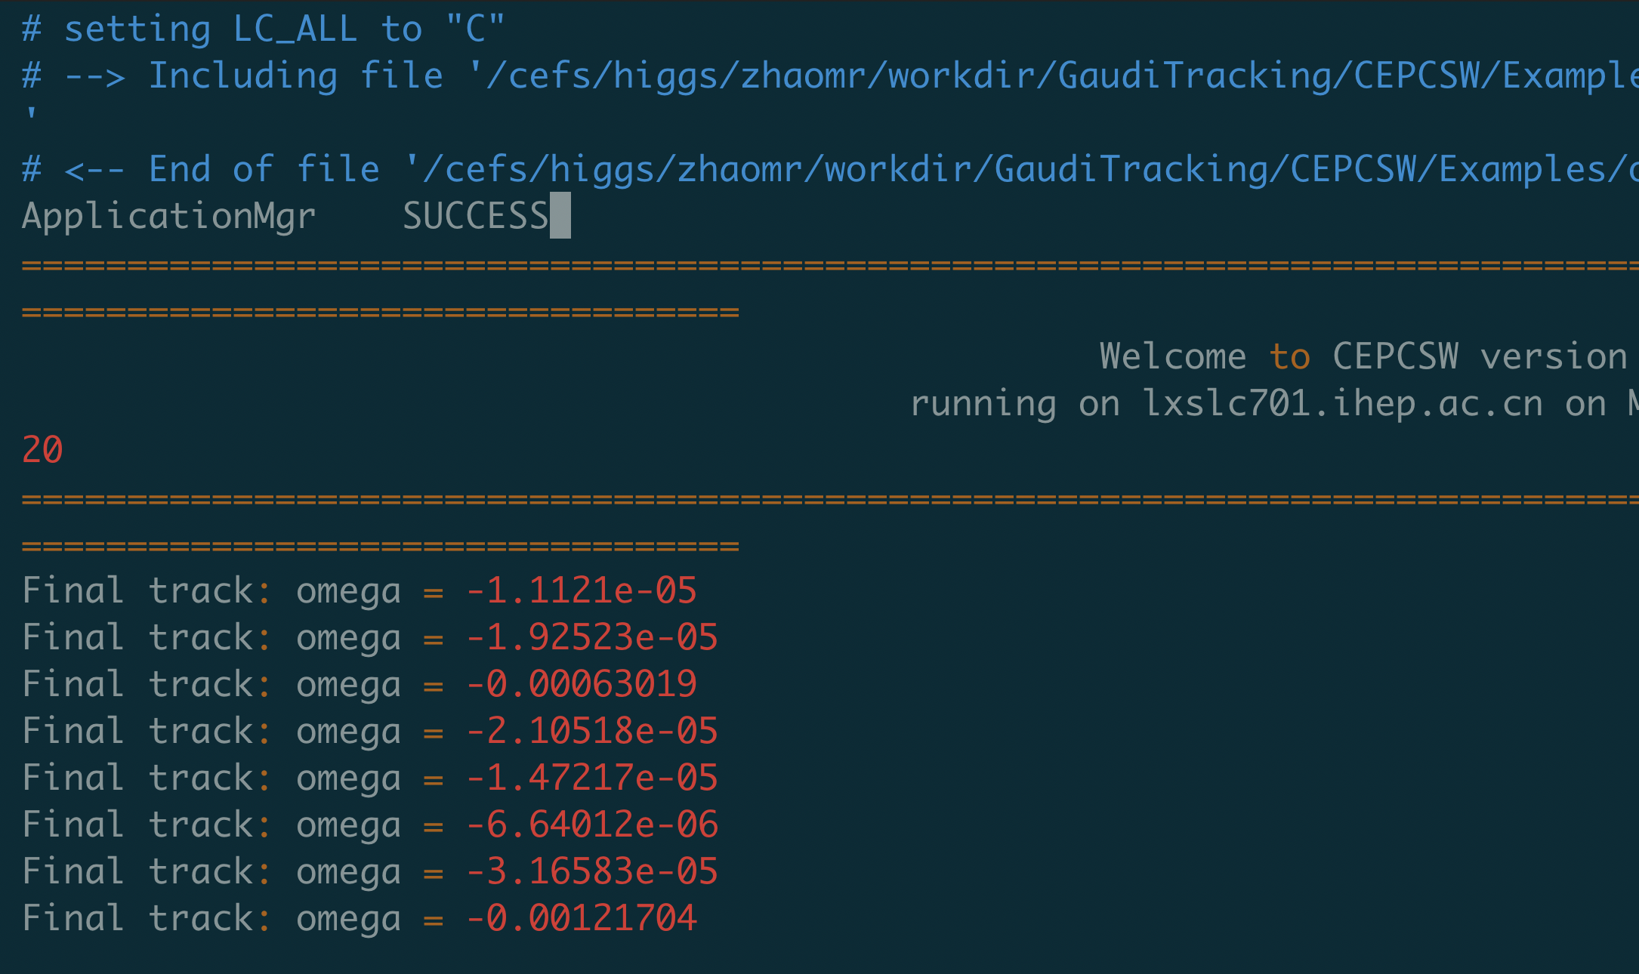
PLCIO

Slide 4
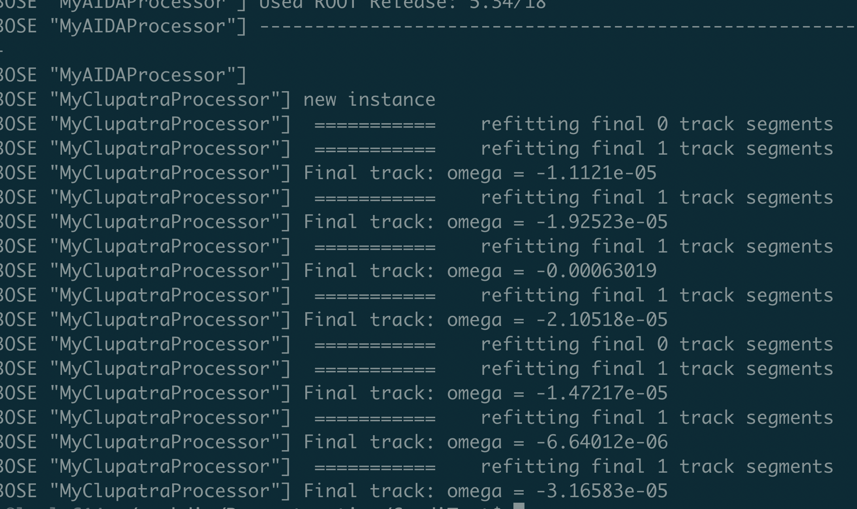
LCIO

Slide 5
EDM4hep

Slide 6
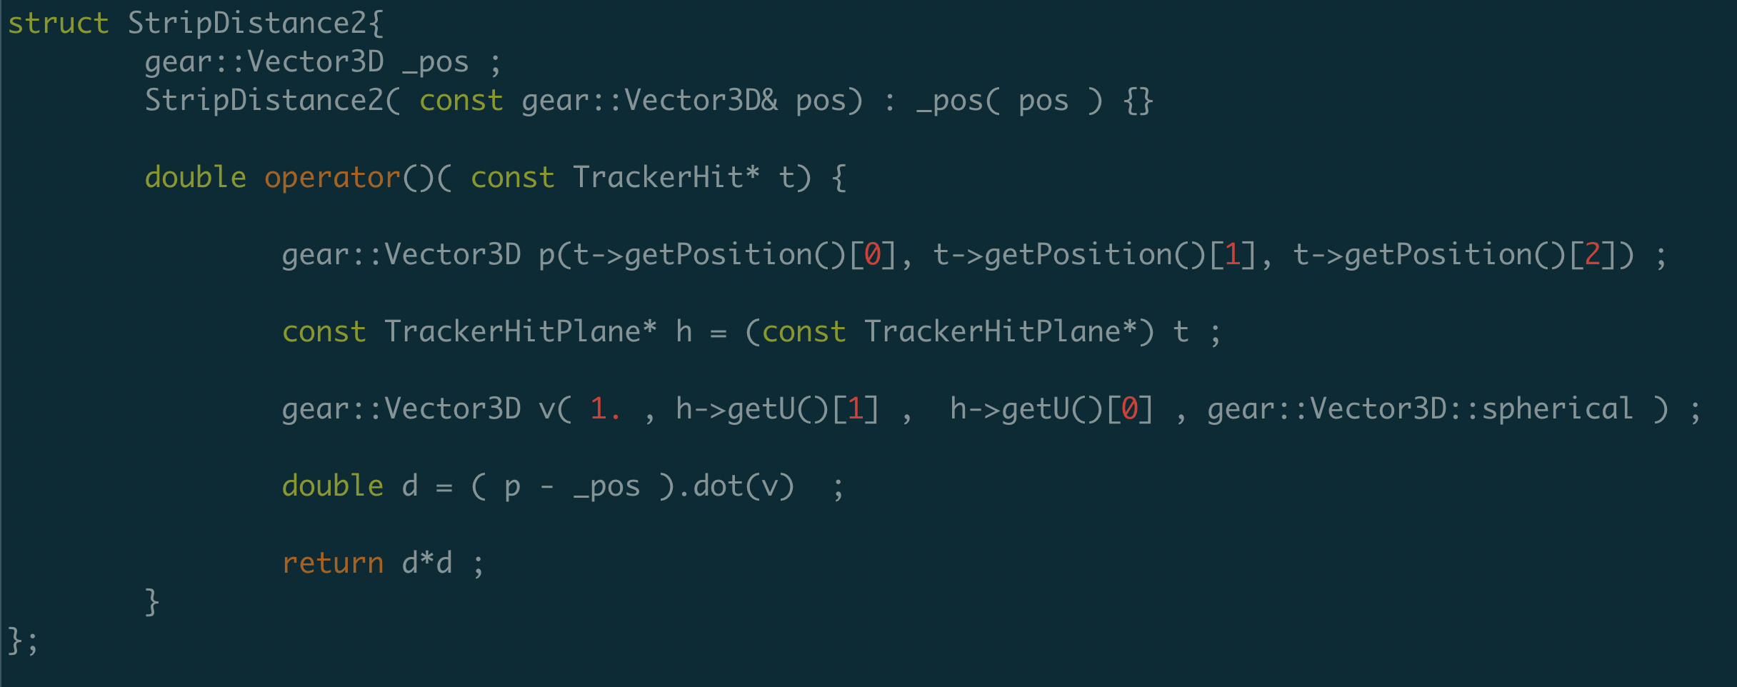
Remaining problems:
TrackerHitPlane?

Slide 7
Remaining problems:
Output
Put on git
Test on large sample

