Slide 1
The Study of Energy Reconstruction by LHAASO-WFCTA
The First LHAASO Collaboration Meeting in 2020 & Engineering Construction Seminar
Ma Lingling, Zhang Shoushan,Yin Liqiao, Wang Yudong,You Zhiyong
IHEP
2020.8.18-22 @ Chengdu Tianfu

Slide 2
Outline
Introduction of LHAASO-WFCTA
The method of energy reconstruction by LHAASO-WFCTA
Improvement of the resolution of energy reconstruction
Factors affecting the accuracy of energy reconstruction
Accuracy and bias of energy reconstruction

Slide 3
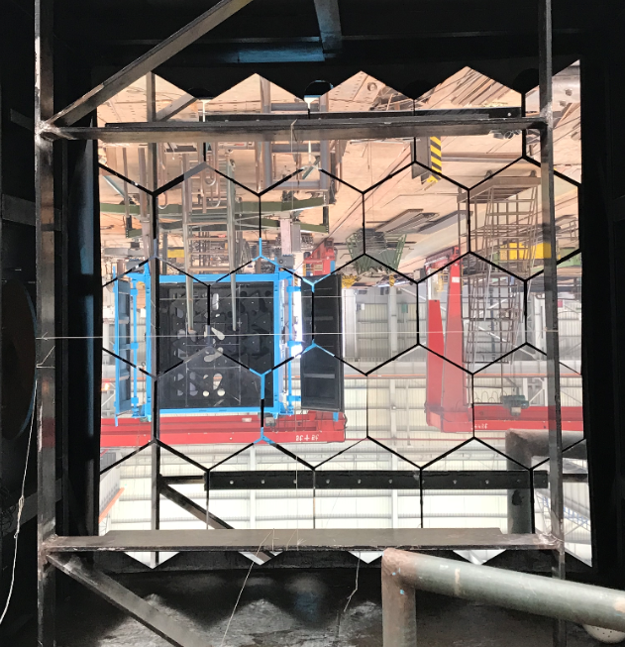
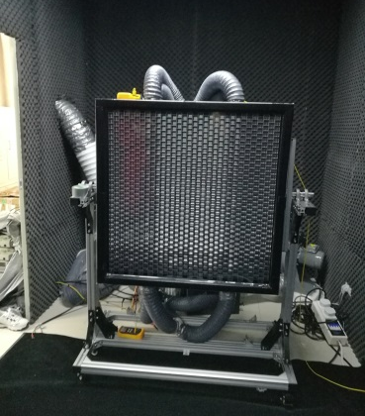
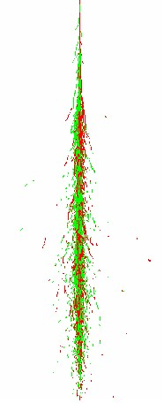
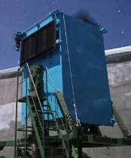
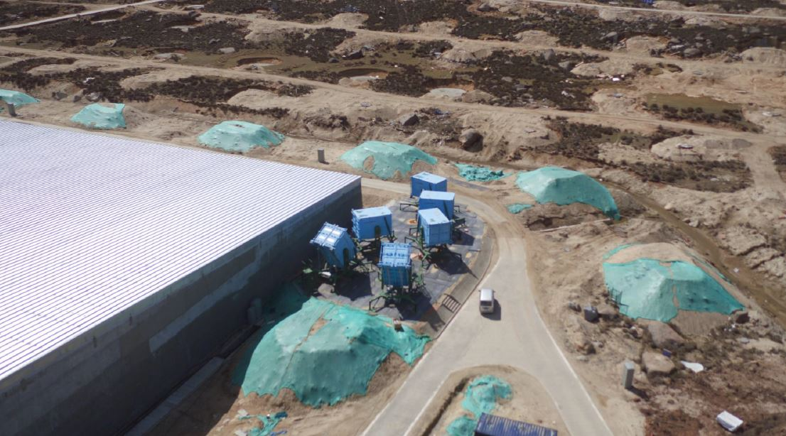
Wide Field of view Cherenkov Telescope Array
18 telescopes make an array
Mirror:
Spherical, 5m2
Camera:
Pixel：SiPM + Weston Cone
32 X 32，0.5°X 0.5°
FOV: 16°X 16°
Cherenkov light
Measure energies of cosmic rays
Discriminate compositions of cosmic rays
Cherenkov light pool
Measure energy spectra of cosmic rays pieces by pieces combined with KM2A and WCDA
8.2 m
~6 nsec
~130 m

Slide 4
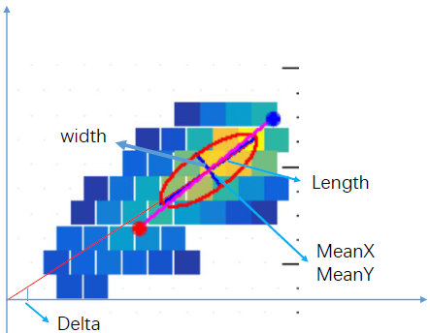
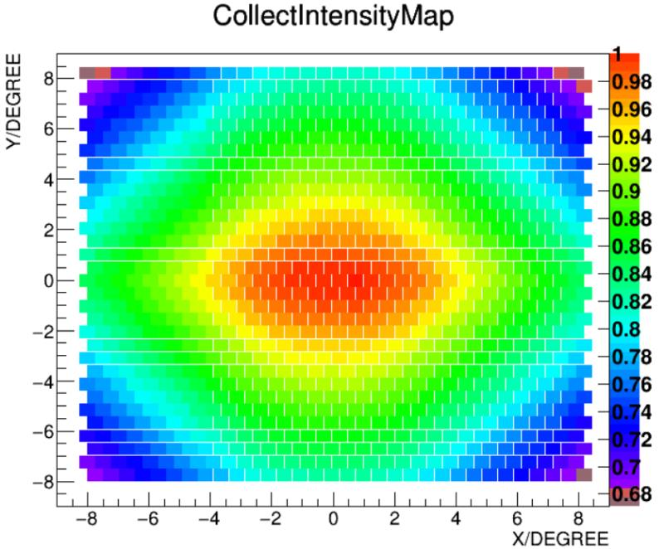
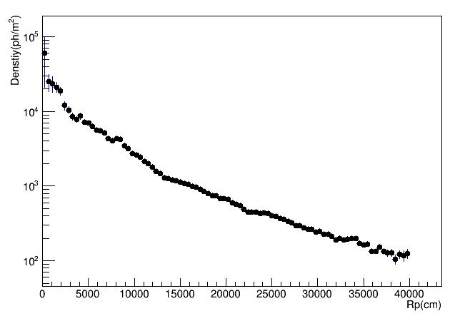
The method of energy reconstruction by LHAASO-WFCTA
The total pe in the image (size) is an energy estimator
According to the lateral distribution of Cherenkov light，the Size is Rp dependent
Due to shelter of the containtor， the Size is also the view angle dependent
The relestionships between primary energy, Size and Rp are studied by simulation
Data Sample of Simulation：
Five composition groups
P,He,CNO,MgAlSi,Iron
10TeV – 10PeV with -2.6 index
QGSJETII04+Fluka
Sample area：-200m-200m

Slide 5
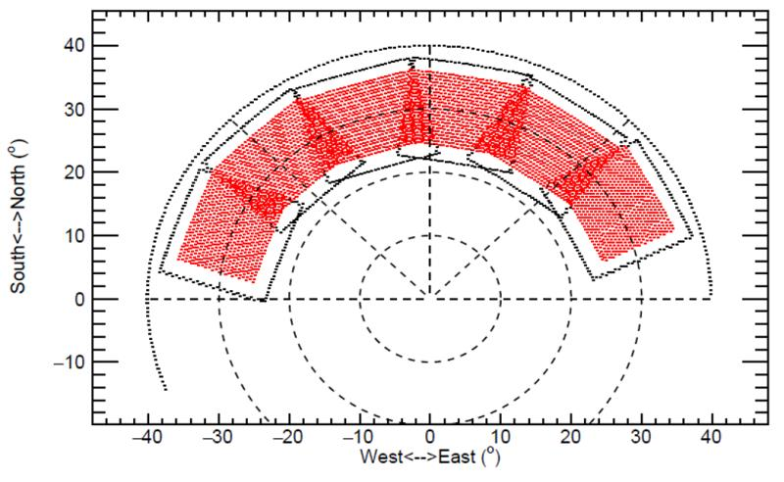
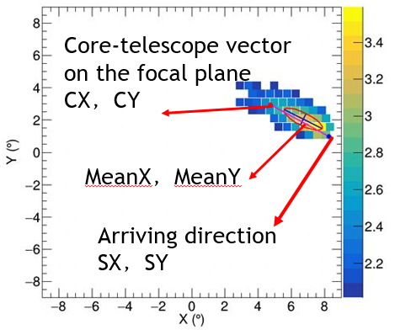
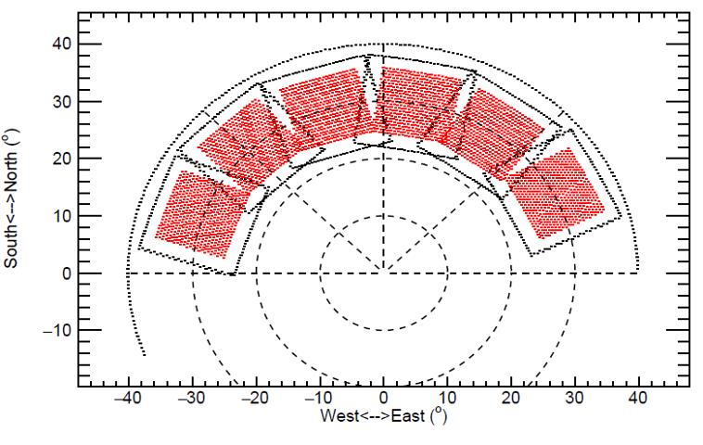
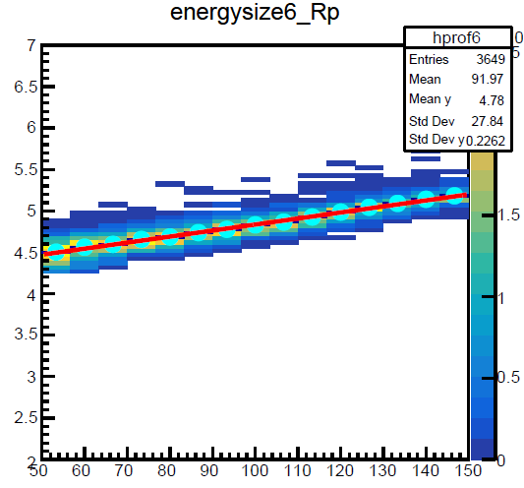
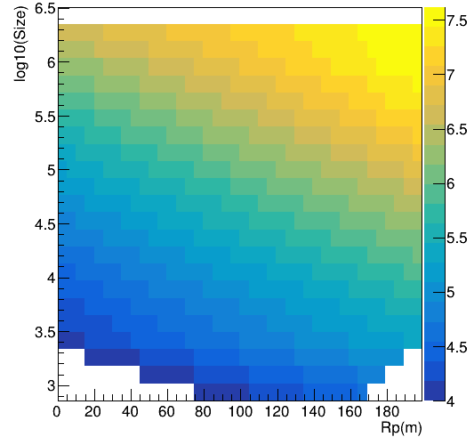
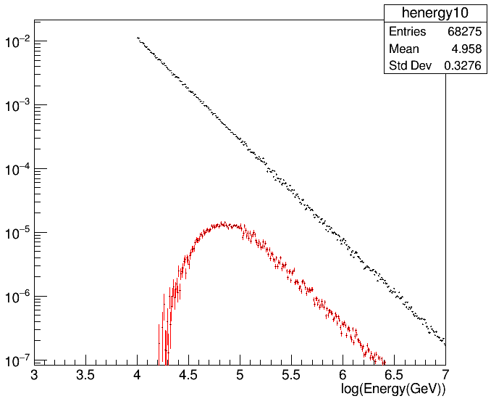
Data selection criteria：
Npix>10
Image integrity cuts
|MeanX|<6 &|MeanY|<6
|SX|<7 & |SY|<7
|CX|<9 & |CY|<9
EnergyThreshold:
80TeV
In a give size bin, higher energies are needed for further events
Proton
Proton

Slide 6
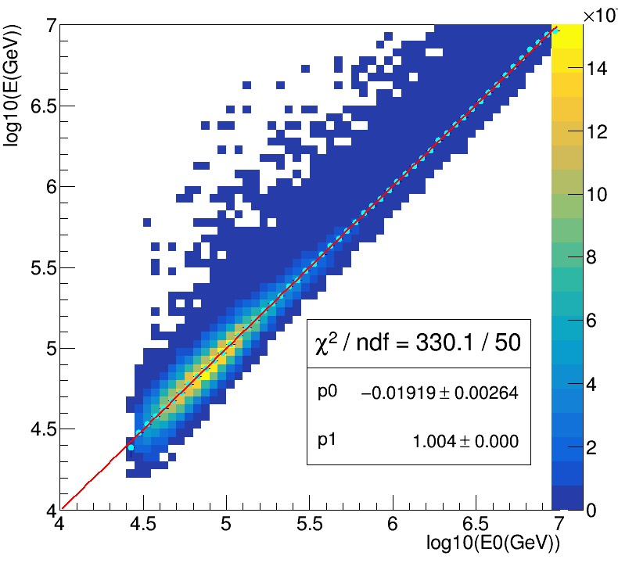
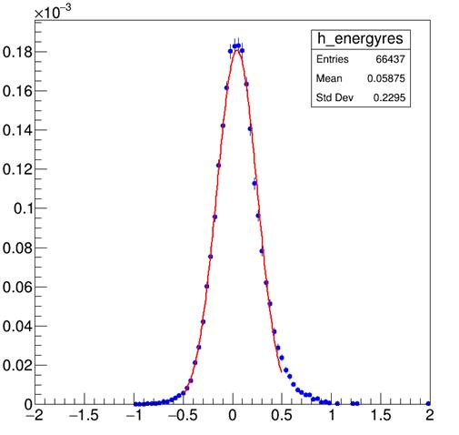
Results of energy reconstruction
Proton
Proton

Slide 8
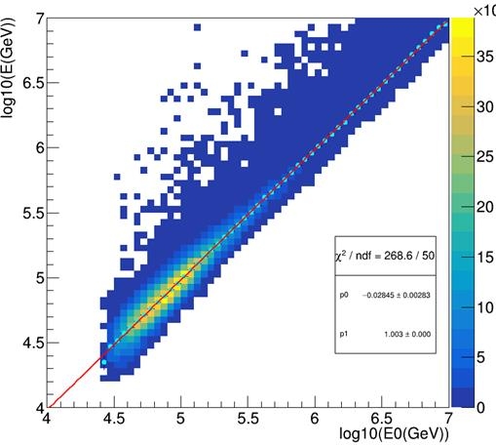
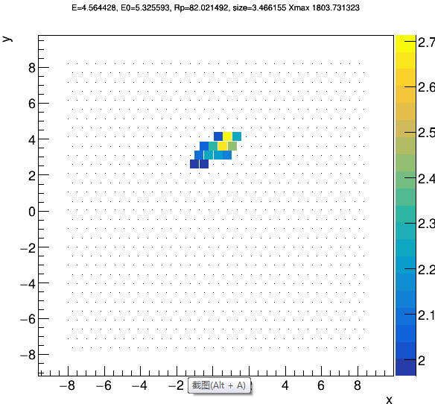
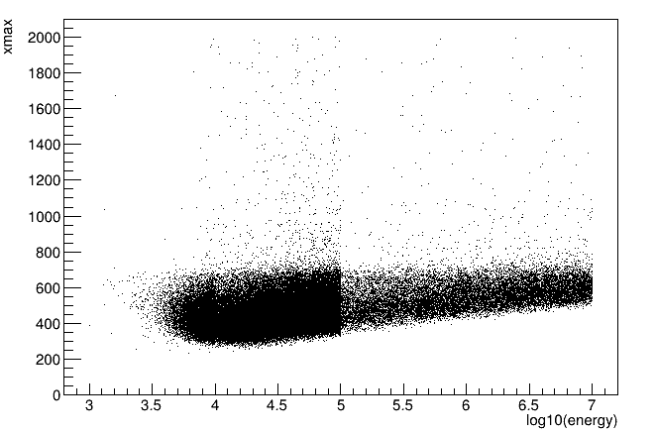
Improvement of the resolution of energy reconstruction
It is caused by the big fluctuation during the development of air showers
we can not cut the Xmax directly, but we can reconstruct the Xmax, then give a cut to the reconstructed Xmax.

Slide 9
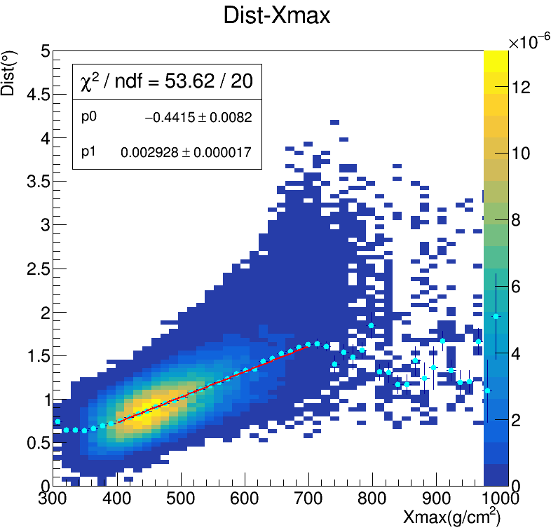
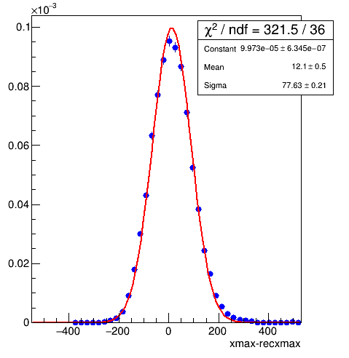
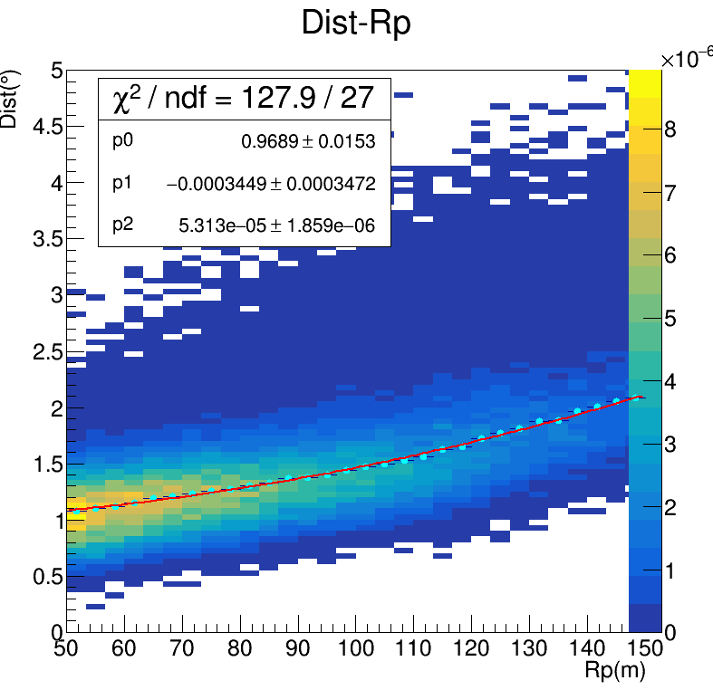
Improvement of the resolution of energy reconstruction ---reconstruction of Xmax
Dist
Dist: The distance between the image center and the arriving directions is Xmax related
Dist is Rp dependent due to the geometry
It can be fitted by function A*x2+B*x+C.

Slide 10
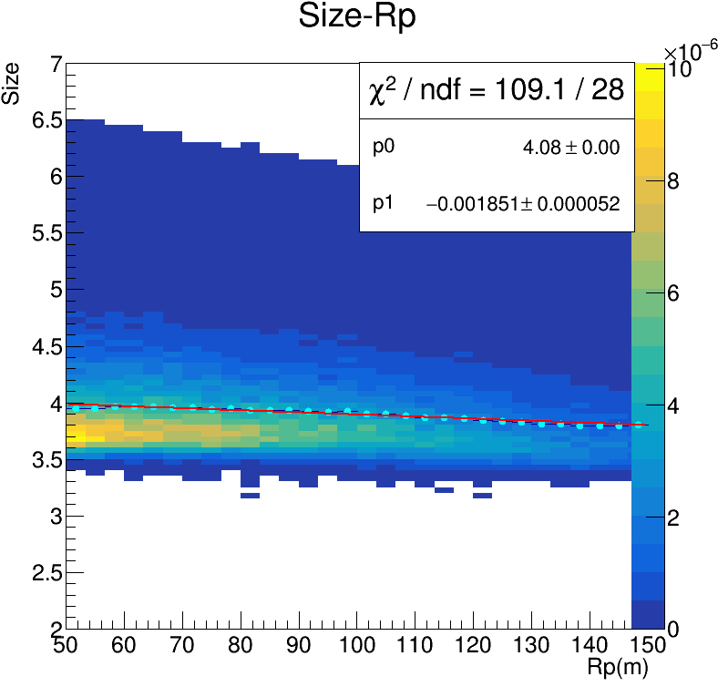
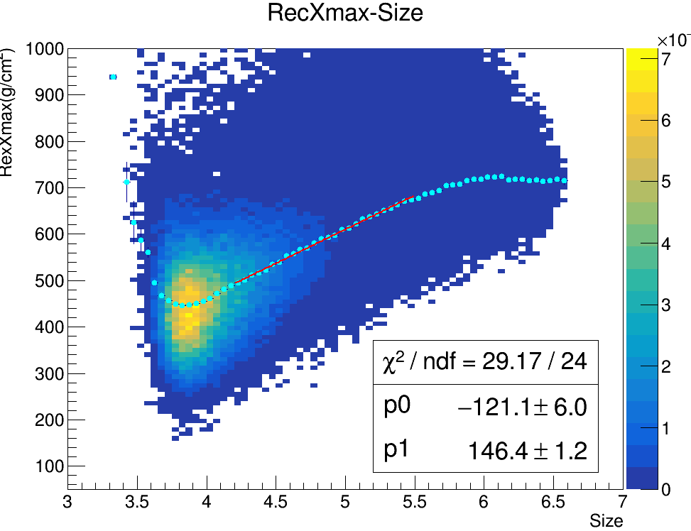
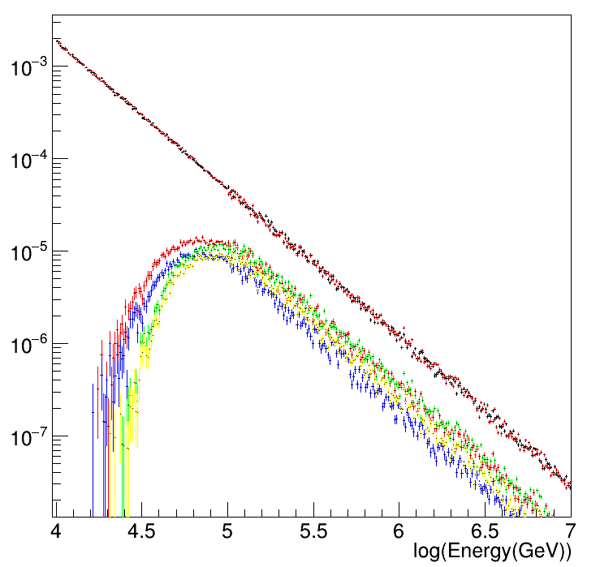
RecXmax cut changes with size
Xmax increases with primary energy of CRs
Energy Threshold 80TeV

Slide 11
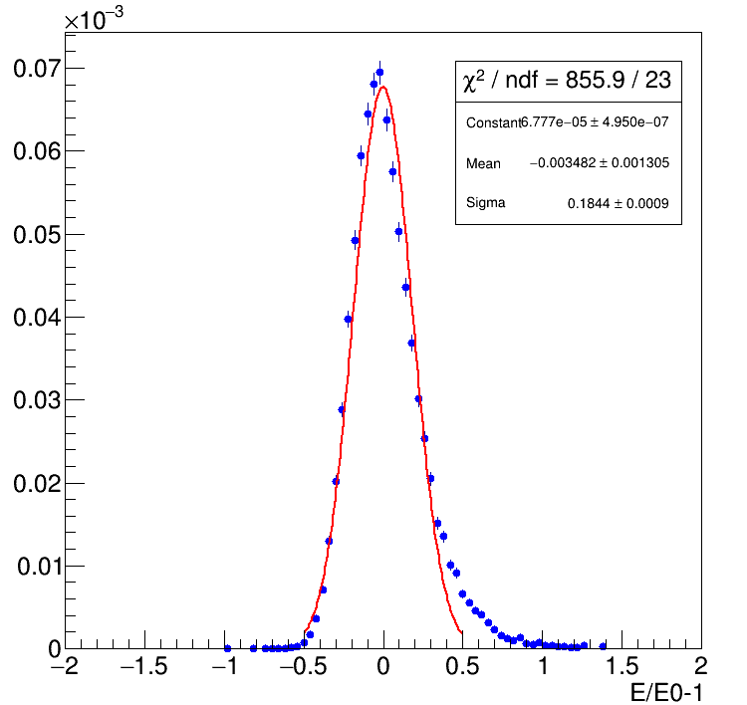
Based on resolution of Rp = 5m

Slide 12
Energy Resolution in each bin

Slide 13
Energy resolution and bias

Slide 14
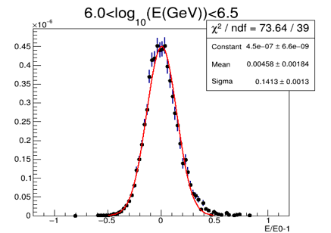
Rp effects to the energy resolution
RpRes 3m
EnergyRes：13%
RpRes 5m
Energy Res: 14%

Slide 15
Summary and next
Full FOV coverage can be achieved
Energy Resolution is about 14% for samples of P:He=1:1 with energies higher than 1PeV ， Rp resolution 5m
The improvement of RP can improve the accuracy of energy reconstruction
The system uncertainties caused by the hadronic models and composition models will be studied soon
Thank you for your attention

