Slide 1
The motion of high-energy charged particles in a dipole magnetic field
王润娜、刘四明、陈起辉、祝凤荣、熊安达
2020.8.20 成都

Slide 2
Outline
Background
Methods
Results
Discussions

Slide 3
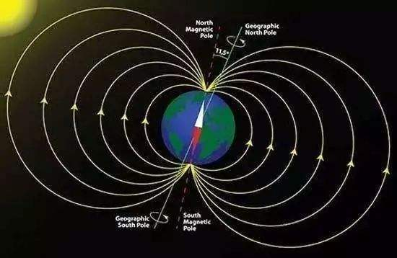
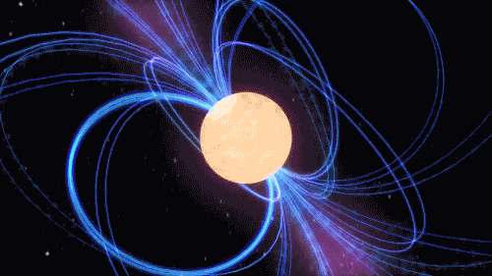
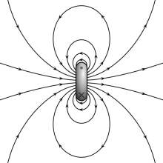
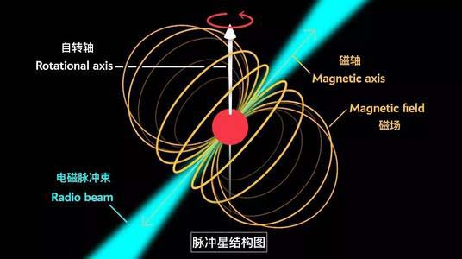
Background
地球磁场
脉冲星
磁偶极的磁场

Slide 4
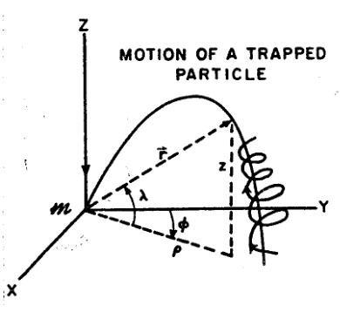
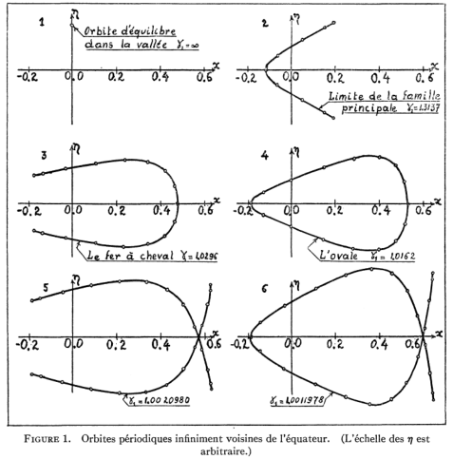
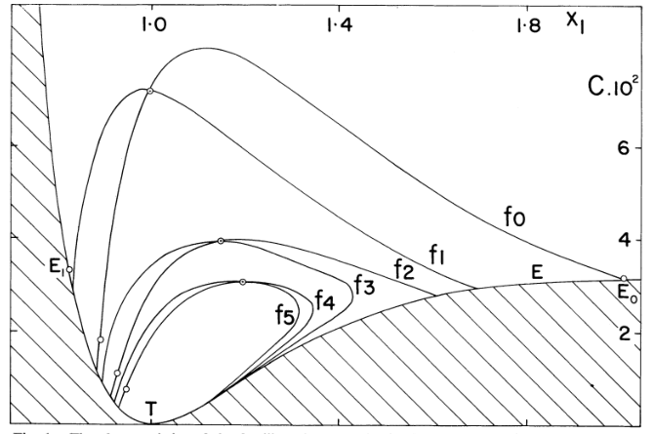
1.Most previous studies focus on particles with relatively low energies so that the guiding center approximation may be applied.
2. The nature of the trajectory depends on the energy of the particle. [ O. F. De Alcantara Bonfim, D. J. Griffiths, andS. Hinkley, Interna-tional Journal of Bifurcation and Chaos10, 265 (2000),https://doi.org/10.1142/S02181274]
3.Stable quasi-periodic orbit.
Schematic representation of trapped charged particle motion in a magnetic dipole field.
Rene De Vogelaere,Canadian Journal of Mathematics,https://doi.org/10.4153/CJM-1950-042-0
Markellos, V. V.; Klimopoulos, S.; Halioulias, A. A,Celestial Mechanics, Volume 17, Issue 3, pp.215-232, 10.1007/BF01232828

Slide 5
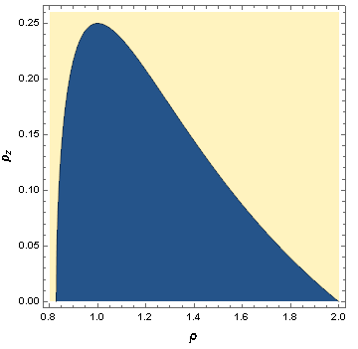
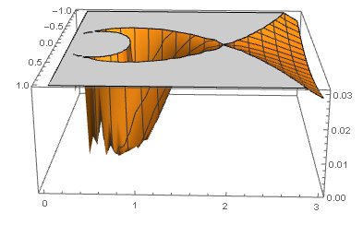
Methods
Schematic representation of trapped charged particle motion in a magnetic dipole field.
Potential well
Two-dimensional initial value space

Slide 6
1. Lyapunov exponent：
（1） When a Lyapunov exponents is positive, we will say that the system is chaotic.
2. Poincare map：
（1） The Poincare map of the quasi-periodic orbit should include a curve, while the periodic orbit has only a few isolated points.
（2）The Poincare map of the chaotic orbit is a set of dense points.

Slide 7
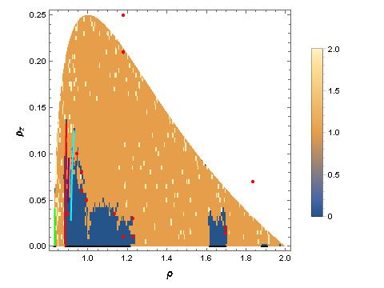
Results
N=0：Periodic or quasi-periodic motion
N=1：Chaos motion
N=2：Hyperchaos motion
Via evaluation of the Lyapunov exponent of orbits of particles launched from the equatorial plane with an axial velocity, we found a significant set of quasi-periodic orbits around stable periodic orbits in the equatorial plane at highenergies.
Number of positive Lyapunov exponent in the (ρ, pz) plane with z = 0 and pρ = 0.

Slide 8
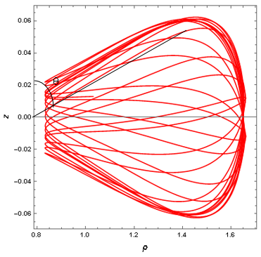
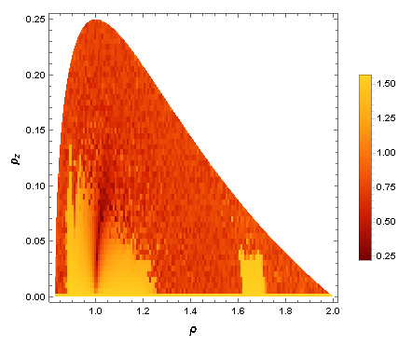
Particles in these orbits oscillate around the equatorial plane and their radial distance from the dipole can vary by a factor of ∼ 2.
Distribution of the maximum polar angle.

Slide 9
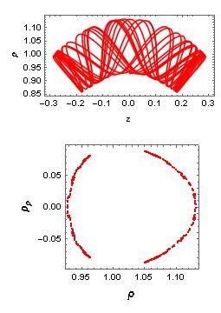
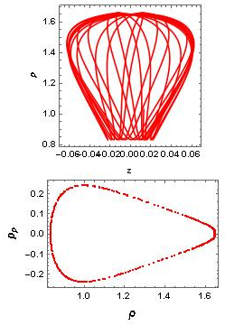
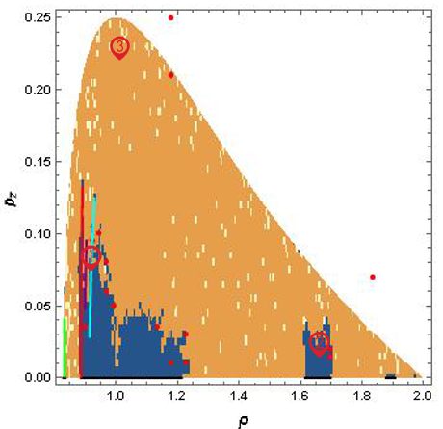
Typical orbits ( for a period of 250) and their Poincare maps ( for a period of 10000)

Slide 10
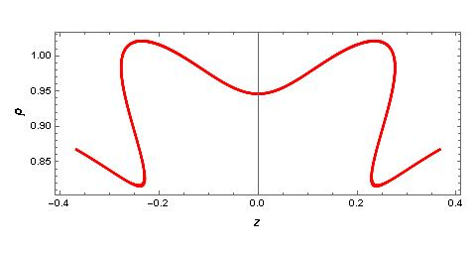
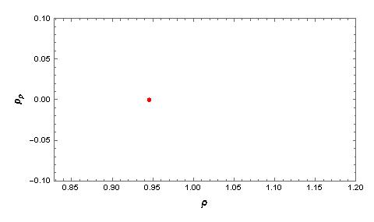
Typical orbit (top for a period of 250) and its Poincare map (bottom for a period of 10000) .
Conservation of energy

Slide 11
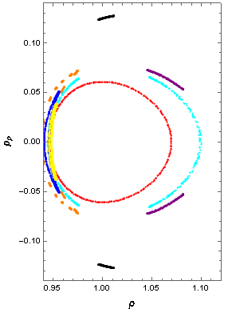
Poincare maps
Number of positive Lyapunov exponent

Slide 12
Discussions
1.Connection with the radiation belt
2.Four-dimensional phase space
3.Practical applicacons

Slide 13
Thanks

