Slide 1
Measurement of diffusion coefficient around Geminga by KM2A
Reporter：Ying-ying Guo^{1，2}
Collaborator：Y.Zhang^{2，1} Q.Yuan² Y.L Feng² S.P. Zhao³ R. Zhang² L.Q. Gao¹ E.S. Chen¹ H.B. Hu¹ X.J. Bi¹
Institution：1. Institute of High Energy Physics, CAS
2. Purple Mountain Observatory, CAS
3. Shandong University

Slide 2
Content
The discover and interpretation of Low-diffusion
Data selection
The description of PSF
The diffusion coefficient around Geminga
The flux of Geminga
Conclusion && plan

Slide 3
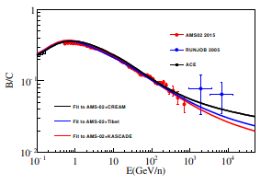
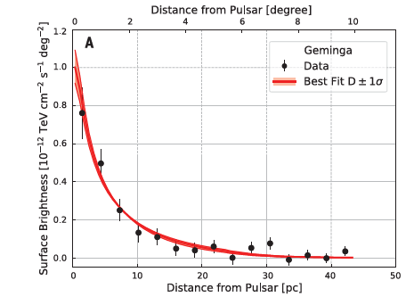
The propagation of CRs:diffusion
${ \sim 1e29cm}^{2}/s$
~1$\text{e}\text{2}{7cm}^{2}/s$
@100TeV
B/C ratio constrains diffusion coefficient
The measurement of diffusion coefficient
The Low diffusion zone is concentrated on the pulsars or property of ISM?
How does diffusion depend on energy?
Abeysekara et al., Science 358, 911–914 (2017) 17 November 2017
Notes:
低能限制→外推高能→直接测量
你这个题目，主要还是研究宇宙线的起源和传播。
a. 研究起源的办法， 就是源不同区域的能谱不同 （像银心的工作），
多信使分析其形态。
b.传播，就是研究扩撒系数。
所以你的研究背景和意义可以稍微再整理一下。

Slide 4
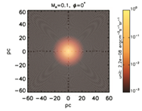
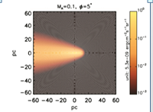
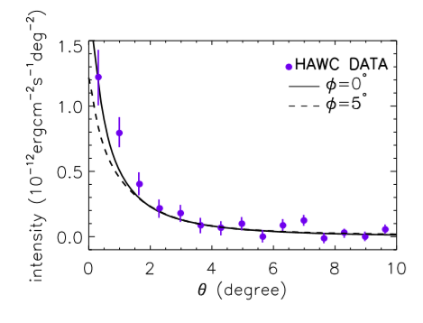
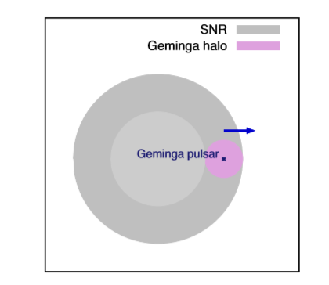
The interpretation of low diffusion
anisotropic diffusion : ISM property
Magnetic field direction approximately aligned with our LOS
Geminga may be inside the SNR： Pulsar
Low diffusion is generated by the shock wave of SNR
arXiv:1904.11536； MNRAS 488, 4074–4080 (2019）
Notes:
the strong turbulence is generated by the shock wave of the parent supernovaremnant(SNR)ofGeminga.GemingamaystillbeinsidetheSNR,andweﬁndthat the SNR can provide enough energy to generate the slow-diffusion circumstance---→local PULSAR/SNR 才会有
the local mean magnetic ﬁeld direction approximately aligned with our line of sight towards Geminga, --→有星际磁场的地方，也可能是其他的天体，不仅仅PWN

Slide 5
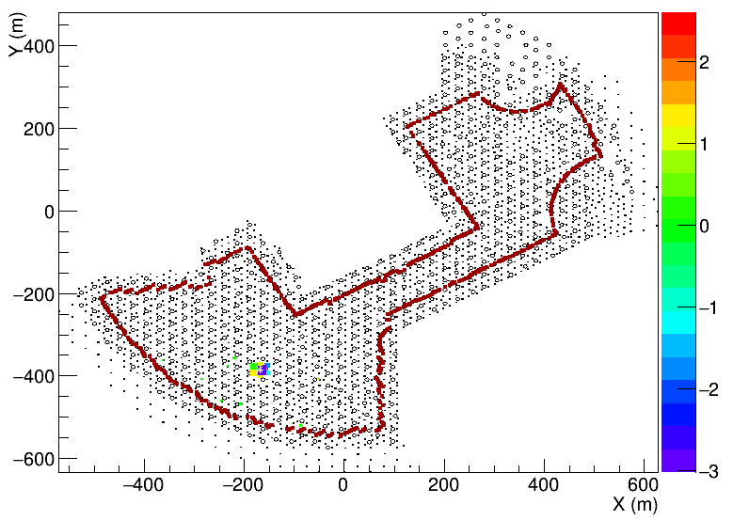
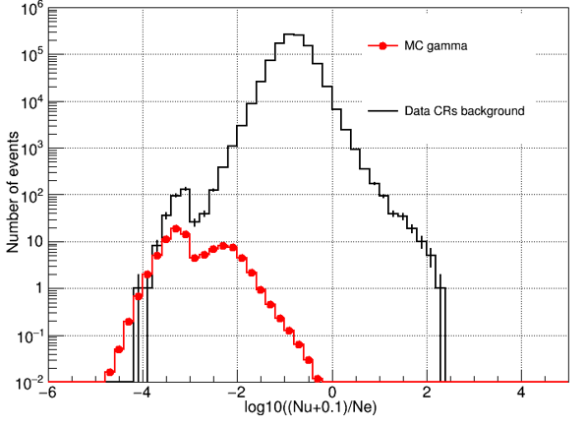
Data sample
γ-like events
芯位筛选
r/p 分布
Version: /eos/lhaaso/rec/km2a/half_array/V0
Date: 2019/12/27-2020/06/28
Core selection: The core position is 40m away from the edge of the array
Reconstructed Energy bin: 1,1.2,1.4,1.6,1.8,2,2.2,2.4,2.6,2.8,>2.8
γ/p discrimination: -2.2,-2.6,-2.8,-3.0,-2.5,-2.6,-2.7,-2.6,-2.6,-2.6
Zenith angle: <50度

Slide 6
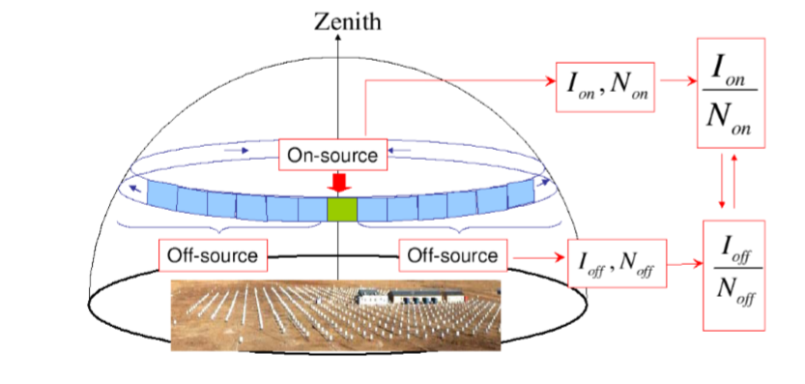
Background Estimation
$$N_{bkg}$$
$$N_{on}$$
$$N_{off}$$
$$\left\langle N_{off}\right\rangle$$
Equi-zenith assumption：On the same zenith angle belt, the detection efficiency is the same

Slide 7
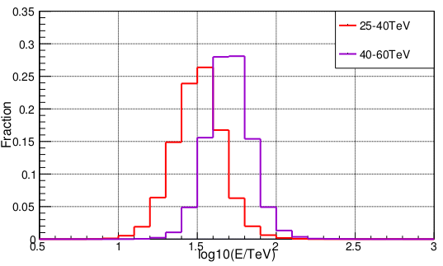
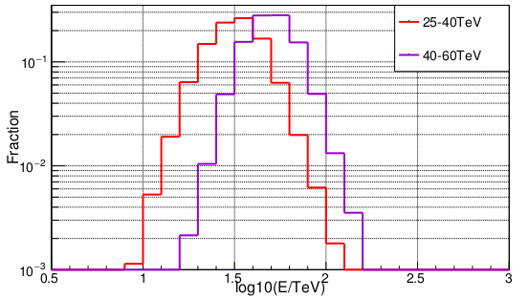
Energy distribution
Pivot energy（TeV） | Energy resolution
30 | 16%
50 | 14%

Slide 8
Two-dimensional significance map
25-40TeV
40-60TeV
60-100TeV
PSF smoothing
Smooth angle=1deg

Slide 9
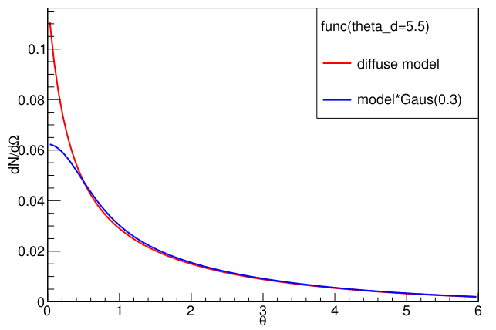
Detector response to diffuse model
Diffuse model:
$$f_{d}=\frac{const}{θ_{d}(θ+0.06θ_{d})}exp⁡(({\frac{θ}{θ_{d}})}^{2})$$
Abeysekara et al., Science 358, 911–914 (2017) 17 November 2017

Slide 10
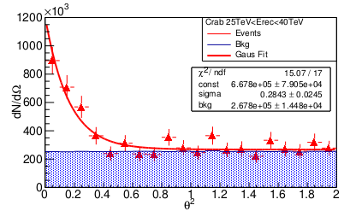
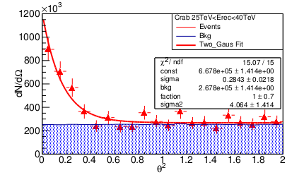
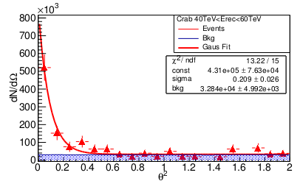
The description of PSF
30TeV
double-gauss
30TeV
Single-gauss
50TeV
Single-gauss
double-gauss Function:
$$ρ（θ）=αG1\left(θ\right)+(1−α)G2(θ)$$
30TeV: single Gauss: sigma=0.28±0.024 chi2=15/17
double Gauss: sigma1=0.28±0.021 chi2=15/15
50TeV: single Gauss: sigma=0.2±0.03

Slide 11
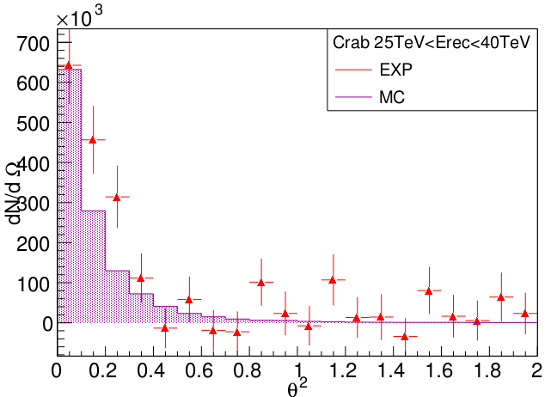
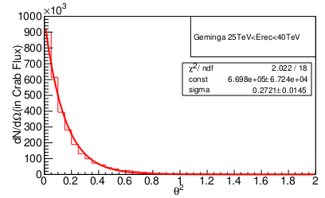
PSFVS declination
Crab: dec=22.02
MC: Sigma=0.27
Exp: Sigma=0.28±0.02
Geminga: dec=17.77
Sigma=0.272
The simulated PSF of Crab basically agree with the experiment
The simulation expects that the PSF near Geminga and Crab are basically the same
The PSF of Crab in the experimental data is used to describe the experimental PSF around Geminga

Slide 12
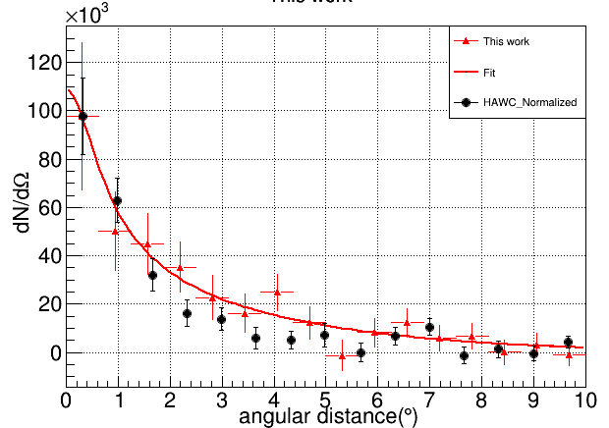
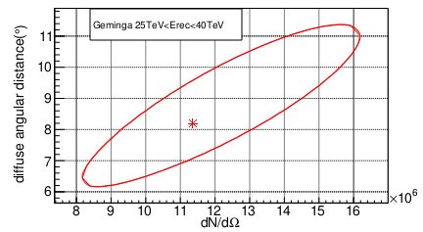
The measurement of isotropic diffusion coefficient
Emedian=30TeV
diffuse angle: 8.17+-2.4
diffusion coefficient: $\left(7.1±4.3\right)\text{e}\text{+2}7{cm}^{2}/s$ @130TeV 电子
HAWC: $\left(4.5±1.2\right)\text{e}\text{+2}{7cm}^{2}/s$ @100TeV 电子
Notes:
0 BinContent: 130.000 93.535 Ns=36.465 sr=0.000 rst: 97597.225
1 BinContent: 335.000 278.625 Ns=56.375 sr=0.001 rst: 50296.364
2 BinContent: 549.000 465.003 Ns=83.997 sr=0.002 rst: 44968.155
3 BinContent: 741.000 648.777 Ns=92.223 sr=0.003 rst: 35269.826
4 BinContent: 912.000 835.470 Ns=76.530 sr=0.003 rst: 22767.638
5 BinContent: 1084.000 1017.530 Ns=66.470 sr=0.004 rst: 16182.743
6 BinContent: 1342.000 1221.490 Ns=120.510 sr=0.005 rst: 24831.251
7 BinContent: 1458.000 1389.518 Ns=68.482 sr=0.006 rst: 12232.837
8 BinContent: 1566.000 1574.392 Ns=-8.392 sr=0.006 rst: -1323.120
9 BinContent: 1824.000 1766.198 Ns=57.802 sr=0.007 rst: 8156.892
10 BinContent: 2040.000 1944.349 Ns=95.651 sr=0.008 rst: 12217.303
11 BinContent: 2172.000 2121.369 Ns=50.631 sr=0.009 rst: 5907.179
12 BinContent: 2361.000 2298.610 Ns=62.390 sr=0.009 rst: 6699.987
13 BinContent: 2487.000 2486.127 Ns=0.873 sr=0.010 rst: 86.854
14 BinContent: 2702.000 2669.059 Ns=32.941 sr=0.011 rst: 3052.844

Slide 13
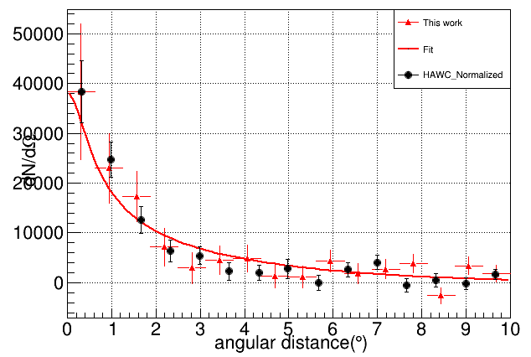
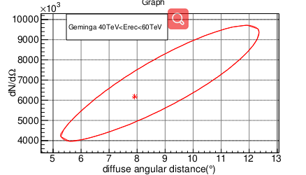
The measurement of isotropic diffusion coefficient
Emedian=50TeV
diffuse angle: 7.9+-3.16
diffusion coefficient: $\left(4.7±3.8\right)\text{e}\text{+2}7{cm}^{2}/s$ @190TeV 电子
Notes:
形态：不同位置处的流强&能谱
BinContent: 26.000 11.682 Ns=14.318 sr=0.000 rst: 38320.770
BinContent: 61.000 35.247 Ns=25.753 sr=0.001 rst: 22976.263
BinContent: 90.000 57.587 Ns=32.413 sr=0.002 rst: 17352.427
BinContent: 98.000 79.306 Ns=18.694 sr=0.003 rst: 7149.310
BinContent: 111.000 101.054 Ns=9.946 sr=0.003 rst: 2958.875
BinContent: 140.000 121.204 Ns=18.796 sr=0.004 rst: 4575.963
BinContent: 170.000 146.250 Ns=23.750 sr=0.005 rst: 4893.821
BinContent: 175.000 167.991 Ns=7.009 sr=0.006 rst: 1251.935
BinContent: 197.000 189.594 Ns=7.406 sr=0.006 rst: 1167.644
BinContent: 243.000 212.251 Ns=30.749 sr=0.007 rst: 4339.223
BinContent: 248.000 233.077 Ns=14.923 sr=0.008 rst: 1906.027
BinContent: 276.000 252.548 Ns=23.452 sr=0.009 rst: 2736.222
BinContent: 309.000 273.009 Ns=35.991 sr=0.009 rst: 3865.035
BinContent: 270.000 296.355 Ns=-26.355 sr=0.010 rst: -2621.959
BinContent: 357.000 320.595 Ns=36.405 sr=0.011 rst: 3373.849
BinContent: 360.000 339.119 Ns=20.881 sr=0.012 rst: 1811.425

Slide 14
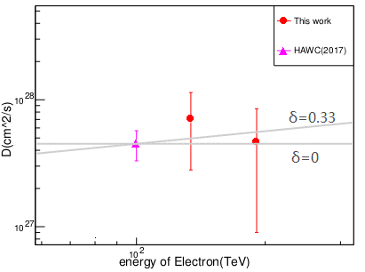
Evolution of diffusion coefficient with energy
Half-year KM2A data yet provide good constraint on the diffusion index
More data is expected
Notes:
形态：不同位置处的流强&能谱

Slide 15
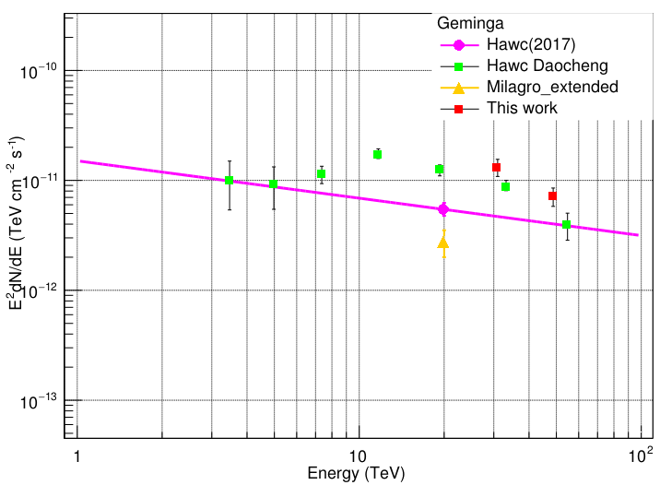
The flux of Geminga
Notes:
Assume: index=-2.34
Double_t nhitEdges_NfiltE[10] ={1.4,1.6,1.8};
Double_t nEst[9] ={-2.8,-3.0};//NfiltE
Double_t nSmooth[9]={10,10,10,10};
Double_t crabNon[9]={24537,3131};
Double_t crabNoff[9]={23654.089,2836.37};

Slide 16
Conclusion && Plan
The measurement of diffusion coefficient：
KM2A:$\left(7.1±4.3\right)\text{e}\text{+2}7{cm}^{2}/s$ @130TeV
HAWC : $\left(4.5±1.2\right)\text{e}\text{+2}{7cm}^{2}/s$ @100TeV
Two experiment agrees within statistic error, however, our statistic error is very large
Diffusion coefficient changes with energy require more accurate measurement
Spectrum：Assuming that the energy spectrum index is -2.34, the flux of Geminga is measured.
Thank You!

Slide 17
卷积的结果和能量展宽的影响

Slide 18
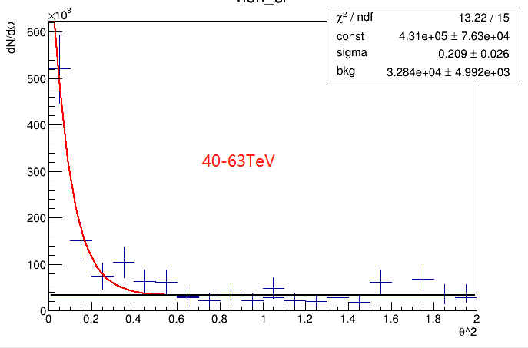
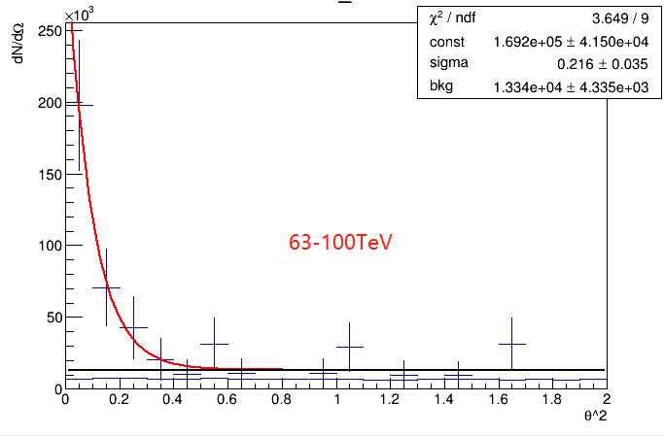
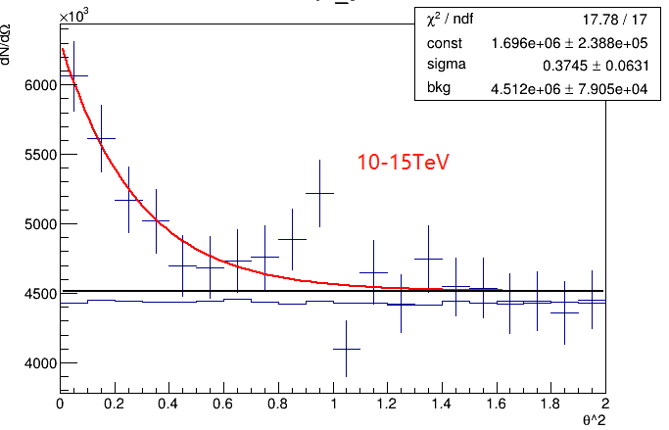
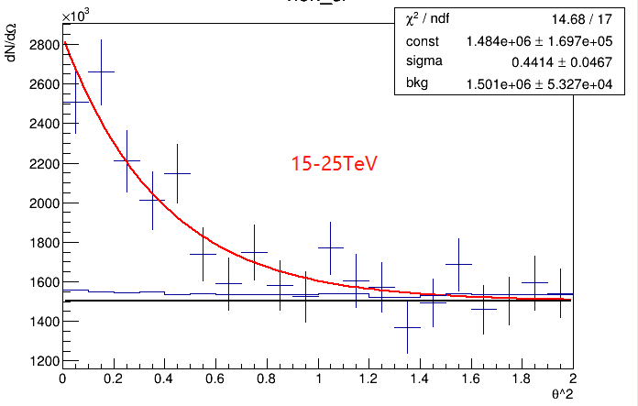
Backup: 实验角分辨M1

Slide 19
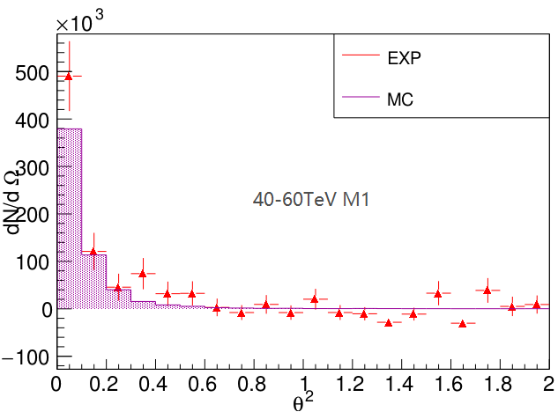
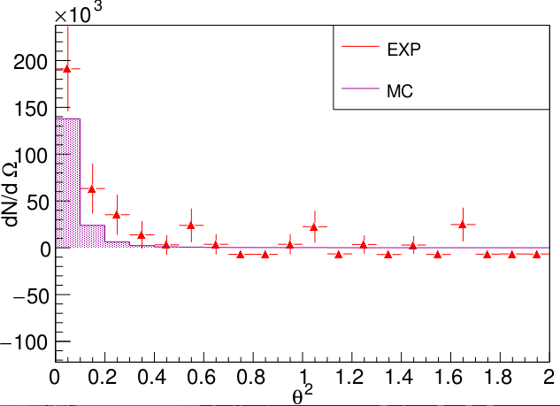
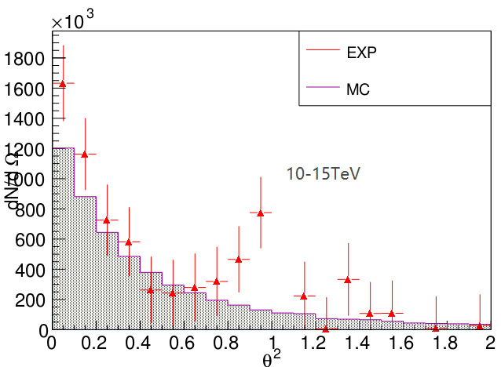
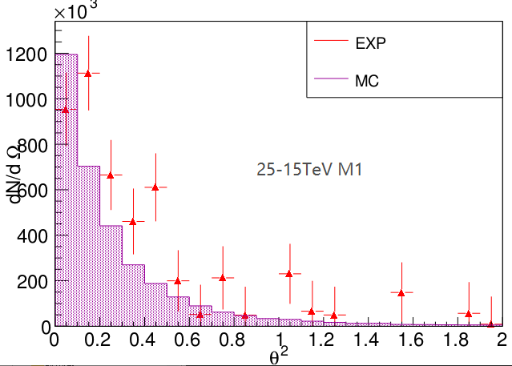

Slide 20
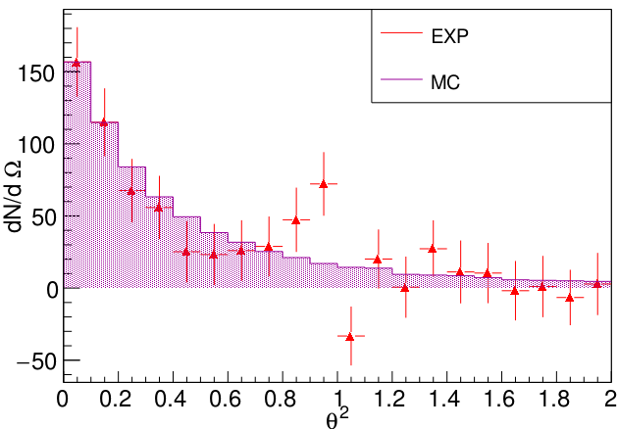

Slide 21
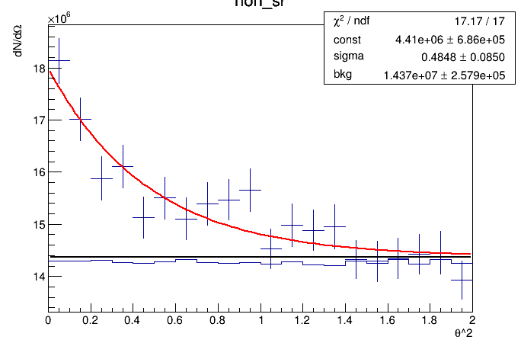
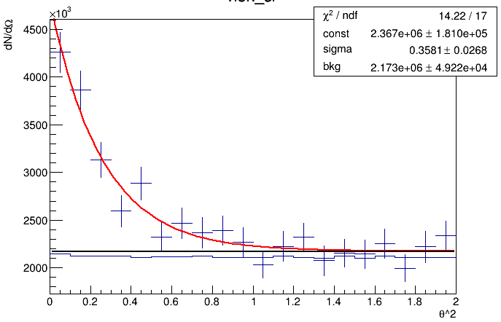
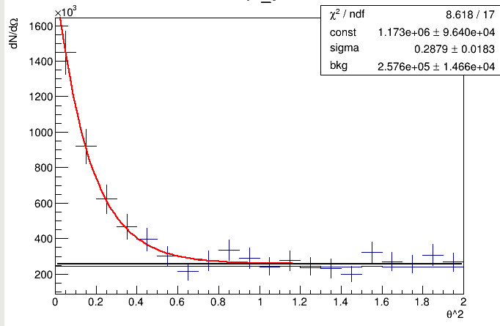
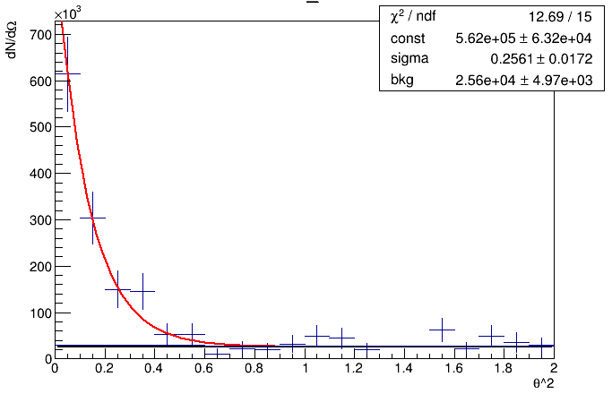
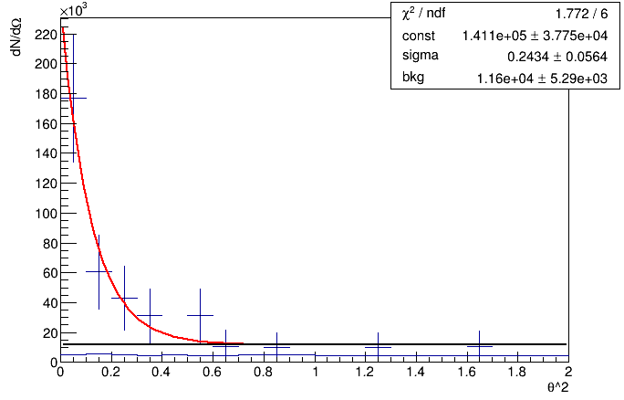
Backup: 实验角分辨M2
Bin00
Bin01
Bin02
Bin03
Bin04

Slide 22
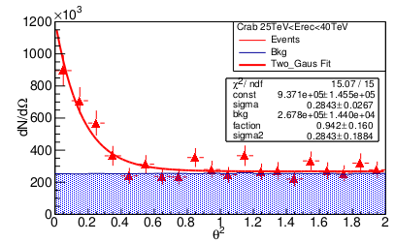
双Gaus 的角分辨拟合Bin02

Slide 23
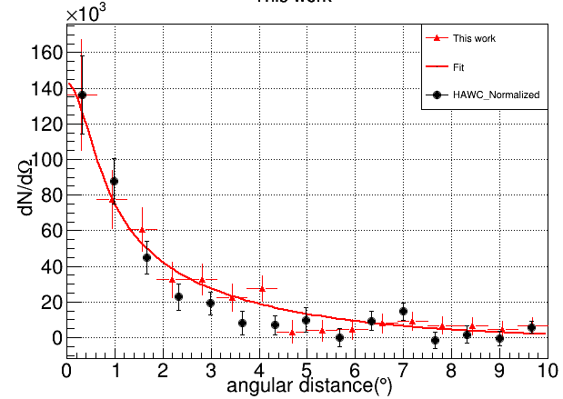
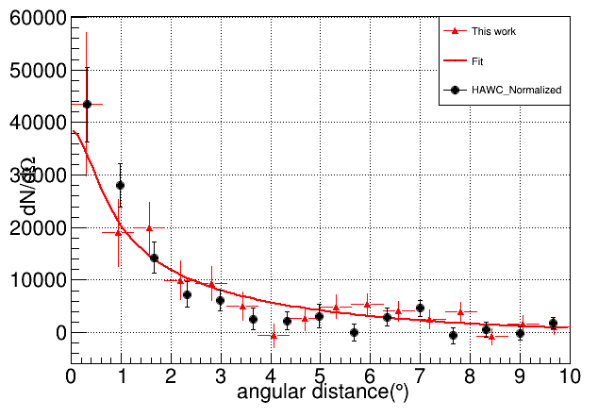
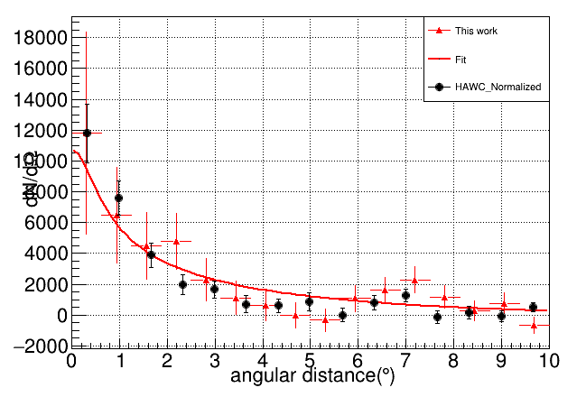
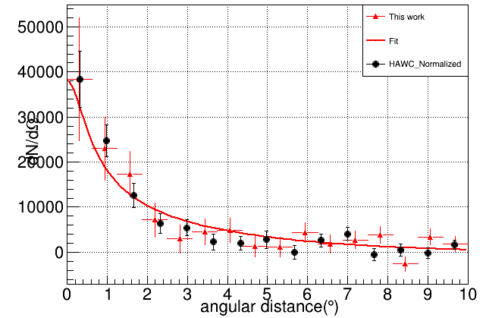
不同Bin 的结果
外部事例
25-40TeV:
R_d: 7.56+-1.88153
40-60TeV:
R_d: 8.91+-2.74286
60-100TeV:
R_d: 9.24+-4.24766
内部事例
8.16+-2.44
7.94+-3.16119

Slide 24
Geminga 100TeV的事例

Slide 25
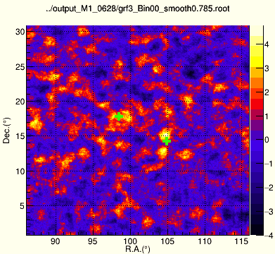
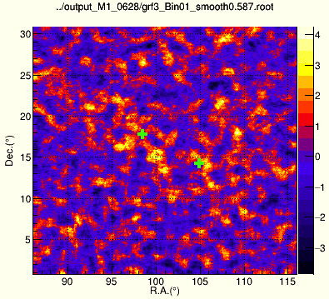
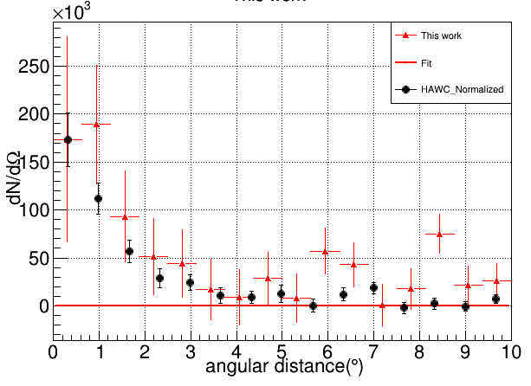
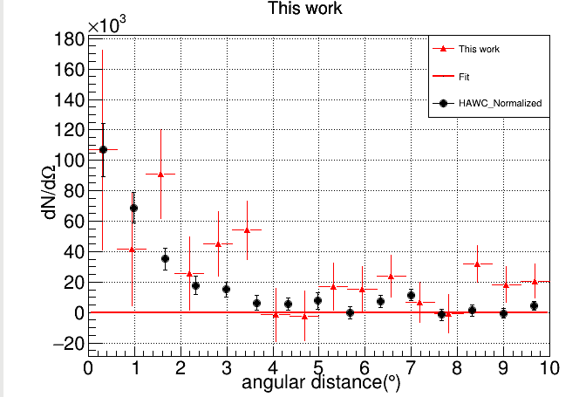
M1 低能显著性

Slide 26
Pixel 拟合的结果 比较

Slide 27
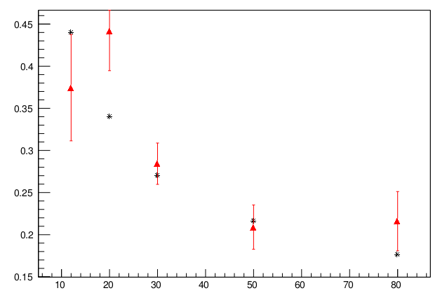
M1角分辨实验模拟
Notes:
实验sigma: 3.74500e-01, 4.41356e-01, 2.84271e-01, 2.09000e-01, 2.16027e-01, 1.70860e-01
实验smooth: 0.785 0.587 0.459 0.372 0.312 0.270 0.235 0.201 0.201 0.201 (From M2)
模拟： 0.44,0.34,0.27,0.216,0.176

Slide 28
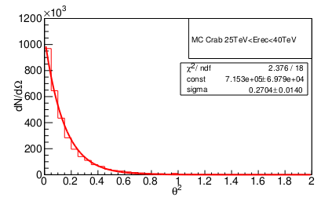
Backup: 实验模拟角分辨的对比
MC: Sigma=0.27
Exp：Sigma=0.28±0.02
Crab: dec=22
Sigma=0.27
Crab: dec=22
Sigma=0.27

Slide 29
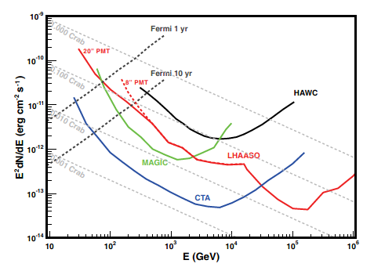
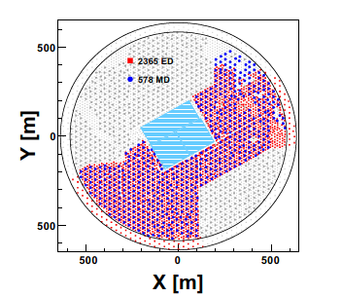
LHAASO-KM2A运行
KM2A
LHAASO 是目前最灵敏的百TeV探测器，且具有全天候大视场的特点
KM2A适合高能Pulsar halo 的观测
KM2A：2019年底完成half-array的建设
积累了半年的物理分析数据

