Slide 1
Study of solar magnetic field using solar shadow measured by LHAASO-WCDA experiment
He guanda
Supervisor : Prof. Liu jiali
Kunming University

Slide 2
outline
1. Introduction
2. IMF Analysis
3. The Sun Shadow Analysis
4. Summary and discussion

Slide 3
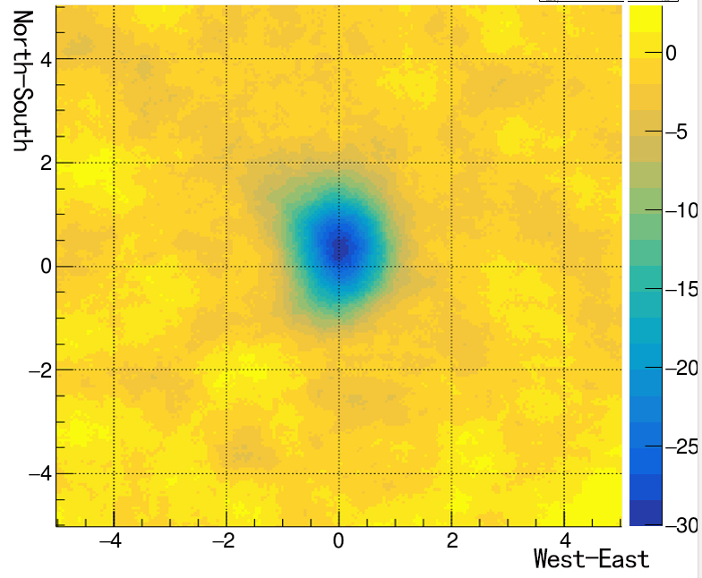
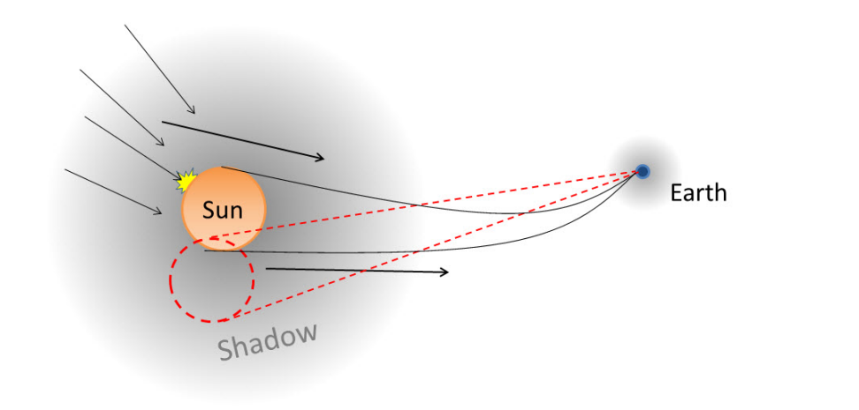
Introduction
The north-south deflection of solar shadow is related with the y-component of IMF.
Measuring the solar shadow can probe the large-scale average IMF.

Slide 4
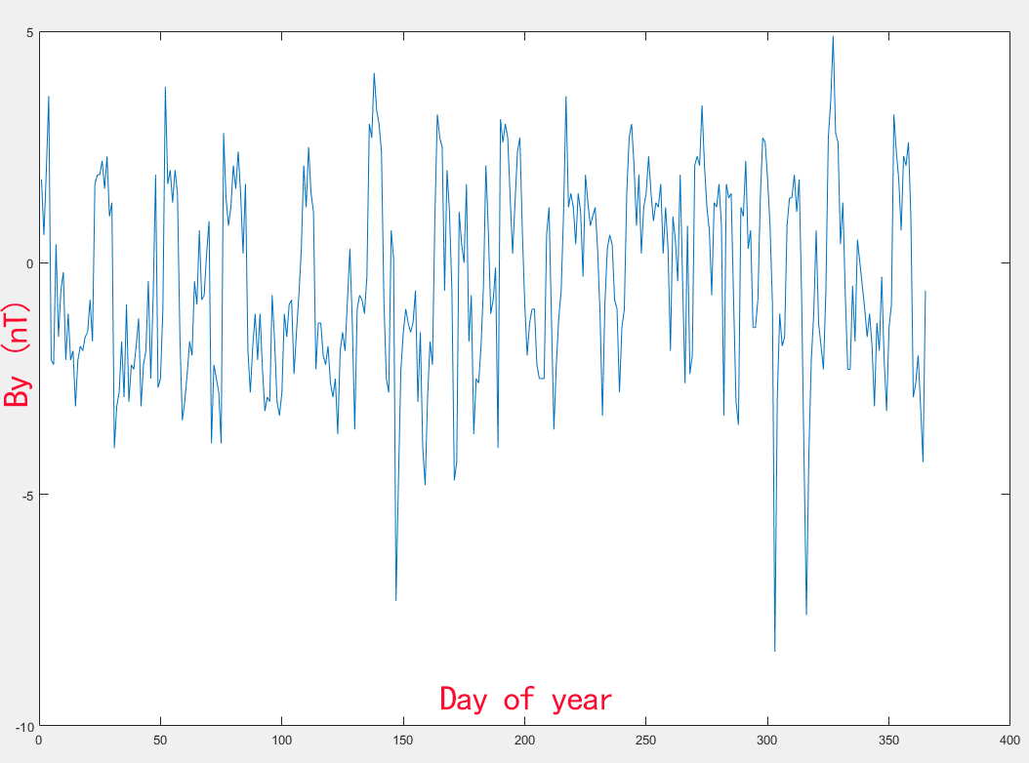
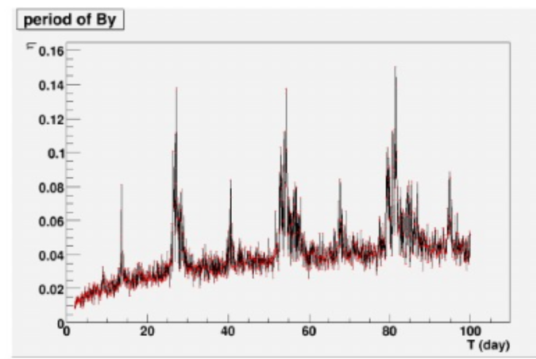
IMF cycle
Lomb-Scargle Fourier transform
From: YE.N., ZHU.F.R., ZHOU.X.M., JIA.H.Y., Short-term periodicity of Solar Mean Magnetic Field during Solar Maximum and Mininum, Solar Physics, 2012
IMF By component has an obvious cycle of 14 days and 28 days.

Slide 5
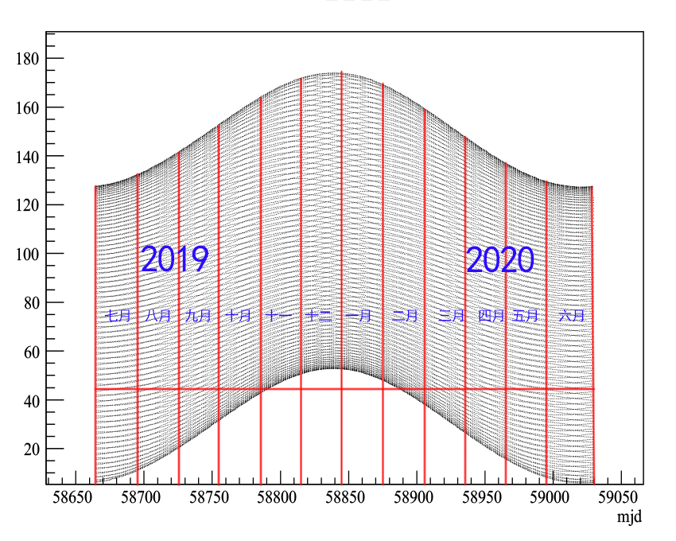
Data sample
Event cut
-- compact < 15
-- nfitc >100
-- ze < 50 deg
20190701-20190831
N=8.44E8
IMF cycle
toward | away
Bx > 0 By <0 | Bx < 0 By > 0
701 | 703
705 | 704
706 | 709
719 | 710
722 | 711
723 | 712
724 | 713
725 | 714
726 | 715
727 | 716
730 | 717
731 | 718
801 | 728
802 | 729
803 | 804
toward | away
Bx > 0 By <0 | Bx < 0 By > 0
820 | 805
821 | 806
825 | 807
826 | 808
827 | 809
828 | 810
829 | 811
 | 813
 | 814
 | 815
 | 816
 | 817
 | 818
 | 822
 | 823
 | 824
 | 830
 | 831
Sun orbit in zenith
ze

Slide 6
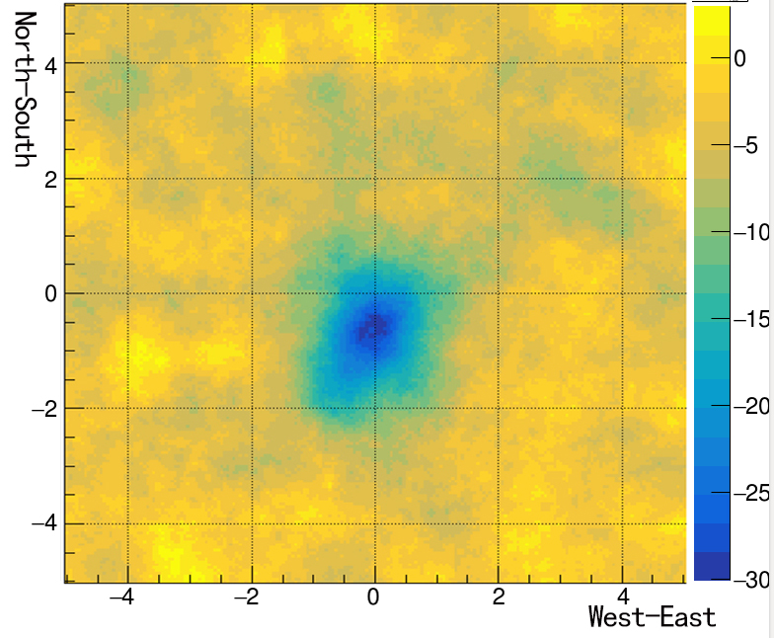
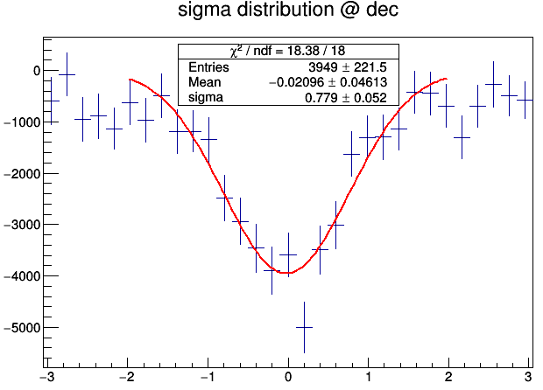
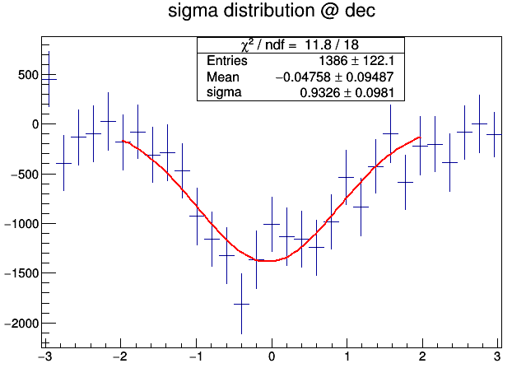
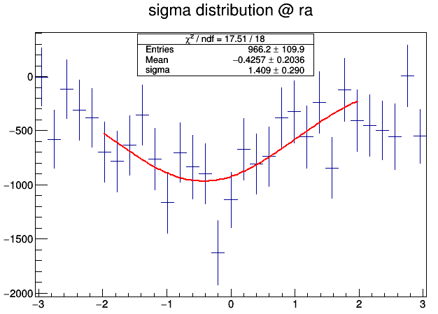
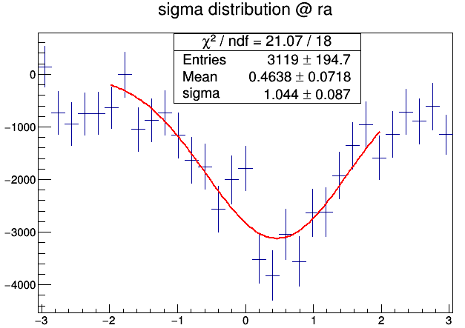
Sun shadow
toward
Bx > 0 By < 0
away
Bx < 0 By > 0

Slide 7
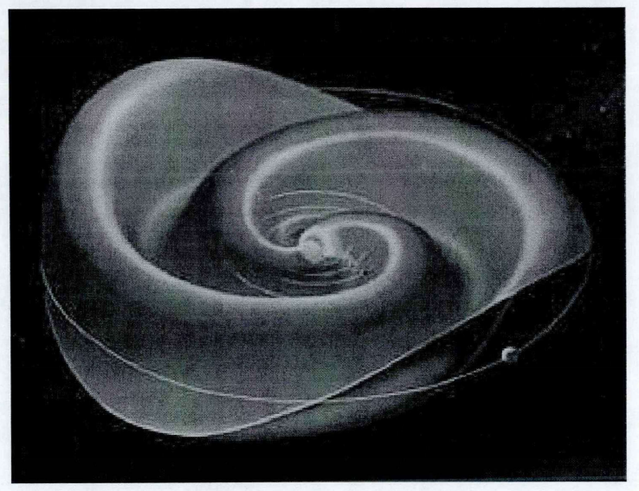
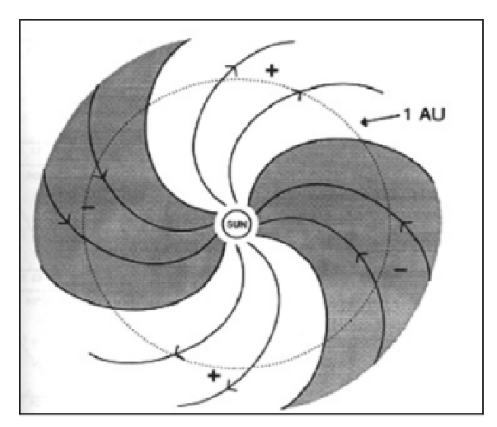
Carrington
phase
0-30 | 30-60 | 60-90 | 90-120 | 120-150 | 150-180 | 180-210 | 210-240 | 240-270 | 270-300 | 300-330 | 330-360
0725 | 0723 | 0720 | 0718 | 0716 | 0714 | 0711 | 0709 | 0707 | 0704 | 0702 | 0701
0726 | 0724 | 0721 | 0719 | 0717 | 0715 | 0712 | 0710 | 0708 | 0705 | 0703 | 0727
0821 | 0819 | 0722 | 0814 | 0812 | 0810 | 0713 | 0805 | 0803 | 0706 | 0729 | 0728
0822 | 0820 | 0817 | 0815 | 0813 | 0811 | 0808 | 0806 | 0804 | 0801 | 0730 | 0823
 |  | 0818 | 0816 |  |  | 0809 | 0807 | 0830 | 0802 | 0731 | 0824
 |  |  |  |  |  |  |  | 0831 | 0828 | 0826 | 0825
 |  |  |  |  |  |  |  |  | 0829 | 0827

Slide 8
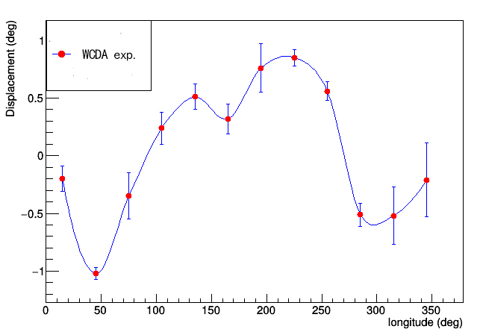
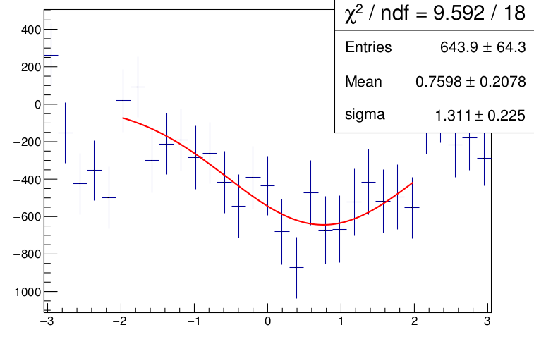
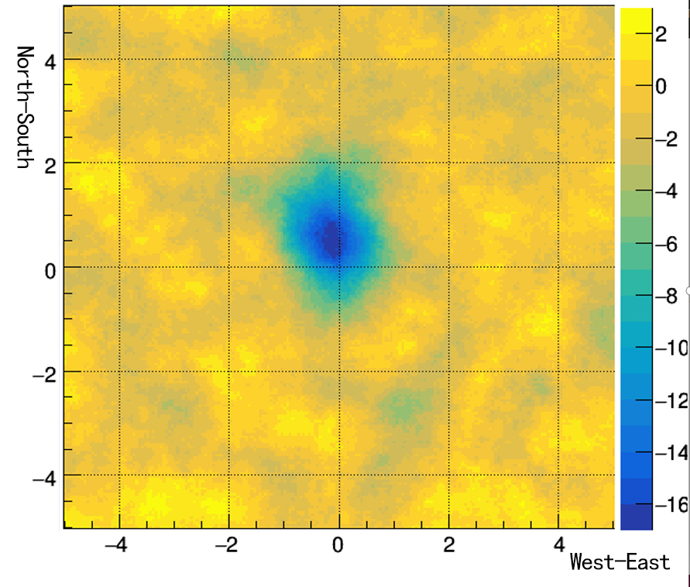
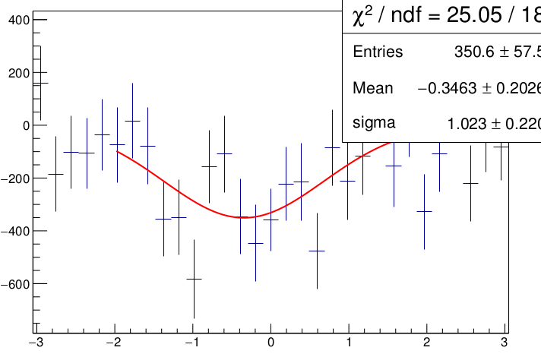
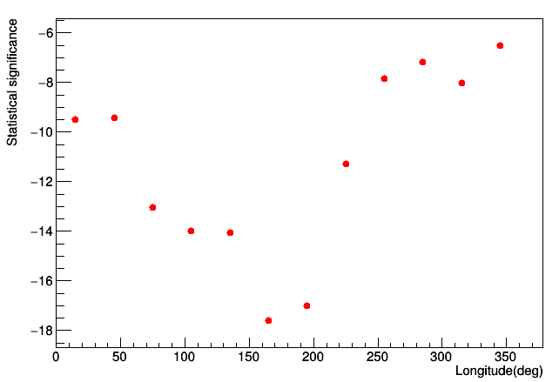
Solar shadow displacement

Slide 9
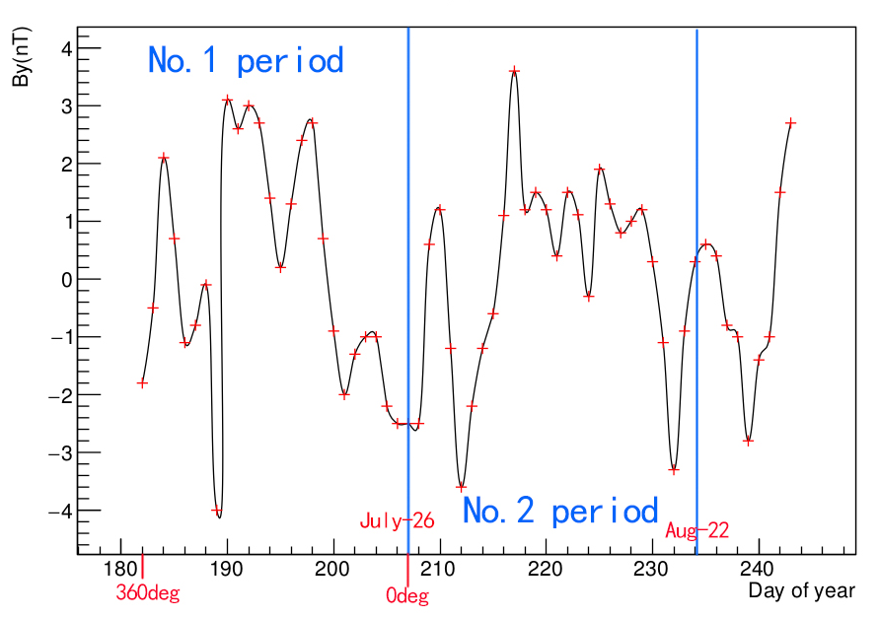
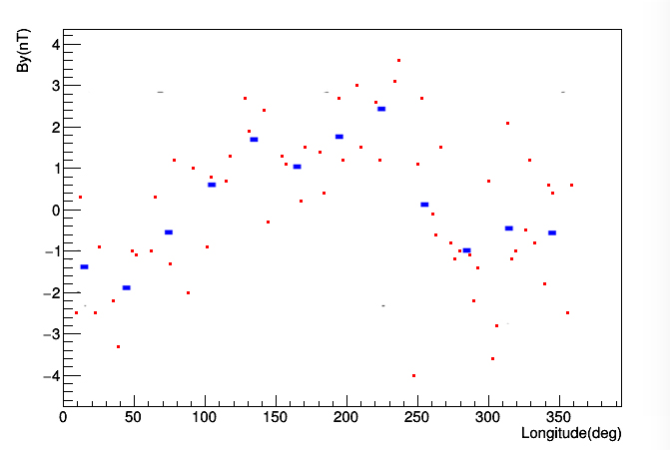
IMF By distribution
OMNI_DATA

Slide 10
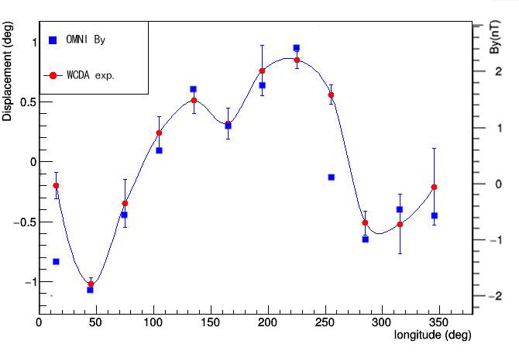
The correlation between IMF By and solar shadow

Slide 11
Summary and discussion
The correlation between IMF By component and the displacement of solar shadow has been observed by LHAASO-WCDA.
The next work is the MC simulation of the sun shadow observed by LHHASO-WCDA.
The space forecasting like the coronal mass ejection by LHAASO-WCDA will be investigated in future.

Slide 12
Thank you

