Slide 1
Progress of LHAASO Muon Detector array
Gang Xiao
Cheng Du
18.Aug.2020

Slide 2
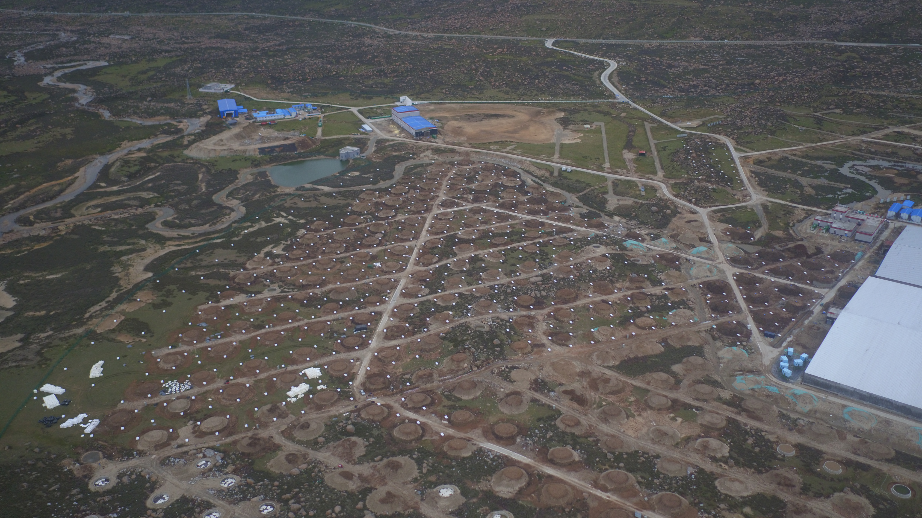
outline
brief introduction of MD array
Progress of MD
Plan of MD

Slide 3
Brief introduction
Array
Unit detector

Slide 4
General specifications of muon detector
performance parameter | Index requirements
detection efficiency | ≥95%
Particle number resolution | Single particle：25%；10000 particles：<5%
Time resolved | <10ns
dynamic range | 1～10,000particles
Punch-through Effect | The purity of μ measurement>95%
Long term stability | Signal attenuation less than 20% in 10 years

Slide 5
LHAASO-MDA
30meters spacing
40000 m^2 effective area

Slide 6
detector design
electronics
soil
6.8m
PMT
1.2m
ultrapure water

Slide 7
progress
1、Production and inspection of components
2、Installation progress
3、1/2 array performance

Slide 8
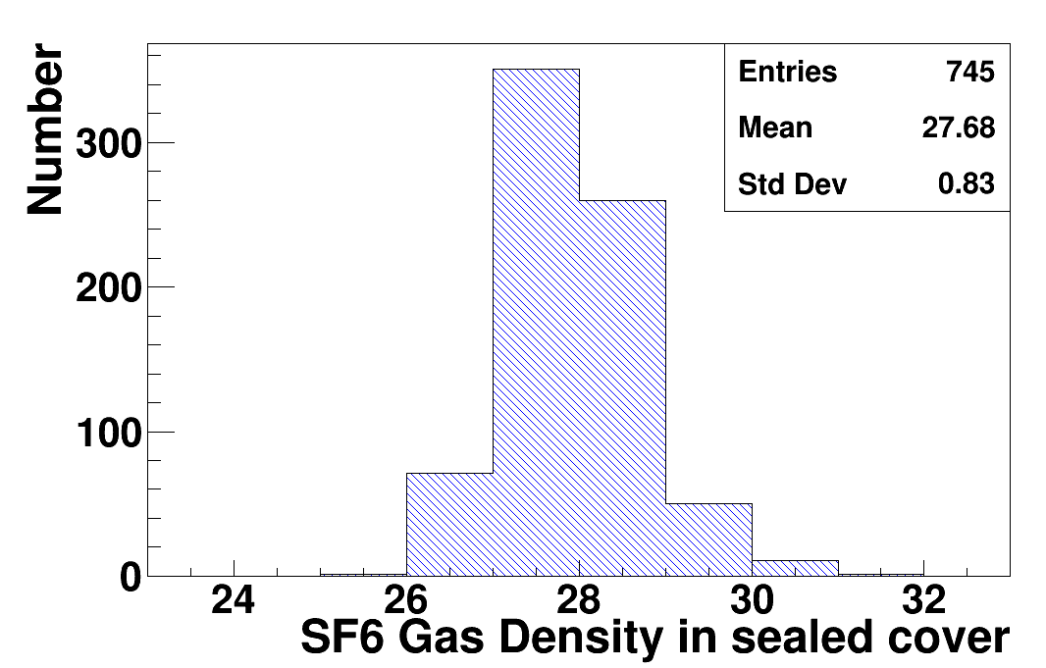
Summary of the development of ultra pure water inner liner
1184/1230 liners completed.
1084 sets of inner liner have been transported to Daocheng, including 306 sets of double Tyvek inner liner.
The inner liner installed by MD is in good sealing condition .
In 2020, the production of inner liner shall meet the requirements of project schedule and meet the project installation schedule.

Slide 9
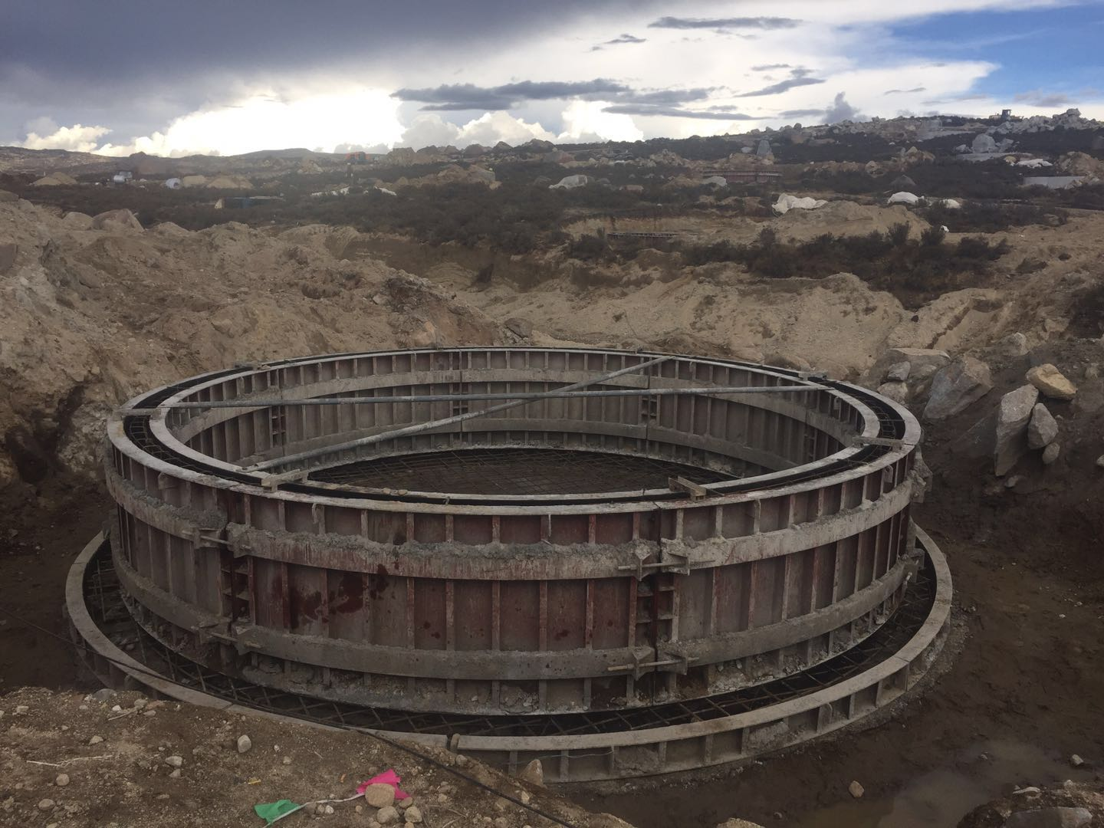
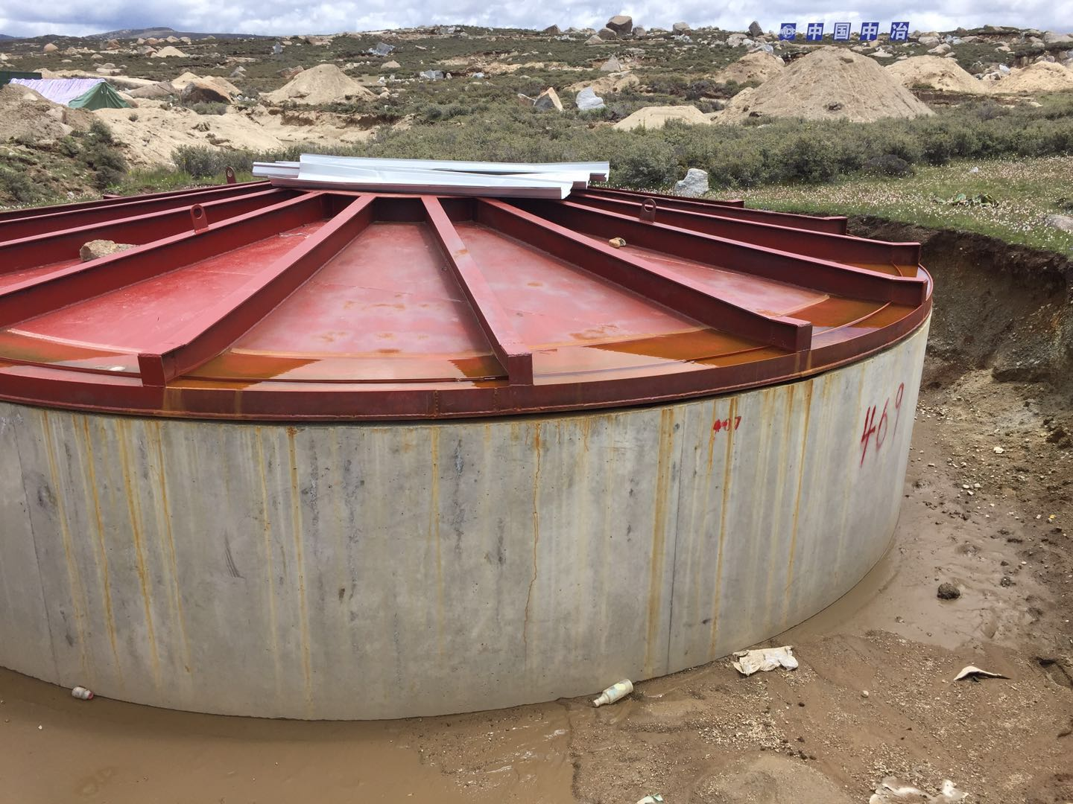
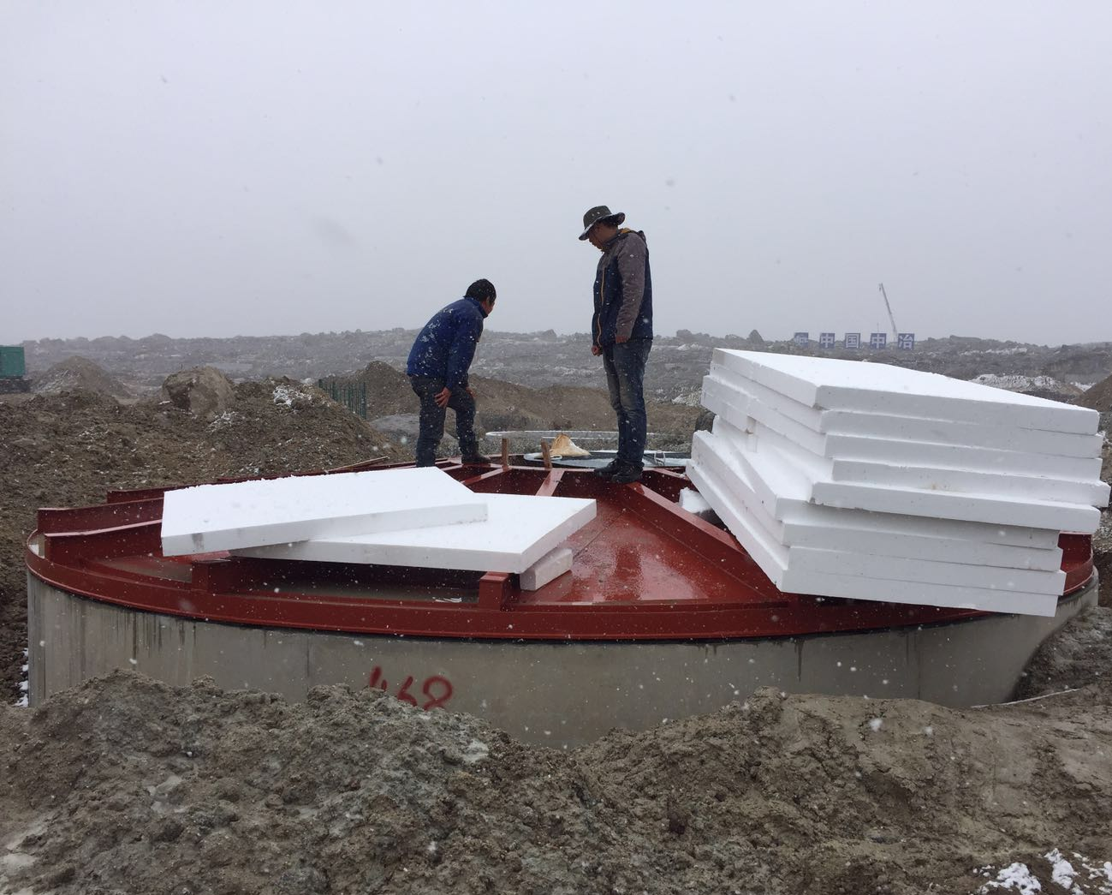
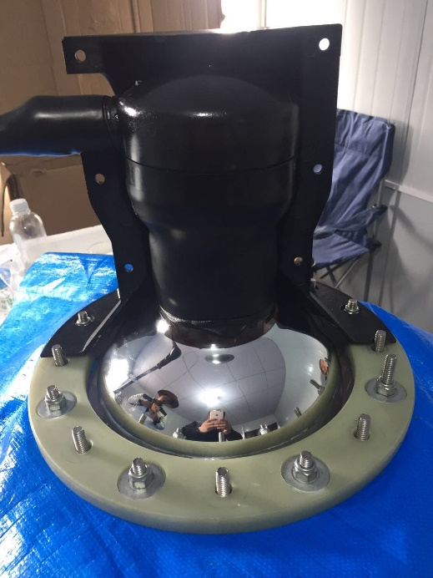
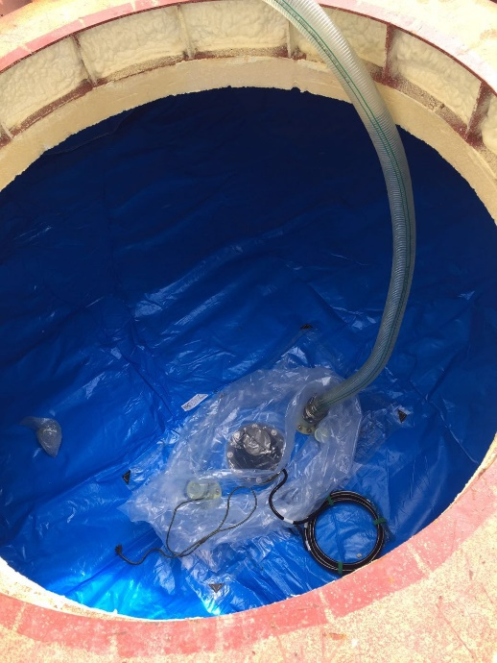
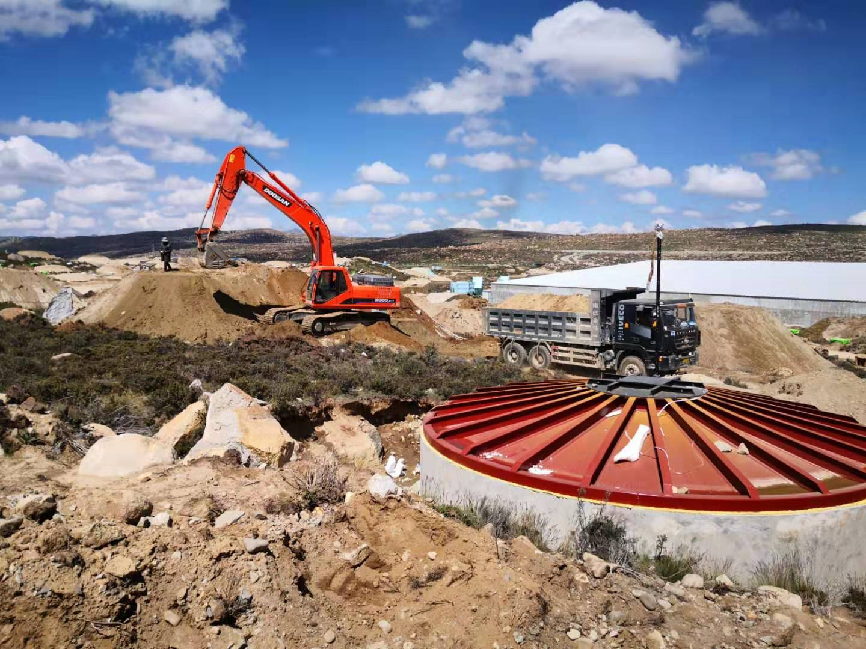
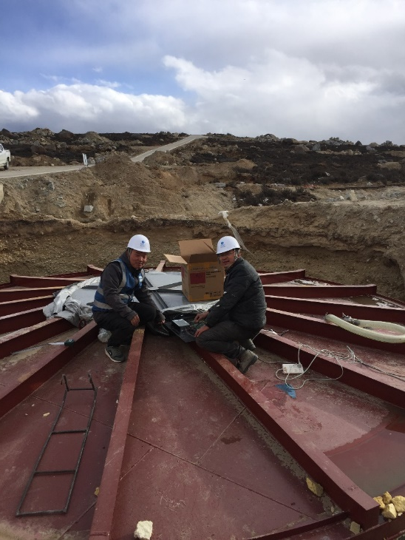
Foundation pit treatment
Fabrication of side wall and bottom plate
Head cover mounting
Install insulation board
Installation technology
Install liner and PMT
ultrapure water infusion
debug
Covering soil
intergrated test

Slide 10
Map of the Progress
Irrigation completed(846)
Debugging completed(831)
Completion of soil covering(808)
Power on completion(700)
Electronics installation completed(593)
Detector operation(593)

Slide 11
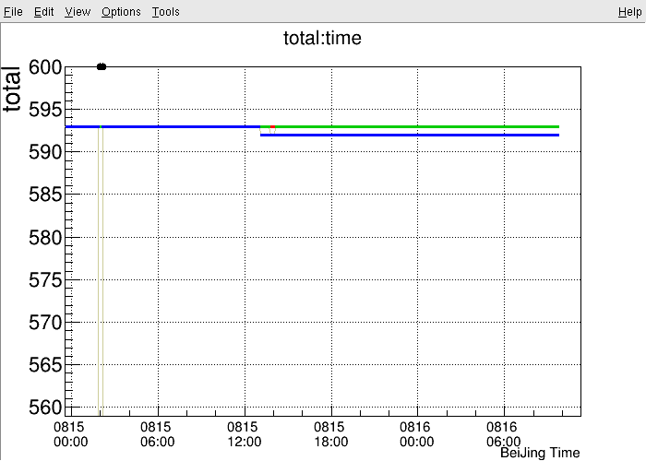
Performance of 1/2 MD array
numbers of MD:
593 MDs in DAQ；
593 TCP/IP attachable(8.16)；
592 with hits information(8.16)；
For details of performance of the 1/2 MD array，Please pay attention to Xiong Zuo’s report: Performances and calibration of 1/2 LHAASO-MD array

Slide 12
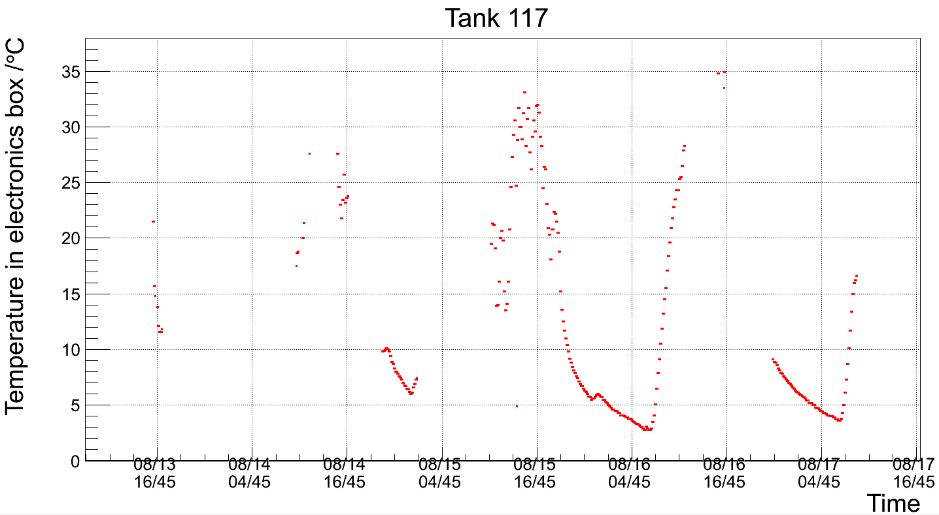
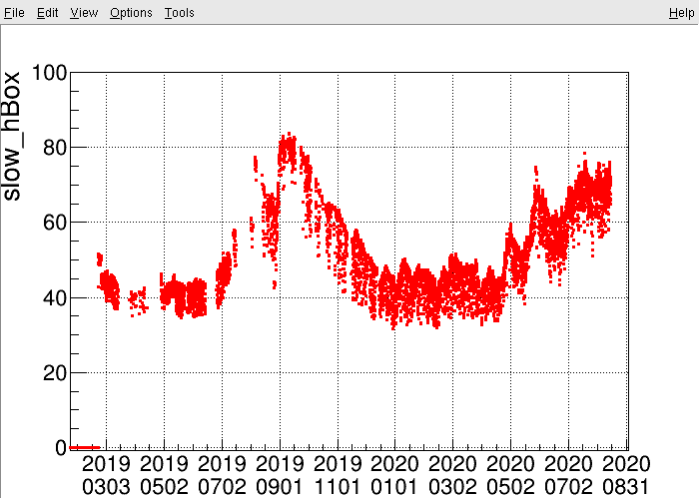
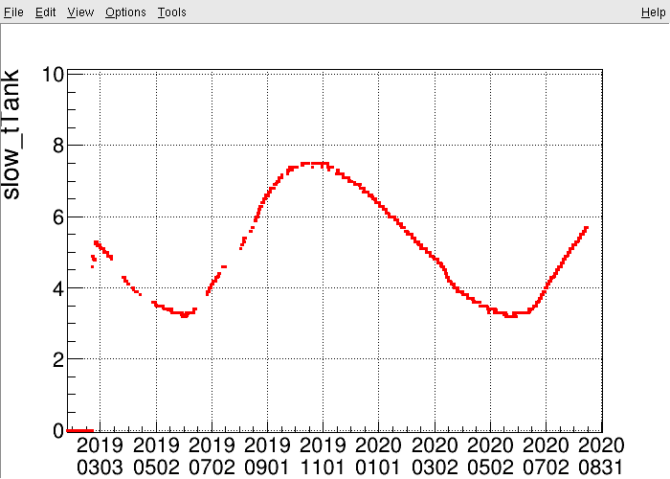
Some long-term operation diagrams
Temperature ( external)
humidity
Temperature (internal)

Slide 13
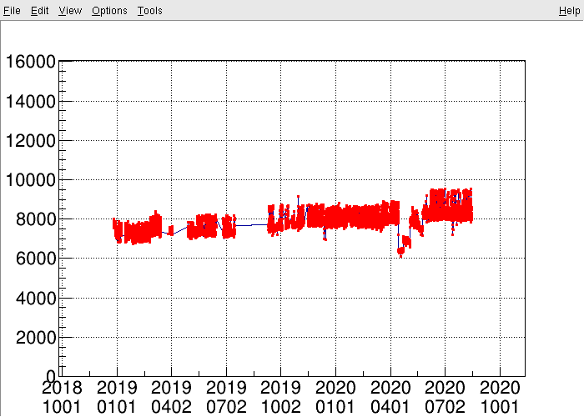
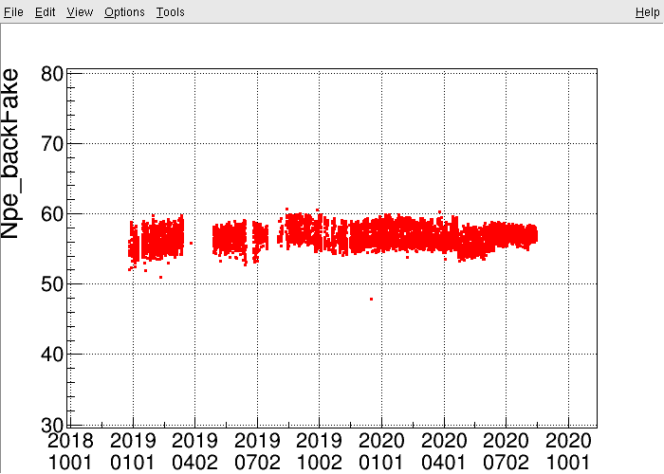
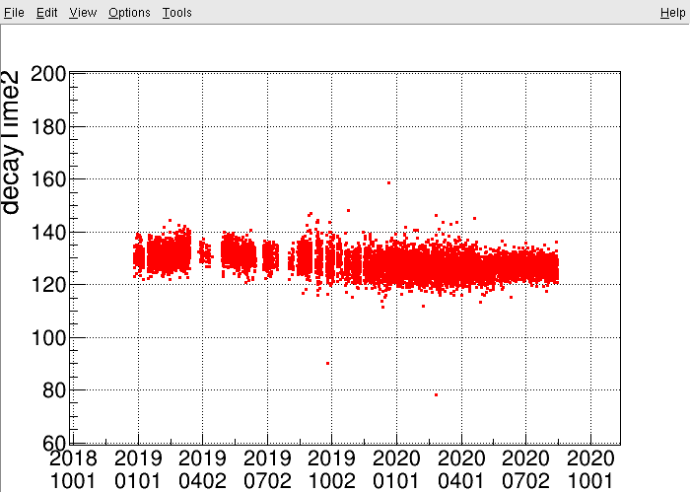
single rate
NPE
decay time
AD ratio

Slide 14
Next step plan
2020 plan: 3/4
2021 plan: entire

Slide 15
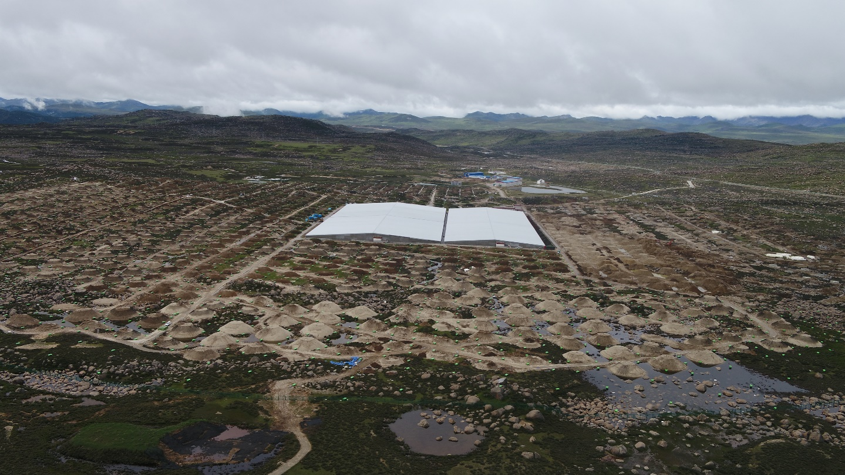
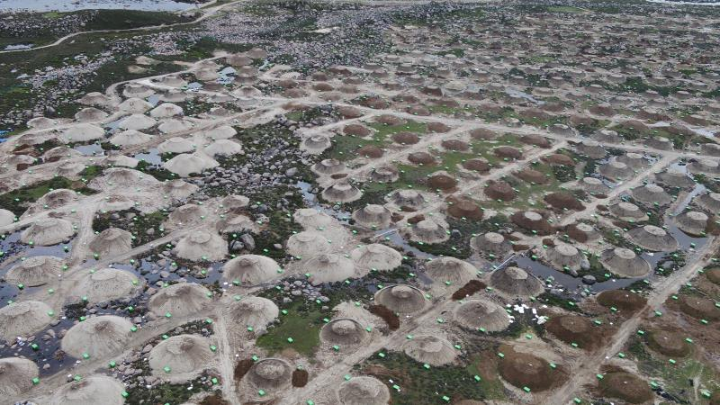
summary
1/2 array of LHAASO-MD has been constructed and put into DAQ access ,The monitoring results show that the detector works well.
3/4 array installation plan is expected to be completed successfully in 2020

